Slide 1
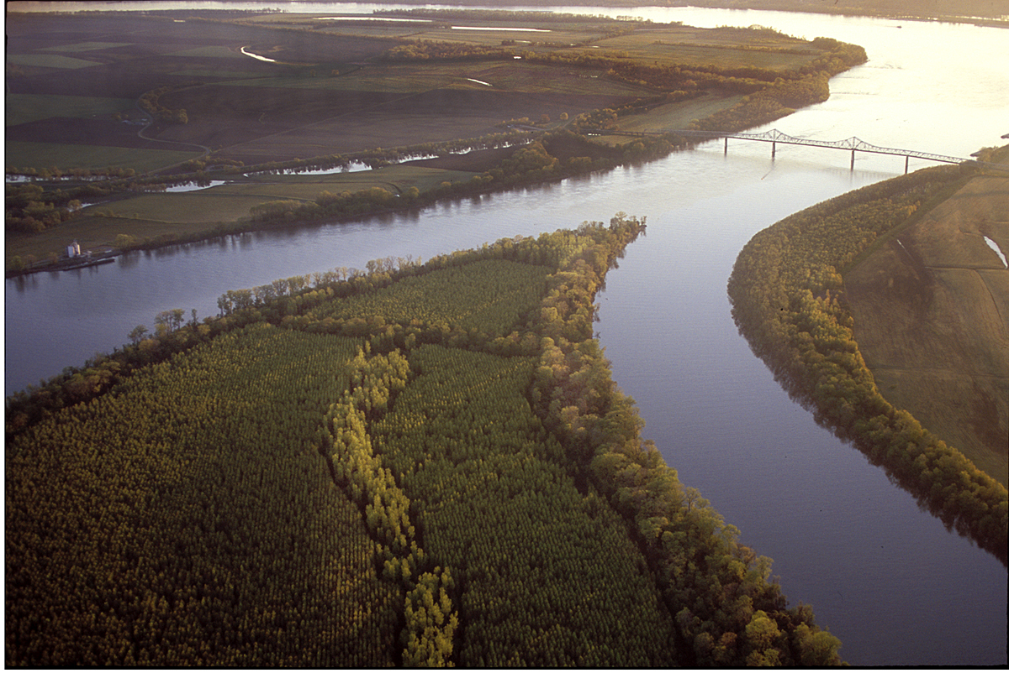
Transverse Jet Circulations and their Impact on the Production of Sensible Weather
Andrew C. Winters
METR 3123
3 March 2017

Slide 2
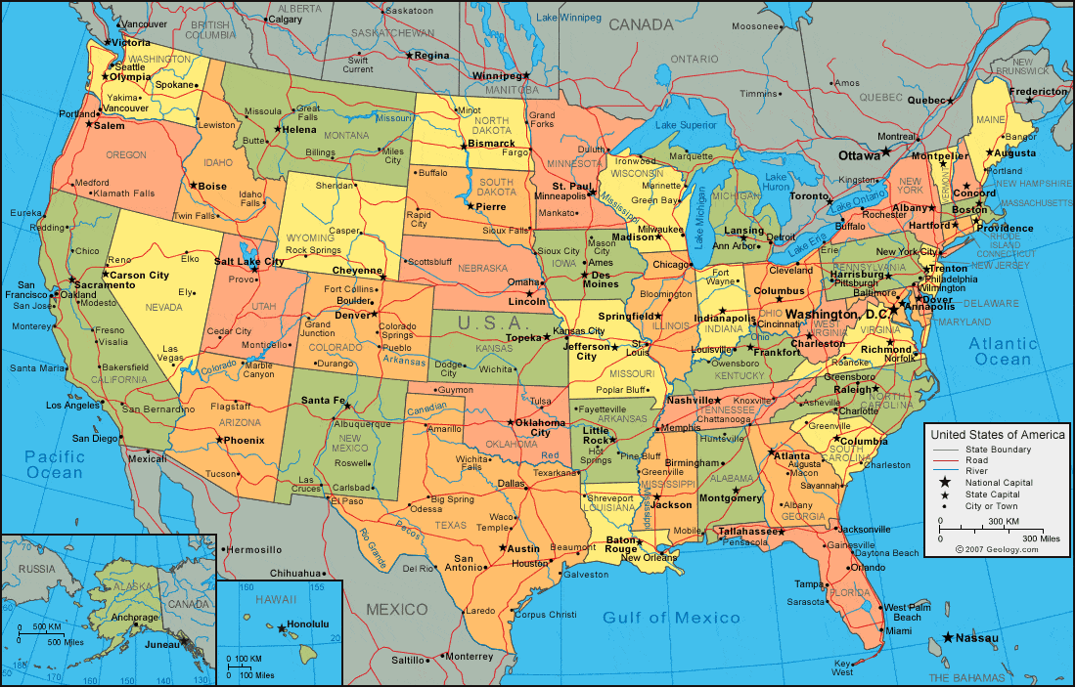



Geology.com

Slide 3


Geology.com

Slide 4


Geology.com

Slide 5
Geology.com

Slide 6


Geology.com

Slide 7
Learning Objectives
What are the characteristics of the Jet Stream?
How was the Jet Stream “discovered”?
How do transverse jet circulations impact the production of sensible weather?

Slide 8
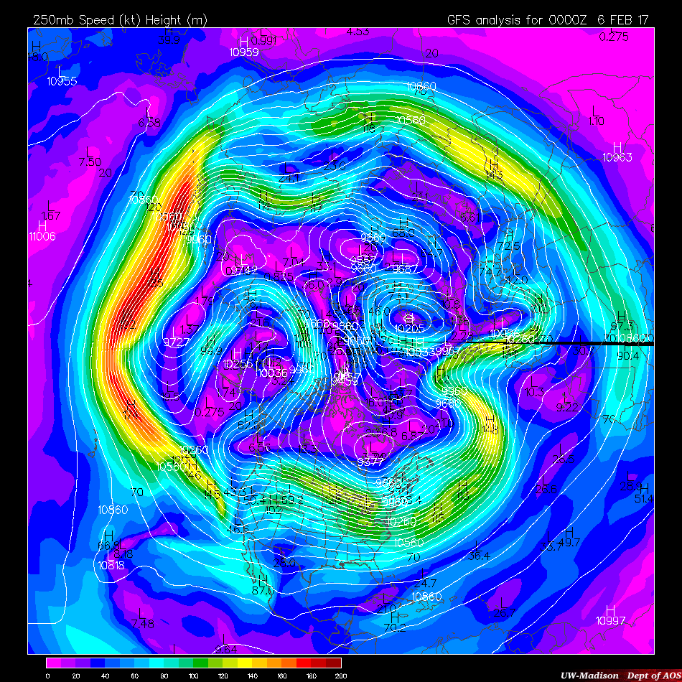
250-hPa Wind Speed
0000 UTC
6 Feb 2017
NP
Norman, OK
NP North Pole
UW-Madison AOS
Notes:
Jet streaks can extend on the order of 1000s of km, while their width is only on the order of 100s of km. Considerable lateral shear. Jets circumnavigate the globe and exhibit substantial meridional meanders.

Slide 9
250-hPa Wind Speed
0000 UTC
6 Feb 2017
NP
Jet Stream
Norman, OK
NP North Pole
UW-Madison AOS
Notes:
Jet streaks can extend on the order of 1000s of km, while their width is only on the order of 100s of km. Considerable lateral shear. Jets circumnavigate the globe and exhibit substantial meridional meanders.

Slide 10
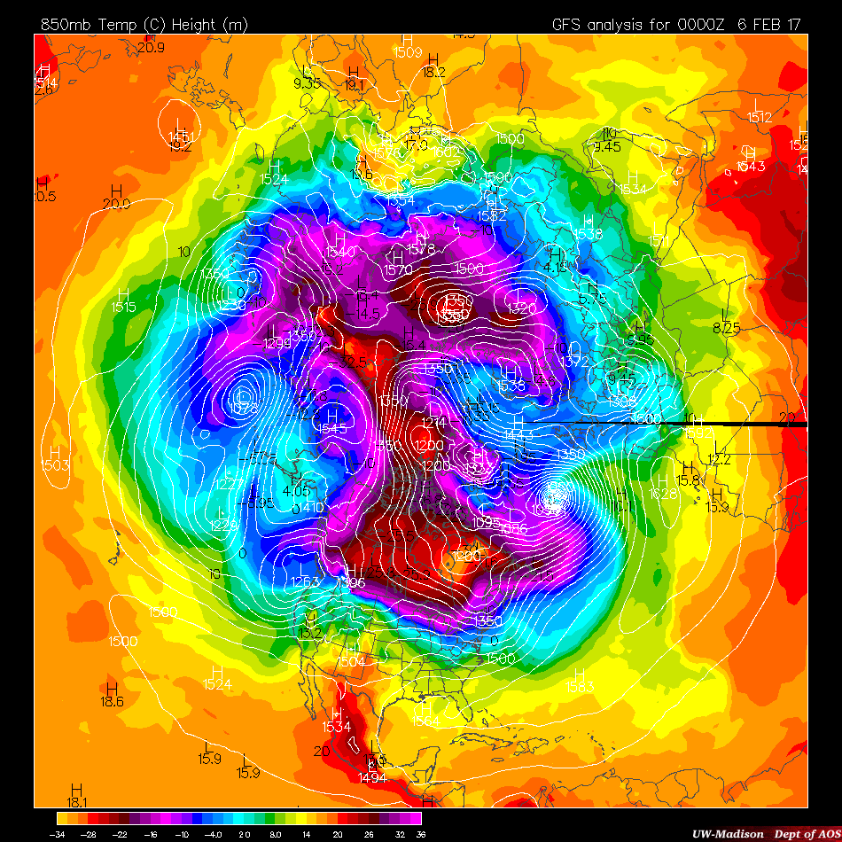
850-hPa Temperature
0000 UTC
6 Feb 2017
NP
Jet Stream
Norman, OK
NP North Pole
UW-Madison AOS
Notes:
Jet streaks can extend on the order of 1000s of km, while their width is only on the order of 100s of km. Considerable lateral shear. Jets circumnavigate the globe and exhibit substantial meridional meanders.

Slide 11
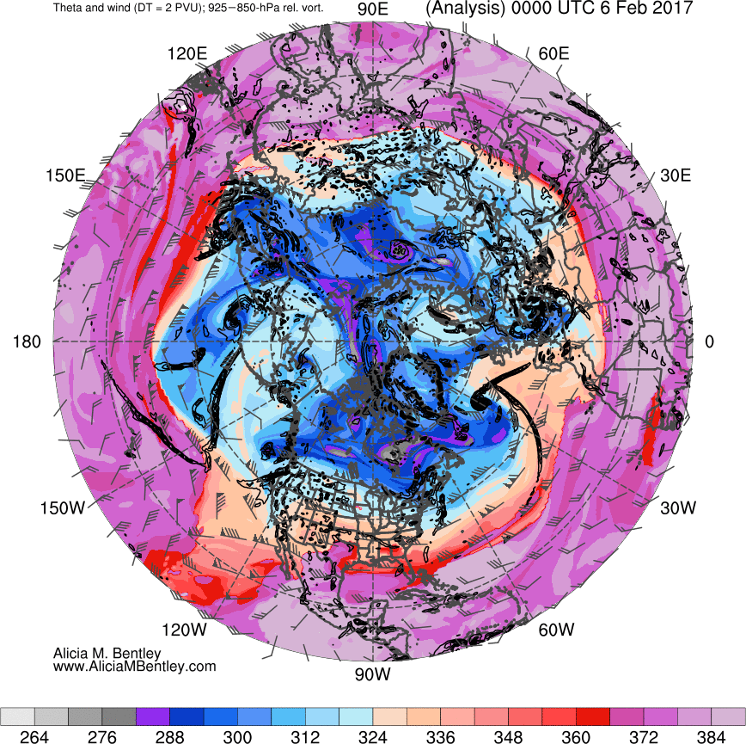
Tropopause Potential Temperature
0000 UTC
6 Feb 2017
NP
Jet Stream
Norman, OK
NP North Pole
Notes:
Jet streaks can extend on the order of 1000s of km, while their width is only on the order of 100s of km. Considerable lateral shear. Jets circumnavigate the globe and exhibit substantial meridional meanders.

Slide 12
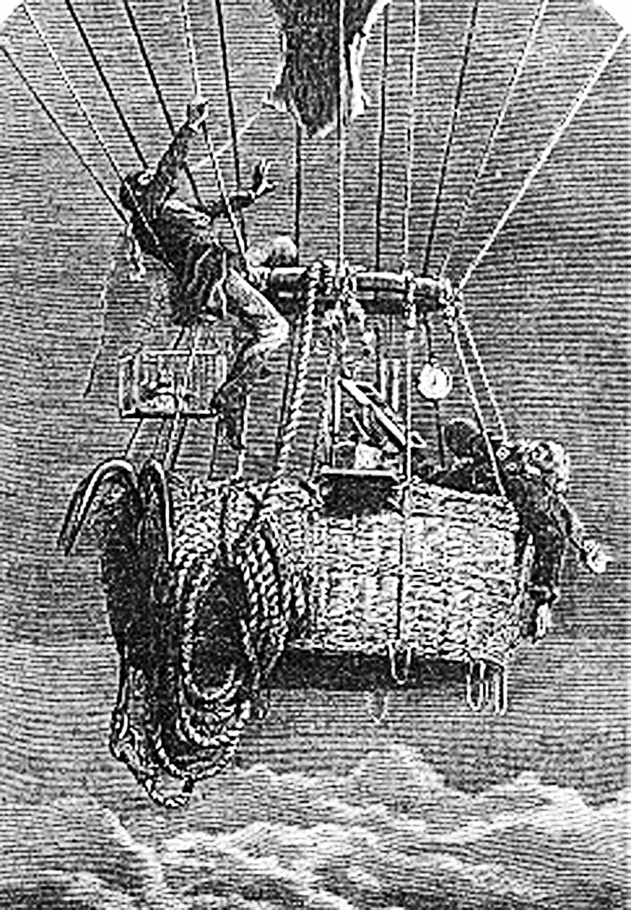
Building Blocks to Jet Stream “Discovery”
Coxwell and Glaischer
(1862)
The Flight of a
Lifetime!
Manned balloon ascent to
~29000 feet.
Illustrated London News

Slide 13
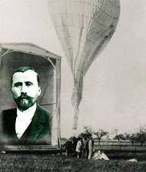
Building Blocks to Jet Stream “Discovery”
Teisserenc de Bort (1902)
Discovery of the stratosphere
Temperature stops decreasing at a particular distance above the Earth’s surface.
Nature
Notes:
200 different balloon ascents went into the scientific conclusion.

Slide 14
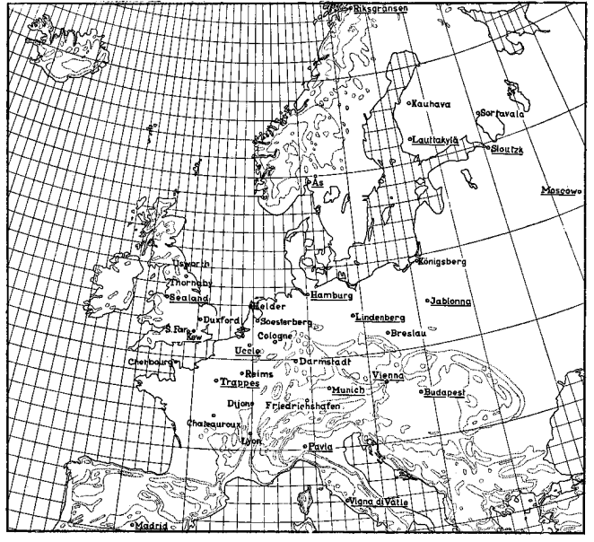
Building Blocks to Jet Stream “Discovery”
Bjerknes and
Palmén
(1937)
Coordinated “swarm ascents” at 18 different locations across Europe.
Notes:
Meteorgraphs. Coordinated international effort to launch balloon soundings at 18 diff. locations across Europe. Wanted to capture the horizontal and vertical temperature structure throughout Europe.

Slide 15
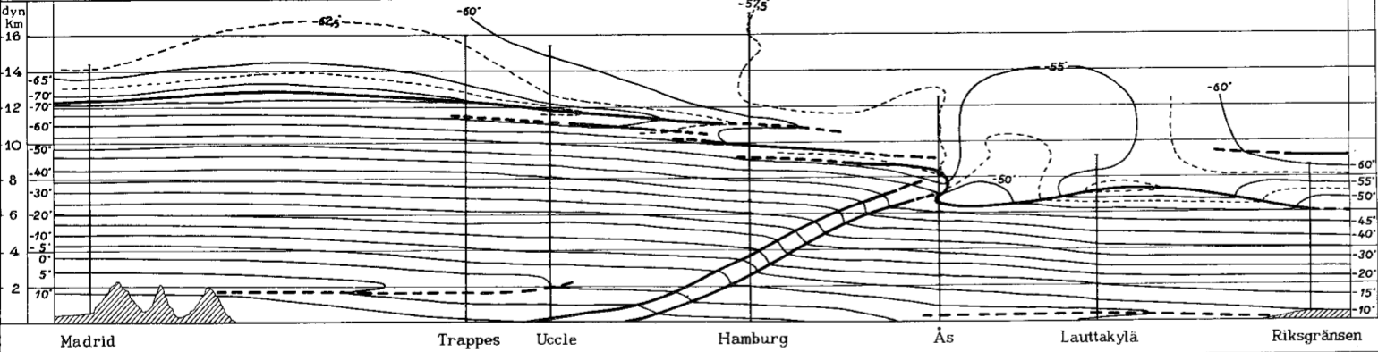
Building Blocks to Jet Stream “Discovery”
Bjerknes and Palmén (1937)
Notes:
Also noted that areas characterized by a strong horizontal temperature gradient exhibited stronger vertical wind shear.

Slide 16
Building Blocks to Jet Stream “Discovery”
Bjerknes and Palmén (1937)
The front is a transition zone across which the temperature gradient is discontinuous.
Notes:
Also noted that areas characterized by a strong horizontal temperature gradient exhibited stronger vertical wind shear.

Slide 17
Building Blocks to Jet Stream “Discovery”
Bjerknes and Palmén (1937)
The front is a transition zone across which the temperature gradient is discontinuous.
The tropopause abruptly lowers at the location where the polar front intersects the tropopause.
Notes:
Also noted that areas characterized by a strong horizontal temperature gradient exhibited stronger vertical wind shear.

Slide 18
Building Blocks to Jet Stream “Discovery”
Bjerknes and Palmén (1937)
COLD
WARM
WARM
COLD
The front is a transition zone across which the temperature gradient is discontinuous.
The tropopause abruptly lowers at the location where the polar front intersects the tropopause.
The meridional temperature gradient reverses directly above the tropopause break.
Notes:
Also noted that areas characterized by a strong horizontal temperature gradient exhibited stronger vertical wind shear.

Slide 19

“Discovery” of the Jet Stream
Reid Bryson and Bill Plumley – Weather Officers in the Pacific during World War II (1944)
(Bryson 1994).
CCR
Notes:
Use dissertation here for notes on the full story!

Slide 20
“Discovery” of the Jet Stream
Reid Bryson and Bill Plumley – Weather Officers in the Pacific during World War II (1944)
(Bryson 1994).
Heinrich Seilkopf – “die Strahlströmung”,
Which translates to “jet flow” (1939)
(Reiter 1963, p. 3).
Notes:
Use dissertation here for notes on the full story!

Slide 21
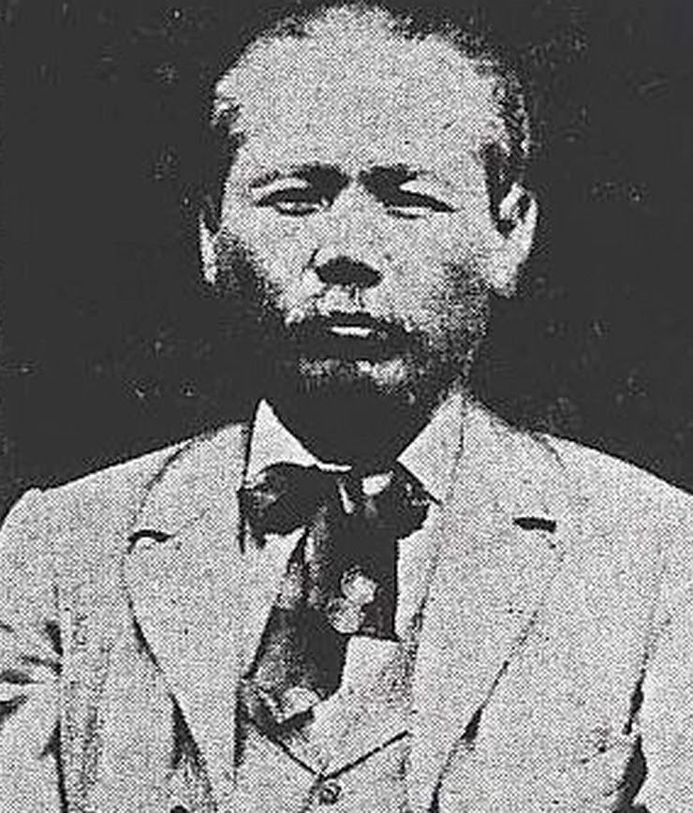
“Discovery” of the Jet Stream
Reid Bryson and Bill Plumley – Weather Officers in the Pacific during World War II (1944)
(Bryson 1994).
Heinrich Seilkopf – “die Strahlströmung”,
Which translates to “jet flow” (1939)
(Reiter 1963, p. 3).
Wasaburo Ooishi – observed and
documented large climatological wind
speeds over Japan (1926).
Cliff Mass
Notes:
Use dissertation here for notes on the full story!

Slide 22
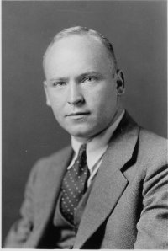
“Discovery” of the Jet Stream
Reid Bryson and Bill Plumley – Weather Officers in the Pacific during World War II (1944)
(Bryson 1994).
Heinrich Seilkopf – “die Strahlströmung”,
Which translates to “jet flow” (1939)
(Reiter 1963, p. 3).
Wasaburo Ooishi – observed and
documented large climatological wind
speeds over Japan (1926).
Carl-Gustaf Rossby – First to refer to the phenomenon as the “jet stream” (1947).
MIT
Notes:
Use dissertation here for notes on the full story!

Slide 23
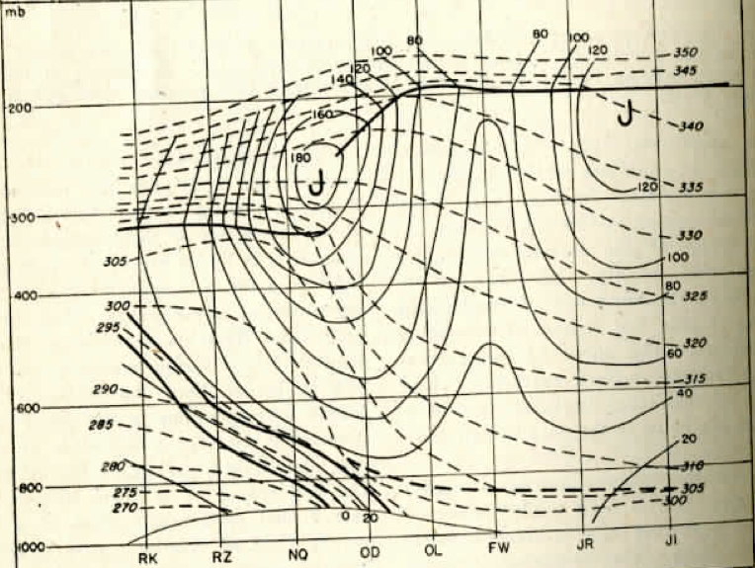
“Discovery” of the Jet Stream
University of Chicago (1947)
One of the first hemispheric examinations of the midlatitude circulation.
1) The jet was characterized by a nearly continuous band of strong zonal wind speeds.
2) The jet sat atop the strongly baroclinic polar front.
3) The jet was nestled squarely in a tropopause break.
Notes:
Use dissertation here for notes on the full story!

Slide 24
How do Jet Streams Impact the Weather?
Notes:
Use dissertation here for notes on the full story!

Slide 25

How do Jet Streams Impact the Weather?
Photoeverywhere.co.uk
Notes:
Use dissertation here for notes on the full story!

Slide 26
How do Jet Streams Impact the Weather?
ENTRANCE
EXIT
Notes:
Use dissertation here for notes on the full story!

Slide 27
How do Jet Streams Impact the Weather?
ENTRANCE
EXIT
Notes:
Use dissertation here for notes on the full story!

Slide 28
How do Jet Streams Impact the Weather?
ENTRANCE
EXIT
Areas where you accelerate or decelerate with respect to the walkway are important for generating clumsiness
Notes:
Use dissertation here for notes on the full story!

Slide 29
250-hPa Wind Speed
0000 UTC
6 Feb 2017
NP
Norman, OK
NP North Pole
UW-Madison AOS
Notes:
Jet streaks can extend on the order of 1000s of km, while their width is only on the order of 100s of km. Considerable lateral shear. Jets circumnavigate the globe and exhibit substantial meridional meanders.

Slide 30
How do Jet Streams Impact the Weather?
y
250-hPa
x
No wind speed
Slow wind speed
Fast wind speed
Wind Vectors
Notes:
Use dissertation here for notes on the full story!

Slide 31
How do Jet Streams Impact the Weather?
y
250-hPa
x
ENTRANCE
EXIT
No wind speed
Slow wind speed
Fast wind speed
Wind Vectors
Notes:
Use dissertation here for notes on the full story!

Slide 32
How do Jet Streams Impact the Weather?
y
250-hPa
x
ENTRANCE
EXIT
Areas where the wind accelerates or decelerates are important for generating weather
No wind speed
Slow wind speed
Fast wind speed
Wind Vectors
Notes:
Use dissertation here for notes on the full story!

Slide 33
How do Jet Streams Impact the Weather?
y
250-hPa
x
ENTRANCE
EXIT
No wind speed
Slow wind speed
Fast wind speed
Wind Vectors
Notes:
Use dissertation here for notes on the full story!

Slide 34
How do Jet Streams Impact the Weather?
y
250-hPa
x
ENTRANCE
EXIT
No wind speed
Slow wind speed
Fast wind speed
Wind Vectors
Notes:
Use dissertation here for notes on the full story!

Slide 35
How do Jet Streams Impact the Weather?
y
250-hPa
x
ENTRANCE
EXIT
No wind speed
Slow wind speed
Fast wind speed
Wind Vectors
Notes:
Use dissertation here for notes on the full story!

Slide 36
How do Jet Streams Impact the Weather?
y
250-hPa
x
ENTRANCE
EXIT
No wind speed
Slow wind speed
Fast wind speed
Wind Vectors
Notes:
Use dissertation here for notes on the full story!

Slide 37
How do Jet Streams Impact the Weather?
y
250-hPa
x
ENTRANCE
EXIT
No wind speed
Slow wind speed
Fast wind speed
Wind Vectors
Notes:
Use dissertation here for notes on the full story!

Slide 38
How do Jet Streams Impact the Weather?
y
250-hPa
x
CONV
DIV
ENTRANCE
EXIT
DIV
CONV
No wind speed
Slow wind speed
Fast wind speed
Wind Vectors
Notes:
Use dissertation here for notes on the full story!

Slide 39
How do Jet Streams Impact the Weather?
y
250-hPa
x
SINKING
RISING
ENTRANCE
EXIT
RISING
SINKING
No wind speed
Slow wind speed
Fast wind speed
Wind Vectors
Notes:
Use dissertation here for notes on the full story!

Slide 40
How do Jet Streams Impact the Weather?
y
250-hPa
x
SINKING
RISING
ENTRANCE
EXIT
RISING
SINKING
Areas where the wind accelerates or decelerates are important for generating weather
No wind speed
Slow wind speed
Fast wind speed
Wind Vectors
Notes:
Use dissertation here for notes on the full story!

Slide 41
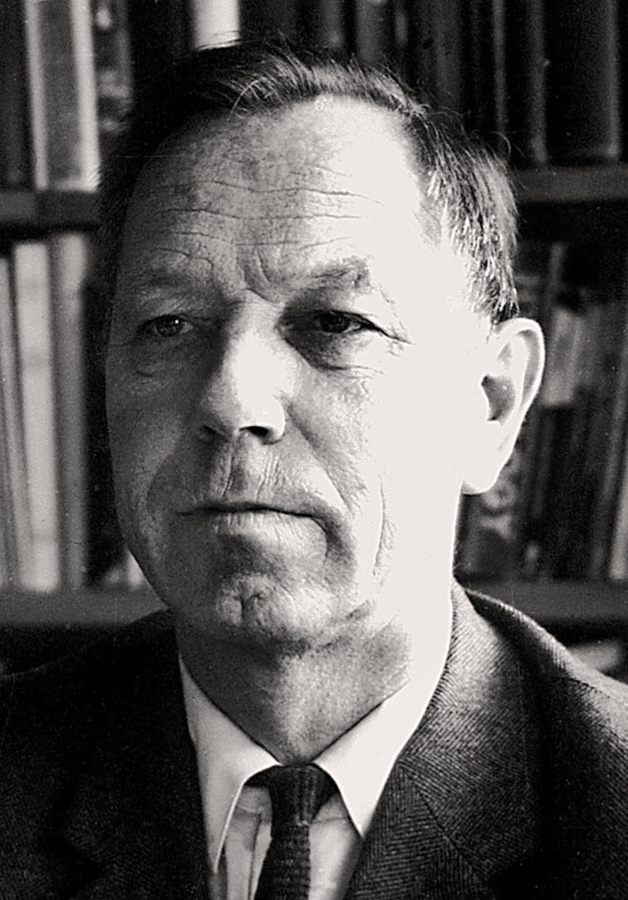
Transverse Jet Circulations
The Sawyer (1956)–Eliassen (1962) Circulation Equation provides a way to diagnose the transverse circulations associated with active fronts.
Arnt Eliassen
Norwegian Encyclopedia

Slide 42
Sawyer–Eliassen Circulation Equation
Where:
X
Y

Slide 43
Sawyer–Eliassen Circulation Equation
Where:
X
Y

Slide 44
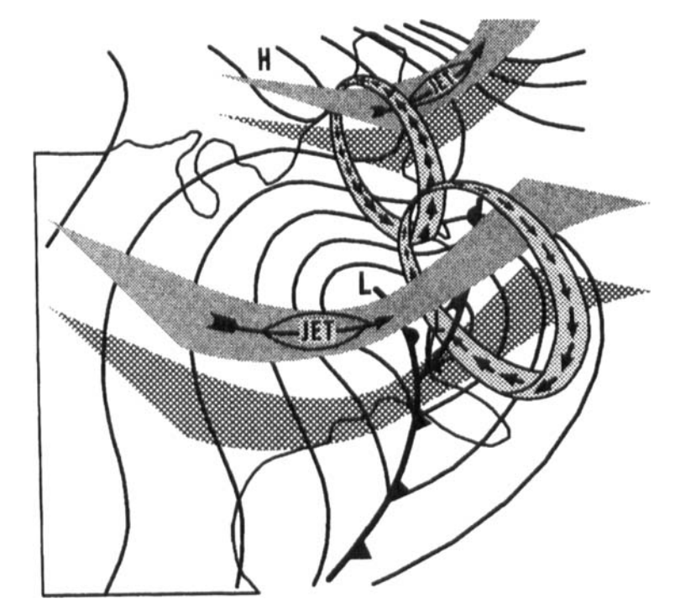
Sawyer–Eliassen Circulation Equation
Uccellini and Kocin (1987)

Slide 45
Sawyer–Eliassen Circulation Equation
Where:
X
Y

Slide 46
Sawyer–Eliassen Circulation Equation
Static Stability
Where:
X
Y

Slide 47
Sawyer–Eliassen Circulation Equation
Static Stability
Across-Front Baroclinicity
Where:
X
Y

Slide 48
Sawyer–Eliassen Circulation Equation
Static Stability
Across-Front Baroclinicity
Horizontal Absolute Vorticity
Where:
X
Y

Slide 49
Sawyer–Eliassen Circulation Equation
Static Stability
Across-Front Baroclinicity
Horizontal Absolute Vorticity
Frontal Characteristics
Where:
X
Y

Slide 50
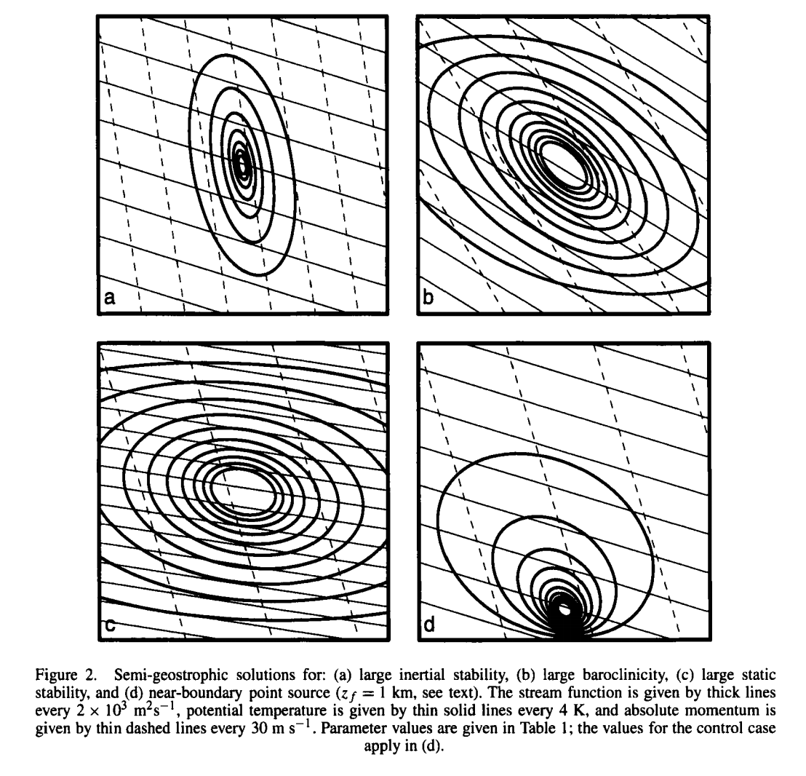
Sawyer–Eliassen Circulation Equation
Rel. Vorticity
Baroclinicity
Hakim and Keyser (2001)
How does modulation of the coefficients to the Sawyer–Eliassen Equation impact the resultant circulation?
Static Stability
Near Boundary

Slide 51
Sawyer–Eliassen Circulation Equation
Static Stability
Across-Front Baroclinicity
Horizontal Absolute Vorticity
Geostrophic and Diabatic Forcing
Frontal Characteristics
Where:
X
Y
Shearing
Confluence

Slide 52
Sawyer–Eliassen Circulation Equation
Shearing
Confluence

Slide 53
Sawyer–Eliassen Circulation Equation
Shearing
Confluence

Slide 54
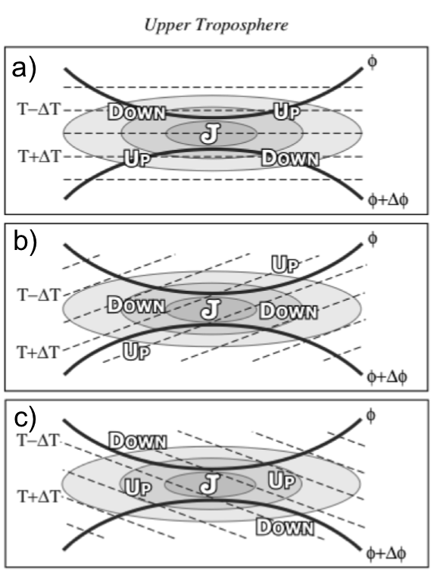
Sawyer–Eliassen Circulation Equation
No Temp. Advection
Shearing
Confluence
The absence of any along-jet temperature advection returns the traditional four-quadrant model.
Lang and Martin (2012)

Slide 55
Sawyer–Eliassen Circulation Equation
No Temp. Advection
Shearing
Confluence
Geo. CAA
Along-jet temperature advection acts to “shift” the circulations relative to the jet axis.
Geo. WAA
Lang and Martin (2012)

Slide 56
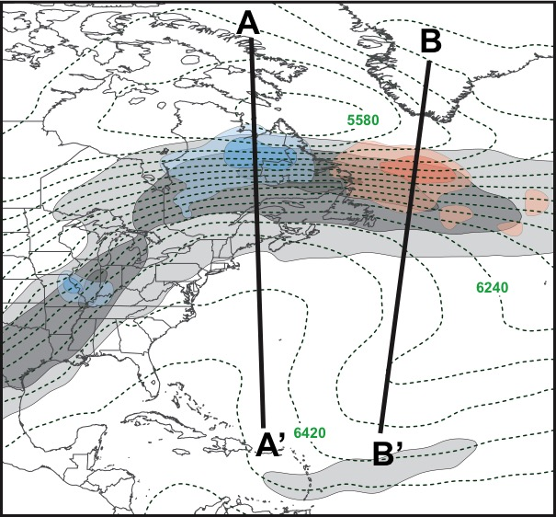
Sawyer–Eliassen Circulation Equation
1200 UTC
22 Dec 2013
Geo. CAA in the jet entrance region
Geo. WAA in the jet exit region

Slide 57
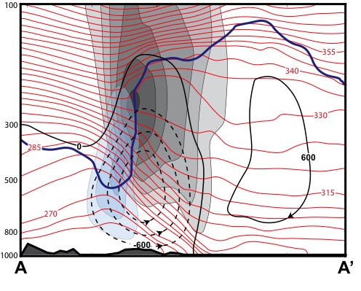
Sawyer–Eliassen Circulation Equation
1200 UTC
22 Dec 2013
The result is a thermally direct circulation.
Subsidence is present slightly poleward of the jet core.
Geo. CAA

Slide 58
Sawyer–Eliassen Circulation Equation
1200 UTC
22 Dec 2013
Geo. CAA in the jet entrance region
Geo. WAA in the jet exit region

Slide 59
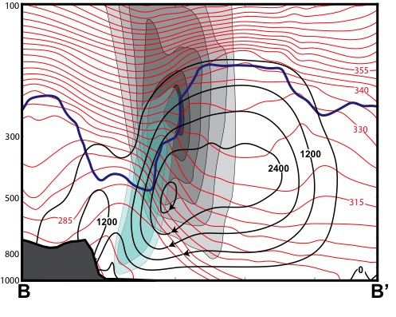
Sawyer–Eliassen Circulation Equation
1200 UTC
22 Dec 2013
The result is a thermally indirect circulation.
Ascent is present slightly poleward of the jet core.
Geo. WAA

Slide 60
How do Jet Streams Impact the Weather?
Impacts of Transverse Jet Circulations on the Production of Sensible Weather
– Severe Weather Outbreaks
(e.g., Omoto 1965; Uccellini and Johnson 1979; Hobbs et al. 1990; Martin et al. 1993)

Slide 61
How do Jet Streams Impact the Weather?
Impacts of Transverse Jet Circulations on the Production of Sensible Weather
– Severe Weather Outbreaks
(e.g., Omoto 1965; Uccellini and Johnson 1979; Hobbs et al. 1990; Martin et al. 1993)
– Cyclogenesis
(e.g., Uccellini et al. 1984; Uccellini et al. 1985; Uccellini and Kocin 1987; Whitaker et al. 1988; Barnes and Colman 1993; Lackmann et al. 1997)

Slide 62
How do Jet Streams Impact the Weather?
Impacts of Transverse Jet Circulations on the Production of Sensible Weather
– Severe Weather Outbreaks
(e.g., Omoto 1965; Uccellini and Johnson 1979; Hobbs et al. 1990; Martin et al. 1993)
– Cyclogenesis
(e.g., Uccellini et al. 1984; Uccellini et al. 1985; Uccellini and Kocin 1987; Whitaker et al. 1988; Barnes and Colman 1993; Lackmann et al. 1997)
– Moisture Transport
(e.g., Uccellini and Johnson 1979; Uccellini et al. 1984; Uccellini and Kocin 1987; Winters and Martin 2014)

Slide 63
How do Jet Streams Impact the Weather?
Severe Weather Outbreaks
Uccellini and Kocin (1987)

Slide 64
How do Jet Streams Impact the Weather?
Severe Weather Outbreaks
Cyclogenesis
Uccellini and Kocin (1987)

Slide 65
How do Jet Streams Impact the Weather?
Severe Weather Outbreaks
Cyclogenesis
Moisture Transport
Uccellini and Kocin (1987)

Slide 66
References
Barnes, S. L., and B. R. Colman, 1993: Quasigeostrophic diagnosis of cyclogenesis associated with a cutoff extratropical cyclone – The Christmas 1987 storm. Mon. Wea. Rev., 121, 1613-1634.
Bjerknes, J., and E. Palmén, 1937: Investigations of selected European cyclones by means of serial ascents. Geofys. Publika., 12 (2), 1-62.
Bryson, R., 1994: Discovery of the Jet Stream. Wisconsin Academy Review 40 (3) Madison, Wisconsin: Wisconsin Academy of Science, Arts, and Letters, Summer 1994.
Eliassen, A., 1962: On the vertical circulation in frontal zones. Geophys. Publ., 24, 147-160.
Hakim, G. J., and D. Keyser, 2001: Canonical frontal circulation patterns in terms of Green’s functions for the Sawyer–Eliassen equation. Quart. J. Roy. Meteor. Soc., 127, 1795–1814.
Hobbs, P. V., J. D. Locatelli, and J. E. Martin, 1990: Cold fronts aloft and forecasting of precipitation and severe weather east of the Rocky Mountains. Wea. Forecasting, 5, 613-626.
Lackmann, G. M., D. Keyser, L. F. Bosart, 1997: A characteristic life cycle of upper-tropospheric cyclogenetic precursors during Experiment on Rapidly Intensifying Cyclones of the Atlantic (ERICA). Mon. Wea. Rev., 125, 2729-2758.
Lang, A. A., and J. E. Martin, 2012: The structure and evolution of lower stratospheric frontal zones. Part I: Examples in northwesterly and southwesterly flow. Quart. J. Roy. Meteor. Soc., 138, 1350-1365.

Slide 67
References
Martin, J. E., J. D. Locatelli, and P. V. Hobbs, 1993: Organization and structure of clouds and precipitation on the mid-Atlantic coast of the United States. Part VI: The synoptic evolution of a deep tropospheric frontal circulation and attendant cyclogenesis. Mon. Wea. Rev., 121, 1299-1316.
Omoto, Y., 1965: On pre-frontal precipitation zones in the United States. J. Meteor. Soc. Japan, 43, 310-330.
Ooishi, W., 1926: Raporto de la Aerologia Observatorio de Tateno (in Esperanto). Aerological Observatory Rep. 1, Central Meteorological Observatory, Japan, 213 pp.
Reiter, E., 1963: Jet Stream Meteorology. University of Chicago Press, 515 pp.
Sawyer, J. S., 1956: The vertical circulation at meteorological fronts and its relation to frontogenesis. Proc. Roy. Soc. London, 234A, 346-362.
Uccellini, L. W., and D. R. Johnson, 1979: The coupling of upper and lower tropospheric jet streaks and implications for the development of severe convective storms. Mon. Wea. Rev., 107, 682-703.
________, and P. J. Kocin, 1987: The interaction of jet streak circulations during heavy snow events along the East Coast of the United States. Wea. Forecasting, 2, 289-308.

Slide 68
References
________, ________, R. A. Petersen, C. H. Wash, and K. F. Brill, 1984: The Presidents’ Day cyclone of 18-19 February 1979; Synoptic overview and analysis of the subtropical jet streak influencing the pre-cyclogenetic period. Mon. Wea. Rev., 112, 31-55.
________, D. Keyser, K. F. Brill, and C. H. Wash, 1985: The Presidents’ Day cyclone of 18-19 February 1979: Influence of upstream trough amplification and associated tropopause folding on rapid cyclogenesis. Mon. Wea. Rev., 113, 962-988.
University of Chicago, Department of Meteorology, 1947: On the general circulation of the atmosphere in middle latitudes. Bull. Amer. Meteor. Soc., 28, 255-280.
Whitaker, J. S., L. W. Uccellini, and K. F. Brill, 1988: A model-based diagnostic study of the rapid development phase of the Presidents’ Day cyclone. Mon. Wea. Rev., 116, 2337-2365.
Winters, A. C., and J. E. Martin, 2014: The role of a polar/subtropical jet superposition in the May 2010 Nashville Flood. Wea. Forecasting, 29, 954-974.

