Slide 1
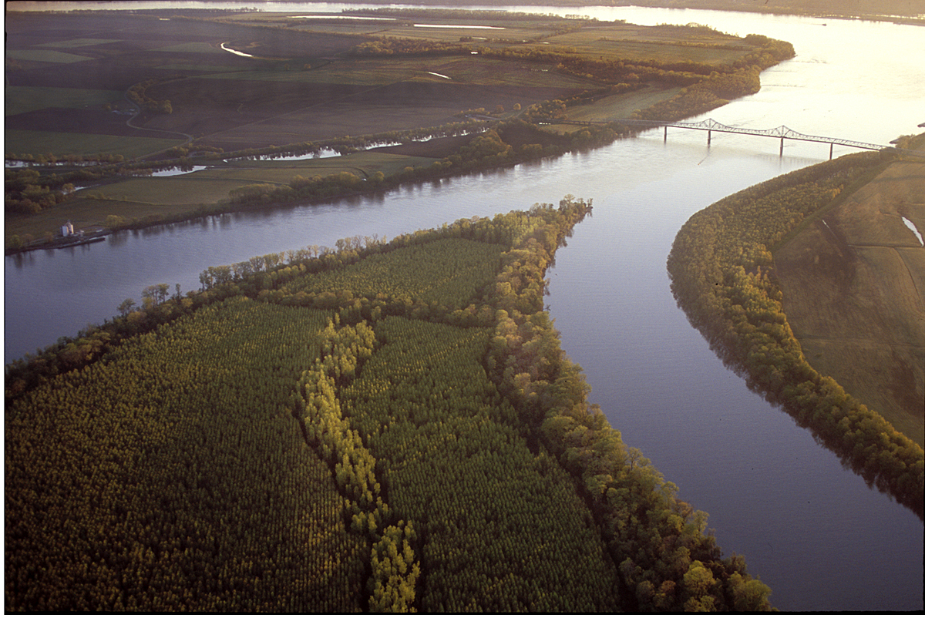


The Role of Subsidence during the Development of North American Polar/Subtropical Jet Superpositions
Daniel Keyser
University at Albany, SUNY
Andrew C. Winters
University of Colorado Boulder
Lance F. Bosart
University at Albany, SUNY
Department of Meteorology and
Atmospheric Science
The Pennsylvania State University
29 January 2020
This work was funded by an NSF-PRF (AGS-1624316)

Slide 2
Outline
Background
Jet Superposition Event Identification and Classification
Jet Superposition Event Composites
Piecewise QGPV Inversion
Along- and Across-Front Vertical Motion
Summary

Slide 3
Background

Slide 4
Background
STJ
Modified from Defant and Taba (1957)
Subtropical Jet
PJ
Polar Jet
STJ
PJ

Slide 5
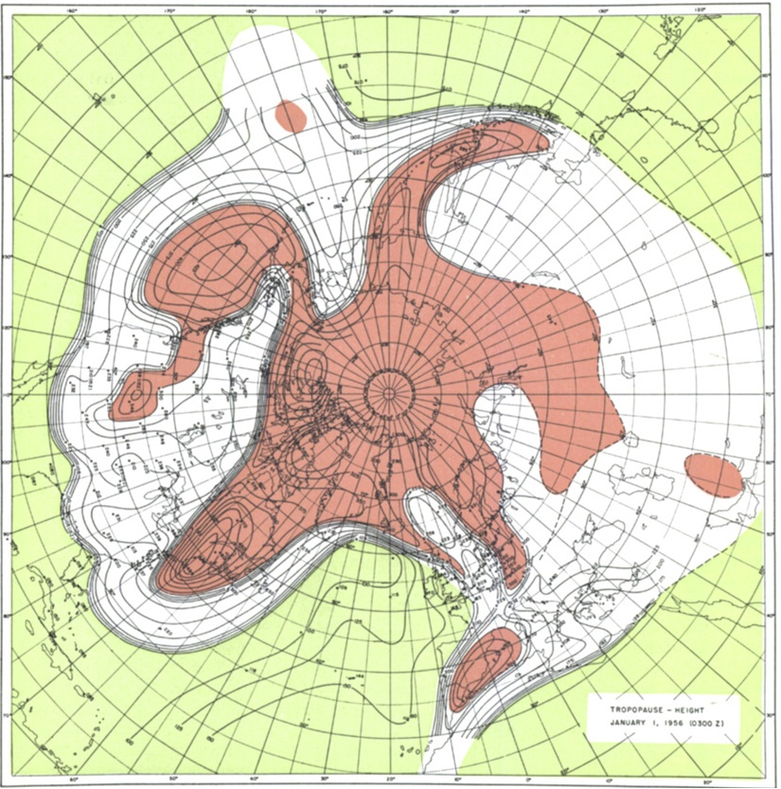
Background
Tropopause Pressure (hPa)
Phoenix
NP
North Pole
Maps of tropopause pressure help to identify the location of the jets.
While each jet occupies its own climatological latitude band, substantial meanders are common.
Occasionally, the latitudinal separation between the jets can vanish resulting in a vertical jet superposition.
STJ
PJ
NP
PJ
Tropical Tropopause
Subtropical Tropopause
Polar Tropopause
Polar Jet
STJ
Modified from Defant and Taba (1957)
Subtropical Jet

Slide 6
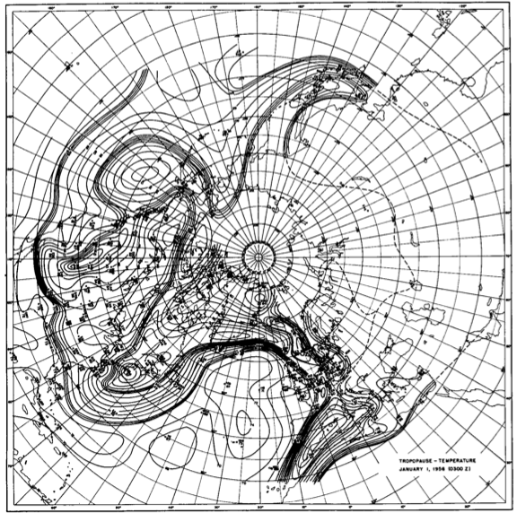
Background
Tropopause Temperature (ºC)
Phoenix
NP
North Pole
The pole-to-equator baroclinicity is combined into a much narrower zone of contrast in the vicinity of a jet superposition.
Intensified frontal structure is often accompanied by a strengthening of the transverse circulation associated with the superposed jet.
STJ
PJ
NP
Modified from Defant and Taba (1957)

Slide 7
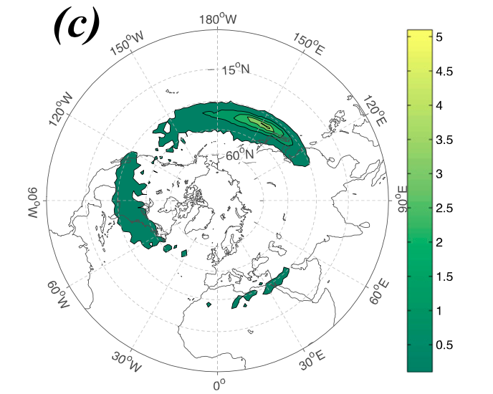
Background
Christenson et al. (2017) highlight three locations that experience the greatest frequency of
jet superpositions:
1) Western Pacific
2) North America
3) Northern Africa
Climatological frequency of Northern Hemisphere jet superposition events per cold season (Nov–Mar) 1960–2010
Number of Events
Christenson et al. (2017)

Slide 8
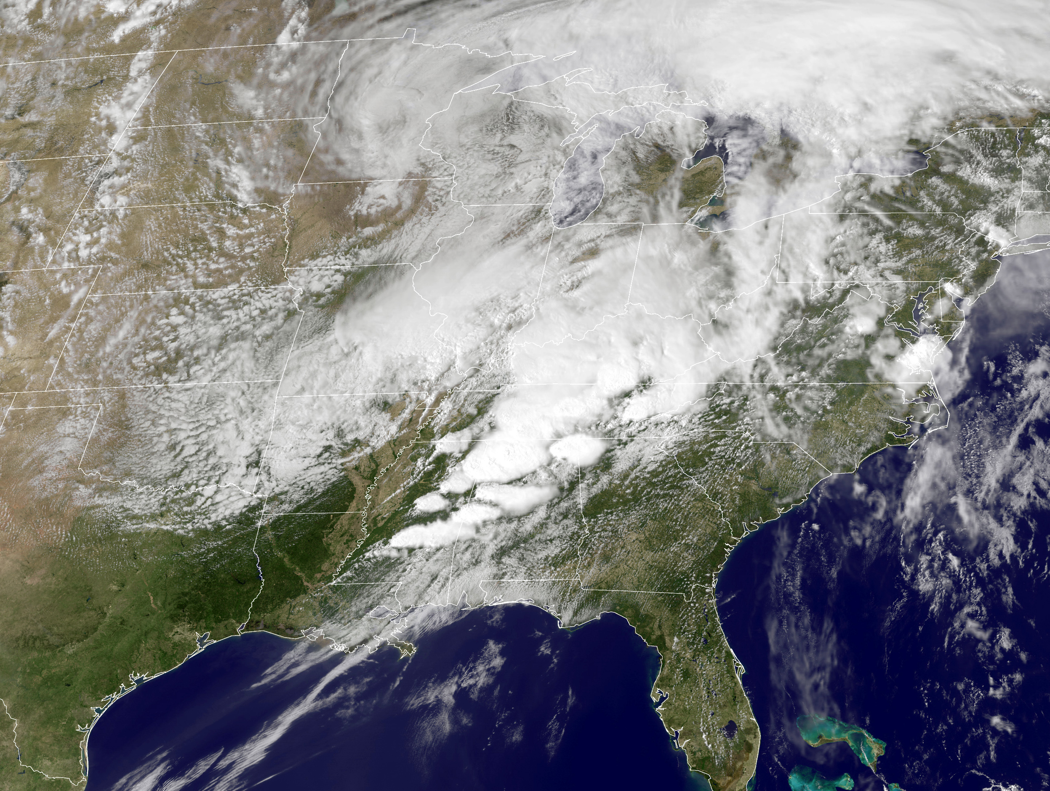
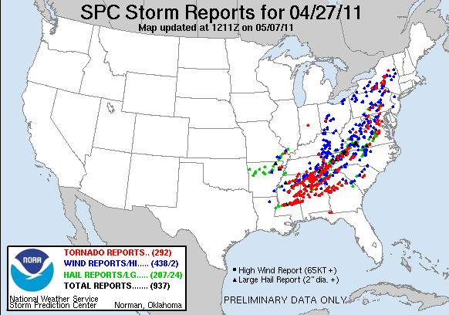
Jet Superpositions and High-Impact Weather
Jet superpositions can be an element of high-impact weather events
1–3 May 2010 Nashville Flood
Jet superposition enhanced the poleward moisture transport via its ageostrophic circulation (Winters and Martin 2014; 2016).
18–20 December 2009 Mid-Atlantic Blizzard
Jet superposition was associated with a rapidly deepening East Coast cyclone (Winters and Martin 2016; 2017).
26 October 2010: Explosive Cyclogenesis Event
Jet superposition over the West Pacific preceded the development of an intense Midwest U.S. cyclone.
25–28 April 2011 Tornado Outbreak
Jet superposition occurred over the West Pacific prior to the outbreak (Knupp et al. 2014; Christenson and Martin 2012).
NASA
SPC

Slide 9
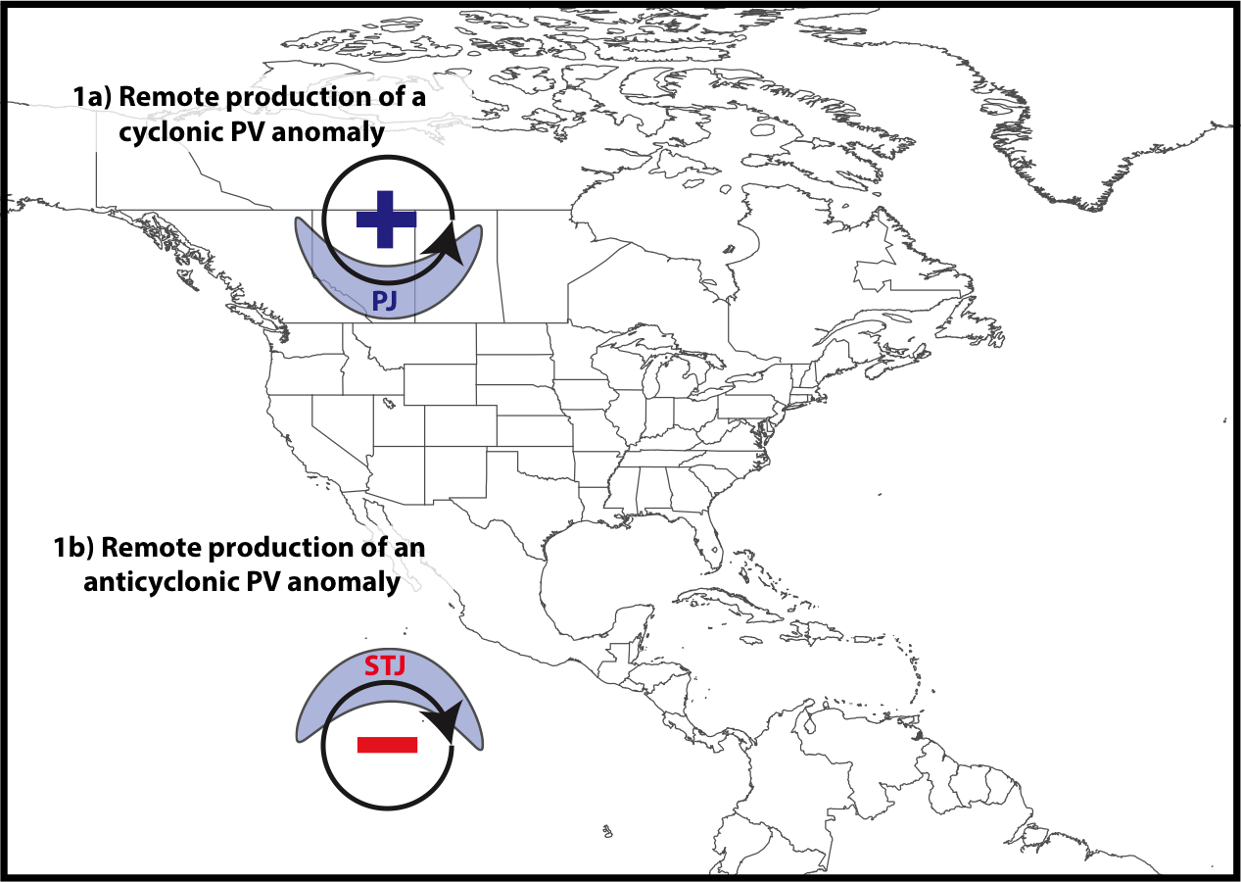
Jet Superposition Conceptual Model
Winters and Martin (2017)

Slide 10
Jet Superposition Conceptual Model
Polar cyclonic PV anomalies:
Often referred to as coherent tropopause disturbances (Pyle et al. 2004) or tropopause polar vortices (Cavallo and Hakim 2010).
Characterize a dynamical environment conducive to midlatitude cyclogenesis.
Winters and Martin (2017)

Slide 11
Jet Superposition Conceptual Model
Winters and Martin (2017)

Slide 12
Jet Superposition Conceptual Model
Tropical anticyclonic PV anomalies:
Feature a thermodynamic environment characterized by weak upper-tropospheric static stability.
An atmospheric river often forms within the poleward-directed branch of the low-level circulation induced by an anticyclonic PV anomaly.
Winters and Martin (2017)

Slide 13
Jet Superposition Conceptual Model
A
A’
Winters and Martin (2017)

Slide 14
Jet Superposition Conceptual Model
A
2-PVU Contour
Potential Temp.
Wind Speed
A’
Winters and Martin (2017)

Slide 15
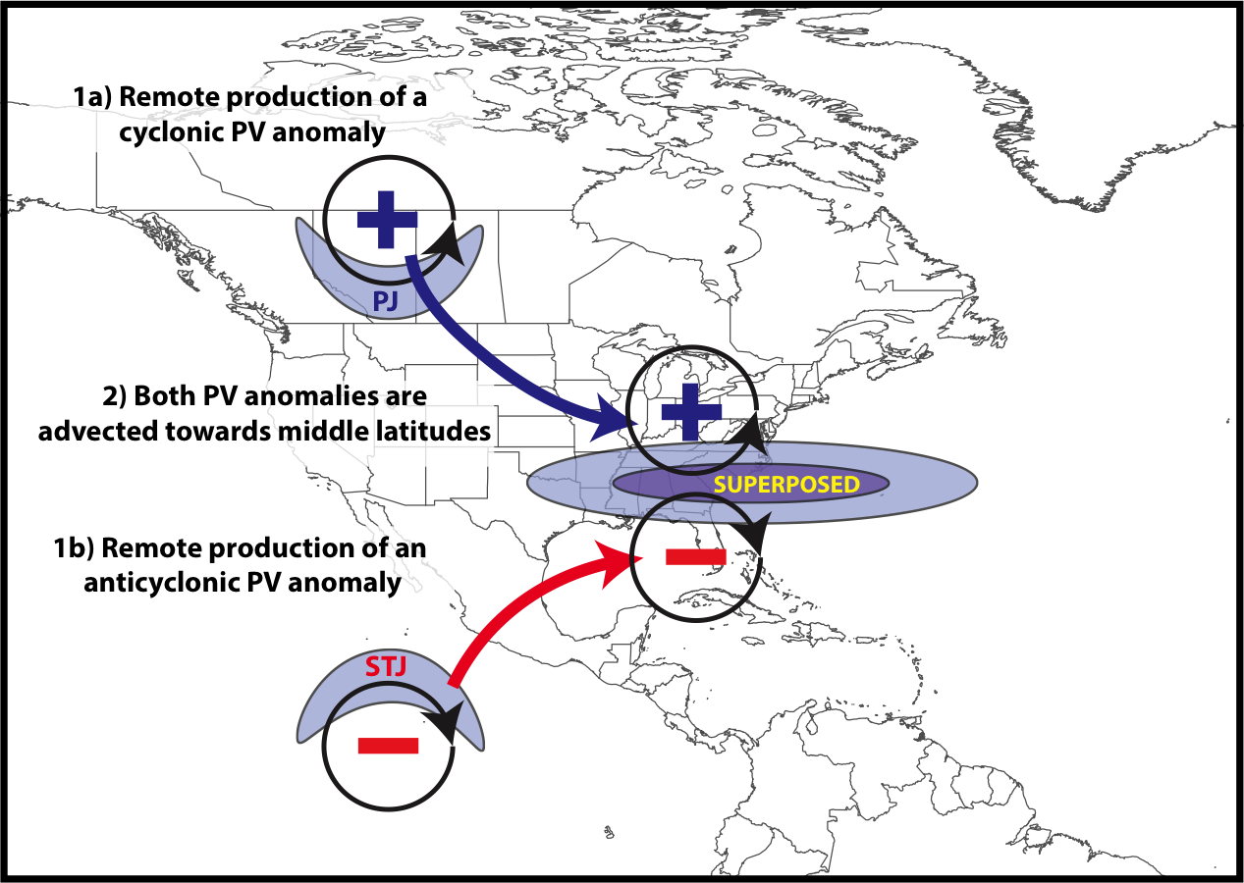
Jet Superposition Conceptual Model
Jet Superpositions:
Characterized by a rapid increase in upper-tropospheric wind speed
Represent a dynamical and thermodynamic environment conducive to high-impact weather
Winters and Martin (2017)

Slide 16
Jet Superposition Conceptual Model
B
B’
Winters and Martin (2017)

Slide 17
Jet Superposition Conceptual Model
B
2-PVU Contour
Potential Temp.
Wind Speed
B’
Winters and Martin (2017)

Slide 18
Jet Superposition Conceptual Model
The relative importance of the antecedent PV anomalies is highly variable between jet superposition events
Winters and Martin (2017)

Slide 19
Jet Superposition Conceptual Model
What role do the antecedent PV anomalies play during the process of jet superposition?
Winters and Martin (2017)

Slide 20
Jet Superposition Event Identification and Classification

Slide 21
Jet Superposition Event Identification
Isolated NCEP CFSR (Saha et al. 2014) grid points over North America characterized by a jet superposition during Nov.–Mar. 1979–2010 using the Christenson et al. (2017) scheme.
Retained analysis times that rank in the top 10% in terms of the number of grid points characterized by a jet superposition.
Filtered retained analysis times to group together jet superpositions that are < 30 h and < 1500 km apart.
326 jet superposition events

Slide 22
Jet Superposition Event Identification
Isolated NCEP CFSR (Saha et al. 2014) grid points over North America characterized by a jet superposition during Nov.–Mar. 1979–2010 using the Christenson et al. (2017) scheme.
Retained analysis times that rank in the top 10% in terms of the number of grid points characterized by a jet superposition.
Filtered retained analysis times to group together jet superpositions that are < 30 h and < 1500 km apart.
Classified jet superposition events based on the deviations of the polar and subtropical jets from their respective climatological latitude bands at the time of jet superposition.

Slide 23
Jet Superposition Event Classification
Determined the mean position of the 2-PVU contour on the 320-K and 350-K surfaces at each analysis time in the CFSR.
0000 UTC 1 January
Winters et al. (2020, in revision)

Slide 24
Jet Superposition Event Classification
Determined the mean position of the 2-PVU contour on the 320-K and 350-K surfaces at each analysis time in the CFSR.
0000 UTC 1 January
Polar Jet
Subtropical Jet
Winters et al. (2020, in revision)

Slide 25
Jet Superposition Event Classification
Determined the mean position of the 2-PVU contour on the 320-K and 350-K surfaces at each analysis time in the CFSR.
Compared the position of the jet superposition centroid at the start of each event against the climatological position of the 2-PVU contour.
0000 UTC 1 January
Winters et al. (2020, in revision)

Slide 26
Jet Superposition Event Classification
Determined the mean position of the 2-PVU contour on the 320-K and 350-K surfaces at each analysis time in the CFSR.
Compared the position of the jet superposition centroid at the start of each event against the climatological position of the 2-PVU contour.
Polar Dominant
0000 UTC 1 January
Jet Superposition Centroid
Winters et al. (2020, in revision)

Slide 27
Jet Superposition Event Classification
Determined the mean position of the 2-PVU contour on the 320-K and 350-K surfaces at each analysis time in the CFSR.
Compared the position of the jet superposition centroid at the start of each event against the climatological position of the 2-PVU contour.
Polar Dominant
Subtropical Dominant
0000 UTC 1 January
Jet Superposition Centroid
Winters et al. (2020, in revision)

Slide 28
Jet Superposition Event Classification
Determined the mean position of the 2-PVU contour on the 320-K and 350-K surfaces at each analysis time in the CFSR.
Compared the position of the jet superposition centroid at the start of each event against the climatological position of the 2-PVU contour.
Polar Dominant
Subtropical Dominant
Hybrid
0000 UTC 1 January
Jet Superposition Centroid
Winters et al. (2020, in revision)

Slide 29
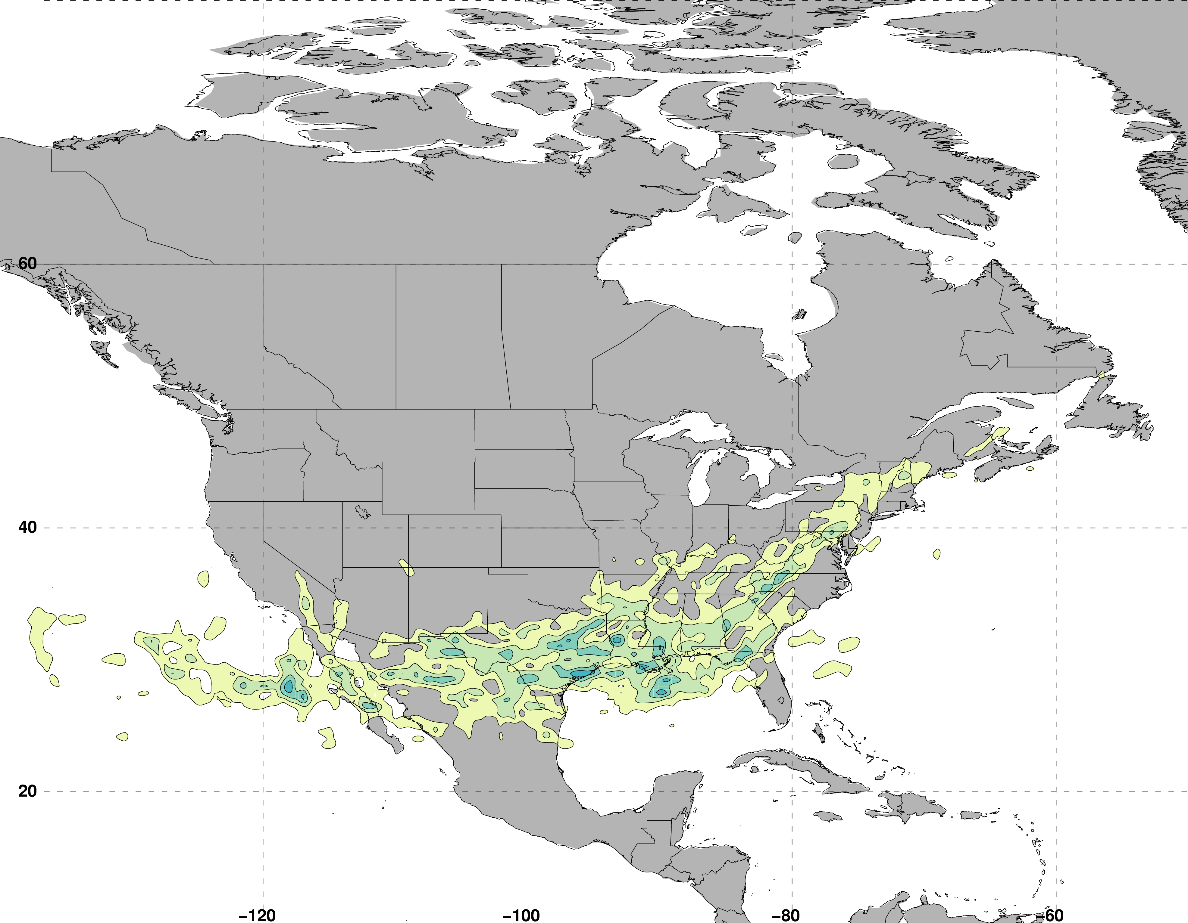
Jet Superposition Event Classification
Frequency of Polar Dominant Jet Superposition Events
N = 80
Legend
Avg. Location of Superposition
Winters et al. (2020, in revision)
Number of events

Slide 30
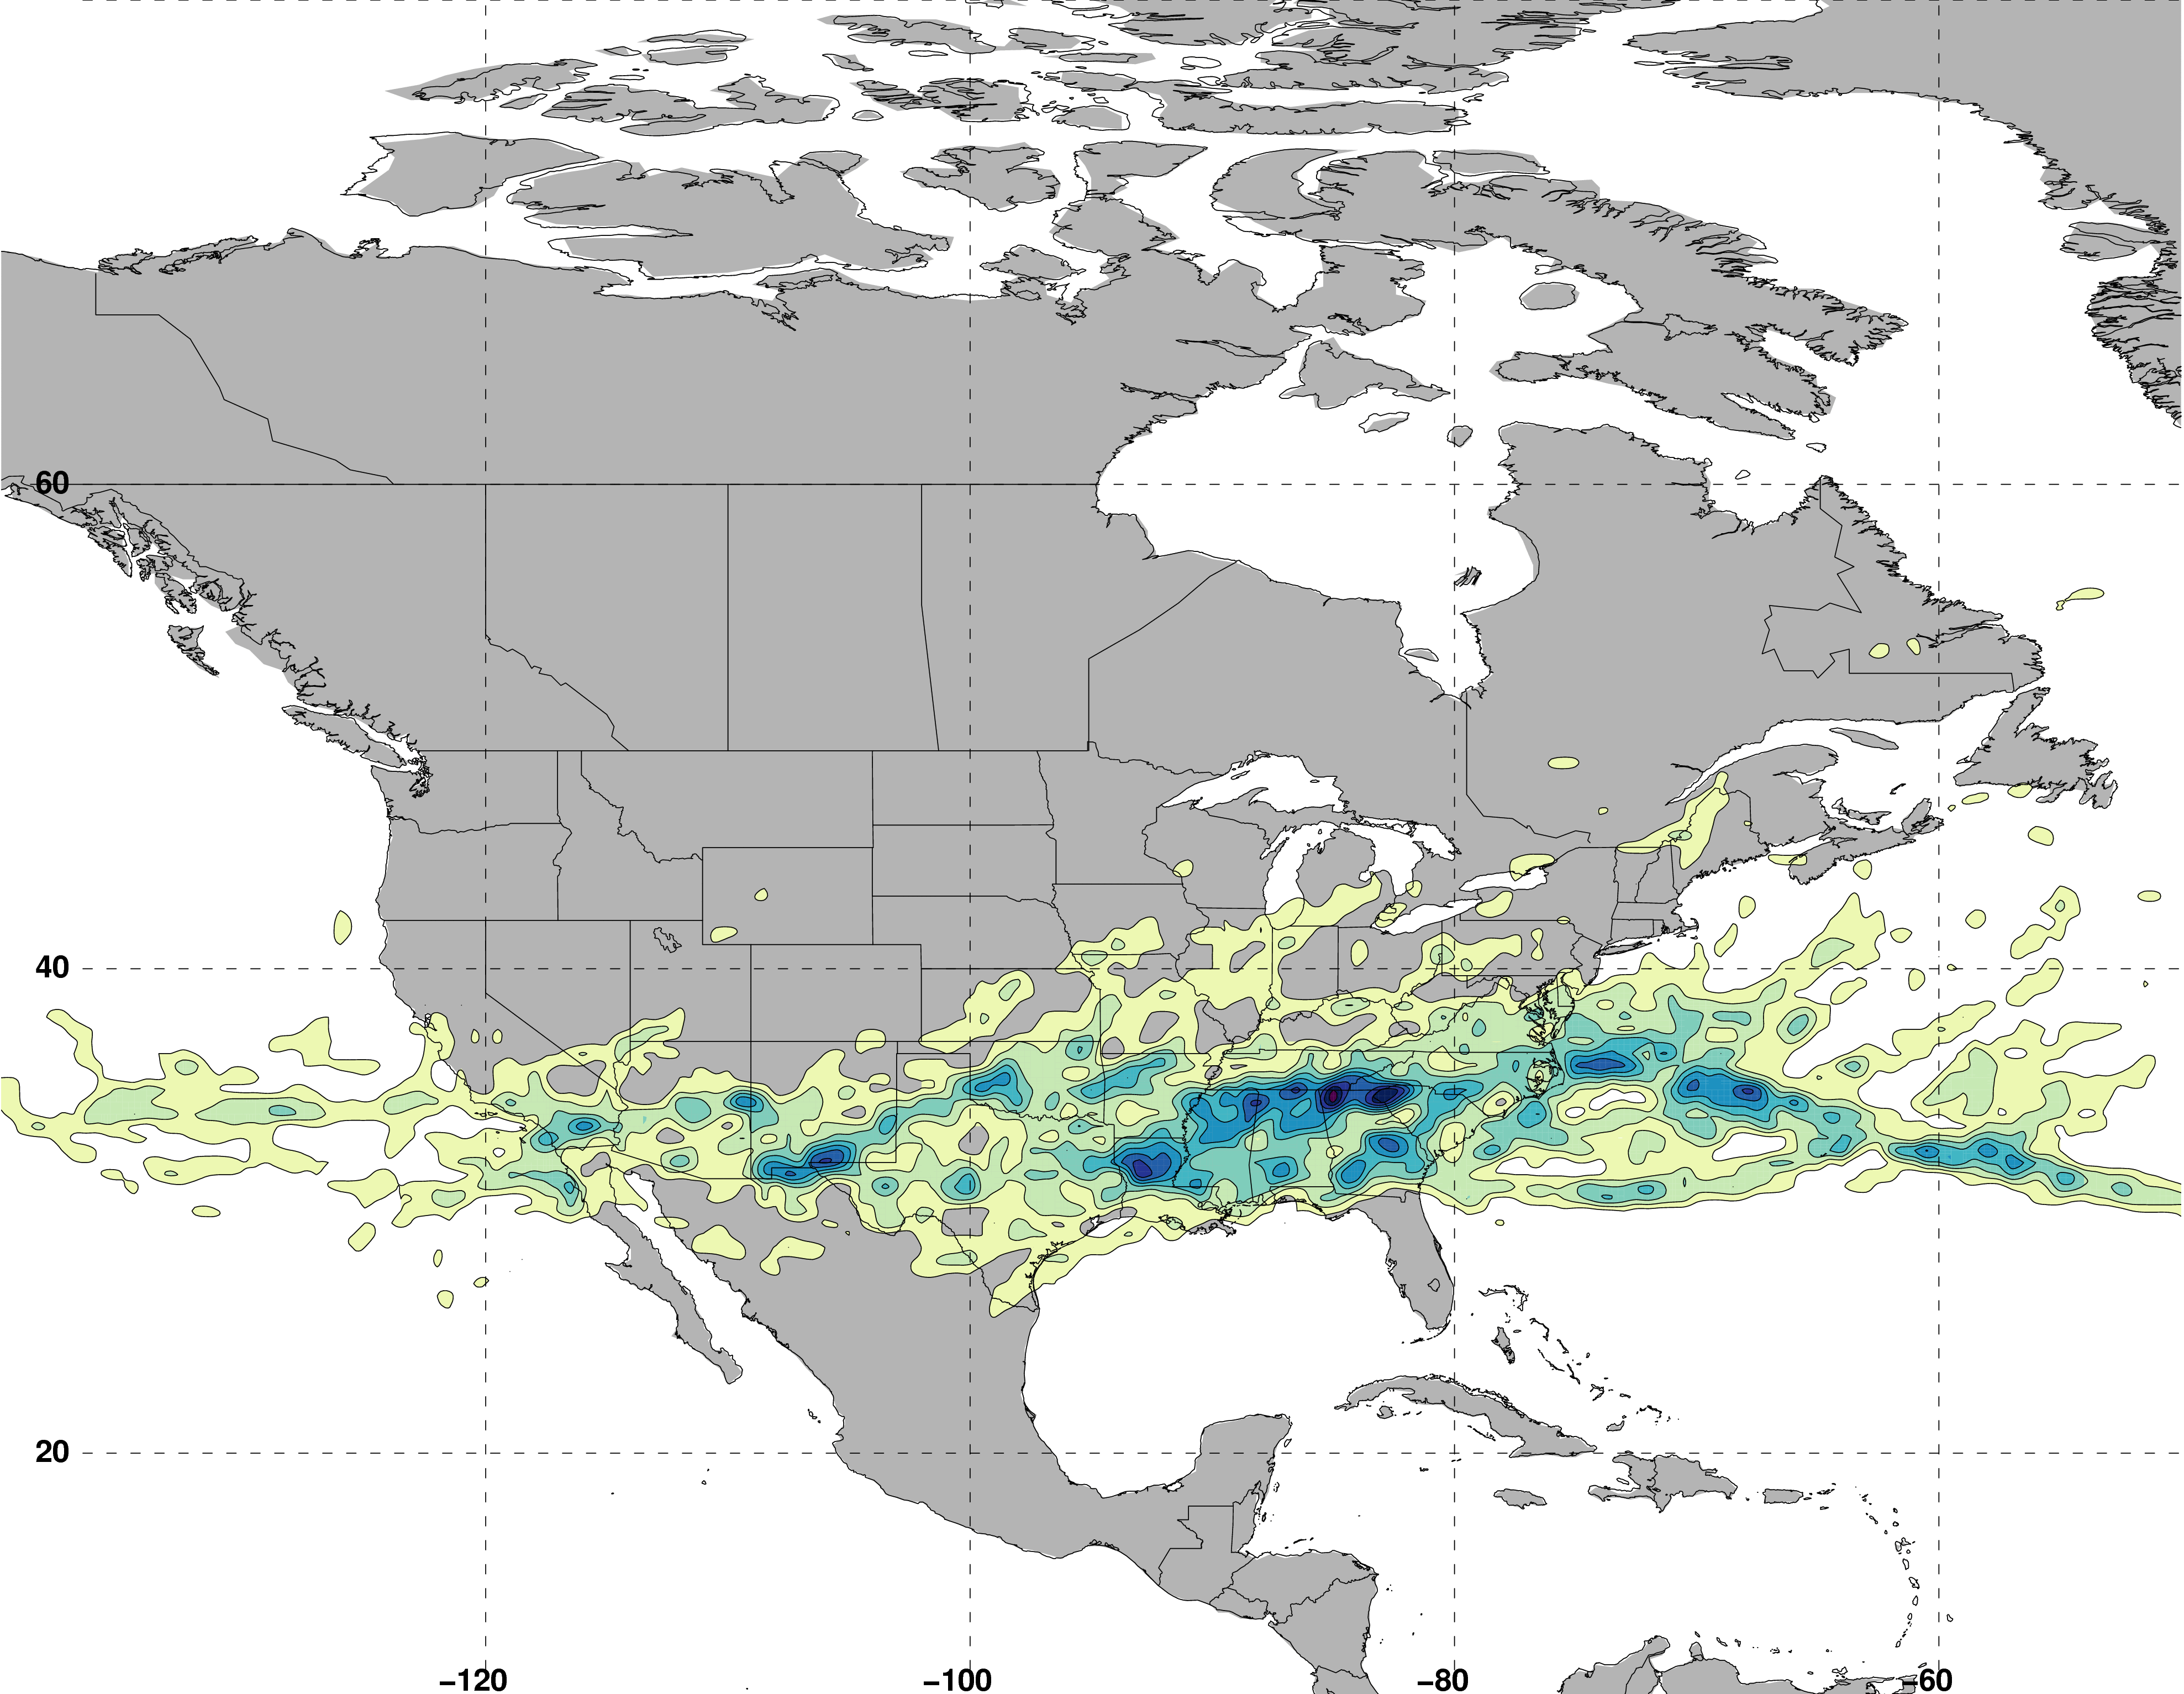
Jet Superposition Event Classification
Frequency of Hybrid Jet Superposition Events
N = 117
Legend
Avg. Location of Superposition
Winters et al. (2020, in revision)
Number of events

Slide 31
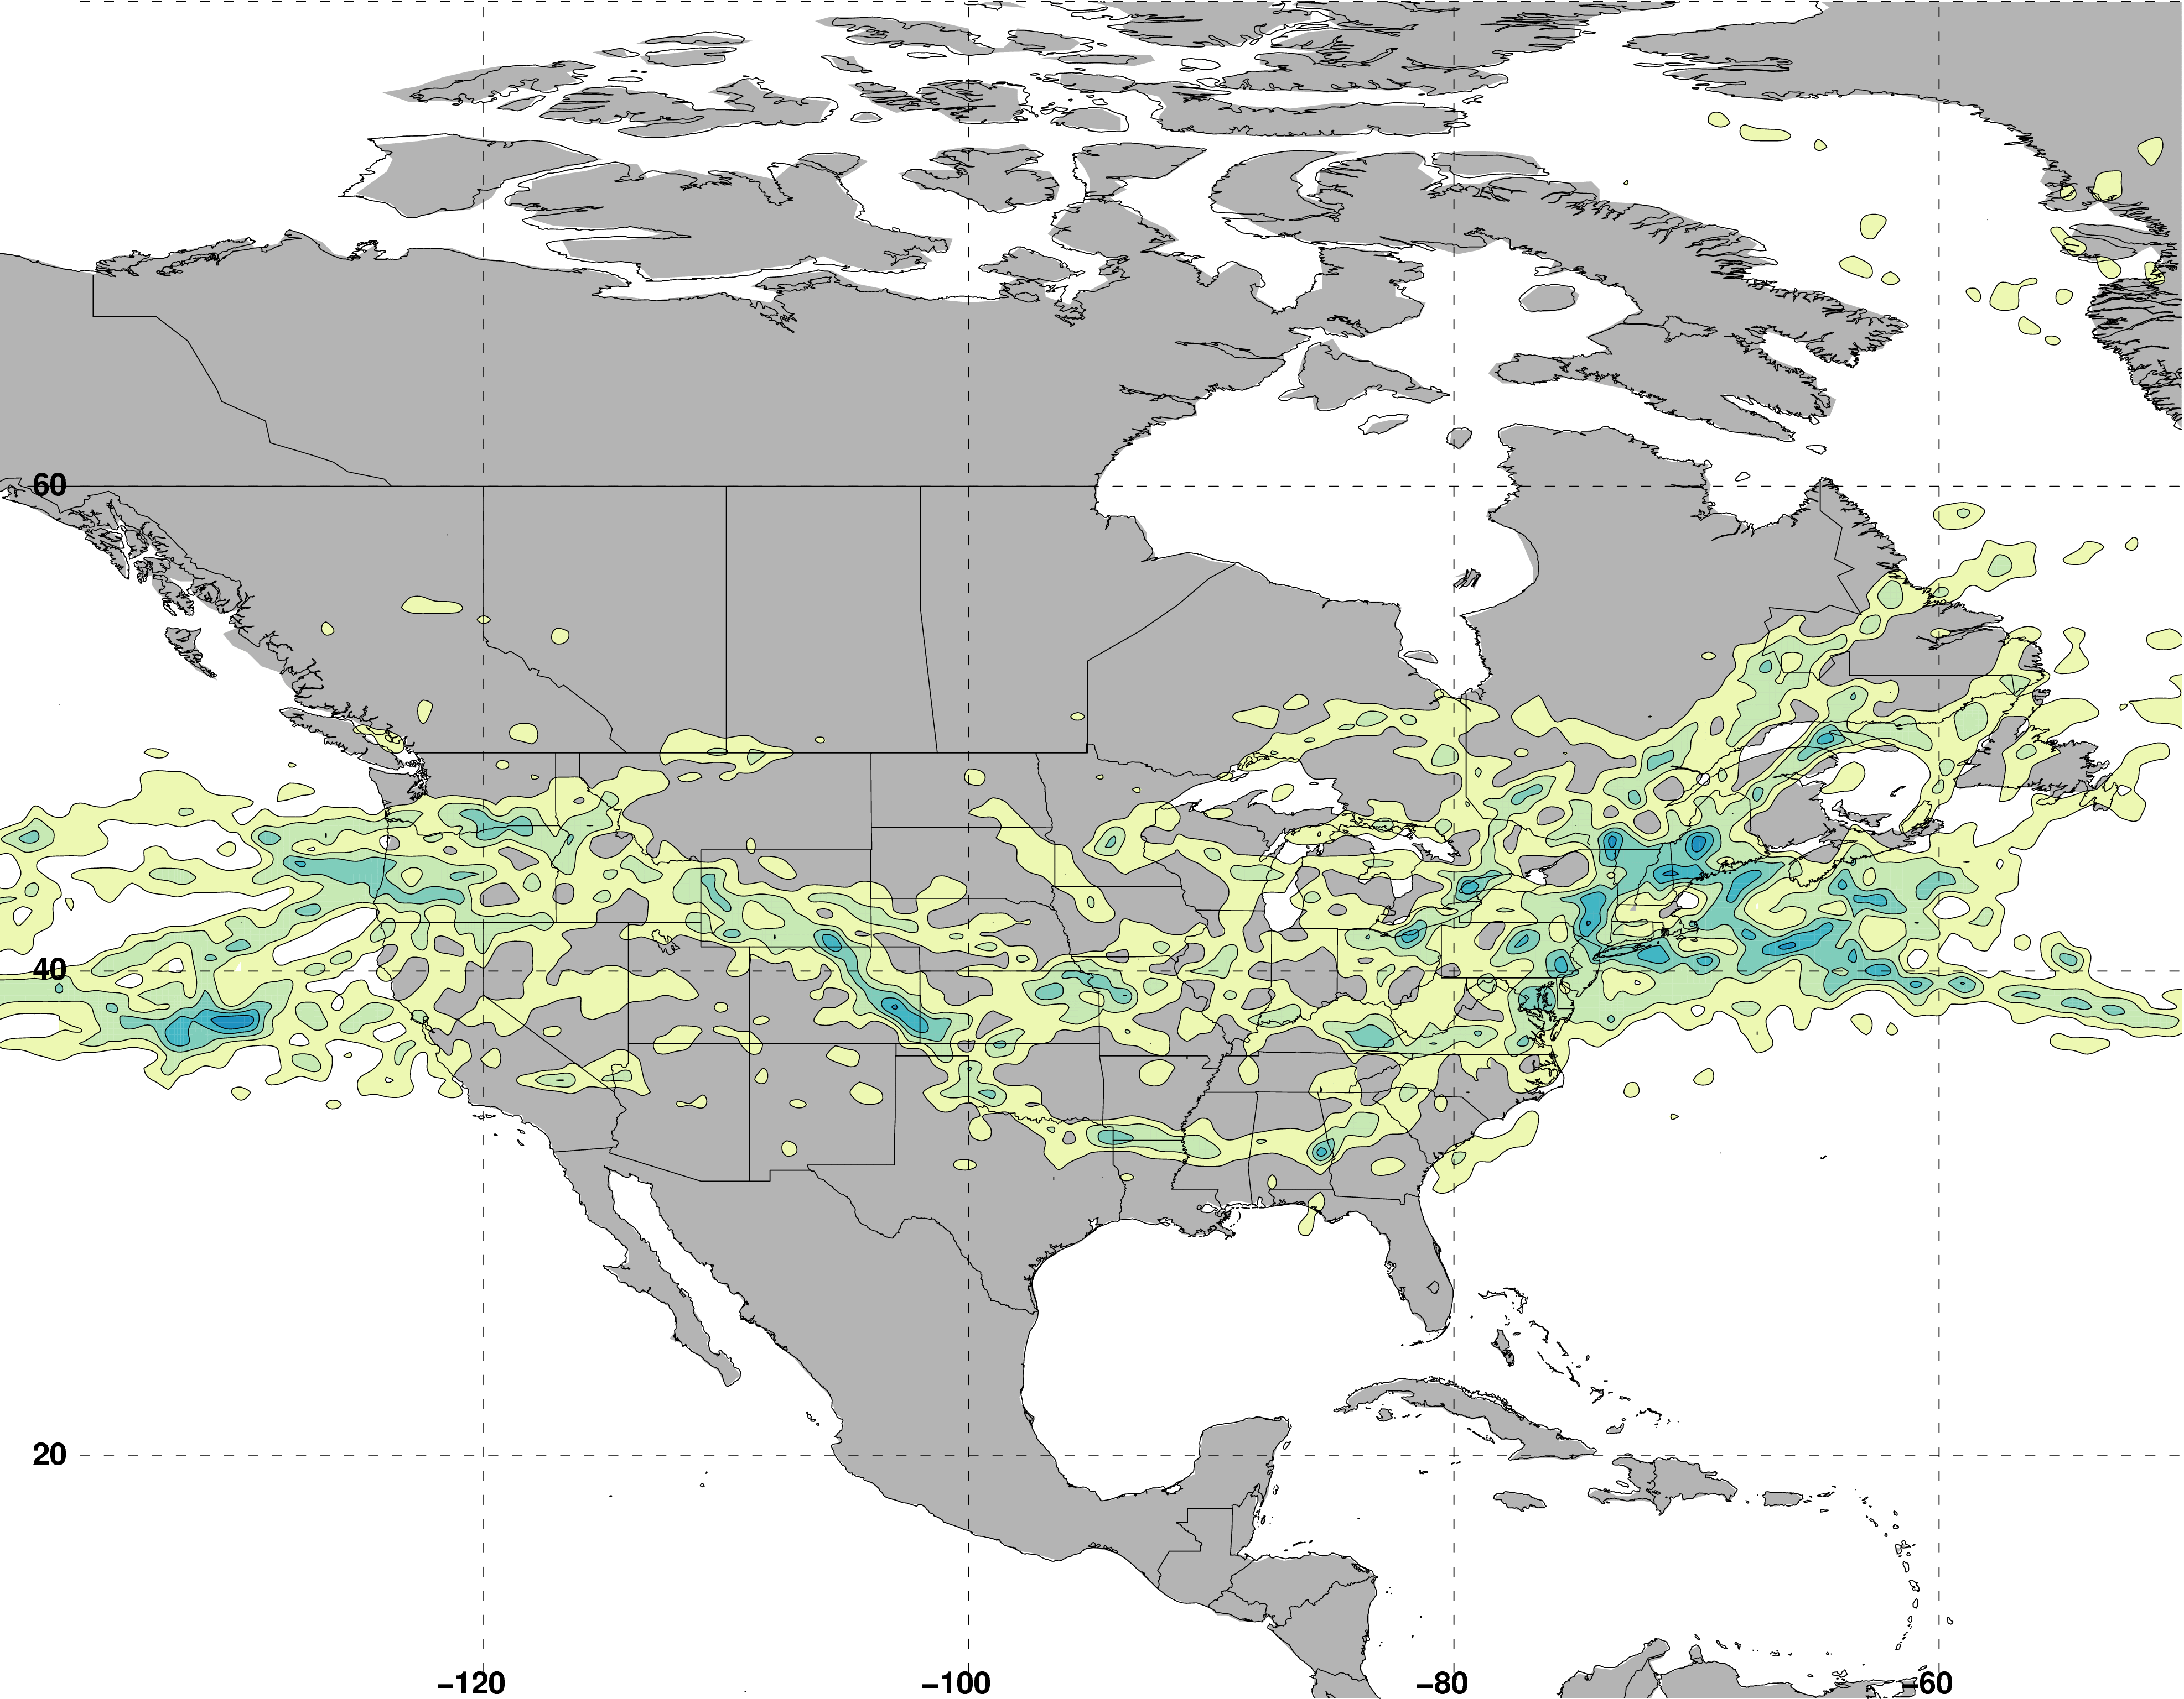
Jet Superposition Event Classification
Frequency of Subtropical Dominant Jet Superposition Events
N = 129
Legend
Avg. Location of Superposition
Winters et al. (2020, in revision)
Number of events

Slide 32
Jet Superposition Event Classification
Frequency of Subtropical Dominant Jet Superposition Events
N = 129
West: N = 53
East: N = 76
Legend
Avg. Location of Superposition
Winters et al. (2020, in revision)
Number of events

Slide 33
Jet Superposition Event
Composites

Slide 34
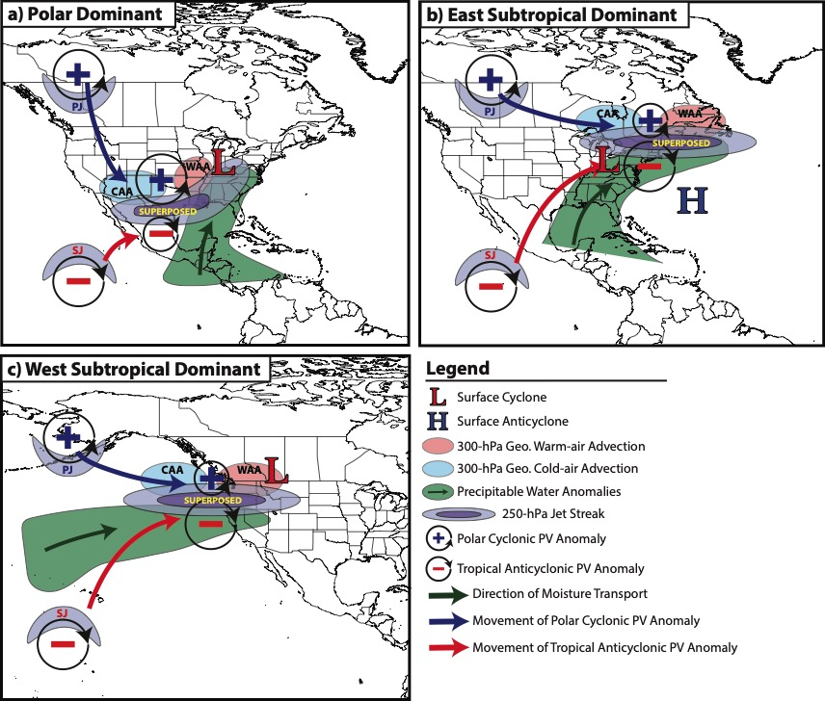
Jet Superposition Event Composites
Winters et al. (2020, in revision)

Slide 35
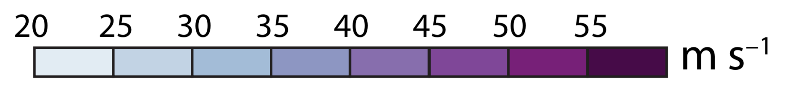
Polar Dominant
Jet Superposition Event Composites
East Subtropical Dominant
West Subtropical Dominant
250-hPa Geo. Height
250-hPa Geo. Height Anomalies
500-hPa Descent
Avg. Location of Superposition
Wind Speed

Slide 36
Polar Dominant
Jet Superposition Event Composites
Descent beneath the jet-entrance region is a common element among the jet superposition event composites.
East Subtropical Dominant
West Subtropical Dominant
250-hPa Geo. Height
250-hPa Geo. Height Anomalies
500-hPa Descent
Avg. Location of Superposition
Wind Speed

Slide 37
Polar Dominant
Jet Superposition Event Composites
C
Descent beneath the jet-entrance region is a common element among the jet superposition event composites.
C’
East Subtropical Dominant
D
D’
West Subtropical Dominant
E
250-hPa Geo. Height
250-hPa Geo. Height Anomalies
500-hPa Descent
Avg. Location of Superposition
E
Wind Speed

Slide 38
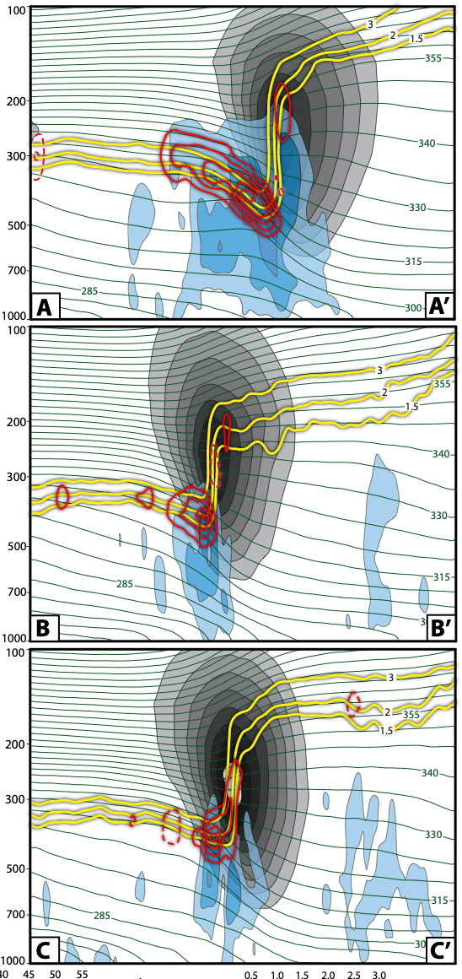
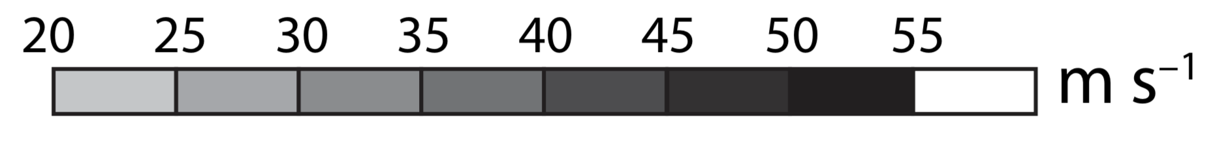
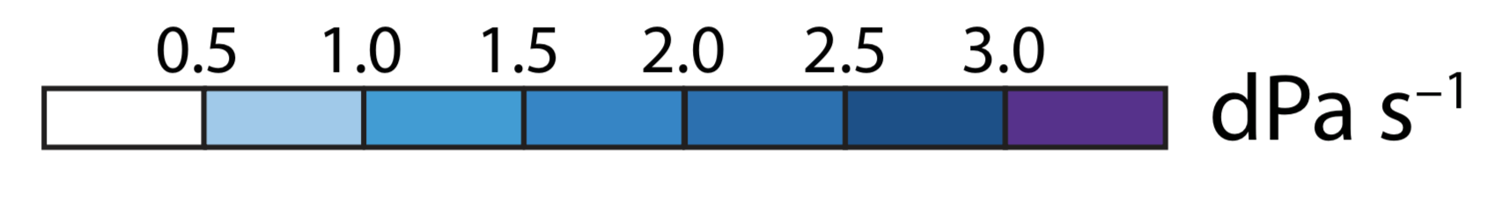
Polar Dominant
Jet Superposition Event Composites
Descent beneath the jet-entrance region is a common element among the jet superposition event composites.
Descent results in downward PV advection within the developing tropopause fold, which steepens the tropopause.
C
C’
East Subtropical Dominant
D
D’
West Subtropical Dominant
1.5-, 2-, 3-PVU
+ PV Advection
Potential Temperature
– PV Advection
Wind Speed
E
E’
Descent

Slide 39
Polar Dominant
Jet Superposition Event Composites
Descent beneath the jet-entrance region is a common element among the jet superposition event composites.
Descent results in downward PV advection within the developing tropopause fold, which steepens the tropopause.
The consistent role of descent motivates further investigation of the dynamical mechanisms responsible for the descent.
C
C’
East Subtropical Dominant
East Subtropical Dominant
D
D’
West Subtropical Dominant
1.5-, 2-, 3-PVU
+ PV Advection
Potential Temperature
– PV Advection
Wind Speed
E
E’
Descent

Slide 40
Piecewise QGPV
Inversion

Slide 41
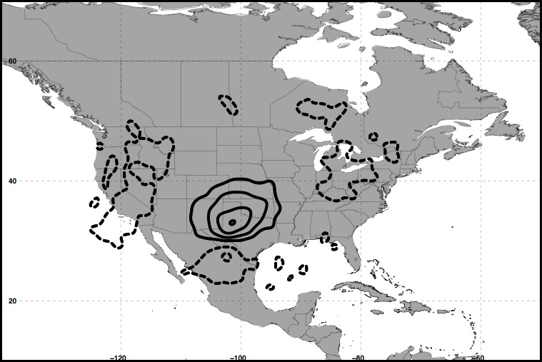
Piecewise QGPV Inversion
Polar Dominant Events
250 hPa
+ QGPV Anomalies
– QGPV Anomalies
Avg. Location
of Superposition
The descent characterizing each jet superposition event composite is examined further by isolating quasi-geostrophic (QG) PV anomalies in the vicinity of the jet superposition.

Slide 42
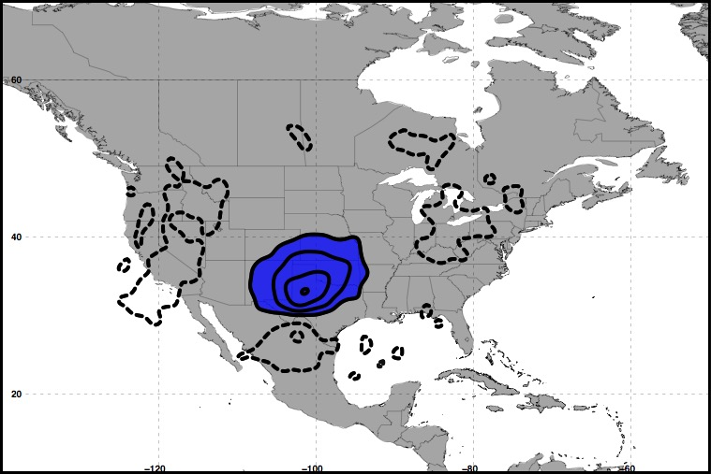
Piecewise QGPV Inversion
Polar Dominant Events
250 hPa
+ QGPV Anomalies
– QGPV Anomalies
Avg. Location
of Superposition
Polar Cyclonic QGPV Anomalies

Slide 43
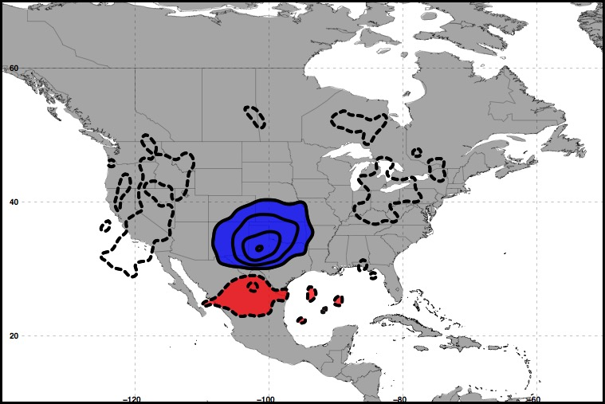
Piecewise QGPV Inversion
Polar Dominant Events
250 hPa
+ QGPV Anomalies
– QGPV Anomalies
Avg. Location
of Superposition
Polar Cyclonic QGPV Anomalies
Tropical Anticyclonic QGPV Anomalies

Slide 44
Piecewise QGPV Inversion
Polar Dominant Events
250 hPa
+ QGPV Anomalies
– QGPV Anomalies
Avg. Location
of Superposition
Polar Cyclonic QGPV Anomalies
Tropical Anticyclonic QGPV Anomalies

Slide 45
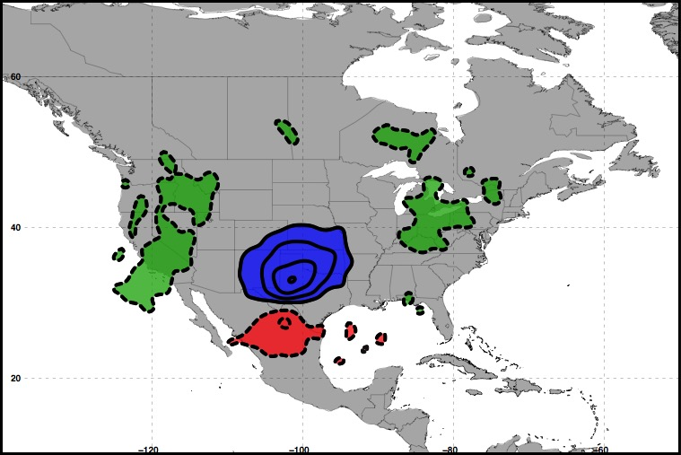
Piecewise QGPV Inversion
Polar Dominant Events
250 hPa
+ QGPV Anomalies
– QGPV Anomalies
Avg. Location
of Superposition
Polar Cyclonic QGPV Anomalies
Residual Upper-Tropospheric QGPV Anomalies
Tropical Anticyclonic QGPV Anomalies

Slide 46
Piecewise QGPV Inversion
Polar Dominant Events
250 hPa
+ QGPV Anomalies
– QGPV Anomalies
Avg. Location
of Superposition
Polar Cyclonic QGPV Anomalies
Residual Upper-Tropospheric QGPV Anomalies
Tropical Anticyclonic QGPV Anomalies
Lower-Tropospheric QGPV Anomalies

Slide 47
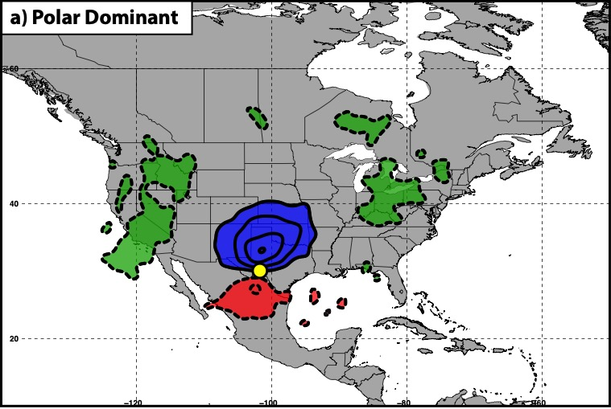
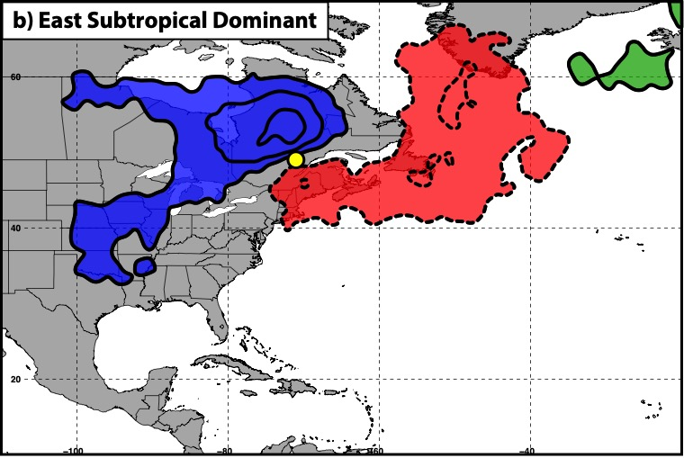
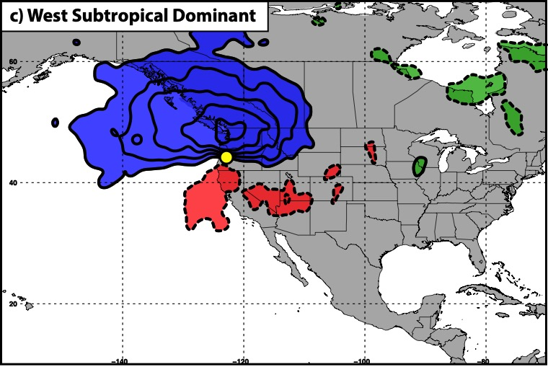
Piecewise QGPV Inversion
250 hPa
300 hPa
300 hPa
+ QGPV Anomalies
– QGPV Anomalies
Avg. Location of Superposition
Polar Cyclonic QGPV Anom.
Tropical Anticyclonic QGPV Anom.
Residual Upper-Tropospheric QGPV Anom.
Lower-Tropospheric QGPV Anom.

Slide 48

Piecewise QGPV Inversion
Each category of QGPV anomalies ($q_{i}^{′}$) is inverted to determine its associated perturbation geopotential ($φ_{i}^{′}$) field:
i
i
i

Slide 49

Piecewise QGPV Inversion
Each category of QGPV anomalies ($q_{i}^{′}$) is inverted to determine its associated perturbation geopotential ($φ_{i}^{′}$) field:
i
i
i
The perturbation geopotential fields and the composite
temperature ($T$) field are used to determine the QG vertical
motion ($ω_{i}$) associated with each category of QGPV:
i
i
i
i
i
i
i
i

Slide 50
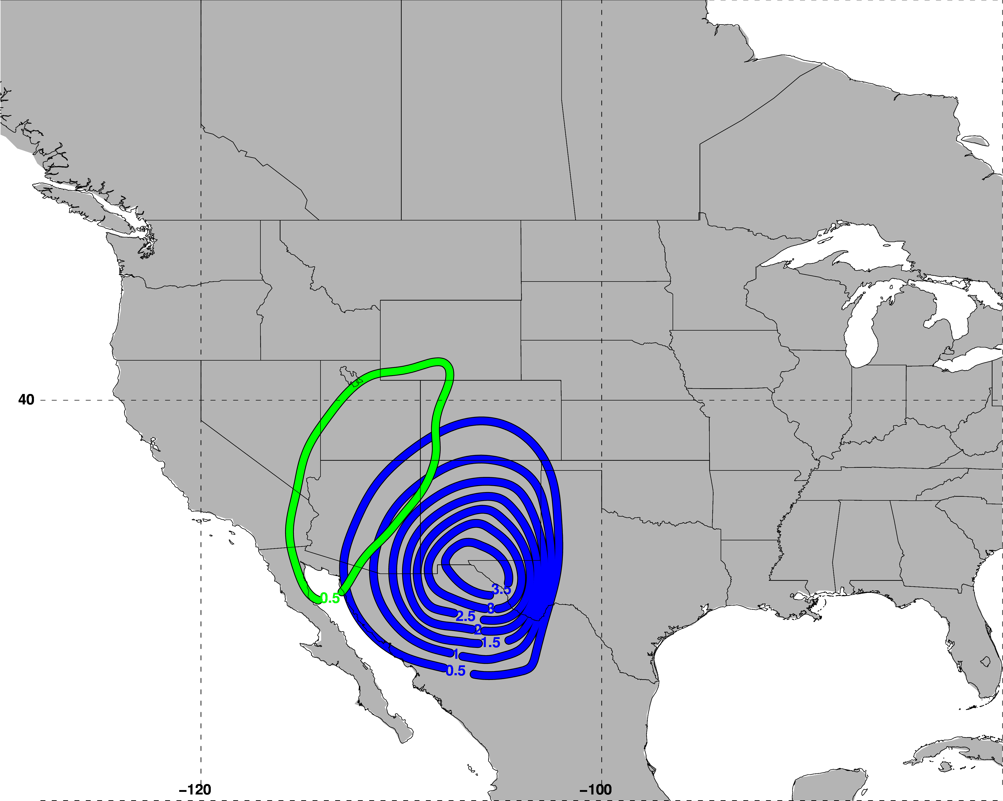
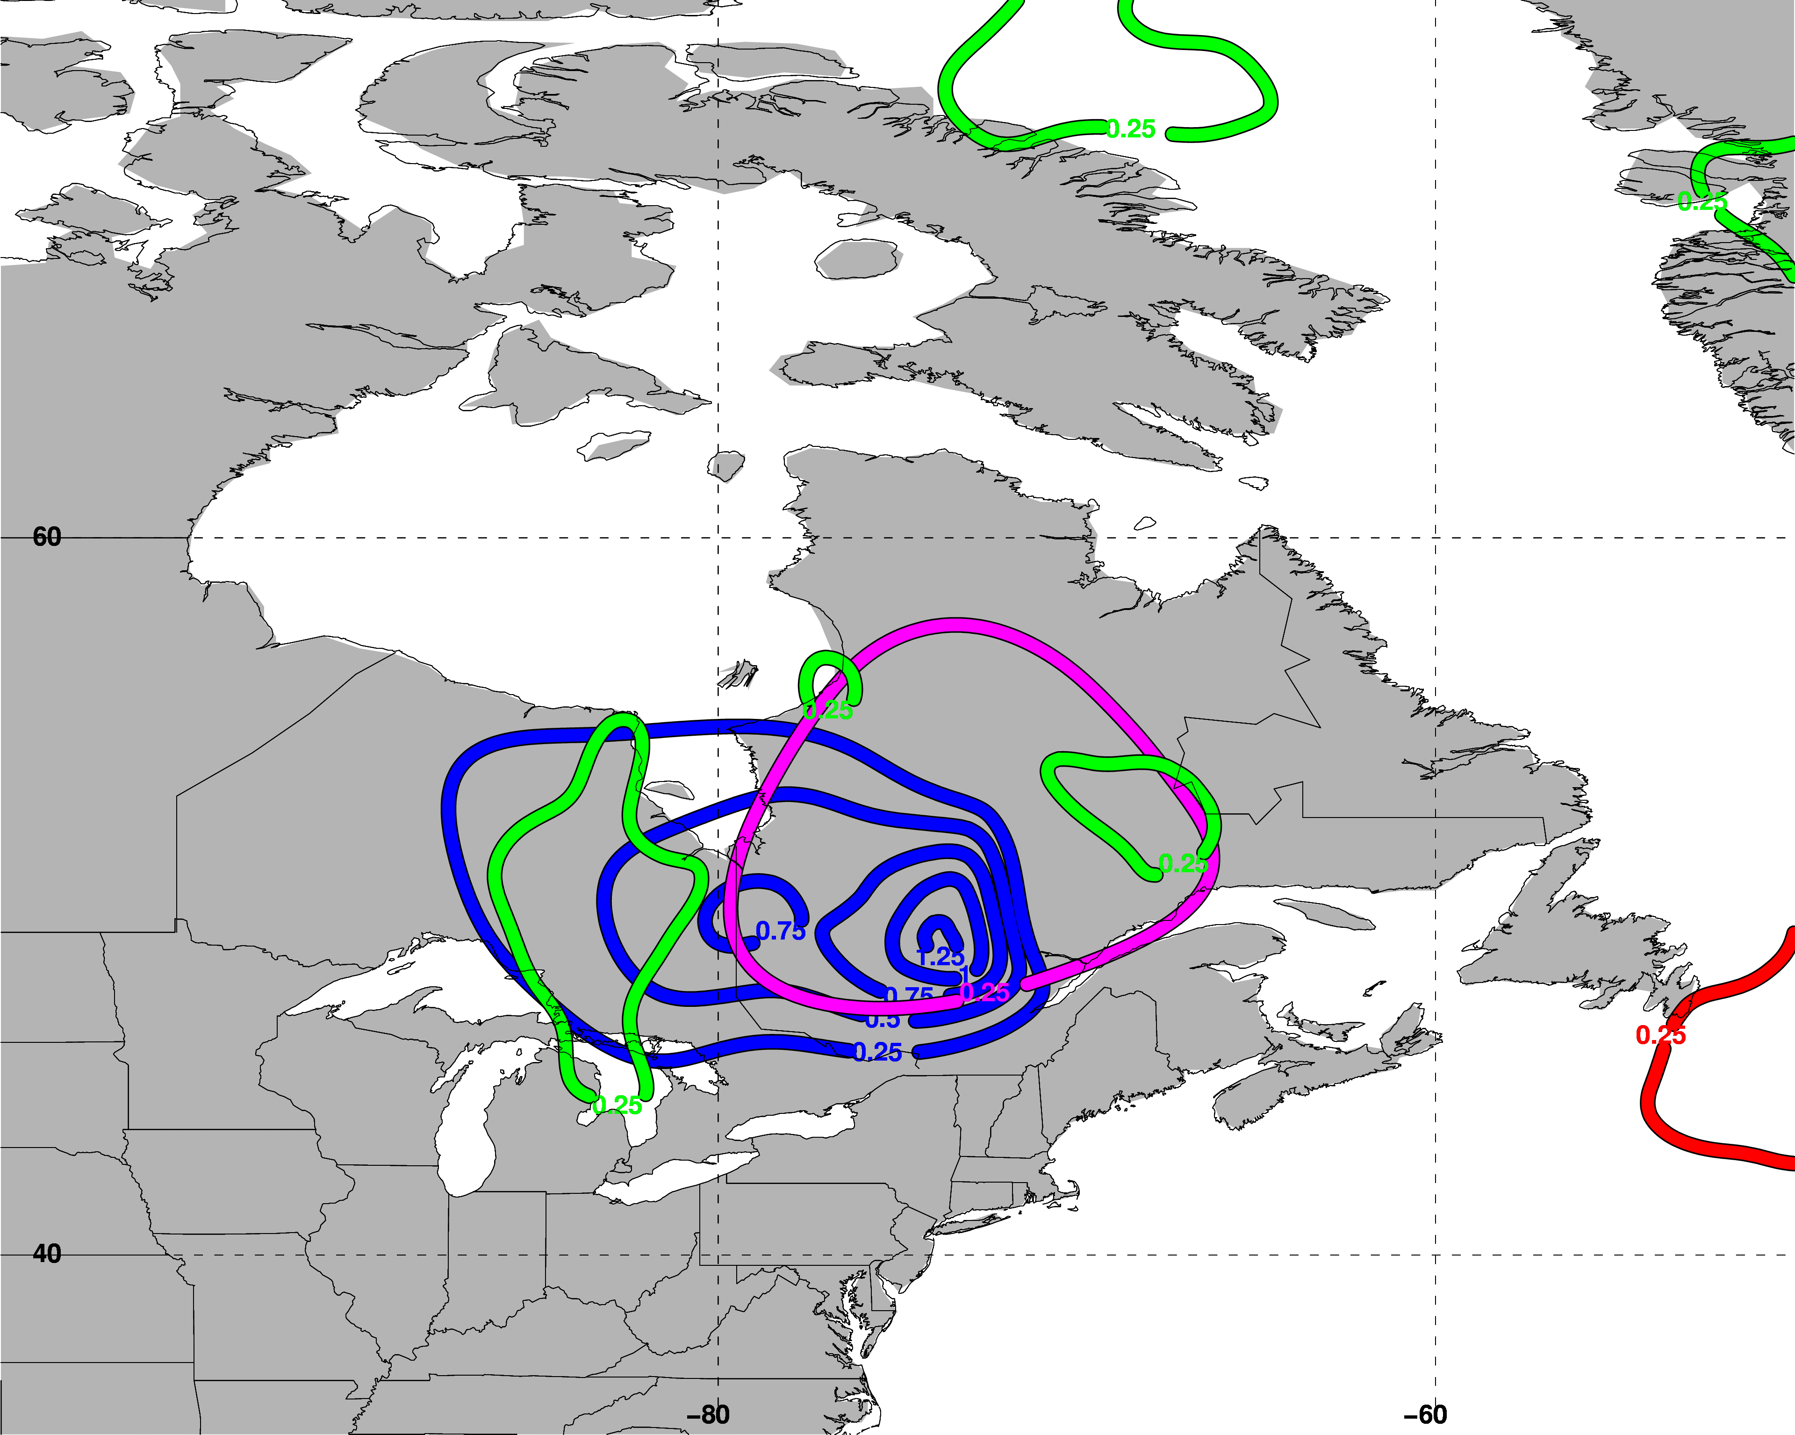
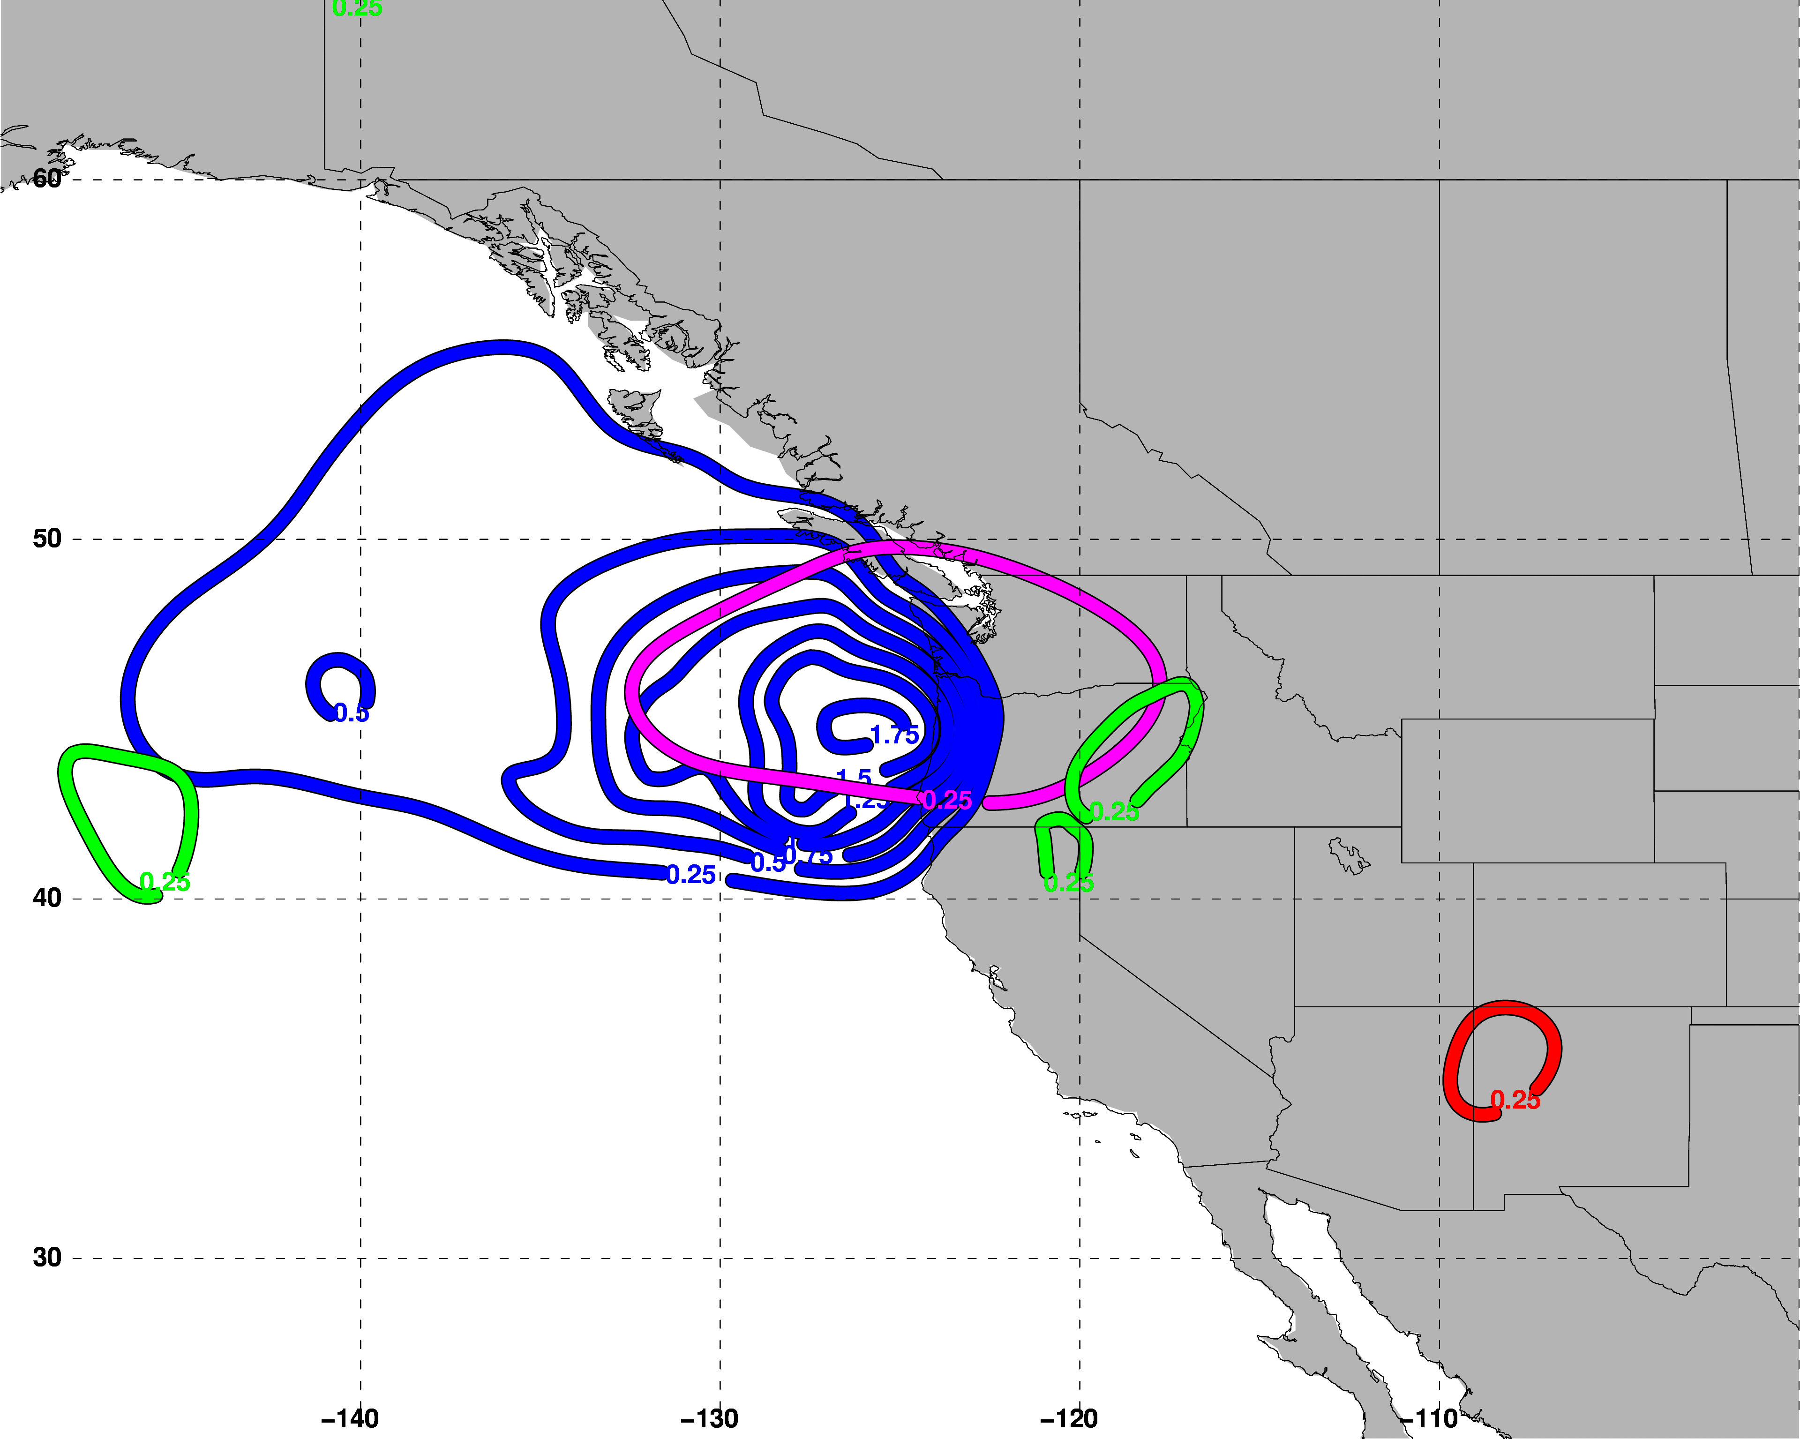
Polar Dominant
East Subtropical Dominant
500 hPa QG Descent
500 hPa QG Descent
West Subtropical Dominant
Polar Cyclonic QGPV Anomalies
Tropical Anticyclonic QGPV Anomalies
Residual Upper-Tropospheric QGPV Anomalies
Lower-Tropospheric QGPV Anomalies
500 hPa QG Descent
Avg. Location of Jet Superposition

Slide 51
Polar Dominant
East Subtropical Dominant
500 hPa QG Descent
500 hPa QG Descent
West Subtropical Dominant
Descent is primarily associated with polar cyclonic QGPV anomalies.
Polar Cyclonic QGPV Anomalies
Tropical Anticyclonic QGPV Anomalies
Residual Upper-Tropospheric QGPV Anomalies
Lower-Tropospheric QGPV Anomalies
500 hPa QG Descent
Avg. Location of Jet Superposition

Slide 52
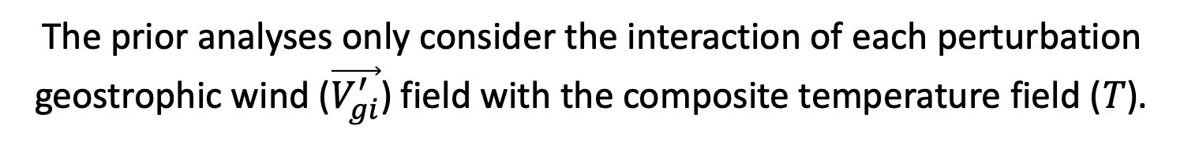
Piecewise QGPV Inversion
i
i
i
i
i
i
i
i
The prior analyses only consider the interaction of each perturbation geostrophic wind ($\vec{V_{gi}^{′}}$) field with the composite temperature field ($T$).

Slide 53

Piecewise QGPV Inversion
i
i
i
i
i
i
i
i
The prior analyses only consider the interaction of each perturbation geostrophic wind ($\vec{V_{gi}^{′}}$) field with the composite temperature field ($T$).
Each perturbation geopotential field ($φ_{i}^{′}$) is also accompanied by a perturbation temperature field ($T_{i}^{′}$) .

Slide 54
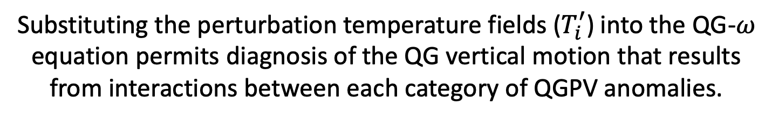
Piecewise QGPV Inversion
i
i
i
i
i
‘
‘
i
i
i
i
i
The prior analyses only consider the interaction of each perturbation geostrophic wind ($\vec{V_{gi}^{′}}$) field with the composite temperature field ($T$).
Each perturbation geopotential field ($φ_{i}^{′}$) is also accompanied by a perturbation temperature field ($T_{i}^{′}$) .
Substituting the perturbation temperature fields ($T_{i}^{′}$) into the QG-$ω$ equation permits diagnosis of the QG vertical motion that results from interactions between each category of QGPV anomalies.

Slide 55



Polar Dominant
East Subtropical Dominant
500-hPa $ω$
500-hPa $ω$
West Subtropical Dominant
Consider the QG $ω$ associated with each interaction term at the location of maximum descent.
500-hPa $ω$
Location of Maximum Descent
2 PVU on the 320-K surface
2 PVU on the 345-K surface
Avg. Location of Jet Superposition

Slide 56
Piecewise QGPV Inversion
P = Polar Dominant
E = East Subtropical Dominant
W = West Subtropical Dominant

Slide 57
Piecewise QGPV Inversion
P = Polar Dominant
E = East Subtropical Dominant
W = West Subtropical Dominant

Slide 58
Piecewise QGPV Inversion
P = Polar Dominant
E = East Subtropical Dominant
W = West Subtropical Dominant

Slide 59
Piecewise QGPV Inversion
P = Polar Dominant
E = East Subtropical Dominant
W = West Subtropical Dominant

Slide 60
Piecewise QGPV Inversion
P = Polar Dominant
E = East Subtropical Dominant
W = West Subtropical Dominant

Slide 61
Piecewise QGPV Inversion
P = Polar Dominant
E = East Subtropical Dominant
W = West Subtropical Dominant

Slide 62
Piecewise QGPV Inversion
P = Polar Dominant
E = East Subtropical Dominant
W = West Subtropical Dominant

Slide 63
Along- and Across-Front
Vertical Motion

Slide 64





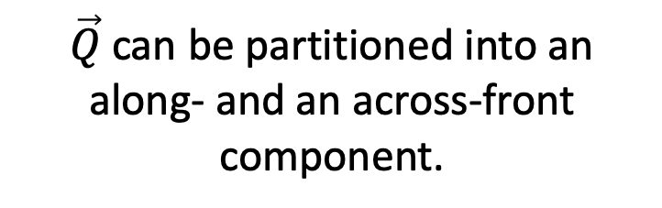
Along- and Across-Front Vertical Motion
$\vec{Q}$can be partitioned into an along- and an across-front component.
$$\vec{Q}$$
Cold
$$θ_{1}$$
s
$$θ_{2}$$
$$θ_{3}$$
Warm
n
$$θ_{4}$$

Slide 65


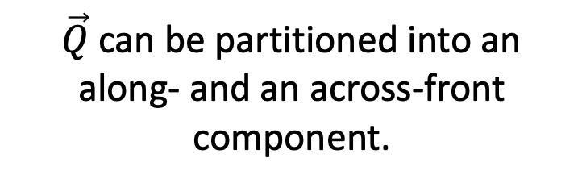

Along- and Across-Front Vertical Motion
$\vec{Q}$can be partitioned into an along- and an across-front component.
$$\vec{Q}$$
$$\vec{Q_{n}}$$
Cold
$$\vec{Q_{s}}$$
$$θ_{1}$$
s
$$θ_{2}$$
$$θ_{3}$$
Warm
n
$$θ_{4}$$

Slide 66
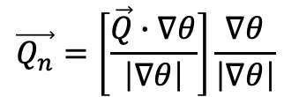
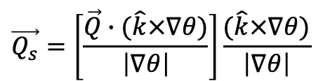

Along- and Across-Front Vertical Motion
$$\vec{Q}=\vec{Q_{s}}+\vec{Q_{n}}$$
$$\vec{Q_{s}}=\left[\frac{\vec{Q}∙(\hat{k}×∇θ)}{\left|∇θ\right|}\right]\frac{(\hat{k}×∇θ)}{\left|∇θ\right|}$$
$$\vec{Q_{n}}=\left[\frac{\vec{Q}∙∇θ}{\left|∇θ\right|}\right]\frac{∇θ}{\left|∇θ\right|}$$
,
$$\vec{Q}$$
$$\vec{Q_{n}}$$
Cold
$$\vec{Q_{s}}$$
$$θ_{1}$$
s
$$θ_{2}$$
$$θ_{3}$$
Warm
n
$$θ_{4}$$

Slide 67
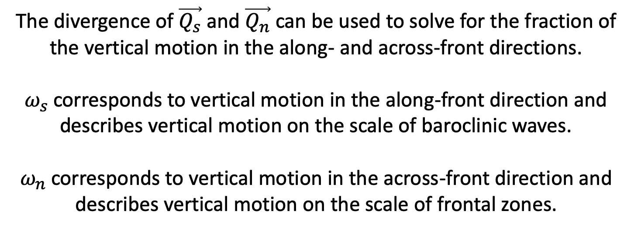

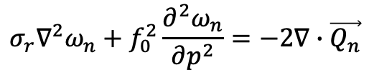
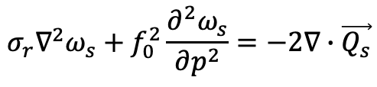
Along- and Across-Front Vertical Motion
$$σ_{r}∇^{2}ω_{s}+f_{0}^{2}\frac{∂^{2}ω_{s}}{∂p^{2}}=−2∇∙\vec{Q_{s}}$$
$${ω=ω}_{s}+ω_{n}$$
$$σ_{r}∇^{2}ω_{n}+f_{0}^{2}\frac{∂^{2}ω_{n}}{∂p^{2}}=−2∇∙\vec{Q_{n}}$$
The divergence of $\vec{Q_{s}}$ and $\vec{Q_{n}}$ can be used to solve for the fraction of the vertical motion in the along- and across-front directions.
$ω_{s}$corresponds to vertical motion in the along-front direction and describes vertical motion on the scale of baroclinic waves.
$ω_{n}$corresponds to vertical motion in the across-front direction and describes vertical motion on the scale of frontal zones.

Slide 68


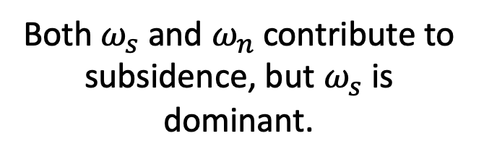
Along- and Across-Front Vertical Motion
Polar Dominant Events
$$ω_{n}$$
$$ω_{s}$$
Both $ω_{s}$ and $ω_{n}$contribute to subsidence, but $ω_{s}$is dominant.
2 PVU on the 320-K surface
2 PVU on the 345-K surface
Avg. Location of Jet Superposition

Slide 69
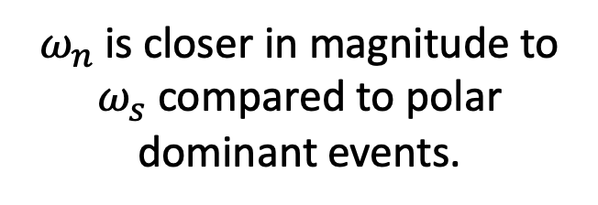
Along- and Across-Front Vertical Motion
East Subtropical Dominant Events
$$ω_{n}$$
$$ω_{s}$$
$ω_{n}$is closer in magnitude to $ω_{s}$compared to polar dominant events.
2 PVU on the 320-K surface
2 PVU on the 345-K surface
Avg. Location of Jet Superposition

Slide 70
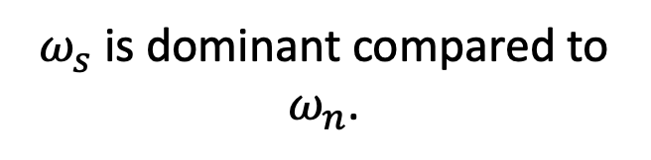
Along- and Across-Front Vertical Motion
West Subtropical Dominant Events
$$ω_{n}$$
$$ω_{s}$$
2 PVU on the 320-K surface
$ω_{s}$is dominant compared to $ω_{n}$.
2 PVU on the 345-K surface
Avg. Location of Jet Superposition

Slide 71
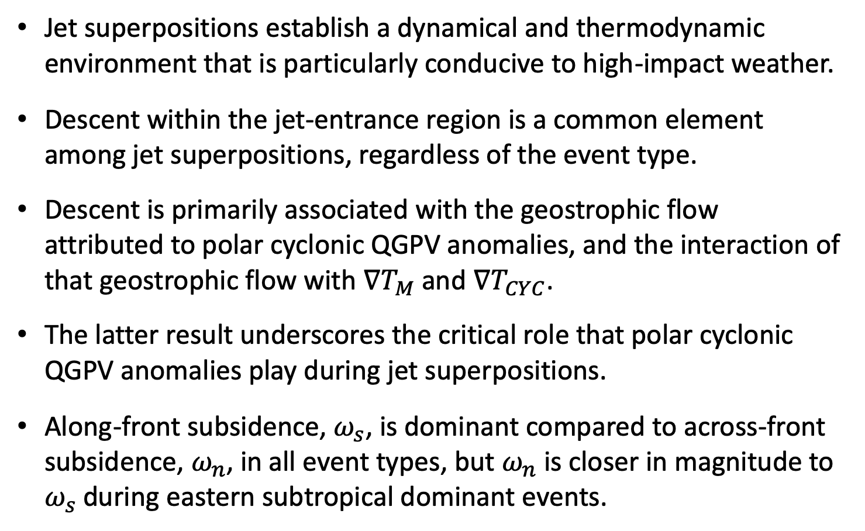
Summary
Jet superpositions establish a dynamical and thermodynamic environment that is particularly conducive to high-impact weather.
Descent within the jet-entrance region is a common element among jet superpositions, regardless of the event type.
Descent is primarily associated with the geostrophic flow attributed to polar cyclonic QGPV anomalies, and the interaction of that geostrophic flow with $∇T_{M}$ and $∇T_{CYC}$.
The latter result underscores the critical role that polar cyclonic QGPV anomalies play during jet superpositions.
Along-front subsidence, $ω_{s}$, is dominant compared to across-front subsidence, $ω_{n}$, in all event types, but $ω_{n}$is closer in magnitude to $ω_{s}$during eastern subtropical dominant events.

Slide 72
Supplementary Slides

Slide 73
References
Cavallo, S. M., and G. J. Hakim, 2010: Composite structure of tropopause polar cyclones. Mon. Wea. Rev., 138, 3840−3857.
Christenson, C. E., and J. E. Martin, 2012: The large-scale environment associated with the 25−28 April 2011 severe weather outbreak. 16th NWA Severe Storms and Doppler Radar Conference, Des Moines, IA, National Weather Association, 31 March 2012.
Christenson, C. E., J. E. Martin, and Z. J. Handlos, 2017: A synoptic-climatology of Northern Hemisphere, cold season polar and subtropical jet superposition events. J. Climate, 30, 7231-7246.
Defant, F., and H. Taba, 1957: The threefold structure of the atmosphere and the characteristics of the tropopause. Tellus, 9, 259-275.
Knupp, K. R., T. A. Murphy, T. A. Coleman, R. A. Wade, S. A. Mullins, C. J. Schultz, E. V. Schultz, L. Carey, A. Sherrer, E. W. McCaul Jr., B. Carcione, S. Latimer, A. Kula, K. Laws, P. T. Marsh, and K. Klockow, 2014: Meteorological overview of the devastating 27 April 2011 Tornado Outbreak. Bull. Amer. Meteor. Soc., 95, 1041−1062.
Moore, B. J., P. J. Neiman, F. M. Ralph, and F. E. Barthold, 2012: Physical processes associated with heavy flooding rainfall in Nashville, Tennessee, and vicinity during 1–2 May 2010: The role of an atmospheric river and mesoscale convective systems. Mon. Wea. Rev., 140, 358–378.
Pyle, M. E., D. Keyser, and L. F. Bosart, 2004: A diagnostic study of jet streaks: Kinematic signatures and relationship to coherent tropopause disturbances. Mon. Wea. Rev., 132, 297−319.
Saha, S. and co-authors, 2014: The NCEP Climate Forecast System Version 2. J. Climate, 27, 2185−2208.
Winters, A. C., and J. E. Martin, 2014: The role of a polar/subtropical jet superposition in the May 2010 Nashville Flood. Wea. Forecasting, 29, 954–974.
Winters, A. C. and J. E. Martin, 2016: Synoptic and mesoscale processes supporting vertical superposition of the polar and subtropical jets in two contrasting cases. Quart. J. Roy. Meteor. Soc., 142, 1133–1149.
Winters, A. C., and J. E. Martin, 2017: Diagnosis of a North American polar/subtropical jet superposition employing piecewise potential vorticity inversion. Mon. Wea. Rev.,145, 1853-1873.
Winters, A.C., D. Keyser, L. F. Bosart, and J. E. Martin, 2020: Composite synoptic-scale environments conducive to North American polar–subtropical jet superposition events. Mon. Wea. Rev., 148, in revision.

Slide 74
Composite Characteristics

Slide 75
Jet Superposition Event Characteristics

Slide 76
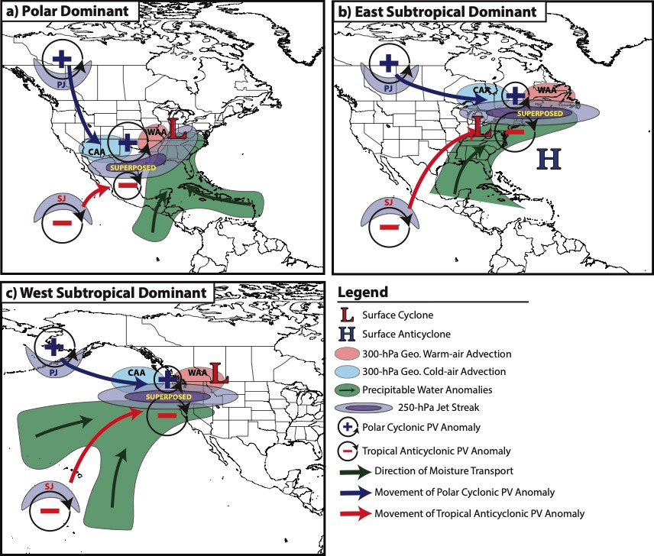
Jet Superposition Event Composites

Slide 77
Downstream Consequences
North Atlantic Oscillation: 5 Days After Jet Superposition
All Events
𝚫NAO
+0.11
Ave. Polar Dominant 𝚫NAO
+0.15
Ave. Subtropical Dominant 𝚫NAO
+0.13
Ave. Hybrid
𝚫NAO
+0.07

Slide 78
Background Material

Slide 79

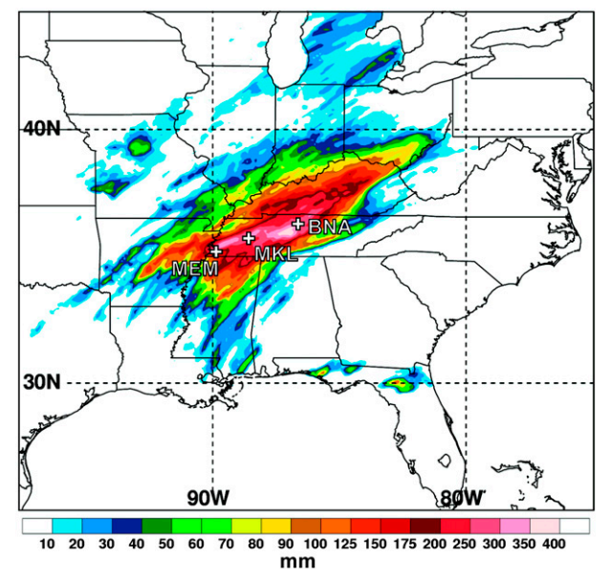
Jet Superpositions and High-Impact Weather
Jet superpositions can be an element of high-impact weather events
1–3 May 2010 Nashville Flood
Jet superposition enhanced the poleward moisture transport via its associated across-front ageostrophic circulation (Winters and Martin 2014; 2016)
Moore et al. (2012; their Fig. 2)

Slide 80
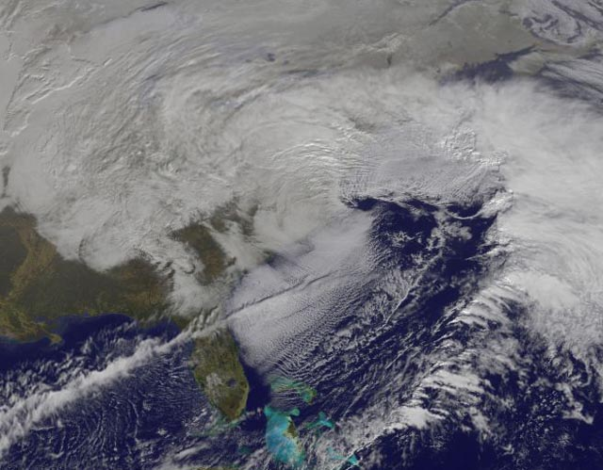
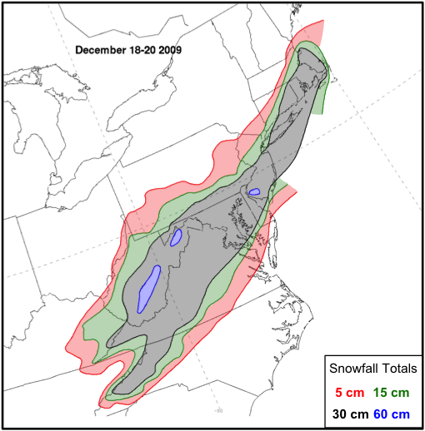
Jet Superpositions and High-Impact Weather
Jet superpositions can be an element of high-impact weather events
1–3 May 2010 Nashville Flood
Jet superposition enhanced the poleward moisture transport via its associated across-front ageostrophic circulation (Winters and Martin 2014; 2016)
18–20 December 2009 Mid-Atlantic Blizzard
Jet superposition was associated with a rapidly deepening East Coast cyclone (Winters and Martin 2016; 2017)

Slide 81
Jet Superpositions and High-Impact Weather
Jet superpositions can be an element of high-impact weather events
1–3 May 2010 Nashville Flood
Jet superposition enhanced the poleward moisture transport via its associated across-front ageostrophic circulation (Winters and Martin 2014; 2016)
18–20 December 2009 Mid-Atlantic Blizzard
Jet superposition was associated with a rapidly deepening East Coast cyclone (Winters and Martin 2016; 2017)
How do these structures develop?

Slide 82
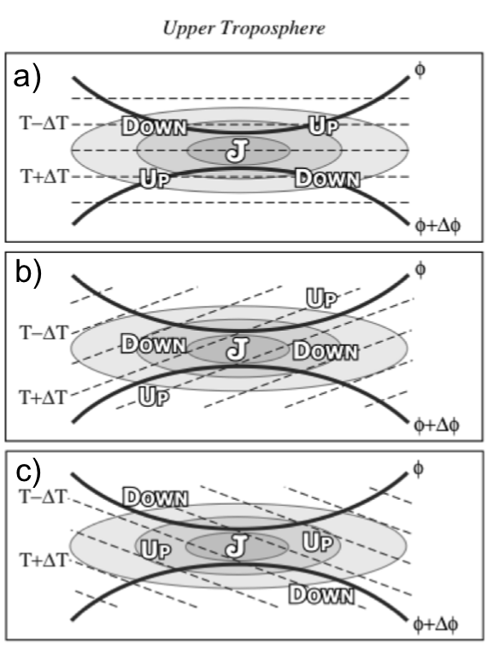
Ageostrophic Transverse Jet Circulations
Traditional four-quadrant model
Geo. cold-air advection (CAA) along the jet axis promotes subsidence through the jet core
Geo. warm-air advection (WAA) along the jet axis promotes
ascent through the jet core
Lang and Martin (2012)

Slide 83
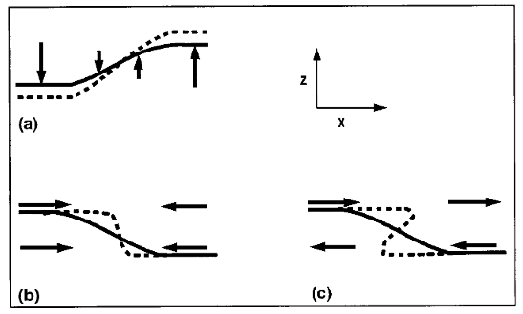
Background
Insight into how the tropopause can be restructured from a PV perspective can be found by consulting Wandishin et al. (2000)
Two processes can account for “foldogenesis”:
Differential vertical motions can vertically steepen the tropopause.
Convergence or a vertical shear can produce a differential horizontal advection of the tropopause surface.
Wandishin et al. 2000
These same mechanisms are also likely to play an important role in superpositions.

Slide 84
Jet Identification

Slide 85
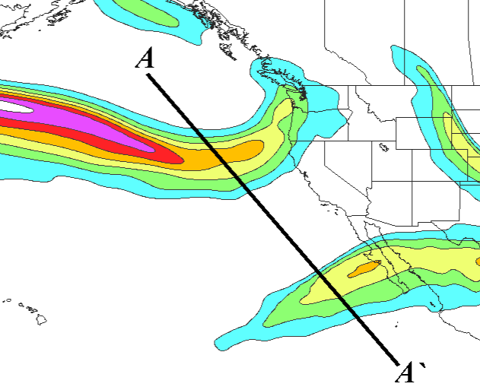
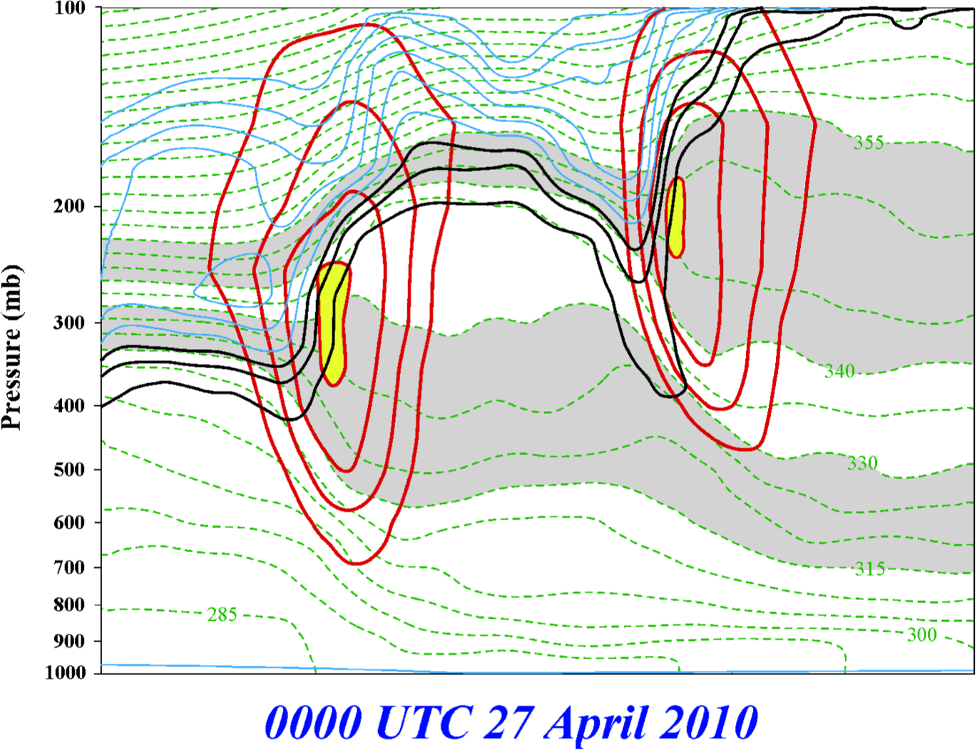
Jet Superposition Event Identification
0000 UTC 27 April 2010
A
PJ
STJ
STJ
A’
250-hPa wind speed
PJ
Isolated grid points over North America in the CFSR (Saha et al. 2014) characterized by polar and subtropical jets during Nov–Mar
1979–2010.
Isotachs
Potential Temp.
1,2,3-PVU contours
A
A’
Winters and Martin (2014, 2016, 2017); Christenson et al. (2017); Handlos and Martin (2016)

Slide 86
Jet Superposition Event Identification
0000 UTC 27 April 2010
A
PJ
STJ
A’
250-hPa wind speed
Isolated grid points over North America in the CFSR (Saha et al. 2014) characterized by polar and subtropical jets during Nov–Mar
1979–2010.
Isotachs
Potential Temp.
1,2,3-PVU contours
Strong horizontal PV gradient within the 1–3-PVU channel in the 315–330-K isentropic layer
A
A’
Winters and Martin (2014, 2016, 2017); Christenson et al. (2017); Handlos and Martin (2016)

Slide 87
Jet Superposition Event Identification
0000 UTC 27 April 2010
A
PJ
STJ
A’
250-hPa wind speed
Isolated grid points over North America in the CFSR (Saha et al. 2014) characterized by polar and subtropical jets during Nov–Mar
1979–2010.
Isotachs
Potential Temp.
1,2,3-PVU contours
Integrated 400–100-hPa wind speed must exceed 30 m s^{–1}
A
A’
Winters and Martin (2014, 2016, 2017); Christenson et al. (2017); Handlos and Martin (2016)

Slide 88
Jet Superposition Event Identification
0000 UTC 27 April 2010
A
PJ
PJ ID’s
STJ
A’
PJ
250-hPa wind speed
Isolated grid points over North America in the CFSR (Saha et al. 2014) characterized by polar and subtropical jets during Nov–Mar
1979–2010.
Isotachs
Potential Temp.
1,2,3-PVU contours
A
A’
Winters and Martin (2014, 2016, 2017); Christenson et al. (2017); Handlos and Martin (2016)

Slide 89
Jet Superposition Event Identification
0000 UTC 27 April 2010
A
PJ
PJ ID’s
STJ
A’
250-hPa wind speed
Isolated grid points over North America in the CFSR (Saha et al. 2014) characterized by polar and subtropical jets during Nov–Mar
1979–2010.
Isotachs
Potential Temp.
1,2,3-PVU contours
Strong horizontal PV gradient within the 1–3-PVU channel in the 340–355-K isentropic layer
A
A’
Winters and Martin (2014, 2016, 2017); Christenson et al. (2017); Handlos and Martin (2016)

Slide 90
Jet Superposition Event Identification
0000 UTC 27 April 2010
A
PJ
PJ ID’s
STJ
A’
250-hPa wind speed
Isolated grid points over North America in the CFSR (Saha et al. 2014) characterized by polar and subtropical jets during Nov–Mar
1979–2010.
Isotachs
Potential Temp.
1,2,3-PVU contours
Integrated 400–100-hPa wind speed must exceed 30 m s^{–1}
A
A’
Winters and Martin (2014, 2016, 2017); Christenson et al. (2017); Handlos and Martin (2016)

Slide 91
Jet Superposition Event Identification
0000 UTC 27 April 2010
A
PJ
STJ
PJ ID’s
STJ
STJ ID’s
A’
250-hPa wind speed
Isolated grid points over North America in the CFSR (Saha et al. 2014) characterized by polar and subtropical jets during Nov–Mar
1979–2010.
Isotachs
Potential Temp.
1,2,3-PVU contours
A
A’
Winters and Martin (2014, 2016, 2017); Christenson et al. (2017); Handlos and Martin (2016)

Slide 92
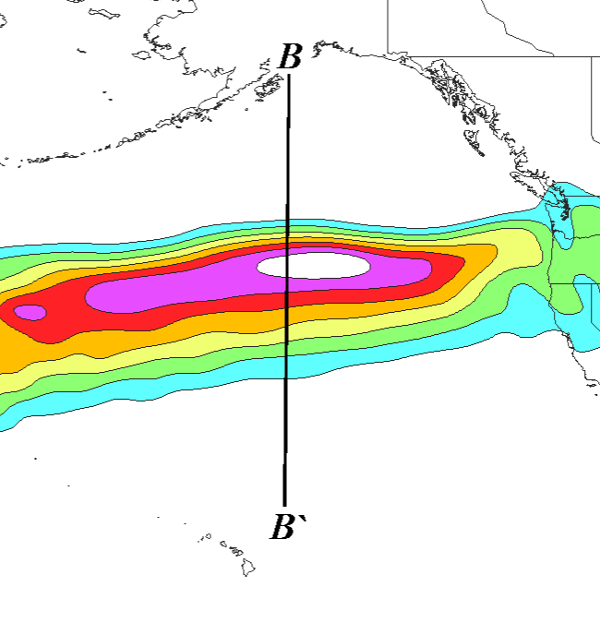
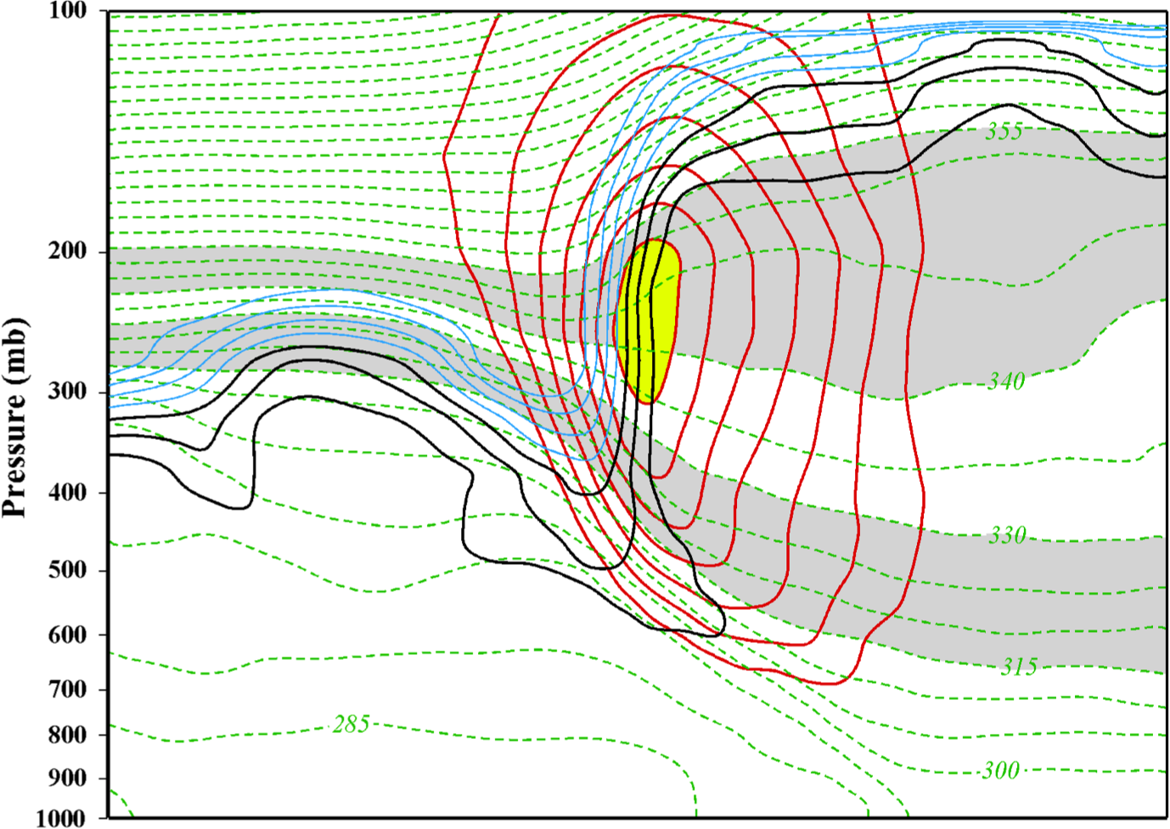
Jet Superposition Event Identification
0000 UTC 24 October 2010
B
SUPJ
B’
250-hPa wind speed
Isolated grid points over North America in the CFSR (Saha et al. 2014) characterized by a jet superposition during Nov–Mar
1979–2010.
Isotachs
Potential Temp.
1,2,3-PVU contours
B
B’
Winters and Martin (2014, 2016, 2017); Christenson et al. (2017); Handlos and Martin (2016)

Slide 93
Jet Superposition Event Identification
0000 UTC 24 October 2010
B
SUPJ
B’
250-hPa wind speed
Isolated grid points over North America in the CFSR (Saha et al. 2014) characterized by a jet superposition during Nov–Mar
1979–2010.
Isotachs
Potential Temp.
1,2,3-PVU contours
Criteria for both the polar and subtropical jets satisfied within the same grid column
B
B’
Winters and Martin (2014, 2016, 2017); Christenson et al. (2017); Handlos and Martin (2016)

Slide 94
Jet Superposition Event Identification
0000 UTC 24 October 2010
B
SUPJ
B’
SUPJ ID’s
250-hPa wind speed
Isolated grid points over North America in the CFSR (Saha et al. 2014) characterized by a jet superposition during Nov–Mar
1979–2010.
Isotachs
Potential Temp.
1,2,3-PVU contours
Criteria for both the polar and subtropical jets satisfied within the same grid column
B
B’
Winters and Martin (2014, 2016, 2017); Christenson et al. (2017); Handlos and Martin (2016)

Slide 95
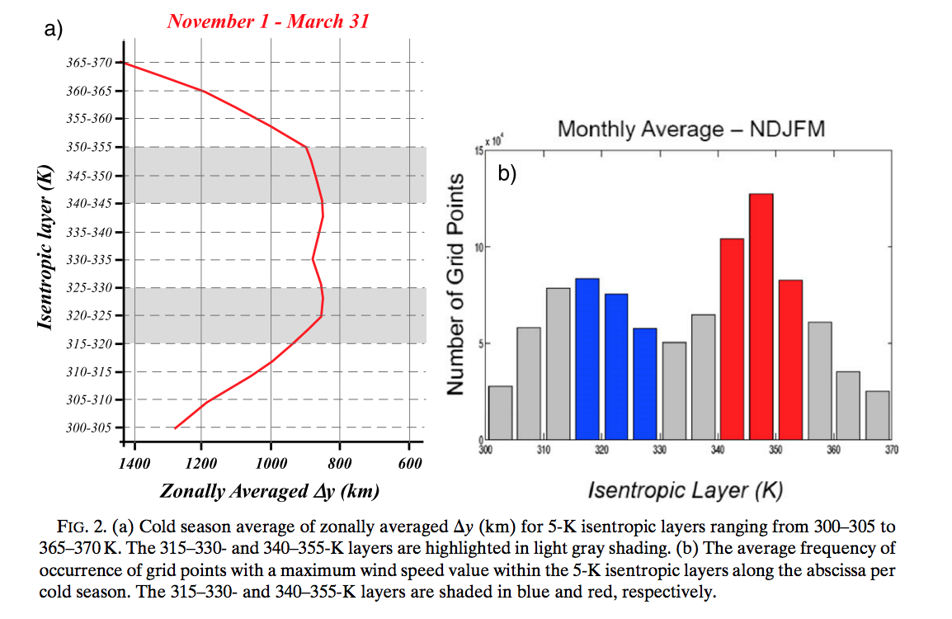
Background
Christenson et al. (2017)

Slide 96
Jet Superposition Event Identification

Slide 97
Jet Superposition Event Identification
Sample Jet Superposition Centroid Calculation
Calculated the centroid of each jet superposition based on all valid grid points at a particular analysis time.
To calculate the centroid, there must exist a group of 18 superposition grid points, of which no superposition grid point is >1000 km away from another superposition grid point.
d >1000 km
d >1000 km
d >1000 km
Used for calculation
Jet superposition centroid
Not used for calculation

