Slide 1



Antecedent Synoptic Environments
Most Conducive to North American
Polar/Subtropical Jet Superpositions
Andrew C. Winters
PSU Department of Meteorology and Atmospheric Science
University Park, PA
28 February 2018
This work is funded by an NSF-PRF (AGS-1624316)

Slide 2
Background
Modified from Defant and Taba (1957)

Slide 3
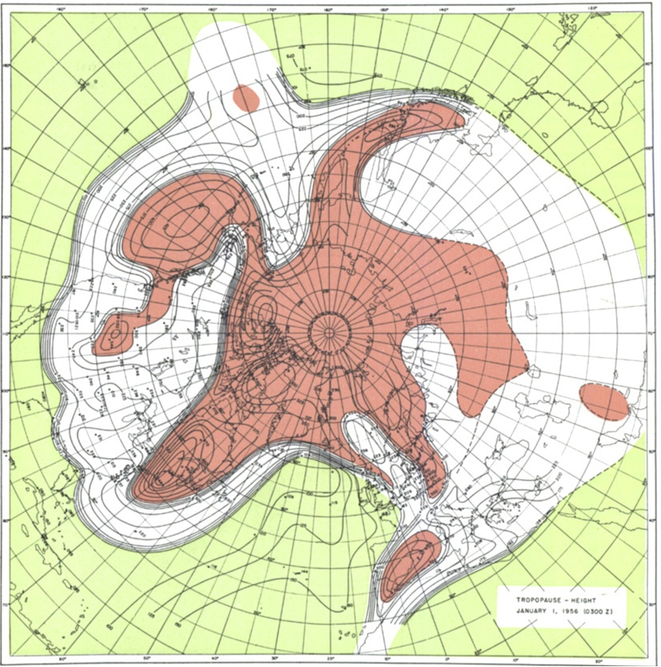
Background
Tropopause Pressure (hPa)
Maps of tropopause pressure help to identify the location of the jets.
While each jet occupies its own climatological latitude band, substantial meanders are common.
STJ
POLJ
Tropical Tropopause
Subtropical Tropopause
Polar Tropopause
Modified from Defant and Taba (1957)

Slide 4
Background
Tropopause Pressure (hPa)
Maps of tropopause pressure help to identify the location of the jets.
While each jet occupies its own climatological latitude band, substantial meanders are common.
Occasionally, the latitudinal separation between the jets can vanish resulting in a vertical jet superposition.
STJ
POLJ
Tropical Tropopause
Subtropical Tropopause
Polar Tropopause
Modified from Defant and Taba (1957)

Slide 5
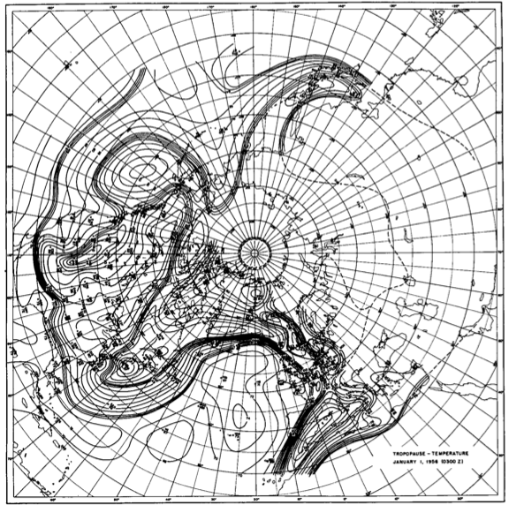
Background
Tropopause Temperature (ºC)
The pole-to-equator baroclinicity is combined into a much narrower zone of contrast in the vicinity of a jet superposition.
Intensified frontal structure is often attended by a strengthening of the superposed jet’s transverse circulation.
STJ
POLJ
Modified from Defant and Taba (1957)

Slide 6
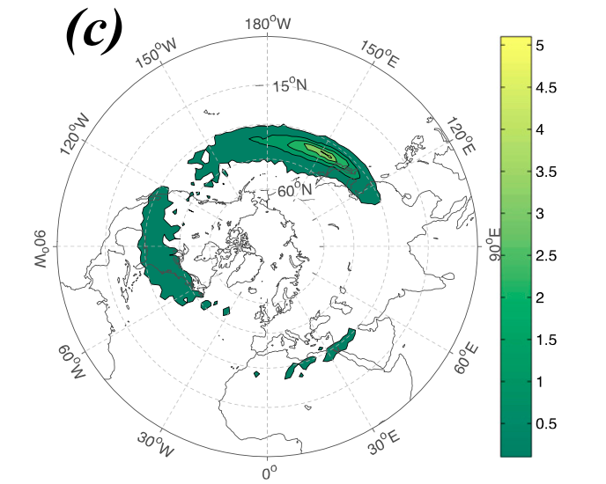
Background
Christenson et al. (2017) highlight three locations that experience the greatest frequency of
jet superpositions:
1) Western Pacific
2) North America
3) Northern Africa
Climatological frequency of Northern Hemisphere jet superposition events per cold season (Nov–Mar) 1960–2010
Number of Events
Christenson et al. (2017)

Slide 7
Background
Christenson et al. (2017) highlight three locations that experience the greatest frequency of
jet superpositions:
1) Western Pacific
2) North America
3) Northern Africa
Climatological frequency of Northern Hemisphere jet superposition events per cold season (Nov–Mar) 1960–2010
Number of Events
Christenson et al. (2017)

Slide 8

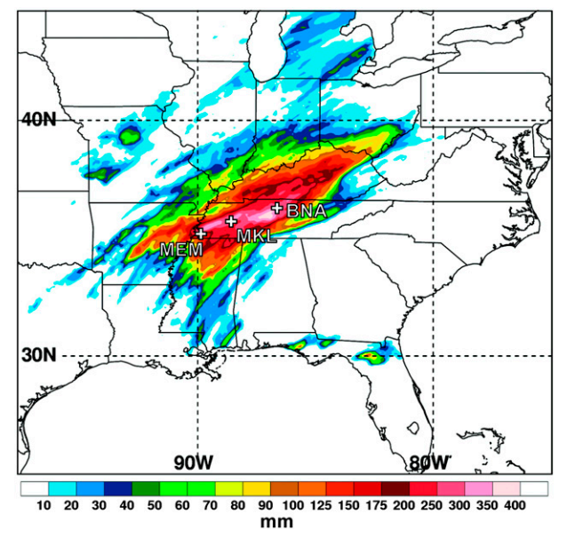
Jet Superpositions and High-Impact Weather
The Tennessean
Jet superpositions can be an element of high-impact weather events
1–3 May 2010 Nashville Flood
Jet superposition enhanced the poleward moisture transport via its ageostrophic circulation (Winters and Martin 2014; 2016).
Moore et al. (2012)

Slide 9
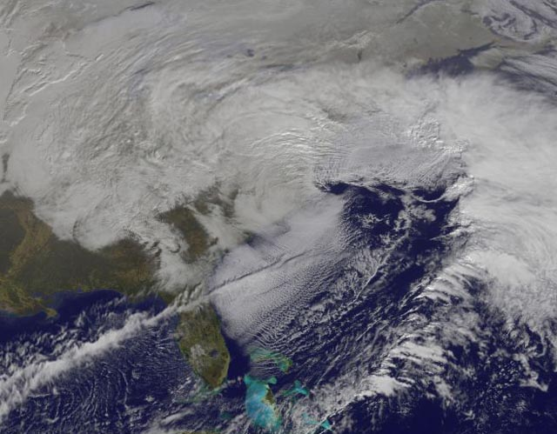
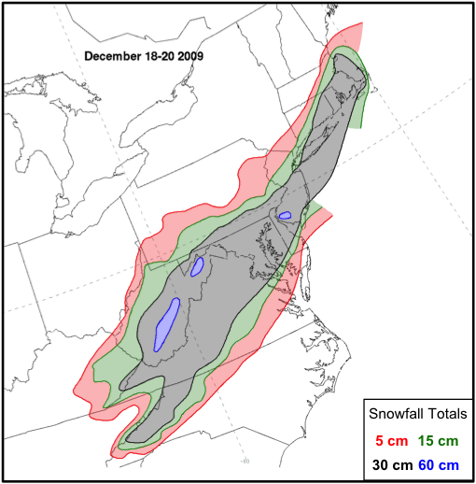
Jet Superpositions and High-Impact Weather
NASA
Jet superpositions can be an element of high-impact weather events
1–3 May 2010 Nashville Flood
Jet superposition enhanced the poleward moisture transport via its ageostrophic circulation (Winters and Martin 2014; 2016).
18–20 December 2009 Mid-Atlantic Blizzard
Jet superposition was associated with a rapidly deepening East Coast cyclone (Winters and Martin 2016; 2017).
Winters and Martin (2016)

Slide 10
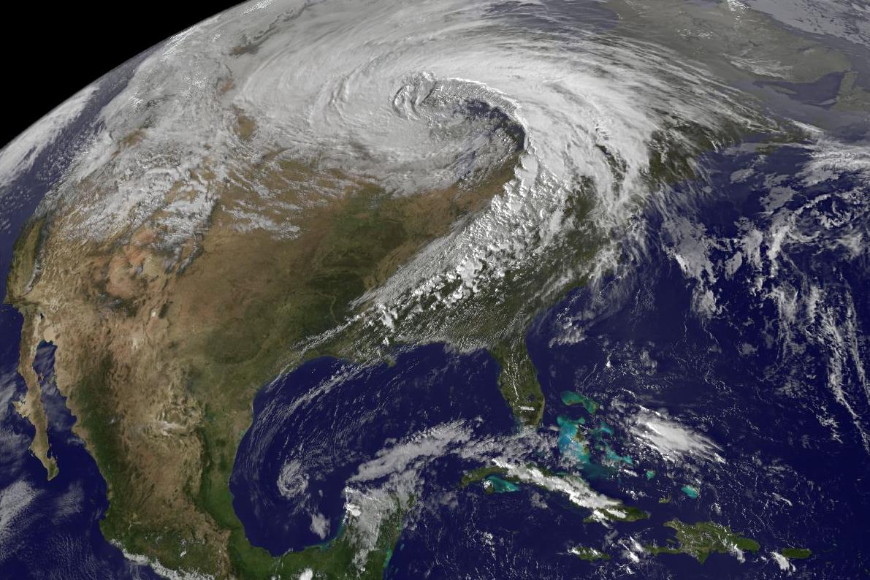
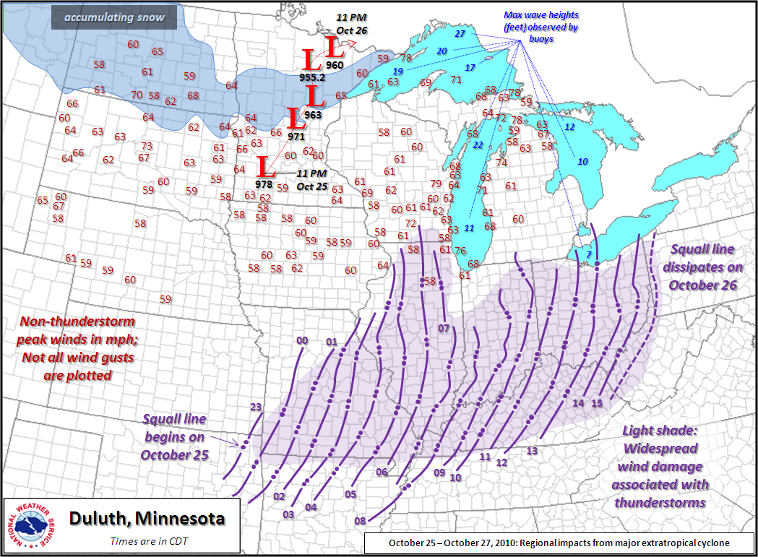
Jet Superpositions and High-Impact Weather
Jet superpositions can be an element of high-impact weather events
1–3 May 2010 Nashville Flood
Jet superposition enhanced the poleward moisture transport via its ageostrophic circulation (Winters and Martin 2014; 2016).
18–20 December 2009 Mid-Atlantic Blizzard
Jet superposition was associated with a rapidly deepening East Coast cyclone (Winters and Martin 2016; 2017).
26 October 2010: Explosive Cyclogenesis Event
Jet superposition over the West Pacific preceded the development of an intense Midwest U.S. cyclone.
NASA
NWS

Slide 11
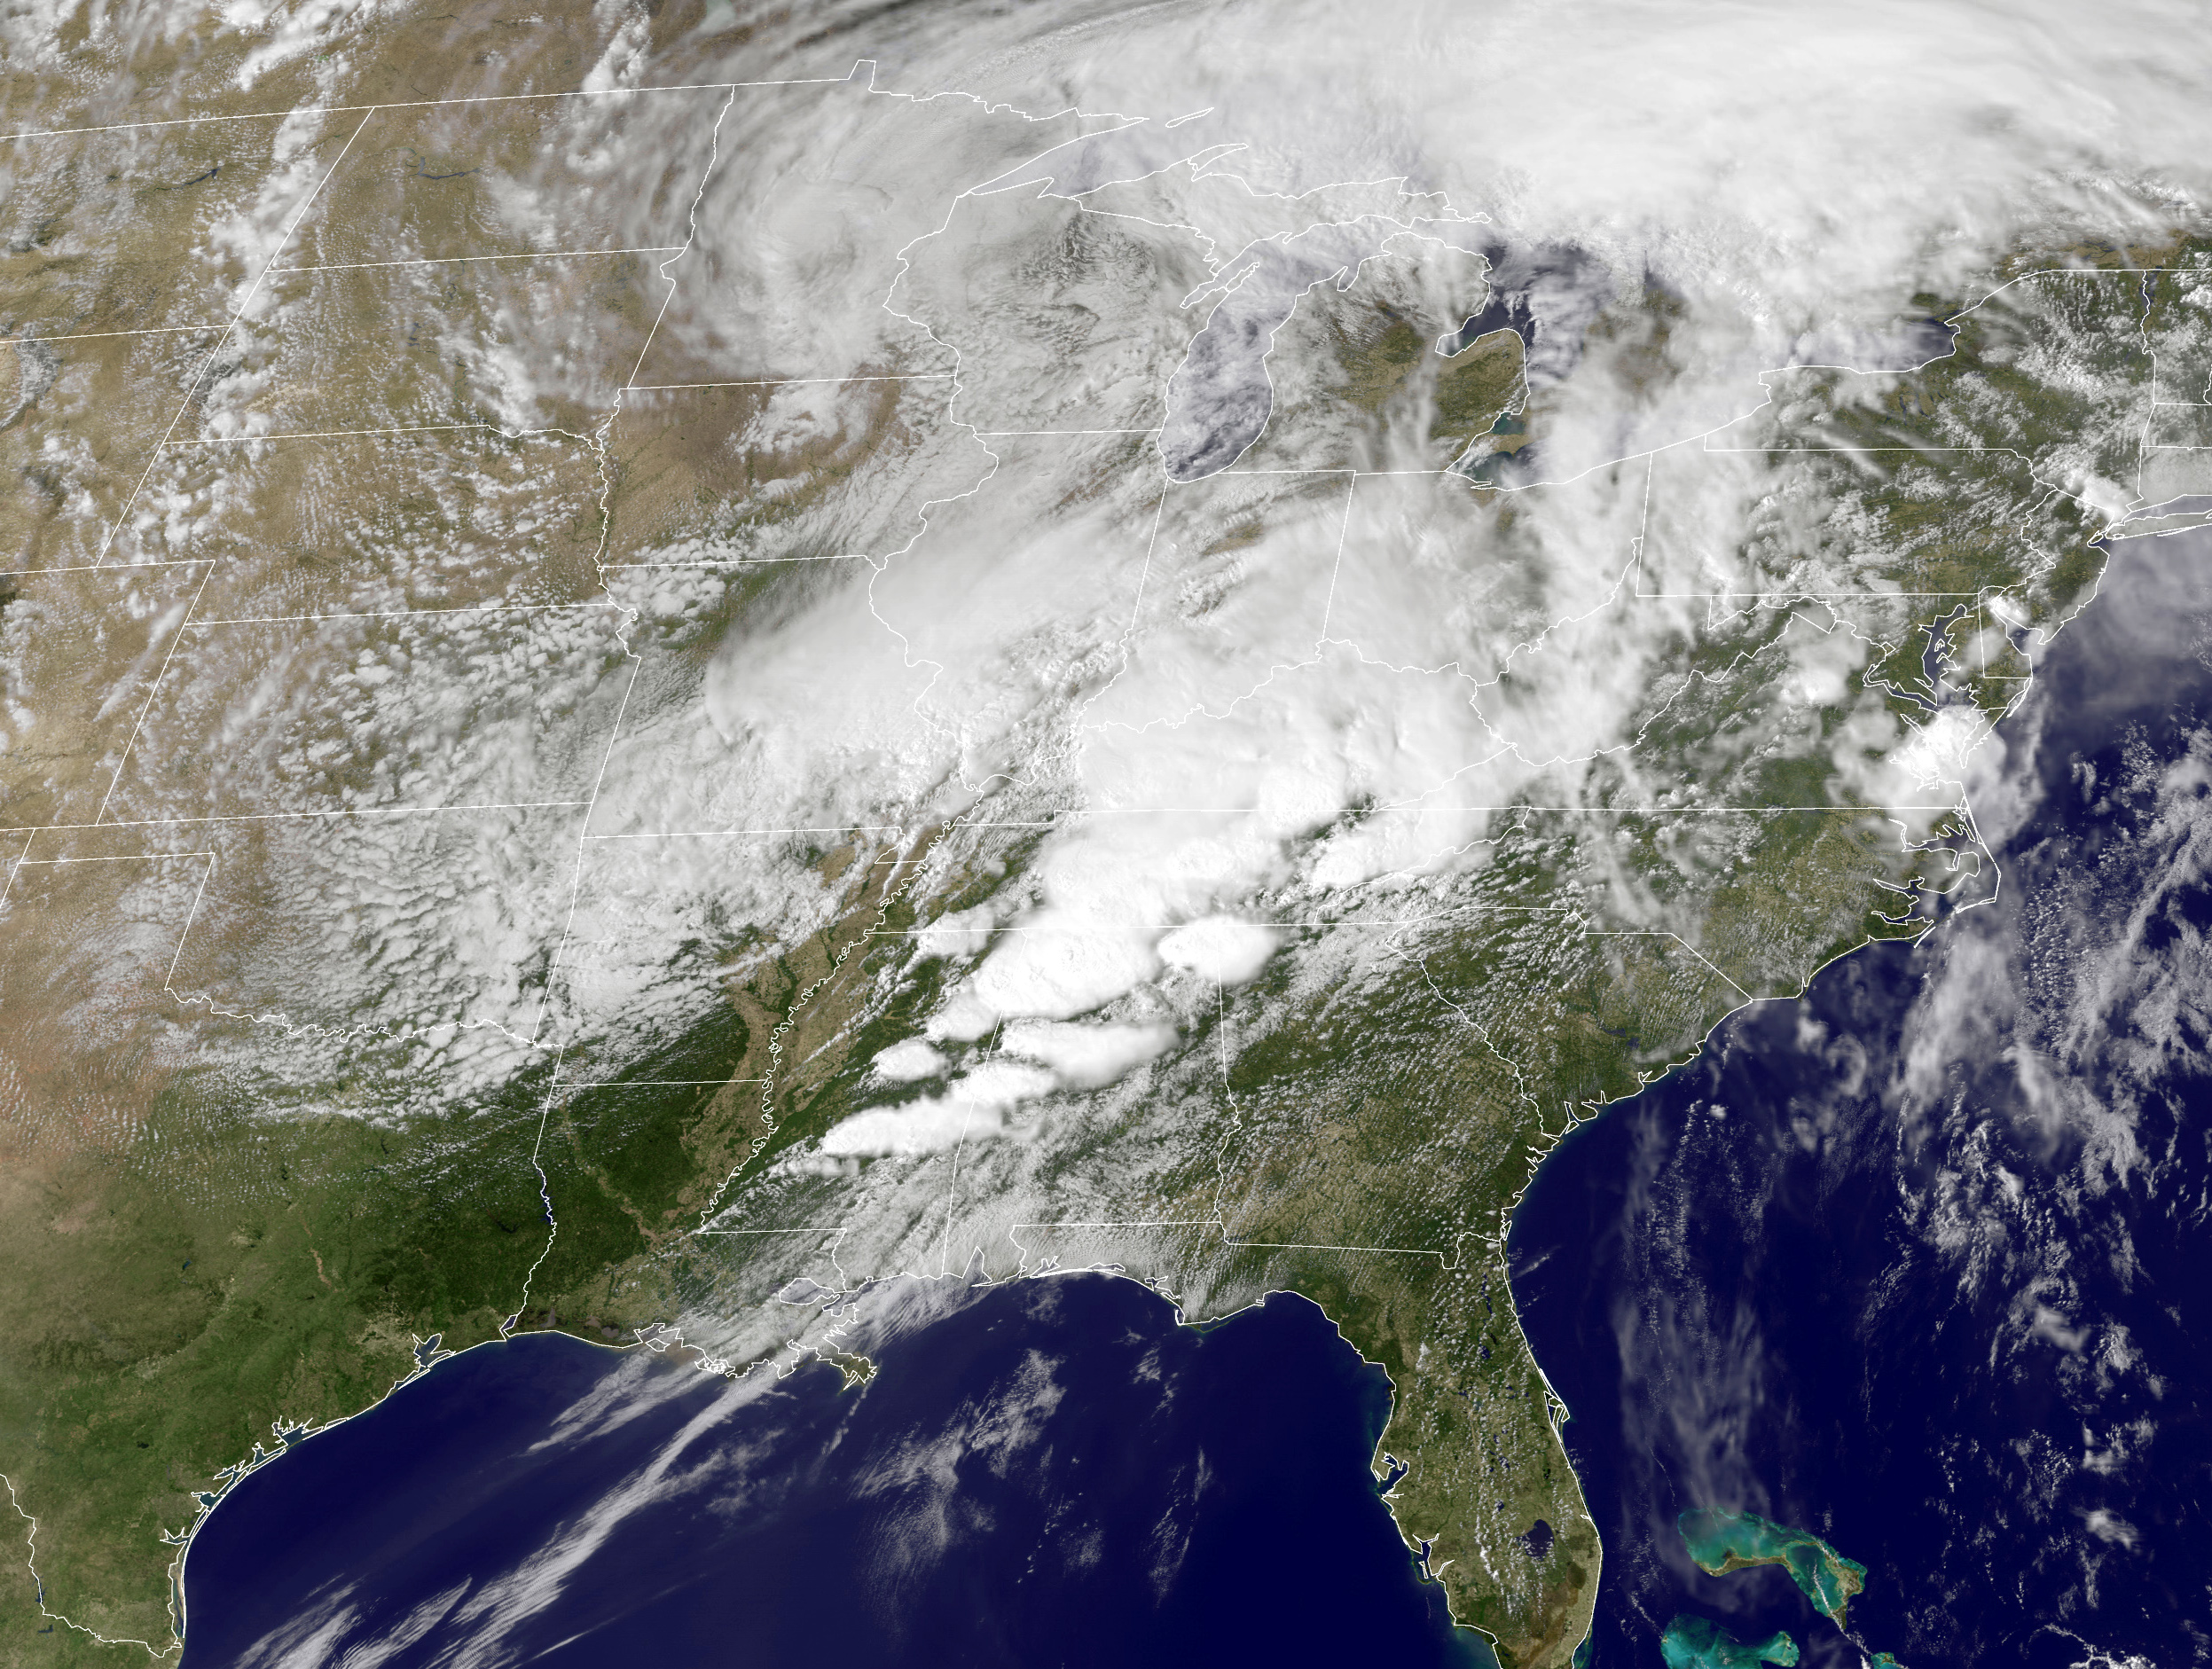
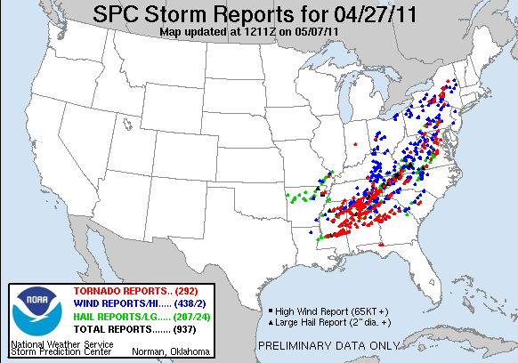
Jet Superpositions and High-Impact Weather
Jet superpositions can be an element of high-impact weather events
1–3 May 2010 Nashville Flood
Jet superposition enhanced the poleward moisture transport via its ageostrophic circulation (Winters and Martin 2014; 2016).
18–20 December 2009 Mid-Atlantic Blizzard
Jet superposition was associated with a rapidly deepening East Coast cyclone (Winters and Martin 2016; 2017).
26 October 2010: Explosive Cyclogenesis Event
Jet superposition over the West Pacific preceded the development of an intense Midwest U.S. cyclone.
25–28 April 2011 Tornado Outbreak
Jet superposition occurred over the West Pacific prior to the outbreak (Knupp et al. 2014; Christenson and Martin 2012).
NASA
SPC

Slide 12
Jet Superpositions and High-Impact Weather
Jet superpositions can be an element of high-impact weather events
1–3 May 2010 Nashville Flood
Jet superposition enhanced the poleward moisture transport via its ageostrophic circulation (Winters and Martin 2014; 2016).
18–20 December 2009 Mid-Atlantic Blizzard
Jet superposition was associated with a rapidly deepening East Coast cyclone (Winters and Martin 2016; 2017).
26 October 2010: Explosive Cyclogenesis Event
Jet superposition over the West Pacific preceded the development of an intense Midwest U.S. cyclone.
25–28 April 2011 Tornado Outbreak
Jet superposition occurred over the West Pacific prior to the outbreak (Knupp et al. 2014; Christenson and Martin 2012).
How do these structures develop?

Slide 13
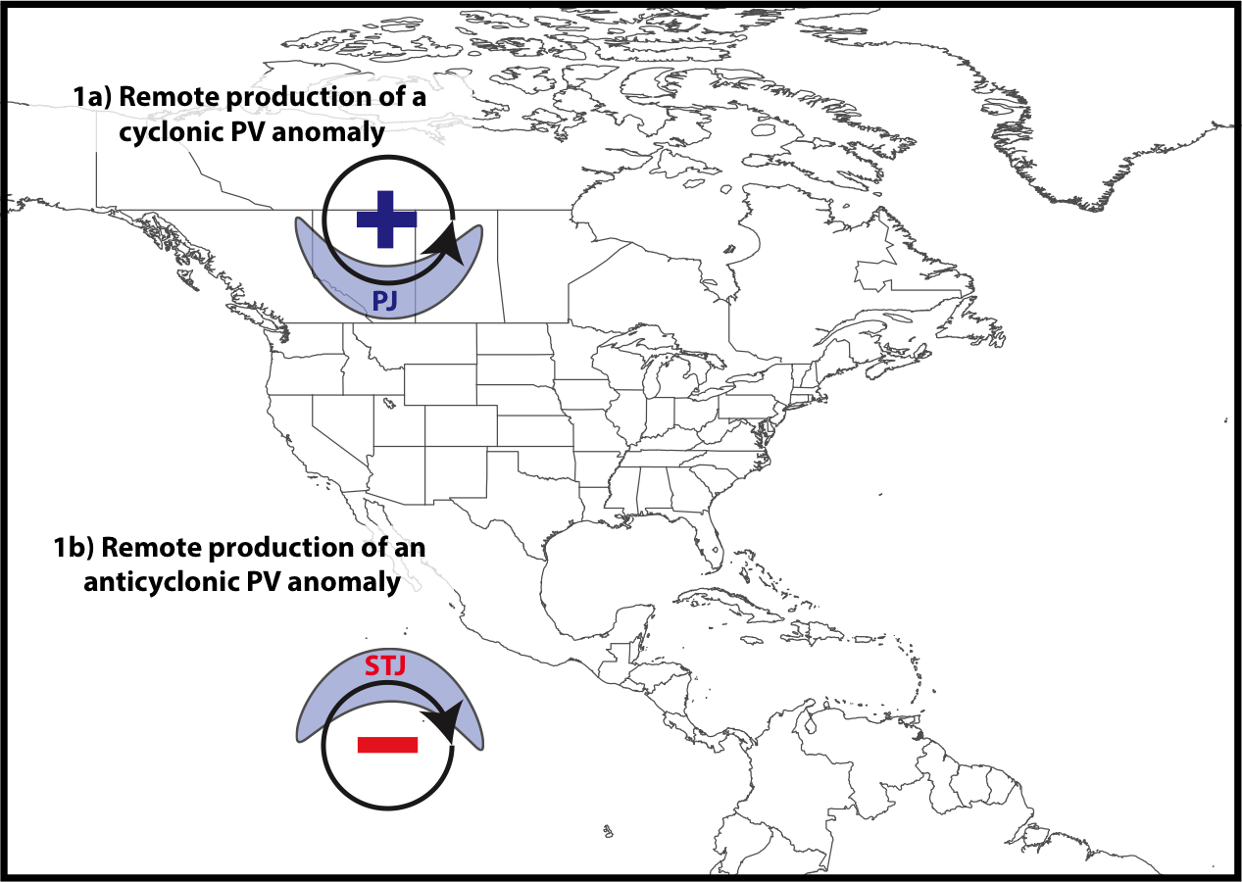
Jet Superposition Conceptual Model
Winters and Martin (2017)

Slide 14
Jet Superposition Conceptual Model
Polar cyclonic PV anomalies:
Often referred to as coherent tropopause disturbances (Pyle et al. 2004) or tropopause polar vortices (Cavallo and Hakim 2010).
Typify a dynamical environment conducive to midlatitude cyclogenesis.
Winters and Martin (2017)

Slide 15
Jet Superposition Conceptual Model
Winters and Martin (2017)

Slide 16
Jet Superposition Conceptual Model
Tropical anticyclonic PV anomalies:
Typify a thermodynamic environment characterized by weak upper-tropospheric static stability.
Atmospheric rivers often form within the poleward-directed branch of their circulation.
Winters and Martin (2017)

Slide 17
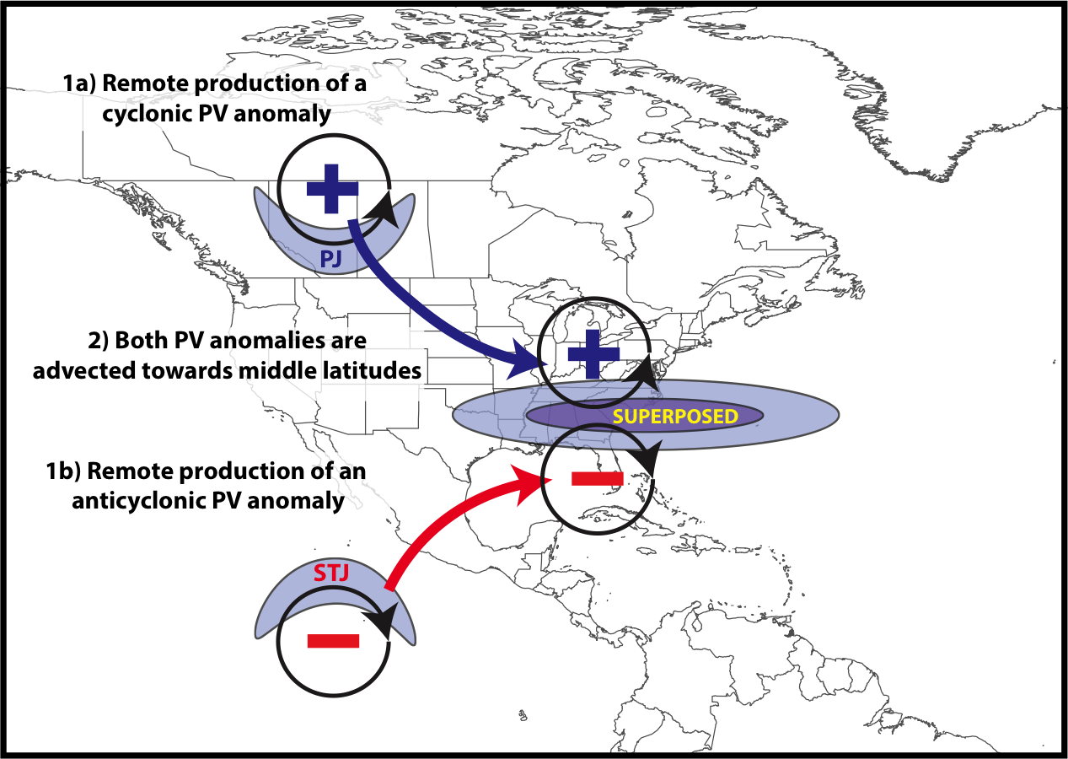
Jet Superposition Conceptual Model
Winters and Martin (2017)

Slide 18
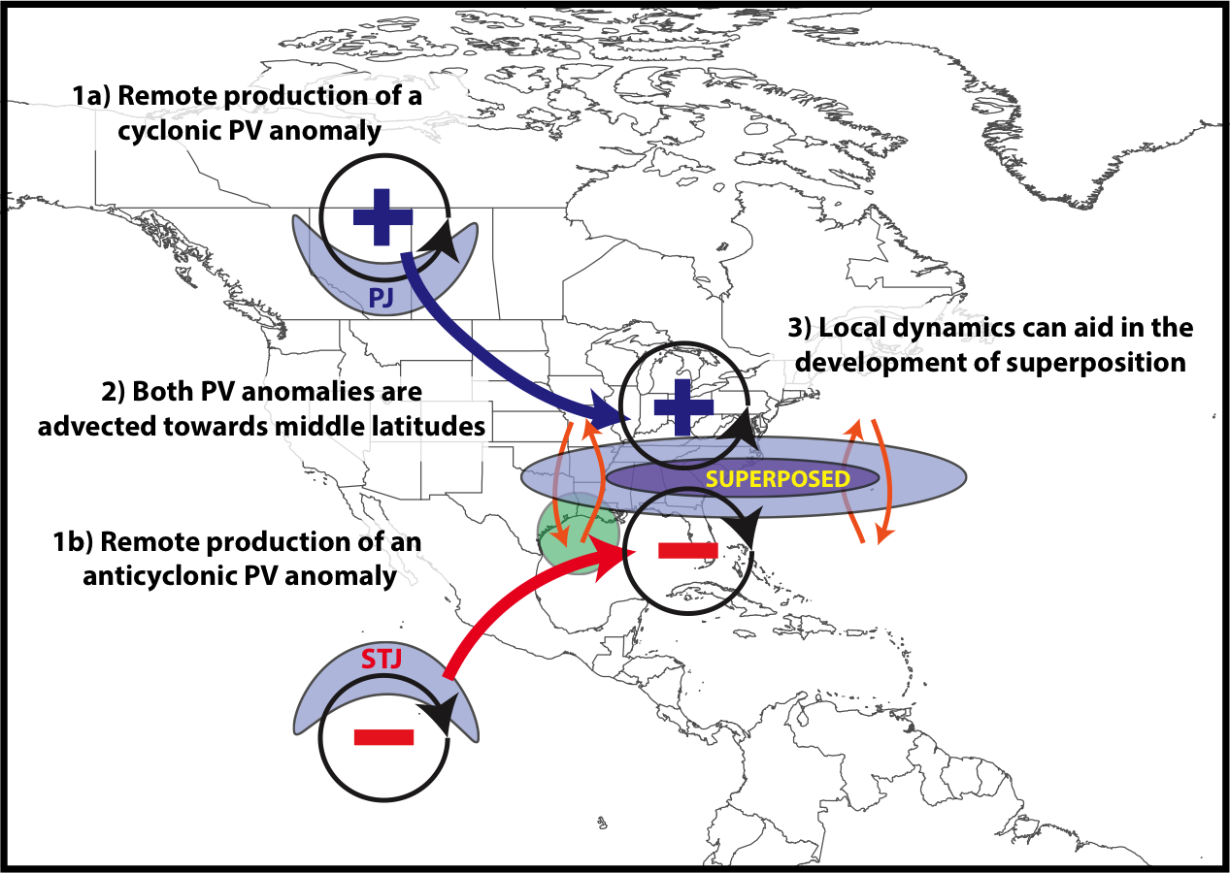
Jet Superposition Conceptual Model
Winters and Martin (2017)

Slide 19
Jet Superposition Conceptual Model
The relative importance of these PV anomalies is highly variable between jet superposition events
Winters and Martin (2017)

Slide 20
Jet Superposition Conceptual Model
GOAL: To determine the characteristic types of interaction that exist between upper-tropospheric PV anomalies during a jet superposition event
Winters and Martin (2017)

Slide 21
Jet Superposition Event Identification and Classification

Slide 22
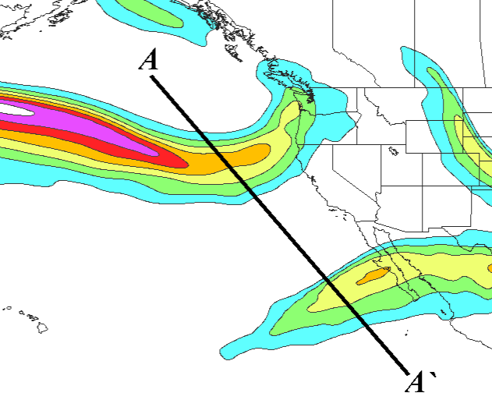
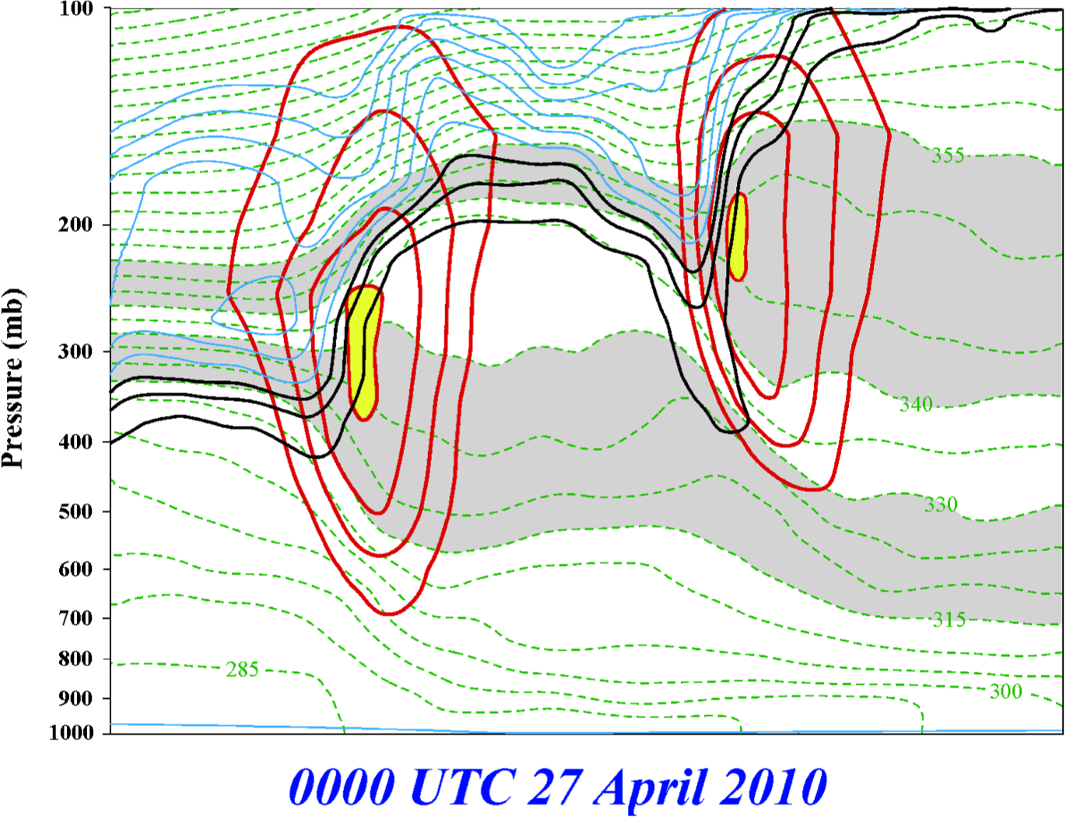
Jet Superposition Event Identification
0000 UTC 27 April 2010
A
PJ
STJ
STJ
A’
PJ
250-hPa wind speed
Isolated grid points over North America in the CFSR (Saha et al. 2014) characterized by a polar and subtropical jets during Nov–Mar
1979–2010.
Isotachs
Potential Temp.
1,2,3-PVU contours
A
A’
Winters and Martin (2014); Christenson et al. (2017)

Slide 23
Jet Superposition Event Identification
0000 UTC 27 April 2010
A
PJ
STJ
A’
250-hPa wind speed
Isolated grid points over North America in the CFSR (Saha et al. 2014) characterized by a polar and subtropical jets during Nov–Mar
1979–2010.
Isotachs
Potential Temp.
1,2,3-PVU contours
Strong horizontal PV gradient within the 1–3-PVU channel in the 315–330-K isentropic layer
A
A’
Winters and Martin (2014); Christenson et al. (2017)

Slide 24
Jet Superposition Event Identification
0000 UTC 27 April 2010
A
PJ
STJ
A’
250-hPa wind speed
Isolated grid points over North America in the CFSR (Saha et al. 2014) characterized by a polar and subtropical jets during Nov–Mar
1979–2010.
Isotachs
Potential Temp.
1,2,3-PVU contours
Integrated 400–100-hPa wind speed must exceed 30 m s^{–1}
A
A’
Winters and Martin (2014); Christenson et al. (2017)

Slide 25
Jet Superposition Event Identification
0000 UTC 27 April 2010
A
PJ
STJ
A’
PJ
250-hPa wind speed
Isolated grid points over North America in the CFSR (Saha et al. 2014) characterized by a polar and subtropical jets during Nov–Mar
1979–2010.
Isotachs
Potential Temp.
1,2,3-PVU contours
A
A’
Winters and Martin (2014); Christenson et al. (2017)

Slide 26
Jet Superposition Event Identification
0000 UTC 27 April 2010
A
PJ
STJ
A’
250-hPa wind speed
Isolated grid points over North America in the CFSR (Saha et al. 2014) characterized by a polar and subtropical jets during Nov–Mar
1979–2010.
Isotachs
Potential Temp.
1,2,3-PVU contours
Strong horizontal PV gradient within the 1–3-PVU channel in the 340–355-K isentropic layer
A
A’
Winters and Martin (2014); Christenson et al. (2017)

Slide 27
Jet Superposition Event Identification
0000 UTC 27 April 2010
A
PJ
STJ
A’
250-hPa wind speed
Isolated grid points over North America in the CFSR (Saha et al. 2014) characterized by a polar and subtropical jets during Nov–Mar
1979–2010.
Isotachs
Potential Temp.
1,2,3-PVU contours
Integrated 400–100-hPa wind speed must exceed 30 m s^{–1}
A
A’
Winters and Martin (2014); Christenson et al. (2017)

Slide 28
Jet Superposition Event Identification
0000 UTC 27 April 2010
A
PJ
STJ
STJ
A’
250-hPa wind speed
Isolated grid points over North America in the CFSR (Saha et al. 2014) characterized by a polar and subtropical jets during Nov–Mar
1979–2010.
Isotachs
Potential Temp.
1,2,3-PVU contours
A
A’
Winters and Martin (2014); Christenson et al. (2017)

Slide 29
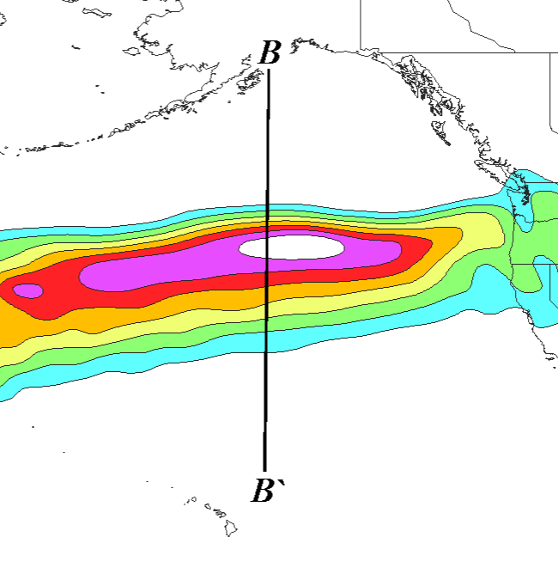
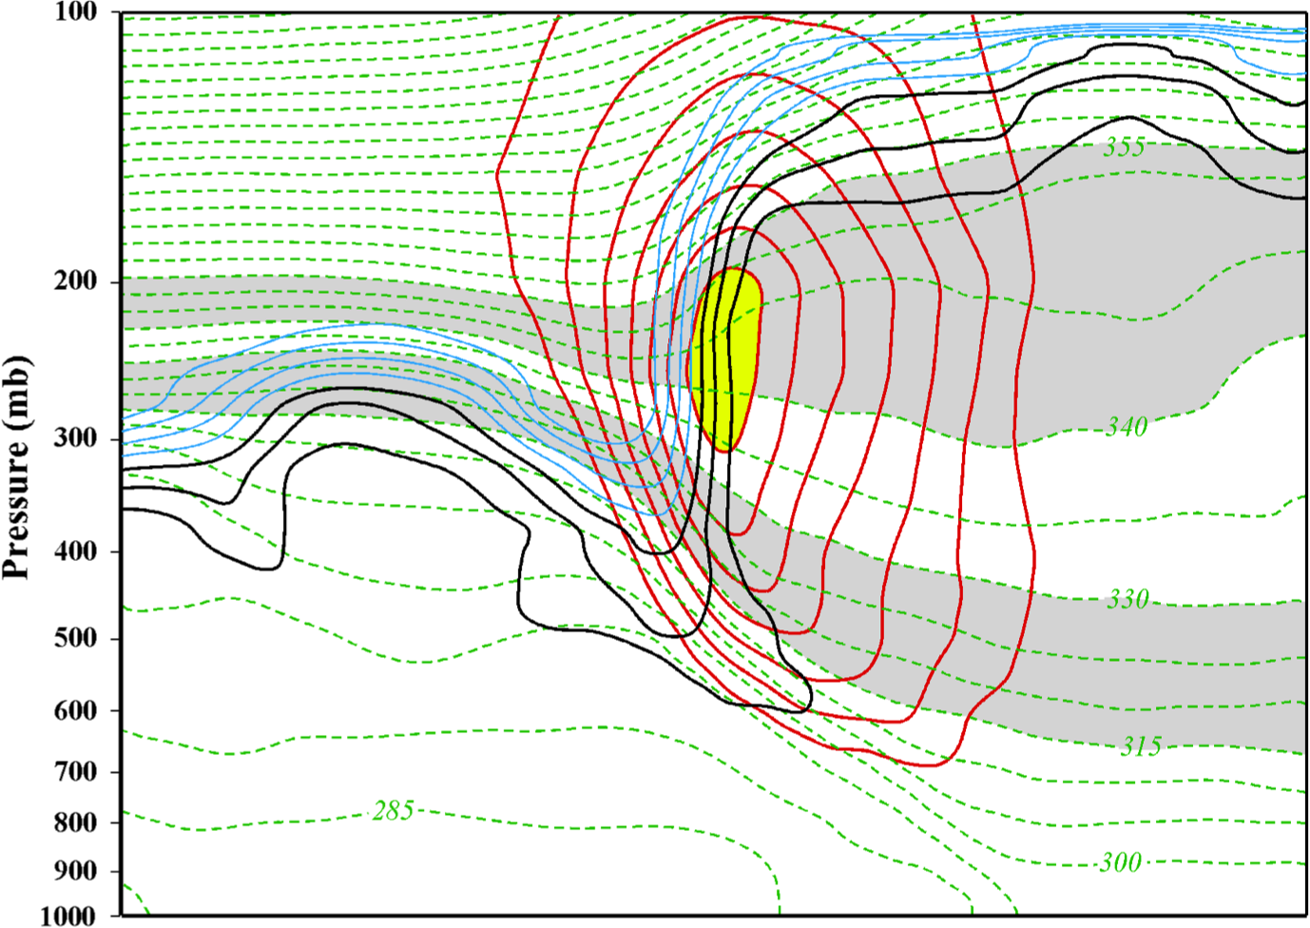
Jet Superposition Event Identification
0000 UTC 24 October 2010
B
SUPJ
B’
250-hPa wind speed
Isolated grid points over North America in the CFSR (Saha et al. 2014) characterized by a jet superposition during Nov–Mar
1979–2010.
Isotachs
Potential Temp.
1,2,3-PVU contours
B
B’
Winters and Martin (2014); Christenson et al. (2017)

Slide 30
Jet Superposition Event Identification
0000 UTC 24 October 2010
B
SUPJ
B’
250-hPa wind speed
Isolated grid points over North America in the CFSR (Saha et al. 2014) characterized by a jet superposition during Nov–Mar
1979–2010.
Isotachs
Potential Temp.
1,2,3-PVU contours
Criteria for both the polar and subtropical jets satisfied within the same grid column
B
B’
Winters and Martin (2014); Christenson et al. (2017)

Slide 31
Jet Superposition Event Identification
0000 UTC 24 October 2010
B
SUPJ
B’
250-hPa wind speed
Isolated grid points over North America in the CFSR (Saha et al. 2014) characterized by a jet superposition during Nov–Mar
1979–2010.
Isotachs
Potential Temp.
1,2,3-PVU contours
Criteria for both the polar and subtropical jets satisfied within the same grid column
B
B’
Winters and Martin (2014); Christenson et al. (2017)

Slide 32
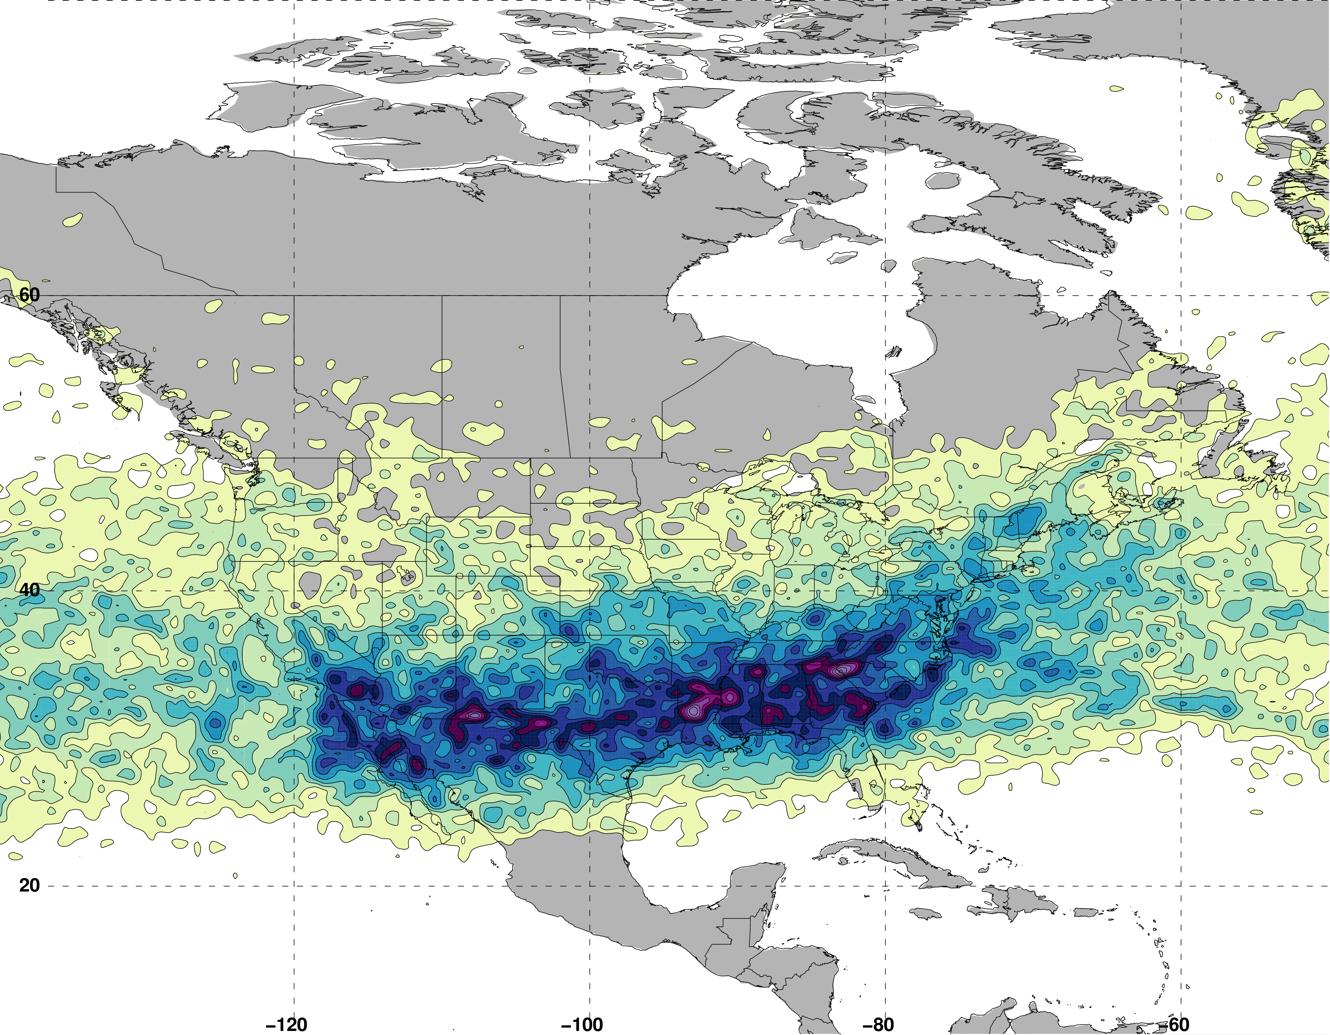
Jet Superposition Event Identification
Isolated grid points over North America in the CFSR (Saha et al. 2014) characterized by a jet superposition during Nov–Mar 1979–2010.
Jet Superposition Frequency – All Times
N = 61660

Slide 33
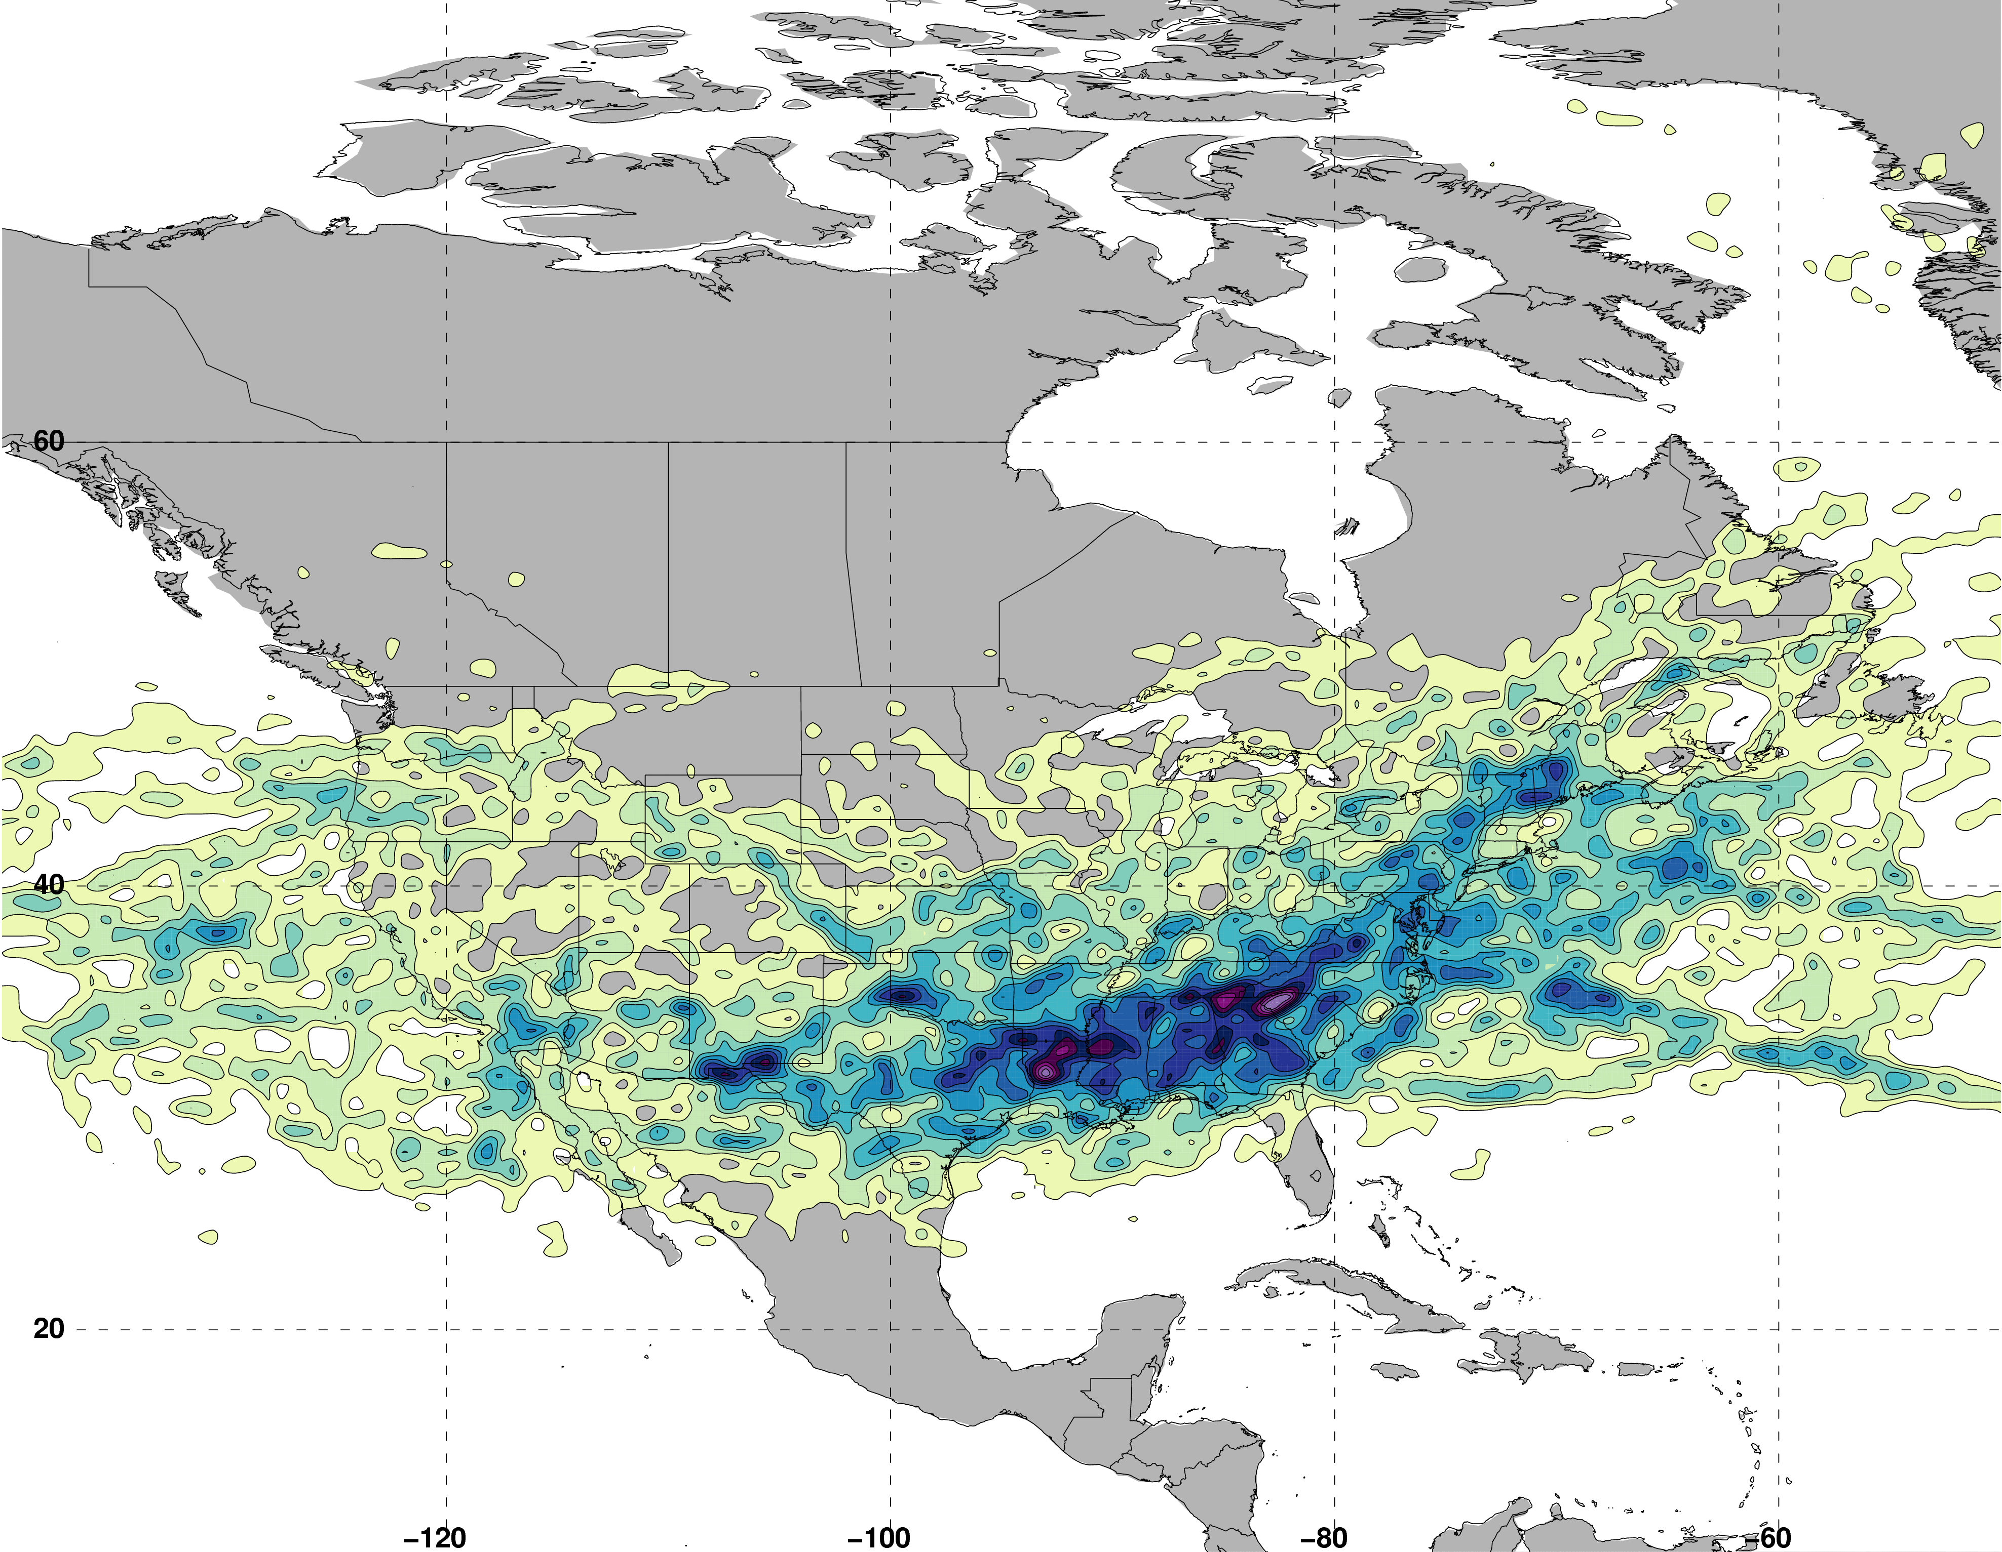
Jet Superposition Event Identification
Isolated grid points over North America in the CFSR (Saha et al. 2014) characterized by a jet superposition during Nov–Mar 1979–2010.
Retained analysis times that rank in the top 10% in terms the number of grid points characterized by a jet superposition.
Jet Superposition Frequency – Top 10% Times
N = 19485

Slide 34
Jet Superposition Event Identification
Isolated grid points over North America in the CFSR (Saha et al. 2014) characterized by a jet superposition during Nov–Mar 1979–2010.
Retained analysis times that rank in the top 10% in terms the number of grid points characterized by a jet superposition.
Filtered retained analysis times to group together jet superpositions that are < 30 h and < 1500 km of one another.
Jet Superposition Frequency – Top 10% Times
N = 19485
326 unique jet superposition events

Slide 35
Jet Superposition Event Classification
Determined the mean position of the 2-PVU contour on the 320-K and 350-K surfaces at each analysis time in the CFSR.
0000 UTC 1 January

Slide 36
Jet Superposition Event Classification
Determined the mean position of the 2-PVU contour on the 320-K and 350-K surfaces at each analysis time in the CFSR.
0000 UTC 1 January
Polar Jet
Subtropical Jet

Slide 37
Jet Superposition Event Classification
Determined the mean position of the 2-PVU contour on the 320-K and 350-K surfaces at each analysis time in the CFSR.
Compared the position of the jet superposition centroid at the start of each event against the climatological position of the 2-PVU contour.
0000 UTC 1 January

Slide 38
Jet Superposition Event Classification
Determined the mean position of the 2-PVU contour on the 320-K and 350-K surfaces at each analysis time in the CFSR.
Compared the position of the jet superposition centroid at the start of each event against the climatological position of the 2-PVU contour.
Polar Dominant
0000 UTC 1 January
Jet Superposition Centroid

Slide 39
Jet Superposition Event Classification
Determined the mean position of the 2-PVU contour on the 320-K and 350-K surfaces at each analysis time in the CFSR.
Compared the position of the jet superposition centroid at the start of each event against the climatological position of the 2-PVU contour.
Polar Dominant
Subtropical Dominant
0000 UTC 1 January
Jet Superposition Centroid

Slide 40
Jet Superposition Event Classification
Determined the mean position of the 2-PVU contour on the 320-K and 350-K surfaces at each analysis time in the CFSR.
Compared the position of the jet superposition centroid at the start of each event against the climatological position of the 2-PVU contour.
Polar Dominant
Subtropical Dominant
Hybrid
0000 UTC 1 January
Jet Superposition Centroid

Slide 41
Jet Superposition Event Classification

Slide 42
Jet Superposition Event Classification

Slide 43
Jet Superposition Event Classification

Slide 44
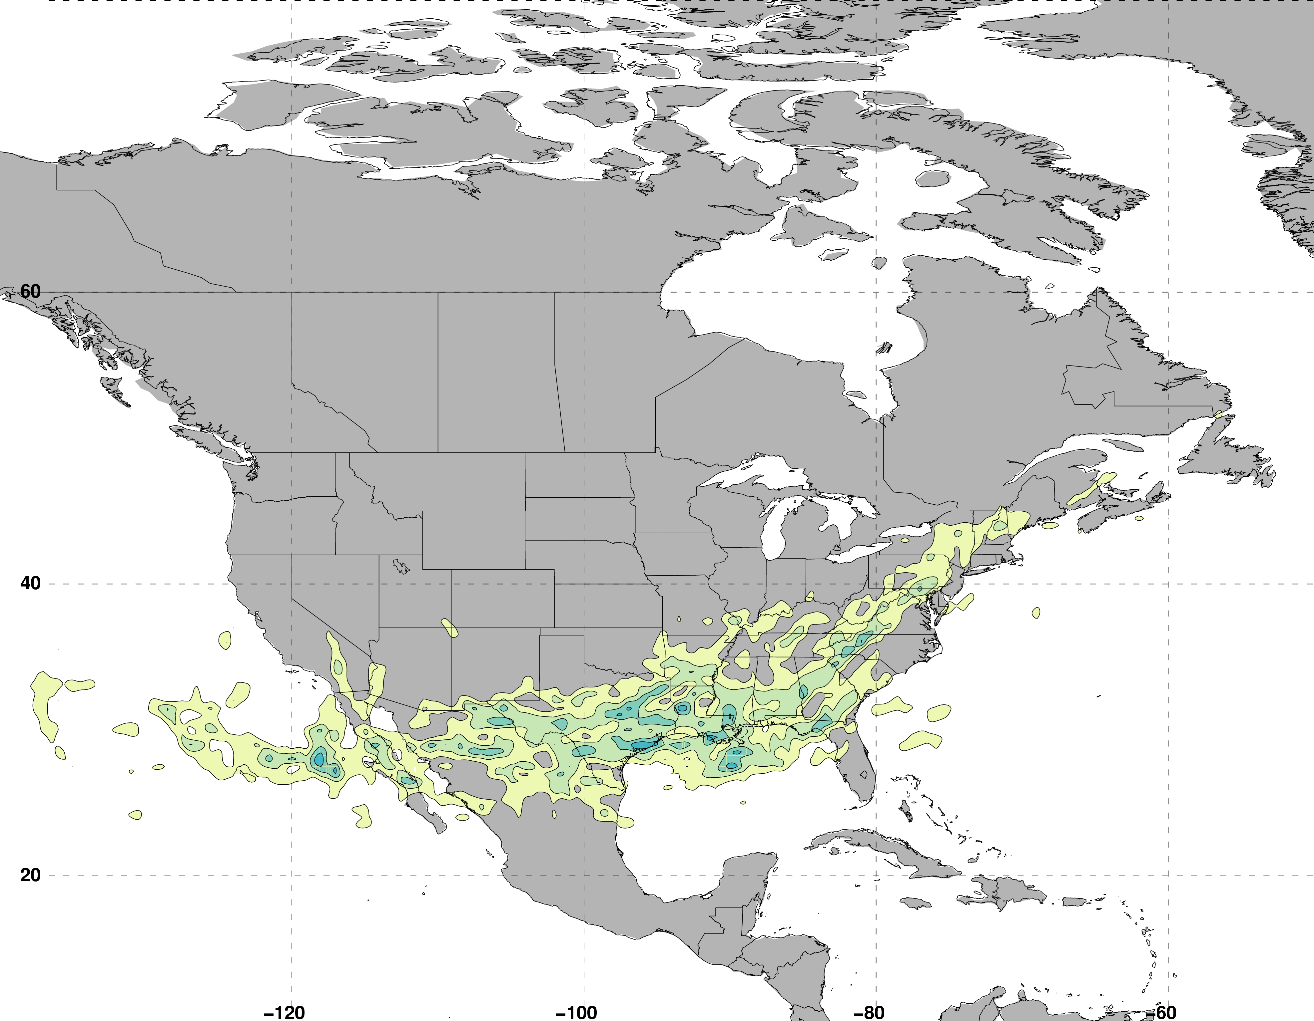
Jet Superposition Event Classification
Frequency of Polar Dominant Jet Superposition Events
N = 80
Legend
Centroid of all events
Composite movement of superposition
Number of events

Slide 45
Jet Superposition Event Classification
Frequency of Polar Dominant Jet Superposition Events
N = 80
Legend
Centroid of all events
Composite movement of superposition
Number of events

Slide 46
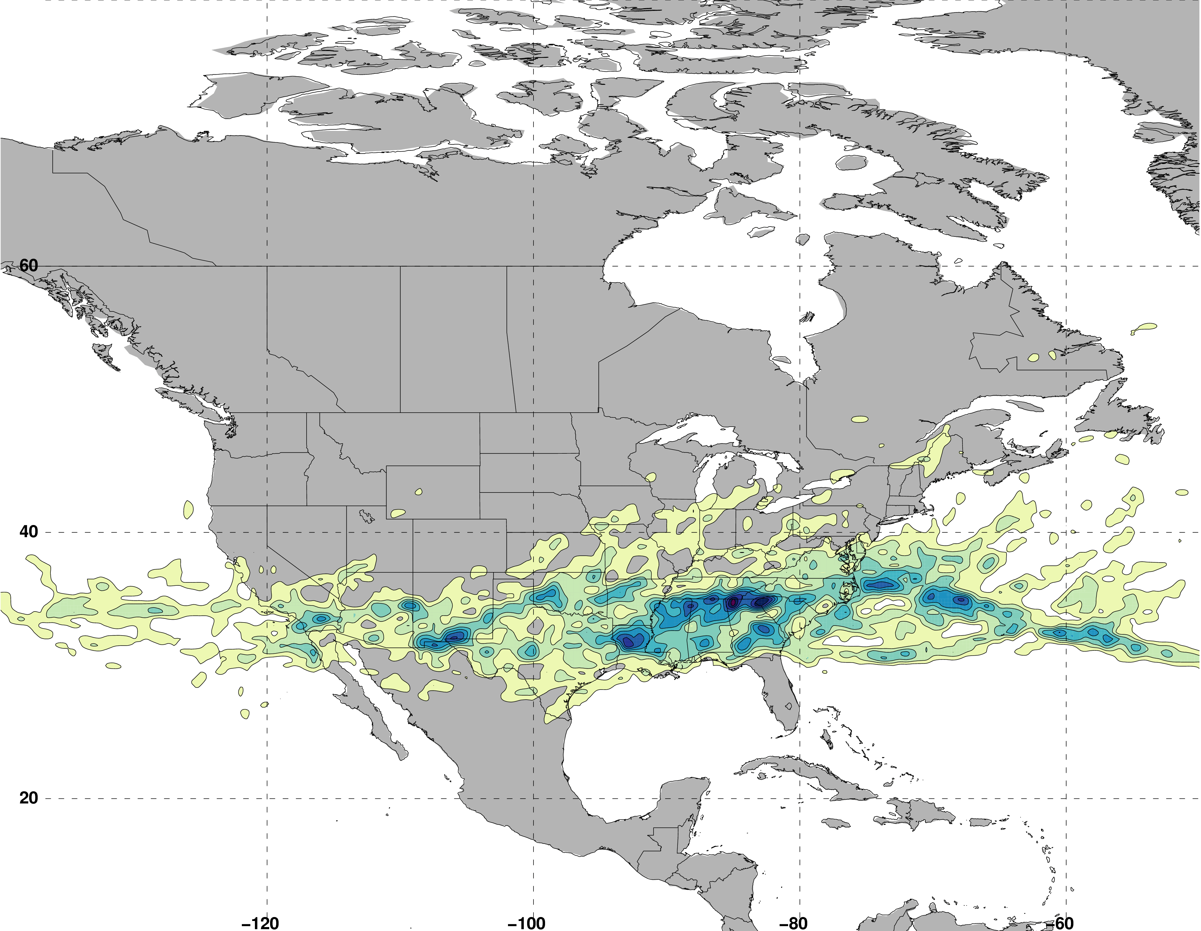
Jet Superposition Event Classification
Frequency of Hybrid Jet Superposition Events
N = 117
Legend
Centroid of all events
Composite movement of superposition
Number of events

Slide 47
Jet Superposition Event Classification
Frequency of Hybrid Jet Superposition Events
N = 117
Legend
Centroid of all events
Composite movement of superposition
Number of events

Slide 48
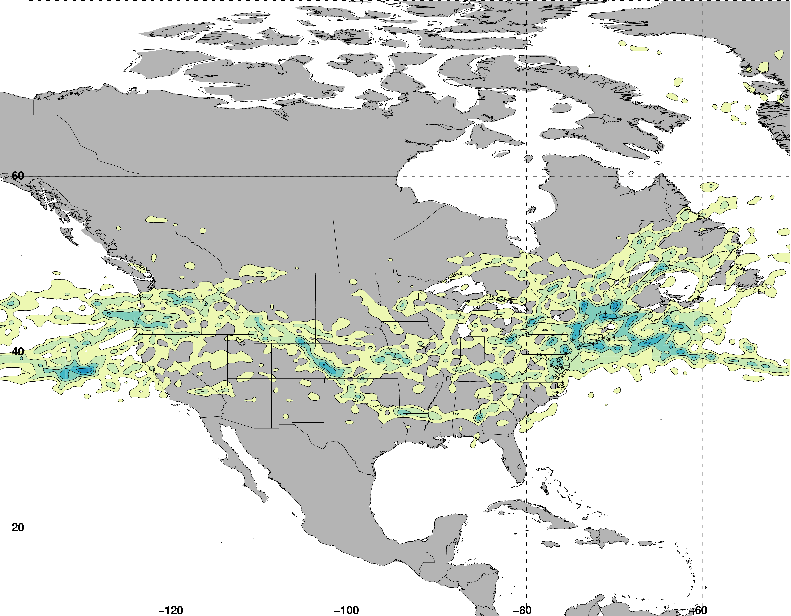
Jet Superposition Event Classification
Frequency of Subtropical Dominant Jet Superposition Events
N = 129
Legend
Centroid of all events
Composite movement of superposition
Number of events

Slide 49
Jet Superposition Event Classification
Frequency of Subtropical Dominant Jet Superposition Events
N = 129
West: N = 53
East: N = 76
Legend
Centroid of all events
Composite movement of superposition
Number of events

Slide 50
Jet Superposition Event Classification
Frequency of Subtropical Dominant Jet Superposition Events
N = 129
West: N = 53
East: N = 76
Legend
Centroid of all events
Composite movement of superposition
Number of events

Slide 51
Jet Superposition Event Composites:
Polar Dominant
vs.
East Subtropical Dominant

Slide 52
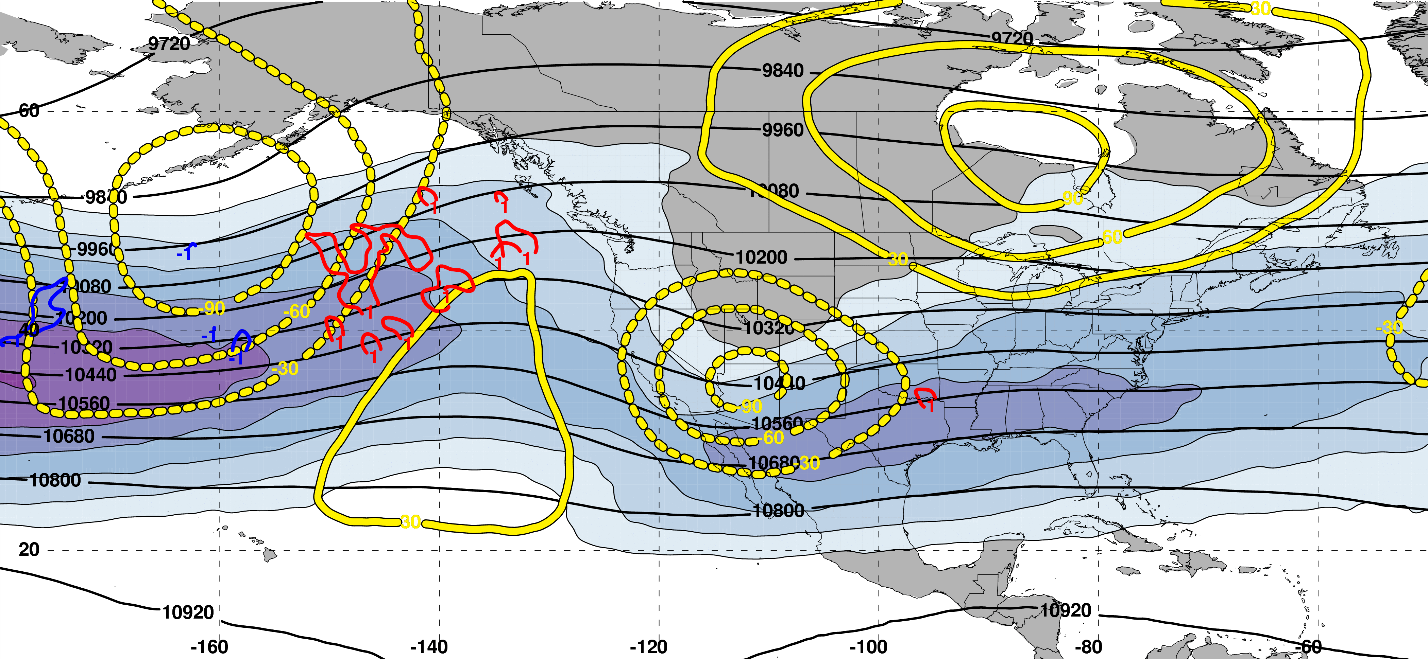
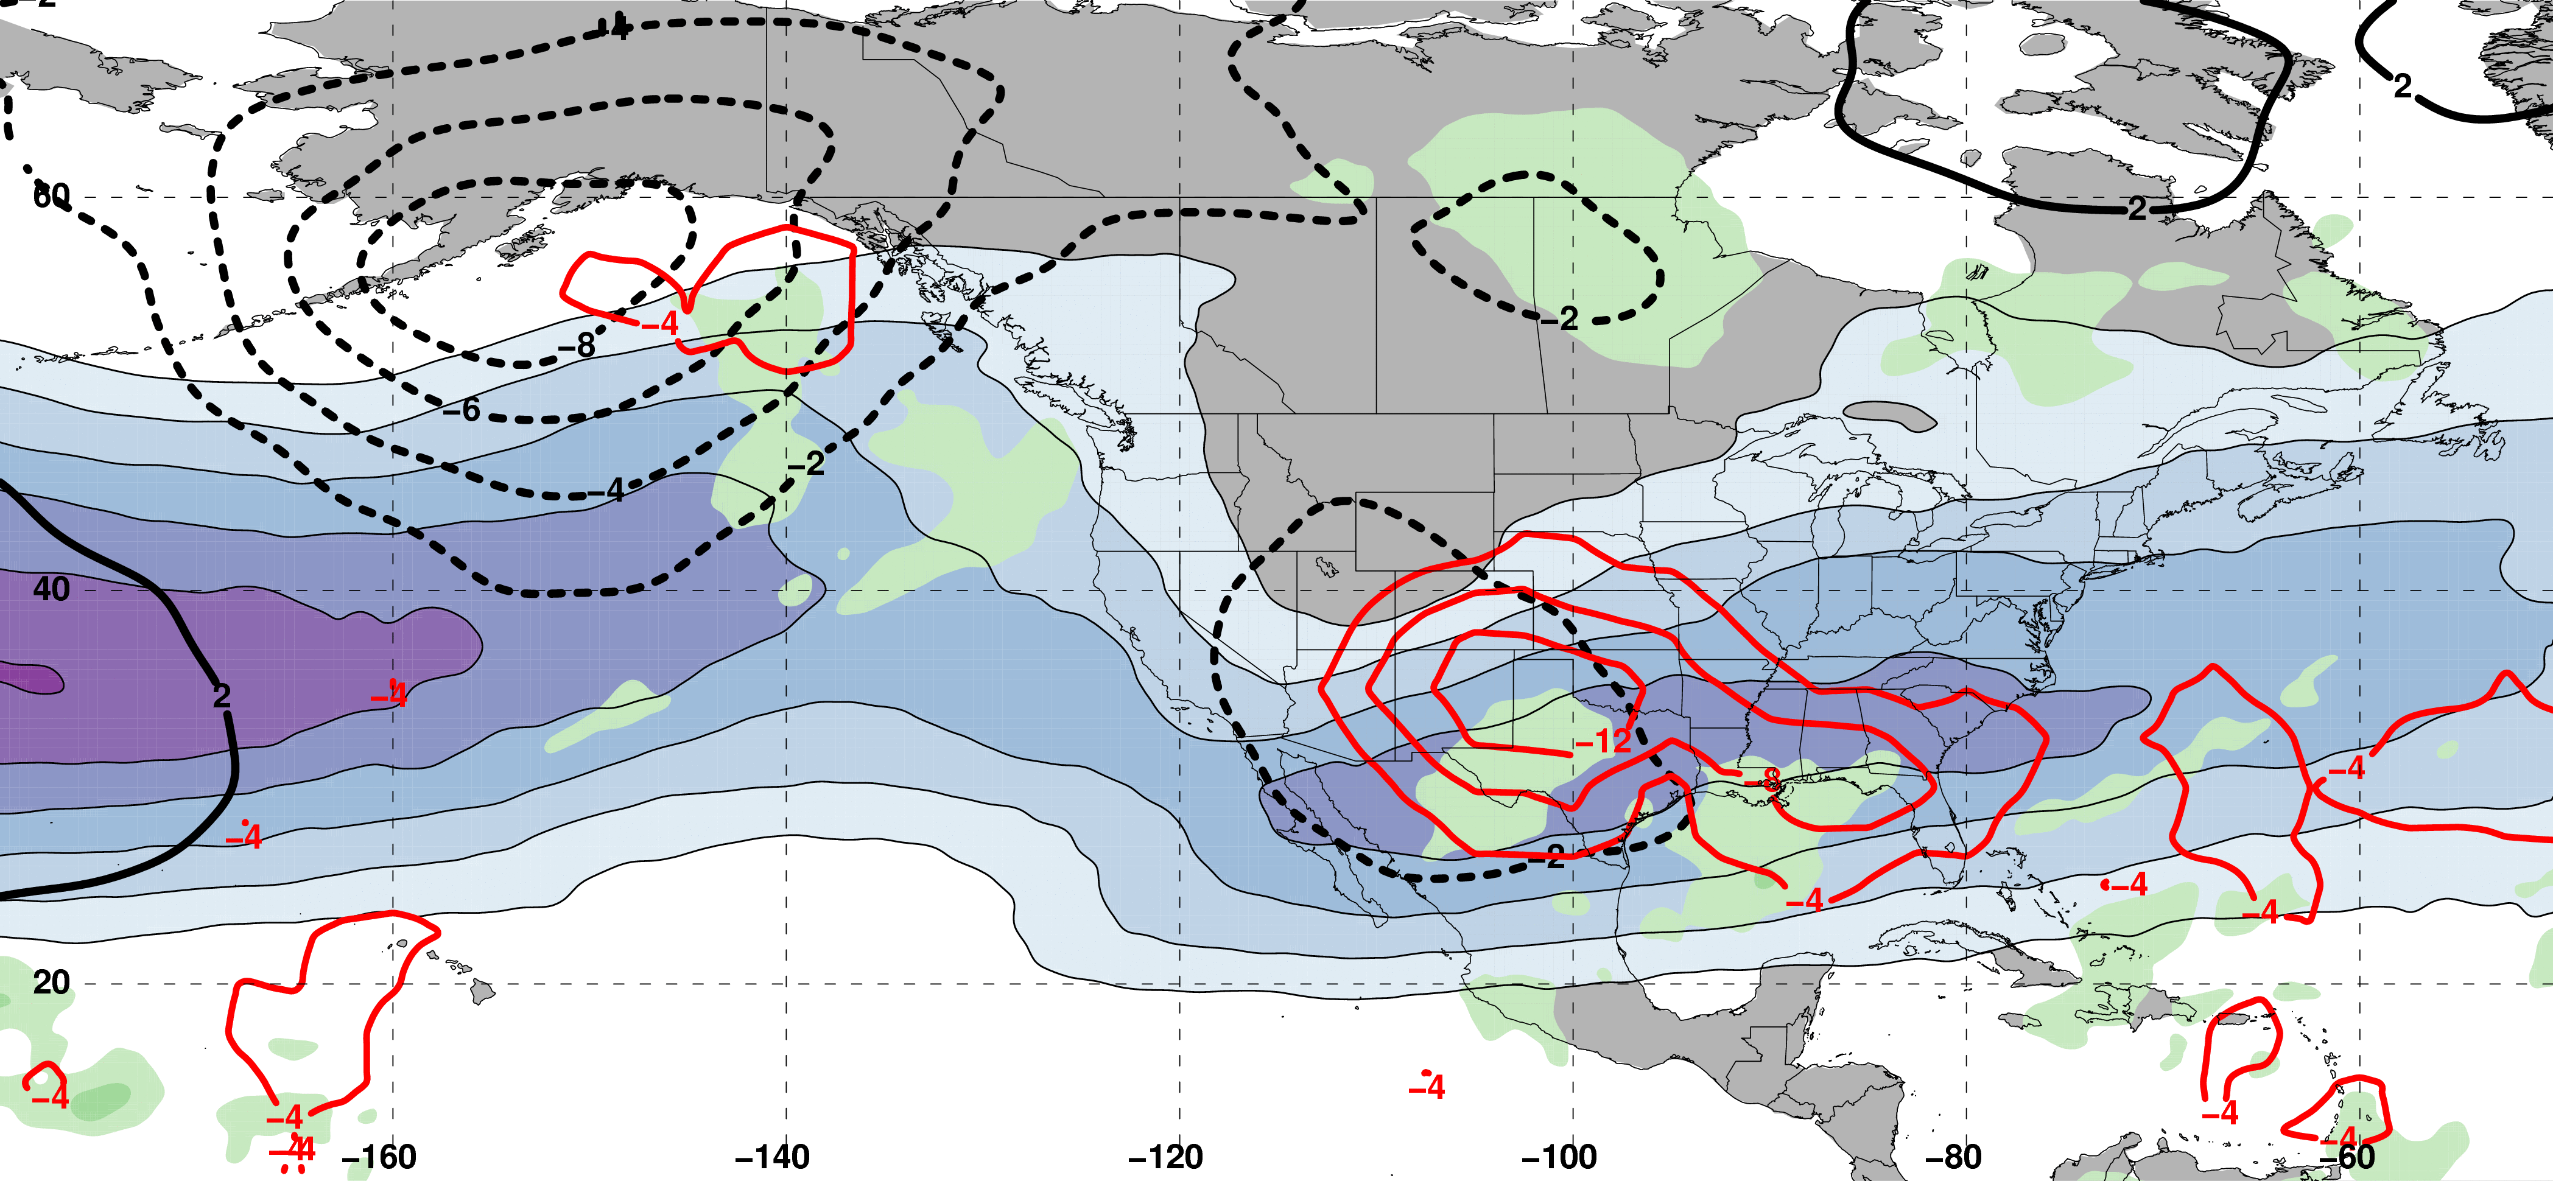
Polar Dominant Jet Superposition Events
250-hPa Jet, Geo. Height, & Geo. Height Anom., & 300-hPa Geo. Temp Adv.
250-hPa Geo. Height
300-hPa
Geo. WAA
2 Days
Prior to Jet Superposition
250-hPa Geo. Height Anom.
300-hPa
Geo. CAA
m s^{–1}
250-hPa Jet, MSLP Anom., PWAT Anom., & –OLR Anom.
L
L
N=80
MSLP Anom.
Neg. OLR
Anom.
mm

Slide 53
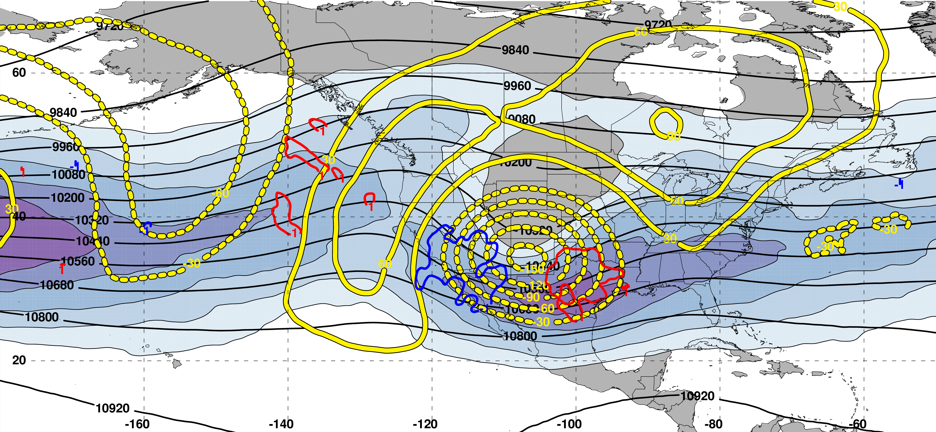
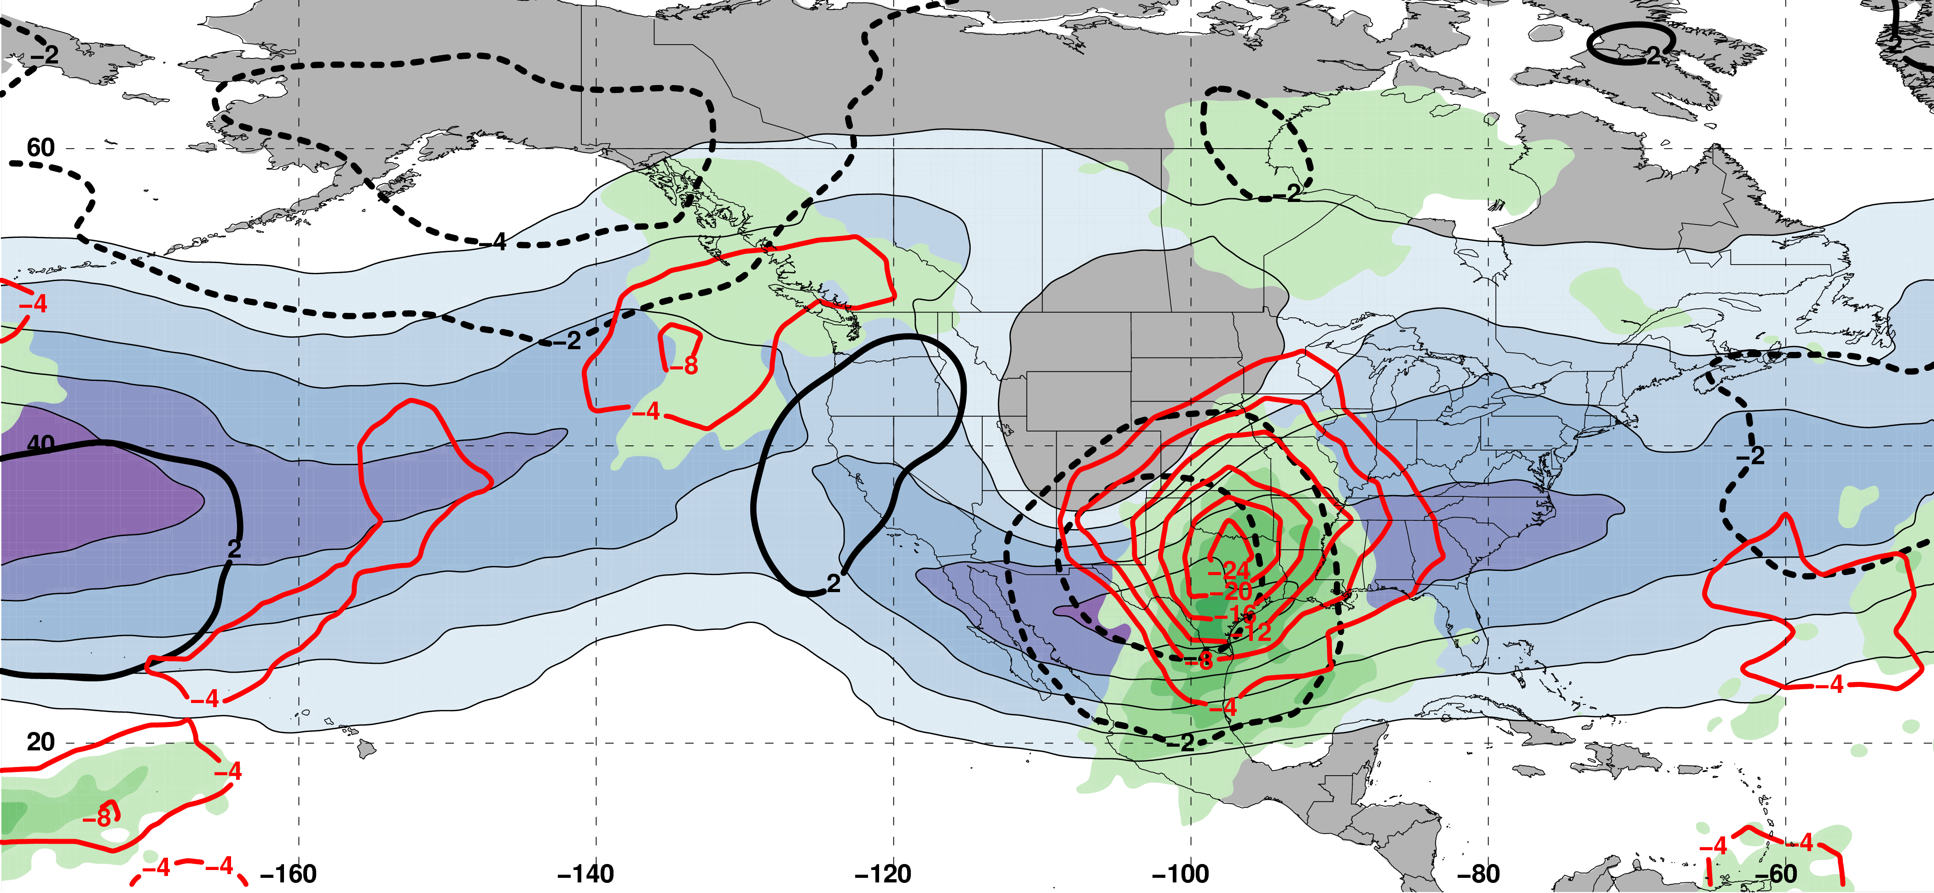
Polar Dominant Jet Superposition Events
250-hPa Jet, Geo. Height, & Geo. Height Anom., & 300-hPa Geo. Temp Adv.
250-hPa Geo. Height
300-hPa
Geo. WAA
1 Day
Prior to Jet Superposition
250-hPa Geo. Height Anom.
300-hPa
Geo. CAA
m s^{–1}
250-hPa Jet, MSLP Anom., PWAT Anom., & –OLR Anom.
L
H
L
N=80
MSLP Anom.
Neg. OLR
Anom.
mm

Slide 54
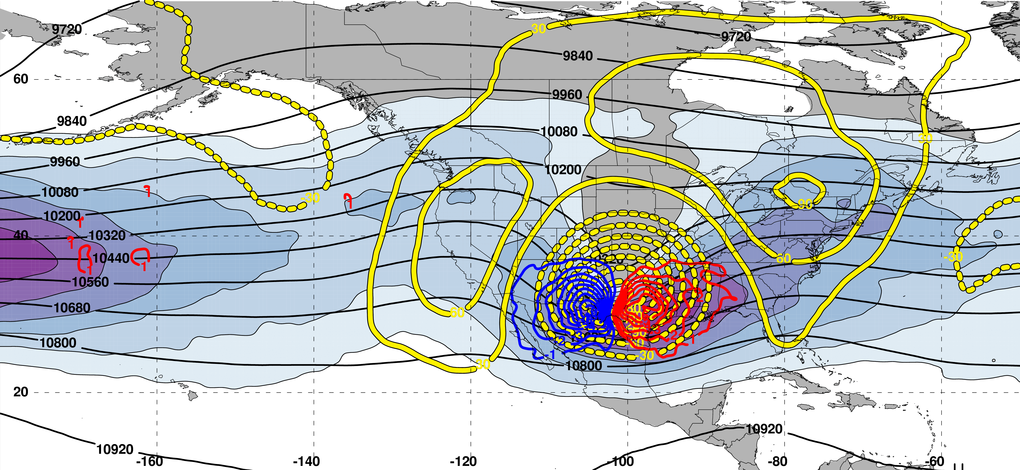
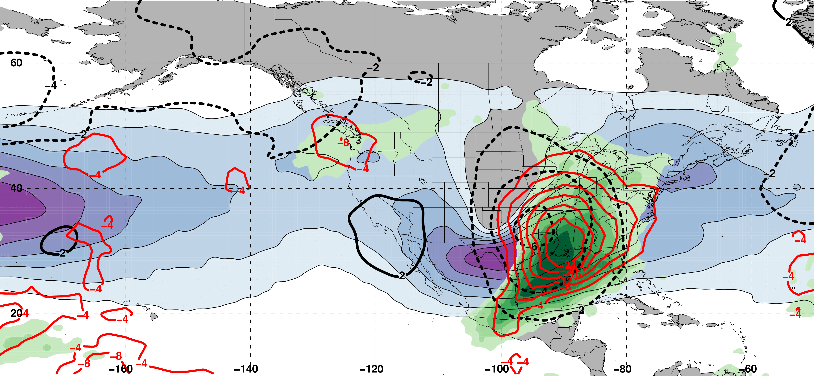
Polar Dominant Jet Superposition Events
250-hPa Jet, Geo. Height, & Geo. Height Anom., & 300-hPa Geo. Temp Adv.
250-hPa Geo. Height
300-hPa
Geo. WAA
0 Days
Prior to Jet Superposition
250-hPa Geo. Height Anom.
300-hPa
Geo. CAA
m s^{–1}
250-hPa Jet, MSLP Anom., PWAT Anom., & –OLR Anom.
Jet Superposition Centroid
H
L
N=80
MSLP Anom.
Neg. OLR
Anom.
mm

Slide 55
Polar Dominant Jet Superposition Events
250-hPa Jet, Geo. Height, & Geo. Height Anom., & 300-hPa Geo. Temp Adv.
A
250-hPa Geo. Height
300-hPa
Geo. WAA
A’
0 Days
Prior to Jet Superposition
250-hPa Geo. Height Anom.
300-hPa
Geo. CAA
m s^{–1}
250-hPa Jet, MSLP Anom., PWAT Anom., & –OLR Anom.
A
Jet Superposition Centroid
H
L
A’
N=80
MSLP Anom.
Neg. OLR
Anom.
mm

Slide 56
Polar Dominant Jet Superposition Events
250-hPa Jet, Geo. Height, & Geo. Height Anom., & 300-hPa Geo. Temp Adv.
A
B
250-hPa Geo. Height
300-hPa
Geo. WAA
A’
B’
0 Days
Prior to Jet Superposition
250-hPa Geo. Height Anom.
300-hPa
Geo. CAA
m s^{–1}
250-hPa Jet, MSLP Anom., PWAT Anom., & –OLR Anom.
A
B
Jet Superposition Centroid
H
L
A’
B’
N=80
MSLP Anom.
Neg. OLR
Anom.
mm

Slide 57
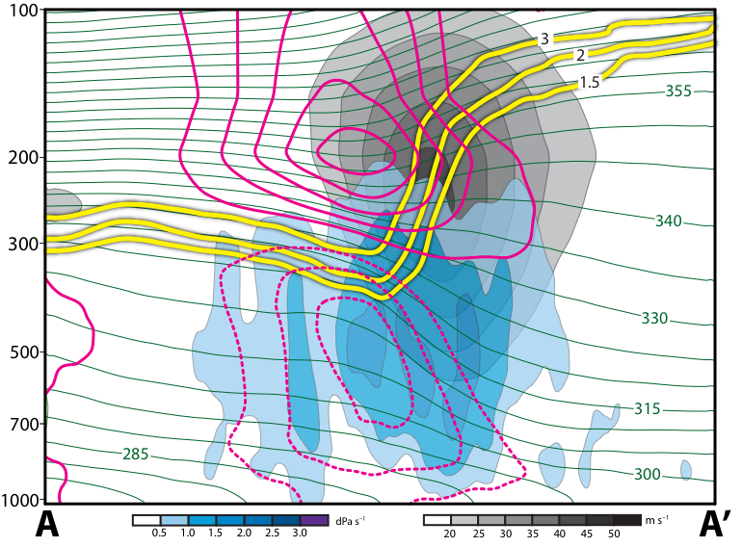
Polar Dominant Jet Superposition Events
12 Hours Prior to Jet Superposition
Legend
1.5-,2-,
3-PVU
θ
+ pert. θ
– pert. θ
ω
wind speed

Slide 58
Polar Dominant Jet Superposition Events
12 Hours Prior to Jet Superposition
Legend
1.5-,2-,
3-PVU
Warm and cold anomalies indicative of a strong positive PV anomaly
θ
+ pert. θ
Subsidence directly beneath and poleward of the jet core
– pert. θ
ω
wind speed

Slide 59
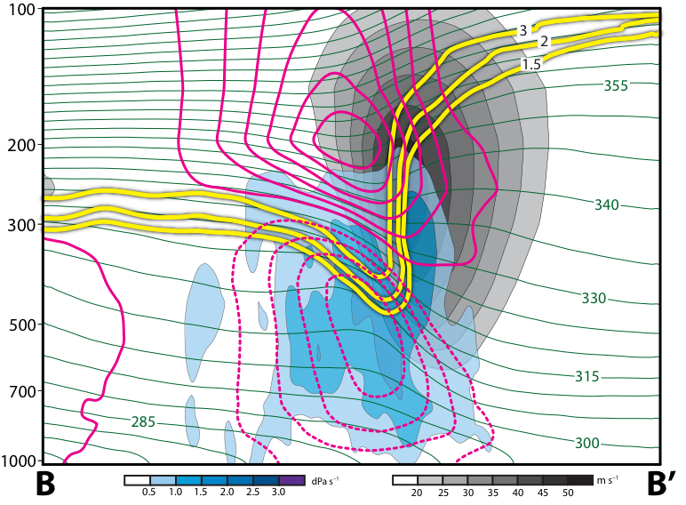
Polar Dominant Jet Superposition Events
0 Hours Prior to Jet Superposition
Legend
1.5-,2-,
3-PVU
θ
+ pert. θ
– pert. θ
ω
wind speed

Slide 60
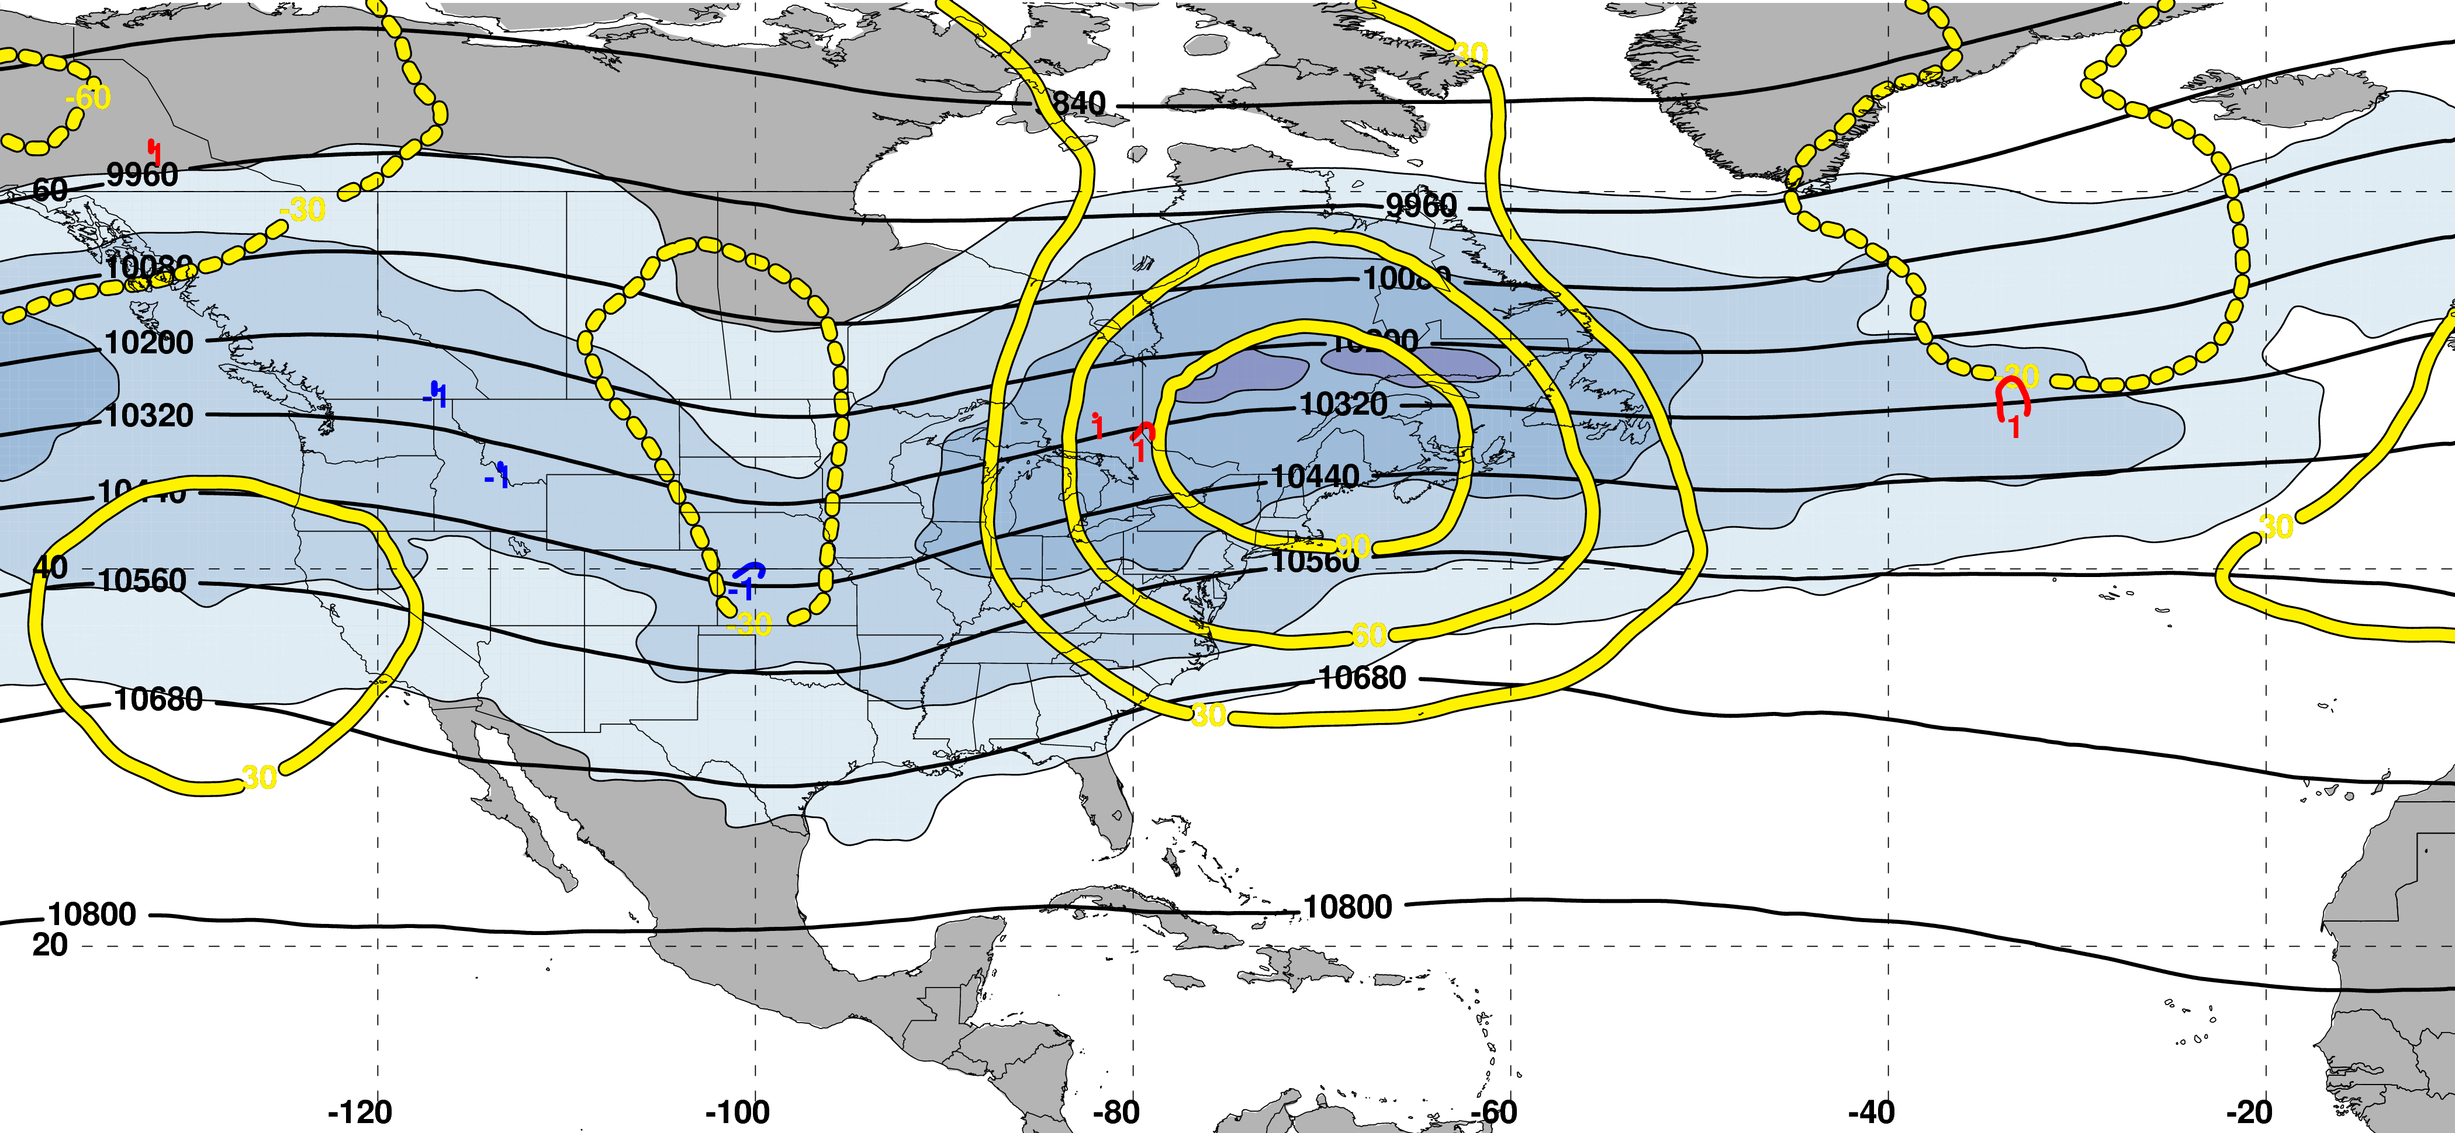
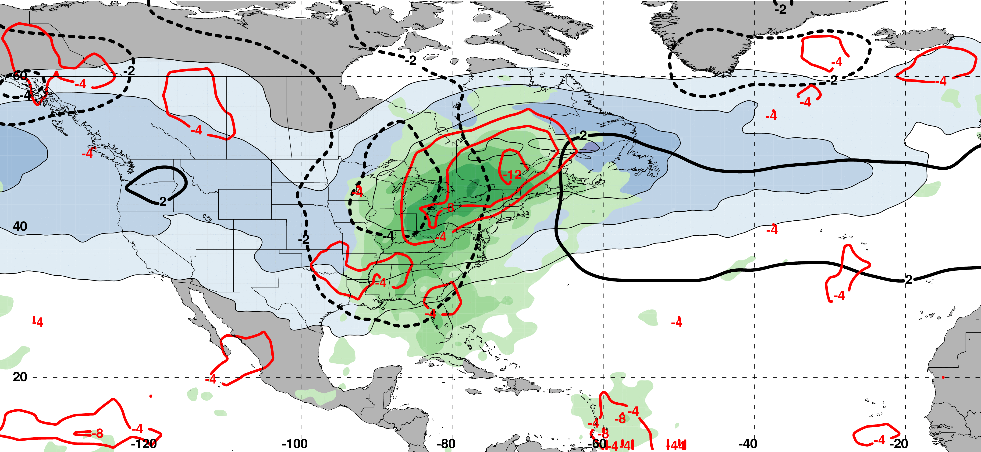
E. Subtropical Dominant Jet Superposition Events
250-hPa Jet, Geo. Height, & Geo. Height Anom., & 300-hPa Geo. Temp Adv.
250-hPa Geo. Height
300-hPa
Geo. WAA
2 Days
Prior to Jet Superposition
250-hPa Geo. Height Anom.
300-hPa
Geo. CAA
m s^{–1}
250-hPa Jet, MSLP Anom., PWAT Anom., & –OLR Anom.
L
H
N=76
MSLP Anom.
Neg. OLR
Anom.
mm

Slide 61
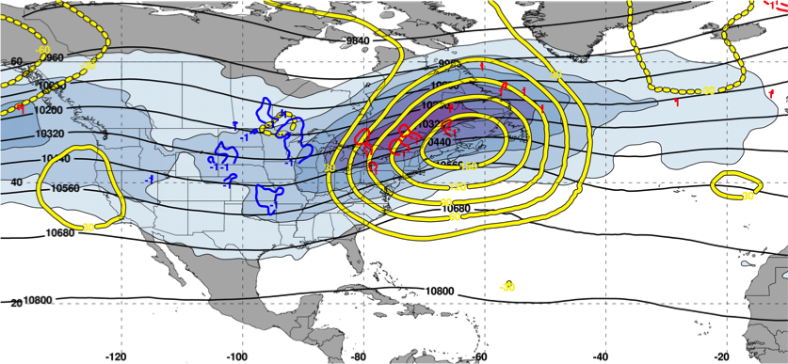
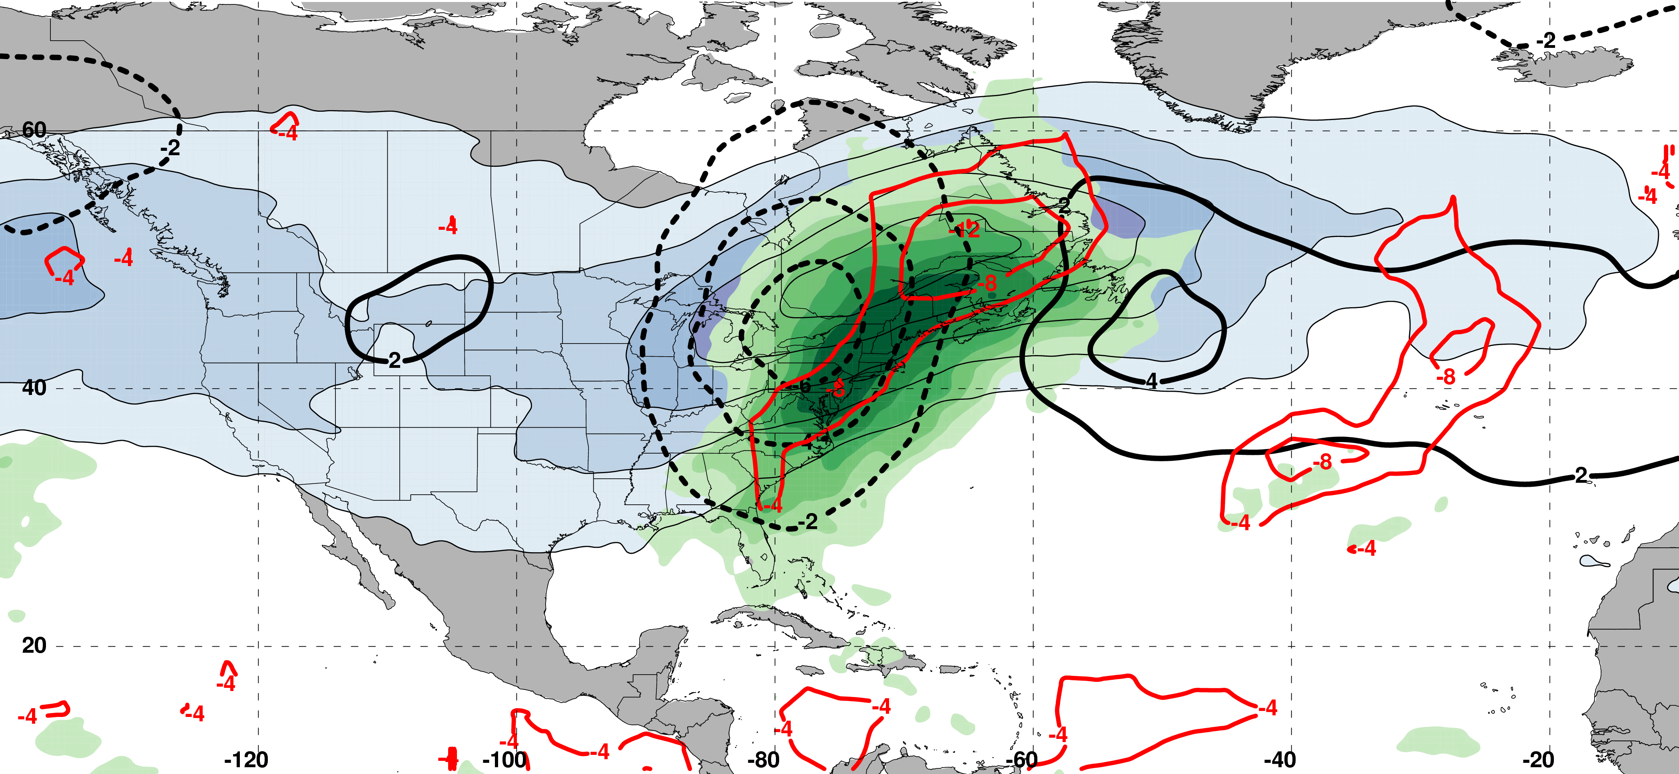
E. Subtropical Dominant Jet Superposition Events
250-hPa Jet, Geo. Height, & Geo. Height Anom., & 300-hPa Geo. Temp Adv.
250-hPa Geo. Height
300-hPa
Geo. WAA
1 Day
Prior to Jet Superposition
250-hPa Geo. Height Anom.
300-hPa
Geo. CAA
m s^{–1}
250-hPa Jet, MSLP Anom., PWAT Anom., & –OLR Anom.
L
H
N=76
MSLP Anom.
Neg. OLR
Anom.
mm

Slide 62
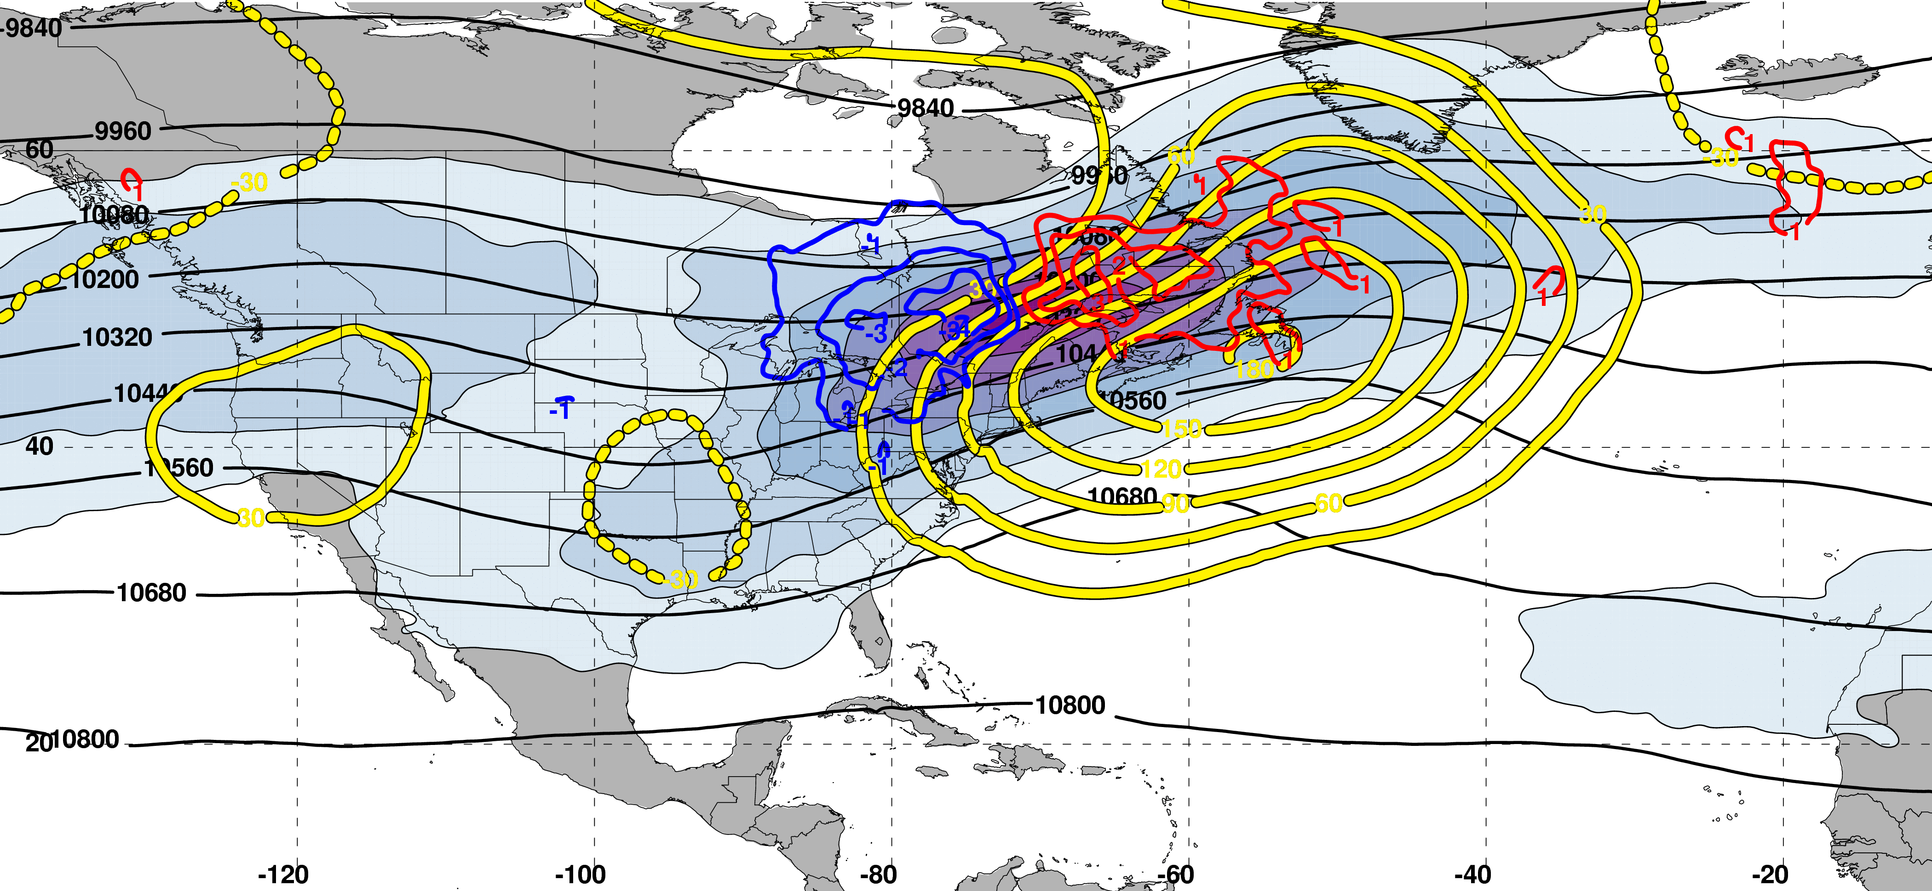
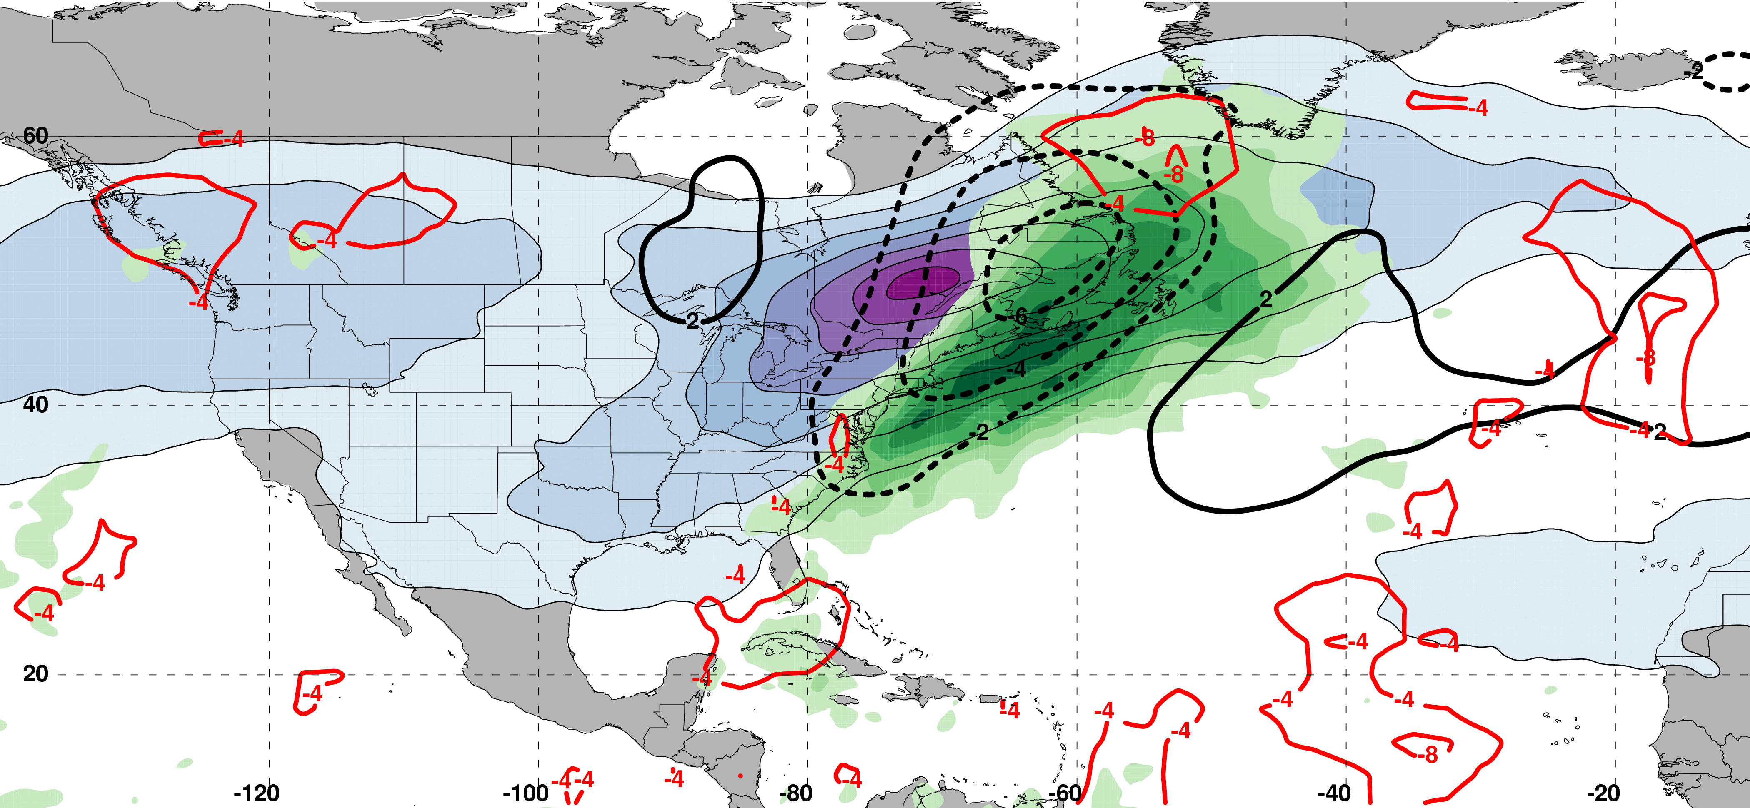
E. Subtropical Dominant Jet Superposition Events
250-hPa Jet, Geo. Height, & Geo. Height Anom., & 300-hPa Geo. Temp Adv.
250-hPa Geo. Height
300-hPa
Geo. WAA
0 Days
Prior to Jet Superposition
250-hPa Geo. Height Anom.
300-hPa
Geo. CAA
m s^{–1}
250-hPa Jet, MSLP Anom., PWAT Anom., & –OLR Anom.
L
Jet Superposition Centroid
H
N=76
MSLP Anom.
Neg. OLR
Anom.
mm

Slide 63
E. Subtropical Dominant Jet Superposition Events
250-hPa Jet, Geo. Height, & Geo. Height Anom., & 300-hPa Geo. Temp Adv.
C
250-hPa Geo. Height
300-hPa
Geo. WAA
C’
0 Days
Prior to Jet Superposition
250-hPa Geo. Height Anom.
300-hPa
Geo. CAA
m s^{–1}
250-hPa Jet, MSLP Anom., PWAT Anom., & –OLR Anom.
C
L
Jet Superposition Centroid
H
C’
N=76
MSLP Anom.
Neg. OLR
Anom.
mm

Slide 64
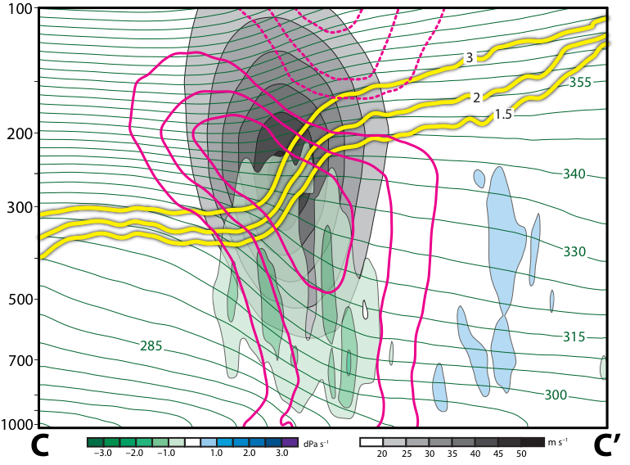
E. Subtropical Dominant Jet Superposition Events
12 Hours Prior to Jet Superposition
Legend
1.5-,2-,
3-PVU
θ
+ pert. θ
– pert. θ
ω
wind speed

Slide 65
E. Subtropical Dominant Jet Superposition Events
12 Hours Prior to Jet Superposition
Legend
Cold anomaly in the lower stratosphere and deep layer warm anomaly in the troposphere indicative of a negative PV anomaly
1.5-,2-,
3-PVU
θ
+ pert. θ
Ascent directly beneath the jet core
– pert. θ
ω
wind speed

Slide 66
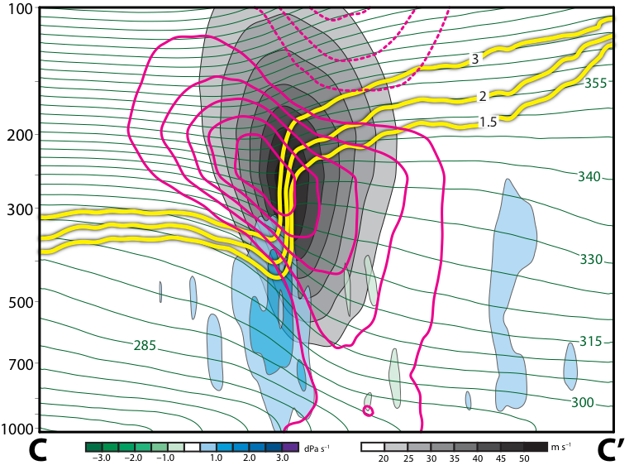
E. Subtropical Dominant Jet Superposition Events
0 Hours Prior to Jet Superposition
Legend
1.5-,2-,
3-PVU
θ
+ pert. θ
– pert. θ
ω
wind speed

Slide 67
E. Subtropical Dominant Jet Superposition Events
0 Hours Prior to Jet Superposition
Warm anomaly strengthens poleward of the jet, indicative of the arrival of a positive PV anomaly
Legend
1.5-,2-,
3-PVU
θ
+ pert. θ
Subsidence directly beneath and poleward of the jet core
– pert. θ
ω
wind speed

Slide 68
Summary

Slide 69
Summary
Polar Dominant Events:

Slide 70
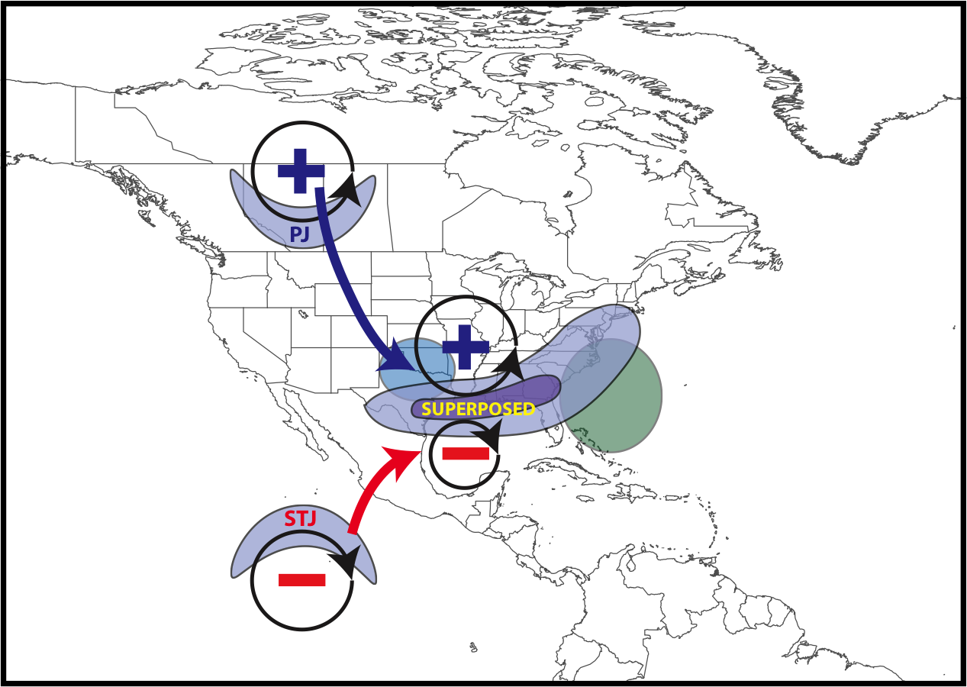
Summary
Polar Dominant Events:
Anticyclonic wave breaking event amplifies the flow over North America
QG descent beneath the jet core forced by geostrophic CAA facilitates jet superposition
Downstream precipitation slows the propagation of the upper-level trough
L
CAA
Precip.

Slide 71
Summary
East Subtropical Dominant Events:

Slide 72
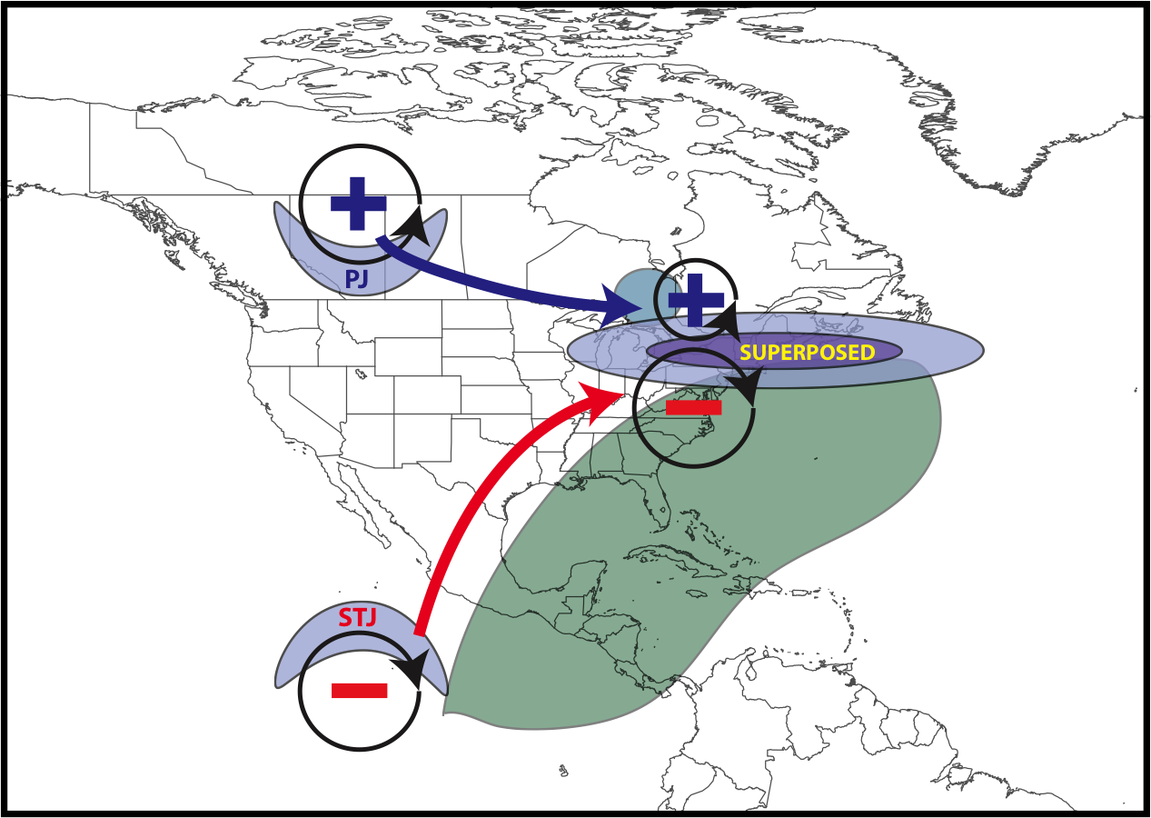
Summary
L
CAA
Antecedent moisture and precip.
East Subtropical Dominant Events:
Antecedent precipitation and southerly flow amplify ridge over eastern North America
Arrival of upper-level trough is associated with geostrophic CAA at the time of jet superposition
Geostrophic CAA forces QG descent beneath the jet core and completes jet superposition

Slide 73
Future Work
Apply piecewise PV inversion (e.g., Davis and Emanuel 1991) to quantify the influence that polar cyclonic and tropical anticyclonic PV anomalies have on deforming the tropopause during each type of superposition event.
Examine the impact that each type of jet superposition event has on the evolution of the downstream large-scale flow pattern.
Utilize numerical simulations of jet superposition events to examine the sensitivity of jet superposition to diabatic processes.
Further illuminate the connection between jet superposition events and high-impact weather events (e.g., severe weather, cyclogenesis, floods).

Slide 74
Supplementary Slides

Slide 75
References
Cavallo, S. M., and G. J. Hakim, 2010: Composite structure of tropopause polar cyclones. Mon. Wea. Rev., 138, 3840−3857.
Christenson, C. E., and J. E. Martin, 2012: The large-scale environment associated with the 25−28 April 2011 severe weather outbreak. 16th NWA Severe Storms and Doppler Radar Conference, Des Moines, IA, National Weather Association, 31 March 2012.
Christenson, C. E., J. E. Martin, and Z. J. Handlos, 2017: A synoptic-climatology of Northern Hemisphere, cold season polar and subtropical jet superposition events. J. Climate, 30, 7231-7246.
Defant, F., and H. Taba, 1957: The threefold structure of the atmosphere and the characteristics of the tropopause. Tellus, 9, 259-275.
Lang, A. A., and J. E. Martin, 2012: The structure and evolution of lower stratospheric frontal zones. Part I: Examples in northwesterly and southwesterly flow. Quart. J. Roy. Meteor. Soc., 138, 1350-1365.
Knupp, K. R., T. A. Murphy, T. A. Coleman, R. A. Wade, S. A. Mullins, C. J. Schultz, E. V. Schultz, L. Carey, A. Sherrer, E. W. McCaul Jr., B. Carcione, S. Latimer, A. Kula, K. Laws, P. T. Marsh, and K. Klockow, 2014: Meteorological overview of the devastating 27 April 2011 Tornado Outbreak. Bull. Amer. Meteor. Soc., 95, 1041−1062.
Moore, B. J., P. J. Neiman, F. M. Ralph, and F. E. Barthold, 2012: Physical processes associated with heavy flooding rainfall in Nashville, Tennessee, and vicinity during 1-2 May 2010: The role of an atmospheric river and mesoscale convective systems. Mon. Wea. Rev., 140, 358-378.
Pyle, M. E., D. Keyser, and L. F. Bosart, 2004: A diagnostic study of jet streaks: Kinematic signatures and relationship to coherent tropopause disturbances. Mon. Wea. Rev., 132, 297−319.
Saha, S. and co-authors, 2014: The NCEP Climate Forecast System Version 2. J. Climate, 27, 2185−2208.
Winters, A. C., and J. E. Martin, 2014: The role of a polar/subtropical jet superposition in the May 2010 Nashville Flood. Wea. Forecasting, 29, 954–974.
Winters, A. C. and J. E. Martin, 2016: Synoptic and mesoscale processes supporting vertical superposition of the polar and subtropical jets in two contrasting cases. Quart. J. Roy. Meteor. Soc., 142, 1133–1149.
Winters, A. C., and J. E. Martin, 2017: Diagnosis of a North American polar/subtropical jet superposition employing potential vorticity inversion. Mon. Wea. Rev.,145, 1853-1873.

Slide 76
Jet Superposition Event Identification

Slide 77
Jet Superposition Event Identification
Sample Jet Superposition Centroid Calculation
Calculated the centroid of each jet superposition based on all valid grid points at a particular analysis time.
To calculate the centroid, there must exist a group of 18 superposition grid points, of which no superposition grid point is >1000 km away from another superposition grid point.
d >1000 km
d >1000 km
d >1000 km
Used for calculation
Jet superposition centroid
Not used for calculation

Slide 78
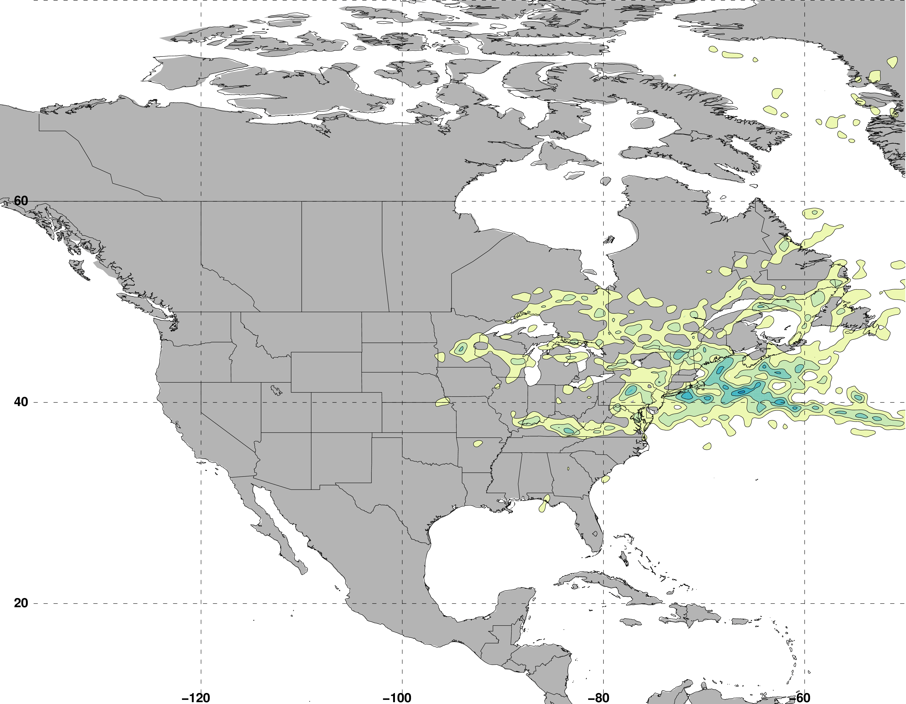
Jet Superposition Event Identification
Frequency of East Subtropical Dominant Jet Superposition Events
N = 76
Legend
Centroid of all events
Composite movement of superposition

Slide 79
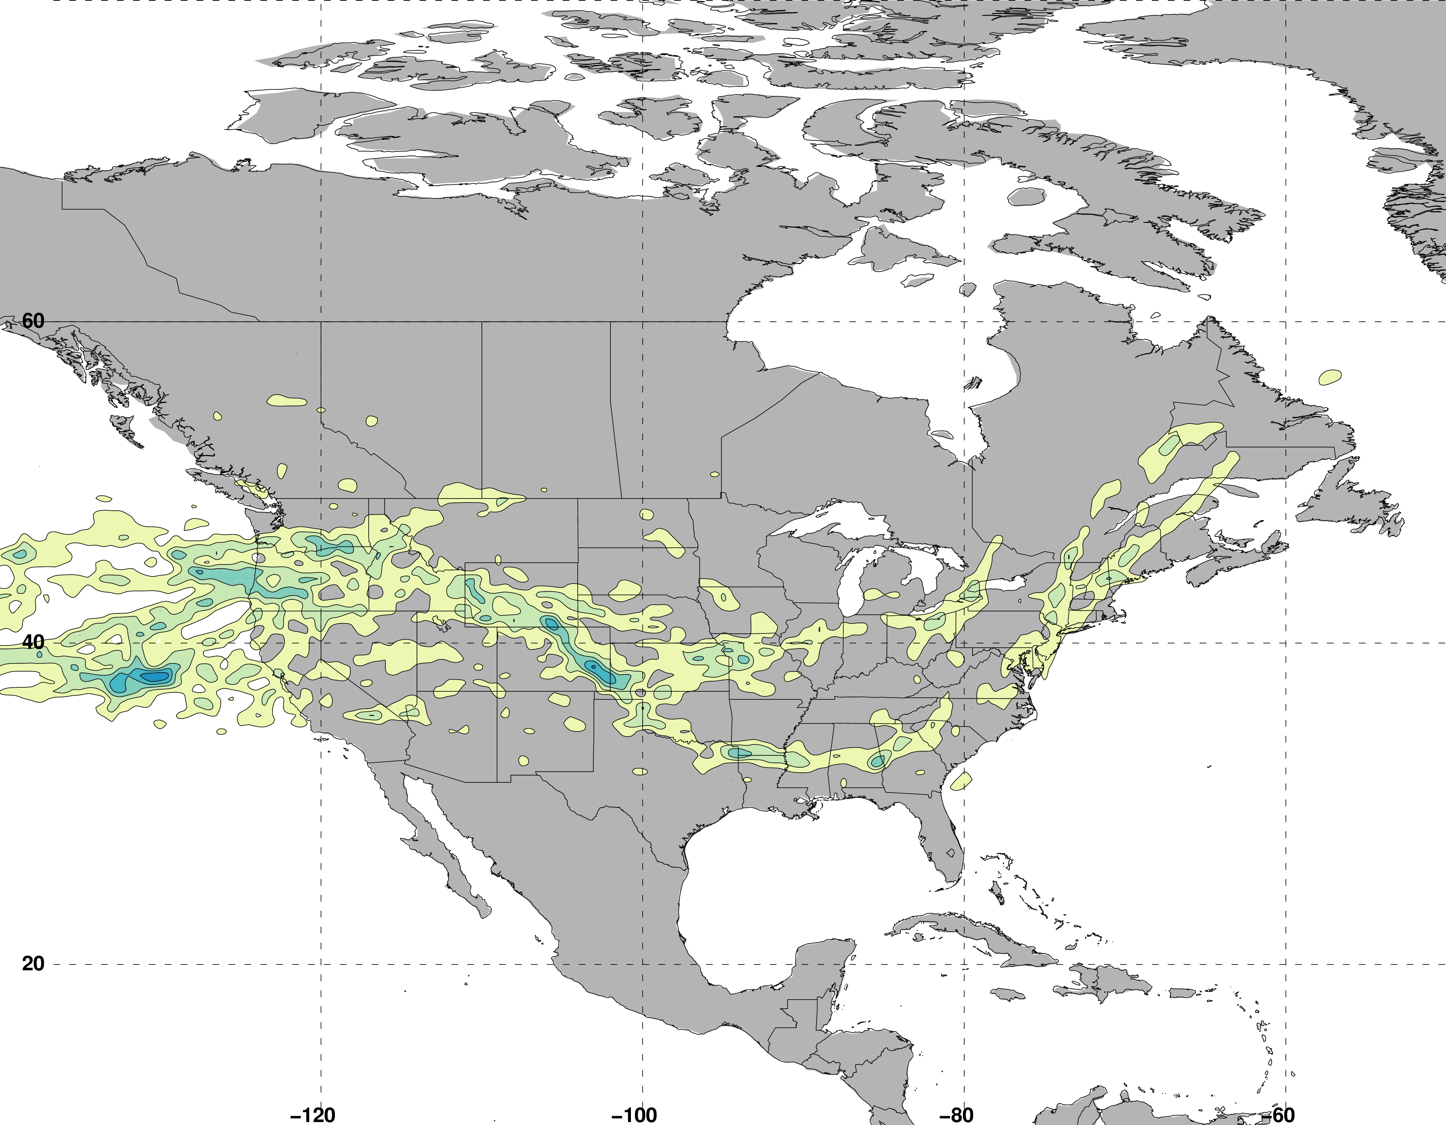
Jet Superposition Event Identification
Frequency of West Subtropical Dominant Jet Superposition Events
N = 53
Legend
Centroid of all events
Composite movement of superposition

Slide 80
Jet Superposition Event Classification

Slide 81
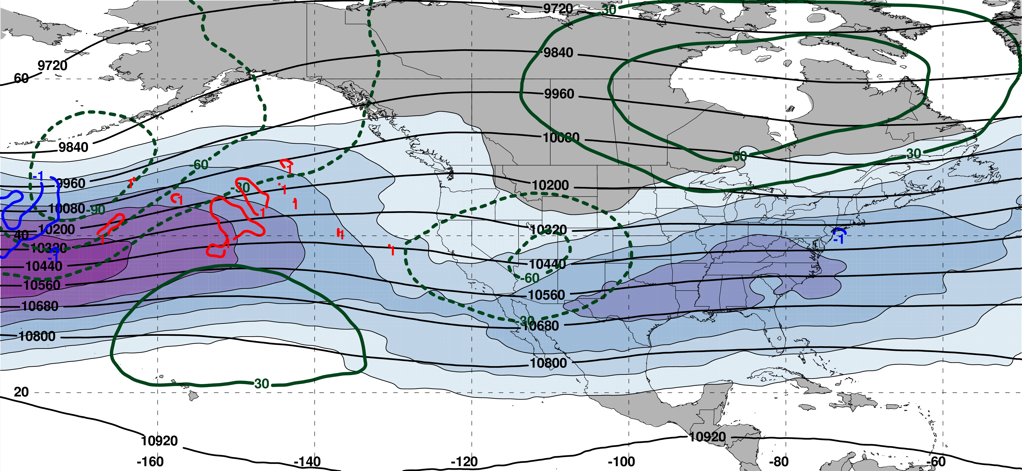
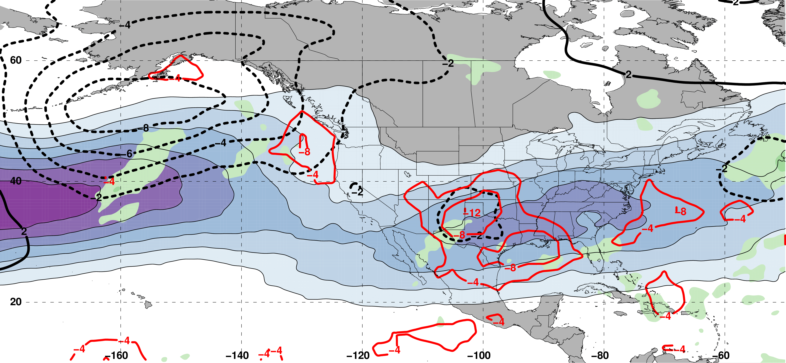
Polar Dominant Jet Superposition Events
250-hPa Jet, Geo. Height, & Geo. Height Anom., & 300-hPa Geo. Temp Adv.
3 Days
Prior to Jet Superposition
m s^{–1}
250-hPa Jet, MSLP Anom., PWAT Anom., & OLR Anom.
N=80
mm

Slide 82
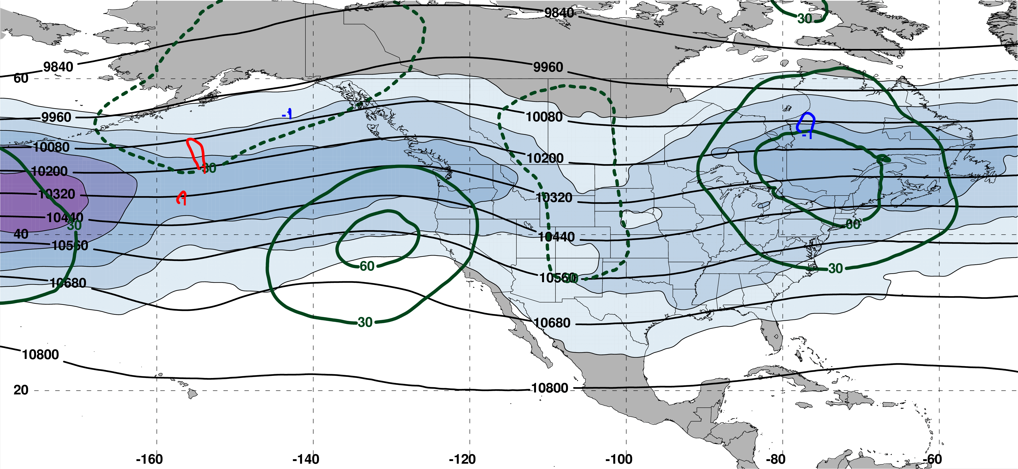
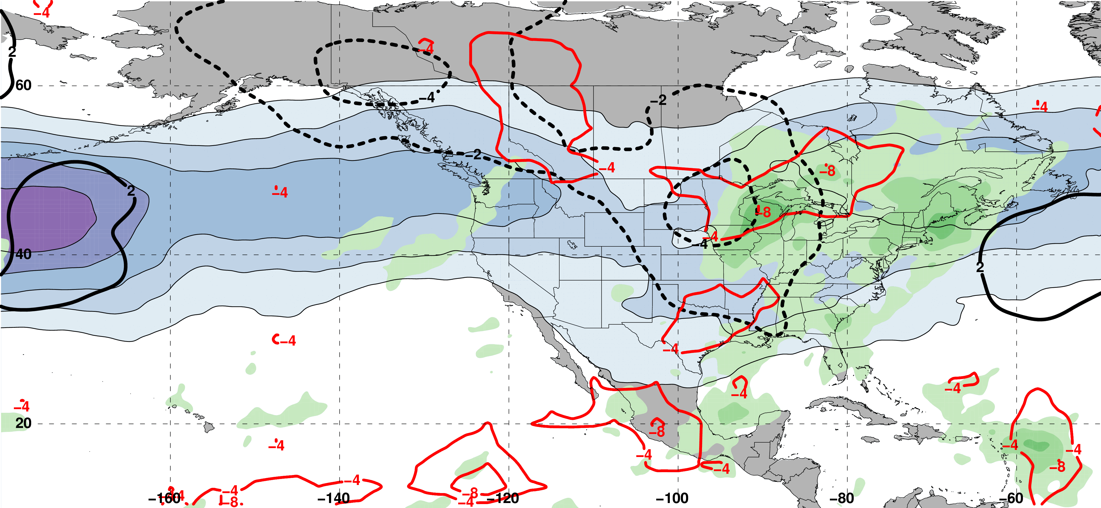
E. Subtropical Dominant Jet Superposition Events
250-hPa Jet, Geo. Height, & Geo. Height Anom., & 300-hPa Geo. Temp Adv.
3 Days
Prior to Jet Superposition
m s^{–1}
250-hPa Jet, MSLP Anom., PWAT Anom., & OLR Anom.
N=76
mm

Slide 83
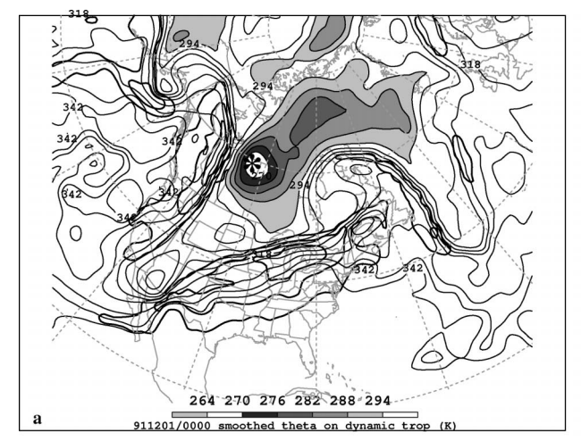
Jet Superposition Conceptual Model
Dynamic Tropopause Potential Temperature
Pyle et al. (2004)

Slide 84
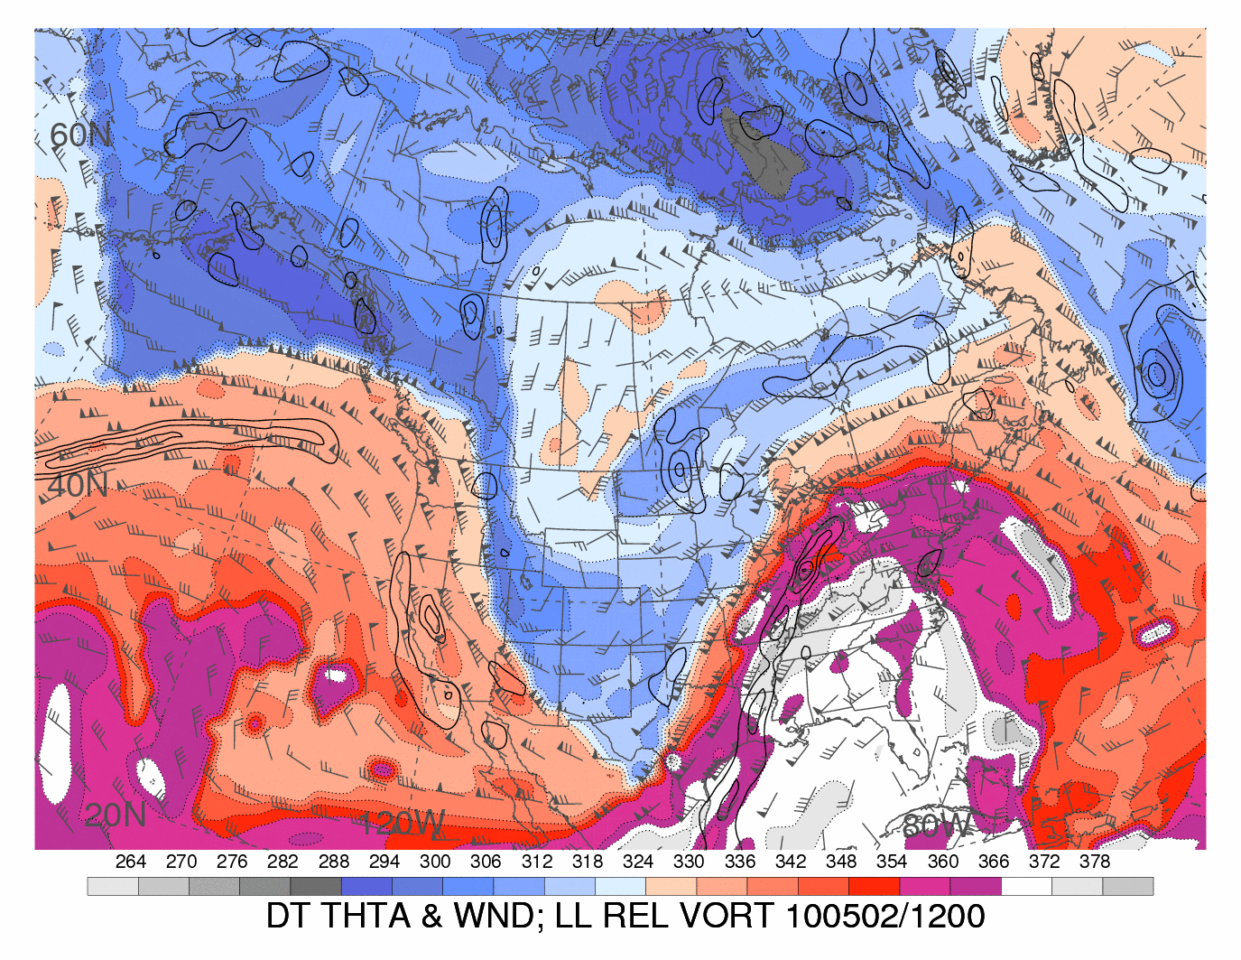
Jet Superposition Conceptual Model
Dynamic Tropopause Potential Temperature
Heather Archambault

Slide 85
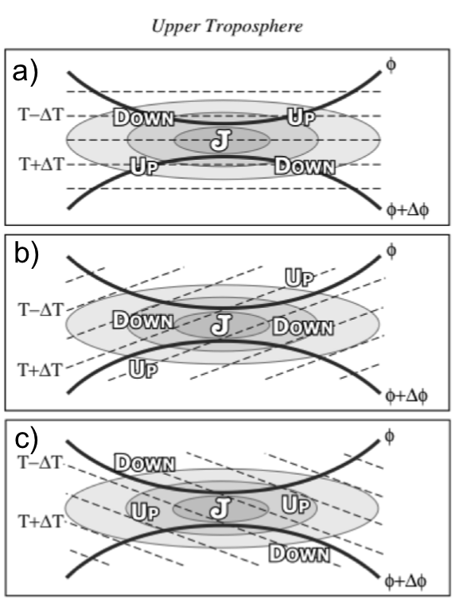
Ageostrophic Transverse Jet Circulations
Traditional four-quadrant model
Geo. cold-air advection (CAA) along the jet axis promotes subsidence through the jet core
Geo. warm-air advection (WAA) along the jet axis promotes
ascent through the jet core
Lang and Martin (2012)

Slide 86
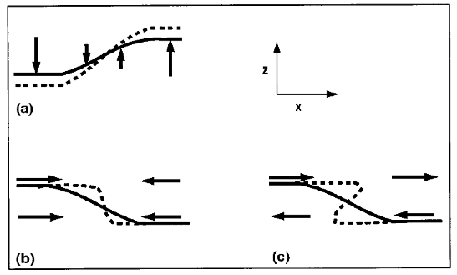
Background
Insight into how the tropopause can be restructured from a PV perspective can be found by consulting Wandishin et al. (2000)
Two processes can account for “foldogenesis”:
Differential vertical motions can vertically steepen the tropopause.
Convergence or a vertical shear can produce a differential horizontal advection of the tropopause surface.
Wandishin et al. 2000
These same mechanisms are also likely to play an important role in superpositions.

Slide 87

Background
Christenson et al. (2017)

