Slide 1
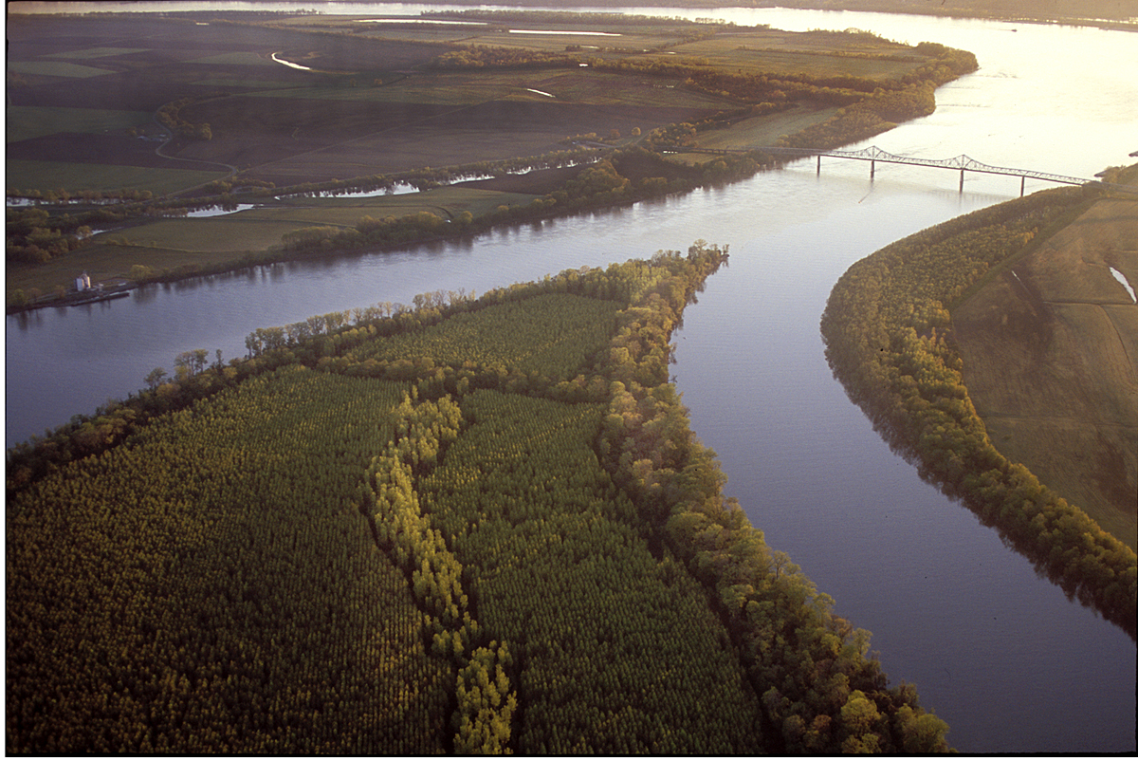


Antecedent Synoptic Environments
Most Conducive to North American
Polar/Subtropical Jet Superpositions
Andrew C. Winters
School of Marine and Atmospheric Sciences
Stony Brook University
Stony Brook, NY
10 April 2019
This work is funded by an NSF-PRF (AGS-1624316)

Slide 2
Superposition represents the “merger” of two separate, rapidly-moving air streams

Slide 3
Background
Modified from Defant and Taba (1957)
Pressure (hPa)

Slide 4
Background
STJ
Modified from Defant and Taba (1957)
Subtropical Jet
STJ
Pressure (hPa)

Slide 5
Background
STJ
Modified from Defant and Taba (1957)
Subtropical Jet
PJ
Polar Jet
STJ
Pressure (hPa)
PJ

Slide 6
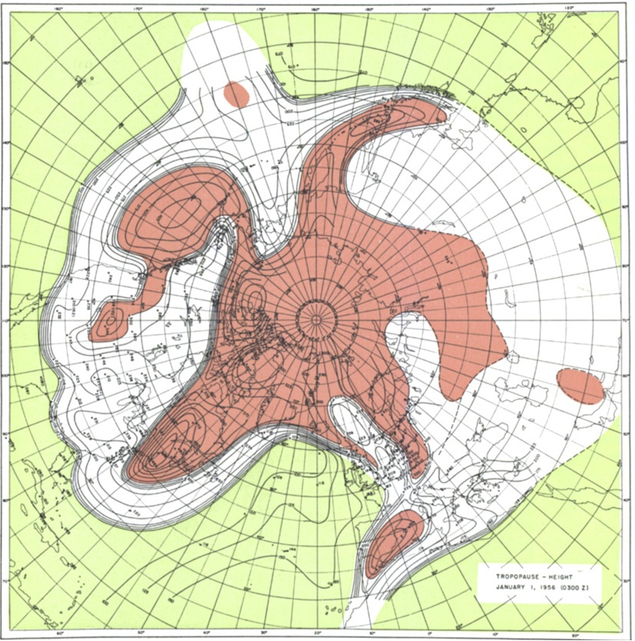
Background
Tropopause Pressure (hPa)
Stony Brook
NP
North Pole
Maps of tropopause pressure help to identify the location of the jets.
While each jet occupies its own climatological latitude band, substantial meanders are common.
STJ
PJ
NP
Tropical Tropopause
Subtropical Tropopause
Polar Tropopause
Modified from Defant and Taba (1957)

Slide 7
Background
Tropopause Pressure (hPa)
Stony Brook
NP
North Pole
Maps of tropopause pressure help to identify the location of the jets.
While each jet occupies its own climatological latitude band, substantial meanders are common.
Occasionally, the latitudinal separation between the jets can vanish resulting in a vertical jet superposition.
STJ
PJ
NP
Tropical Tropopause
Subtropical Tropopause
Polar Tropopause
Modified from Defant and Taba (1957)

Slide 8
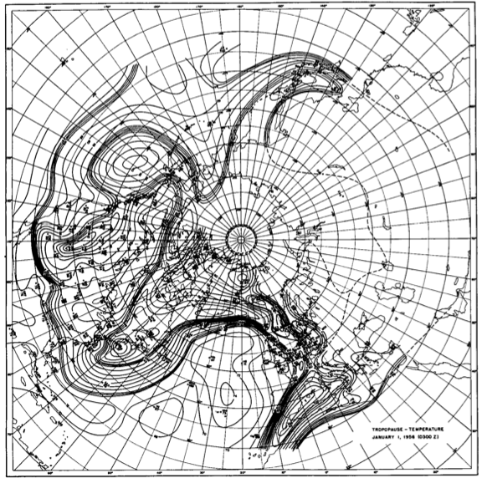
Background
Tropopause Temperature (ºC)
Stony Brook
NP
North Pole
The pole-to-equator baroclinicity is combined into a much narrower zone of contrast in the vicinity of a jet superposition.
Intensified frontal structure is often attended by a strengthening of the superposed jet’s transverse circulation.
STJ
PJ
NP
Modified from Defant and Taba (1957)

Slide 9
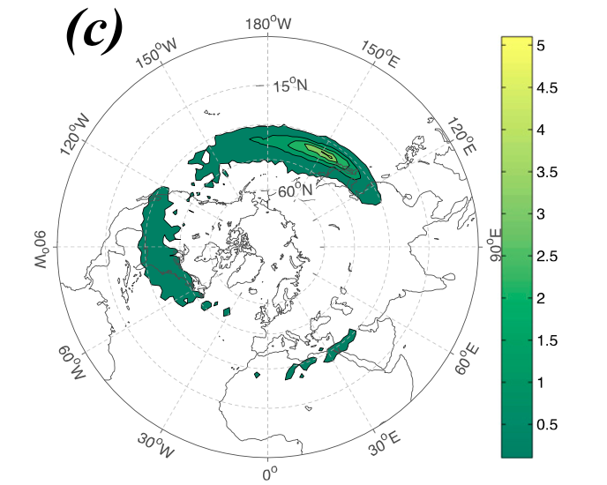
Background
Christenson et al. (2017) highlight three locations that experience the greatest frequency of
jet superpositions:
1) Western Pacific
2) North America
3) Northern Africa
Climatological frequency of Northern Hemisphere jet superposition events per cold season (Nov–Mar) 1960–2010
Number of Events
Christenson et al. (2017)

Slide 10
Background
Christenson et al. (2017) highlight three locations that experience the greatest frequency of
jet superpositions:
1) Western Pacific
2) North America
3) Northern Africa
Climatological frequency of Northern Hemisphere jet superposition events per cold season (Nov–Mar) 1960–2010
Number of Events
Christenson et al. (2017)

Slide 11

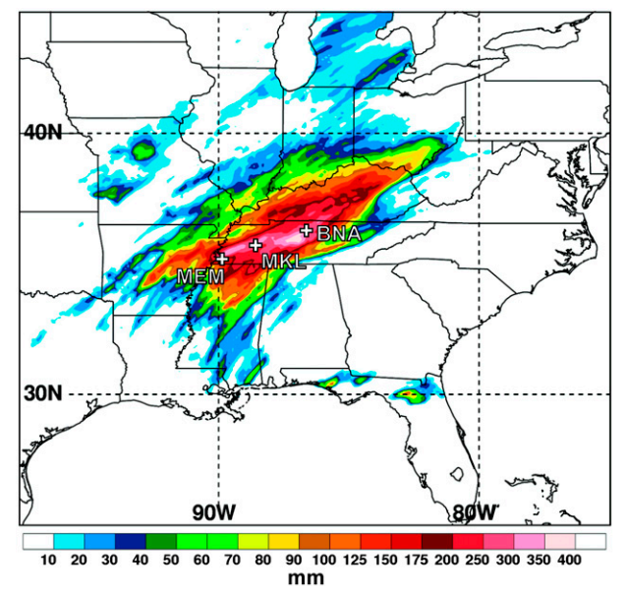
Jet Superpositions and High-Impact Weather
The Tennessean
Jet superpositions can be an element of high-impact weather events
1–3 May 2010 Nashville Flood
Jet superposition enhanced the poleward moisture transport via its ageostrophic circulation (Winters and Martin 2014; 2016).
Moore et al. (2012)

Slide 12
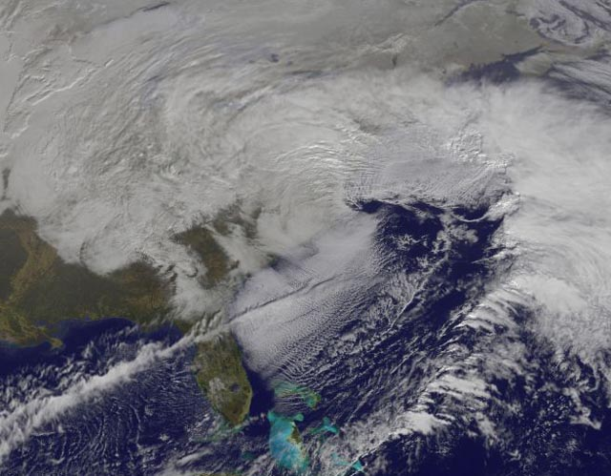
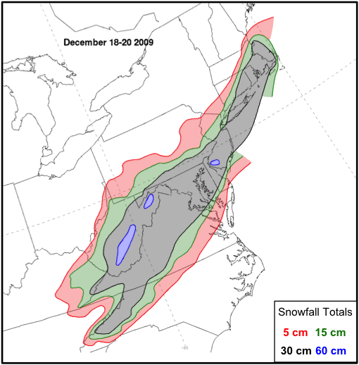
Jet Superpositions and High-Impact Weather
NASA
Jet superpositions can be an element of high-impact weather events
1–3 May 2010 Nashville Flood
Jet superposition enhanced the poleward moisture transport via its ageostrophic circulation (Winters and Martin 2014; 2016).
18–20 December 2009 Mid-Atlantic Blizzard
Jet superposition was associated with a rapidly deepening East Coast cyclone (Winters and Martin 2016; 2017).
Winters and Martin (2016)

Slide 13
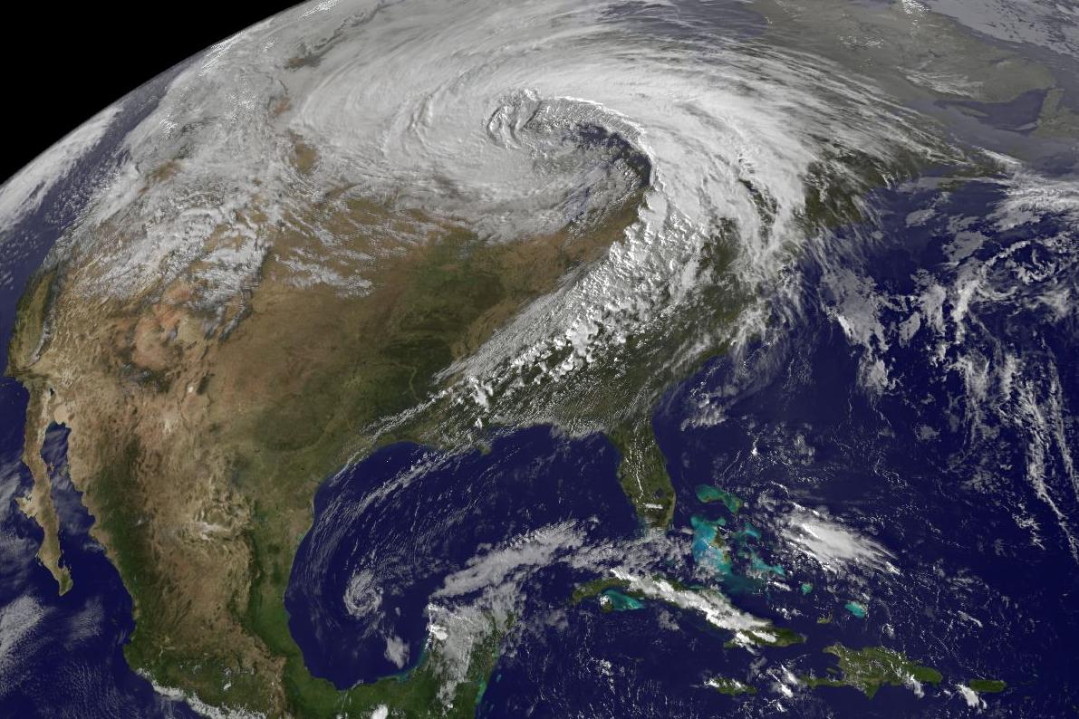
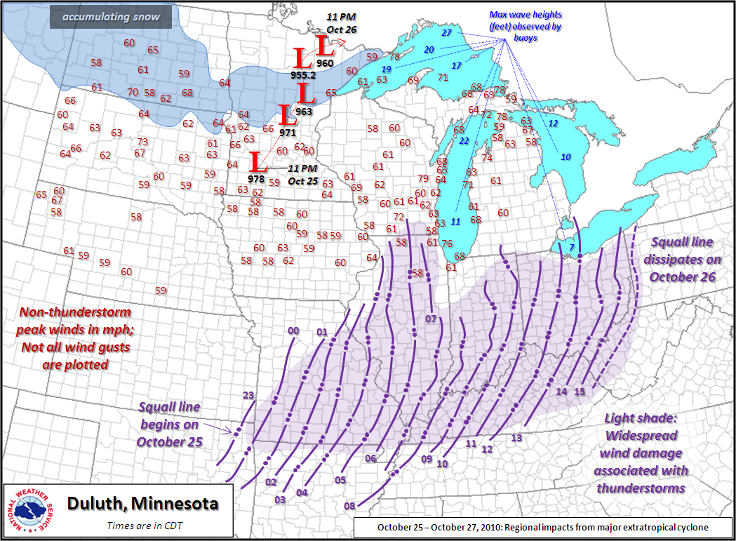
Jet Superpositions and High-Impact Weather
Jet superpositions can be an element of high-impact weather events
1–3 May 2010 Nashville Flood
Jet superposition enhanced the poleward moisture transport via its ageostrophic circulation (Winters and Martin 2014; 2016).
18–20 December 2009 Mid-Atlantic Blizzard
Jet superposition was associated with a rapidly deepening East Coast cyclone (Winters and Martin 2016; 2017).
26 October 2010: Explosive Cyclogenesis Event
Jet superposition over the West Pacific preceded the development of an intense Midwest U.S. cyclone.
NASA
NWS

Slide 14
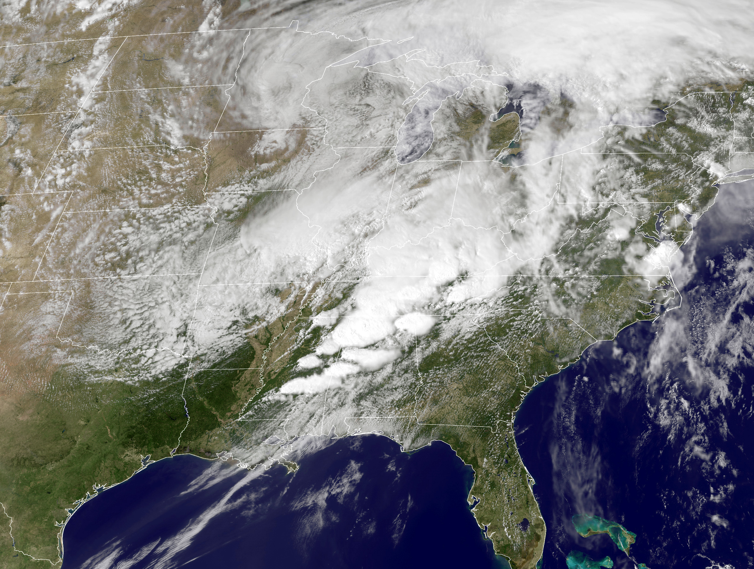
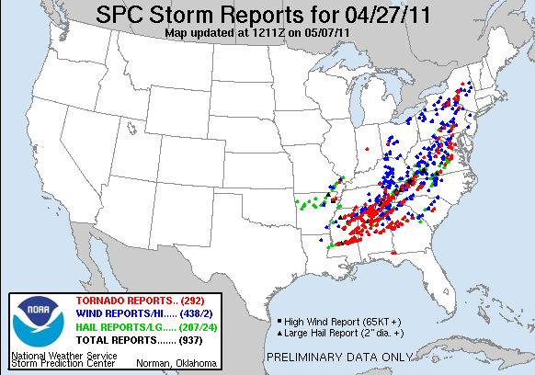
Jet Superpositions and High-Impact Weather
Jet superpositions can be an element of high-impact weather events
1–3 May 2010 Nashville Flood
Jet superposition enhanced the poleward moisture transport via its ageostrophic circulation (Winters and Martin 2014; 2016).
18–20 December 2009 Mid-Atlantic Blizzard
Jet superposition was associated with a rapidly deepening East Coast cyclone (Winters and Martin 2016; 2017).
26 October 2010: Explosive Cyclogenesis Event
Jet superposition over the West Pacific preceded the development of an intense Midwest U.S. cyclone.
25–28 April 2011 Tornado Outbreak
Jet superposition occurred over the West Pacific prior to the outbreak (Knupp et al. 2014; Christenson and Martin 2012).
NASA
SPC

Slide 15
Jet Superpositions and High-Impact Weather
Jet superpositions can be an element of high-impact weather events
1–3 May 2010 Nashville Flood
Jet superposition enhanced the poleward moisture transport via its ageostrophic circulation (Winters and Martin 2014; 2016).
18–20 December 2009 Mid-Atlantic Blizzard
Jet superposition was associated with a rapidly deepening East Coast cyclone (Winters and Martin 2016; 2017).
26 October 2010: Explosive Cyclogenesis Event
Jet superposition over the West Pacific preceded the development of an intense Midwest U.S. cyclone.
25–28 April 2011 Tornado Outbreak
Jet superposition occurred over the West Pacific prior to the outbreak (Knupp et al. 2014; Christenson and Martin 2012).
How do these structures develop?

Slide 16
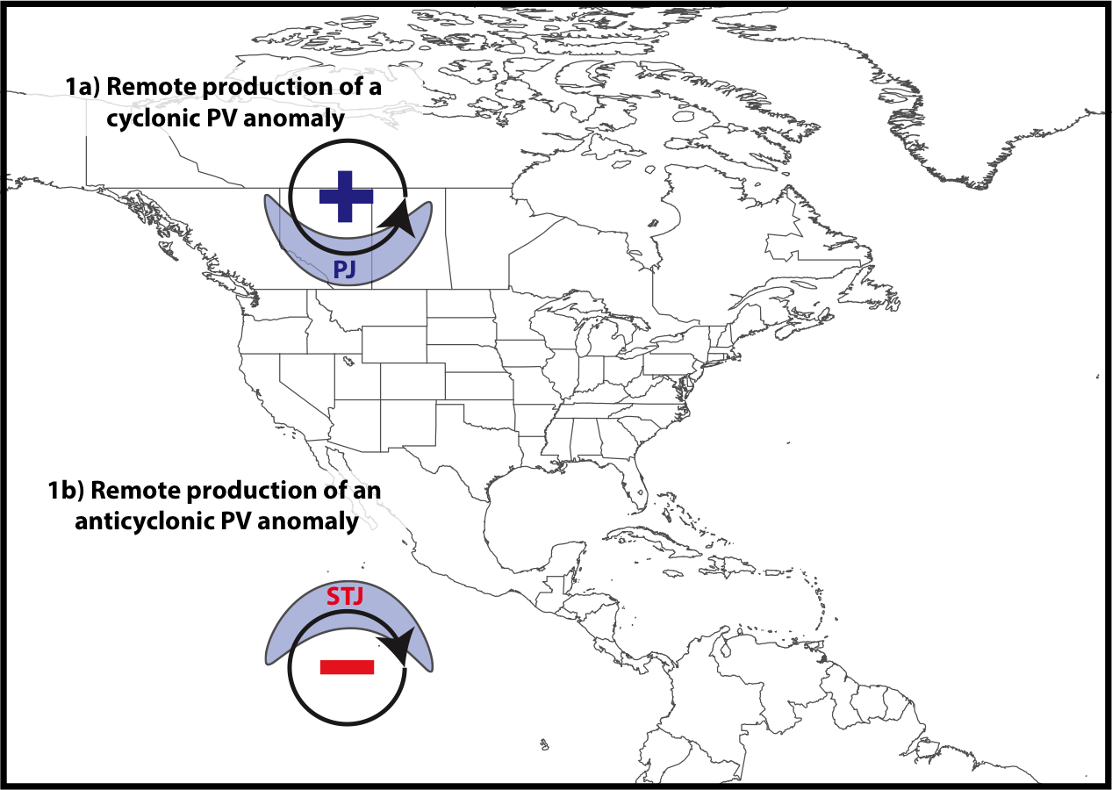
Jet Superposition Conceptual Model
Winters and Martin (2017)

Slide 17
Jet Superposition Conceptual Model
Polar cyclonic PV anomalies:
Often referred to as coherent tropopause disturbances (Pyle et al. 2004) or tropopause polar vortices (Cavallo and Hakim 2010).
Typify a dynamical environment conducive to midlatitude cyclogenesis.
Winters and Martin (2017)

Slide 18
Jet Superposition Conceptual Model
Winters and Martin (2017)

Slide 19
Jet Superposition Conceptual Model
Tropical anticyclonic PV anomalies:
Typify a thermodynamic environment characterized by weak upper-tropospheric static stability.
Atmospheric rivers often form within the poleward-directed branch of their circulation.
Winters and Martin (2017)

Slide 20
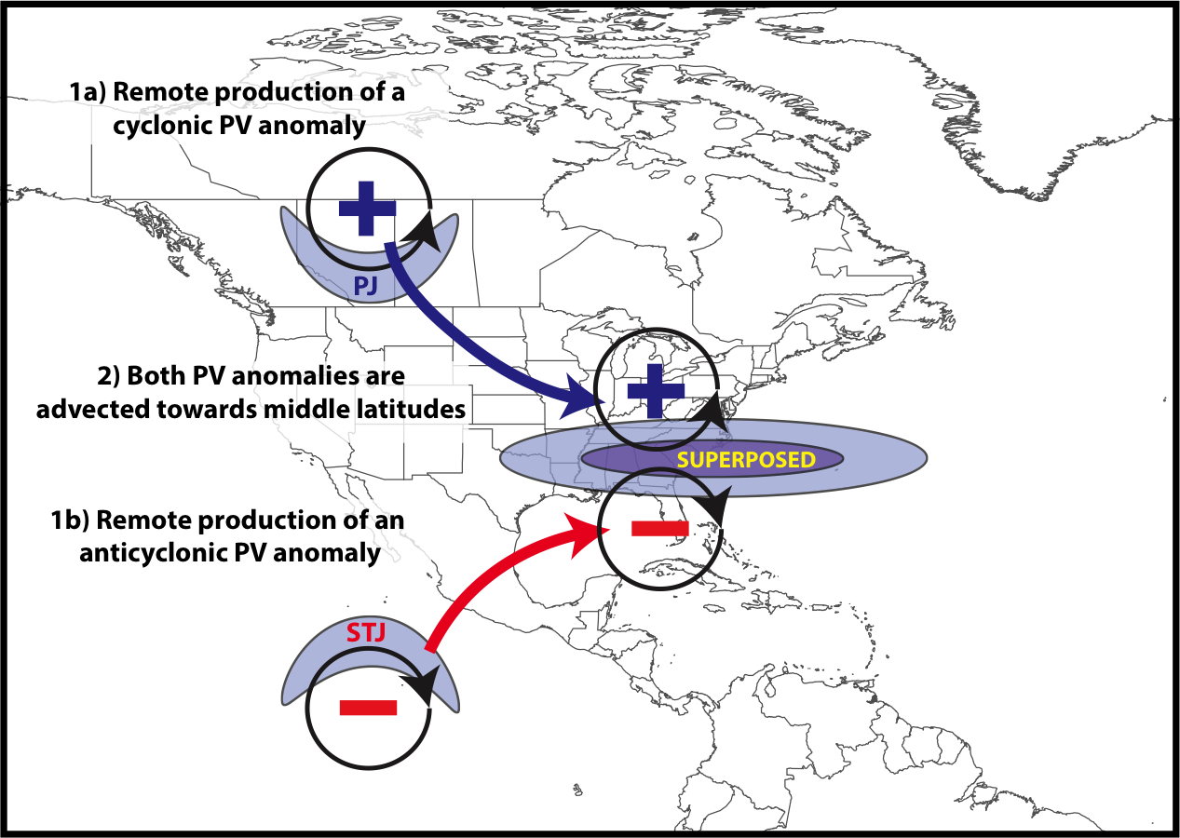
Jet Superposition Conceptual Model
Winters and Martin (2017)

Slide 21
Jet Superposition Conceptual Model
A
A’
Winters and Martin (2017)

Slide 22
Jet Superposition Conceptual Model
A
1200 UTC 20 Dec 2009
2-PVU contour
Potential Temp.
Wind Speed
A’
Winters and Martin (2017)

Slide 23
Jet Superposition Conceptual Model
The relative importance of these PV anomalies is highly variable between jet superposition events
Winters and Martin (2017)

Slide 24
Jet Superposition Conceptual Model
GOAL: To determine the characteristic types of interaction that exist between upper-tropospheric PV anomalies during jet superposition events
Winters and Martin (2017)

Slide 25
Jet Superposition Event Identification and Classification

Slide 26
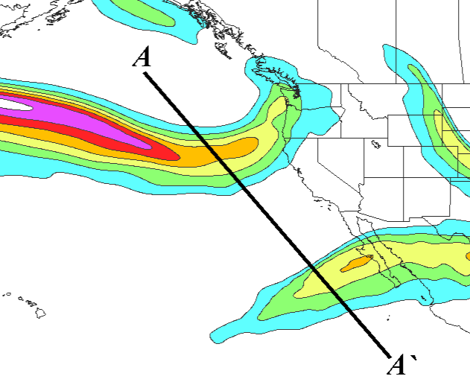
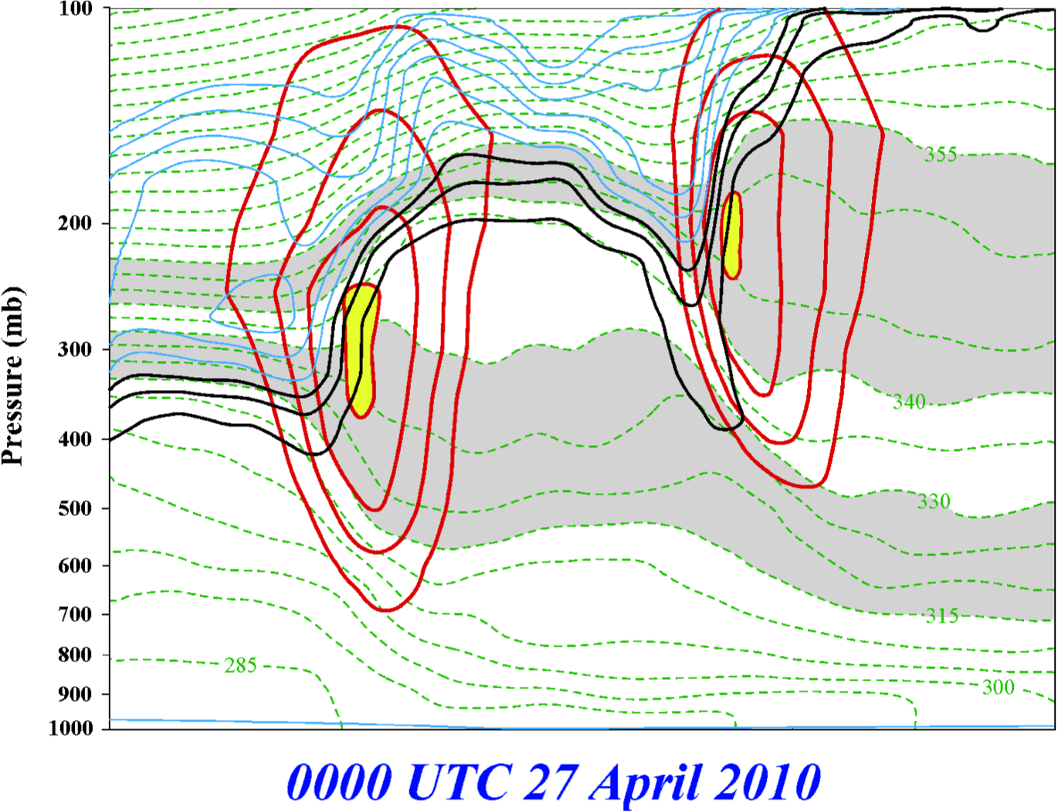
Jet Superposition Event Identification
0000 UTC 27 April 2010
A
PJ
STJ
STJ
A’
250-hPa wind speed
PJ
Isolated grid points over North America in the CFSR (Saha et al. 2014) characterized by polar and subtropical jets during Nov–Mar
1979–2010.
Isotachs
Potential Temp.
1,2,3-PVU contours
A
A’
Winters and Martin (2014, 2016, 2017); Christenson et al. (2017); Handlos and Martin (2016)

Slide 27
Jet Superposition Event Identification
0000 UTC 27 April 2010
A
PJ
STJ
A’
250-hPa wind speed
Isolated grid points over North America in the CFSR (Saha et al. 2014) characterized by polar and subtropical jets during Nov–Mar
1979–2010.
Isotachs
Potential Temp.
1,2,3-PVU contours
Strong horizontal PV gradient within the 1–3-PVU channel in the 315–330-K isentropic layer
A
A’
Winters and Martin (2014, 2016, 2017); Christenson et al. (2017); Handlos and Martin (2016)

Slide 28
Jet Superposition Event Identification
0000 UTC 27 April 2010
A
PJ
STJ
A’
250-hPa wind speed
Isolated grid points over North America in the CFSR (Saha et al. 2014) characterized by polar and subtropical jets during Nov–Mar
1979–2010.
Isotachs
Potential Temp.
1,2,3-PVU contours
Integrated 400–100-hPa wind speed must exceed 30 m s^{–1}
A
A’
Winters and Martin (2014, 2016, 2017); Christenson et al. (2017); Handlos and Martin (2016)

Slide 29
Jet Superposition Event Identification
0000 UTC 27 April 2010
A
PJ
PJ ID’s
STJ
A’
PJ
250-hPa wind speed
Isolated grid points over North America in the CFSR (Saha et al. 2014) characterized by polar and subtropical jets during Nov–Mar
1979–2010.
Isotachs
Potential Temp.
1,2,3-PVU contours
A
A’
Winters and Martin (2014, 2016, 2017); Christenson et al. (2017); Handlos and Martin (2016)

Slide 30
Jet Superposition Event Identification
0000 UTC 27 April 2010
A
PJ
PJ ID’s
STJ
A’
250-hPa wind speed
Isolated grid points over North America in the CFSR (Saha et al. 2014) characterized by polar and subtropical jets during Nov–Mar
1979–2010.
Isotachs
Potential Temp.
1,2,3-PVU contours
Strong horizontal PV gradient within the 1–3-PVU channel in the 340–355-K isentropic layer
A
A’
Winters and Martin (2014, 2016, 2017); Christenson et al. (2017); Handlos and Martin (2016)

Slide 31
Jet Superposition Event Identification
0000 UTC 27 April 2010
A
PJ
PJ ID’s
STJ
A’
250-hPa wind speed
Isolated grid points over North America in the CFSR (Saha et al. 2014) characterized by polar and subtropical jets during Nov–Mar
1979–2010.
Isotachs
Potential Temp.
1,2,3-PVU contours
Integrated 400–100-hPa wind speed must exceed 30 m s^{–1}
A
A’
Winters and Martin (2014, 2016, 2017); Christenson et al. (2017); Handlos and Martin (2016)

Slide 32
Jet Superposition Event Identification
0000 UTC 27 April 2010
A
PJ
STJ
PJ ID’s
STJ
STJ ID’s
A’
250-hPa wind speed
Isolated grid points over North America in the CFSR (Saha et al. 2014) characterized by polar and subtropical jets during Nov–Mar
1979–2010.
Isotachs
Potential Temp.
1,2,3-PVU contours
A
A’
Winters and Martin (2014, 2016, 2017); Christenson et al. (2017); Handlos and Martin (2016)

Slide 33
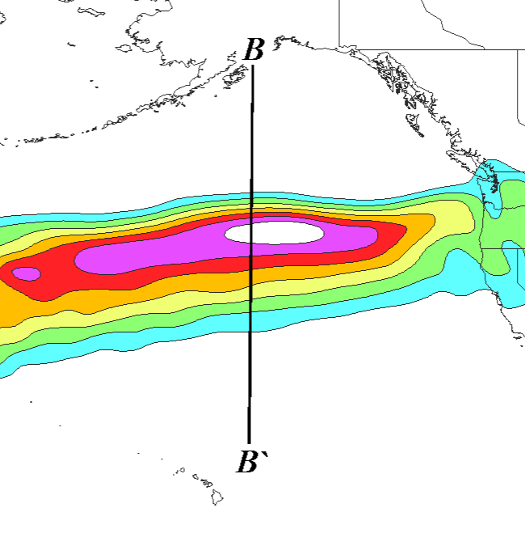
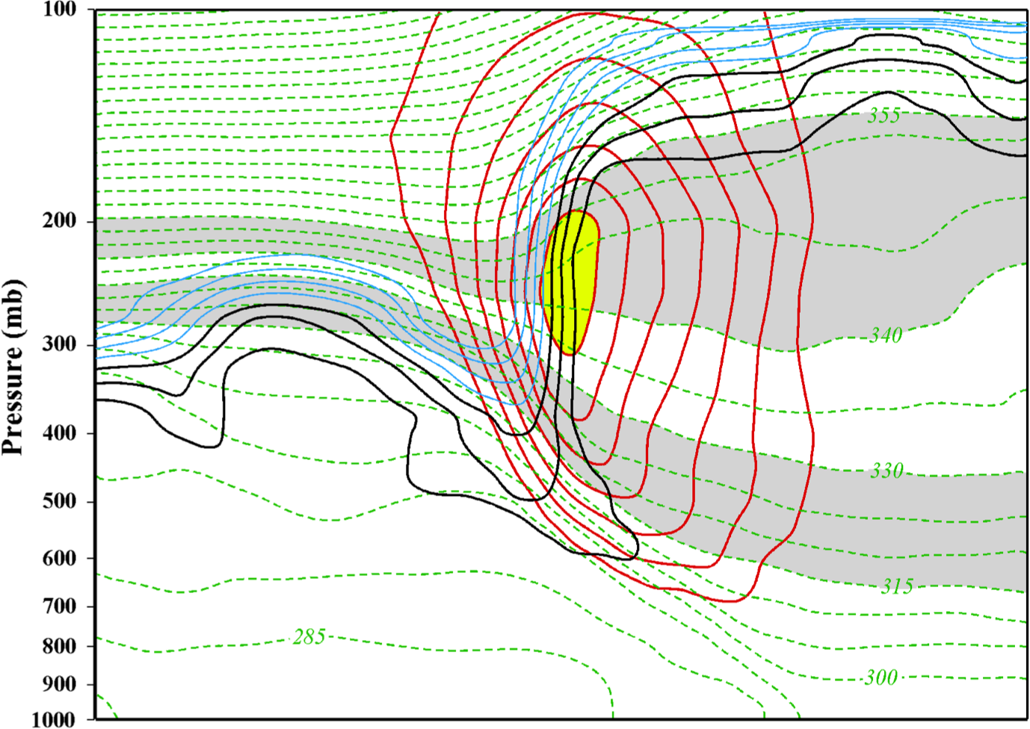
Jet Superposition Event Identification
0000 UTC 24 October 2010
B
SUPJ
B’
250-hPa wind speed
Isolated grid points over North America in the CFSR (Saha et al. 2014) characterized by a jet superposition during Nov–Mar
1979–2010.
Isotachs
Potential Temp.
1,2,3-PVU contours
B
B’
Winters and Martin (2014, 2016, 2017); Christenson et al. (2017); Handlos and Martin (2016)

Slide 34
Jet Superposition Event Identification
0000 UTC 24 October 2010
B
SUPJ
B’
250-hPa wind speed
Isolated grid points over North America in the CFSR (Saha et al. 2014) characterized by a jet superposition during Nov–Mar
1979–2010.
Isotachs
Potential Temp.
1,2,3-PVU contours
Criteria for both the polar and subtropical jets satisfied within the same grid column
B
B’
Winters and Martin (2014, 2016, 2017); Christenson et al. (2017); Handlos and Martin (2016)

Slide 35
Jet Superposition Event Identification
0000 UTC 24 October 2010
B
SUPJ
B’
250-hPa wind speed
Isolated grid points over North America in the CFSR (Saha et al. 2014) characterized by a jet superposition during Nov–Mar
1979–2010.
Isotachs
Potential Temp.
1,2,3-PVU contours
Criteria for both the polar and subtropical jets satisfied within the same grid column
B
B’
Winters and Martin (2014, 2016, 2017); Christenson et al. (2017); Handlos and Martin (2016)

Slide 36
Jet Superposition Event Identification
0000 UTC 24 October 2010
B
SUPJ
B’
SUPJ
SUPJ ID’s
250-hPa wind speed
Isolated grid points over North America in the CFSR (Saha et al. 2014) characterized by a jet superposition during Nov–Mar
1979–2010.
Isotachs
Potential Temp.
1,2,3-PVU contours
Criteria for both the polar and subtropical jets satisfied within the same grid column
B
B’
Winters and Martin (2014, 2016, 2017); Christenson et al. (2017); Handlos and Martin (2016)

Slide 37
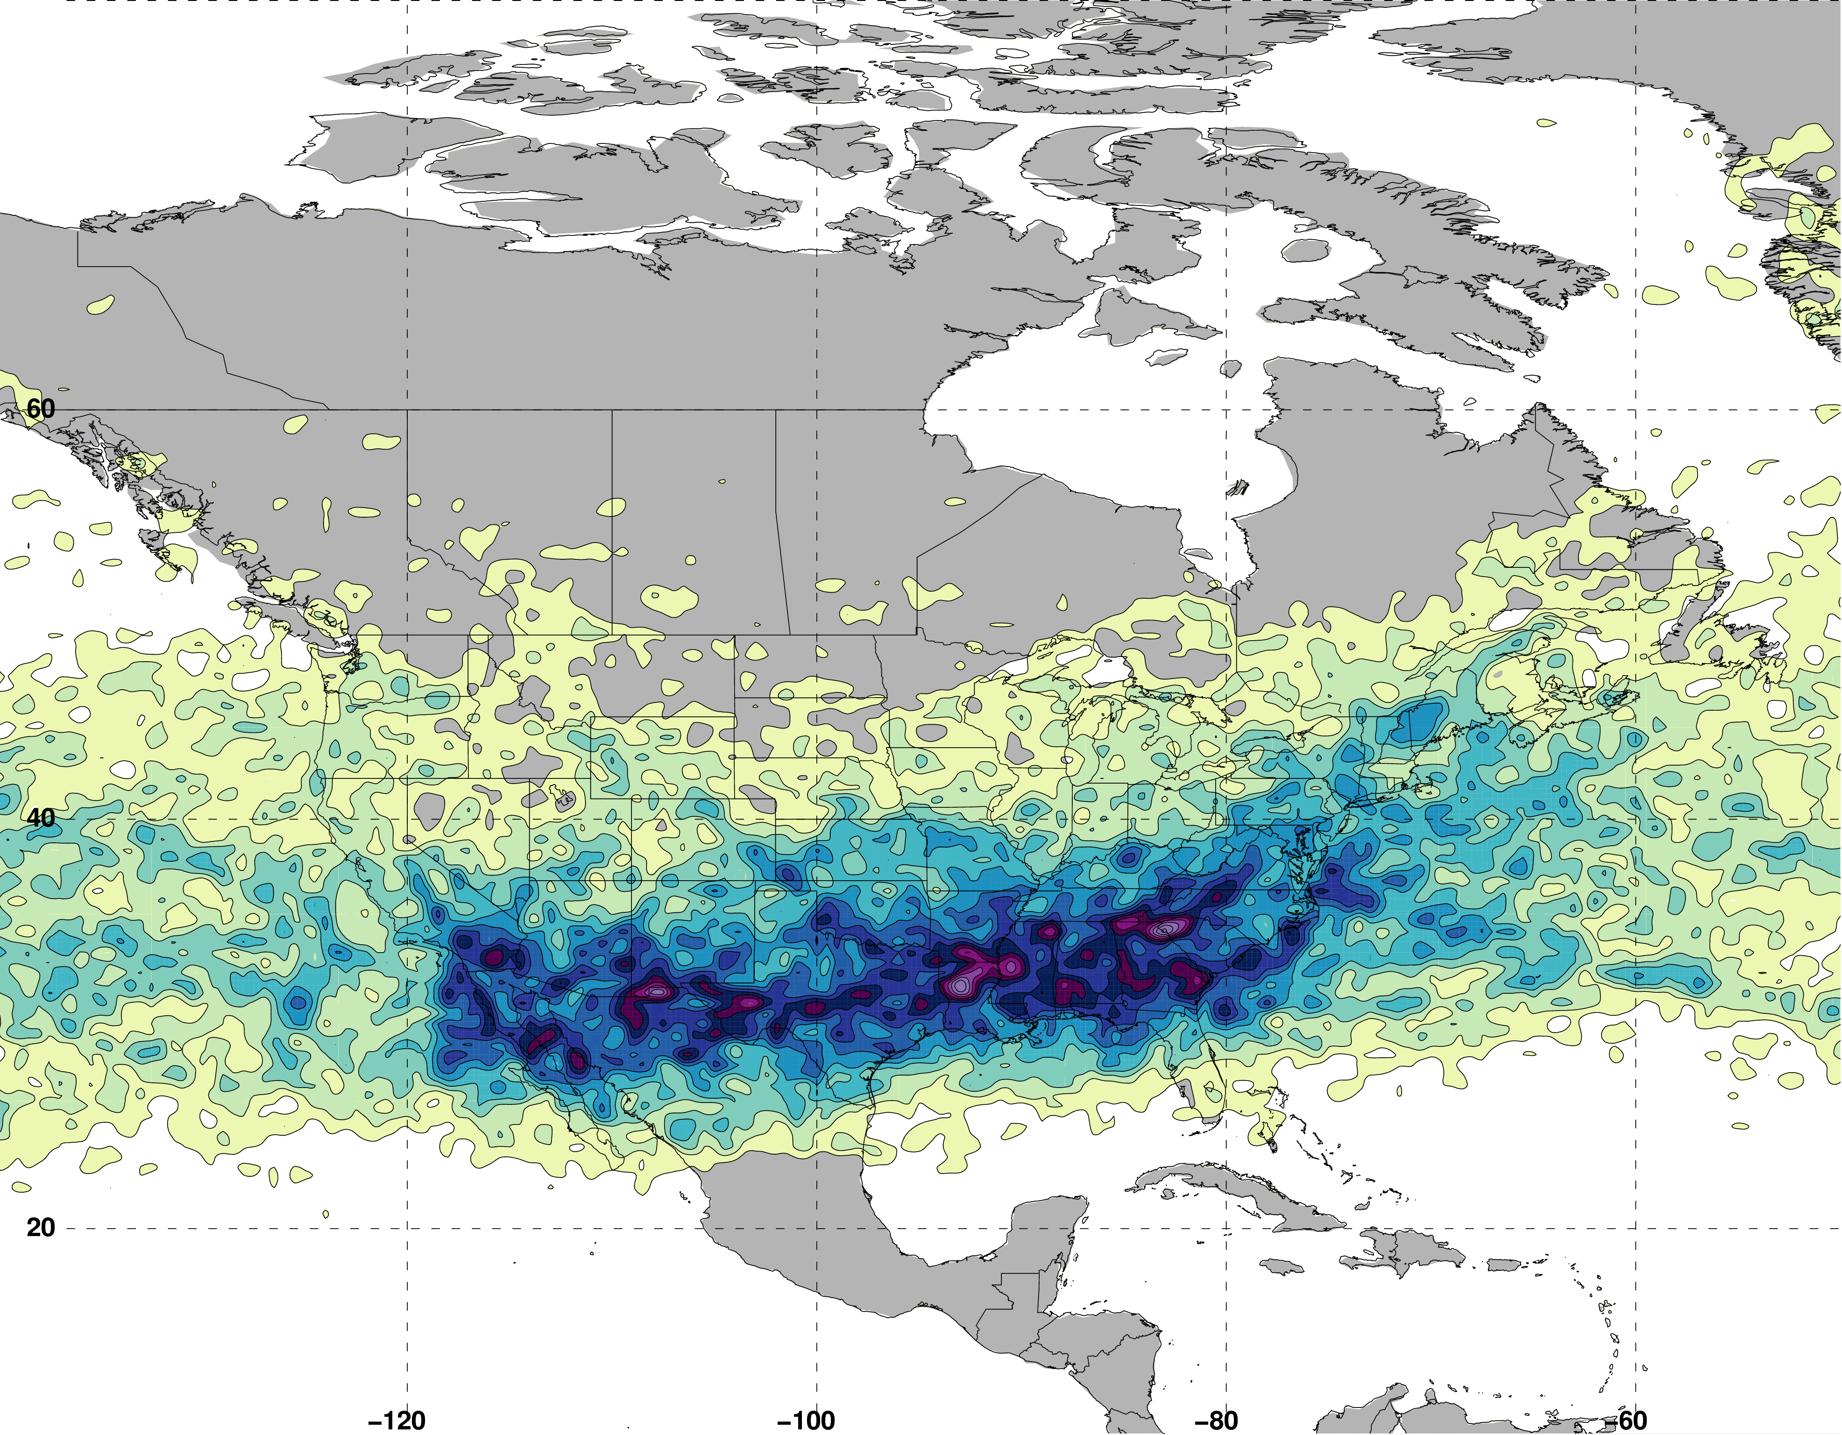
Jet Superposition Event Identification
Isolated grid points over North America in the CFSR (Saha et al. 2014) characterized by a jet superposition during Nov–Mar 1979–2010.
Jet Superposition Frequency – All Times
N = 61660

Slide 38
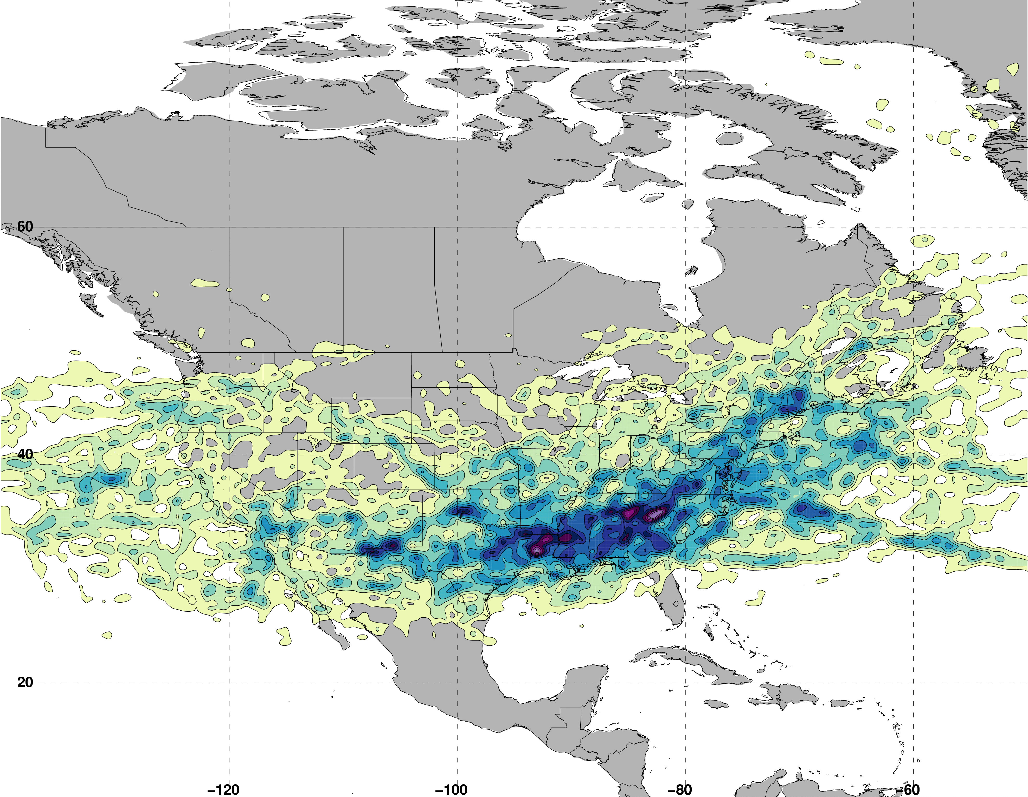
Jet Superposition Event Identification
Isolated grid points over North America in the CFSR (Saha et al. 2014) characterized by a jet superposition during Nov–Mar 1979–2010.
Retained analysis times that rank in the top 10% in terms the number of grid points characterized by a jet superposition.
Jet Superposition Frequency – Top 10% Times
N = 19485

Slide 39
Jet Superposition Event Identification
Isolated grid points over North America in the CFSR (Saha et al. 2014) characterized by a jet superposition during Nov–Mar 1979–2010.
Retained analysis times that rank in the top 10% in terms the number of grid points characterized by a jet superposition.
Filtered retained analysis times to group together jet superpositions that are < 30 h and < 1500 km apart.
Jet Superposition Frequency – Top 10% Times
N = 19485
326 unique jet superposition events

Slide 40
Jet Superposition Event Classification
Determined the mean position of the 2-PVU contour on the 320-K and 350-K surfaces at each analysis time in the CFSR.
0000 UTC 1 January

Slide 41
Jet Superposition Event Classification
Determined the mean position of the 2-PVU contour on the 320-K and 350-K surfaces at each analysis time in the CFSR.
0000 UTC 1 January
Polar Jet
Subtropical Jet

Slide 42
Jet Superposition Event Classification
Determined the mean position of the 2-PVU contour on the 320-K and 350-K surfaces at each analysis time in the CFSR.
Compared the position of the jet superposition centroid at the start of each event against the climatological position of the 2-PVU contour.
0000 UTC 1 January

Slide 43
Jet Superposition Event Classification
Determined the mean position of the 2-PVU contour on the 320-K and 350-K surfaces at each analysis time in the CFSR.
Compared the position of the jet superposition centroid at the start of each event against the climatological position of the 2-PVU contour.
Polar Dominant
0000 UTC 1 January
Jet Superposition Centroid

Slide 44
Jet Superposition Event Classification
Determined the mean position of the 2-PVU contour on the 320-K and 350-K surfaces at each analysis time in the CFSR.
Compared the position of the jet superposition centroid at the start of each event against the climatological position of the 2-PVU contour.
Polar Dominant
Subtropical Dominant
0000 UTC 1 January
Jet Superposition Centroid

Slide 45
Jet Superposition Event Classification
Determined the mean position of the 2-PVU contour on the 320-K and 350-K surfaces at each analysis time in the CFSR.
Compared the position of the jet superposition centroid at the start of each event against the climatological position of the 2-PVU contour.
Polar Dominant
Subtropical Dominant
Hybrid
0000 UTC 1 January
Jet Superposition Centroid

Slide 46
Climatological Characteristics of
Jet Superposition Events

Slide 47
Jet Superposition Event Characteristics

Slide 48
Jet Superposition Event Characteristics

Slide 49
Jet Superposition Event Characteristics

Slide 50
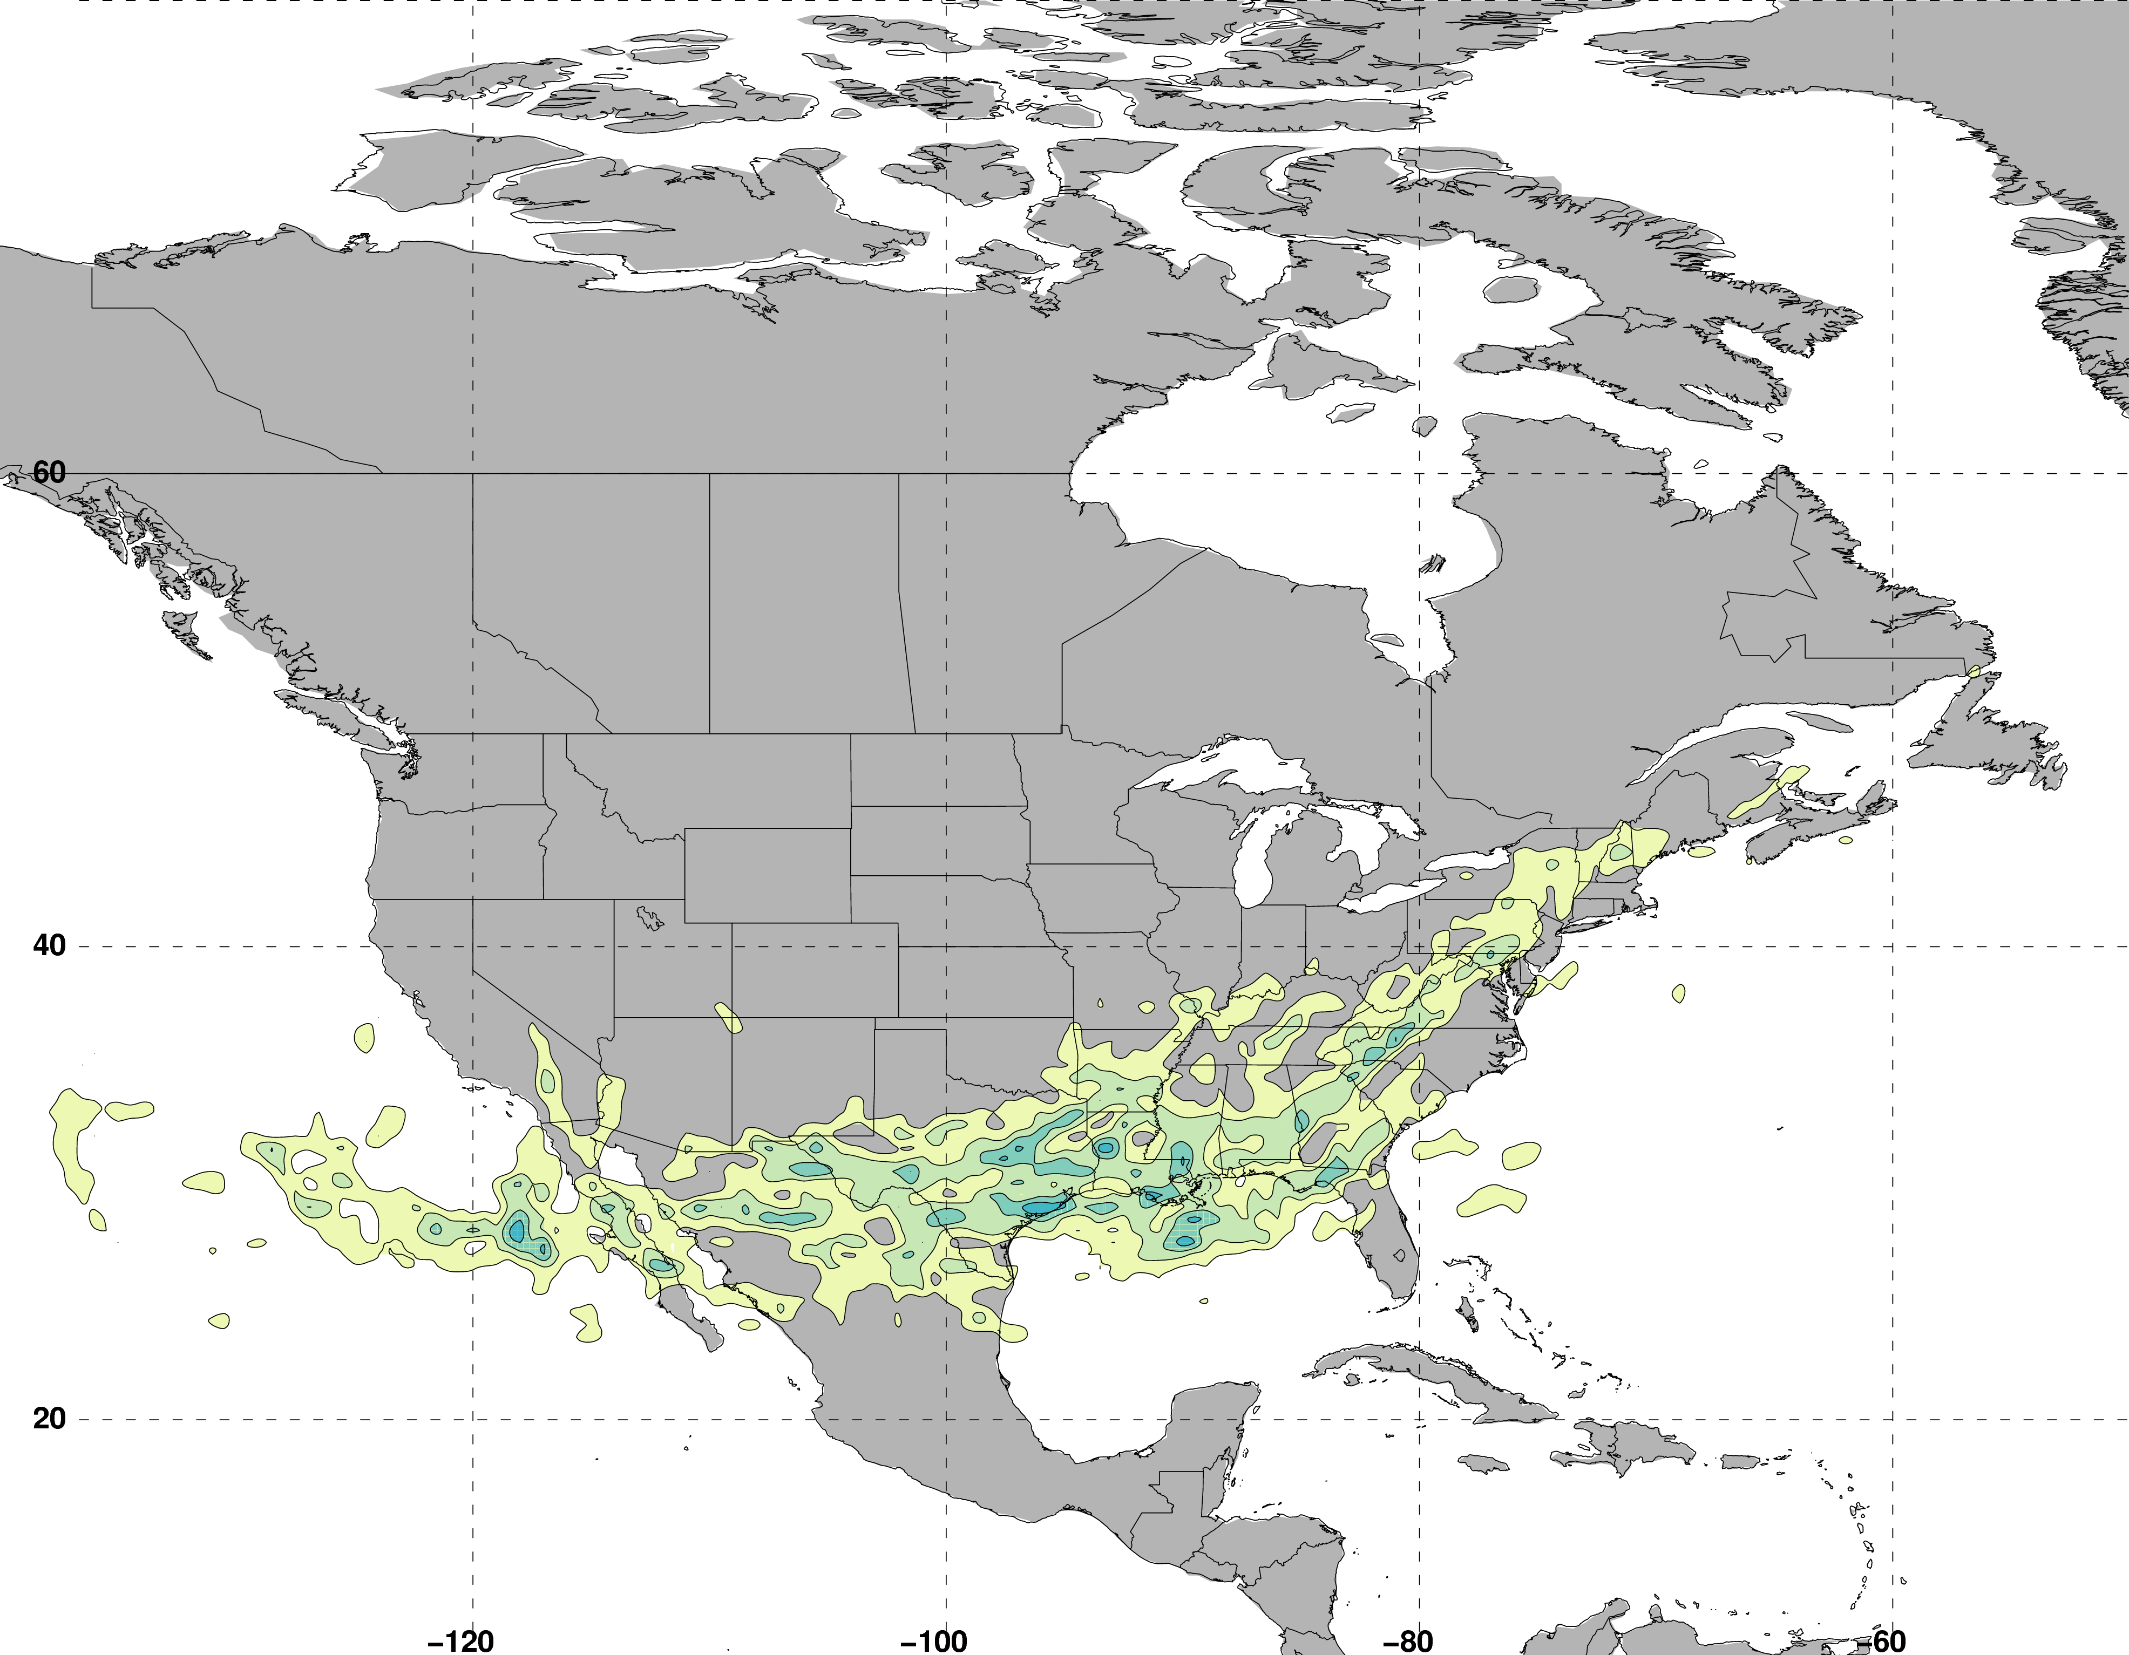
Jet Superposition Event Characteristics
Frequency of Polar Dominant Jet Superposition Events
N = 80
Legend
Avg. Location of Superposition
Number of events

Slide 51
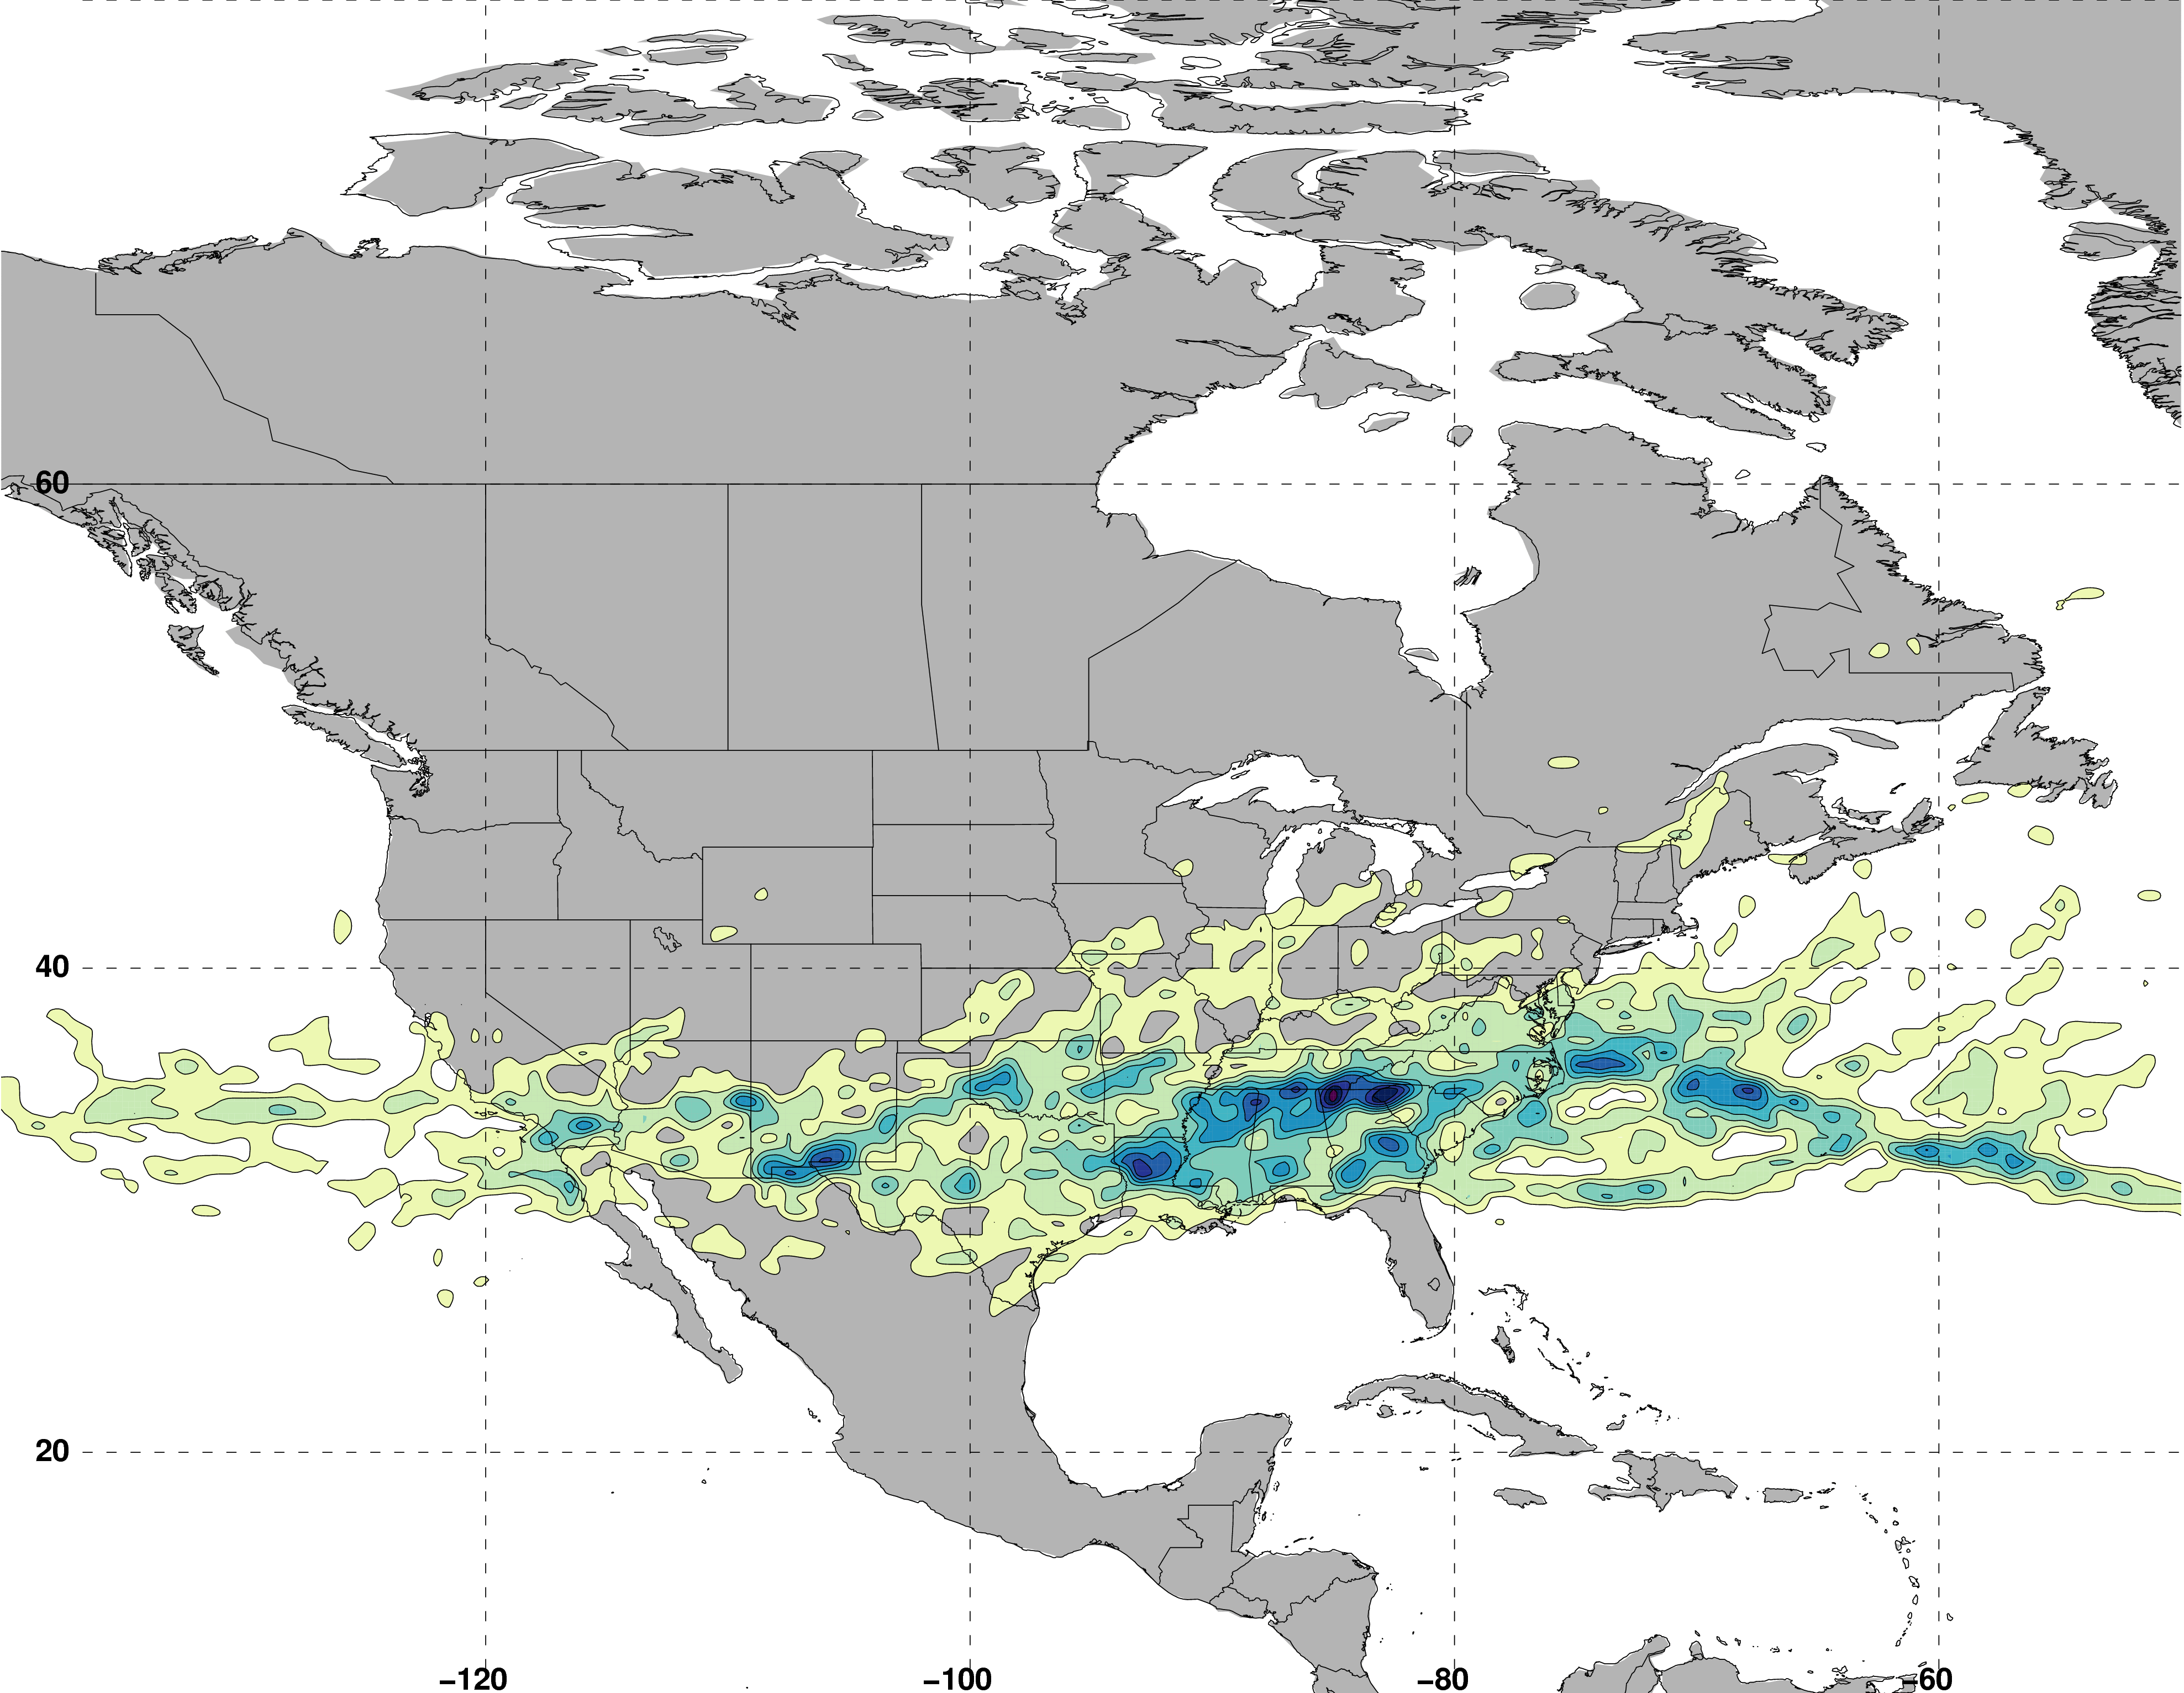
Jet Superposition Event Characteristics
Frequency of Hybrid Jet Superposition Events
N = 117
Legend
Avg. Location of Superposition
Number of events

Slide 52
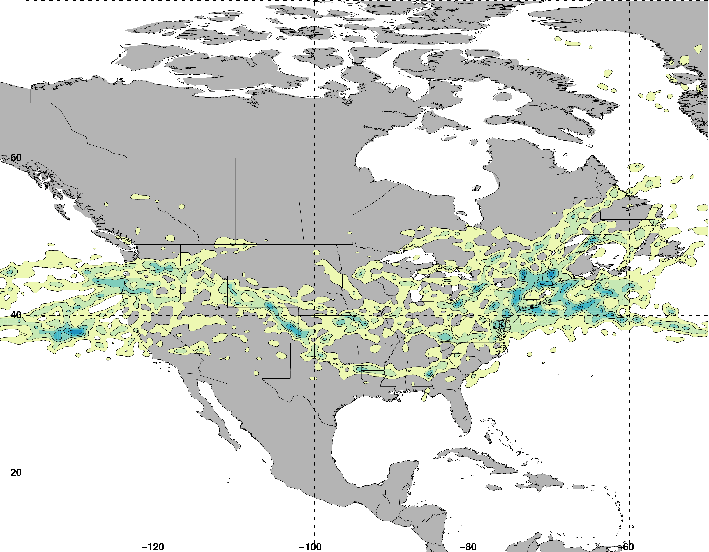
Jet Superposition Event Characteristics
Frequency of Subtropical Dominant Jet Superposition Events
N = 129
Legend
Avg. Location of Superposition
Number of events

Slide 53
Jet Superposition Event Characteristics
Frequency of Subtropical Dominant Jet Superposition Events
N = 129
West: N = 53
East: N = 76
Legend
Avg. Location of Superposition
Number of events

Slide 54
Jet Superposition Event Composites:
Polar Dominant
vs.
East Subtropical Dominant

Slide 55
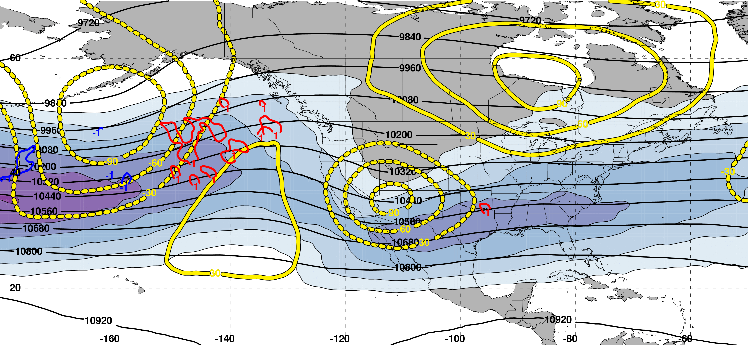
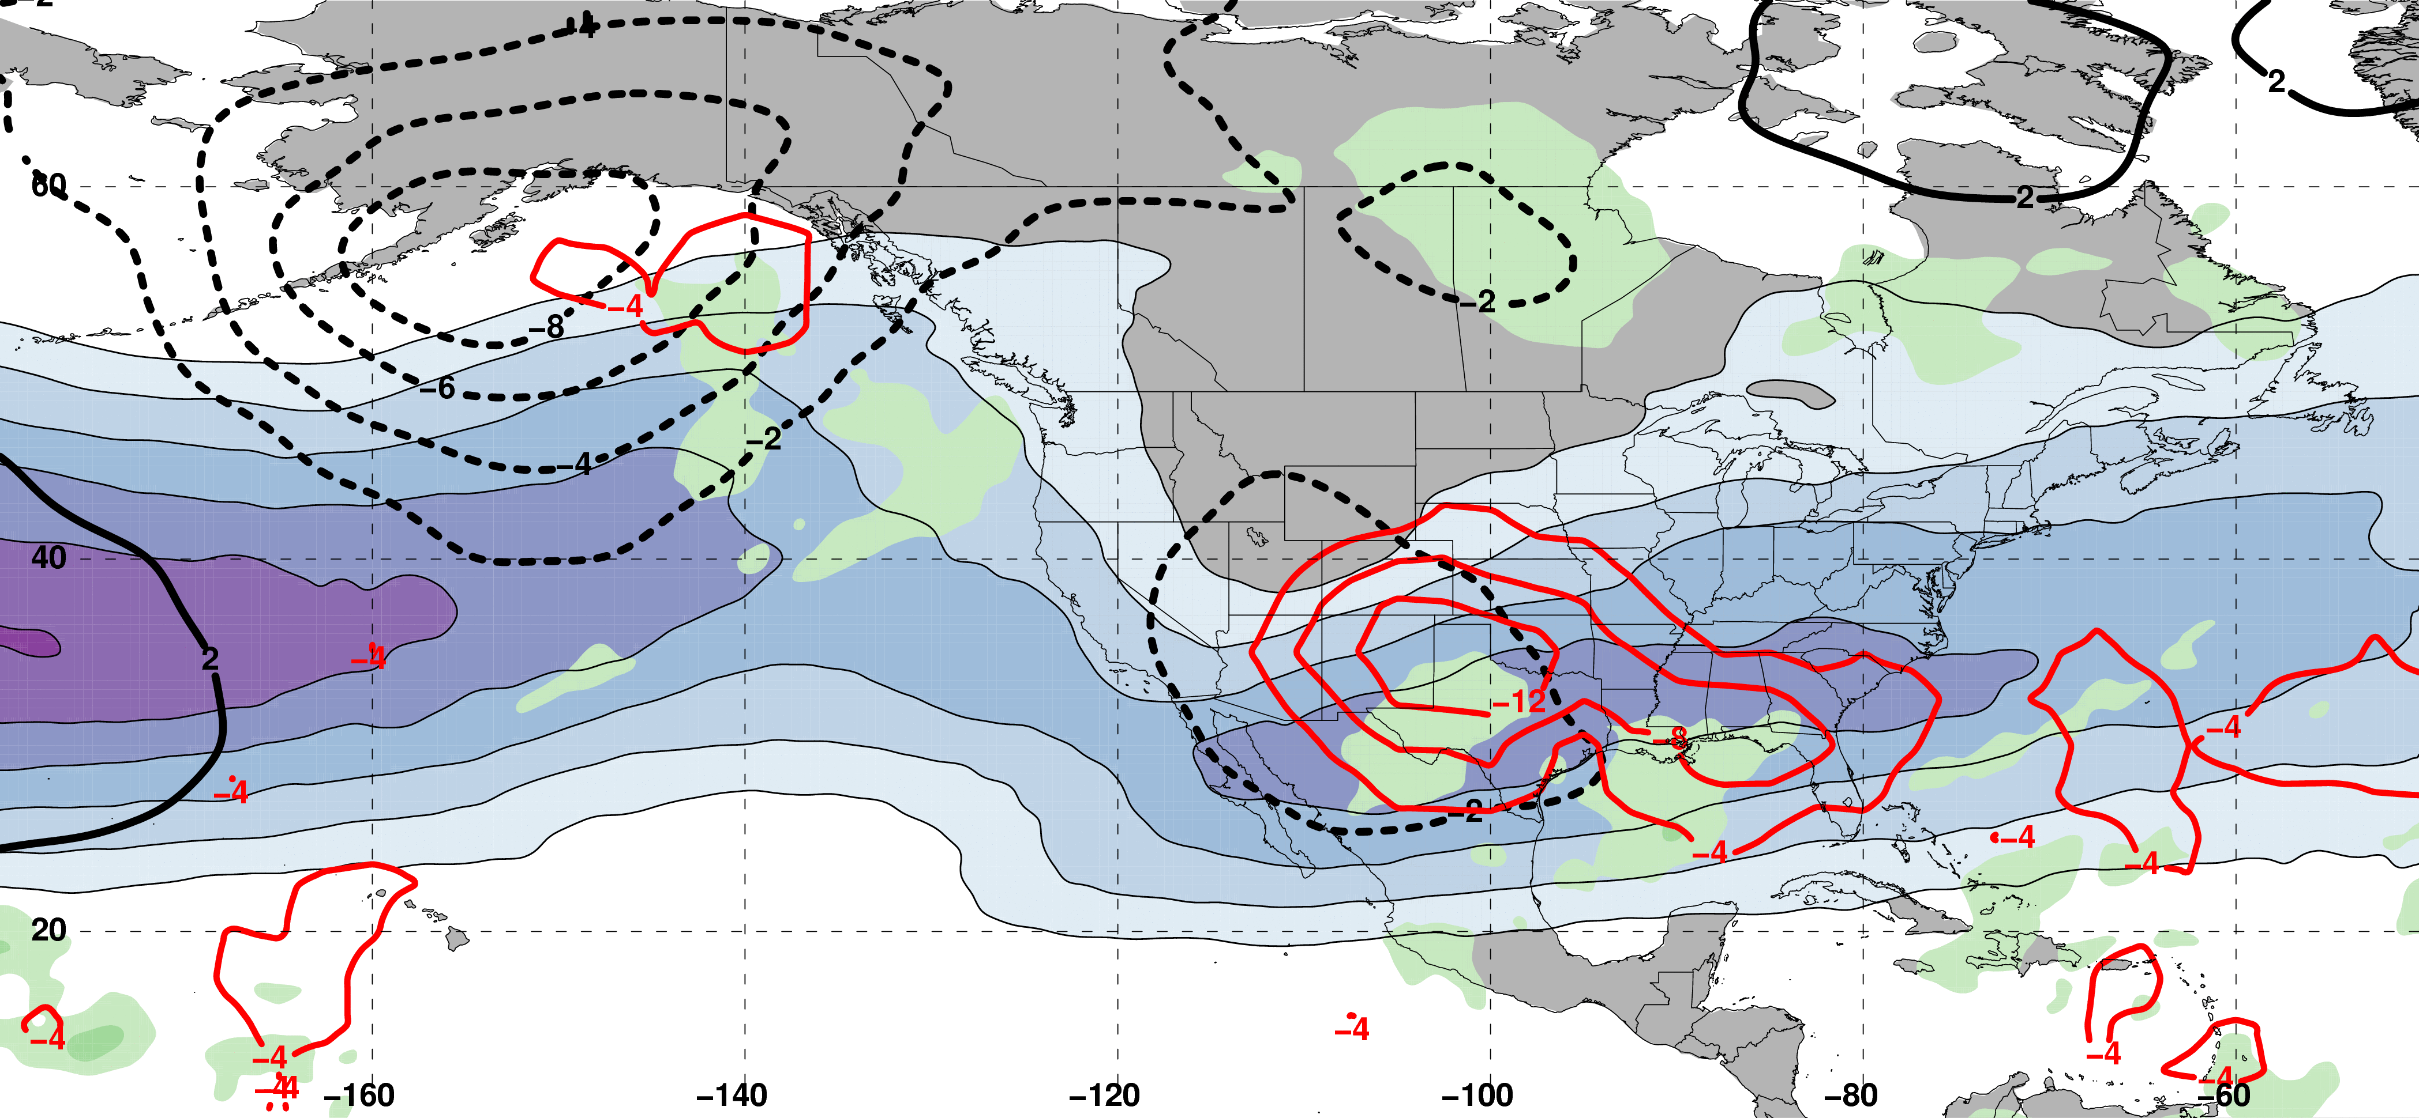
Polar Dominant Jet Superposition Events
250-hPa Jet, Geo. Height, & Geo. Height Anom., & 300-hPa Geo. Temp Adv.
250-hPa Geo. Height
300-hPa
Geo. WAA
2 Days
Prior to Jet Superposition
250-hPa Geo. Height Anom.
300-hPa
Geo. CAA
m s^{–1}
250-hPa Jet, MSLP Anom., PWAT Anom., & –OLR Anom.
L
L
N=80
MSLP Anom.
Neg. OLR
Anom.
mm

Slide 56
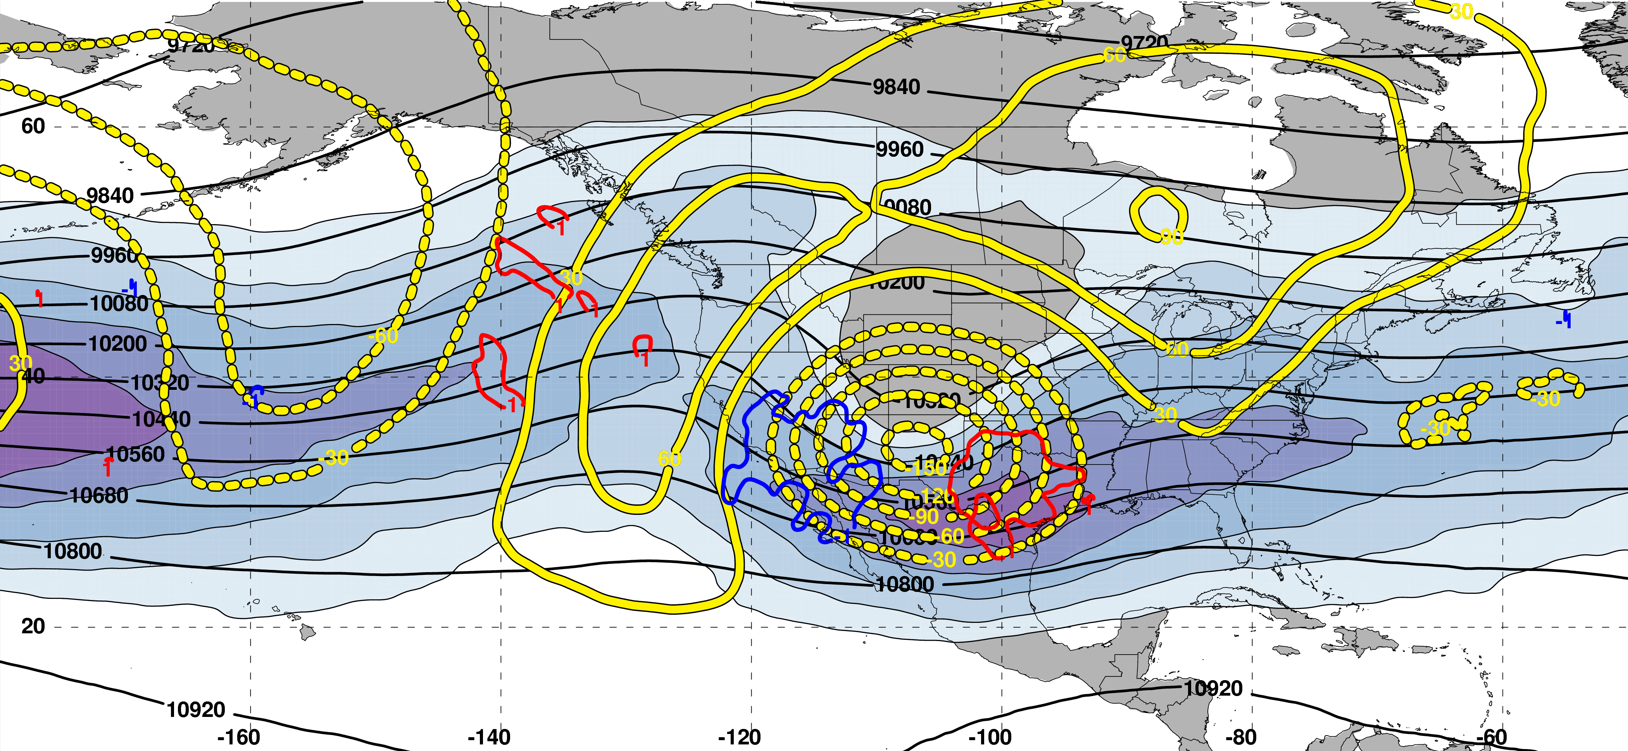
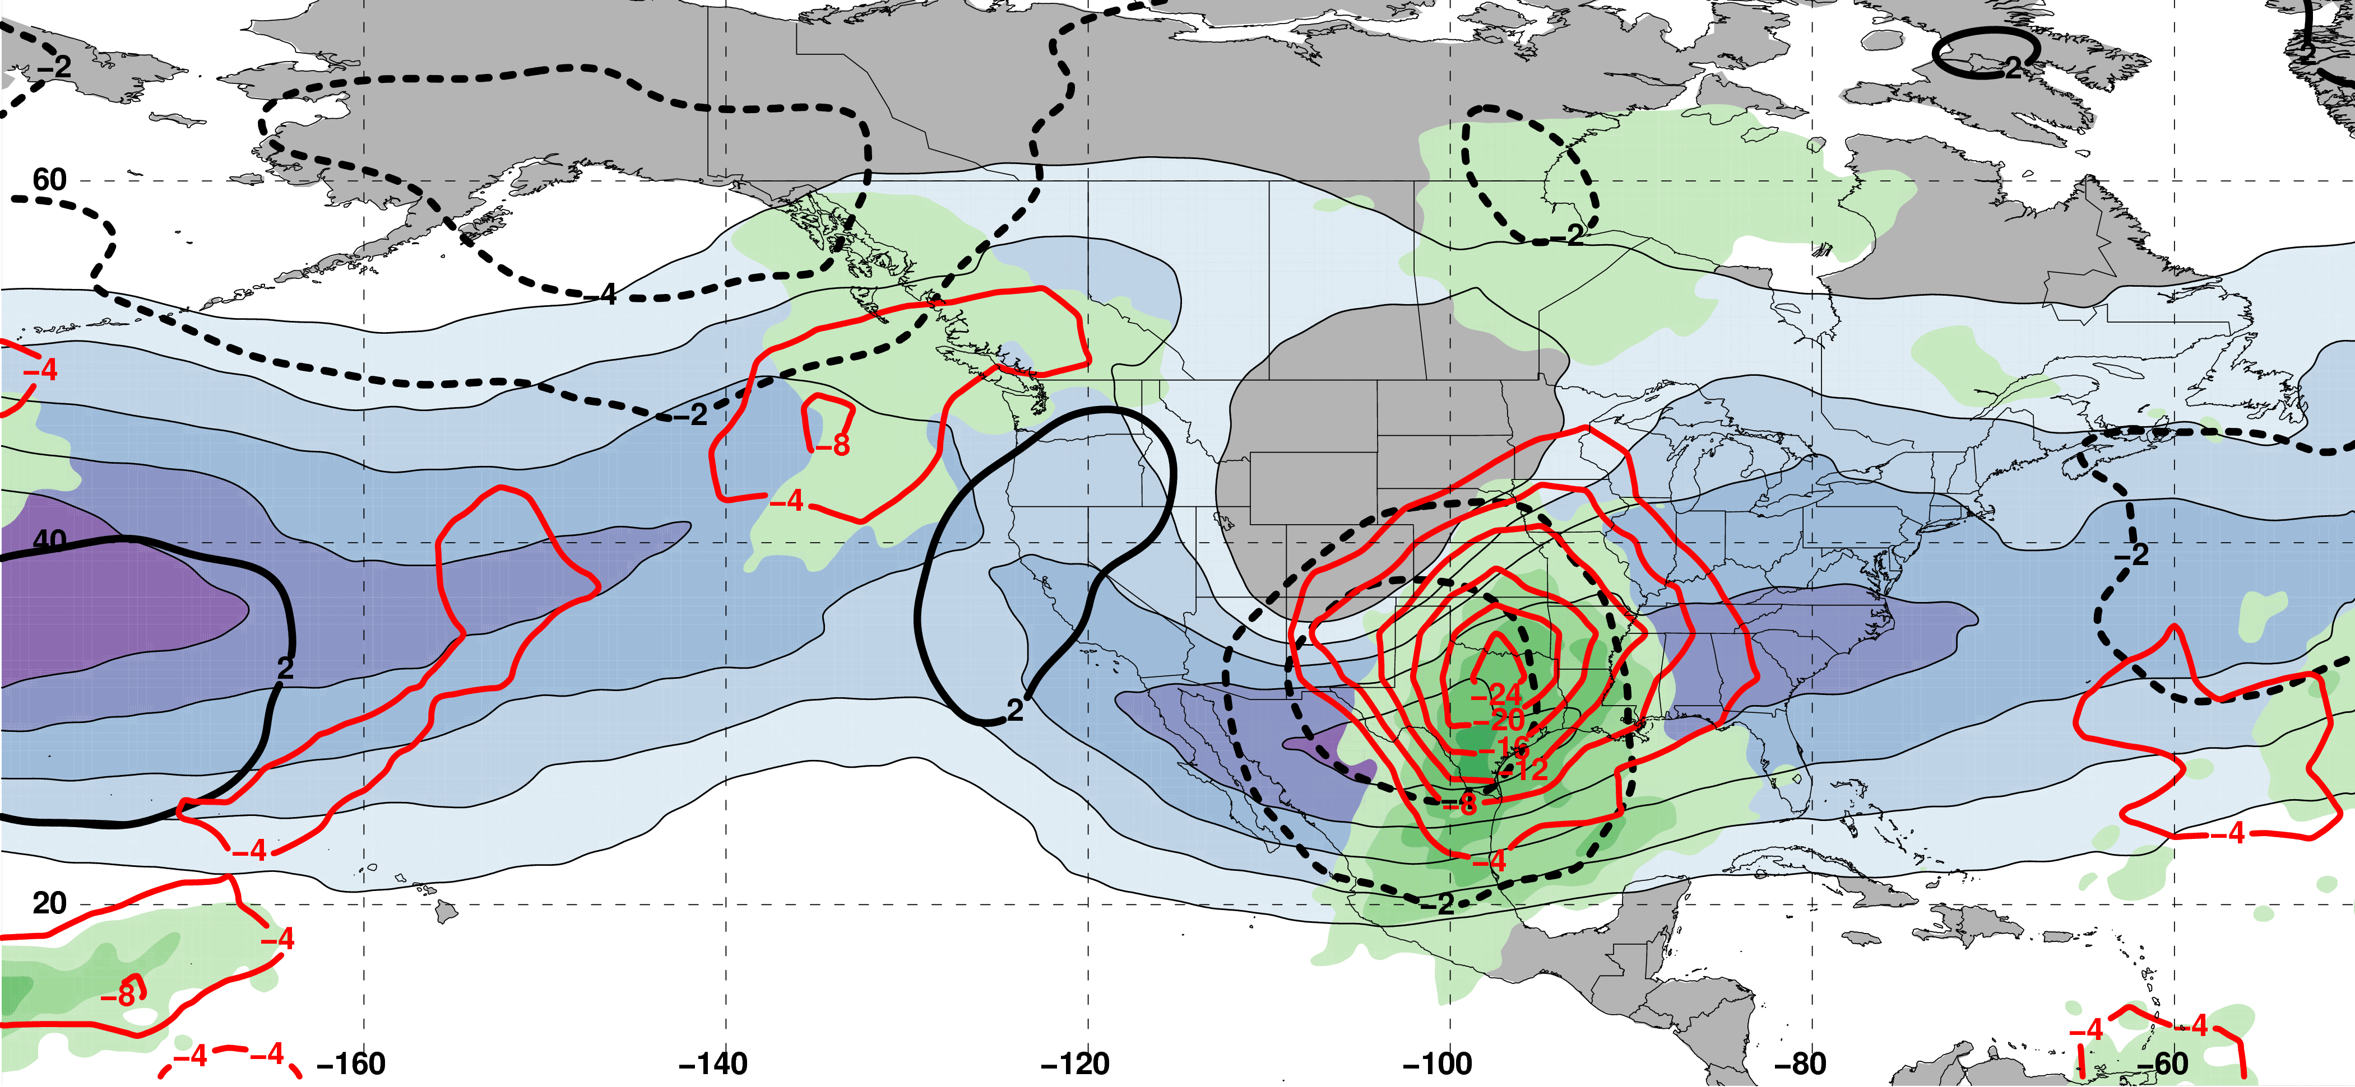
Polar Dominant Jet Superposition Events
250-hPa Jet, Geo. Height, & Geo. Height Anom., & 300-hPa Geo. Temp Adv.
250-hPa Geo. Height
300-hPa
Geo. WAA
1 Day
Prior to Jet Superposition
250-hPa Geo. Height Anom.
300-hPa
Geo. CAA
m s^{–1}
250-hPa Jet, MSLP Anom., PWAT Anom., & –OLR Anom.
L
H
L
N=80
MSLP Anom.
Neg. OLR
Anom.
mm

Slide 57
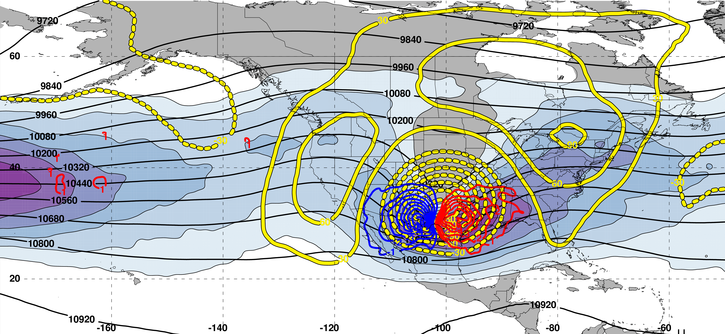
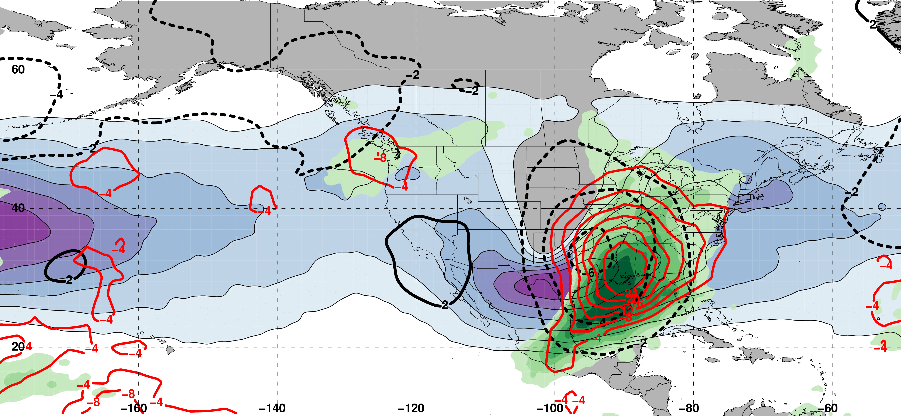
Polar Dominant Jet Superposition Events
250-hPa Jet, Geo. Height, & Geo. Height Anom., & 300-hPa Geo. Temp Adv.
250-hPa Geo. Height
300-hPa
Geo. WAA
0 Days
Prior to Jet Superposition
250-hPa Geo. Height Anom.
300-hPa
Geo. CAA
m s^{–1}
250-hPa Jet, MSLP Anom., PWAT Anom., & –OLR Anom.
Average
Location of Superposition
H
L
N=80
MSLP Anom.
Neg. OLR
Anom.
mm

Slide 58
Polar Dominant Jet Superposition Events
250-hPa Jet, Geo. Height, & Geo. Height Anom., & 300-hPa Geo. Temp Adv.
A
250-hPa Geo. Height
300-hPa
Geo. WAA
A’
0 Days
Prior to Jet Superposition
250-hPa Geo. Height Anom.
300-hPa
Geo. CAA
m s^{–1}
250-hPa Jet, MSLP Anom., PWAT Anom., & –OLR Anom.
A
Average
Location of Superposition
H
L
A’
N=80
MSLP Anom.
Neg. OLR
Anom.
mm

Slide 59
Polar Dominant Jet Superposition Events
250-hPa Jet, Geo. Height, & Geo. Height Anom., & 300-hPa Geo. Temp Adv.
A
B
250-hPa Geo. Height
300-hPa
Geo. WAA
A’
B’
0 Days
Prior to Jet Superposition
250-hPa Geo. Height Anom.
300-hPa
Geo. CAA
m s^{–1}
250-hPa Jet, MSLP Anom., PWAT Anom., & –OLR Anom.
A
B
Average
Location of Superposition
H
L
A’
B’
N=80
MSLP Anom.
Neg. OLR
Anom.
mm

Slide 60
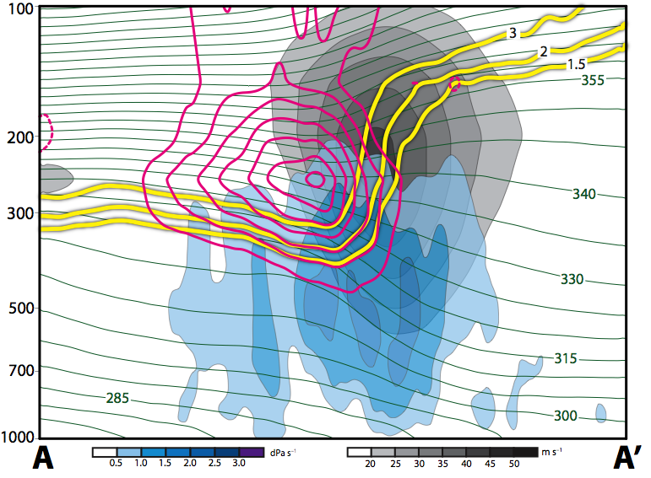
Polar Dominant Jet Superposition Events
12 Hours Prior to Jet Superposition
Legend
1.5-,2-,
3-PVU
θ
+ pert. PV
– pert. PV
ω
wind speed

Slide 61
Polar Dominant Jet Superposition Events
12 Hours Prior to Jet Superposition
Legend
1.5-,2-,
3-PVU
Strong cyclonic PV anomaly poleward of the developing jet superposition
θ
+ pert. PV
– pert. PV
Wind into page
Wind out
of page
ω
wind speed

Slide 62
Polar Dominant Jet Superposition Events
12 Hours Prior to Jet Superposition
Legend
1.5-,2-,
3-PVU
θ
+ pert. PV
Subsidence directly beneath and poleward of the jet core
– pert. PV
ω
wind speed

Slide 63
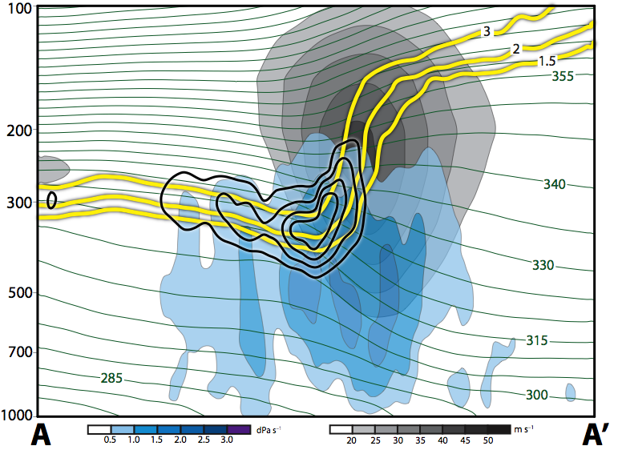
Polar Dominant Jet Superposition Events
12 Hours Prior to Jet Superposition
Legend
1.5-,2-,
3-PVU
θ
+ PV adv.
Subsidence acts to steepen the tropopause
– PV adv.
ω
wind speed

Slide 64
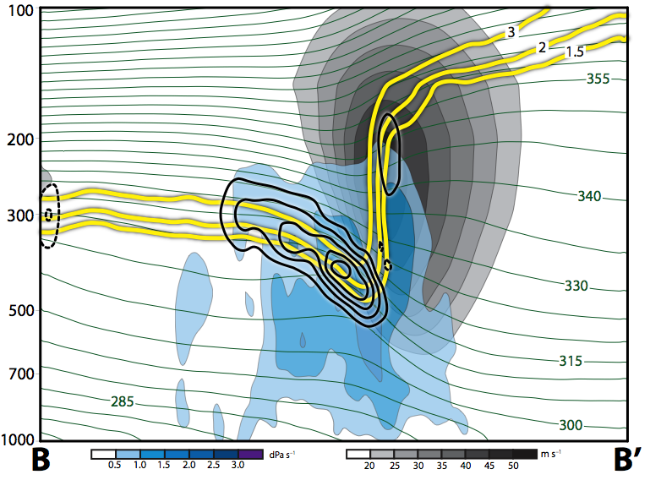
Polar Dominant Jet Superposition Events
0 Hours Prior to Jet Superposition
Legend
1.5-,2-,
3-PVU
θ
+ PV adv.
Subsidence acts to steepen the tropopause
– PV adv.
ω
wind speed

Slide 65
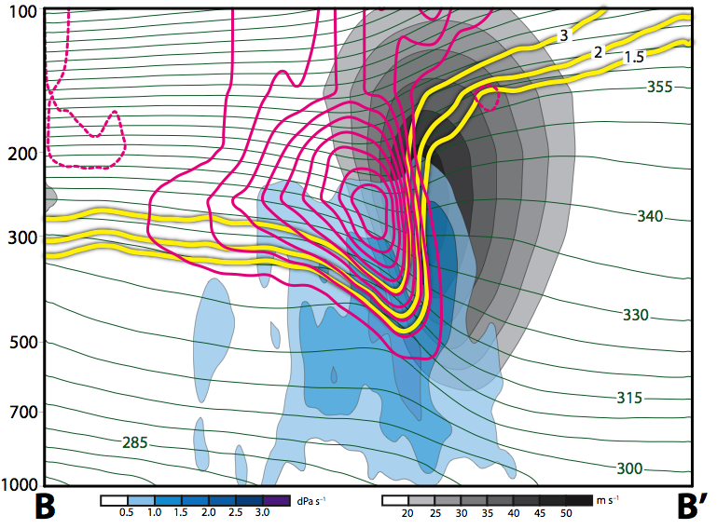
Polar Dominant Jet Superposition Events
0 Hours Prior to Jet Superposition
Legend
1.5-,2-,
3-PVU
θ
Cyclonic PV anomaly intensifies poleward of the jet superposition
+ pert. PV
– pert. PV
Wind into page
Wind out
of page
ω
wind speed

Slide 66
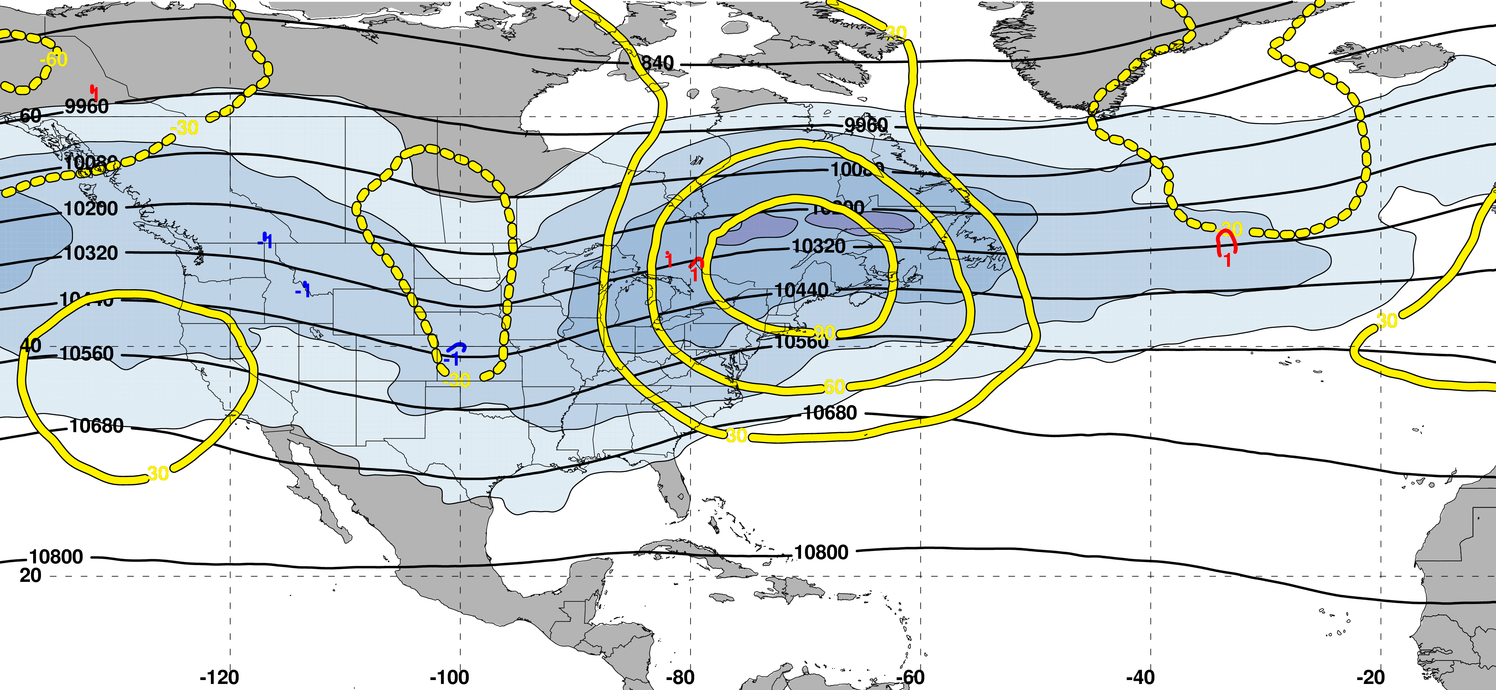
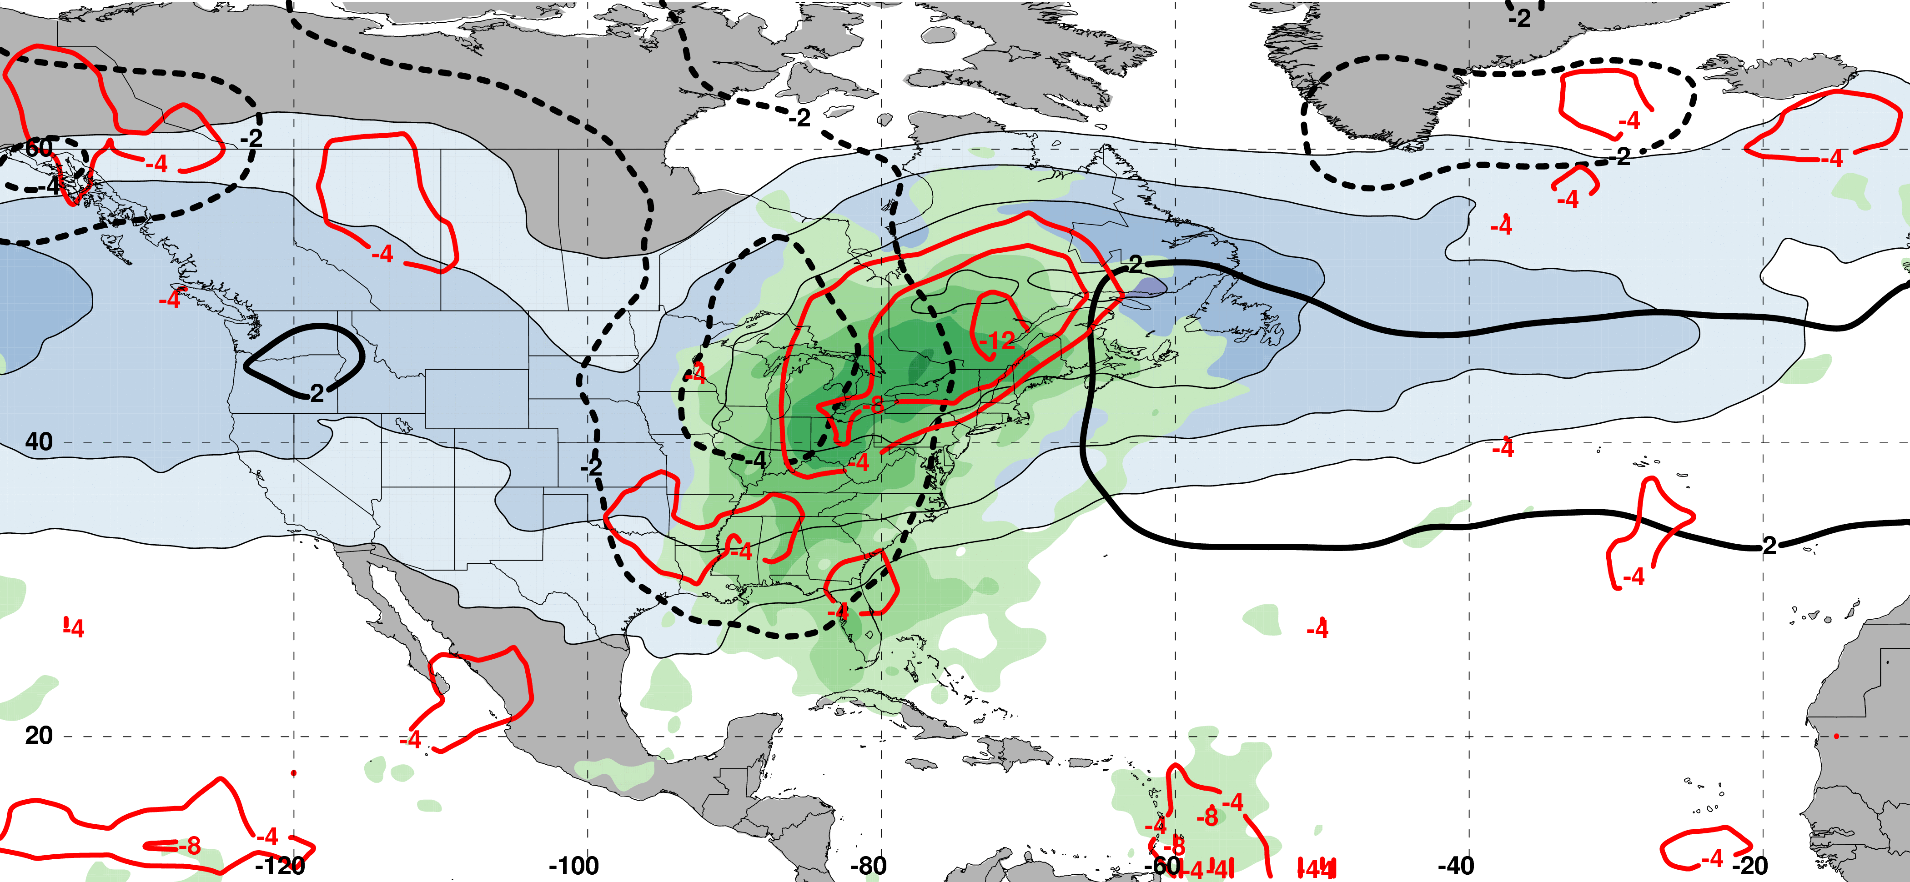
E. Subtropical Dominant Jet Superposition Events
250-hPa Jet, Geo. Height, & Geo. Height Anom., & 300-hPa Geo. Temp Adv.
250-hPa Geo. Height
300-hPa
Geo. WAA
2 Days
Prior to Jet Superposition
250-hPa Geo. Height Anom.
300-hPa
Geo. CAA
m s^{–1}
250-hPa Jet, MSLP Anom., PWAT Anom., & –OLR Anom.
L
H
N=76
MSLP Anom.
Neg. OLR
Anom.
mm

Slide 67
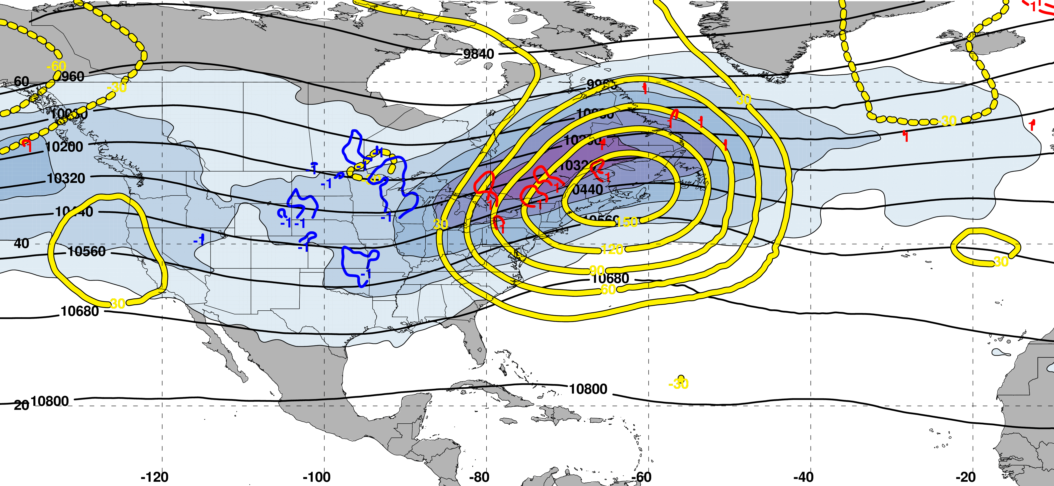
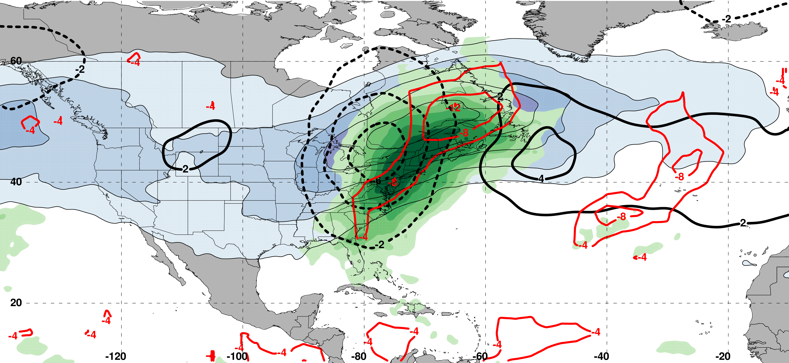
E. Subtropical Dominant Jet Superposition Events
250-hPa Jet, Geo. Height, & Geo. Height Anom., & 300-hPa Geo. Temp Adv.
250-hPa Geo. Height
300-hPa
Geo. WAA
1 Day
Prior to Jet Superposition
250-hPa Geo. Height Anom.
300-hPa
Geo. CAA
m s^{–1}
250-hPa Jet, MSLP Anom., PWAT Anom., & –OLR Anom.
L
H
N=76
MSLP Anom.
Neg. OLR
Anom.
mm

Slide 68
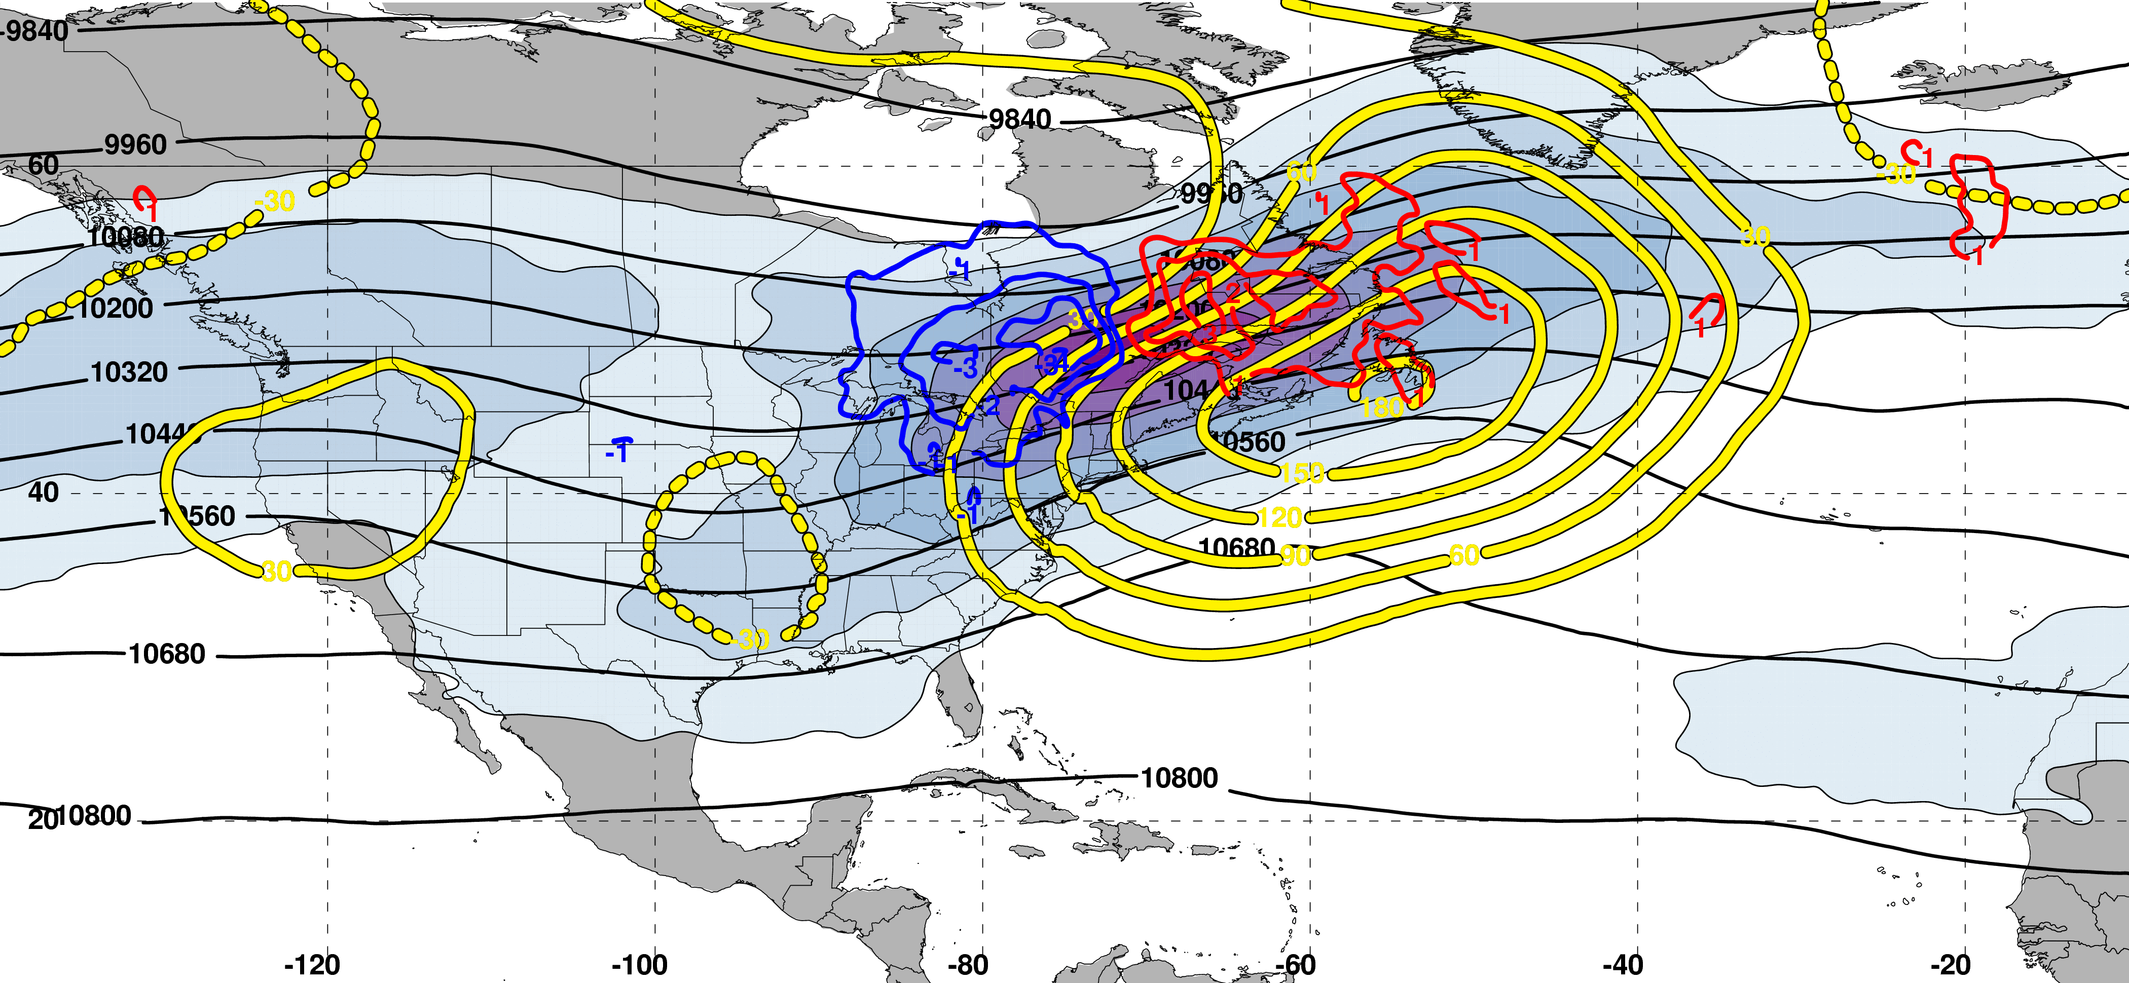
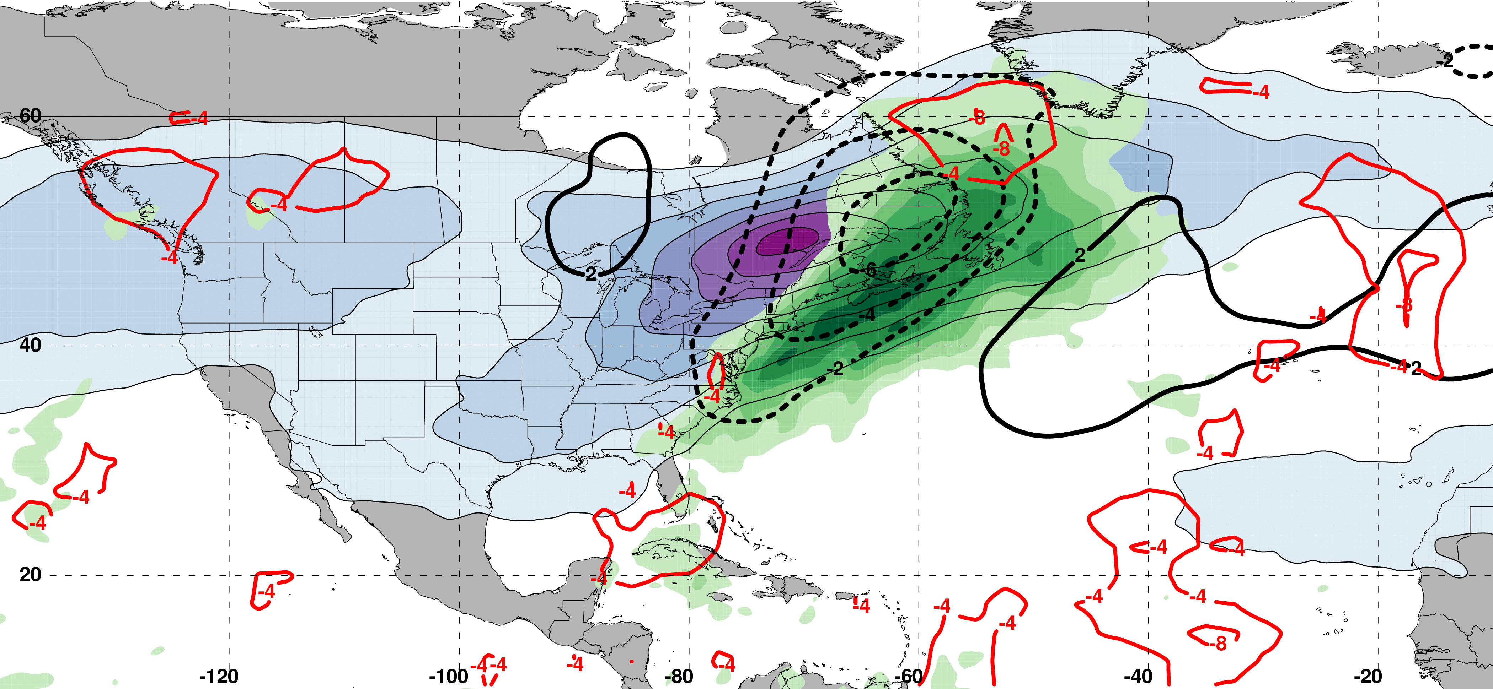
E. Subtropical Dominant Jet Superposition Events
250-hPa Jet, Geo. Height, & Geo. Height Anom., & 300-hPa Geo. Temp Adv.
250-hPa Geo. Height
300-hPa
Geo. WAA
0 Days
Prior to Jet Superposition
250-hPa Geo. Height Anom.
300-hPa
Geo. CAA
m s^{–1}
250-hPa Jet, MSLP Anom., PWAT Anom., & –OLR Anom.
L
Average
Location of Superposition
H
N=76
MSLP Anom.
Neg. OLR
Anom.
mm

Slide 69
E. Subtropical Dominant Jet Superposition Events
250-hPa Jet, Geo. Height, & Geo. Height Anom., & 300-hPa Geo. Temp Adv.
C
250-hPa Geo. Height
300-hPa
Geo. WAA
C’
0 Days
Prior to Jet Superposition
250-hPa Geo. Height Anom.
300-hPa
Geo. CAA
m s^{–1}
250-hPa Jet, MSLP Anom., PWAT Anom., & –OLR Anom.
C
L
Average
Location of Superposition
H
C’
N=76
MSLP Anom.
Neg. OLR
Anom.
mm

Slide 70
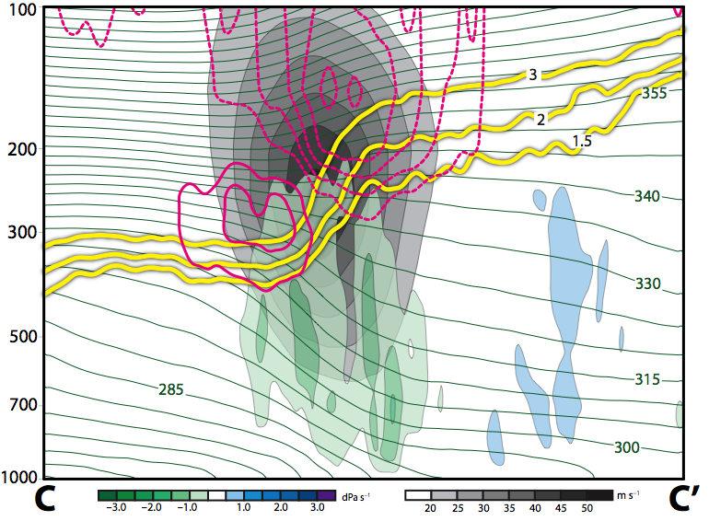
E. Subtropical Dominant Jet Superposition Events
12 Hours Prior to Jet Superposition
Legend
1.5-,2-,
3-PVU
θ
+ pert. PV
– pert. PV
ω
wind speed

Slide 71
E. Subtropical Dominant Jet Superposition Events
12 Hours Prior to Jet Superposition
Legend
1.5-,2-,
3-PVU
θ
+ pert. PV
Juxtaposition of cyclonic and anticyclonic PV anomalies near the tropopause.
– pert. PV
Wind into page
Wind out
of page
ω
wind speed

Slide 72
E. Subtropical Dominant Jet Superposition Events
12 Hours Prior to Jet Superposition
Legend
1.5-,2-,
3-PVU
θ
+ pert. PV
Ascent directly beneath the jet core
– pert. PV
ω
wind speed

Slide 73
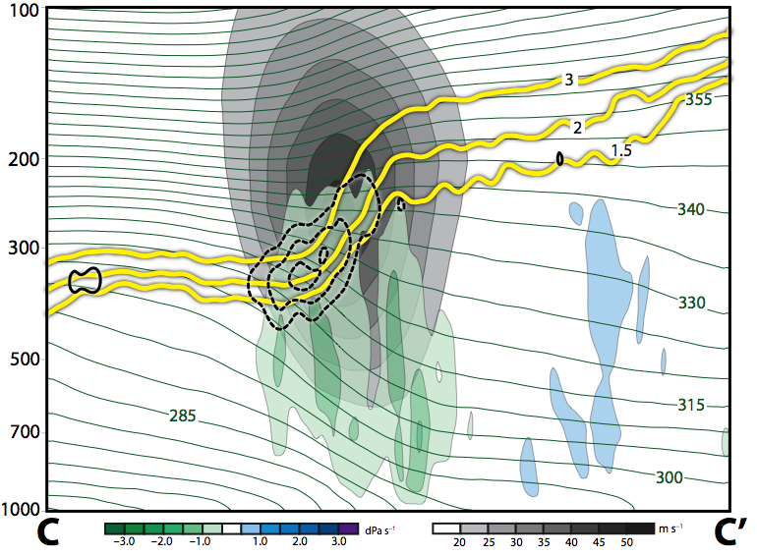
E. Subtropical Dominant Jet Superposition Events
12 Hours Prior to Jet Superposition
Legend
1.5-,2-,
3-PVU
θ
+ PV adv.
Ascent and the diabatic destruction of PV act to steepen the tropopause
– PV adv.
ω
wind speed

Slide 74
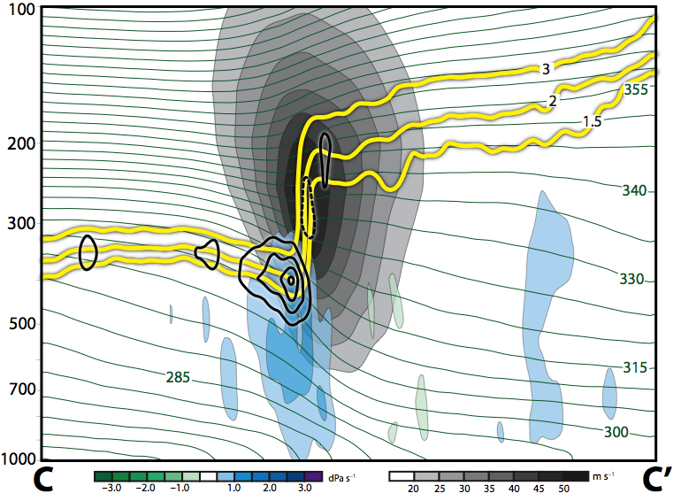
E. Subtropical Dominant Jet Superposition Events
0 Hours Prior to Jet Superposition
Legend
1.5-,2-,
3-PVU
θ
+ PV adv.
Subsidence develops beneath the jet core and acts to further steepen the tropopause
– PV adv.
ω
wind speed

Slide 75
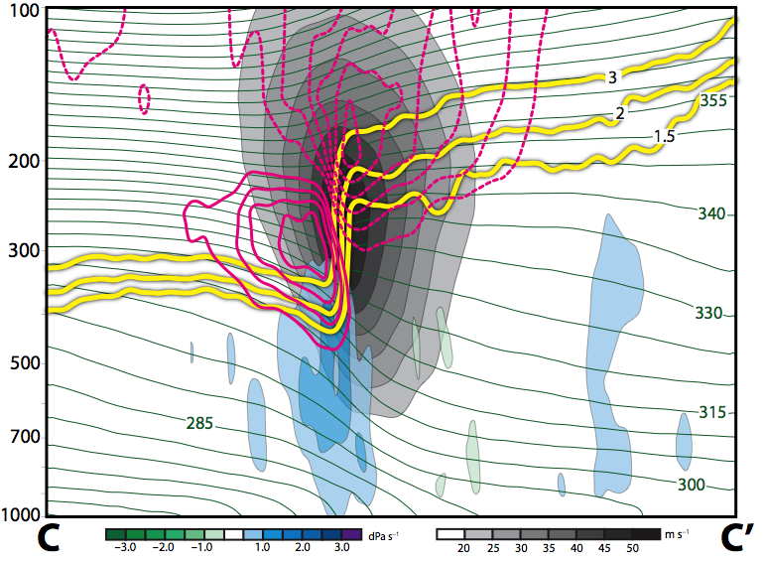
E. Subtropical Dominant Jet Superposition Events
0 Hours Prior to Jet Superposition
Legend
1.5-,2-,
3-PVU
θ
The intensification of both PV anomalies is associated with an acceleration of jet wind speeds
+ pert. PV
– pert. PV
Wind into page
Wind out
of page
ω
wind speed

Slide 76
Jet Superposition Event Composites

Slide 77
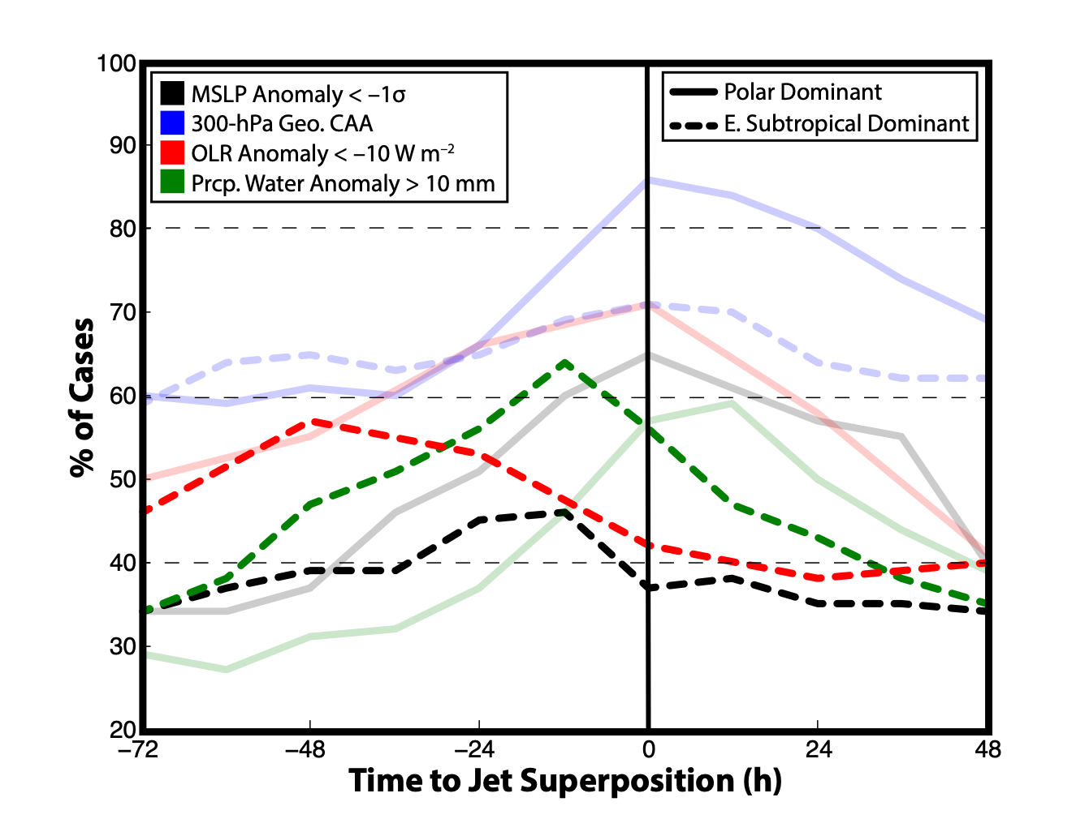
Jet Superposition Event Composites
Surface cyclogenesis and precipitation processes
lead superposition

Slide 78
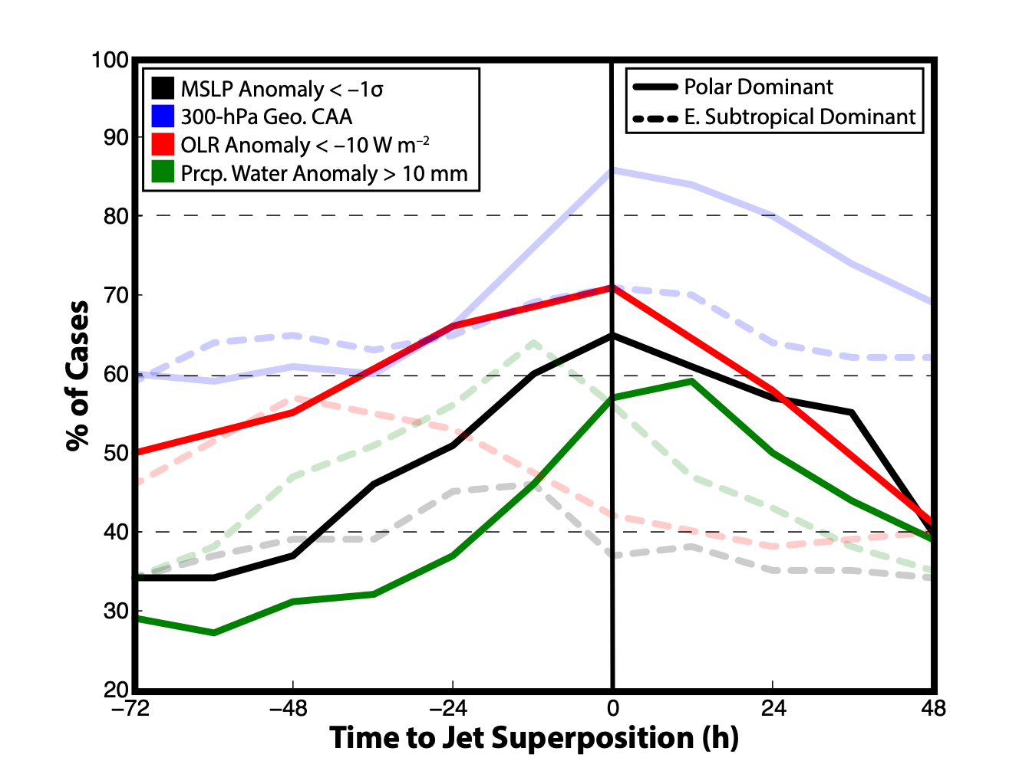
Jet Superposition Event Composites
Surface cyclogenesis and precipitation processes coincide with superposition

Slide 79
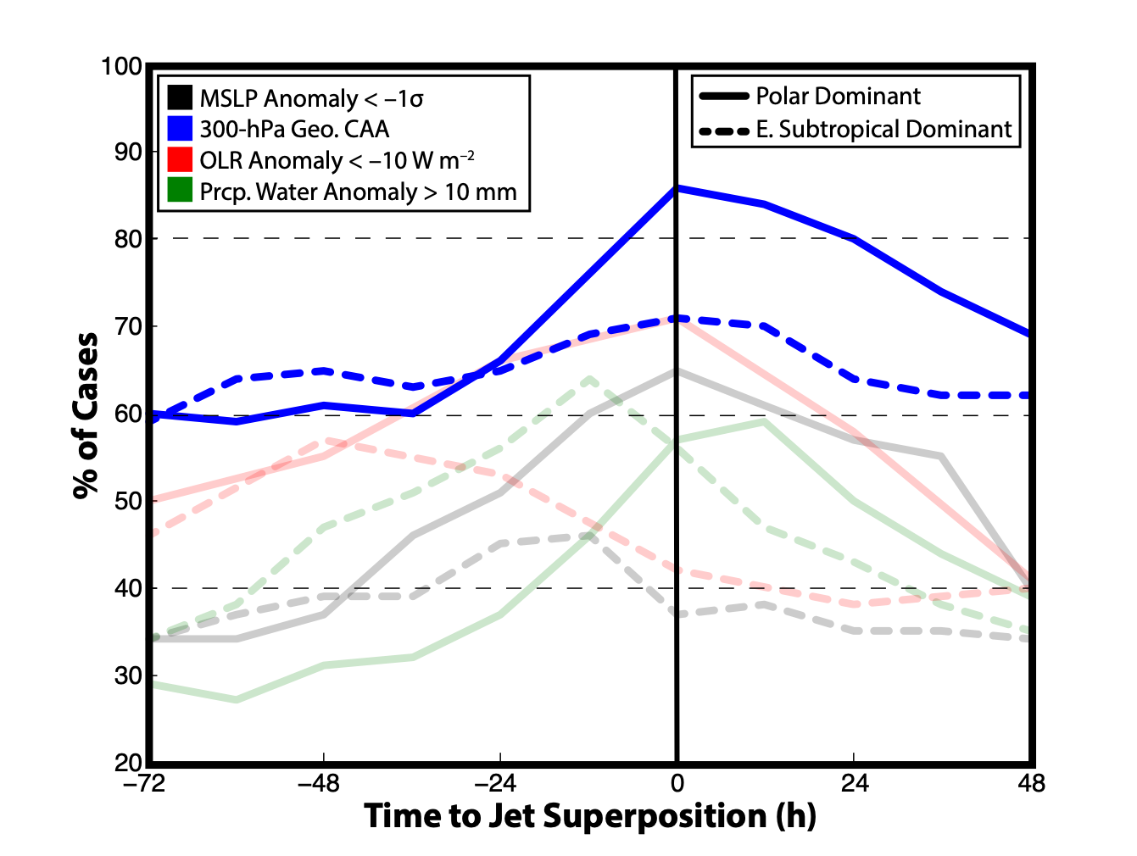
Jet Superposition Event Composites
Forcing for QG descent peaks at the time of superposition for both event types

Slide 80
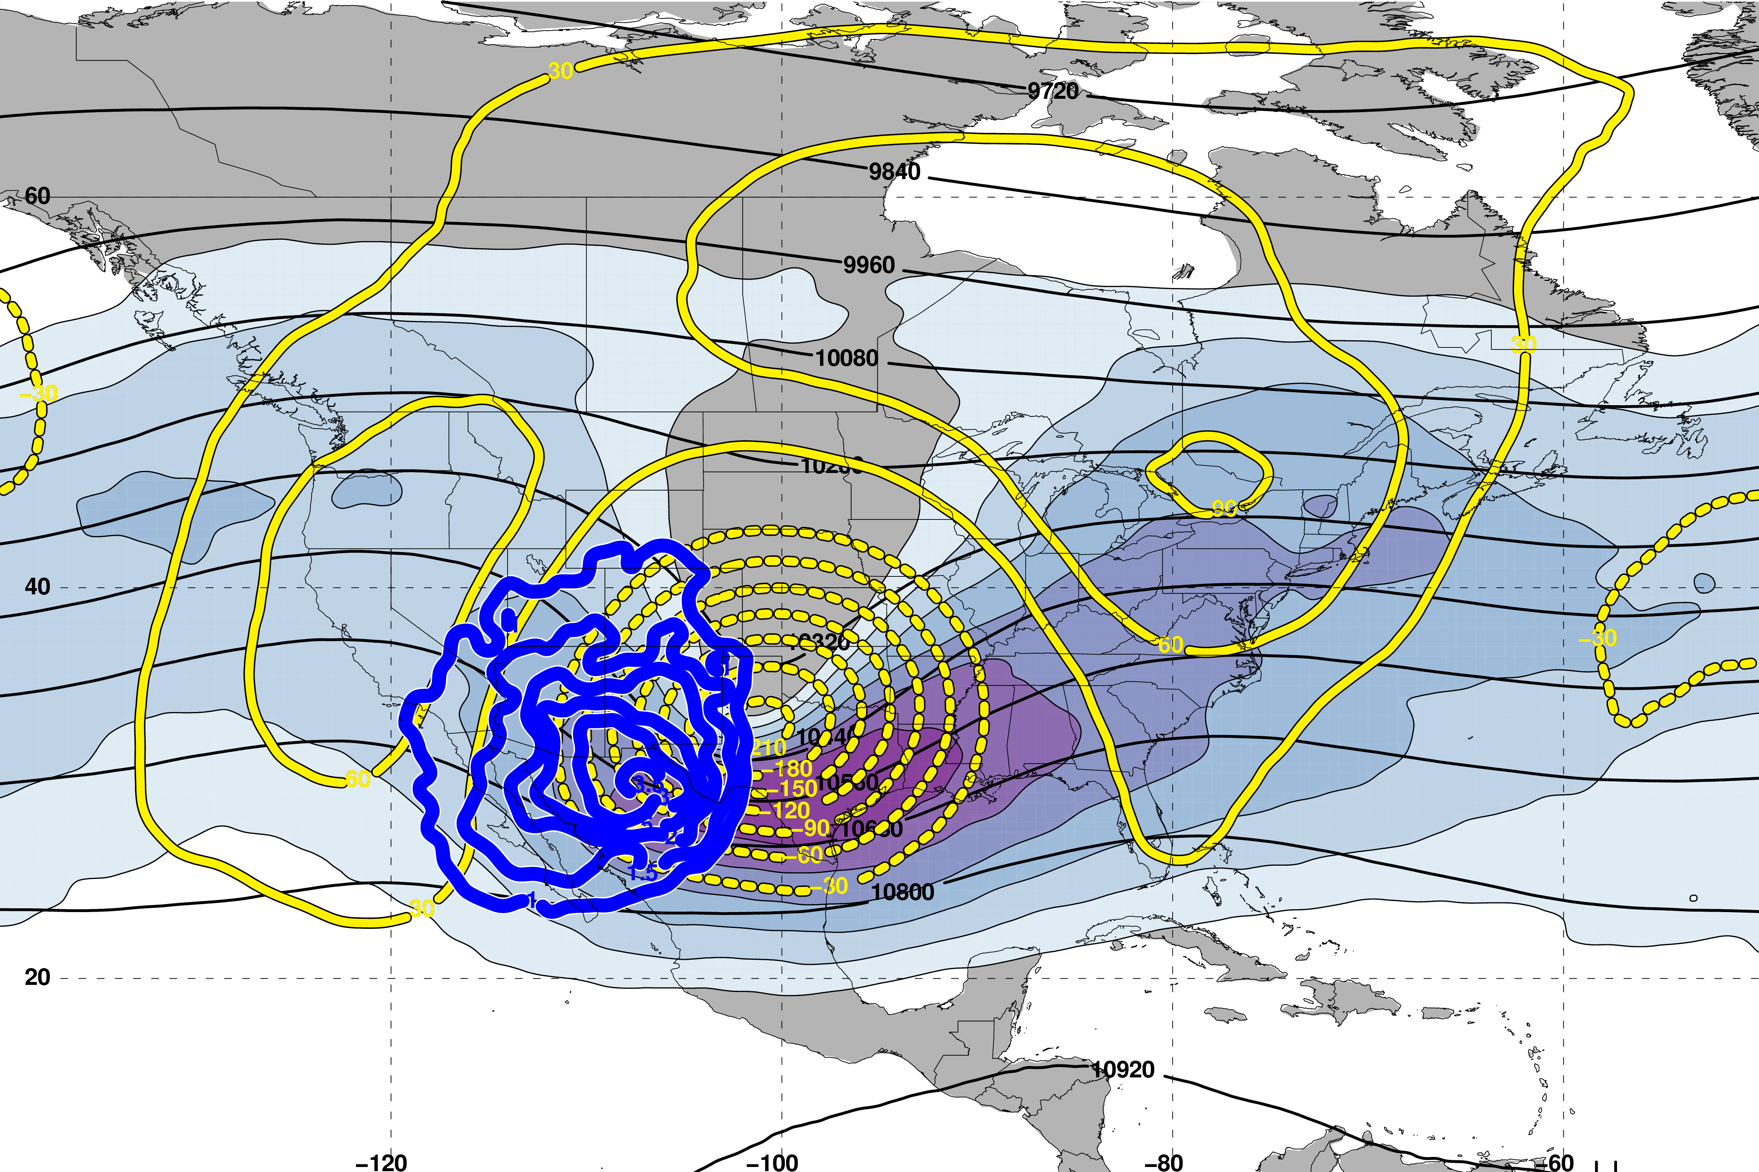
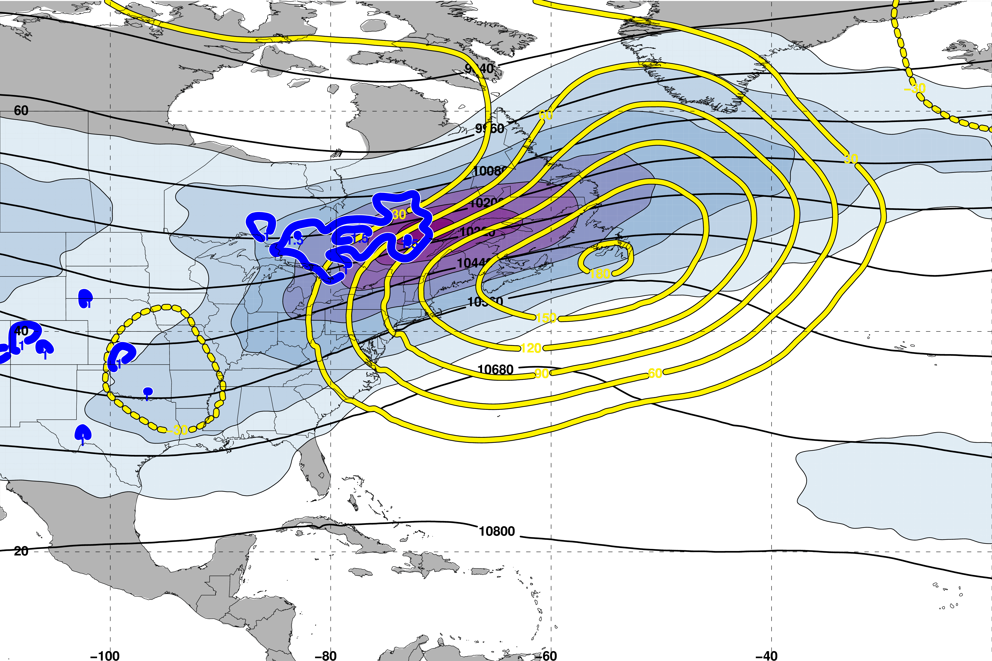
The Consistent Role of Descent
Polar Dominant Events
East Subtropical Dominant Events
0 h
N=80
0 h
N=76
m s^{–1}
250-hPa Geo. Height
Descent within the jet-entrance region is a common element among the jet superposition event composites.
250-hPa Geo. Height Anomalies
500-hPa Descent
Avg. Location of Superposition

Slide 81
The Consistent Role of Descent
Polar Dominant Events
East Subtropical Dominant Events
0 h
N=80
0 h
N=76
m s^{–1}
The consistent role of descent motivates further investigation
of the dynamical structures responsible for the
observed descent.
250-hPa Geo. Height
250-hPa Geo. Height Anomalies
500-hPa Descent
Avg. Location of Superposition

Slide 82
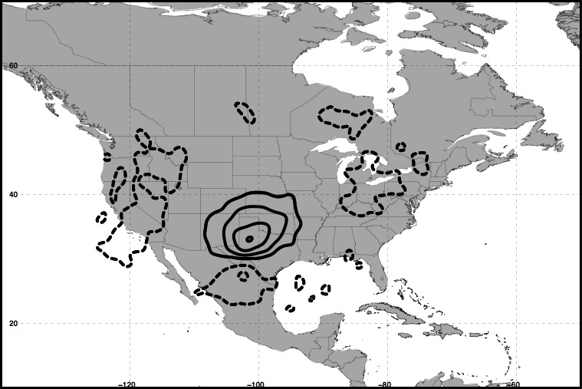
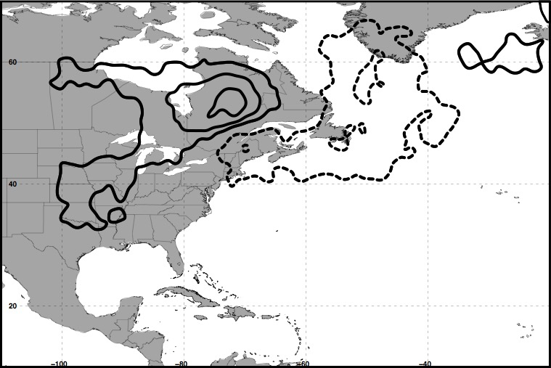
The Consistent Role of Descent
Polar Dominant Events
East Subtropical Dominant Events
0 h
0 h
250 hPa
300 hPa
+ QGPV Anomalies
– QGPV Anomalies
Avg. Location of Superposition
The descent characterizing each jet superposition event composite is examined further by isolating quasi-geostrophic (QG) PV anomalies in the vicinity of the jet superposition.

Slide 83
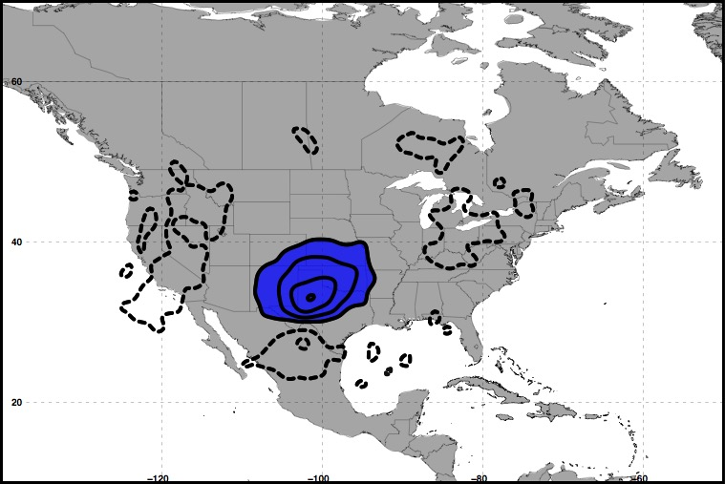

The Consistent Role of Descent
Polar Dominant Events
East Subtropical Dominant Events
0 h
0 h
250 hPa
300 hPa
Polar Cyclonic QGPV Anomalies
Avg. Location of Superposition

Slide 84


The Consistent Role of Descent
Polar Dominant Events
East Subtropical Dominant Events
0 h
0 h
250 hPa
300 hPa
Polar Cyclonic QGPV Anomalies
Tropical Anticyclonic QGPV Anomalies
Avg. Location of Superposition

Slide 85
The Consistent Role of Descent
Polar Dominant Events
East Subtropical Dominant Events
0 h
0 h
250 hPa
300 hPa
Polar Cyclonic QGPV Anomalies
Tropical Anticyclonic QGPV Anomalies
Avg. Location of Superposition

Slide 86


The Consistent Role of Descent
Polar Dominant Events
East Subtropical Dominant Events
0 h
0 h
250 hPa
300 hPa
Polar Cyclonic QGPV Anomalies
Tropical Anticyclonic QGPV Anomalies
Residual Upper-Tropospheric QGPV Anomalies
Avg. Location of Superposition

Slide 87
The Consistent Role of Descent
Polar Dominant Events
East Subtropical Dominant Events
0 h
0 h
250 hPa
300 hPa
Polar Cyclonic QGPV Anomalies
Tropical Anticyclonic QGPV Anomalies
Residual Upper-Tropospheric QGPV Anomalies
Lower-Tropospheric QGPV Anomalies
Avg. Location of Superposition

Slide 88
The Consistent Role of Descent
Each category of QGPV anomalies (𝑞’) is inverted to determine its associated geopotential (𝜙’) field:

Slide 89
The Consistent Role of Descent
Each category of QGPV anomalies (𝑞’) is inverted to determine its associated geopotential (𝜙’) field:
The geopotential fields and the composite
temperature (𝑇) field are used to determine the QG vertical
motion (𝜔) associated with each category of QGPV:

Slide 90


The Consistent Role of Descent
Polar Dominant Events
East Subtropical Dominant Events
0 h
500 hPa
0 h
500 hPa
Polar Cyclonic QGPV Anomalies
Tropical Anticyclonic QGPV Anomalies
Residual Upper-Tropospheric QGPV Anomalies
Lower-Tropospheric QGPV Anomalies
Avg. Location of Superposition

Slide 91
The Consistent Role of Descent
Polar Dominant Events
East Subtropical Dominant Events
0 h
500 hPa
0 h
500 hPa
Polar Cyclonic QGPV Anomalies
Descent is primarily associated with polar cyclonic QGPV anomalies.
Tropical Anticyclonic QGPV Anomalies
Residual Upper-Tropospheric QGPV Anomalies
Lower-Tropospheric QGPV Anomalies
Avg. Location of Superposition

Slide 92
The Consistent Role of Descent
Polar Dominant Events
East Subtropical Dominant Events
0 h
500 hPa
0 h
500 hPa
Polar Cyclonic QGPV Anomalies
Polar cyclonic QGPV anomalies play a critical role during jet superpositions.
Tropical Anticyclonic QGPV Anomalies
Residual Upper-Tropospheric QGPV Anomalies
Lower-Tropospheric QGPV Anomalies
Avg. Location of Superposition

Slide 93
Summary
Polar Dominant Events:

Slide 94

Summary
Polar Dominant Events:
Anticyclonic wave breaking event amplifies the flow over North America
QG descent beneath the jet core facilitates jet superposition
Downstream precipitation slows the propagation of the upper-level trough
L
CAA
Precip.

Slide 95
Summary
East Subtropical Dominant Events:

Slide 96

Summary
L
CAA
Antecedent moisture and precip.
East Subtropical Dominant Events:
Antecedent precipitation and southerly flow amplify ridge over eastern North America
Arrival of upper-level trough is associated with geostrophic CAA at the time of jet superposition
QG descent beneath the jet core completes jet superposition

Slide 97
Future Work
Examine the impact that each type of jet superposition event has on the evolution of the downstream large-scale flow pattern.
Decipher the relationship between each type of jet superposition and the development of high-impact weather.
Utilize numerical simulations of jet superposition events to examine the sensitivity of jet superposition to diabatic processes.
Examine the frequency and characteristics of jet superposition events within future climate scenarios.
Contact: acwinters@albany.edu

Slide 98
Supplementary Slides

Slide 99
References
Cavallo, S. M., and G. J. Hakim, 2010: Composite structure of tropopause polar cyclones. Mon. Wea. Rev., 138, 3840−3857.
Christenson, C. E., and J. E. Martin, 2012: The large-scale environment associated with the 25−28 April 2011 severe weather outbreak. 16th NWA Severe Storms and Doppler Radar Conference, Des Moines, IA, National Weather Association, 31 March 2012.
Christenson, C. E., J. E. Martin, and Z. J. Handlos, 2017: A synoptic-climatology of Northern Hemisphere, cold season polar and subtropical jet superposition events. J. Climate, 30, 7231-7246.
Defant, F., and H. Taba, 1957: The threefold structure of the atmosphere and the characteristics of the tropopause. Tellus, 9, 259-275.
Lang, A. A., and J. E. Martin, 2012: The structure and evolution of lower stratospheric frontal zones. Part I: Examples in northwesterly and southwesterly flow. Quart. J. Roy. Meteor. Soc., 138, 1350-1365.
Handlos, Z. J. and J. E. Martin, 2016: Composite analysis of large-scale environments conducive to west Pacific polar/subtropical jet superposition. J. Climate, 29, 7145–7165.
Knupp, K. R., T. A. Murphy, T. A. Coleman, R. A. Wade, S. A. Mullins, C. J. Schultz, E. V. Schultz, L. Carey, A. Sherrer, E. W. McCaul Jr., B. Carcione, S. Latimer, A. Kula, K. Laws, P. T. Marsh, and K. Klockow, 2014: Meteorological overview of the devastating 27 April 2011 Tornado Outbreak. Bull. Amer. Meteor. Soc., 95, 1041−1062.
Moore, B. J., P. J. Neiman, F. M. Ralph, and F. E. Barthold, 2012: Physical processes associated with heavy flooding rainfall in Nashville, Tennessee, and vicinity during 1-2 May 2010: The role of an atmospheric river and mesoscale convective systems. Mon. Wea. Rev., 140, 358-378.
Pyle, M. E., D. Keyser, and L. F. Bosart, 2004: A diagnostic study of jet streaks: Kinematic signatures and relationship to coherent tropopause disturbances. Mon. Wea. Rev., 132, 297−319.
Saha, S. and co-authors, 2014: The NCEP Climate Forecast System Version 2. J. Climate, 27, 2185−2208.
Winters, A. C., and J. E. Martin, 2014: The role of a polar/subtropical jet superposition in the May 2010 Nashville Flood. Wea. Forecasting, 29, 954–974.
Winters, A. C. and J. E. Martin, 2016: Synoptic and mesoscale processes supporting vertical superposition of the polar and subtropical jets in two contrasting cases. Quart. J. Roy. Meteor. Soc., 142, 1133–1149.
Winters, A. C., and J. E. Martin, 2017: Diagnosis of a North American polar/subtropical jet superposition employing piecewise potential vorticity inversion. Mon. Wea. Rev.,145, 1853-1873.

Slide 100
Jet Superposition Event Identification

Slide 101
Jet Superposition Event Identification
Sample Jet Superposition Centroid Calculation
Calculated the centroid of each jet superposition based on all valid grid points at a particular analysis time.
To calculate the centroid, there must exist a group of 18 superposition grid points, of which no superposition grid point is >1000 km away from another superposition grid point.
d >1000 km
d >1000 km
d >1000 km
Used for calculation
Jet superposition centroid
Not used for calculation

Slide 102

Jet Superposition Event Identification
Frequency of East Subtropical Dominant Jet Superposition Events
N = 76
Legend
Centroid of all events
Composite movement of superposition

Slide 103

Jet Superposition Event Identification
Frequency of West Subtropical Dominant Jet Superposition Events
N = 53
Legend
Centroid of all events
Composite movement of superposition

Slide 104
Jet Superposition Event Classification

Slide 105
Downstream Consequences
North Atlantic Oscillation: 5 Days After Jet Superposition
All Events
𝚫NAO
+0.11
Ave. Polar Dominant 𝚫NAO
+0.15
Ave. Subtropical Dominant 𝚫NAO
+0.13
Ave. Hybrid
𝚫NAO
+0.07

Slide 106


Polar Dominant Jet Superposition Events
250-hPa Jet, Geo. Height, & Geo. Height Anom., & 300-hPa Geo. Temp Adv.
3 Days
Prior to Jet Superposition
m s^{–1}
250-hPa Jet, MSLP Anom., PWAT Anom., & OLR Anom.
N=80
mm

Slide 107


E. Subtropical Dominant Jet Superposition Events
250-hPa Jet, Geo. Height, & Geo. Height Anom., & 300-hPa Geo. Temp Adv.
3 Days
Prior to Jet Superposition
m s^{–1}
250-hPa Jet, MSLP Anom., PWAT Anom., & OLR Anom.
N=76
mm

Slide 108

Jet Superposition Conceptual Model
Dynamic Tropopause Potential Temperature
Pyle et al. (2004)

Slide 109

Jet Superposition Conceptual Model
Dynamic Tropopause Potential Temperature
Heather Archambault

Slide 110

Ageostrophic Transverse Jet Circulations
Traditional four-quadrant model
Geo. cold-air advection (CAA) along the jet axis promotes subsidence through the jet core
Geo. warm-air advection (WAA) along the jet axis promotes
ascent through the jet core
Lang and Martin (2012)

Slide 111

Background
Insight into how the tropopause can be restructured from a PV perspective can be found by consulting Wandishin et al. (2000)
Two processes can account for “foldogenesis”:
Differential vertical motions can vertically steepen the tropopause.
Convergence or a vertical shear can produce a differential horizontal advection of the tropopause surface.
Wandishin et al. 2000
These same mechanisms are also likely to play an important role in superpositions.

Slide 112

Background
Christenson et al. (2017)

