Slide 1
NGGPS Project Update
Andrew C. Winters,
Lance F. Bosart, Daniel Keyser
11–12 October 2016
NCEP–WPC

Slide 2
Outline
1) Discuss composites of days that reside within a particular quadrant of the North Pacific Jet (NPJ) phase diagram
2) Discuss continued development of real-time NPJ phase diagram products
3) Identify verification metrics for the NPJ phase diagram

Slide 3
250-hPa North Pacific Zonal Wind Variability
Removed the mean and the annual and diurnal cycles from 6-hourly, 250-hPa zonal wind data from the CFSR (1979–2014)
Restricted data to the cool season (Sept.–May)
Performed an EOF analysis on the zonal wind anomalies within the domain: 10–80°N ; 100°E–120°W
Analysis techniques and resultant EOF patterns are consistent with related work on the North Pacific Jet:
Athanasiadis et al. (2010)
Jaffe et al. (2011)
Griffin and Martin (2016)

Slide 4
250-hPa North Pacific Zonal Wind Variability
EOF 1 – Jet Extension/Retraction
Sept.–May mean 250-hPa zonal wind: black contours
Sept.–May 250-hPa zonal wind EOF 1 pattern: shading
+ EOF 1: Jet Extension
– EOF 1: Jet Retraction

Slide 5
250-hPa North Pacific Zonal Wind Variability
EOF 1 – Jet Extension/Retraction
Hypothetical Zonal Wind
Sept.–May mean 250-hPa zonal wind: black contours
Sept.–May 250-hPa zonal wind EOF 1 pattern: shading
+ EOF 1: Jet Extension
– EOF 1: Jet Retraction
Notes:
The outermost green contour is 20 m/s and contour interval for green contours is every 10 m/s. The green contours are calculated by adding the EOF patterns to the mean zonal wind. The resultant wind distribution would project onto the point (1,0) on the N. Pacific Jet phase diagram.

Slide 6
250-hPa North Pacific Zonal Wind Variability
EOF 1 – Jet Extension/Retraction
Hypothetical Zonal Wind
Sept.–May mean 250-hPa zonal wind: black contours
Sept.–May 250-hPa zonal wind EOF 1 pattern: shading
+ EOF 1: Jet Extension
– EOF 1: Jet Retraction
Notes:
The distribution of zonal wind in this slide would project onto the point (-1,0) on the N. Pacific Jet phase diagram.

Slide 7
250-hPa North Pacific Zonal Wind Variability
EOF 2 – Poleward/Equatorward Shift
Sept.–May mean 250-hPa zonal wind: black contours
Sept.–May 250-hPa zonal wind EOF 2 pattern: shading
+ EOF 2: Poleward Shift
– EOF 2: Equatorward Shift

Slide 8
250-hPa North Pacific Zonal Wind Variability
EOF 2 – Poleward/Equatorward Shift
Hypothetical Zonal Wind
Sept.–May mean 250-hPa zonal wind: black contours
Sept.–May 250-hPa zonal wind EOF 2 pattern: shading
+ EOF 2: Poleward Shift
– EOF 2: Equatorward Shift
Notes:
The zonal wind pattern in green would project onto the point (0,1) on the N. Pacific Jet phase diagram.

Slide 9
250-hPa North Pacific Zonal Wind Variability
EOF 2 – Poleward/Equatorward Shift
Hypothetical Zonal Wind
Sept.–May mean 250-hPa zonal wind: black contours
Sept.–May 250-hPa zonal wind EOF 2 pattern: shading
+ EOF 2: Poleward Shift
– EOF 2: Equatorward Shift
Notes:
The zonal wind pattern in green would project onto the point (0,-1) on the N. Pacific Jet phase diagram.

Slide 10
250-hPa North Pacific Zonal Wind Variability
0000 UTC 8 November 2014
250-hPa wind speed: shaded
Instantaneous 250-hPa zonal wind anomalies can be projected onto EOF 1 and EOF 2, resulting in a point on a North Pacific Jet phase diagram

Slide 11
NPJ-based Composites
Projected 250-hPa zonal wind anomalies at 6-h intervals during Sept–May from 1979–2014 onto the NPJ phase diagram
Cataloged all times during which the position within the phase diagram was a distance > 1 PC-unit from the origin for at least 3 days
Classified the identified times by the quadrant of the phase diagram they reside in
 | Jet Extension | Jet Retraction | Poleward Shift | Equatorward Shift
# Events | 159 | 162 | 189 | 149

Slide 12
Jet Extension

Slide 13
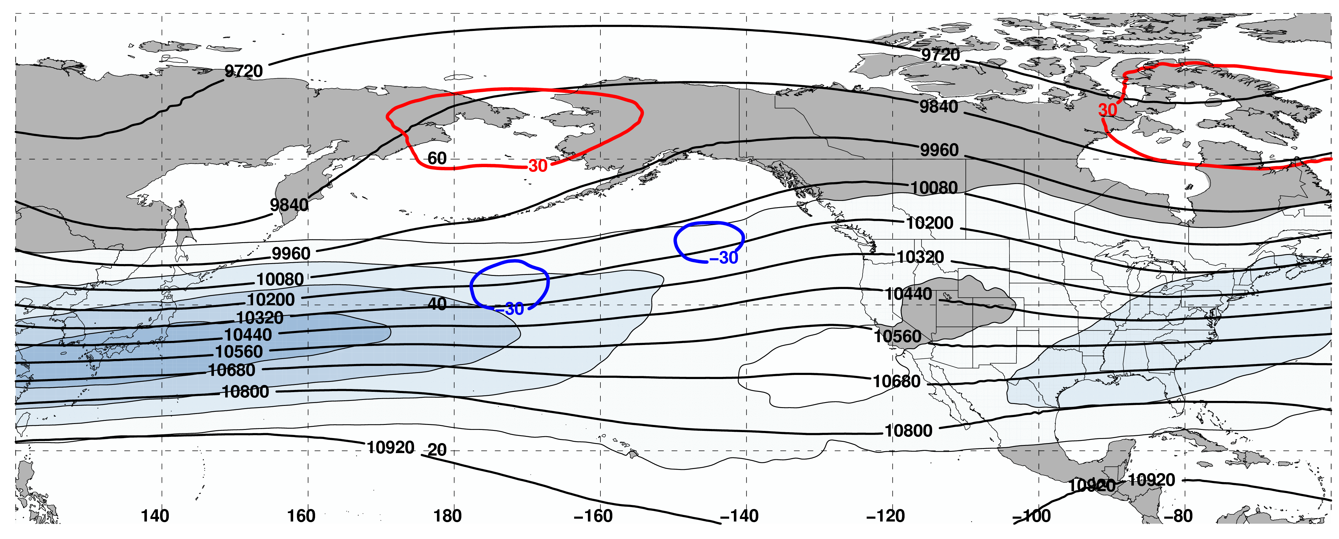
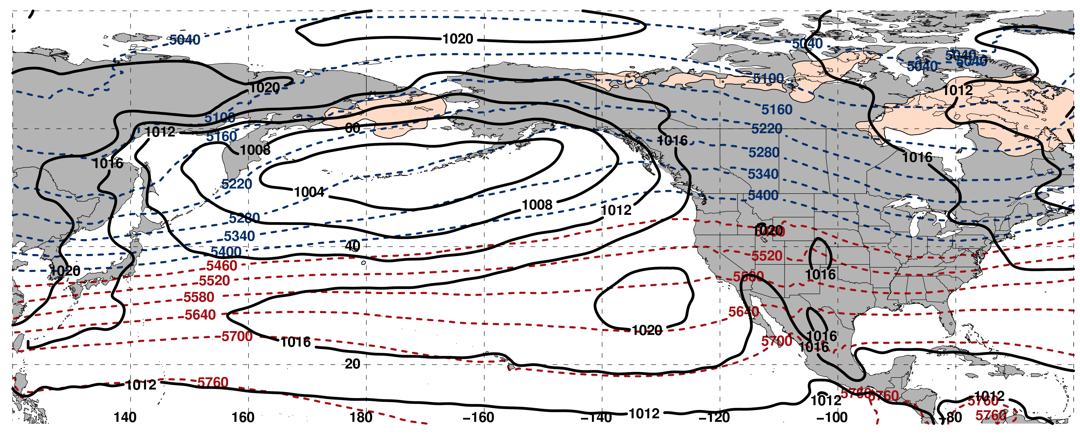
250-hPa Wind Speed, Geo. Heights, Geo. Height Anomalies: Day −10
Jet Extension (n = 159)
m s^{–1}
Mean Sea-Level Pressure, 1000–500-hPa Thickness, 850-hPa Temp. Anomalies: Day −10
K

Slide 14
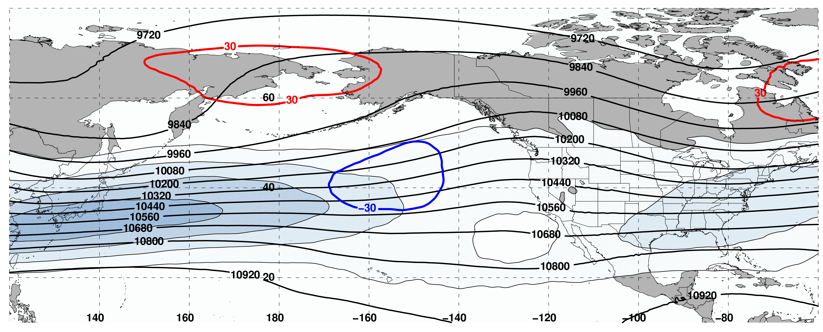
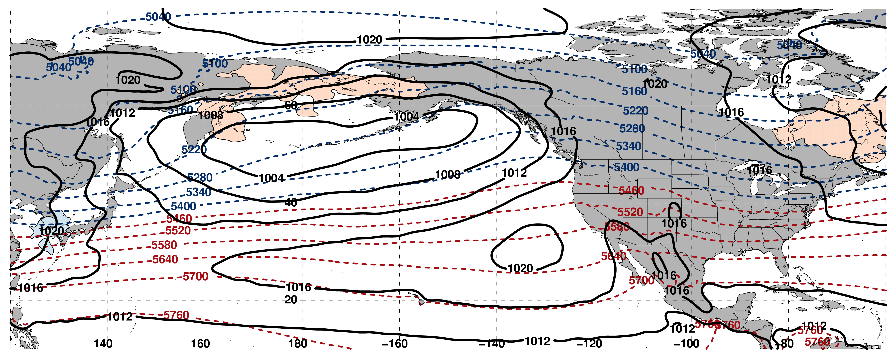
250-hPa Wind Speed, Geo. Heights, Geo. Height Anomalies: Day −8
Jet Extension (n = 159)
m s^{–1}
Mean Sea-Level Pressure, 1000–500-hPa Thickness, 850-hPa Temp. Anomalies: Day −8
K

Slide 15
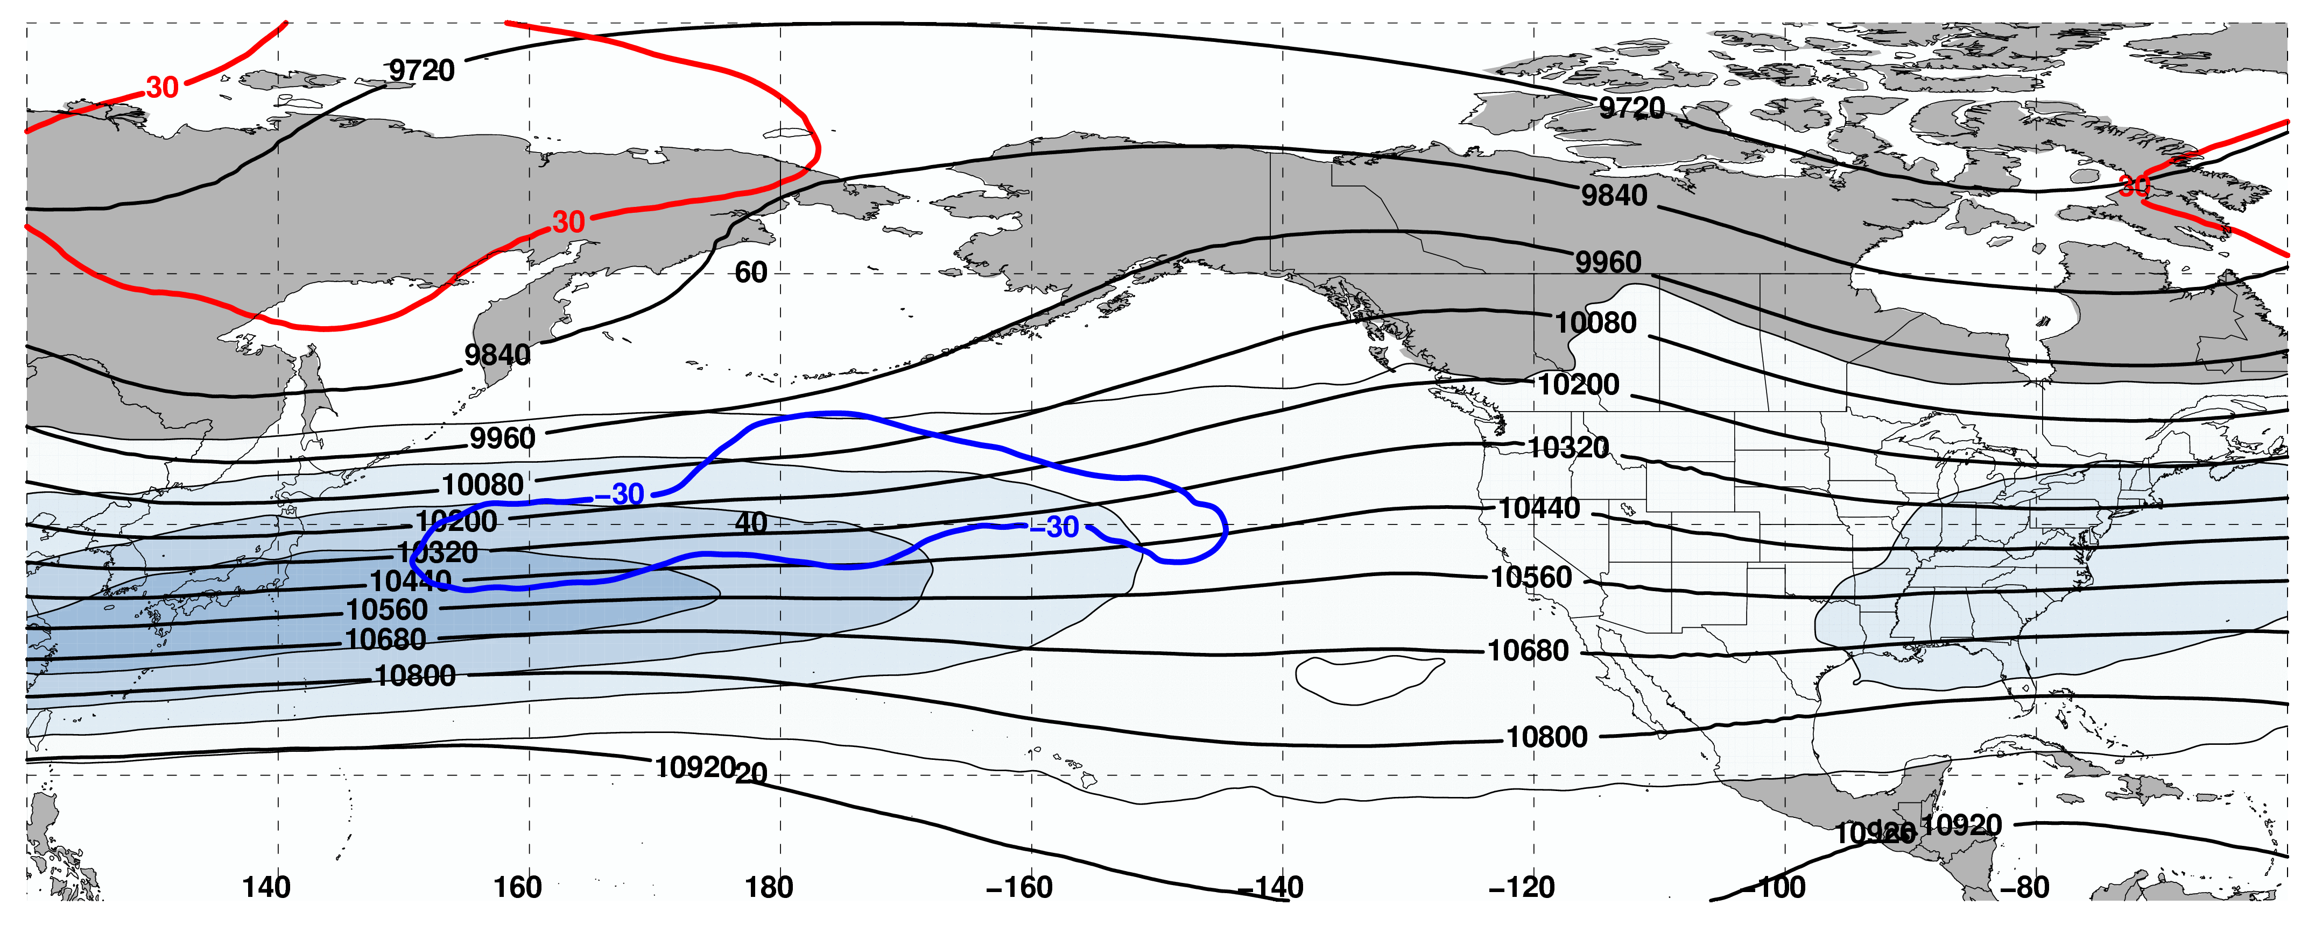
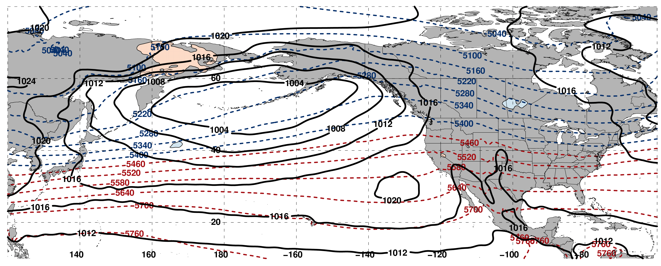
250-hPa Wind Speed, Geo. Heights, Geo. Height Anomalies: Day −6
Jet Extension (n = 159)
m s^{–1}
Mean Sea-Level Pressure, 1000–500-hPa Thickness, 850-hPa Temp. Anomalies: Day −6
K

Slide 16
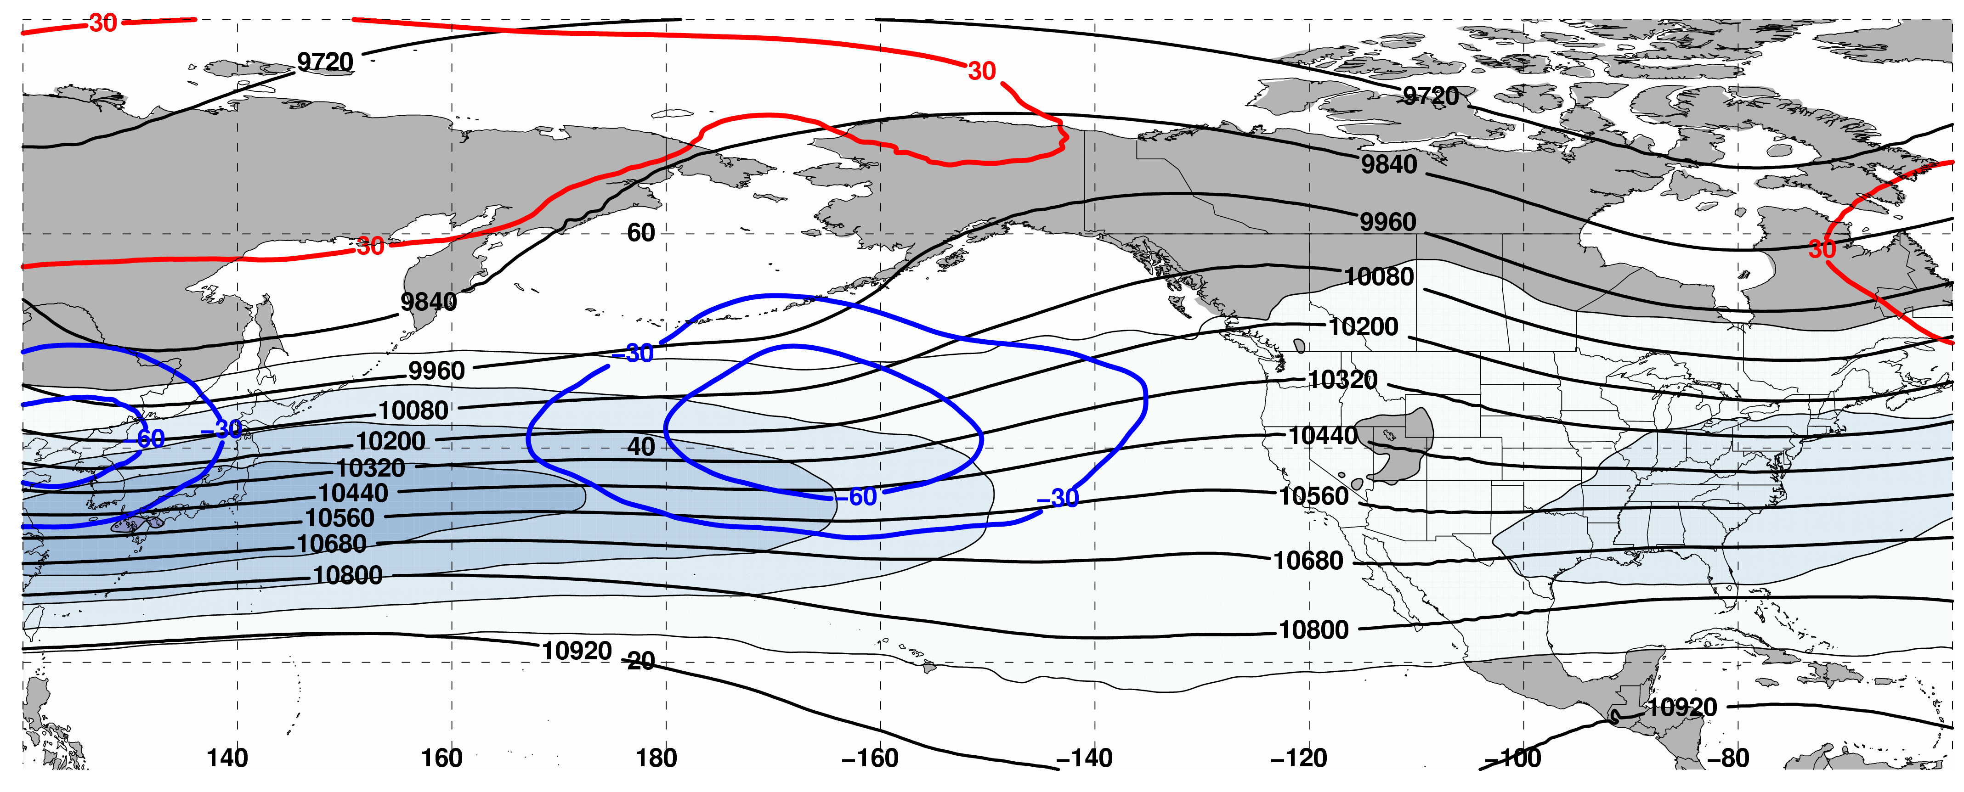
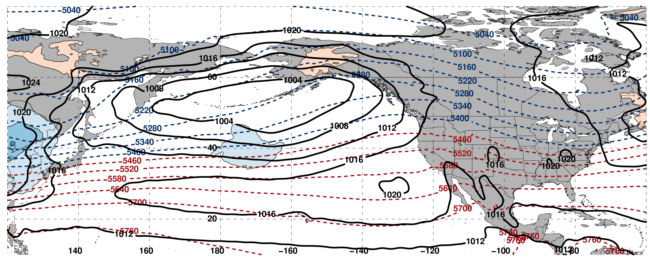
250-hPa Wind Speed, Geo. Heights, Geo. Height Anomalies: Day −4
Jet Extension (n = 159)
m s^{–1}
Mean Sea-Level Pressure, 1000–500-hPa Thickness, 850-hPa Temp. Anomalies: Day −4
K

Slide 17
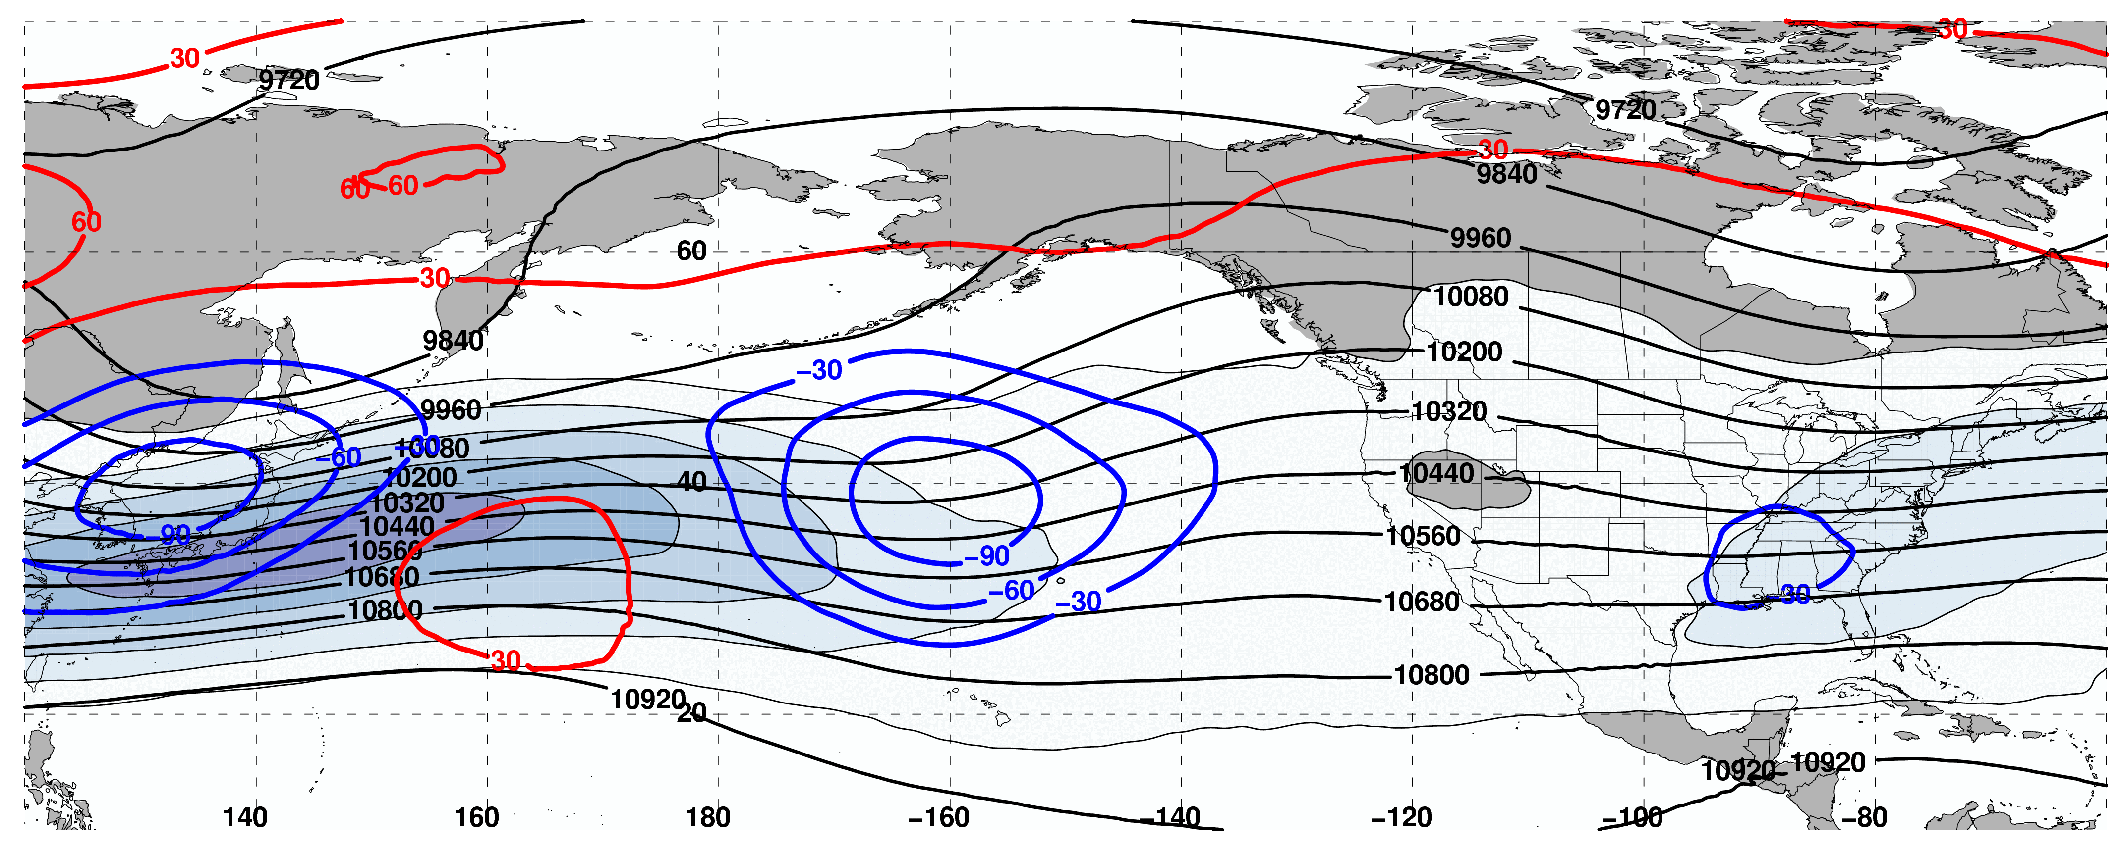
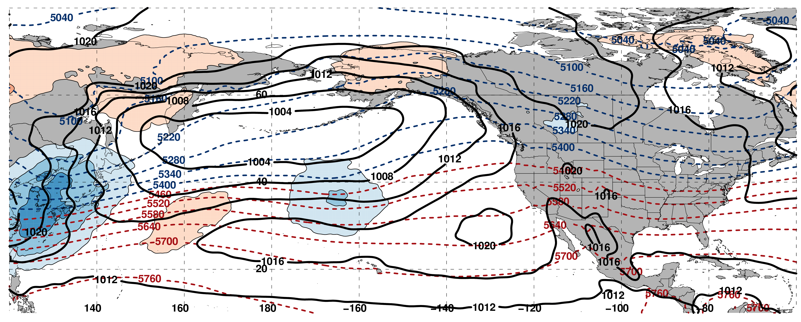
250-hPa Wind Speed, Geo. Heights, Geo. Height Anomalies: Day −2
Jet Extension (n = 159)
m s^{–1}
Mean Sea-Level Pressure, 1000–500-hPa Thickness, 850-hPa Temp. Anomalies: Day −2
K

Slide 18
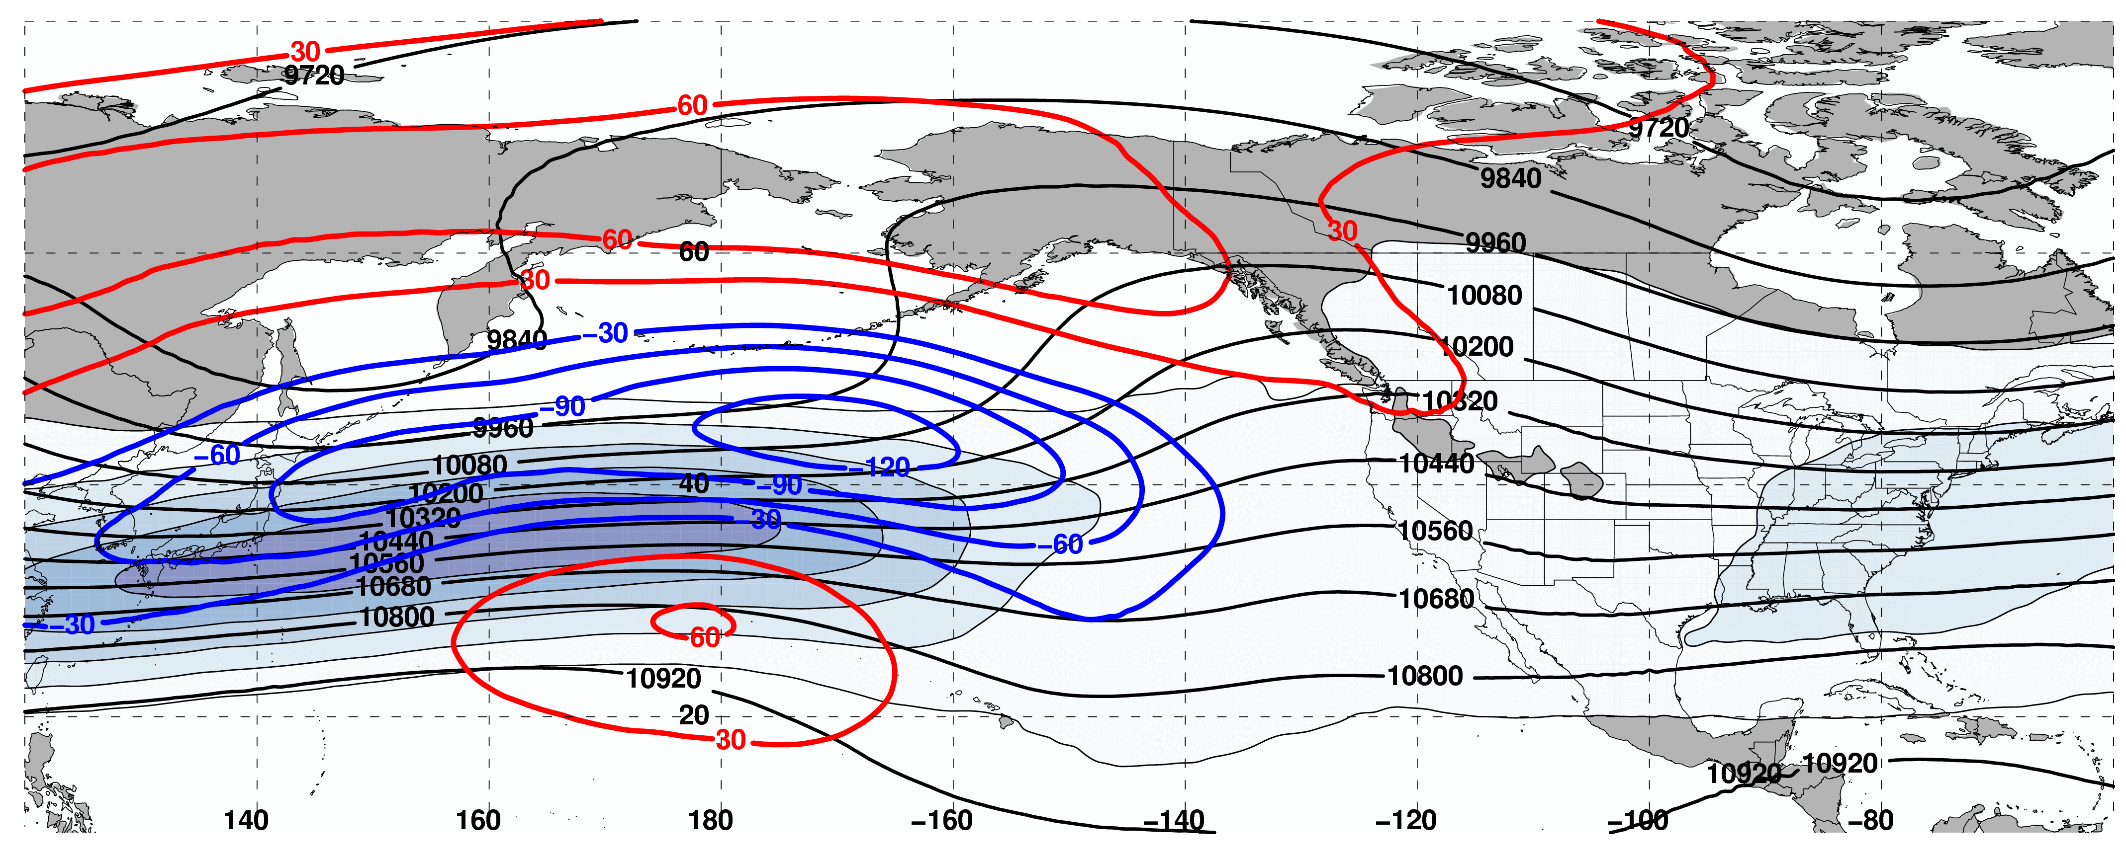
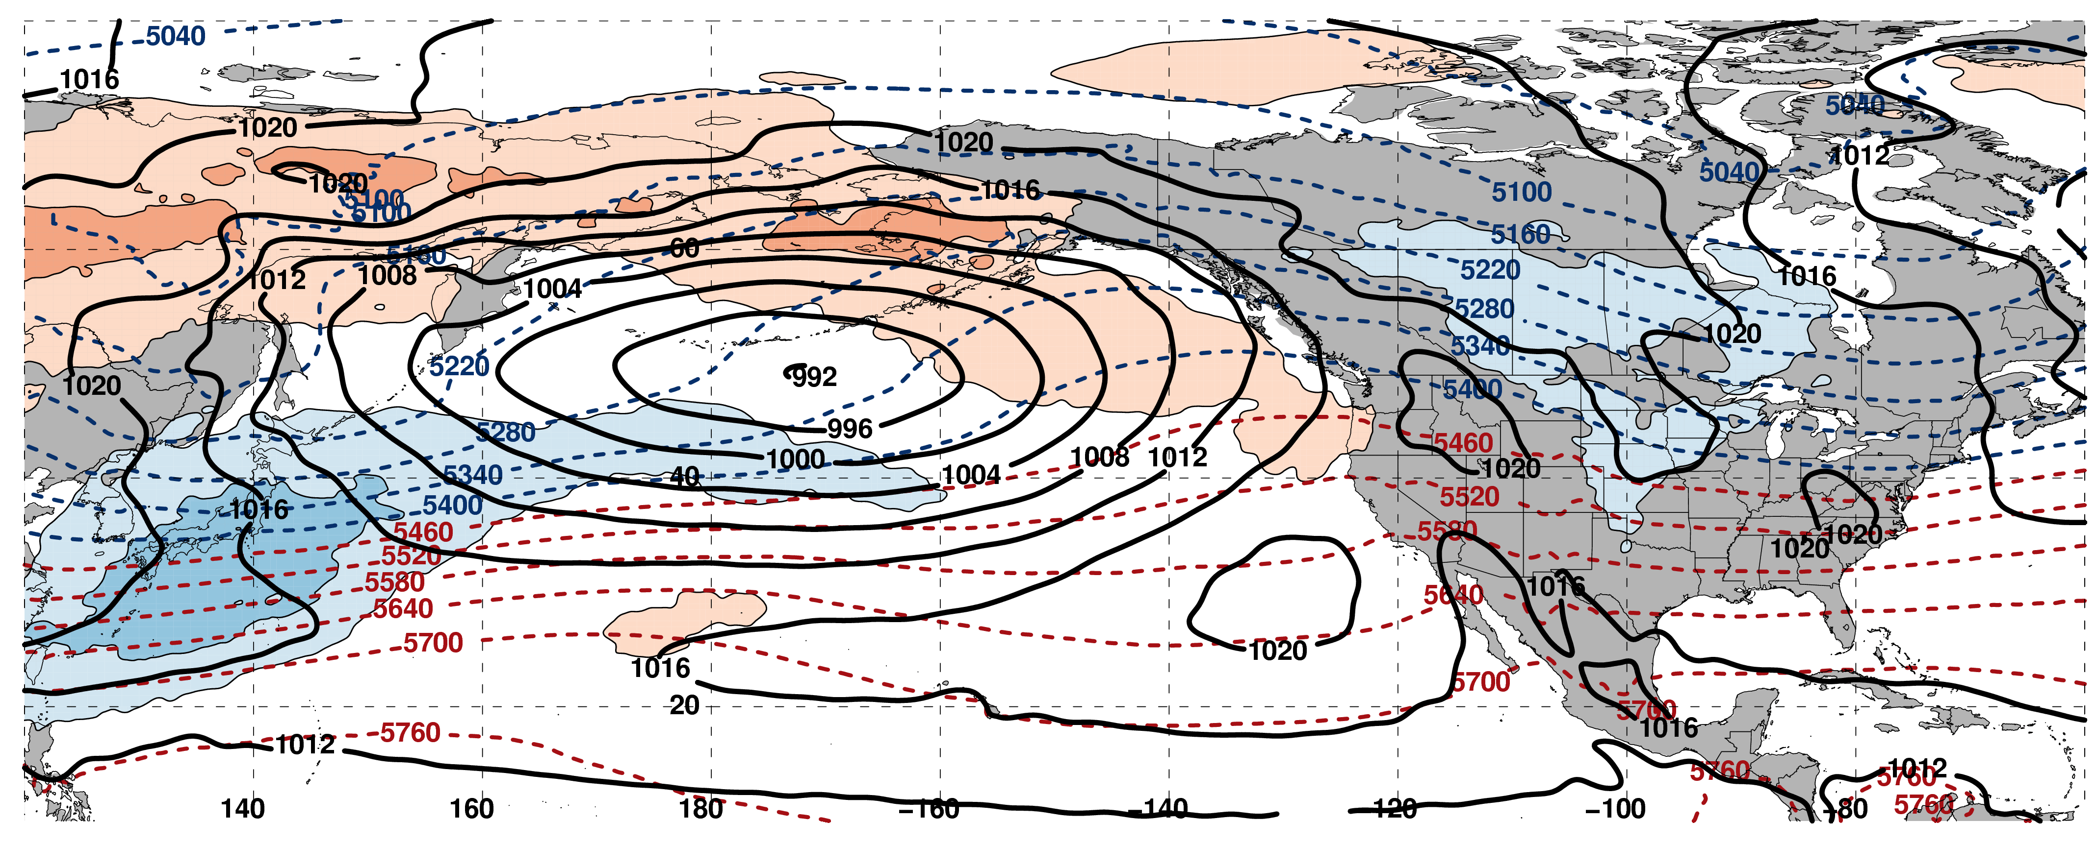
250-hPa Wind Speed, Geo. Heights, Geo. Height Anomalies: Day 0
Jet Extension (n = 159)
m s^{–1}
Mean Sea-Level Pressure, 1000–500-hPa Thickness, 850-hPa Temp. Anomalies: Day 0
K

Slide 19
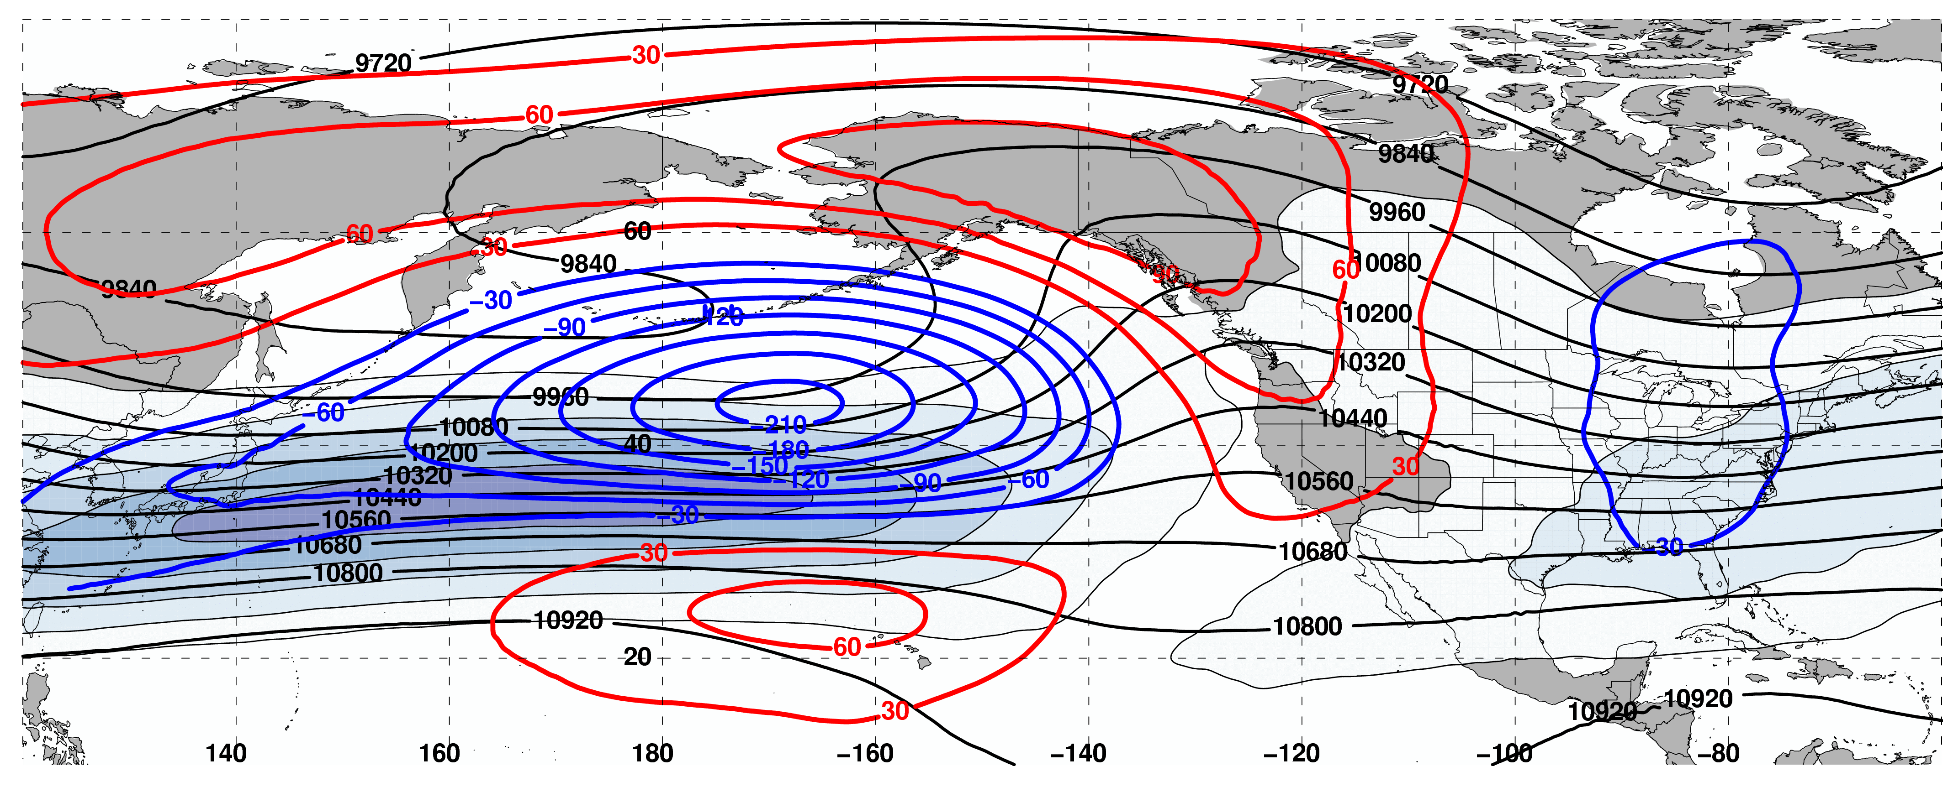
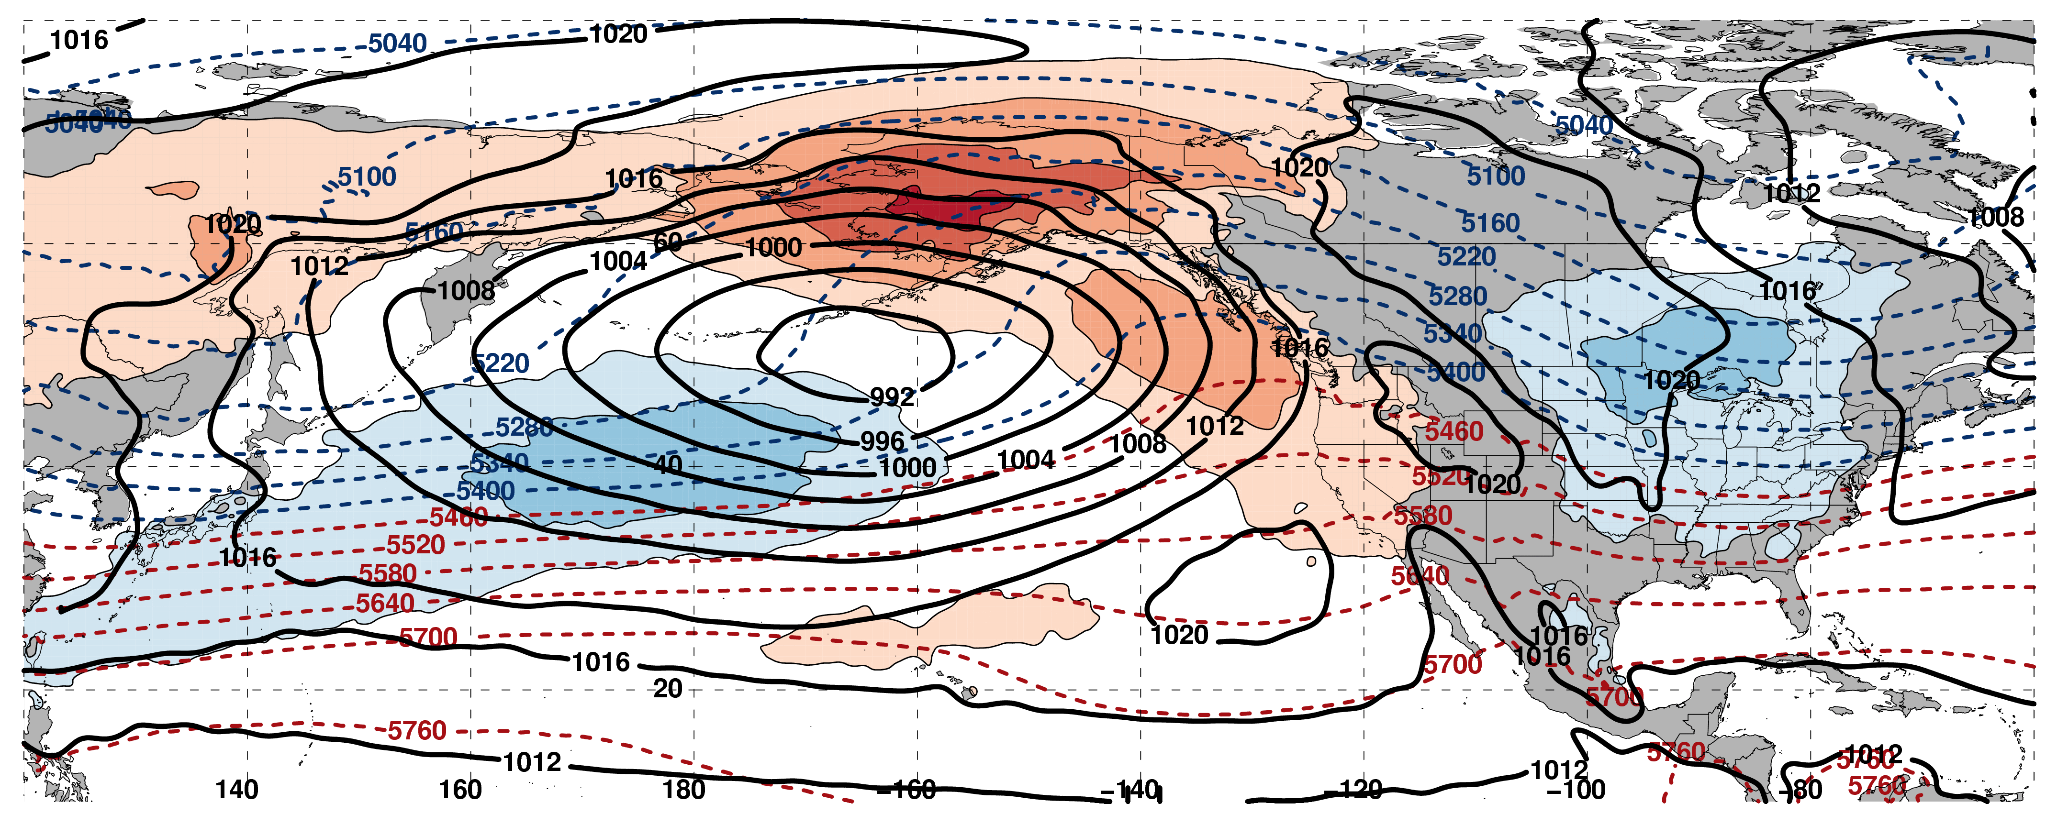
250-hPa Wind Speed, Geo. Heights, Geo. Height Anomalies: Day 2
Jet Extension (n = 159)
m s^{–1}
Mean Sea-Level Pressure, 1000–500-hPa Thickness, 850-hPa Temp. Anomalies: Day 2
K

Slide 20
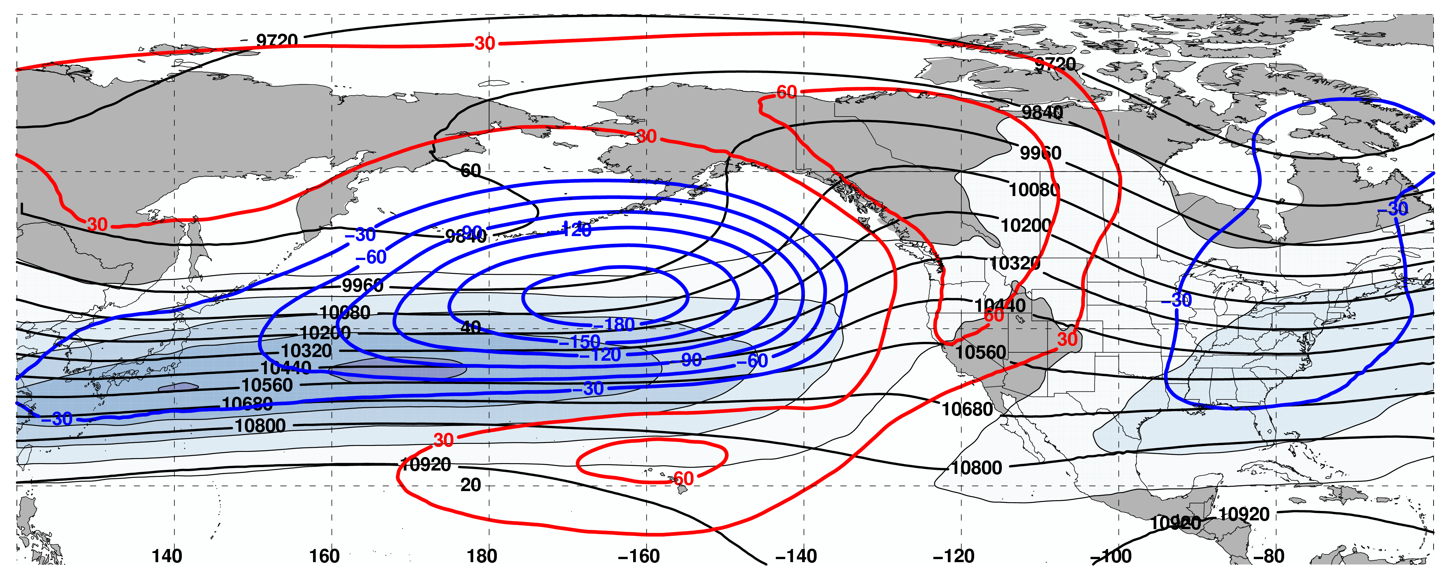
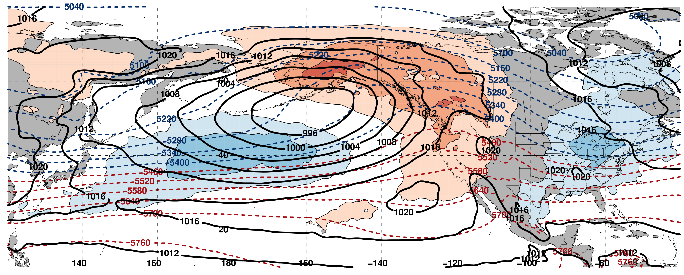
250-hPa Wind Speed, Geo. Heights, Geo. Height Anomalies: Day 4
Jet Extension (n = 159)
m s^{–1}
Mean Sea-Level Pressure, 1000–500-hPa Thickness, 850-hPa Temp. Anomalies: Day 4
K

Slide 21
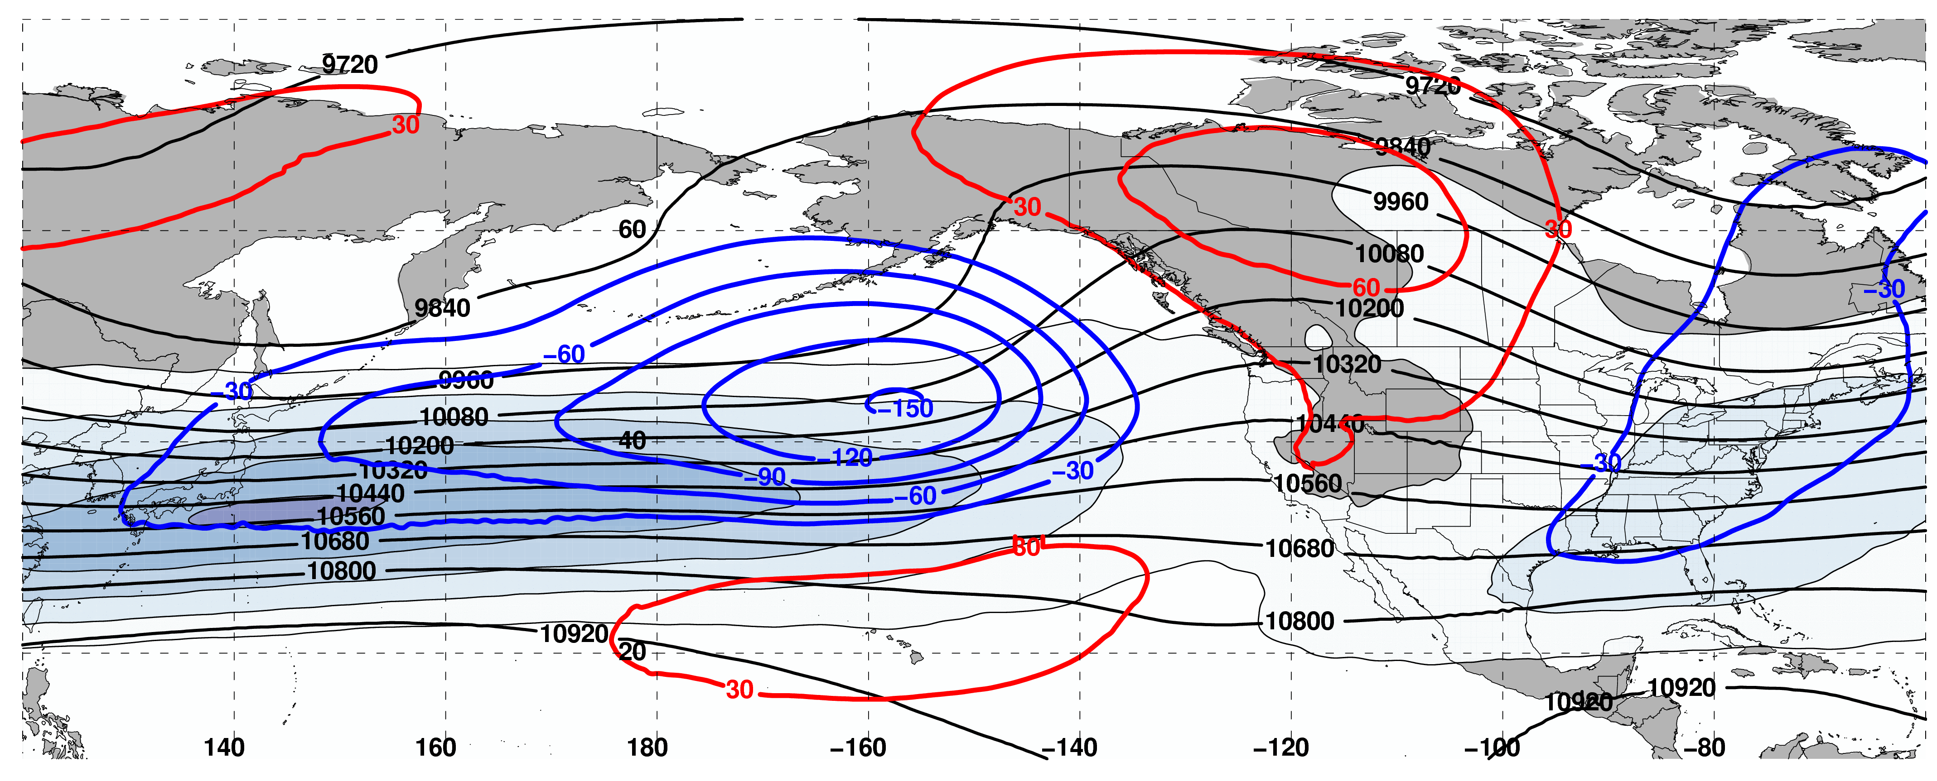
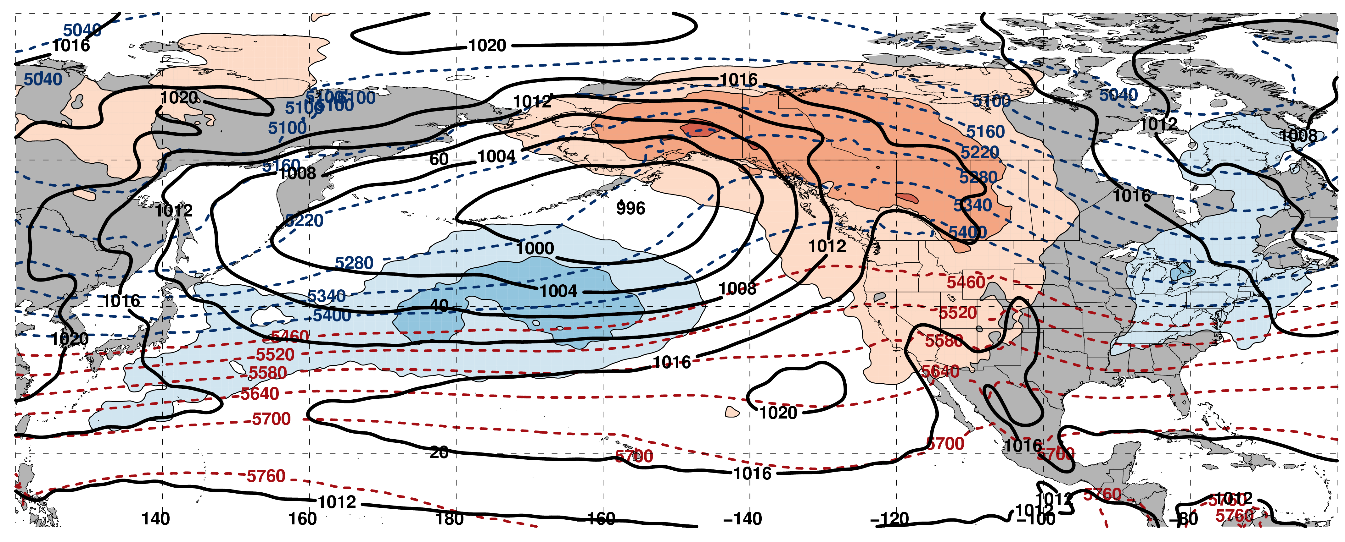
250-hPa Wind Speed, Geo. Heights, Geo. Height Anomalies: Day 6
Jet Extension (n = 159)
m s^{–1}
Mean Sea-Level Pressure, 1000–500-hPa Thickness, 850-hPa Temp. Anomalies: Day 6
K

Slide 22
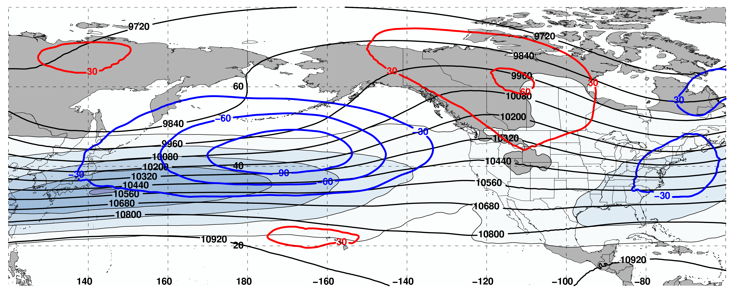
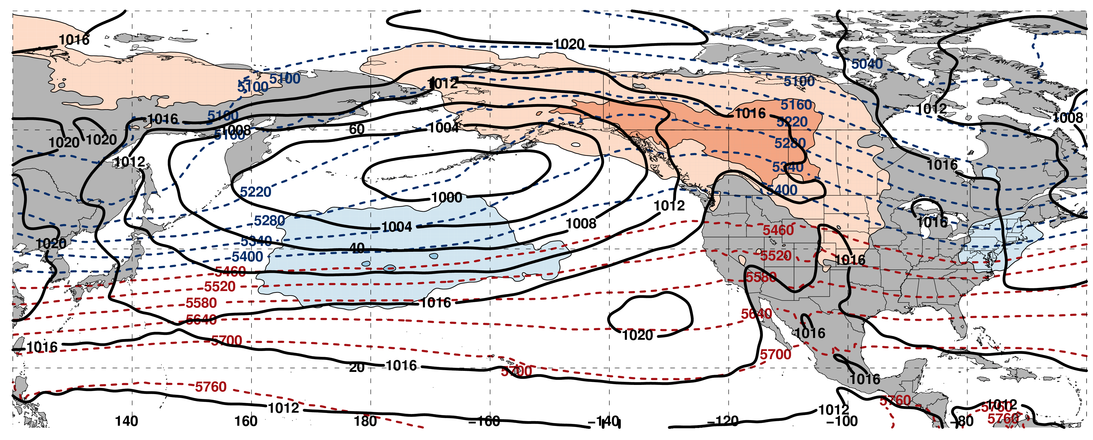
250-hPa Wind Speed, Geo. Heights, Geo. Height Anomalies: Day 8
Jet Extension (n = 159)
m s^{–1}
Mean Sea-Level Pressure, 1000–500-hPa Thickness, 850-hPa Temp. Anomalies: Day 8
K

Slide 23
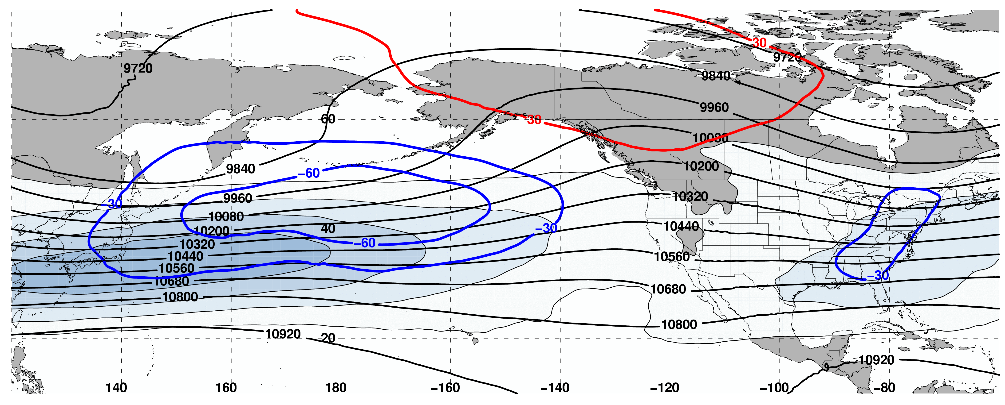
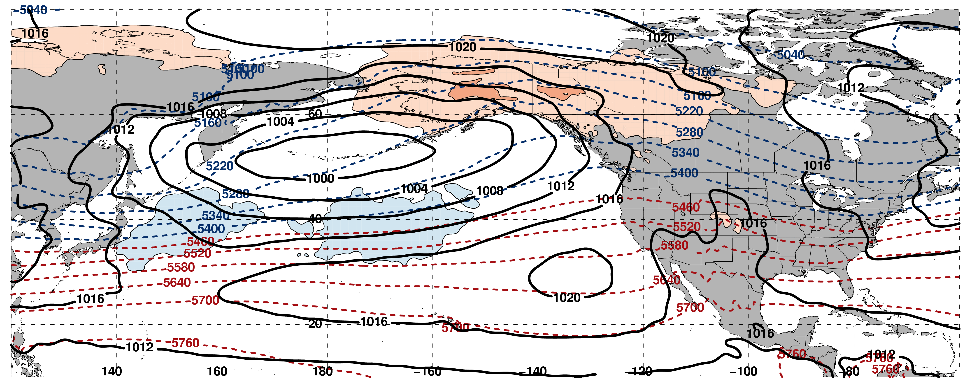
250-hPa Wind Speed, Geo. Heights, Geo. Height Anomalies: Day 10
Jet Extension (n = 159)
m s^{–1}
Mean Sea-Level Pressure, 1000–500-hPa Thickness, 850-hPa Temp. Anomalies: Day 10
K

Slide 24
Jet Retraction

Slide 25
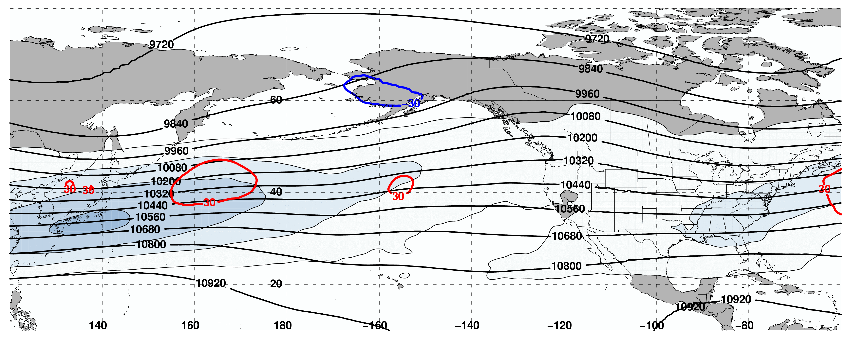
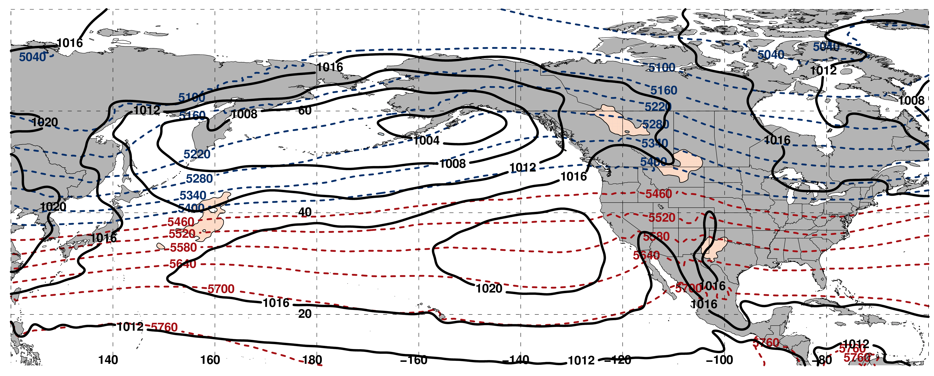
250-hPa Wind Speed, Geo. Heights, Geo. Height Anomalies: Day –10
Jet Retraction (n = 162)
m s^{–1}
Mean Sea-Level Pressure, 1000–500-hPa Thickness, 850-hPa Temp. Anomalies: Day –10
K

Slide 26
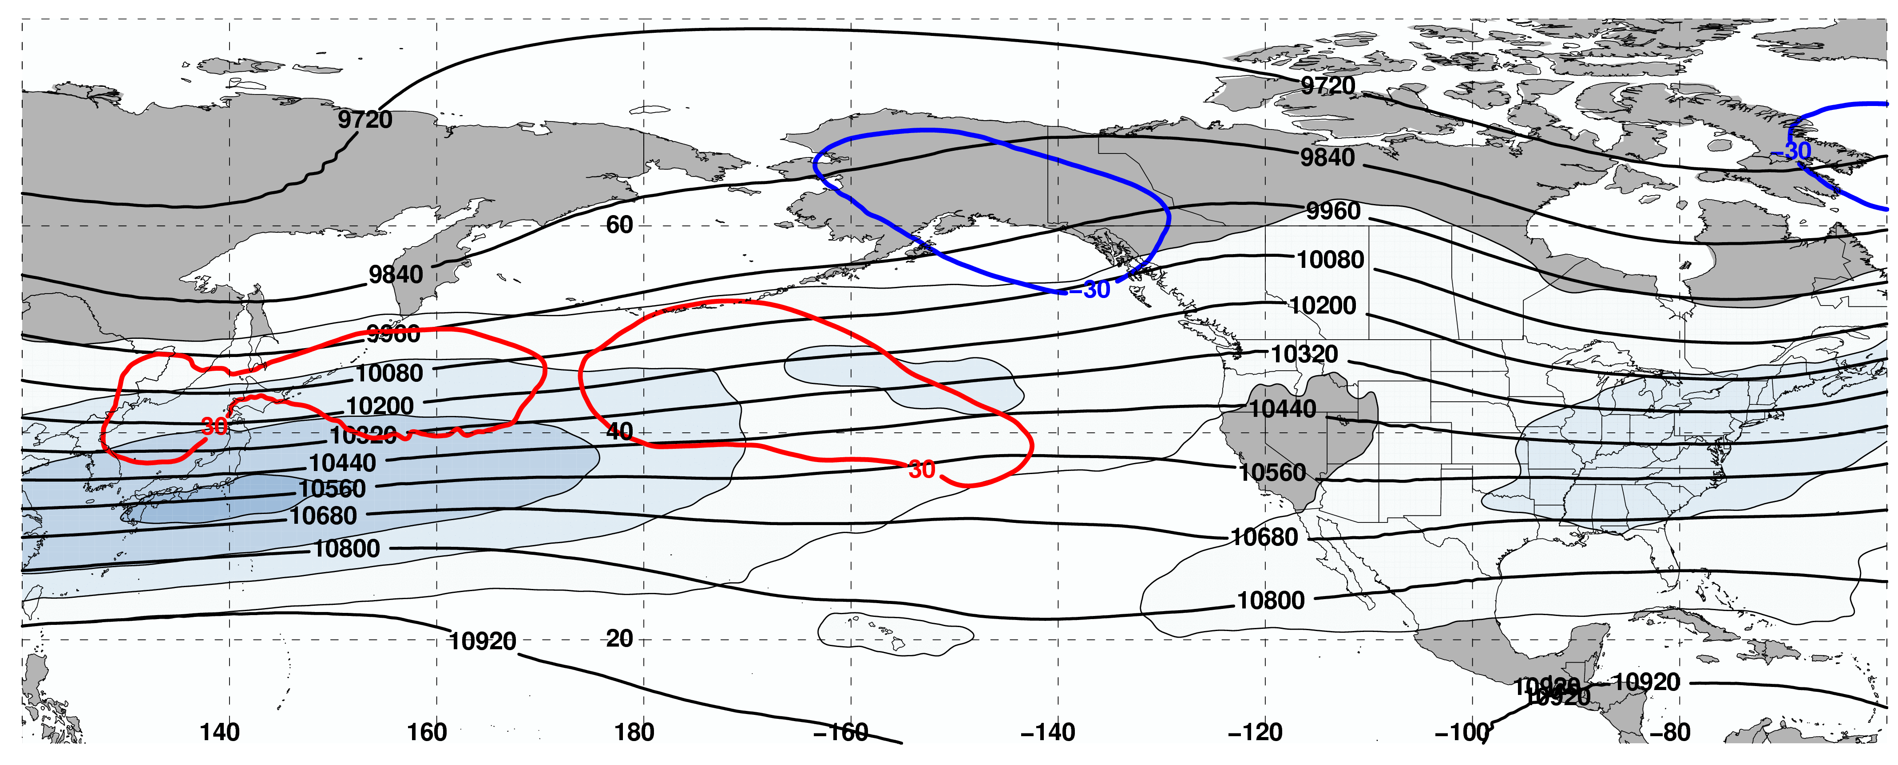
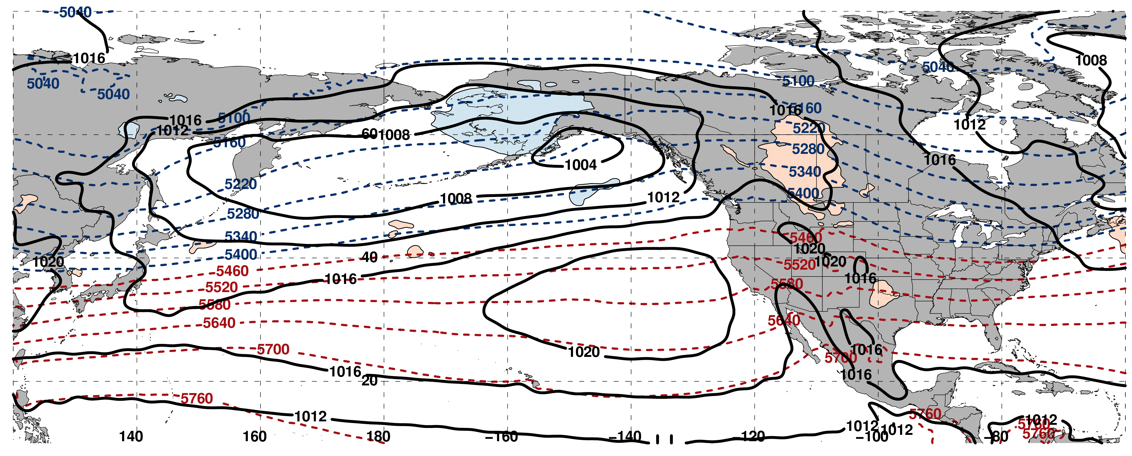
250-hPa Wind Speed, Geo. Heights, Geo. Height Anomalies: Day –8
Jet Retraction (n = 162)
m s^{–1}
Mean Sea-Level Pressure, 1000–500-hPa Thickness, 850-hPa Temp. Anomalies: Day –8
K

Slide 27
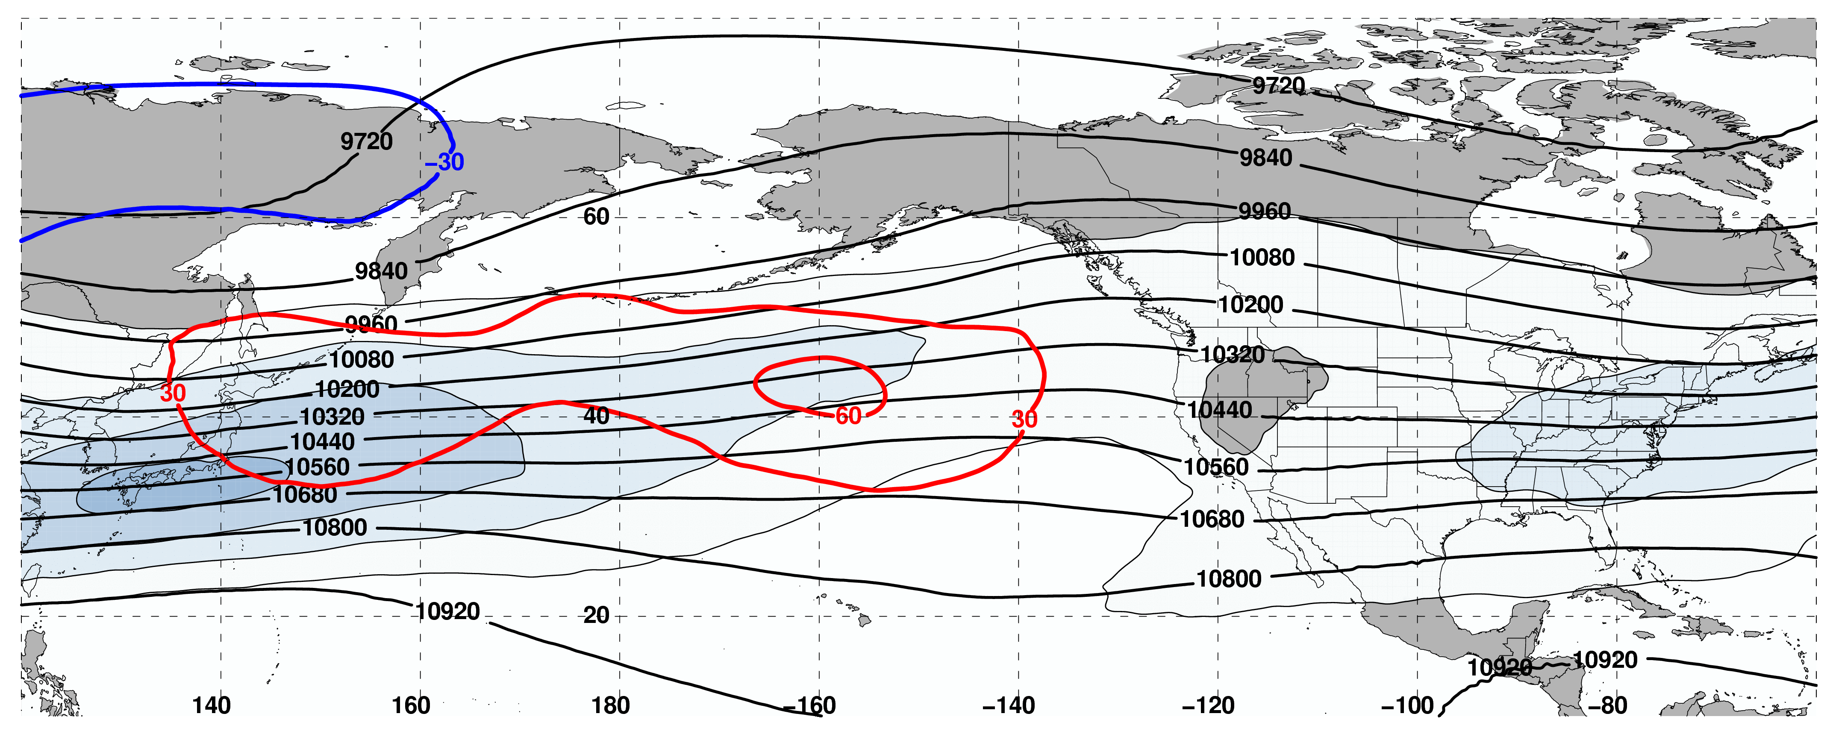
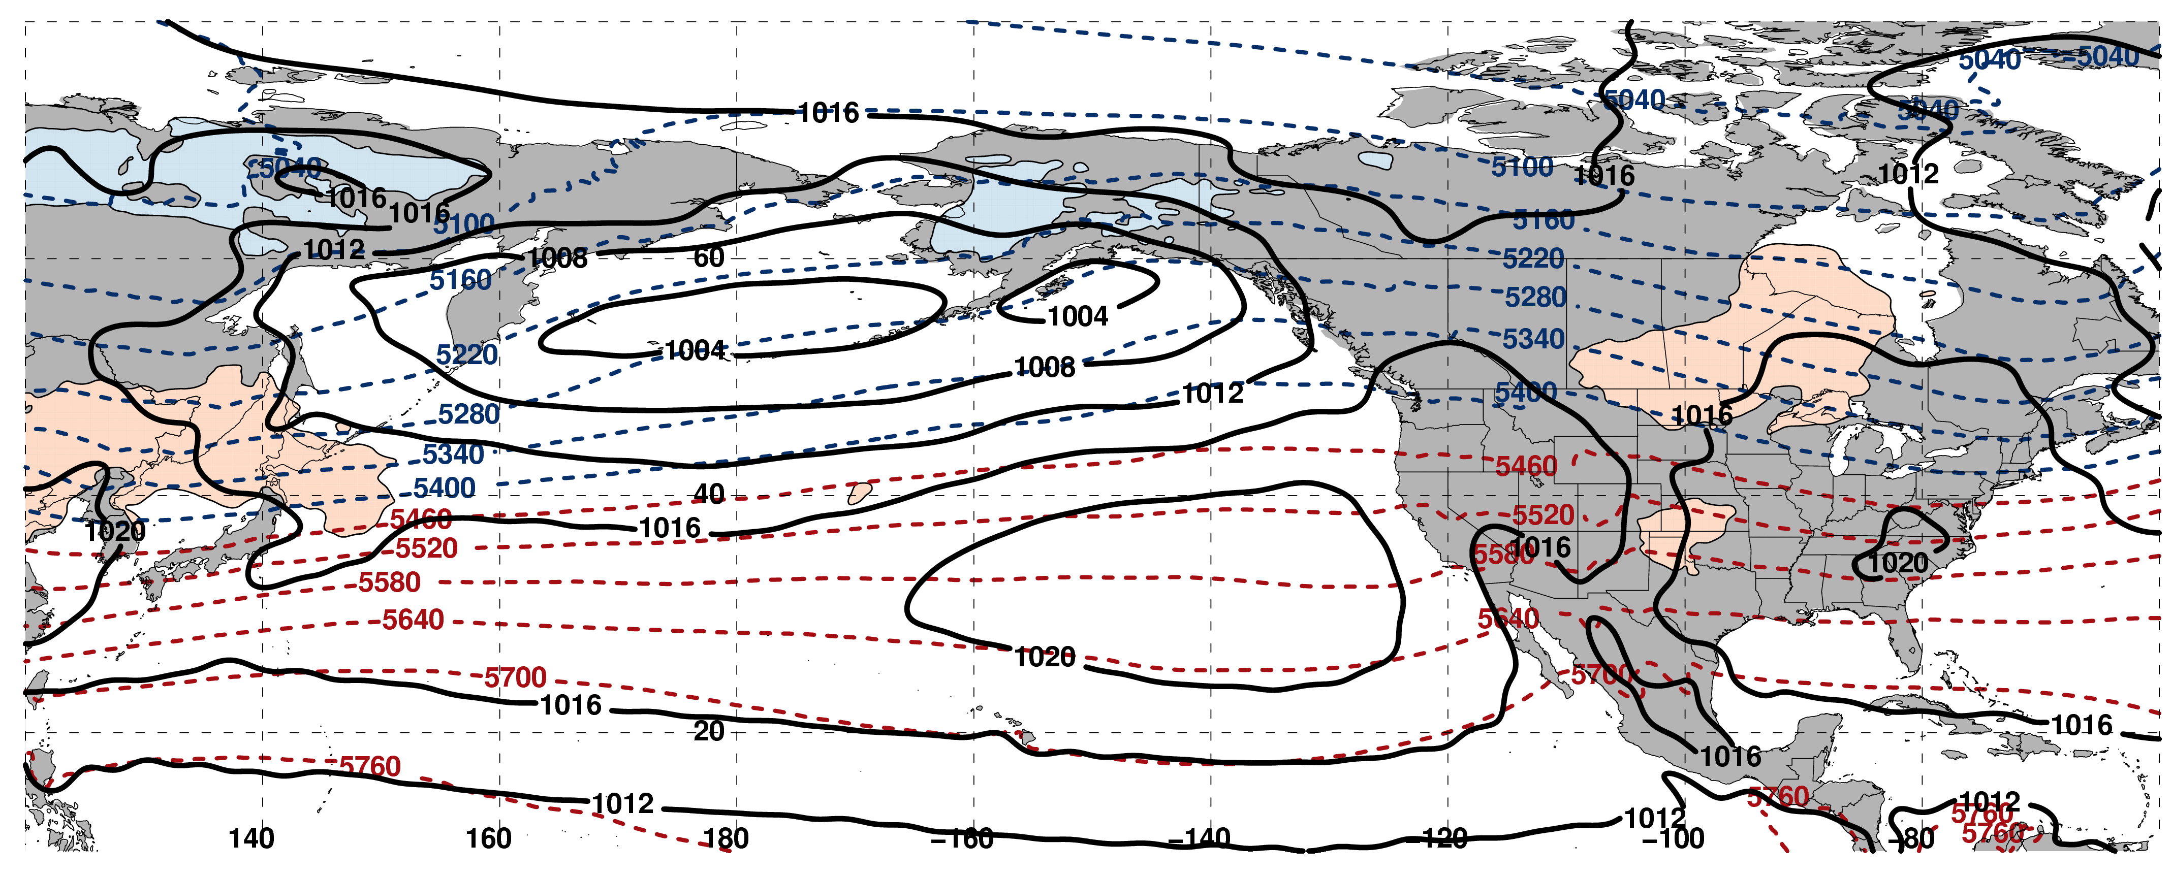
250-hPa Wind Speed, Geo. Heights, Geo. Height Anomalies: Day –6
Jet Retraction (n = 162)
m s^{–1}
Mean Sea-Level Pressure, 1000–500-hPa Thickness, 850-hPa Temp. Anomalies: Day –6
K

Slide 28
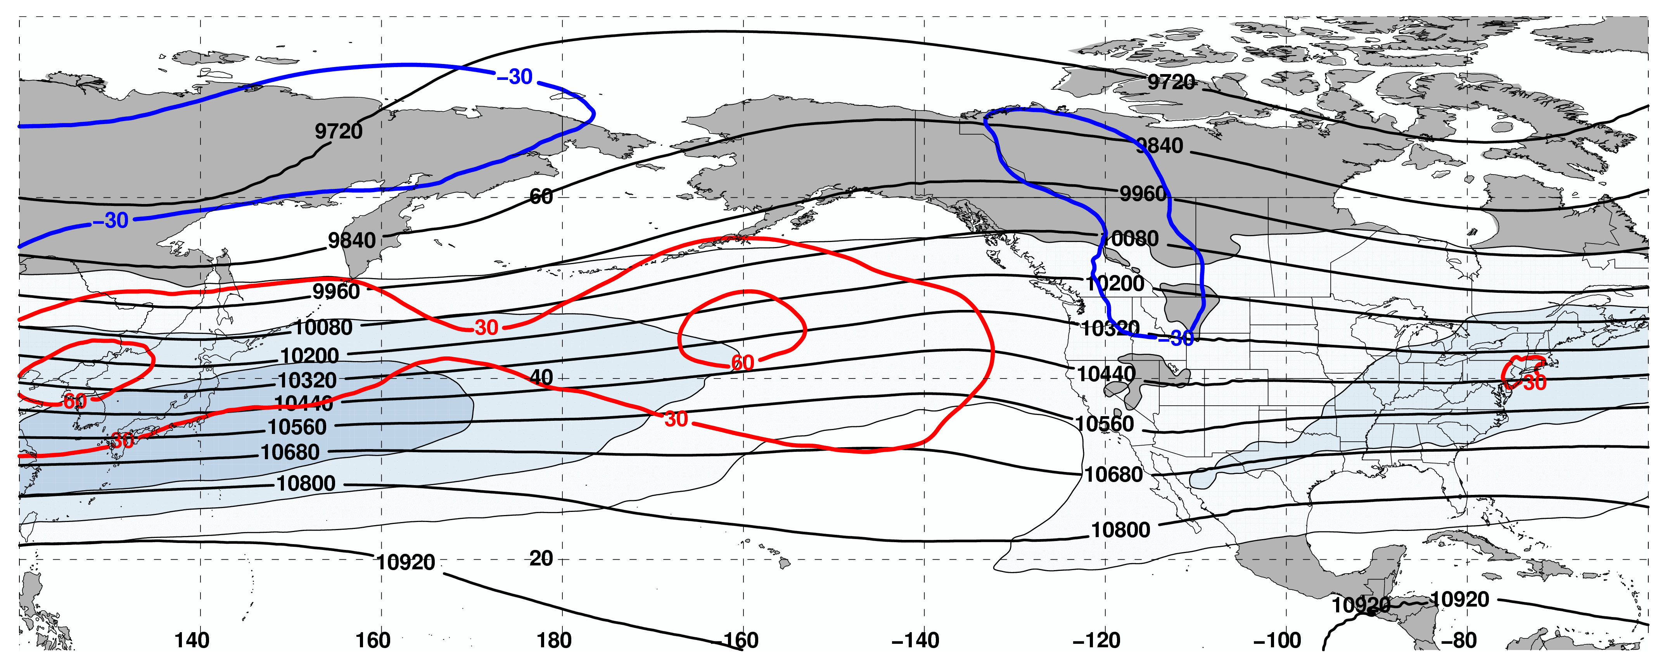
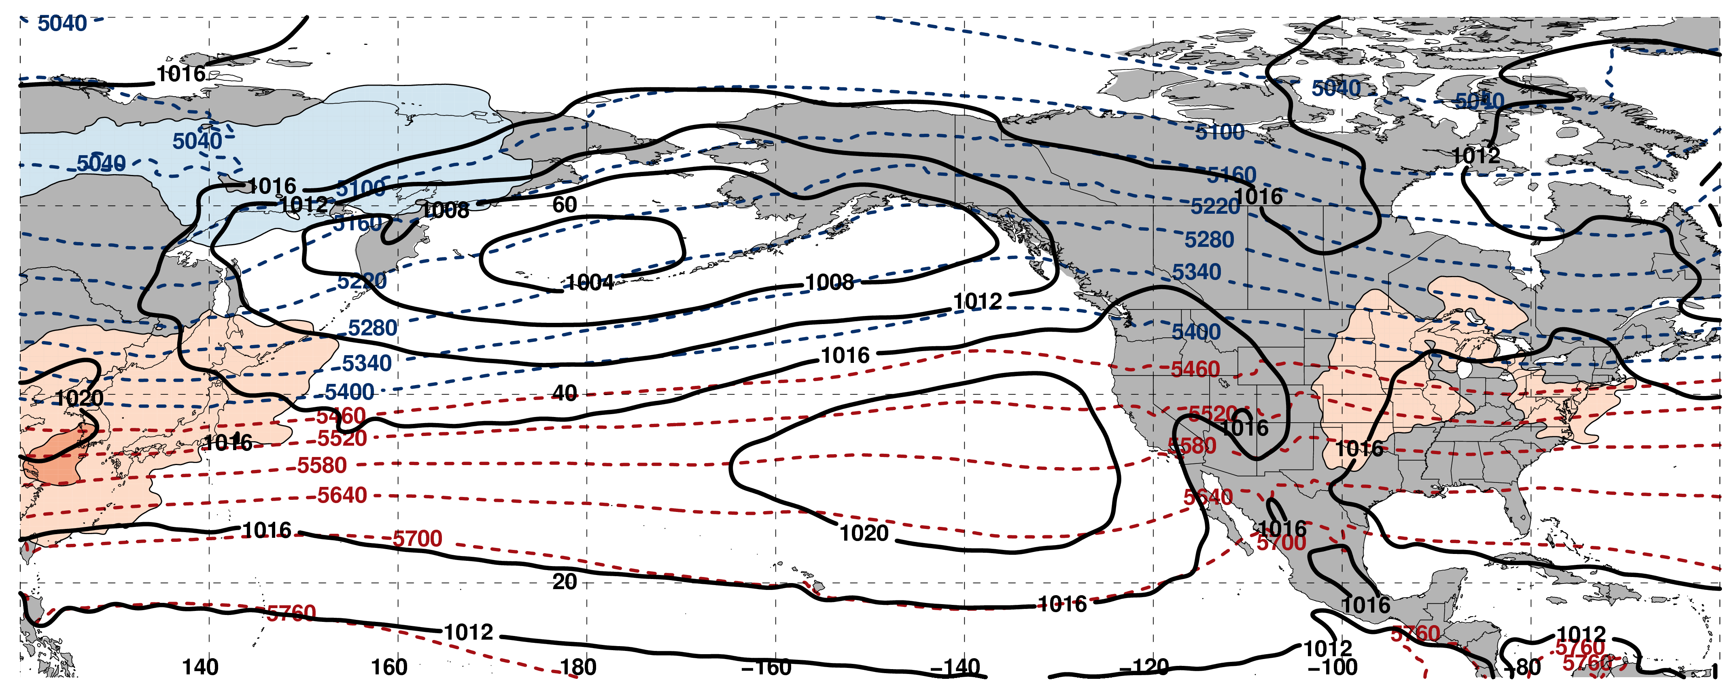
250-hPa Wind Speed, Geo. Heights, Geo. Height Anomalies: Day –4
Jet Retraction (n = 162)
m s^{–1}
Mean Sea-Level Pressure, 1000–500-hPa Thickness, 850-hPa Temp. Anomalies: Day –4
K

Slide 29
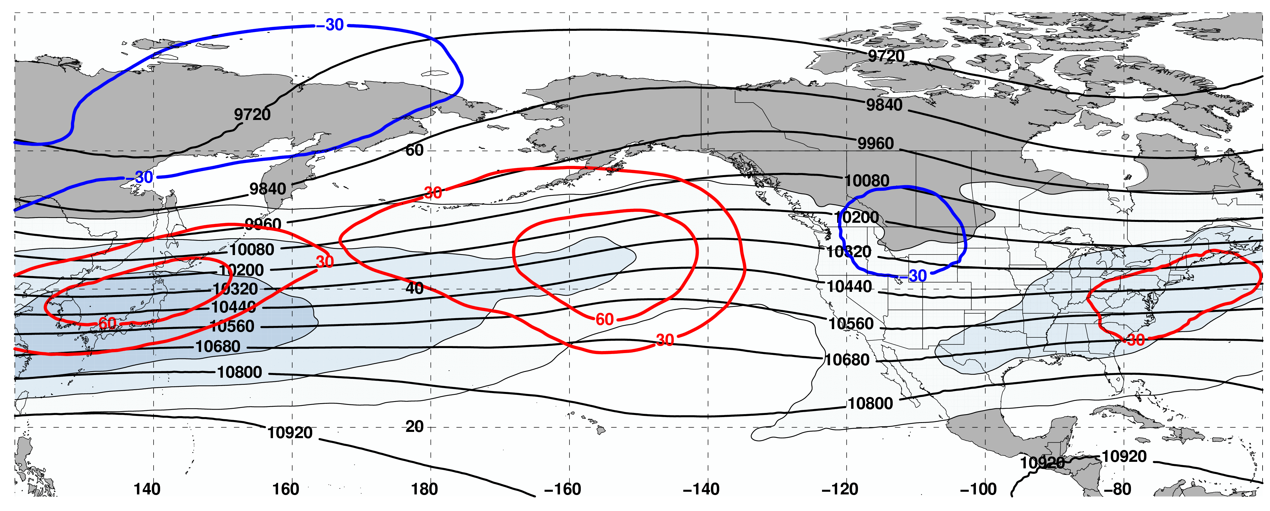
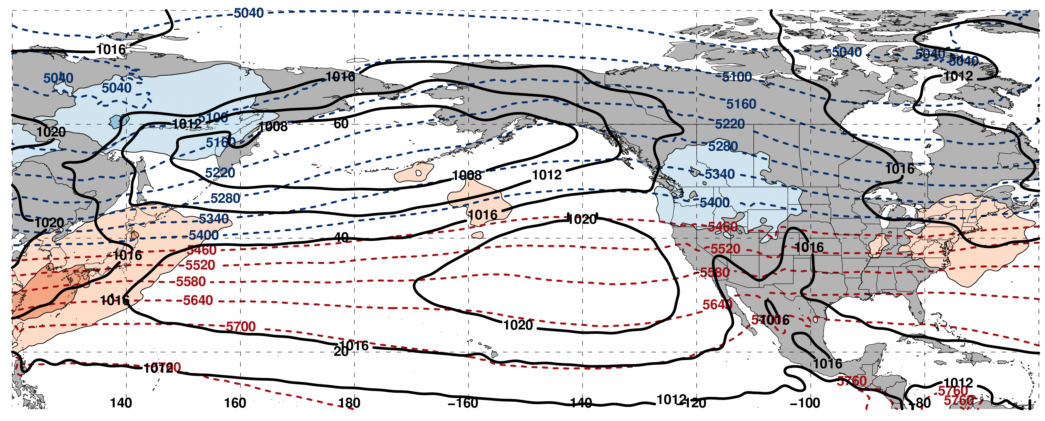
250-hPa Wind Speed, Geo. Heights, Geo. Height Anomalies: Day –2
Jet Retraction (n = 162)
m s^{–1}
Mean Sea-Level Pressure, 1000–500-hPa Thickness, 850-hPa Temp. Anomalies: Day –2
K

Slide 30
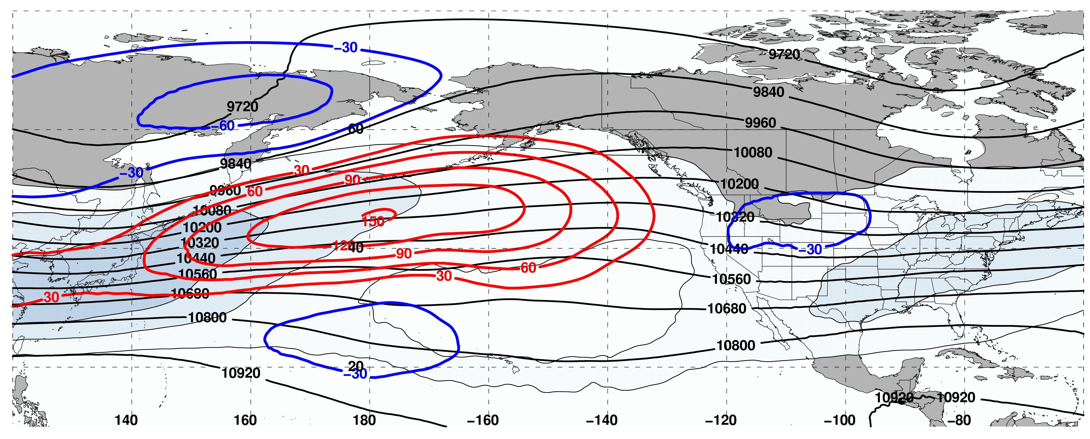
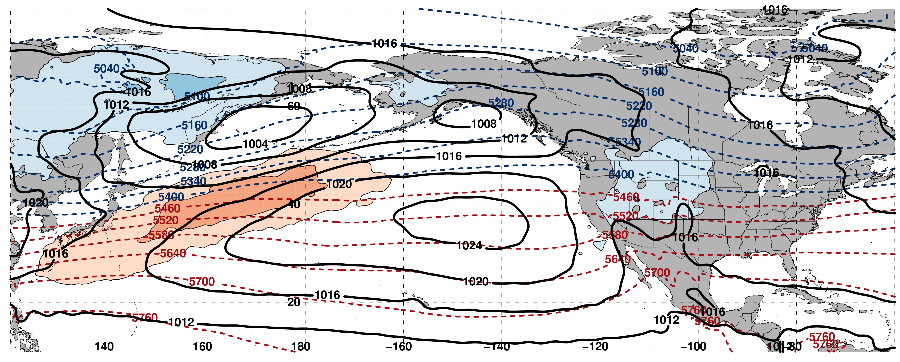
250-hPa Wind Speed, Geo. Heights, Geo. Height Anomalies: Day 0
Jet Retraction (n = 162)
m s^{–1}
Mean Sea-Level Pressure, 1000–500-hPa Thickness, 850-hPa Temp. Anomalies: Day 0
K

Slide 31
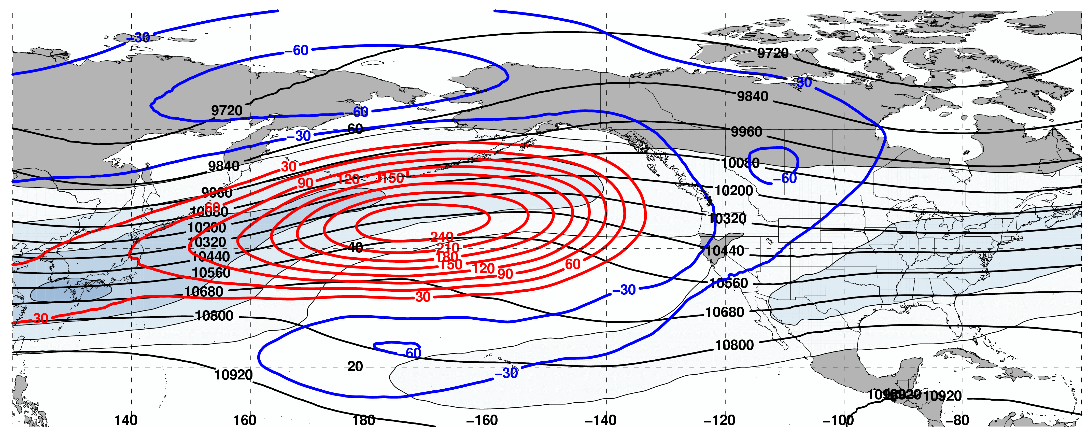
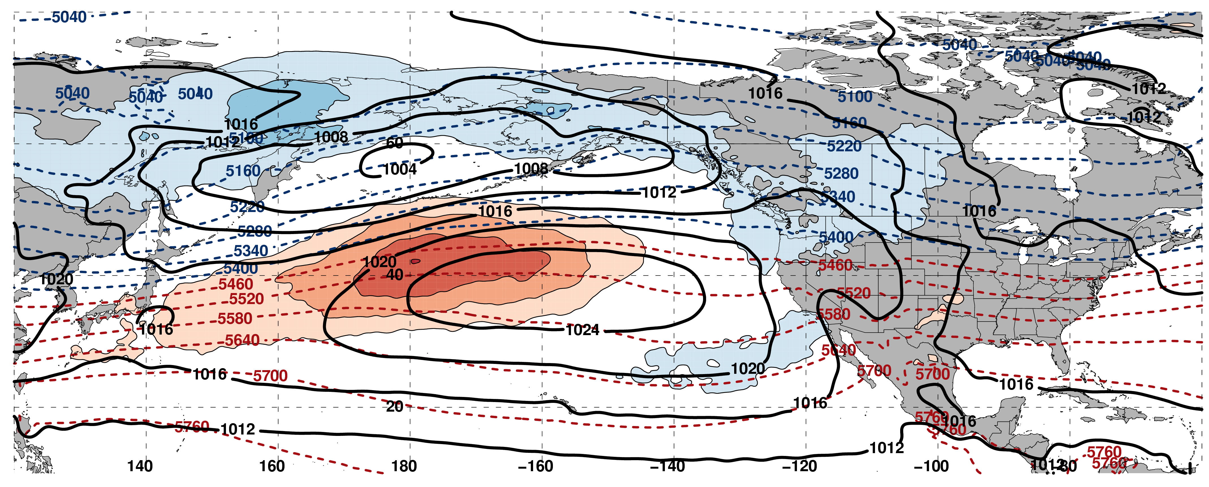
250-hPa Wind Speed, Geo. Heights, Geo. Height Anomalies: Day 2
Jet Retraction (n = 162)
m s^{–1}
Mean Sea-Level Pressure, 1000–500-hPa Thickness, 850-hPa Temp. Anomalies: Day 2
K

Slide 32
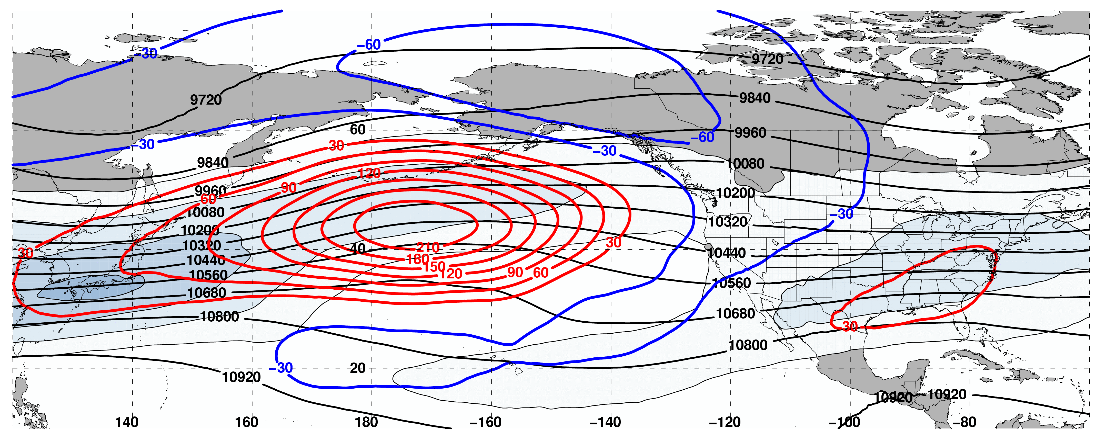
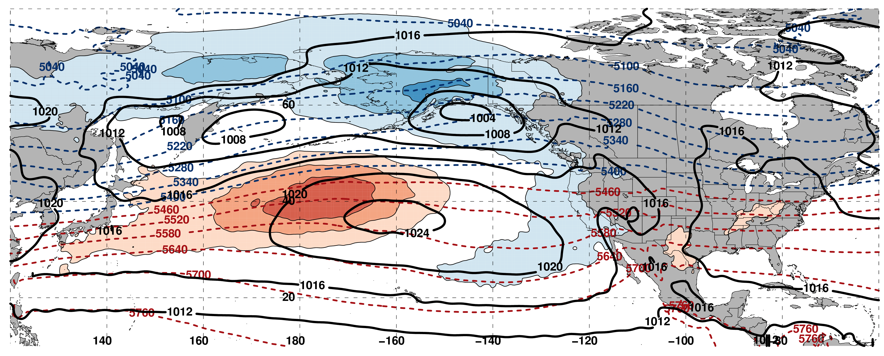
250-hPa Wind Speed, Geo. Heights, Geo. Height Anomalies: Day 4
Jet Retraction (n = 162)
m s^{–1}
Mean Sea-Level Pressure, 1000–500-hPa Thickness, 850-hPa Temp. Anomalies: Day 4
K

Slide 33
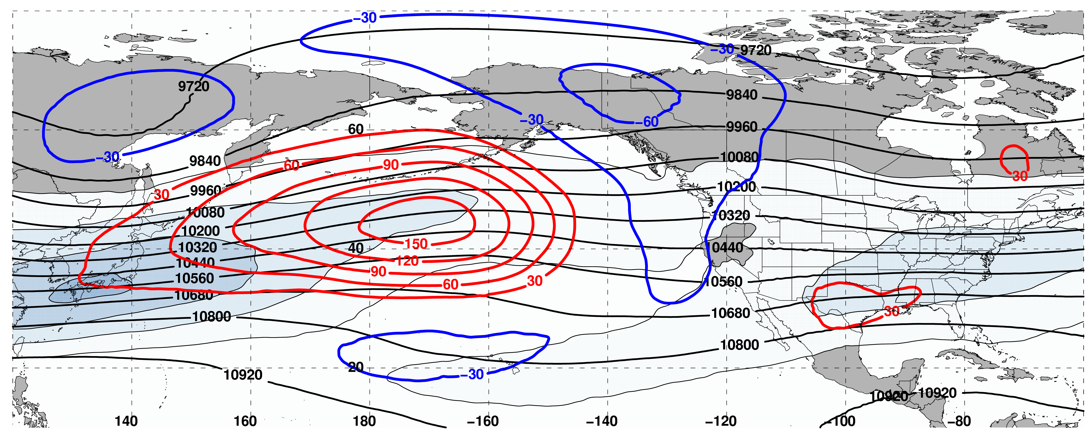
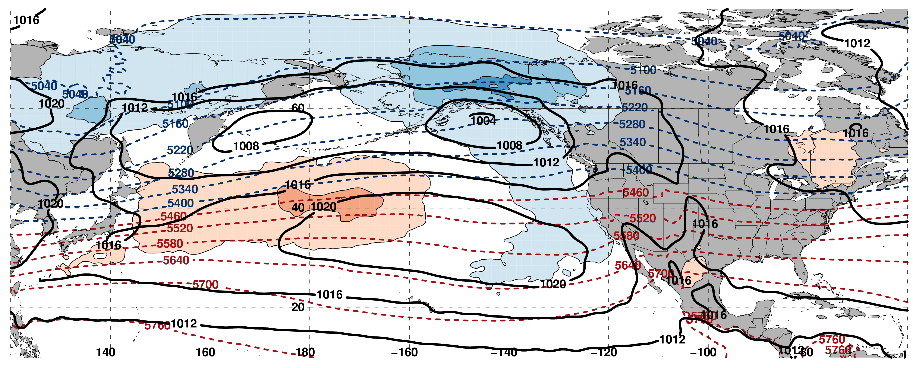
250-hPa Wind Speed, Geo. Heights, Geo. Height Anomalies: Day 6
Jet Retraction (n = 162)
m s^{–1}
Mean Sea-Level Pressure, 1000–500-hPa Thickness, 850-hPa Temp. Anomalies: Day 6
K

Slide 34
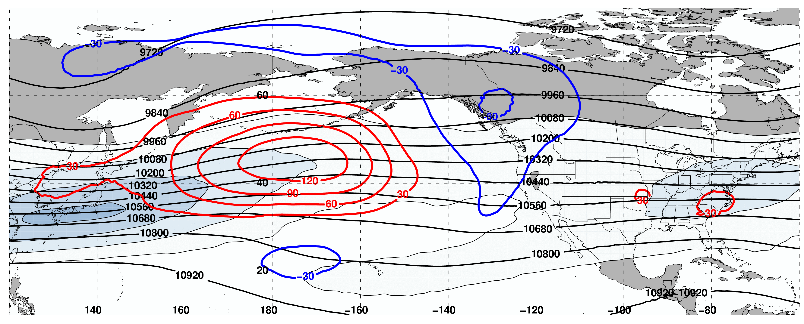
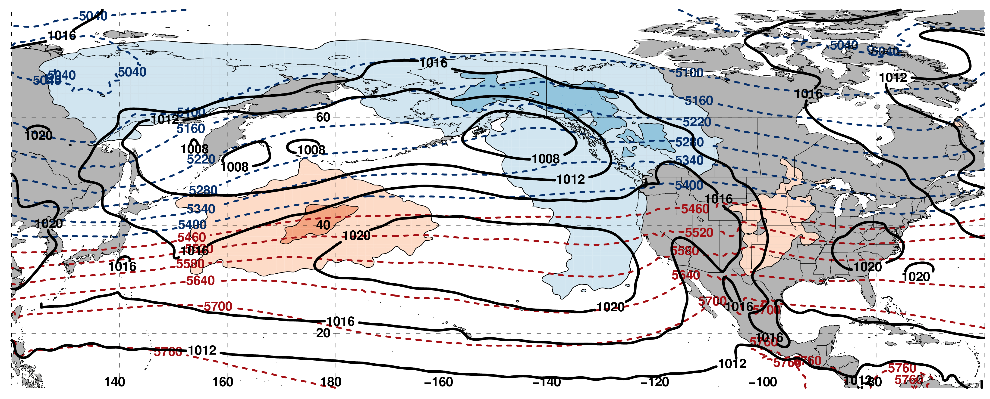
250-hPa Wind Speed, Geo. Heights, Geo. Height Anomalies: Day 8
Jet Retraction (n = 162)
m s^{–1}
Mean Sea-Level Pressure, 1000–500-hPa Thickness, 850-hPa Temp. Anomalies: Day 8
K

Slide 35
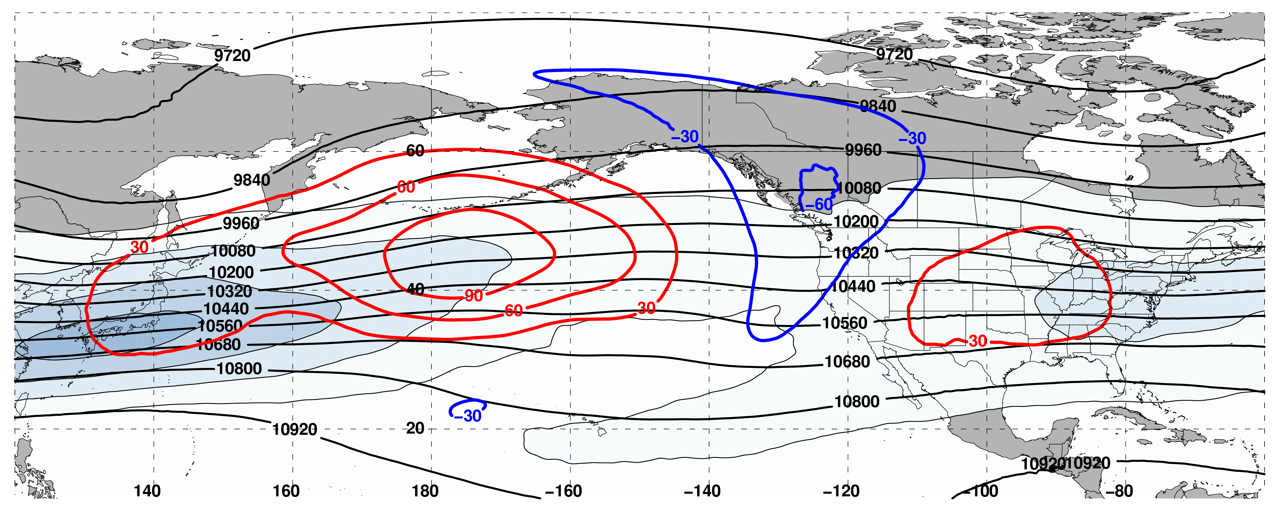
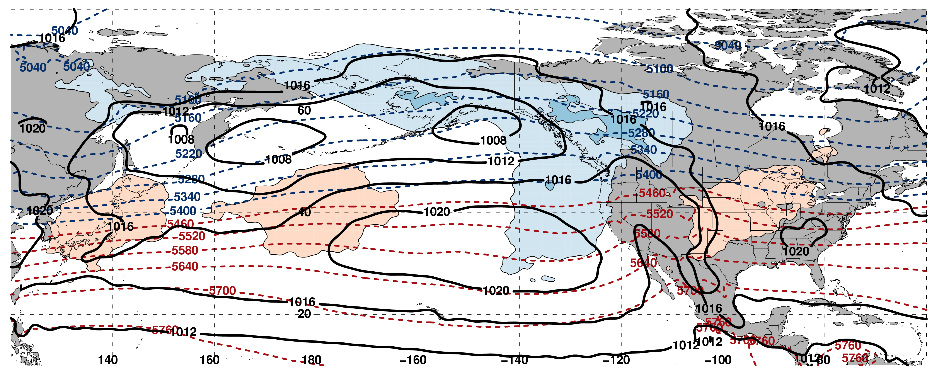
250-hPa Wind Speed, Geo. Heights, Geo. Height Anomalies: Day 10
Jet Retraction (n = 162)
m s^{–1}
Mean Sea-Level Pressure, 1000–500-hPa Thickness, 850-hPa Temp. Anomalies: Day 10
K

Slide 36
Poleward Shift

Slide 37
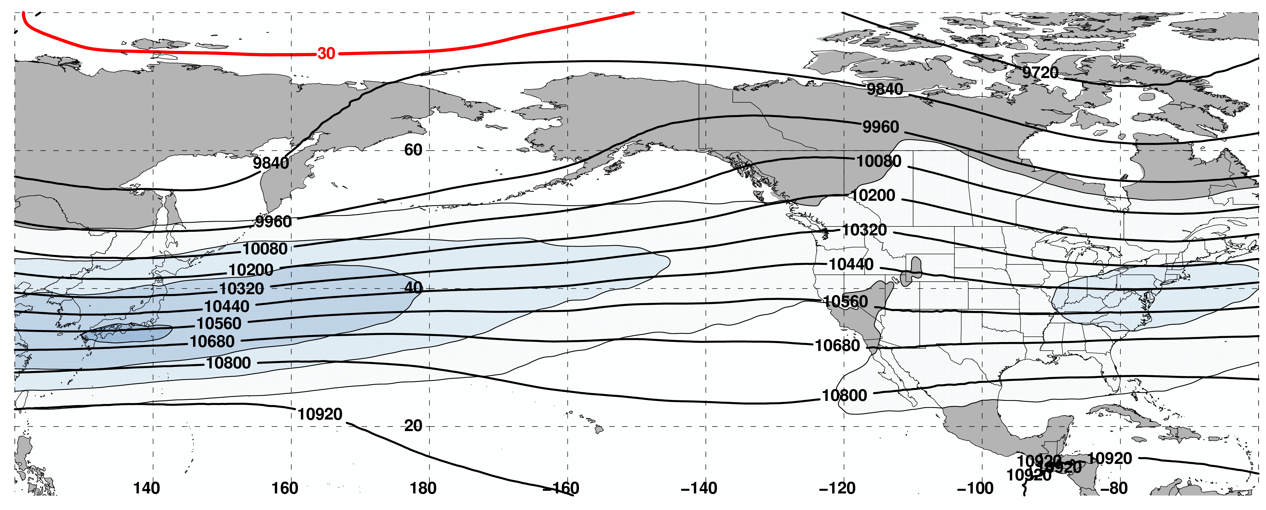
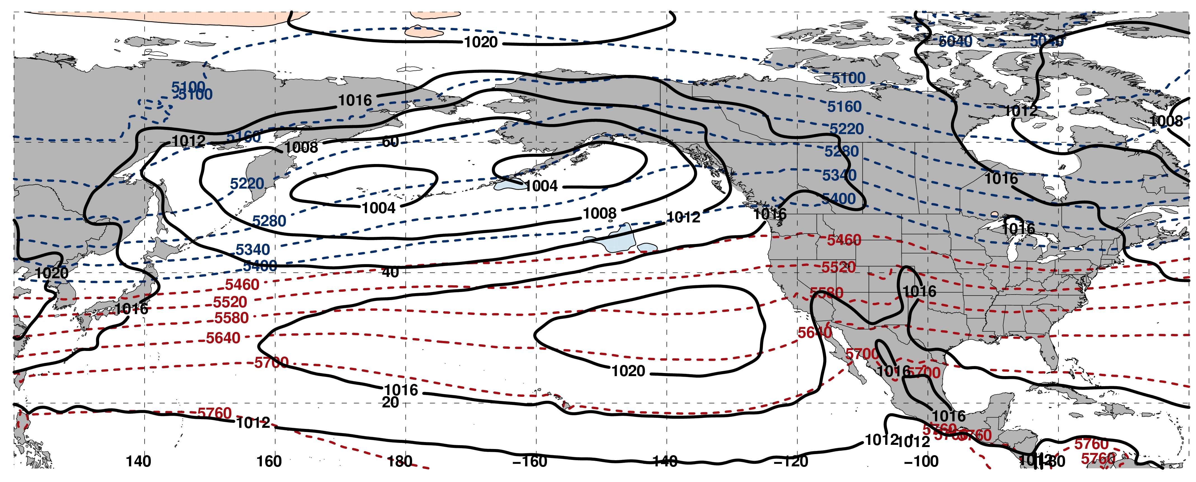
250-hPa Wind Speed, Geo. Heights, Geo. Height Anomalies: Day –10
Poleward Shift (n = 189)
m s^{–1}
Mean Sea-Level Pressure, 1000–500-hPa Thickness, 850-hPa Temp. Anomalies: Day –10
K

Slide 38
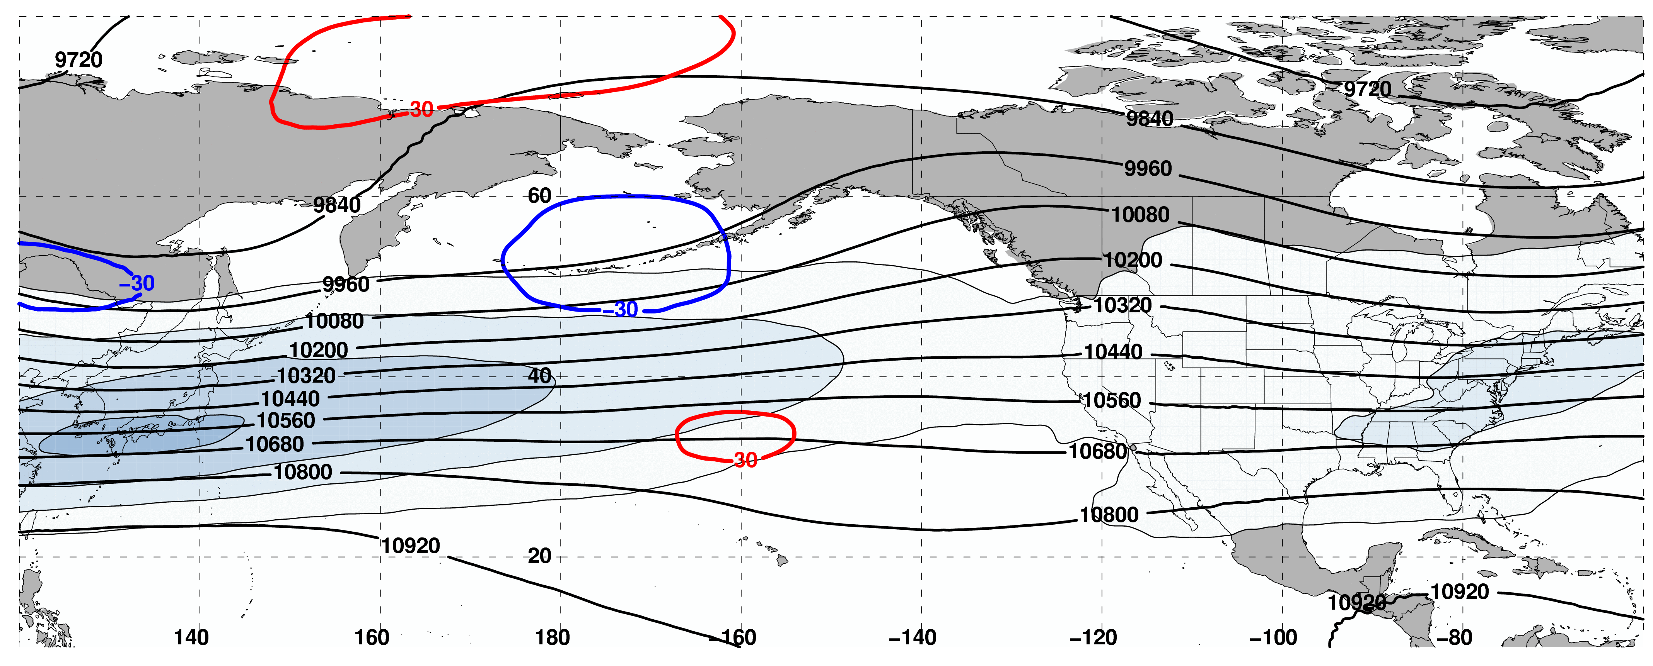
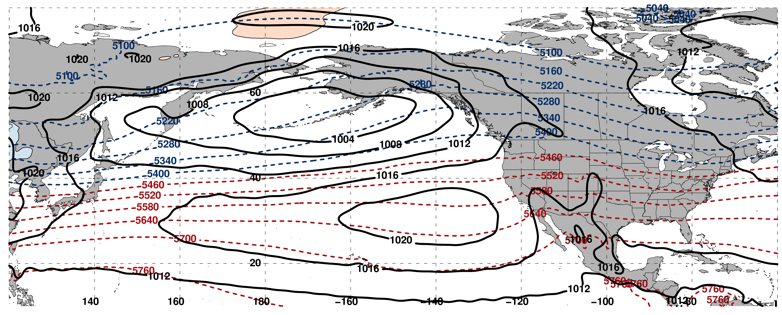
250-hPa Wind Speed, Geo. Heights, Geo. Height Anomalies: Day –8
Poleward Shift (n = 189)
m s^{–1}
Mean Sea-Level Pressure, 1000–500-hPa Thickness, 850-hPa Temp. Anomalies: Day –8
K

Slide 39
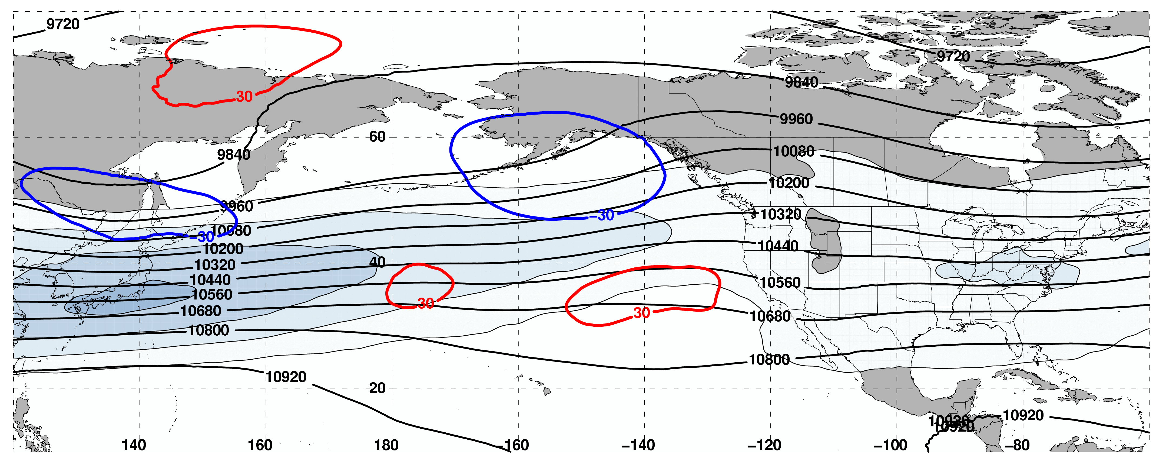
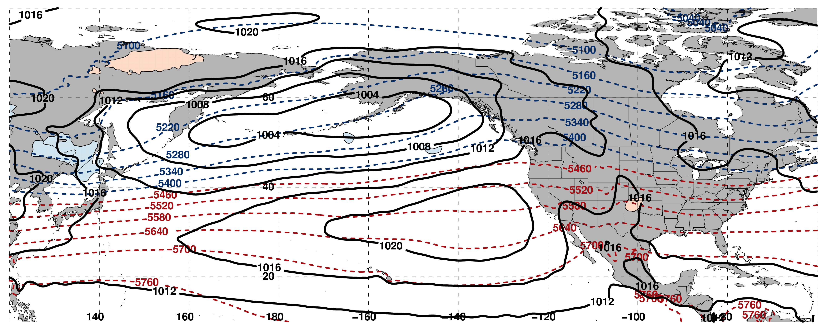
250-hPa Wind Speed, Geo. Heights, Geo. Height Anomalies: Day –6
Poleward Shift (n = 189)
m s^{–1}
Mean Sea-Level Pressure, 1000–500-hPa Thickness, 850-hPa Temp. Anomalies: Day –6
K

Slide 40


250-hPa Wind Speed, Geo. Heights, Geo. Height Anomalies: Day –4
Poleward Shift (n = 189)
m s^{–1}
Mean Sea-Level Pressure, 1000–500-hPa Thickness, 850-hPa Temp. Anomalies: Day –4
K

Slide 41


250-hPa Wind Speed, Geo. Heights, Geo. Height Anomalies: Day –2
Poleward Shift (n = 189)
m s^{–1}
Mean Sea-Level Pressure, 1000–500-hPa Thickness, 850-hPa Temp. Anomalies: Day –2
K

Slide 42


250-hPa Wind Speed, Geo. Heights, Geo. Height Anomalies: Day 0
Poleward Shift (n = 189)
m s^{–1}
Mean Sea-Level Pressure, 1000–500-hPa Thickness, 850-hPa Temp. Anomalies: Day 0
K

Slide 43


250-hPa Wind Speed, Geo. Heights, Geo. Height Anomalies: Day 2
Poleward Shift (n = 189)
m s^{–1}
Mean Sea-Level Pressure, 1000–500-hPa Thickness, 850-hPa Temp. Anomalies: Day 2
K

Slide 44


250-hPa Wind Speed, Geo. Heights, Geo. Height Anomalies: Day 4
Poleward Shift (n = 189)
m s^{–1}
Mean Sea-Level Pressure, 1000–500-hPa Thickness, 850-hPa Temp. Anomalies: Day 4
K

Slide 45


250-hPa Wind Speed, Geo. Heights, Geo. Height Anomalies: Day 6
Poleward Shift (n = 189)
m s^{–1}
Mean Sea-Level Pressure, 1000–500-hPa Thickness, 850-hPa Temp. Anomalies: Day 6
K

Slide 46


250-hPa Wind Speed, Geo. Heights, Geo. Height Anomalies: Day 8
Poleward Shift (n = 189)
m s^{–1}
Mean Sea-Level Pressure, 1000–500-hPa Thickness, 850-hPa Temp. Anomalies: Day 8
K

Slide 47


250-hPa Wind Speed, Geo. Heights, Geo. Height Anomalies: Day 10
Poleward Shift (n = 189)
m s^{–1}
Mean Sea-Level Pressure, 1000–500-hPa Thickness, 850-hPa Temp. Anomalies: Day 10
K

Slide 48
Equatorward Shift

Slide 49


250-hPa Wind Speed, Geo. Heights, Geo. Height Anomalies: Day –10
Equatorward Shift (n = 149)
m s^{–1}
Mean Sea-Level Pressure, 1000–500-hPa Thickness, 850-hPa Temp. Anomalies: Day –10
K

Slide 50


250-hPa Wind Speed, Geo. Heights, Geo. Height Anomalies: Day –8
Equatorward Shift (n = 149)
m s^{–1}
Mean Sea-Level Pressure, 1000–500-hPa Thickness, 850-hPa Temp. Anomalies: Day –8
K

Slide 51


250-hPa Wind Speed, Geo. Heights, Geo. Height Anomalies: Day –6
Equatorward Shift (n = 149)
m s^{–1}
Mean Sea-Level Pressure, 1000–500-hPa Thickness, 850-hPa Temp. Anomalies: Day –6
K

Slide 52


250-hPa Wind Speed, Geo. Heights, Geo. Height Anomalies: Day –4
Equatorward Shift (n = 149)
m s^{–1}
Mean Sea-Level Pressure, 1000–500-hPa Thickness, 850-hPa Temp. Anomalies: Day –4
K

Slide 53


250-hPa Wind Speed, Geo. Heights, Geo. Height Anomalies: Day –2
Equatorward Shift (n = 149)
m s^{–1}
Mean Sea-Level Pressure, 1000–500-hPa Thickness, 850-hPa Temp. Anomalies: Day –2
K

Slide 54


250-hPa Wind Speed, Geo. Heights, Geo. Height Anomalies: Day 0
Equatorward Shift (n = 149)
m s^{–1}
Mean Sea-Level Pressure, 1000–500-hPa Thickness, 850-hPa Temp. Anomalies: Day 0
K

Slide 55


250-hPa Wind Speed, Geo. Heights, Geo. Height Anomalies: Day 2
Equatorward Shift (n = 149)
m s^{–1}
Mean Sea-Level Pressure, 1000–500-hPa Thickness, 850-hPa Temp. Anomalies: Day 2
K

Slide 56


250-hPa Wind Speed, Geo. Heights, Geo. Height Anomalies: Day 4
Equatorward Shift (n = 149)
m s^{–1}
Mean Sea-Level Pressure, 1000–500-hPa Thickness, 850-hPa Temp. Anomalies: Day 4
K

Slide 57


250-hPa Wind Speed, Geo. Heights, Geo. Height Anomalies: Day 6
Equatorward Shift (n = 149)
m s^{–1}
Mean Sea-Level Pressure, 1000–500-hPa Thickness, 850-hPa Temp. Anomalies: Day 6
K

Slide 58


250-hPa Wind Speed, Geo. Heights, Geo. Height Anomalies: Day 8
Equatorward Shift (n = 149)
m s^{–1}
Mean Sea-Level Pressure, 1000–500-hPa Thickness, 850-hPa Temp. Anomalies: Day 8
K

Slide 59


250-hPa Wind Speed, Geo. Heights, Geo. Height Anomalies: Day 10
Equatorward Shift (n = 149)
m s^{–1}
Mean Sea-Level Pressure, 1000–500-hPa Thickness, 850-hPa Temp. Anomalies: Day 10
K

Slide 60
Real-time NPJ Phase Diagram Products
Updates every day ~1200 UTC employing 0000 UTC GFS and GEFS forecasts out to 216-h (9 day forecast)
Depicts variations of the NPJ phase diagram alongside complementary forecasts of 250-hPa wind speed, 850-hPa temperature, and 24-h accumulated precipitation
Website:
http://www.atmos.albany.edu/facstaff/awinters/realtime/Deterministic_NPJPD.php

Slide 61
Verification Metrics
Reliability Diagram
  Evaluates the performance of GEFS probabilistic ensemble forecasts with respect to the NPJ Phase Diagram
ROC
  Evaluates the performance of GEFS ensemble forecasts of EWEs with respect to the NPJ Phase Diagram
100
Reliability Diagram
% occurrence
0
% forecasted
100
1
POD
ROC
0
FAR
1
Notes:
Reconsider “with respect to”.. Add schematics

Slide 62
Verification Metrics
EWE Predictability
  What is the predictability of EWEs in the GEFS reforecast dataset with respect to the NPJ Phase Diagram?
General Predictability
  What is the predictability of all GEFS ensemble reforecasts with respect to the NPJ Phase Diagram?
  Metrics:
    Average position error within the phase diagram
    Probability of detection
    Separate metrics for each quadrant of the phase diagram
Notes:
Reconsider “with respect to”.. Add schematics

