Slide 1
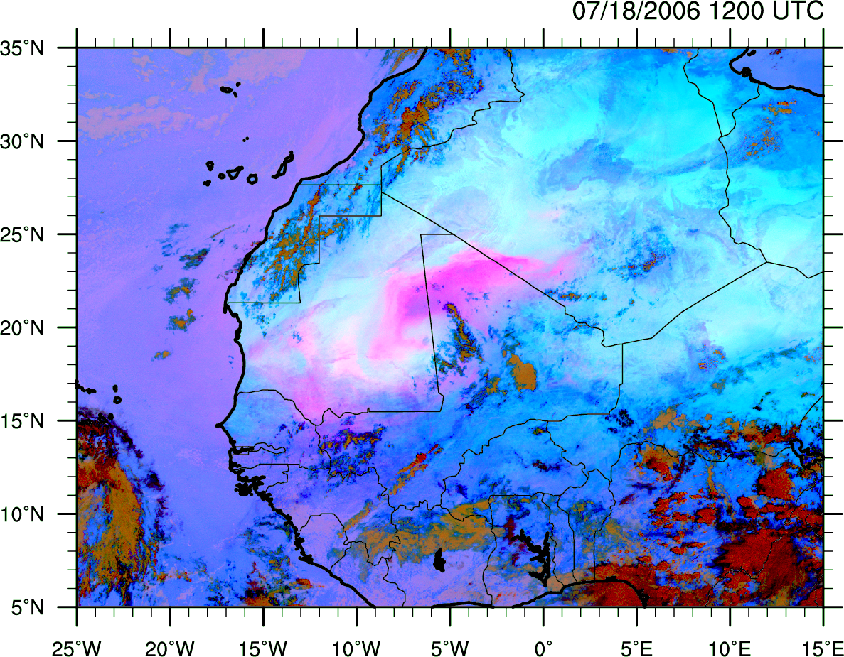
Dust lofting and transport during a case of intense Saharan cyclogenesis
Chris Thorncroft, Matt Janiga and Earle Williams

Slide 2
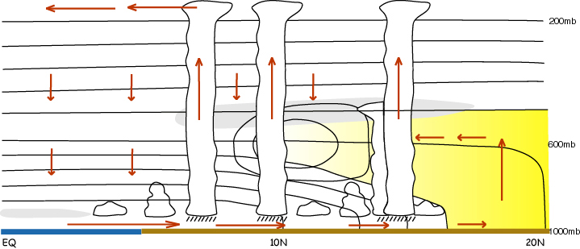
Dust is important for weather, climate and society
Direct Impact on weather and climate starting to be appreciated and understood
Indirect impact (microphysics) is more difficult!
Mobilisation and transport are important to understand and, ultimately, predict.
Health impacts locally and possibly ecological impacts locally and far (e.g. Caribbean)

Slide 3
Dust is important for weather, climate and society
Key things to note regarding mobilisation and transport:
* increased surface winds and mixing
* lift due to the passage of cold pools – linked to convection
* meso and synoptic scale uplift along sloping isentropes – potentially important for long-range transport into the Atlantic and beyond

Slide 4
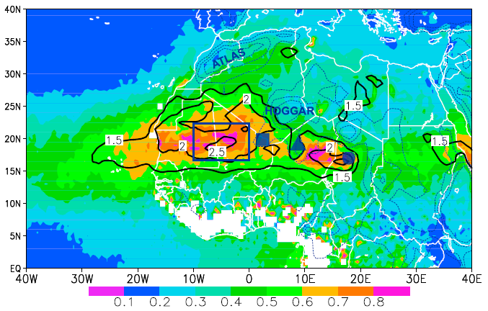
Outline
Mean Dust Concentrations
The greatest
summer dust concentrations are found in a belt extending from Niger to Mauritania between 15°-25°N.
This is south of the driest region but has AEW activity and MCSs.
Climatological JJAS 2000-2006 Aerosol Loading (Aerosol Optical Thickness at 558 nm)
Knippertz and Todd (2010)

Slide 5
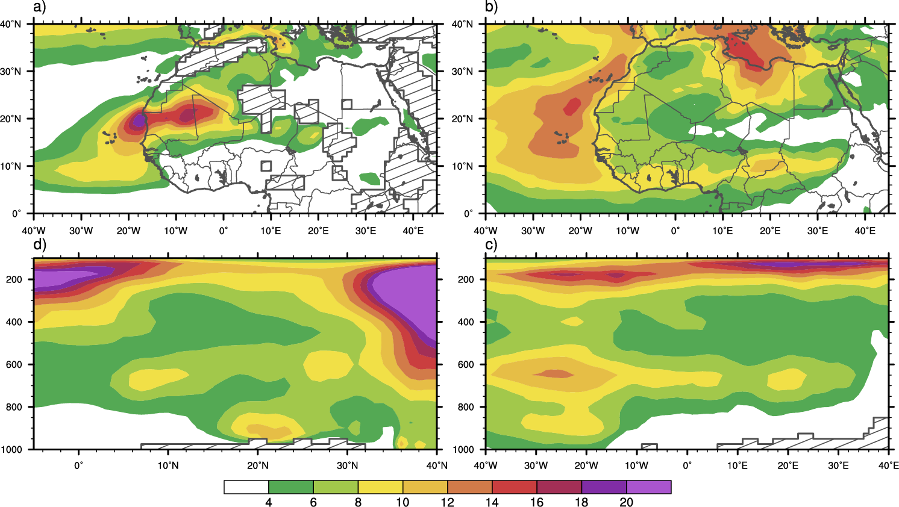
Outline
1998-2009 Climatological EKE
925 hPa
700 hPa
5°E-5°W
5-15°N
Climatological JJAS 2000-2006 Aerosol Loading (Aerosol Optical Thickness at 558 nm)
[m²s⁻²]
Knippertz and Todd (2010)

Slide 6
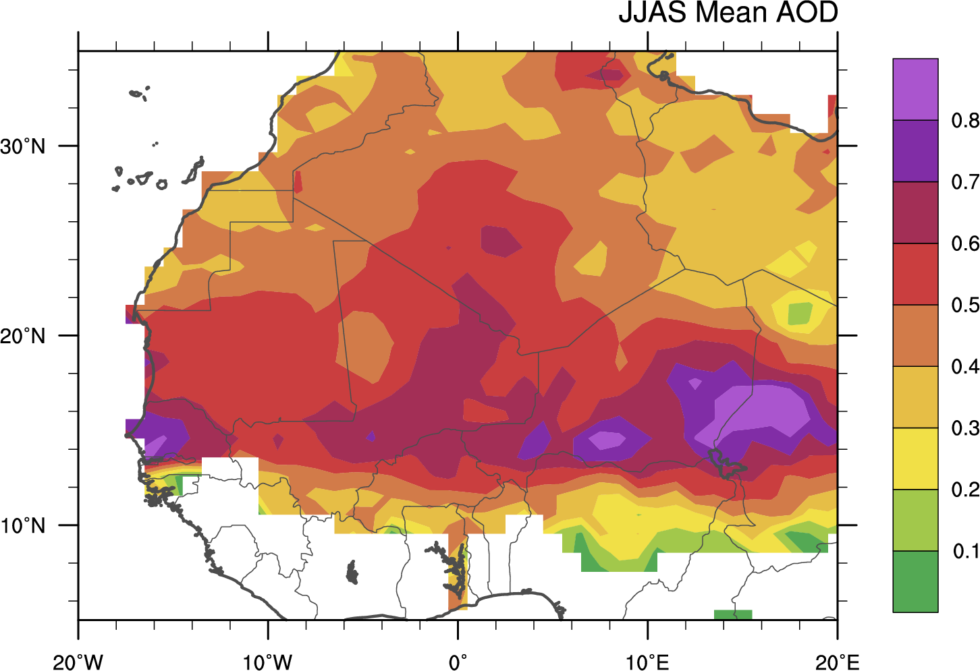
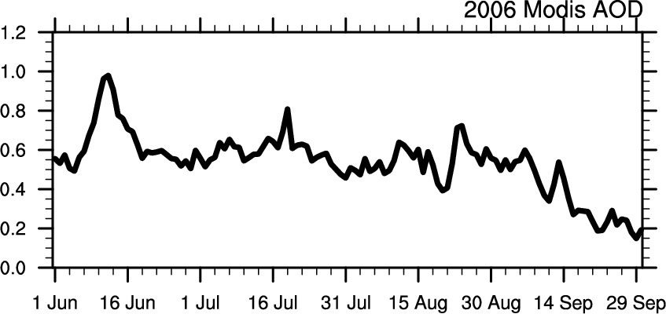
JJAS 2006 mean
TS over selected box
Aerosol Optipical Depth from the 550nm MODIS deep blue land-masked dataset.

Slide 7
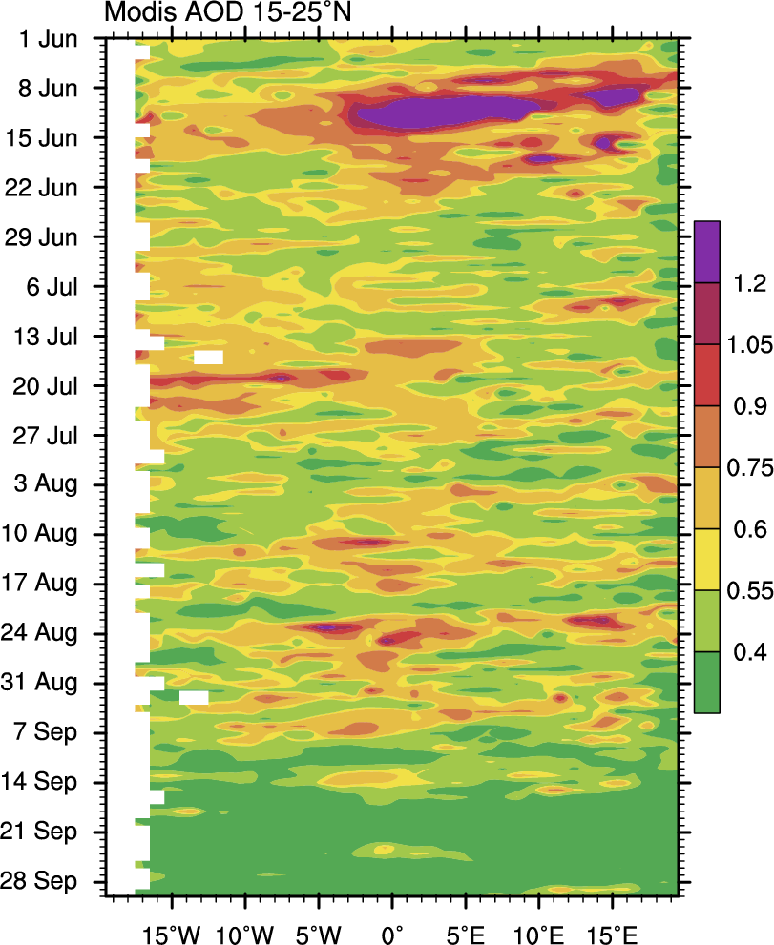
1
2
Dust events as determined from the AOD have a tendency to propagate westward.
These also tend to be associated with westward moving disturbances in most cases.
Some grouping is also apparent (associated with equatorial waves)
3
4
5
6

Slide 8
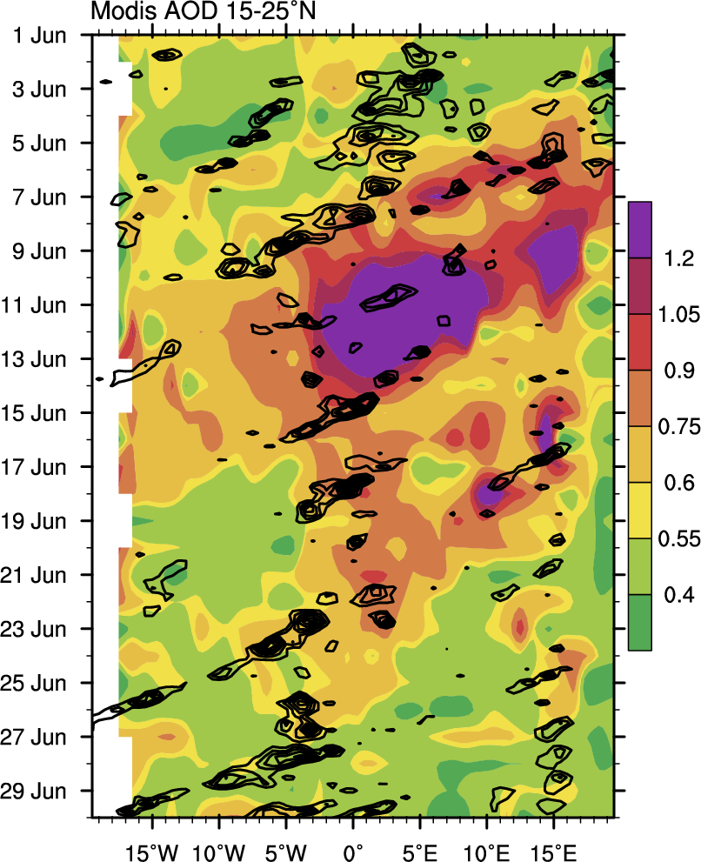
June 2006
Event 1 was unusual in 2006 in its extent and longevity.
It will be shown that this period was associated with large amounts of convective activity associated with equatorial Kelvin waves. It was also the only event comprised of multiple NVs.
1
2
AOD (shaded)
Black = 15-25N 925 Vorticity (1x10⁻⁵ s⁻¹)

Slide 9
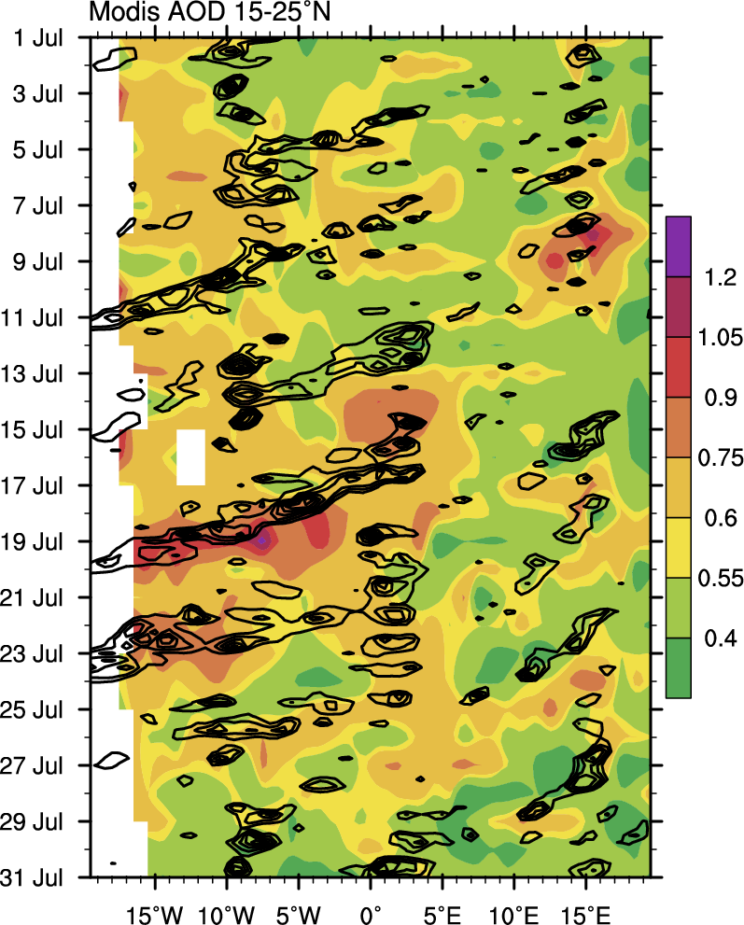
July 2006
July had several strong NVs the strongest was Event 3.
3
4
AOD (shaded)
Black = 15-25N 925 Vorticity (1x10⁻⁵ s⁻¹)

Slide 10
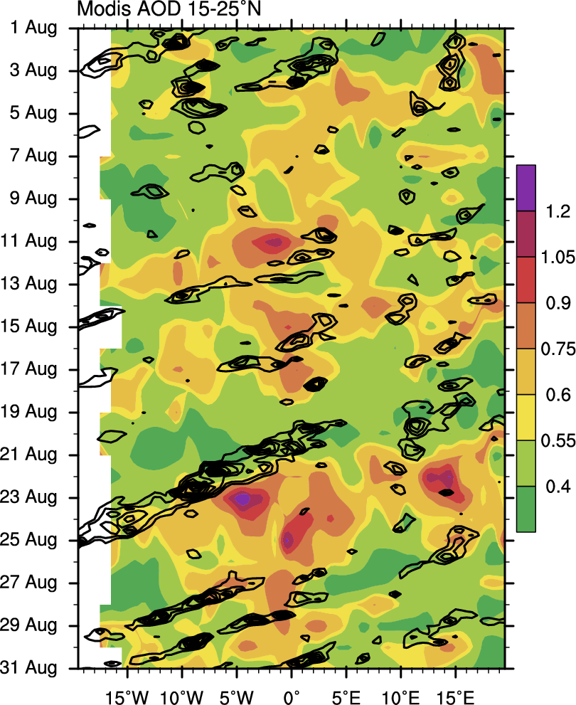
August 2006
5
Event 5 although visually striking it was short lived since the synoptic-scale support didn’t last.
Event 6 had a large longitudinal extent and was associated with a very large AEW.
6
AOD (shaded)
Black = 15-25N 925 Vorticity (1x10⁻⁵ s⁻¹)

Slide 11
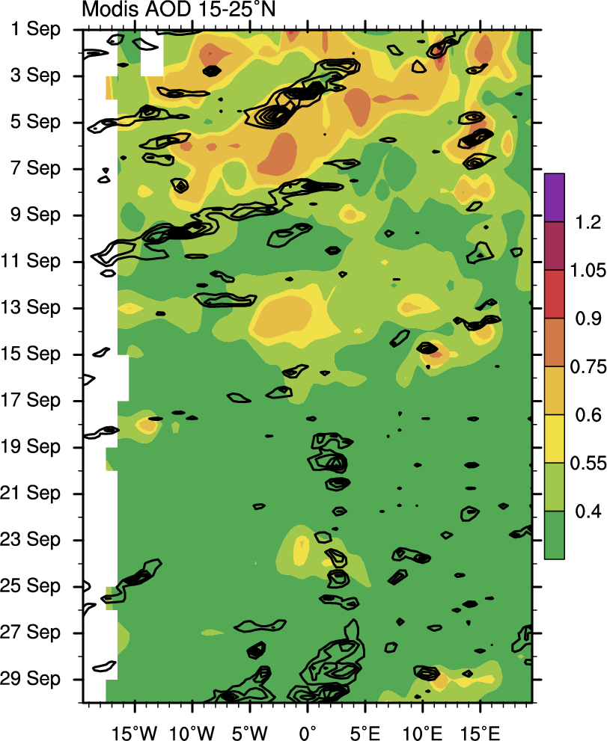
September 2006
September was fairly quiet except for the AEW preceding the Helene AEW.
AOD (shaded)
Black = 15-25N 925 Vorticity (1x10⁻⁵ s⁻¹)

Slide 12
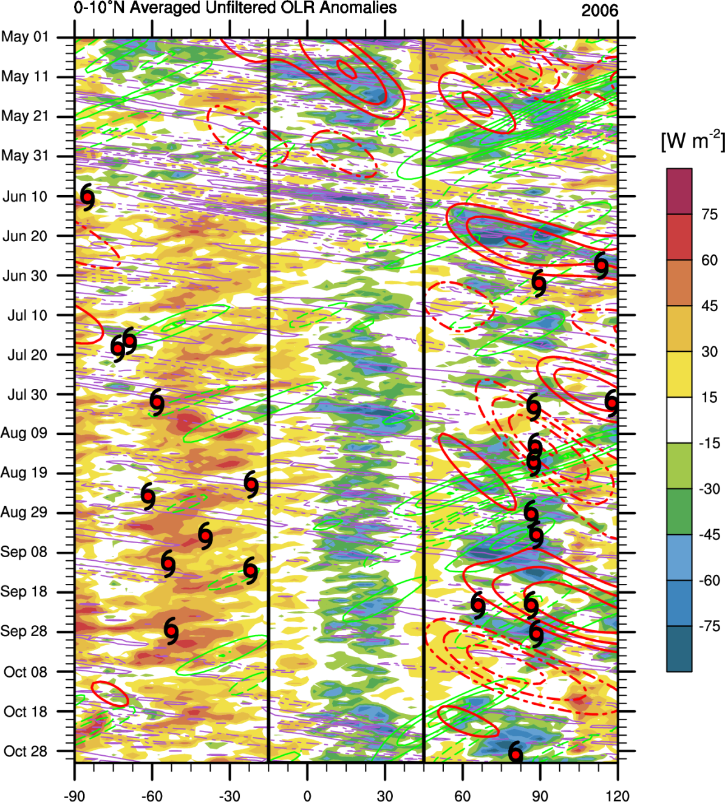
2006 Dust Activity and the Equatorial Waves
There seems to be a relationship between periods of enhanced rainfall associated with favorable equatorial waves. To be explored!
High
AOD
Red = MJO (every 5 W m²)
Green = ER (every 5 W m²)
Purple = Kelvin (every 10 W m²)

Slide 13
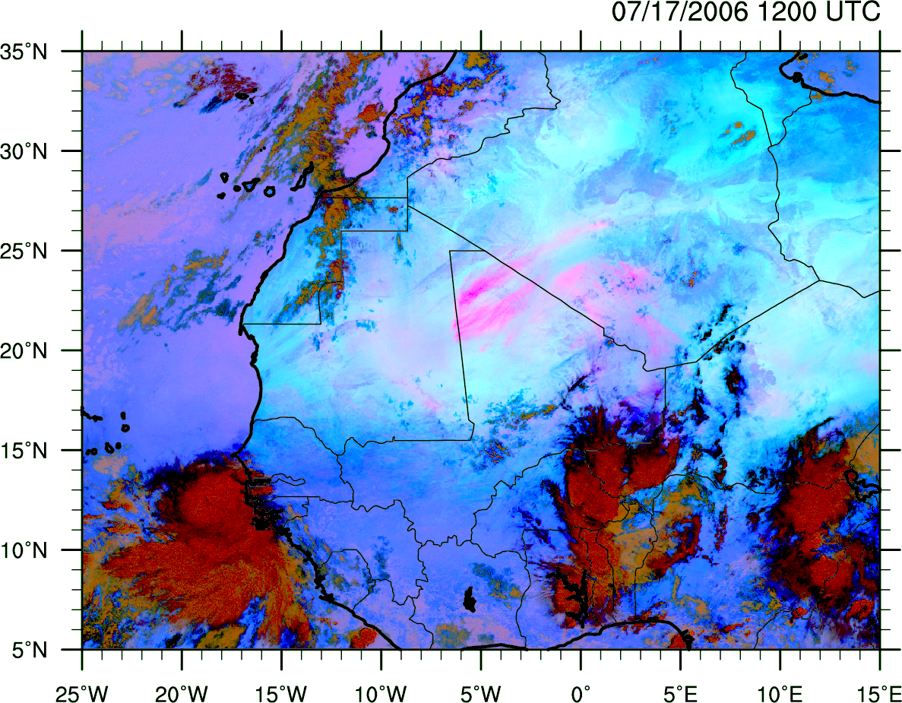
MSG False Color Dust

Slide 14
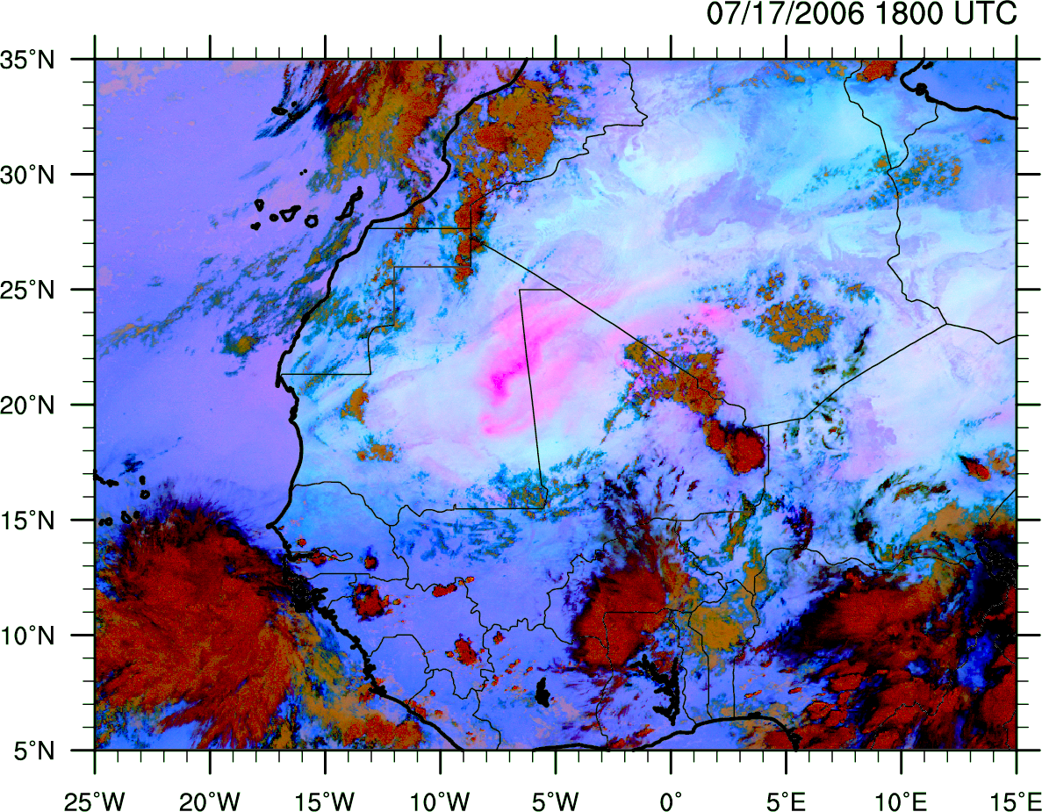
MSG False Color Dust

Slide 15
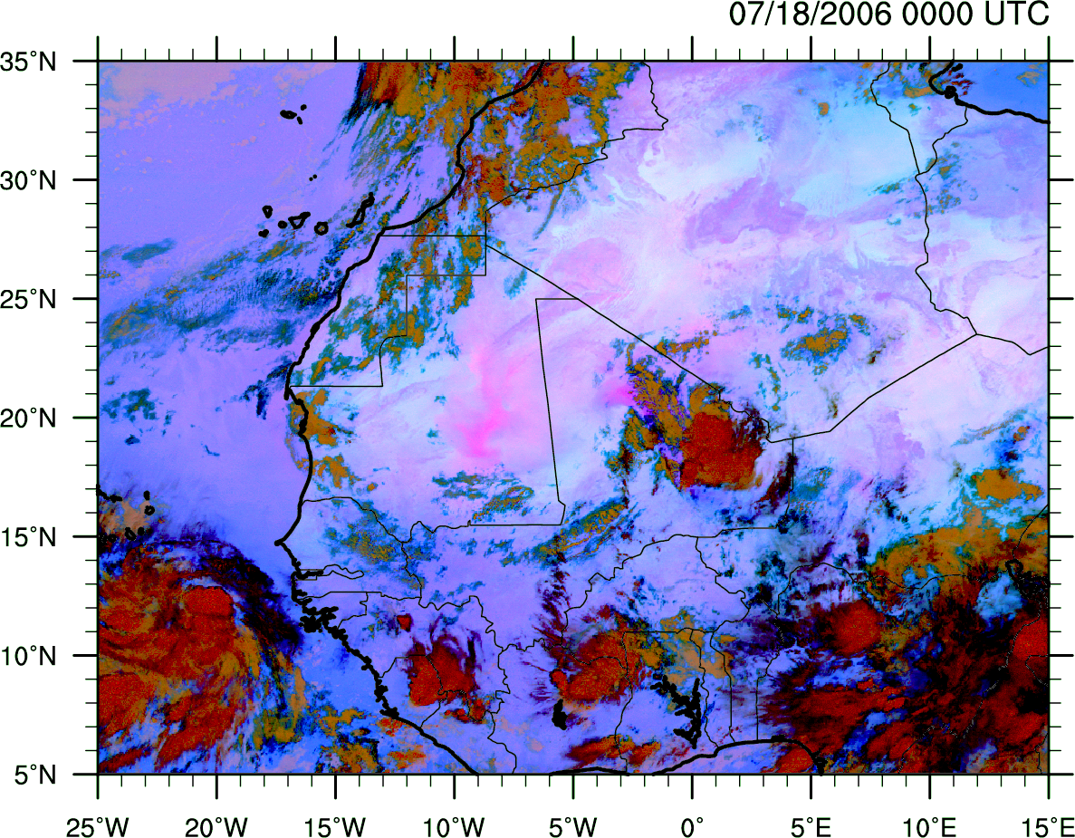
MSG False Color Dust

Slide 16
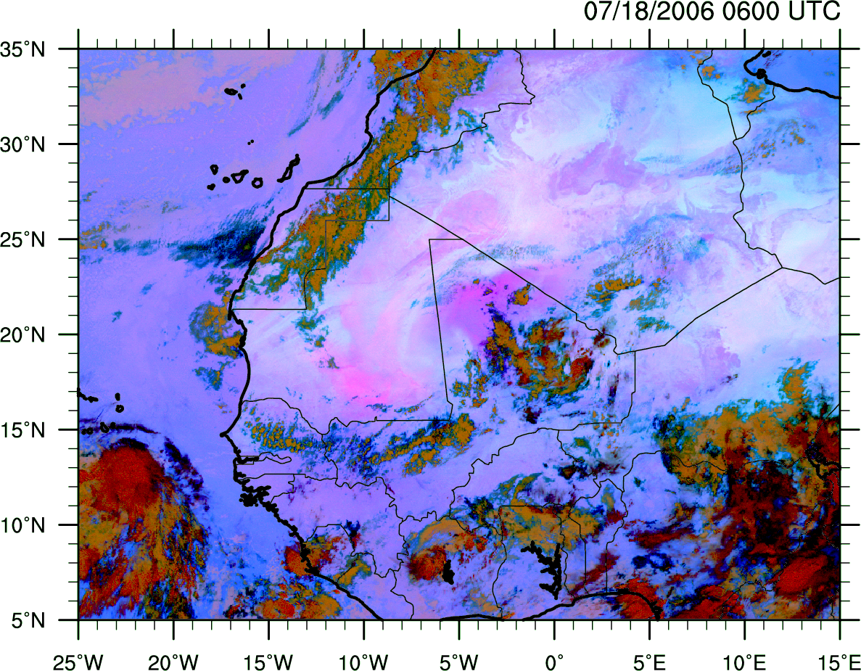
MSG False Color Dust

Slide 17
MSG False Color Dust

Slide 18
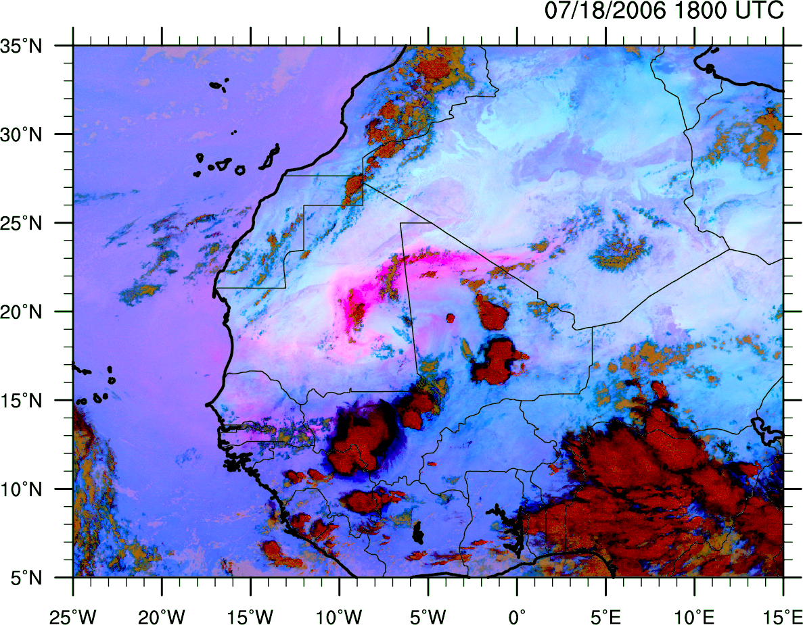
MSG False Color Dust

Slide 19
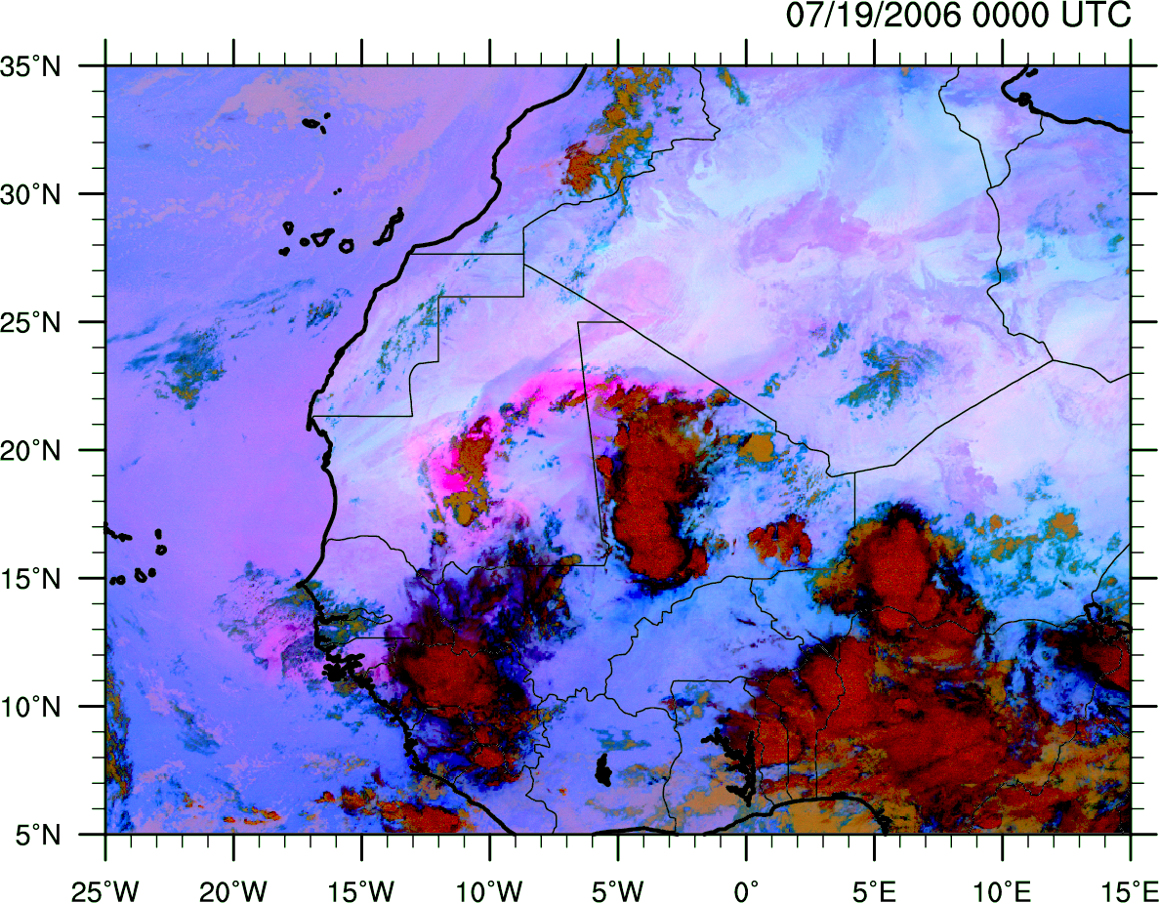
MSG False Color Dust

Slide 20
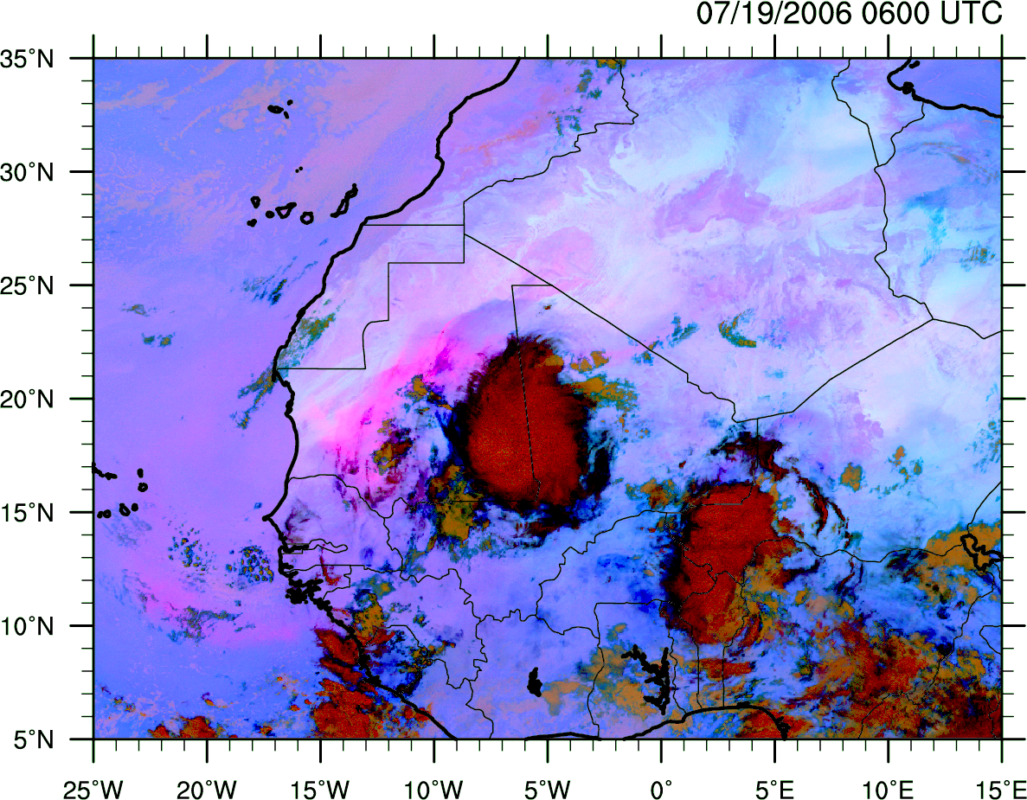
MSG False Color Dust

Slide 21
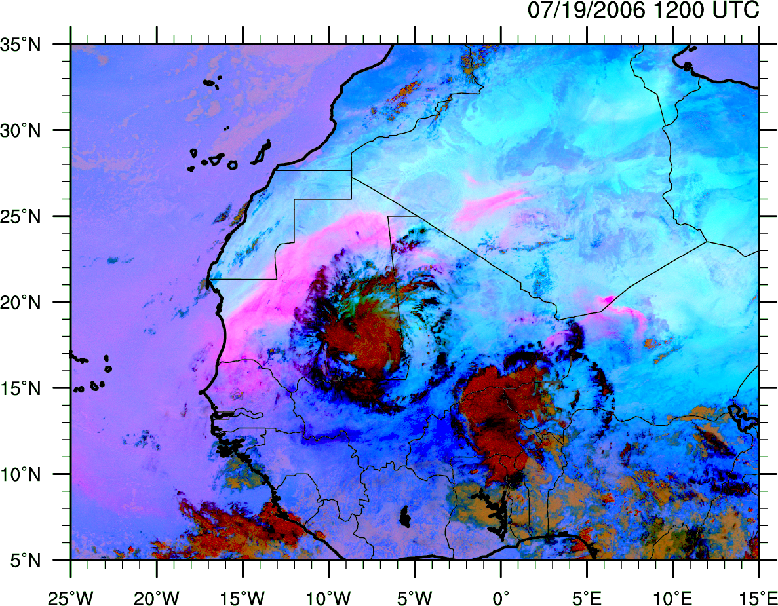
MSG False Color Dust

Slide 22
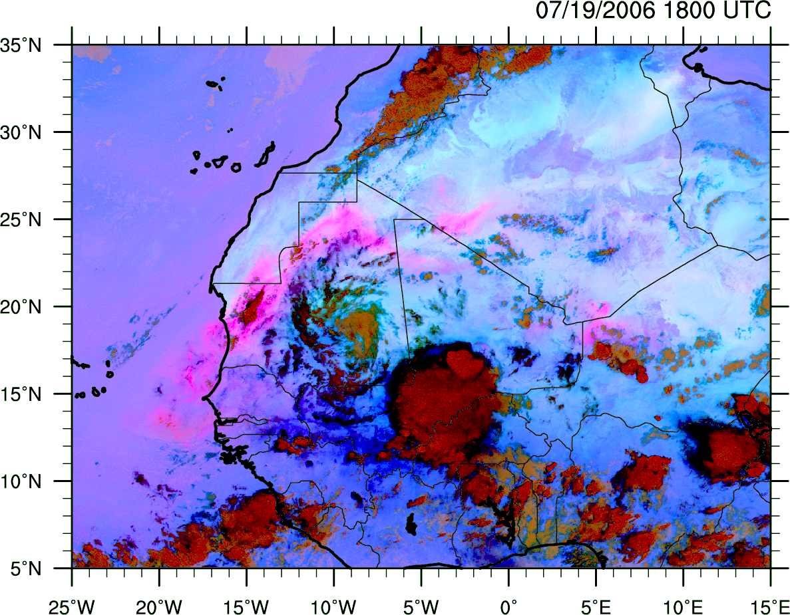
MSG False Color Dust

Slide 23
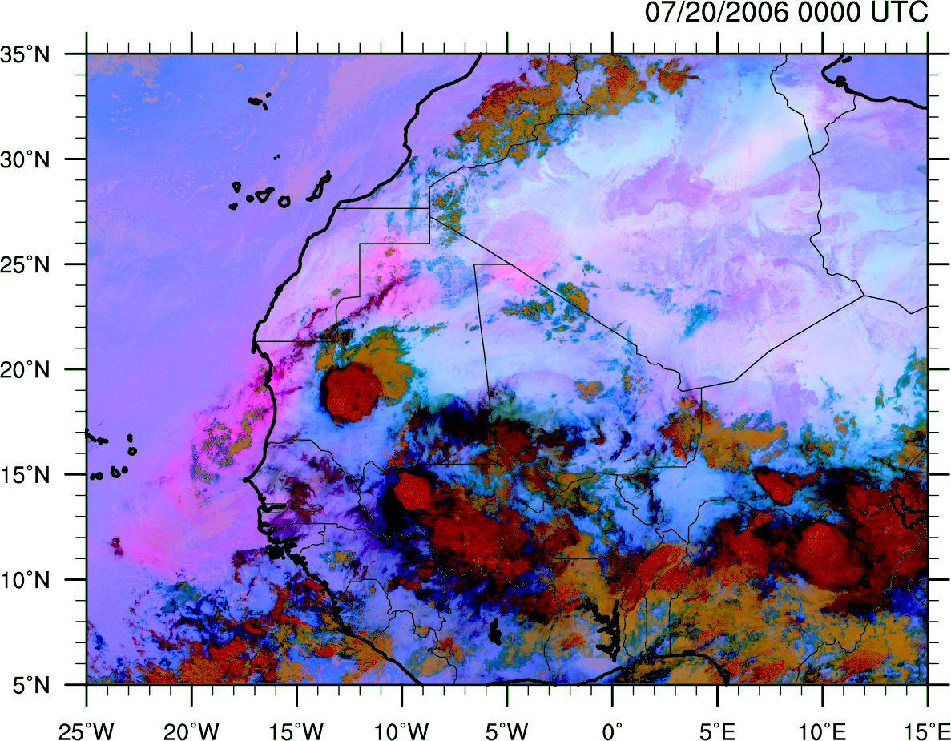
MSG False Color Dust

Slide 24
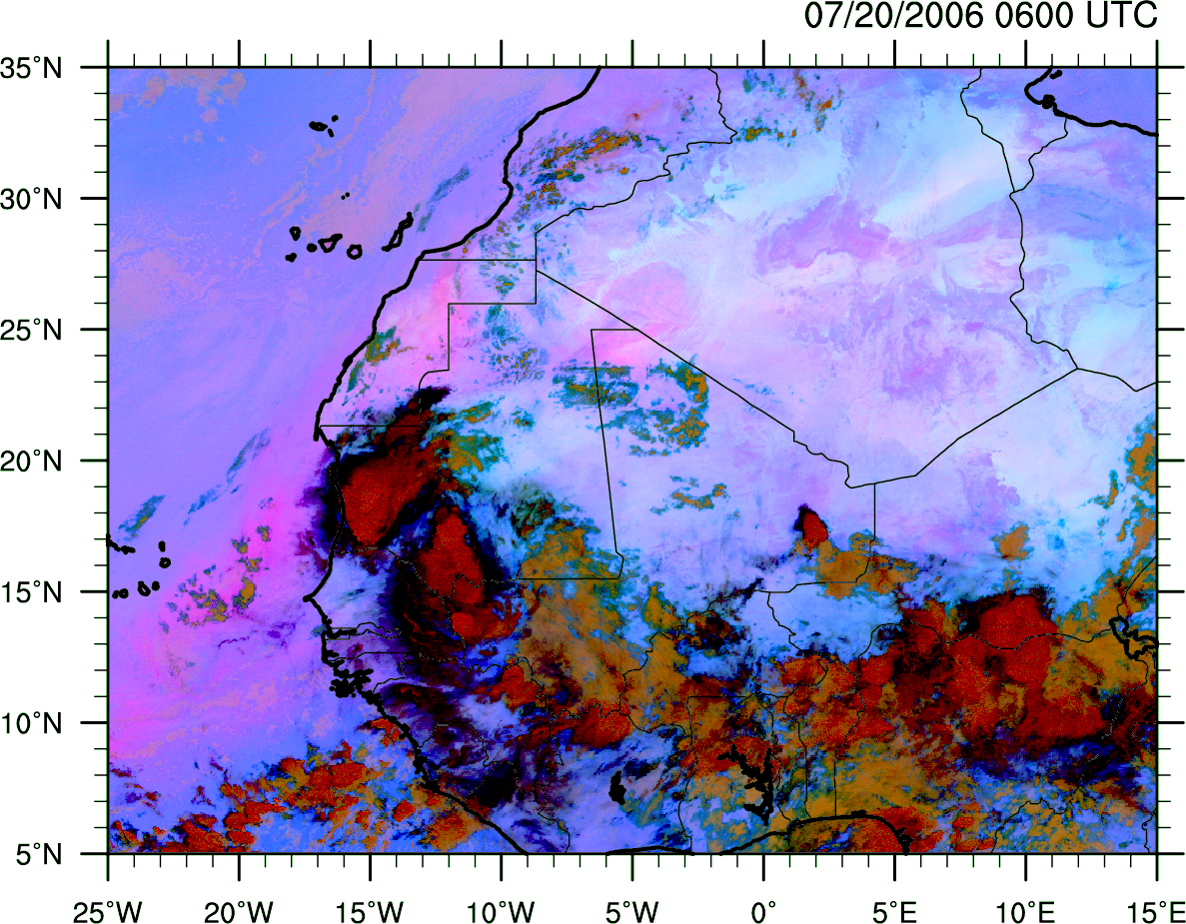
MSG False Color Dust

Slide 25
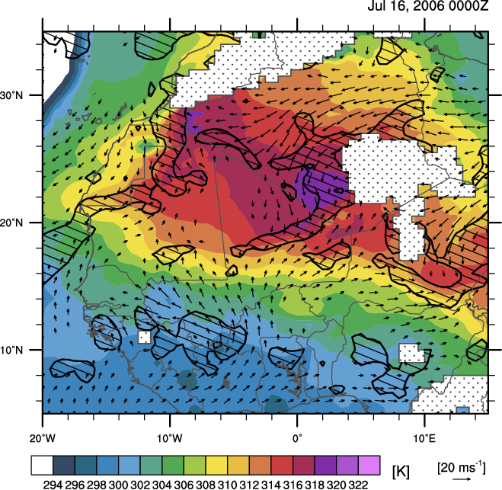
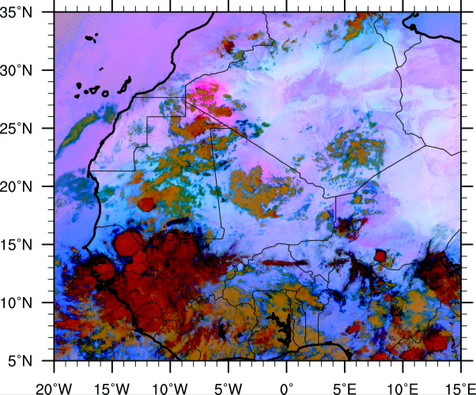
Outline
July 17-18, 2006 Event (NV Type)
MSG False Color Dust Image
0.5° AMMA Reanalysis 925 θ (K, shaded),
ζ (> 2.5x10⁻⁵ s⁻¹, pattern),
winds (ms⁻¹, vectors)
7/16/0600 UTC

Slide 26
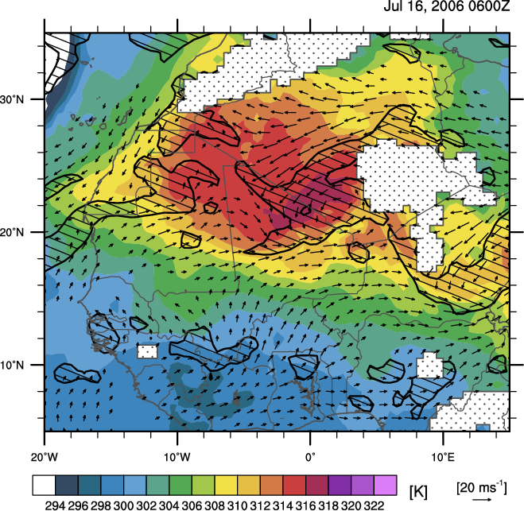
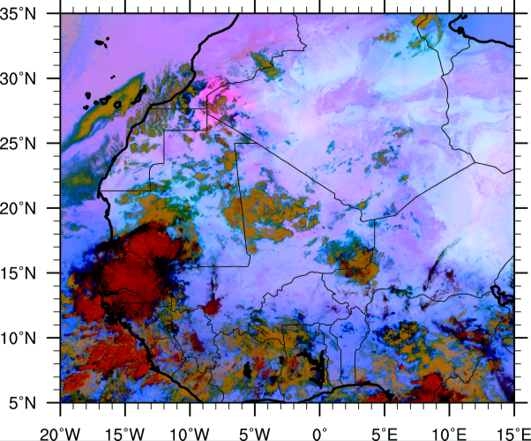
Outline
July 17-20, 2006 Event (NV Type)
MSG False Color Dust Image
0.5° AMMA Reanalysis 925 θ (K, shaded),
ζ (> 2.5x10⁻⁵ s⁻¹, pattern),
winds (ms⁻¹, vectors)
7/16/1200 UTC

Slide 27
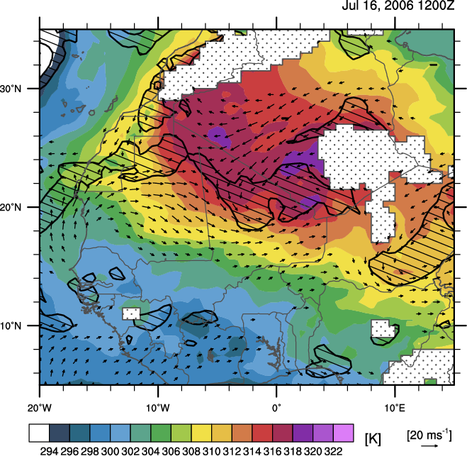
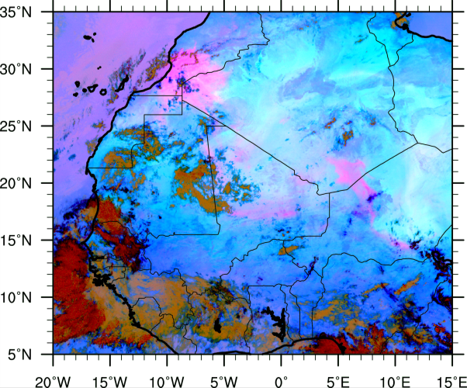
Outline
July 17-20, 2006 Event (NV Type)
MSG False Color Dust Image
0.5° AMMA Reanalysis 925 θ (K, shaded),
ζ (> 2.5x10⁻⁵ s⁻¹, pattern),
winds (ms⁻¹, vectors)
7/16/1800 UTC

Slide 28
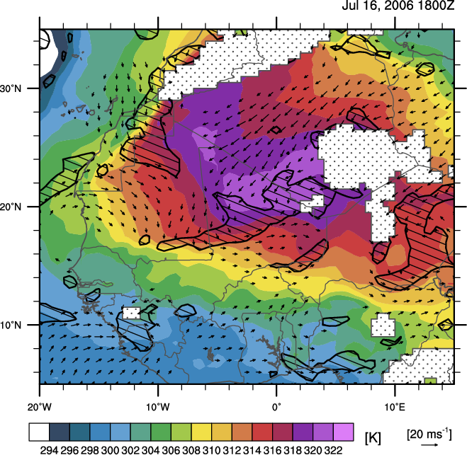
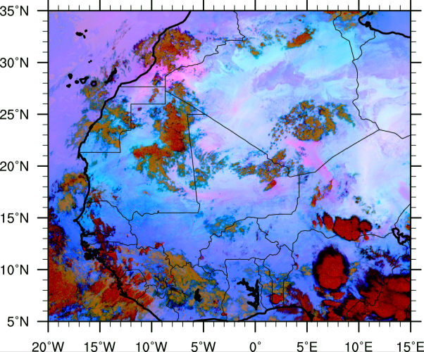
Outline
July 17-20, 2006 Event (NV Type)
MSG False Color Dust Image
0.5° AMMA Reanalysis 925 θ (K, shaded),
ζ (> 2.5x10⁻⁵ s⁻¹, pattern),
winds (ms⁻¹, vectors)
7/17/0000 UTC

Slide 29
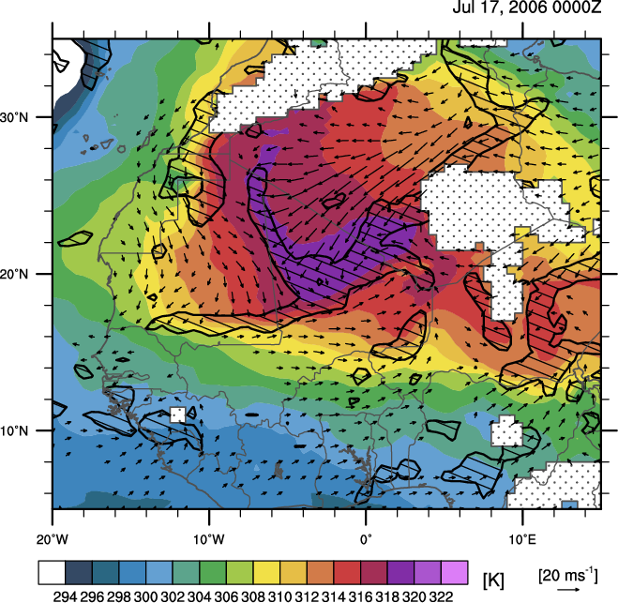
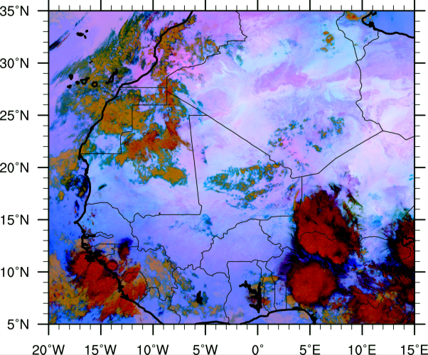
Outline
July 17-20, 2006 Event (NV Type)
MSG False Color Dust Image
0.5° AMMA Reanalysis 925 θ (K, shaded),
ζ (> 2.5x10⁻⁵ s⁻¹, pattern),
winds (ms⁻¹, vectors)
7/17/0600 UTC

Slide 30
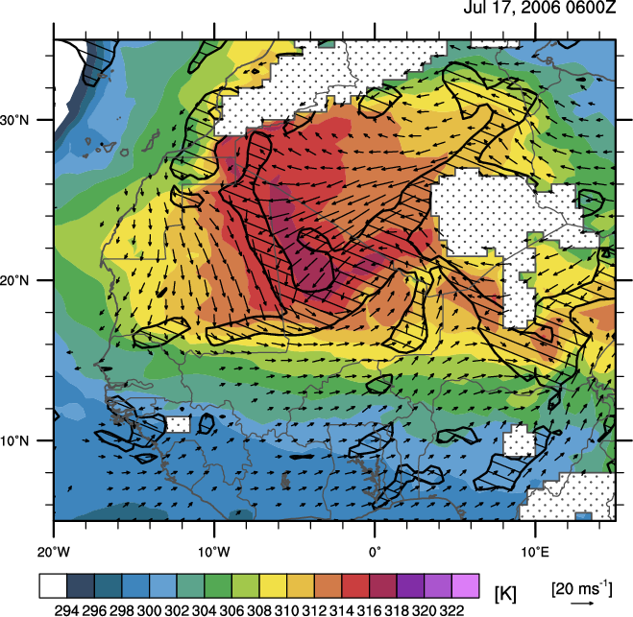
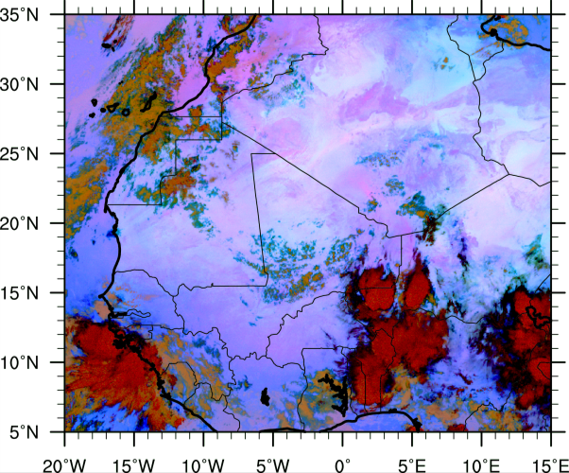
Outline
July 17-20, 2006 Event (NV Type)
MSG False Color Dust Image
0.5° AMMA Reanalysis 925 θ (K, shaded),
ζ (> 2.5x10⁻⁵ s⁻¹, pattern),
winds (ms⁻¹, vectors)
7/17/1200 UTC

Slide 31
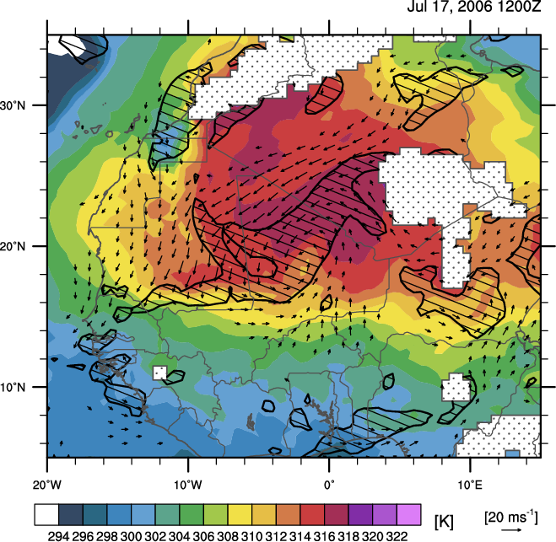
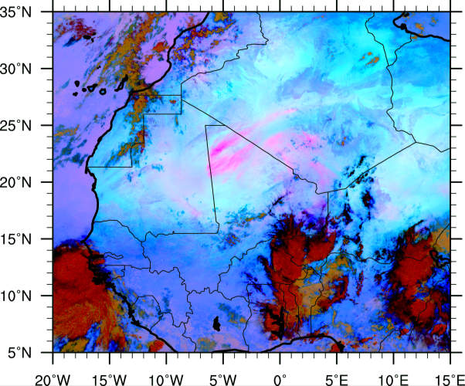
Outline
July 17-20, 2006 Event (NV Type)
MSG False Color Dust Image
0.5° AMMA Reanalysis 925 θ (K, shaded),
ζ (> 2.5x10⁻⁵ s⁻¹, pattern),
winds (ms⁻¹, vectors)
7/17/1800 UTC

Slide 32
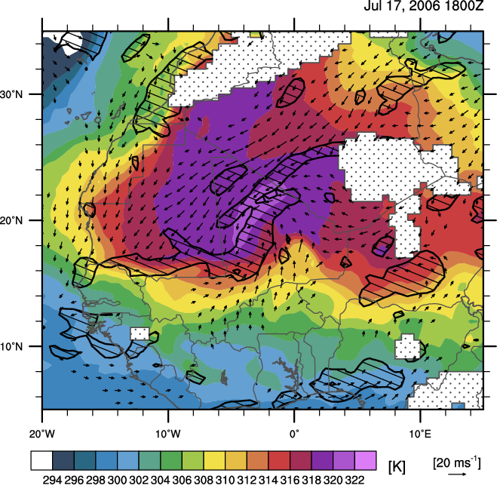
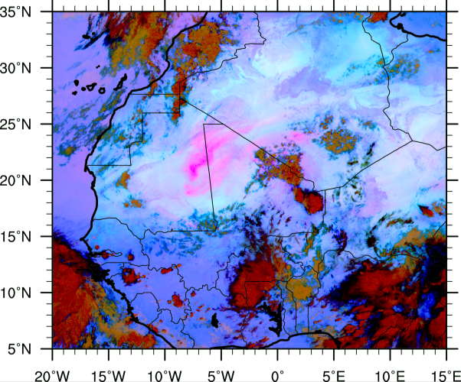
Outline
July 17-20, 2006 Event (NV Type)
MSG False Color Dust Image
0.5° AMMA Reanalysis 925 θ (K, shaded),
ζ (> 2.5x10⁻⁵ s⁻¹, pattern),
winds (ms⁻¹, vectors)
7/18/0000 UTC

Slide 33
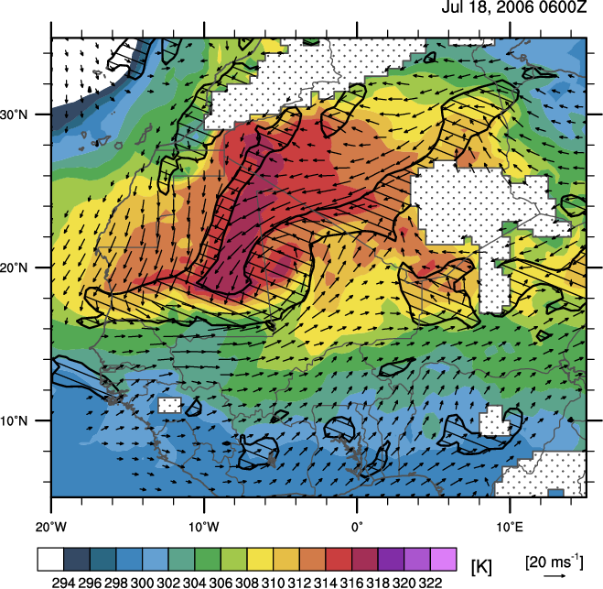
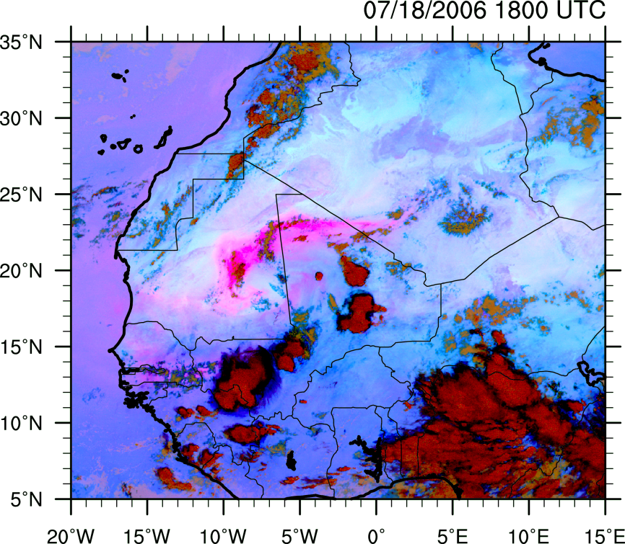
Outline
July 17-20, 2006 Event (NV Type)
MSG False Color Dust Image
0.5° AMMA Reanalysis 925 θ (K, shaded),
ζ (> 2.5x10⁻⁵ s⁻¹, pattern),
winds (ms⁻¹, vectors)
7/18/0600 UTC

Slide 34
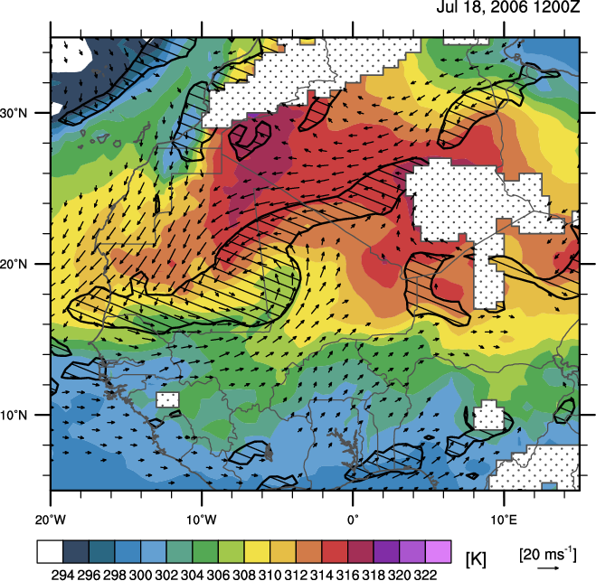
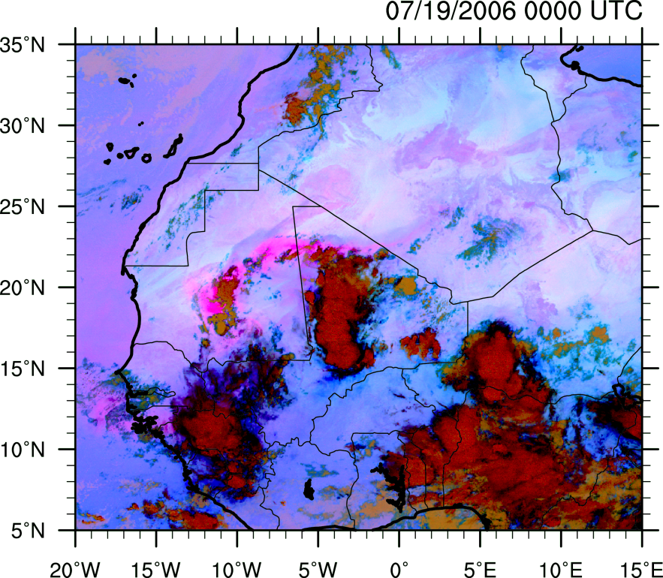
Outline
July 17-20, 2006 Event (NV Type)
MSG False Color Dust Image
0.5° AMMA Reanalysis 925 θ (K, shaded),
ζ (> 2.5x10⁻⁵ s⁻¹, pattern),
winds (ms⁻¹, vectors)
7/18/1200 UTC

Slide 35
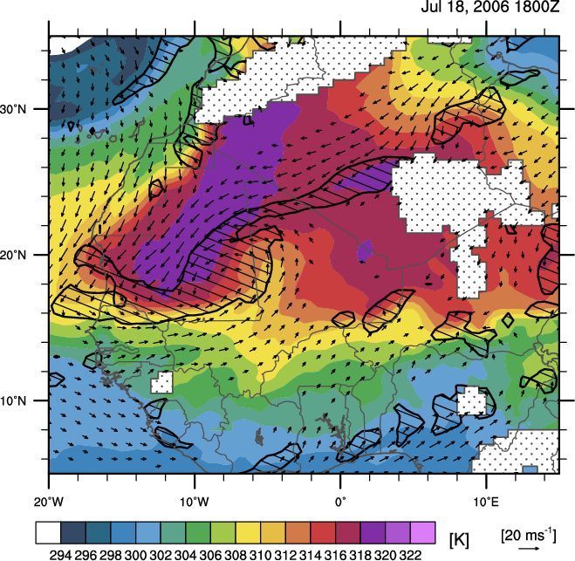
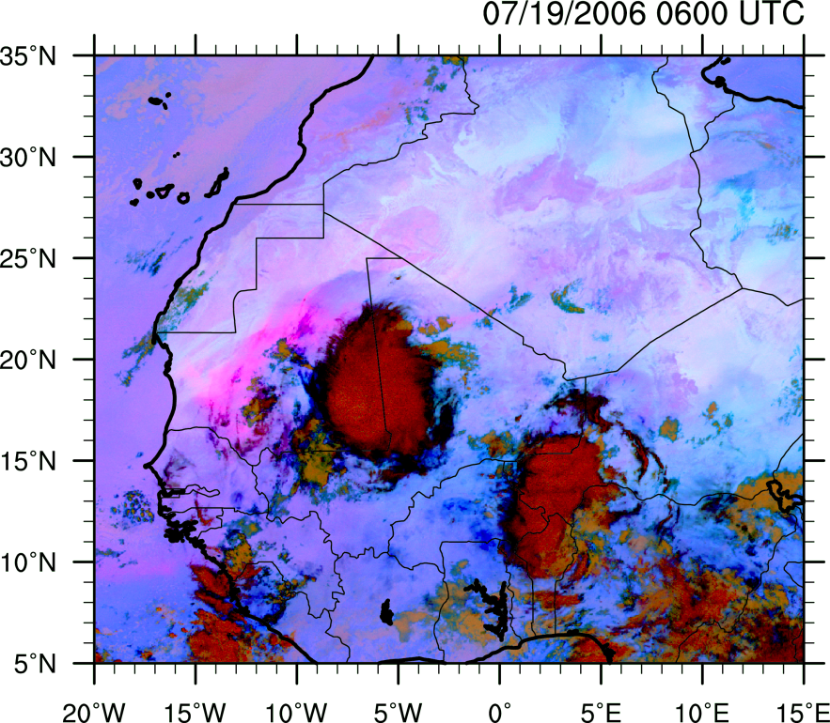
Outline
July 17-20, 2006 Event (NV Type)
MSG False Color Dust Image
0.5° AMMA Reanalysis 925 θ (K, shaded),
ζ (> 2.5x10⁻⁵ s⁻¹, pattern),
winds (ms⁻¹, vectors)
7/18/1800 UTC

Slide 36
700 hPa PV, Streamfunction, and Winds
Description
  Source: AMMA Reanalysis Model Level Data
  Resolution: 0.5x0.5°.
  Key: 700 hPa potential vorticity (x10⁻¹ PVU, shaded), 700 hPa winds (ms⁻¹, vectors), streamfunction (x10⁶ m²s-²).

Slide 37
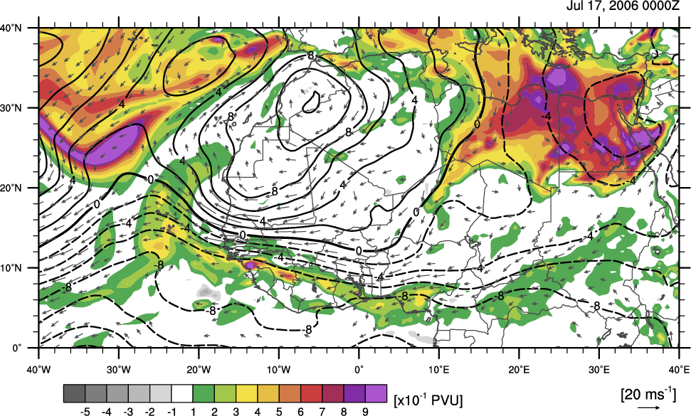
700 hPa PV and Winds

Slide 38
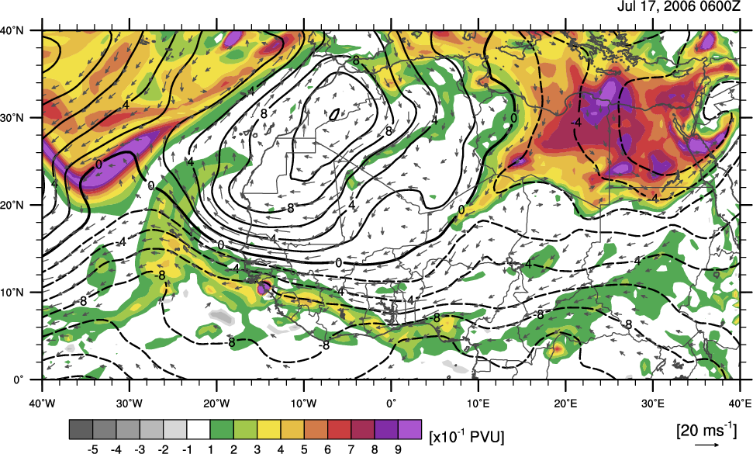
700 hPa PV and Winds

Slide 39
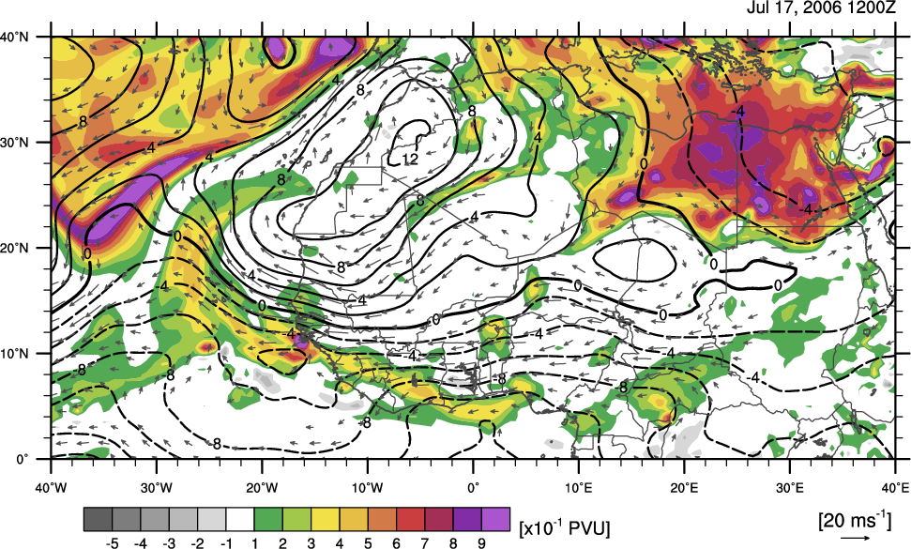
700 hPa PV and Winds

Slide 40
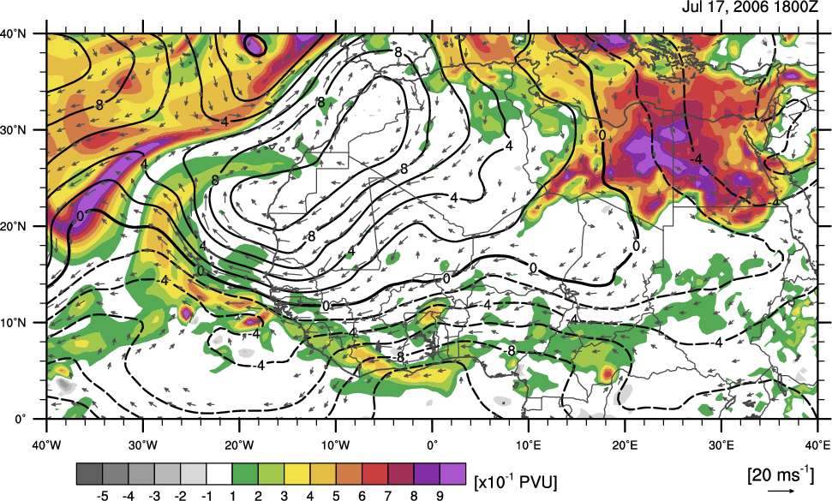
700 hPa PV and Winds

Slide 41
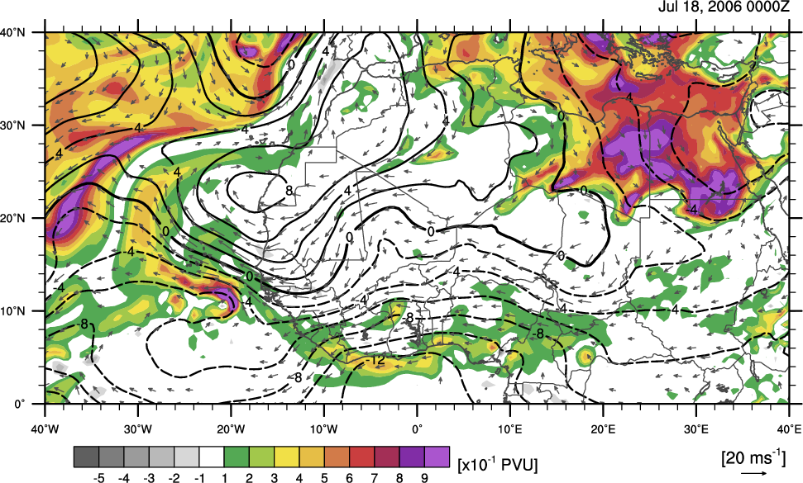
700 hPa PV and Winds

Slide 42

700 hPa PV and Winds

Slide 43

700 hPa PV and Winds

Slide 44

700 hPa PV and Winds

Slide 45

700 hPa PV and Winds

Slide 46

700 hPa PV and Winds

Slide 47

700 hPa PV and Winds

Slide 48

700 hPa PV and Winds

Slide 49

700 hPa PV and Winds

Slide 50

700 hPa PV and Winds

Slide 51
400 hPa PV, Streamfunction, and Winds
Description
  Source: AMMA Reanalysis Model Level Data
  Resolution: 0.5x0.5°.
  Key: 400 hPa potential vorticity (x10⁻¹ PVU, shaded), 400 hPa winds (ms⁻¹, vectors), streamfunction (x10⁶ m²s-²).

Slide 52

400 hPa PV, Streamfunction, and Winds

Slide 53

400 hPa PV, Streamfunction, and Winds

Slide 54

400 hPa PV, Streamfunction, and Winds

Slide 55

400 hPa PV, Streamfunction, and Winds

Slide 56

400 hPa PV, Streamfunction, and Winds

Slide 57

400 hPa PV, Streamfunction, and Winds

Slide 58

400 hPa PV, Streamfunction, and Winds

Slide 59

400 hPa PV, Streamfunction, and Winds

Slide 60

400 hPa PV, Streamfunction, and Winds

Slide 61

400 hPa PV, Streamfunction, and Winds

Slide 62

400 hPa PV, Streamfunction, and Winds

Slide 63

400 hPa PV, Streamfunction, and Winds

Slide 64

400 hPa PV, Streamfunction, and Winds

Slide 65

400 hPa PV, Streamfunction, and Winds

Slide 66
Cross-Sections

Slide 67
MSG False Color Dust
D
C

Slide 68

925 hPa θv, Vorticity, Streamfunction, and Winds
D
C

Slide 69
700 hPa PV, Streamfunction, and Winds
D
C

Slide 70
400 hPa PV, Streamfunction, and Winds
D
C

Slide 71

C:D Cross-Section PV and θ

Slide 72

C:D Cross-Section Vorticity and θ

Slide 73
MSG False Color Dust
C
D

Slide 74

925 hPa θv, Vorticity, Streamfunction, and Winds
C
D

Slide 75

C:D Cross-Section PV and θ

Slide 76

C:D Cross-Section Vorticity and θ

