Slide 1
Diagnosing the Electrical Structure of Dusty Gust Fronts in the Sahel
Earle Williams, Harvey Elliott, Nilton Renno, Jasper Kok, William Beasley, Nathalie Nathou and Brian Russell
AMS Annual Meeting
Seattle, Washington
January 26, 2011

Slide 2
Outline
Charge separation in dust storms
Physical structure of Haboobs (Dusty gust fronts)
Field mill measurements in Niger (2006)
Tower measurements of space charge density (2010)
Discussion on saltation layer

Slide 3
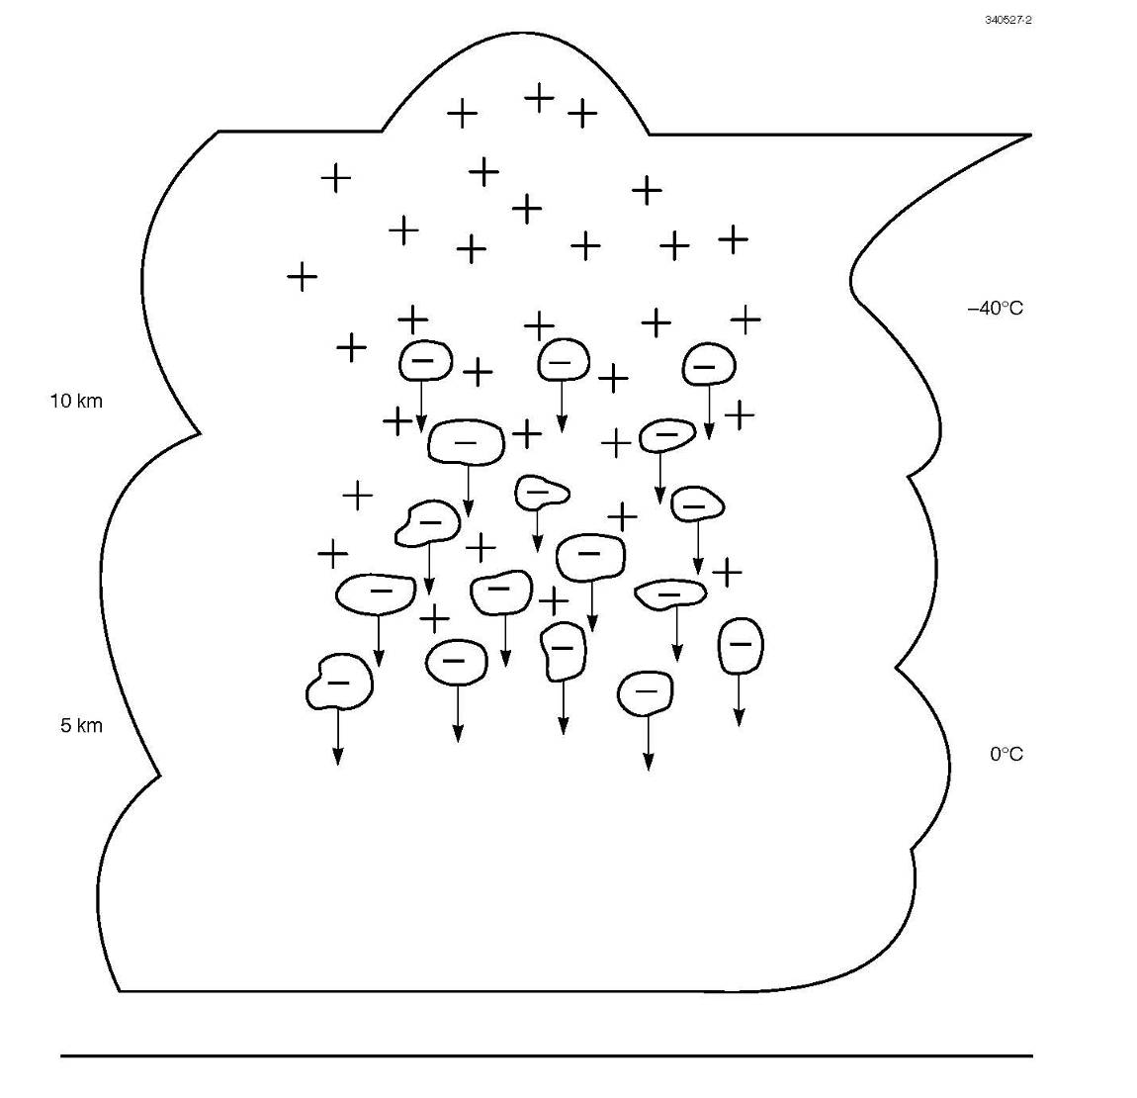
Thundercloud Charge Separation by Ice Particle Collisions

Slide 4
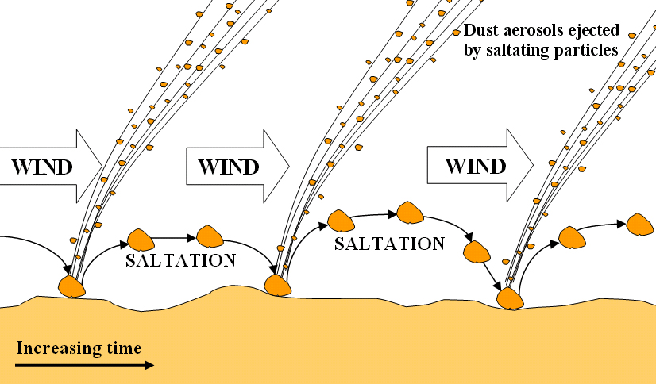
Saltation of large sand grains and emission of dust particles
1 meter

Slide 5
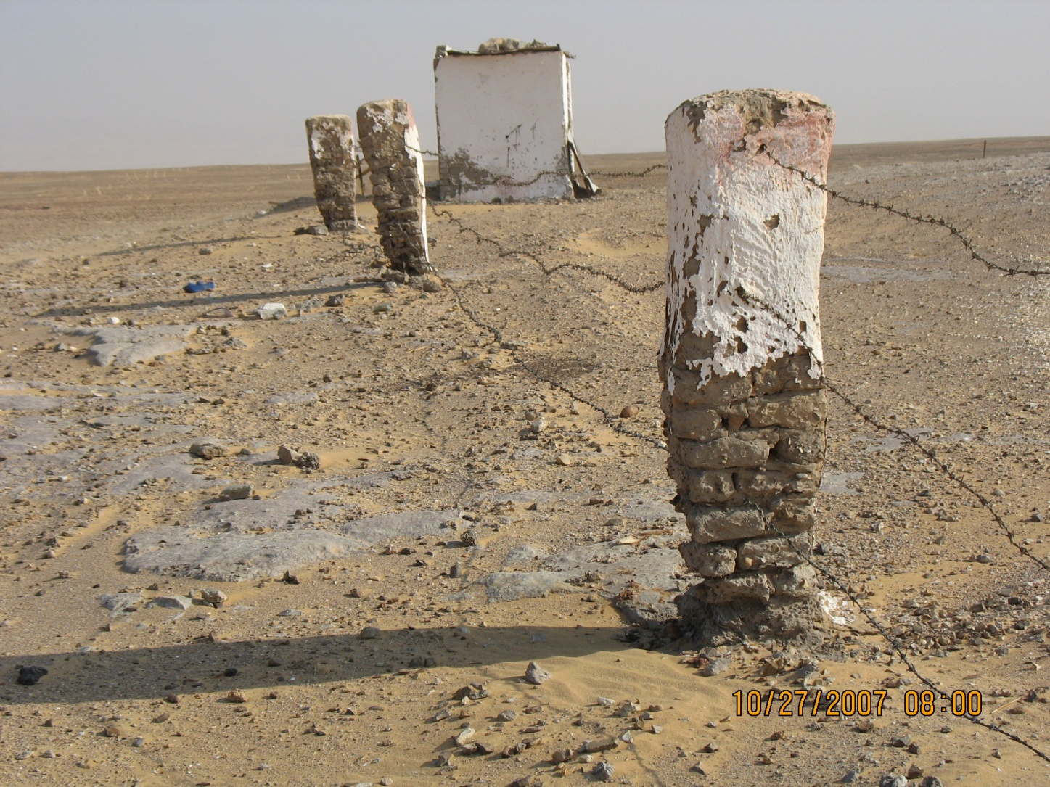
Post Abrasion over the Height Range of Saltation Layer
(Western Desert, Egypt)

Slide 6
Experimental Facilities
MIT C-band Doppler radar
10 meter tower with four cylindrical field mills
Campbell inverted field mill
Mission Instruments goose-neck field mill

Slide 7
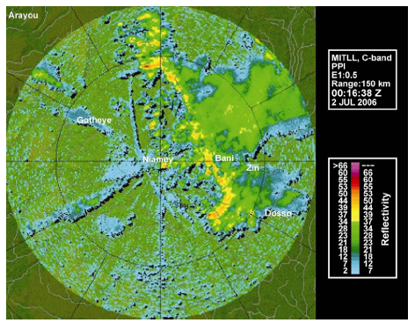
Gust front ahead of squall line in Niamey, Niger

Slide 8
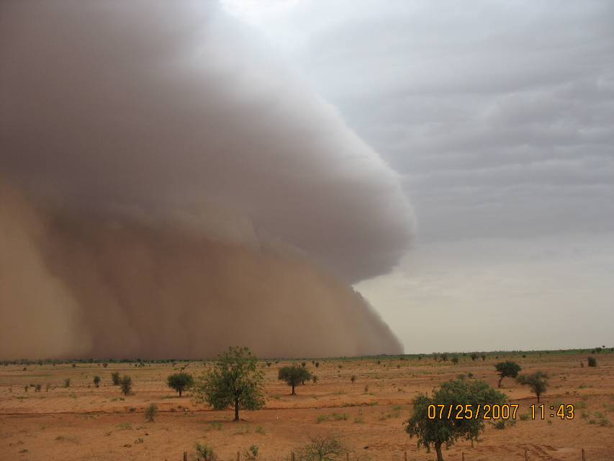
Gust front in Niger topped with
white cumulus on leading updraft

Slide 9
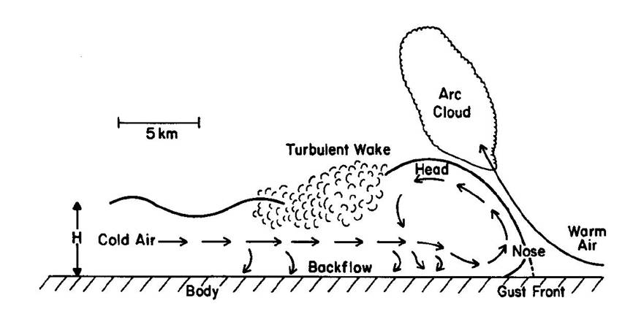
Cross section of gust front
From Droegmeier and Wilhelmson (1987)

Slide 10
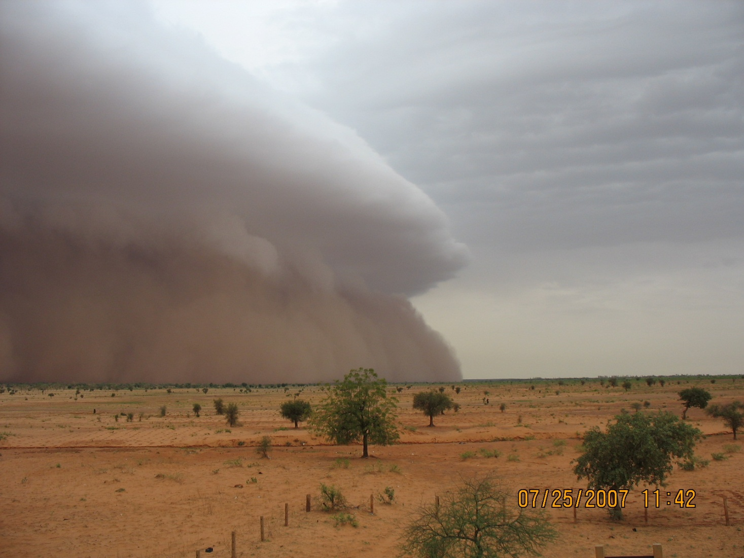
Haboob on July 25, 2007 at t = 0

Slide 11
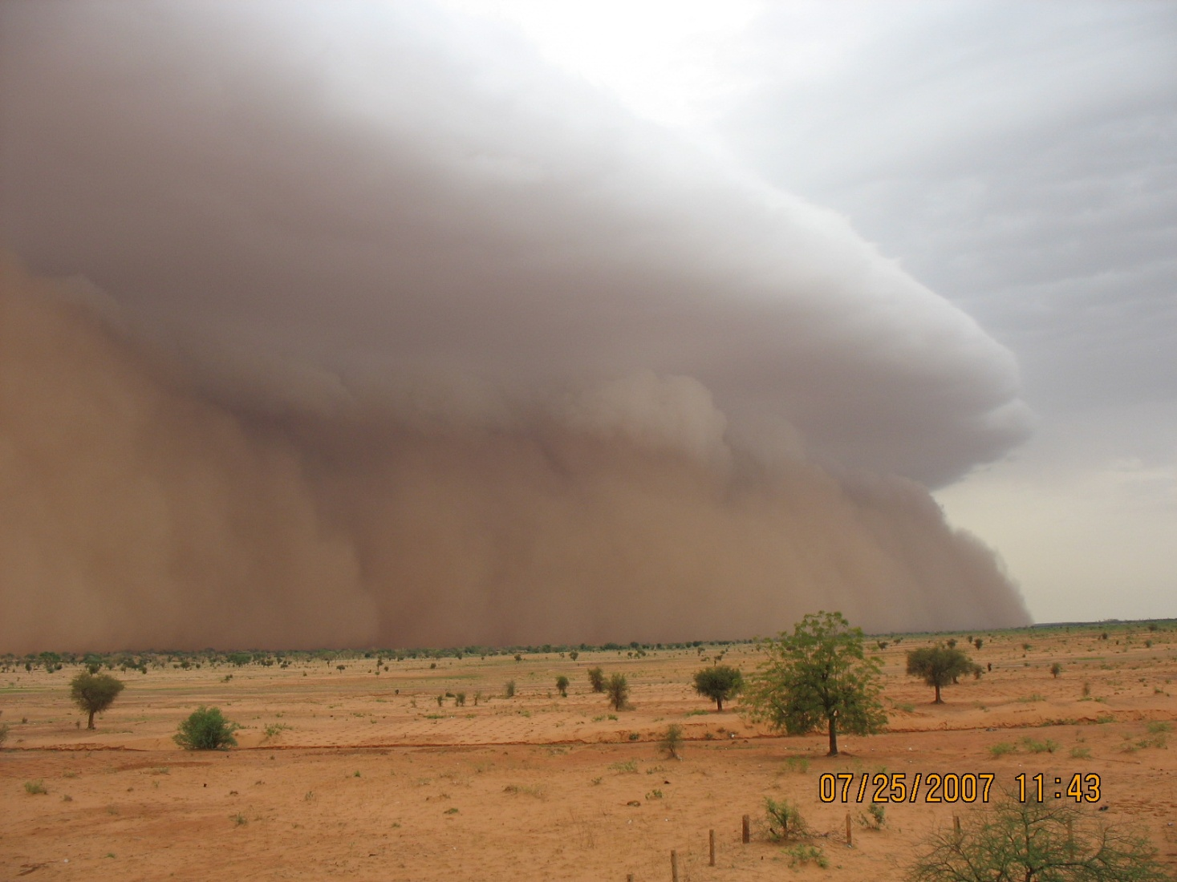
Haboob on July 25, 2007 at t = 1 min

Slide 12
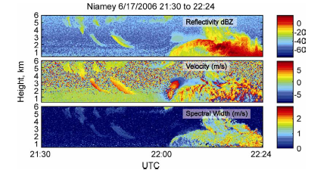
Vertically pointing Doppler radar observations on gust front

Slide 13
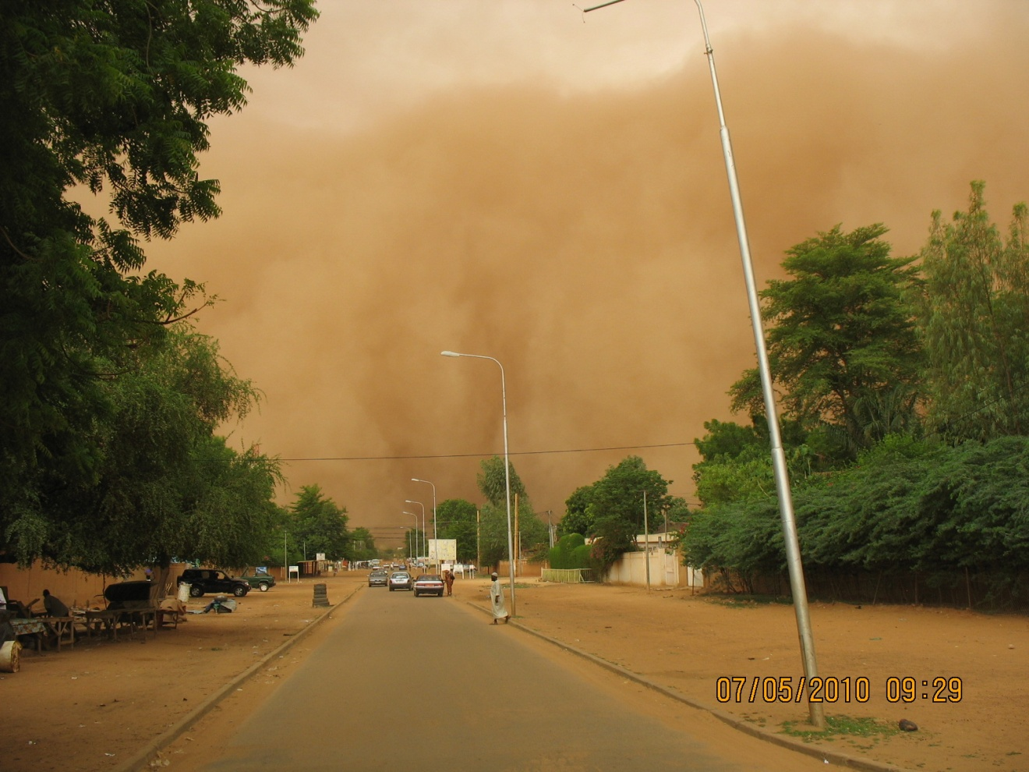
Dust wall over Niamey,
Niger July 5, 2010

Slide 14
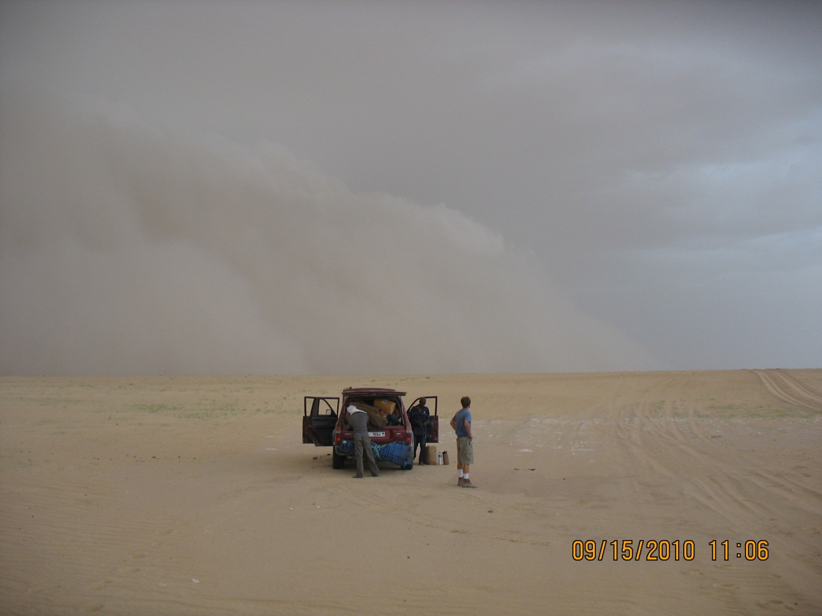
Grey gust front approaching
In Sand Sea of Bodélé Depression

Slide 15
Strategy for Electrical Analysis
In 2006,2007 single field mill at radar site
Electric field soundings by tethered balloon are impractical
Measurement of surface electric field is limited
  2010 Two field sites and use of 10-m tower

Slide 16
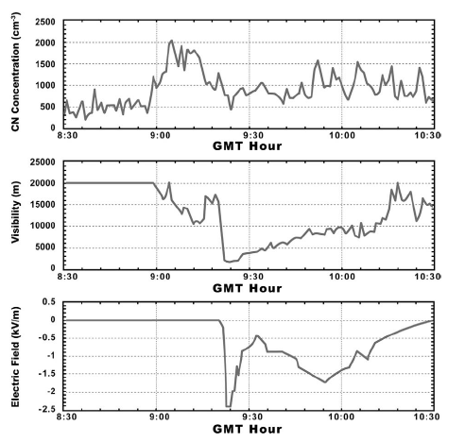
Electric field record of a gust front with monopolar behavior

Slide 17
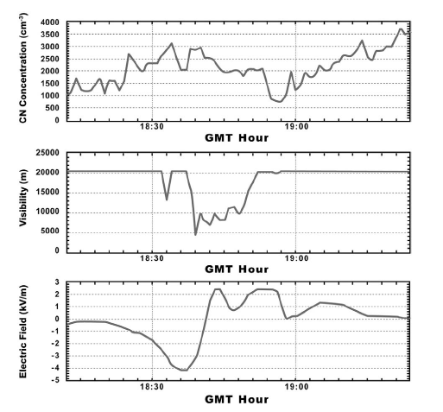
Electric field record of a gust front with bipolar behavior

Slide 18
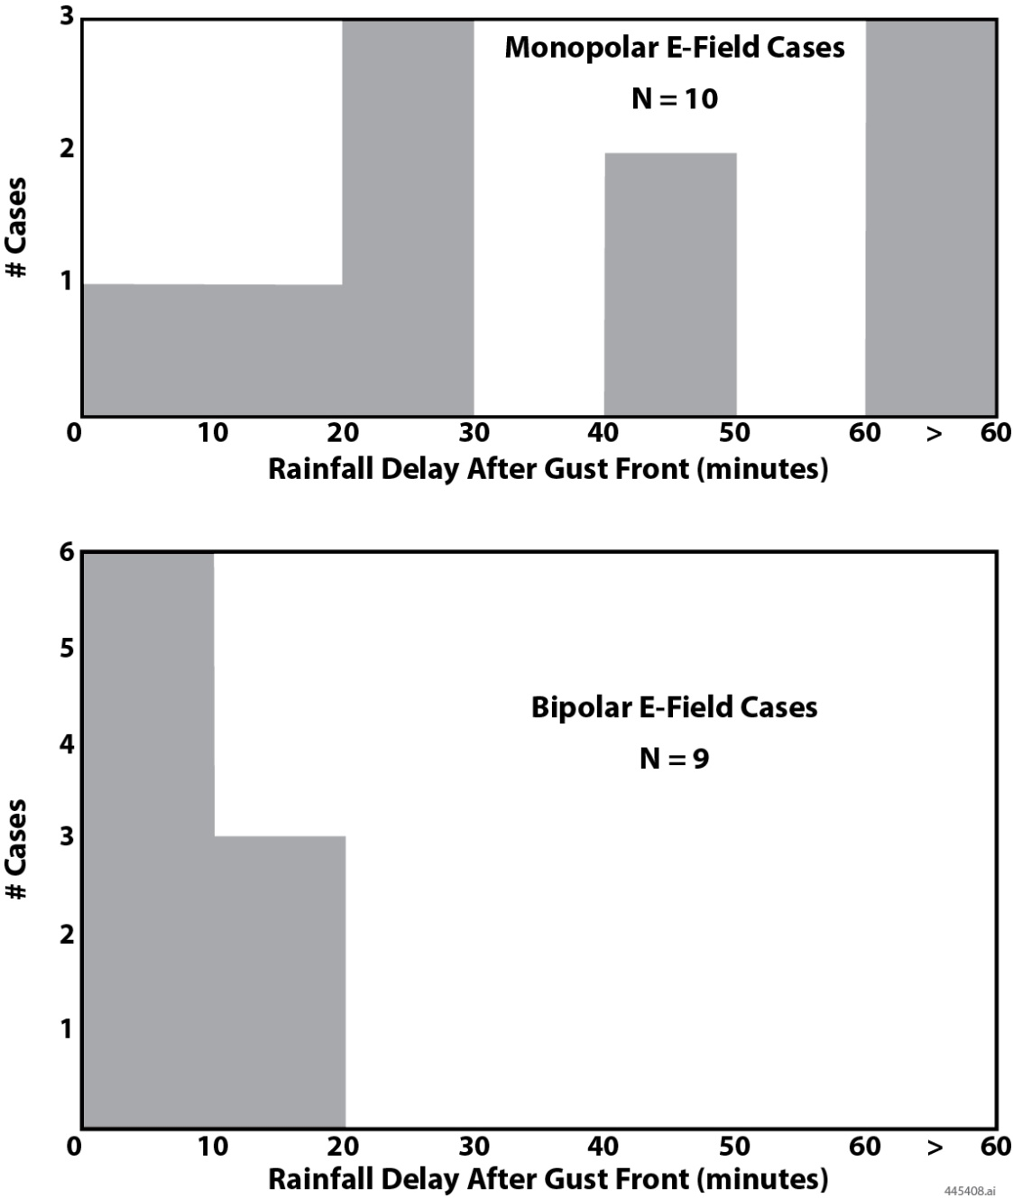
Comparisons for Monopolar and Bipolar Gust Front Cases

Slide 19
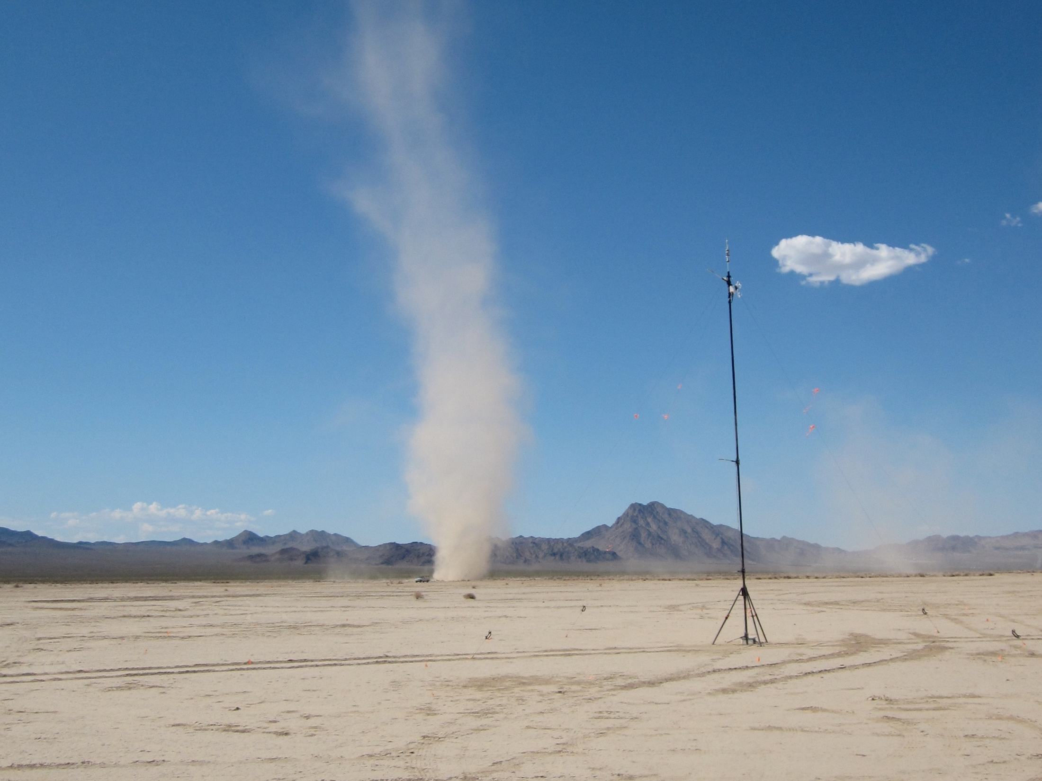
Previous sensor deployment to study electrification of dust devils
Eldorado Campaign
20 June 2010 – 01 July 2010
Harvey Elliott

Slide 20
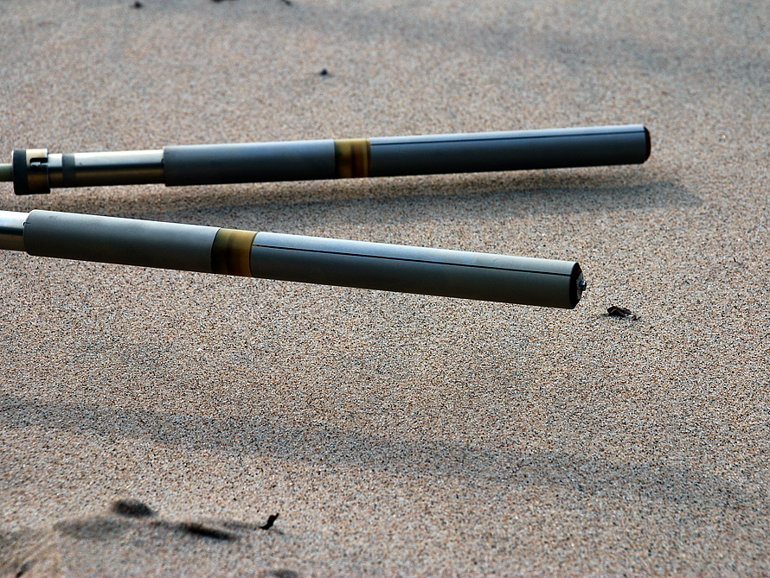
Cylindrical Field Mill Sensors
Used in This Study
Sensor 1 at ~3.5 cm
Sensor 3 at ~10 cm

Slide 21
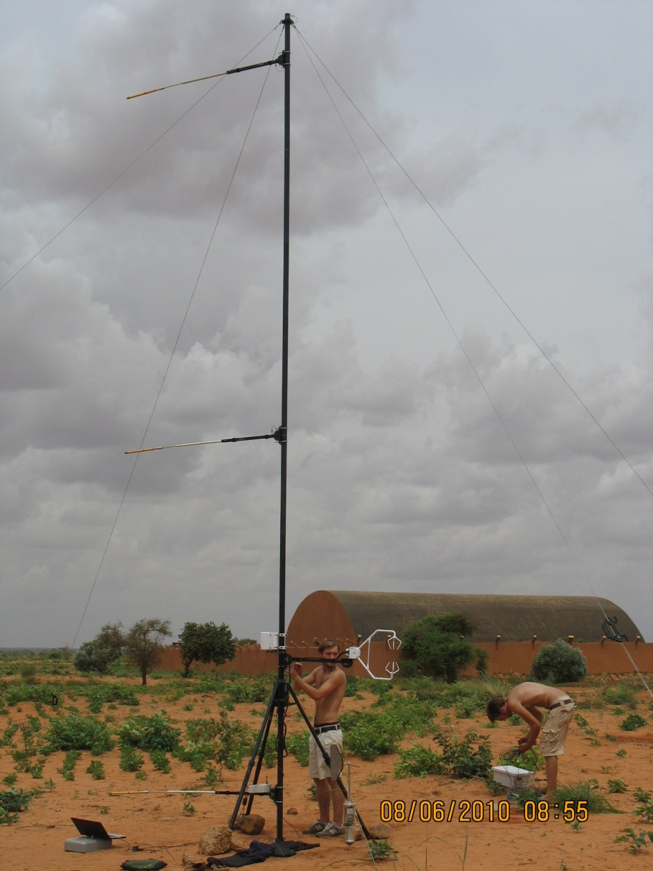
10-meter tower with electric field sensors

Slide 22
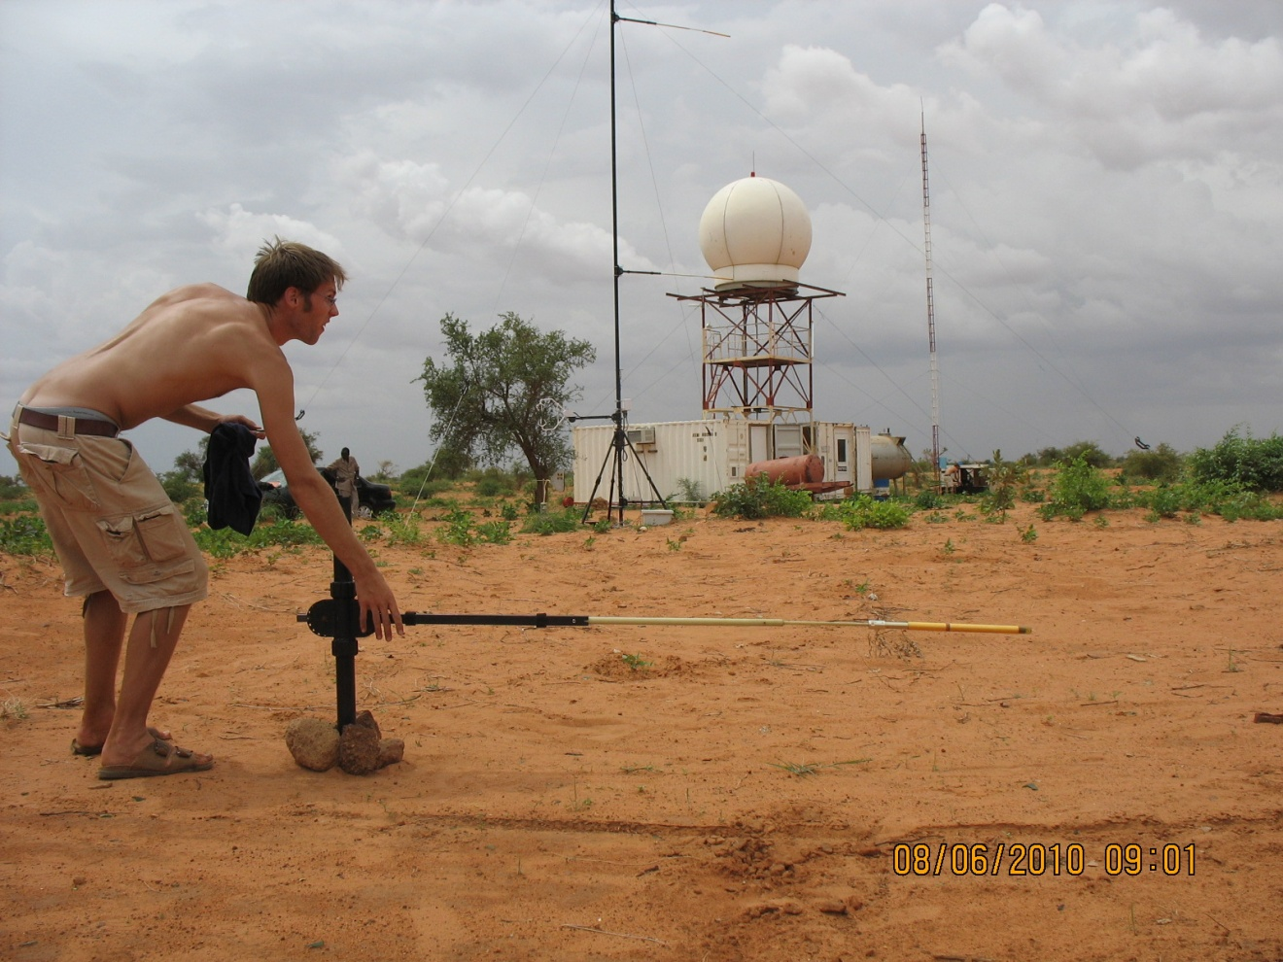
Calibration of cylindrical field mill

Slide 23
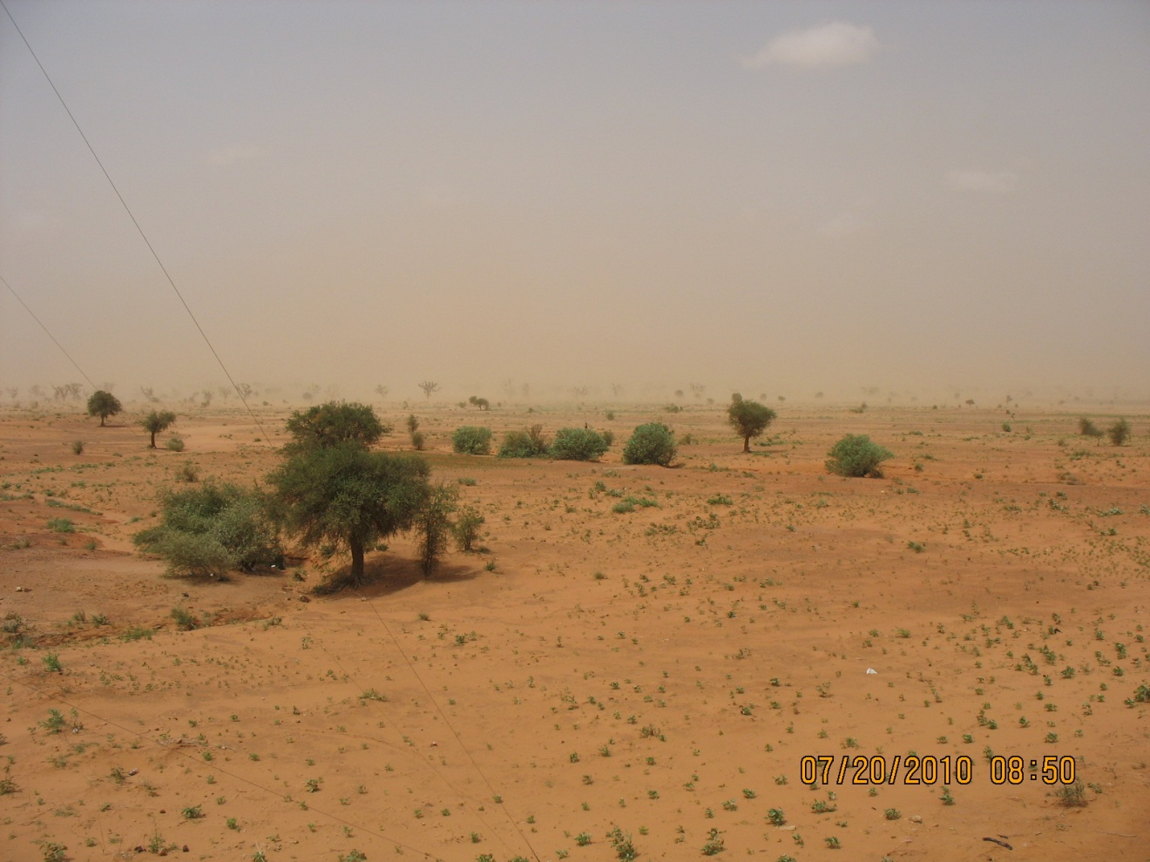
Straight line winds case Niamey, Niger July 20, 2010

Slide 24
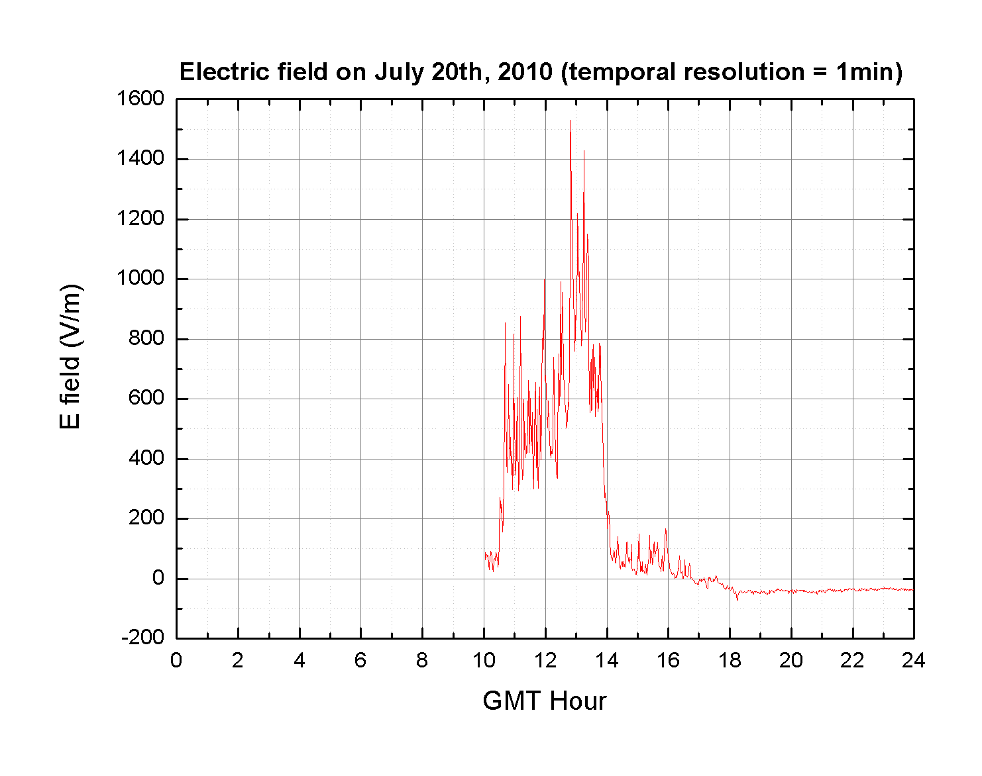
Campbell field mill record for July 20, 2010
(Straight line winds case)

Slide 25
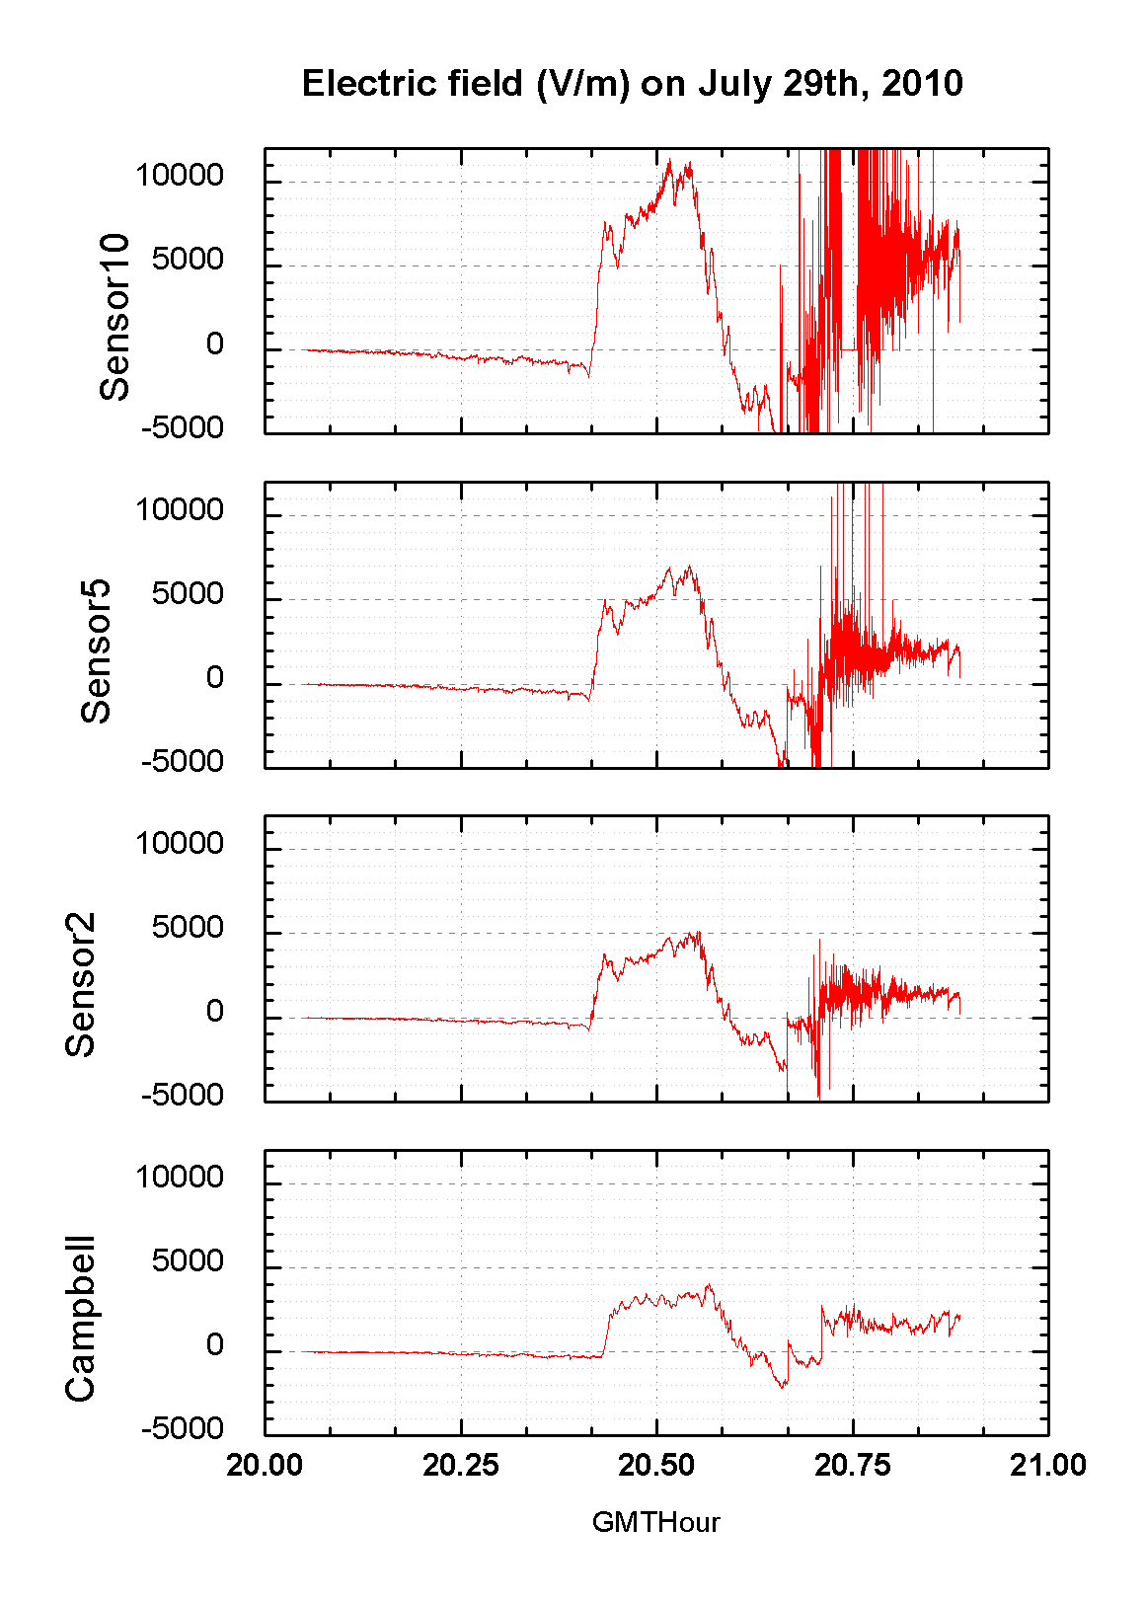
Multi-sensor electric field records for gust front on July 29, 2010

Slide 26
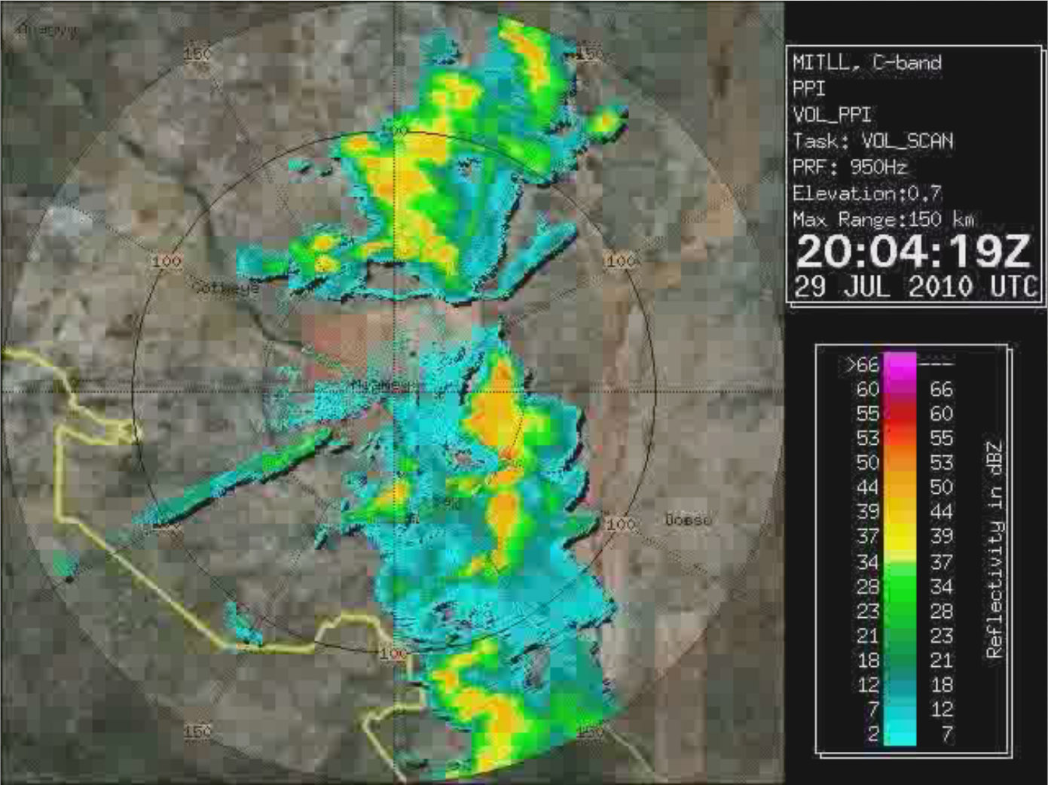
Niamey Squall line and gust front 20:04 Z
July 29, 2010

Slide 27
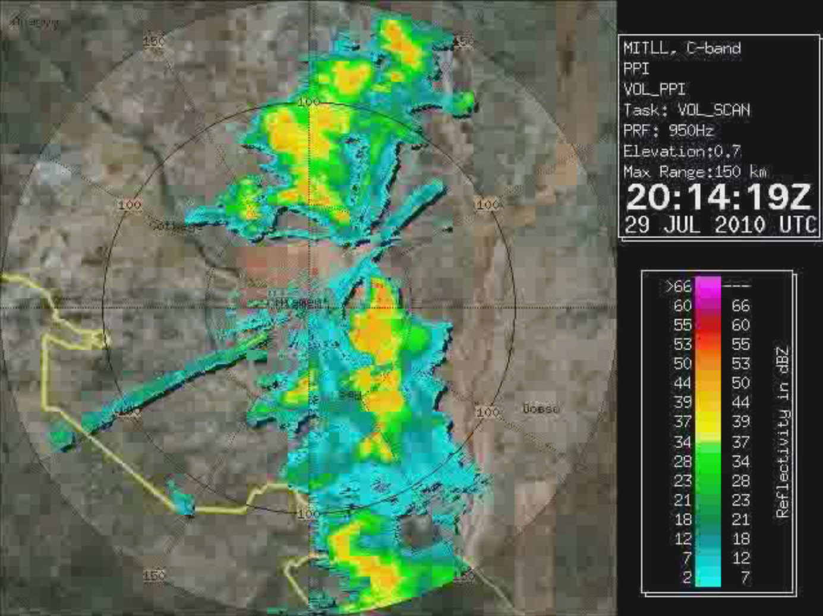
Niamey Squall line and gust front 20:14 Z
July 29, 2010

Slide 28
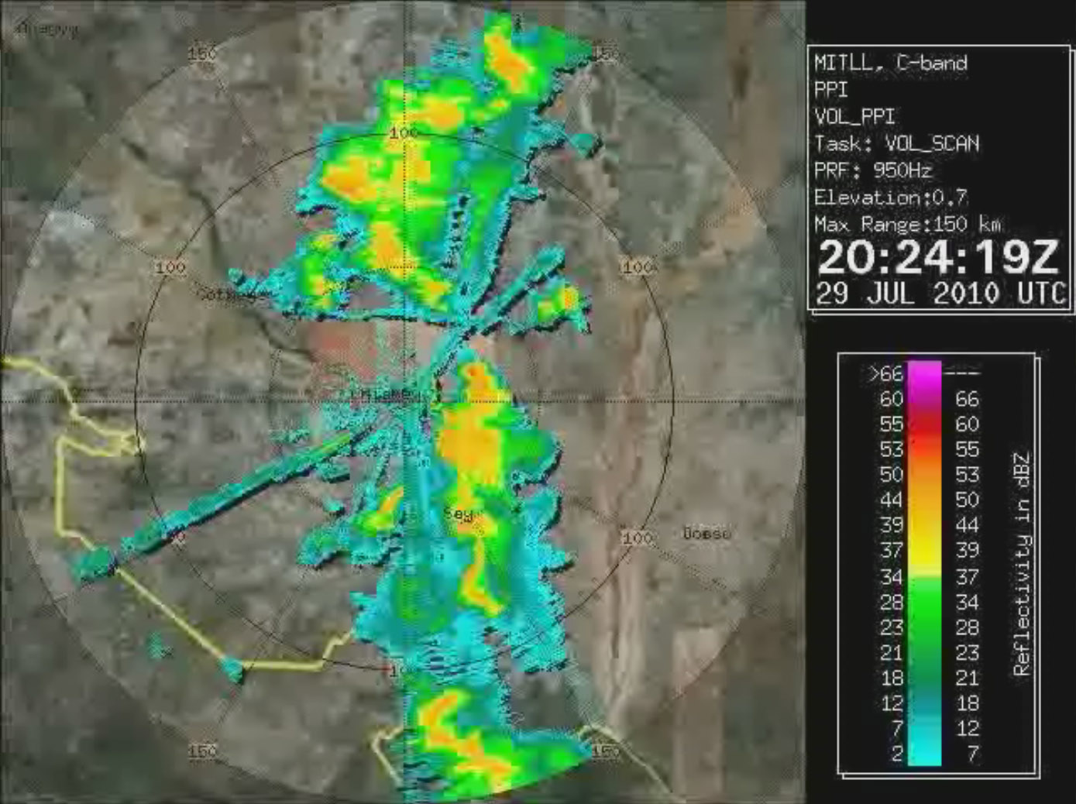
Niamey Squall line and gust front 20:24 Z
July 29, 2010

Slide 29
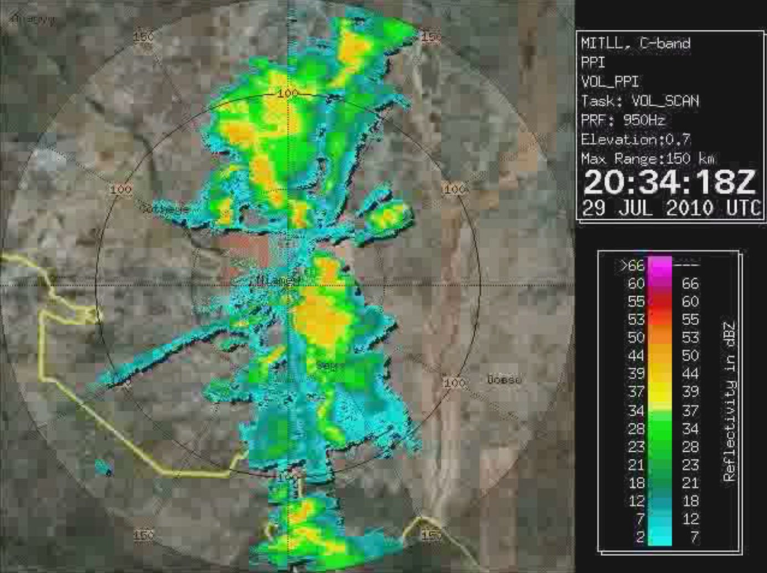
Niamey Squall line and gust front 20:34 Z
July 29, 2010

Slide 30
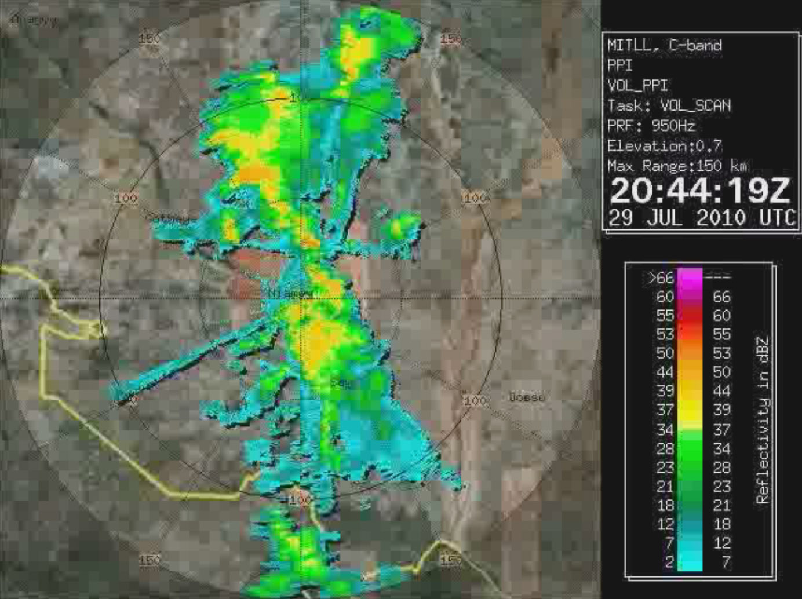
Niamey Squall line and gust front 20:44 Z
July 29, 2010

Slide 31
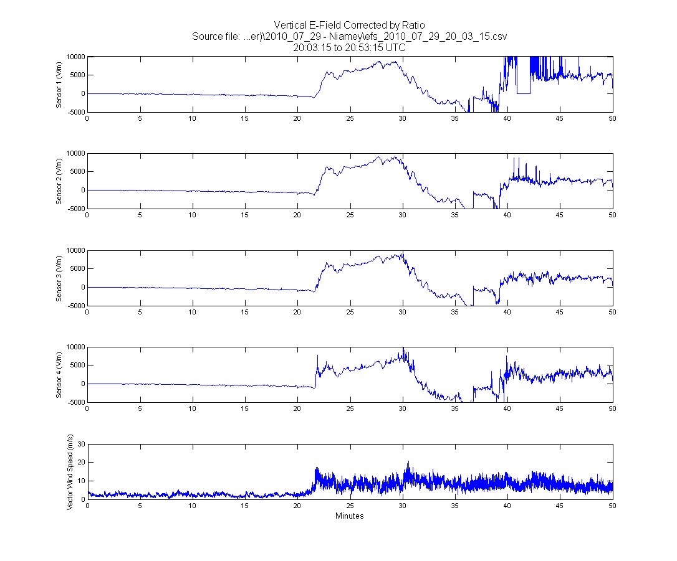
Profiles of electric field for gust front passage July 29, 2010

Slide 32
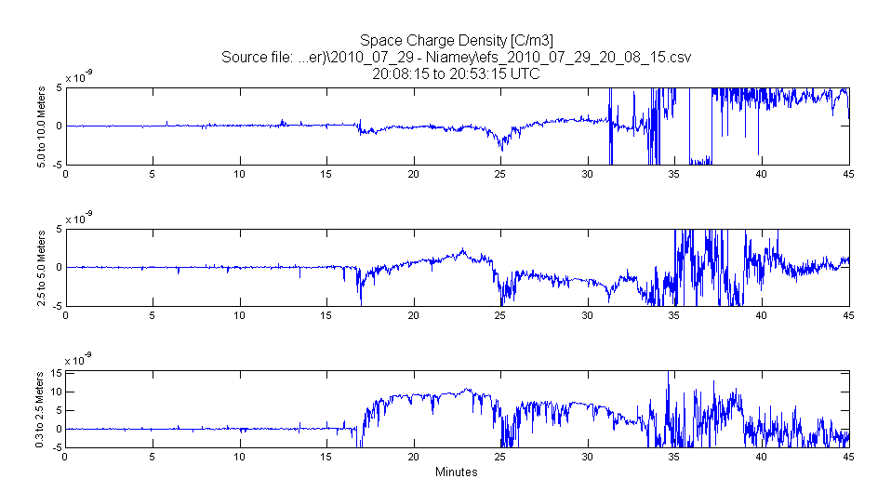
Profiles of computed space charge density July 29, 2010

Slide 33
Conclusions
Dusty gust fronts (haboobs) are electrified with surface fields of 1 – 10 KV/m and space charge density in nanocoulomb/m³ range
Charge separation in the saltation layer (<1m scale) is playing primary role
Monopolar field behavior is prevalent (with negative charge on small particles aloft) because saltation layer (and positively charged sand grains) so close to surface
Mechanism/polarity in dust devils is essentially the same

Slide 34
Electric field sensors: cylindrical field mills
σ = ε₀ E⊥
y (Up)
x (W)
ω
2r
z (N)
h
E = {Ex, Ey}
y (Up) 270º
The electric field sensor measures the current between two sectors, I(t), at 16 points per rotation. This is converted to a magnitude and direction vector of the electric field using:
Sensor (rotating part) geometry:
h = 150 mm, r = 11 mm
ω
Q₁
β_{i}(t)+π
r
x (W)
0º
σ(θ) = ε₀ (Ex cos θ + Ey sin θ)
Q_{i} = rh ∫σ(θ) dθ
180º
θ
β_{i}(t)
I(t) = d(Q₁- Q₂)/dt = - 4 r h ε₀ω E cos(ωt + arctg(Ex/Ey))
Q₂
90º

Slide 35
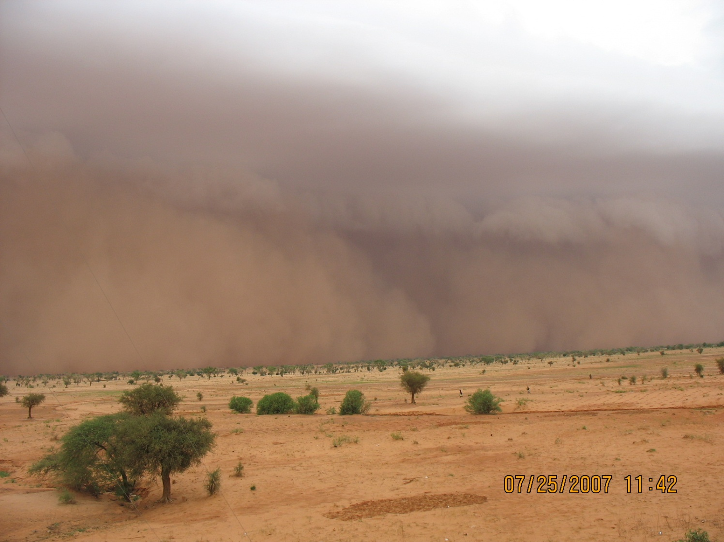
Dust storm in Niamey, Niger

Slide 36
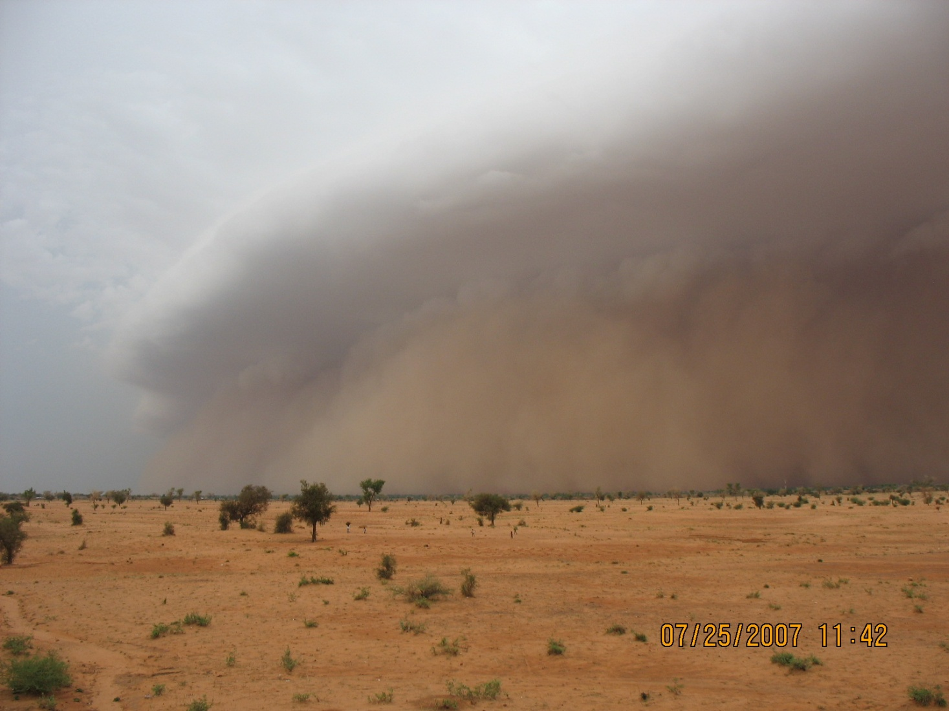
Haboob overlain by cloud

Slide 37
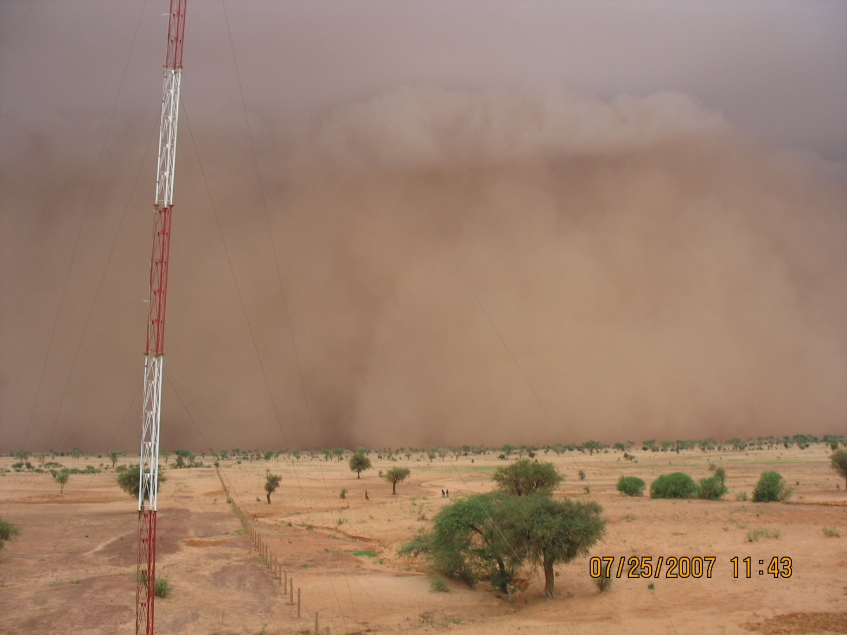
Approaching haboob in Niamey, Niger, West Africa

Slide 38
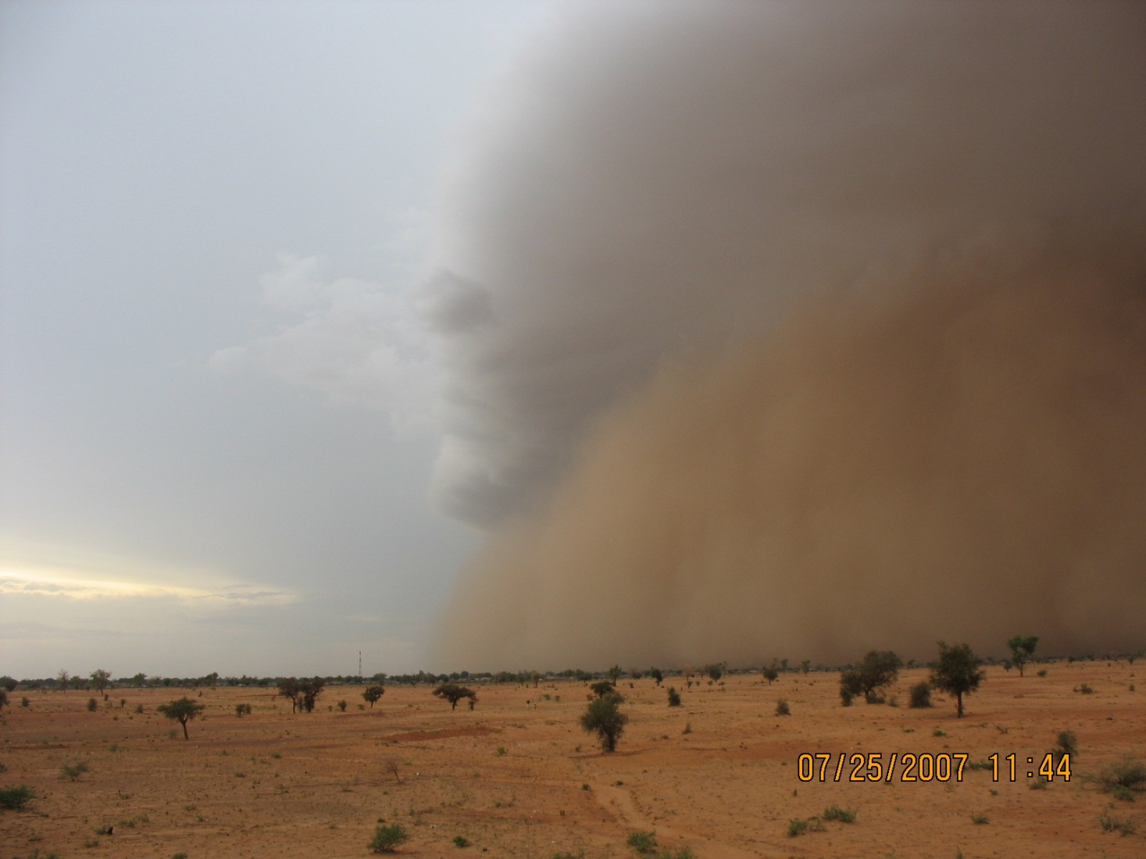
Haboob lofting cumulus cloud

Slide 39

Dust gust front over Niger
River in Niamey

Slide 40
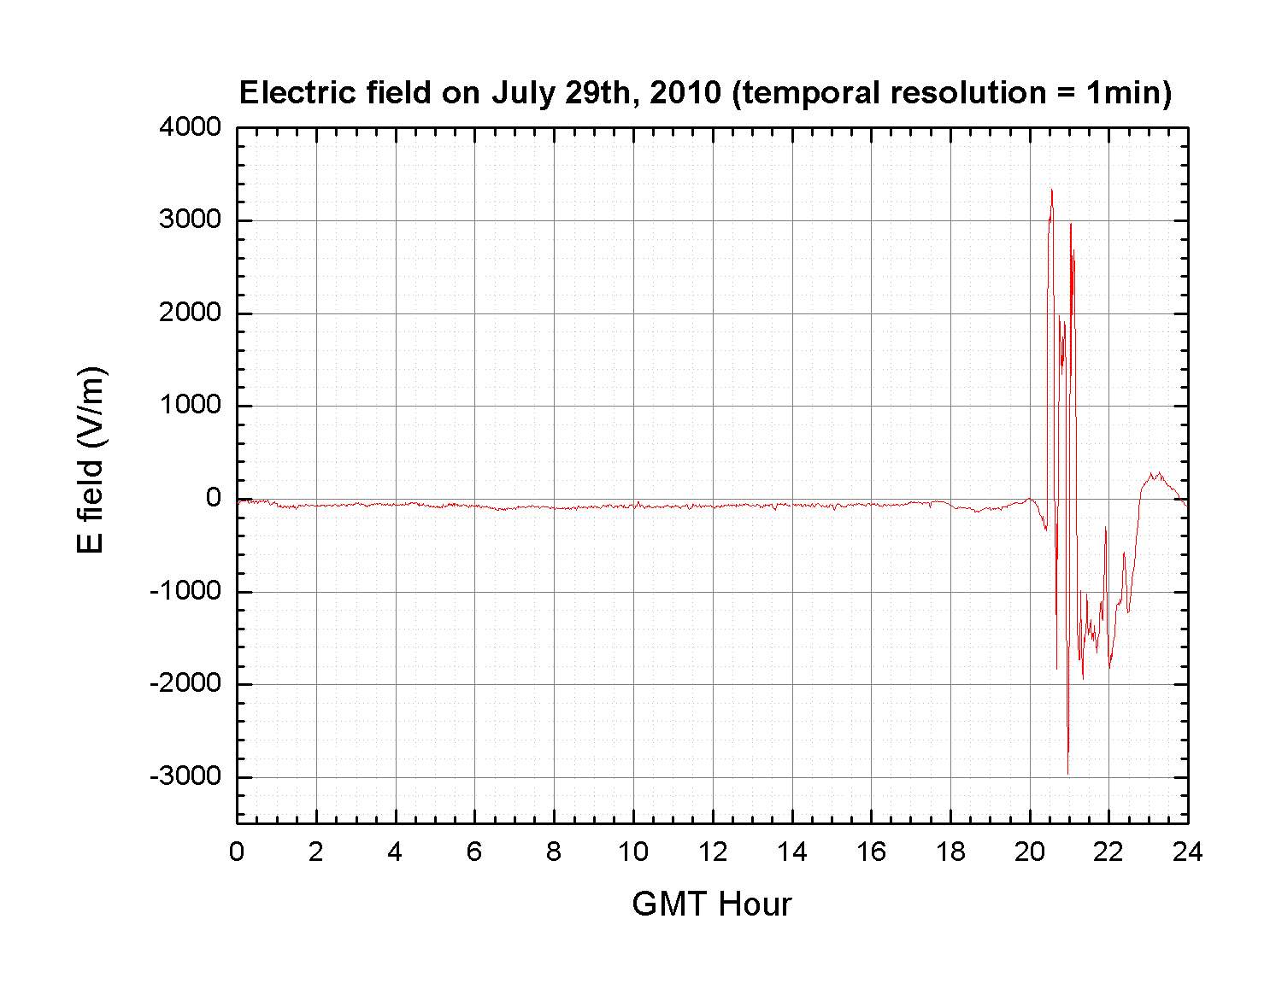
Electric field record for dusty gust front July 29, 2010

Slide 41
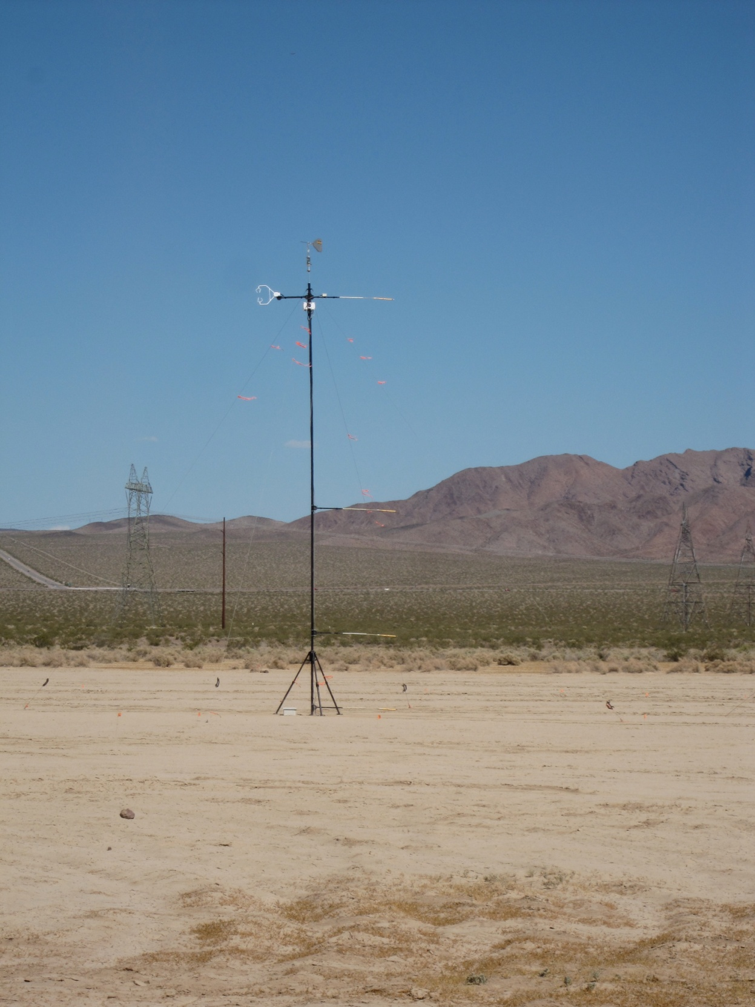
Mast Configuration
Prandtl Probe
Electric Field Sensors
10m
3D Anemometer
5m
2m
0.2m

Slide 42
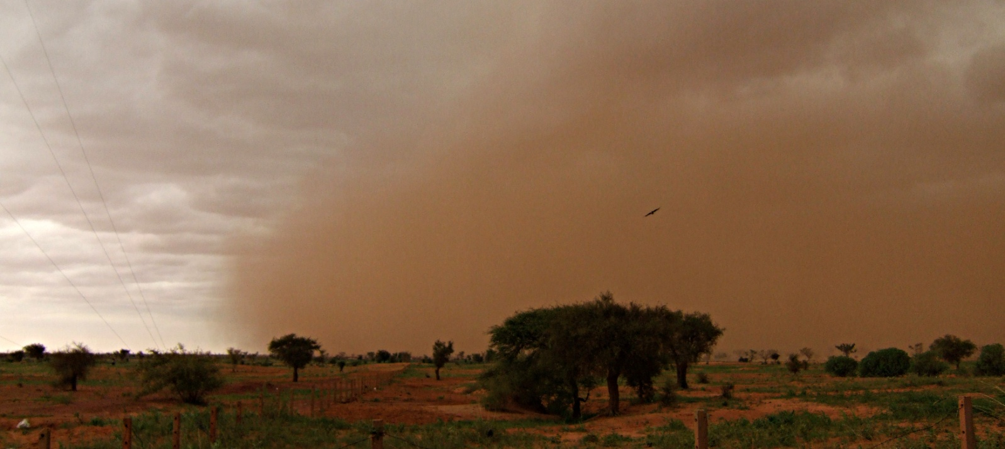
Gust front in Niger, with typical
orange-red appearance

Slide 43
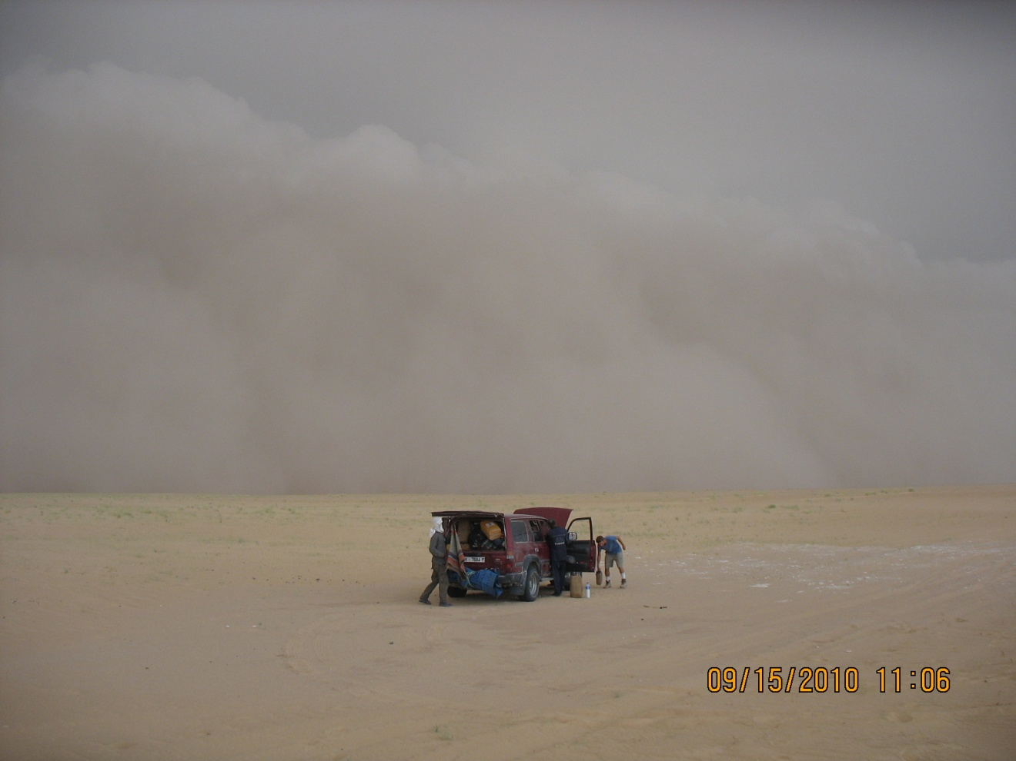
Grey gust front approaching

