Slide 1
Decadal Climate Variability and Prediction
Introduction to Decadal Climate Variability
The Atlantic Multidecadal Oscillation
The Pacific Decadal Oscillation
Decadal Prediction

Slide 2
“Climate is now recognized as being continuously variable, on all scales of time”
J. Murray Mitchell Jr., Quaternary Research, 1976

Slide 3
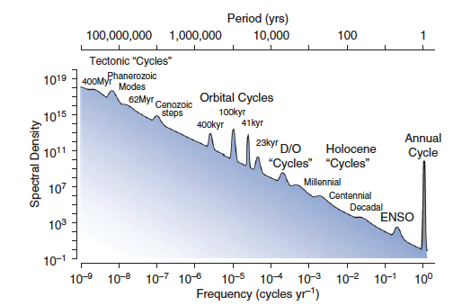
Bartlein, Encyclopedia of Quaternary Science, 2006

Slide 4
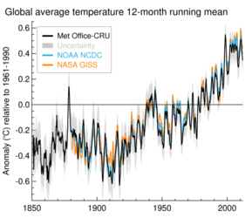
Make a Prediction…
20
40
60
80

Slide 5
… was anyone right?

Slide 6
Example 1: Global temperature
NEWSWEEK published an article in 1975 worried about global cooling and a new ice age!!
*this was not the scientific consensus at the time though
From www.metoffice.gov.uk

Slide 7
Example 1: Global temperature
It is important to consider decadal variations on top of any long term trend
From www.metoffice.gov.uk

Slide 8
Example 1: Global temperature
It is important to consider decadal variations on top of any long term trend
Decadal variability alternately disguises and accentuates the secular warming trend
From www.metoffice.gov.uk

Slide 9
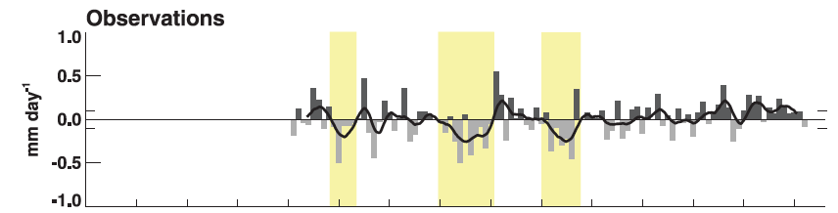
Example 2: The US Dust Bowl
Rainfall
McCrary and Randall, J. Climate, 2010
During 1930s, US experienced one of the most devastating droughts of the past century. Affected ~2/3 of US, parts of Mexico and Canada
Drought is a example of decadal climate variability that the public understand.

Slide 10
Example 3: Sahel Drought
Wet conditions in 50s and 60s
Drought in 70s and 80s:
* Affected 20 countries, 150 million people
*30 million were in urgent need of food aid
*10 million refugees seeking food and water
*100,000 to 250,00 deaths

Slide 11
“An improved understanding of decadal climate variability is very important because stakeholders and policymakers want to know the likely climate trajectory for the coming decades for applications to water resources, agriculture, energy, and infrastructure development.”
Mehta et al., BAMS, 2011

Slide 12
2) The AMO:
Atlantic Multidecadal Oscillation

Slide 13
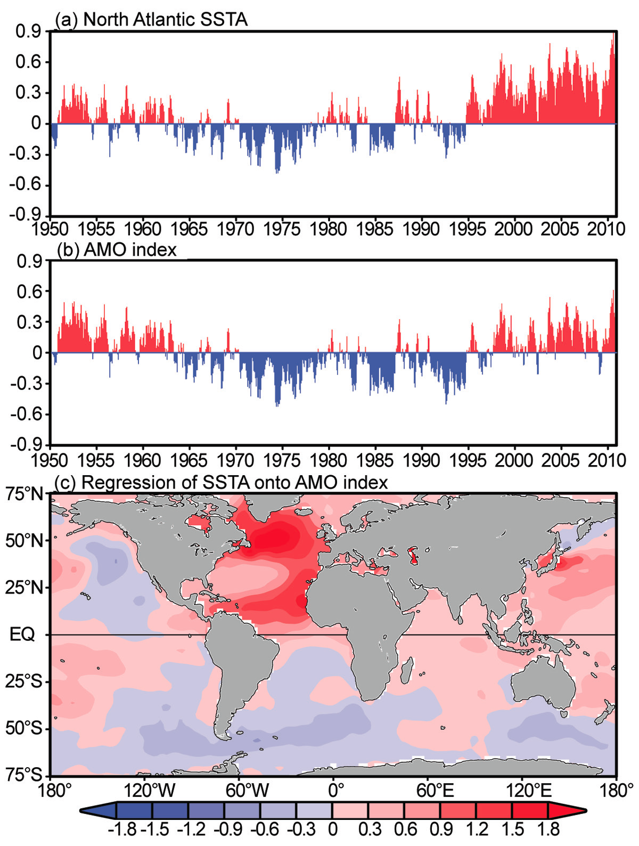
AMO Spatial Signature
Wang, State of the Climate 2010, BAMS, 2011
Positive signal over whole North Atlantic – horseshoe pattern
Weak SST signal across over global ocean regions

Slide 14
The AMO Index
The AMO index is the detrended SST anomalies in the North Atlantic
Removing basic global warming signal – we want the decadal climate variability
Wang, State of the Climate 2010, BAMS, 2011

Slide 15
The AMO index: SST anomalies averaged over 0° - 70°N, 75° - 10°W
detrended
low-pass-filtered (extracts the decadal variations)
??????
COLD
WARM
??????
??????

Slide 16
Did the AMO exist before 1900?
How can we tell if it did or didn’t?

Slide 17
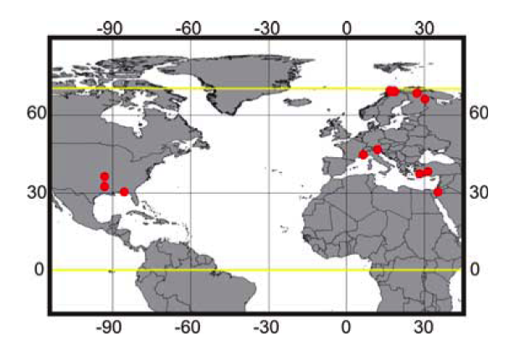
Did the AMO exist before 1900?
12 tree ring sites
(1567-1990), detrended
Calibration period (1922-1990)
Verification period (1856-1921)
Reconstruct a time series of the AMO index that agrees with SST instrument measurements but can be extended back in to the past
Gray et al., Geophys. Res. Lett., 2004

Slide 18
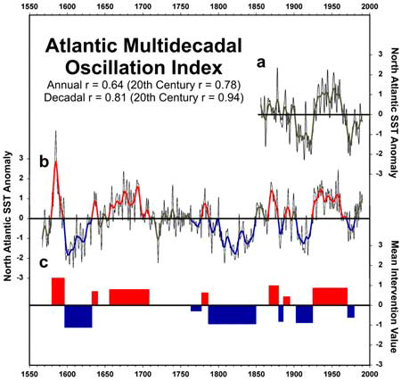
AMO Reconstruction from Tree Ring Data
SST observations (in-situ/satellite)
AMO Index from tree rings
Warm/Cold AMO periods

Slide 19
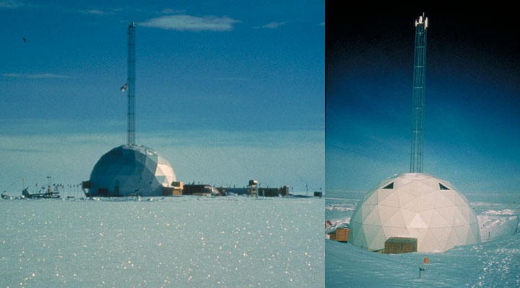
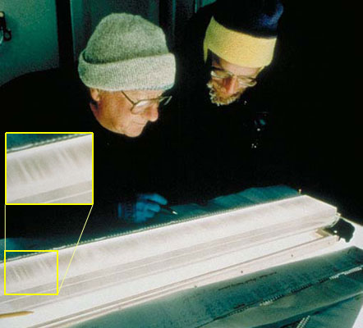
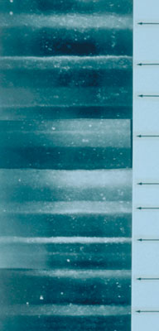
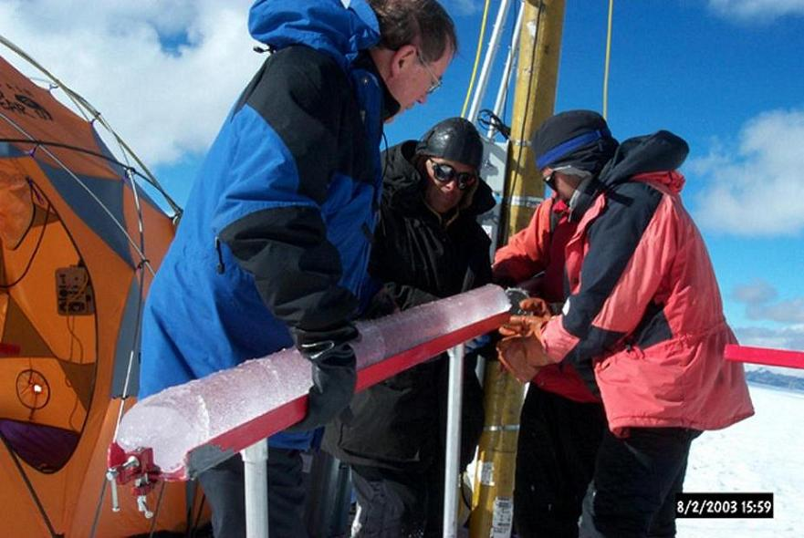
Principle Sources of Proxy Data for Paleoclimate Reconstructions
The Greenland Ice Sheet Project 2 drill site, located on the Greenland ice sheet at 72.6° N and 38.5° W at an elevation of 3,207 meters.
Glaciological (Ice Cores)
Oxygen isotopes
Physical properties
Trace element & microparticle concentrations
Closeup view of layers within a different sample; arrows indicate lighter summer layers (right).
Peru:http://bprc.osu.edu/Icecore/Quelccaya2003.html
http://eo.ucar.edu/staff/rrussell/climate/paleoclimate/ice_core_proxy_records.html

Slide 20
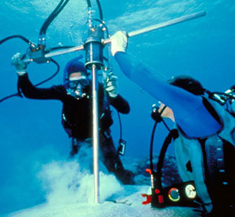
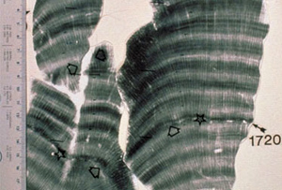
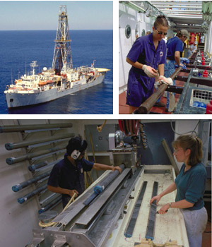
Principle Sources of Proxy Data for Paleoclimate Reconstructions
Geological
A. Sediments
1. Marine (ocean sediment cores)
i) Organic sediments (planktonic & benthic fossils)
Oxygen isotopes
Faunal & floral abundances
Morphological variations
ii) Inorganic sediments
Mineralogical composition & surface texture
Distribution of terrigenous material
Ice-rafted debris
Geochemistry
2. Terrestrial
Periglacial features
Glacial deposits & erosional features
Glacio-eustatic features (shorelines)
Aeolian deposits (sand dunes)
Lacustrine deposits/varves (lakes)
B. Sedimentary Rocks
Facies analysis
Fossil/microfossil analysis
Mineral analysis
Isotope geochemistry
Scientists in SCUBA gear use a drill to extract a coral sample from Clipperton Atoll (lower) This X-ray image of coral samples from the Galapagos Islands clearly shows the banded growth pattern
The ship JOIDES Resolution (top left) has recovered thousands of sediment cores from the ocean floor with a drilling rig. Scientists aboard the ship (top right) clean and prepare one of the 9.5 meter-long cores soon after it was pulled up from the deep ocean. The long cores are cut into shorter segments and split lengthwise down the middle. (lower)
http://www.windows2universe.org/earth/climate/CDcourses_investigate_climate.html

Slide 21
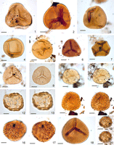
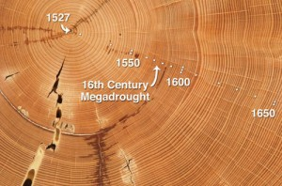
Principle Sources of Proxy Data for Paleoclimate Reconstructions
Biological
Tree rings (width, density, isotope analysis)
Pollen (species, abundances)
Insects
http://palynology.geoscienceworld.org/content/34/1/3.figures-only

Slide 22
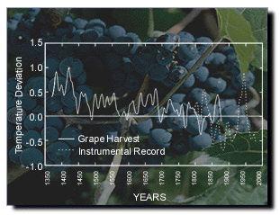
Principle Sources of Proxy Data for Paleoclimate Reconstructions
Historical
meteorological records
parameteorological record (environmental indicators)
phenological records (biological indicators)
The example above demonstrates how historical grape harvest dates were used to reconstruct summer temperatures (April - September) in Paris from 1370 - 1879. [From Bradley, 1990; based on data from Le Roy Ladurie and Baulant, 1980.]

Slide 23
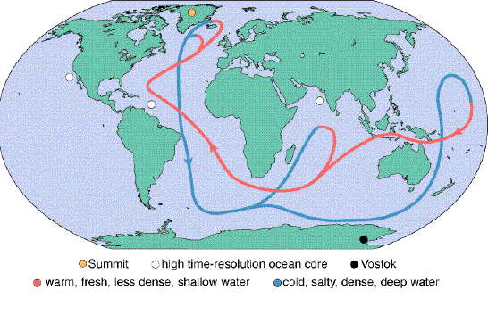
The Thermohaline Circulation (THC)
Atlantic Meridional Overturning Circulation (AMOC)

Slide 24
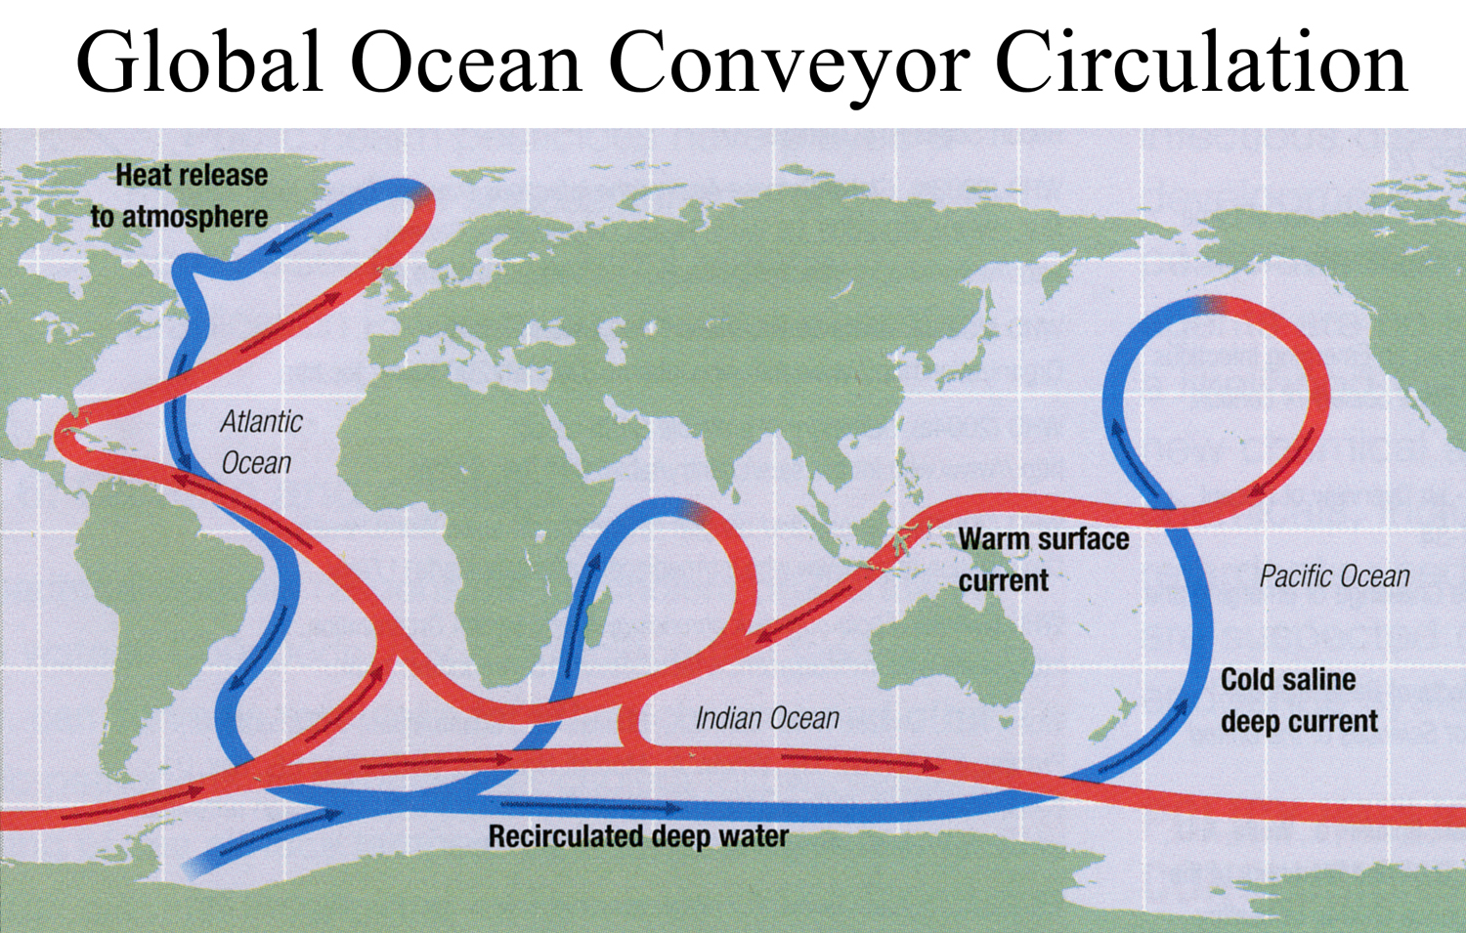

Slide 25
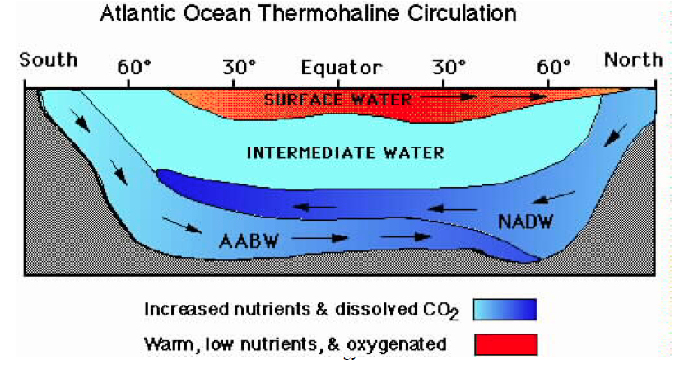
Warm N. Atlantic
Sinking in N. Atlantic

Slide 26
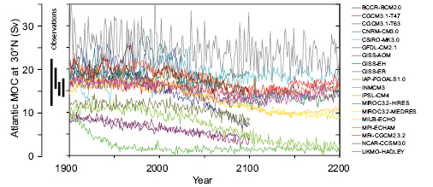
Future changes in the THC
(Atlantic Meridional Overturning Circulation)
www.ipcc.ch
Future: weakening of THC due to higher temperatures and more rain (freshwater is less salty)

Slide 27
Observing the Ocean is Hard…
To observed the THC we need to measure below the surface as deep as possible
This isn’t easy
ARGO floats have really helped

Slide 28
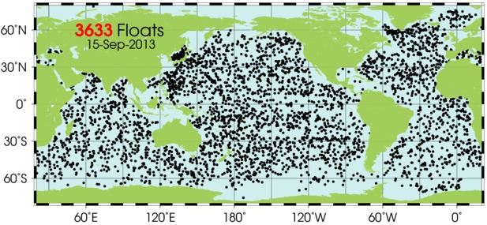
http://www.argo.ucsd.edu/
Locations of ARGO floats
What regions are missing floats??

Slide 29
To measure the THC, and how it modulates the AMO we need a long term record
ARGO float locations over the past 50 years…
We need something in addition to observations to supplement our understanding of the ocean and how it impacts the atmosphere

Slide 30
What can General Circulation Models models tell us?
Long (~1400 year) model integrations with HadCM3 able to simulate the observed pattern and amplitude of the AMO (Knight et al., 2005)
Model did not include any fluctuations in external forcing
(greenhouses gases, aerosols, etc.)
→ suggests AMO is internal climate variability persisting for many centuries
→ Model hints that AMO results from variability in the oceanic THC

Slide 31
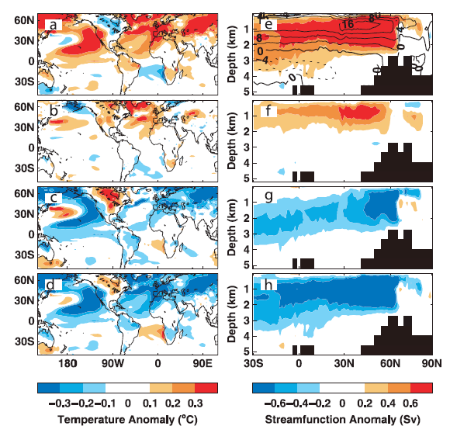
Evolution of AMO cycle in HadCM3
Knight et al. (2005)
-phase 0° (THC at max.): coherent large-scale temperature pattern, widespread warm anomalies in N. hemisphere
- phase 60° and 120°: signal
weakening
Phase 180° (THC at min.): signal out of phase, much of N. Hemisphere anomalously cool
Spatial patterns and magnitudes of observed and simulated variability are comparable
Repeating this study with a slab (50m deep) ocean does not generate an AMO,
→ deep ocean is necessary to produce the AMO.
→Fluctuations in THC appear to be responsible for multidecadal SST signal

Slide 32
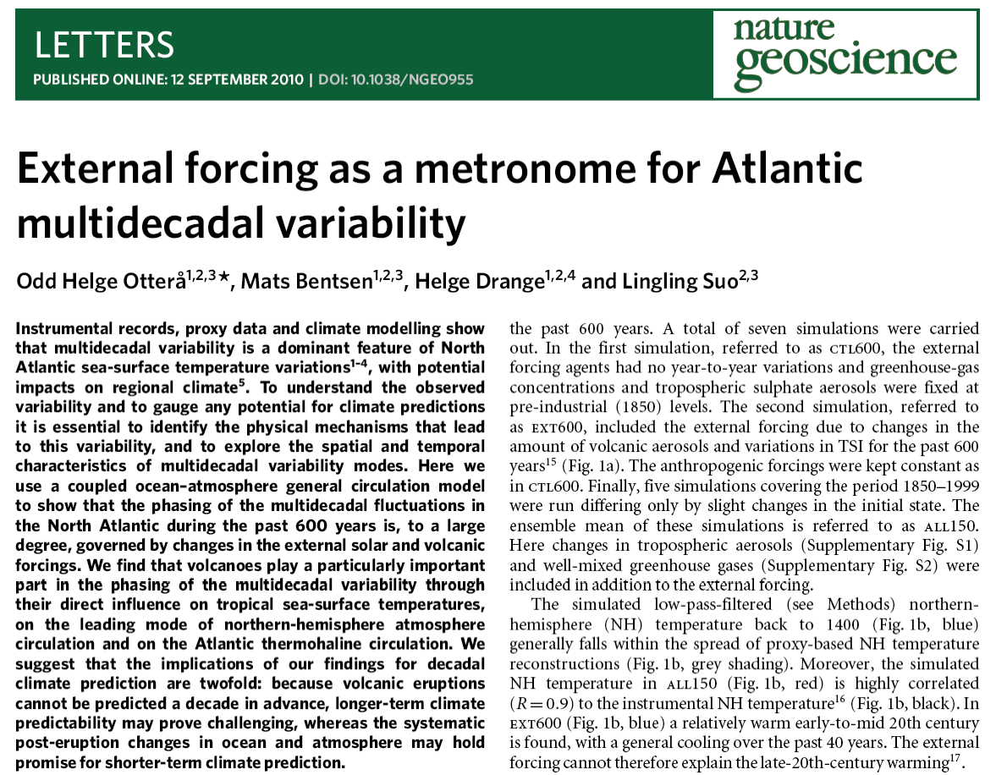
Is it all natural?
Ottera et al., Nat. Geosc., 2010
Booth et al. Nature, 2012

Slide 33
AMO Impacts
Warm SSTs over N. Atlantic
What potential impacts are there on surrounding regions?

Slide 34
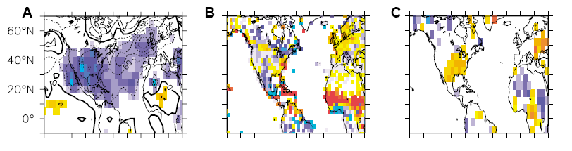
One method of looking at impacts is to make composite (or averages) of warm and cold period and take the difference (e.g. 1931/60 – 1961/90)
So, when the AMO is in a warm period:
SLP (Pa)
Precip (mm/day)
Surf. temp. (°C)
Low SLP across Atlantic and N. America
Wet in West Africa, Europe, dry in central US
Warm in East US
Sutton and Hodson, Science, 2005

Slide 35
AMO Impacts Globally
You can also look at correlations between time series….
Sahel rainfall
Indian monsoon rainfall
Hurricane numbers?
Zhang and Delworth, Geophys. Res. Lett., 2006

Slide 36
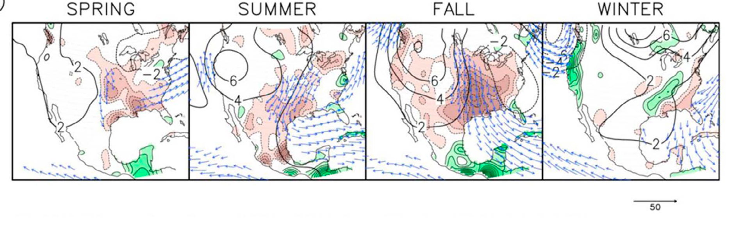
AMO Impacts in the US
So, when the AMO is in a warm period:
Dry conditions in Central US, especially in Fall
Wet conditions in Central America and Florida
Changes in wind accompany rainfall changes
Nigam et. al., Geophys. Res. Lett., 2011

Slide 37
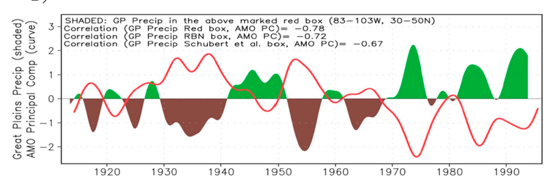
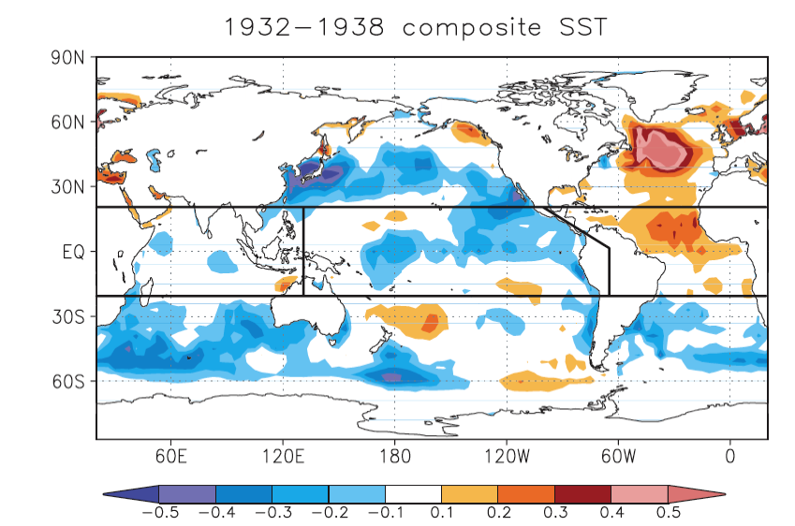
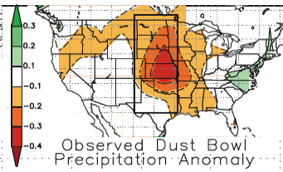
The AMO and the The Dust Bowl
Nigam et. al., Geophys. Res. Lett., 2011
Dust Bowl
Warm N. Atlantic
Schubert et al., 2004

Slide 38
The AMO and Hurricanes
Cold AMO period
Warm AMO period
Goldenberg et al., Science, 2001
1971 – 1994
Cold N. Atlantic and small Atlantic warm pool
15 major hurricanes, few hit US
Cheap insurance
Little public and industry awareness of climate risk shifts
1953 – 1970 & 1995 - 2000
Warm N. Atlantic and large Atlantic warm pool
33 major hurricanes, lots hit US
Expensive insurance
More public and industry awareness of climate risk shifts
** Essential to consider decadal changes in hurricanes when assessing impact of climate change **

Slide 39
Summary: AMO Impacts on Climate
AMO plays an important role in modulating climate on multidecadal time scales in US and Europe, especially during boreal summer and fall
  Low pressure centers over SE US and UK
  Enhanced rain in western Europe, Florida, Sahel and N. Africa
  Reduced rain central US and Mexico
  Warm surface temperature anomalies over US and central Europe
May affect not only mean climate but also frequency of extreme events (US droughts, hurricanes, heat waves)
Phase change of AMO around 1960 may have caused summertime cooling in US and Europe
Most recent phase change (around 1990) may have contributed to rapid warming
MUST CONSIDER THESE DECADAL CHANGES WHEN ASSESSING CLIMATE CHANGE

Slide 40
3) The PDO:
Pacific Decadal Oscillation

Slide 41
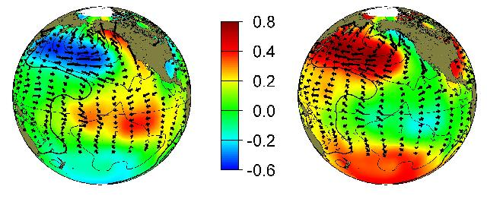
Pacific Decadal Oscillation: SST Pattern
Warm phase Cold Phase
ENSO-like pattern but strongest SST changes in extratropics
See http://jisao.washington.edu/pdo

Slide 42
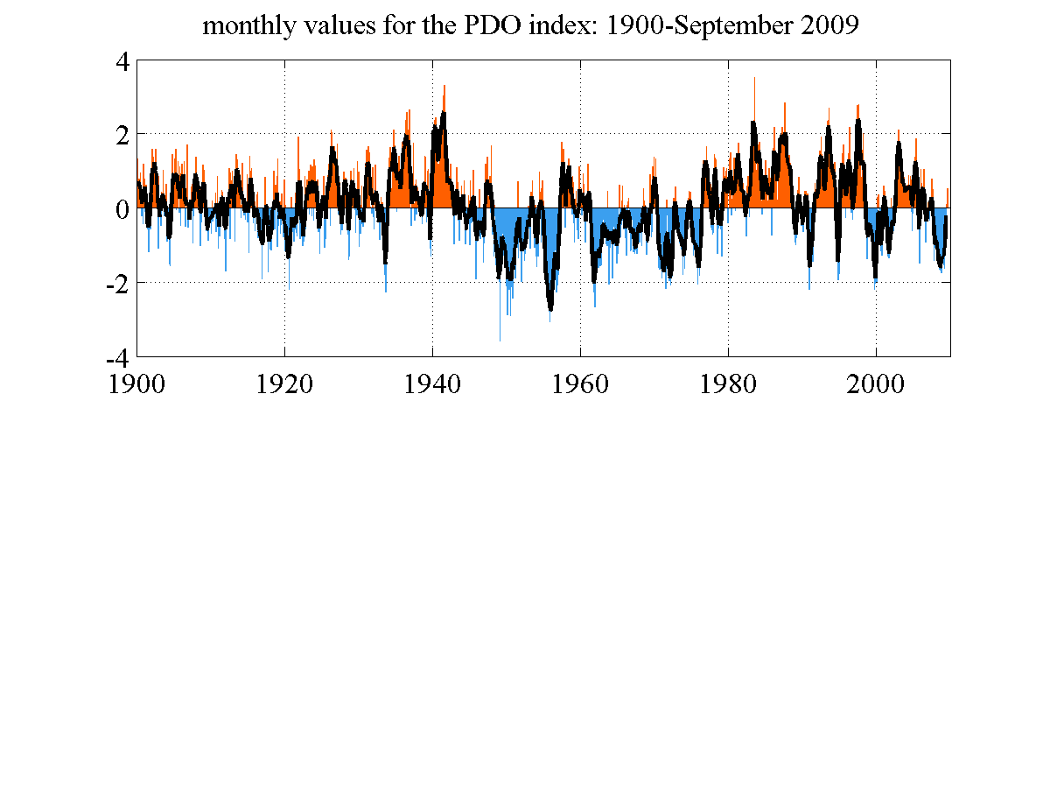
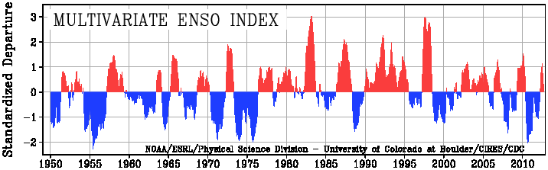
Pacific Decadal Oscillation: Timeseries
PDO and ENSO are on different time scales
Time series have similarities but are not identical

Slide 43
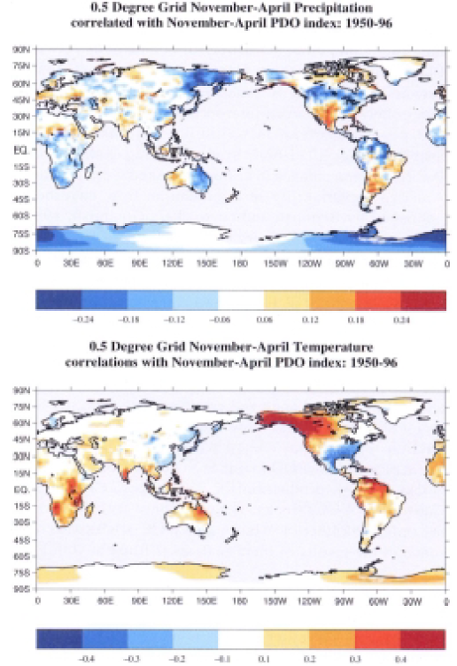
PDO Impacts in US
Warm PDO:
Wet S, SW US
Dry in NW, Great Lakes
Warm in W. Canada, Alaska
Cold in E US
Snow pack and streamflow in NW US is reduced
Winter and spring flood risk in NW US is reduced
Mantua and Hare, J. Oceanog., 2002

Slide 44
Combined Impacts

Slide 45
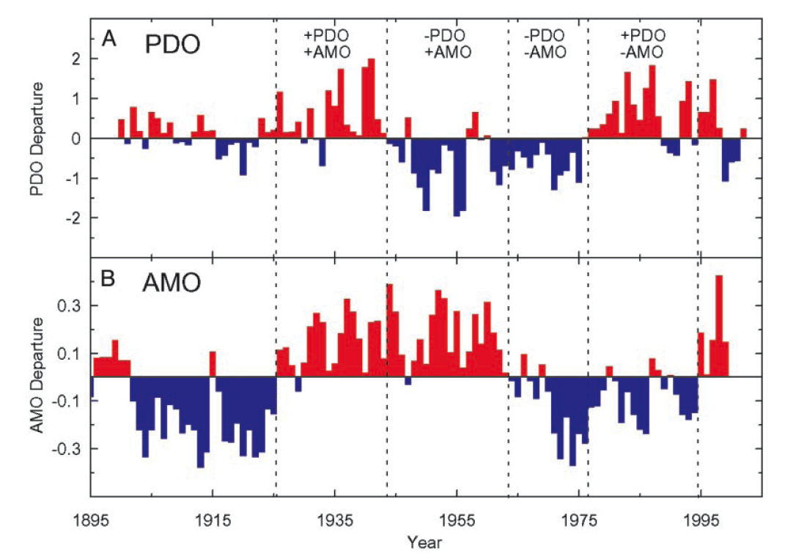
McCabe et al., PNAS, 2004
Note that the PDO and AMO operate on different time scales too!

Slide 46
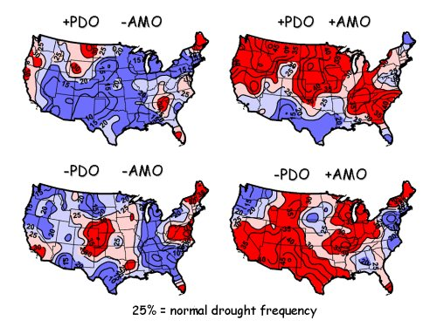
The PDO and AMO combined: Drought Frequency
McCabe et al., PNAS, 2004

Slide 47
PDO vs. AMO impacts in the US
AMO+ (warm) : much of US under drought conditions, regardless of PDO state
More than half (52%) of spatiotemporal variance in multidecadal drought frequency over US attributable to combined PDO / AMO influence
Recent US droughts (1996, 1999–2002) associated N. Atlantic warming (positive AMO) and NE and tropical Pacific cooling (negative PDO)
→ Much of the long-term predictability of drought frequency may reside in the multi-decadal behavior of the N. Atlantic
McCabe et al., 2004

Slide 48
“The decadal time scale offers a critical bridge for informing adaption strategies as climate varies and changes”
Meehl et al., BAMS, 2009

Slide 49
Decadal Prediction
Now we know about ways the climate varies on decadal timescales so the next questions are:
  Is it predictable?
  Can we predict it?
The decadal time scale is widely recognized as a key planning horizon for governments, businesses, and other societal entities

Slide 50
Decadal Predictability
Meehl et al., BAMS, 2009

Slide 51
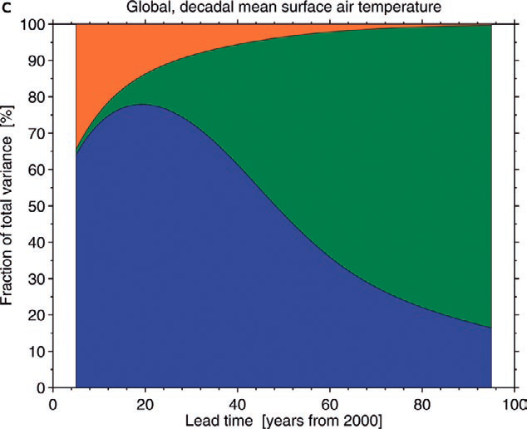
Decadal Predictability
ORANGE
Internal Variability: Natural fluctuations in the climate system. AMO, PDO, ENSO etc.
BLUE
Model Uncertainty: Different models respond differently to the same forcing
GREEN
Scenario Uncertainty: Changes in future greenhouse gas emission
At decadal scales:
Internal variability and model uncertainty have more importance than scenario
At centennial scales:
Scenario uncertainty is dominant
Hawkins and Sutton, BAMS, 2009

Slide 52
Decadal Hindcast Example
Kirtman, 2011

Slide 53
Decadal Hindcast Example
Hindcast: run a model to assess how well it predicts what has already happened. Compare results to the real world
10 year hindcasts of the Atlantic meridional circulation:
Some are better than others!
Are some periods more predictable than others?
Mignot et al., 2011

Slide 54
Decadal Prediction and the IPCC
(Intergovernmental Panel on Climate Change)
They have begun exploring decadal predictions with lots of new model experiments in the newest climate change models (CMIP5). However…
“Users of CMIP5 model output should take note that decadal predictions with climate models are in an exploratory stage…. The experiments aim to advance understanding of predictability”
Taylor et al., BAMS, 2012

Slide 55
Decadal Prediction Challenges
Initializing: we need to know the current conditions of the atmosphere and ocean
Improved climate models: Need climate models to be more accurate, especially in regions with high decadal variability
Ensembles and Uncertainty: How to represent errors in the initial conditions
Hindcasts and Evaluation: How to measure how good or bad a prediction is
Providing regional information to users: Even if we can make a perfect prediction, how do we tell the people who need to know (governments, water managers, businesses etc.)
Murphy et al., 2012

Slide 56
“An improved understanding of decadal climate variability is very important because stakeholders and policymakers want to know the likely climate trajectory for the coming decades for applications to water resources, agriculture, energy, and infrastructure development.”
Mehta et al., BAMS, 2011

