Slide 1
Course Outline
Introduction to the Climate System
Natural Climate Variability
Climate Change
Future Perspectives

Slide 2
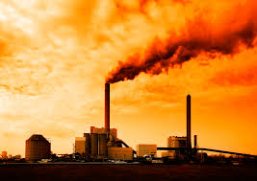
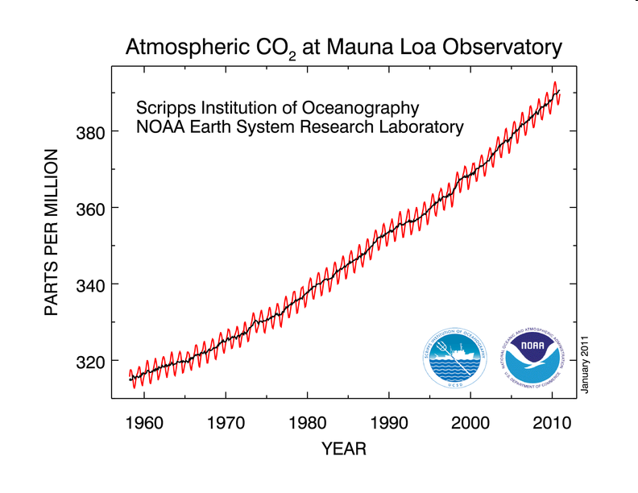
3. Climate Change
3.1 Introduction
3.2 The IPCC Process
3.3 Theory of Climate Change
3.4 Observations
3.5 Climate Change Prediction
3.6 Summary

Slide 3
3.1 Introduction

Slide 4
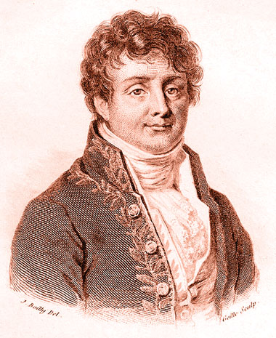
Study of Climate Change –
Jean Baptiste Joseph Fourier
Scientists have been interested in Earth’s climate for a long time
In one of the first studies with climate relevance, Jean Baptiste Joseph Fourier (French mathematician, 1768 – 1830) derived the greenhouse effect by analysis of Earth’s equilibrium temperature
  showed that a planet of Earth's size and distance from the Sun should be colder than it is
  the atmosphere acts is an insulator
  → greenhouse effect

Slide 5
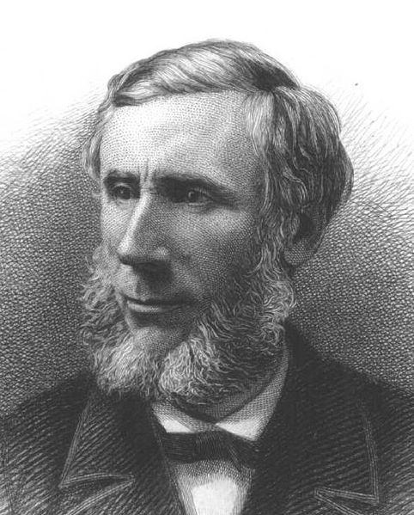
Study of Climate Change –
John Tyndall
In 1864, John Tyndall (1820-1893, an Irish physicist) showed that water vapor, carbon dioxide, methane, and other hydrocarbons were effective at absorbing infrared radiation

Slide 6
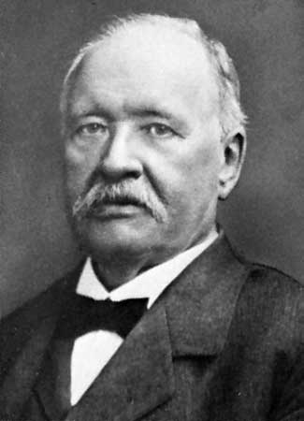
Study of Climate Change –
Svante Arrhenius
In 1896, Svante Arrhenius (1859 - 1927, Swedish chemist and physicist, Nobel Prize in Chemistry in 1903) showed that changing levels of CO₂ in the atmosphere would effect atmospheric temperature as a result of the greenhouse effect
Doubling of the percentage of CO₂ in the air would raise the temperature of the Earth's surface by 4°

Slide 7
Study of Climate Change –
E. O. Hulbert and Guy Stewart Callendar
In 1931, American physicist E. O. Hulbert confirmed Arrhenius's estimate and showed that
  "doubling or tripling the amount of the carbon dioxide of the atmosphere increases the average sea level temperature by about 4° and 7°K, respectively; halving or reducing to zero the carbon dioxide decreases the temperature by similar amounts.“
In 1938, English Steam Engineer Guy Stewart Callendar showed
  that temperature and CO₂ levels in the atmosphere had risen over the preceding 50 years
  that CO₂ is an effective absorber of infrared radiation
  this would lead to atmospheric warming in the future

Slide 8
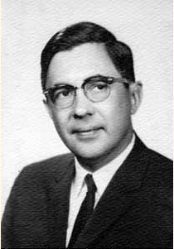
Study of Climate Change –
Gavin Plass
Gavin Norman Plass (1920 – 2004) Canadian physicist, Texas A&M University
Showed that doubling CO₂ in the atmosphere would warm the planet by 3.6°C (1956)
Predicted that CO₂ levels in 2000 would be 30% higher than in 1900, given the rate of increase at the time
Predicted that Earth would be about 1°C warmer in 2000 than in 1900

Slide 9

Study of Climate Change –
Syukuro Manabe and Richard Wetherald
Syukuro Manabe (Japanese meteorologist and climatologist) and Richard Wetherald (Geophysical Fluid Dynamics Laboratory)
First computer climate model calculations (1967) showed the effect of increasing CO₂ on atmospheric temperature
Results showed that, in the absence of unknown feedbacks (clouds, for instance, were not taken into account), doubling CO₂ would result in approximately 2°C increase in global temperature

Slide 10
Very Abbreviated History of Climate Change Research
1824 - Joseph Fourier calculates that the Earth would be far colder if it lacked an atmosphere.
1859 - Tyndall discovers that some gases block infrared radiation. He suggests that changes in the concentration of the gases could bring climate change.
1896 - Arrhenius publishes first calculation of global warming from human emissions of CO₂.
1930s - Global warming trend since late 19th century reported. Milankovitch proposes orbital changes as the cause of ice ages.
1938 - Callendar argues that CO₂ greenhouse global warming is underway, reviving interest in the question.
1956 - Phillips produces a somewhat realistic computer model of the global atmosphere; Plass calculates that adding CO₂ to the atmosphere will have a significant effect on the radiation balance.
1957 - Revelle finds that CO₂ produced by humans will not be readily absorbed by the oceans.
1958 - Telescope studies show a greenhouse effect raises temperature of the atmosphere of Venus far above the boiling point of water.
1960 - Keeling accurately measures CO₂ in the Earth’s atmosphere and detects an annual rise. The level is 315 ppm.
1967 - International Global Atmospheric Research Program established, mainly to gather data for better short-range weather prediction but including climate.

Slide 11
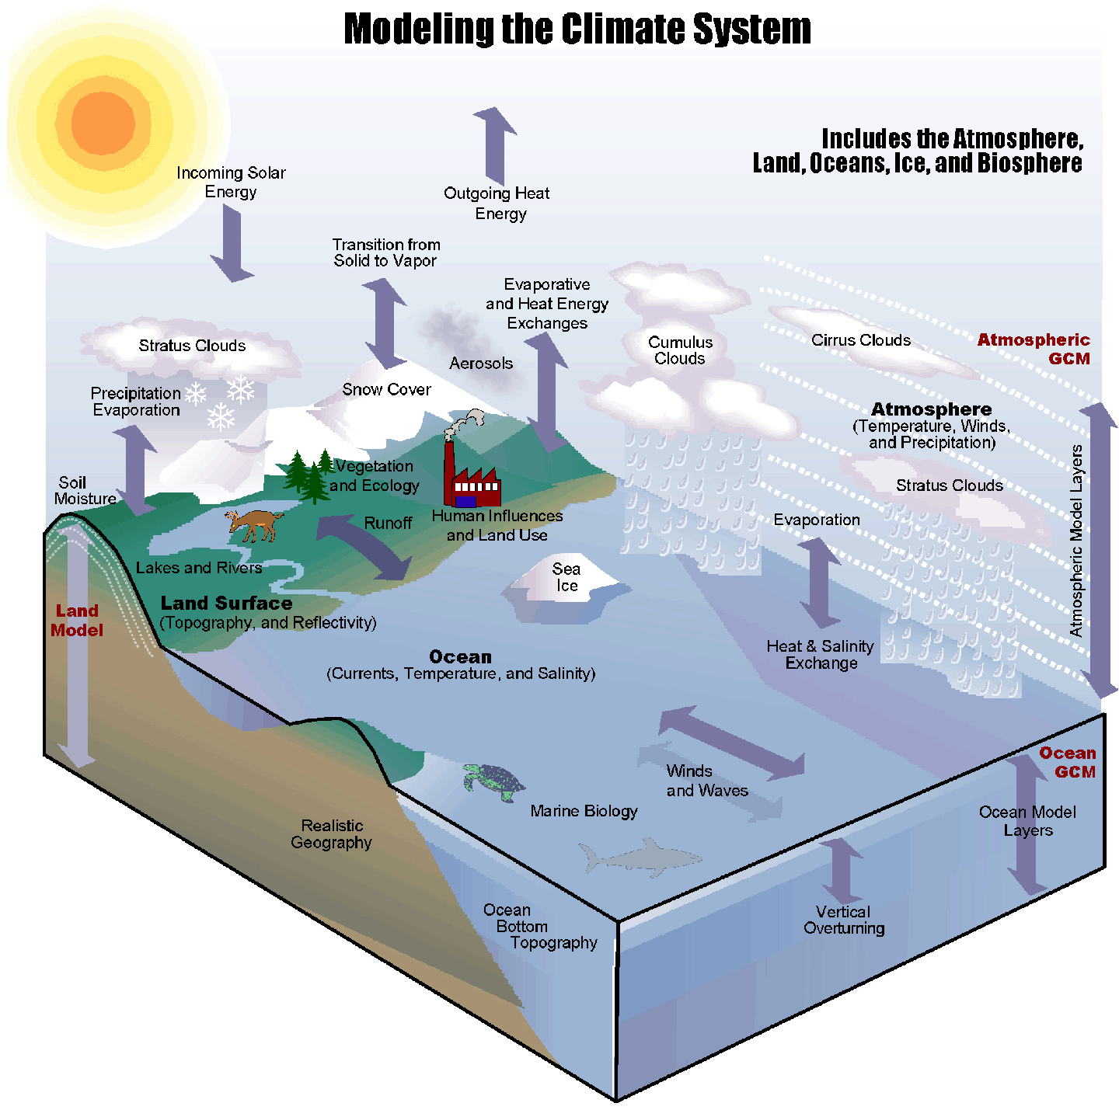
Climate Models
Based on our best models that predict the weather
Improved steadily by a global community of weather and climate scientists over the past 50 years.
Processes included and model resolution have been steadily improved
Used to understand climate system response as well as to predict future climate change
Success at modeling past climate change provides confidence for future predictions

Slide 12
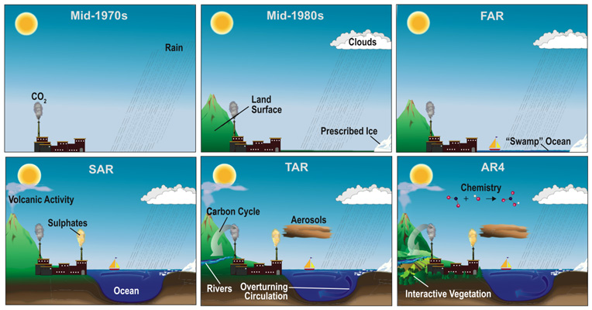
Increasing Complexity of Processes

Slide 13
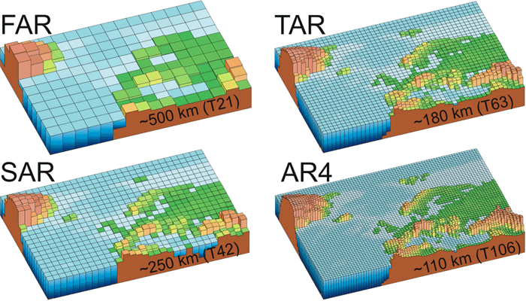
Increasing Model Resolution

Slide 14
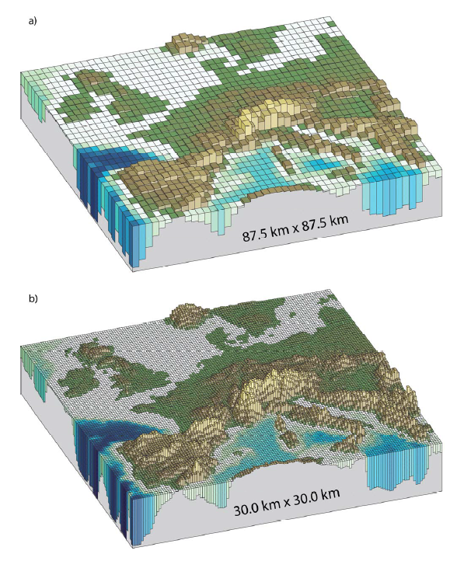
Today’s High Resolution Models (“Nested Grid”)
Still, highest resolution is of the order of 10s of km grid spacing
…some clouds are much smaller still…

Slide 15
Today
There are thousands of scientists from around the world studying Earth’s climate
Many different groups
  ~20 major modeling teams
  More than 40 models in use and continual development
Large collaborative efforts examining all aspects of Earth system coupling and climate change
Prolific production of research results by this large community!
Growth in membership (in thousands) of the American Geophysical Union, the largest geoscience professional society globally, since 1919.

Slide 16
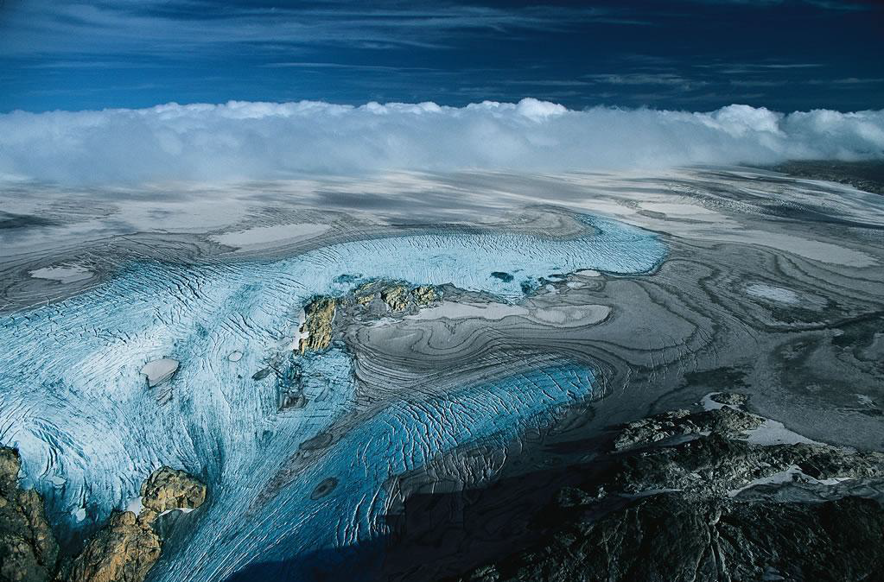
3.2 The IPCC Process

Slide 17

The IPCC
The Intergovernmental Panel on Climate Change was created in 1988 by the World Meteorological Organization (WMO) and the United Nations Environment Program (UNEP)
  Mission – “to provide the world with a clear scientific view on the current state of knowledge in climate change and its potential environmental and socio-economic impacts”
  Involves thousands of scientists and other experts from around the world (voluntary, unpaid)
  Involves representatives from ~120 countries

Slide 18
What does the IPCC do?
Community works iteratively examining research every ~5-7 years, synthesizing the results, identifying implications, and issuing reports that address consequences of climate change
  does not carry out its own original research
  does no monitoring of climate or related phenomena
  assessments based mainly on peer reviewed and published scientific literature
The IPCC is the internationally accepted authority on climate change, producing reports which have the agreement of leading climate scientists and the consensus of participating governments
Has published 5 comprehensive reports to date, and numerous supplementary reports
www.ipcc.ch

Slide 19
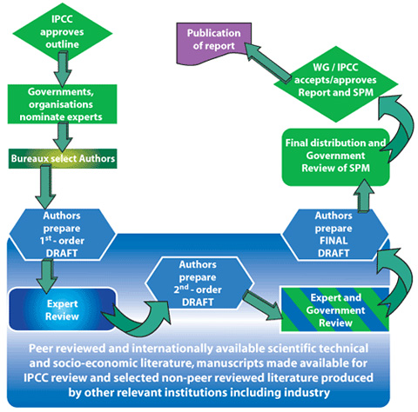
Report Preparation Process
Review
Expert review (6–8 weeks)
Government/expert review
Government review of:
  Summaries for Policymakers
  Overview Chapters
  Synthesis Report
Reports tend to have multiple parts:
Synthesis/Summary for Policy Makers
Working Group 1: The Physical Science Basis
Working Group 2: Impacts, Adaptation and Vulnerability
Working Group 3: Mitigation of Climate Change

Slide 20
Authors
Each chapter has a number of authors who are responsible for writing and editing
  A chapter typically has two "coordinating lead authors", ten to fifteen "lead authors", and a somewhat larger number of "contributing authors"
  Coordinating lead authors responsible for assembling contributions of the other authors, ensuring that they meet stylistic and formatting requirements, and reporting to the Working Group chairs
  Lead authors are responsible for writing sections of chapters
  Contributing authors prepare text, graphs or data for inclusion by the lead authors
Authors for the IPCC reports are chosen from a list of researchers prepared by governments and participating organizations, by the Working Group/Task Force Office, as well as other experts known through their published work
IPCC aims for a range of views, expertise and geographical representation, ensuring representation of experts from developing and developed countries and countries with economies in transition

Slide 21
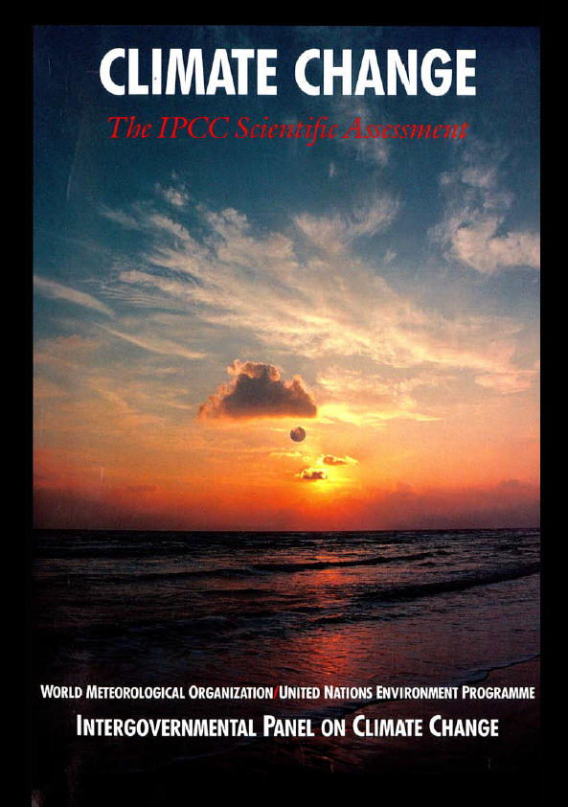
First Assessment Report (FAR) - 1990
The IPCC first assessment report was completed in 1990
Emissions resulting from human activities are substantially increasing the atmospheric concentrations of the greenhouse gases, resulting on average in an additional warming of the Earth's surface
CO₂ has been responsible for over half the enhanced greenhouse effect
Global mean surface air temperature has increased by 0.3 to 0.6 °C over the last 100 years
  consistent with prediction of climate models
  also of the same magnitude as natural climate variability.
The unequivocal detection of the enhanced greenhouse effect is not likely for a decade or more (in 1990)

Slide 22
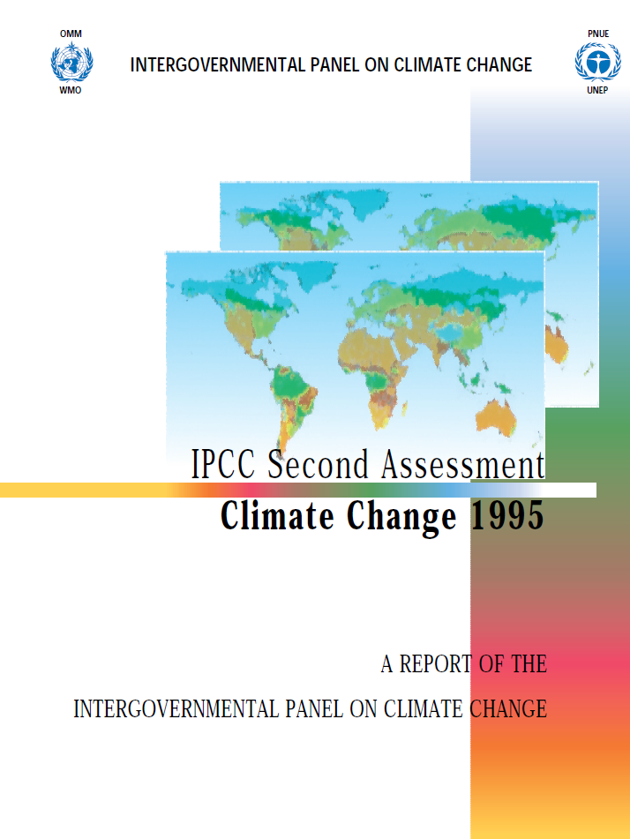
Second Assessment Report (SAR) - 1995
Climate Change 1995, the IPCC Second Assessment Report (SAR)
Greenhouse gas concentrations have continued to increase
Anthropogenic aerosols tend to produce negative radiative forcings
Climate has changed over the past century (air temperature has increased by between 0.3 and 0.6 °C since the late 19th century
The balance of evidence suggests a discernible human influence on global climate (more firm since 1990 report)

Slide 23
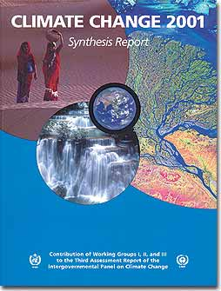
Third Assessment Report (TAR) - 2001
The Third Assessment Report (TAR) was completed in 2001
Includes quantitative estimates of probability
"Observations show Earth's surface is warming. Globally, 1990s very likely warmest decade in instrumental record".
Atmospheric concentrations of anthropogenic (i.e., human-emitted) greenhouse gases have increased substantially
Since the mid-20th century, most of the observed warming is "likely" (greater than 66% probability) due to human activities

Slide 24
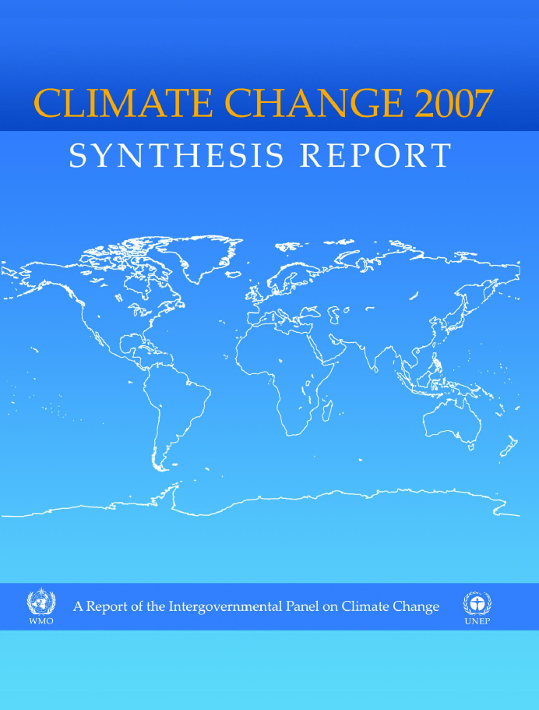
Fourth Assessment Report, 2007
The Fourth Assessment Report (AR4) was published in 2007
"Warming of the climate system is unequivocal”
Most of the global average warming over the past 50 years is "very likely" (greater than 90% probability) due to human activities.
"Impacts [of climate change] will very likely increase due to increased frequencies and intensities of some extreme weather events."
"Anthropogenic warming and sea level rise would continue for centuries even if GHG emissions were to be reduced sufficiently for GHG concentrations to stabilize, due to the time scales associated with climate processes and feedbacks.“
"Some planned adaptation (of human activities) is occurring now; more extensive adaptation is required to reduce vulnerability to climate change."
"Unmitigated climate change would, in the long term, be likely to exceed the capacity of natural, managed and human systems to adapt"
"Many impacts [of climate change] can be reduced, delayed or avoided by mitigation."

Slide 25


Slide 26
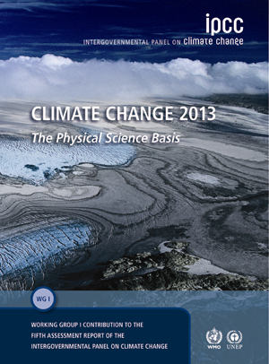
Fifth Assessment Report - 2013
The IPCC is in the process of releasing the 5th Assessment Report
Summary for Policy Makers has been approved
  Climate Change 2013: The Physical Science Basis - Working Group 1 Final Draft has been accepted by Working Group 1 – out now
  Working Group II (Impacts, Adaptation, and Vulnerability) – March 2014
  Working Group III (Mitigation of Climate Change) – April 2014
  Synthesis Report – October 2014
Increased certainty that human activities are driving warming from "very likely" (90% confidence) in 2007, to "extremely likely" (95% confidence) now
…and many more, which we will examine in detail…

Slide 27
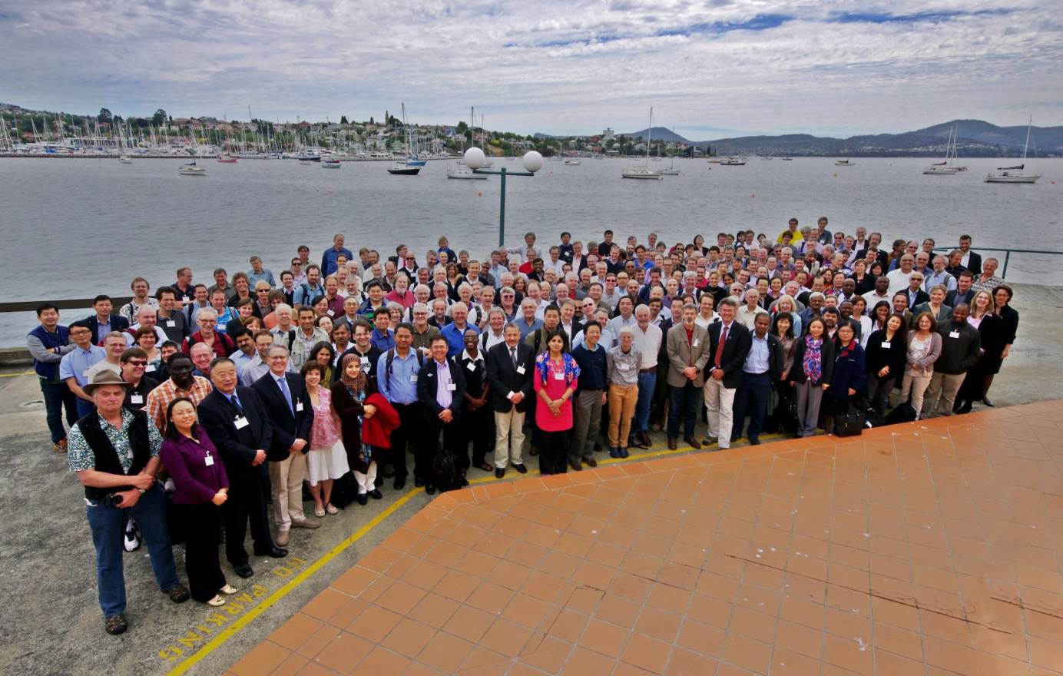
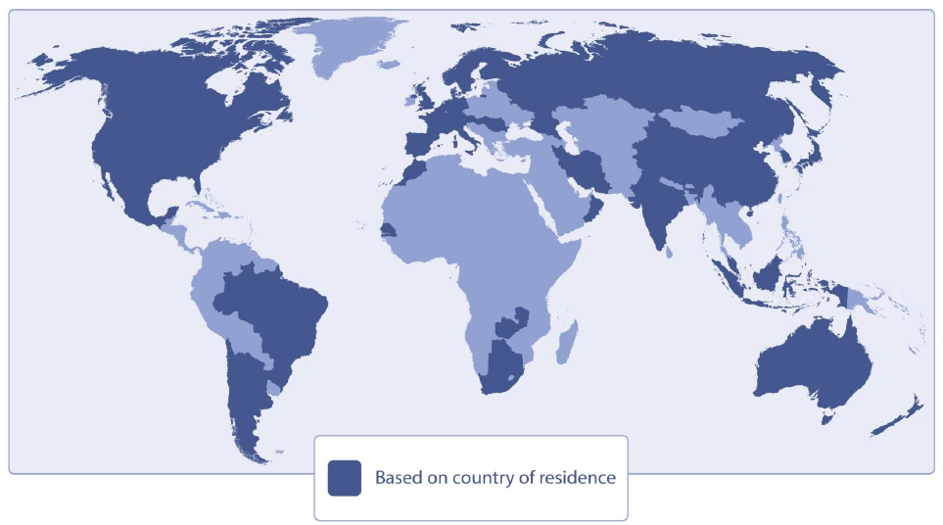
IPCC 5th Assessment Working Group 1 Author Team
209 Lead Authors and 50 Review Editors from 39 countries
Over 600 Contributing Authors from 32 countries

Slide 28
Certainty?
Degree of certainty in key findings based on the author teams’ evaluations of underlying scientific understanding, expressed
  as a qualitative level of confidence (very low - very high)
  probabilistically, when possible, with a quantified likelihood (exceptionally unlikely - virtually certain)
Confidence in the validity of a finding is based on the type, amount, quality, and consistency of evidence and the degree of agreement
Probabilistic estimates of quantified measures of uncertainty in a finding are based on statistical analysis of observations or model results, or both, and expert judgment
  Virtually certain 99–100% probability
  Very likely 90–100% probability
  Likely 66–100% probability
  About as likely as not 33–66% probability
  Unlikely 0–33% probability
  Very unlikely 0–10% probability
  Exceptionally unlikely 0–1% probability
Additional terms (extremely likely: 95–100% probability, more likely than not: >50–100% probability, and extremely unlikely: 0–5% probability) also used when appropriate

Slide 29
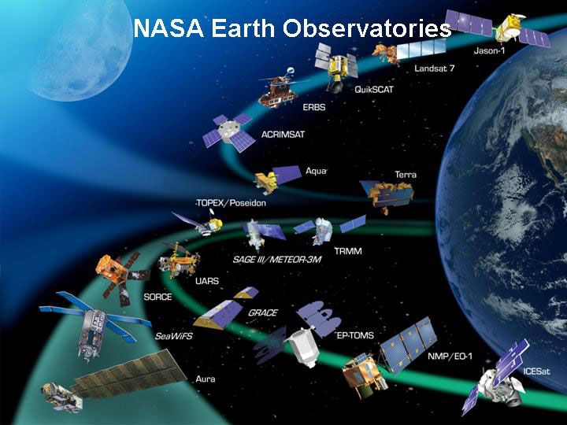
Observing Changes in the Climate System
Observations of the climate system are based on direct measurements and remote sensing from satellites and other platforms
Global-scale observations from the instrumental era began in the mid-19th century for temperature and other variables, with more comprehensive and diverse sets of observations available for the period 1950 onwards
Paleoclimate reconstructions extend some records back hundreds to millions of years
Together, they provide a comprehensive view of the variability and long-term changes in the atmosphere, the ocean, the cryosphere, and the land surface
NASA Earth Observatories have been key to making progress understanding climate

Slide 30
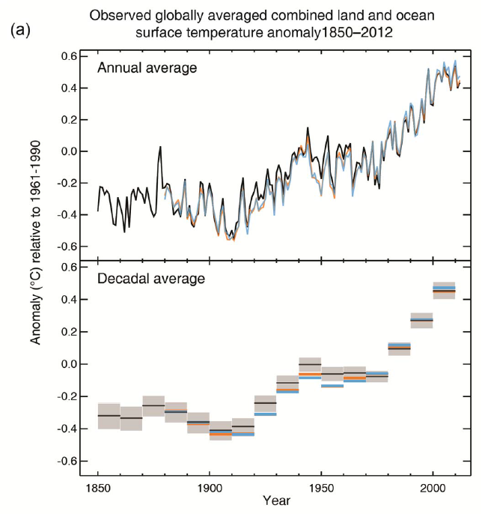
Recent Warming
(IPCC 5th Assessment, 2013)
Observed global mean combined land and ocean surface temperature anomalies, from 1850 to 2012 from three data sets
Top panel: annual mean values
Bottom panel: decadal mean values including the estimate of uncertainty for one dataset (black). Anomalies are relative to the mean of 1961−1990.
Each of the last three decades has been successively warmer at the Earth’s surface than any preceding decade since 1850

Slide 31
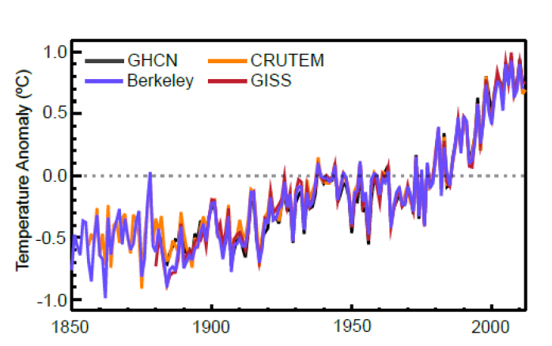
Land-Surface Air Temperature (LSAT)
LSAT temperatures have increased from .08 to .27°C/decade since 1880, depending on how you determine the fit
This reanalysis includes four different data sets, using different techniques
Careful study to address concerns about station sites, data distribution, have been taken into account
In summary, it is certain that globally averaged LSAT has risen since the late 19th century, and that this warming has been particularly marked since the 1970s.
Global annual average land-surface air temperature (LSAT) anomalies relative to 1961-1990 climatology from four different datasets

Slide 32
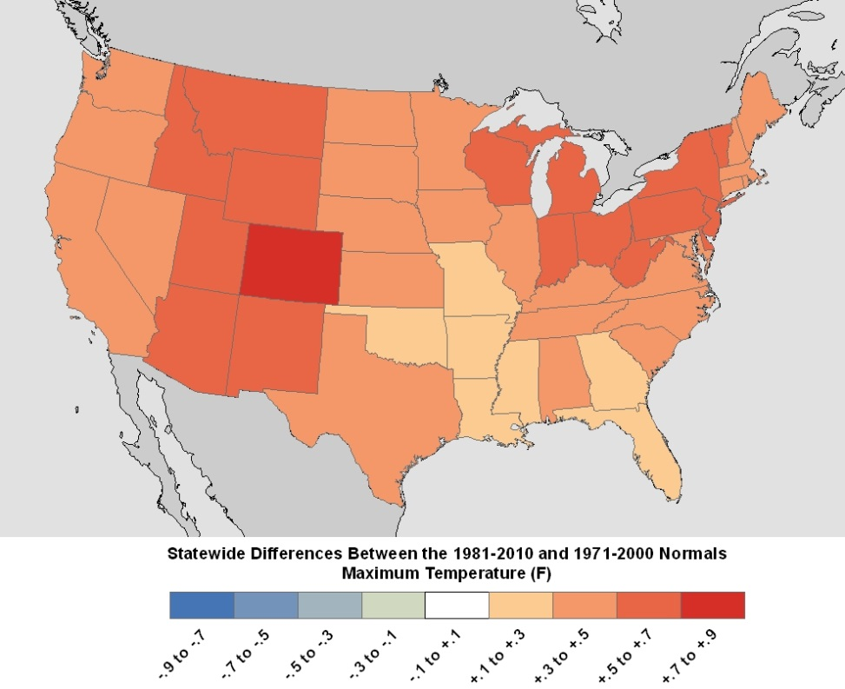
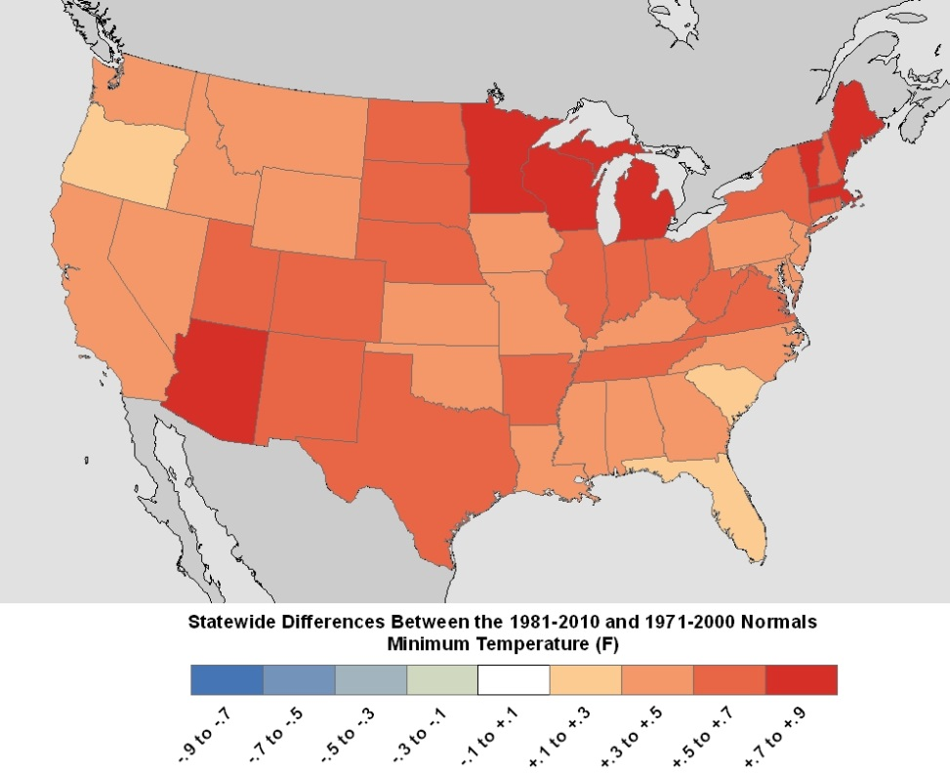
Changes in Climate “Normals” from 1971-2000 to 1981-2010 Averages NOAA Data
Climate “Normals” are 30-year averages of NOAA climatological data
(http://www.ncdc.noaa.gov/oa/climate/normals/usnormals.html)

Slide 33
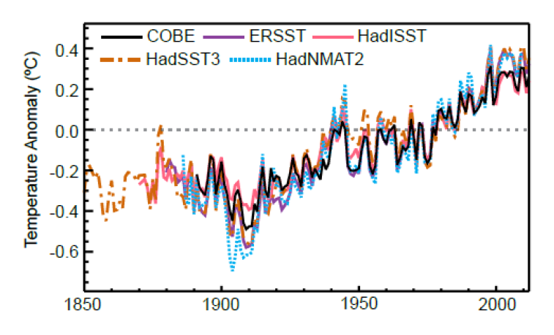
Sea Surface Temperatures (SSTs)
Measurements of sea surface temperature are available from buckets, engine room intake, hull contact sensors, moored and drifting buoys, and satellites
Careful data analysis needed (measurement biases and validation)
Nonetheless, certain that global average sea surface temperatures (SSTs) have increased since the 1950s, as well as since the beginning of the 20th century
Global average SST relative to 1961-1990 climatology from gridded (interpolated) data sets. Interpolated (solid), non-interpolated (dashed).

Slide 34
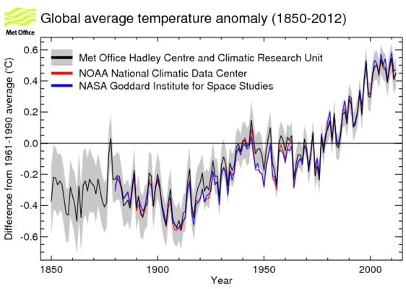

Slide 35
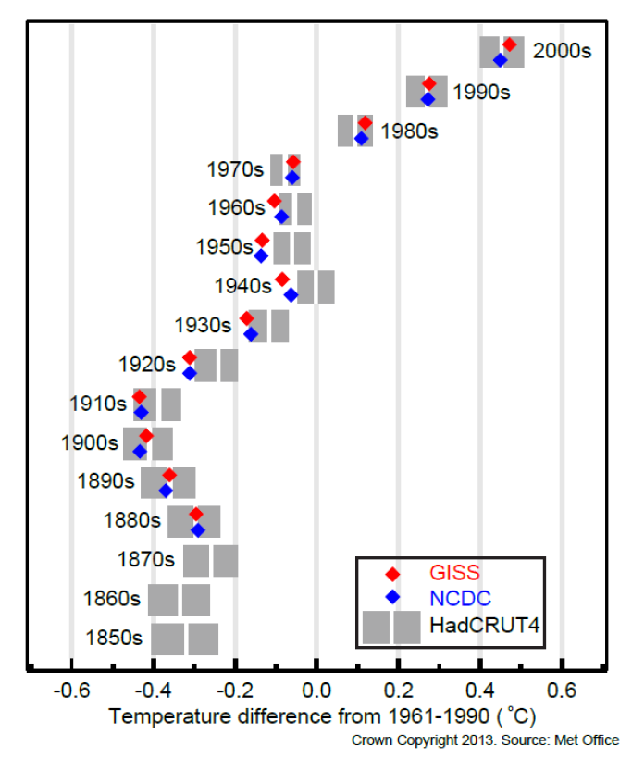
Global Temperature (Land and Sea)
All 10 of the warmest years in the record have occurred since 1997
2010 and 2005 tied for warmest in all three data sets
Global mean trends are significant for all data sets
HadCRUT4 – warming from 1850-1900 (early-industrial) to 1986-2005 average is 0.61°C ±0.06°C (90% confidence)
Decadal global mean surface temperature (GMST) anomalies

