Slide 1
3.3 Theory of Climate Change
Key concepts:
Earth’s Radiation Budget
Greenhouse Effect
Key Climate Factors that can change global climate

Slide 2
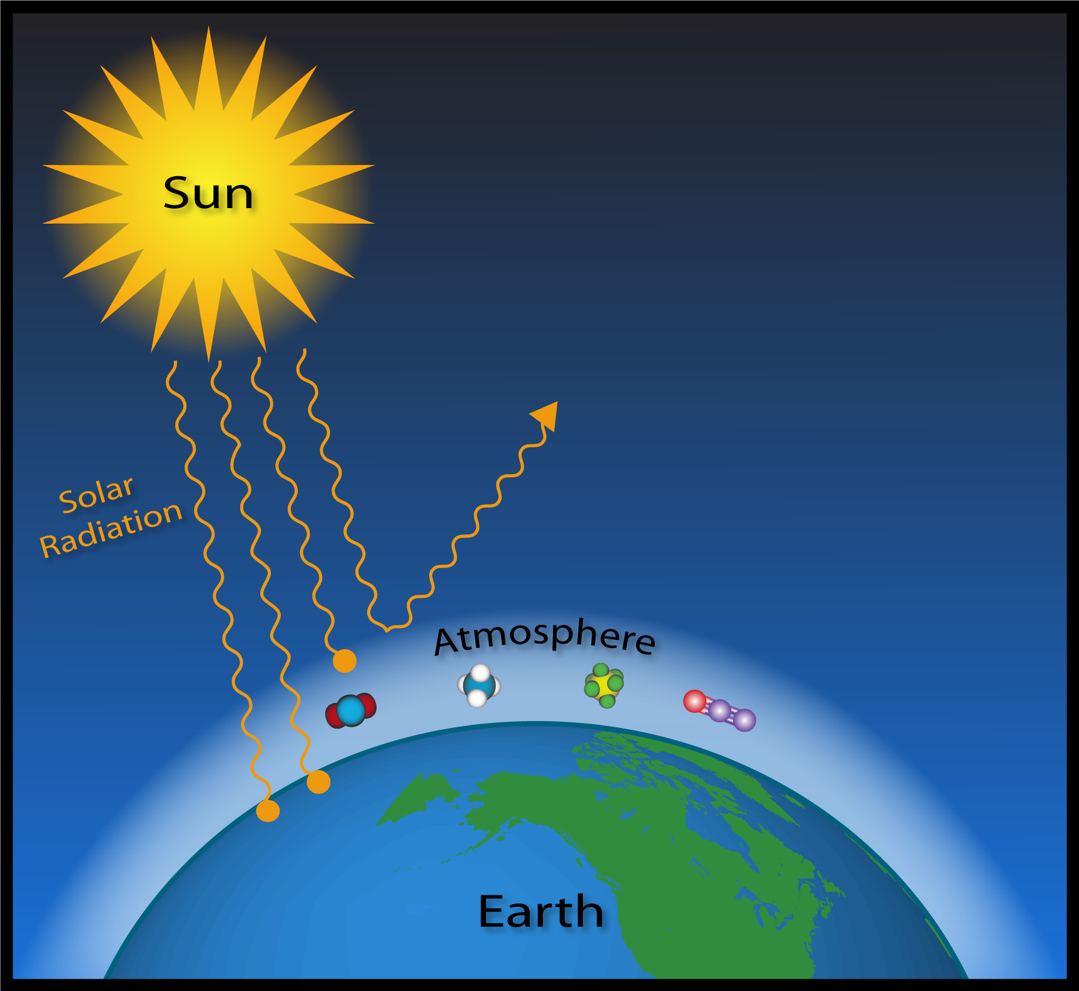
Ways to Change Our Global Climate
Change energy from the Sun
Change reflection from the atmosphere and planet
Change composition of the atmosphere

Slide 3
How can these climate factors change?
Radiation from the Sun
  Changes in energy radiated from the Sun
  Changes in Earth’s distance from the Sun
  Changes in Earth’s inclination relative to the Sun
Atmospheric composition
  Changes in concentration of gases in atmosphere that absorb energy (“greenhouse gases”)
    Through natural processes (volcanic emissions, emissions from flora and fauna, soil, etc)
    Through the action of humans (consumption choices)
Reflectivity of the planet
  Changing the reflectivity of the surface (snow, ice, forests, soot, etc)
  Changing the reflectivity of the atmosphere (clouds, aerosols)

Slide 4
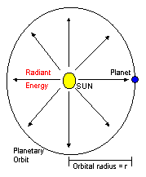
Solar Radiation
Sun is a star with a surface temperature of ~5780K
The Sun emits radiation over a wide spectrum of wavelengths out into space
As radiation spreads out into space, it is spread out over an increasingly large area 4πr²
A small amount of that energy is intercepted by the Earth in it’s orbit around the Sun.
r is the radius at which the planet orbits the Sun

Slide 5



Radiation at the top of the Earth’s atmosphere ~1360 W/m²
(solar “constant”)
Earth is ~150 x 10⁶ km from the Sun
Radius of sphere = r
Radiation from surface of Sun = 63 X 10⁶ W/m²
Area of a sphere = 4πr²
Radiation from an object falls off by the inverse square of the distance

Slide 6
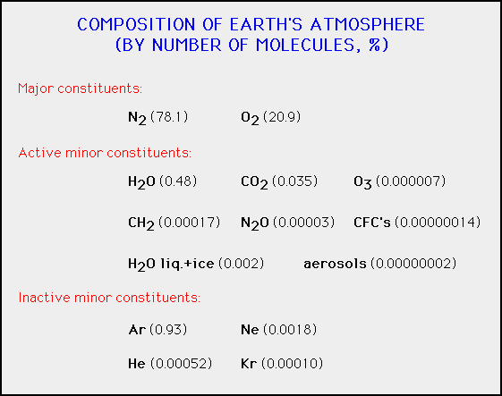

Slide 7
Solar Radiation at Earth
At the top of Earth’s atmosphere, ~1360 W/m² of energy strikes the Earth’s atmosphere
Some of this energy is reflected back into space from the Earth, and some of it is absorbed by the Earth
Albedo – the reflectivity of a surface (between 0 and 1)
  White object and light colored objects have high albedo (near 1)
  Dark objects have low albedo (near 0)
  Earth’s average albedo is about 0.3 (including the ground, plants, oceans, ice, snow, clouds, …)
    ~30% of the radiation is reflected
    ~70% is absorbed

Slide 8
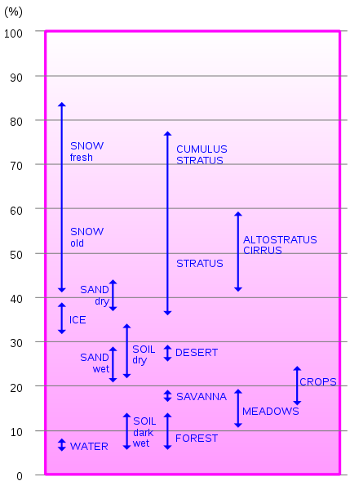
Albedo of Various Surfaces
Snow and clouds have the highest albedo
Water, dark wet soil, and forest has the lowest albedo
Everything else is in between

Slide 9
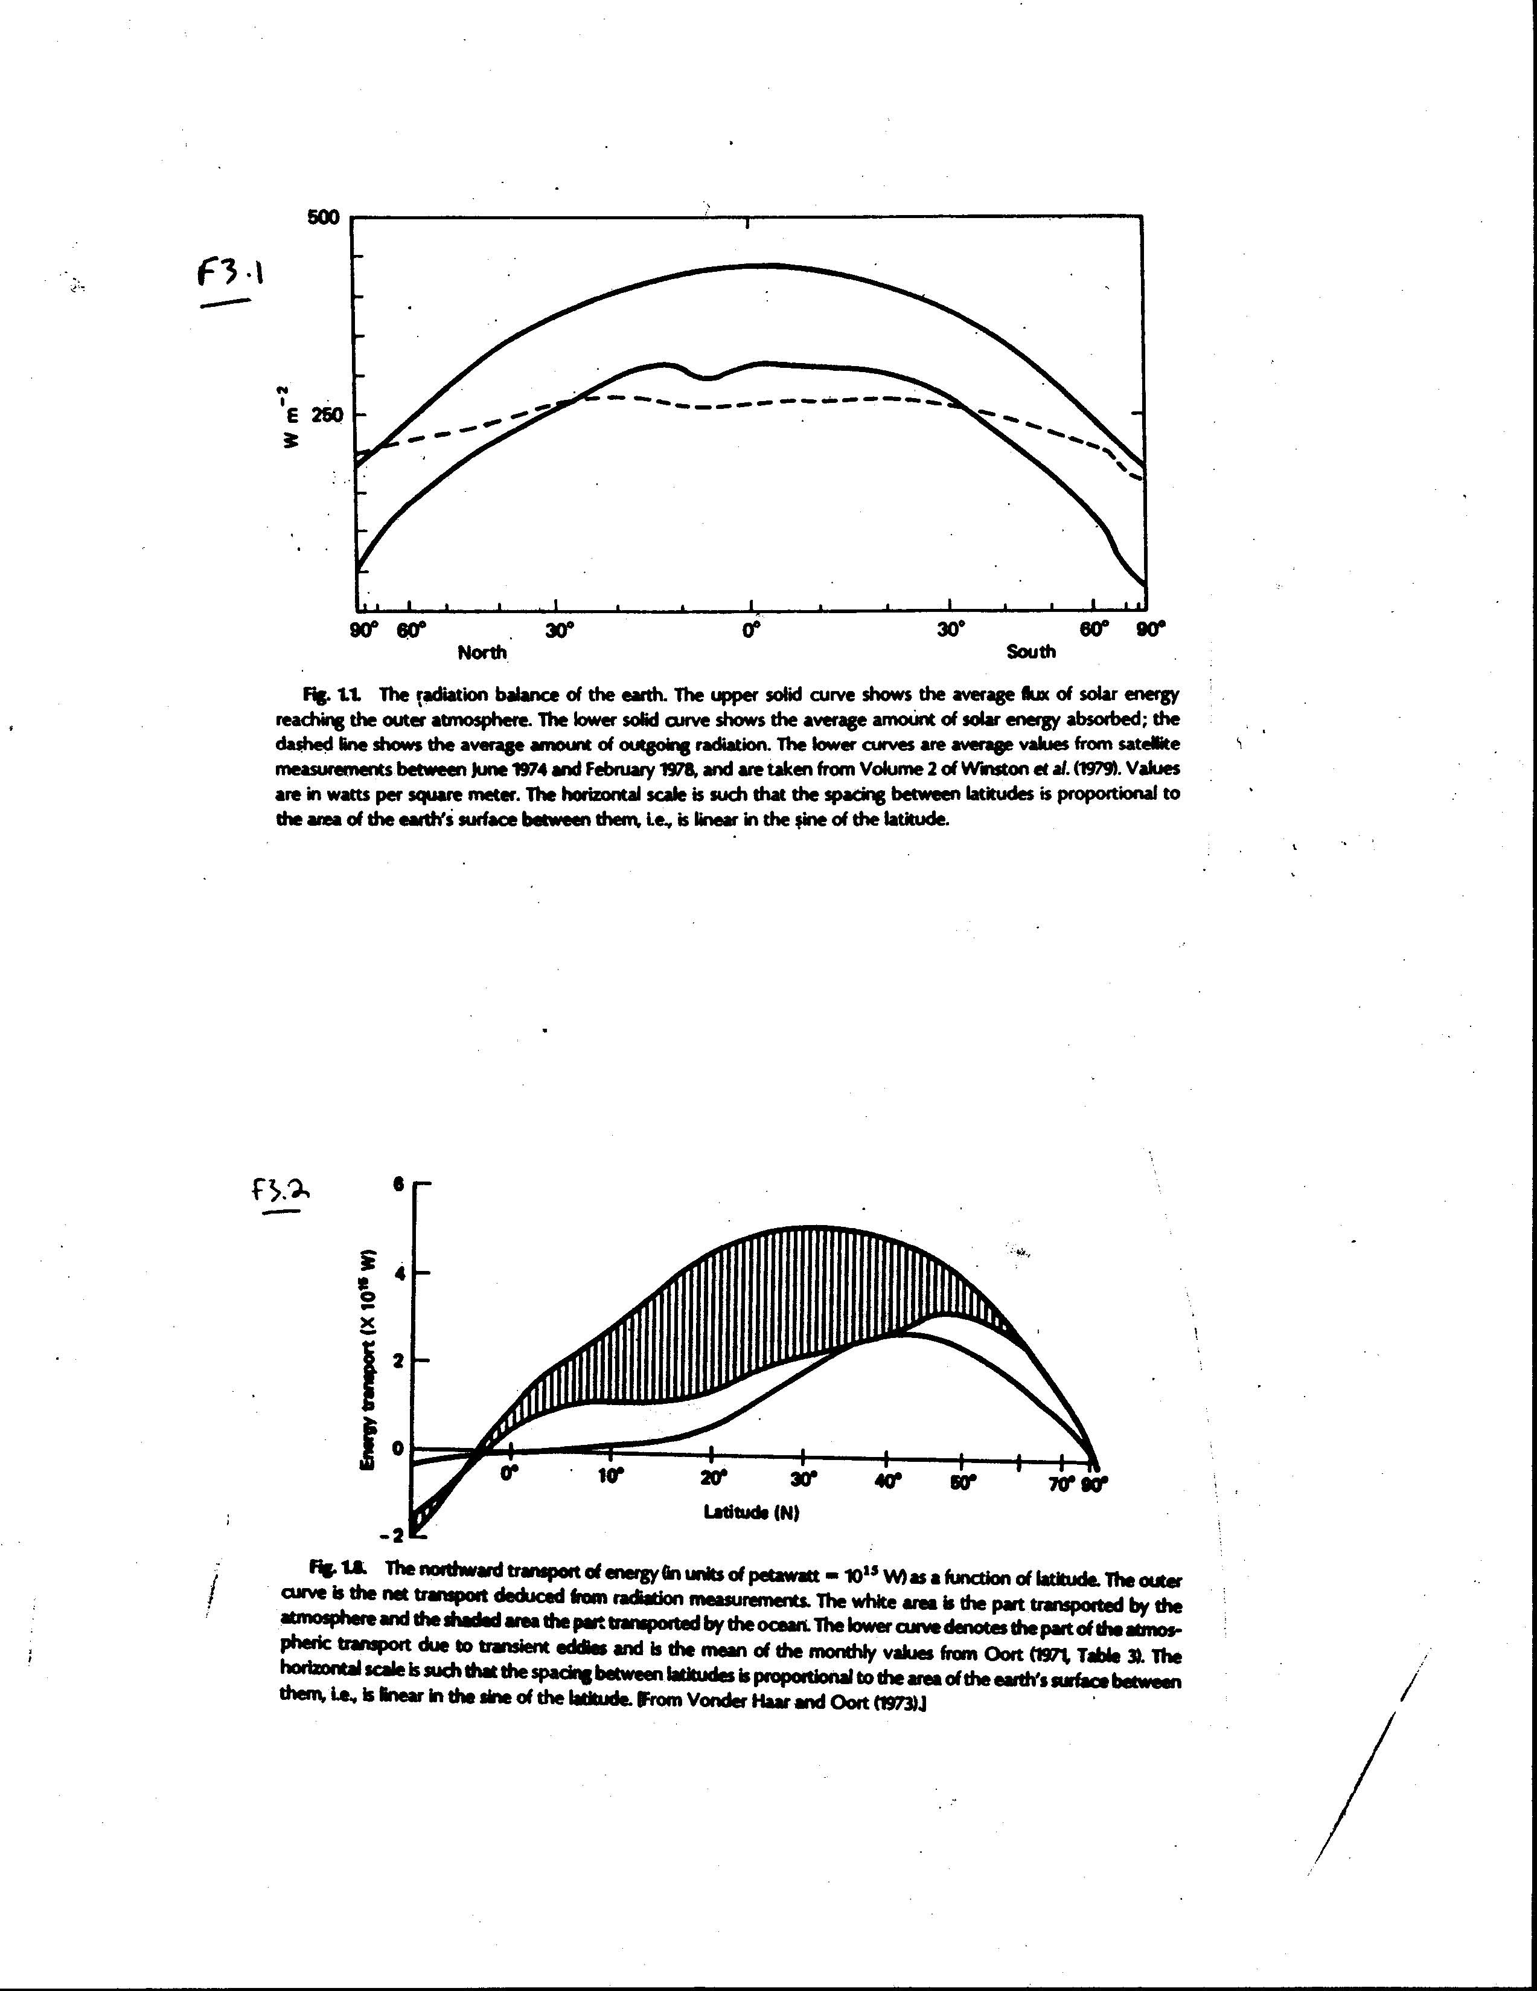
Earth’s Radiation Budget
(see notes)
Solar Radiation Received at TOA (short wave)
Solar absorbed
(short wave)
Outgoing radiation (long wave)

Slide 10
Earth Temperature
What would Earth’s temperature be, if we didn’t have an atmosphere?
Earth’s “equilibrium” temperature
  Where the energy received from the Sun equals the energy re-emitted by the Earth
  Equilibrium means steady-state energy balance
  Energy in = energy out
To figure out Earth’s equilibrium temperature, we need a few concepts…

Slide 11
Stefan-Boltzman Law
All objects with a temperature emit radiation
  E = σ T⁴
  Where E is the total radiation (energy emitted) over all wavelengths emitted in W/m²
  σ is the Stefan-Boltzman constant = 5.67 x 10⁻⁸ W/m² K⁴
  T is the temperature in Kelvin (K)
When Earth absorbs energy from the Sun’s radiation, it warms up, and by the Stefan-Boltzman Law, re-radiates energy back into space

Slide 12
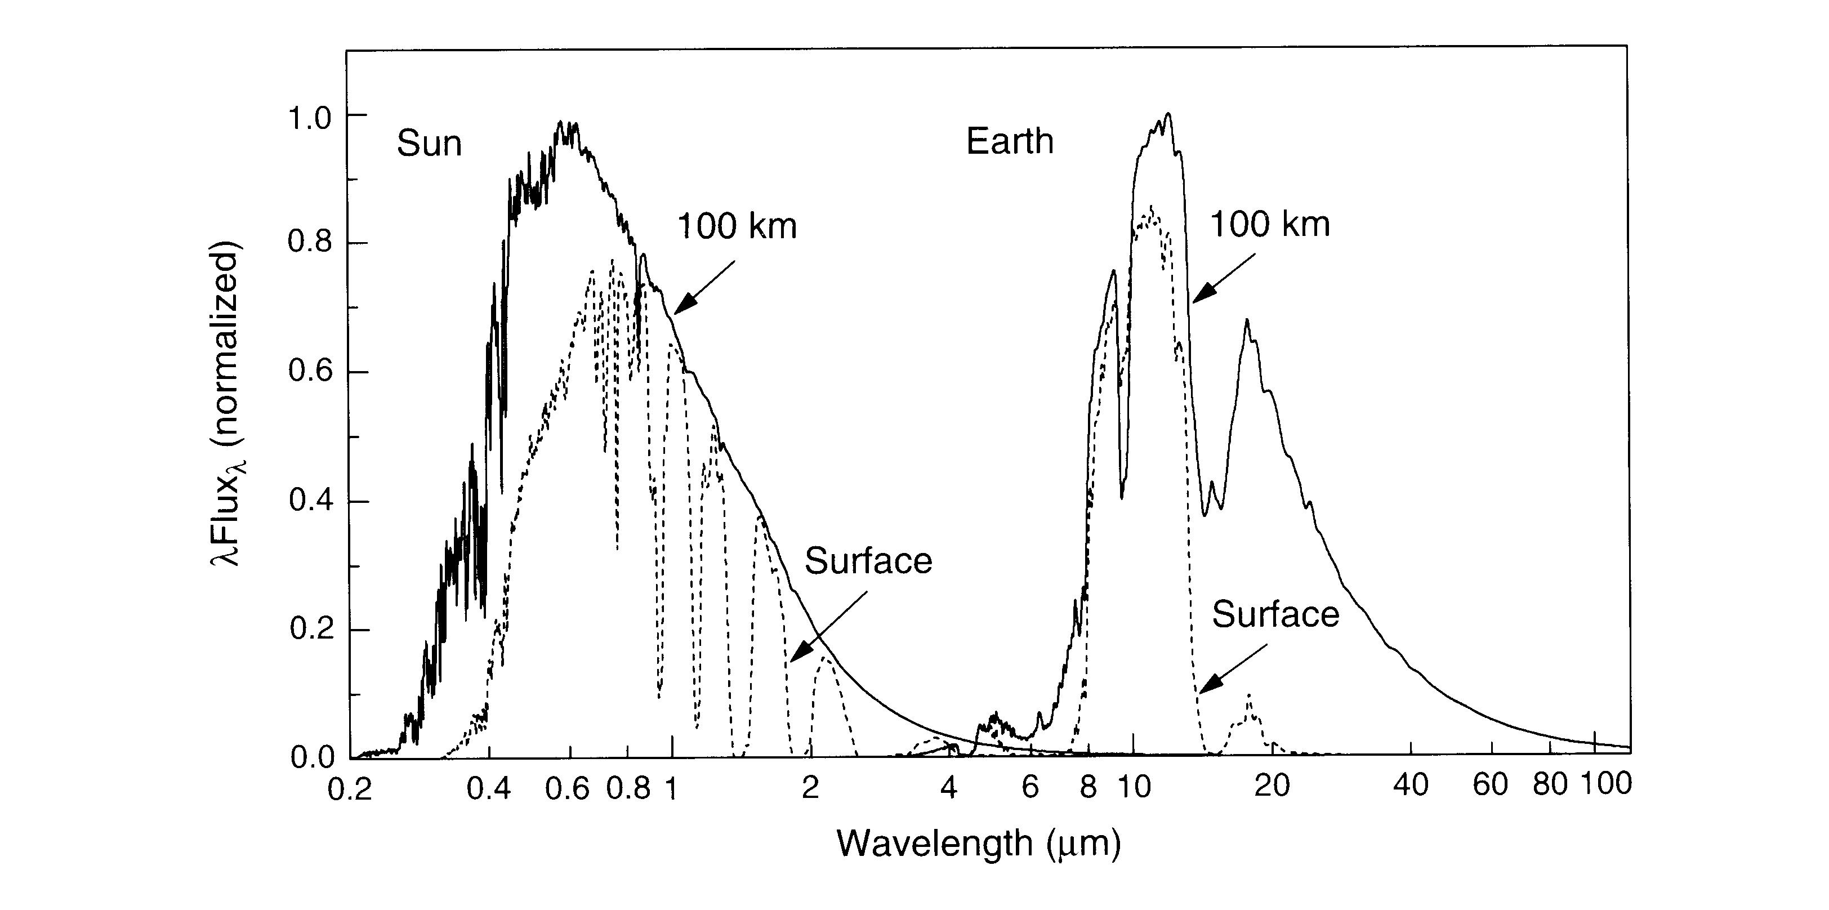
Shortwave and Longwave Radiation
Incoming Solar radiation
OutgoingTerrestrial radiation
Visible radiation
Solar radiation is shortwave
Terrestrial radiation is longwave (infrared)

Slide 13
See Notes

Slide 14
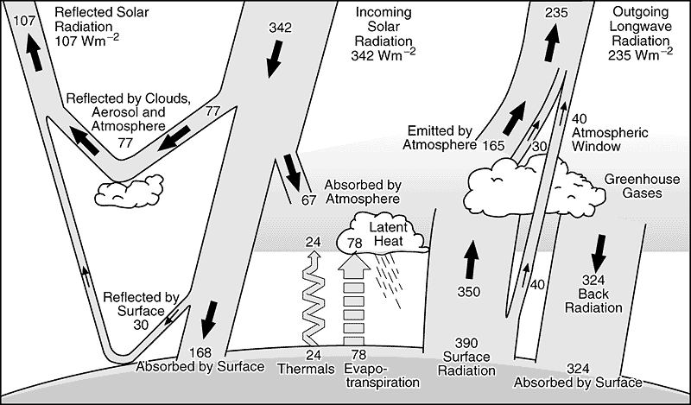
Earth’s Energy Balance

Slide 15
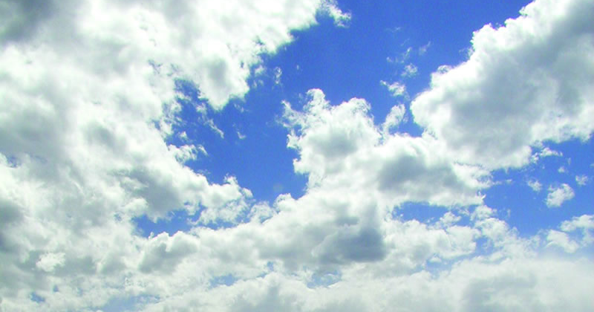
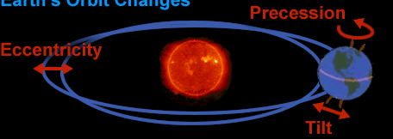
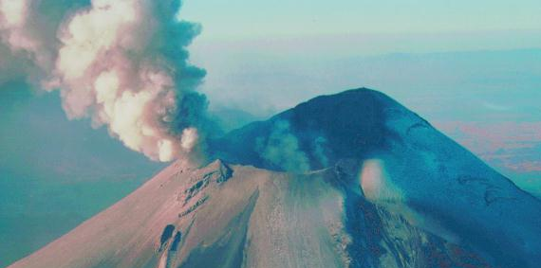
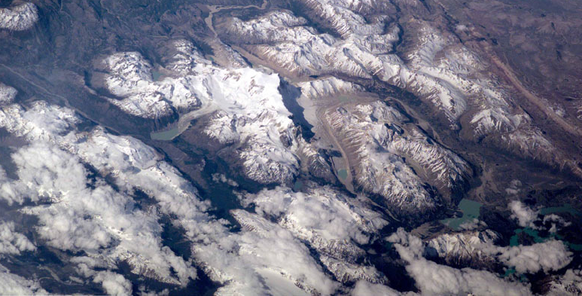
Key climate factors
The Sun & Earth’s orbit
Clouds
Volcanic eruptions
Reflective snow & ice
And the amount of greenhouse gases…

Slide 16
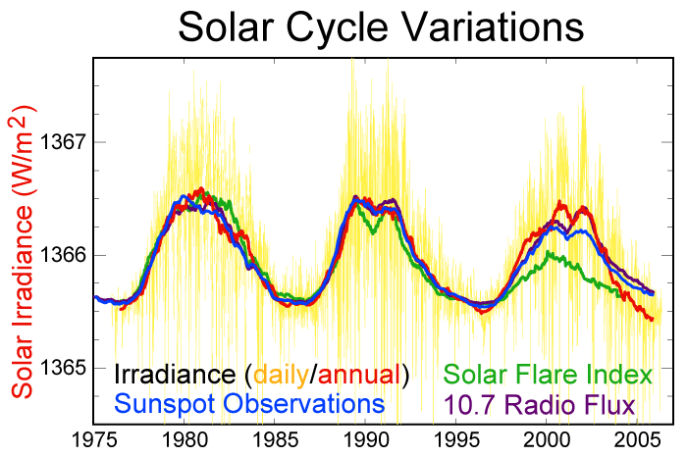
Is the Solar “Constant” Constant?
No, not really!
Radiation from the Sun does vary slightly with time
Over the “solar cycle”, solar radiation varies by about 1 or 2 W/m2 (about 0.1%)

Slide 17
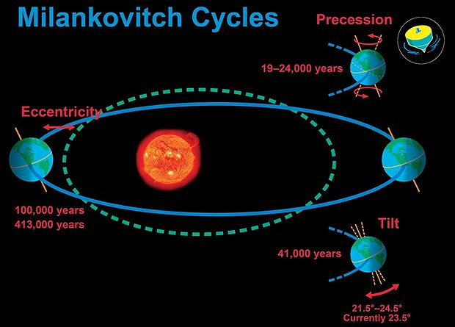
Orbital Variations
Milankovitch Cycles – long term changes in the Earth’s orbit:
  Eccentricity: the shape of the Earth's orbit around the Sun. The eccentricity of the Earth’s orbit varies over about 100,000 years between slightly more or less elliptical.
  Precession: Earth wobbles on it axis as it spins completing a full wobble every 23,000 years.
  Tilt: the angle of the Earth's axis relative to the plane of its orbit varies between 21.5 and 24.5 degrees over a period of 41,000 years.

Slide 18
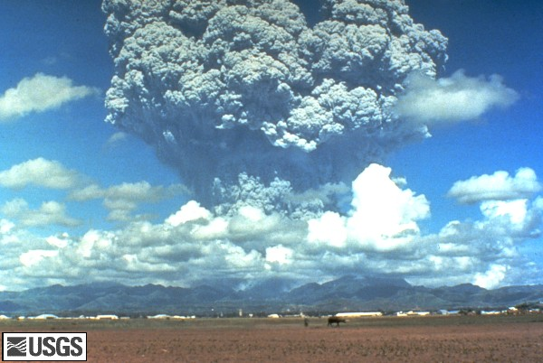
Effects of Volcanic Eruptions on Climate
Volcanic eruptions can cause cooling of the atmosphere due to reflection of incident radiation by aerosols
  Effect is short-lived (2 yrs or less)
Eruptions can cause warming by release of carbon dioxide gas in eruptive gases

Slide 19
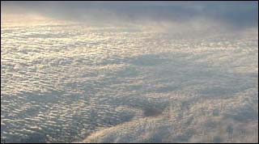
Clouds
Clouds reflect radiation back into space
Clouds also retain radiation emitted from the surface, helping to warm the atmosphere
On a cloudless night, it gets VERY cold at night – much colder than if there are clouds…

Slide 20
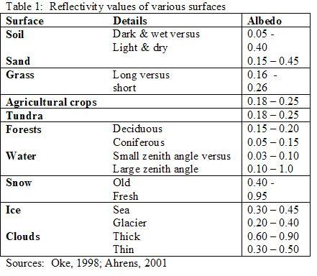
Snow and Ice
Snow and ice are highly reflective, and are critically important to the Earth’s energy balance
Both reflect a large fraction of incident light back to space, helping to keep the planet cool

Slide 21
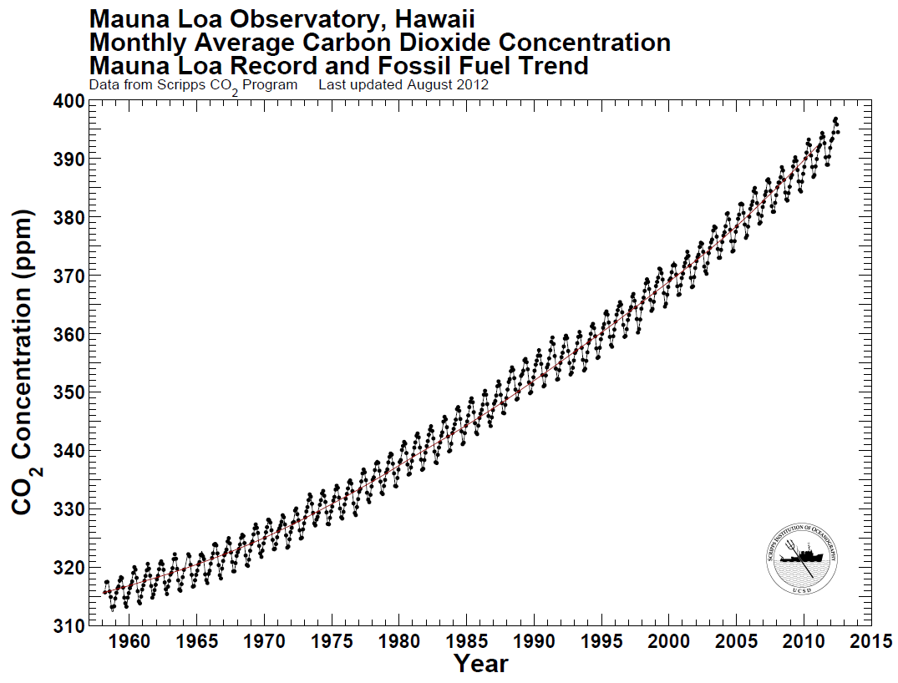
Greenhouse Gases
January, 2013 ~395 ppm
Pre-industrial ~280 ppm
The rise has been relentless and shows a remarkably constant relationship with fossil-fuel burning, and can be well accounted for based on the simple premise that 57% of fossil-fuel emissions remain airborne. Here the number 57% was selected to fit the curve at the ends of the record, but what is significant is how well this link with fossil-fuel burning also fits the curvature in the record, sloping upwards less rapidly at the beginning, and more rapidly at the end.
http://scrippsco2.ucsd.edu/program_history/keeling_curve_lessons_3.html

Slide 22
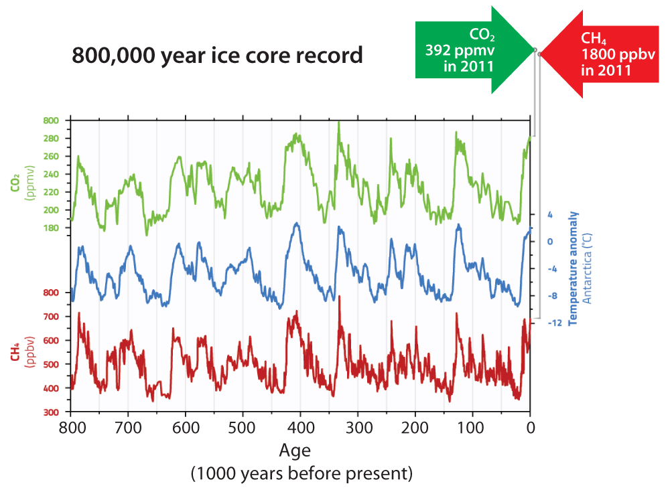
Has CO₂ been this high over the past 800,000 years?
Neither CO₂ nor CH₄ have been this high in the past 800,000 years
300
Previous CO₂ maximum ~300 ppm
Previous CH₄ maximum ~780 ppb

Slide 23
Based on the fact that CO2 has increased over the past century and the knowledge of the greenhouse gas effect – what would we have expected to see happen to the Earth’s climate during this period?

