Slide 1
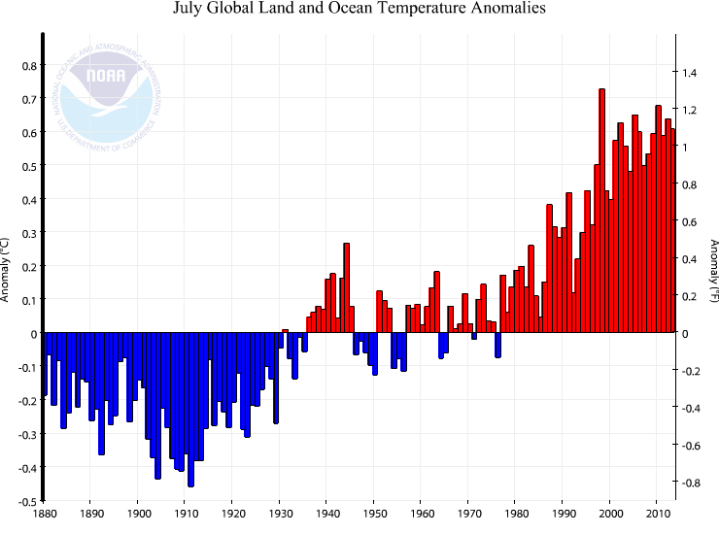
Section 4 Future Perspectives

Slide 2
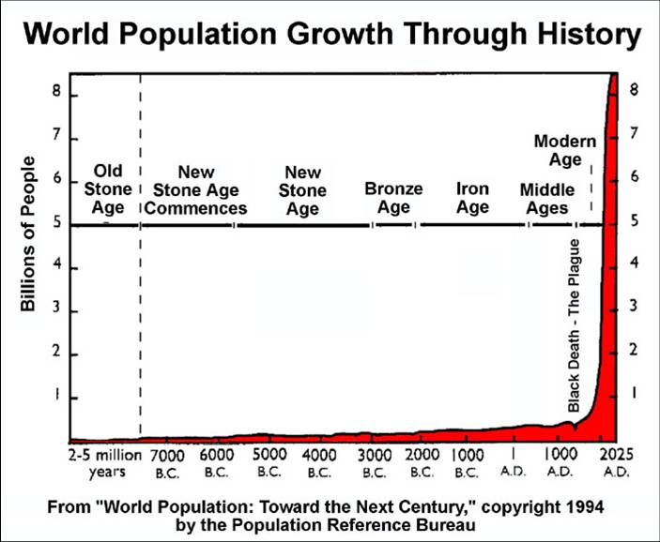

Slide 3
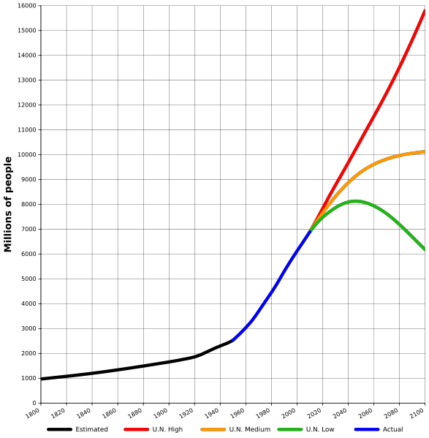

Slide 4
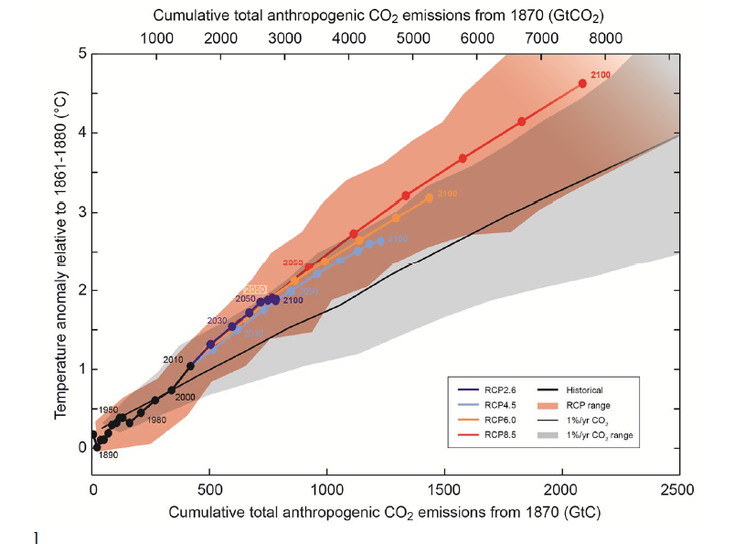
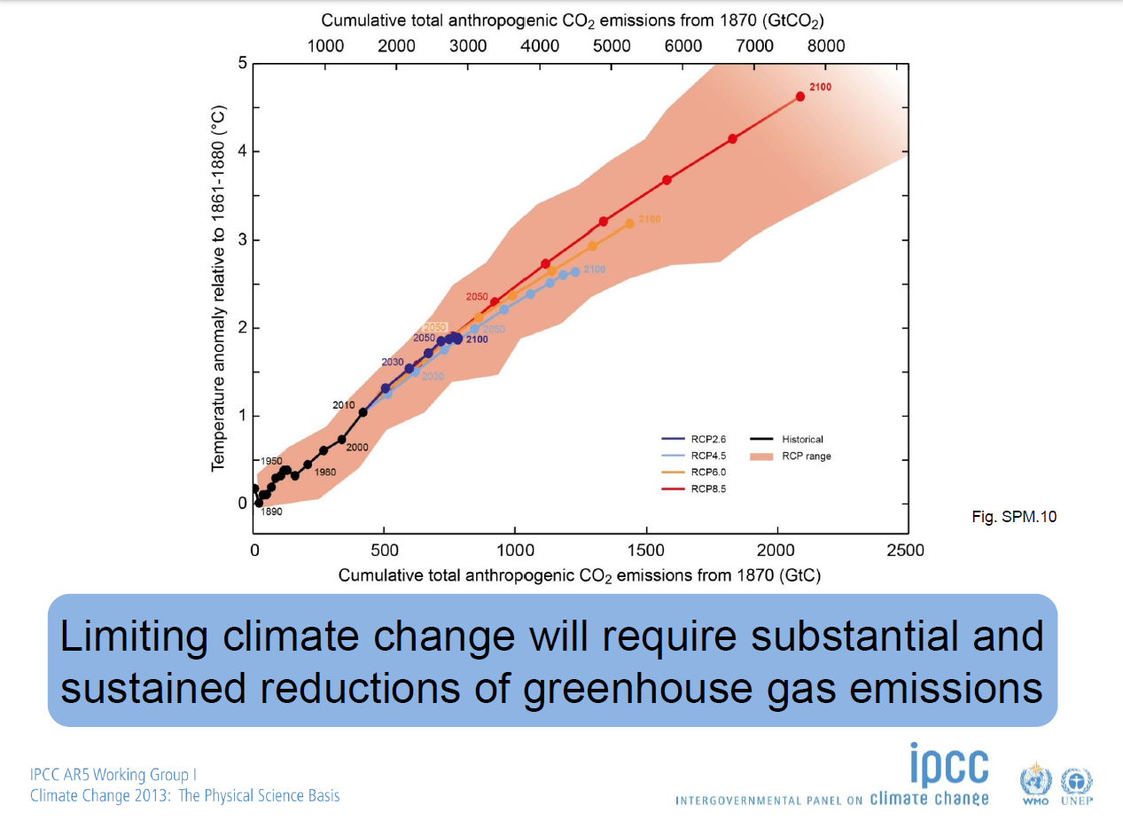

Slide 5
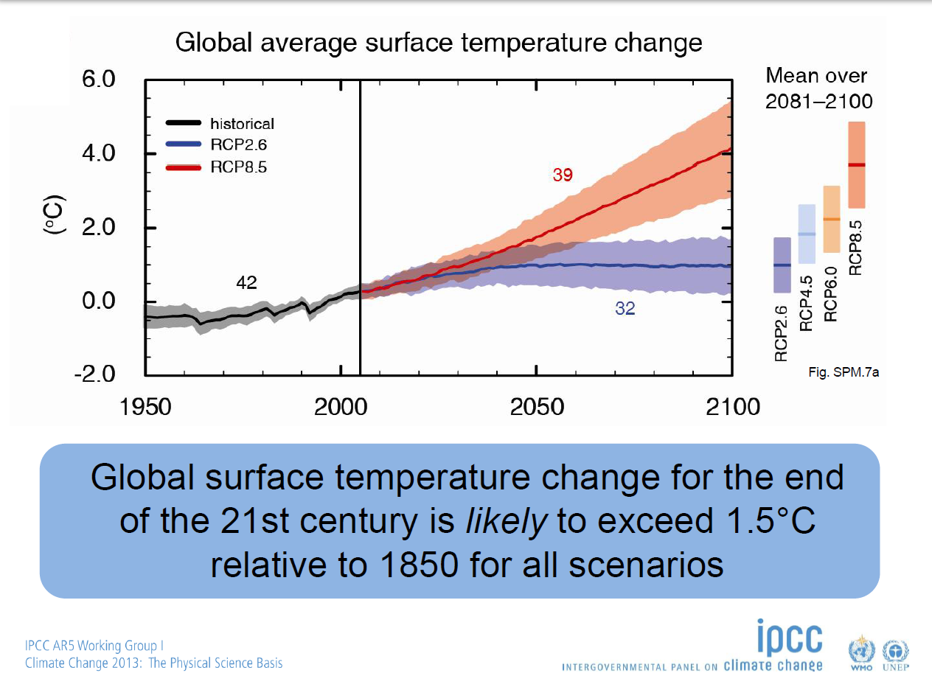
Relative to 1986-2005 average
2.6° to 4.8°C
0.3° to 1.7°C

Slide 6
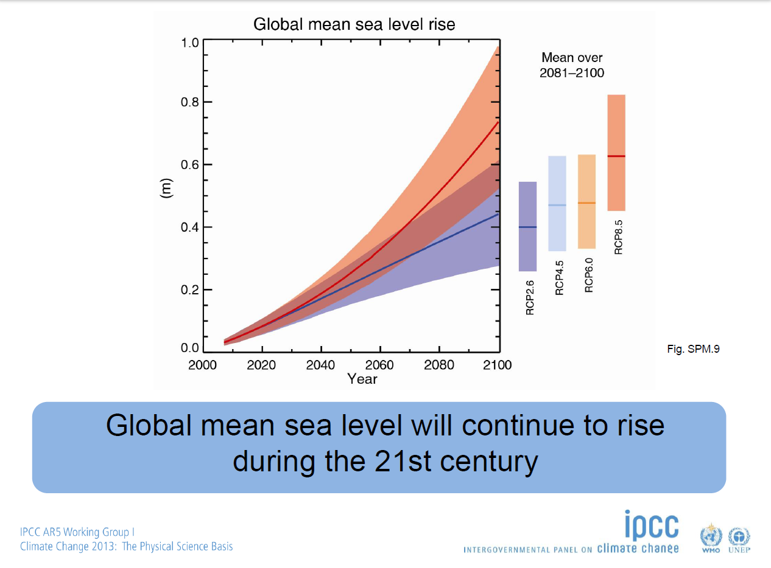

Slide 7
Can we achieve emissions reduction commitments to stabilize GHG levels by 2100 at a level that limits global warming to no more than 2°C above preindustrial levels?

Slide 8
Need to Reduce Greenhouse Gases
In order to avoid the negative consequences to the environment, living things, and society, we need to reduce greenhouse gas concentrations in the atmosphere
Scale of the negative consequences depends on how much carbon accumulates in the atmosphere over time
To keep temperatures below a 2°C temperature rise, we need to act quickly and make significant changes
  Slower and less significant change in fossil fuel combustion will lead to higher temperatures and more impacts on the environment, living things, and society

Slide 9
A Very Hard Problem
The science is comparatively easy!
Reducing greenhouse gas accumulation in the atmosphere fast enough to avoid intolerable temperature rise and associated consequences…
  challenges values of individuals (and societies?)
  poses questions of fairness and equity
  raises need to consider more than solely individual (national) interests
  requires getting people with very different backgrounds and perspectives to agree on a set of actions
  requires thinking long term (climate change is a problem that comes on relatively slowly – not a sudden disaster)
  requires development of new technologies which will need funding
  requires implementing new energy policies that will transition from the status quo
  potentially lead to conflicts with well-funded organizations, industries, and nations with an interest in maintaining the status quo
The Challenge of Sustainability – Environment, Economy, and Society
“People and values”
“Science and Tech, Money”
“Policy, Industry, Power”

Slide 11
In a World of 20 People
 | # People | Annual Fossil Fuel Emissions % of Global | Fossil Fuel Emissions per capita relative to developing world | Gross Domestic Product relative to developing world
United States | 1 | 19% | 8.52 | 13.69
European Union | 1 | 13% | 3.65 | 8.81
Other Developed | 2 | 17% | 4.28 | 5.74
China | 4 | 23% | 2.39 | 1.43
India | 4 | 6% | .69 | 0.58
Other Developing | 8 | 21% | 1.00 | 1.00

Slide 12
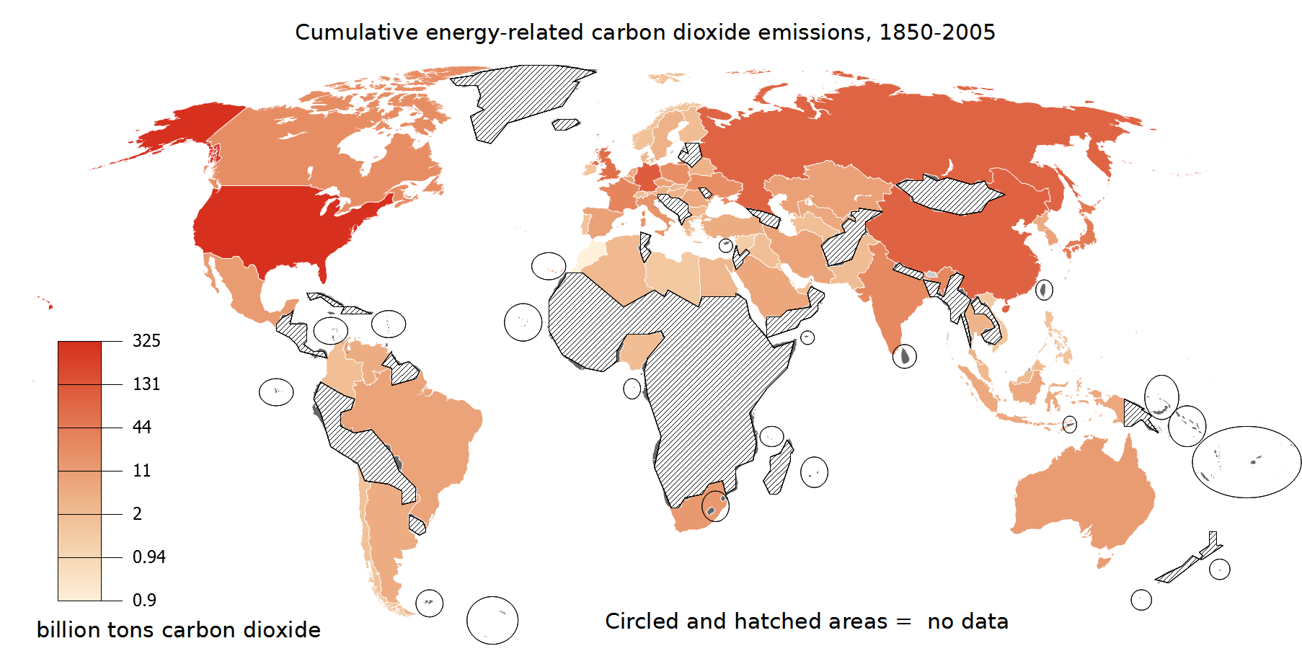
Cumulative CO2 Emissions from Fossil Fuels – 1850 - 2005

Slide 13
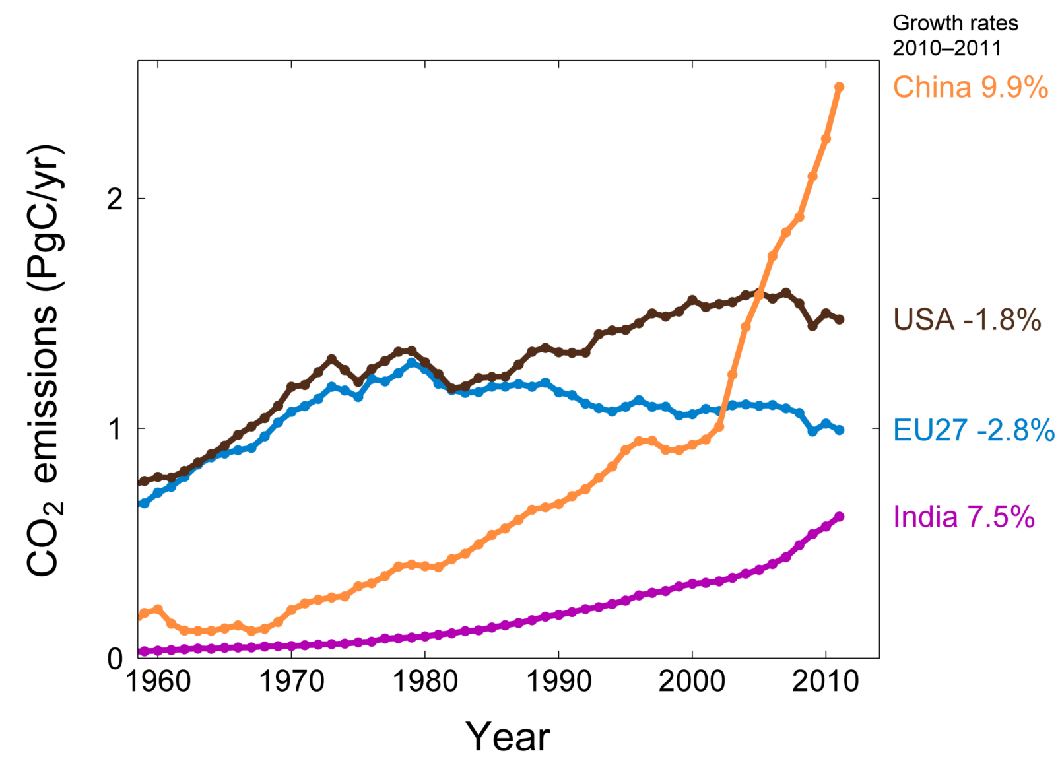
Top Fossil Fuel Emitters (Absolute)
Top four emitters in 2011 covered 62% of global emissions
China (28%), United States (16%), EU27 (11%), India (7%)
The growing gap between EU27 and USA is due to emission decreases in Germany (45% of the 1990-2011 cumulative difference), UK (19%), Romania (13%), Czech Republic (8%), and Poland (5%)
Source: CDIAC Data; Le Quéré et al. 2012; Global Carbon Project 2012

Slide 14
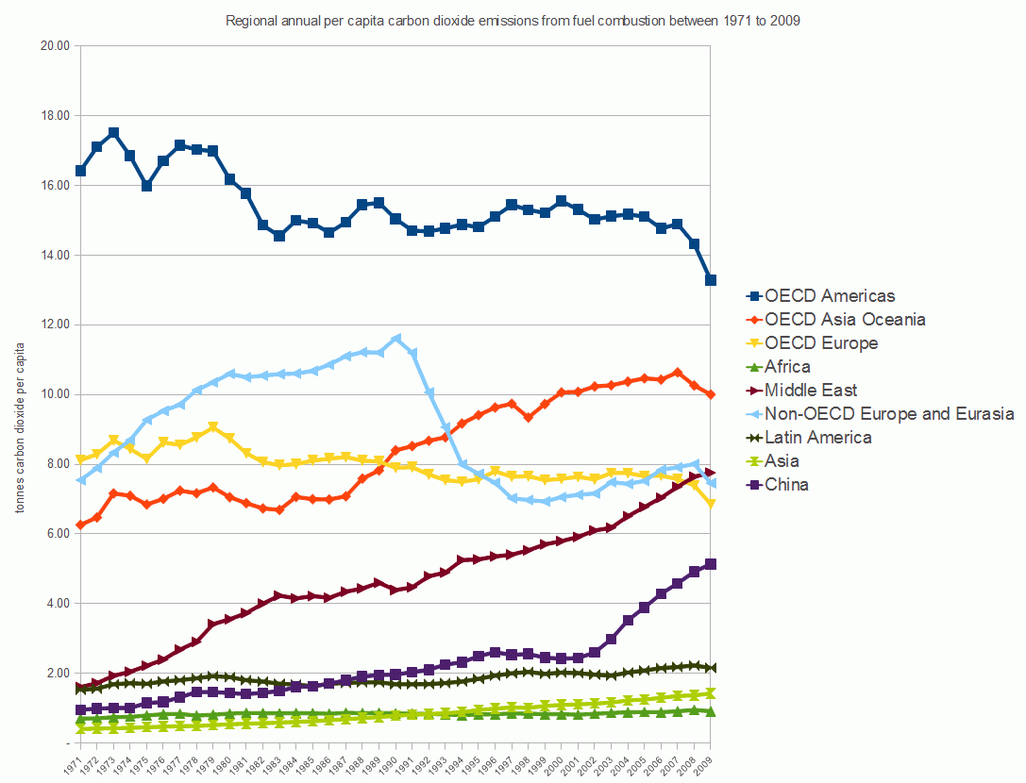
Per Capita CO₂ Emissions by Country/Region
Americas
Non OECD Europe and Eurasia
Asia Oceania
Europe
Middle East
China
Latin America
Asia
Africa

Slide 15
Weather Forecast in 2050
https://www.youtube.com/watch?v=65ScX7kNR_g

Slide 16
The Climate Change Challenge
Society has three options:
Mitigation: reducing the pace & magnitude of the changes in global climate being caused by human activities
  moving to sustainability - reducing emissions of GHG, enhancing “sinks” for these gases, using sustainable fuels (solar, wind, tidal) and “geoengineering” to counteract the warming effects of GHG
Adaptation: reducing the adverse impacts on human well-being resulting from the changes in climate that do occur
  changing agricultural practices, strengthening defenses against climate-related disease, and building more dams and dikes, moving inland (away from the water front), developing heat and drought resistant crops
Suffering the adverse impacts that are not avoided by either mitigation or adaptation

Slide 17
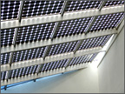
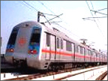
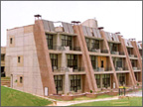
Key technologies to reduce emissions
Key mitigation technologies and practices currently commercially available
Energy
Supply
Efficiency; fuel switching; renewable (hydropower, solar, wind, geothermal and bioenergy); combined heat and power; nuclear power; early applications of CO₂ capture and storage
Transport
More fuel efficient vehicles; hybrid vehicles; biofuels;
modal shifts from road transport to rail and public
transport systems; cycling, walking; land-use planning
Buildings
Efficient lighting; efficient appliances and air conditioning; improved insulation ; solar heating and cooling; alternatives for fluorinated gases in insulation and appliances
Notes:
Table SPM 3: Key mitigation technologies and practices by sector. Sectors and technologies are listed in no particular order. Non-technological practices, such as lifestyle changes, which are cross-cutting, are not included in this table (but are addressed in paragraph 7 in this SPM).

Slide 18
Policy
Pricing of emissions (cap and trade, taxes)
Mandates/regulations
Government subsidies
Voluntary/educational
Individual actions – measure your own CO₂ output and move to lower emission choices – EPA’s Household Carbon Footprint Calculator

Slide 19
Different Roles
Politicians
Media
Educators
Industry
Public

Slide 20
http://newsroom.unfccc.int/

Slide 21

The Historian’s Challenge
“Facts do not cease to exist because they are ignored”
Aldous Huxley, Proper Studies (1927)
“Civilizations die from suicide, not by murder"
Arnold Toynbee, A Study of History (1961)
“A phenomenon noticeable throughout history regardless of place or period is the pursuit by government of policies contrary to their own interests.”
Barbara Tuchman,
The March of Folly: From Troy to Vietnam (1984)

Slide 22
We need a new generation of young scientists to solve
our future energy problems – education is key!

