Slide 1
3.5 Monsoons
3.5 Monsoons
(i) West African Monsoon
(ii) Asian Monsoon
(iii) North American Monsoon
3.6 Comparing ITCZ over land and ocean

Slide 2
Monsoons
See Monsoons Chapter in Tropical Meteorology Publication on COMET website: https://www.meted.ucar.edu/, Chapter 3.5!
If you are logged in, this link will take you there:
http://www.meted.ucar.edu/tropical/textbook_2nd_edition/navmenu.php?tab=4&page=5.0.0

Slide 3
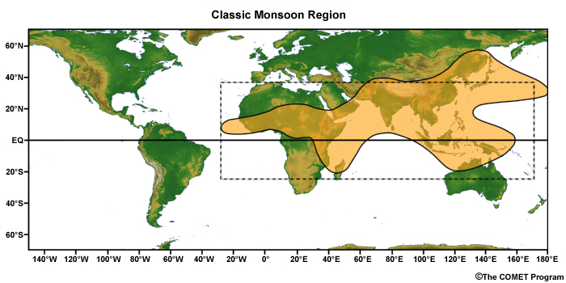
The classical criteria for a monsoon as specified by Ramage (1971) are:
Prevailing wind shifts 120° between January and July
Average frequency of prevailing wind > 40%
Speed of mean wind exceeds 3 m s-1
Pressure patterns satisfy a steadiness criterion

Slide 4
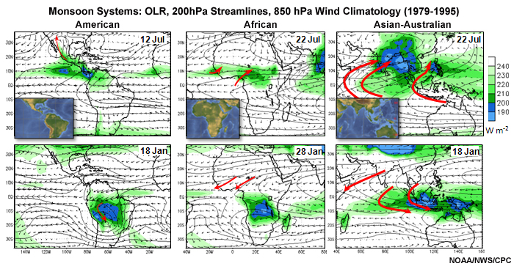

Slide 5
Planetary-scale monsoon can be considered to have these fundamental mechanisms:
The seasonal oscillation of solar heating with net heating in the summer hemisphere, which leads to migration of the equatorial trough and the tropical convergence zones
The differential heating between the land and ocean and the resulting pressure gradient (Halley 1686)
The swirl introduced to the winds by the rotation of the Earth (Hadley 1735)
Moisture processes and convection

Slide 6
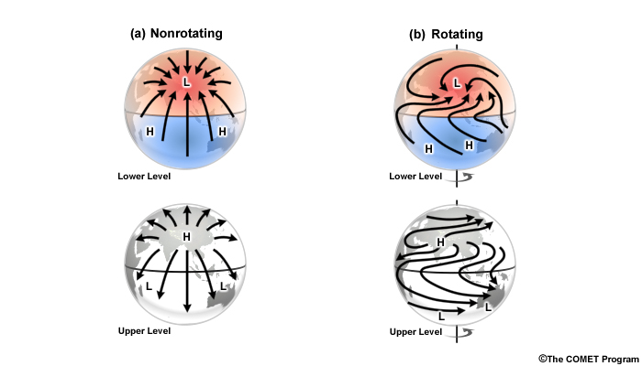
Mark J. Rodwell and Brian J. Hoskins, 1995: A Model of the Asian Summer Monsoon.Part II: Cross-Equatorial Flow and PV Behavior. J. Atmos. Sci., 52, 1341–1356.

Slide 7
Asian Monsoon

Slide 8
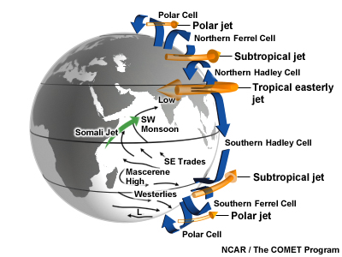

Slide 9
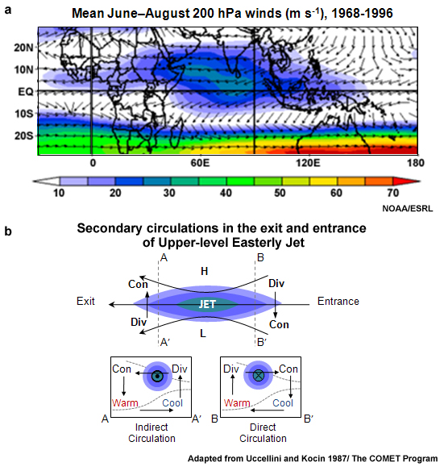

Slide 10
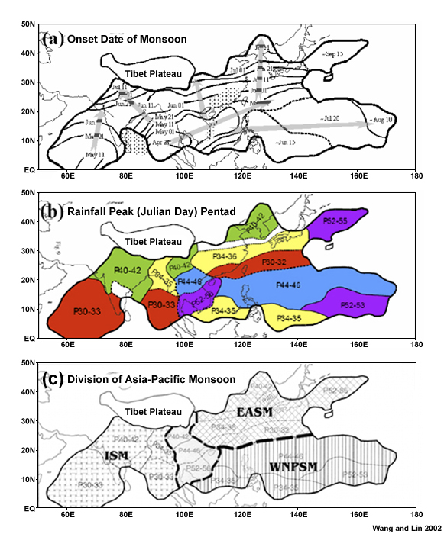

Slide 11
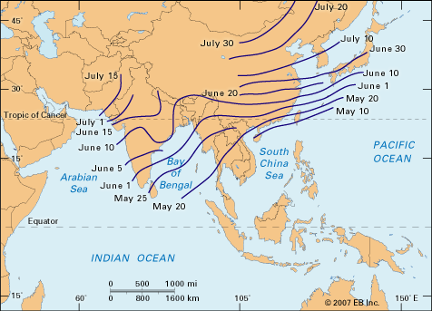

Slide 12
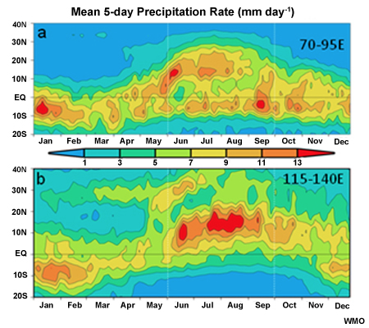

Slide 13
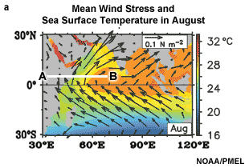
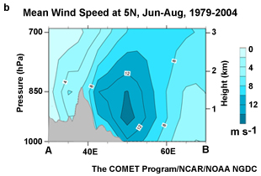

Slide 14
North American Monsoon see: http://www.eol.ucar.edu/field_projects/name

Slide 15
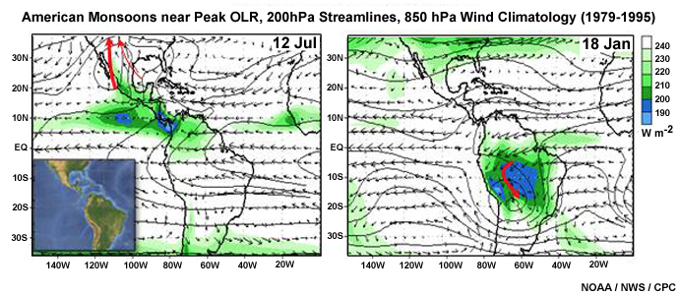
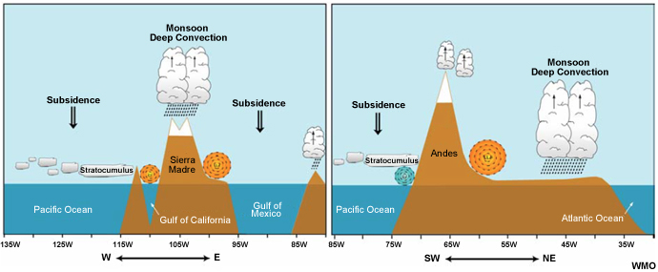

Slide 16
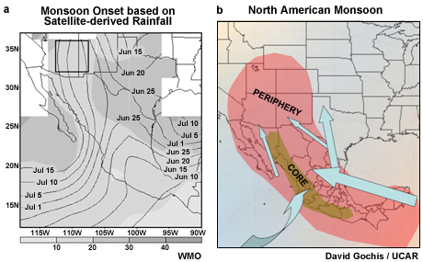

Slide 17
Monsoons
See also: http://www.clivar.org/panels-and-working-groups/monsoons

Slide 18
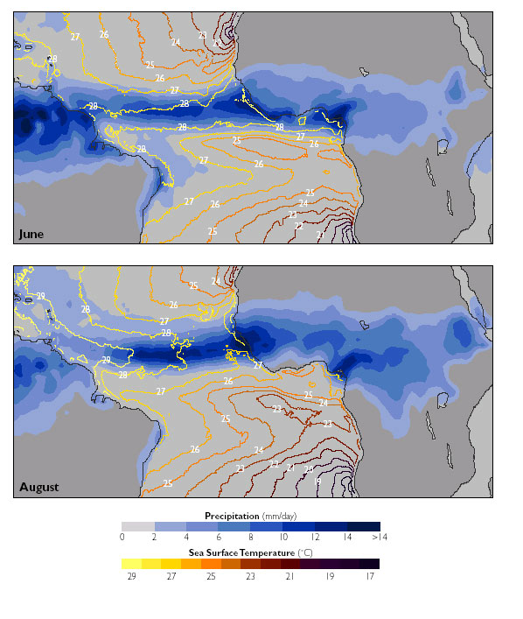
3.6 Comparing ITCZ over land and ocean

Slide 19
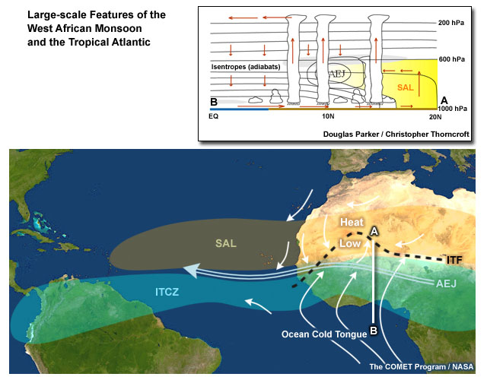
3.6 Comparing ITCZ over land and ocean

