Slide 1
5 Kelvin Waves
5.1 Introduction
5.2 Theory
5.3 Observations of Convectively Coupled Kelvin Waves
5.3.1 Power Spectra
5.3.2 Kelvin Waves over Africa
5.3.3 Kelvin Waves and Atlantic Tropical Cyclones
5.3.4 Kelvin Waves and Other regions!

Slide 2
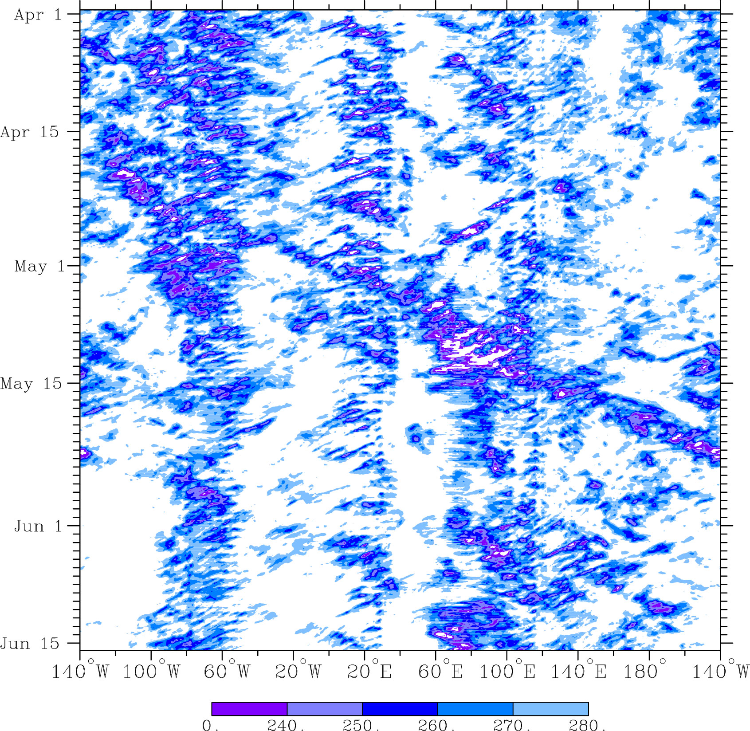
5.1 Introduction
1998 CLAUS Brightness Temperature 5ºS-5º N

Slide 3
5.1 Introduction
Kelvin waves were first identified by William Thomson (Lord Kelvin) in the nineteenth century.
Kelvin waves are large-scale waves whose structure "traps" them so that they propagate along a physical boundary such as a mountain range in the atmosphere or a coastline in the ocean.
In the tropics, each hemisphere can act as the barrier for a Kelvin wave in the opposite atmosphere, resulting in "equatorially-trapped" Kelvin waves.
Oceanic Kelvin waves are thought to be important for initiation of El Niño Southern Oscillation (ENSO).
Atmospheric Kelvin waves are a key component of of the MJO.

Slide 4
5.1 Introduction
Convectively-coupled atmospheric Kelvin waves have a typical period of 6-7 days when measured at a fixed point and phase speeds of 12-25 m s⁻¹.
Dry Kelvin waves in the lower stratosphere have phase speed of 30-60 m s⁻¹.
Kelvin waves over the Indian Ocean generally propagate more slowly (12–15 m s⁻¹) than other regions.
They are also slower, more frequent, and have higher amplitude when they occur in the active convective stage of the MJO.

Slide 5
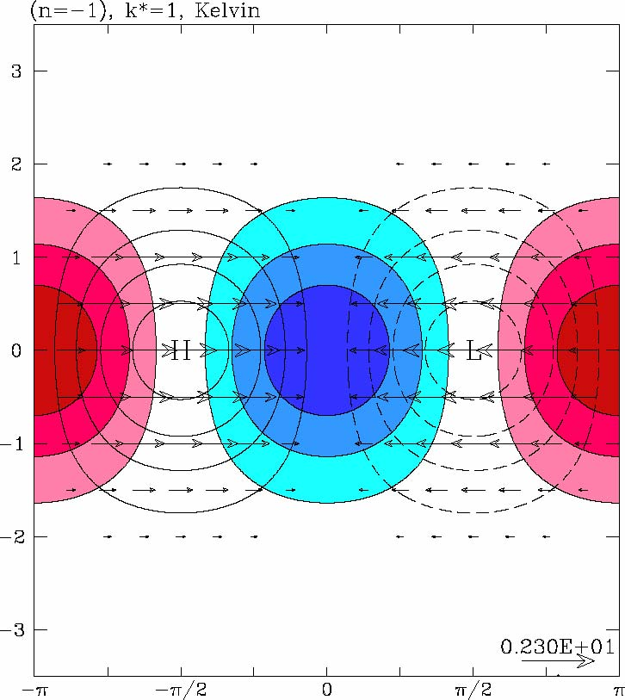
5.2 Theory
See Notes
Wind, Pressure (contours),
Divergence, blue negative

Slide 6
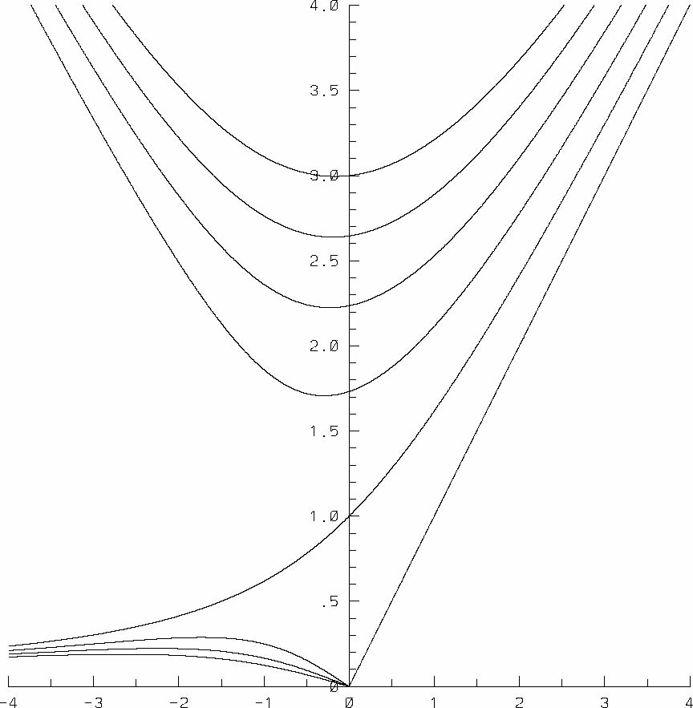
Theoretical Dispersion Relationships for Shallow Water Modes on Eq. β Plane
Frequency ω
Matsuno, 1966
Zonal Wavenumber k
Notes:
6

Slide 7
Theoretical Dispersion Relationships for Shallow Water Modes on Eq. β Plane
Frequency ω
Westward
Eastward
Matsuno, 1966
Zonal Wavenumber k
Notes:
7

Slide 8
Theoretical Dispersion Relationships for Shallow Water Modes on Eq. β Plane
Westward Inertio-Gravity
Eastward Inertio-Gravity
n = 4
n = 3
Kelvin
n = 2
Frequency ω
n = 1
n = 0
n = -1
Mixed Rossby-gravity (Yanai)
Equatorial Rossby
Matsuno, 1966
n = 1
n = 3
Zonal Wavenumber k
Notes:
8

Slide 9
Kelvin Wave Theoretical Structure
Wind, Pressure (contours),
Divergence, blue negative
Notes:
9

Slide 10
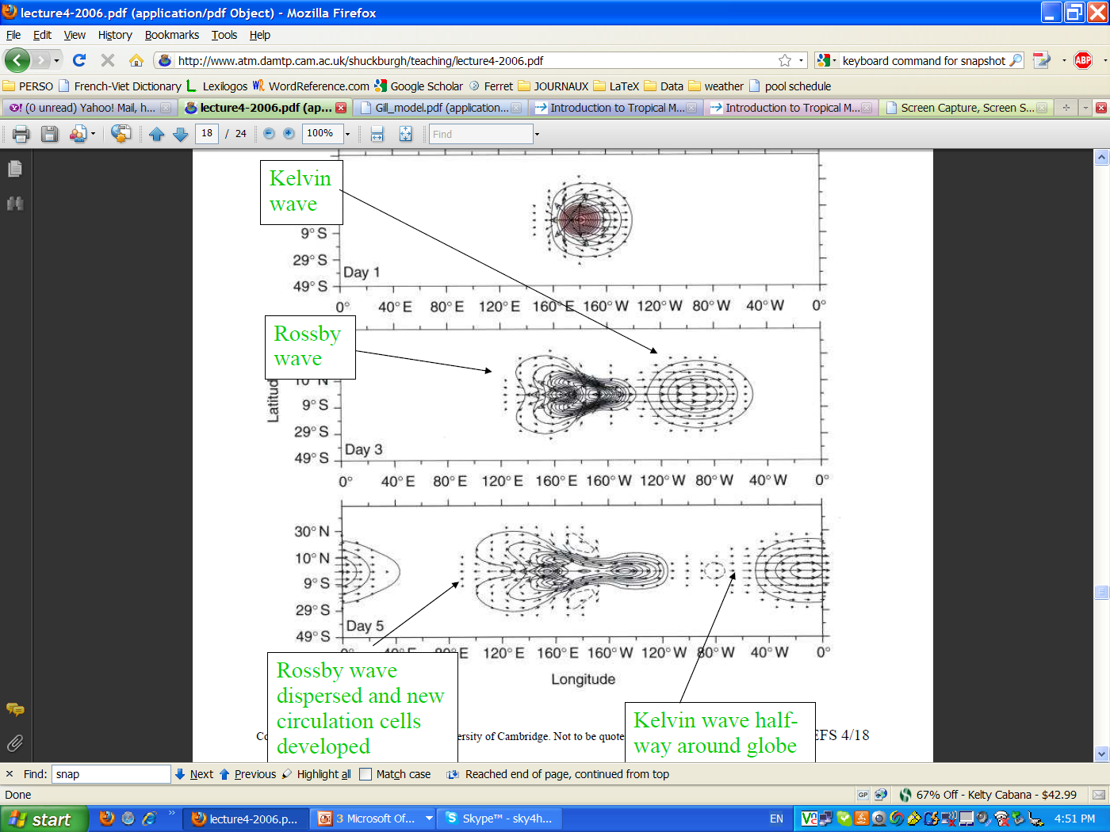
Model experiment: Gill model
Multilevel primitive atmospheric model forced by latent heating in organized convection over 2 days.
imposed heating
Vectors: 200 hPa horizontal wind anomalies
Contours: surface temperature perturbations

Slide 11
5.3 Observations
5.3.1 Power Spectra
Important References
See: Wheeler and Kiladis (1999) Convectively Coupled Equatorial Waves: Analysis of Clouds and Temperature in the wavenumber-frequency domain, JAS, 56, 374-399
As of today cited 570 times!
See also: Kiladis et al (2009): Convectively Coupled Equatorial Waves, Rev. Geophys., 47, doi:10.1029/2008RG000266.

Slide 12
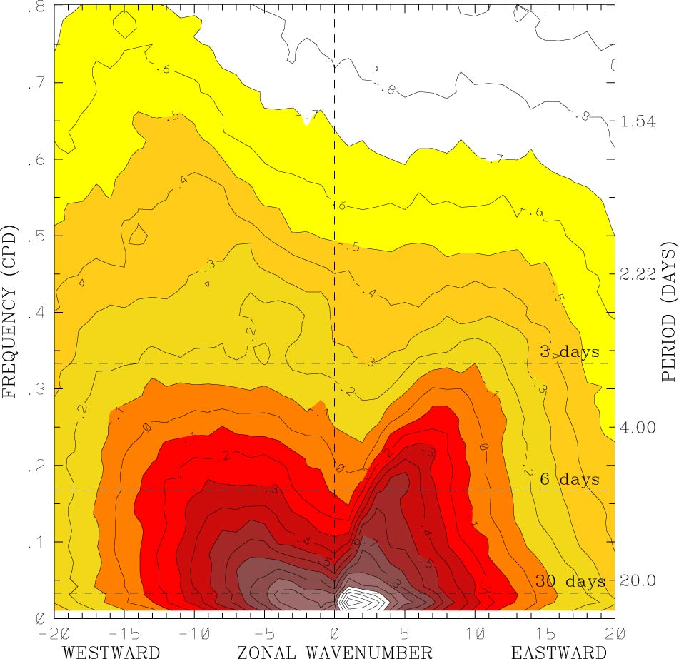
Wave-number frequency spectrum of convectively coupled equatorial waves
CLAUS Tb
Averaged 15ºS-15ºN, 1983–2005
Symmetric component
Courtesy of G. Kiladis
Notes:
12

Slide 13
Wave-number frequency spectrum of convectively coupled equatorial waves
1.25 Days
Westward Power
Eastward Power
96 Days
Notes:
13

Slide 14
Wave-number frequency spectrum of convectively coupled equatorial waves
Kelvin
Notes:
14

Slide 15
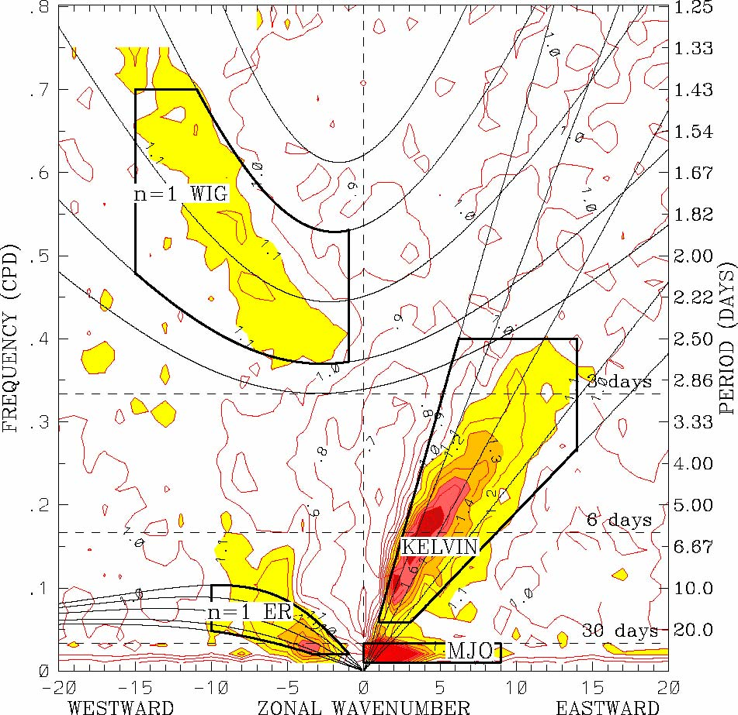
Wave-number frequency spectrum of convectively coupled equatorial waves
Outgoing Longwave Radiation (OLR)
Average: 15ºS-15ºN, 1979–2001
Symmetric component
Background removed
Wheeler and Kiladis, 1999
Notes:
15

Slide 16
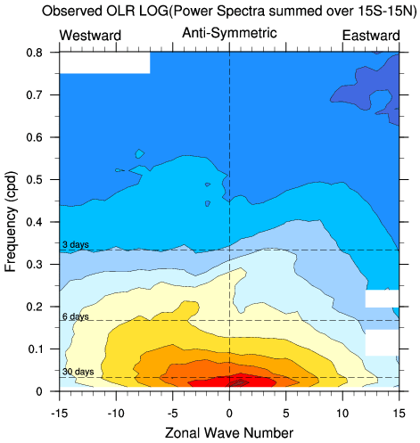
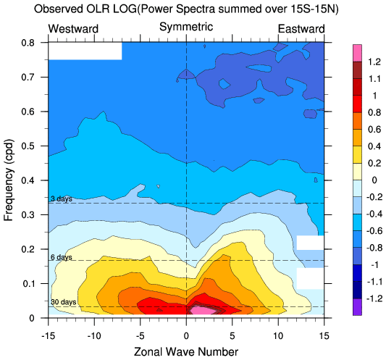
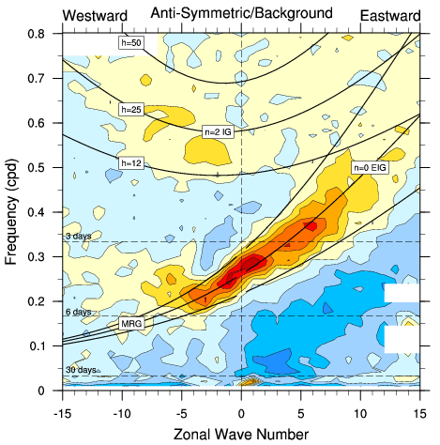
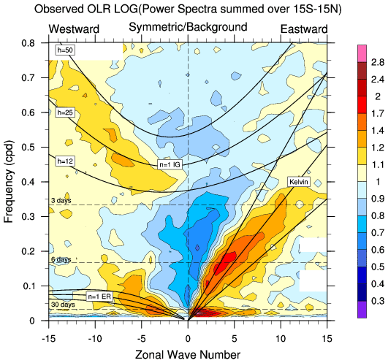
Raw power spectra of OLR in 15°S-15°N band for years 1979-2000.
Separately for anti-symmetric and symmetric parts about the equator.
Normalized power spectra
Convectively-coupled equatorial waves (CCEWs)
Courtesy of NCAR, adapted from Wheeler and Kiladis (1999)
MJO
Notes:
These figures show power spectra of such observations of OLR covering all latitudes from 15S to 15N. Hence, these figures describe all the variability that occurred over this 22 year period between these latitudes.
On the figures, the planetary zonal wavenumber is on this axis, and the frequency in cycles per day is on this axis. The perios of 3 days, 6 days, and 30 days are here. Wavenumber 0 is the zonal mean, and variability that propagates to the west is on the left of each panel, while variability propagating to the east is on the right.
One thing that I did prior to this analysis was to separate the data into symmetric and antisymmetric components about the equator. The reason for this is because the theory of waves trapped in the equatorial wave guide suggest that waves should either be symmetric or antisymmetric. The antisymmetric component is here on the left and the symmetric is in these panels.
The top two panels are the raw power spectra, while the bottom two panels are the raw power normalized by an estimated red background spectrum. So the normalized spectrum shows where there are relative peaks in the raw spectrum, such as through here and here.
The MJO appears as an absolute peak here for wavenumber of about 1 to 3 and periods between 30 and 80 days. It is mostly in the symmetric component.
Elsewhere in the spectrum, however, we can see spectral peaks running along these dispersion curves that are derived from fairly simple theory. These are known as Kelvin waves, the se as equatorial rossby waves, and these as mixed-Rossby gravity waves. As well as some inertio-gravity waves at high frequencies.
Together, these waves that fall on the theoretical dispersion curves are called the convectively-coupled equatorial waves. The MJO, in contrast, does not lie on one of these theoretical curves.

Slide 17
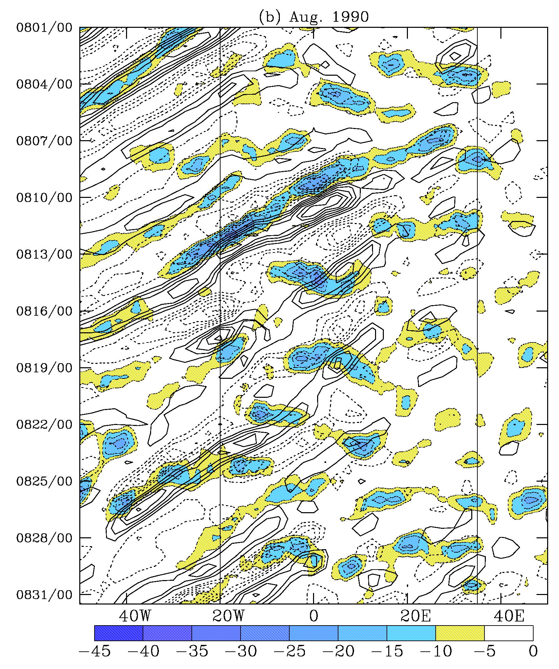
5.3.2 Kelvin Waves over Africa
Some motivation for studying Kelvin Waves over Africa
2-6d filtered T_{B} (shaded) and 700hPa υ (contoured); averaged in 10-15N
From Mekonnen et al, 2006 (J. Climate).

Slide 18
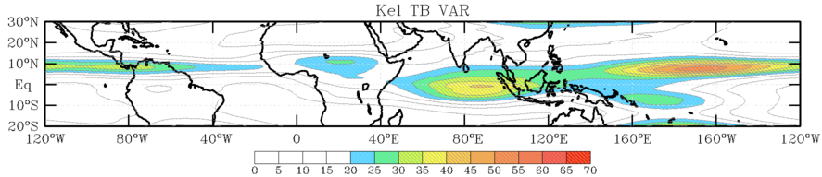
5.3.2 Kelvin Waves over Africa
Average Kelvin filtered T_{B} variance (JAS 1984-2004)
Peaks over tropical Africa, equatorial Indian Ocean, tropical Pacific
Max. over Africa near 10N, 20E

Slide 19
5.3.2 Kelvin Waves over Africa
.
Base point : 10N, 20E
Composites based on regression technique ….
Total fields (T_{B}, wind, height, velocity potential, etc. ) are lag regressed onto Kelvin filtered time series at a base point.
The results are anomalies with respect to -1 standard deviation of the base point Kelvin filtered time series.

Slide 20
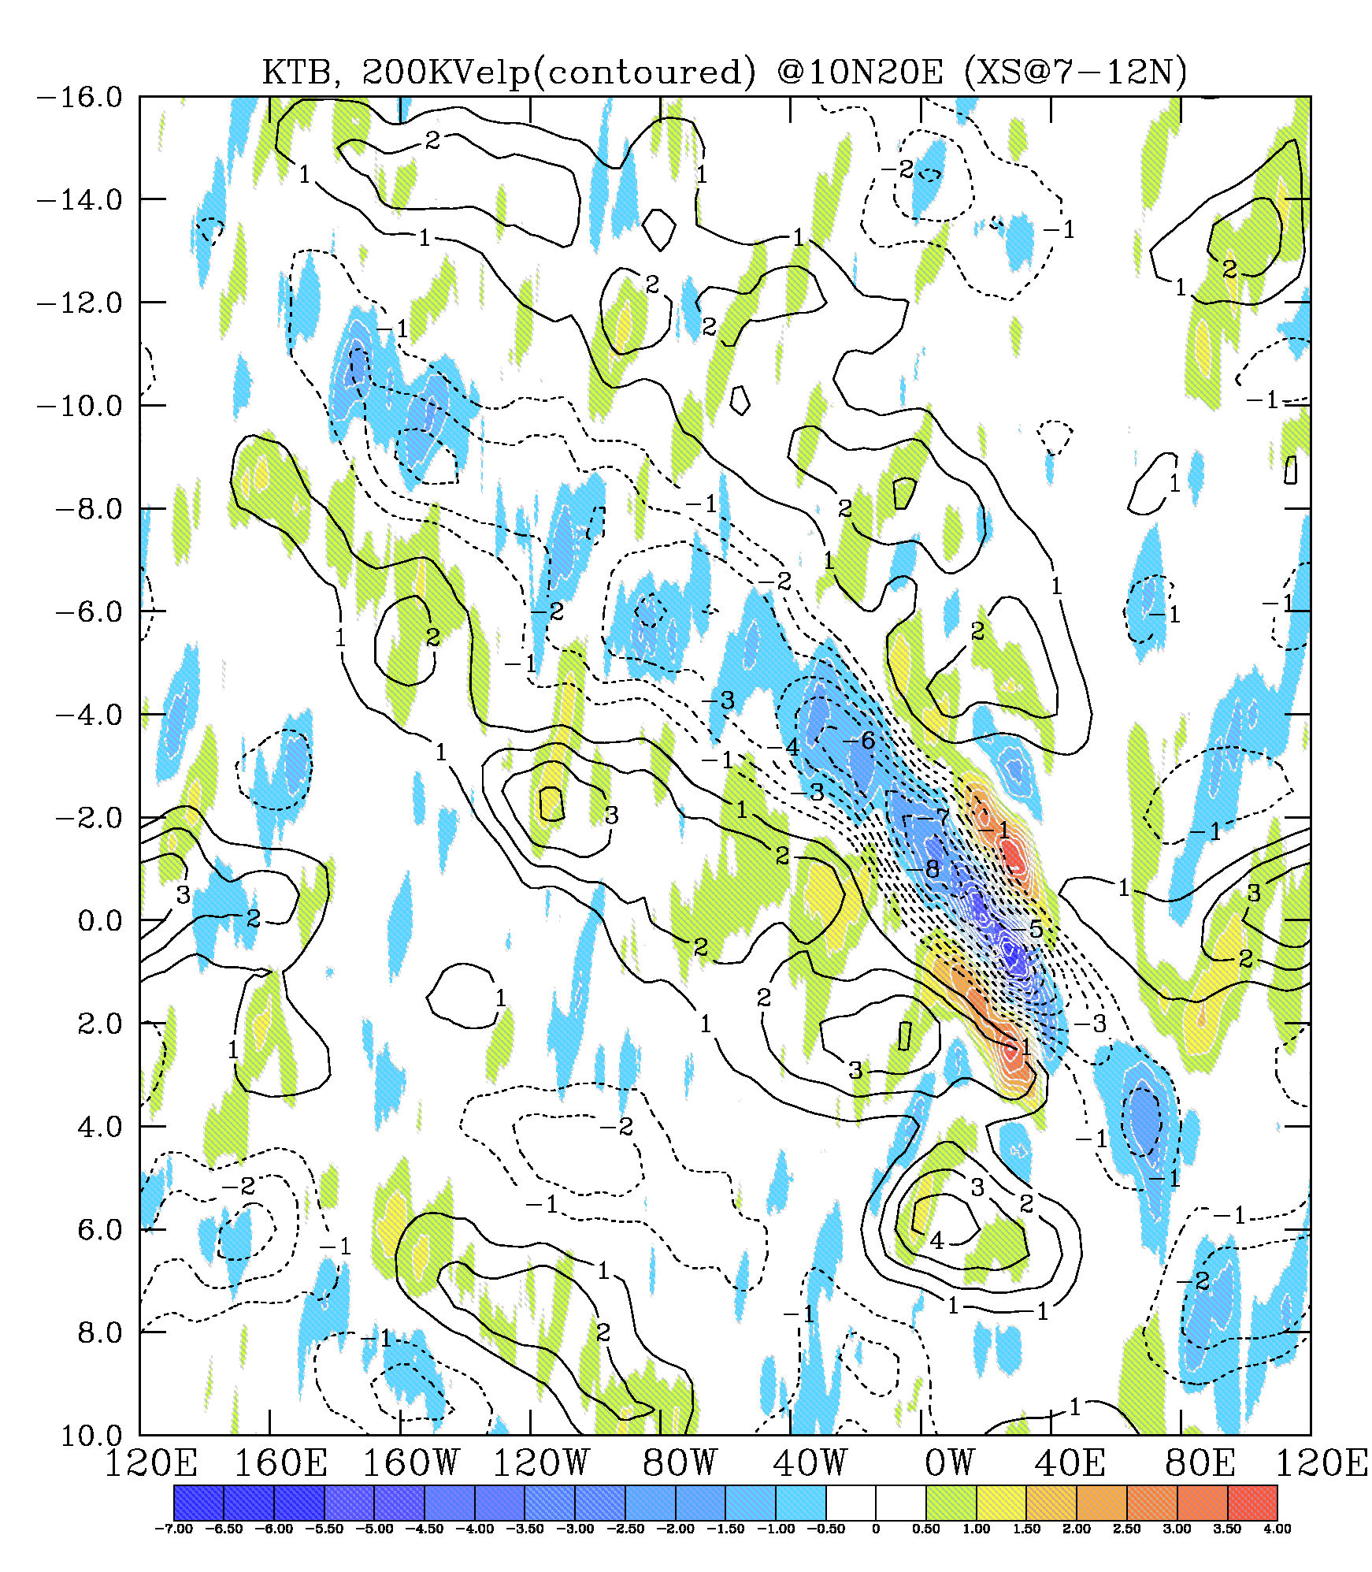
KT_{B} anomalies (shaded), Velocity potential @ 200-hPa (contoured)
Winds can be separated into their contribution to the divergent and rotational flow.
The velocity potential highlights the regions where the winds are divergent and convergent.
Negative values are associated with large-scale regions or divergence.
Lag (days)

Slide 21
KT_{B} anomalies (shaded), Velocity potential @ 200-hPa (contoured)
Lag (days)

Slide 22
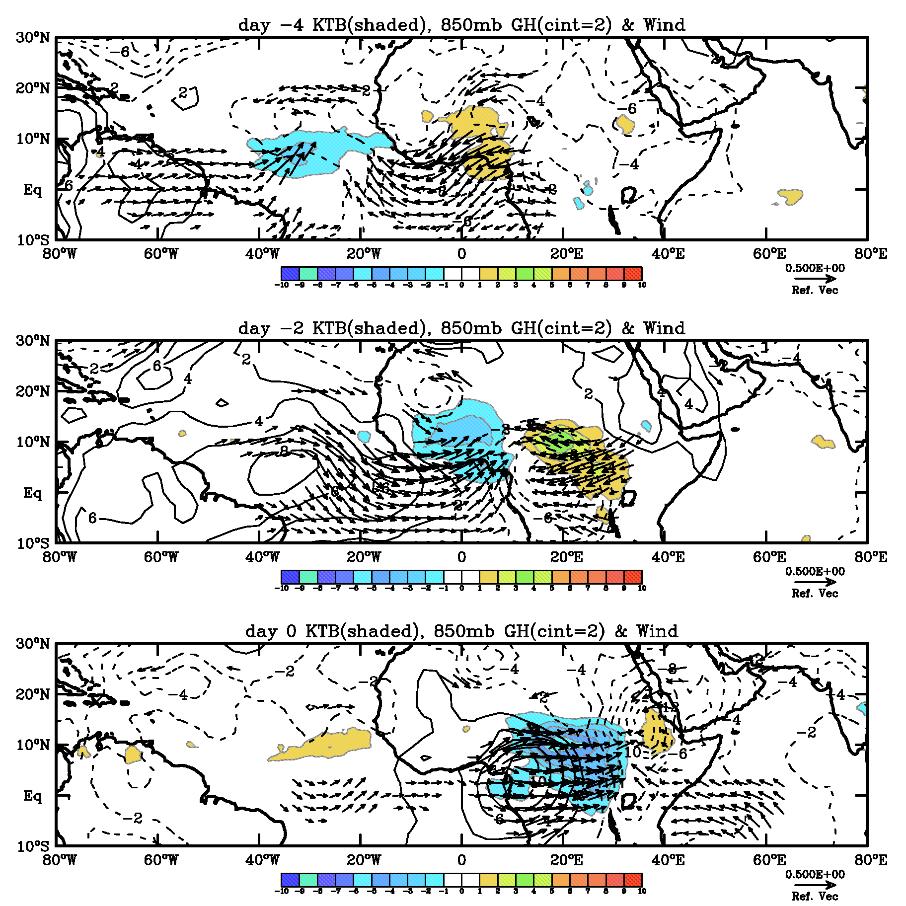
Day -4
Evolution from lag day -4 to day 4:
Convection, 850mb , Geopotential height anomalies
( significant > 95%)
Day -2
Day 0

Slide 23
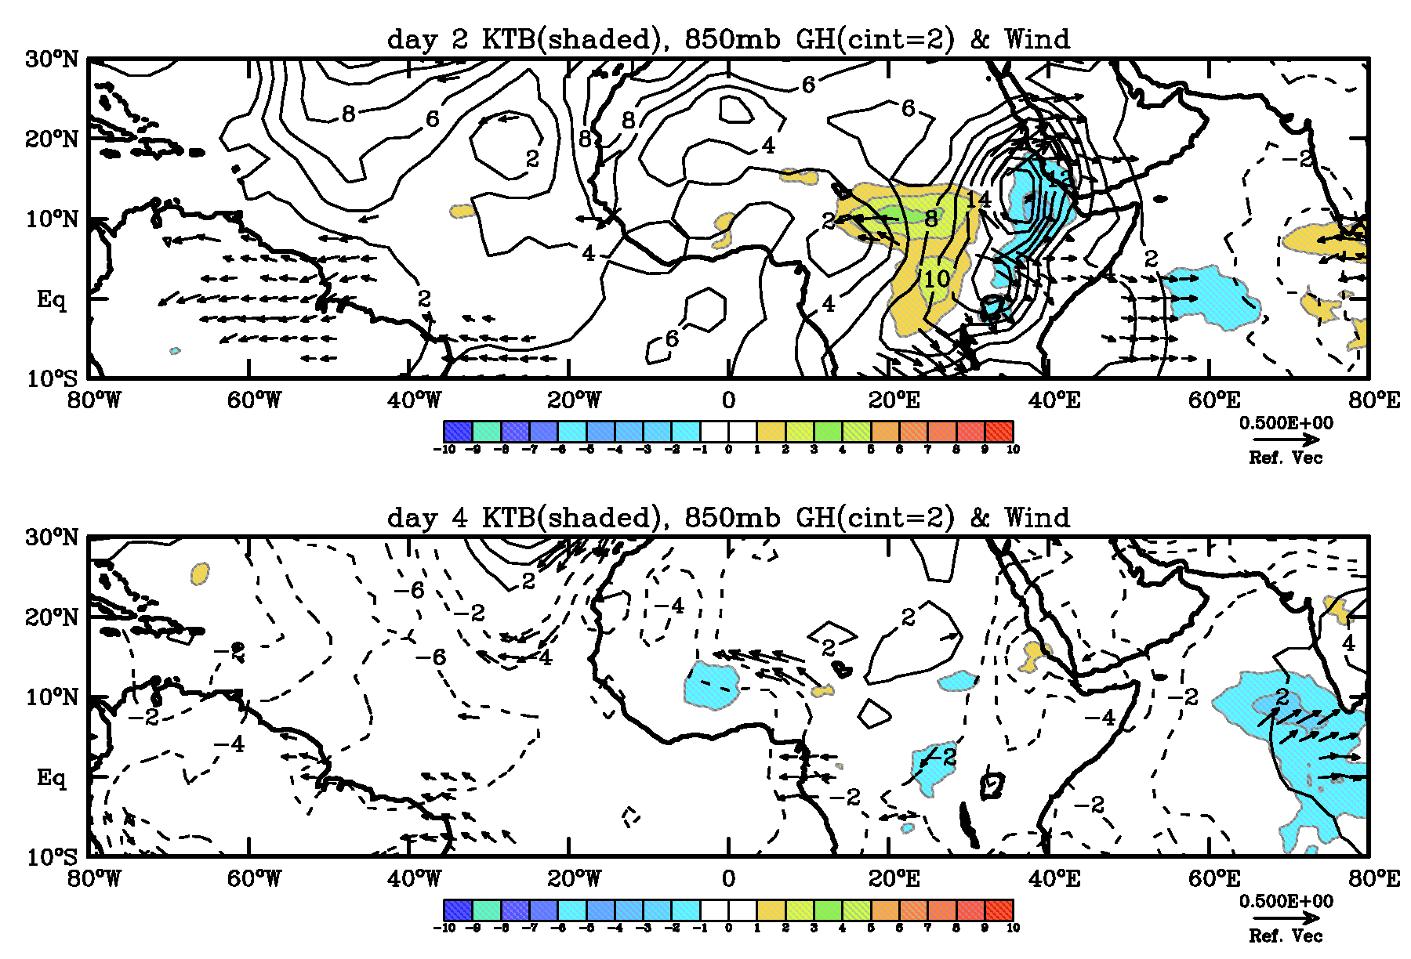
Day 2
Day 4
Evidence, based on composite analysis, of eastward moving convective envelope associated with dynamical signals that can be tracked back to the Pacific and western Atlantic.

Slide 24
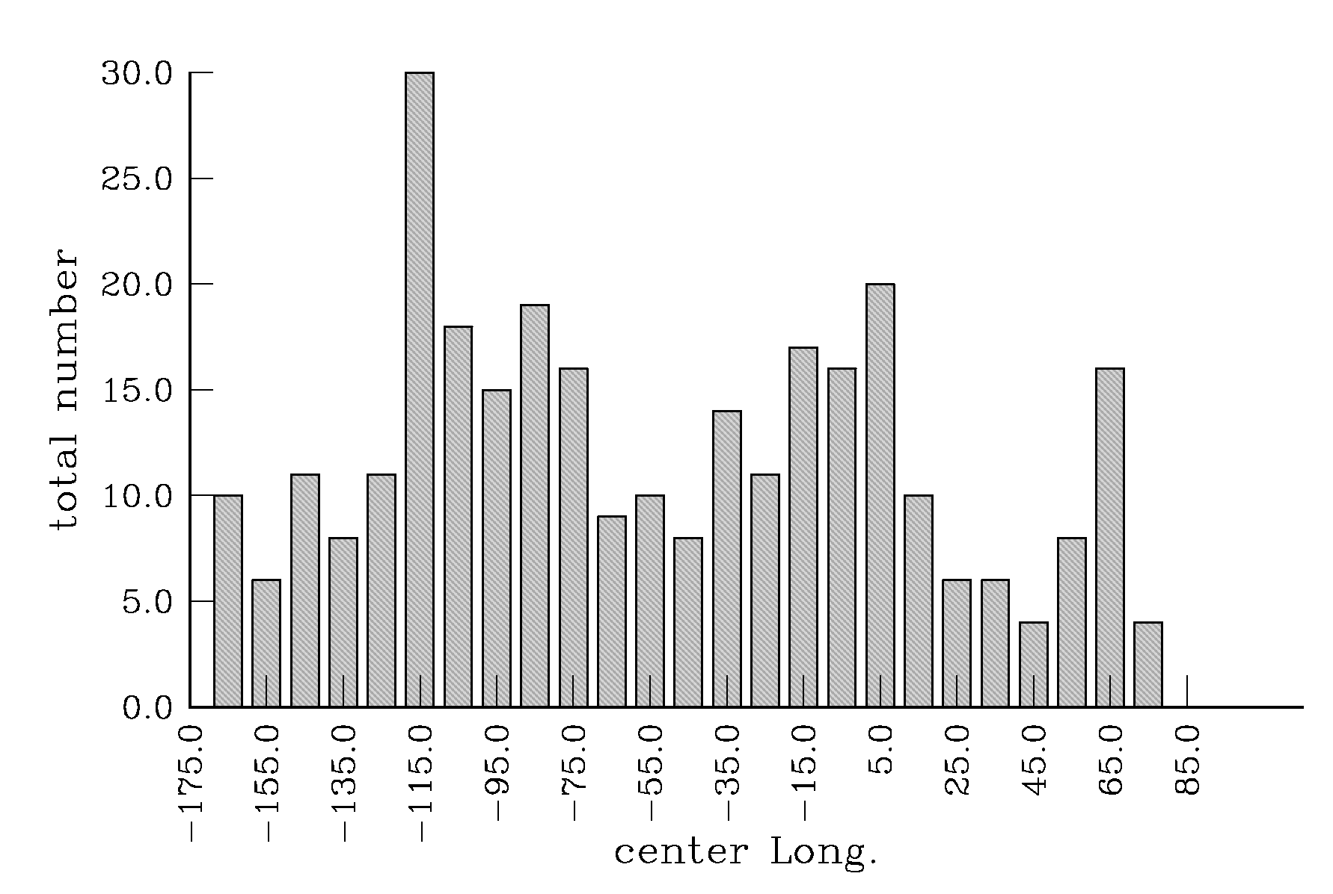
Source regions?
Kelvin convection that originate in a 10º-wide in the region between 180W-90E ( in Lat 7-12N). The Kelvin waves are ≤ -5K and waves must propagate at least for 4-days and for 5000km from the origin

Slide 25
Summary of composite analysis:
Evidence of convectively coupled Kelvin wave that originated over central and eastern Pacific and western Atlantic that have significant impact over tropical Africa
Convectively coupled Kelvin wave characterized by an average C_{ph} ~15m/s and λ ~5000-6000km

Slide 26
Weather event:
July-September 1987 (high Kelvin variance year)

Slide 27
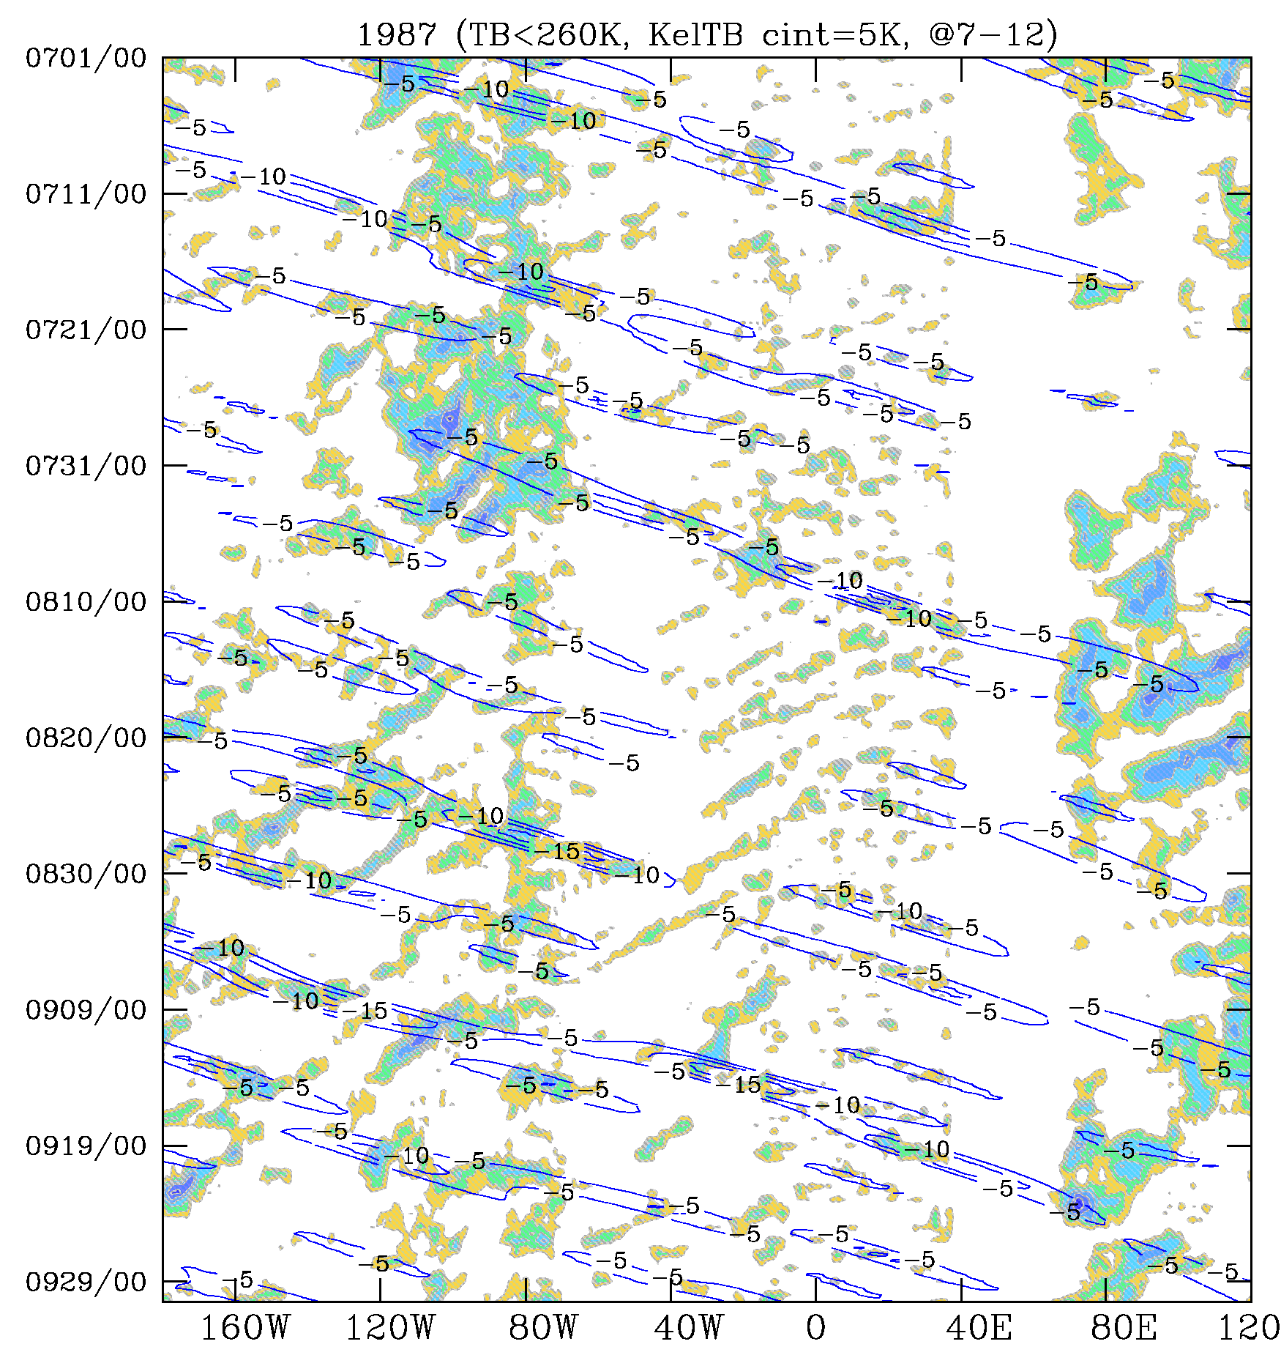
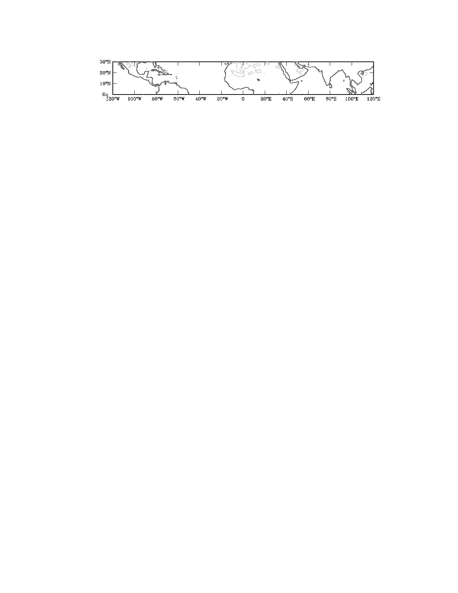
convection (T_{B} < 260K) and
Kelvin filtered T_{B} < -5K (only
negatives shown).
Lat. Average: 7-12N.
Started
July 29
Decayed
Aug. 18

Slide 28
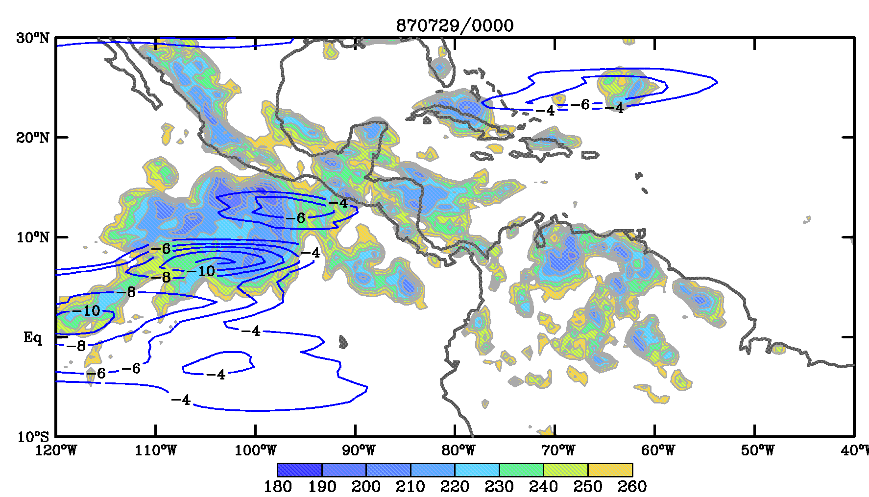
Convection (shaded T_{B} < 260K), Kelvin T_{B} (<-4K contoured)

Slide 29
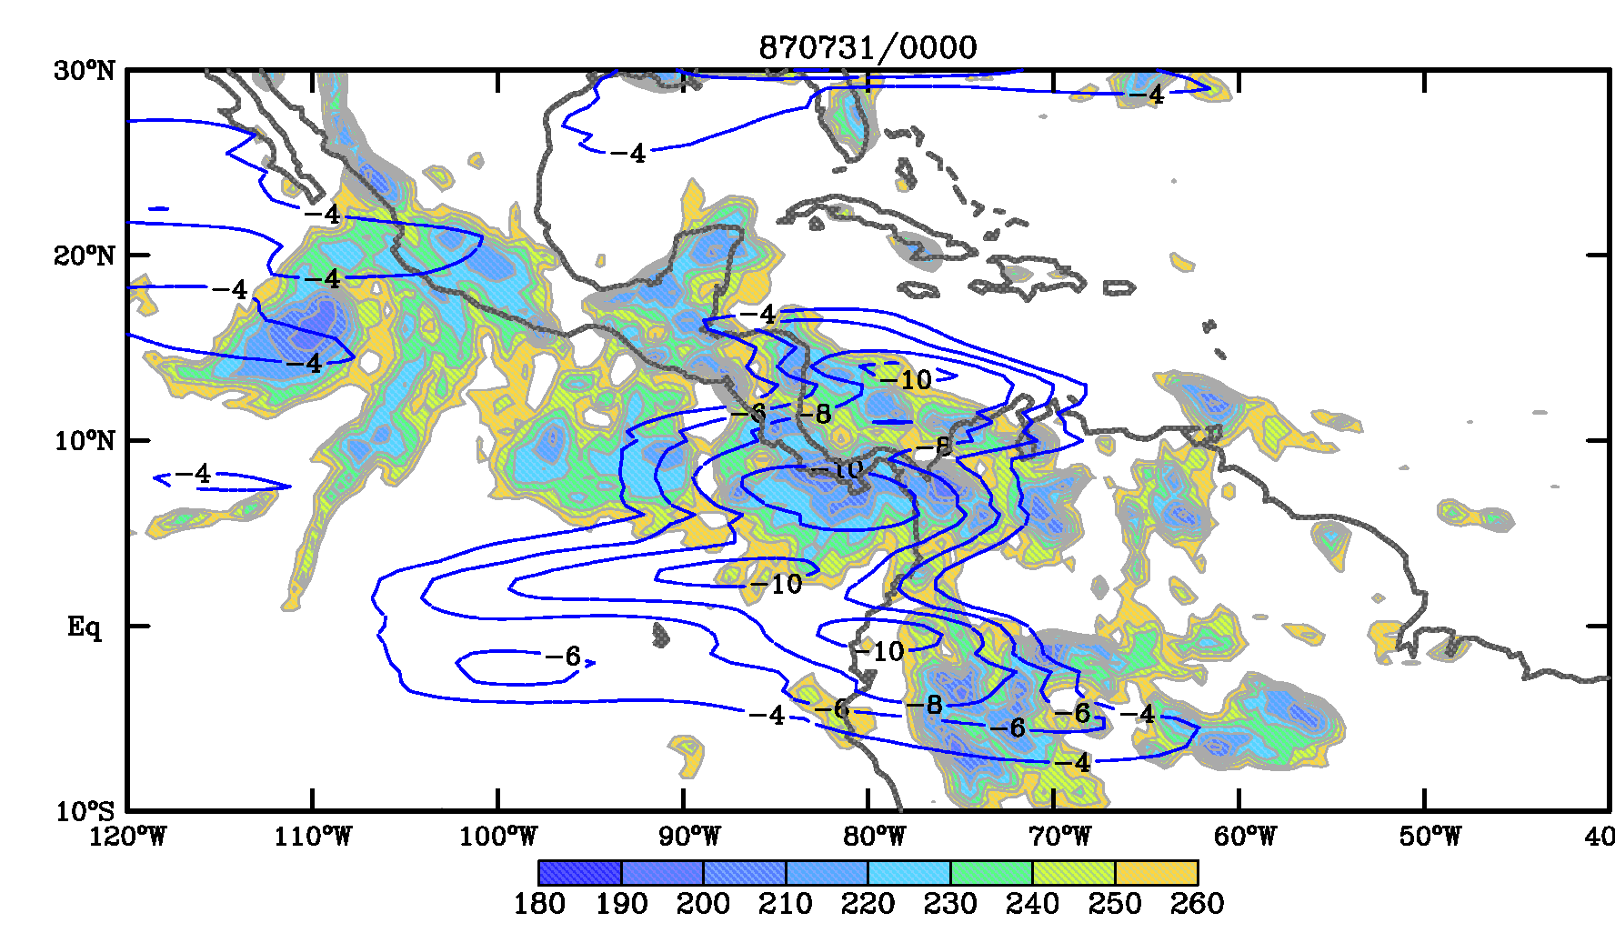
Convection (shaded T_{B} < 260K), Kelvin T_{B} (<-4K contoured)

Slide 30
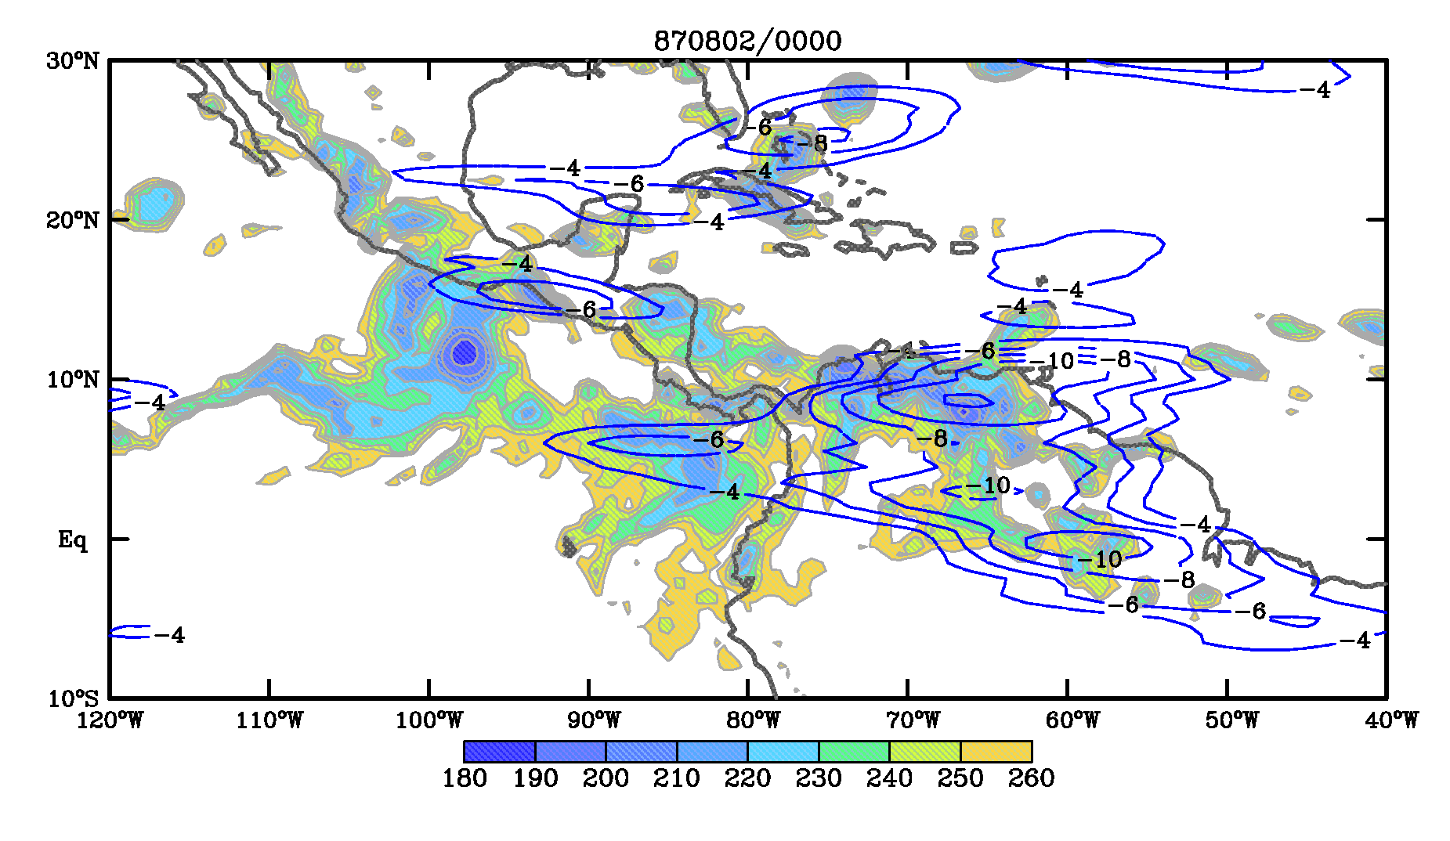
Convection (shaded T_{B} < 260K), Kelvin T_{B} (<-4K contoured)

Slide 31
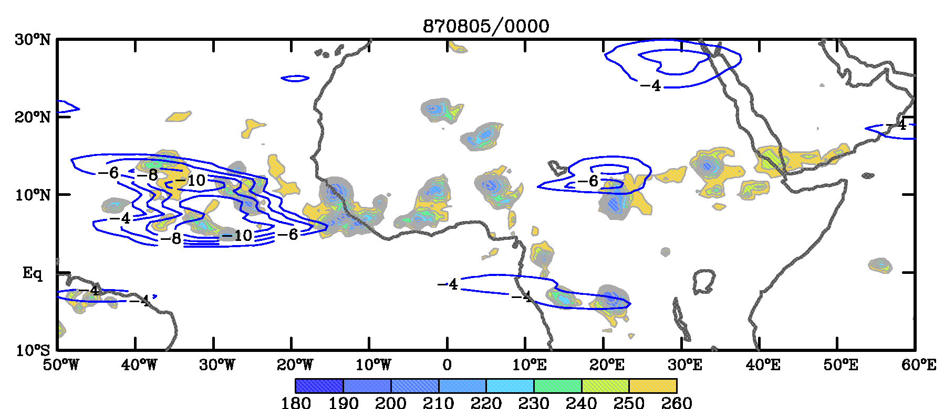
Convection (shaded T_{B} < 260K), Kelvin T_{B} (<-4K contoured)

Slide 32
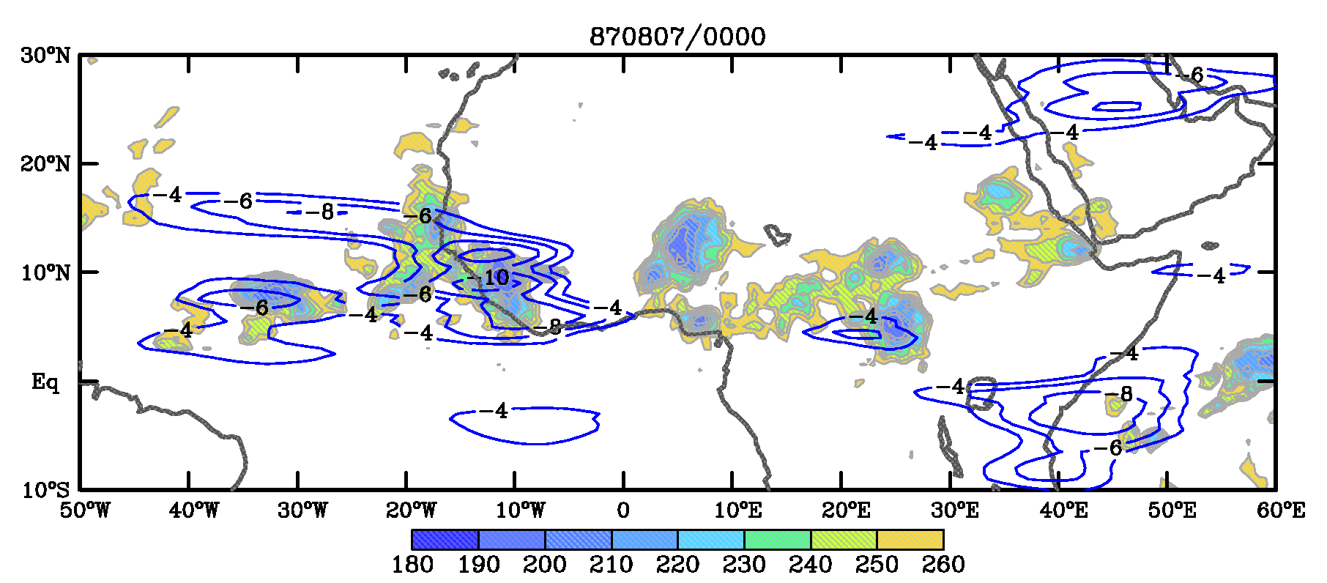
Convection (shaded T_{B} < 260K), Kelvin T_{B} (<-4K contoured)

Slide 33
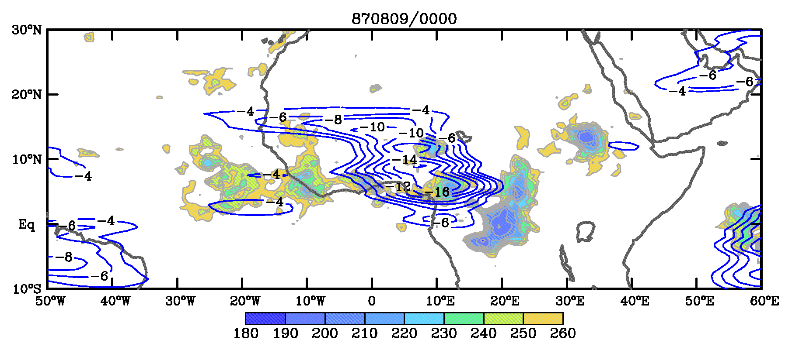
Convection (shaded T_{B} < 260K), Kelvin T_{B} (<-4K contoured)

Slide 34
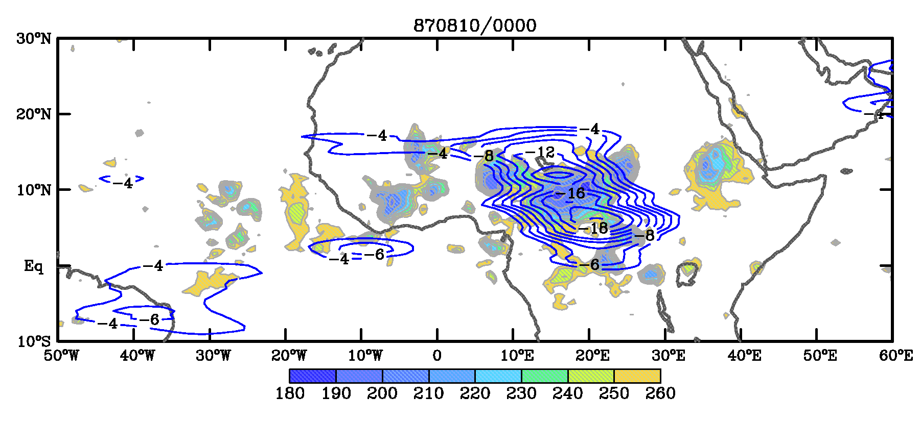
Convection (shaded T_{B} < 260K), Kelvin T_{B} (<-4K contoured)

Slide 35
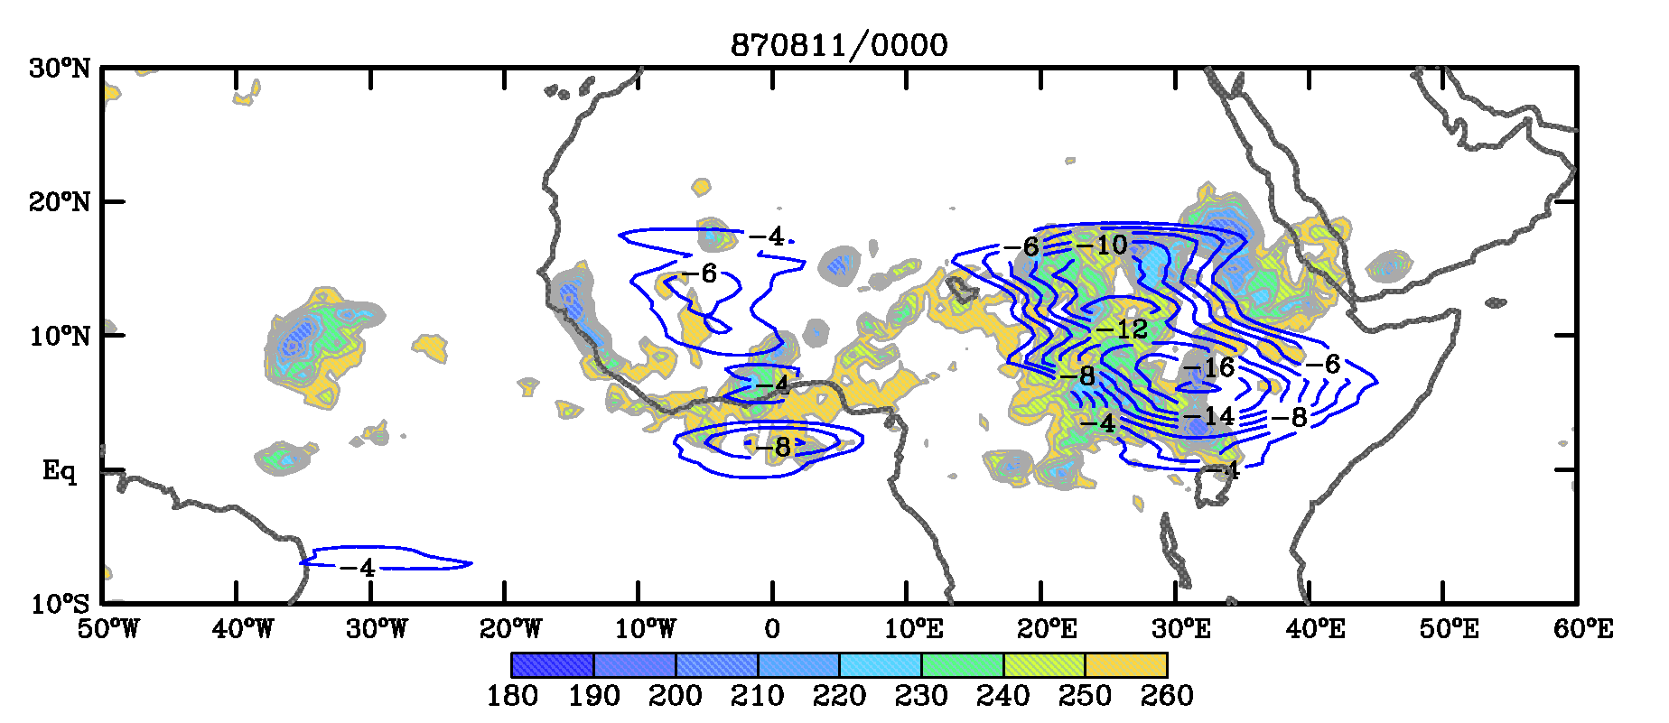
Convection (shaded T_{B} < 260K), Kelvin T_{B} (<-4K contoured)

Slide 36
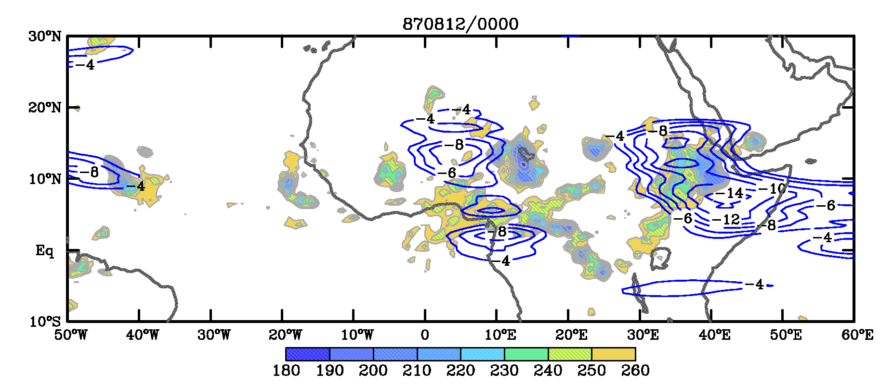
Convection (shaded T_{B} < 260K), Kelvin T_{B} (<-4K contoured)

Slide 37
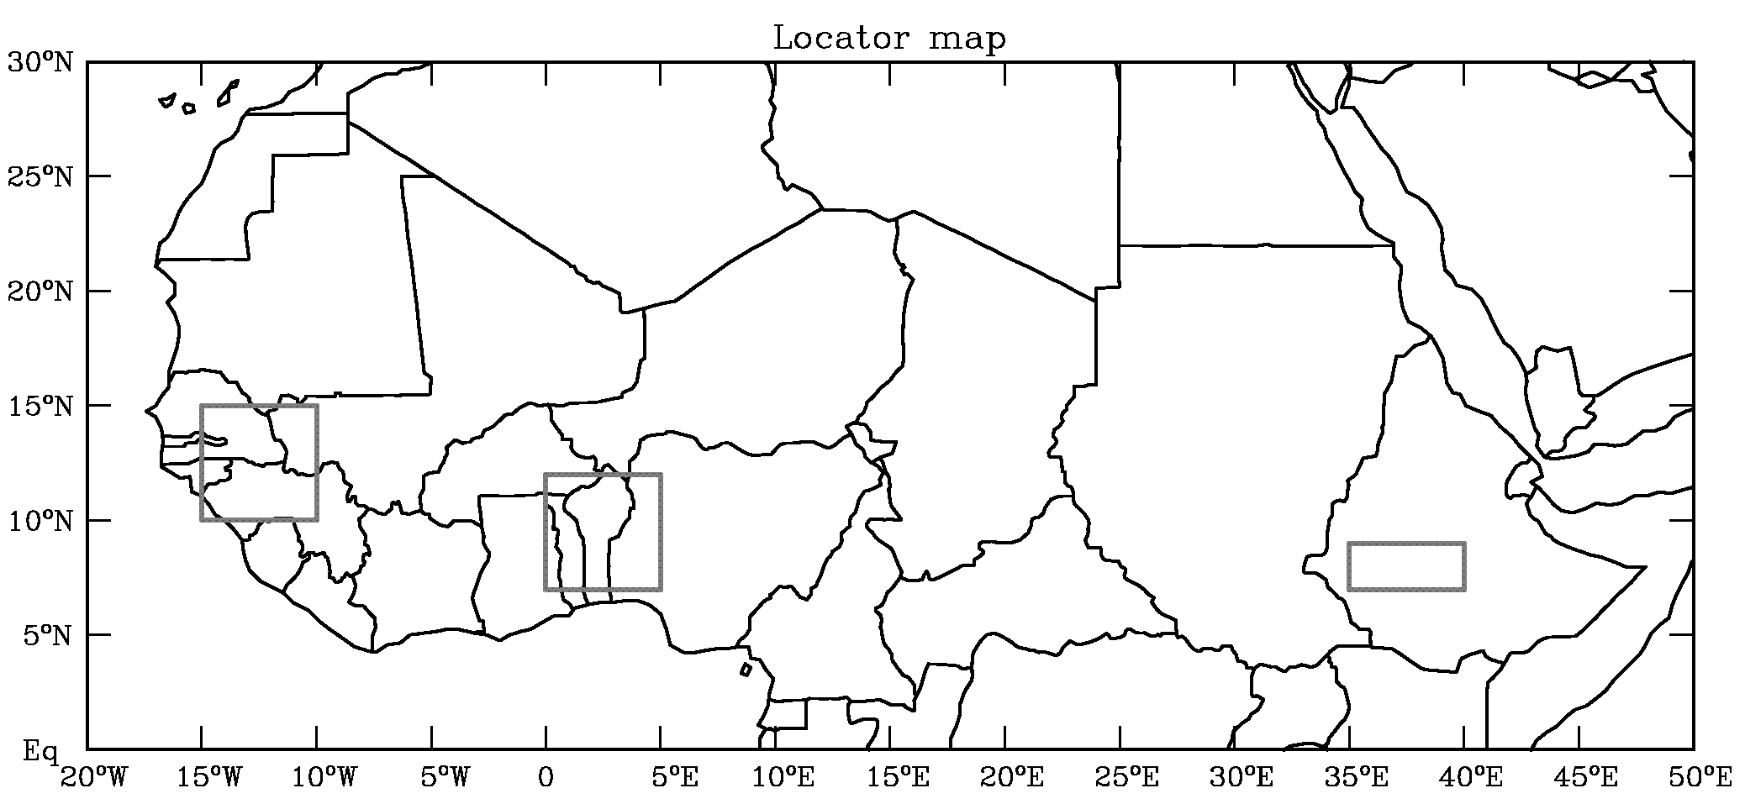
Aug. 1987
Aug.
Aug.
Aug.

Slide 38
Kelvin waves and AEWs

Slide 39
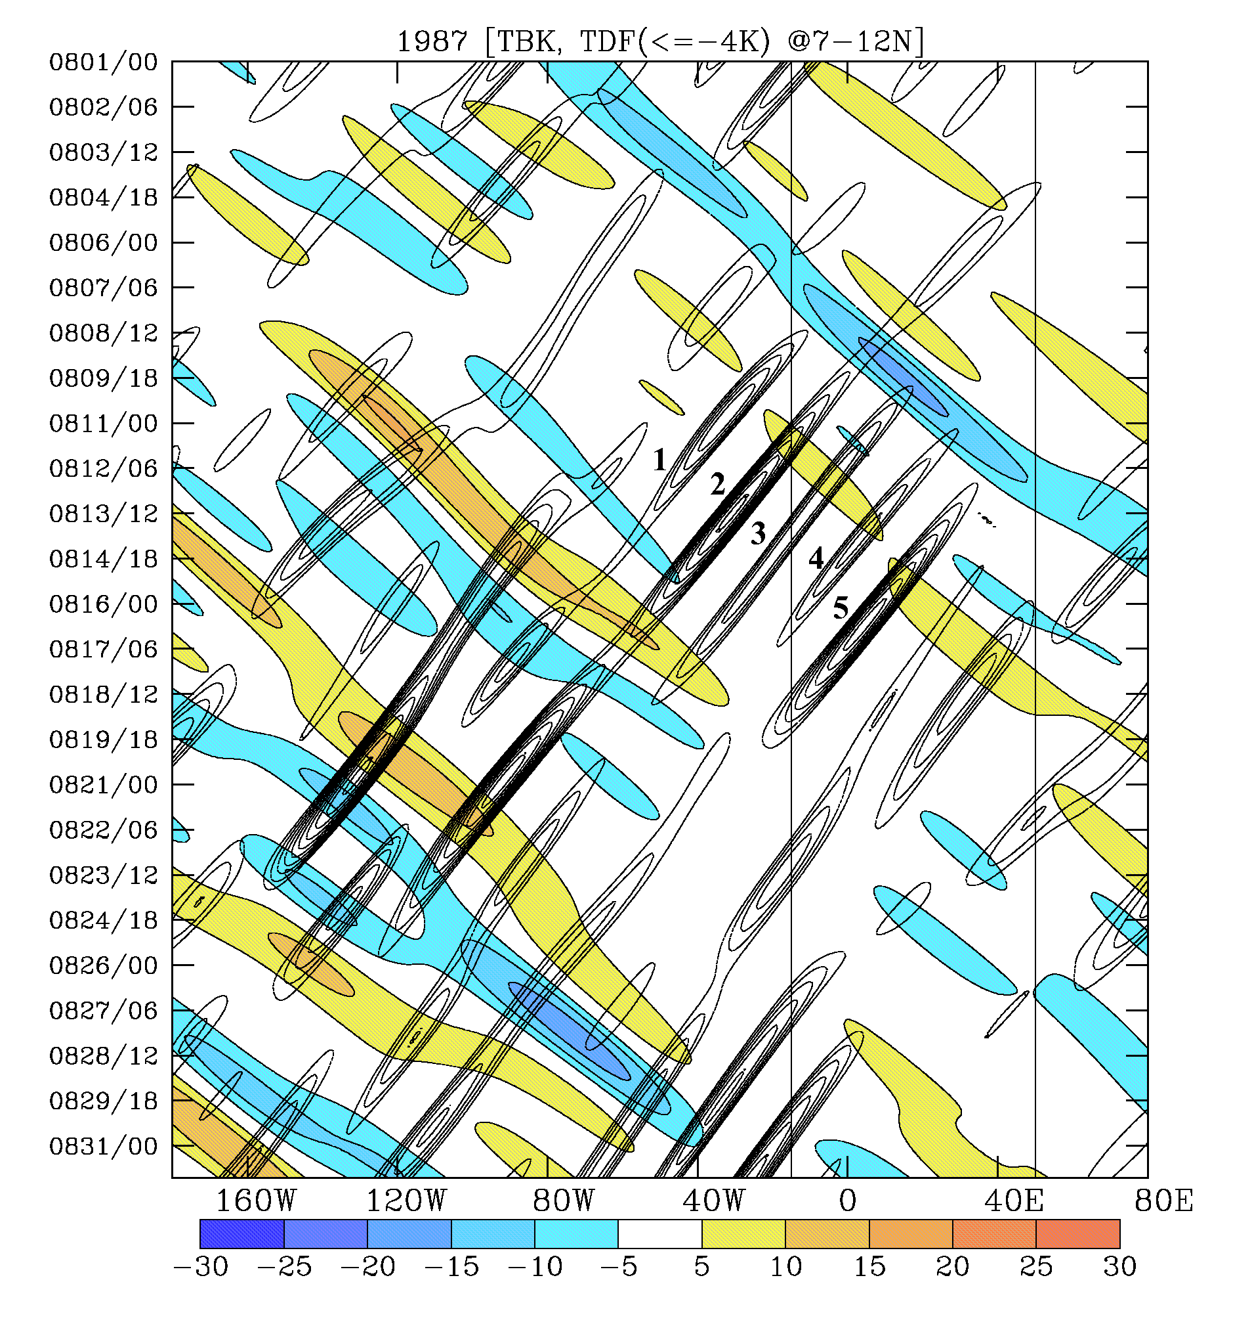
Kelvin wave (shaded), enhanced AEWs (contoured, only one phase shown).
A series of AEWs that were initiated or enhanced in association with Kelvin wave (AEWs are labeled).
AEW-4 became TS Bret, the first tropical storm of the season.

Slide 40
Weather event (July-September 1987):
A Kelvin wave that started over east Pacific reached Africa 6-7days later had a strong impact on convection
Convective activity over tropical Africa deepens and rainfall sharply increases with the approach of the Kelvin wave
Convection weakens after the Kelvin wave passed by the region
A series of AEWs were initiated over Africa in association with enhanced Kelvin wave

Slide 41
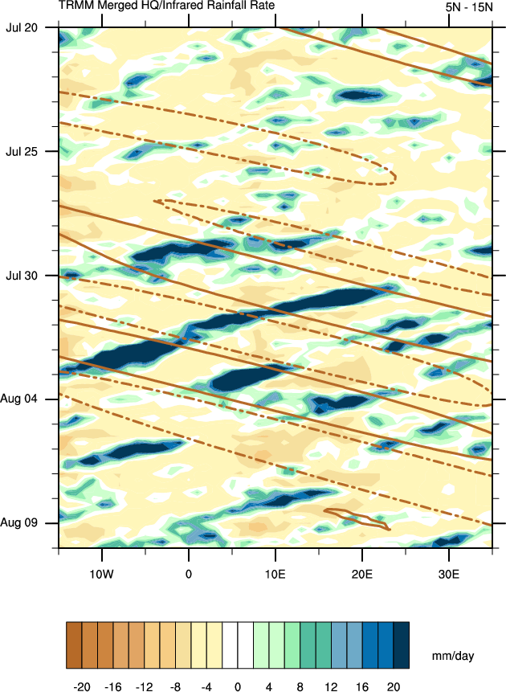
The Berry and Thorncroft (2005) AEW formed during the passage of the convectively active phase of a CCKW
A time-longitude plot of TRMM 3B42 unfiltered rain rate anomalies (shaded) during 2000 July 20-August 10. Kelvin filtered TRMM anomalies are overlaid. The +/- 2 mm/day Kelvin filtered TRMM anomaly is only contoured. Negative Kelvin filtered TRMM anomalies are dashed.

Slide 42
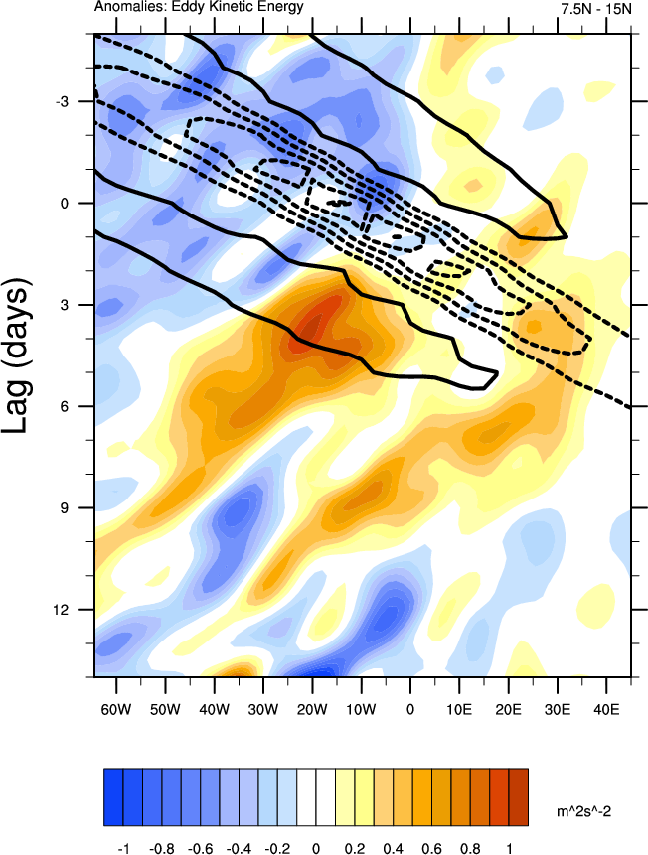
Time-longitude composite of 2-10d filtered EKE averaged over each day of the CCKW index from 7.5-15°N. Kelvin filtered OLR anomalies are contoured (dashed if negative).

Slide 43
Kelvin waves over
Central Africa

Slide 44
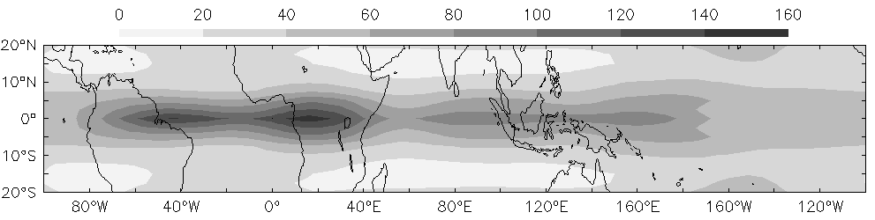
Kelvin-domain-filtered symetric OLR variance in Spring (MAM)

Slide 45
Kelvin-domain-filtered symetric OLR variance in Spring (MAM)

Slide 46
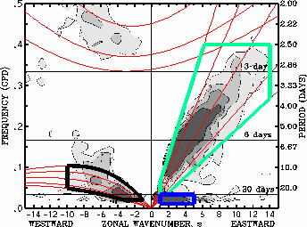
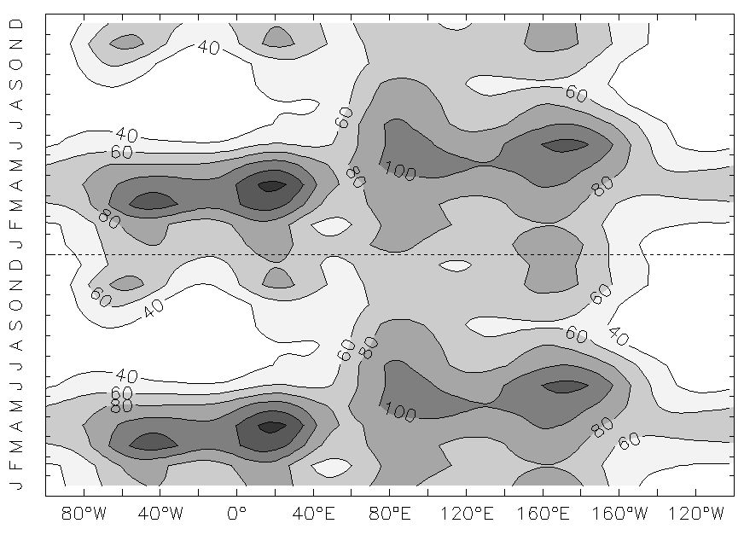
Kelvin-wave-filtered OLR variance
90
50
25
Wheeler and Kiladis 1999
The Kelvin wave domain is represented by the green polygon
12
8
(5ºS-5ºN) meridional mean Kelvin wave filtered OLR variance
Peaks from the Amazon-Atlantic (AA) in March to the Pacific ocean (PO) in June.
Strongest signal over Equatorial Africa (EA) in April
Role of the surface favoring the Kelvin wave growth.
Equatorial position of the ITCZ in spring.
AA
EA
IO
PO

Slide 47
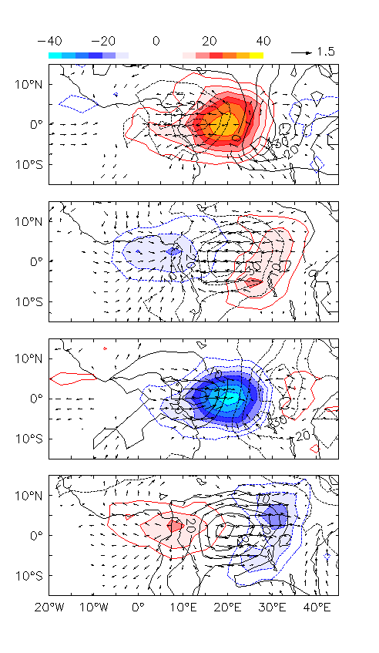
Horizontal structure
OLR (shading, W/m²)‏
Wind at 850 hPa (vector, m/s)‏
Surface Pressure (contours, Pa)
L
H
OLR and dynamical signal centered on the equator along the ITCZ.
Winds are primarily zonal.
Low pressure (convergence) and easterlies to east of lowest OLR
High pressure (divergence) and westerlies to west of lowest OLR

Slide 48
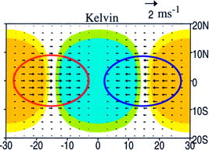
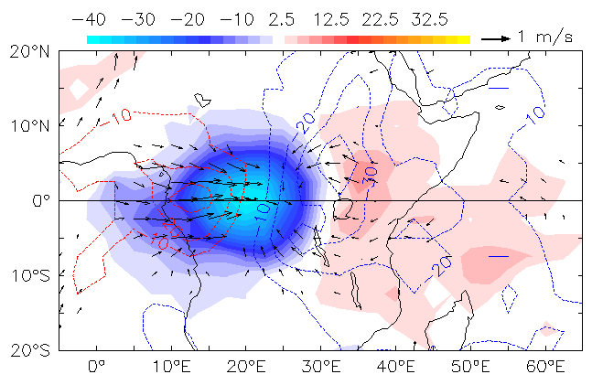
Comparison with theoretical structure
cat3
Solution of the shallow water model
Convection is close to the theoretical convergence region but shifted slightly to the west in the region of low-level westerlies
Notes:
48

Slide 49
5.3.3 Kelvin Waves and Tropical Cyclones

Slide 50
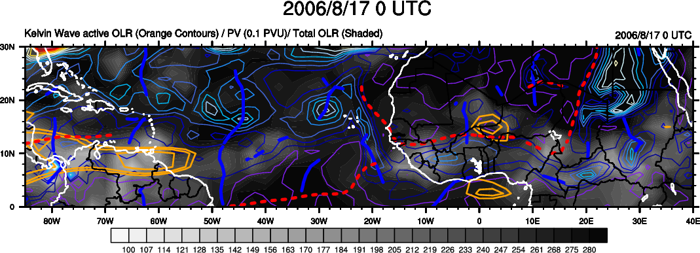
A convectively-coupled Kelvin wave associated with T.S. Debby and enhanced rainfall over tropical Africa
Total OLR – Grey Shading
Kelvin filtered active OLR – Orange Contours
650 hPa PV – Colored contours
AEJ – Red dashed lines
AEW troughs – blue solid contours
Debby – Red arrow

Slide 51
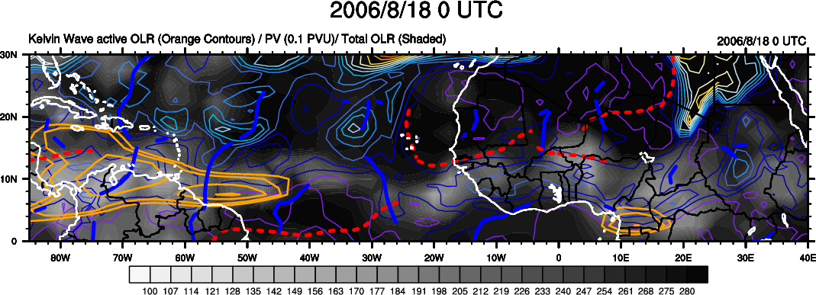
Total OLR – Grey Shading
Kelvin filtered active OLR – Orange Contours
650 hPa PV – Colored contours
AEJ – Red dashed lines
AEW troughs – blue solid contours
Debby – Red arrow

Slide 52
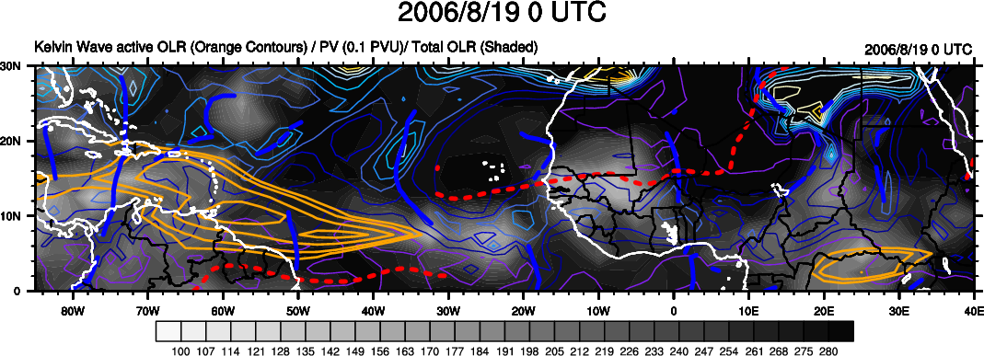
Total OLR – Grey Shading
Kelvin filtered active OLR – Orange Contours
650 hPa PV – Colored contours
AEJ – Red dashed lines
AEW troughs – blue solid contours
Debby – Red arrow

Slide 53
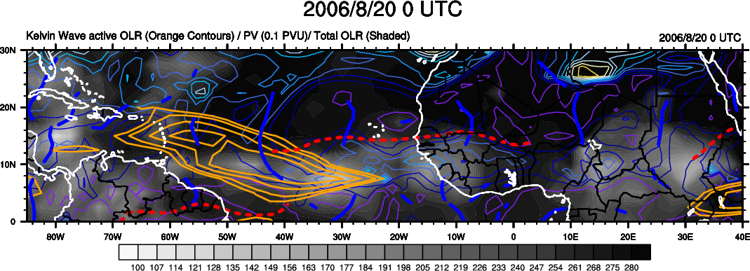
Total OLR – Grey Shading
Kelvin filtered active OLR – Orange Contours
650 hPa PV – Colored contours
AEJ – Red dashed lines
AEW troughs – blue solid contours
Debby – Red arrow

Slide 54
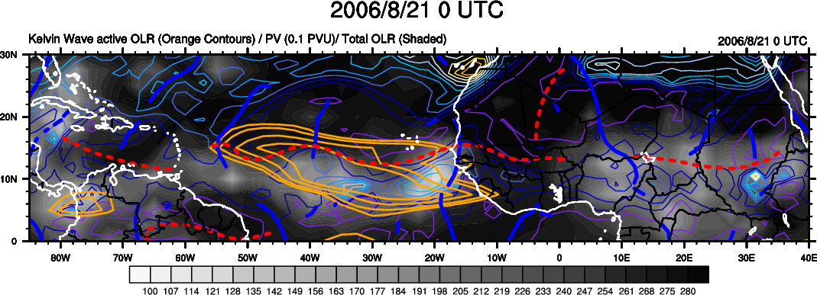
Total OLR – Grey Shading
Kelvin filtered active OLR – Orange Contours
650 hPa PV – Colored contours
AEJ – Red dashed lines
AEW troughs – blue solid contours
Debby – Red arrow

Slide 55
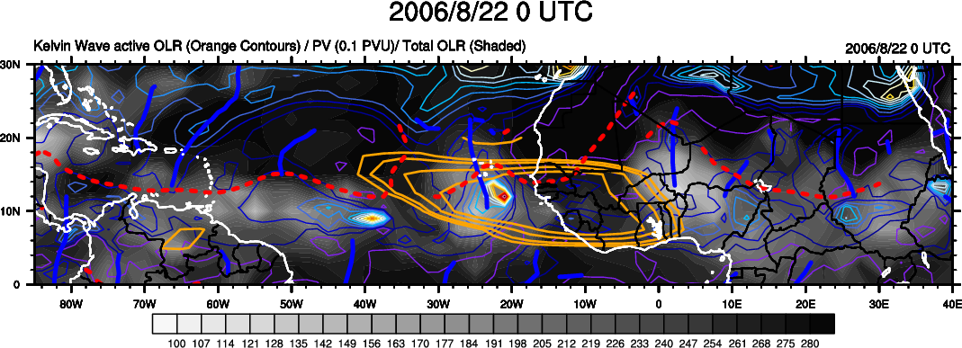
Total OLR – Grey Shading
Kelvin filtered active OLR – Orange Contours
650 hPa PV – Colored contours
AEJ – Red dashed lines
AEW troughs – blue solid contours
Debby – Red arrow

Slide 56
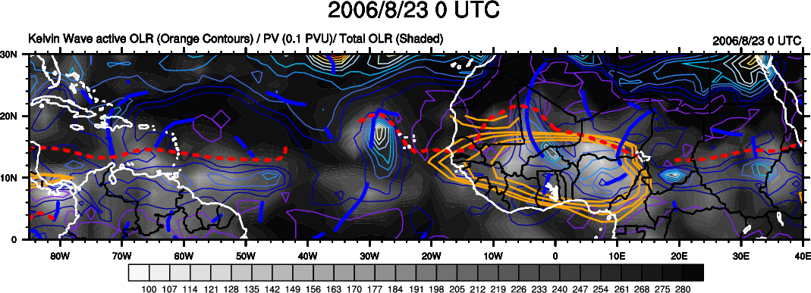
Total OLR – Grey Shading
Kelvin filtered active OLR – Orange Contours
650 hPa PV – Colored contours
AEJ – Red dashed lines
AEW troughs – blue solid contours
Debby – Red arrow

Slide 57
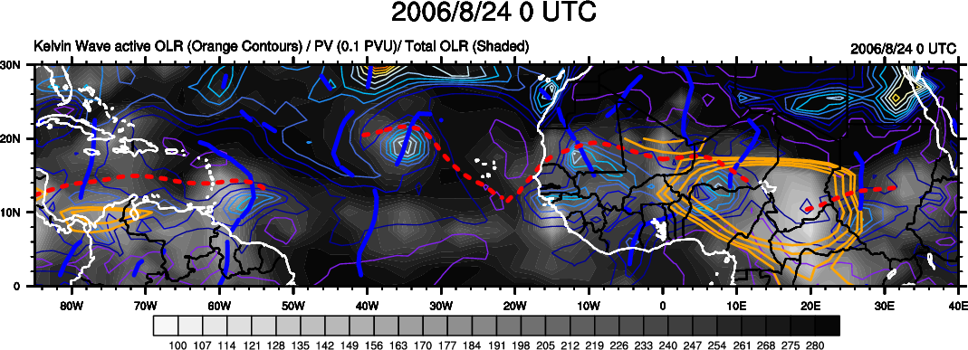
Total OLR – Grey Shading
Kelvin filtered active OLR – Orange Contours
650 hPa PV – Colored contours
AEJ – Red dashed lines
AEW troughs – blue solid contours
Debby – Red arrow

Slide 58
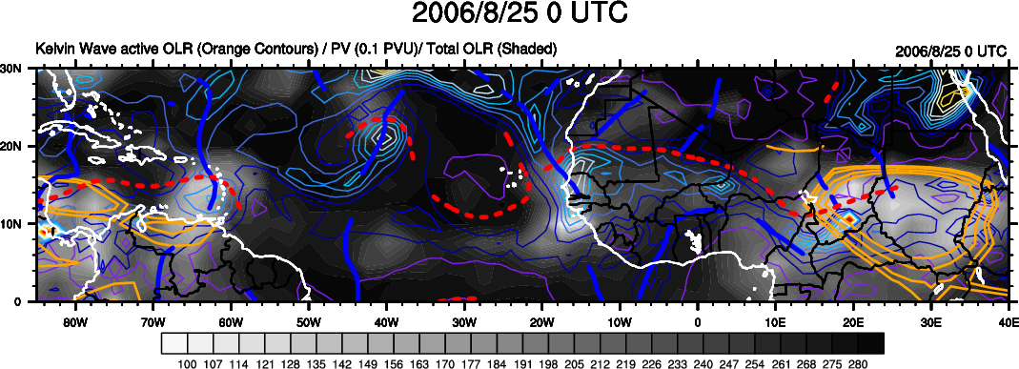
Total OLR – Grey Shading
Kelvin filtered active OLR – Orange Contours
650 hPa PV – Colored contours
AEJ – Red dashed lines
AEW troughs – blue solid contours
Debby – Red arrow

Slide 68
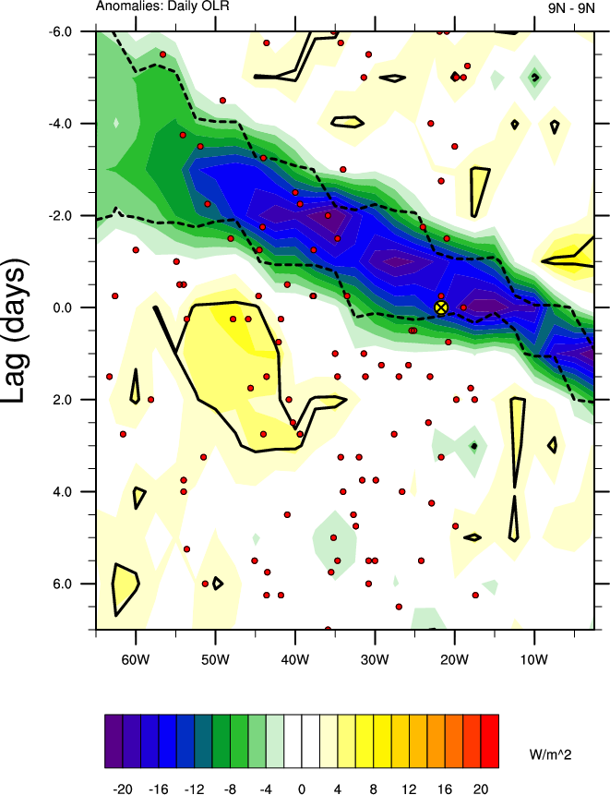
JJAS 1979-2009 Composite
Unfiltered OLR anomalies (shaded)
Positive OLR anomalies statistically
different than zero at the 95% level
are within the solid contour.
Negative OLR anomalies statistically
different than zero at the 95% level
are within dashed contour.
Tropical cyclogenesis within the MDR
(5-25°N, 15-65°W) for any given lag
is denoted by a red circle.
The genesis of Tropical Storm Debby
is highlighted by the large yellow
crossed circle.

Slide 69
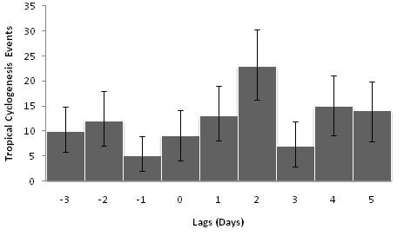
-t
t
Tropical cyclogenesis events over the MDR
(5-25°N, 15-65°W) relative to the CCKW during
June-September 1979-2009
Day 0 highlights the transition to statistically
significant negative unfiltered OLR anomalies, or the
eastern-most side of the convectively active phase of
the CCKW.
Error bars indicate the 95% confidence interval.

Slide 70
Tropical cyclogenesis
relative to the Kelvin wave
-

Slide 71
5.3.4 Kelvin Waves in other Regions!

