Slide 1
Homework 1 Solutions

Slide 2
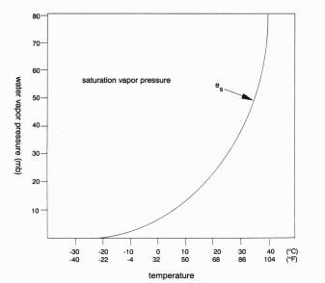
Problem One
Use Clausius-Clapeyron Curve
From 0ºC to 3ºC – Change of ~1mb
From 25ºC to 28ºC – Change of ~5mb
(8)

Slide 3
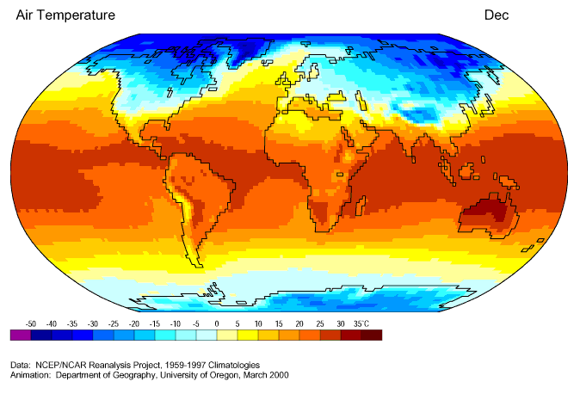
More rainfall in tropics due to higher surface temperatures (which results in higher SVP)
(2)

Slide 4
Problem 2
Heat Capacity of Ocean > Heat Capacity of Land
  Therefore land heats up and cools down faster than the ocean
(4)
Monsoon Regions
Summer
Winter
(6)
H
L
L
H
Land
Land
Ocean
Ocean
Cool
Warm
Warm
Cool

Slide 5
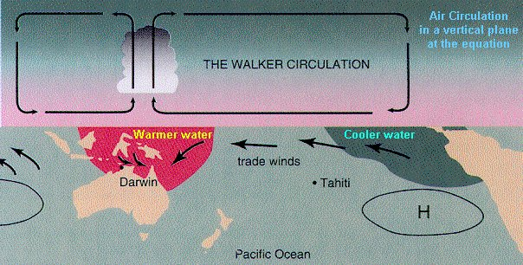
Problem 3
SSTs generally warm from east to west
Results in
        More Precipitation where SSTs are higher (more moisture due to C-C equation) (3)
        Warmer boundary layer over warmer SSTs
        Surface pressure lower over higher SSTs (3)
        Large scale vertical circulation produced (Walker Cell) (4)
(10)

Slide 6
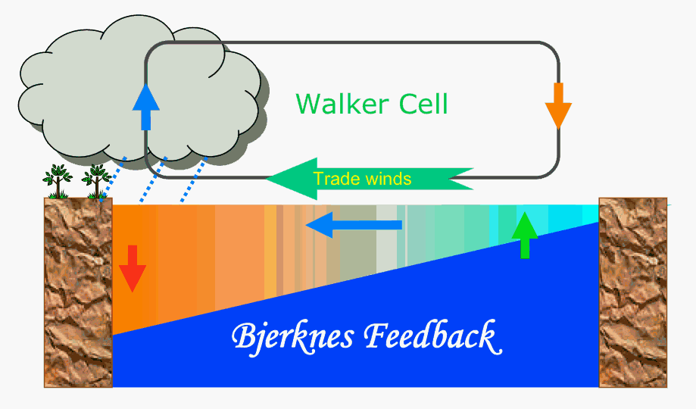
Thermocline deepens from east to west
Thermocline differences due:
        Easterly trade winds
          Promote upwelling in east (cooler SSTs) (2)
          Winds pile up warm water in the west (2)
          SST Contrasts related to thermocline depth contrasts (2)
(6)

Slide 7
Problem 4
Weather – short term variations in the atmospheric circulation (2)
Climate – average weather conditions in a region taken over a long period of time (usually 30 years) (2)

Slide 8
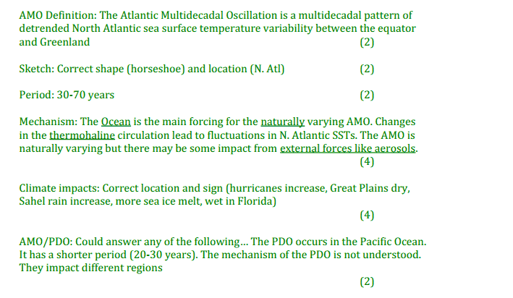
Problem 5

Slide 9
Problem 6
Timescale differ days vs. 10-30 years vs. 100 years (1)
Type of predictability… initial conditions (weather) vs. boundary conditions (climate) vs. both (decadal) (3)

