Slide 1
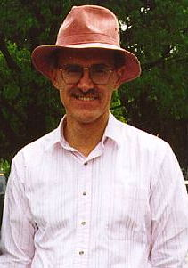
The Russell L. DeSouza Award
Collaboration and Cooperation
Or
The Importance of Community Service to Unidata
David Knight
4/1/2012

Slide 2
I’ve been asked to talk briefly about:
My involvement with Unidata.
Distribution of NLDN data.
How we use Unidata data and software.

Slide 3
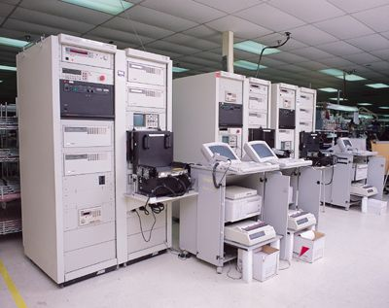
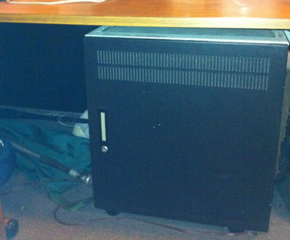
First a Little History
Before there were desktop, or laptop, computers there were “mainframe” and “desk” computers.

Slide 4
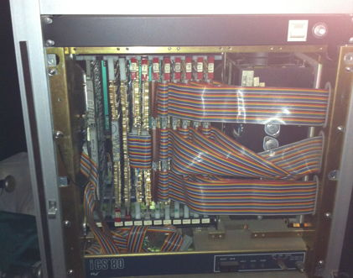
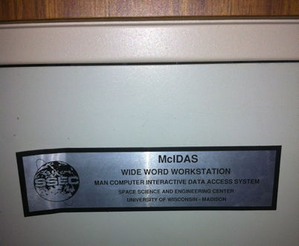
One of these “desk” computers was a McIDAS (Man computer Interactive Data Access System) from Univ. Wisconsin

Slide 5
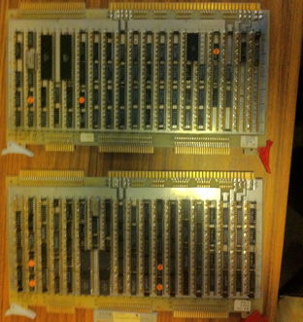
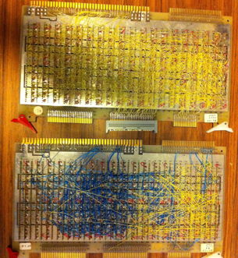
These took awhile to create

Slide 6
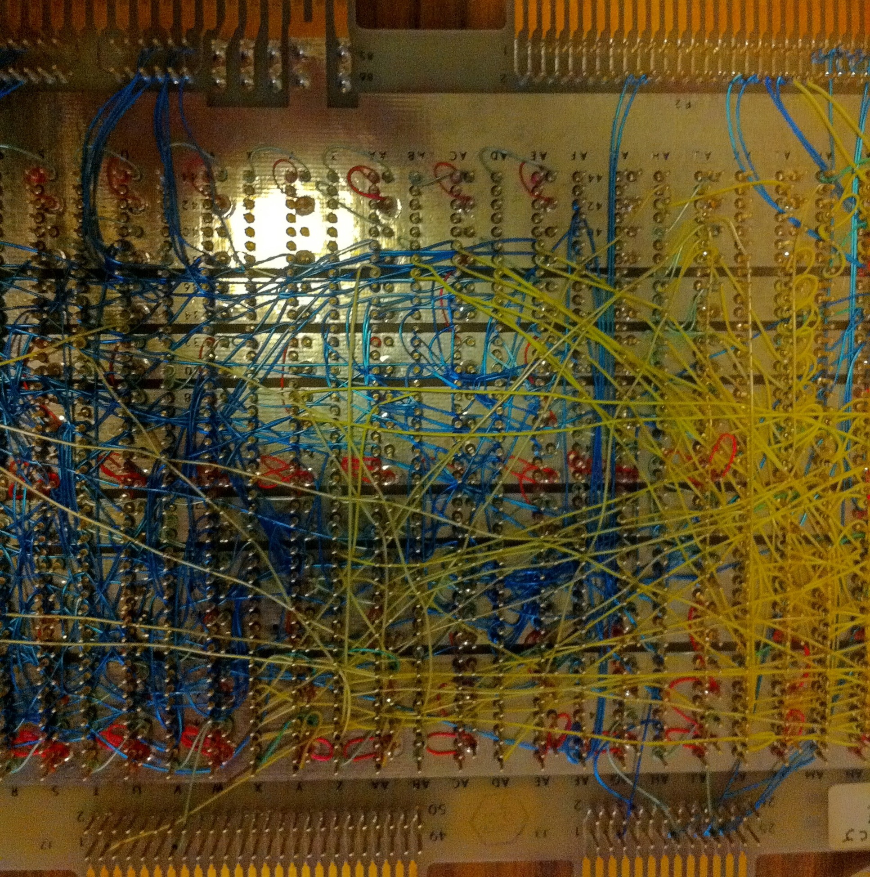

Slide 7
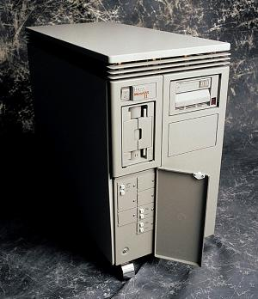
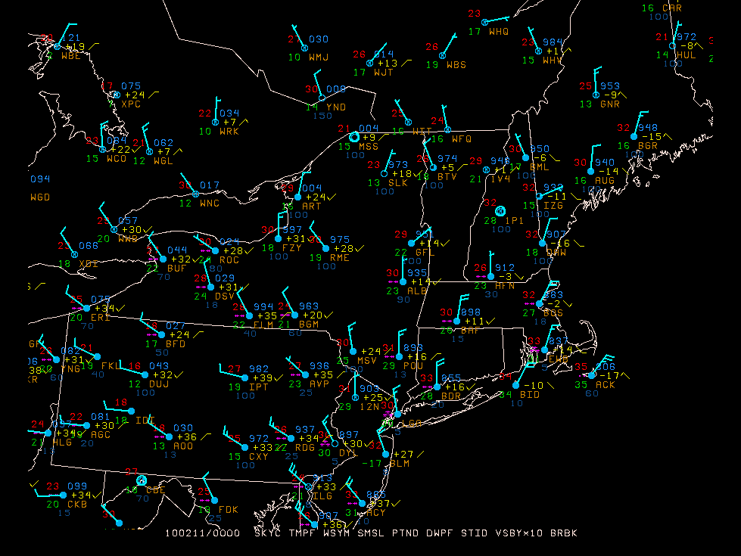
At about the same time, NASA released GEMPAK, (GEneral Meteorology PAcKage)
Gempak had the advantage of running on commercially available Digital VAX (Virtual Address eXtension) systems

Slide 8
Data was delivered via Satellite dish and/or dedicated land line.
Many Universities were trying to create their own version of computer aided data analysis software.
This resulted in a lot of duplicative effort.
Not everybody could participate because the cost was high.
Clearly this was not sustainable.

Slide 9
Fortunately this was realized and steps were taken.
In the early 1980’s a group consisting of people from UWisc, CSU, Purdue, Utah, UWash, UAlbany (then SUNYA) NSF, UCAR, and others, gathered to discus the situation and solution.
In 1983 Unidata was formed.
By combining University and Data, they cleverly came up with the name UniData.

Slide 10
Or maybe other words were used.
United Data.
Universal Data.
Or perhaps it was just made up – somebody knows, but not me.
The important point is that Unidata was created through Collaboration and Cooperation.

Slide 11
Good decisions were made
Housed under the existing UCAR umbrella.
Supported directly by NSF.
No membership fees.
Shared Community based governance.
Policy, Users, and Adhoc.

Slide 12
Unidata is a Community based on Collaboration and Cooperation
You already know that, which why you are here.
Without your efforts, and the efforts of many others, Unidata would not be possible. Thank You.
Which brings me to why I am here today.

Slide 13
I’m proud to have been nominated for the Russell L. DeSouza Award.
Honors individuals whose energy, expertise, and active involvement enable the Unidata Program to better serve geoscience. Honorees personify Unidata's ideal of a community that shares data, software, and ideas through computing and networking technologies.
An honor indeed!

Slide 14
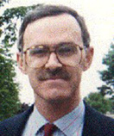
I’m not sure when UAlbany started using Unidata software and data. I got there in 1988 and I think we were using it then.
I served on the Unidata Users Committee 1993-1997.
This is where I first met Russ DeSouza, who was the Policy Committee liaison to the UserComm.
Millersville managing the McIdas Educational floater.

Slide 15
I served on the Unidata Policy committee from 1998-2001.
Unlike some committees the Unidata governing committees are actually listened to.
Committees are an important part of cooperation and collaboration in the Unidata community.
People don’t mind working hard when their work is valued. Community service is more fun when the community cares.

Slide 16
NLDN Data
In the early 1990’s NLDN network left SUNYA.
Around 1994 Ron Henderson had the idea to try and make NLDN data available to the Unidata community.
A 1 year formal agreement was reached.
By 1995, with the help of Unidata staff, data was flowing and decoders were ready.
When Ron left SUNYA, I took over the NLDN feed. It was too important to the community to abandon!

Slide 17
NLDN Data (cont.)
The company was sold several times.
Y2k - Sandy Whitesel - Unidata.
Saying no.
Vaisalla – Scott Sternberg - Tom Yoksas – Unidata.
Cooperation, Collaboration, Community service.

Slide 18
Unidata data, software and tools.
Used extensively at both undergraduate and graduate level.
For both research and education.
Web graphics.
Normally I would show many examples.
LDM - NetCDF
Cooperation, Collaboration, Community service.

Slide 19
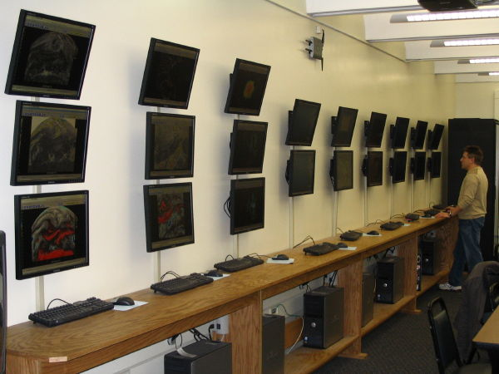
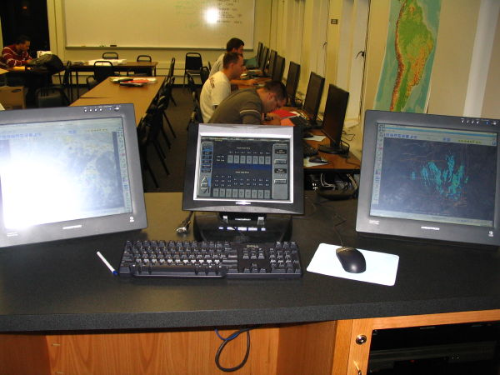
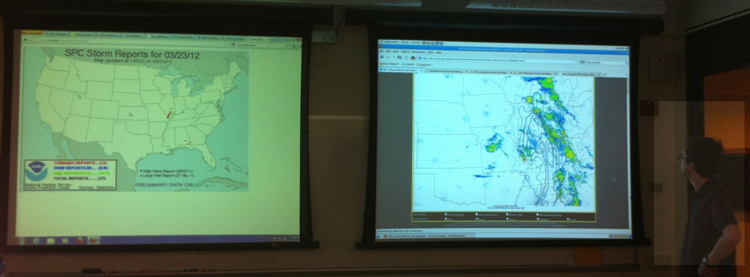
Unidata Software for “map” discussions
Send discussion summary to “map” mail list (~ 300 members)

Slide 20
Discuss
Thanks again for selecting me to receive the
Russell L. DeSouza Award.

Slide 21
Collaboration, Cooperation and Community service.

Slide 22
Intentionally left blank

