Slide 1
Graduate Student Finance Seminar
Melissa Piper
September 7, 2022
Based off Matt Vaughan’s previous presentations

Slide 2


Today’s Presentation…
Is
  Information on stipends, taxes, and residency
  An introduction to personal finance including:
    Credit cards, budgeting
  A conversation starter
Is NOT
  Professional advice
  100% satisfaction guaranteed
  The only way to be financially literate

Slide 3


Roadmap
Stipends
Residency
Credit Cards
Budgeting
Investing
*Not being presented

Slide 4

Stipends
2022-2023 stipend amounts:
  No M.S. -> $28,500
  Entered with M.S./passed written exam -> $30,000
  Passed Ph.D. prospectus exam -> $31,500

Slide 5
Stipends
2022-2023 stipend amounts:
  No M.S. -> $28,500
  Entered with M.S./passed written exam -> $30,000
  Passed Ph.D. prospectus exam -> $31,500
Paycheck amounts vary between the academic year and the summer, especially if you are a TA
  FICA taxes apply during the summer (SS, Medicare) – about $90/paycheck for me in 2022

Slide 6
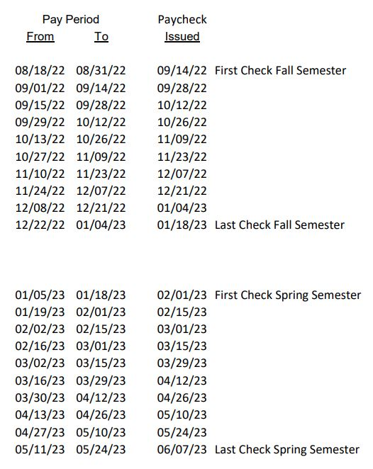

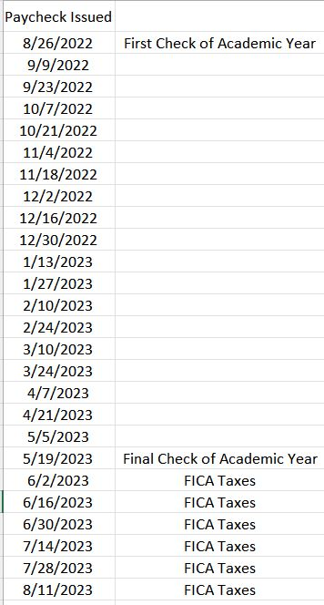
TA Pay
Academic Year
  Funded through the state
  Payment every 2 weeks
    Note the delay in payment dates
  Final payment aligns with start of summer RF pay
Summer
  Funded through the RF
  Payment is higher than academic year (but overall total is the same as RAs)
  ~ 3-week gap between final summer payment and first academic year payment
  Will need to fill out a monthly time sheet

Slide 7
RA Pay
Academic Year
  Funded through the RF
  Payment every other Friday
  Submit monthly time sheets
Summer
  FICA taxes (was roughly $90/paycheck in 2022)
  Payment every other Friday
  Submit monthly time sheets

Slide 8
Links
RF Calendars: https://www.albany.edu/rfhr/calendars.php
TA Pay Schedule: https://www.albany.edu/hr/assets/GA-TA_and_PT_lecturer_PaySchedule.pdf
View TA Paychecks/W-2: https://www.albany.edu/hr/view-pay.php
View RA Paychecks/W-2/submit time sheets: https://www.rfsuny.org/Information-For/Employee-Center-/Self-Service/

Slide 9

Benefits
Eligible for health/dental/vision insurance through the GSEU agreement
  ** plans are slightly different between TA/RAs
  ~$22 per paycheck
  GREAT coverage (trust me, I’ve used it a BUNCH the past year… 😬)
  Can be combined with your parent’s insurance if you are still on it
    This would be your primary insurance; your parents would be your secondary
RAs: sign up through SUNY RF self service
TAs: sign up through instructions in the benefit email sent on August 22
I’m happy to discuss this more after the seminar!

Slide 10

NYS Residency
Yes, we’ve mentioned it a bunch, but it is INCREDIBLY important that you start preparing if you haven’t already
If you are not from New York, you must apply for NYS residency for tuition purposes before the start of your second year
You must start establishing the required documents that are submitted with the application now
https://livealbany.sharepoint.com/:b:/s/web_cost_and_aid/EQ5nYEAn375LjjTf1cux4E8BfcDCRdXcA2SZ4WO4CBjwKg?e=f92Ses

Slide 11
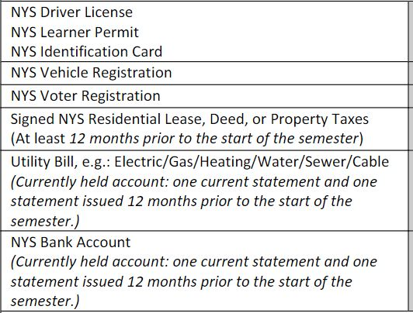
NYS Residency
You must provide at least 3 of these documents to demonstrate that you have lived in New York for at least 12 consecutive months (August 2022 – August 2023)
  Make your DMV appointment now!! You can register to vote while your get your NYS driver license
It’s better to provide as many of these as possible

Slide 12
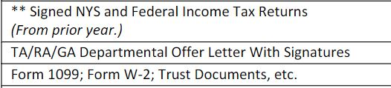
NYS Residency
You must provide at least 1 of these documents to demonstrate that you are financially independent
  When you do your 2022 taxes next spring, put that you are an independent
It’s better to provide as many of these as possible

Slide 13

So, you’re getting paid now. How are you going to spend that money?
Credit Cards

Slide 14
Why is this important?
If you ever attempt to buy a house, a car, apply for a loan, etc., your credit score is used to determine your “credit worthiness” or if you are worth the risk of receiving loans for large purchases.
It may not seem important now but establishing and maintaining a good credit score will make it a lot easier to get approved for various types of loans with good interest rates.
Additionally, being aware of debt/credit and developing responsible habits now can help save you from trouble in the future.

Slide 15
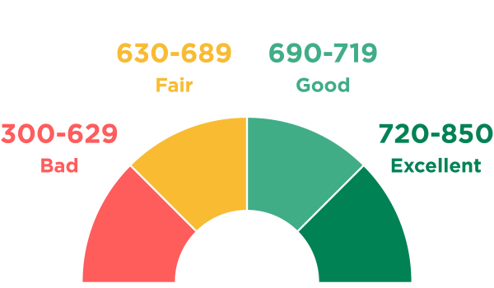
Credit Score
“A number between 300-850 that depicts a consumer’s creditworthiness”
Based on your credit history:
  Repayment history, types of loans, length of credit history, credit utilization, & total debt
Used by lenders and credit card issuers to help them decide whether to approve your credit application
  Higher score = better chance to get approved AND better loan terms
  Lower score may come with higher interest rates, higher payments, require a co-signer, or even be denied a loan or tenant application
Your credit report is a record of your credit history and contains your credit score
  3 major credit bureaus -> Equifax, Experian, & TransUnion

Slide 16

Credit Score
There are 2 scoring models with multiple versions: FICO and VantageScore
  Your credit score may vary depending on the model and version used
You can get a free copy of your credit report once a year from each of the 3 main credit bureaus through AnnualCreditReport.com
Other websites (like Credit Karma) or your credit card issuer can show an estimate of your credit score
  The actual score used by lenders is directly from each of the 3 main credit bureaus
  Helpful for estimating your score when deciding whether you should apply for something that will do a hard credit pull (affects your credit score)

Slide 17

Building Your Credit Score
Pay all your bills, not just credit cards, on time
Use no more than 30% of your credit limit on any card
Keep accounts open and active when possible
Avoid opening too many new accounts at once
Monitor your credit score for errors
*It is possible to have zero credit history – a good place to start with establishing credit is a secured credit card

Slide 18

How Do Credit Cards Work?
Essentially your own personal monthly loan
You’re given ~1 month to pay off what you buy before interest starts accruing
You can spend up to your credit limit until you must pay off some of the balance
Helps improve your credit score if used responsibly
Credit cards can be a very slippery slope to debt if you aren’t careful, but they can also have a lot of benefits

Slide 19
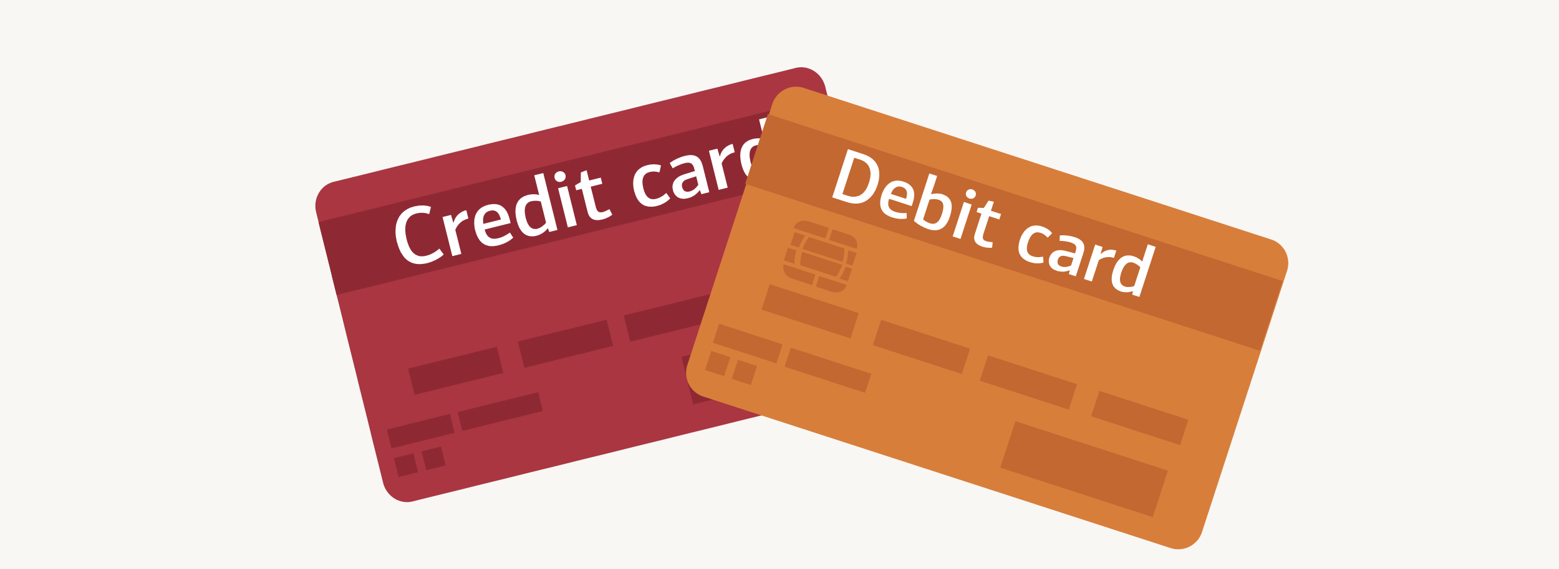
Credit vs Debit Cards
Credit Cards
Debit Cards
Safer
  Bank account remains intact if card is stolen/lost
Affects credit history/score
  Aids in getting approved for other types of credit
  Higher credit score helps you get lower interest rates on mortgages, auto loans, etc.
Rewards
  Far more lucrative than debit cards
Through your bank
Attached to your checking account
Money immediately removed from your account

Slide 20
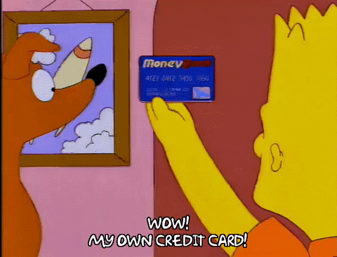
Credit Card Best Practices
PAY IT OFF EVERY MONTH!
  Often have double digit interest rates
  “Minimum” payment is never the least expensive
If you’ve never had a credit card, try starting with a secured card or a student card
  Usually have lower credit limits, but very useful for developing your credit score
Try to keep total credit utilization below 30%
  Helps your credit score
Avoid cards with annual fees
  Some exceptions apply, but do your homework. Typically need to be in a higher spending bracket to make these worth it.
Don’t spend more than you have, and don’t forget about what you have spent

Slide 21

Melissa’s Wallet
Chase Debit Card (rarely used)
Capital One Platinum (originally a secured card) – since April 2018, limit $500
Discover IT Student – since August 2020, limit $3,600
  Cashback rewards: 5% rotating categories, 1% all other purchases, cashback match for first year
CareCredit – since October 2020, limit $2,100
  Only valid at participating medical offices, offers varying amounts of months to make interest free payments
Chase Freedom Flex – since February 2021, limit $6,800
  Cashback rewards: 5% rotating categories, 3% at restaurants, 3% at drugstores, 1% all other purchases
Citi Custom Cash – since February 2022, limit $3,500
  Cashback rewards: 5% on highest spending category, 1% all other purchases
Chase Freedom Unlimited – since May 2022, limit $5,400
  Cashback rewards: 3% at restaurants, 3% at drugstores, 1.5% all other purchases

Slide 22
Melissa’s Wallet
Chase Debit Card (rarely used)
Capital One Platinum (originally a secured card) – since April 2018, limit $500
Discover IT Student – since August 2020, limit $3,600
  Cashback rewards: 5% rotating categories, 1% all other purchases
CareCredit – since October 2020, limit $2,100
  Only valid at participating medical offices, offers varying amounts of months to make interest free payments
Chase Freedom Flex – since February 2021, limit $6,800
  Cashback rewards: 5% rotating categories, 3% at restaurants, 3% at drugstores, 1% all other purchases
Citi Custom Cash – since February 2022, limit $3,500
  Cashback rewards: 5% on highest spending category, 1% all other purchases
Chase Freedom Unlimited – since May 2022, limit $5,400
  Cashback rewards: 3% at restaurants, 3% at drugstores, 1.5% all other purchases
Use for 5% category (currently restaurants)
Use for 5% category (currently gas stations)
Use for groceries
Use for everything else

Slide 23

My Advice
Make a habit of reviewing your bank/credit card accounts to check for errors, fraud, and to be aware of your balances
Don’t let anyone you don’t trust have access to your accounts
If your credit card has an app – download it to your phone
Do sufficient research on a bank/credit card company before opening an account with them
  Some have a history of sketchy practices and behaviors

Slide 24
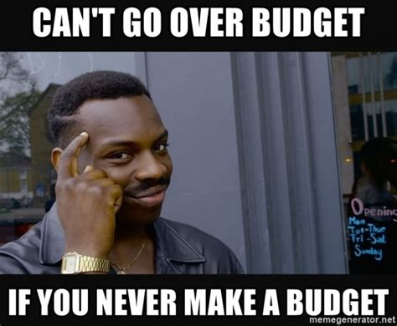
Okay, so you have money and a way to spend it – How do you avoid spending it all?!
Budgeting

Slide 25

Why do you need a budget?
Gives you control over your money
Helps you focus on your financial goals
Keeps you on top of what you’re spending
Makes it easier to stay aware of your savings and debts
Helps you save for unexpected costs
Show you where money issues are likely to come from
Can help lower your financial stress

Slide 26

Budgeting
There’s no “one size fits all” way to budget
  Can be as simple or complex as you want it to be
Make your budget work for you
  Just because one method of budgeting works for others doesn’t mean it has to work for you
Budgeting doesn’t have to be stressful or overwhelming
  Ideally, it should help you feel better about your purchases and money habits
At the bare minimum, your budget should tell you how much money you can spend while still having money for mandatory spending (rent, food, utilities, etc.)

Slide 27

Tips to get started
Calculate your monthly income
Calculate your total monthly mandatory spending
  How much is rent?
  Average monthly utility bill?
  Car payment? Cell phone payment?
  Average monthly grocery bill?
Take what is left after mandatory spending and decide how much you want to put in your savings/emergency fund each month
What’s left is what you can spend each month and still be able to pay your mandatory expenses

Slide 28
Melissa’s Budget
Made in google sheets
Every cent of each paycheck is allocated to a different category (rent, utilities, wifi, spotify, prescriptions, phone payment, car payment, furniture payment, food, savings, other)
Allocation amounts are determined by:
  Determine how much money each category needs per month (ex: rent category = $1245, wifi category = $40)
  Calculate how much money each category needs annually, then divide that by the number of paychecks each year to get amount per paycheck (ex: rent category = ($1245*12)/26 = $574.62 per paycheck)
  Whatever is left per paycheck goes to savings and other categories
Every purchase I make is inputted into the budget and subtracted from the total amount allocated from that category

Slide 29
Melissa’s Budget
Made in google sheets
Every cent of each paycheck is allocated to a different category (rent, utilities, wifi, spotify, prescriptions, phone payment, car payment, furniture payment, food, savings, other)
Allocation amounts are determined by:
  Determine how much money each category needs per month (ex: rent category = $1245, wifi category = $40)
  Calculate how much money each category needs annually, then divide that by the number of paychecks each year to get amount per paycheck (ex: rent category = ($1245*12)/26 = $574.62 per paycheck)
  Whatever is left per paycheck goes to savings and other categories
Every purchase I make is inputted into the budget and subtracted from the total amount allocated from that category
Remember, what works for me might not work for you!

Slide 30
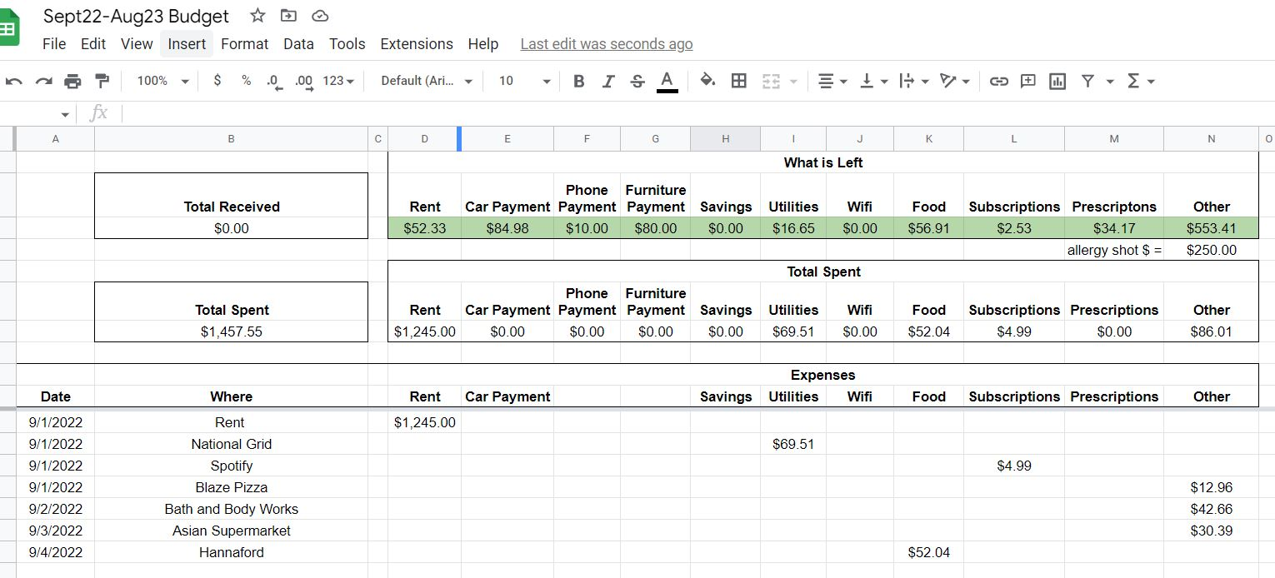
Melissa’s Budget – Expenses Sheet
Calculate how much is left in each category by subtracting expenses from total amount that has been allocated
Enter the date and where the purchase was for easy record keeping
Enter amount spent in the column that corresponds to the category it was spent from here

Slide 31

Budgeting
Remember, what works for me may not work for you!
  It may take some trial and error to figure out the method that works best for you
It is possible to over-budget – be flexible and kind to yourself!
Always make sure you have the money to pay for your basic needs (rent, food, utilities, medical)
There are many online tools and guides describing budgeting methods
  Envelope method, Mint, Personal Capital, You Need a Budget, etc

Slide 32

General Themes to Take Away
Remember the “big picture”
  Keep in mind the monthly/annual expenses
  Be aware of when you get your paychecks, especially as a TA
Understand what is a luxury and what is a necessity (or “close” necessity)
  Necessity: rent, food, utilities, car payment, medical, etc.
Money is a tool, make it work for you
  I’m not here to tell you what to spend your money on
  The same budgeting/financial habits don’t work for everyone
  Start building good credit now, future you will thank you!

Slide 33
Questions?
Feel free to contact me with questions or to further discuss finances: mpiper@albany.edu
ETEC 424G

Slide 34
Old Stock market/Investing slides
From Matt Vaughn, last updated Fall 2020

Slide 35

The stock market and you
That thing you hear about on TV

Slide 36
Why should you invest
Grow wealth through stocks and high-yield bonds
Provide income during retirement through lower-risk investments
Protect wealth from inflation

Slide 37
Ok, but why invest NOW?
Compound interest
You can’t take out a loan for retirement
Retirement numbers are large
  A $80–90k salary in retirement demands a sum of ~$2.2 million using 4% rule
  You could try saving $30k annually at age 25 in a savings account averaging 2% for 45 years
    IMPORTANT: This doesn’t account for inflation (i.e. you need to save more)

Slide 38
Ok, but why invest NOW?
Most importantly…People are demonstrably bad at saving for retirement

Slide 39
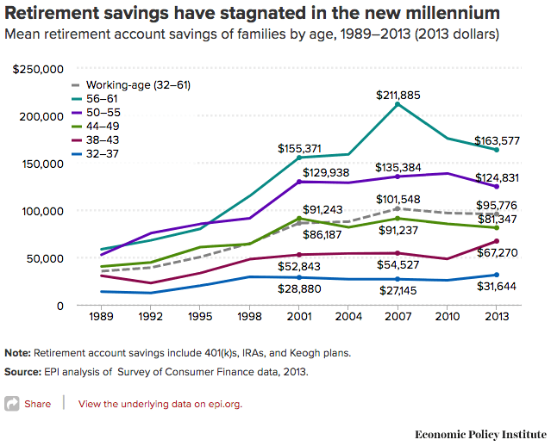
Ok, but why invest NOW?
Most importantly…People are demonstrably bad at saving for retirement

Slide 40
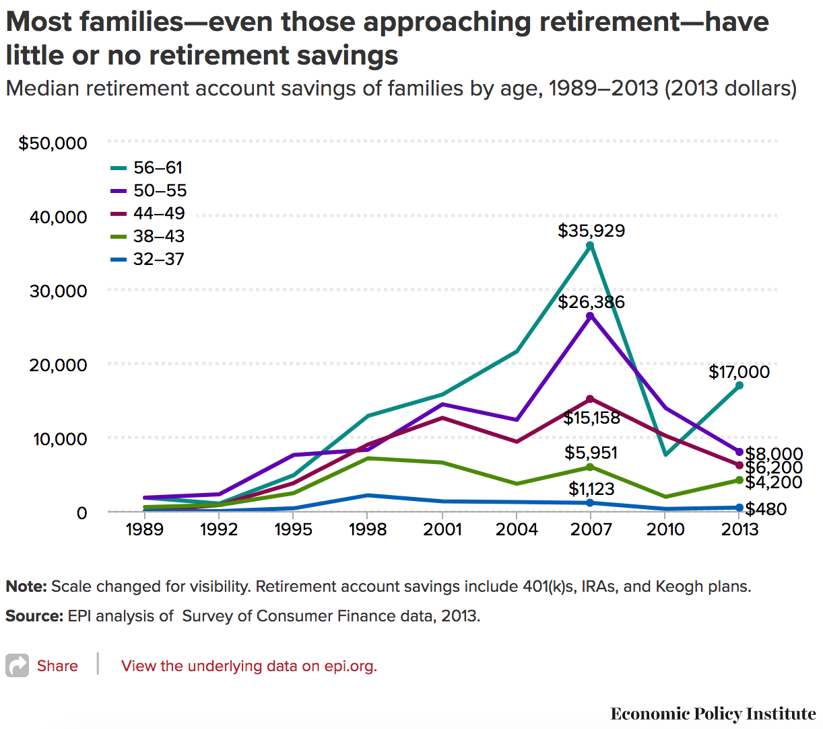
Ok, but why invest NOW?
Most importantly…People are demonstrably bad at saving for retirement

Slide 41
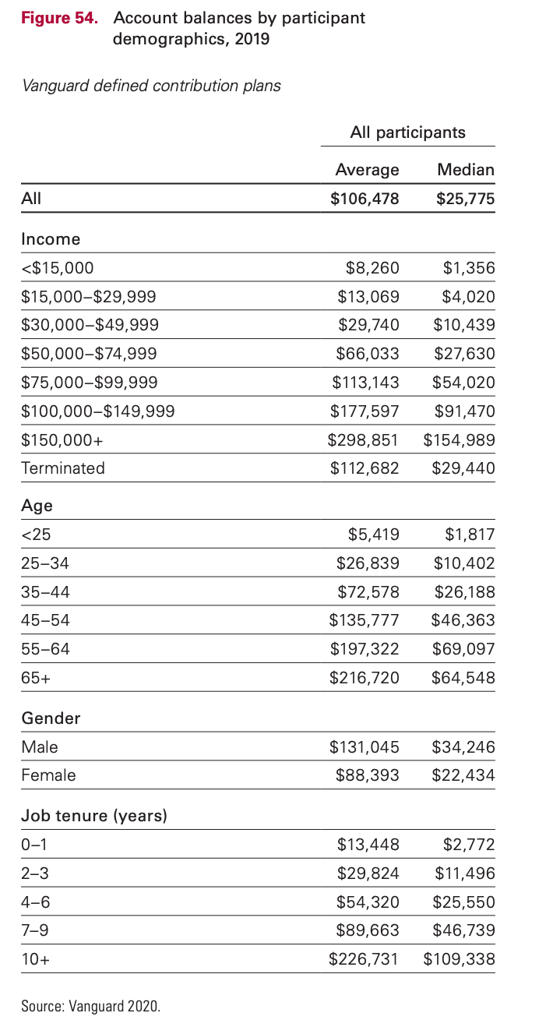
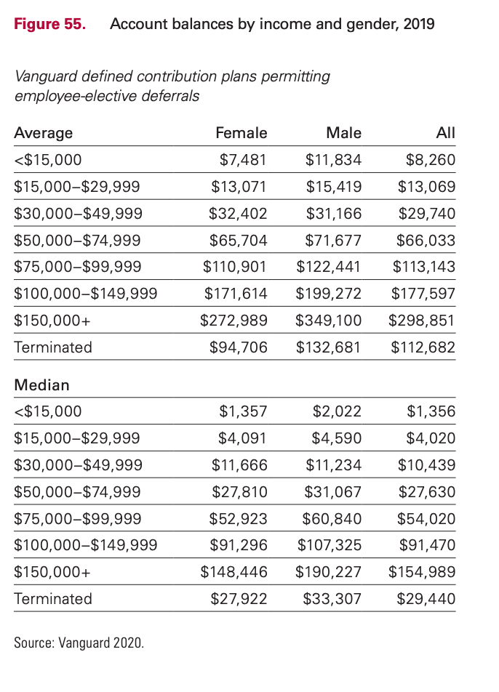
Everyone is bad at saving

Slide 42
Ok, but why invest NOW???

Slide 43
Ok, but why invest NOW???
$4,700

Slide 44
Ok, but why invest NOW???

Slide 45
Ok, but why invest NOW???
$72,000

Slide 46
Ok, but why invest NOW???
$1,000 invested at age 22 gives $4,700 at age 70 vs. $1,000 invested at age 25
A $1000 annual savings plan started at age 22 gives $72,000 vs. starting at age 25 (conservative 4% gives ~$19,000)
  Even jumpstarting the annual savings plan with $4000 at age 25 lags the age 22 savings plan by ~$9,200 at age 70

Slide 47
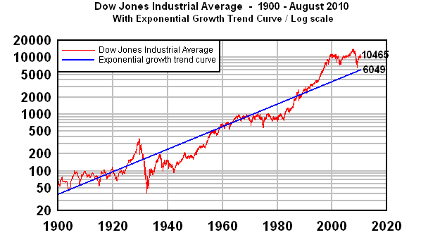
What does growth look like?
Take the Dow Jones Average over the past 110 years on a log scale

Slide 48
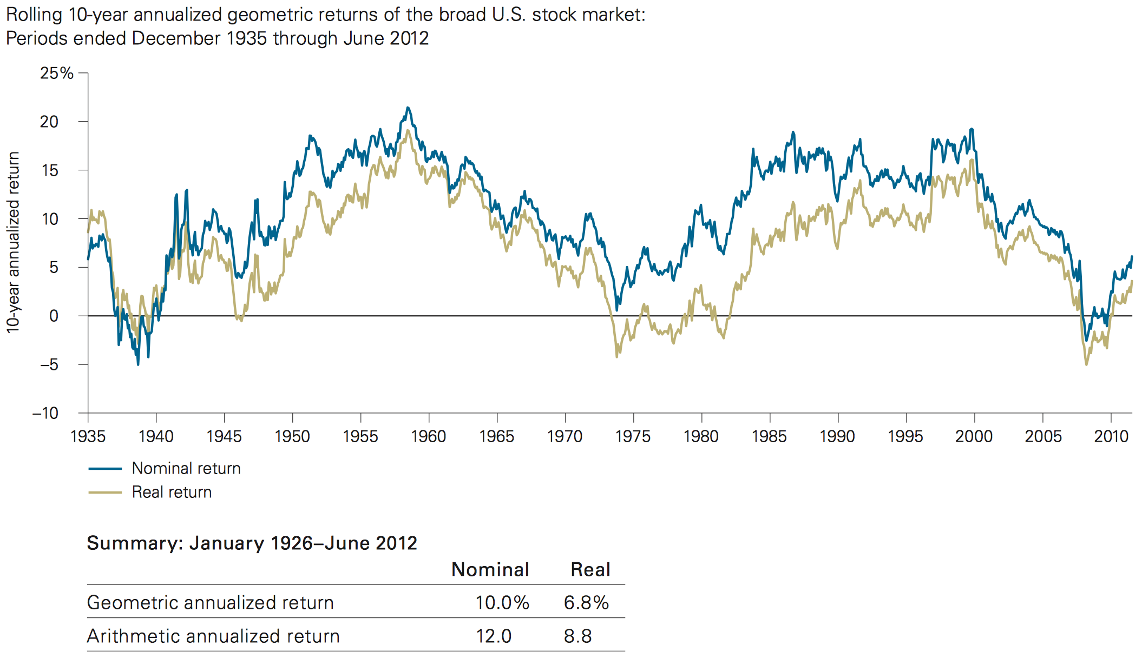
What does growth look like?
Source: Vanguard

Slide 49
Risk
Everything has risk; you can’t escape it
Stocks and high-yield bonds are risky due to enhanced volatility in the short-term
Savings accounts are risky due to inflation in the long-term

Slide 50
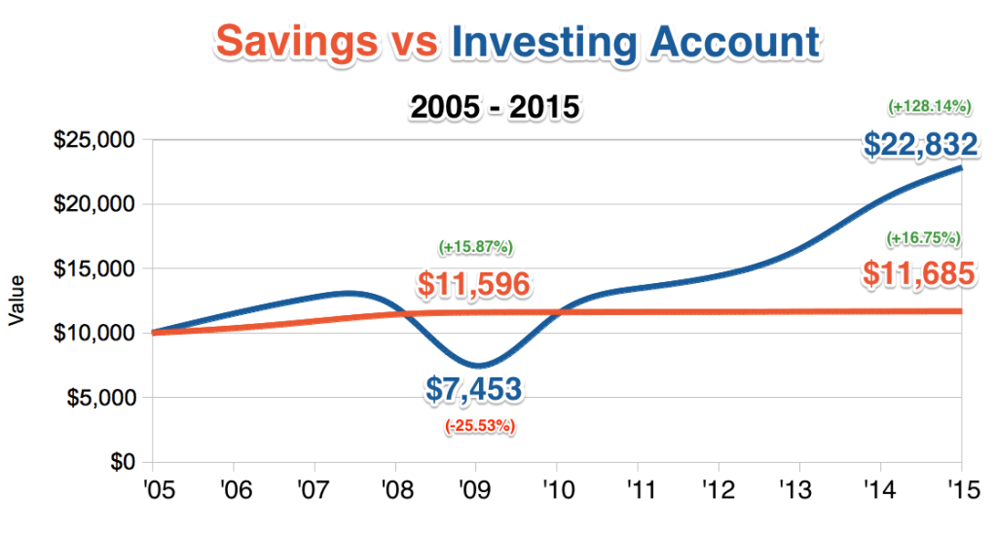
Risk
Blue line is Total Stock Market Index Fund, red line is average savings account

Slide 51
How to Invest: Overview
Accounts (i.e. How to invest)
  Taxable account, IRA, Roth IRA, 401(k), 529 plan, etc.
Holdings (i.e. What to invest in)
  Stocks, bonds, mutual funds, treasury notes, real estate, precious metals, etc.

Slide 52
How to Invest: Accounts
Can invest in whatever your heart desires
Can transfer money to your bank account and back at will
Responsible for paying tax on all earnings
Restrictions on annual investment amount
Withdrawal limitations
Investment options are more limited
Offers lucrative tax benefits when used properly
Taxable Account
Tax-advantaged Account

Slide 53
How to Invest: IRA vs. Roth IRA
$5500 contribution limit
Can deduct investment amount from taxable income
Grows tax-deferred, pay income tax on withdrawals after 59.5
Cannot withdrawal early*
Required distributions after 70.5
$5500 contribution limit
Withdraw contributions at any time
Earnings are tax-free after 59.5
Subject to income limits
No tax deduction
No required distributions
Traditional IRA
Roth IRA
*Penalties and some exceptions apply

Slide 54

How to Invest: 401k
Operates similar to trad. IRA
Company offers list of investment options
Contribute and deduct a portion of your income and the company often matches your contribution up to a certain %
ALWAYS CONTRIBUTE TO GET THE MATCH!
  It’s free money

Slide 55

How to Invest: 529 plans
State-run program for funding post-secondary education (tax-free earnings)
Operates like a Roth IRA but with more restrictive investment options
Some states offer tax deduction
Smart to start saving early if you plan to help pay for a family member’s tuition
  Remember the 6–8% growth rate of tuition?

Slide 56
How to Invest: Investment Options
There’s a lot of material here, but I’ll generalize
Stocks: Share of a company, volatile, high-risk, high-reward
Bonds: Loan to a company or govt, stable, low-risk*, low-reward
Mutual Funds: A “fund of funds”, invests in stocks and bonds, instant diversification

Slide 57
How to Invest: Rules of Thumb
DIVERSIFY!
  Don’t have all your eggs in one basket
  Sector- or market-wide mutual funds are a good way to diversify easily
Be aggressive (stocks) with long time horizons, conservative (bonds) with shorter horizons
  Target Retirement funds are a good starting point (automatically shift toward bonds with time)

Slide 58
How to Invest: Rules of Thumb
Be wary of fees
  “Active” management funds try to beat the market and therefore charge higher fees
  “Passive” management funds seek to track the market indices and have lower fees
I sit firmly on one side of the active/passive fence, but feel free to research this on your own

Slide 59
Active vs. Passive Investing
A study by Barras, Scaillet and Wermers tracked 2,076 actively-managed U.S. domestic equity mutual funds between 1976 and 2006. They found that after fees, three-quarters of the funds exhibited zero “alpha,” a fund’s excess return over a benchmark index. And 24% of the funds were run by unskilled managers (who had negative alpha, or value subtraction). Only 0.6% showed any true skill at beating the market consistently.

Slide 60
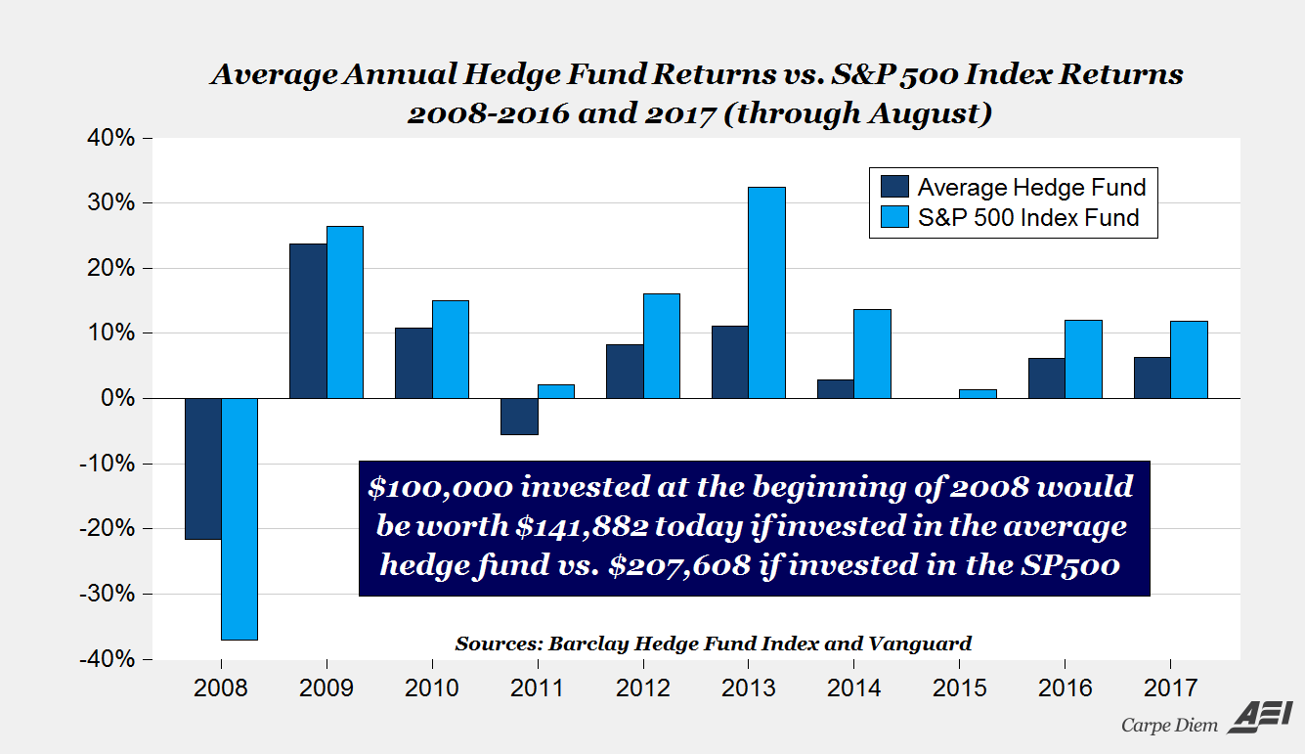
Active vs. Passive Investing
Warren Buffet bet that the S&P500 index would beat out any portfolio of hedge funds over a 10-year period. One manager took the bet…

Slide 61
Matt’s Investments
Vanguard
  Investment management company, specializes in passive index-tracking mutual funds, low fees, no commissions on Vanguard products
Wealthfront
  Robo-investor manages passive investments for fairly low fee; first 5k managed free (if referred)

Slide 62

Big-ticket purchases

Slide 63
Big-ticket purchases
You can pass up all the Starbucks lattes you want, but if you screw these up, it’s tough to financially recover

Slide 64
Big-ticket purchases: House
Will require mortgage unless you are a financial samurai or living in a box
Rules of thumb
  Down payment at least 20% to avoid extra insurance charges
    Don’t be sub-prime (if that word scares you, good); this is linked to your credit history
  Median home price: ~$280k = $56k down plus closing costs (2–5%).
  Aim for housing costs to be 28% or less of income (goes for rent too)

Slide 65
Big-ticket purchases: Cars
Cars, if you’re not buying outright, are usually financed (with dealer or bank)
  Down payment
  Interest rate (remember that credit score?)
  Loan length
  20%/4yr/10% rule of thumb
  Down payment / loan term / percentage of income
Leasing is an option if you enjoy the security of a new car (fewer repairs) combined with the agonizing pain of renting

Slide 66
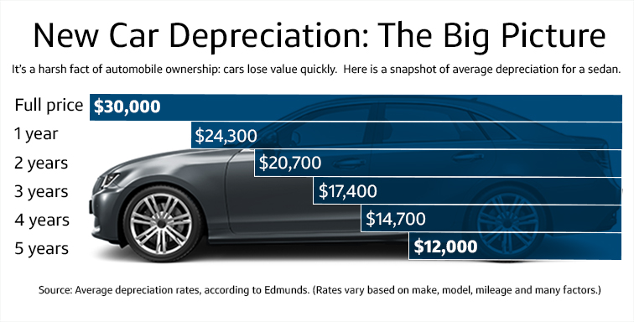
Big-ticket purchases: Cars
Personal Opinion
  Think long and hard about buying a new car
      CPO programs are worth considering
  People are not good at calculating repair bills vs. depreciation/new car payments
  Don’t take a 72-month loan on a car!!!

Slide 67
Big-ticket purchases: Saving Plan
The further away the purchase, the more risky you can be:
  >5 years away: Investing is a viable option
  3–5 years away: Use a more conservative plan with bonds and CDs
  1–2 years away: CDs and Savings to protect down payment

