Slide 1
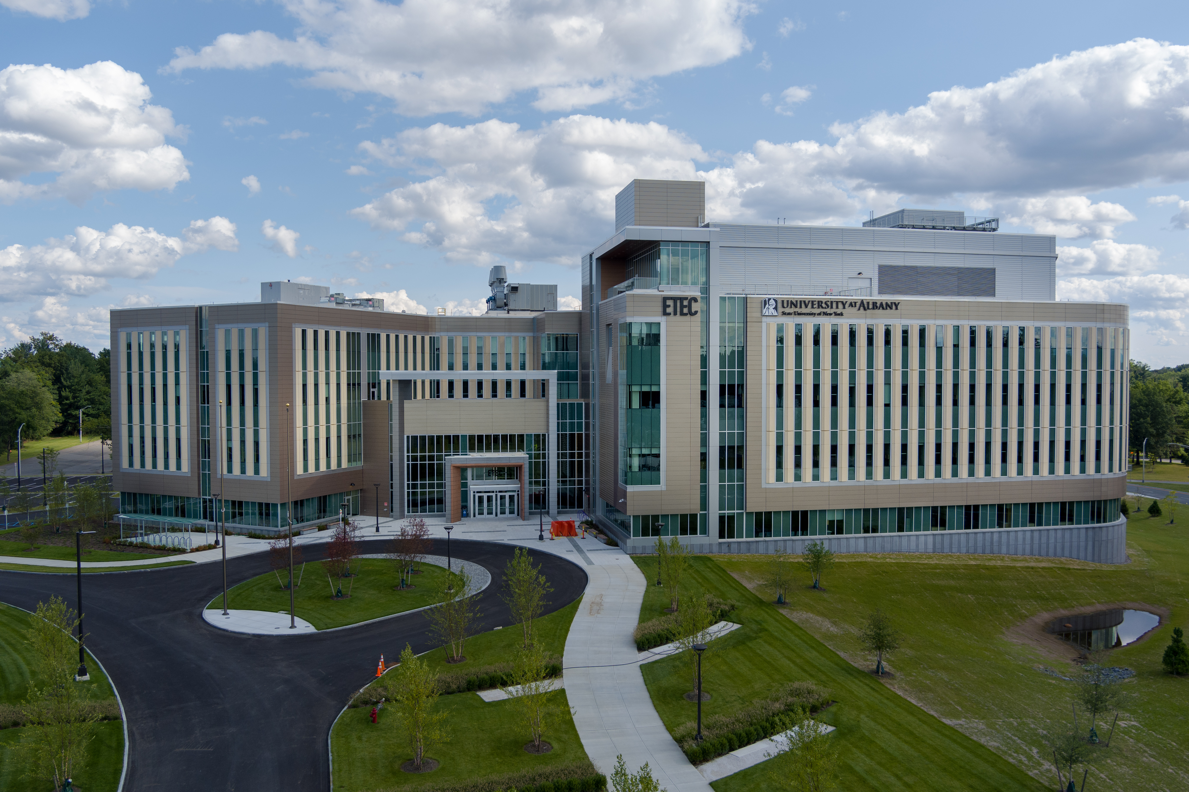
University at Albany
Department of Atmospheric &
Environmental Sciences
Atmospheric Science Research Center

Slide 2
Graduate Program Overview
Kristen Corbosiero
Graduate Program Director

Slide 3
DAES and ASRC
84 graduate students cross three Master’s and PhD programs:

Slide 4
DAES and ASRC
84 graduate students cross three Master’s and PhD programs:
    ~ Research based: Atmospheric Science
    Climate Science

Slide 5
DAES and ASRC
84 graduate students cross three Master’s and PhD programs:
    ~ Research based: Atmospheric Science
    Climate Science
    ~ Internship based: Applied Master’s

Slide 6
DAES and ASRC
84 graduate students cross three Master’s and PhD programs:
    ~ Research based: Atmospheric Science
    Climate Science
    ~ Internship based: Applied Master’s
Students taught and advised by over 30 faculty members and research associates

Slide 7
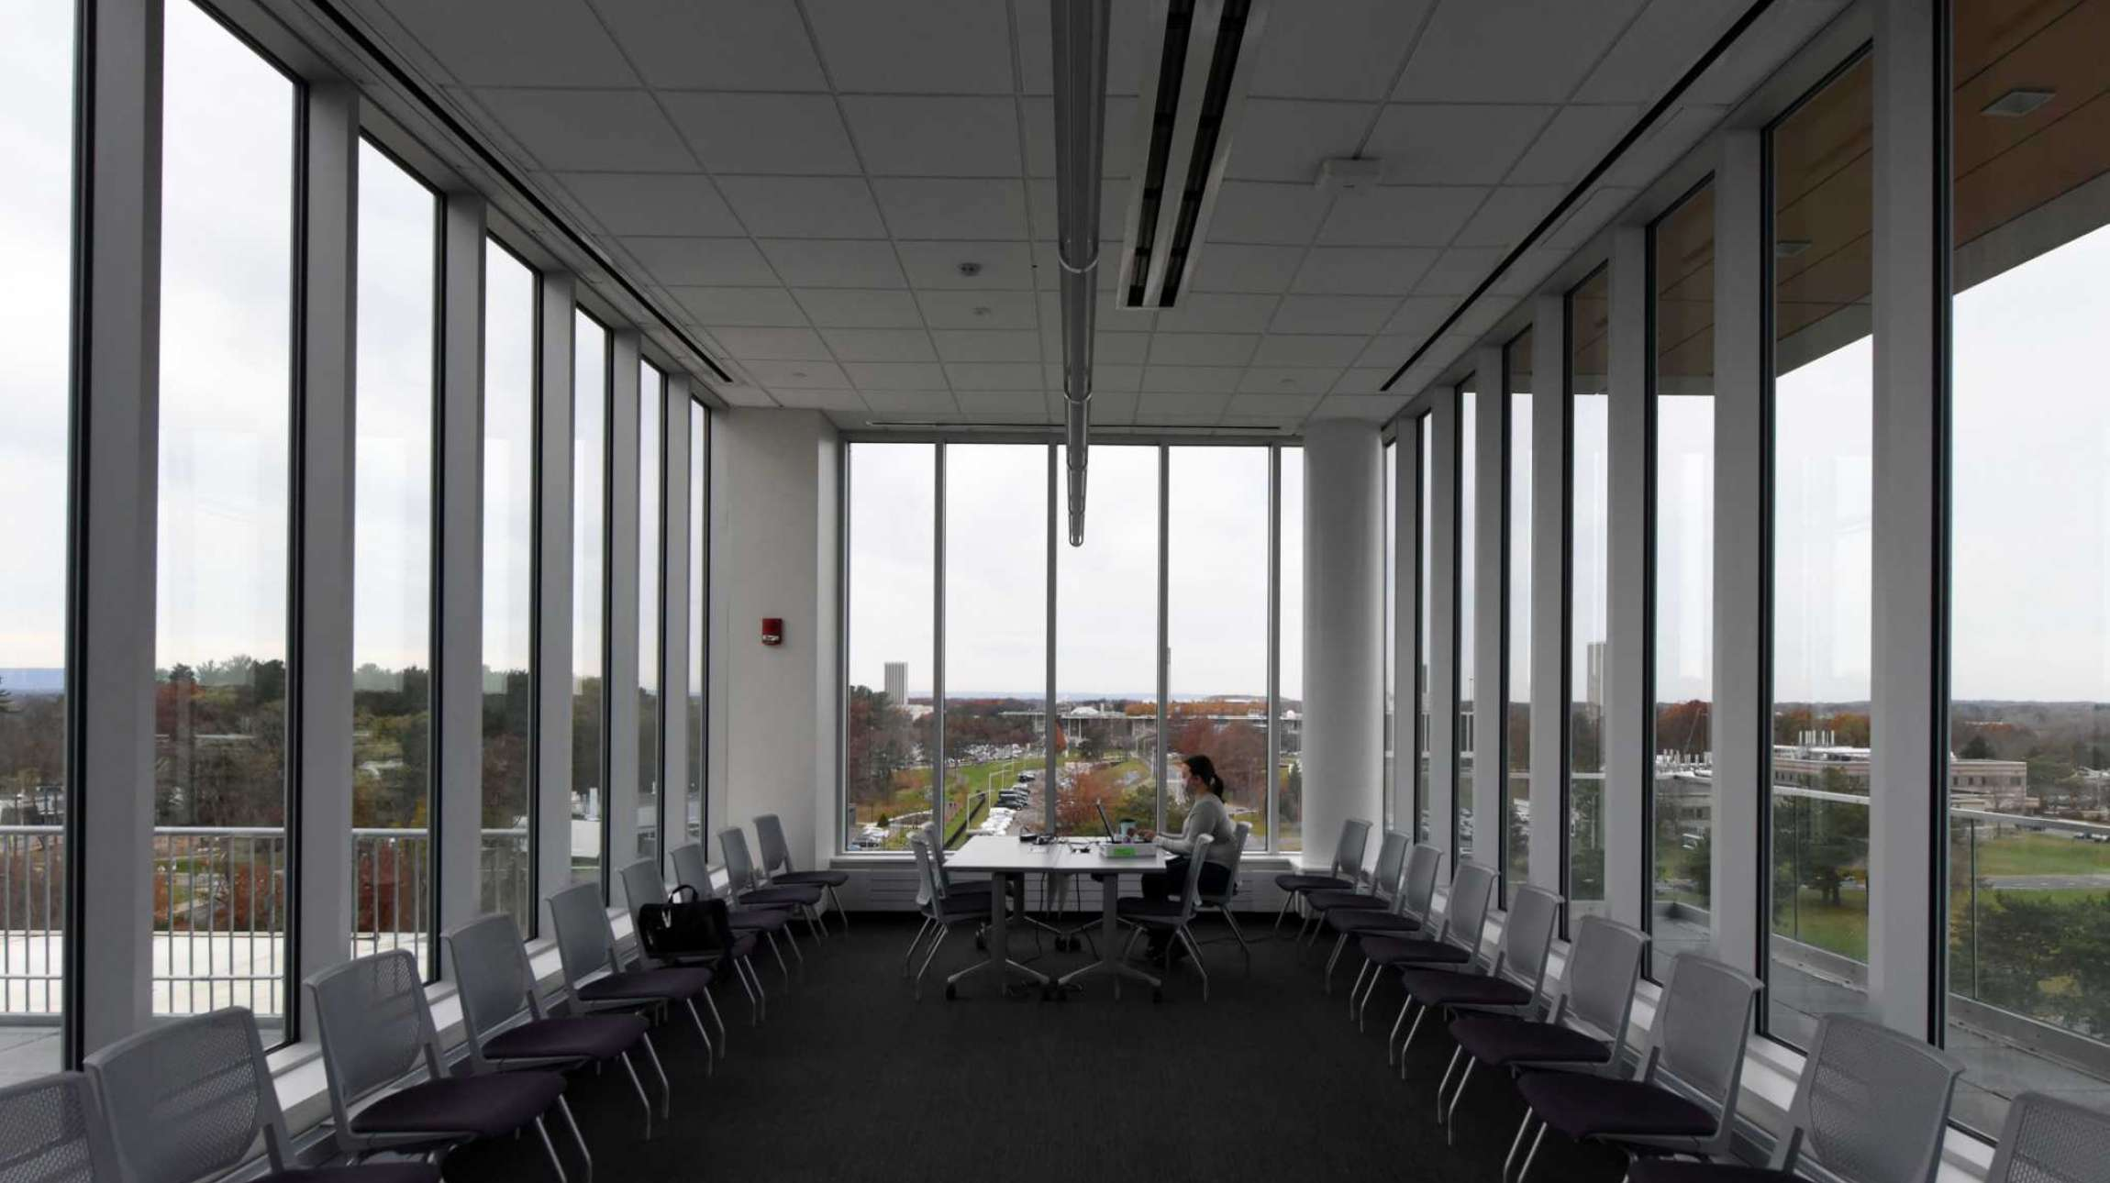
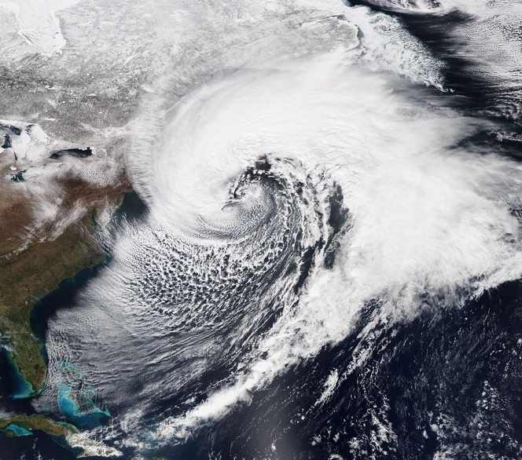
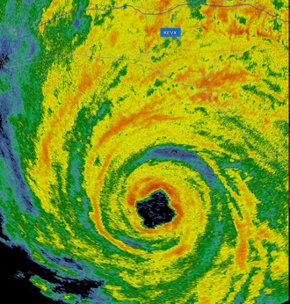
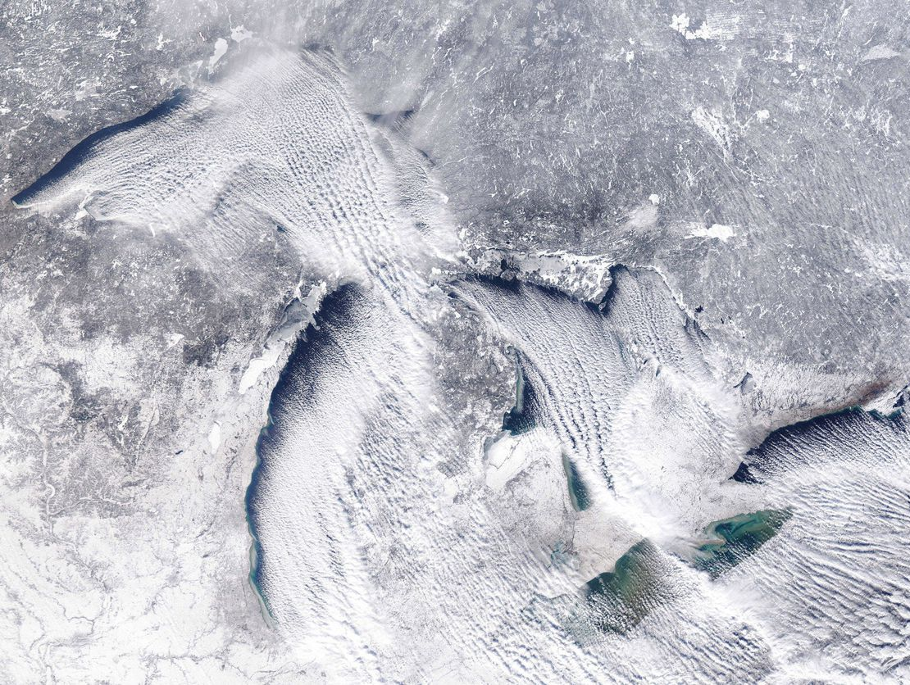
DAES
World-class teaching and research in:
- Synoptic–dynamic, tropical, and
mesoscale meteorology

Slide 8
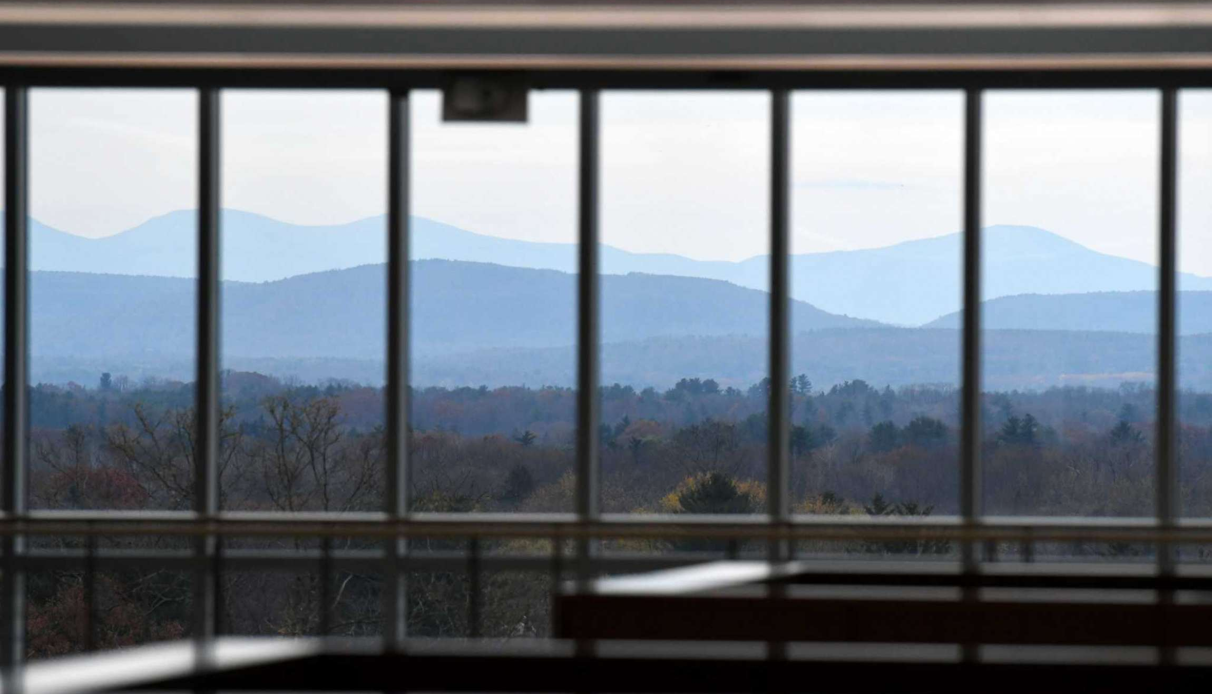
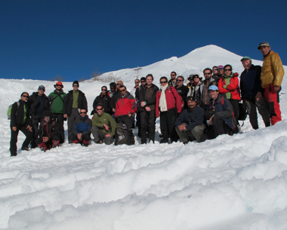
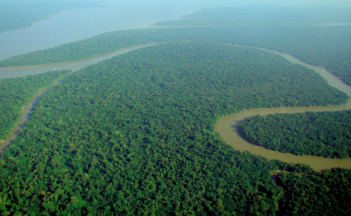
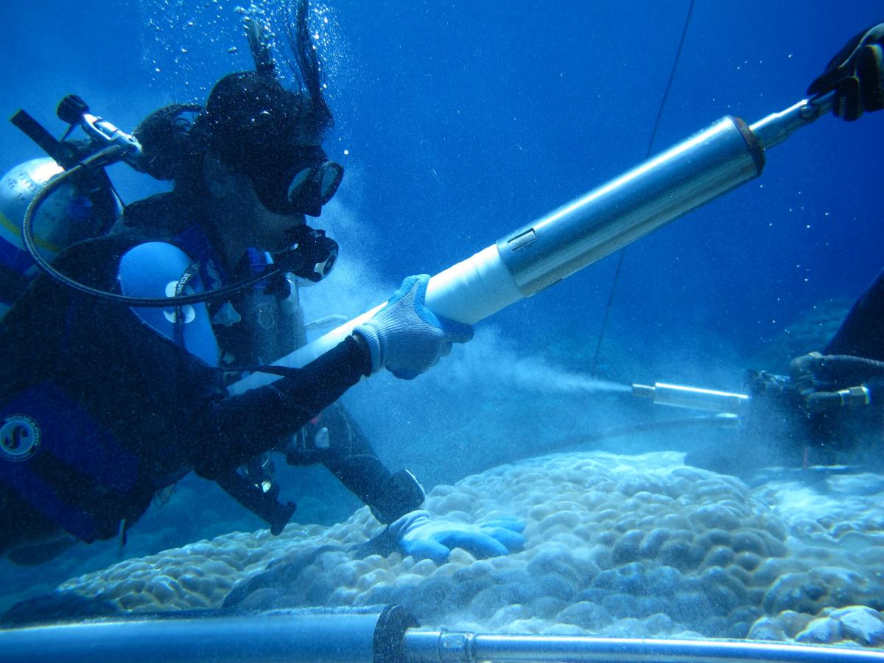
DAES
World-class teaching and research in:
- Climate dynamics, paleoclimate, and
environmental systems

Slide 9
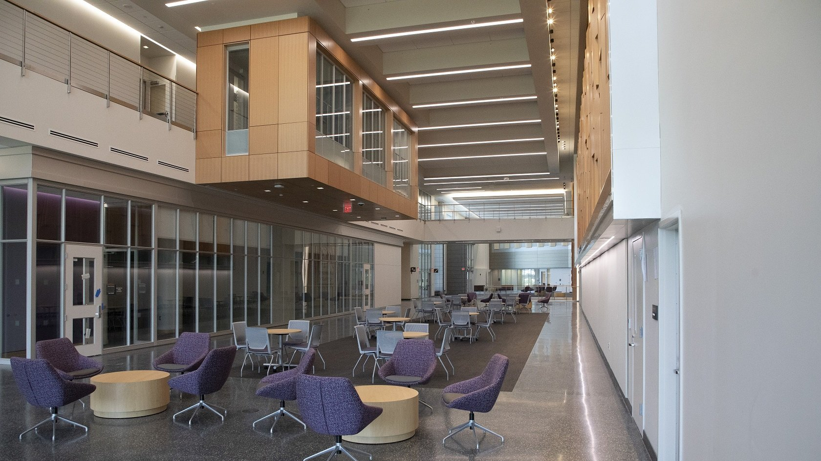
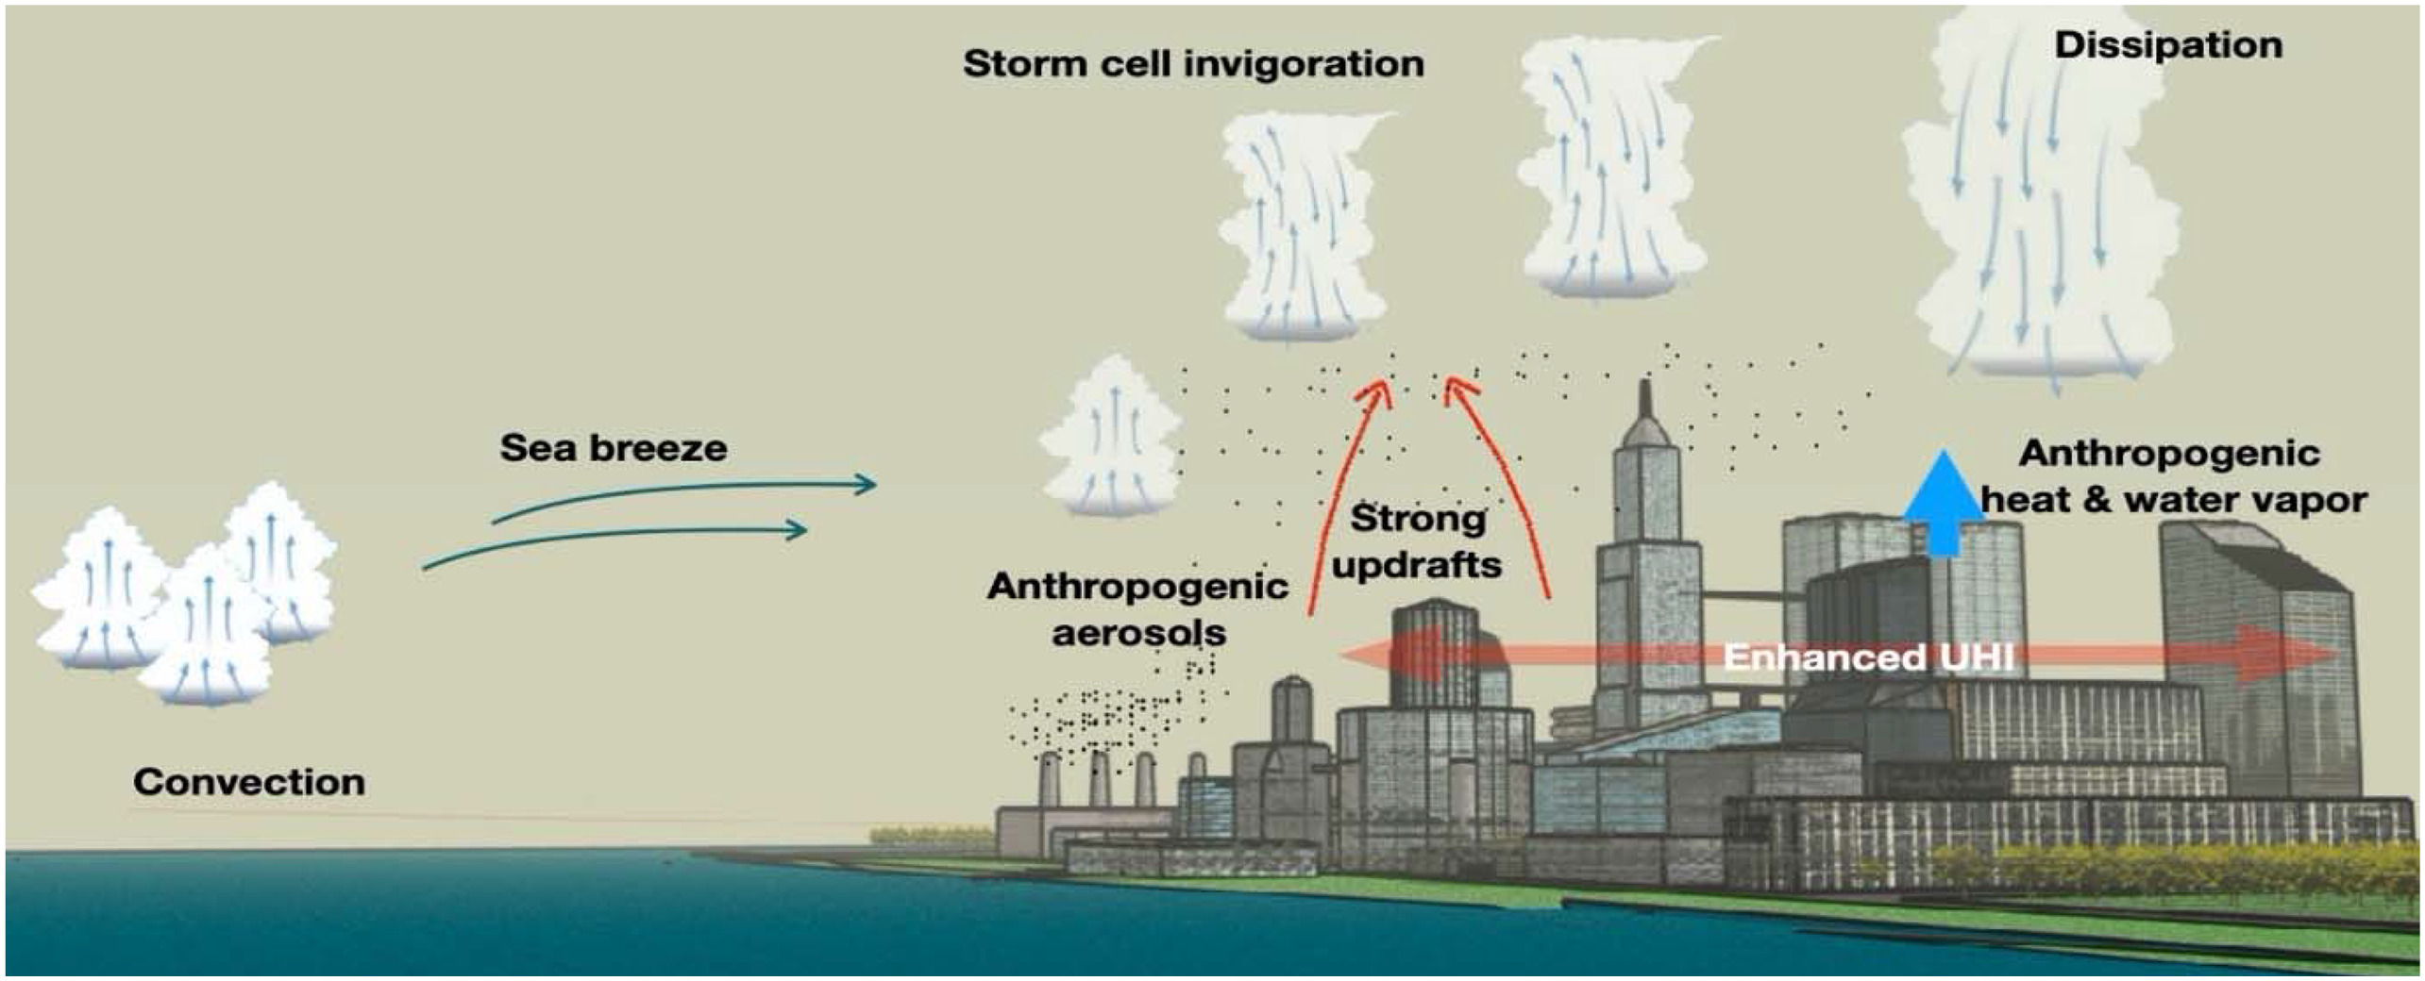
ASRC
World-class teaching and research in:
- Atmospheric chemistry, air quality,
and coastal–urban environments

Slide 10
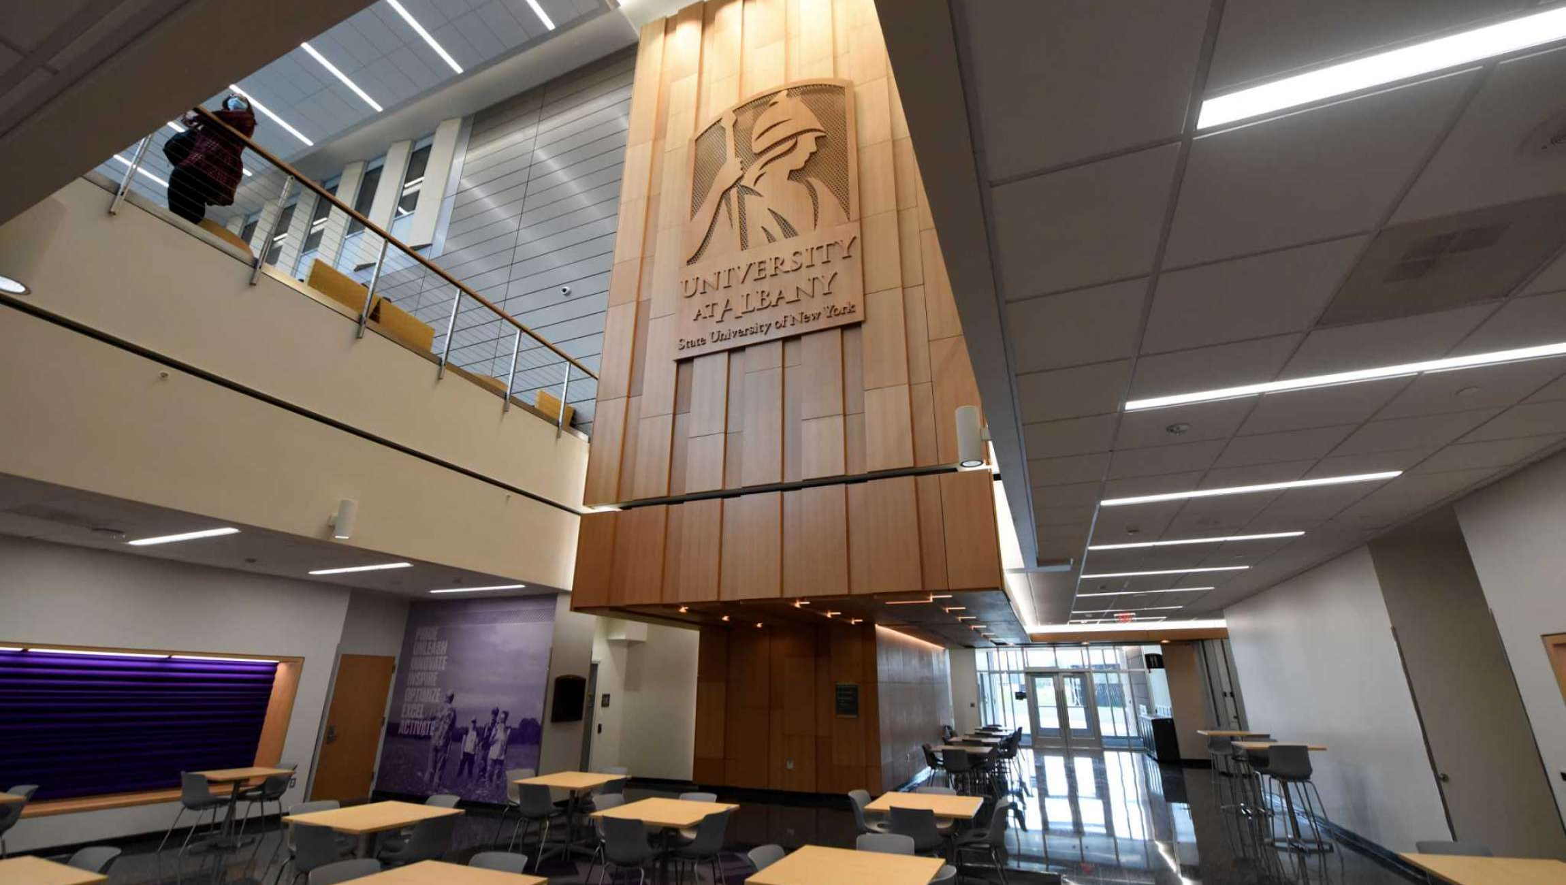
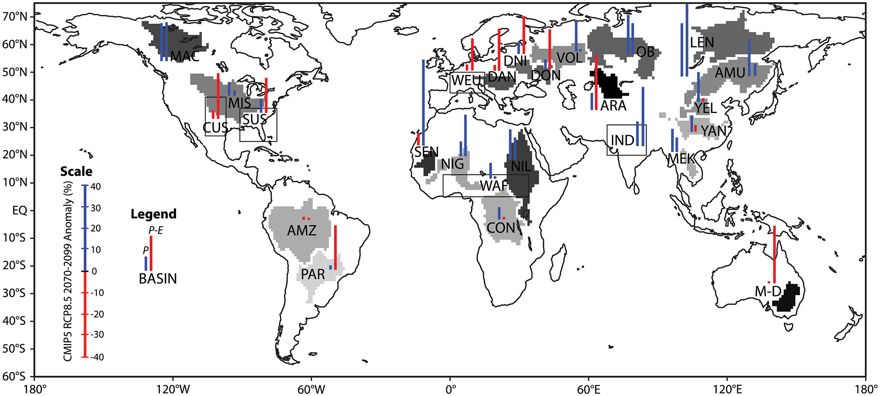
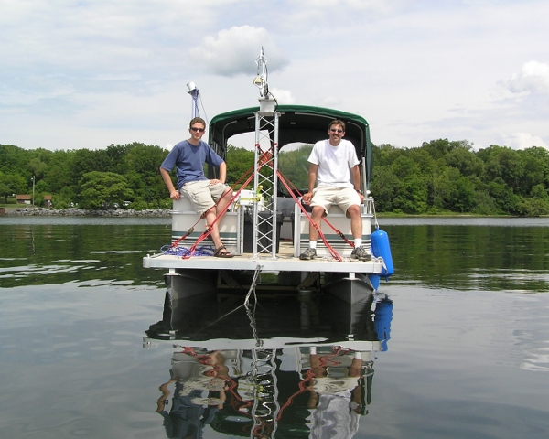
ASRC
World-class teaching and research in:
- Boundary layer meteorology and
air–land–sea interactions

Slide 11
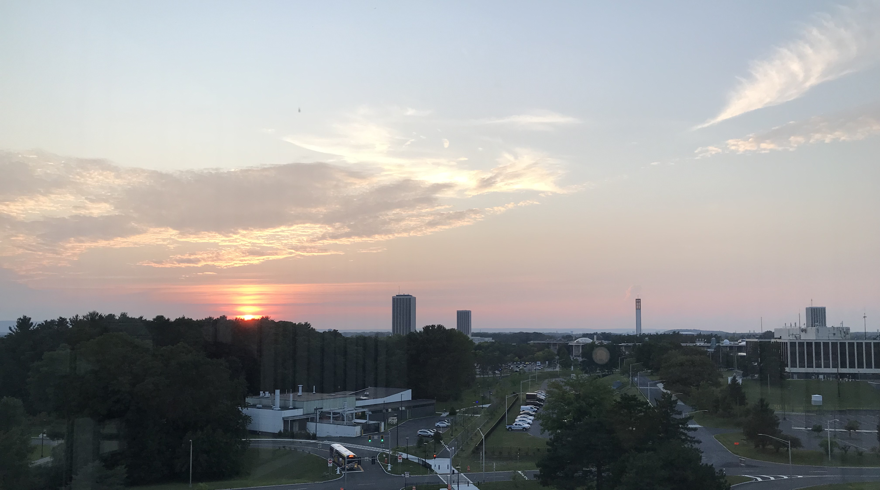
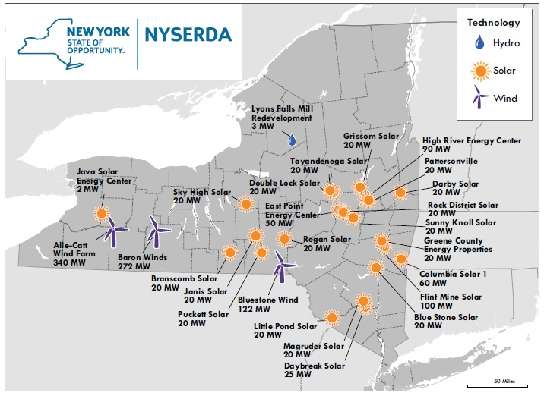
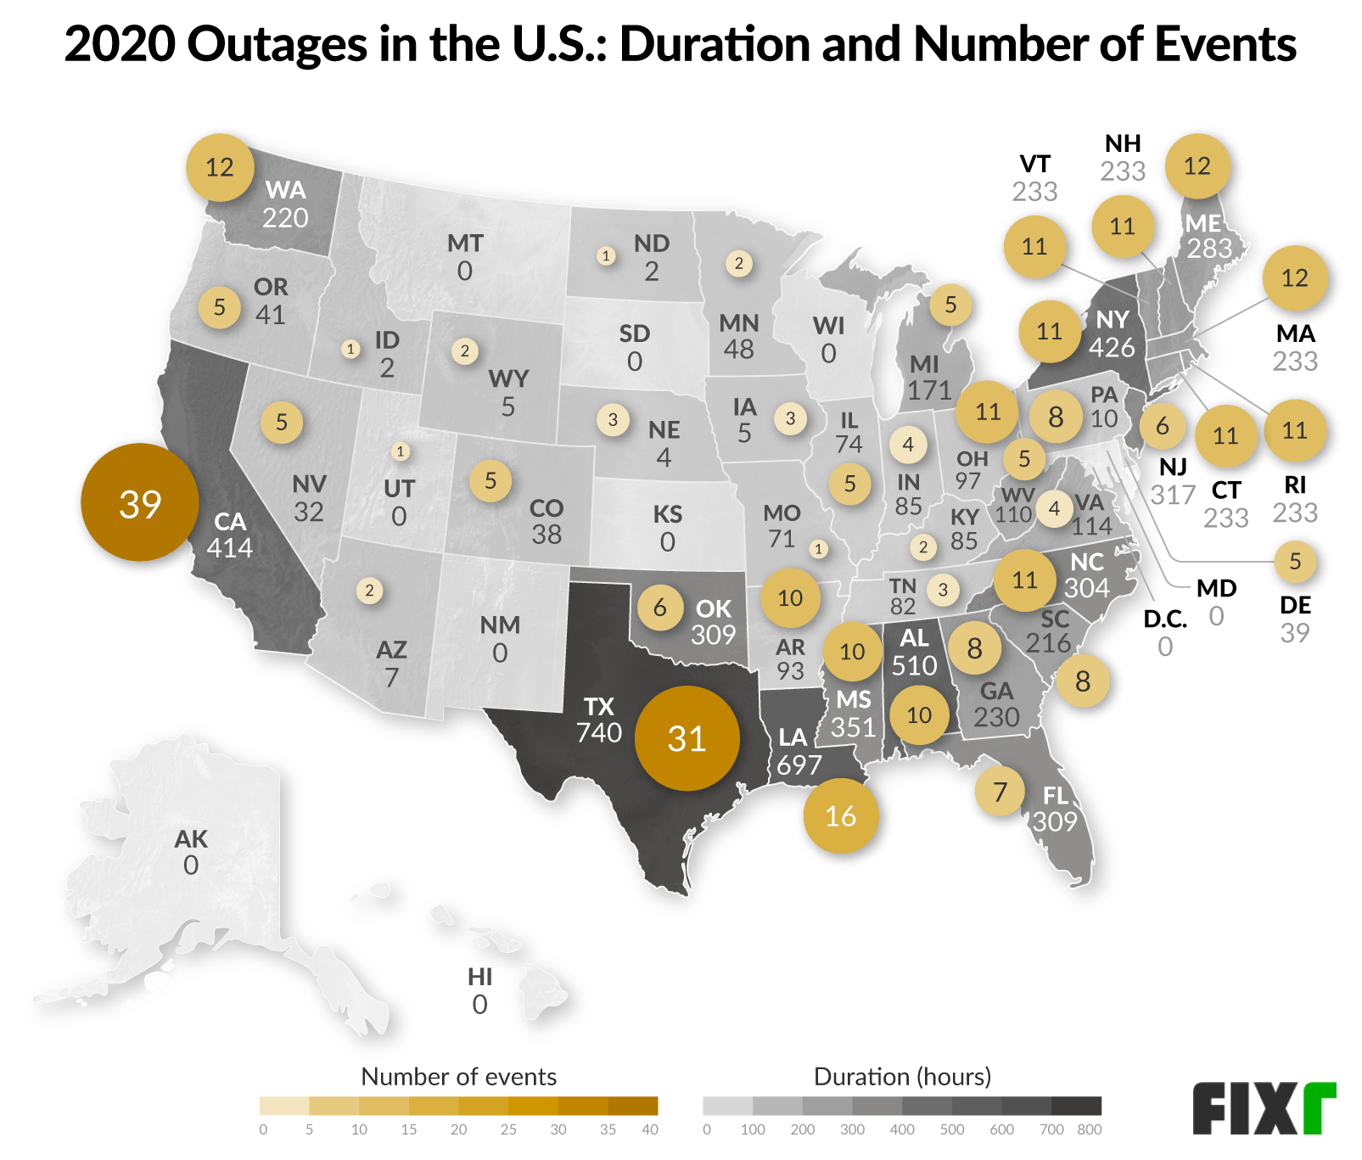
ASRC
World-class teaching and research in:
- Renewable energy

Slide 12
Applied Master’s requirements

Slide 13
Applied Master’s requirements
30 credits of 500+ level classes: 12-credit core, six-credit internship, and 12 credits of track-specific classes

Slide 14
Applied Master’s requirements
30 credits of 500+ level classes: 12-credit core, six-credit internship, and 12 credits of track-specific classes
Tracks are Business, Data Analytics, and Policy and Emergency Preparedness

Slide 15
Applied Master’s requirements
30 credits of 500+ level classes: 12-credit core, six-credit internship, and 12 credits of track-specific classes
Tracks are Business, Data Analytics, and Policy and Emergency Preparedness
Many internships paid and arranged through the UAlbany Center of Excellence in Weather & Climate Analytics

Slide 16
Atmospheric Science requirements

Slide 17
Atmospheric Science requirements
Two courses in Atmospheric Physics and Chemistry (ATM 504 and one of several electives)

Slide 18
Atmospheric Science requirements
Two courses in Atmospheric Physics and Chemistry (ATM 504 and one of several electives)
Two courses in Atmospheric Dynamics
(ATM 500 and one of several electives)

Slide 19
Atmospheric Science requirements
Two courses in Atmospheric Physics and Chemistry (ATM 504 and one of several electives)
Two courses in Atmospheric Dynamics
(ATM 500 and one of several electives)
Two additional classes with the ATM designation
(most students end up taking more)

Slide 20
Climate Science requirements

Slide 21
Climate Science requirements
Four course core of Fundamentals of Earth’s Climate, a Data Fluency class, and two track-specific classes

Slide 22
Climate Science requirements
Four course core of Fundamentals of Earth’s Climate, a Data Fluency class, and two track-specific classes
Tracks are Climate Dynamics, and Climate Physics & Chemistry

Slide 23
Climate Science requirements
Four course core of Fundamentals of Earth’s Climate, a Data Fluency class, and two track-specific classes
Tracks are Climate Dynamics, and Climate Physics & Chemistry
Track specific classes in Atmospheric Dynamics, Physics, Paleoclimate, and Geochemistry

Slide 24
Elective Courses

Slide 25
Elective Courses
Every semester, we strive to offer:

Slide 26
Elective Courses
Every semester, we strive to offer:
  ~ Two Atmospheric Dynamics electives

Slide 27
Elective Courses
Every semester, we strive to offer:
  ~ Two Atmospheric Dynamics electives
  ~ One or two Climate Dynamics electives

Slide 28
Elective Courses
Every semester, we strive to offer:
  ~ Two Atmospheric Dynamics electives
  ~ One or two Climate Dynamics electives
  ~ Two Physics & Chemistry electives

Slide 29
Elective Courses
Every semester, we strive to offer:
  ~ Two Atmospheric Dynamics electives
  ~ One or two Climate Dynamics electives
  ~ Two Physics & Chemistry electives
In addition, we typically have one special topic course, offered once per graduate career

Slide 30
Additional requirements

Slide 31
Additional requirements
Master’s degree

Slide 32
Additional requirements
Master’s degree
  ~ MS thesis (two to three years)

Slide 33
Additional requirements
Master’s degree
  ~ MS thesis (two to three years)
PhD degree

Slide 34
Additional requirements
Master’s degree
  ~ MS thesis (two to three years)
PhD degree
  ~ PhD written exam (typically in third year)

Slide 35
Additional requirements
Master’s degree
  ~ MS thesis (two to three years)
PhD degree
  ~ PhD written exam (typically in third year)
  ~ Written PhD proposal (typically fourth year)

Slide 36
Additional requirements
Master’s degree
  ~ MS thesis (two to three years)
PhD degree
  ~ PhD written exam (typically in third year)
  ~ Written PhD proposal (typically fourth year)
  ~ PhD thesis five to six years

Slide 37
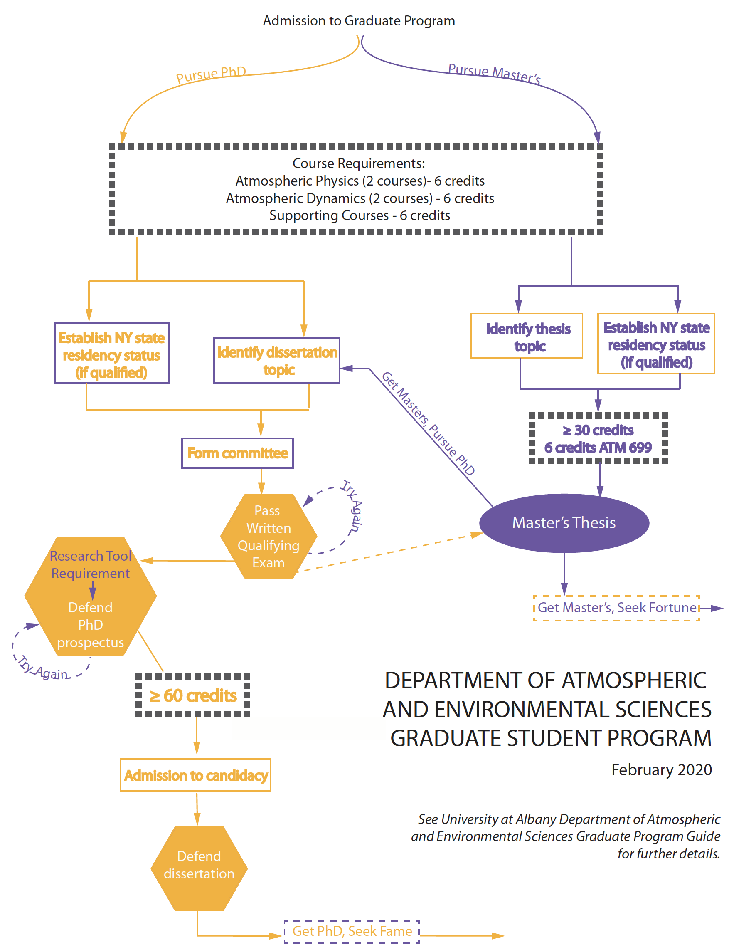

Slide 38
Assistantships

Slide 39
Assistantships
Research assistant (RA)

Slide 40
Assistantships
Research assistant (RA)
~ Students paid by their advisor’s grant
~ Responsible for carrying out research

Slide 41
Assistantships
Research assistant (RA)
~ Students paid by their advisor’s grant
~ Responsible for carrying out research
Teaching assistant (TA)

Slide 42
Assistantships
Research assistant (RA)
~ Students paid by their advisor’s grant
~ Responsible for carrying out research
Teaching assistant (TA)
~ Students paid by University during academic
year, advisor’s grant during summer
~ Assigned to assist an instructor in teaching a
specific course

Slide 43
Assistantships

Slide 44
Assistantships
Both positions include nine credits of tuition per semester and all mandatory fees

Slide 45
Assistantships
Both positions include nine credits of tuition per semester and all mandatory fees
Incoming students offered $33,462 ($35,135 with MS)

Slide 46
Assistantships
Both positions include nine credits of tuition per semester and all mandatory fees
Incoming students offered $33,462 ($35,135 with MS)
Students switch between RA and TA from year to year

Slide 47
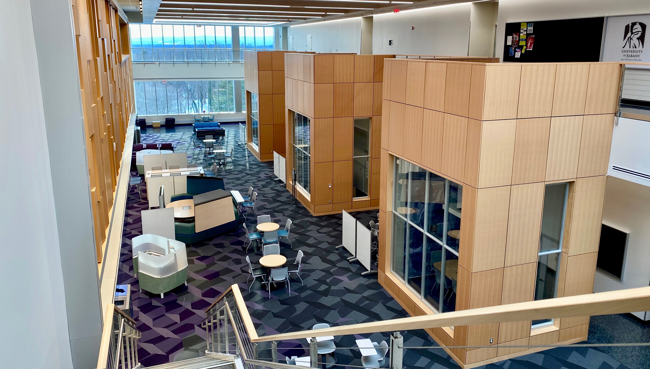
Opportunities

Slide 48
Opportunities
External speakers

Slide 49
Opportunities
External speakers
  ~ Weekly seminars
  ~ Career development discussions

Slide 50
Opportunities
External speakers
  ~ Weekly seminars
  ~ Career development discussions
Informal seminars

Slide 51
Opportunities
External speakers
  ~ Weekly seminars
  ~ Career development discussions
Informal seminars
  ~ Climate Group
  ~ ASRC Colloquy
  ~ Research Groups

Slide 52
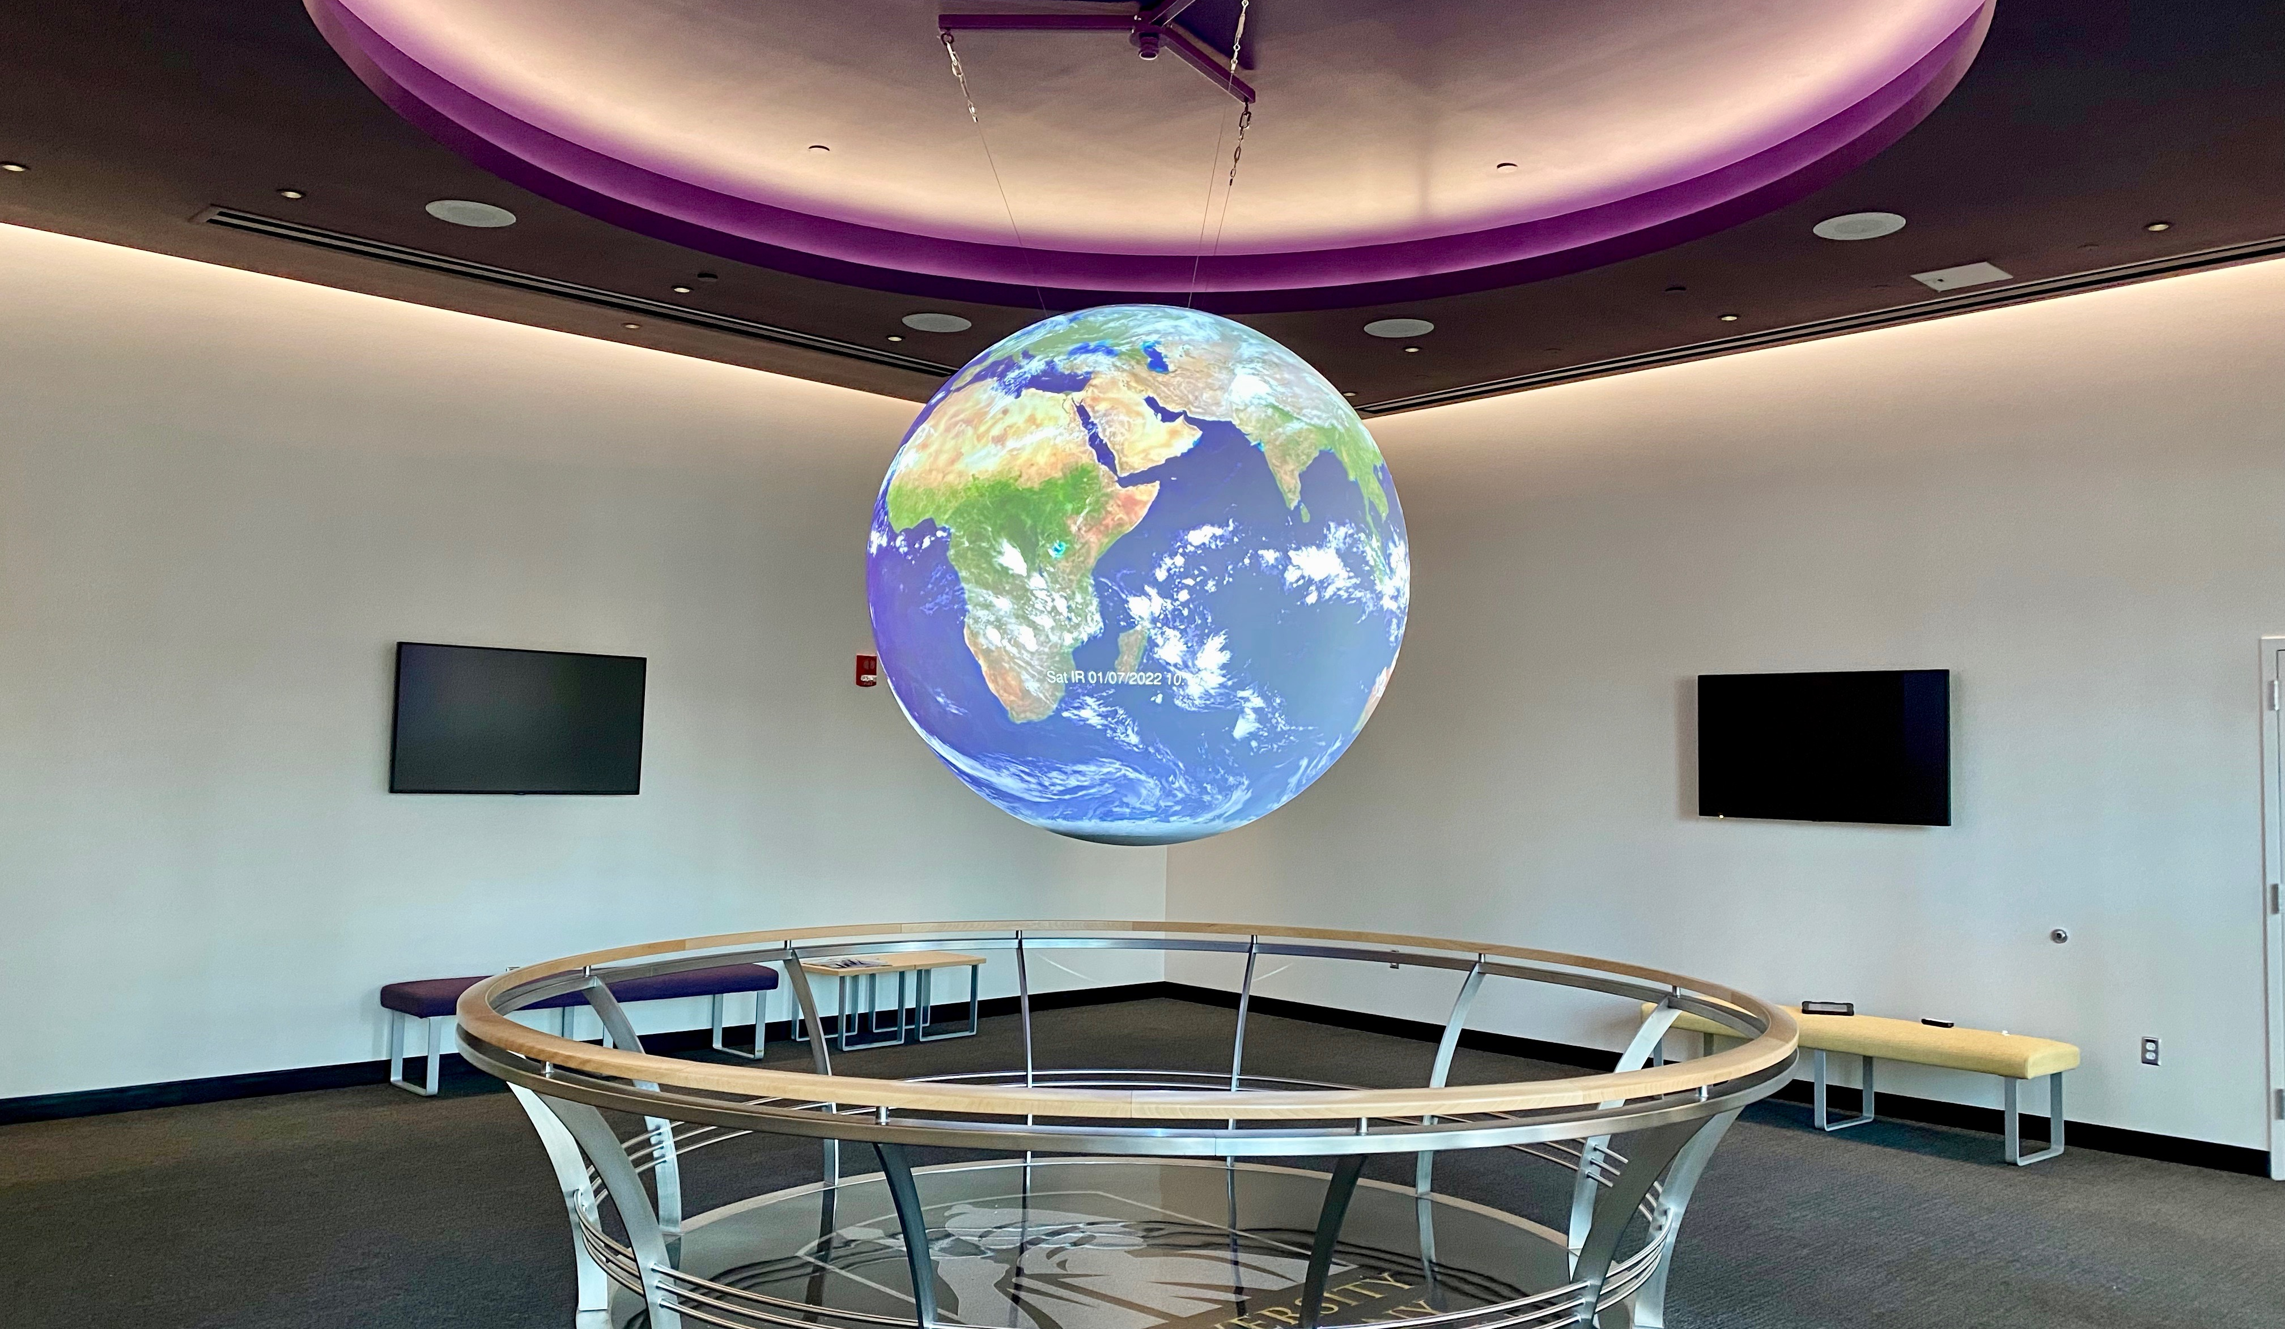
Opportunities

Slide 53
Opportunities
Synoptic & tropical map discussions with SWRCC, NWS Albany, CW3E, etc.

Slide 54
Opportunities
Synoptic & tropical map discussions with SWRCC, NWS Albany, CW3E, etc.
Leadership and outreach

Slide 55
Opportunities
Synoptic & tropical map discussions with SWRCC, NWS Albany, CW3E, etc.
Leadership and outreach
~ Graduate Program and Inclusion &
Diversity Committees; Faculty meetings

Slide 56
Opportunities
Synoptic & tropical map discussions with SWRCC, NWS Albany, CW3E, etc.
Leadership and outreach
~ Graduate Program and Inclusion &
Diversity Committees; Faculty meetings
  ~ Graduate Student Organization

Slide 57
Opportunities
Synoptic & tropical map discussions with SWRCC, NWS Albany, CW3E, etc.
Leadership and outreach
~ Graduate Program and Inclusion &
Diversity Committees; Faculty meetings
  ~ Graduate Student Organization
  ~ Public schools, STEM programs, mentoring

Slide 58
DAES and ASRC
Co-located with:

Slide 59
DAES and ASRC
Co-located with:
- National Weather Service
- NY State Mesonet
- State Weather Risk Communication Center

Slide 60
DAES and ASRC
Co-located with:
- National Weather Service
- NY State Mesonet
- State Weather Risk Communication Center
- Center of Excellence in Weather &
Climate Analytics

Slide 61
DAES and ASRC
Co-located with:
- National Weather Service
- NY State Mesonet
- State Weather Risk Communication Center
- Center of Excellence in Weather &
Climate Analytics
- College of Emergency Preparedness,
Homeland Security, and Cybersecurity

Slide 62


DAES / ASRC Prospective Student Liaisons
Jean Carlos
Peña
David
Marcial
  Recommend contact points based on research interests
  Resource for department offerings, options, and specializations
  Down-to-earth take on grad student life
contact: daesliaison@albany.edu

