Slide 1


Blizzard of 2026
Impacts and Eye Candy

Slide 2
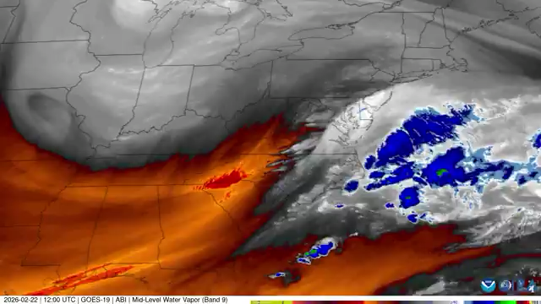
https://x.com/CIRA_CSU/status/2026334195040301417?s=20

Slide 3
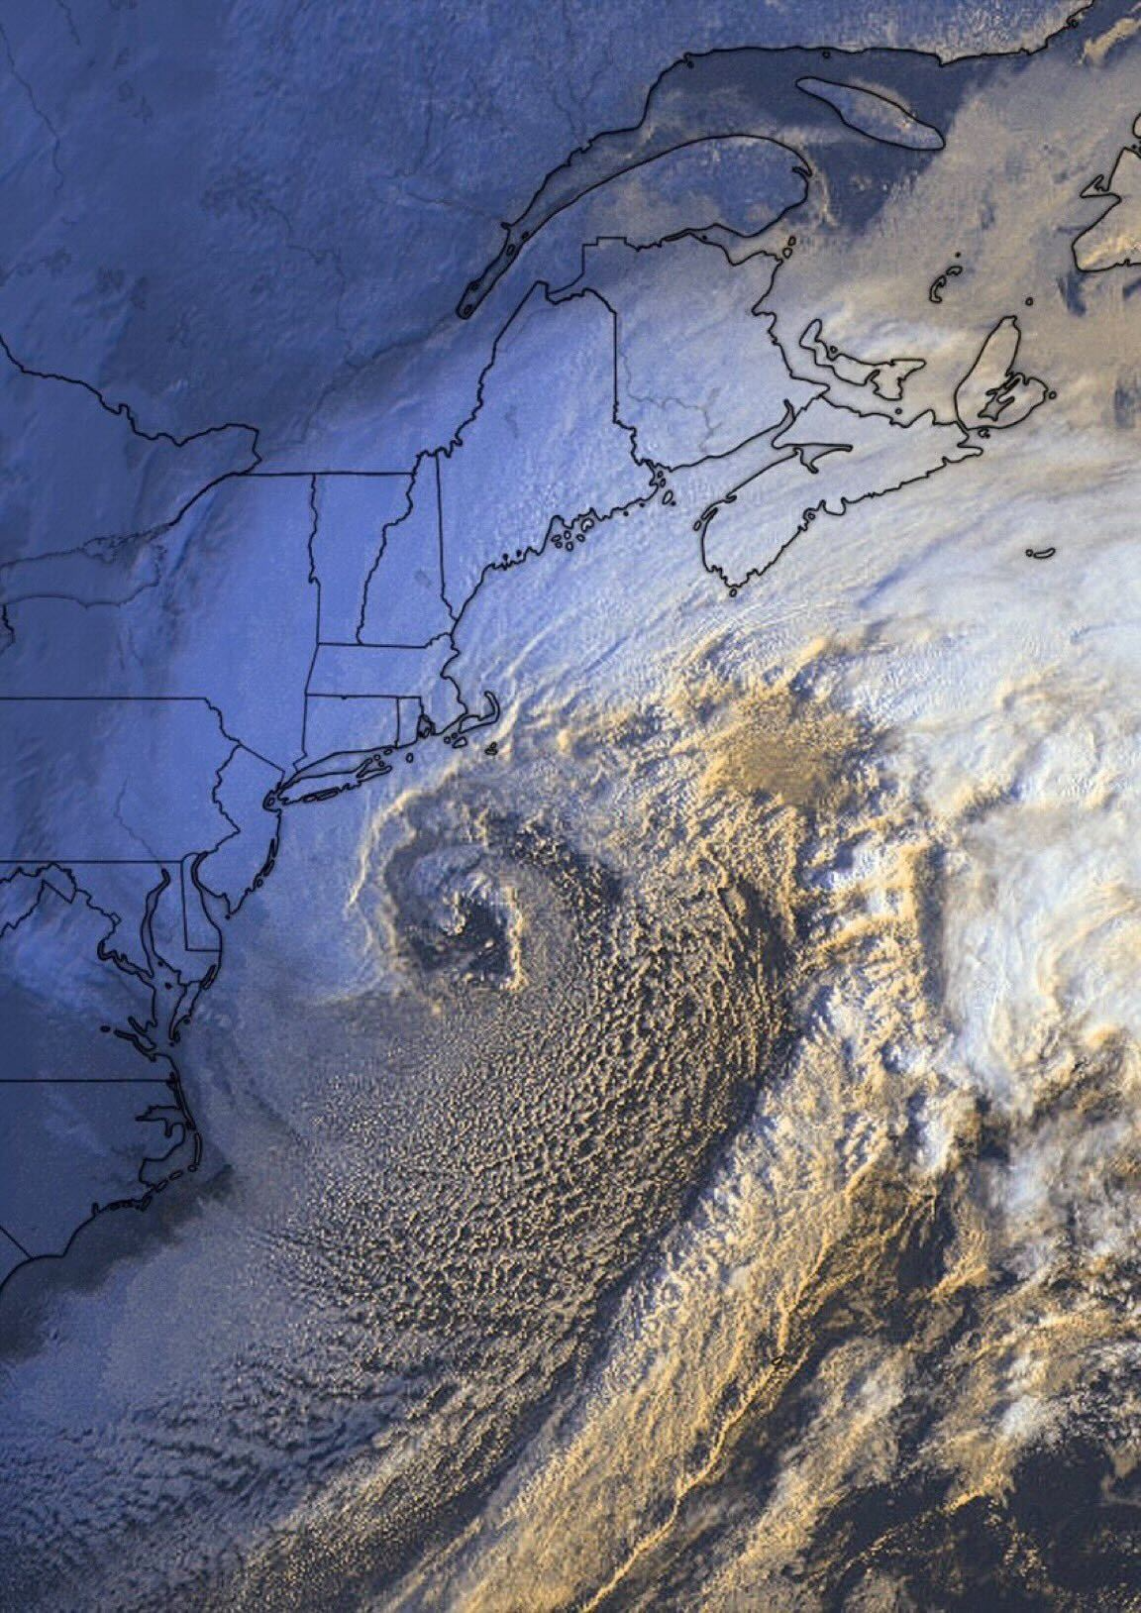

Slide 4
Snowfall Totals

Slide 5
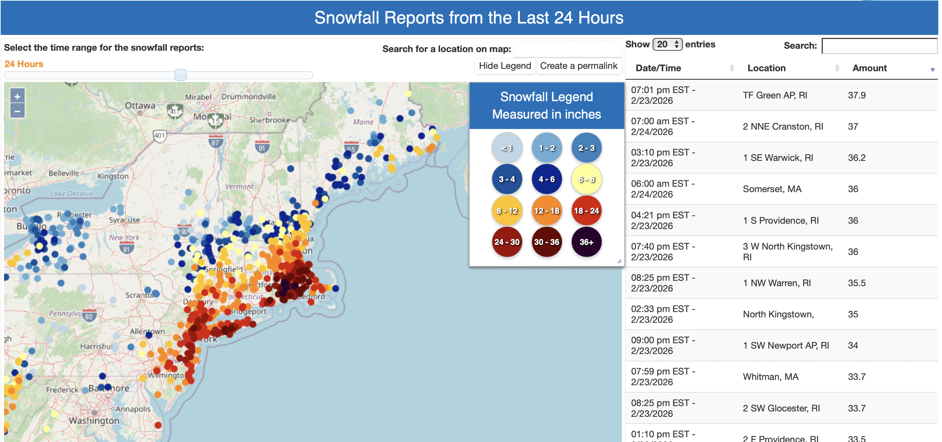
https://www.weather.gov/source/crh/snowmap.html?zoom=5.806067031906572&lat=43.55&lon=-73.05&hr=24

Slide 6
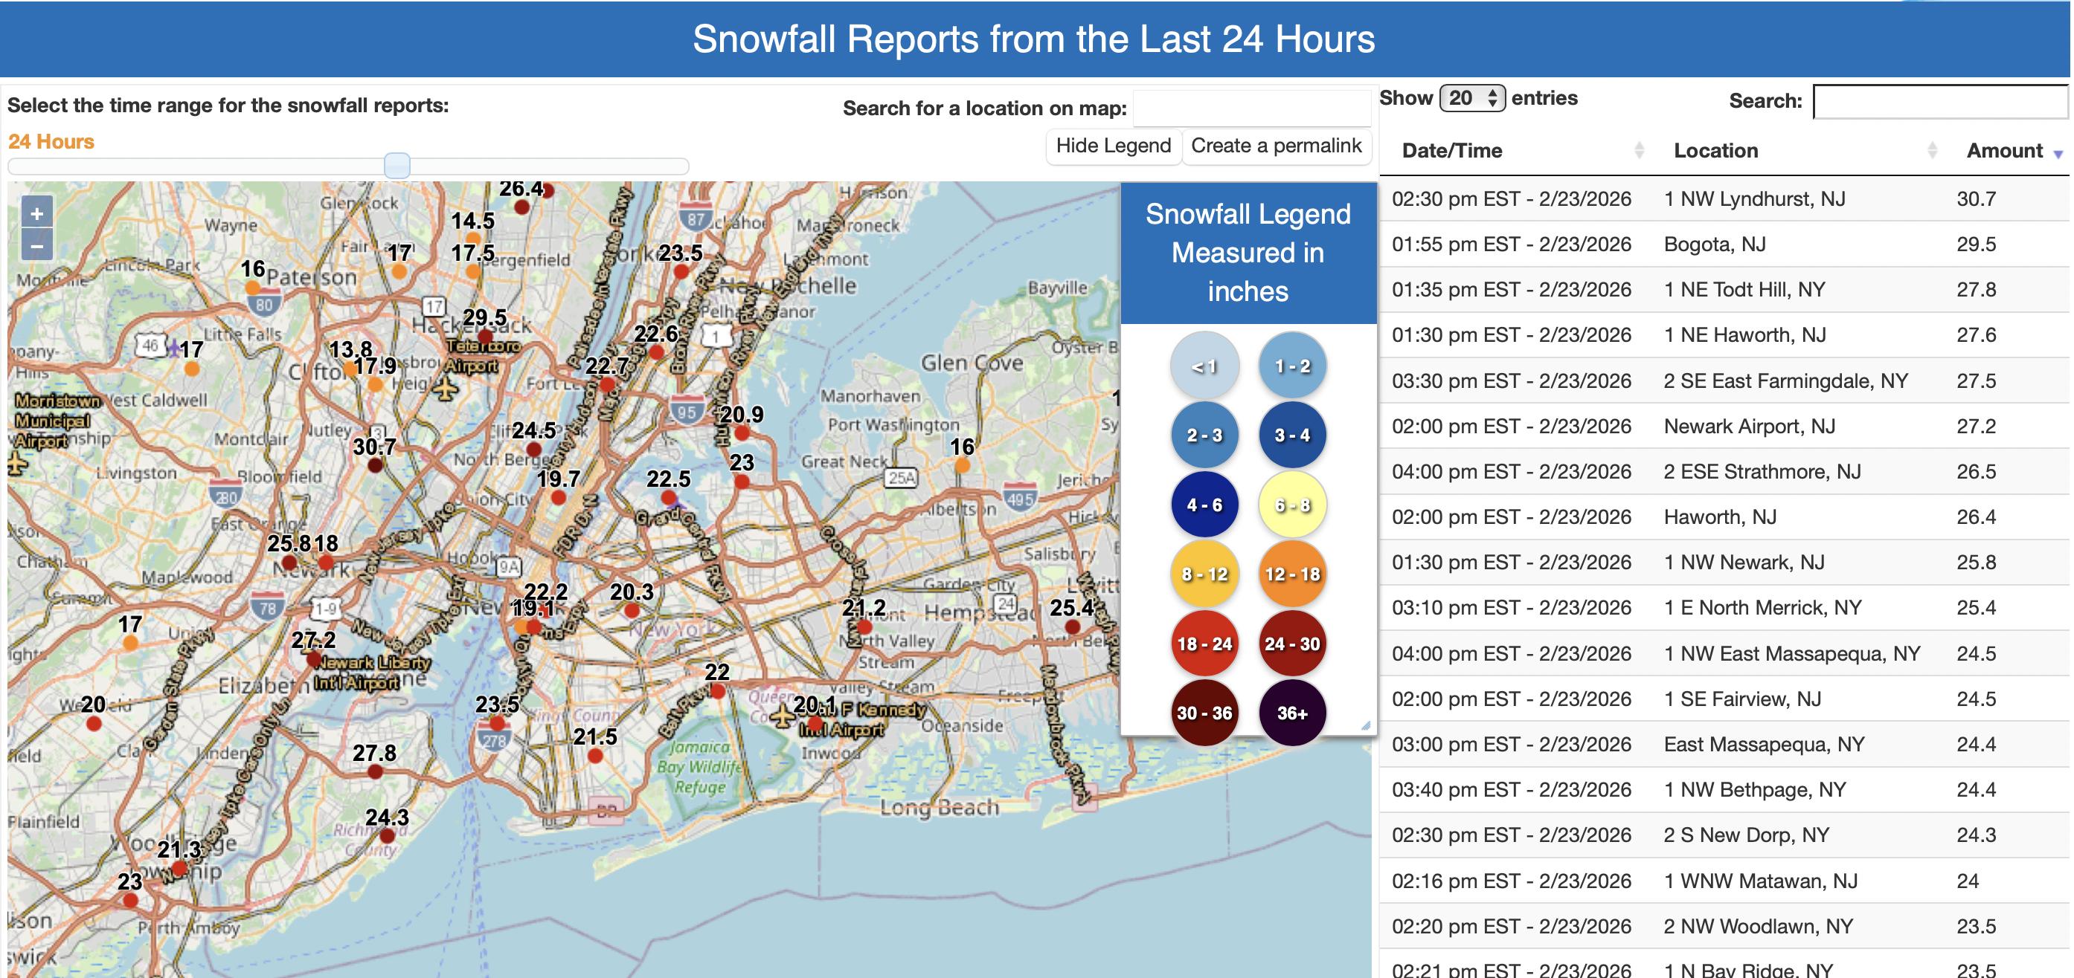
https://www.weather.gov/source/crh/snowmap.html?zoom=5.806067031906572&lat=43.55&lon=-73.05&hr=24

Slide 7
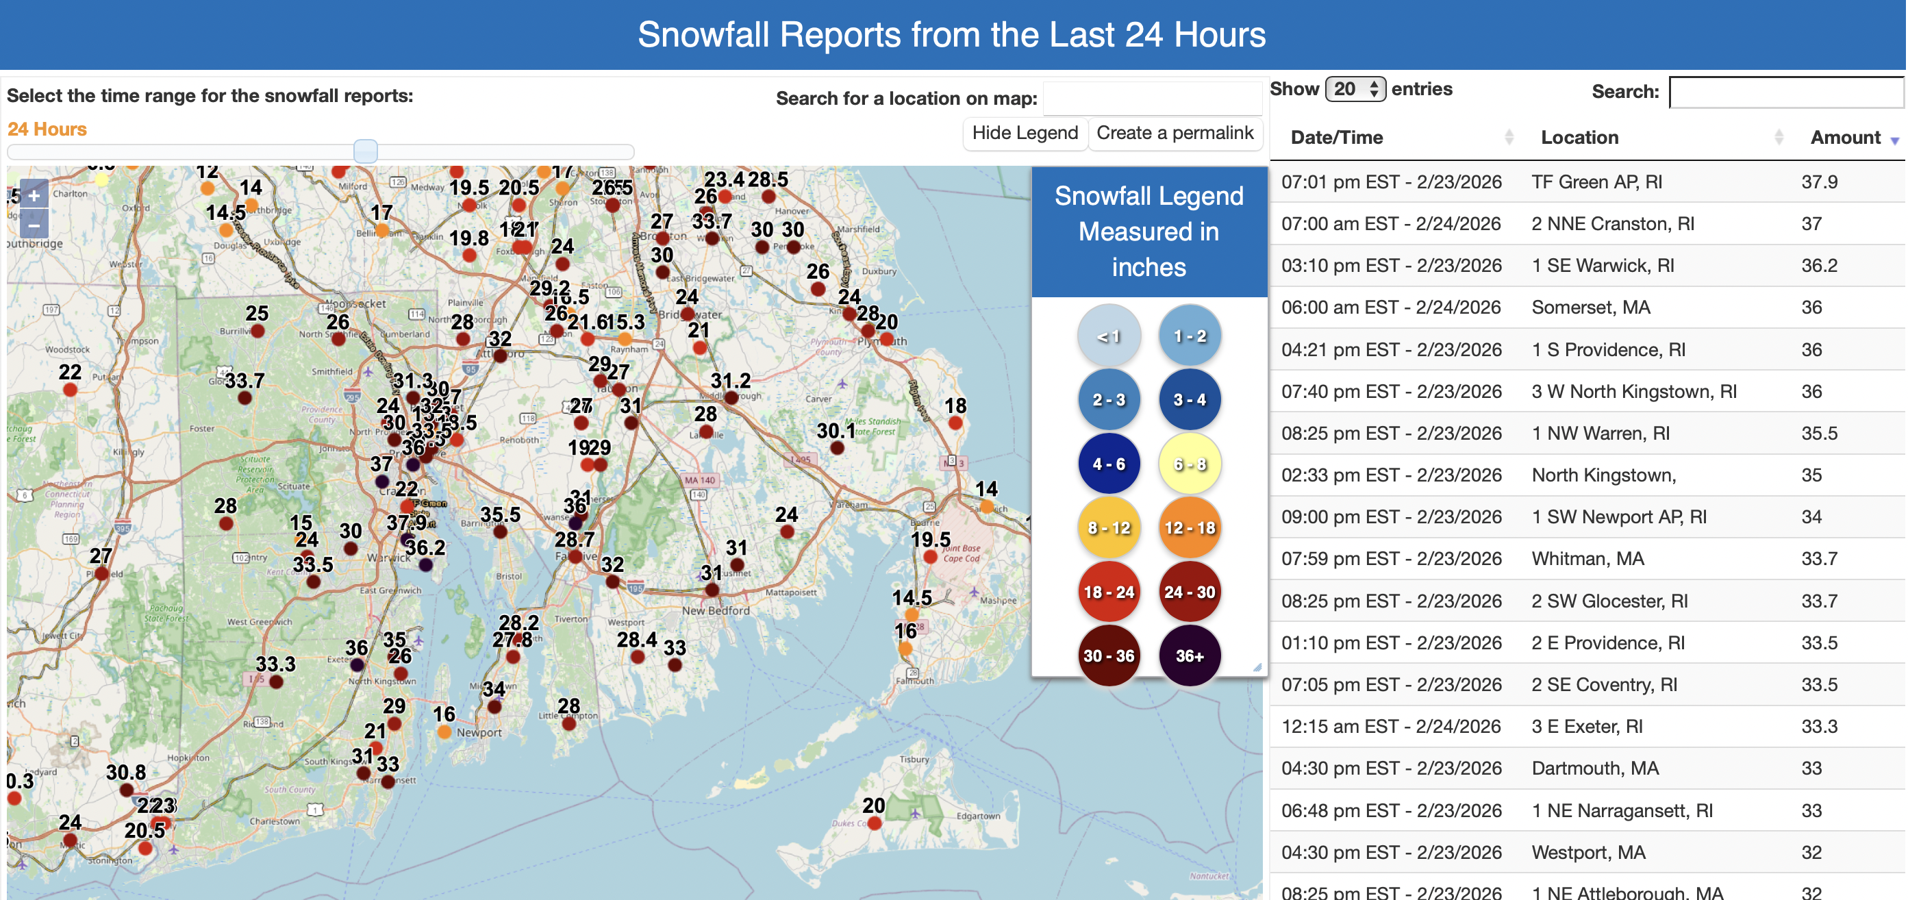
https://www.weather.gov/source/crh/snowmap.html?zoom=5.806067031906572&lat=43.55&lon=-73.05&hr=24

Slide 8
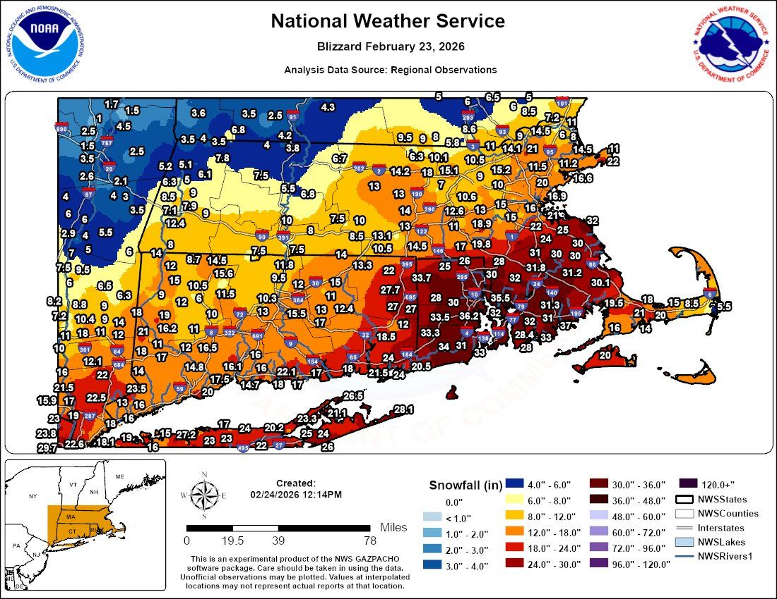
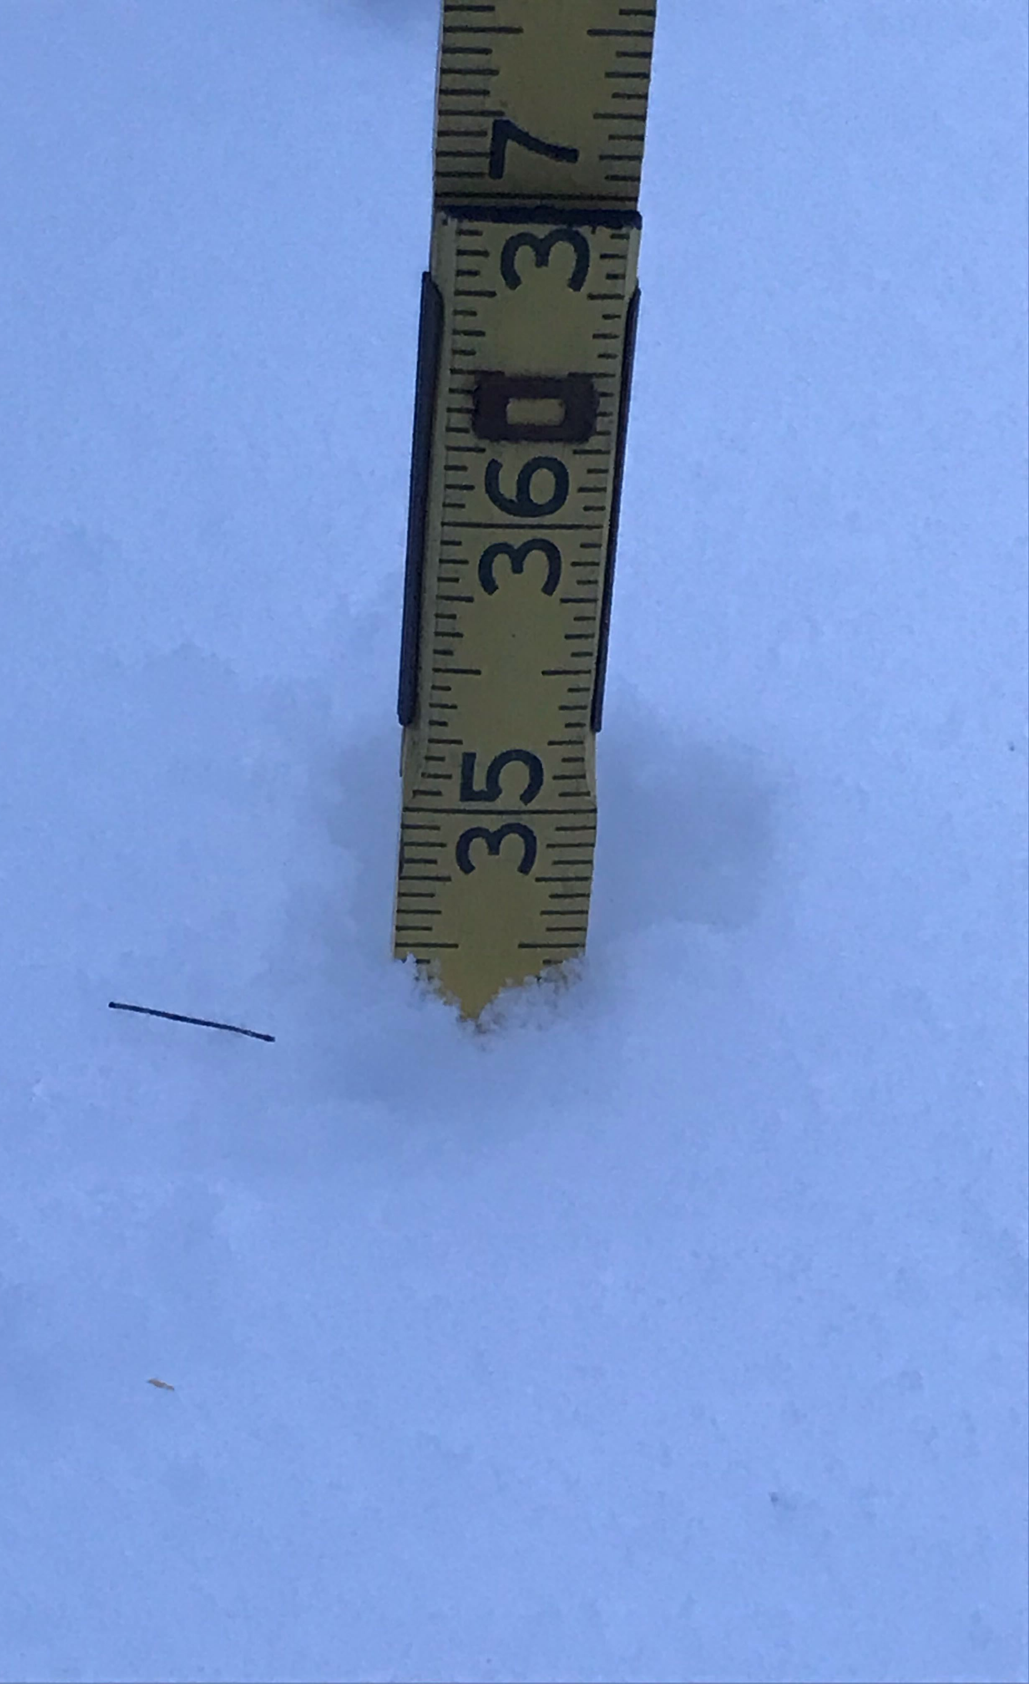
Rochester, MA
Jay’s hometown

Slide 9
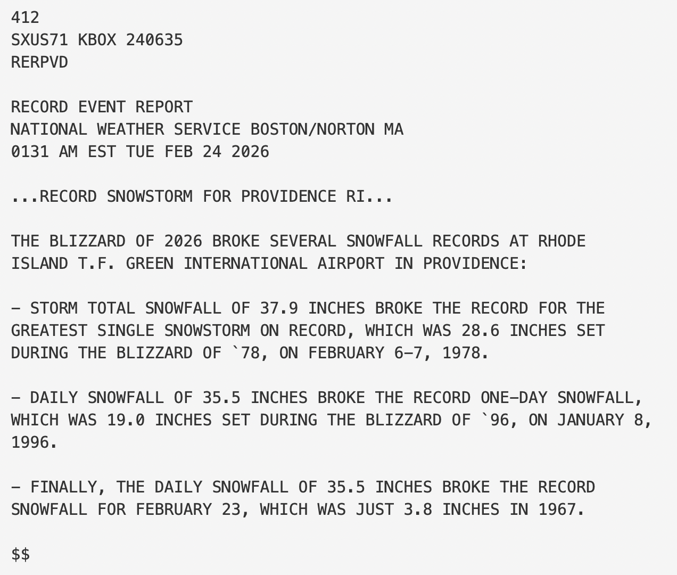
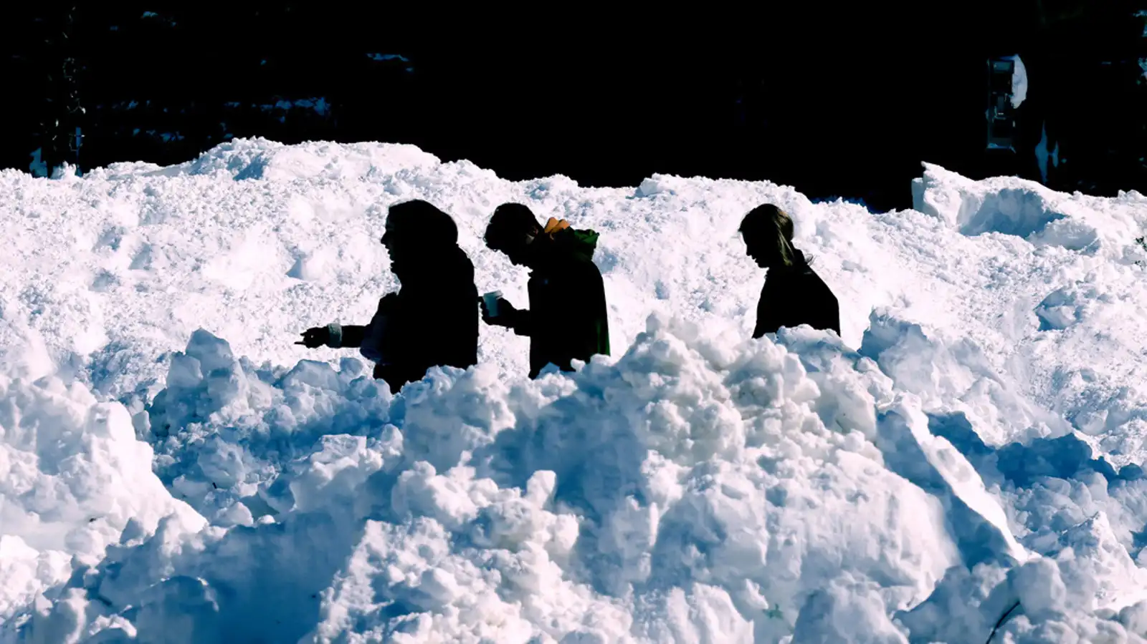
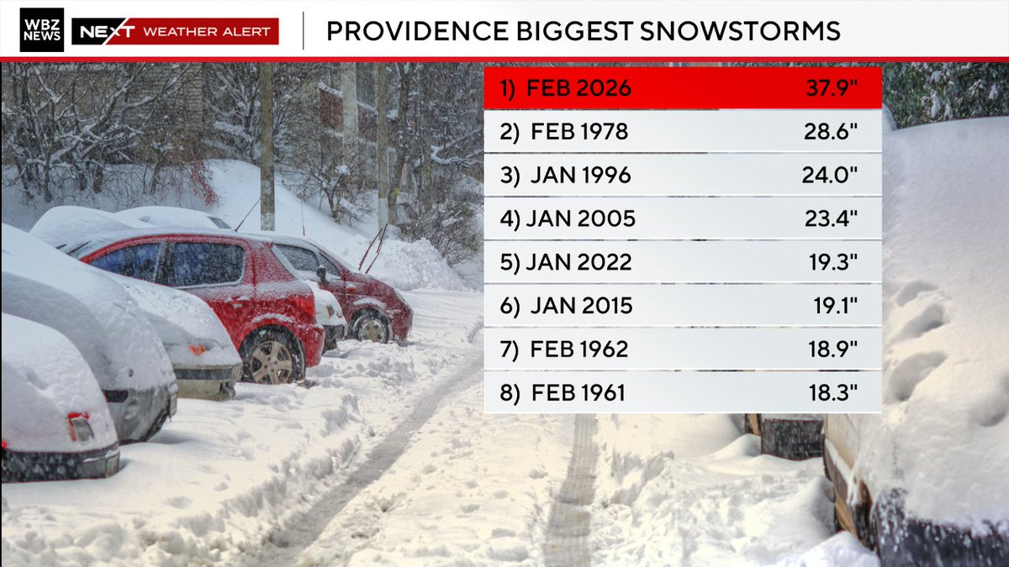
AP Photo/Mark Stockwell)
https://x.com/ericfisher/status/2026087295045005734
Notes:
https://weather.com/storms/winter/news/2026-02-23-east-coast-blizzard-snowstorm-bomb-cyclone-noreaster-recap

Slide 10
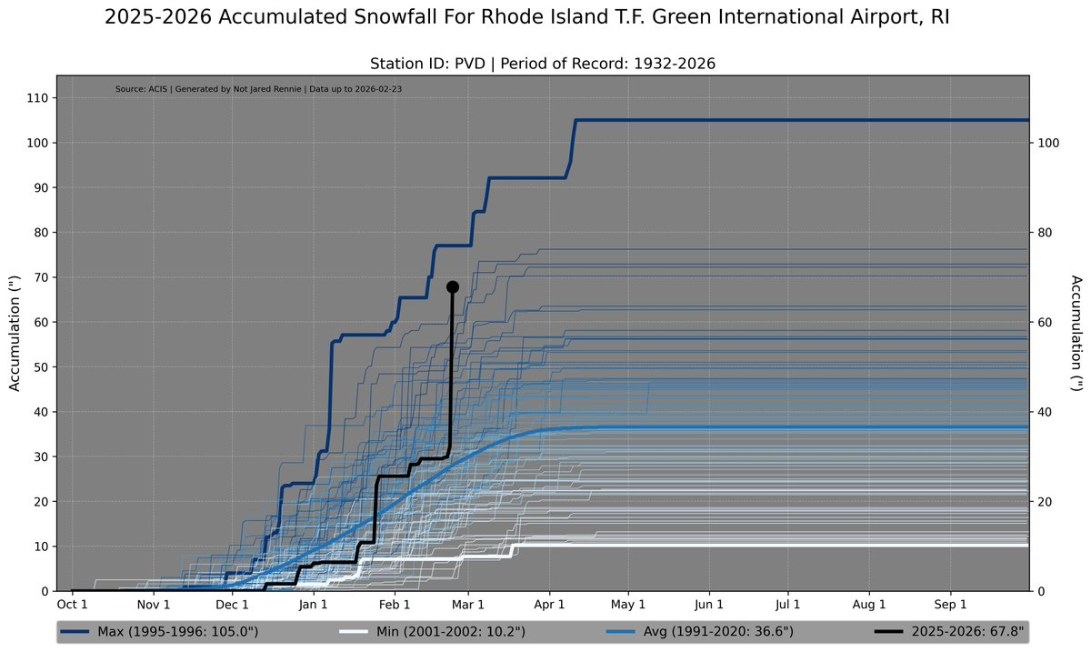
Storm total: 37.9”
Season to date: 67.8”
Storm / Season: 55.9%
Storm / Seasonal Norm: ~103.6%
https://x.com/jjrennie/status/2026351901311193470?s=20
Notes:
https://weather.com/storms/winter/news/2026-02-23-east-coast-blizzard-snowstorm-bomb-cyclone-noreaster-recap

Slide 11
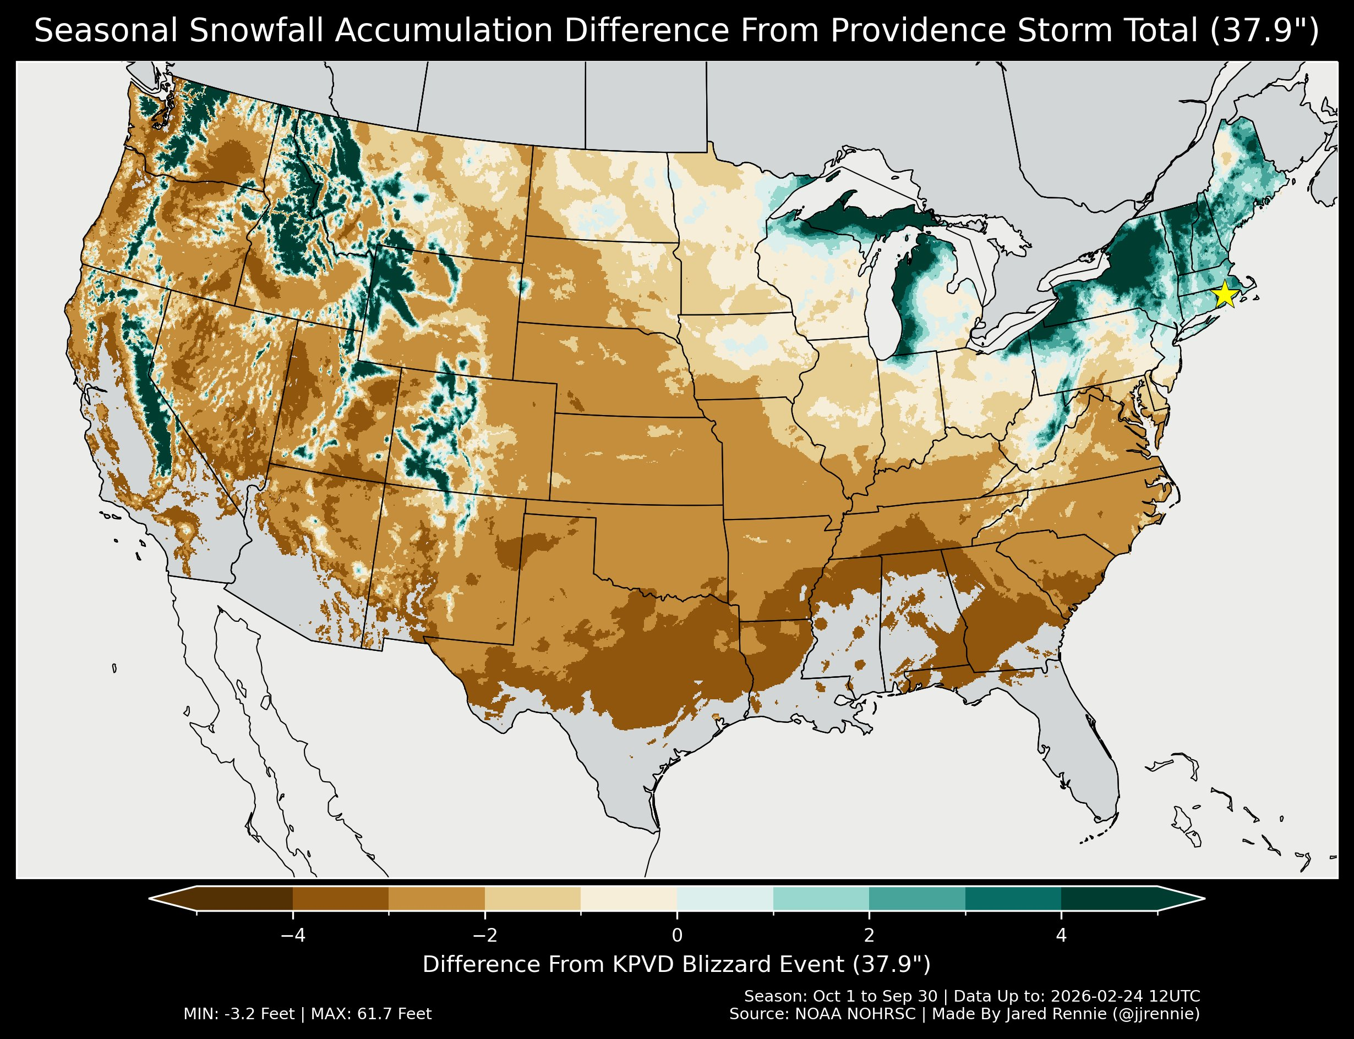
Season has more than Providence’s storm of 37.9”
Season has less than Providence’s storm of 37.9”
https://x.com/jjrennie/status/2026361628397052077?s=20
Notes:
https://weather.com/storms/winter/news/2026-02-23-east-coast-blizzard-snowstorm-bomb-cyclone-noreaster-recap

Slide 12
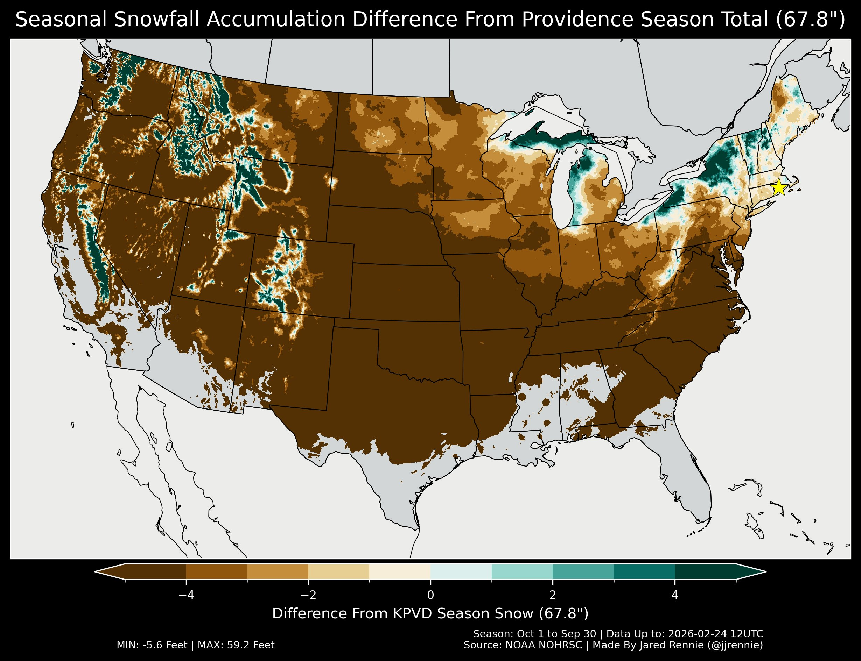
Season has more than Providence’s SEASON of 67.8”
Season has less than Providence’s SEASON of 67.8”
https://x.com/jjrennie/status/2026361628397052077?s=20
Notes:
https://weather.com/storms/winter/news/2026-02-23-east-coast-blizzard-snowstorm-bomb-cyclone-noreaster-recap

Slide 13
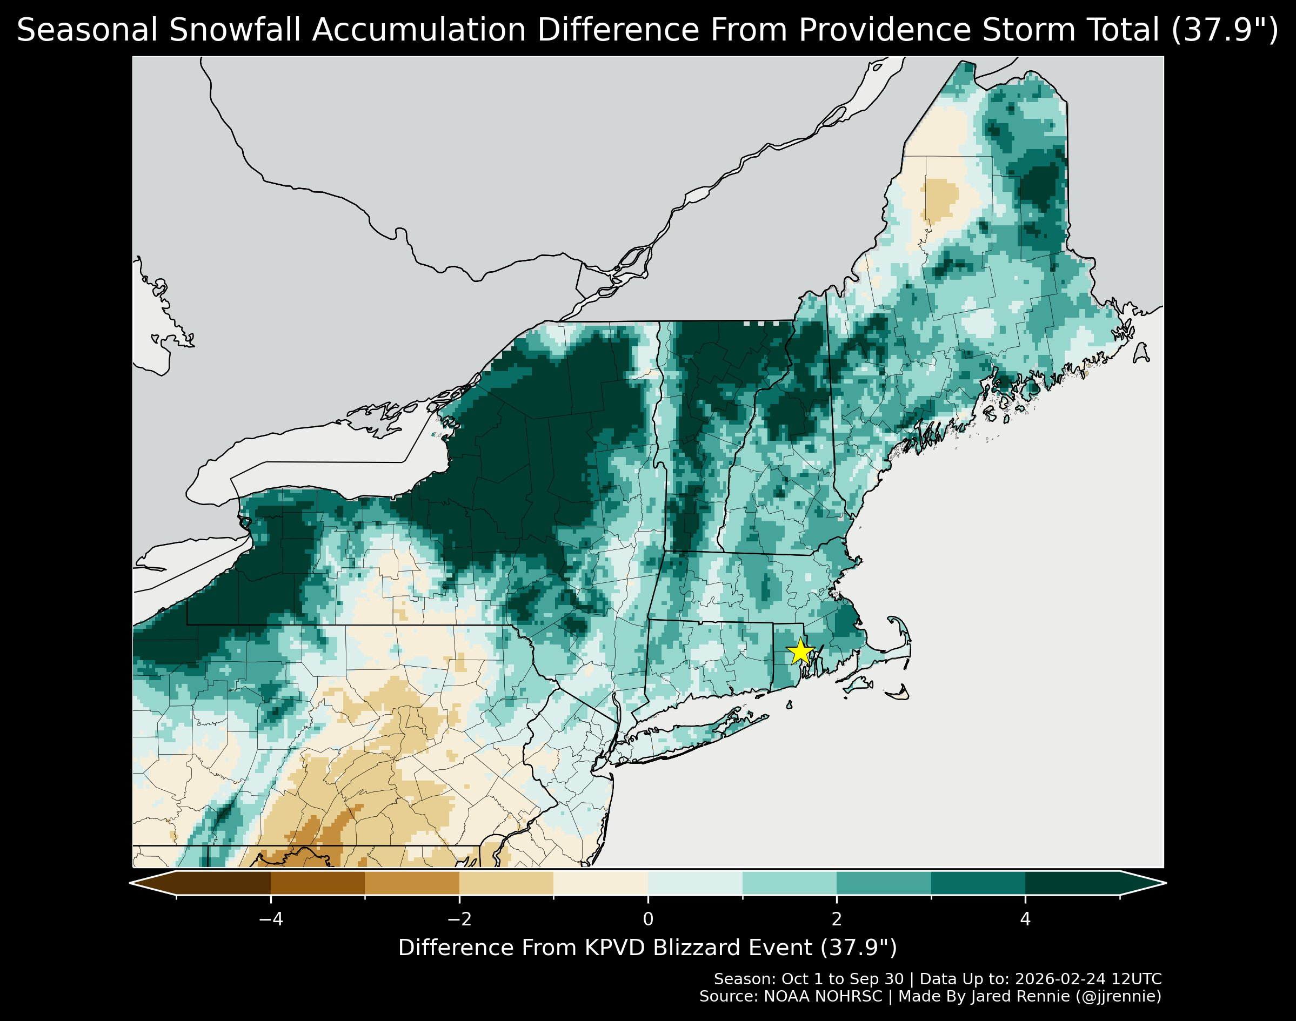
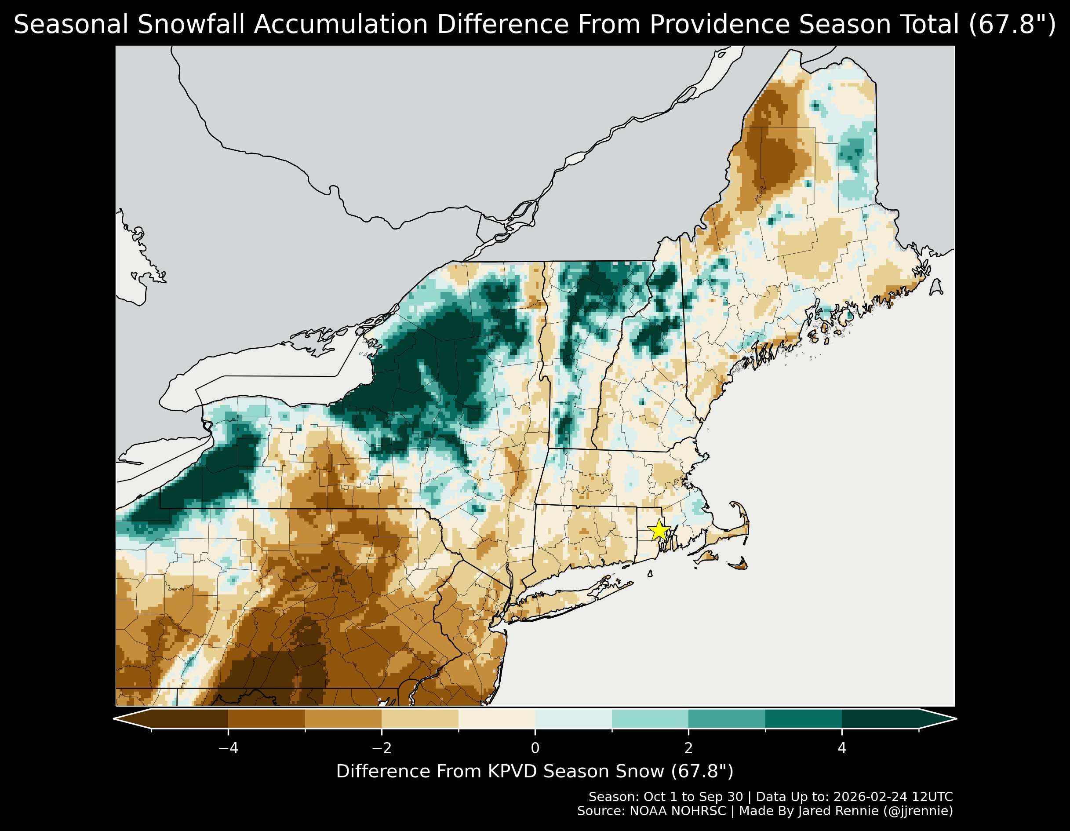
Season >< Providence’s STORM of 37.9”
Season >< Providence’s SEASON of 67.8”
While most of New England has seen more than 37.9” of snow, only the lake-effect belts and the higher terrain has seen more seasonal snowfall than Providence, except for a few near-coastal locations impacted by the January storm and inverted trough storm.
https://x.com/jjrennie/status/2026361628397052077?s=20
Notes:
https://weather.com/storms/winter/news/2026-02-23-east-coast-blizzard-snowstorm-bomb-cyclone-noreaster-recap

Slide 14
Comparison with Past Storms
In Rhode Island

Slide 15
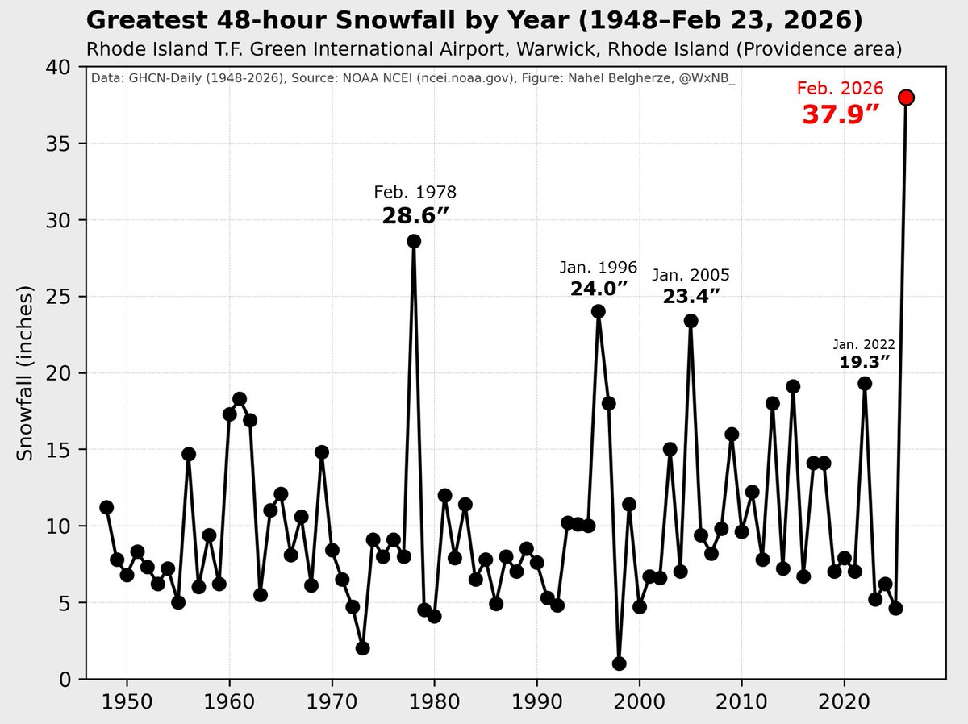
https://x.com/WxNB_/status/2026288027287404935?s=20
Notes:
https://weather.com/storms/winter/news/2026-02-23-east-coast-blizzard-snowstorm-bomb-cyclone-noreaster-recap

Slide 16
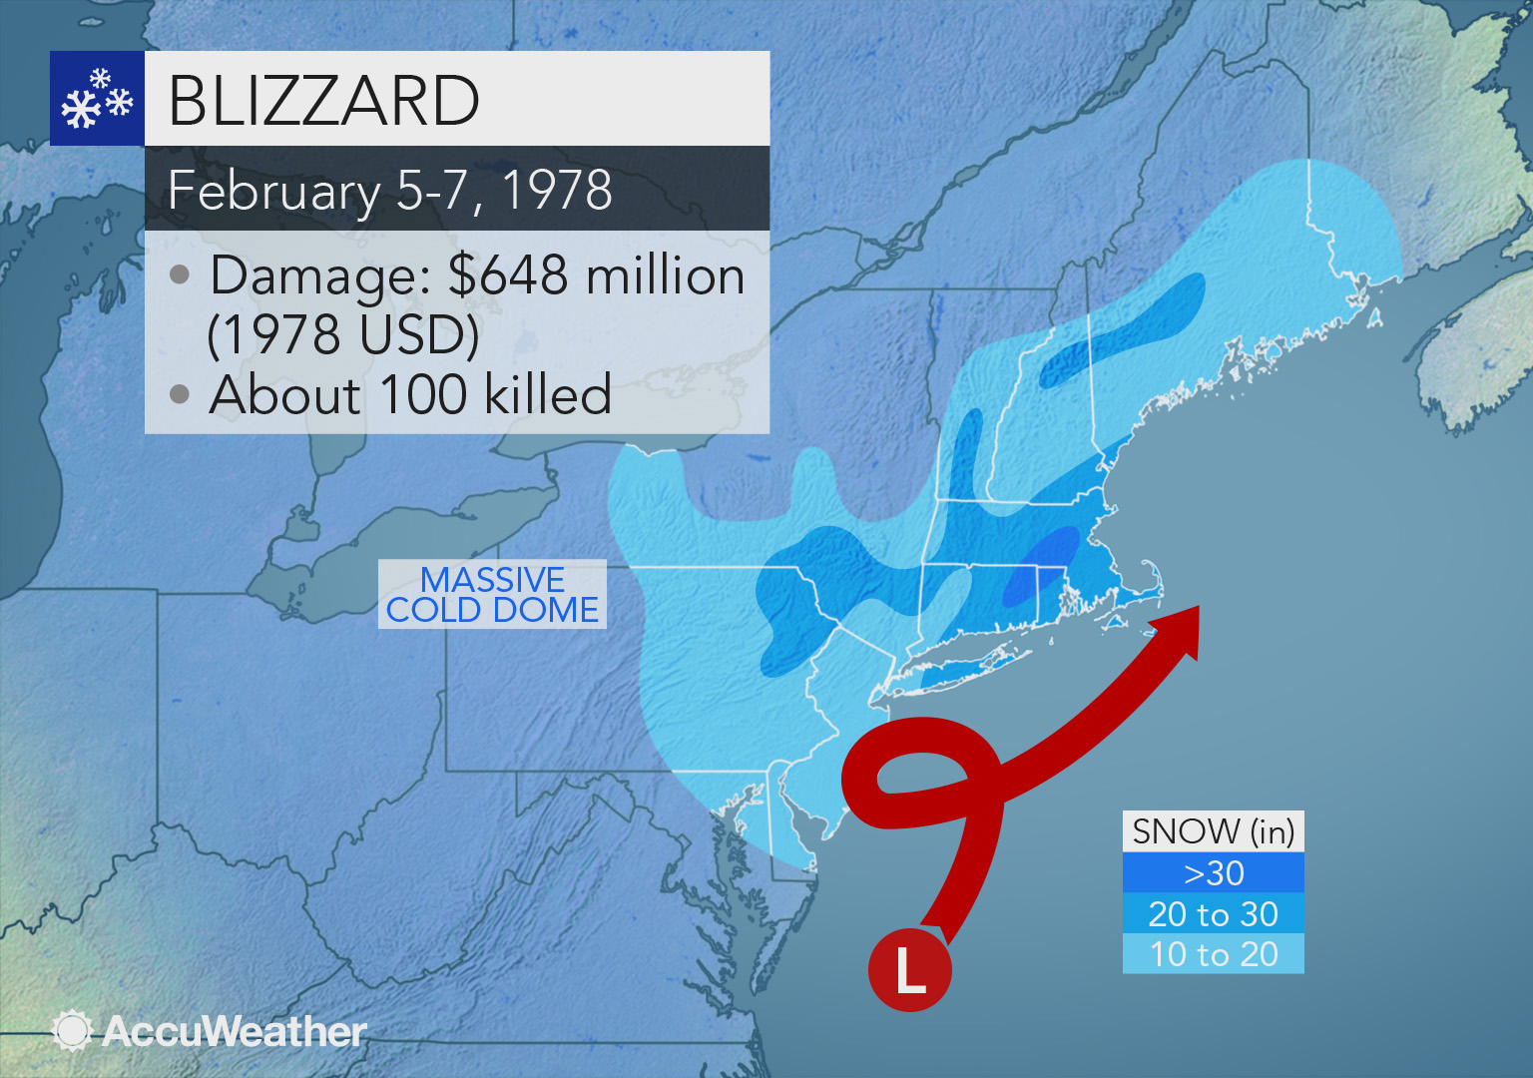
Notes:
https://weather.com/storms/winter/news/2026-02-23-east-coast-blizzard-snowstorm-bomb-cyclone-noreaster-recap

Slide 17
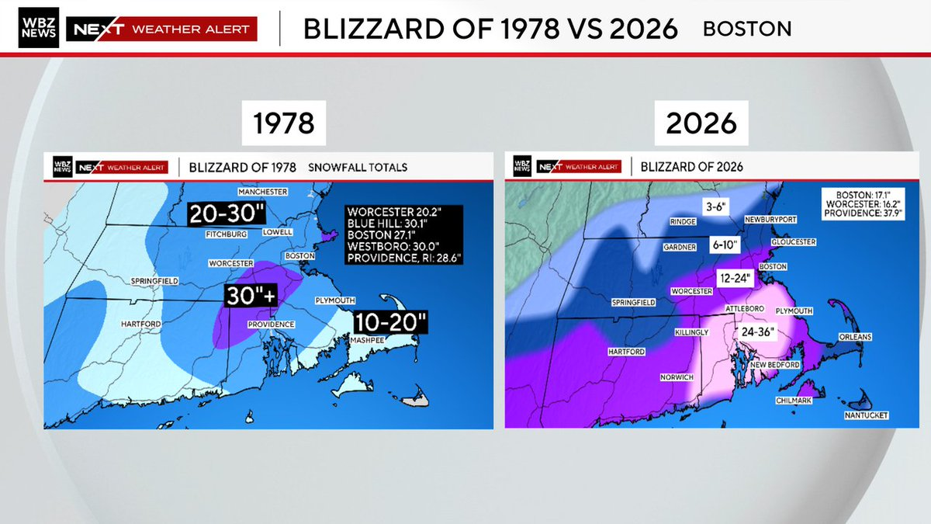
https://x.com/TerryWBZ/status/2026338381018358156?s=20
Notes:
https://weather.com/storms/winter/news/2026-02-23-east-coast-blizzard-snowstorm-bomb-cyclone-noreaster-recap

Slide 18
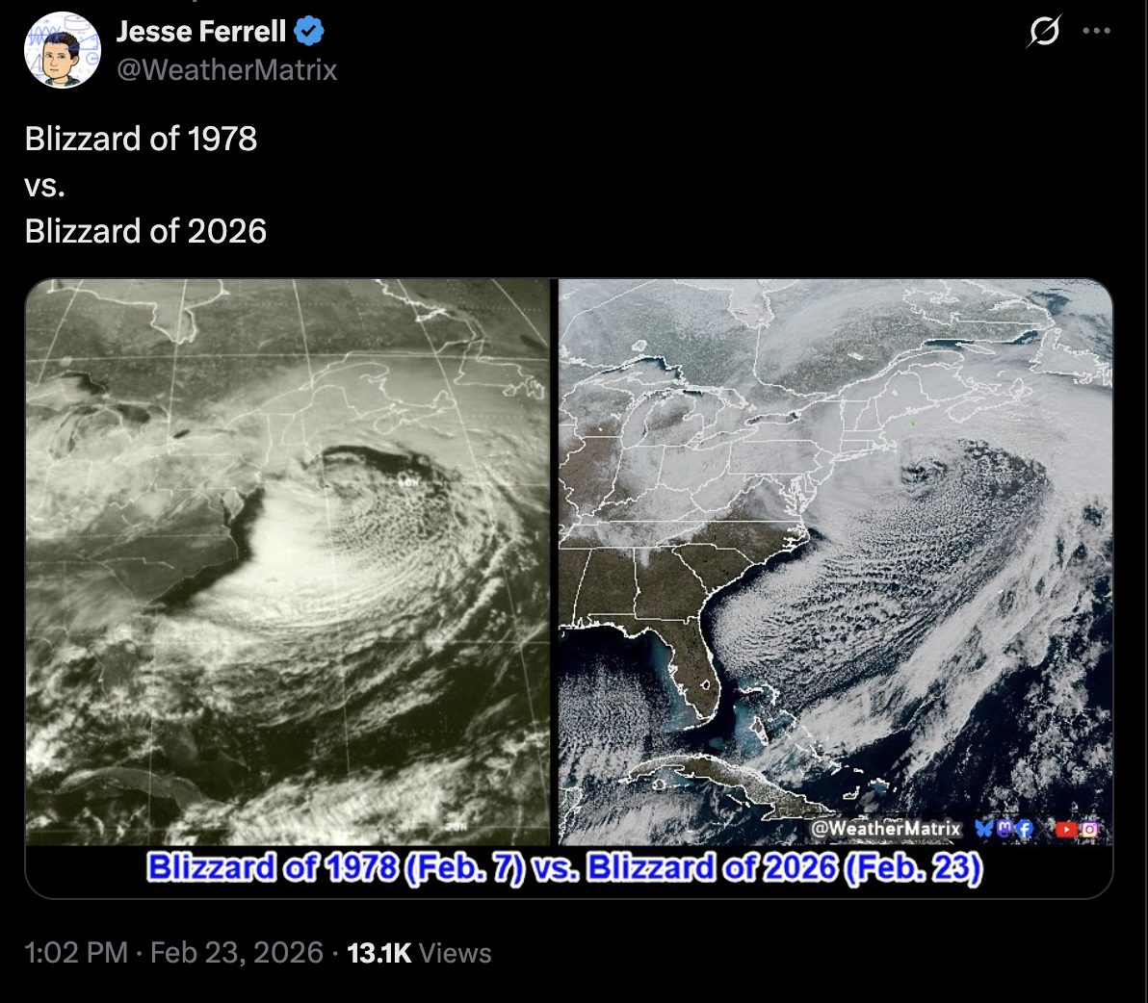
Notes:
https://weather.com/storms/winter/news/2026-02-23-east-coast-blizzard-snowstorm-bomb-cyclone-noreaster-recap

Slide 19
Notes:
https://weather.com/storms/winter/news/2026-02-23-east-coast-blizzard-snowstorm-bomb-cyclone-noreaster-recap

Slide 20
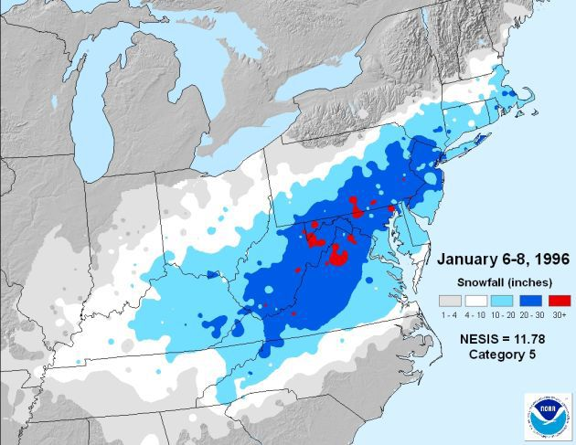
1996
Notes:
https://weather.com/storms/winter/news/2026-02-23-east-coast-blizzard-snowstorm-bomb-cyclone-noreaster-recap

Slide 21
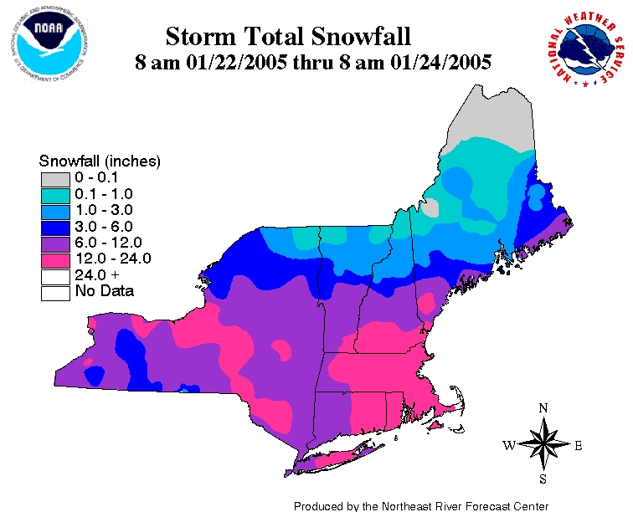
2005
Notes:
https://weather.com/storms/winter/news/2026-02-23-east-coast-blizzard-snowstorm-bomb-cyclone-noreaster-recap

Slide 22
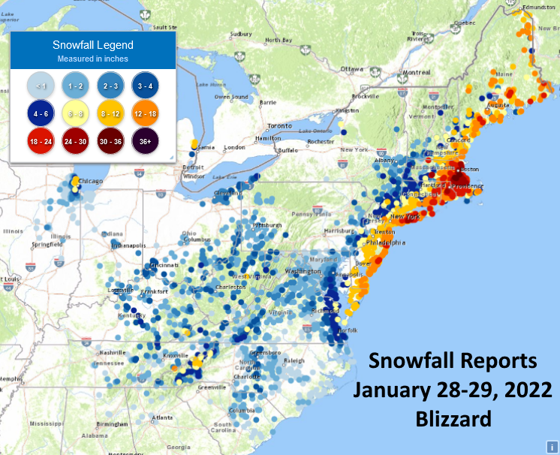
2022
Notes:
https://weather.com/storms/winter/news/2026-02-23-east-coast-blizzard-snowstorm-bomb-cyclone-noreaster-recap

Slide 23
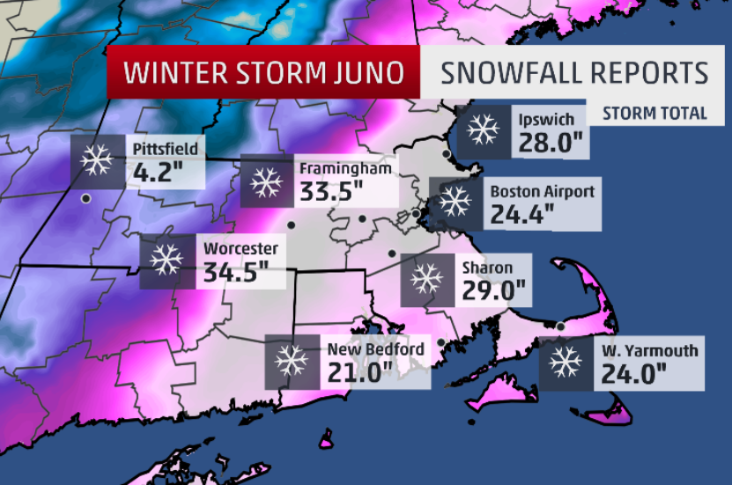
2015
Notes:
https://weather.com/storms/winter/news/2026-02-23-east-coast-blizzard-snowstorm-bomb-cyclone-noreaster-recap

Slide 24
Eye Candy and Photos from Social Media

Slide 25
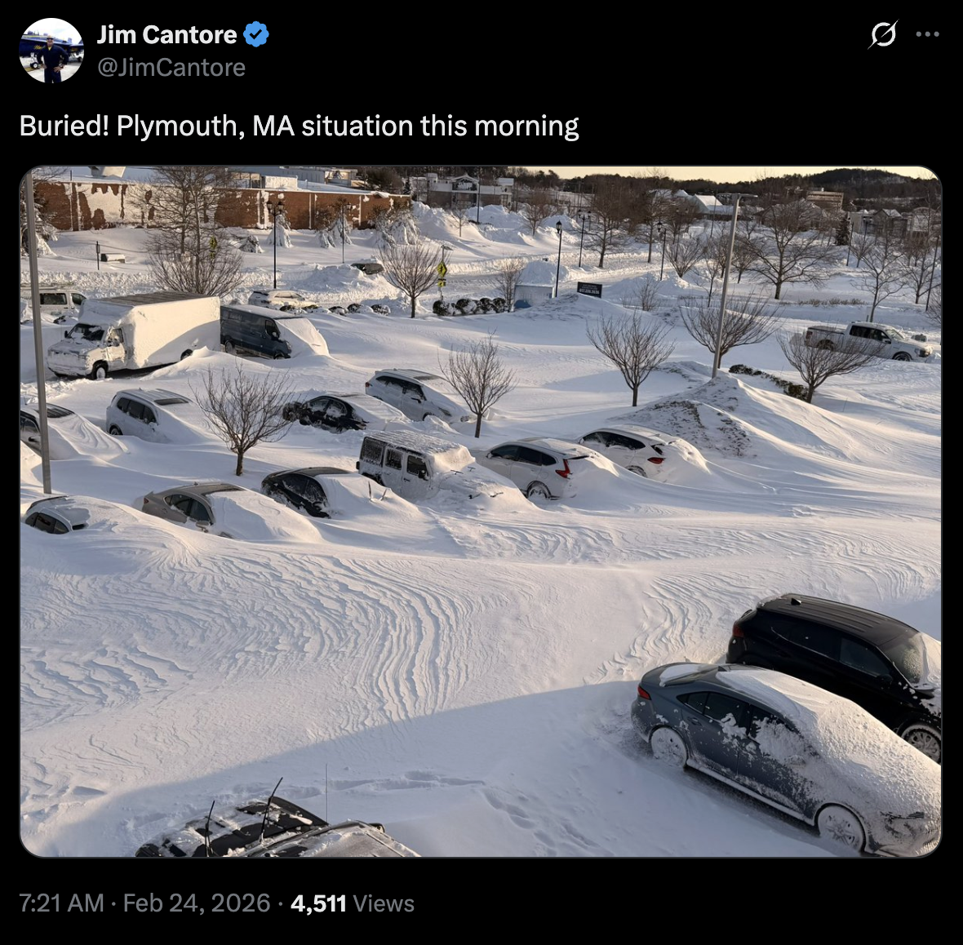
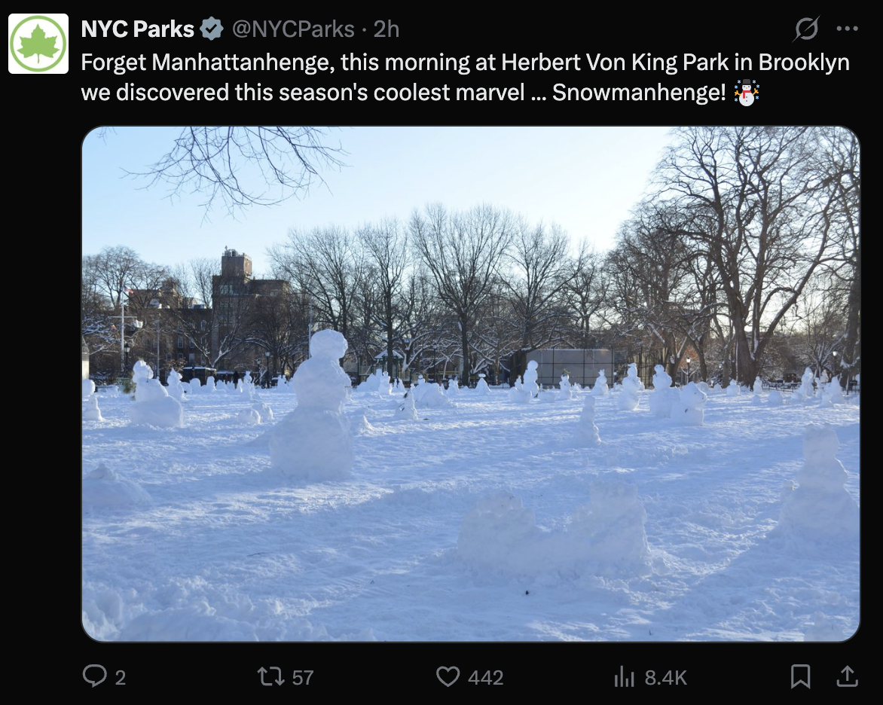
Notes:
https://weather.com/storms/winter/news/2026-02-23-east-coast-blizzard-snowstorm-bomb-cyclone-noreaster-recap

Slide 26
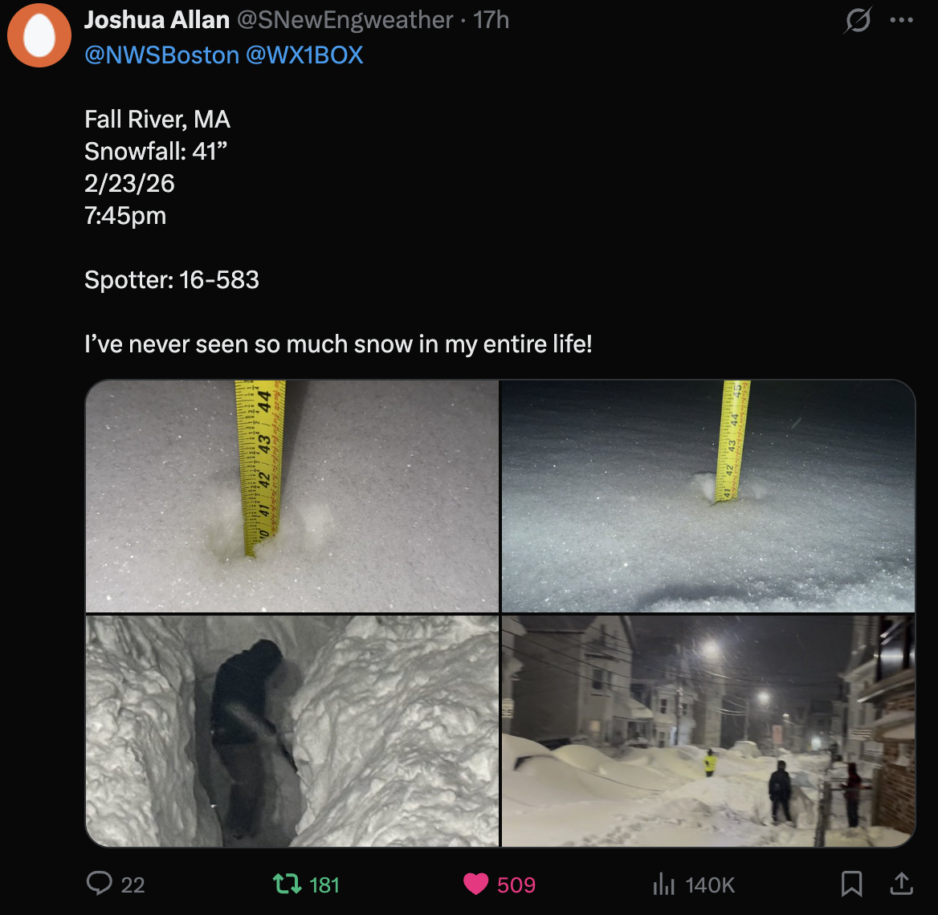
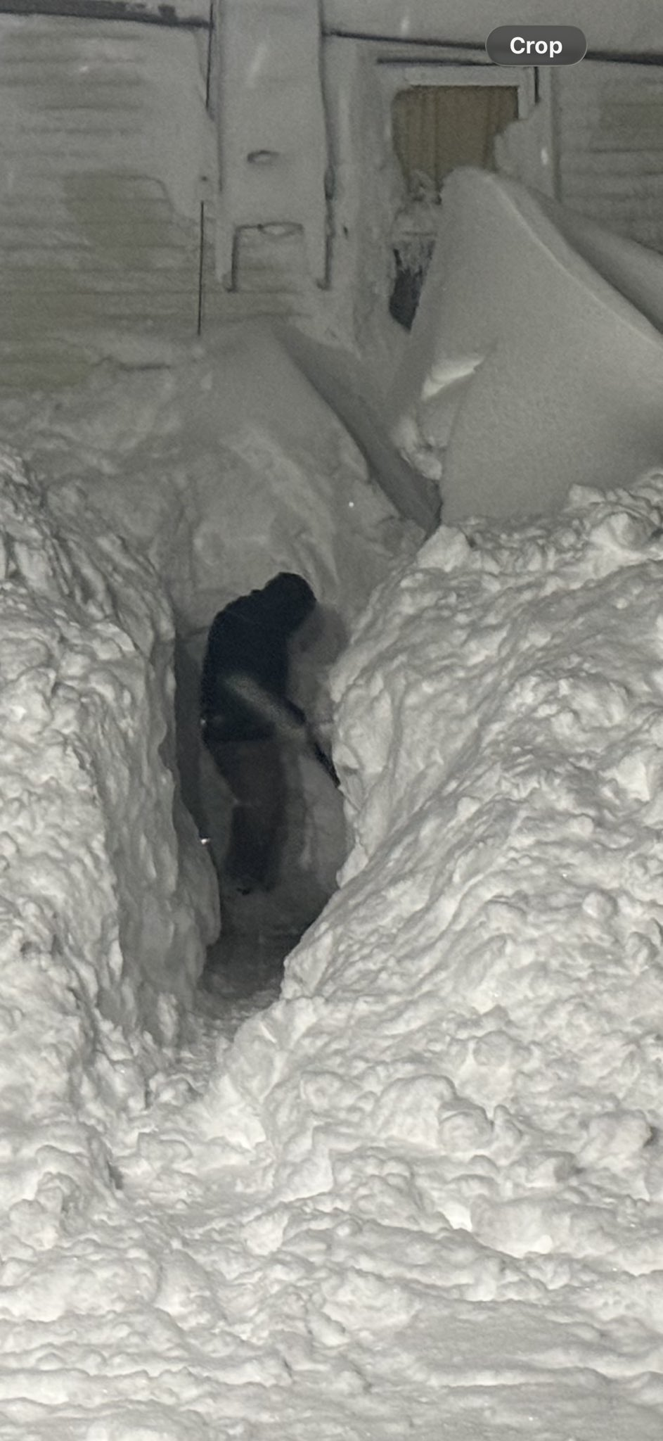
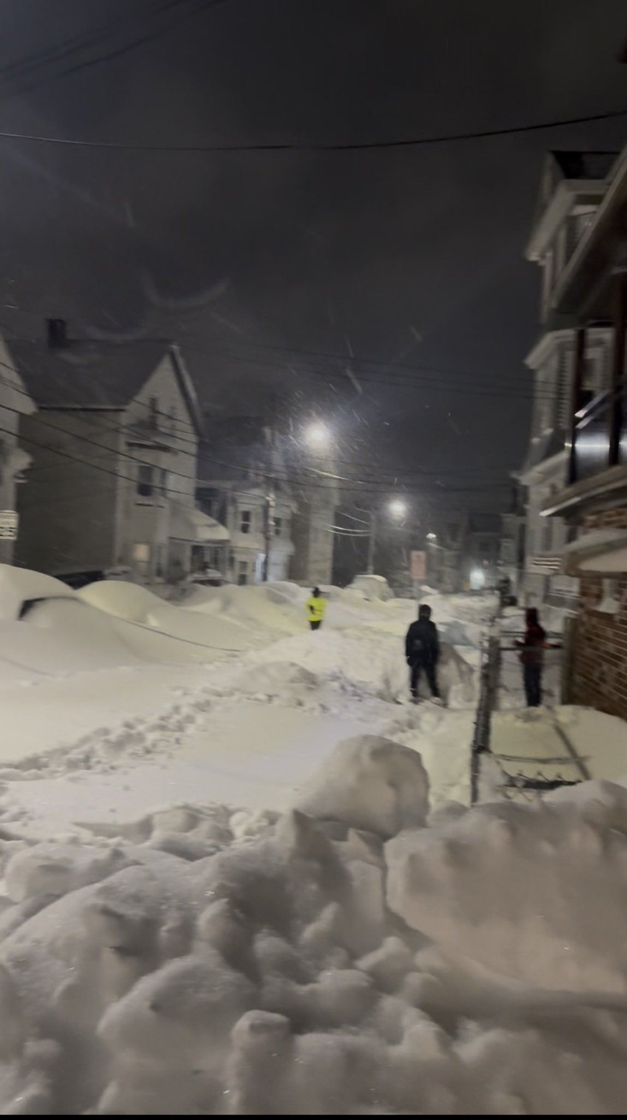
Notes:
https://weather.com/storms/winter/news/2026-02-23-east-coast-blizzard-snowstorm-bomb-cyclone-noreaster-recap

Slide 27
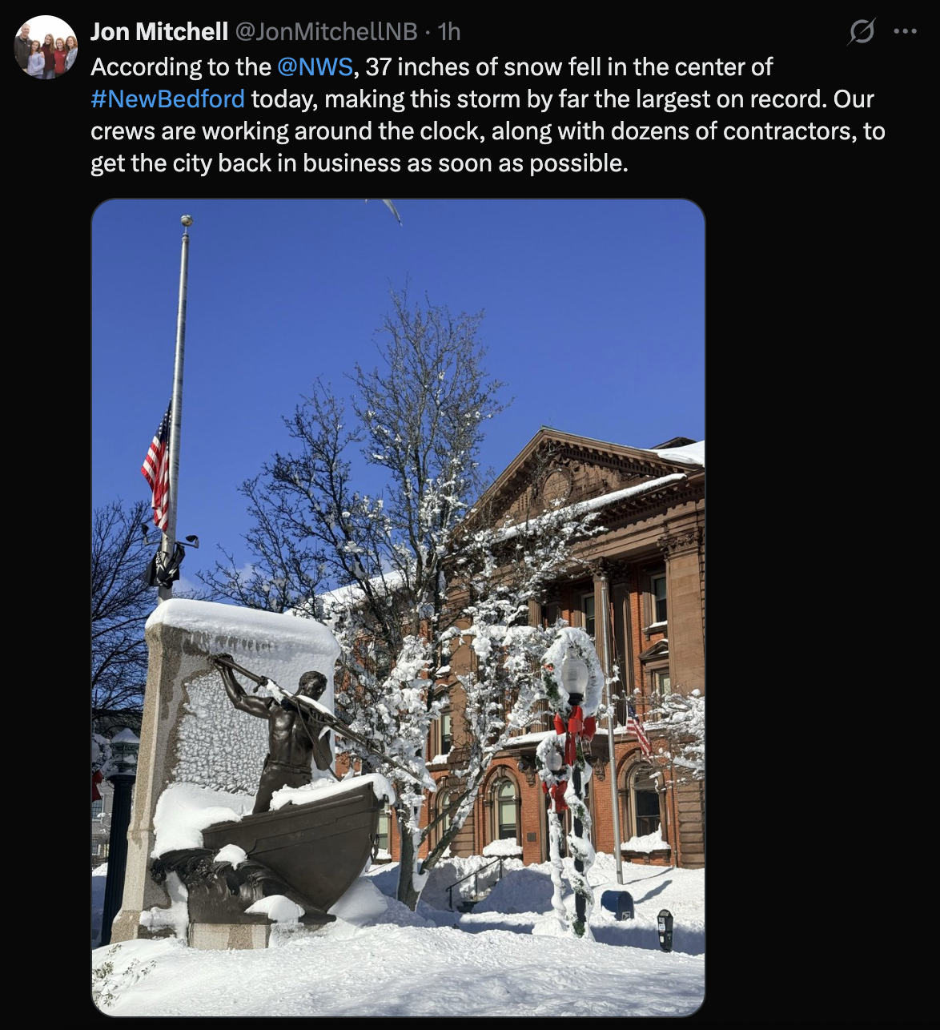
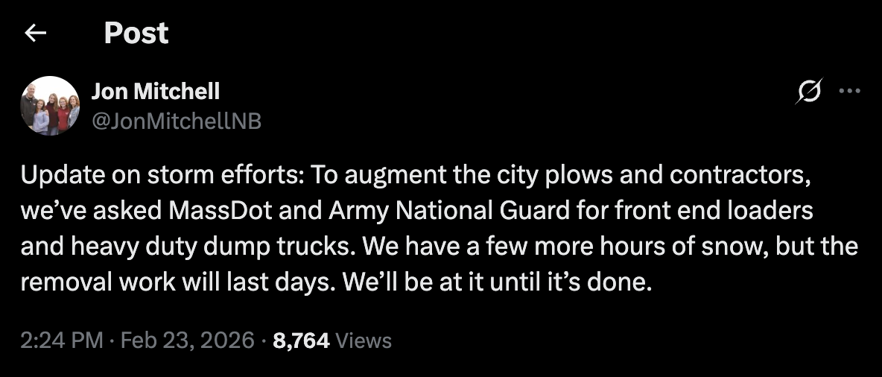
↑ Posted on 23 Feb
←Posted on 24 Feb, Mayor of New Bedford, MA
Notes:
https://weather.com/storms/winter/news/2026-02-23-east-coast-blizzard-snowstorm-bomb-cyclone-noreaster-recap

Slide 28

Notes:
https://weather.com/storms/winter/news/2026-02-23-east-coast-blizzard-snowstorm-bomb-cyclone-noreaster-recap

Slide 29
Snowfall and Banding
(and more eye candy)

Slide 30
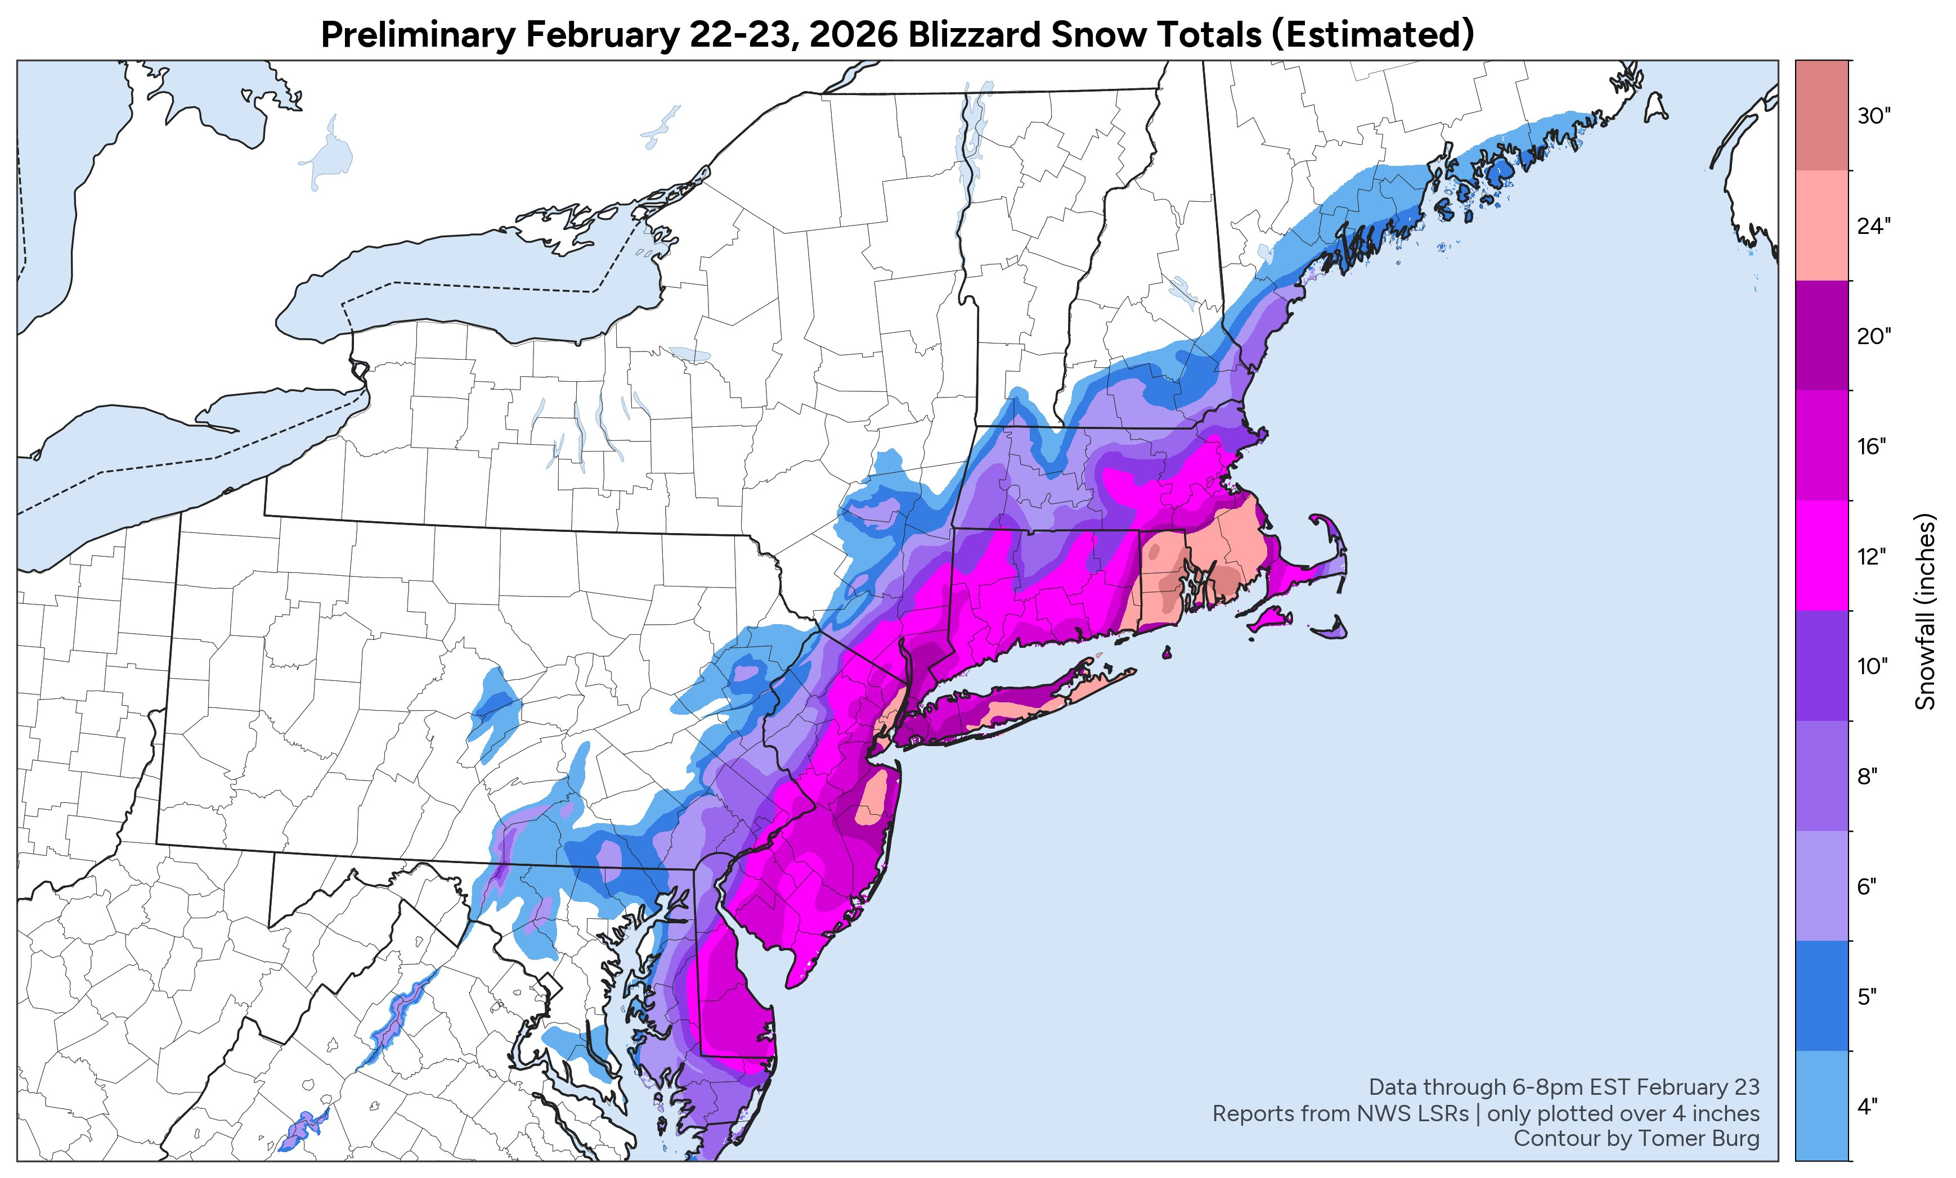
https://x.com/burgwx/status/2026101867470553155?s=20

Slide 31
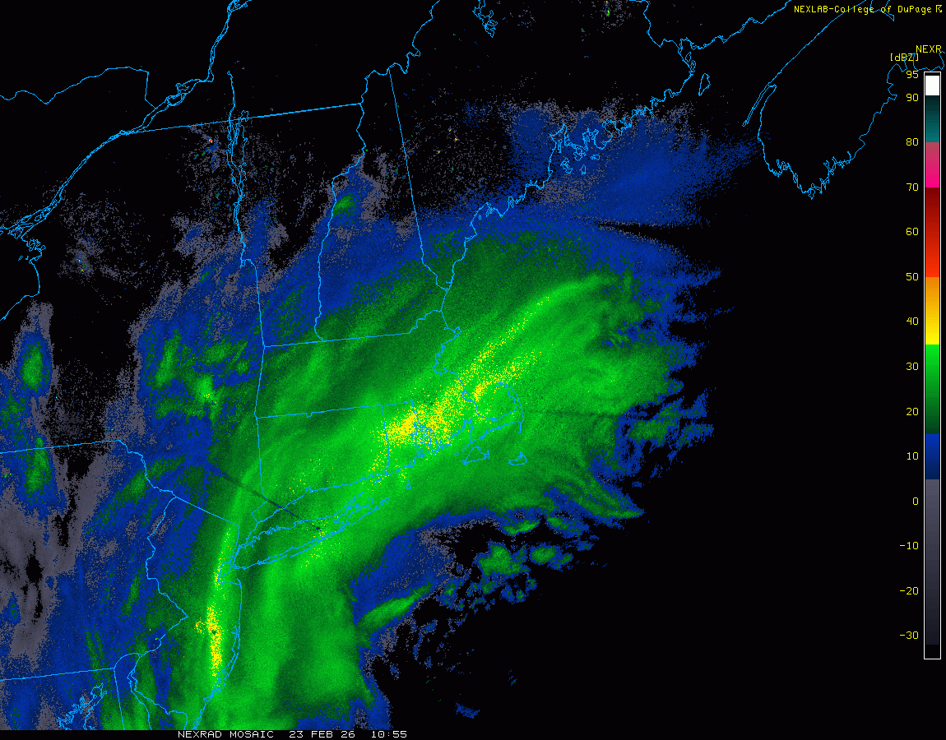
https://x.com/burgwx/status/2026101867470553155?s=20

Slide 32
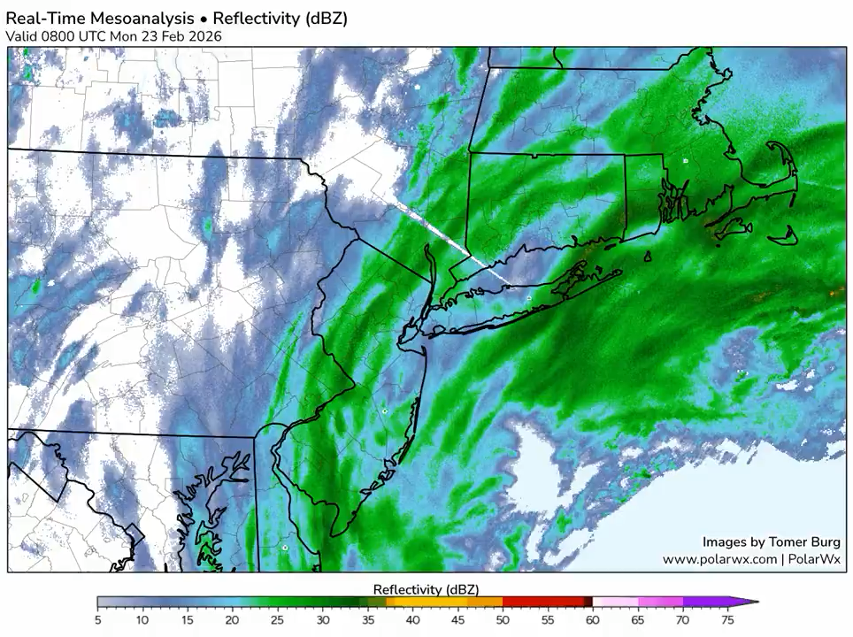
https://x.com/burgwx/status/2026079679485014281
https://x.com/burgwx/status/2026101867470553155?s=20

Slide 33
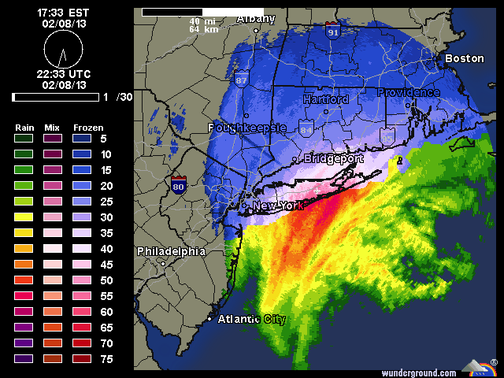
February 2013 Nor’easter with particularly strong mesoscale band that dropped 40” in Hamden, CT
Portland, ME: 31.9”
Nova Scotia gusted to 102 mph
Boston had 4.2-ft storm surge

Slide 34
Other Impacts

Slide 35
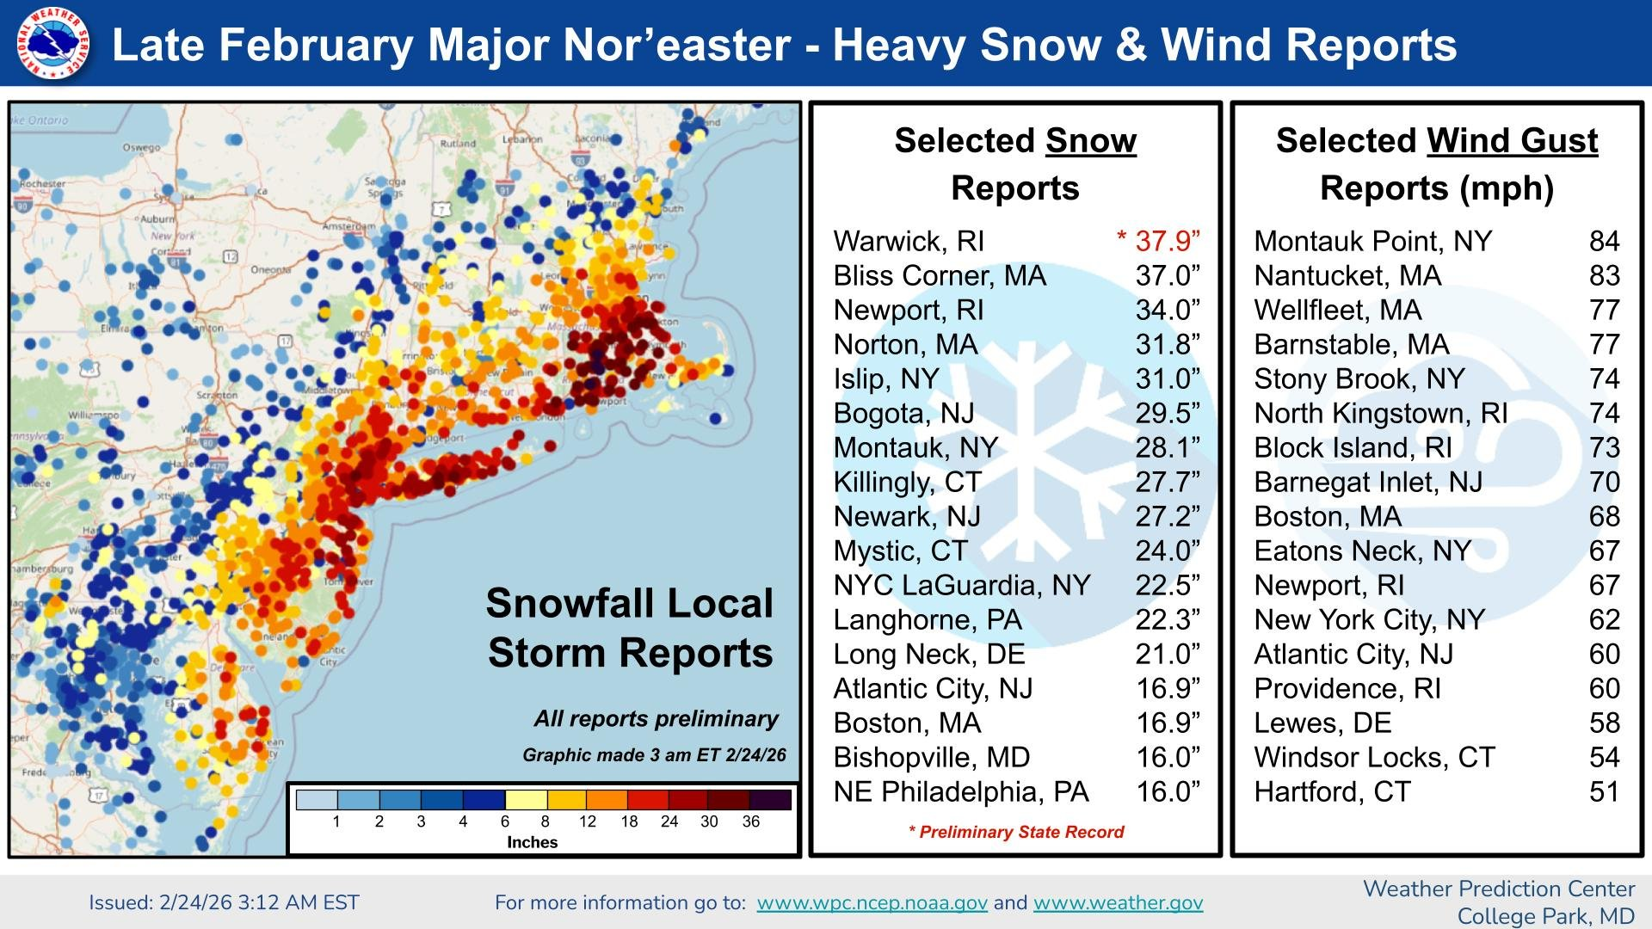

Slide 36
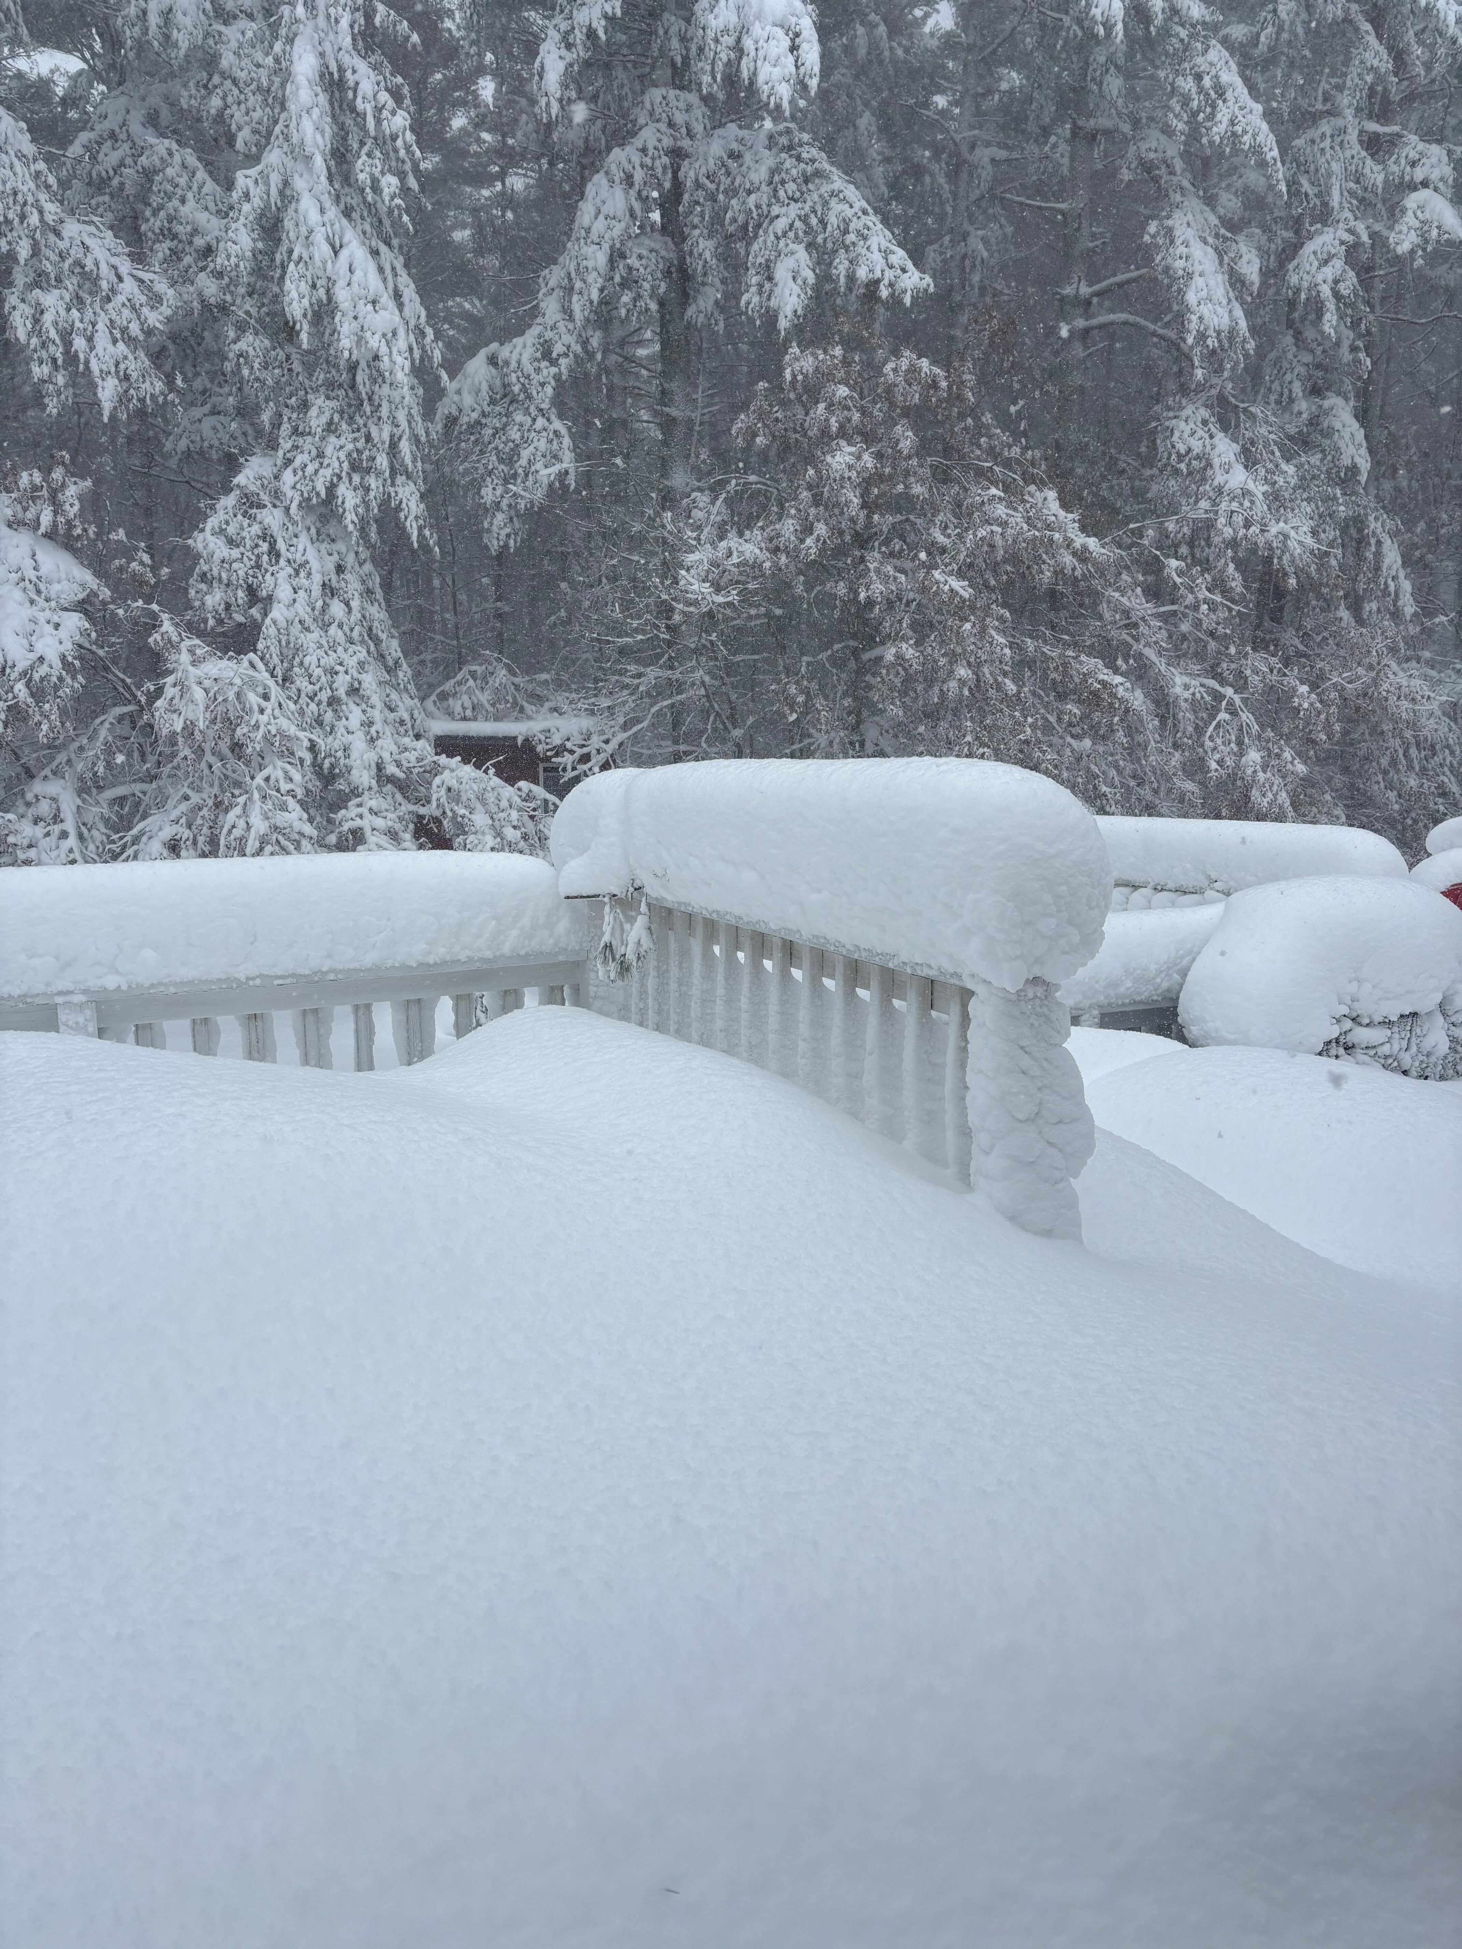
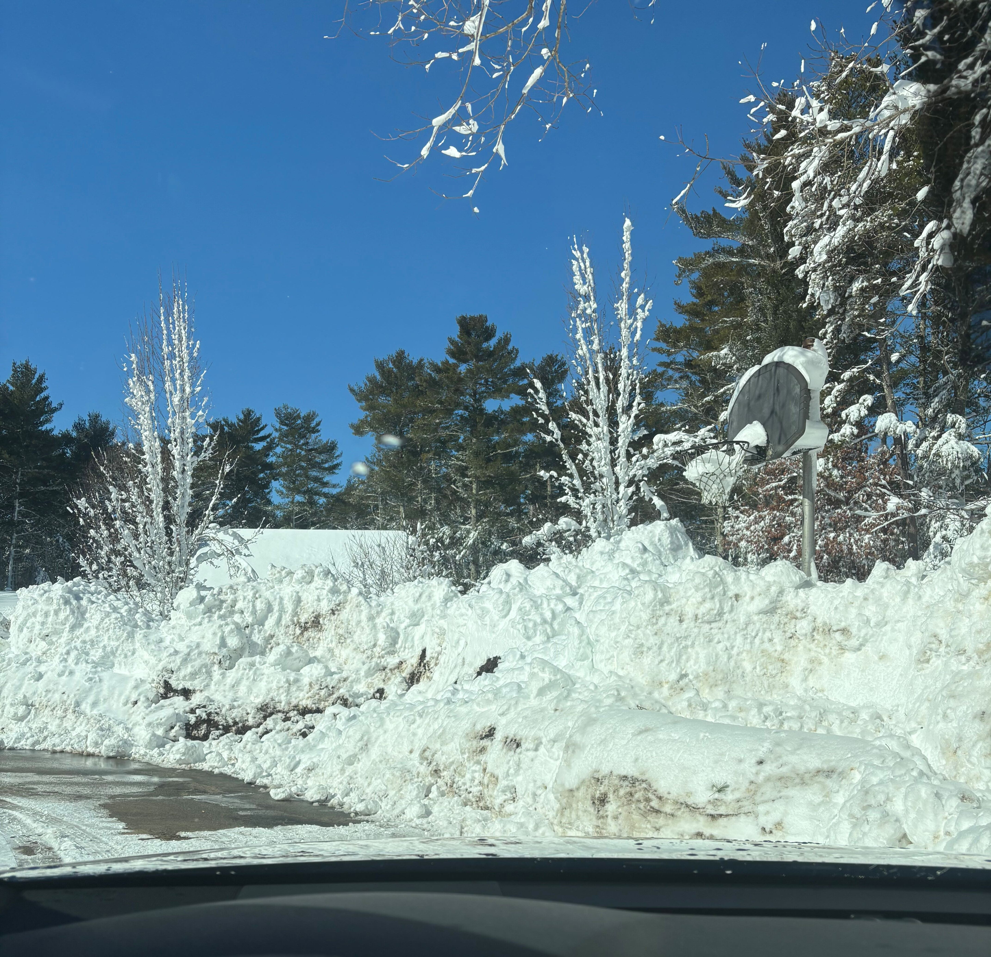

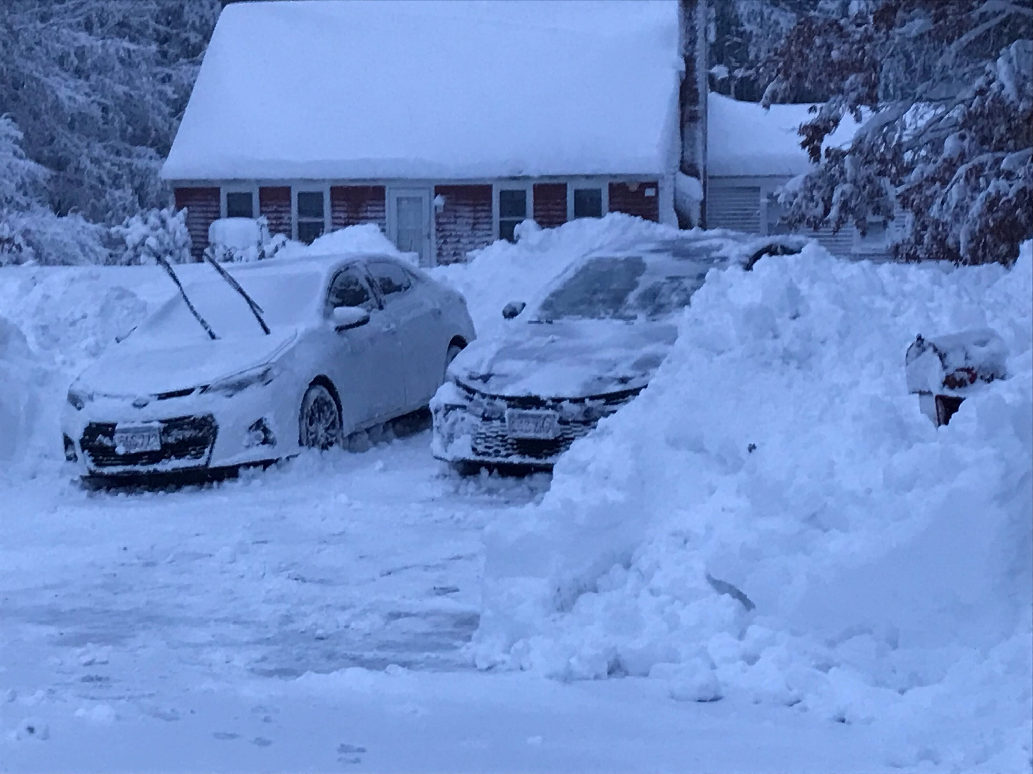
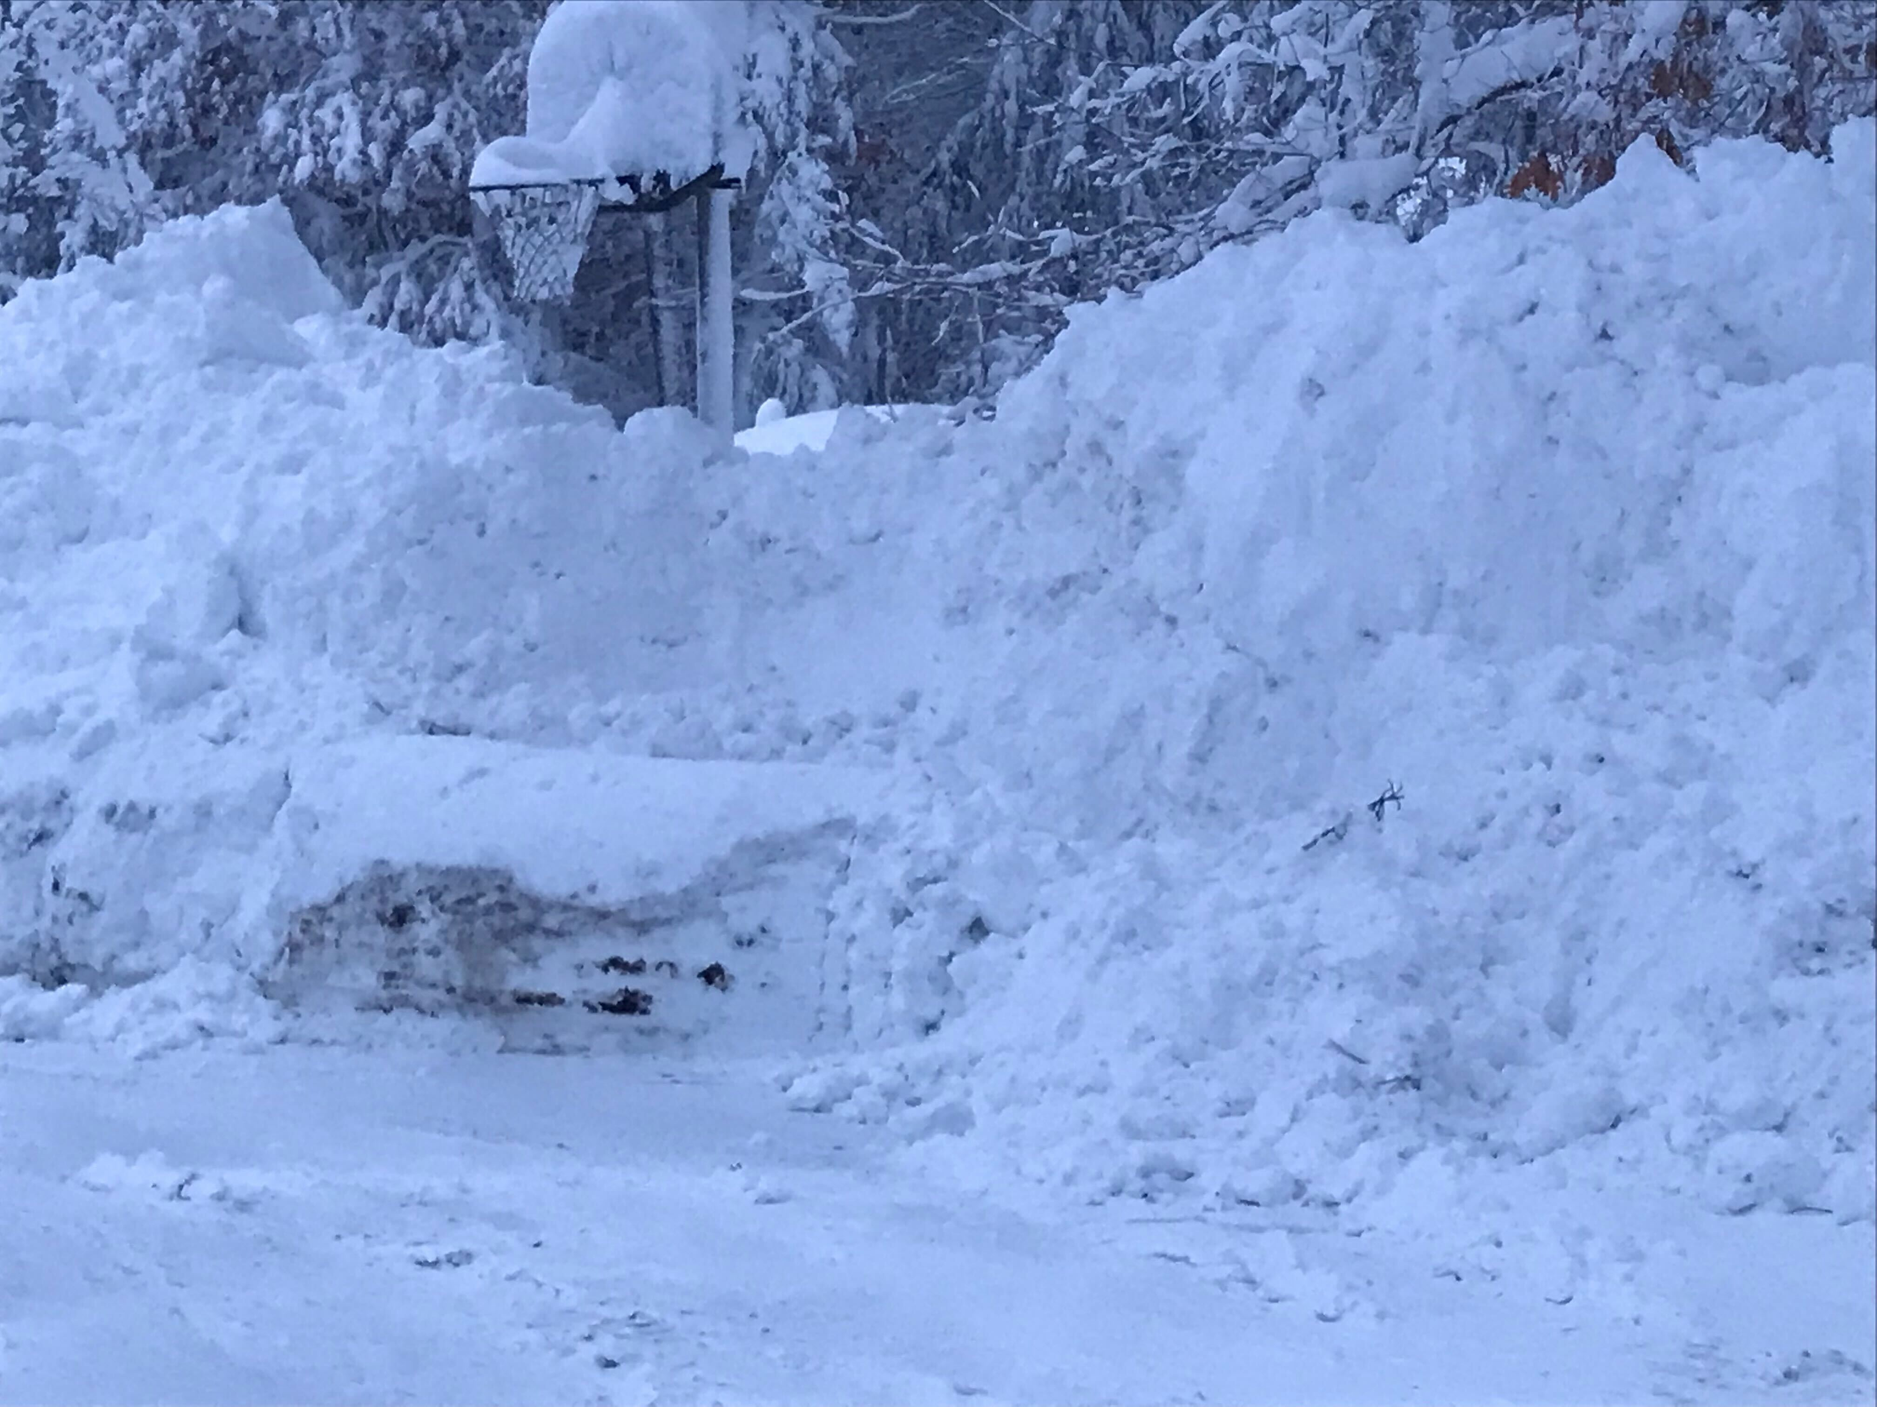

Slide 37
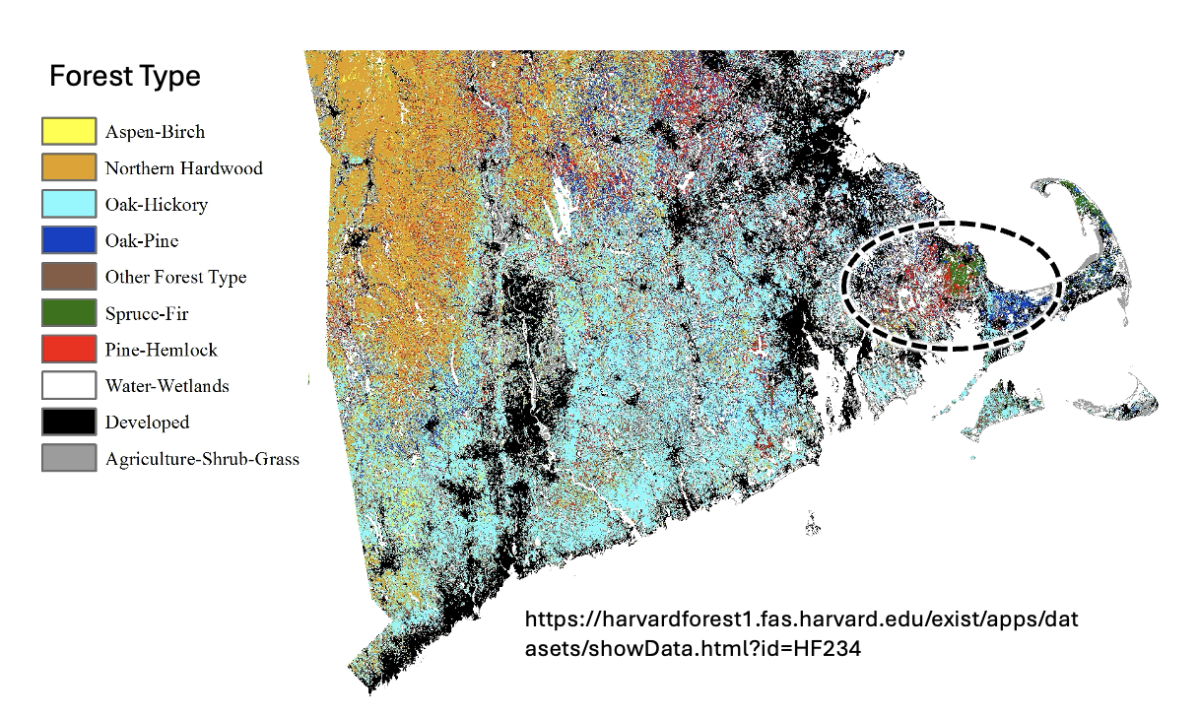

Slide 38
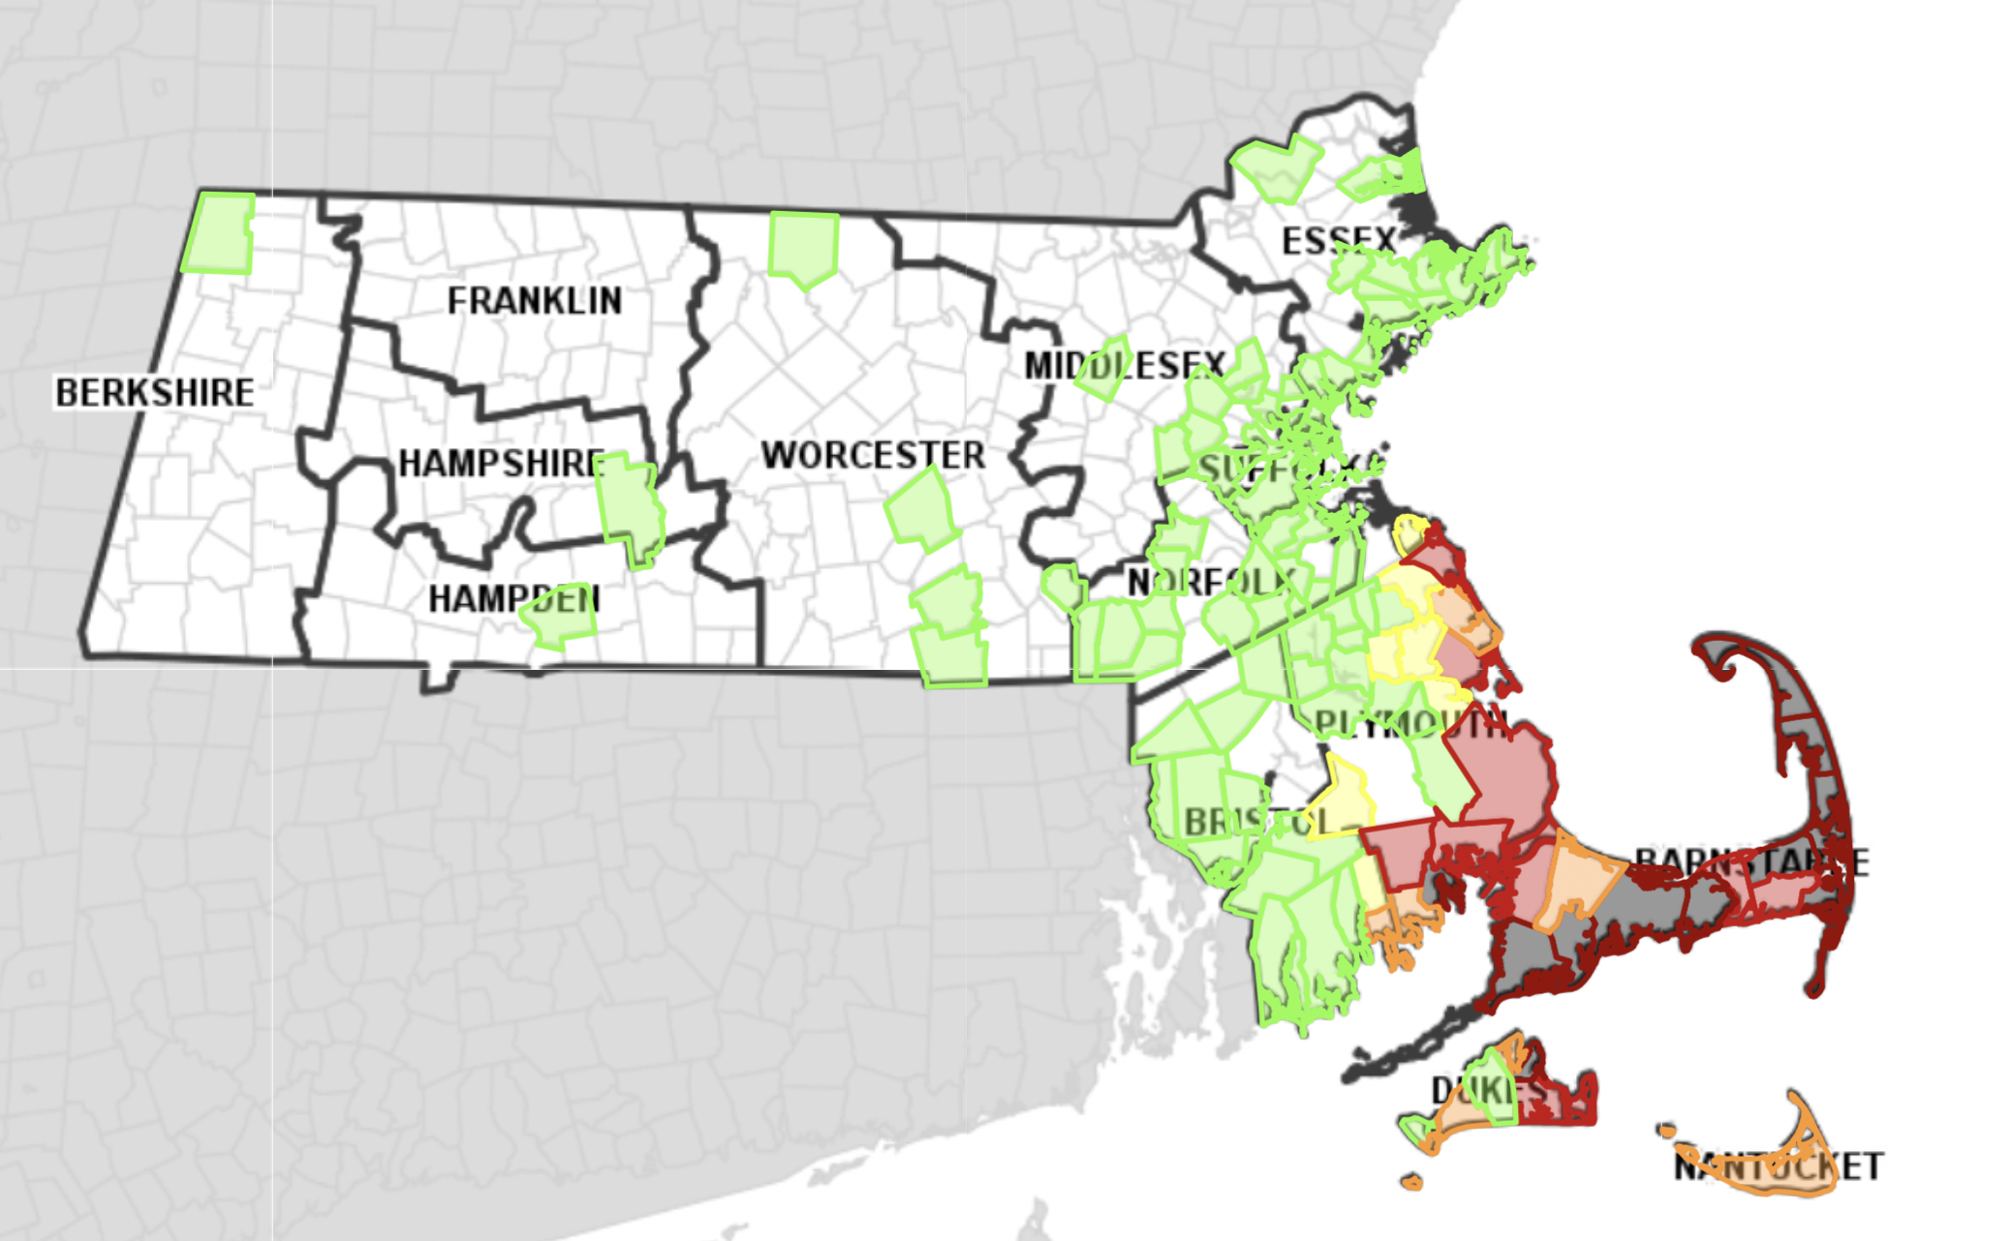
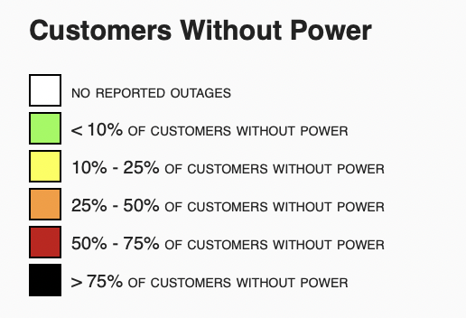
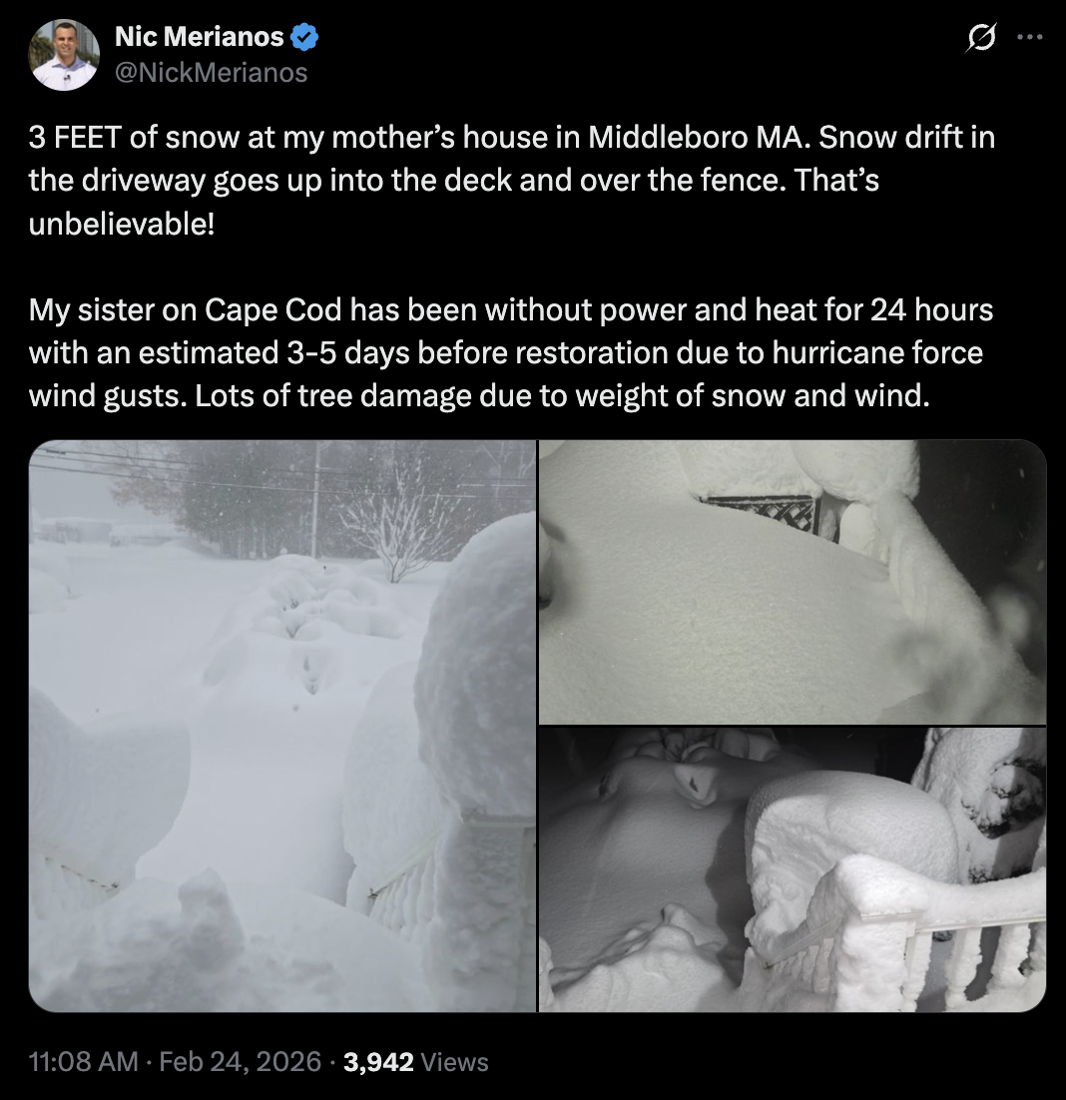
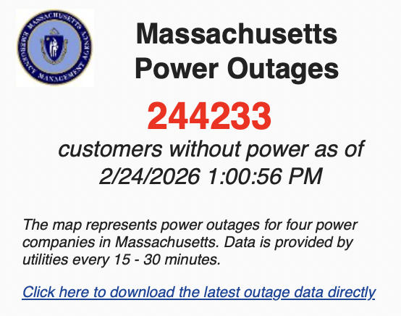
http://mema.mapsonline.net/public.html
Notes:
https://x.com/NickMerianos/status/2026328503835382202

