Slide 1
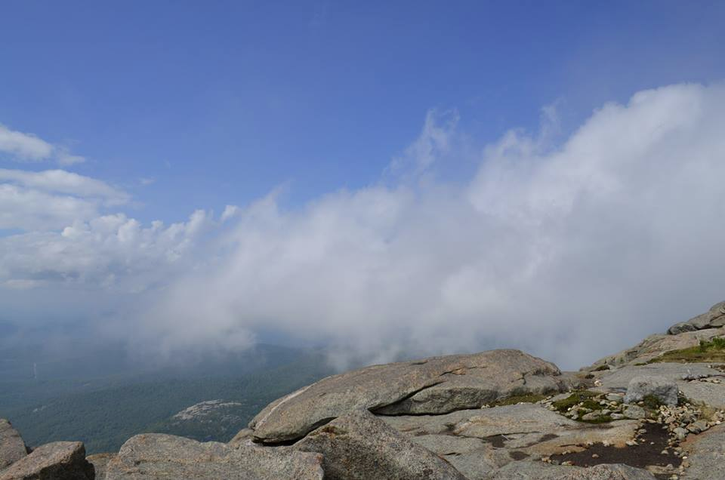
Cloud Types
ATM 209

Slide 2
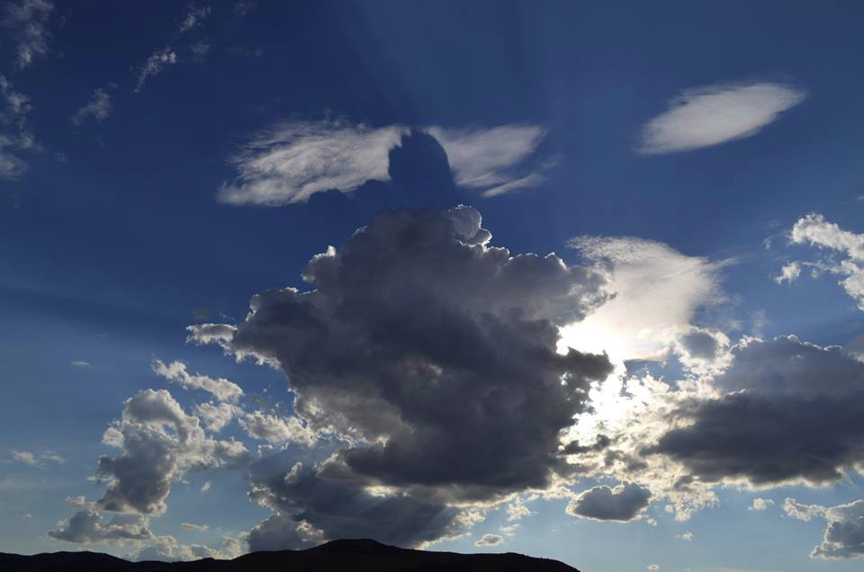
Cloud Types
ATM 209

Slide 3
Cloud: A visible mass of tiny liquid droplets (sometimes super-cooled, i.e., subfreezing liquid water) or tiny ice crystals suspended in the atmosphere.
-Result of saturation of the air (RH = 100%, w=w_{s}) either by:
-Cooling the air (lowering w_{s})
-Moistening the air (increasing w)
(Skew-T example)

Slide 4
Latin prefixes for type:
Upward growth into heaps: Cumulo-
Layered sheets at any altitude: Strato-
High wisps (curls) of ice crystals: Cirro-
Cloud with deep enough vertical extent/velocity to produce precipitation: Nimbo-

Slide 5
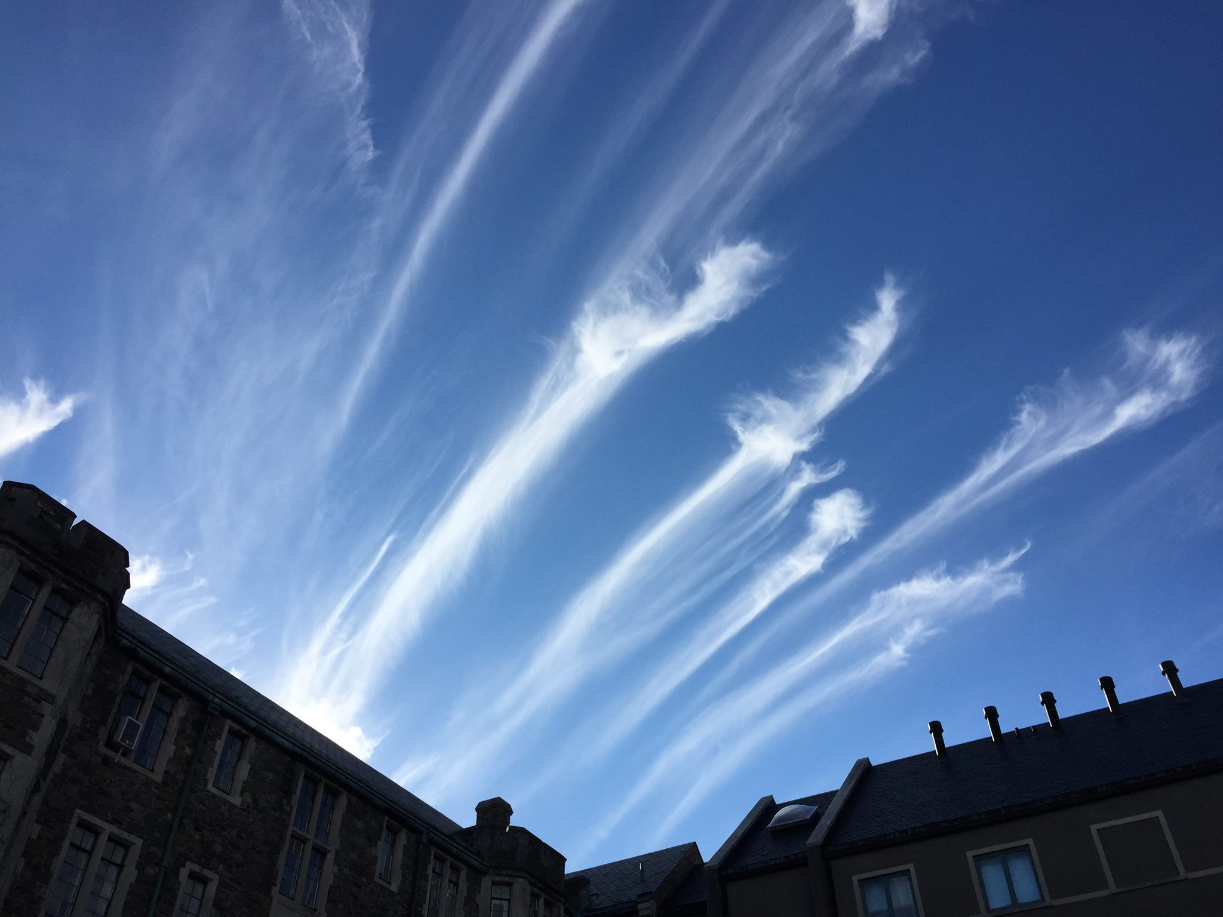
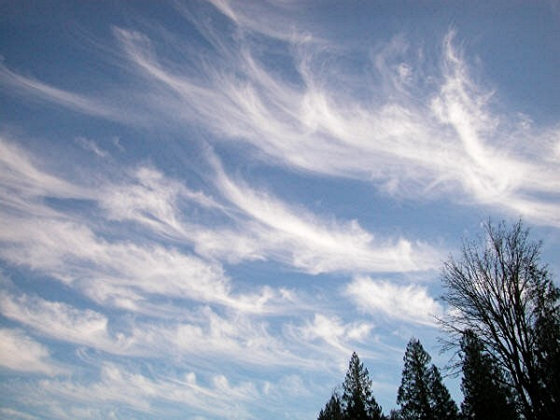
High Clouds
Annandale-on-Hudson, NY – March 13, 2016
CIRRUS (ice only, cirrus = ringlet / curling)

Slide 6
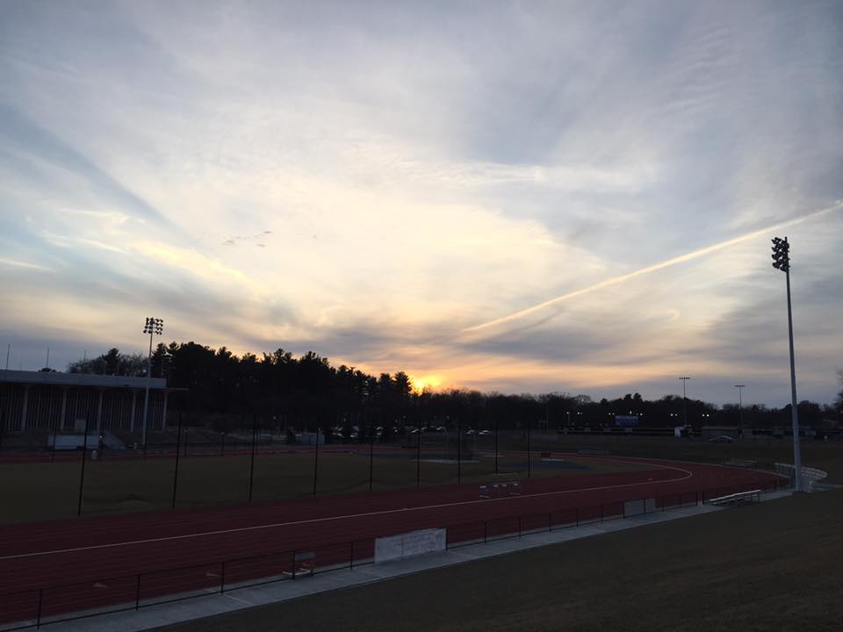
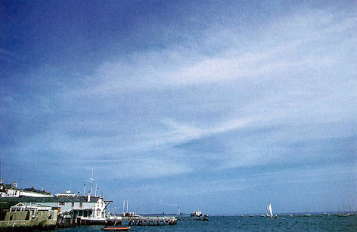
High Clouds
UAlbany – March 13, 2017
CIRROSTRATUS (ice, stratus = layer)

Slide 7
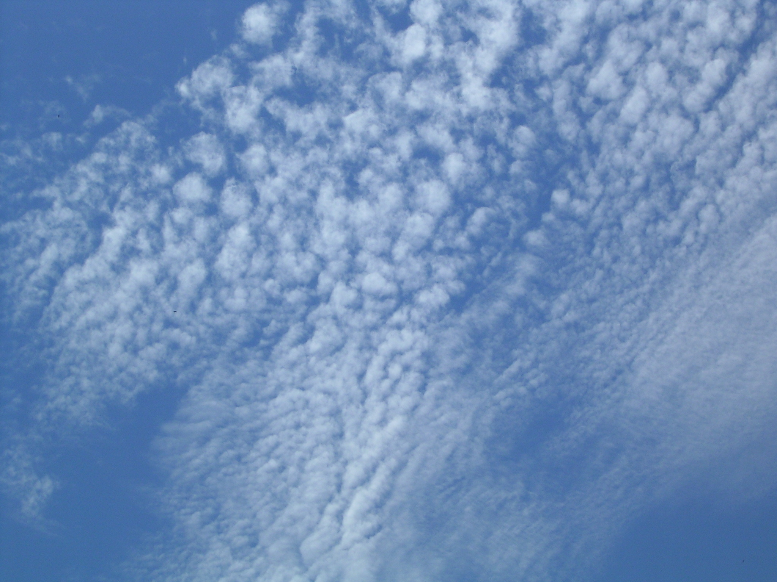
High Clouds
CIRROCUMULUS (cumulo = heap) … contains supercooled water, unlike cirrus

Slide 8
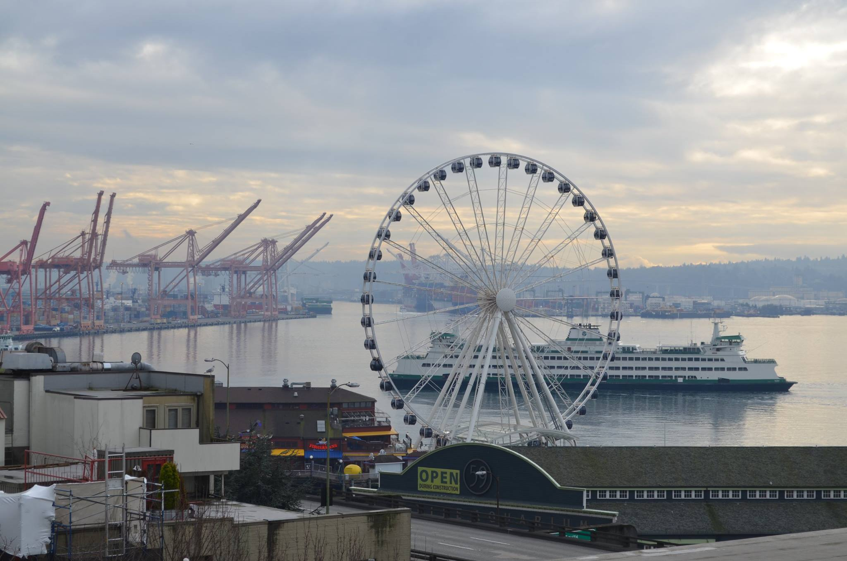
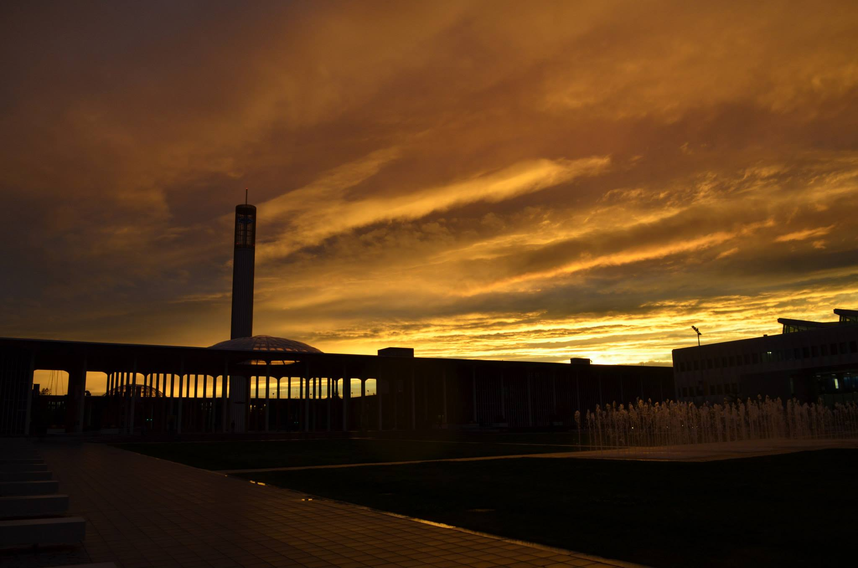
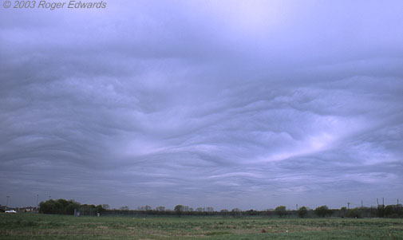
Mid-level Clouds
Seattle, WA – January 2017
ALTOSTRATUS (alto=middle)
(this also is asperatus)

Slide 9
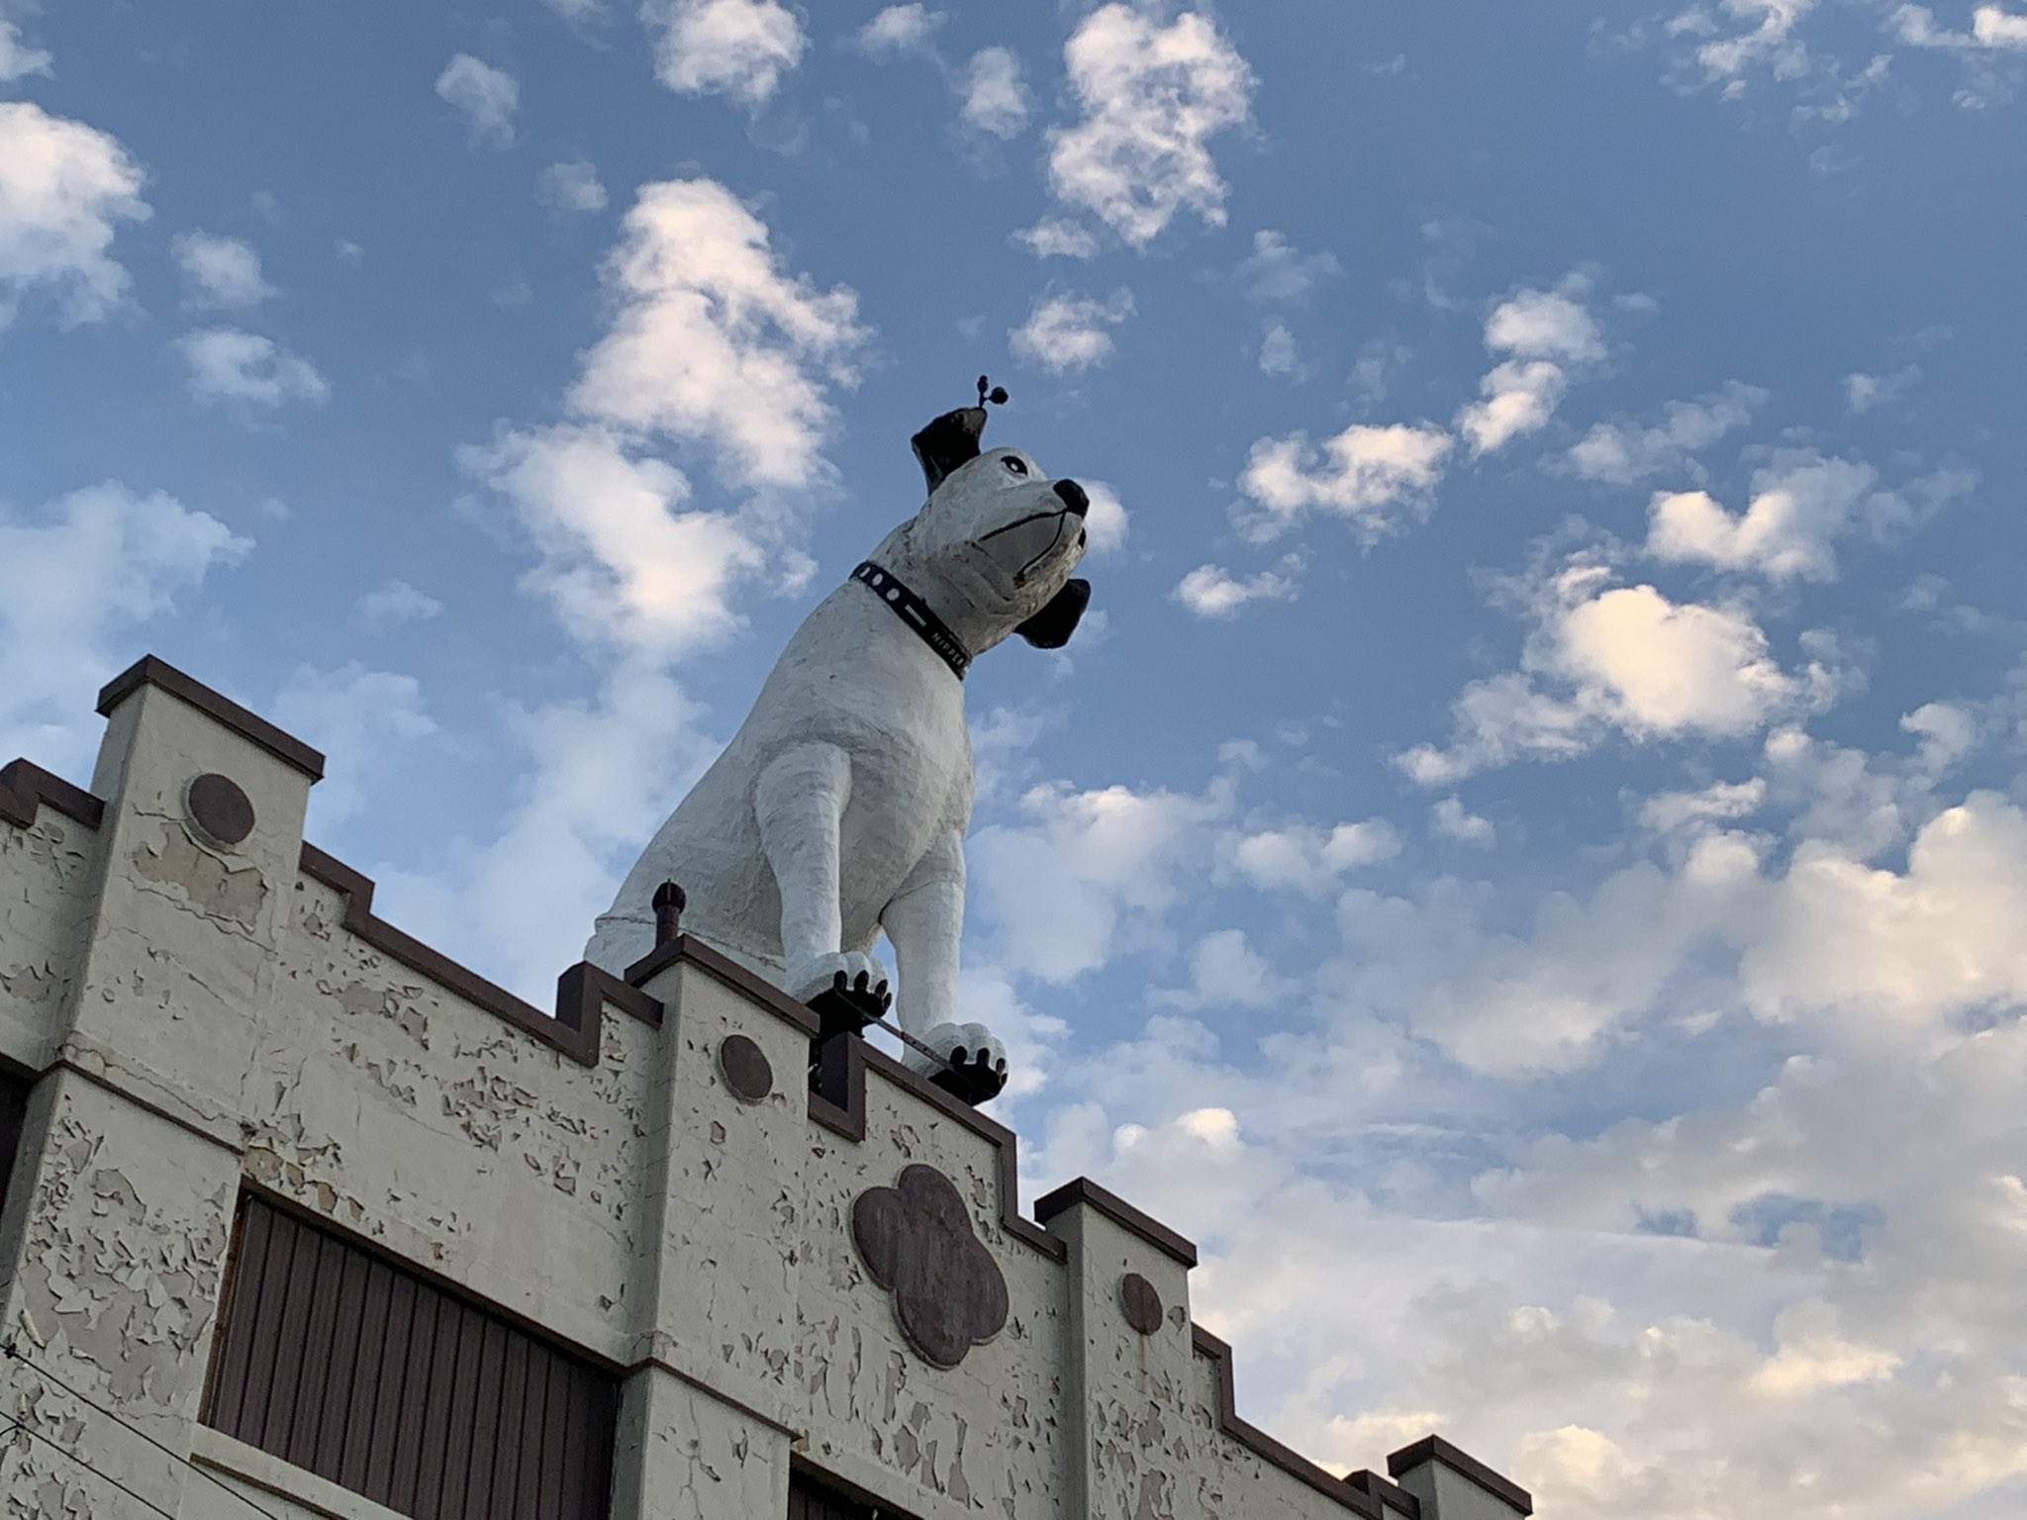
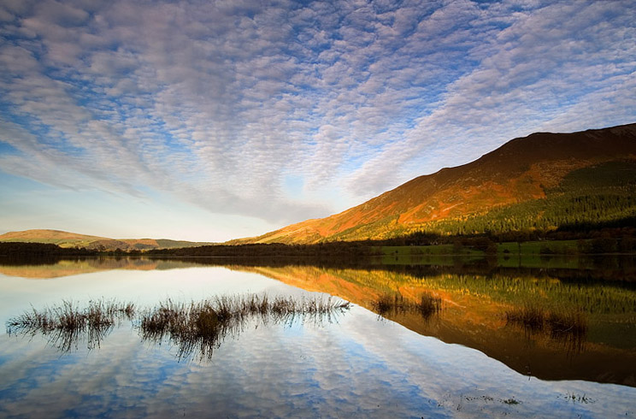
Mid-level Clouds
Albany – October 21, 2021
ALTOCUMULUS

Slide 10
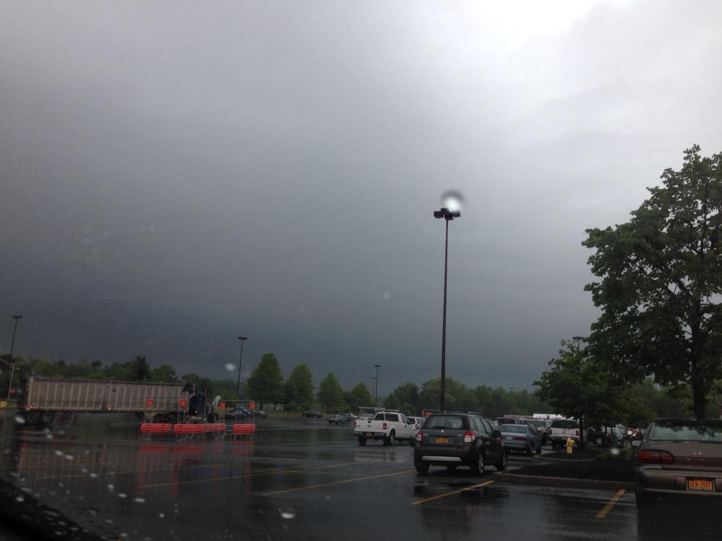
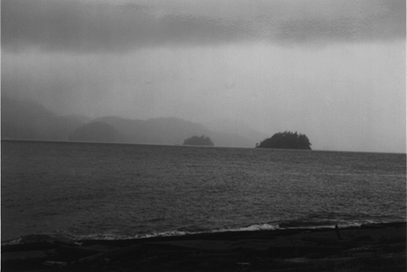
Low-level Clouds
Albany – May 22, 2013
STRATUS (nimbostratus) --- nimbo = rain

Slide 11
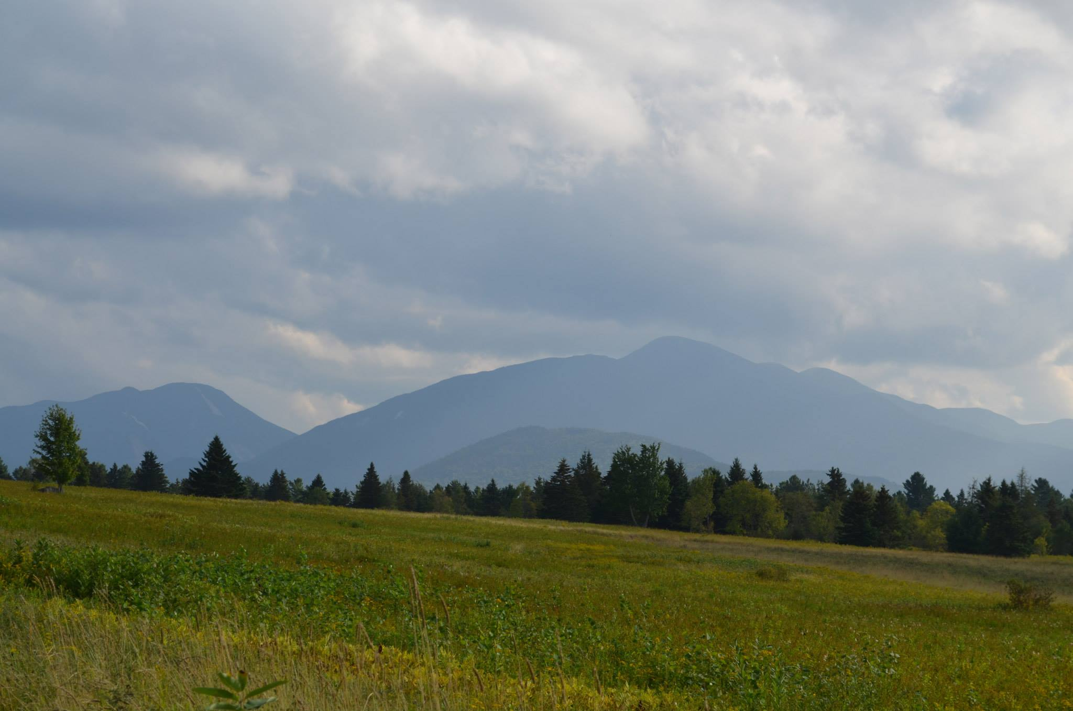
Low-level Clouds
Lake Placid, New York – September 2013
STRATOCUMULUS

Slide 12
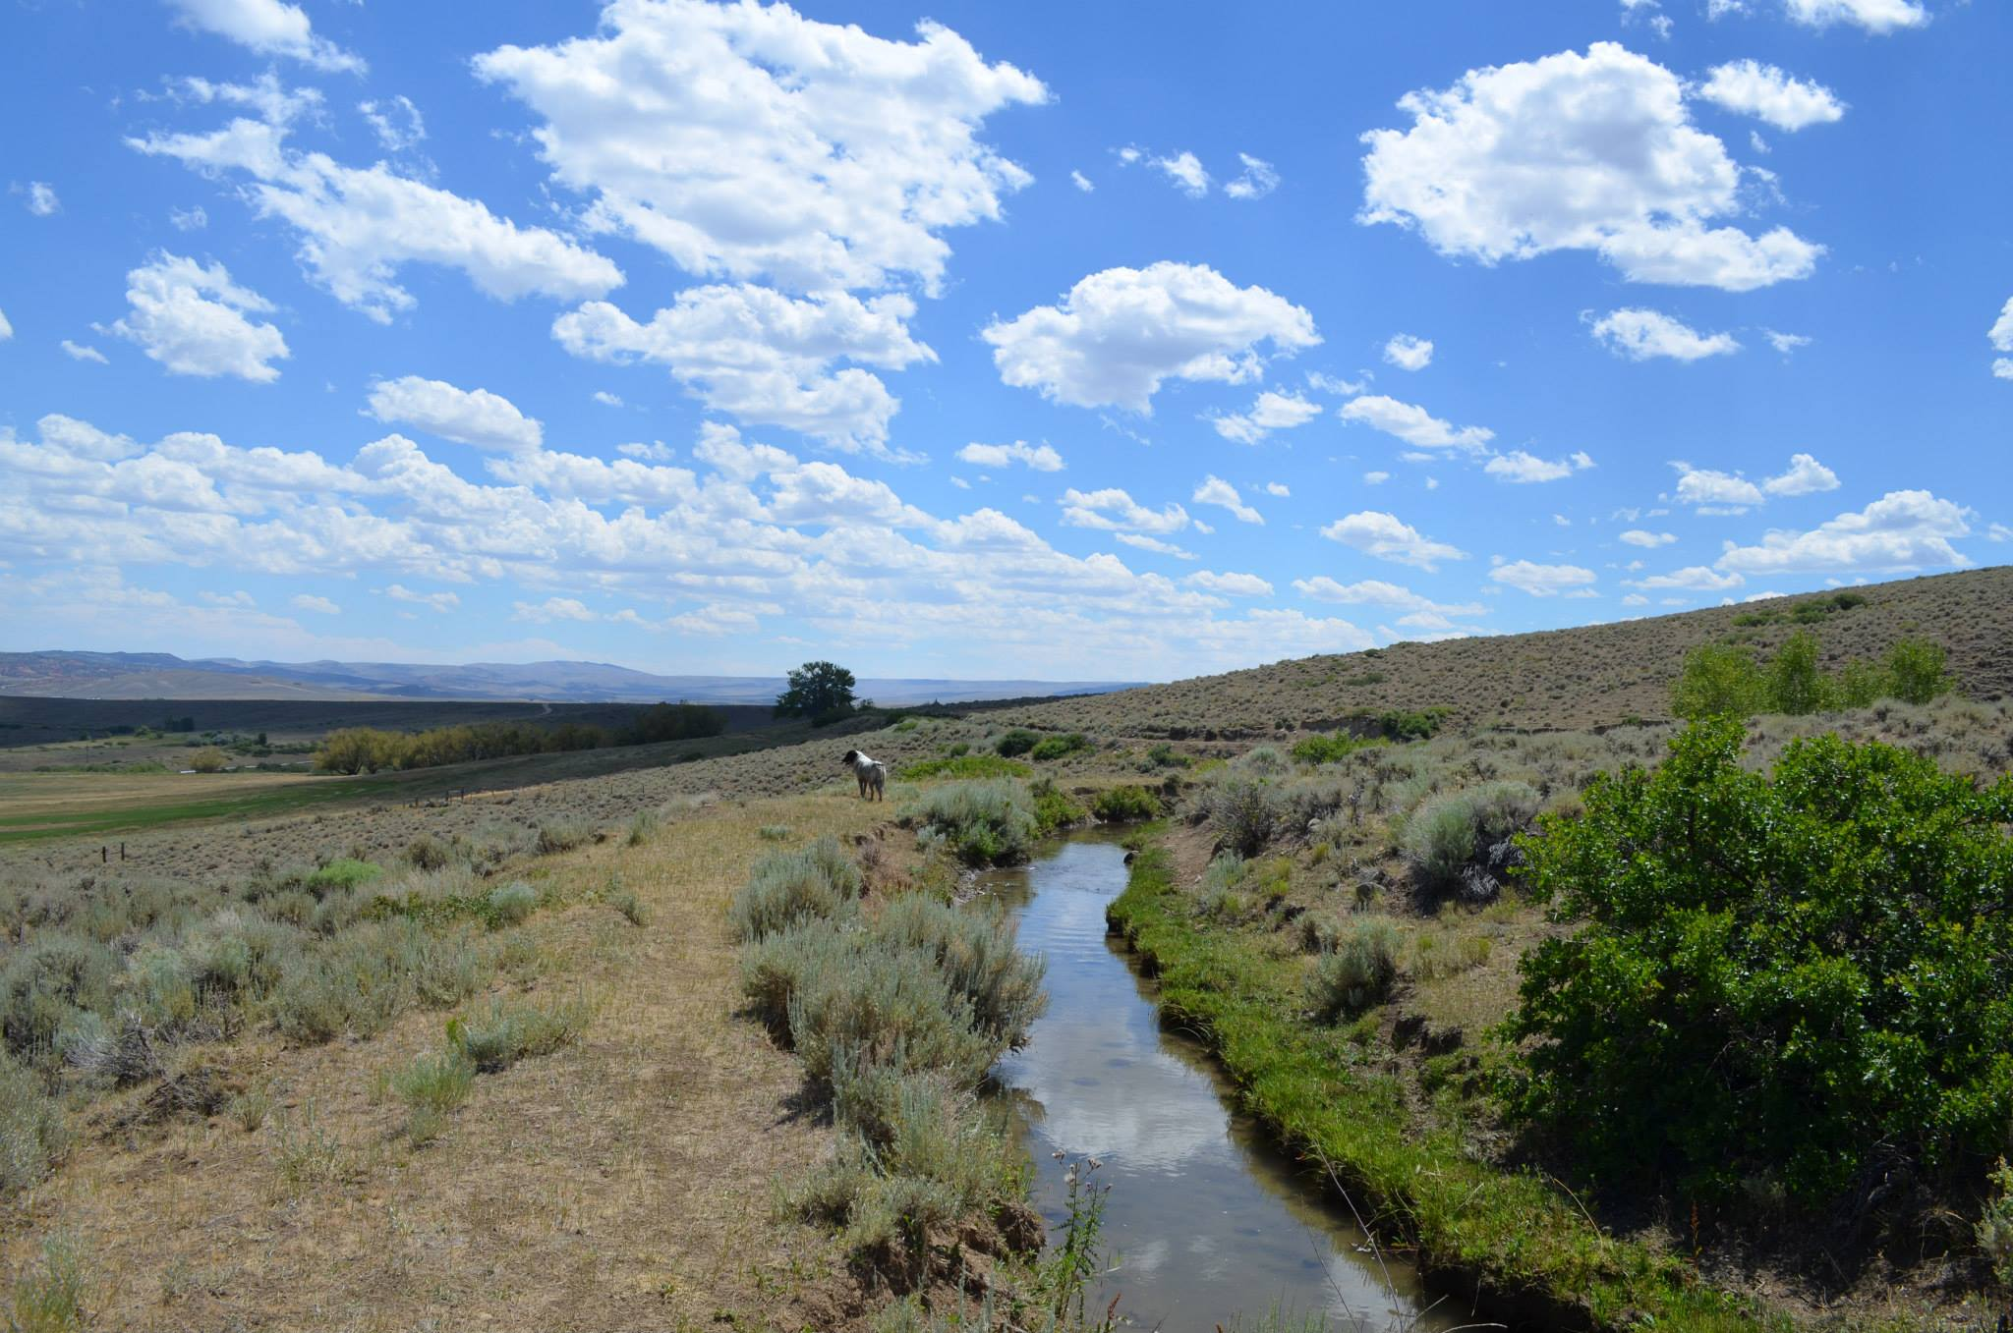
Vertical Clouds
Lander, Wyoming – August 2013
CUMULUS (humilis) -→ Forms through lifting parcels of air until LCL

Slide 13
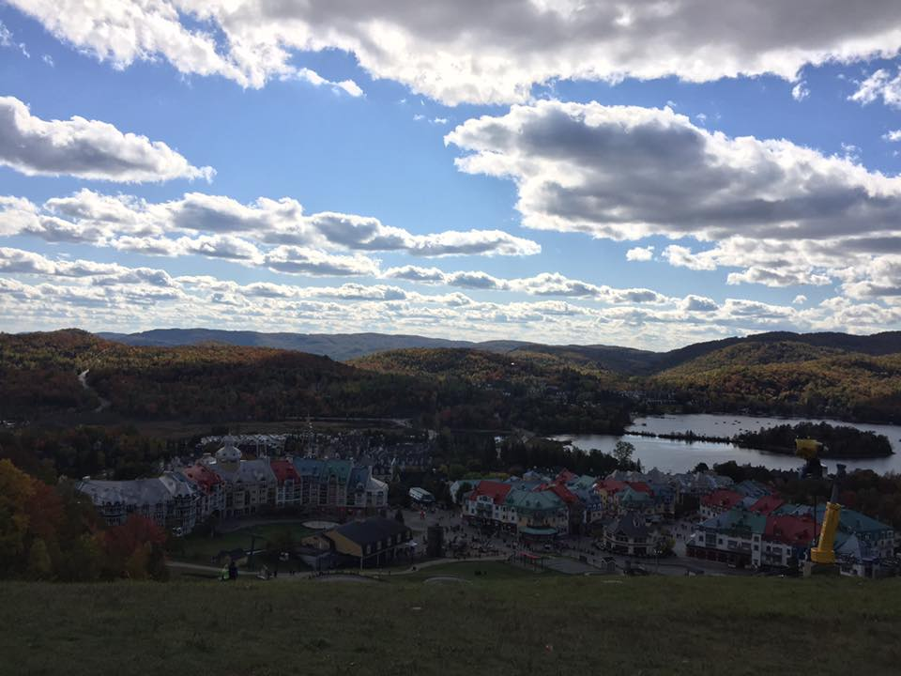
Vertical Clouds
Mont Tremblant, Quebec – October 6, 2017
CUMULUS (humilis) -→ Forms through lifting parcels of air until LCL

Slide 14
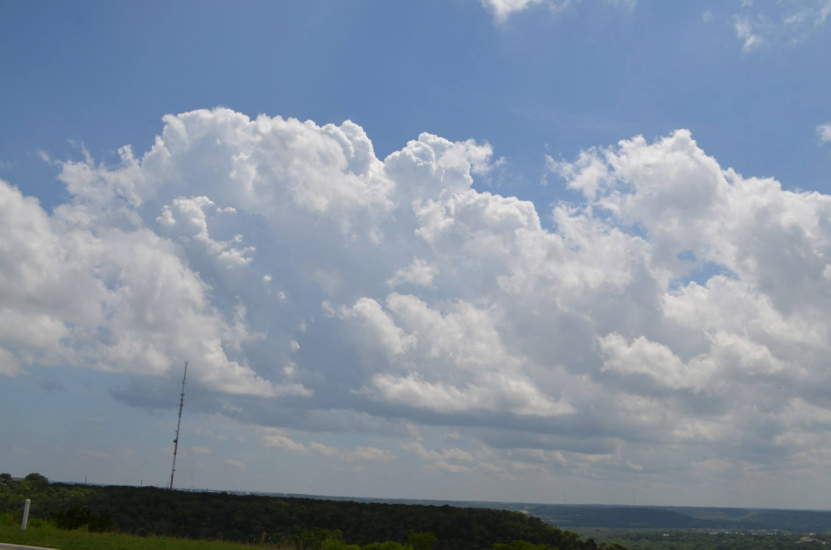
Vertical Clouds
Kerrville, Texas – May 27, 2014
CUMULUS (congestus)

Slide 15
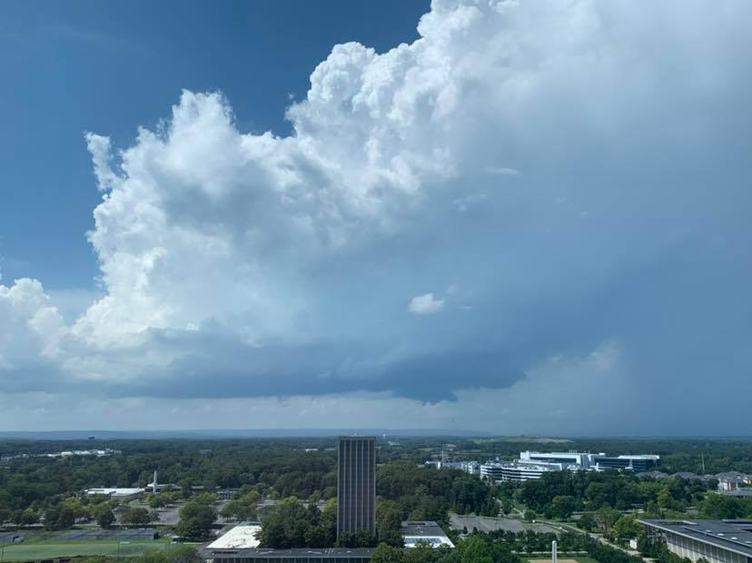
Vertical Clouds
Albany, New York – August 17, 2019
CUMULONIMBUS

Slide 16
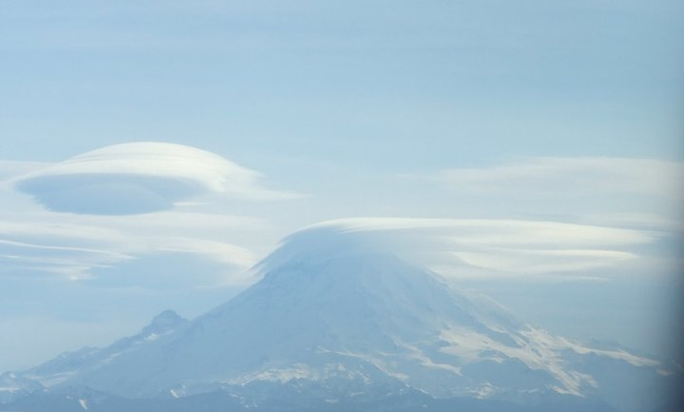
Mt. Rainier, Washington – January 2011
LENTICULARIS

Slide 17
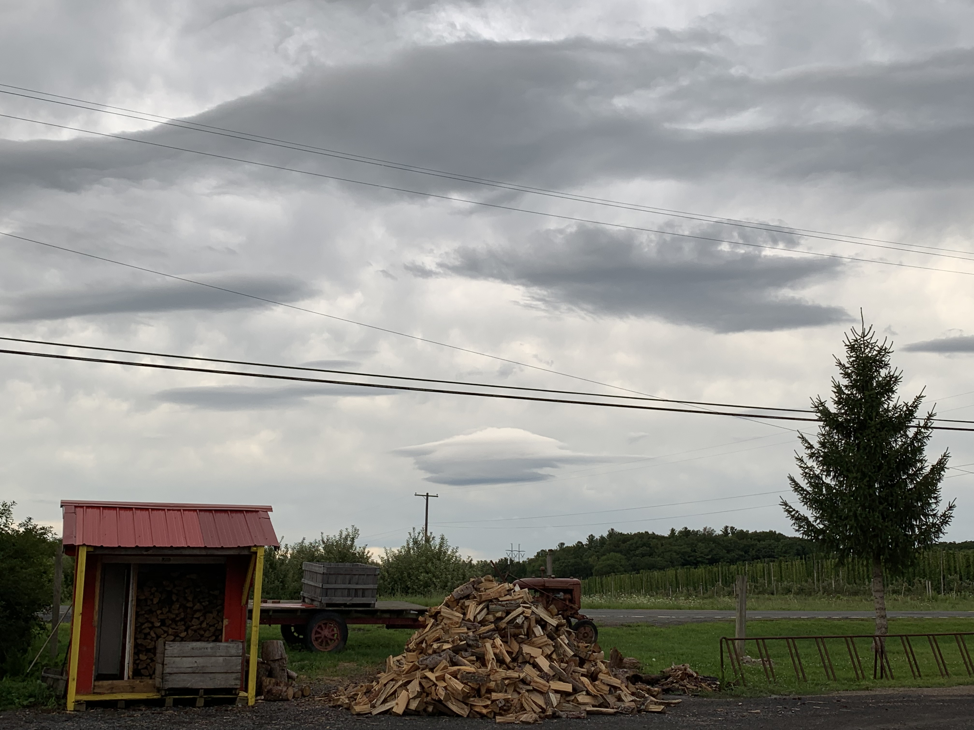
LENTICULARIS (August 8, 2019 in Voorheesvile, N.Y.)

Slide 18
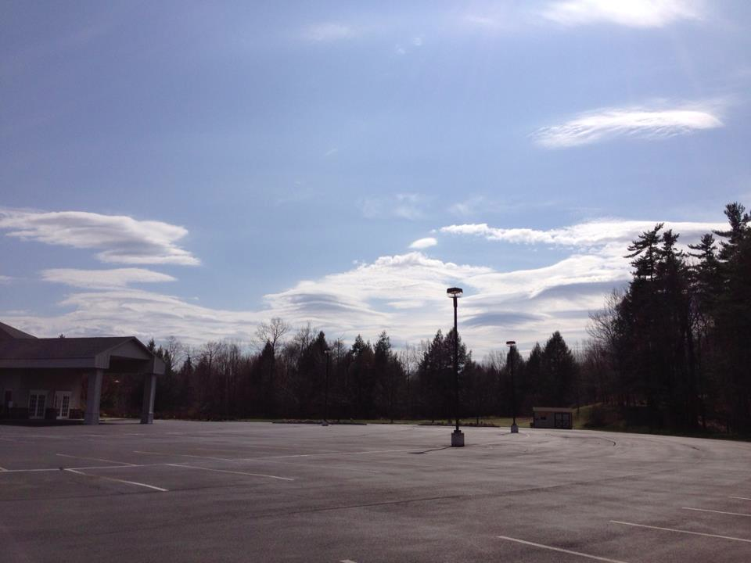
LENTICULARIS (Lenticular clouds away from Catskills)
Spring 2013, Guilderland

Slide 19
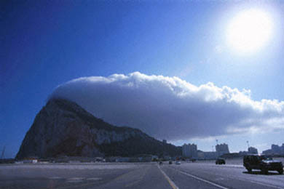
BANNER CLOUD

Slide 20
PILEUS (Latin for “cap”) … rapid ascent atop cumulus congestus

Slide 21
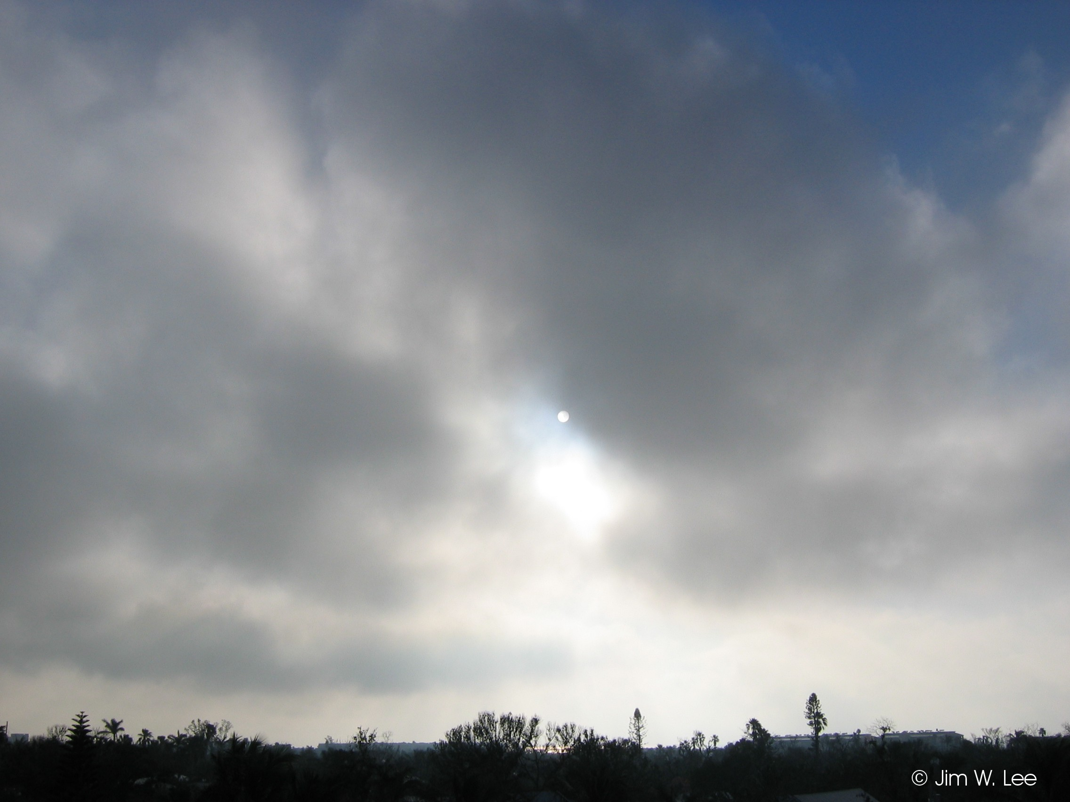
(cumulus) FRACTUS (or stratus fractus)

Slide 22
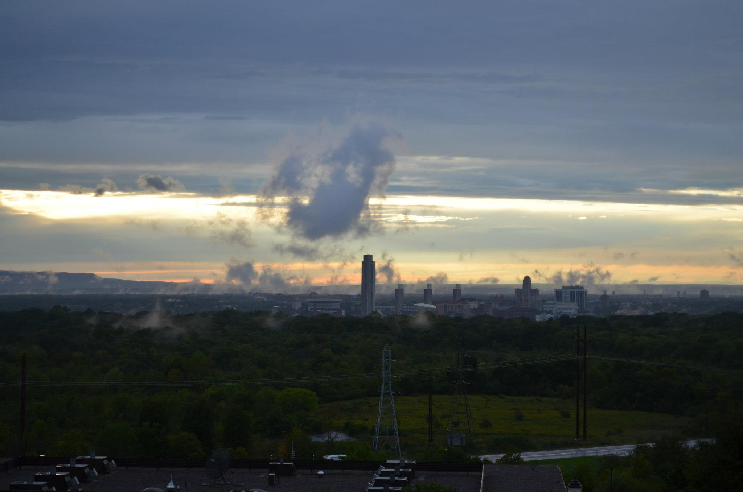
Albany, New York – September 8, 2012
(cumulus) FRACTUS (or stratus fractus)

Slide 23
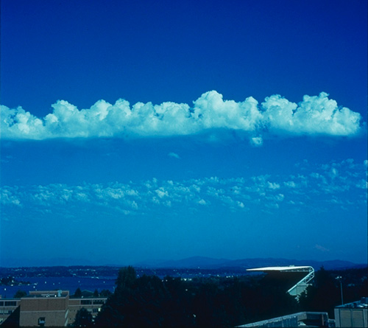
(altocumulus) CASTELLANUS

Slide 24
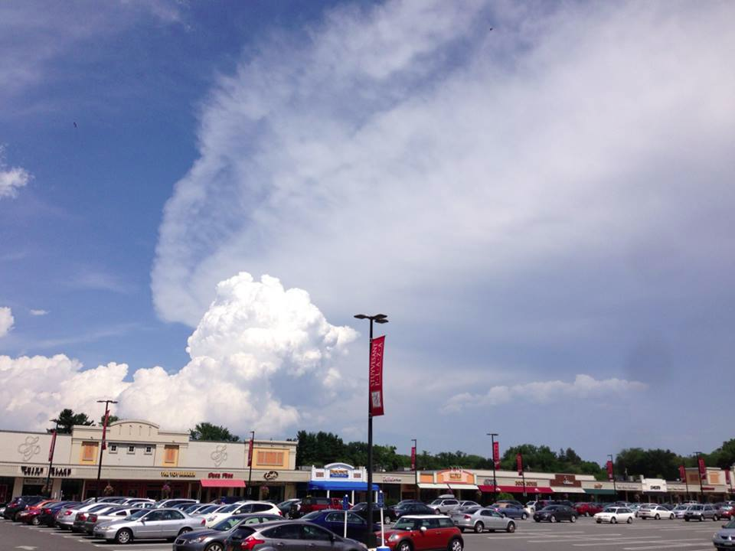
Cirrus “anvil cloud” (with cumulus congestus in foreground)

Slide 25
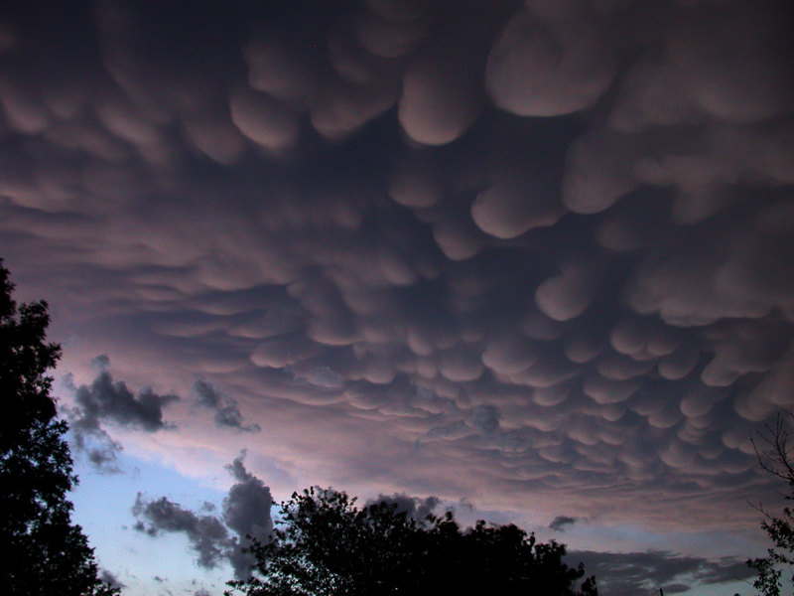
MAMMATUS

Slide 26
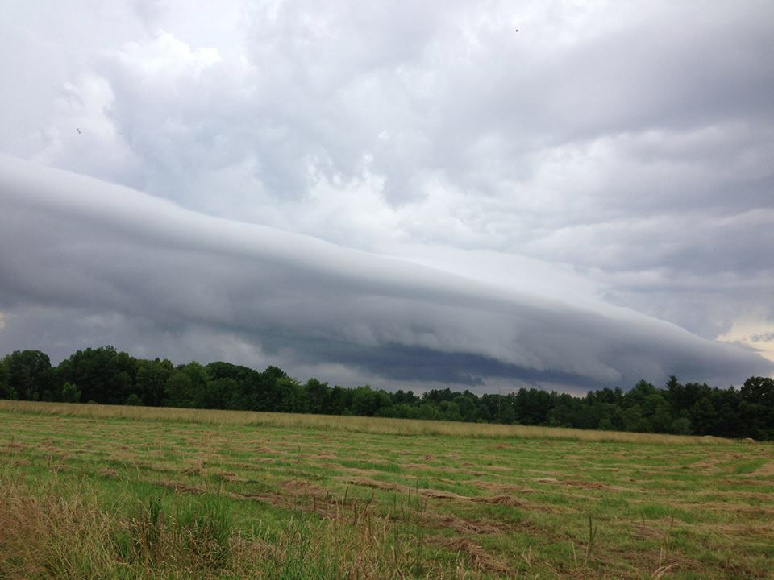
Shelf Cloud

Slide 27
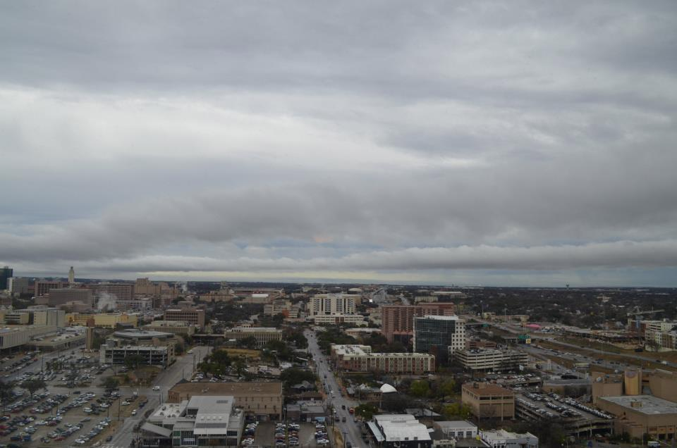
Undular Bore
Austin, TX, January 2013

Slide 28
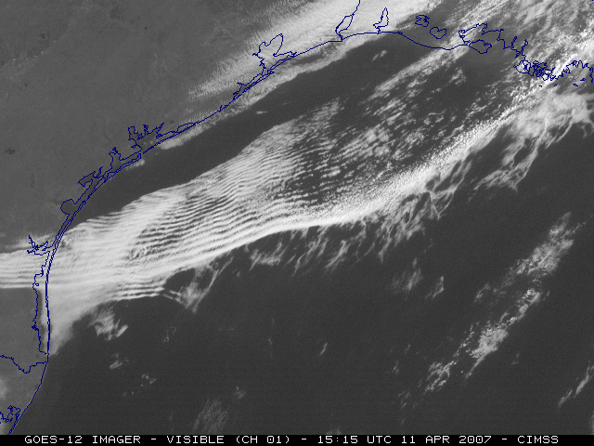
Undular Bore

Slide 29
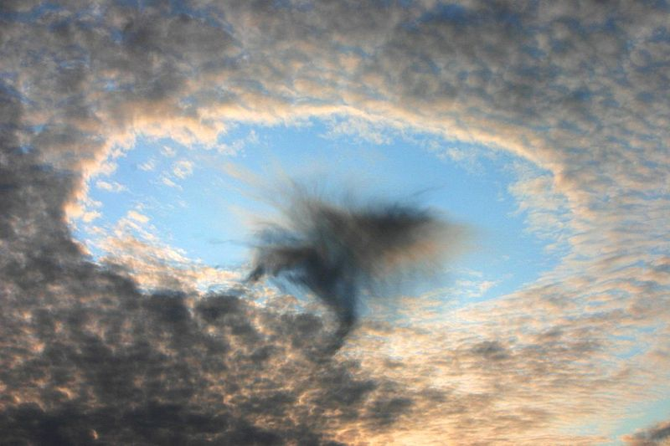
FALLSTREAK (plane moves through supercooled liquid cloud, transitions part of the cloud to ice, then graupel, due to sudden pressure drop as plane flies through it . . . Result is evaporation of water in close proximity

Slide 30
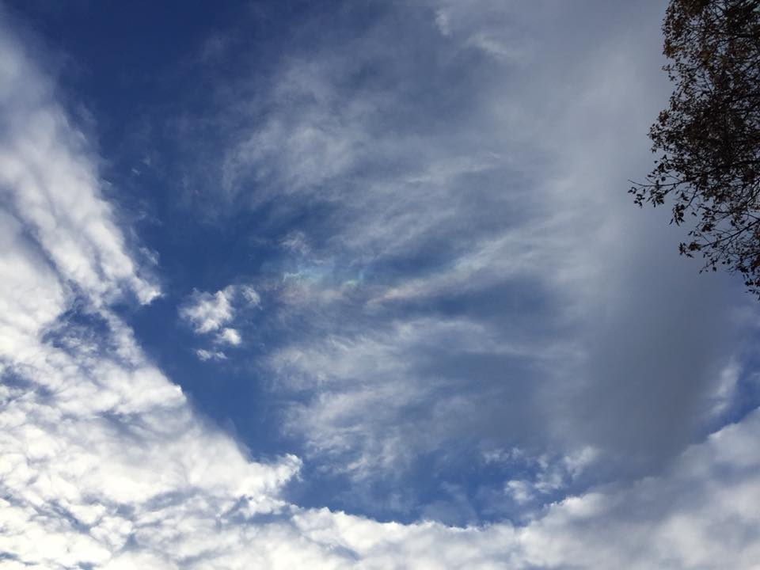
York, Maine – November 23, 2017
FALLSTREAK (plane moves through supercooled liquid cloud, transitions part of the cloud to ice, then graupel, due to sudden pressure drop as plane flies through it . . . Result is evaporation of water in close proximity

Slide 31
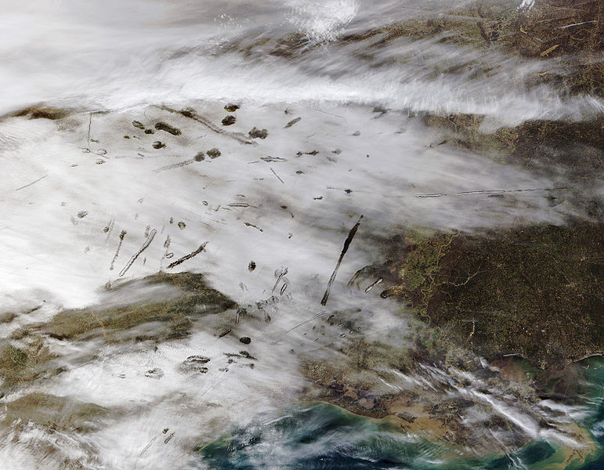
FALLSTREAKS

Slide 32
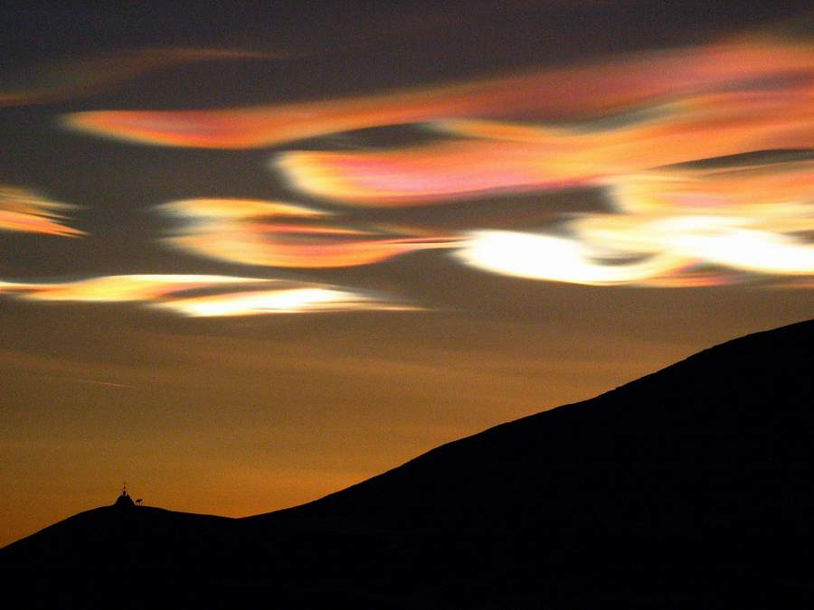
NACREOUS CLOUDS (polar stratospheric clouds, contain H2Ov and other molecules, like nitric acid)

Slide 33
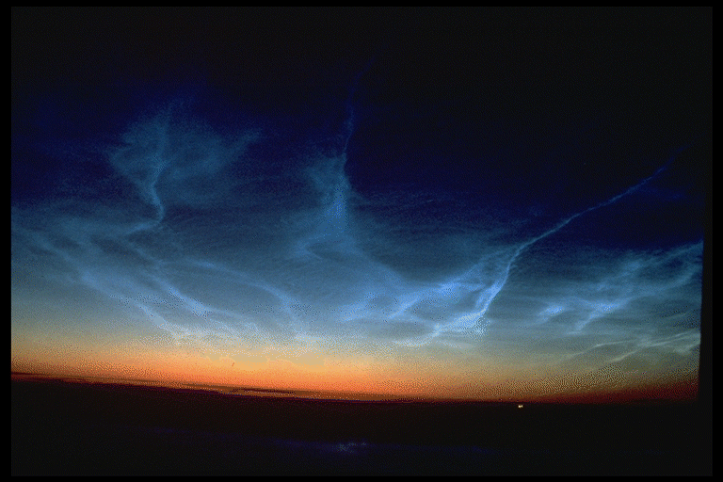
NOCTILUCENT CLOUDS (form in the mesosphere, and only visible in polar twilight (sun shines on them from below, when sun is low on the horizon)

Slide 34
Some ways we can see the atmosphere as a fluid
through clouds

Slide 35
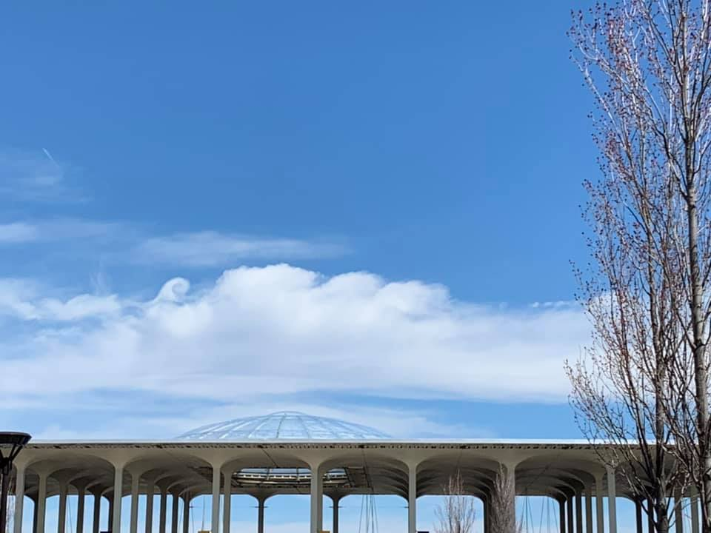

Slide 36
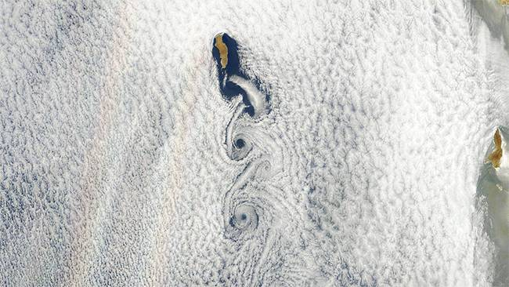
Von Karman vortex clouds

Slide 37
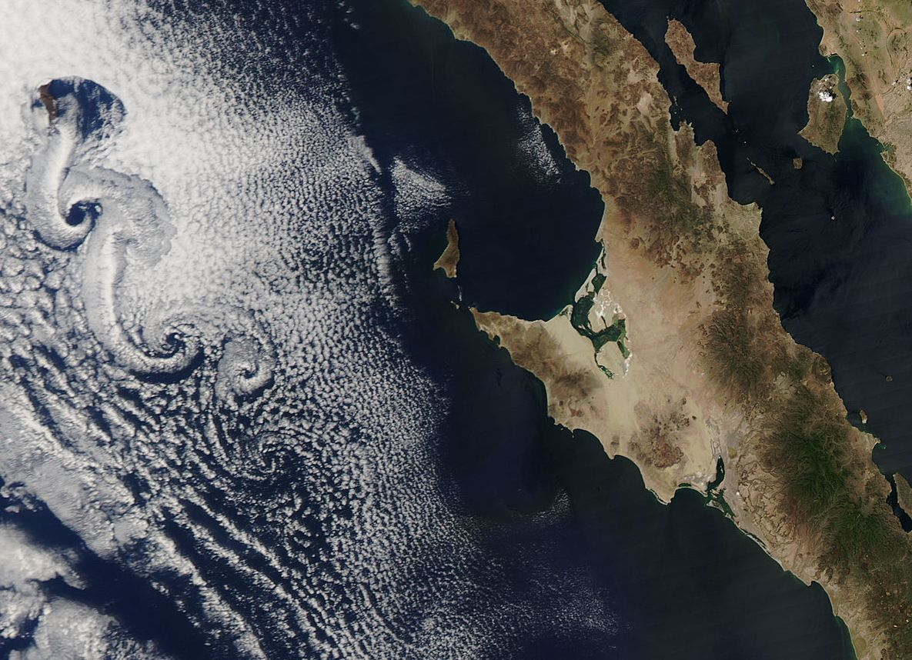
Von Karman vortex clouds

Slide 38
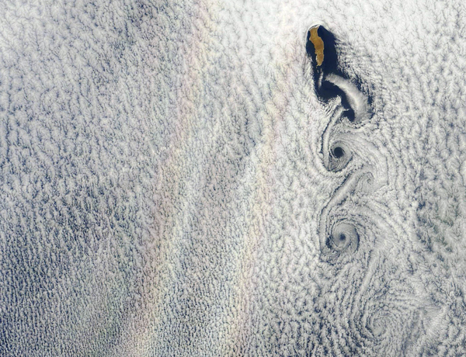
Von Karman vortex clouds

Slide 39
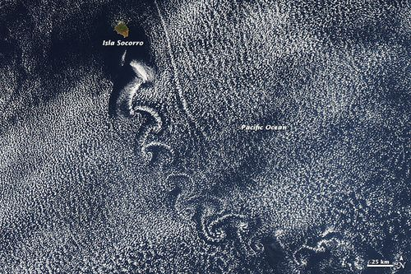
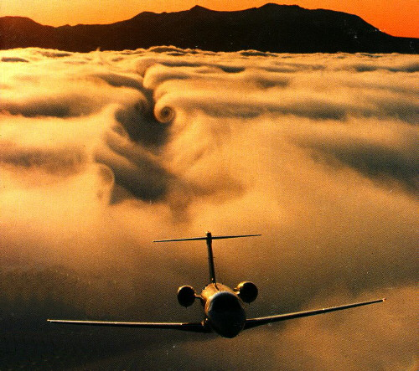
Von Karman vortex clouds

Slide 40
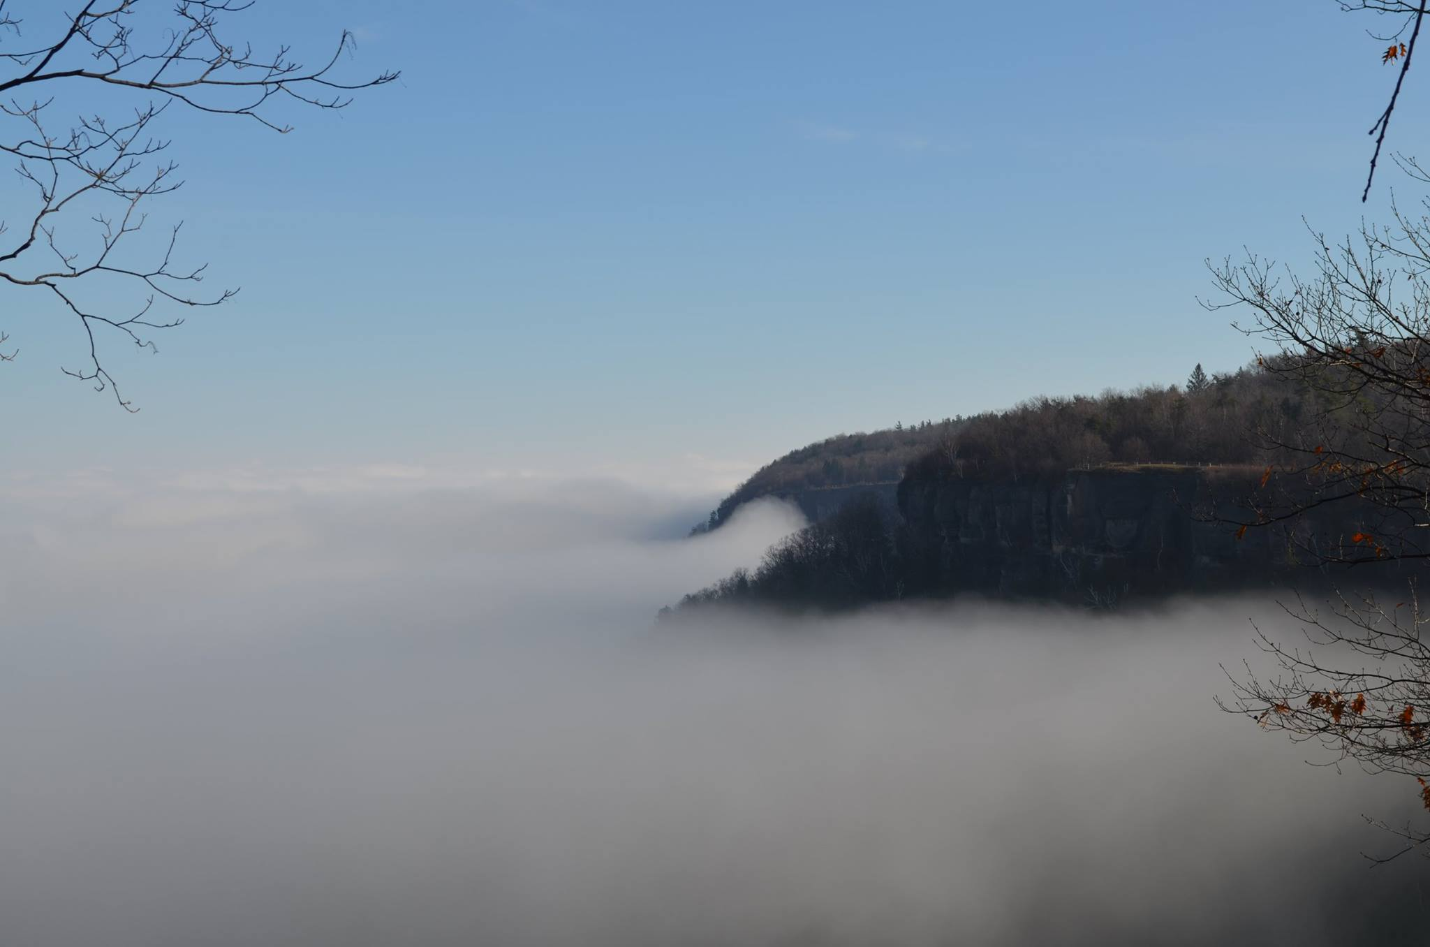
Clouds can also appear as “undercast”
Thacher Park, New York - December 6, 2015

Slide 41
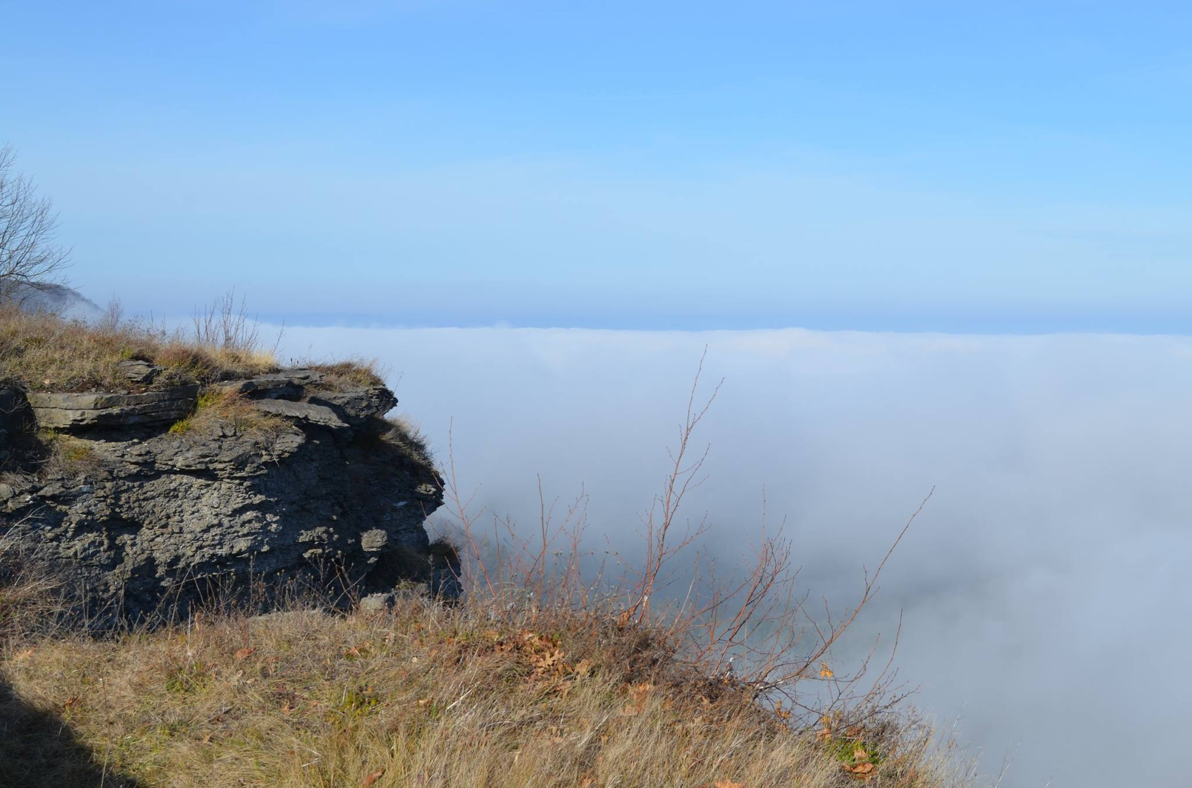
Clouds can also appear as “undercast”
Thacher Park, New York - December 6, 2015

Slide 42
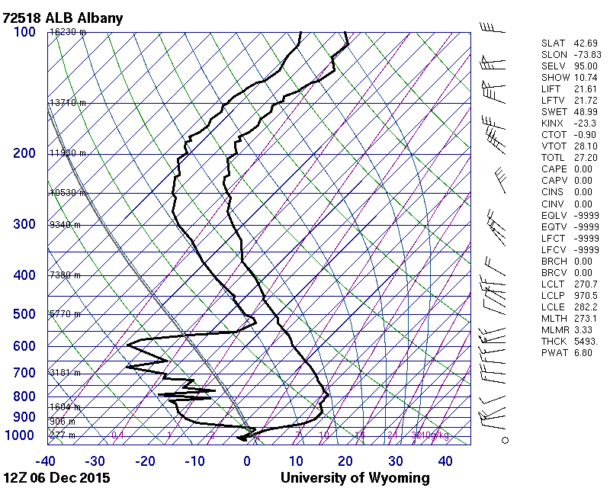
Clouds can also appear as “undercast”

