Slide 1
Contour Analysis

Slide 2
Why do we contour data on a map?

Slide 3
Why do we contour data on a map?

Slide 4
Why do we contour data on a map?
• Easy to identify:
-Important features in the datasets
-Minima and maxima
-Regions where the data changes rapidly…or not so rapidly
Gradient

Slide 5
Isopleth: A line on a map on which a given variable has a constant value
Most common types of isopleths in meteorology:

Slide 6
Isopleth: A line on a map on which a given variable has a constant value
Most common types of isopleths in meteorology:
Isobar: Line (isopleth) of constant pressure

Slide 7
Isopleth: A line on a map on which a given variable has a constant value
Most common types of isopleths in meteorology:
Isobar: Line (isopleth) of constant pressure
Isotherm: Line of constant temperature

Slide 8
Isopleth: A line on a map on which a given variable has a constant value
Most common types of isopleths in meteorology:
Isobar: Line (isopleth) of constant pressure
Isotherm: Line of constant temperature
Isotach: Line of constant wind speed

Slide 9
Isopleth: A line on a map on which a given variable has a constant value
Most common types of isopleths in meteorology:
Isobar: Line (isopleth) of constant pressure
Isotherm: Line of constant temperature
Isotach: Line of constant wind speed
Isodrosotherm: Line of constant dew point
Isohypse: Line of constant geopotential height (height above sea level)

Slide 10
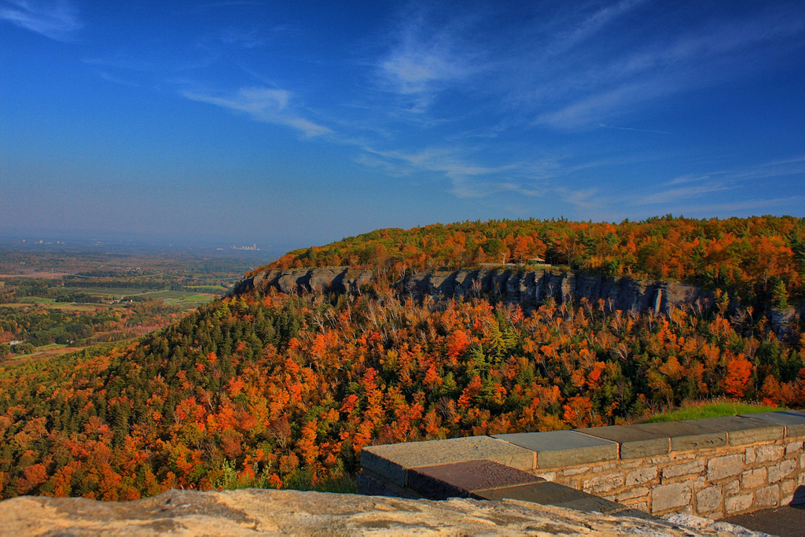
Photo by hbickel / Flickr

Slide 11
800
Photo by hbickel / Flickr

Slide 12


950
900
850
800
750
Photo by hbickel / Flickr

Slide 13
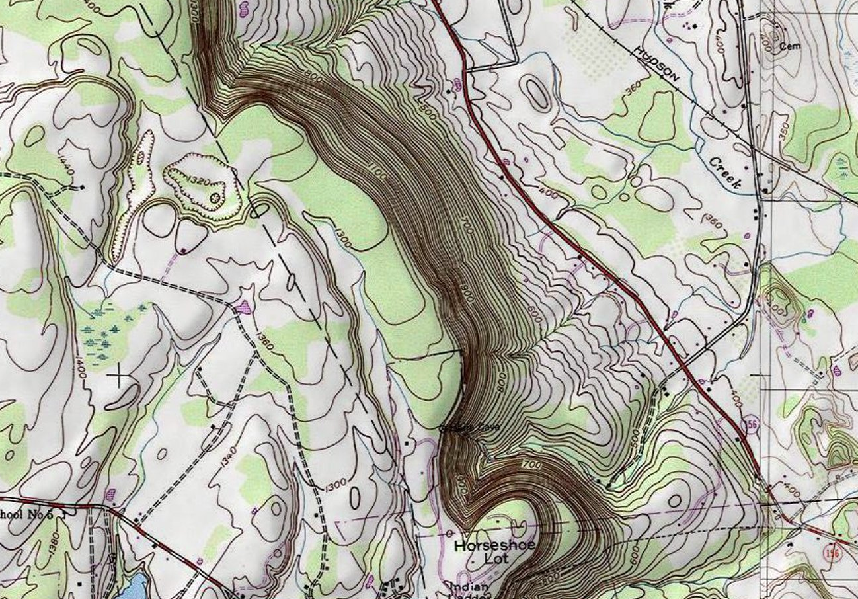

Slide 14
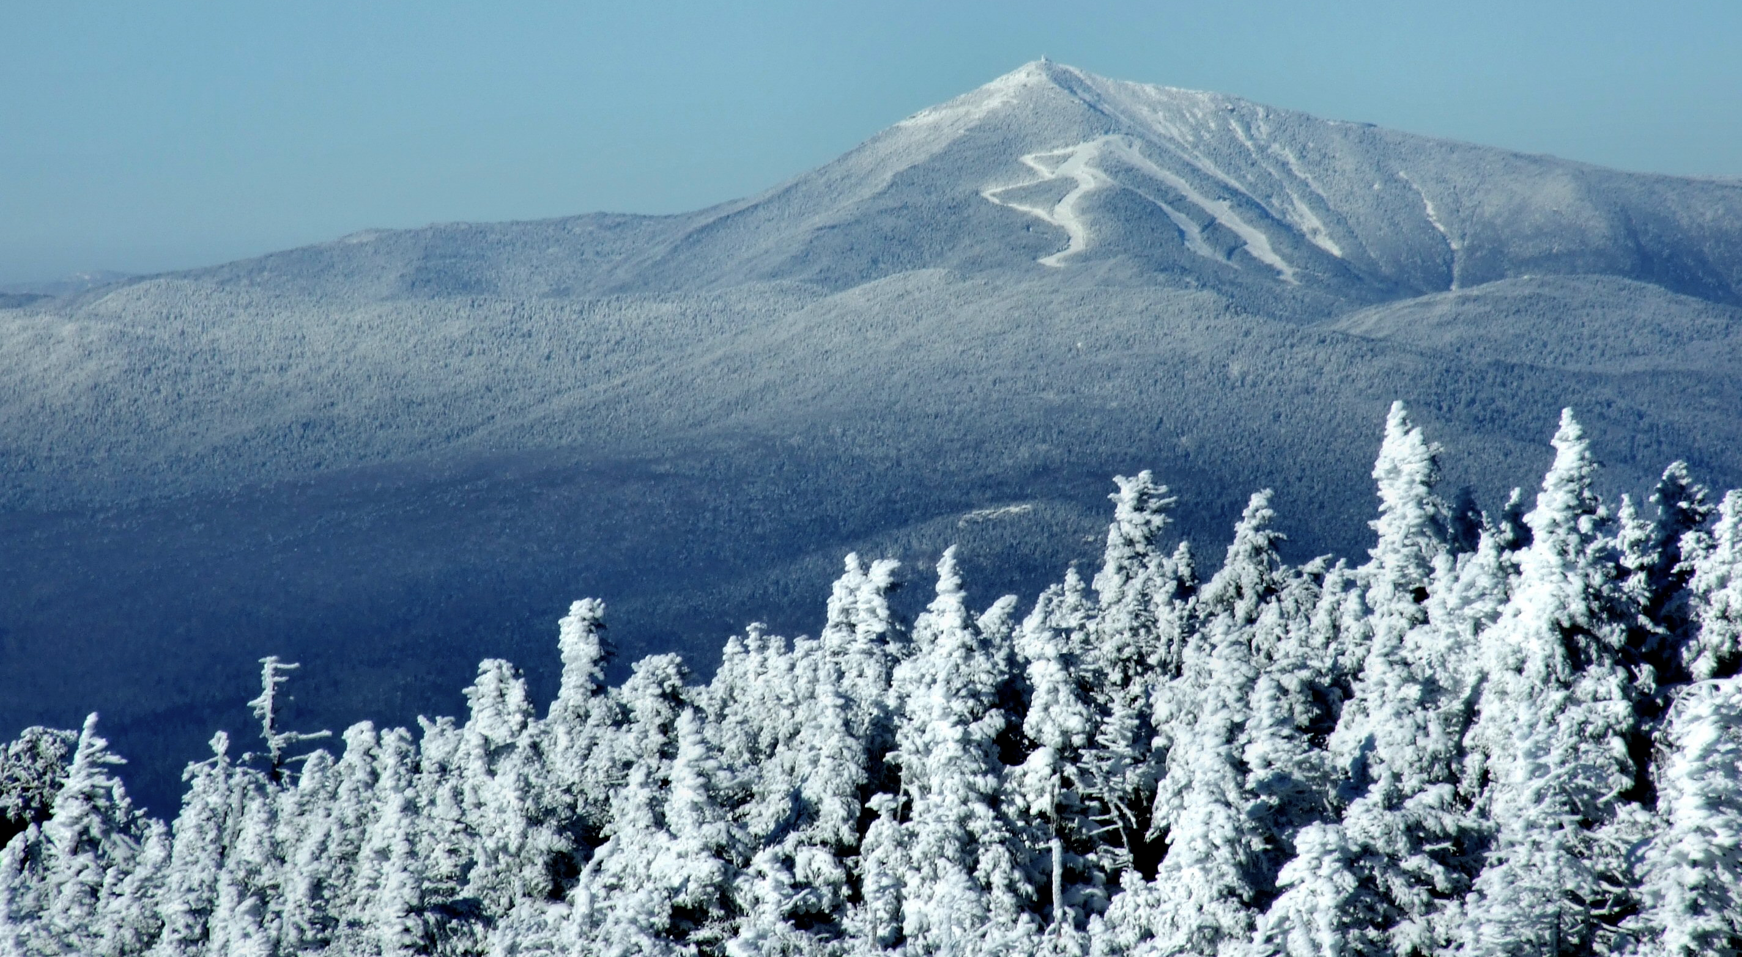
http://images.summitpost.org/original/472861.jpg

Slide 15
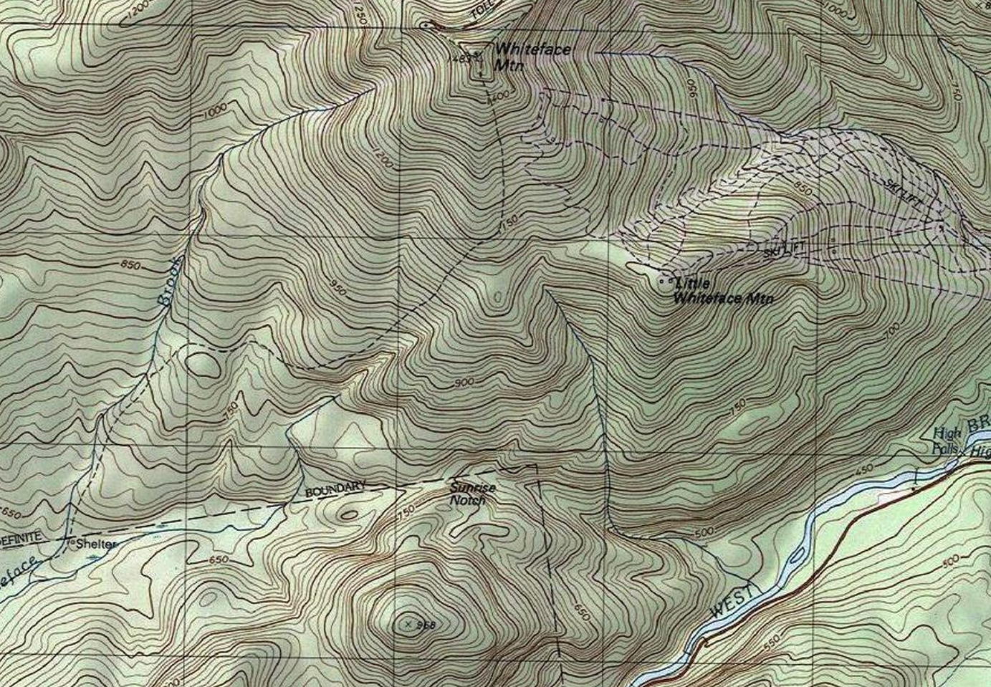

Slide 16
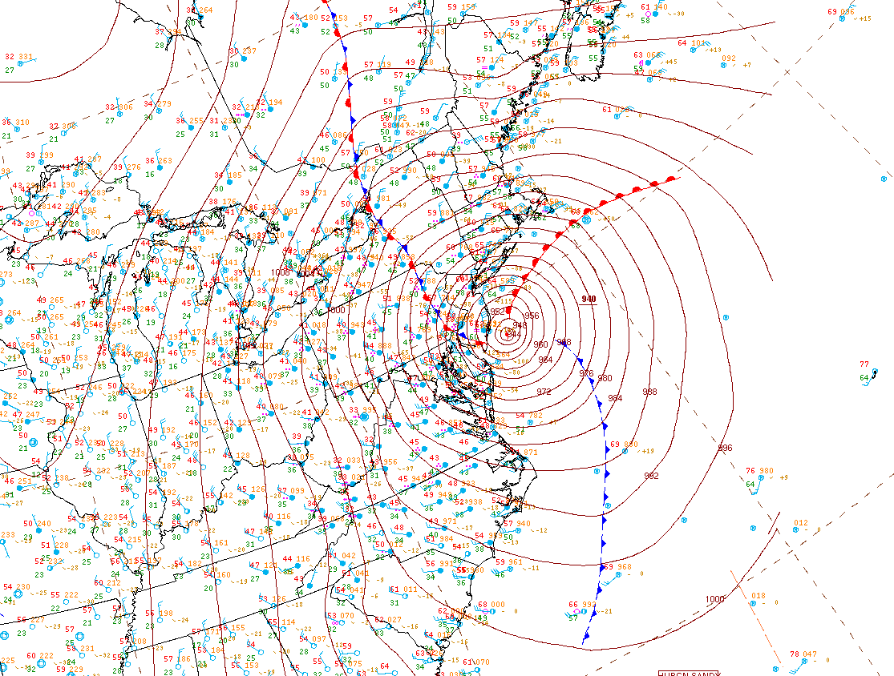

Slide 17
Surface weather station model review…

Slide 18
Surface weather station model review…

Slide 19
Surface weather station model review…

Slide 20
Surface weather station model review…
95

Slide 21
Surface weather station model review…
95
56

Slide 22
Surface weather station model review…
95
143
56

Slide 23
Surface weather station model review…
95
143
56

Slide 24
Surface weather station model review…
95
143
56
Temperature
Dew point temperature
Sea level pressure
Present weather

Slide 25
Contouring rules and tips
1) Contours should be as smooth and even as possible while still representing the data accurately.
2) Try to smooth out any unnecessary “wiggles” in your analysis.
3) Always do at least one rough draft, because in the end, you’ll want to make each contour with one, smooth movement.
4) Contours never cross one another.
5) Contours never branch, or fork.
6) Always label your contours at each edge of the map. Or, if your contours are concentric (closed), draw a label in the middle of the contour:
Example: –––––20–––––
7) The data can have errors! Try not to go out of your way for one single data point … especially if it doesn’t seem to “fit in” with the rest of the data.
8) Don’t contour where there are no observations. For instance, don’t draw long contours connecting points across a large body of water where there are no observations.
9) Contour in multiples of the interval (in most cases): Example: For temperature every 10°F:
20, 30, 40, 50…not 25, 35, 45, 55.

