Slide 1
March 2, 2018
Upstate New York Snowstorm
ATM 350
Ross Lazear

Slide 2
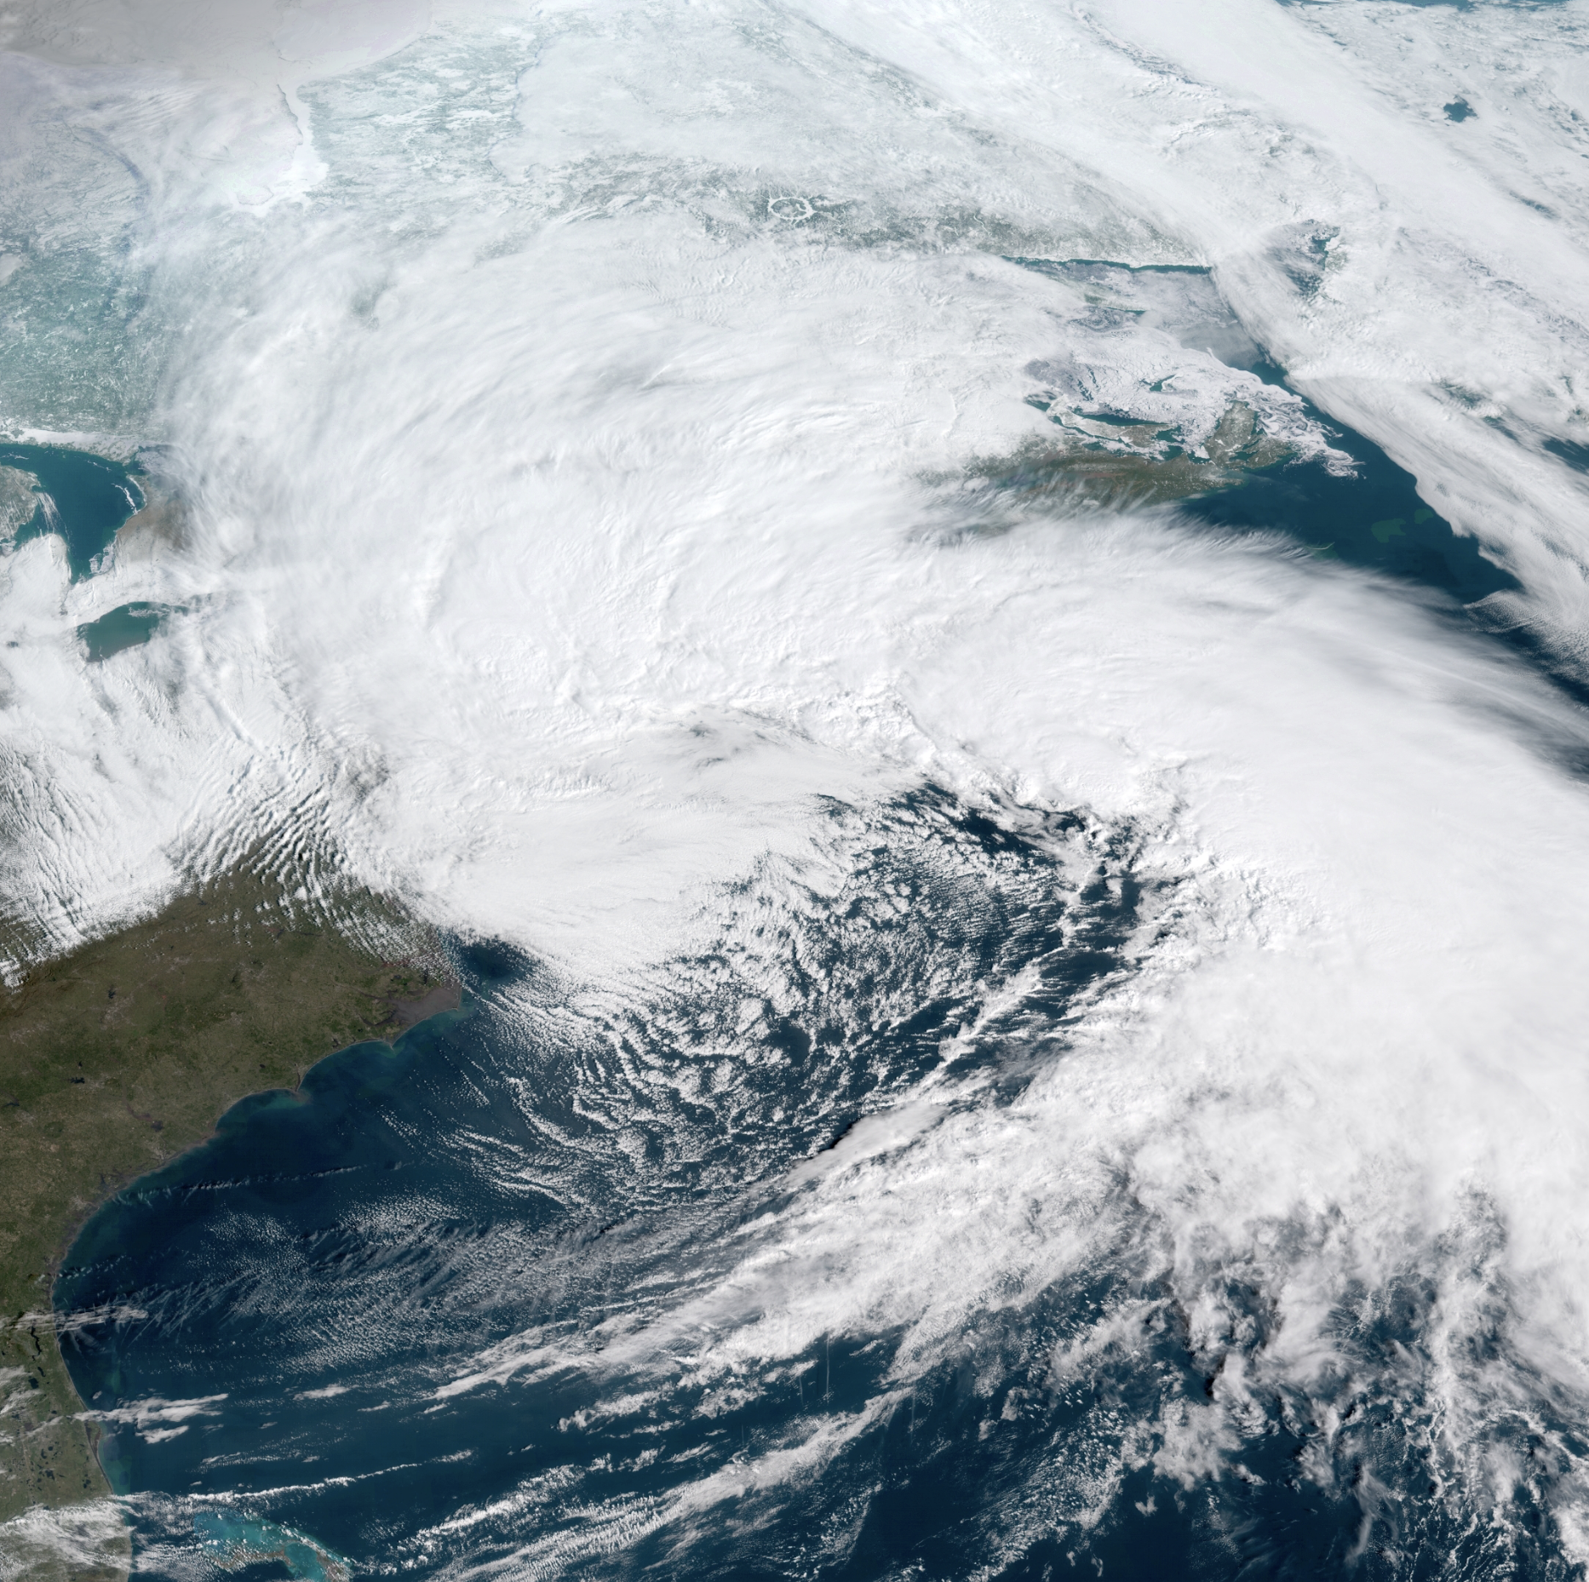
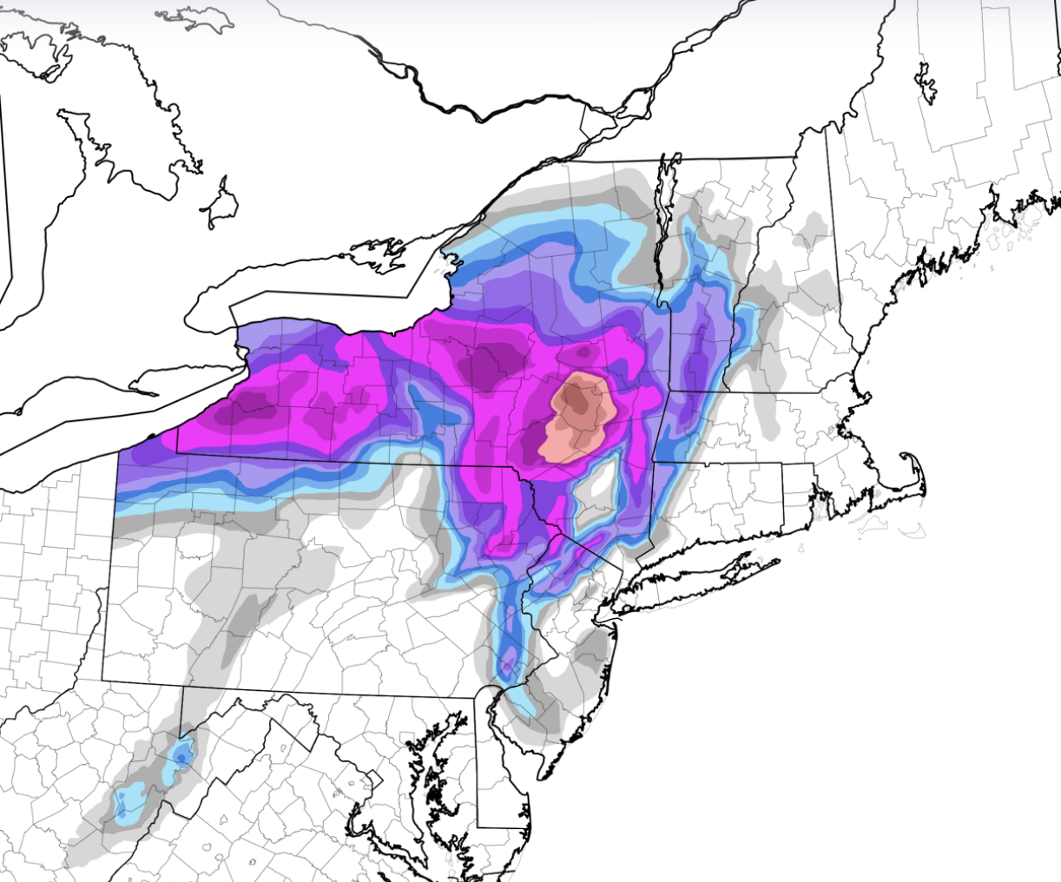
• Record-setting March snowstorm
• Significant upslope / frontogenesis event
• 40” in Richmondville, N.Y. (Schoharie Co.)
• 97-mph wind gust in Wellfleet, MA
• Minimum SLP 974 mb
From Tomer Burg

Slide 3
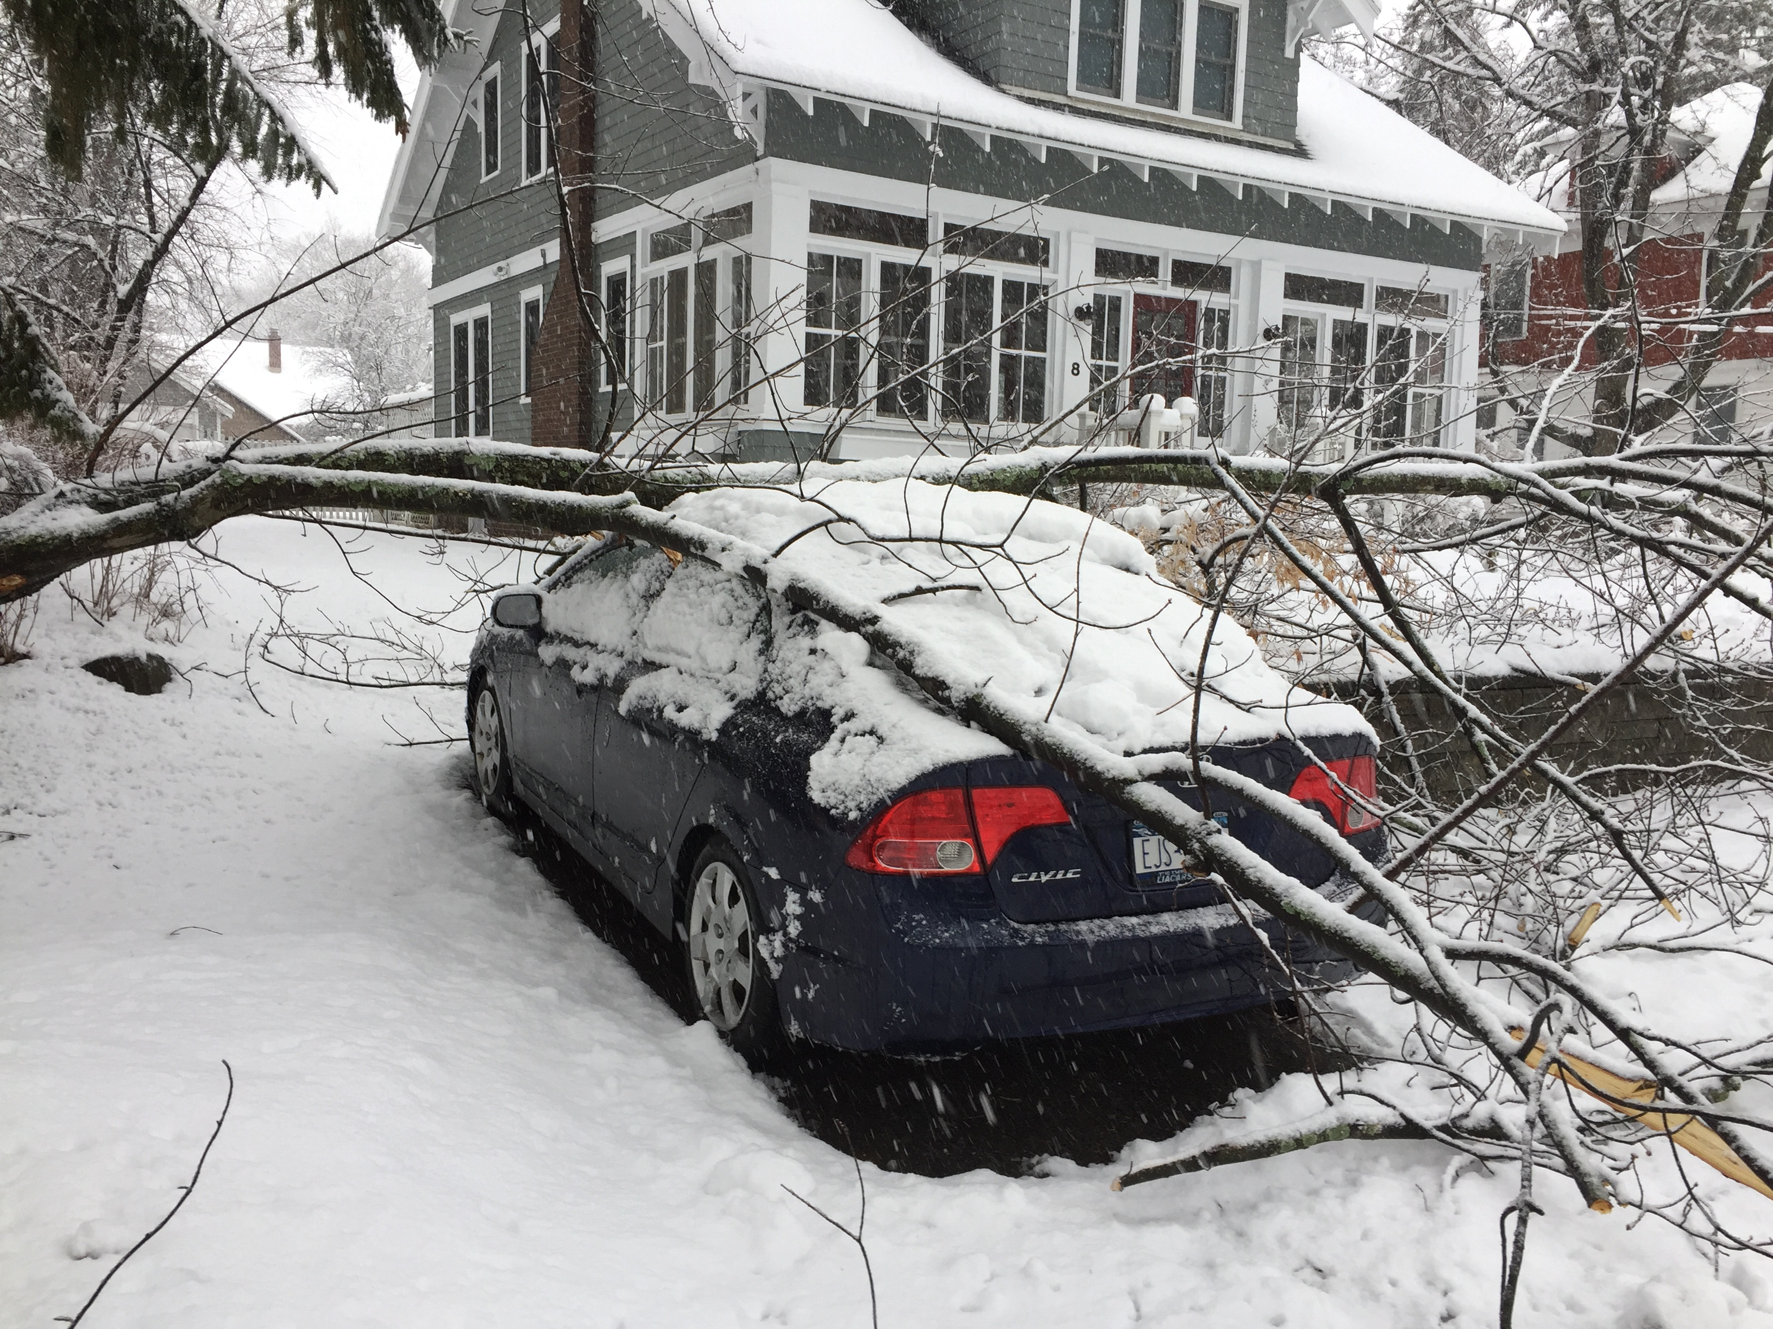

Slide 4
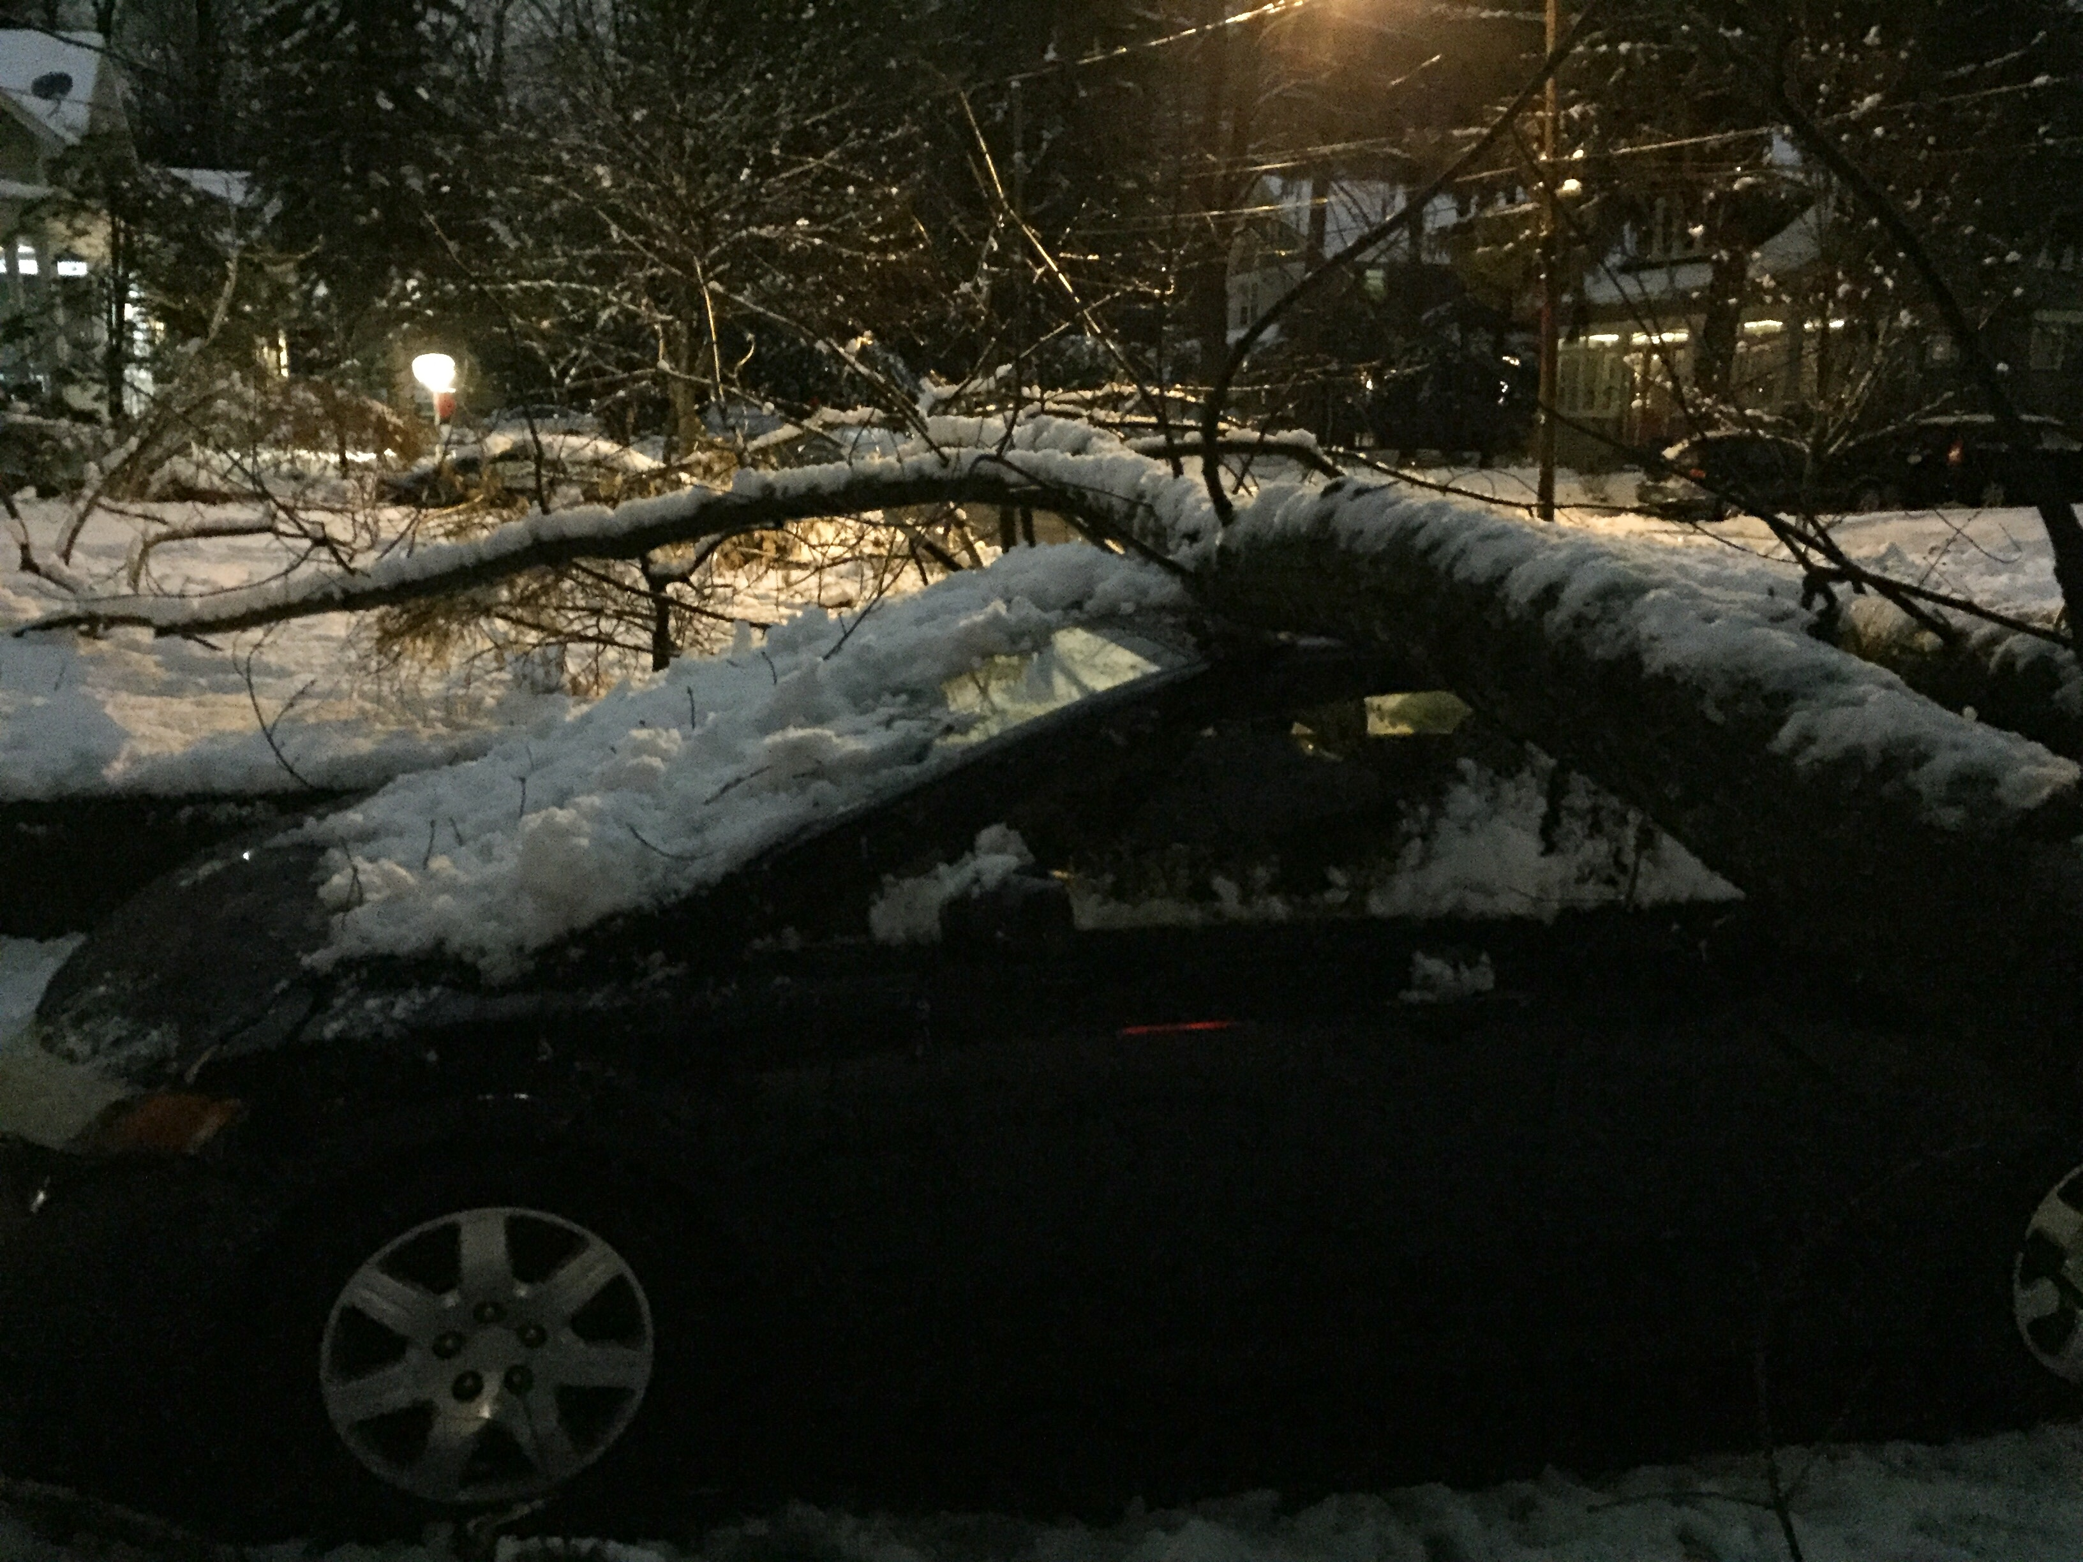

Slide 5
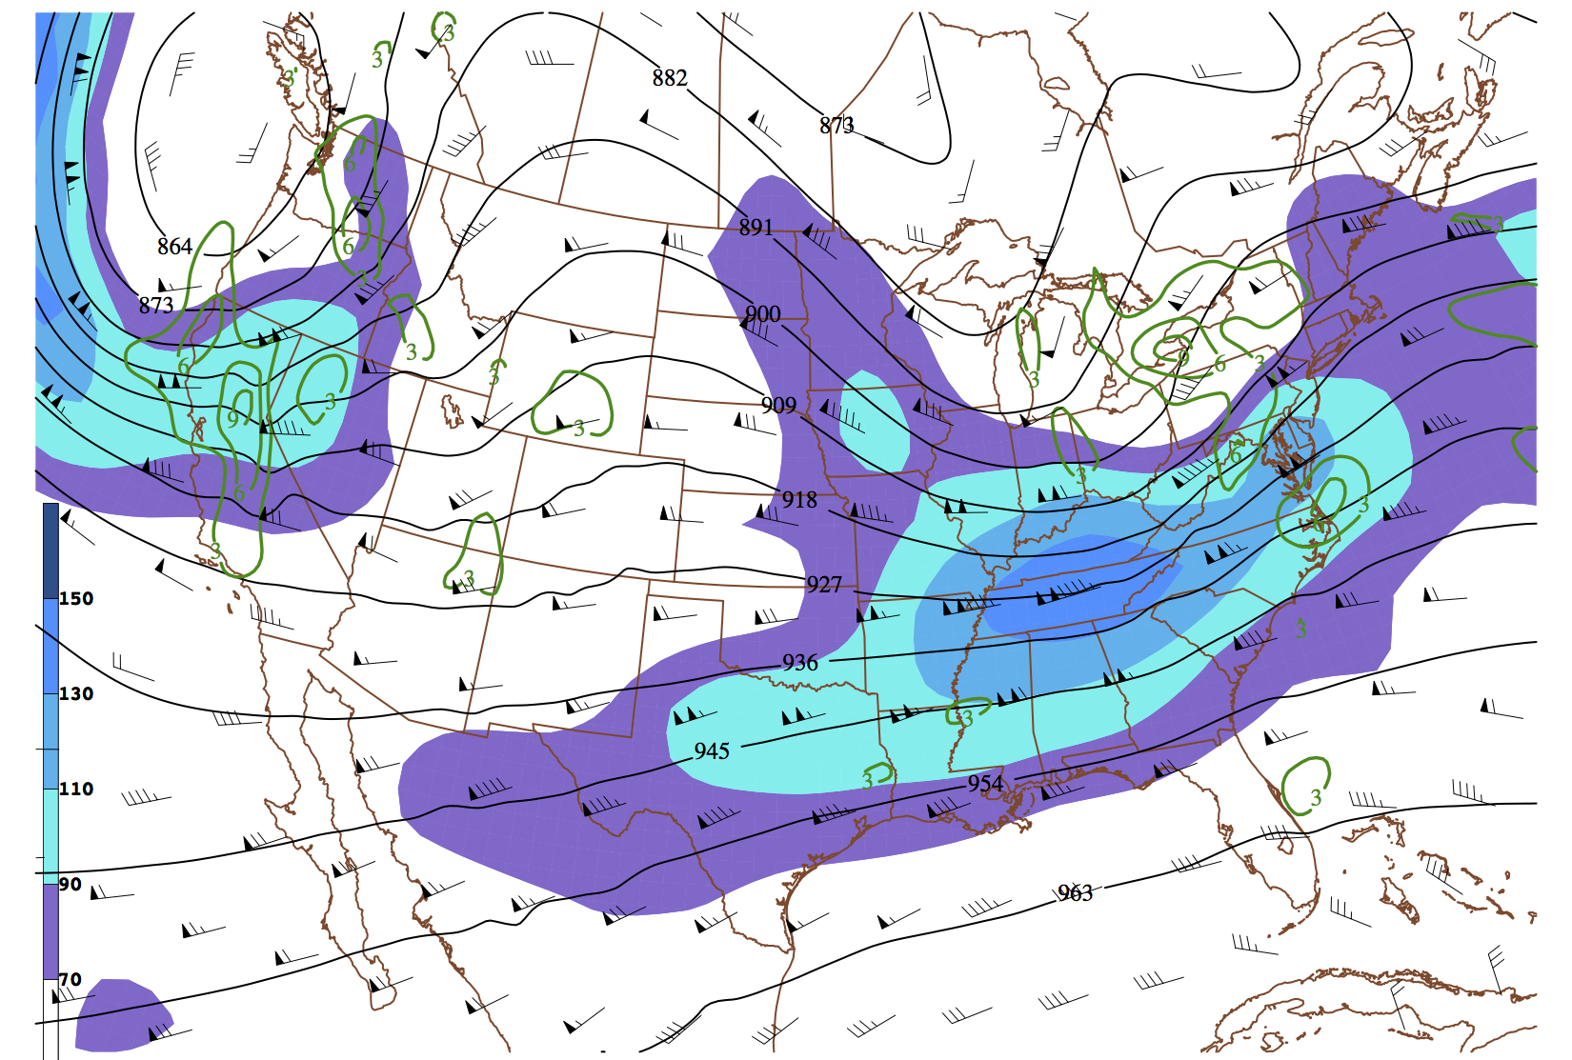
300-mb wind(kt.), divergence (x10⁻⁵ s⁻¹), geopotential height (dam)
0000 UTC 2 March 2018 GFS 1° analysis

Slide 6
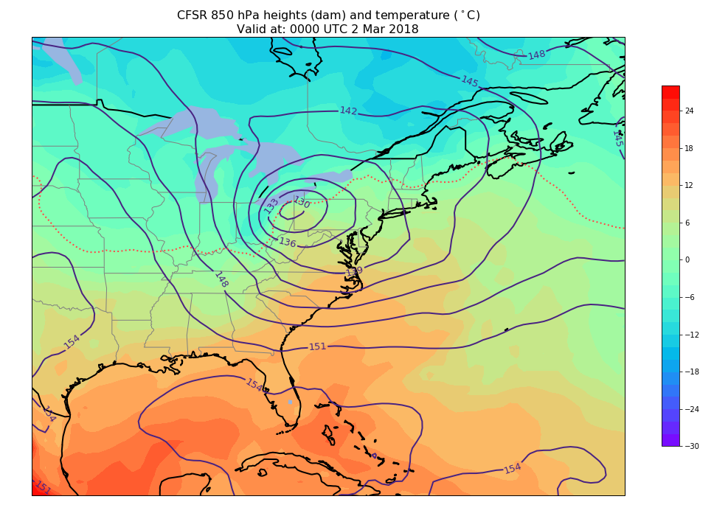

Slide 7
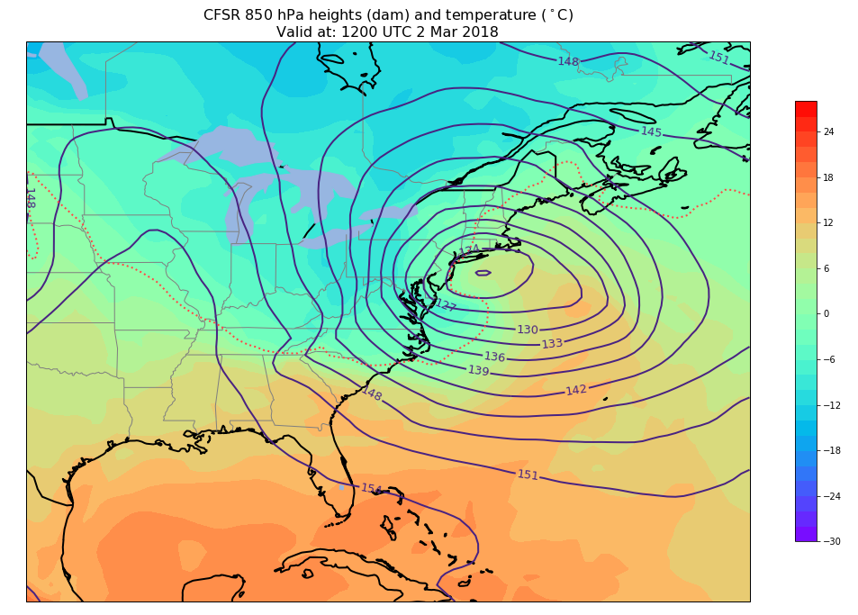

Slide 8
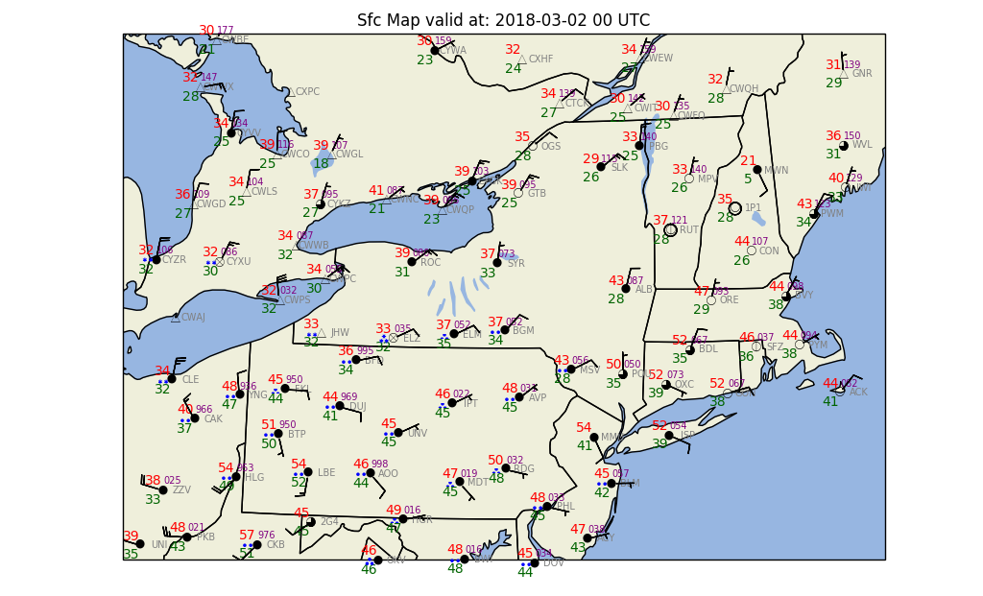

Slide 9
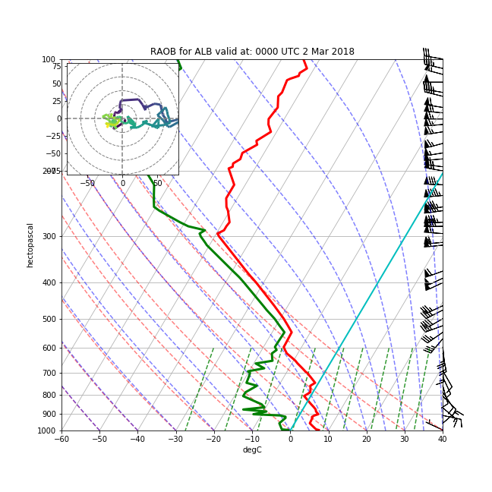
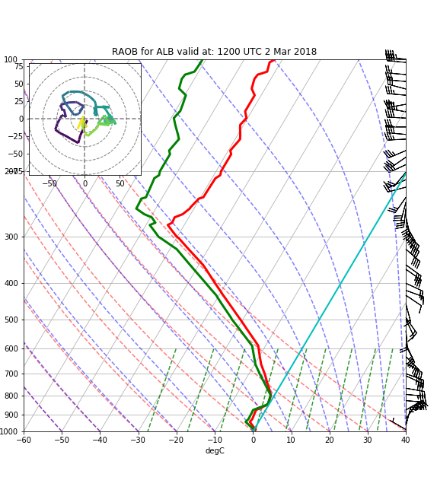
00Z 2 Mar
12Z 2 Mar

Slide 10
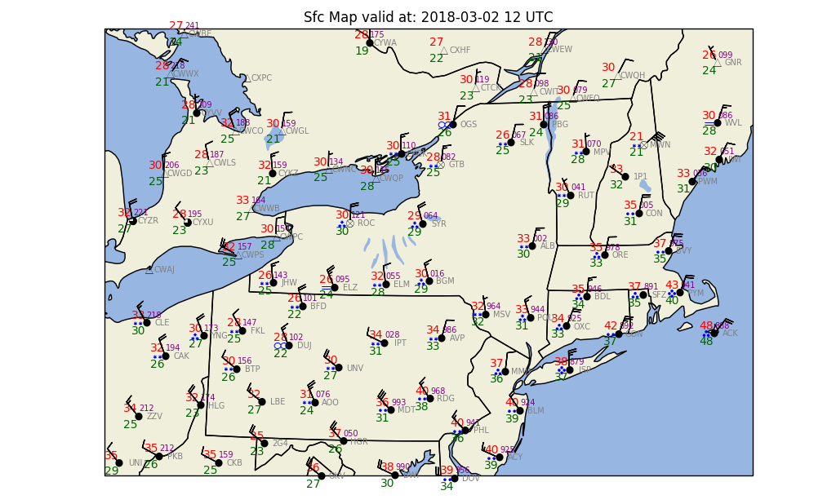

Slide 11
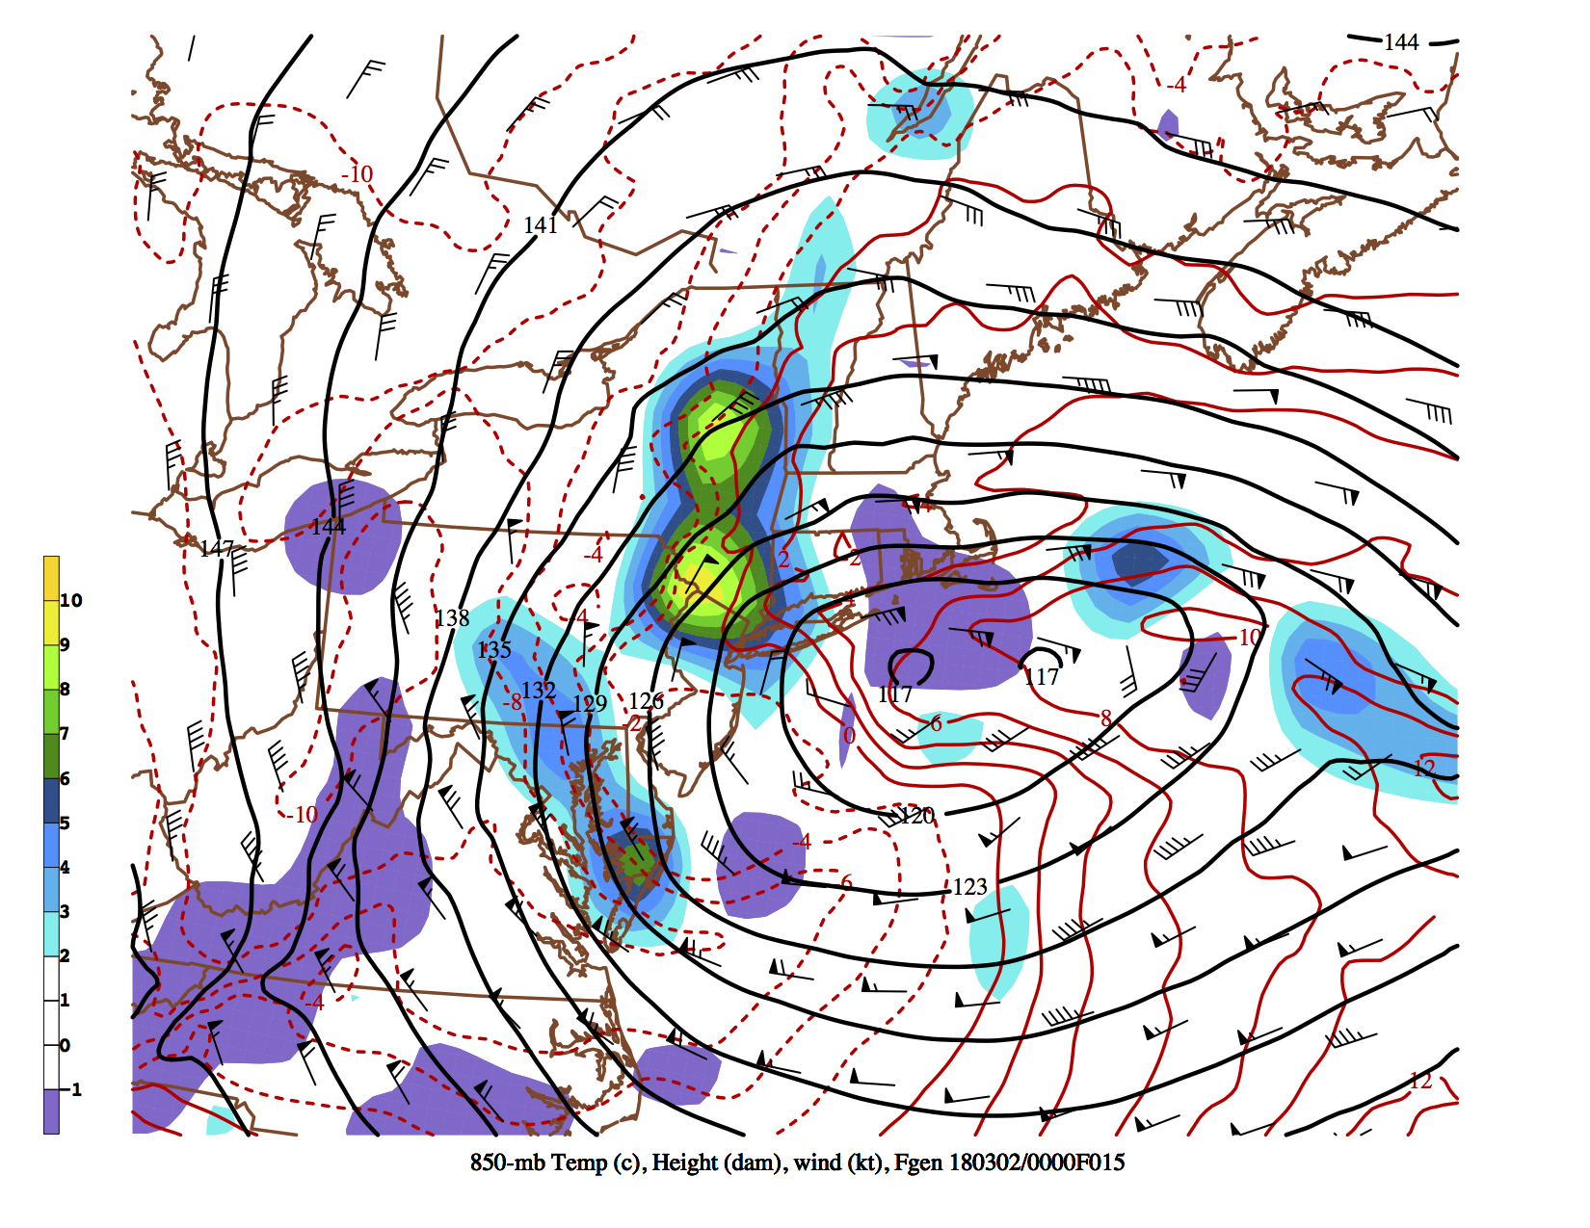
850-mb wind(kt.), frontogenesis (K 100 km⁻¹ 3 h⁻¹), geopotential height (dam), temp. (°C)
1500 UTC 2 March 2018 40-km NAM 15-h forecast from 0000 UTC 2 March 2018

Slide 12
KENX Radar – 1700–1800 UTC 2 March 2018

