Slide 1
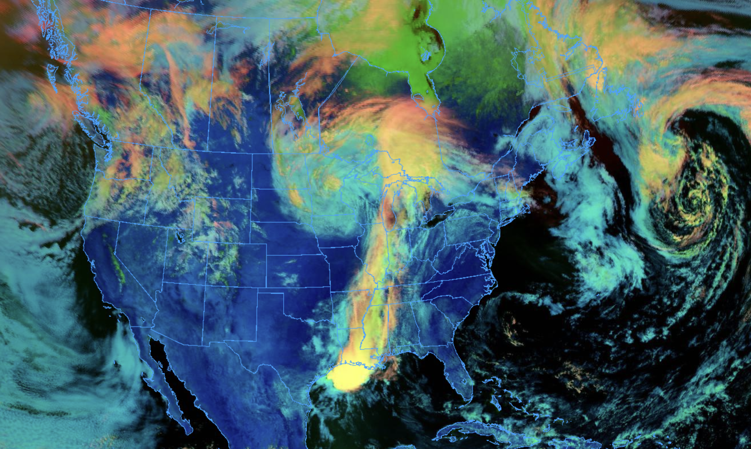
NOAA Science on a Sphere visualizations created by students in AATM 350:
Meteorological Data Analysis and Visualization
Instructors: Kevin Tyle and Ross Lazear
John Farash
Daniel Howard
Alex Kramer
Nathan Meglio
Declan Moynihan
Matthew Palladino
Selena Ramos
Amari Woods
Tianyu Zhu

