Slide 1
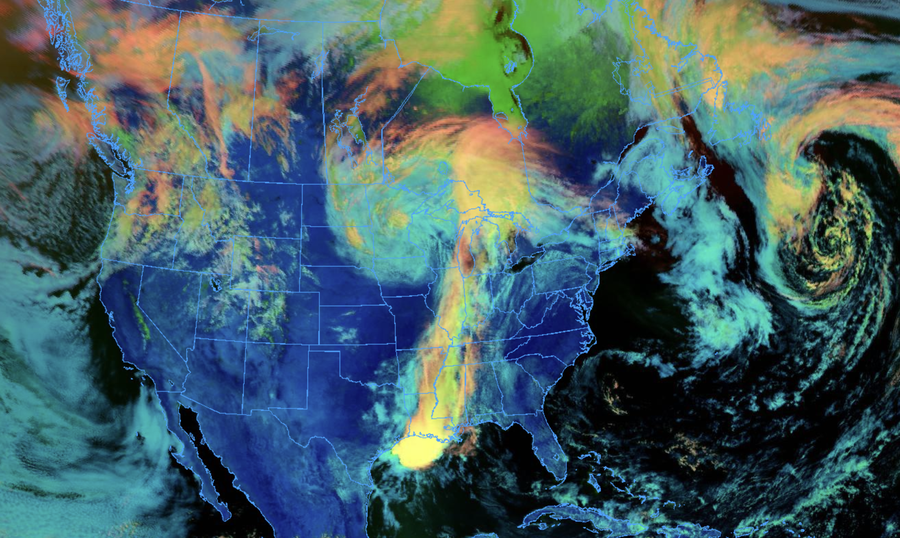
NOAA Science on a Sphere visualizations created by students in AATM 350:
Meteorological Data Analysis and Visualization
Instructors: Kevin Tyle and Ross Lazear
Tino Benfante
Bella Condo
Jack Conklin
Lauren Dunn
Anthony Fiore
Jack Fordyce
Ariel Fuller
Daniel Harkin
Sage Keidel
Allison Lancia
Harrison Miller
Kimberly Riek
Kathryn Rooney
Matthew Schyljuk
EB Smith
Ryan Sontarp
Kal Tellefsen
Liam Terhune
Ethan Wilkinson

