Slide 1

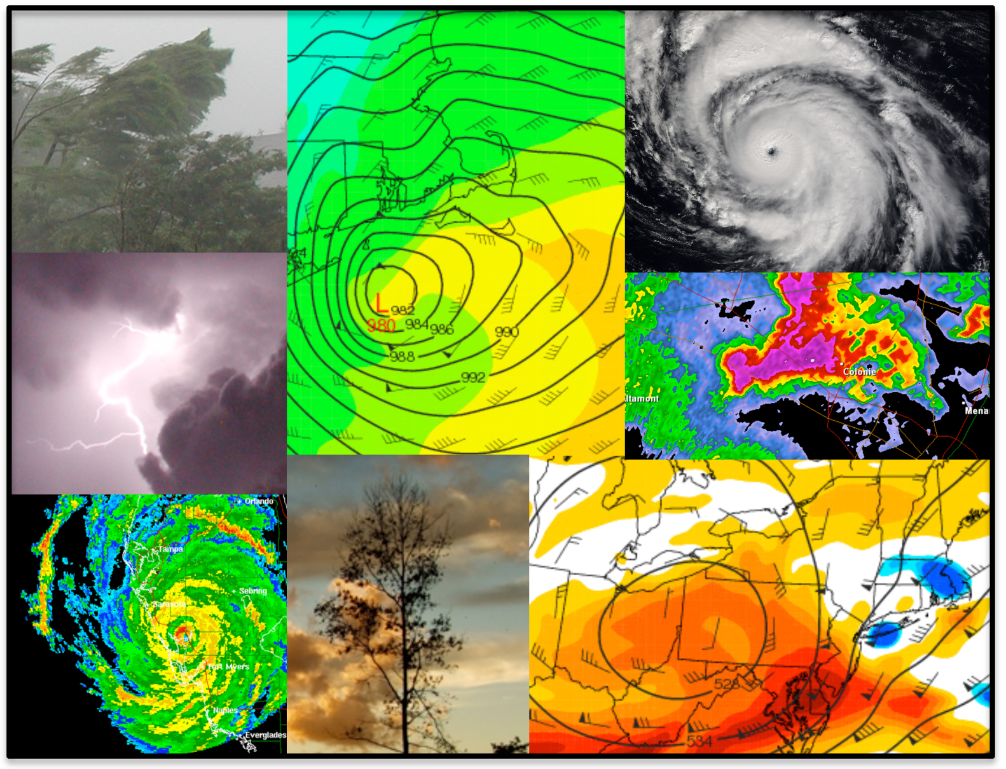
ATMOSPHERIC SCIENCE
in the
Department of Atmospheric and
Environmental Sciences

Slide 2
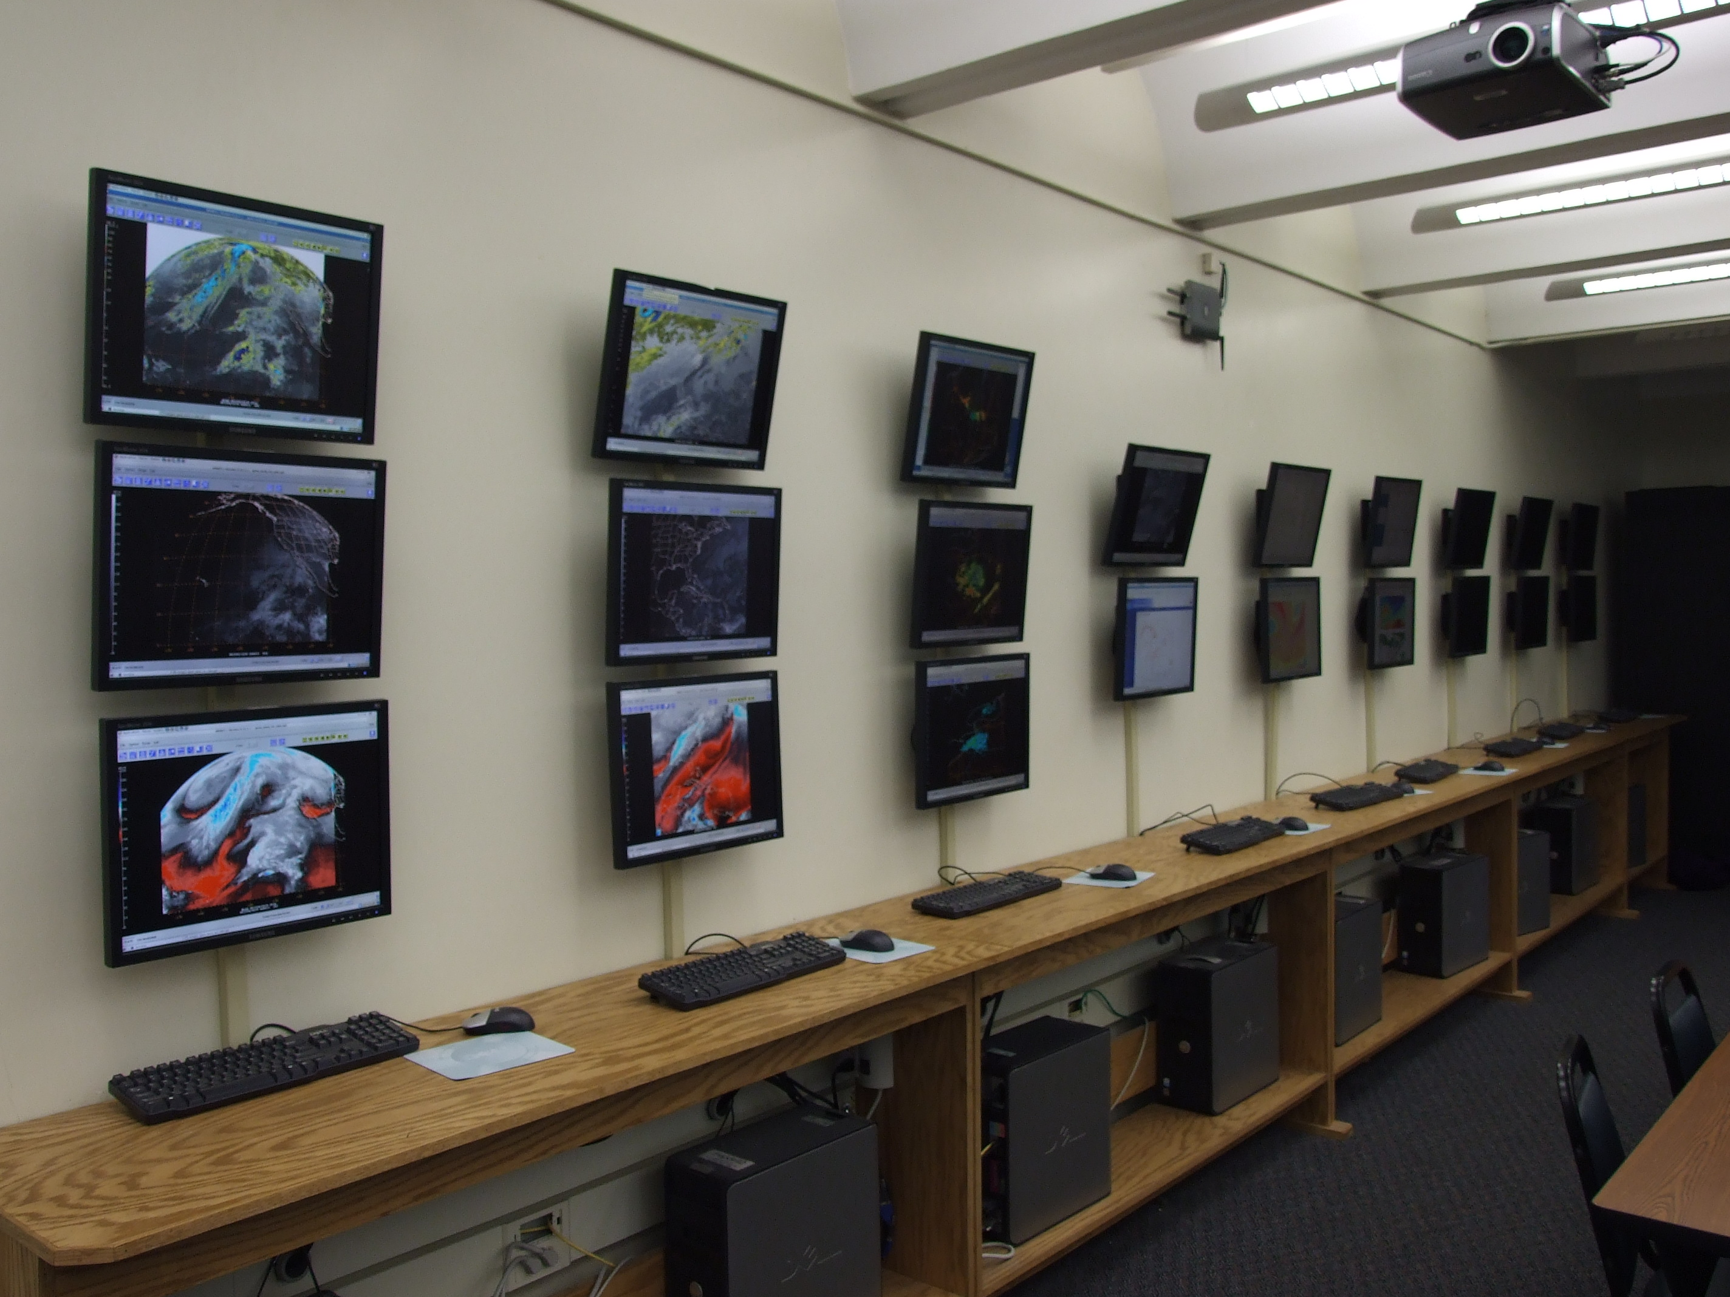
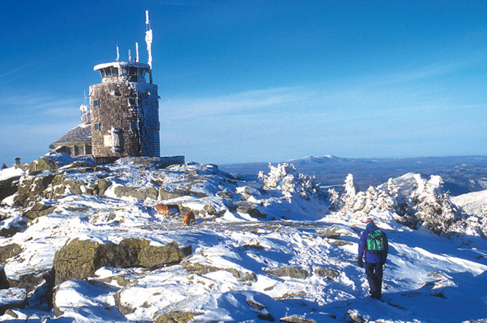
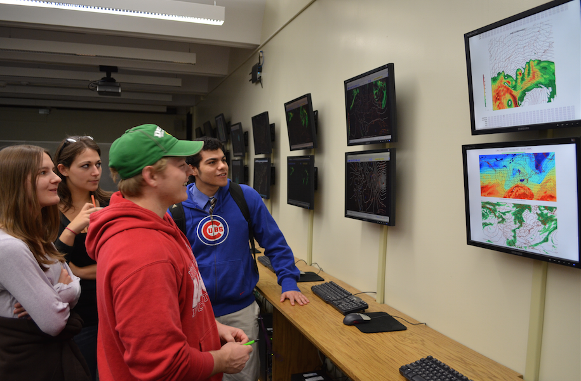
Bachelor of Science Degree in Atmospheric Science
The Atmospheric Science program at the University at Albany is nationally and internationally renowned. The combination of the Department of Atmospheric and Environmental Sciences (DAES) and the Atmospheric Science Research Center (ASRC) gives the University the largest program of education and research in New York State, and one of the largest in the nation. Additionally, the National Weather Service’s regional office is collocated with the ASRC on the main campus. This gives students in the department a unique opportunity to work closely with researchers and forecasters in multiple fields of study within the atmospheric sciences.
Faculty research covers a broad range of interest in the atmospheric and environmental sciences. Topics of research and study include:
• Synoptic-dynamic meteorology
• Mesoscale meteorology
• Weather systems and predictability
• Hurricanes and tropical meteorology
• Climate and climate change
• Cloud and precipitation physics
• Atmospheric chemistry and pollution
• Meteorological instrumentation
Research and Teaching Facilities
Maproom (right): DAES runs a fully equipped electronic map room with satellite, radar, lightning, and model data. The room is used for teaching and frequent weather discussions. The room also houses Linux workstations on which students can study or hone their forecasting skills in one of our many forecast contests.
Whiteface Mtn. Observatory (below): ASRC operates an observation center atop Whiteface Mountain in the Adirondacks, meausring chemical species, cloud properties, acid precipitation, and aerosol content.

Slide 3
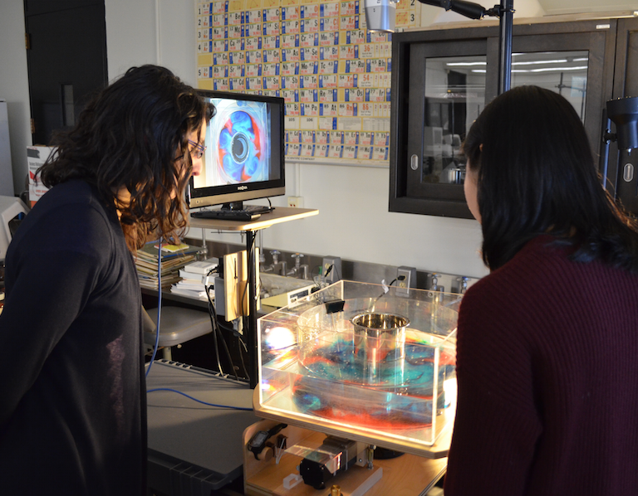
Atmospheric Science Curriculum
Students planning to study atmospheric science should have a good academic preparation in physics and mathematics. Below is a sample four-year plan for an atmospheric science major, with required classes listed in bold (including twelve elective credits):
Semester I Semester 2
MAT 112: Calculus I 4 MAT 113: Calculus II 4
PHY 140, 145: Physics I (w/ lab) 4 PHY 150: Physics II 3
CHM 120: Chemistry I 4 Elective/Gen-ed *
Elective/University Gen. Ed. Requirement * Elective/Gen-ed *
Semester 3 Semester 4
MAT 214: Calculus III 4 MAT 311: Differential Equations 3
ATM 315: Env. Statistics/Comp. 3 ATM 211: Weather Analysis and 4
ATM 209: Weather Workshop 1 Forecasting
ATM 210/Z: Atmospheric Structure, 3 Elective/Gen-ed *
Thermodynamics, and Elective/Gen-ed *
Circulation Elective/Gen-ed *
Elective/Gen-ed *
Semester 5 Semester 6
ATM 316: Dynamic Meteorology I 3 ATM 317: Dynamic Meteorology II 3
ATM 320: Thermodynamics 3 ATM 321: Physical Meteorology 3
ATM Elective * ATM 350: Meteorological Datasets and 2
Elective/Gen-ed / Minor * Numerical Computation
Elective/Minor * ATM Elective *
Elective/Minor *
Semester 7 Semester 8
ATM 418: Dynamic Meteorology III 3 ATM 419: Numerical Weather Pred. 3
ATM Elective/Gen-ed/Internship * ATM Elective/Gen-ed/Internship * Elective / Minor / Research * Elective / Minor / Research *
Elective / Minor * Elective / Minor *
Elective / Minor * Elective / Minor *
Additional (Elective) Courses
ATM 100: The Atmosphere
ATM 103: Introduction to Climate Change
ATM 107: The Oceans
ATM 110: Weather and Climate Issues for the 21st Century
ATM 200: Natural Disasters
ATM 301: Surface Hydrology and Hydrometeorology
ATM 304: Air Quality
ATM 305: Global Physical Climatology
ATM 306: Climate Variability and Change
ATM 307: Atmospheric Chemistry
ATM 311: Severe and Hazardous Weather
ATM 327: Meteorological and Environmental Measurement
ATM 335: Meteorological Remote Sensing
ATM 400: Synoptic Meteorology I
ATM 401: Synoptic Meteorology II
ATM 405: Water and Climate Change
ATM 409: Precipitation Processes
ATM 413: Weather, Climate Change, and Societal Impacts
ATM 414: Air Pollution
ATM 415: Climate Laboratory
ATM 421: Tropical Meteorology
In Dynamic Meteorology, students use a rotating fluids tank in order to demonstrate fundamental atmospheric processes.

Slide 4
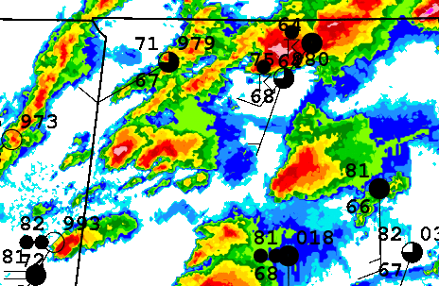
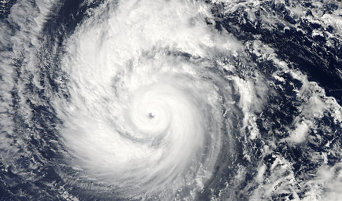
Internship and Research Opportunities
Internships:
DAES allows multiple internship opportunities, all of which provide students with a valuable learning experience and credit towards the major. Some examples are:
National Weather Service (NWS)
The NWS Forecast Office in Albany, a 10-minute walk from DAES, provides an internship that allows students to work with forecasters, launch weather balloons, assist with the forecast process, conduct storm damage surveys, pursue research projects, visit observation sites, etc.
New York State Mesonet
The NYS Mesonet, started in 2015, is a dense network of 125 weather stations across the state. With its control center on campus, students can intern in this project and support field technicians, monitor network communications, assure data quality, and work on related research utilizing Mesonet data.
Broadcast Meteorology
Students can intern with a local TV meteorologist. Duties include working behind the scenes on weather graphics, and practicing on-air time leading to a demo tape.
National Weather Service internship
New York State Mesonet internship
Research:
Many students work on a research project with a faculty member during their junior or senior year. Research ideas may come directly from faculty, but students often come up with their own ideas that fit with a specific faculty member’s research interests.
Some recent undergraduate research projects are:
• Large-scale precursors to major lake-effect snow events
• The effect of the Appalachians on mid-summer squall lines
• Using the convective available potential energy tendency equation in the analysis of a major severe weather outbreak
• Case study of an unusually strong late summer Arctic cyclone
• Processes that lead to an abundance of eastern U.S. heat waves in late August and early September
• Lightning in complex terrain for varying weather patterns
• Analysis of tornado track length and downdraft strength
• Case study of the major tornado outbreak of 27 April 2011
• Warm-season Mohawk–Hudson convergence thunderstorms

Slide 5
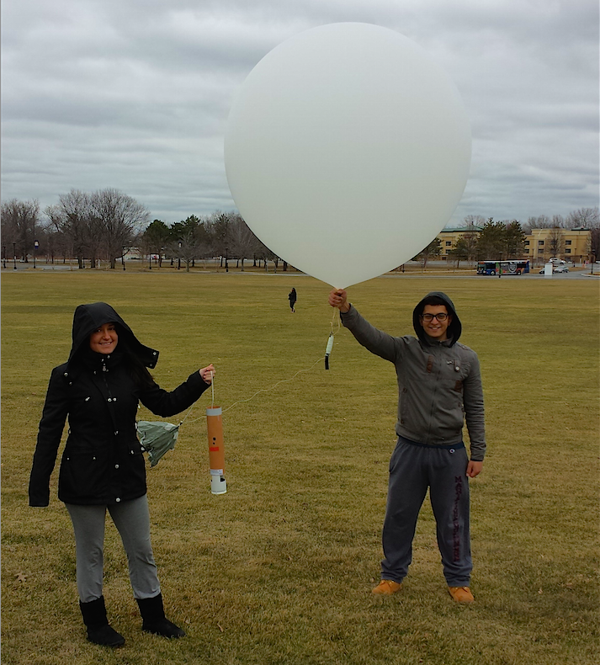
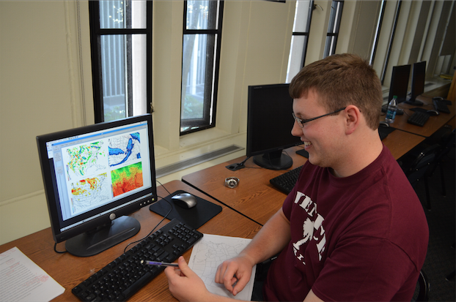
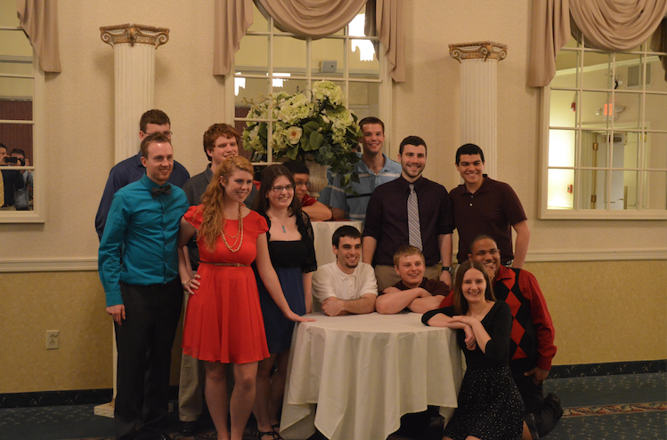
Honors Program:
Students with a cumulative GPA of at least 3.25, and 3.5 in the major, are eligible to apply for a B.S. with honors in atmospheric science. Students must complete 82 credits including two semesters of Undergraduate Research (ATM 499) leading to an undergraduate thesis and oral presentation.
Graduate Program:
Our department also has an active graduate program, offering Ph.D. and M.S. degrees in atmospheric science. A multitude of prominent research in atmospheric science has come from graduate work at UAlbany, and many of our alumni are now employed at some of the top research and teaching facilities in the world.
Students launching a weather balloon in ATM 327
Minors:
While adding a minor isn’t required for atmospheric science majors, many of our students choose to minor in one of these related fields:
• Math (only two additional courses required)
• Physics
• Chemistry
• Computer Science
• Broadcast Meteorology (only for atmos. Sci. majors)
• Sustainability
• Business
• Informatics
• Geographic Information Systems (Certificate)
Careers:
Many of our undergraduate degree recipients continue their education in graduate school, although there are a significant number of jobs available to students with Bachelor’s degrees. Some of the more common jobs are in:
• Research
• Teaching
• Air quality monitoring
• Weather forecasting (private sector and NOAA)
• TV broadcasting and production
• Solar and wind energy, and energy forecasting
• Risk management
• Finance/derivatives
• Meteorological instrumentation
• Environmental legislation
• Forensic meteorology
• Scientific and engineering consultation
Preparing an ATM 401 discussion
Graduates at the senior dinner and faculty roast

Slide 6
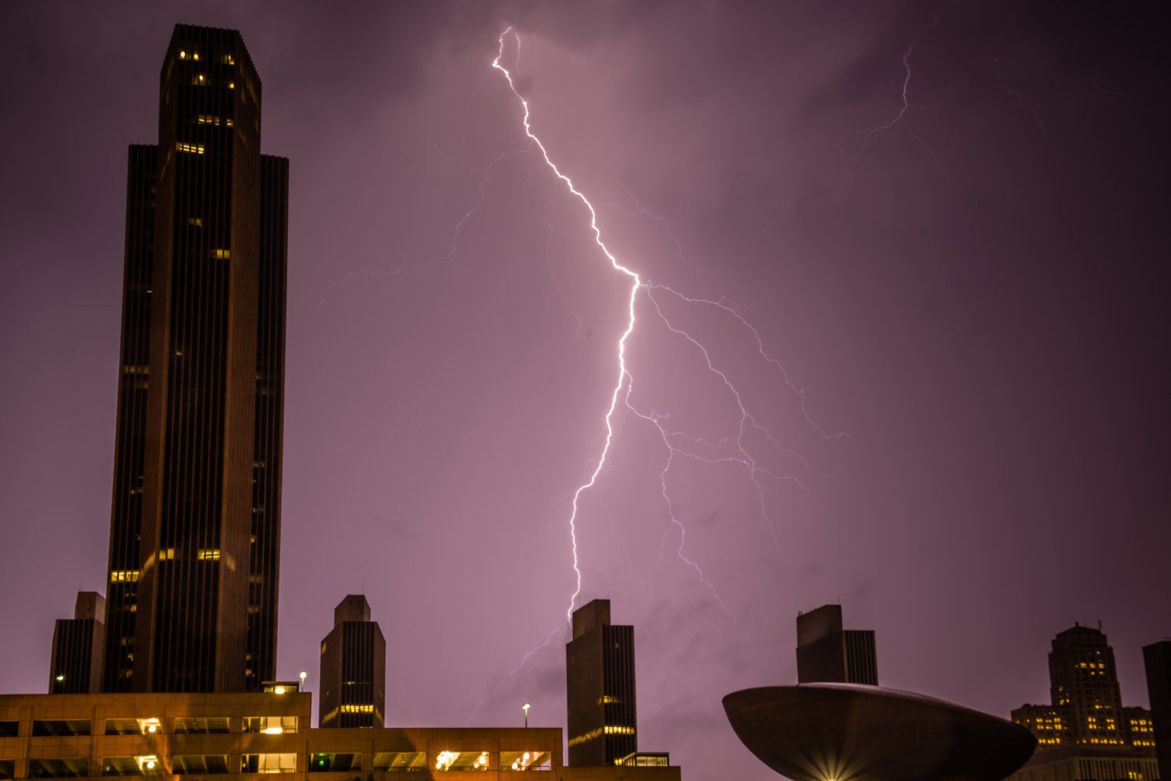
Faculty Research Interests and Contact Information
Lance F. Bosart, Distinguished Professor (Ph.D., MIT)
lbosart@albany.edu
Synoptic meteorology and the weather-climate interface
Kristen Corbosiero, Assistant Professor (Ph.D., University at Albany)
kcorbosiero@albany.edu
Tropical cyclones and lightning
Aiguo Dai, Associate Professor (Ph.D., Columbia Univ.)
adai@albany.edu
Climate change and the global water cycle
Oliver Elison Timm, Associate Professor (Ph.D. Univ. of Kiel)
oelisontimm@albany.edu
Paleoclimatology and regional climate change
Robert Fovell, Professor (Ph.D., Univ. of Illinois)
rfovell@albany.edu
Numerical weather prediction and mesoscale meteorology
Vincent P. Idone, Associate Professor (Ph.D., University at Albany)
vidone@albany.edu
Atmospheric electricity
Robert G. Keesee, Associate Professor (Ph.D., Univ. of Colorado)
rkeesee@albany.edu
Atmospheric chemistry
Daniel Keyser, Professor (Ph.D., Pennsylvania State Univ.)
dkeyser@albany.edu
Synoptic-dynamic meteorology
Andrea L. Lang, Assistant Professor (Ph.D., Univ. of Wisconsin)
alang@albany.edu
Synoptic meteo. and troposphere-stratosphere interaction
Ross A. Lazear, Instructor (M.S., Univ. of Wisconsin)
rlazear@albany.edu
Synoptic and mesoscale meteorology, and forecasting
Jiping Liu, Assistant Professor (Ph.D., Columbia Univ.)
jliu26@albany.edu
Atmosphere-ice-ocean interactions
Justin R. Minder, Assistant Professor (Ph.D., Univ. of Washington)
jminder@albany.edu
Mountain meteorology and mesoscale meteorology
John E. Molinari, Professor (Ph.D., Florida State Univ.)
jmolinari@albany.edu
Tropical cyclones
Brian E. J. Rose, Assistant Professor (Ph.D., MIT)
brose@albany.edu
Planetary-scale climate dynamics
Paul E. Roundy, Associate Professor (Ph.D., Pennsylvania State Univ.
proundy@albany.edu
Tropical atmospheric waves and midlatitude interaction
Brian H. Tang, Assistant Professor (Ph.D., MIT)
btang@albany.edu
Tropical cyclones and mesoscale meteorology
Christopher D. Thorncroft, Professor and Dept. Chair (Ph.D., University of Reading)
cthorncroft@albany.edu
West African monsoon and African easterly waves
Ryan Torn, Associate Professor (Ph.D., Univ. of Washington)
rtorn@albany.edu
Predictability, data assimilation, and mesoscale meteorology
Kevin R. Tyle, Manager of Departmental Computing (M.S., University at Albany)
ktyle@albany.edu
Big data, and meteorological data visualization
Mathias Vuille, Associate Professor (Ph.D., Univ. of Bern)
mvuille@albany.edu
Tropical paleoclimatology and climate change
Junhong Wang, Research Associate Professor (Ph.D., Columbia University)
jwang20@albany.edu
Climate observations and instrumentation
Liming Zhou, Associate Professor (Ph.D., Boston University)
lzhou@albany.edu
Remote sensing and land-climate interactions
Lightning in downtown Albany eyewashere.net
CONTACT THE DEPARTMENT
Dept. of Atmospheric and Environmental Sciences
University at Albany, ES-351
1400 Washington Ave., Albany, NY 12222
(518).442.4556
Email: daeschair@albany.edu

