Slide 1
ATM B.S. REQUIRED COURSES (CORE)
Fall 1
PHY 140 – Physics 1
PHY 145 – Physics Lab 1
CHM 120 – Chemistry 1
MAT 112 – Calculus 1
Fall 2
ATM 209 – Weather Workshop
ATM 210 – Atmos. Structure,
Thermo., Circulation
MAT 214 – Calculus 3
Fall 3
ATM 316 – Dynamics 1
ATM 320 - Thermodynamics
Fall 4
ATM 418 – Dynamics 3
Spring 1
PHY 150 – Physics 2
MAT 113 – Calculus 2
Spring 2
ATM 211 – Weather Analysis & Fcst.
ATM 315 – Env. Stats. and Comp.
[or fall 2]
MAT 311 – Differential Equations
Spring 3
ATM 317 – Dynamics 2
ATM 321 – Physical Meteorology
ATM 350 – Meteo. Data & Visualization
Spring 4
ATM 419 - NWP

Slide 2
ATM B.S. ELECTIVES
ATM 301 – Surface Hydrology and Hydrometeorology
ATM 305 – Global Physical Climatology
ATM 306 – Climate Variability and Climate Change
ATM 307 – Intro. Atmospheric Chemistry
ATM 311 – Severe and Hazardous Weather and Forecasting
ATM 327 – Meteorological and Environmental Measurement
ATM 335 – Meteorological Remote Sensing
ATM 400 – Synoptic Meteorology I
ATM 401 – Synoptic Meteorology II
ATM 404 – Oceans and Climate
ATM 405 – Water and Climate Change
ATM 408 – Hydrometeorology
ATM 409 – Atmospheric Precipitation Processes
ATM 413 – Weather, Climate Cha., and Soc. Impacts
ATM 414 – Air Pollution Meteorology
ATM 415 – Climate Laboratory
ATM 421 – Tropical Meteorology
ATM 490/497/498/499
• 12 credits required
• One of ATM 311 or 405
• 3 max. 490
• 6 max. 497/498/499

Slide 3
DISCUSSION
• Required climate / climate change course
Update writing requirement?
• Too many electives?
Or… should ATM 490 not count towards elective credits?
• Computer programming course (CSI 201? 204?)
• ATM 210 / 315 sections for ATM and ENV
• Need list of objectives for ATM (and ENV)
…What do we want the students to know upon graduation?

Slide 4
AMS DEGREE EQUIVALENT COURSEWORK (2010)

Slide 5
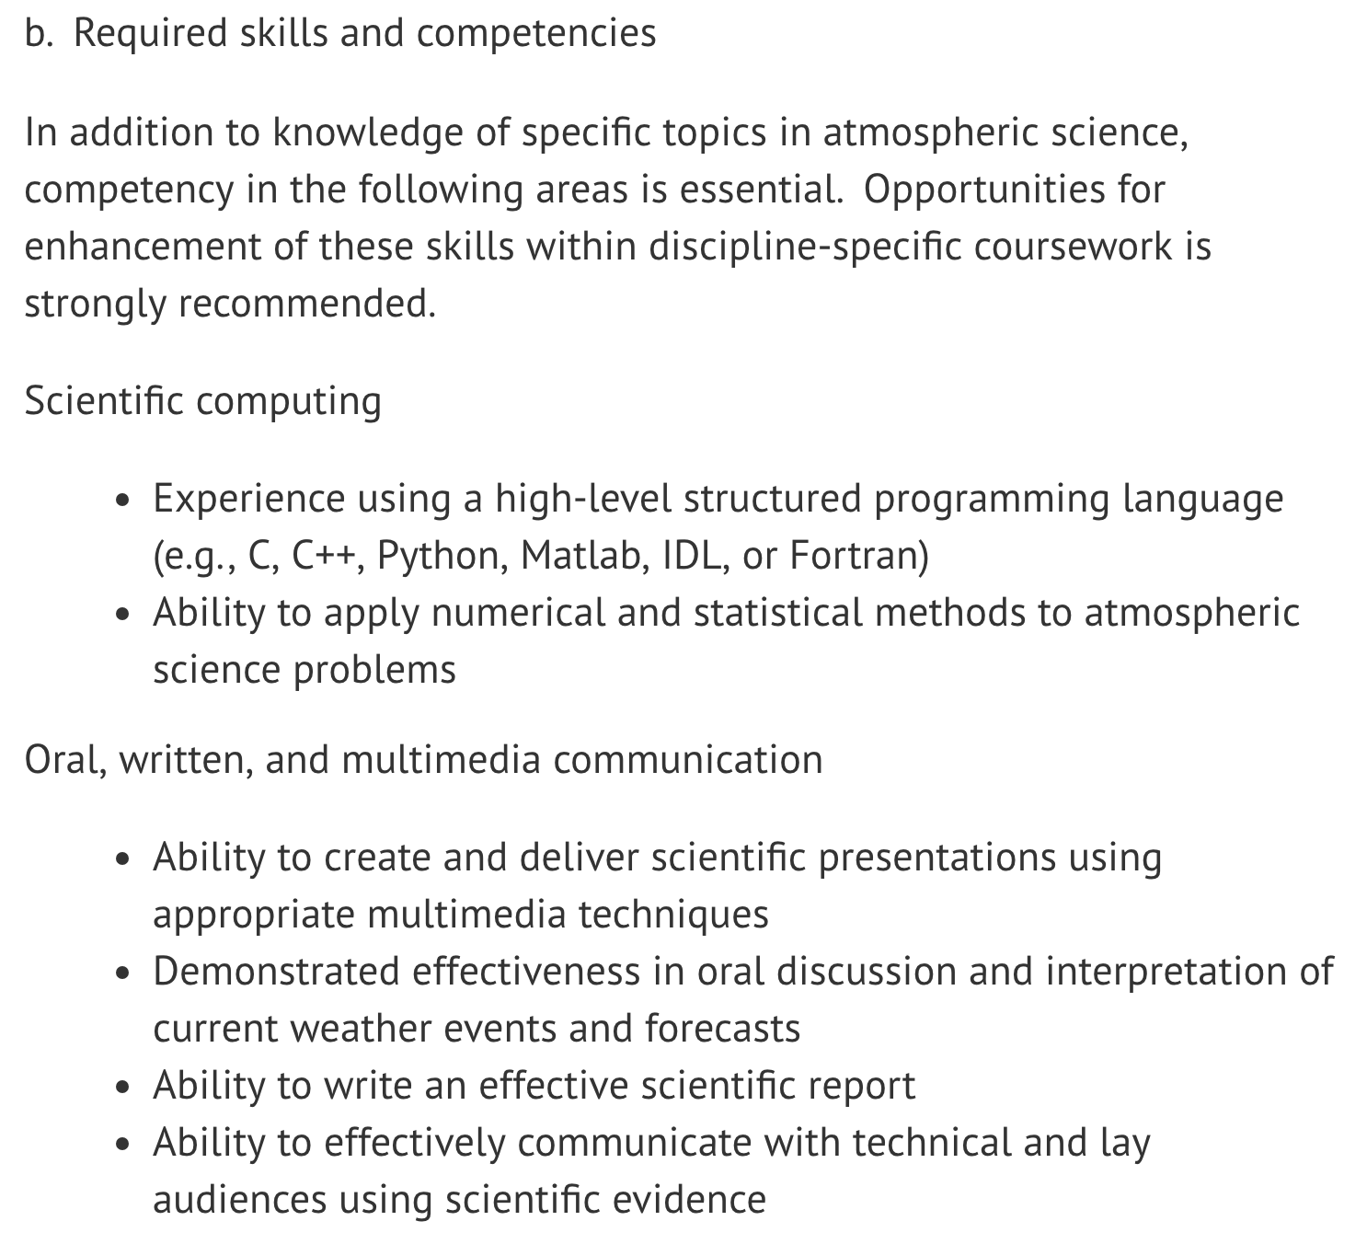

Slide 6
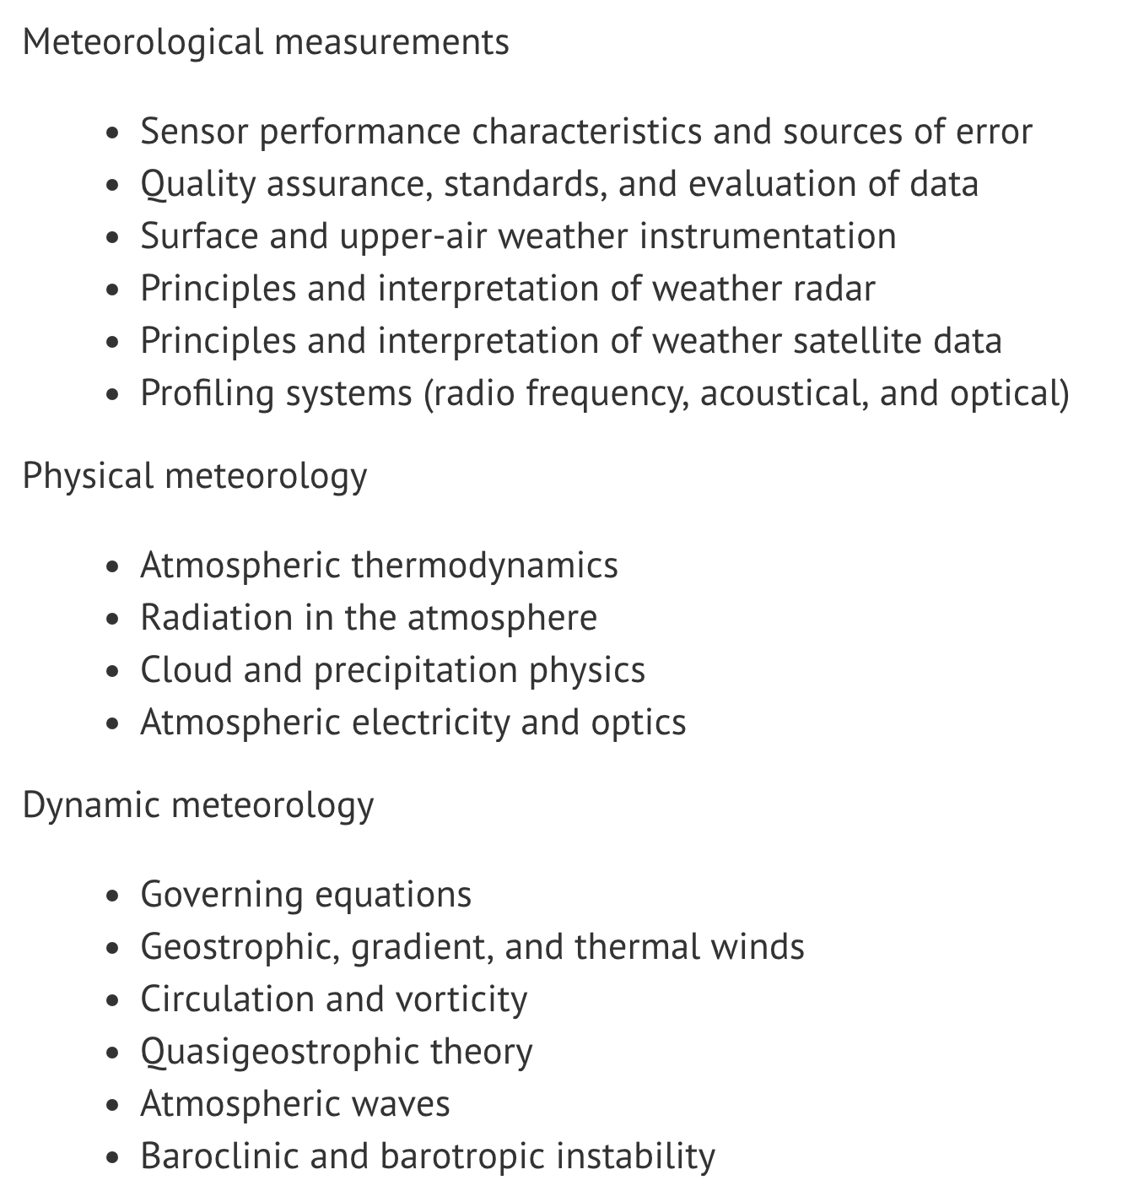
REQUIRED TOPICS in ATMOS. SCI.
AMS DEGREE EQUIVALENT COURSEWORK

Slide 7
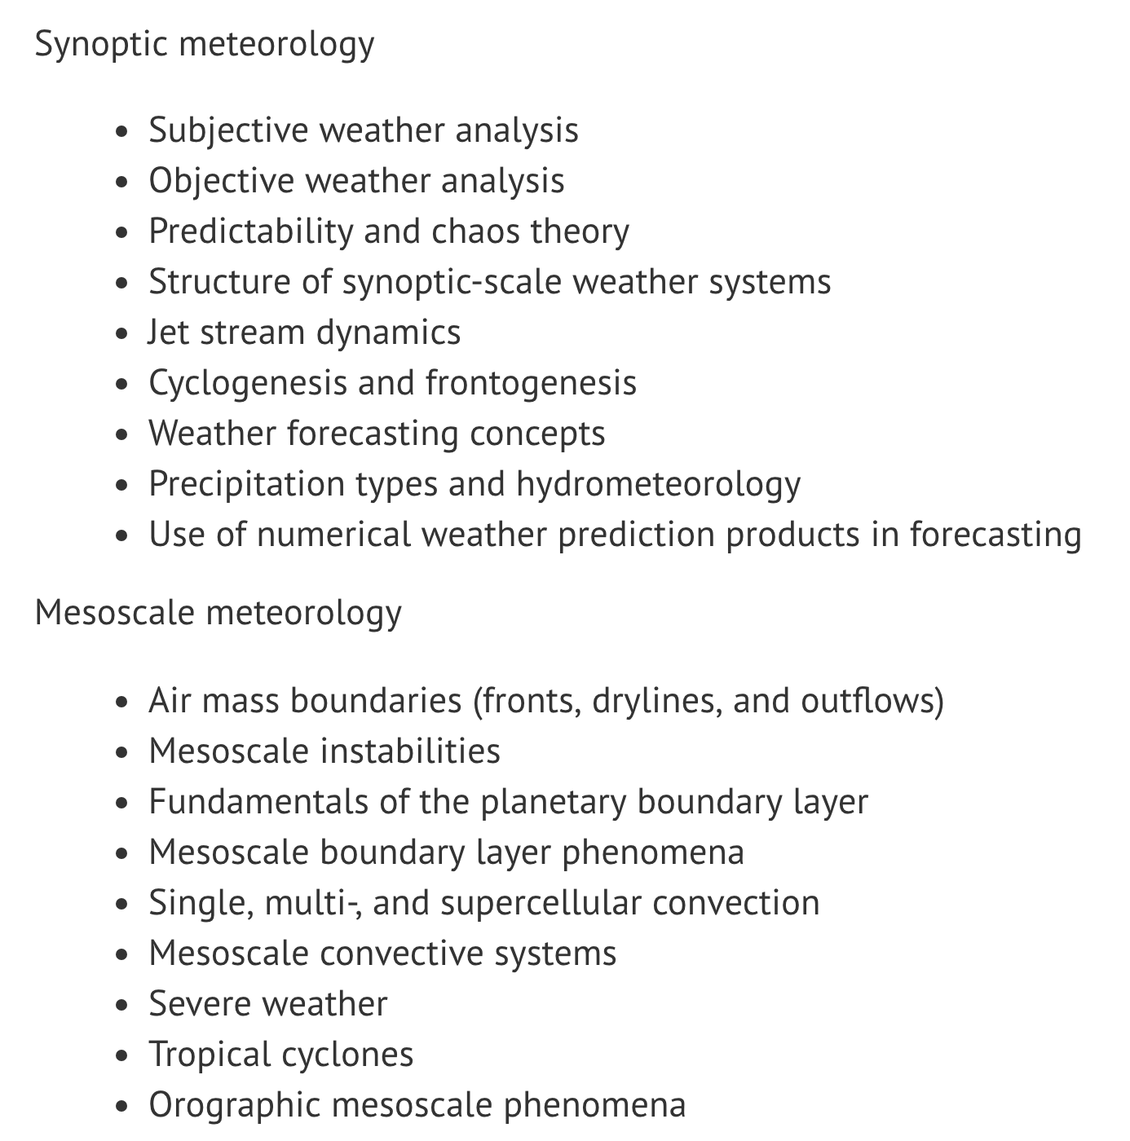
AMS DEGREE EQUIVALENT COURSEWORK

Slide 8
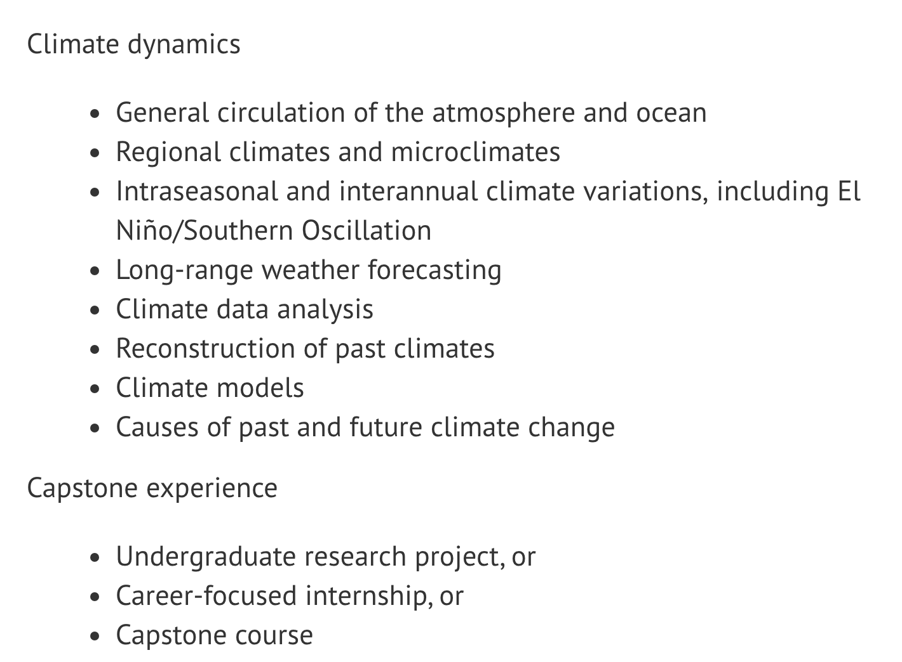
AMS DEGREE EQUIVALENT COURSEWORK

Slide 9
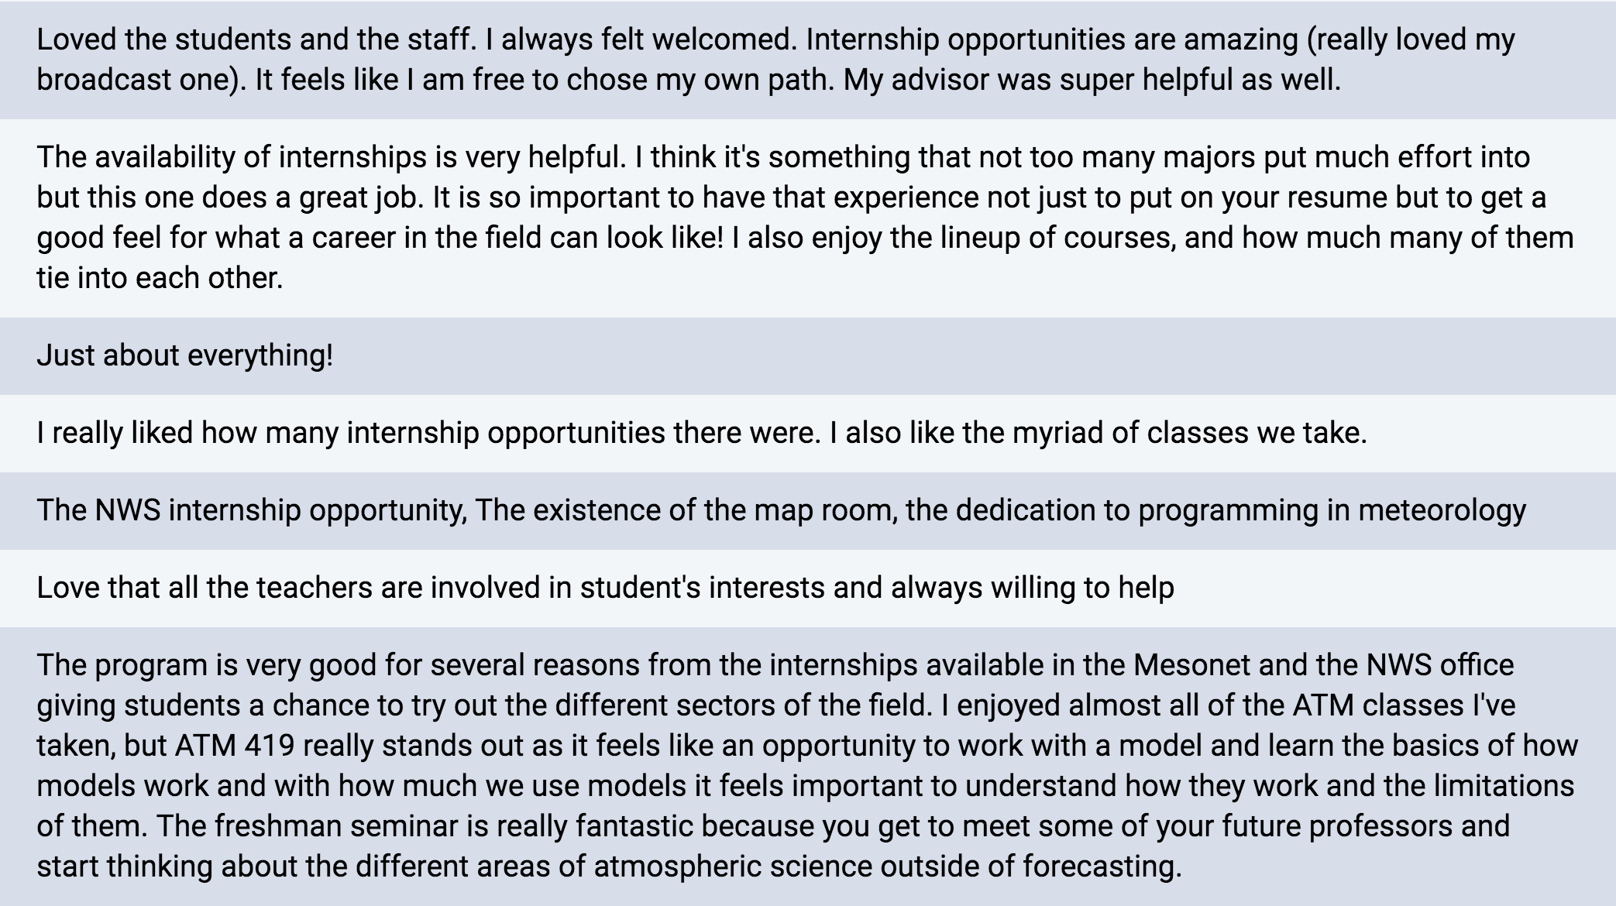
WHAT DID YOU LIKE ABOUT OUR ATMOS. SCI. PROGRAM?

Slide 10
WHAT DID YOU NOT LIKE ABOUT OUR ATMOS. SCI. PROGRAM?
• I still don't know or have never met some well known professors in the department. I wish I had been informed that there is a lot of computer map making so I could have invested my time in some coding classes.
• For the most part the program is perfect. My only complaint would be the amount of work that stacks up from the multiple ATM classes, but that comes with territory of the major and is expected. Possibly moving ATM 419 to the fall semester of senior year would allow students to use what they learned in other ATM classes.
• The ability to gain coding experience early on to be better prepared for the upper level classes

Slide 11
WHAT CHANGES/EFFORTS WOULD YOU RECOMMEND TO MAKE THE CLIMATE IN THE DEPARTMENT MORE SUPPORTIVE TO YOUR EXPERIENCE AS A MAJOR?
• I have had several long absences for medical reasons. I felt coming back that I wasn't given fair or proper treatment in time for me to catch up on work as well as having to take zeros on quizzes to be dropped instead of allowing me to take them.
• Overall the experience of the major and the department is fantastic. However, maybe requiring students to meet with their adviser during the semester or at least placing emphasis on the advantages to discussing the major and their current classes with their adviser.

Slide 12
DO YOU HAVE ANY SPECIFIC CONCERNS OR RECOMMENDATIONS FOR HOW THE PROGRAM COULD BE IMPROVED?
• Add a computer science class requirement to freshman year
• More intro to computer programming classes, make a website from the department that lists all available internships and scholarships so people have an idea of whats's available.
• The only thing I can think of that would have been helpful is the availability of more programming experience. Or even suggestions for other classes in the Comp. Science department or something like that. I feel that I've fallen a little short on programming experience for what is often expected in the workplace for the field. Nothing too big, because there is always time to learn!

Slide 13
DO YOU HAVE ANY SPECIFIC CONCERNS OR RECOMMENDATIONS FOR HOW THE PROGRAM COULD BE IMPROVED?
• Have class in the Mohawk tower.
• None, I love it
• I think adding more computer program based classes or suggesting those classes from COM-SCI would be an improvement. I've noticed on many employment postings, an interest in those who know at least python, but also have knowledge of other computer languages.

