Slide 1
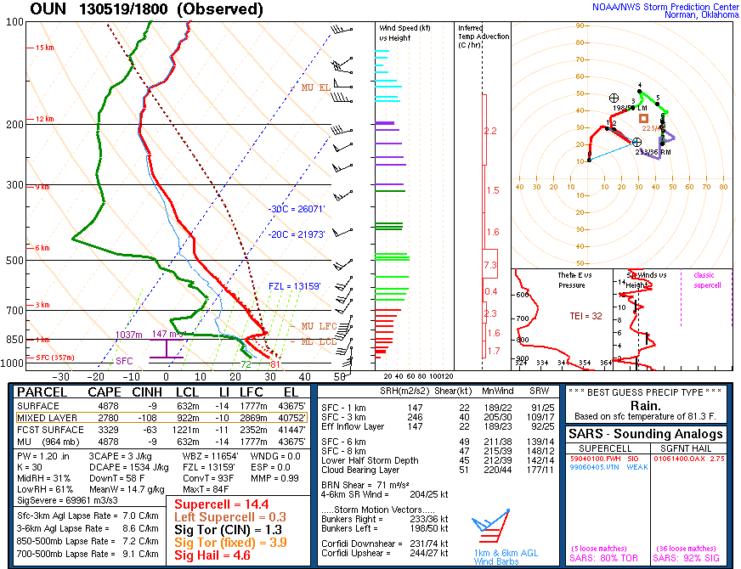
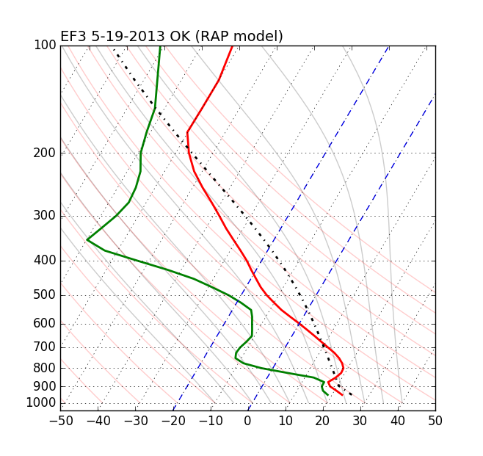
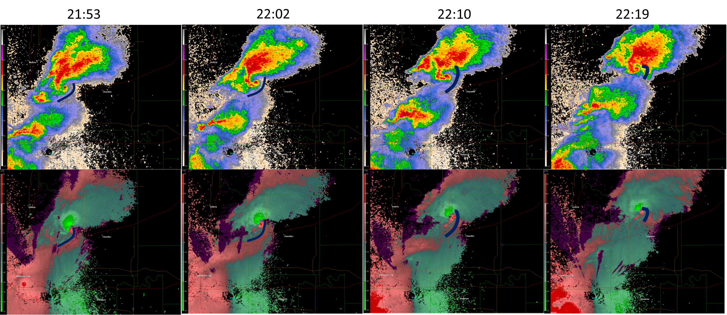
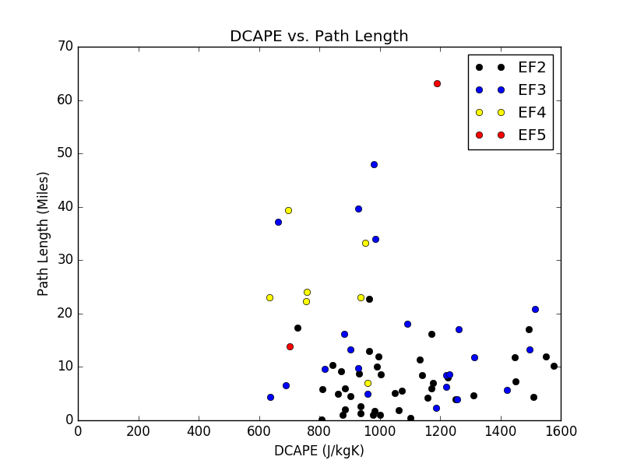
The Effect of Downdraft Strength on Tornado Intensity and Path Length
Dylan R. Card and Ross A. Lazear
Department of Atmospheric & Environmental Sciences, State University of New York, Albany New York
Motivation:
Case Study: 19 May 2013
The rear flanking downdraft (RFD) and secondary rear flanking downdraft (SRFD) can significantly influence tornadogenesis (Markowski 2002)
In idealized simulations, there was a correlation between the relative temperature of the RFD and the intensity, and longevity, of tornadoes (Markowski 2003)
Changes in tornado intensity and structure coincided with changes in the magnitude of the SRFD (Kosiba 2013)
This project examines how downdraft convective available potential energy (DCAPE) affects tornado track length and intensity. The hypothesis is that high DCAPE is detrimental to tornado development and maintenance as strong downdrafts force a rapidly moving RFD and its associated gust front. The RFD gust front then occludes the tornado circulation, quickly weakening the tornado and decreasing its track length
Many tornadoes, ranging from EF0 to EF4 occurred on this day, but we will focus on an EF3 tornado which began at approx. 2000 UTC. This case occurred in a high DCAPE environment (1534 J kg ⁻¹; marked in Fig. 1 with a blue star)
High DCAPE appears to have caused the RFD to rush out ahead of the supercell, quickly occluding the tornado circulation
Methodology:
Fig. 2. Observed sounding from Norman, OK (KOUN) at 1800 UTC 19 May 2013.
Tornado data including path length, intensity, and location were taken from the archives of the Storm Prediction Center (SPC) for 2010–2014
Cases were limited to Oklahoma and Kansas between the months of April and June
EF0 and EF1 tornadoes were removed from the data set because they had generally short path lengths
13-km RAP model soundings were used for the starting location and time of each tornado in the SPC archive
Using the SPC Python code SHARPpy (Halbert et al. 2015), DCAPE values were calculated for each case’s sounding
Fig. 3. Two-hour RAP forecast model sounding initialized at 1800 UTC 19 May 2013 at the starting location of the tornado. DCAPE was 1516 J kg⁻¹
Results:
BR
BR
BR
BR
Longer track tornadoes fall within a range of DCAPE between 600 and 1200 J kg⁻¹
Strength of tornadoes was similarly stratified with weaker tornadoes having shorter path length. No EF4 or EF5 tornadoes occurred outside this range
EF0 and EF1 tornadoes mainly occurred with less than 600 J kg⁻¹ DCAPE and path lengths generally less than 20 miles
No EF2+ tornadoes occurred in environments with less than 600 DCAPE, most likely because an elevated mixed layer would be too close to the ground or nonexistent
SRV
SRV
SRV
SRV
Conclusions and Future Work:
As hypothesized, tornadoes that formed in high DCAPE environments (DCAPE exceeding 1200 J kg⁻¹) had short path lengths compared to tornadoes that formed in lower DCAPE environments.
The case from 19 May 2013 shows that the RFD quickly outran the circulation in the high DCAPE environment.
For future work, I would like to look at more cases in other states to see if DCAPE values influence the development of tornadoes regardless of location or synoptic setup. I would also like to look at downdraft temperature and how it affects tornadogenesis.
 | Mean DCAPE (J kg⁻¹) | Mean path length (m) | n
EF2 | 1081 | 7.24 | 40
EF3 | 1073 | 15.45 | 22
EF4 | 814 | 24.57 | 7
EF5 | 947 | 38.48 | 2
Fig. 1. DCAPE vs. path length of 71 tornado cases in Oklahoma and Kansas from April to June from 2010–14. The intensities of the tornadoes are marked in the colors.
Citations:
Table 1. Mean values for DCAPE and path length for each tornado intensity level.
Markowski, P. M., J. M. Straka, and E. N. Rasmussen, 2002: Direct surface thermodynamic observations within the rear-flank downdrafts of nontornadic and tornadic supercells. Mon. Wea. Rev.,130, 1692–1721.
Markowski, P. M., J. M. Straka, and E. N. Rasmussen, 2003: Tornadogenesis resulting from the transport of circulation by a downdraft: idealized numerical simulations. J. Atmos. Sci., 60, 795–823.
Kosiba, K., J. Wurman, Y. Richardson, P. Markowski, P. Robinson, and J. Marquis, 2013: Genesis of the Goshen county, Wyoming, tornado on 5 June 2009 during VORTEX2. Mon. Wea. Rev., 141, 1157–1181.
Halbert, K. T., W. G. Blumberg, and P. T. Marsh, 2015: "SHARPpy: Fueling the Python Cult". Preprints, 5th Symposium on Advances in Modeling and Analysis Using Python, Phoenix AZ.
Email: dcard@albany.edu

