Slide 1
Contour Analysis

Slide 2
Why do we contour data on a map?

Slide 3
Why do we contour data on a map?

Slide 4
Why do we contour data on a map?
• Easy to identify:
-Important features in the datasets
-Minima and maxima
-Regions where the data changes rapidly…or not so rapidly
Gradient

Slide 5
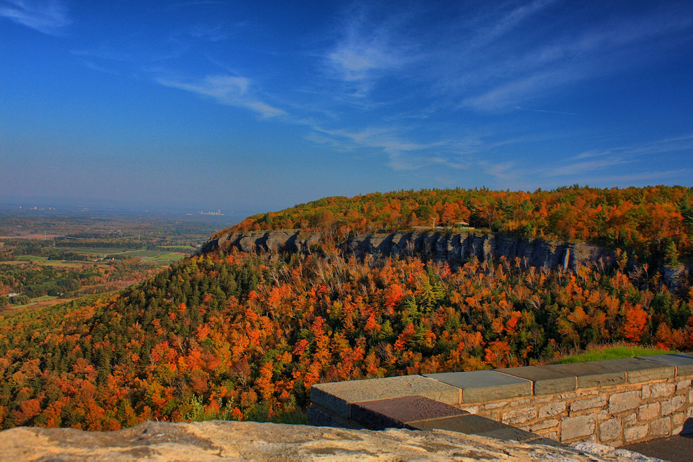
Photo by hbickel / Flickr

Slide 6
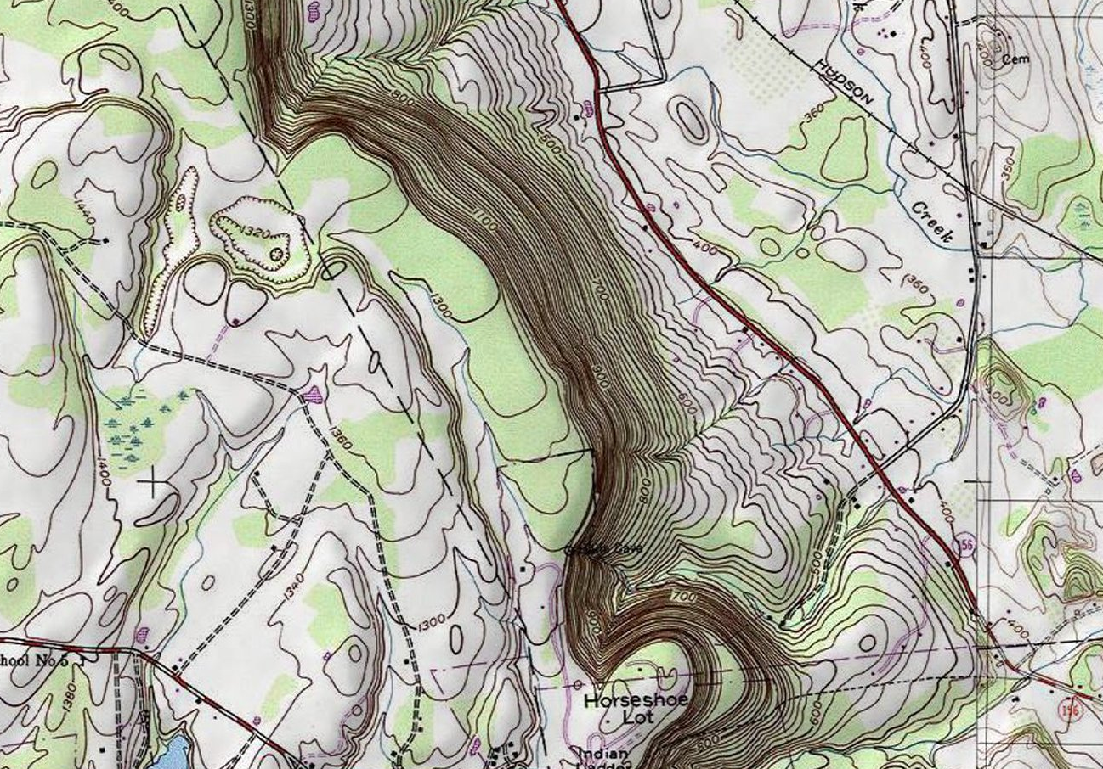

Slide 7
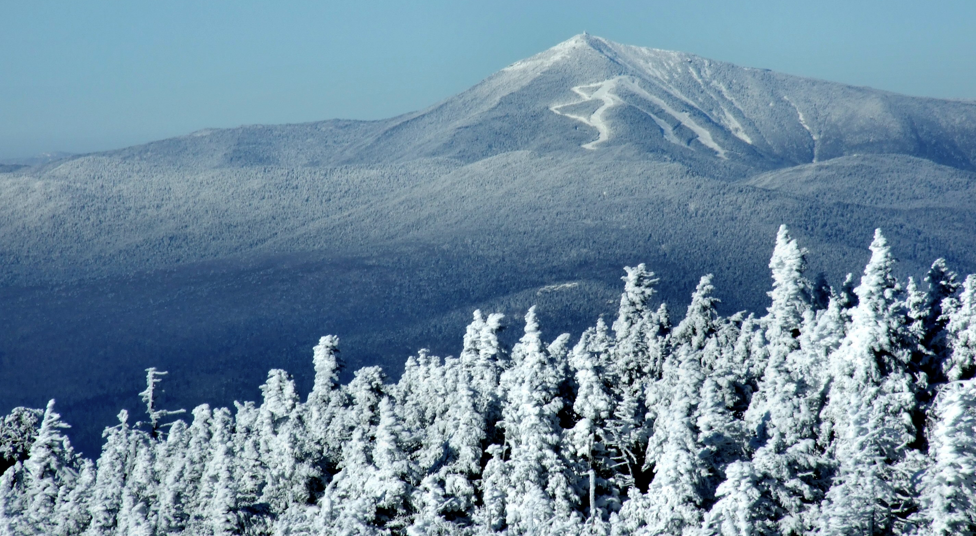
http://images.summitpost.org/original/472861.jpg

Slide 8
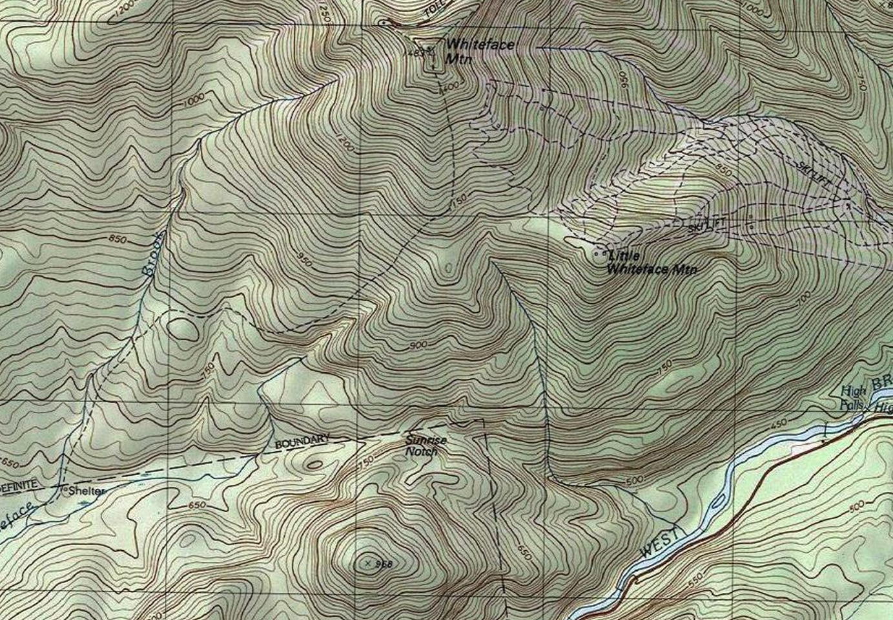

Slide 9
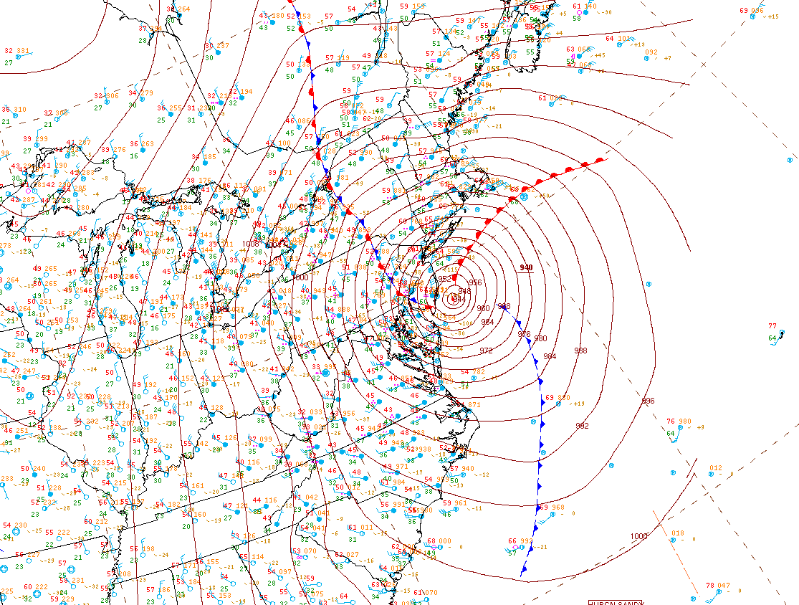

Slide 10
Surface weather station model review…

Slide 11
Surface weather station model review…

Slide 12
Surface weather station model review…

Slide 13
Surface weather station model review…
95

Slide 14
Surface weather station model review…
95
56

Slide 15
Surface weather station model review…
95
1014
56

Slide 16
Surface weather station model review…
95
1014
56

Slide 17
Surface weather station model review…
95
1014
56
Temperature
Dew point temperature
Sea level pressure
Present weather

Slide 18
Contouring rules and tips
1) Contours should be as smooth and even as possible while still representing the data accurately.
2) Try to smooth out any unnecessary “wiggles” in your analysis.
3) Always do at least one rough draft, because in the end, you’ll want to make each contour with one, smooth movement.
4) Contours never cross one another.
5) Contours never branch, or fork.
6) Always label your contours at each edge of the map. Or, if your contours are concentric (closed), draw a label in the middle of the contour:
Example: –––––20–––––
7) The data can have errors! Try not to go out of your way for one single data point … especially if it doesn’t seem to “fit in” with the rest of the data.
8) Don’t contour where there are no observations. For instance, don’t draw long contours connecting points across a large body of water where there are no observations.
9) Contour in multiples of the interval (in most cases): Example: For temperature every 10°F:
20, 30, 40, 50…not 25, 35, 45, 55.

Slide 20
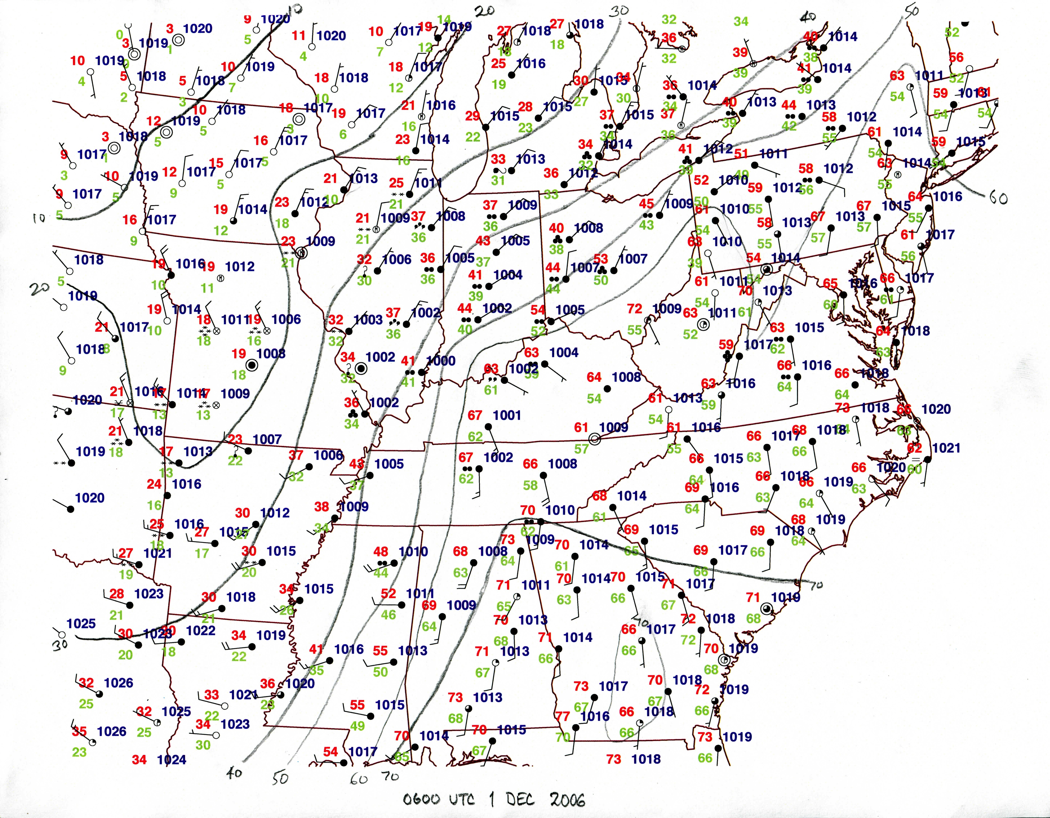

Slide 21
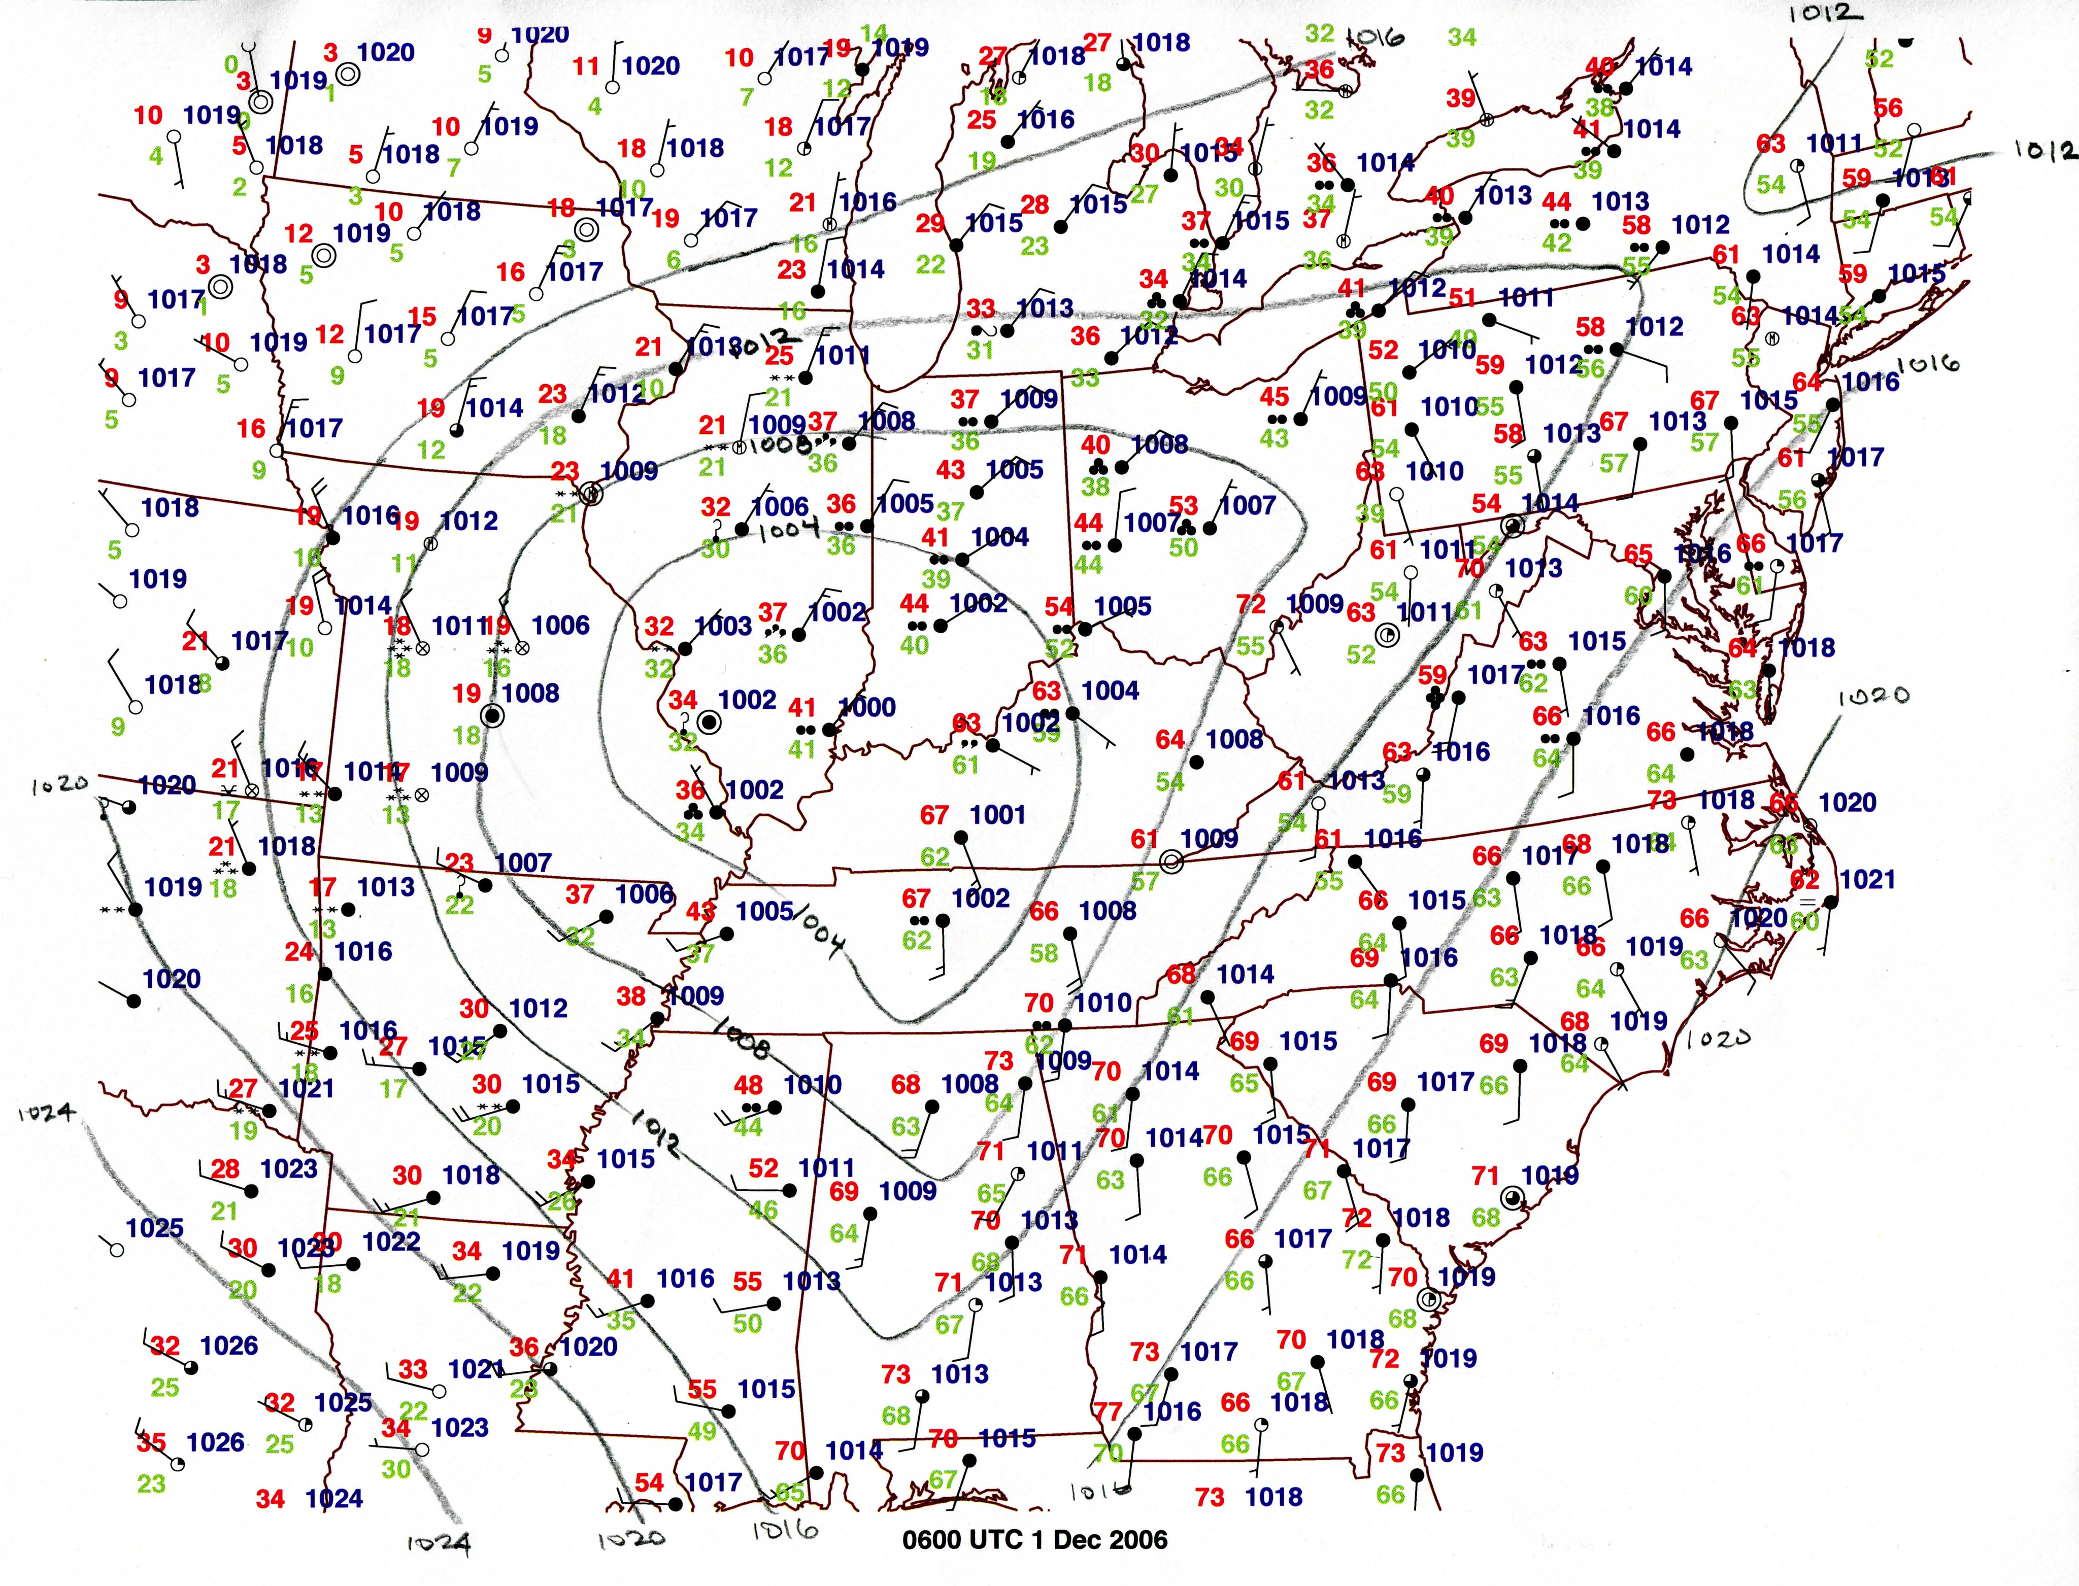

Slide 22
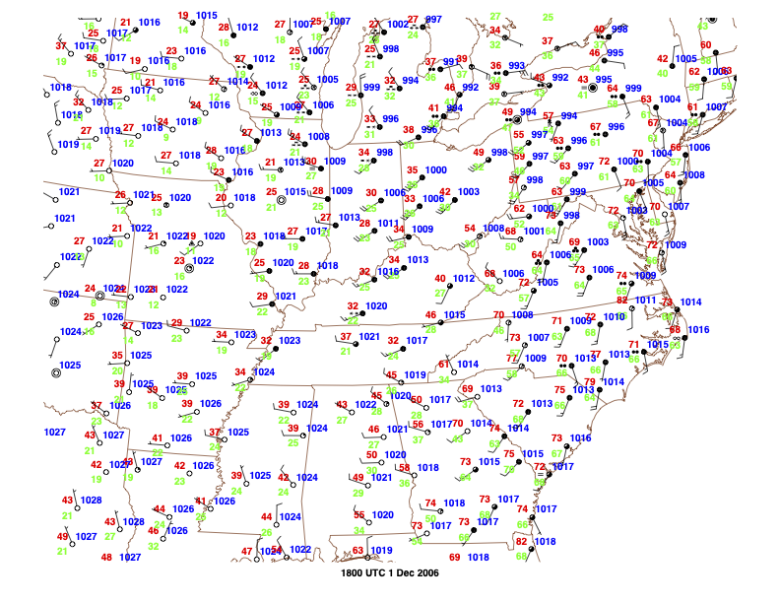

Slide 23
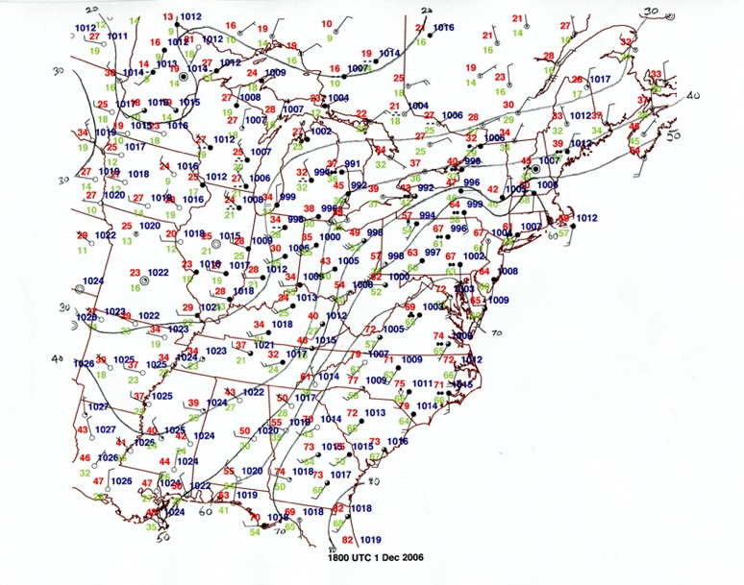

Slide 24
