Slide 1

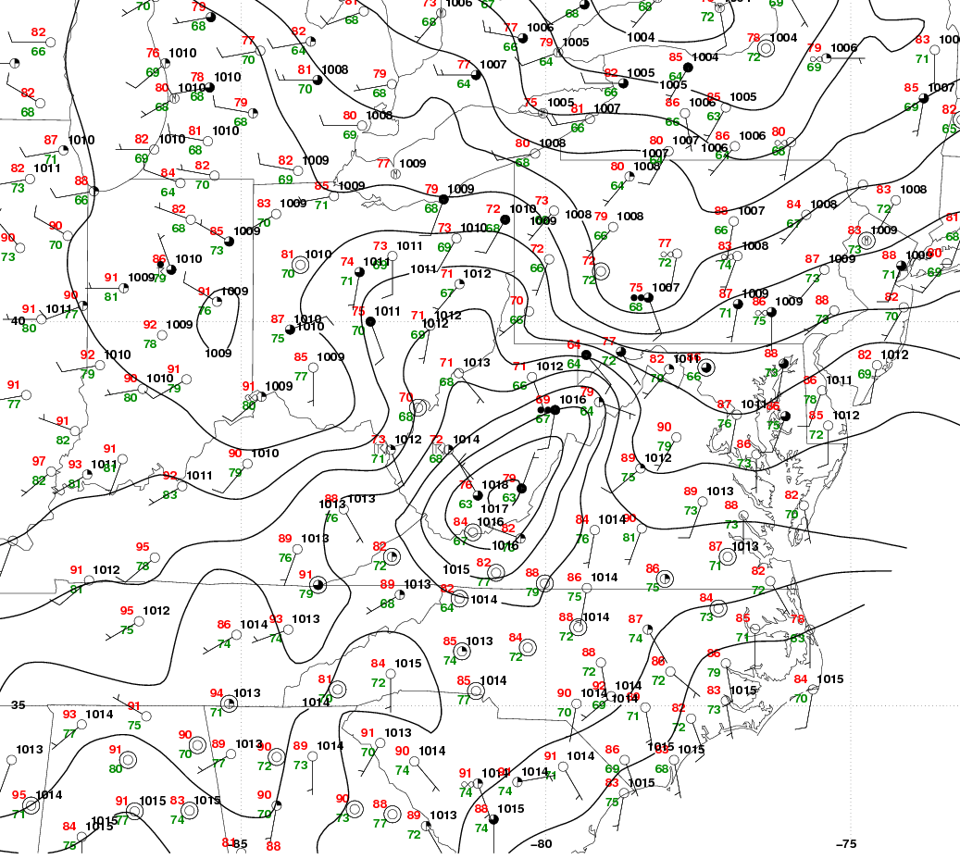
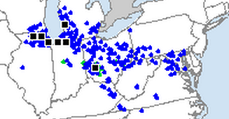
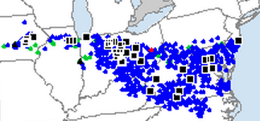
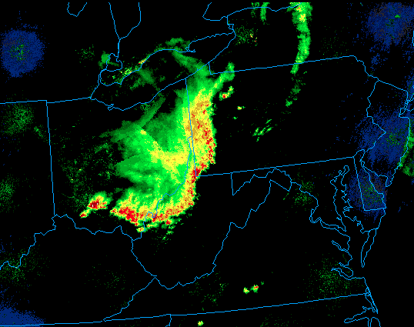
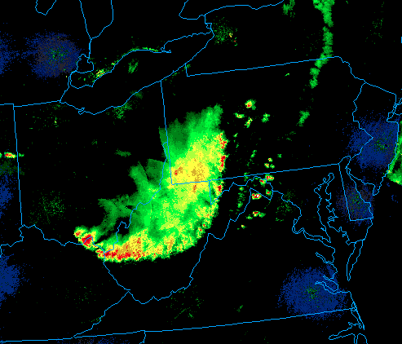
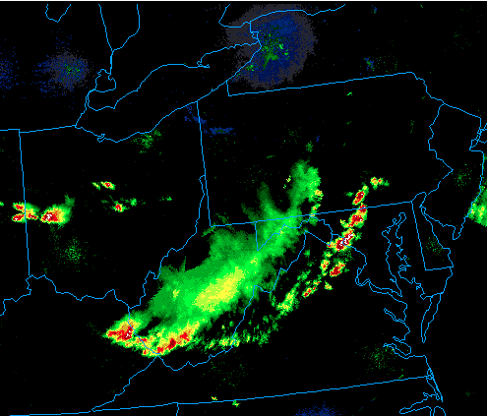

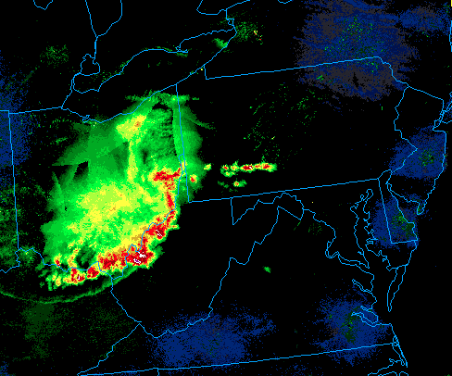
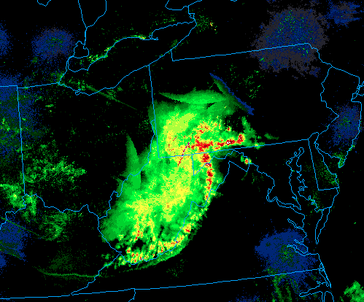
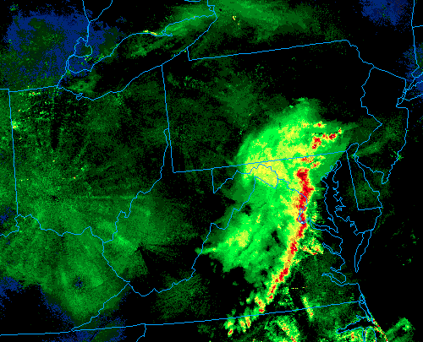
Comparison of the 29−30 June 2012 and 11 July 2011 Derechos: Impact of the Appalachians
Matthew S. Wunsch (mwunsch@albany.edu) and Ross A. Lazear
Department of Atmospheric and Environmental Sciences, University at Albany, SUNY
Motivation:
Synoptic Similarities:
July 2011
June 2012
The 29−30 June 2012 derecho was one of the most destructive severe
weather events in recent history. Beginning as elevated convection over
Iowa at 1200 UTC 29 June, the area of convection quickly moved east,
becoming a dangerous MCS over the Ohio Valley. By 0000 UTC
30 June, the derecho had made its way into West Virginia and toward
the east coast by 0600 UTC.
The Storm Prediction Center (SPC) had difficulty forecasting this derecho
downstream of the Appalachians due to uncertainty if elevated terrain
would impede the derecho from progressing to the coast.
The 11 July 2011 derecho developed in similar synoptic conditions and
shared a similar path to the 29−30 June 2012 derecho. Upon
encountering the Appalachians, the derecho rapidly dissipated.
Why was the 29−30 June 2012 derecho able to sustain itself
after crossing the Appalachians while the 11 July 2011
derecho was not?
Anticyclone to the southwest advected
moisture from the Gulf of Mexico.
Moderate west-northwesterly mid-level flow
across the Ohio Valley and into West
Virginia.
Flow perpendicular to Appalachian Mountains
led to the development of a pressure trough
in the lee of the mountain range.
Thermodynamically unstable airmass lee of
the Appalachians.
Appalachian lee trough:
Adiabatically heats the air in the lee of the
mountains and steepens low-level lapse
rates.
Enhances lower-tropospheric convergence
and moisture along the trough axis.
Alters surface wind direction to increase
low-level shear.
Fig. 5
00 UTC 12 July
Fig. 6
01 UTC 30 June
CAPE = 4377 J/kg
CAPE = 4249 J/kg
Fig. 7
Fig. 8
Fig. 1: SPC storm reports for 11 July 2011
Fig. 2: SPC storm reports for 29 June 2012
0000 UTC 12 July 2011 Surface obs., MSLP, and sounding location
Blue arrow: Derecho outflow propagation
Blue star: Sounding location
Same as Fig 7., except at 0100 UTC 30 June 2012
Gold star: Sounding location
Radar Comparisons:
Fig. 9
Fig. 10
Fig. 3: 11–12 July 2011
21 UTC
2230 UTC
00 UTC
Fig. 9: 1000-hPa to 500-hPa shear magnitude (knots, color fill), 700-hPa height (black contours), 1000-hPa wind (yellow barbs), and 500 hPa wind (orange barbs) for 0000 UTC 12 July 2011.
Fig. 10: Same as Fig. 9, except for 0100 UTC 30 June 2012.
Fig 4. 29–30 June 2012
23 UTC
01 UTC
03 UTC
kt
Summary:
Similarities:
Strong anticyclone to the southwest of the region
Mid-tropospheric flow perpendicular to the
Appalachians provided for development of a lee trough
Extremely unstable airmasses lee of Appalachians
Derecho traversed similar paths
Presence of the Appalachian lee trough enhanced
convergence along trough axis and southerly flow to
the east of the trough axis
Differences:
Mid-level shear axis was slightly stronger in 29 June
2012 case
Closer proximity of the jet stream provided for stronger
and more unidirectional wind shear on 29 June 2012
Lee trough developed much earlier in the day on 29
June 2012
Cold pool of 29 June 2012 derecho was significantly
stronger (higher SLP perturbation in cold pool)
The derecho on 11 July 2011 approached the Appalachians by 2100 UTC, interacted with elevated terrain
by 2230 UTC, and considerably weakened by 0000 UTC 12 July (Fig. 3).
The 29 June 2012 derecho approached the Appalachians by 2300 UTC. It interacted with the mountains
and weakened slightly by 0100 UTC 30 June. By 0300 UTC, the derecho re-intensified in the lee of the
mountains and progressed to the coast (Fig. 4).
Acknowledgements:
Dr. Kristen Corbosiero and Paul Grabkowski

