Slide 1

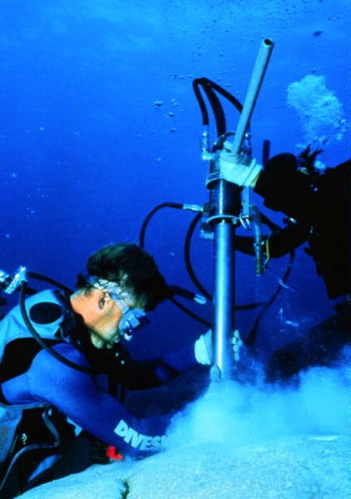
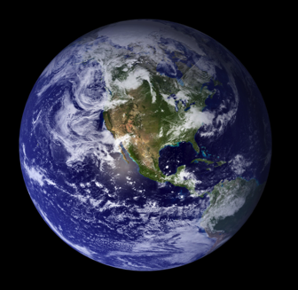
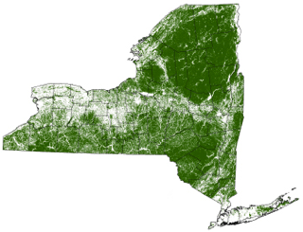
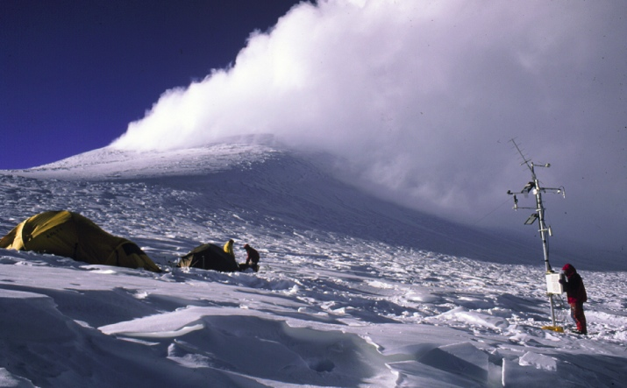
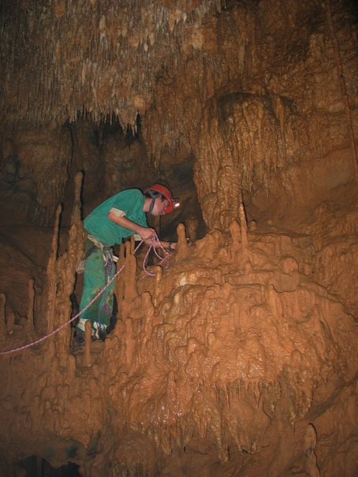
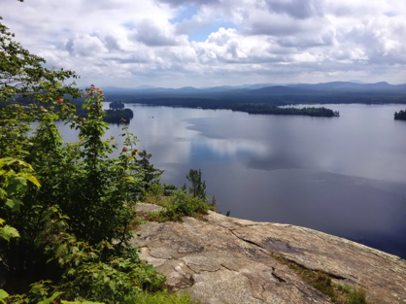
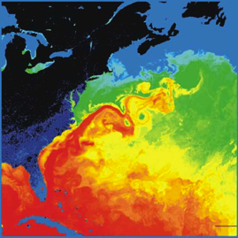
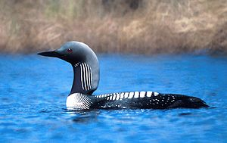
Environmental Science
in the
Department of Atmospheric and
Environmental Sciences (DAES)
http://www.albany.edu/atmos/

Slide 2
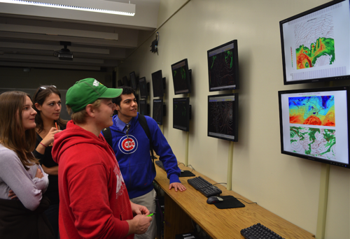
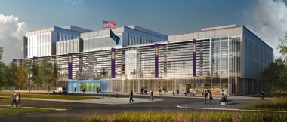
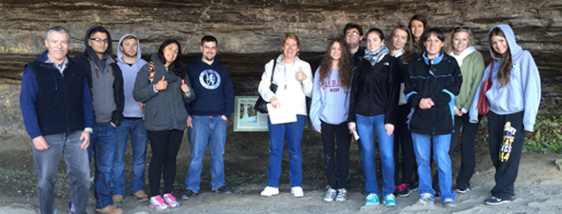
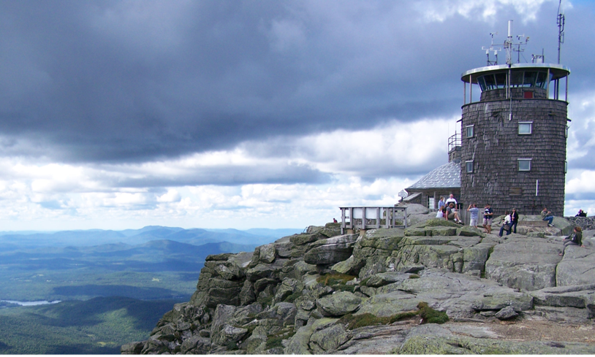
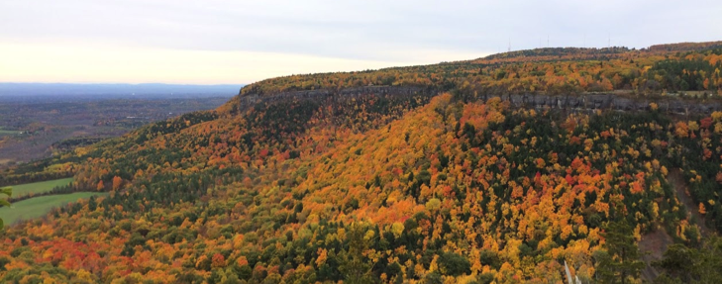
Bachelor of Science Degree in Atmospheric Science
Environmental issues are some of the greatest challenges we face as human society. There is increasing demand for environmental scientists to confront these challenges. Environmental science encompasses the Earth’s oceans, atmosphere, surface, and interior as well as how these physical components of the Earth system interact with life (ecology) and human society. Environmental science plays a central role in major current national and world issues (climate change, sustainability, energy, water resources, and biodiversity).
In the Department of Atmospheric and Environmental Sciences (DAES) students gain strong and multifaceted education in environmental science. They build a strong foundation in the fundamental basic sciences that govern environmental phenomena. Students gain hands-on experience taking environmental measurements and using software and statistics to unlock the secrets of environmental data.
Coursework is taught by over 20 full time faculty and staff members, most of who are active and prominent researchers in their fields of study. Faculty and staff members pride themselves in their teaching and several have won national teaching awards.
Research and Teaching Facilities
ETEC building: Work is underway on a new home for DAES. The new $184 million Emerging Technology and Entrepreneurship (ETEC) building will house DAES starting in 2020. It will have state of the art teaching and research facilities. ETEC will be shared with the Atmospheric Science Research Center, NYS Mesonet, and College of Emergency Preparedness, Homeland Security and Cybersecurity.
Maproom: DAES houses an electronic “map room” for interactive display of meteorological and environmental data
Field trip and fieldwork destinations: Class trips and fieldwork opportunities take advantage of many fantastic nearby environmental sites including: The Albany Pinebush, The New York State Museum, Thacher State Park, Huyck Preserve, and more!
Whiteface Mtn. Observatory: The UAlbany Atmospheric Sciences Research Center (ASRC) operates an observation center atop Whiteface Mountain in the Adirondacks, measuring chemical species, cloud properties, acid precipitation, and aerosol content.
Thacher State Park

Slide 3
Environmental Science Curriculum
Environmental Science is interdisciplinary, tying together knowledge from many areas to understand the world around us. Majors start by building a solid foundation in basic science. In junior and senior years, curriculum is tailored to specific student interests and goals.
Students choose from four
areas of specialization:
Geography
Sustainability Science & Policy
Ecosystems
Climate Change
Sample four-year plan for an environmental science major. required classes listed in bold (credits in parentheses)
Semester I
MAT 112: Calculus I (4)
CHM 120: General Chemistry I (3)
CHM 124: General Chemistry Lab I (1)
BIO 120: General Biology I (3)
Elective/University Gen. Ed. Requirement
Semester 3
PHY 140: Physics I (3)
GEO 221: Understanding the Earth (3)
BIO 201: Intro. Biology lab I (1)
Elective/Gen-ed
Elective/Gen-ed
Semester 5
ENV 302: Ocean Science (3)
BIO 330: Principles of Ecology & Evolution (3) Specialization requirement
Elective/Gen-ed
Elective/Gen-ed
Semester 7
Specialization requirement
Specialization elective
Specialization elective
Elective / Internship / Research
Semester 2
ENV 105&106: Intro. Environmental Science & lab (4)
CHM 121: General Chemistry II (3)
CHM 125: General Chemistry Lab II (1)
BIO 121: General Biology II (3)
Elective/Gen-ed
Semester 4
ATM 210: Atmospheric Structure, Thermo, Circ. (3)
BIO 202: Intro. Biology lab II (1)
ENV 315: Environmental Stats. & Computation (4)
Elective/Gen-ed
Elective/Gen-ed
Semester 6
ENV 327: Meteorological and Envi. Measurement (3)
Specialization requirement
Specialization requirement
Elective/Gen-ed
Elective/Gen-ed
Semester 8
ENV 490: Major Topics in Environmental Science (3)
Specialization elective
Specialization elective
Elective / Internship / Research
Requirements for environmental science specializations (students pick one)
Geography (22 credits):
Required courses (10 credits)
GOG/PLN 220: Introductory Urban Geography
GOG 290: Introduction to Cartography
GOG 496: Geographic Information Systems (GIS)
Sample Electives (choose 12 credits)
GOG 330: Principles of Environmental Management
GOG 344: World Population
GOG 354: Environment & Development
GOG 375: Methods of Urban Analysis
GOG 414: Computer Mapping
GOG 430: Environmental Planning
GOG 460: People, Place, and Power
GOG 479: Fundamentals of Applied Global Positioning Systems (GPS)
GOG 484/5: Remote Sensing I/II
ENV 250: Environmental Sustainability
ATM 301: Hydrology and Hydrometeorology
Sustainability Science and Policy (21 credits):
Required courses (9 credits)
ATM 304: Air Quality
ENV 250: Environmental Sustainability
RPOS 399: Topics in Political Science and/or Public Policy
Sample Electives (choose 12 credits)
ANT 418: Culture, Environment, and Health
ATM 405: Water and Climate Change
ATM 413: Weather, Climate, and Societal Impacts
BIO 311: World Food Crisis
GOG 220: Introductory Urban Geography
GOG 344: World Population
GOG 430: Environmental Planning
RPAD 366: International Environmental Policy
HSPH 321: Global Environmental Issues and Their Effect on Human Health
HSPH 323: Environmental Laboratory Perspectives in Public Health
HSPH 332: Epidemiology and Biostatistics
Ecosystems (22 credits)
Required (10 credits)
BIO 212: Introductory Genetics
BIO 327: Experimental Ecology
BIO 402: Evolution
Sample Electives (choose 12 credits)
ANT 418: Culture, Environment, and Health
ANT 419: Human Evolutionary and Environmental Physiology
ATM 301: Hydrology and Hydrometeorology
BIO 308: Parasitic Diseases and Human Welfare
BIO 311: World Food Crisis
BIO 329: Genetics of Human Disease
BIO 343: Evolutionary Biology and Human Health
BIO 427: Grazing in Terrestrial Ecosystems
ENV 250: Environmental Sustainability
HSPH 321: Global Environmental Issues …
HSPH 332: Epidemiology and Biostatistics
Climate Change (21 credits):
Required (12 credits)
ATM 306: Climate Variability and Change
ATM 405: Water and Climate Change
ATM 415: Climate Laboratory
ATM 450: Paleoclimatology
Sample Electives (choose 9 credits)
ATM 301: Hydrology and Hydrometeorology
ATM 304: Air Quality
ATM 307: Introduction to Atmospheric Chemistry
ATM 335: Meteorological Remote Sensing
ATM 413: Weather, Climate Change, and Societal Impacts
ATM 414: Air Pollution Meteorology
RPAD 366: International Environmental Policy
RPOS 266: International Political Economic Science

Slide 4
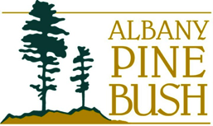
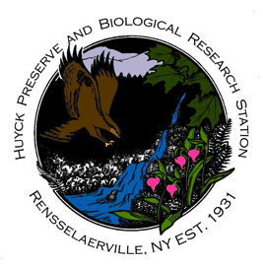



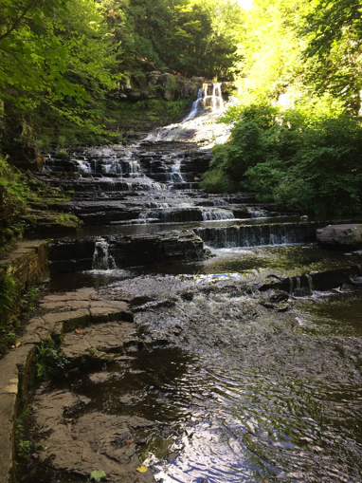
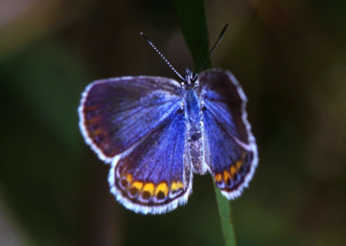
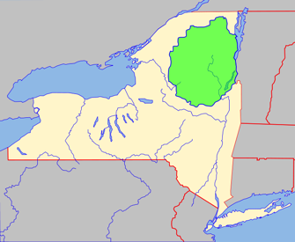
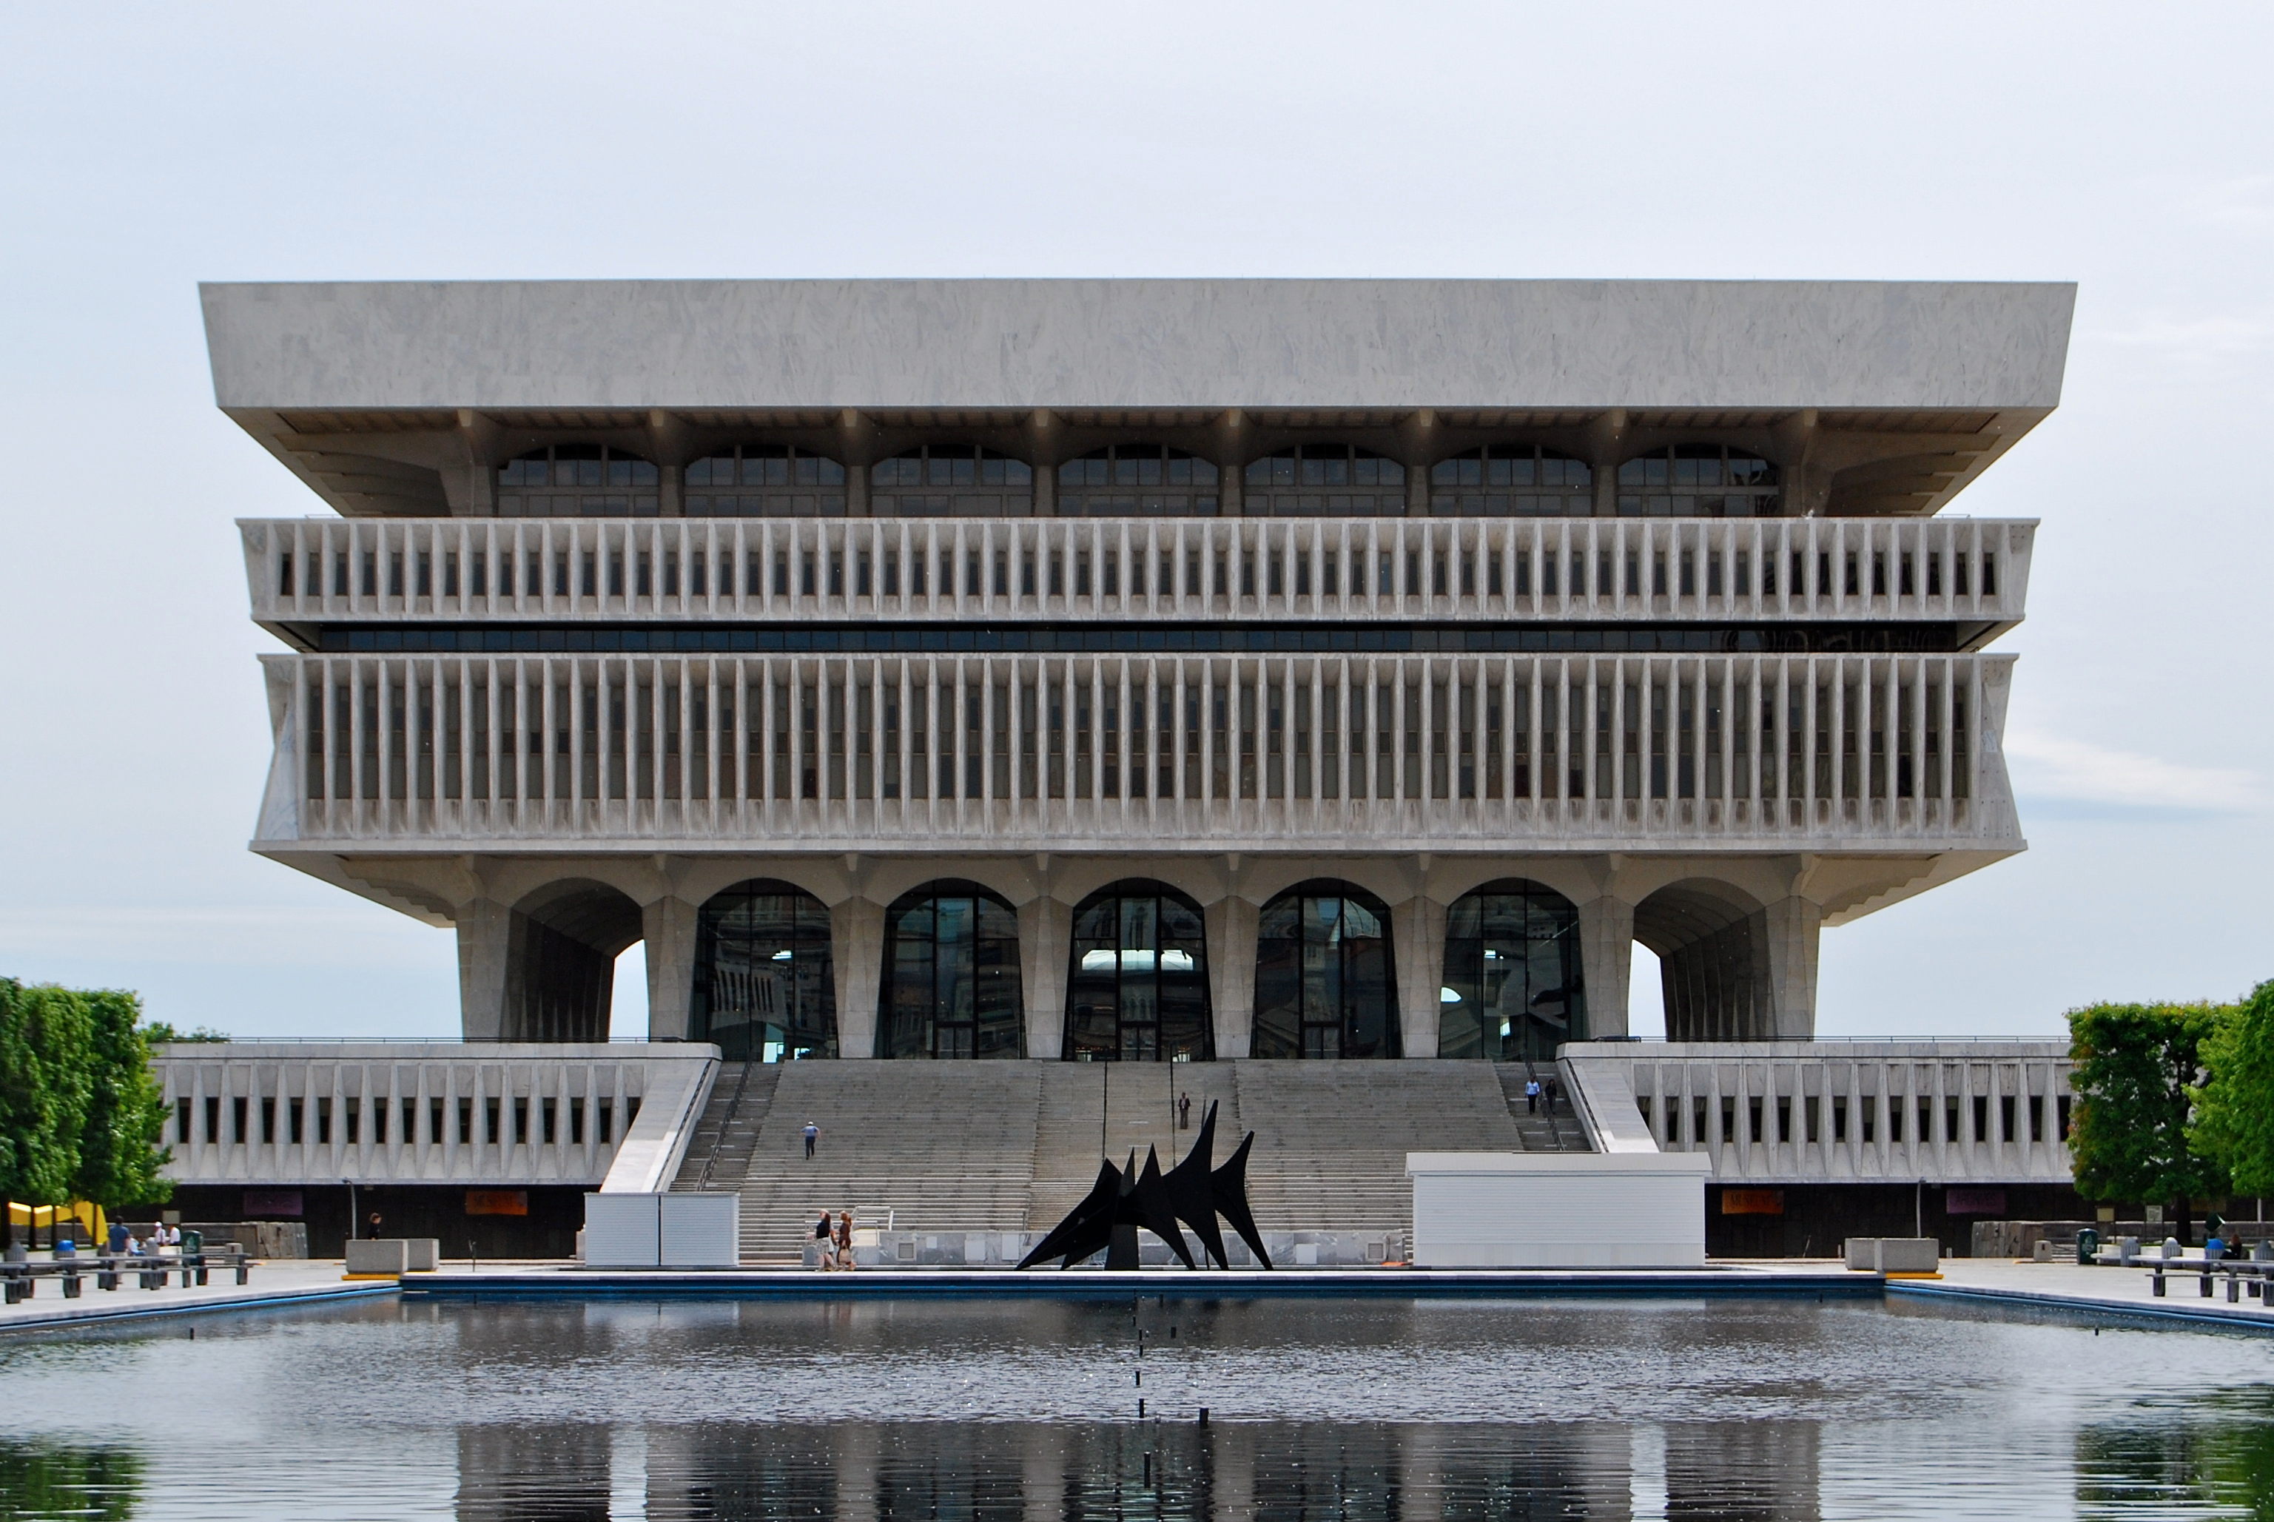
Internship and Research Opportunities
Internships:
DAES students have many nearby opportunities for paid and volunteer internships and seasonal jobs, all of which can provide students with a valuable learning experience and credit towards the major. Some examples are:
NY State Department of Environmental Conservation is the state agency tasked with protecting and enhancing the environment of New York.
NY State Museum houses a wealth of artifacts on the ecology, geology, anthropology, and culture of the state.
New York State Mesonet is a network of 125 environmental stations across the state based on the UAlbany campus.
Albany Pine Bush Preserve Commission protects and manages open space and wildlife at the one of the best remaining examples of an inland pine barrens ecosystem in the world
Huyck Preserve and Biological Research Station is a non-profit organization with over 2,000 acres of forest, field, and wetland habitat. It is dedicated to research, education, recreation, and conservation.
New York State Mesonet internship
The endangered Karner Blue Butterfly
(found at Albany Pine Bush)
Research:
Many students work on a research project (for credit) with a faculty member during their junior or senior year. Research ideas may come directly from faculty, but students often come up with their own ideas that fit with a specific faculty member’s research interests.
Some recent undergraduate research projects include:
•”Exploring Bird Evolution: An Ornithology Lesson for Middle and High School Students”
“The impact of ENSO and AMO on selected glaciers in the Andes of South America”
The Huyck Preserve
U.S. Fish & Wildlife Service National Digital Library
The NYS Museum
The 6.1 million acre
Adirondack Park
CC-BY-SA-3.0/Matt H. Wade at Wikipedia
https://commons.wikimedia.org/wiki/File:Adirondack_Park_map_with_Blue_Line.svg

Slide 5
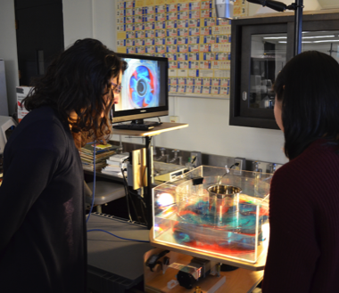
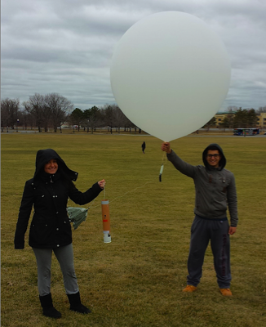
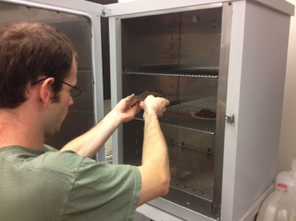
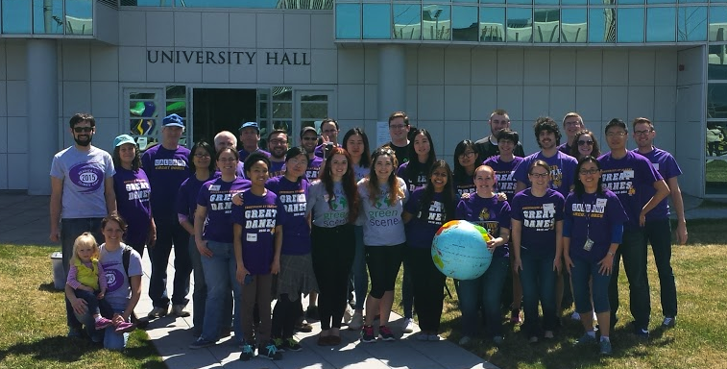

Honors Program:
Students with a cumulative GPA of at least 3.25, and 3.5 in the major, are eligible to apply for a B.S. with honors in environmental science. Students must complete 83 credits including two semesters of Undergraduate Research (ENV 498) leading to an undergraduate thesis and oral presentation.
Extra-curricular activities:
There are hundreds of campus groups where you can meet up with others that share your interests, including a number of sustainability and environmental campus groups:
The UAlbany Outdoors Club
UAlbany Students for Sustainability
UAlbany Grow Green
Many of our students also volunteer at the annual DAES Family Earth Day event.
Hand-on education: simulating atmospheric and oceanic flows in a rotating tank, drying soil samples, launching a weather balloon.
Minors:
While adding a minor isn’t required for environmental science majors, it is a great way to diversify your education and learn extra skills that make you more attractive to future employers. Some common minors among environmental science majors include:
Sustainability
Informatics
Atmospheric Science
Geographic Information Systems (Certificate)
… although dozens of other possibilities exist as well.
Careers:
Many of our undergraduate degree recipients continue their education in graduate school in areas such as environmental engineering, law, teaching, geography/GIS, climate science, or ecology. There are also a significant number of jobs available to students with Bachelor’s degrees. Some of the more common jobs are in:
Environmental monitoring (air & water quality)
Environmental consulting
Renewable energy
Environmental instrumentation
Environmental policy
Environmental education
Volunteers at our annual “Family Earth Day” event
Students hard at work in the map room

Slide 6
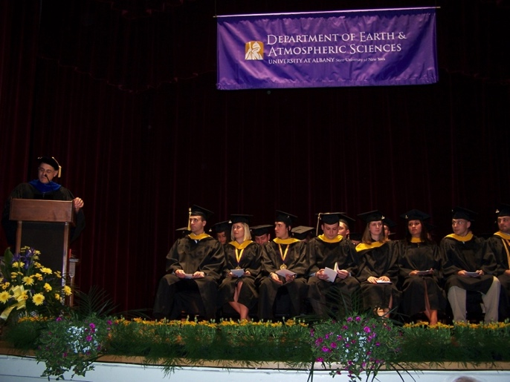
Faculty Research Interests and Contact Information
Lance F. Bosart, Distinguished Professor (Ph.D., MIT)
lbosart@albany.edu
Synoptic meteorology and the weather-climate interface
Kristen Corbosiero, Assistant Professor (Ph.D., University at Albany)
kcorbosiero@albany.edu
Tropical cyclones and lightning
Aiguo Dai, Associate Professor (Ph.D., Columbia Univ.)
adai@albany.edu
Climate change and the global water cycle
Oliver Elison Timm, Associate Professor (Ph.D. Univ. of Kiel)
oelisontimm@albany.edu
Paleoclimatology and regional climate change
Robert Fovell, Professor (Ph.D., Univ. of Illinois)
rfovell@albany.edu
Numerical weather prediction and mesoscale meteorology
Vincent P. Idone, Associate Professor (Ph.D., University at Albany)
vidone@albany.edu
Atmospheric electricity
Robert G. Keesee, Associate Professor (Ph.D., Univ. of Colorado)
rkeesee@albany.edu
Atmospheric chemistry
Daniel Keyser, Professor (Ph.D., Pennsylvania State Univ.)
dkeyser@albany.edu
Synoptic-dynamic meteorology
Andrea L. Lang, Assistant Professor (Ph.D., Univ. of Wisconsin)
alang@albany.edu
Synoptic meteo. and troposphere-stratosphere interaction
Ross A. Lazear, Instructor (M.S., Univ. of Wisconsin)
rlazear@albany.edu
Synoptic and mesoscale meteorology, and forecasting
Jiping Liu, Assistant Professor (Ph.D., Columbia Univ.)
jliu26@albany.edu
Atmosphere-ice-ocean interactions
Justin R. Minder, Assistant Professor (Ph.D., Univ. of Washington)
jminder@albany.edu
Mountain meteorology and mesoscale meteorology
John E. Molinari, Professor (Ph.D., Florida State Univ.)
jmolinari@albany.edu
Tropical cyclones
Brian E. J. Rose, Assistant Professor (Ph.D., MIT)
brose@albany.edu
Planetary-scale climate dynamics
Paul E. Roundy, Associate Professor (Ph.D., Pennsylvania State Univ.
proundy@albany.edu
Tropical atmospheric waves and midlatitude interaction
Brian H. Tang, Assistant Professor (Ph.D., MIT)
btang@albany.edu
Tropical cyclones and mesoscale meteorology
Christopher D. Thorncroft, Professor and Dept. Chair (Ph.D., University of Reading)
cthorncroft@albany.edu
West African monsoon and African easterly waves
Ryan Torn, Associate Professor (Ph.D., Univ. of Washington)
rtorn@albany.edu
Predictability, data assimilation, and mesoscale meteorology
Kevin R. Tyle, Manager of Departmental Computing (M.S., University at Albany)
ktyle@albany.edu
Big data, and meteorological data visualization
Mathias Vuille, Associate Professor (Ph.D., Univ. of Bern)
mvuille@albany.edu
Tropical paleoclimatology and climate change
Junhong Wang, Research Associate Professor (Ph.D., Columbia University)
jwang20@albany.edu
Climate observations and instrumentation
Liming Zhou, Associate Professor (Ph.D., Boston University)
lzhou@albany.edu
Remote sensing and land-climate interactionszz
CONTACT THE DEPARTMENT
Dept. of Atmospheric and Environmental Sciences
University at Albany, ES-351
1400 Washington Ave., Albany, NY 12222
(518).442.4556
Email: daeschair@albany.edu
DAES department
graduation ceremony

