Slide 1
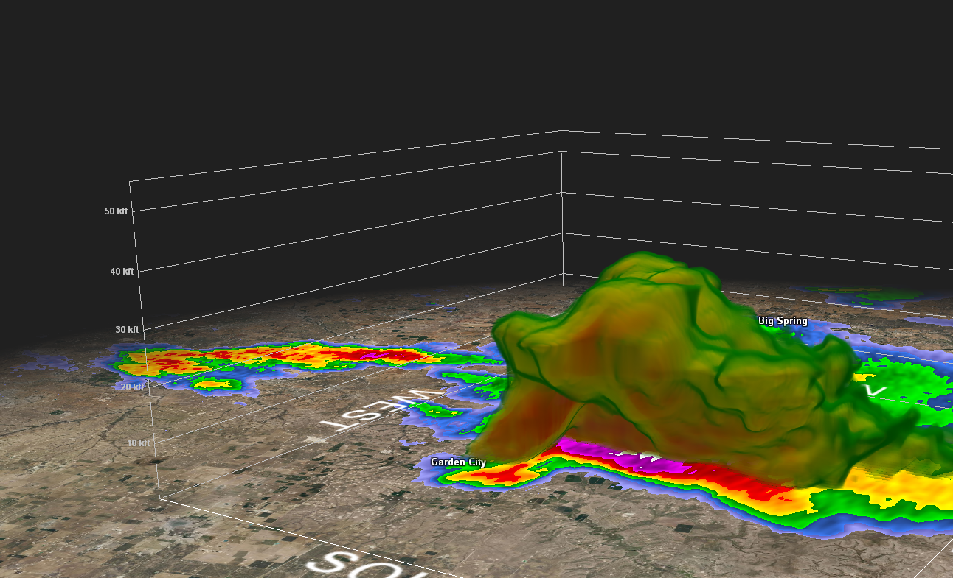
Gibson Ridge (GR) Products
Ross A. Lazear
University at Albany,
State University of New York
January 22, 2017

Slide 2
Gibson Ridge (GR) Products
Windows weather data visualization software
• GREarth
• GRLevel2 – no longer available for purchase
• GRLevel3
• GR2Analyst

Slide 3
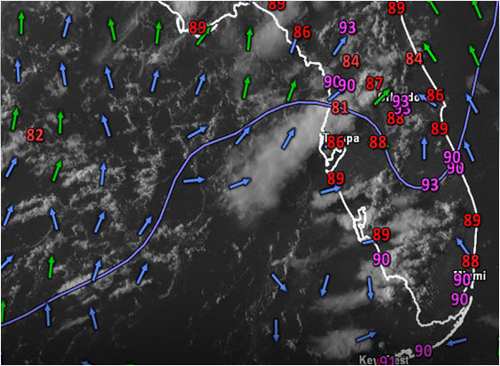
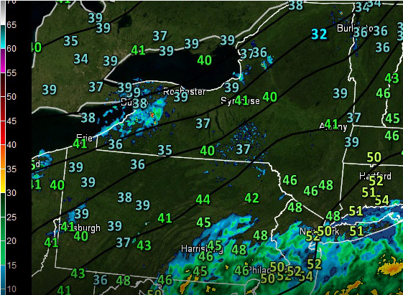
Gibson Ridge (GR) Products
• GREarth
- Worldwide weather data analysis
- METAR observations
- Satellite and radar
- Model and analysis fields
- Integrates NWS, SPC products, webpages, as well as other GR products
- $180/year or $15/month for data feed from AllisonHouse
grearth.co
grearth.co

Slide 4
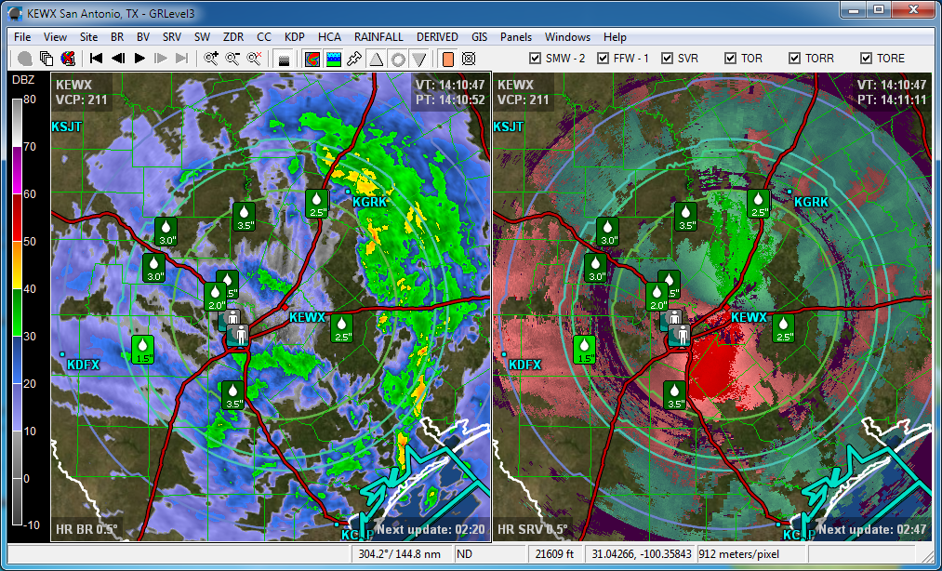
Gibson Ridge (GR) Products
• GRLevel3
- Level-III (post-processed) radar data
- Base, dual-polarization, and derived radar products
- Local storm reports
- Warnings
- $79.95 (21-day free trial)
Images from grlevelx.com

Slide 5
Gibson Ridge (GR) Products
• GR2Analyst
- High resolution Level-II radar
- Base, dual-polarization, and derived radar products
- Local storm reports
- Warnings
- Vertical cross-sections
- Volume scans
- Switch between live feed and archived data
- $250 (21-day free trial)

Slide 6
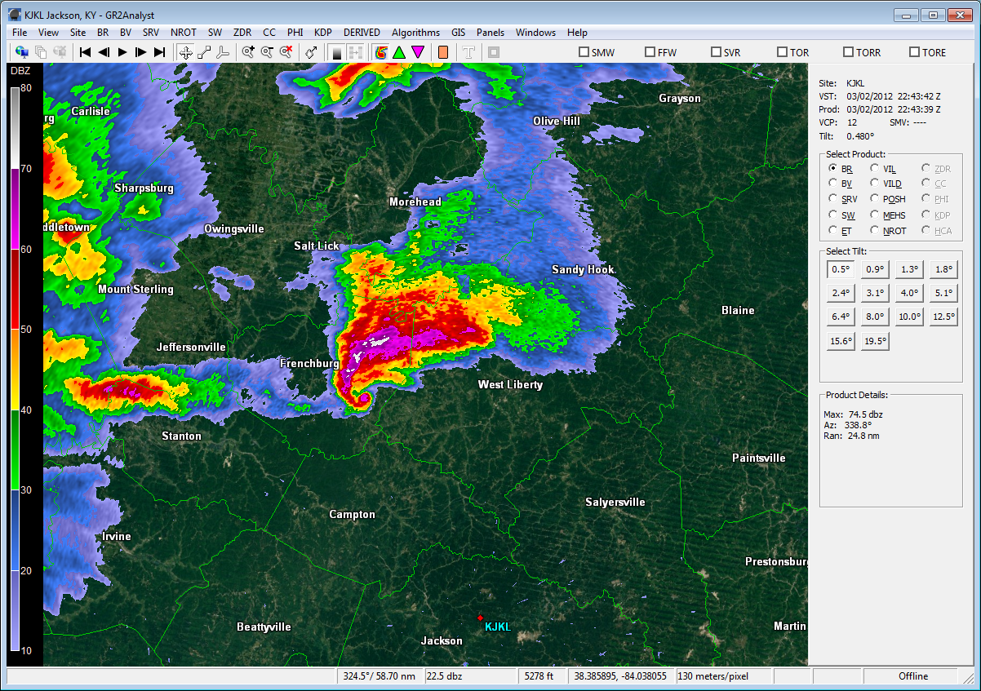
Jackson, KY (KJKL) – 2 March 2012 – 2243 UTC

Slide 7
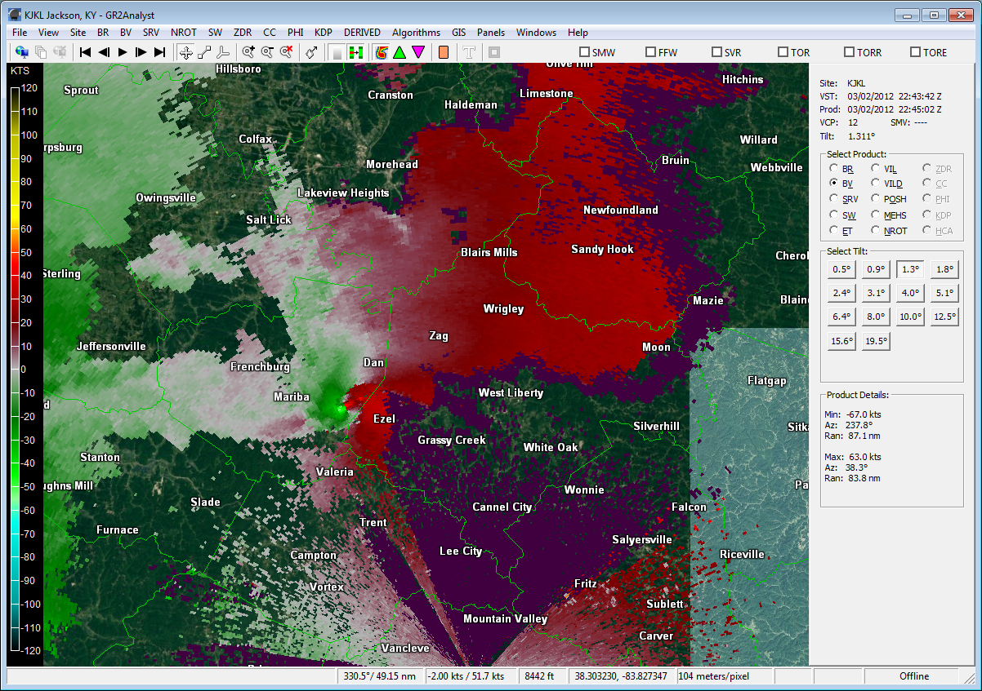
Jackson, KY (KJKL) – 2 March 2012 – 2243 UTC

Slide 8
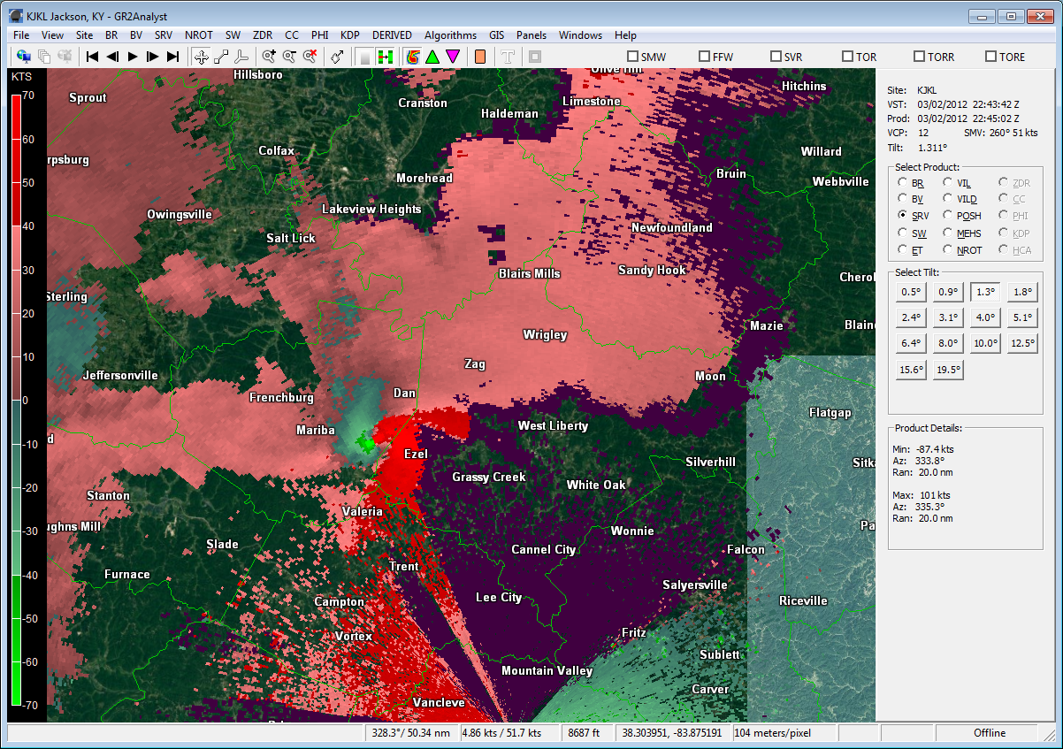
Jackson, KY (KJKL) – 2 March 2012 – 2243 UTC

Slide 9
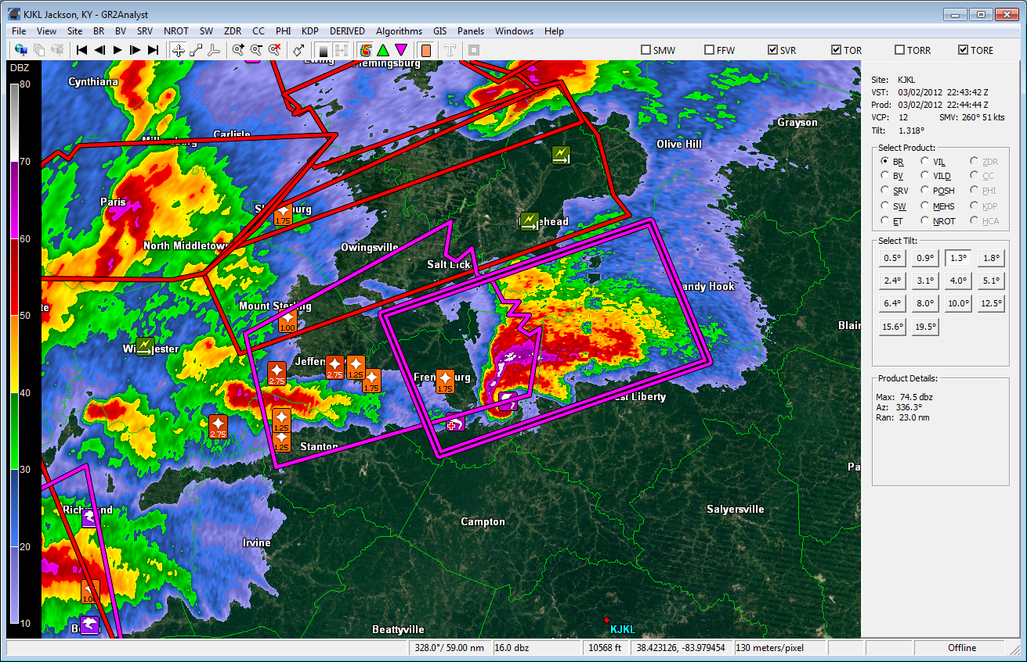
GR2Analyst
Jackson, KY (KJKL) – 2 March 2012 – 2243 UTC
Warnings and local storm reports

Slide 10
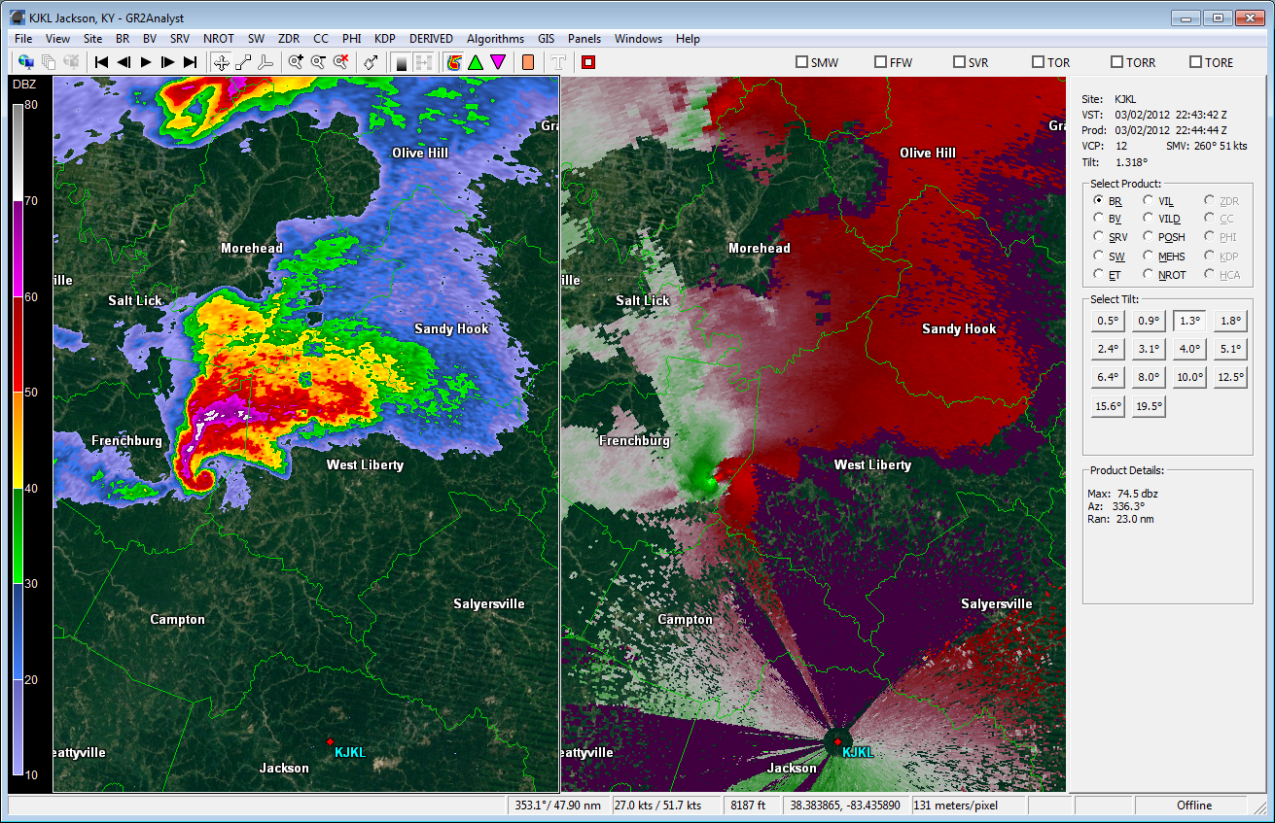
Jackson, KY (KJKL) – 2 March 2012 – 2243 UTC

Slide 11
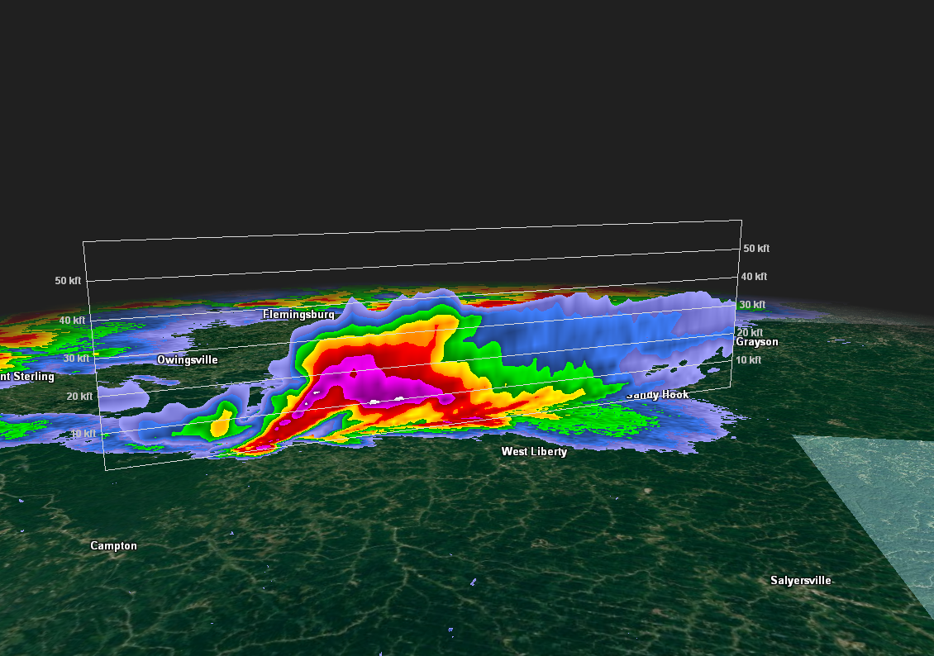
Jackson, KY (KJKL) – 2 March 2012 – 2243 UTC

Slide 12
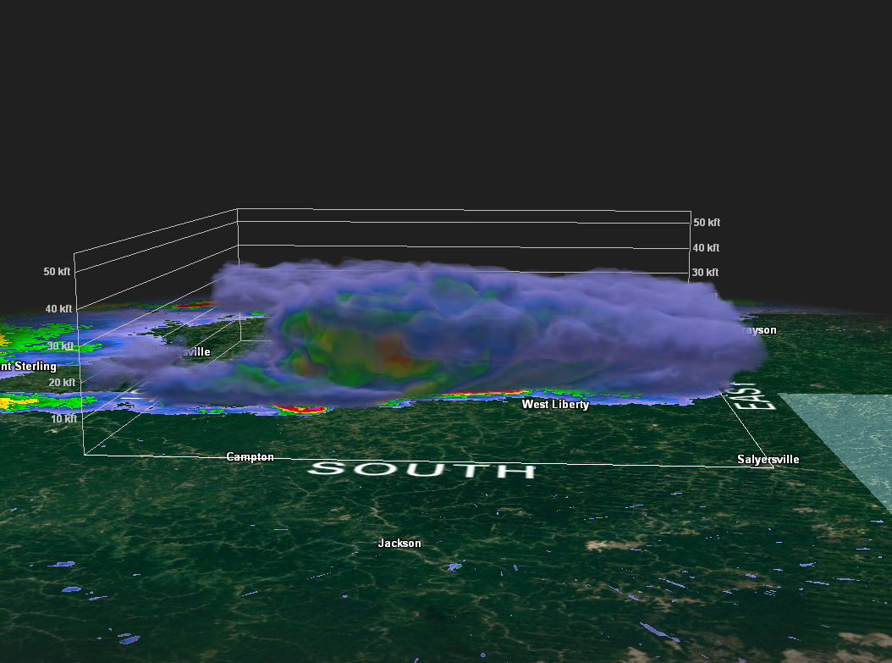
Jackson, KY (KJKL) – 2 March 2012 – 2243 UTC

Slide 13
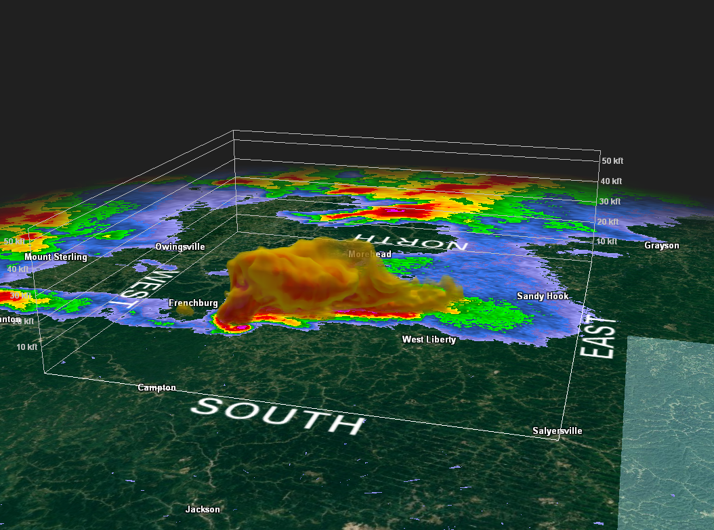
Jackson, KY (KJKL) – 2 March 2012 – 2243 UTC

Slide 14
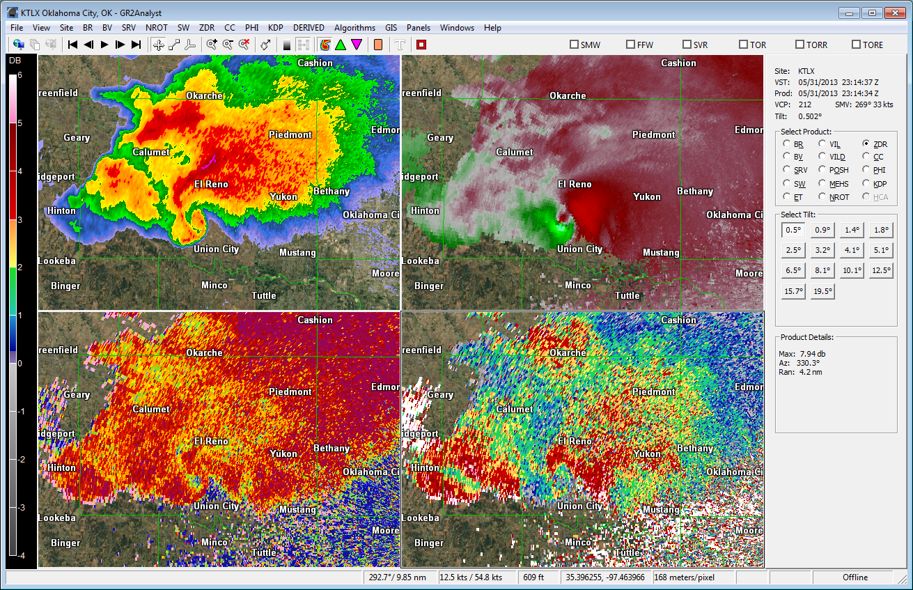
BR
BV
CC
ZDR
Norman, OK (KTLX) – 31 May 2013 – 2314Z

Slide 15
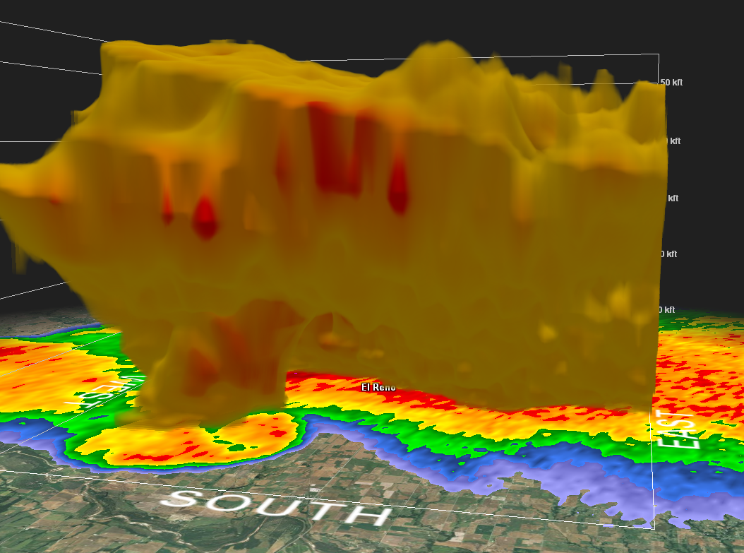
Norman, OK (KTLX) – 31 May 2013 – 2314Z

Slide 16
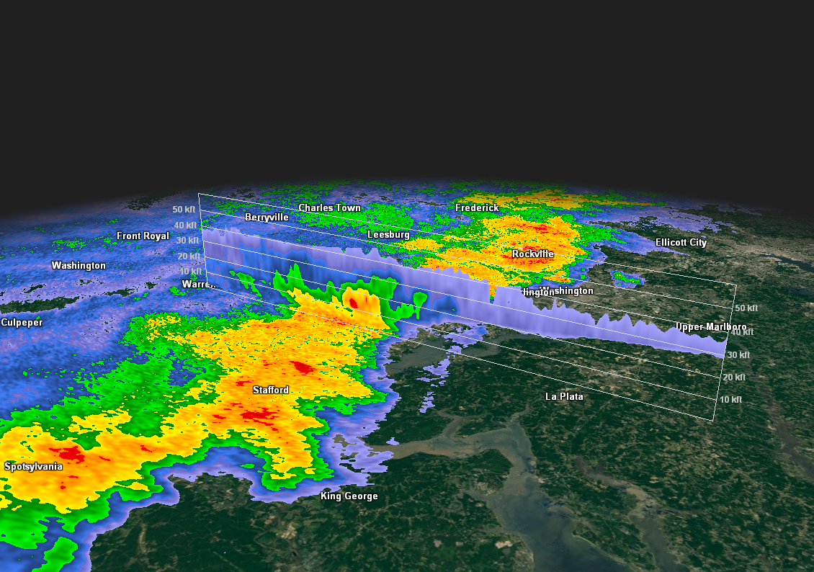
Sterling, VA (KLWX) – 30 June 2012 – 0239 UTC

Slide 17
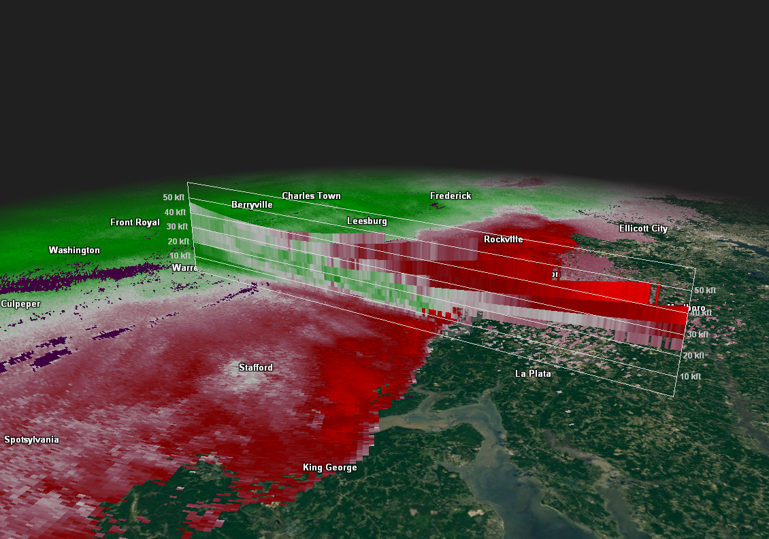
Sterling, VA (KLWX) – 30 June 2012 – 0239 UTC

Slide 18
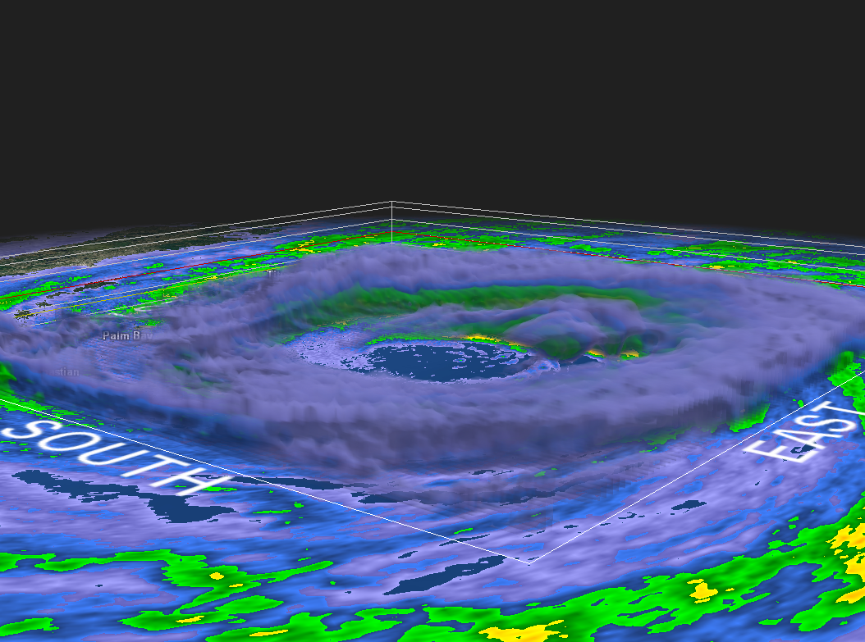
Hurricane Matthew
Melbourne, FL (KMLB) – 7 October 2016 – 0916 UTC

Slide 19
Gibson Ridge (GR) Products
• GREarth, GRLevel3, and GR2Analyst can be purchased from grlevelx.com
• Data feed for GREarth from AllisonHouse at grearth.co
• Level-III radar data feed for GRLevel3 from AllisonHouse
• Level-II radar data feed for GR2Analyst from AllisonHouse or via web link such as Iowa State:
http://mesonet-nexrad.agron.iastate.edu/level2/raw/
• Archived radar data from NCEI:
https://www.ncdc.noaa.gov/has/has.dsselect

