Slide 1
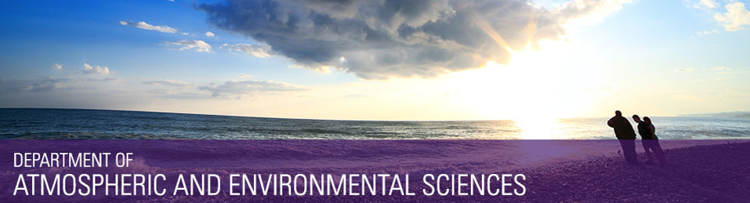
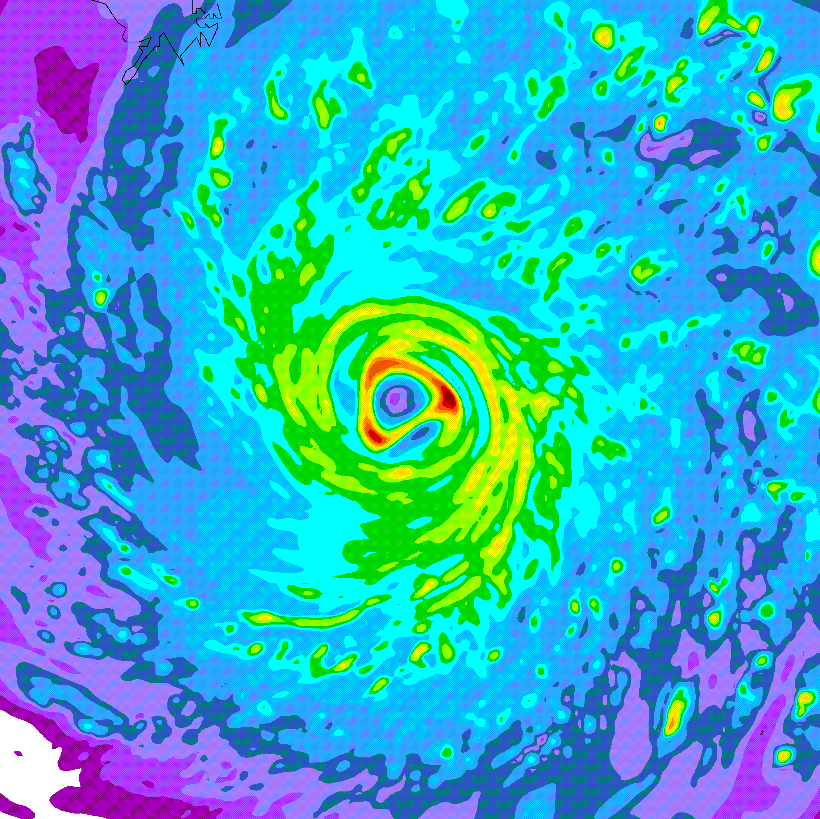
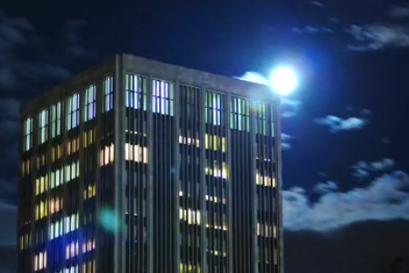
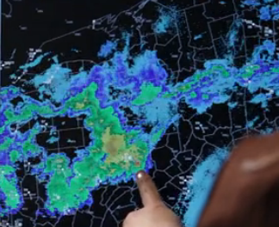

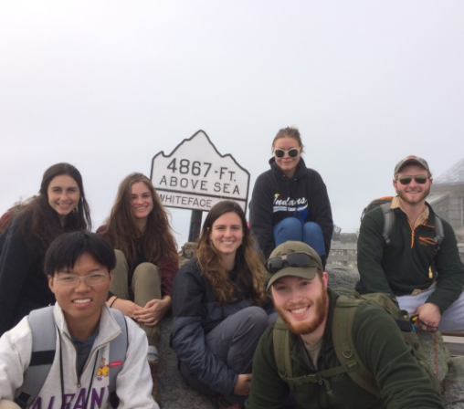
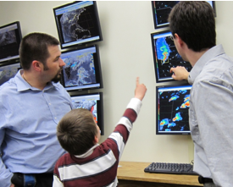
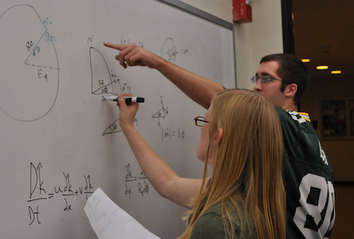
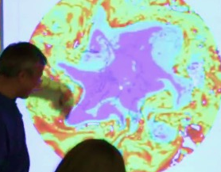
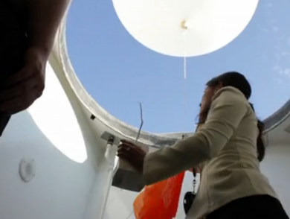
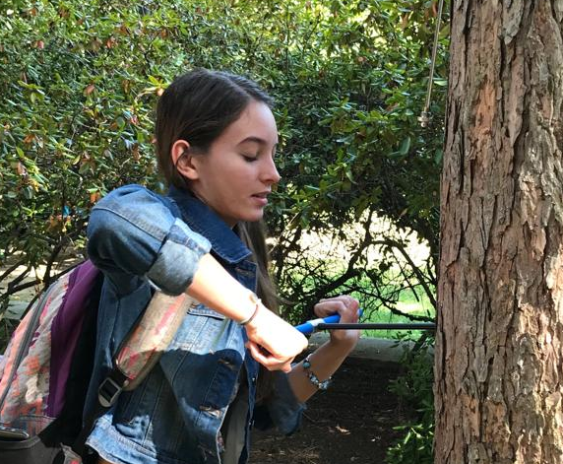
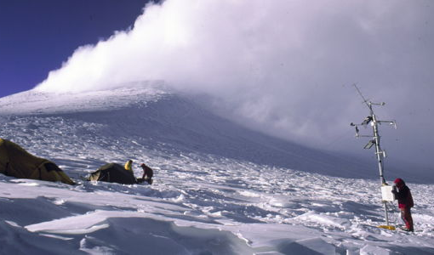
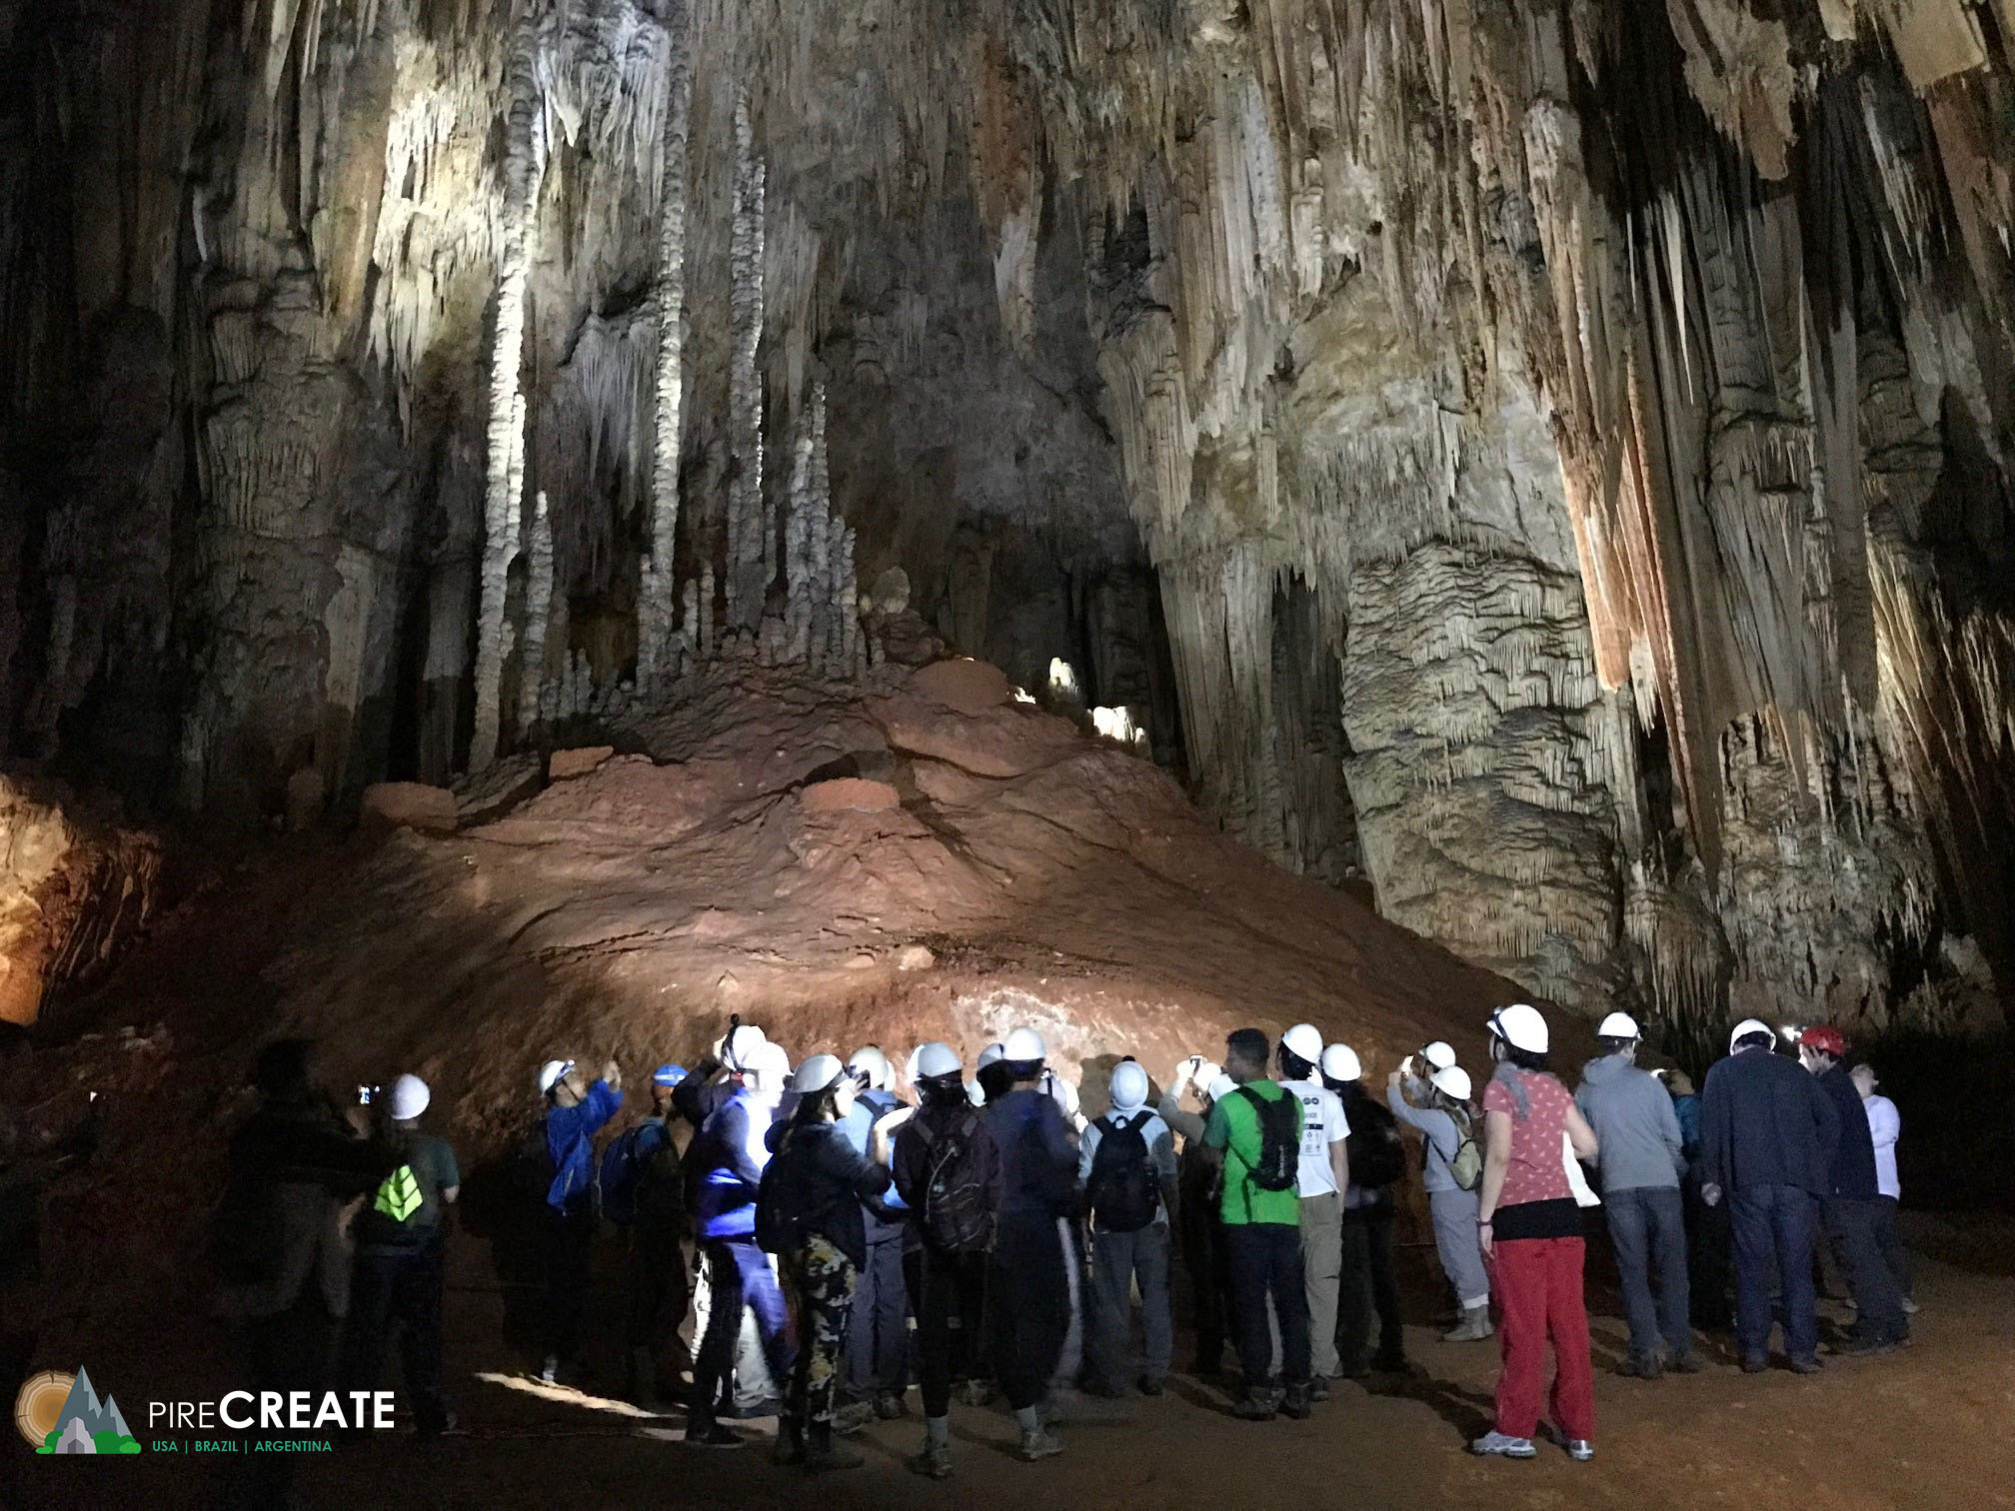


Department of
Atmospheric & Environmental Sciences
Contact me at:
Ross Lazear
rlazear@albany.edu
Web: http://albany.edu/daes/
Notes:
Intro
Welcome & congrats
Great community. World-class education at state-school cost

Slide 2
B.S. in Atmospheric Science
(meteorology and more)
B.S. in Environmental Science
B.S. in Climate Science
(coming soon)
B.A. in Environmental Studies
(coming soon)
Notes:
Intro
Welcome & congrats
Great community. World-class education at state-school cost

Slide 3
World-class teaching and research in:
Weather systems, tropical meteorology, and
mesoscale meteorology (mountain weather, thunderstorms)

Slide 4
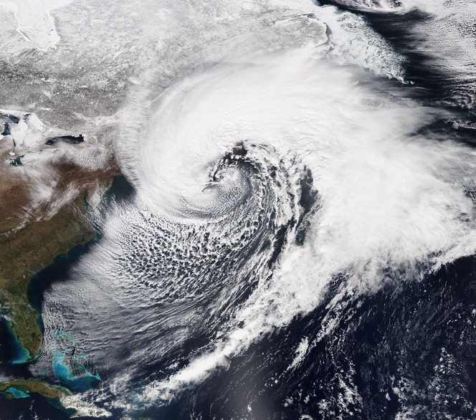
World-class teaching and research in:
Weather systems, tropical meteorology, and
mesoscale meteorology (mountain weather, thunderstorms)

Slide 5
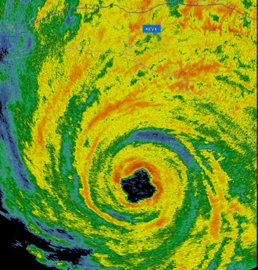
World-class teaching and research in:
Weather systems, tropical meteorology, and
mesoscale meteorology (mountain weather, thunderstorms)

Slide 6
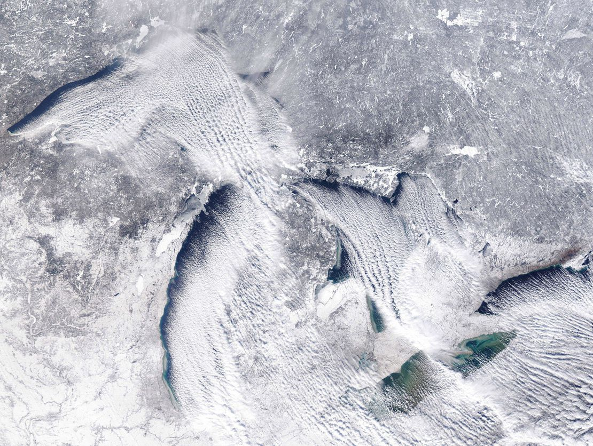
World-class teaching and research in:
Weather systems, tropical meteorology, and
mesoscale meteorology (mountain weather, thunderstorms)

Slide 7
World-class teaching and research in:
Climate dynamics, paleoclimate, and environmental systems

Slide 8
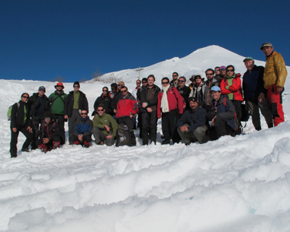
World-class teaching and research in:
Climate dynamics, paleoclimate, and environmental systems

Slide 9
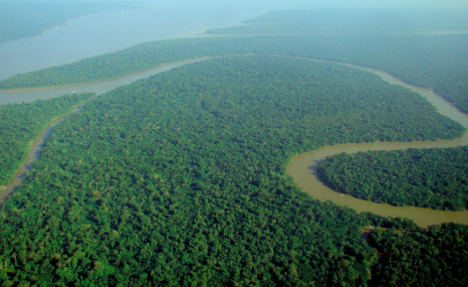
World-class teaching and research in:
Climate dynamics, paleoclimate, and environmental systems

Slide 10
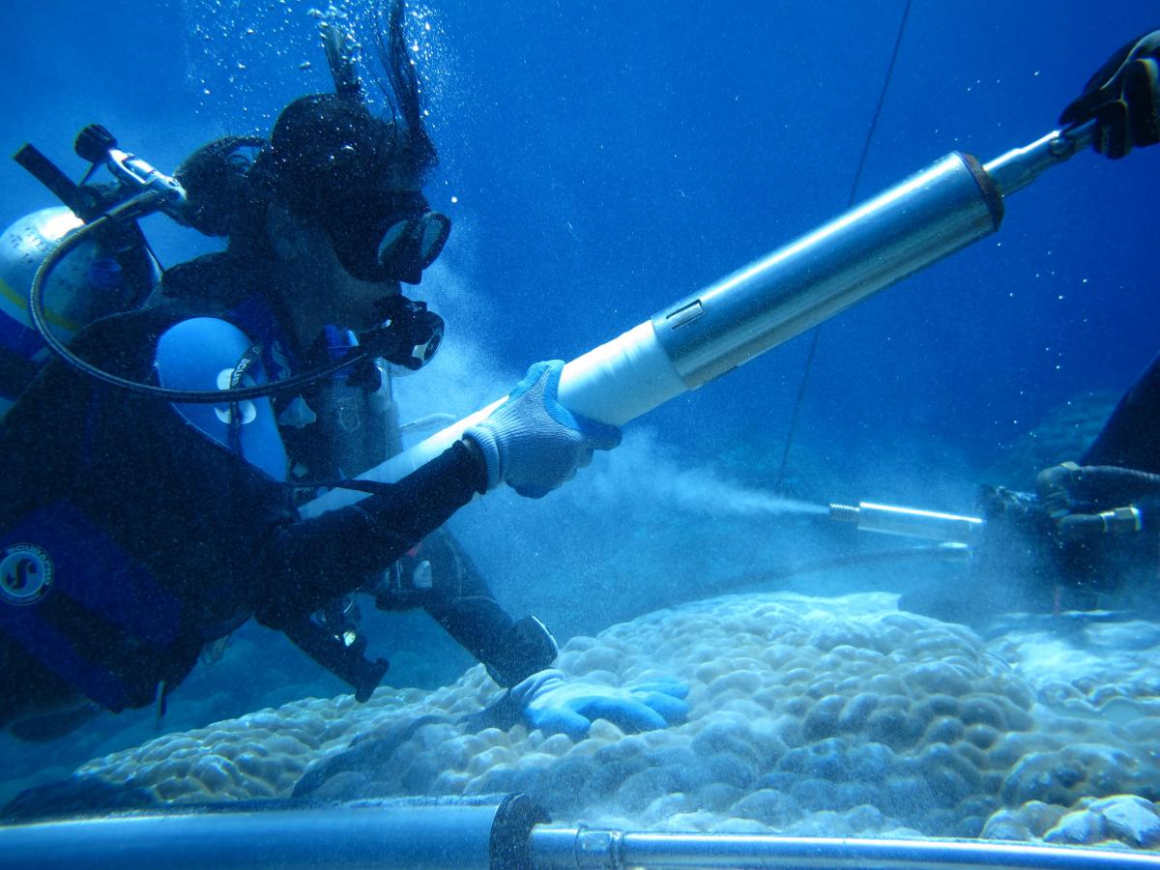
World-class teaching and research in:
Climate dynamics, paleoclimate, and environmental systems

Slide 11
World-class teaching and research in:
Atmospheric chemistry, air quality, and coastal–urban environments

Slide 12
World-class teaching and research in:
Atmospheric chemistry, air quality, and coastal–urban environments

Slide 13
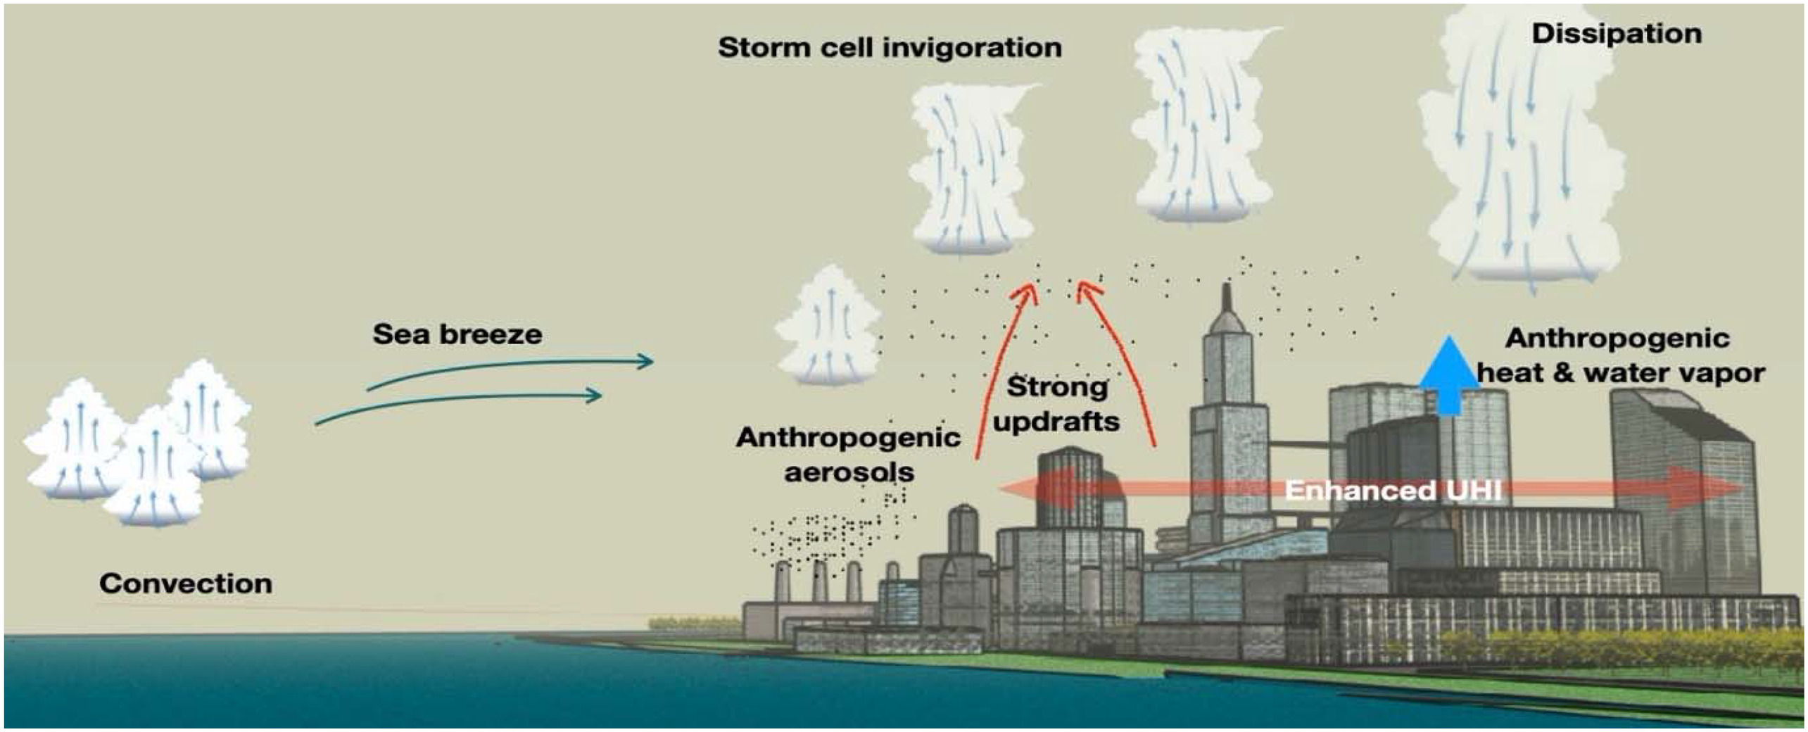
World-class teaching and research in:
Atmospheric chemistry, air quality, and coastal–urban environments

Slide 14
World-class teaching and research in:
Boundary layer meteorology, and air–land–sea interactions

Slide 15
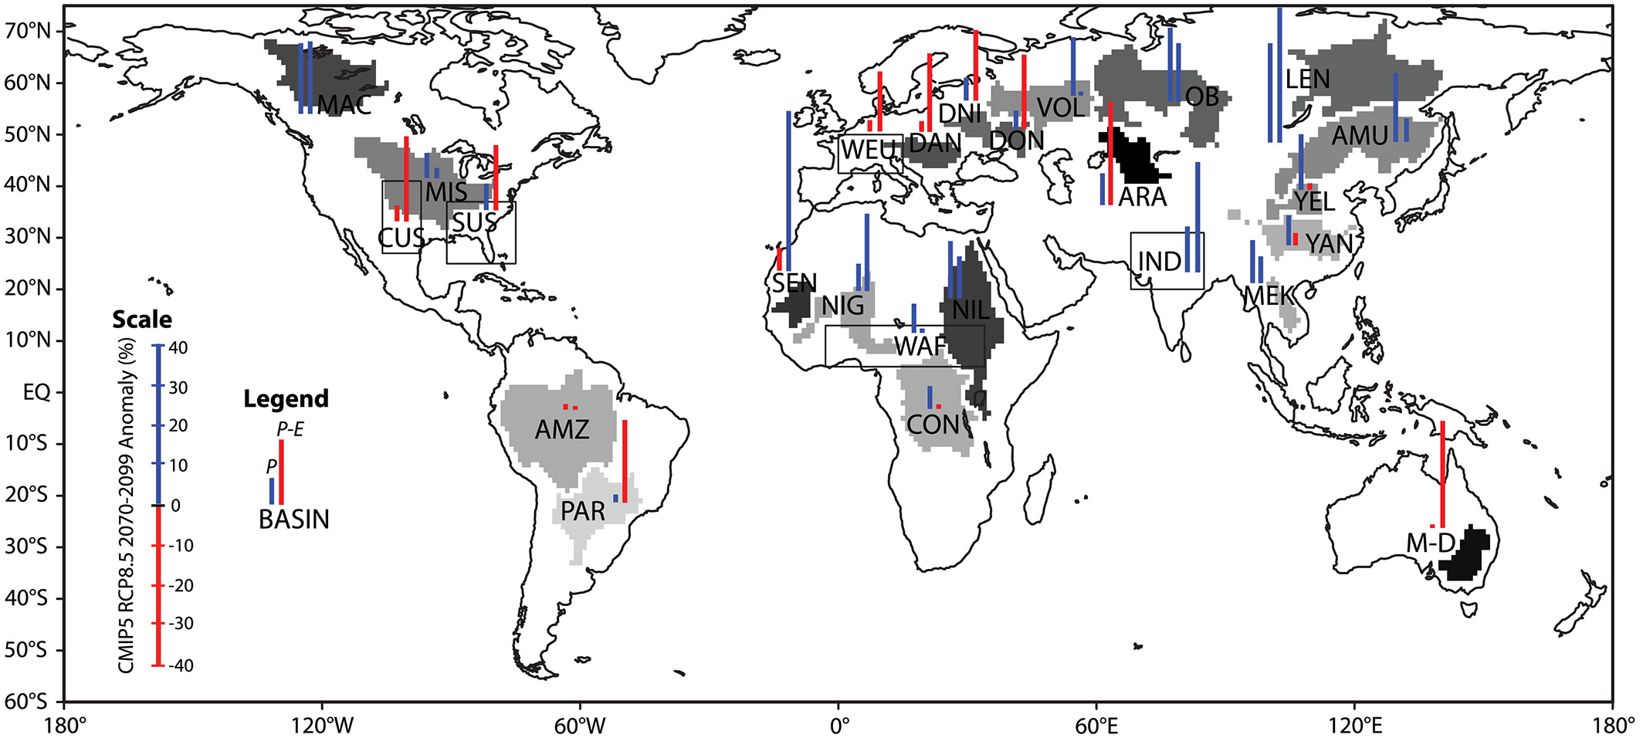
World-class teaching and research in:
Boundary layer meteorology, and air–land–sea interactions

Slide 16
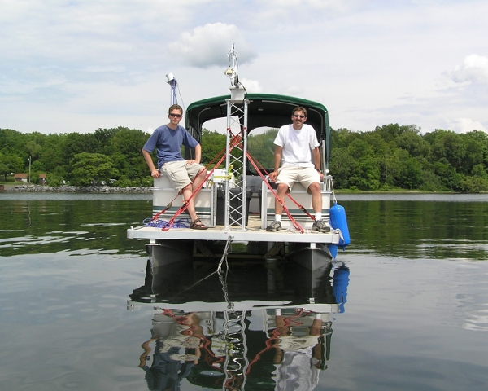
World-class teaching and research in:
Boundary layer meteorology, and air–land–sea interactions

Slide 17
World-class teaching and research in:
Renewable energy

Slide 18
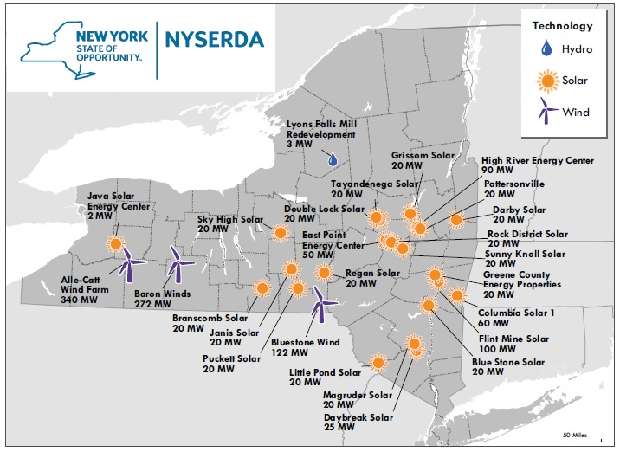
World-class teaching and research in:
Renewable energy

Slide 19
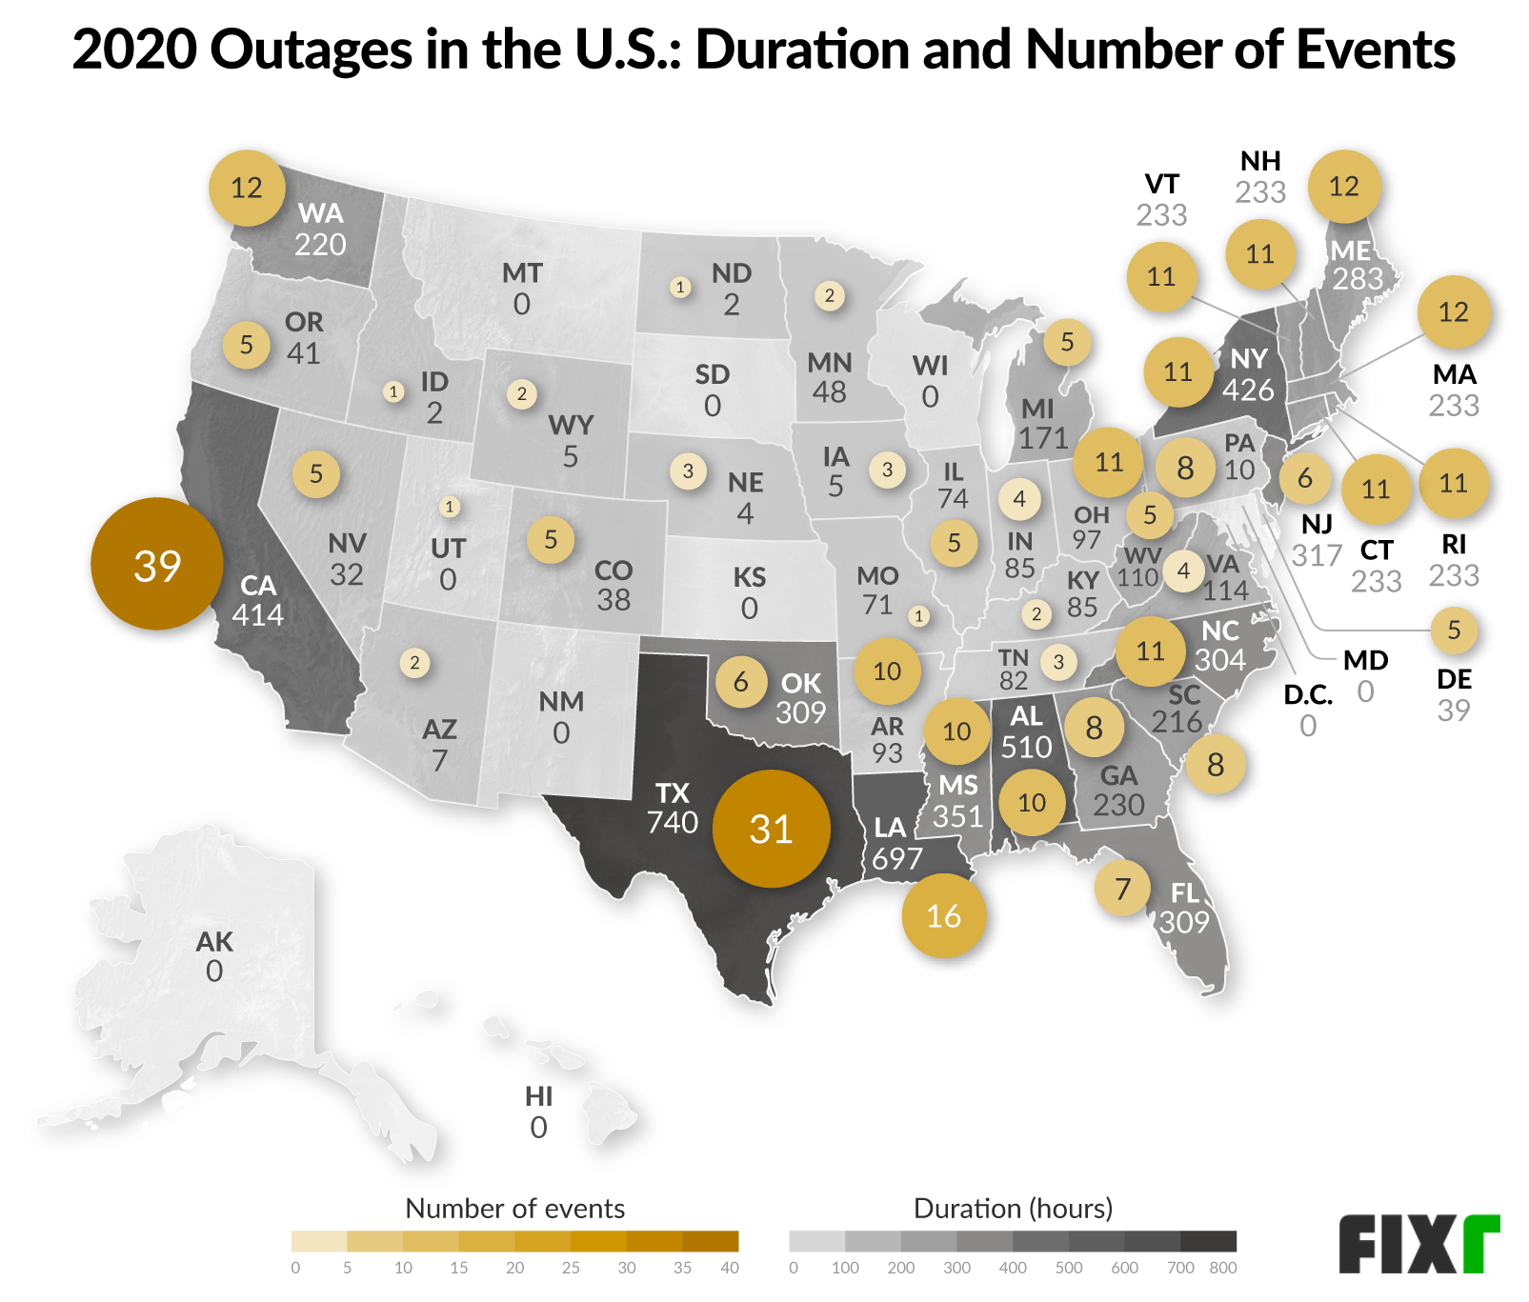
World-class teaching and research in:
Renewable energy

Slide 20
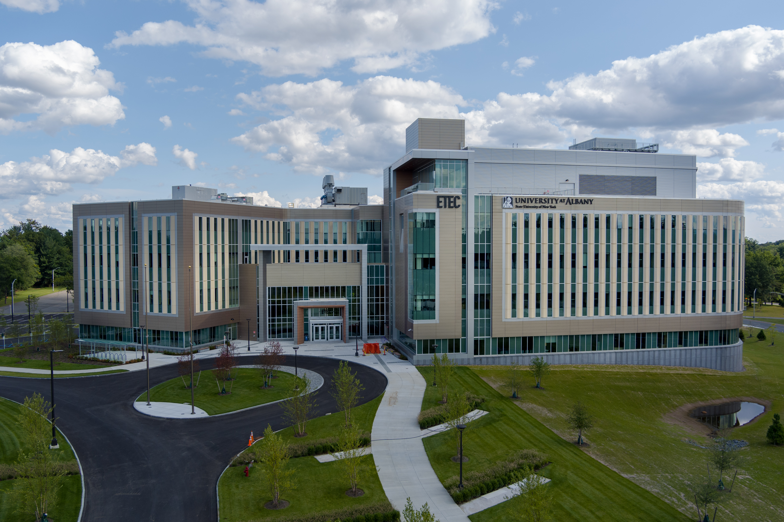
ETEC at UAlbany

Slide 21
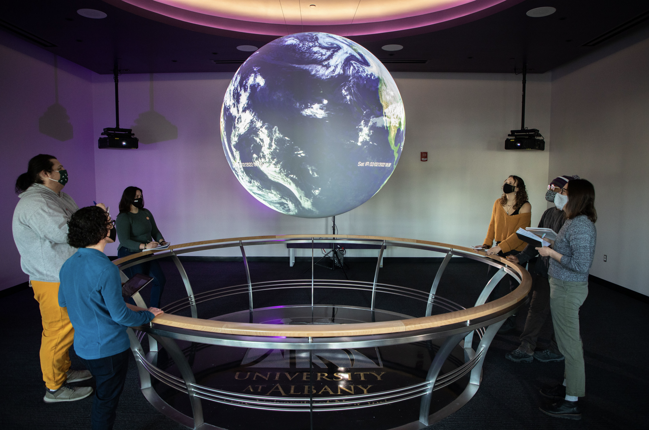
ETEC at UAlbany

Slide 22
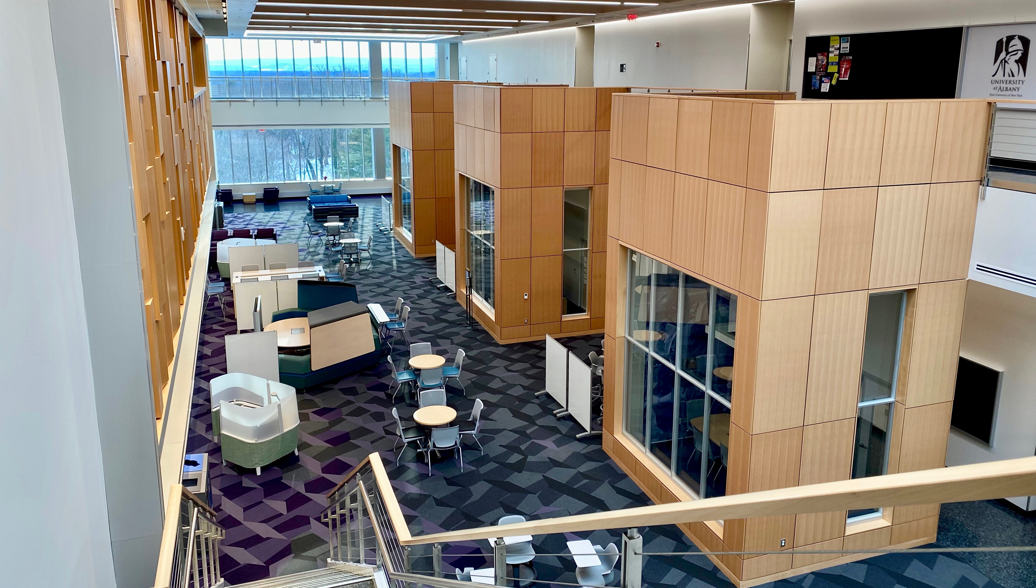
ETEC at UAlbany

Slide 23
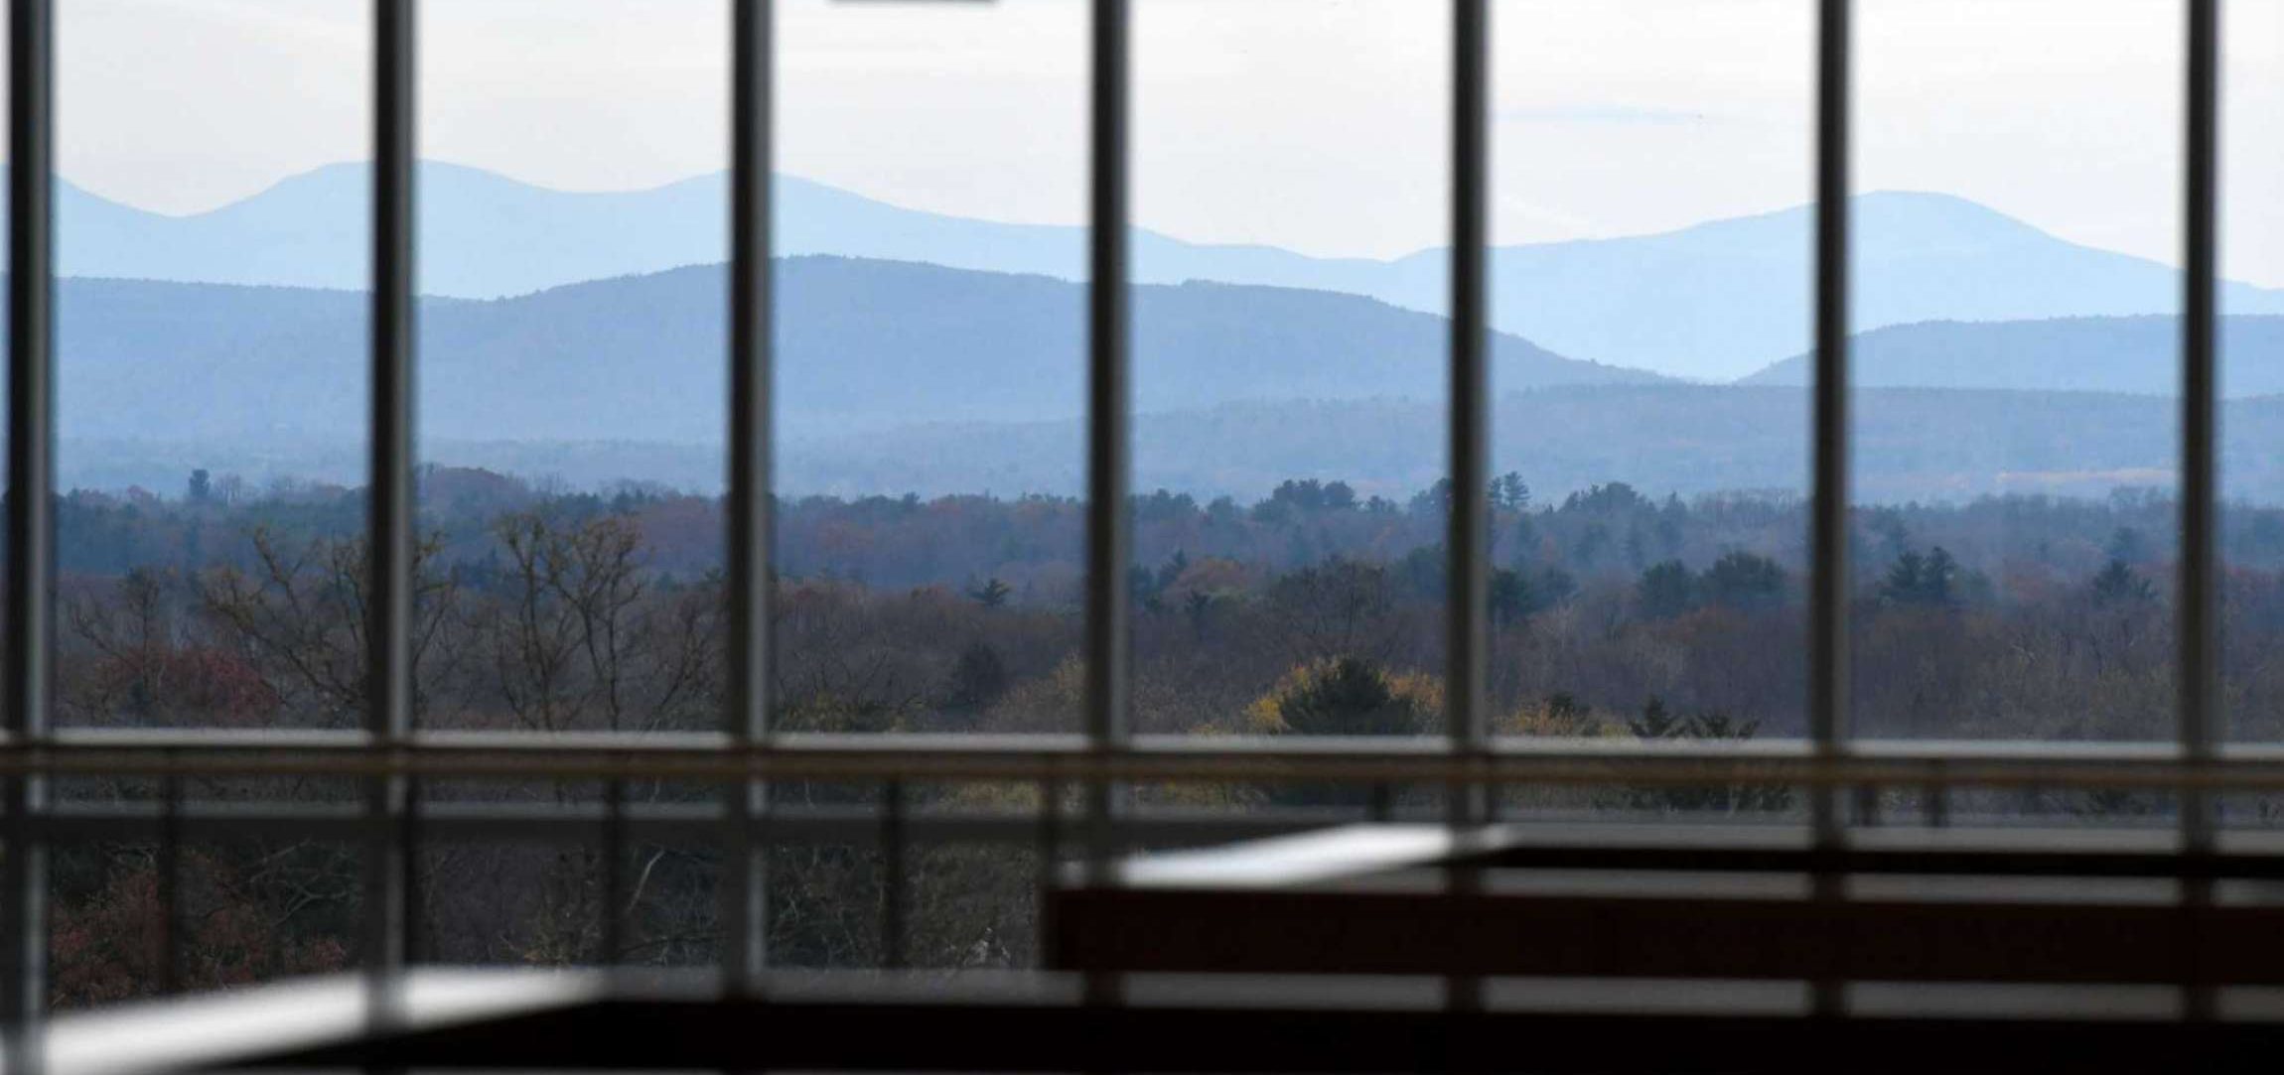
ETEC at UAlbany

Slide 24
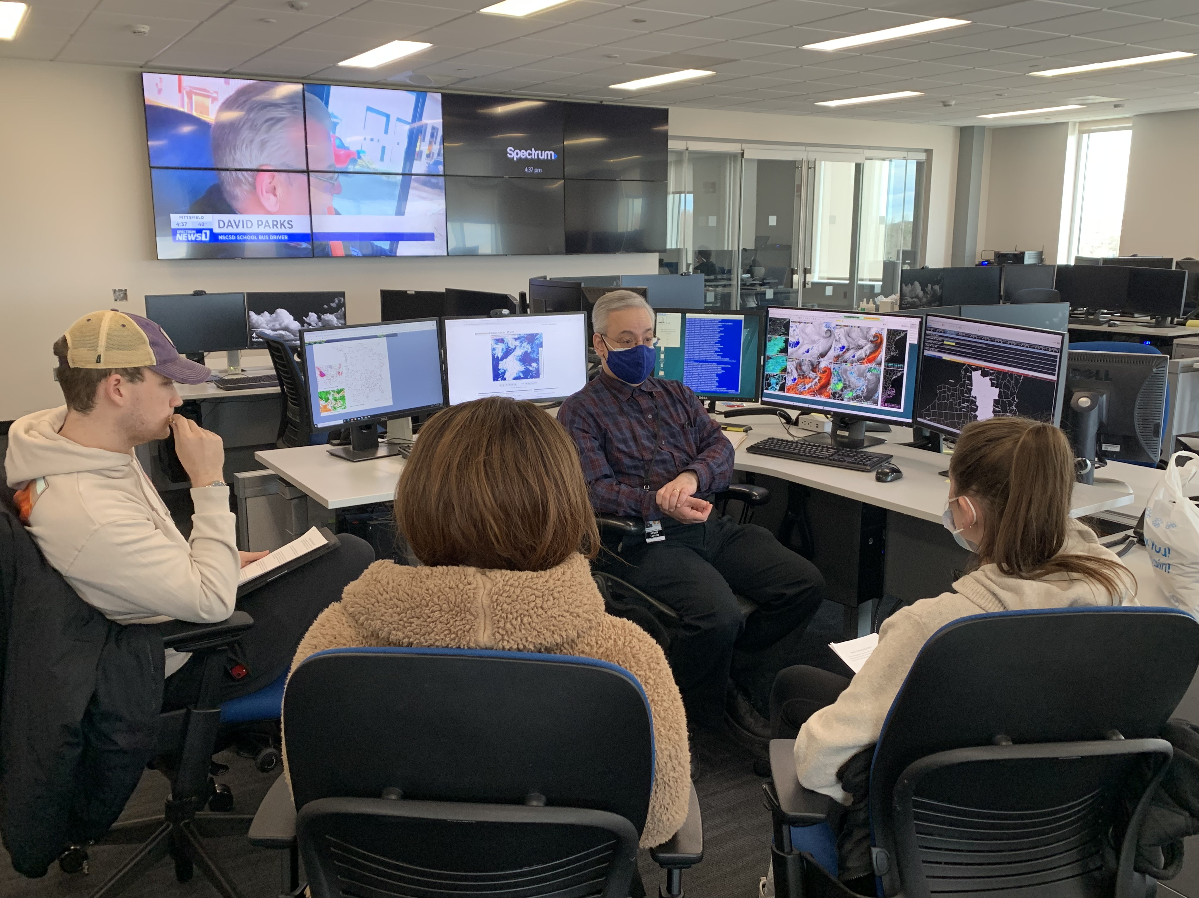
ETEC at UAlbany

Slide 25

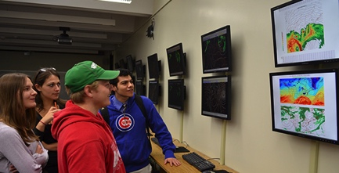
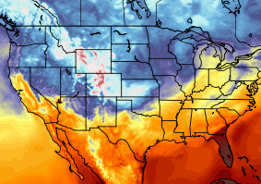
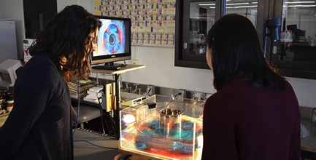
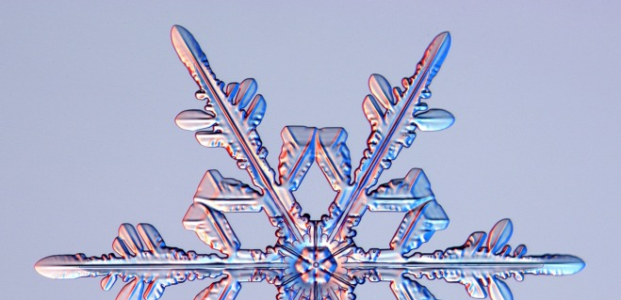
B.S. in Atmospheric Science
Broad foundation in four fundamental areas:
Synoptic
  Observations and weather forecasting
Dynamic
  Theory and computer modeling
Physical
  Clouds and atmospheric chemistry
Climate
  Land-ocean-atmosphere processes
Also available:
Minors: Broadcast Meteorology/Sustainability/Math
Emergency Preparedness, Homeland Security, and Cybersecurity Minor (CEHC)
Masters in Secondary Education (5-year program)
Notes:
The bachelor of science degree in atmospheric science prepares our students in 3 fundamental areas: synoptic meteorology(how weather observations are collected, how do we forecast weather in to the future); dynamic meteorology (the physics which govern the atmosphere, how those physics are handled in computer models to make forecasts); physical meteorology (how clouds and precipitation form, how air pollution forms, why the ozone layer exists)

Slide 26
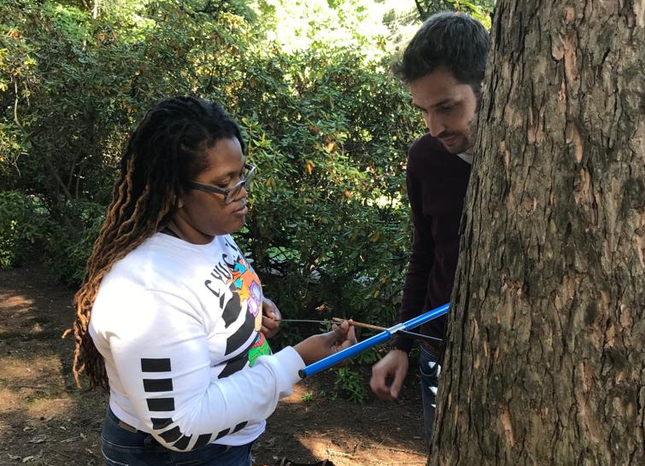
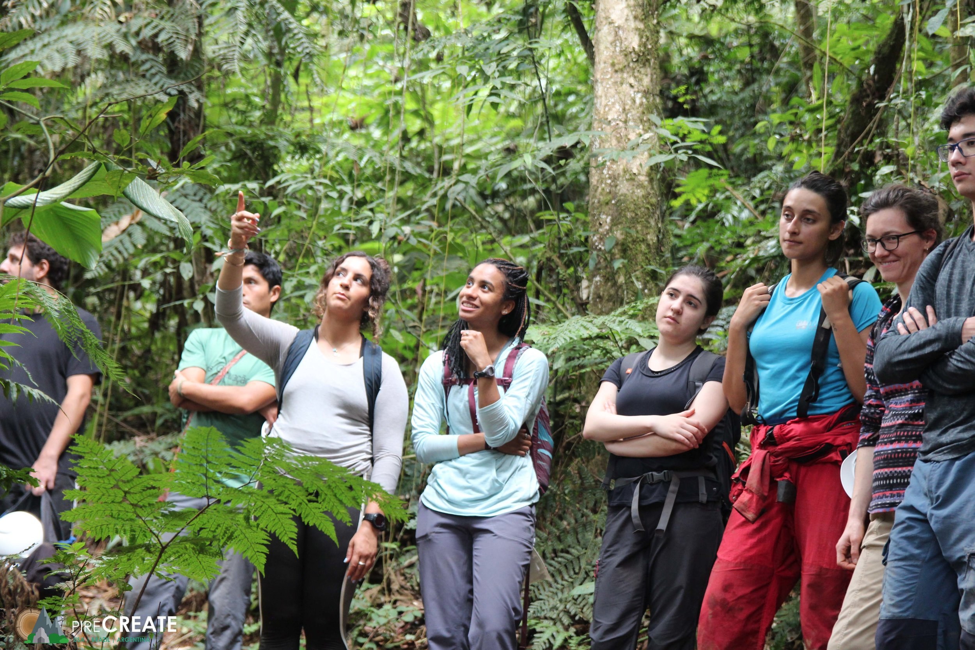
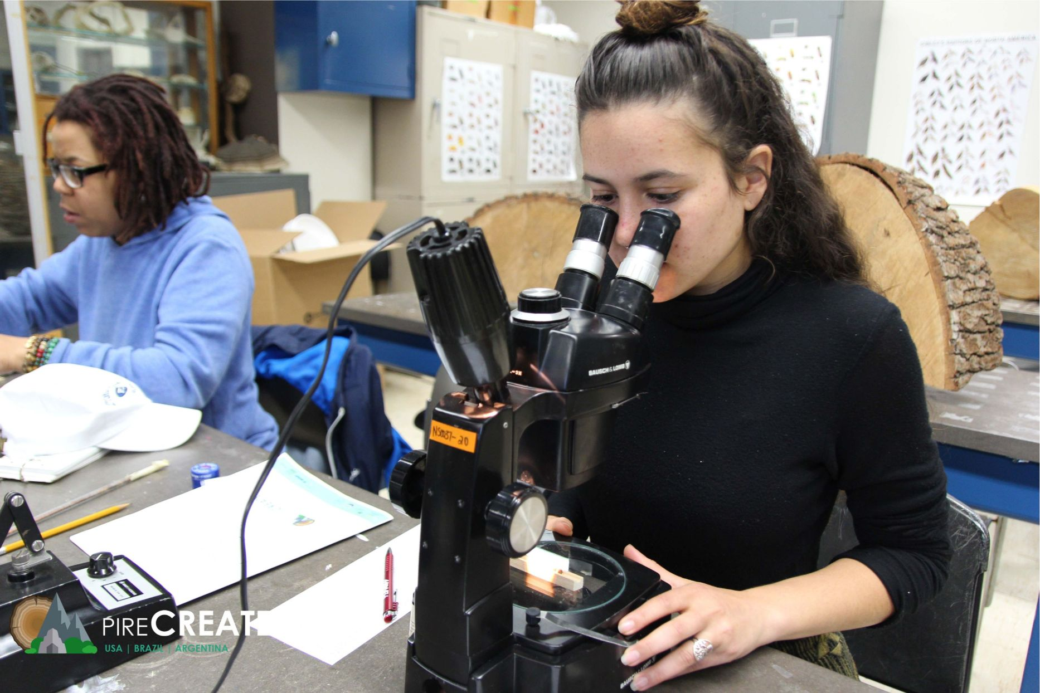
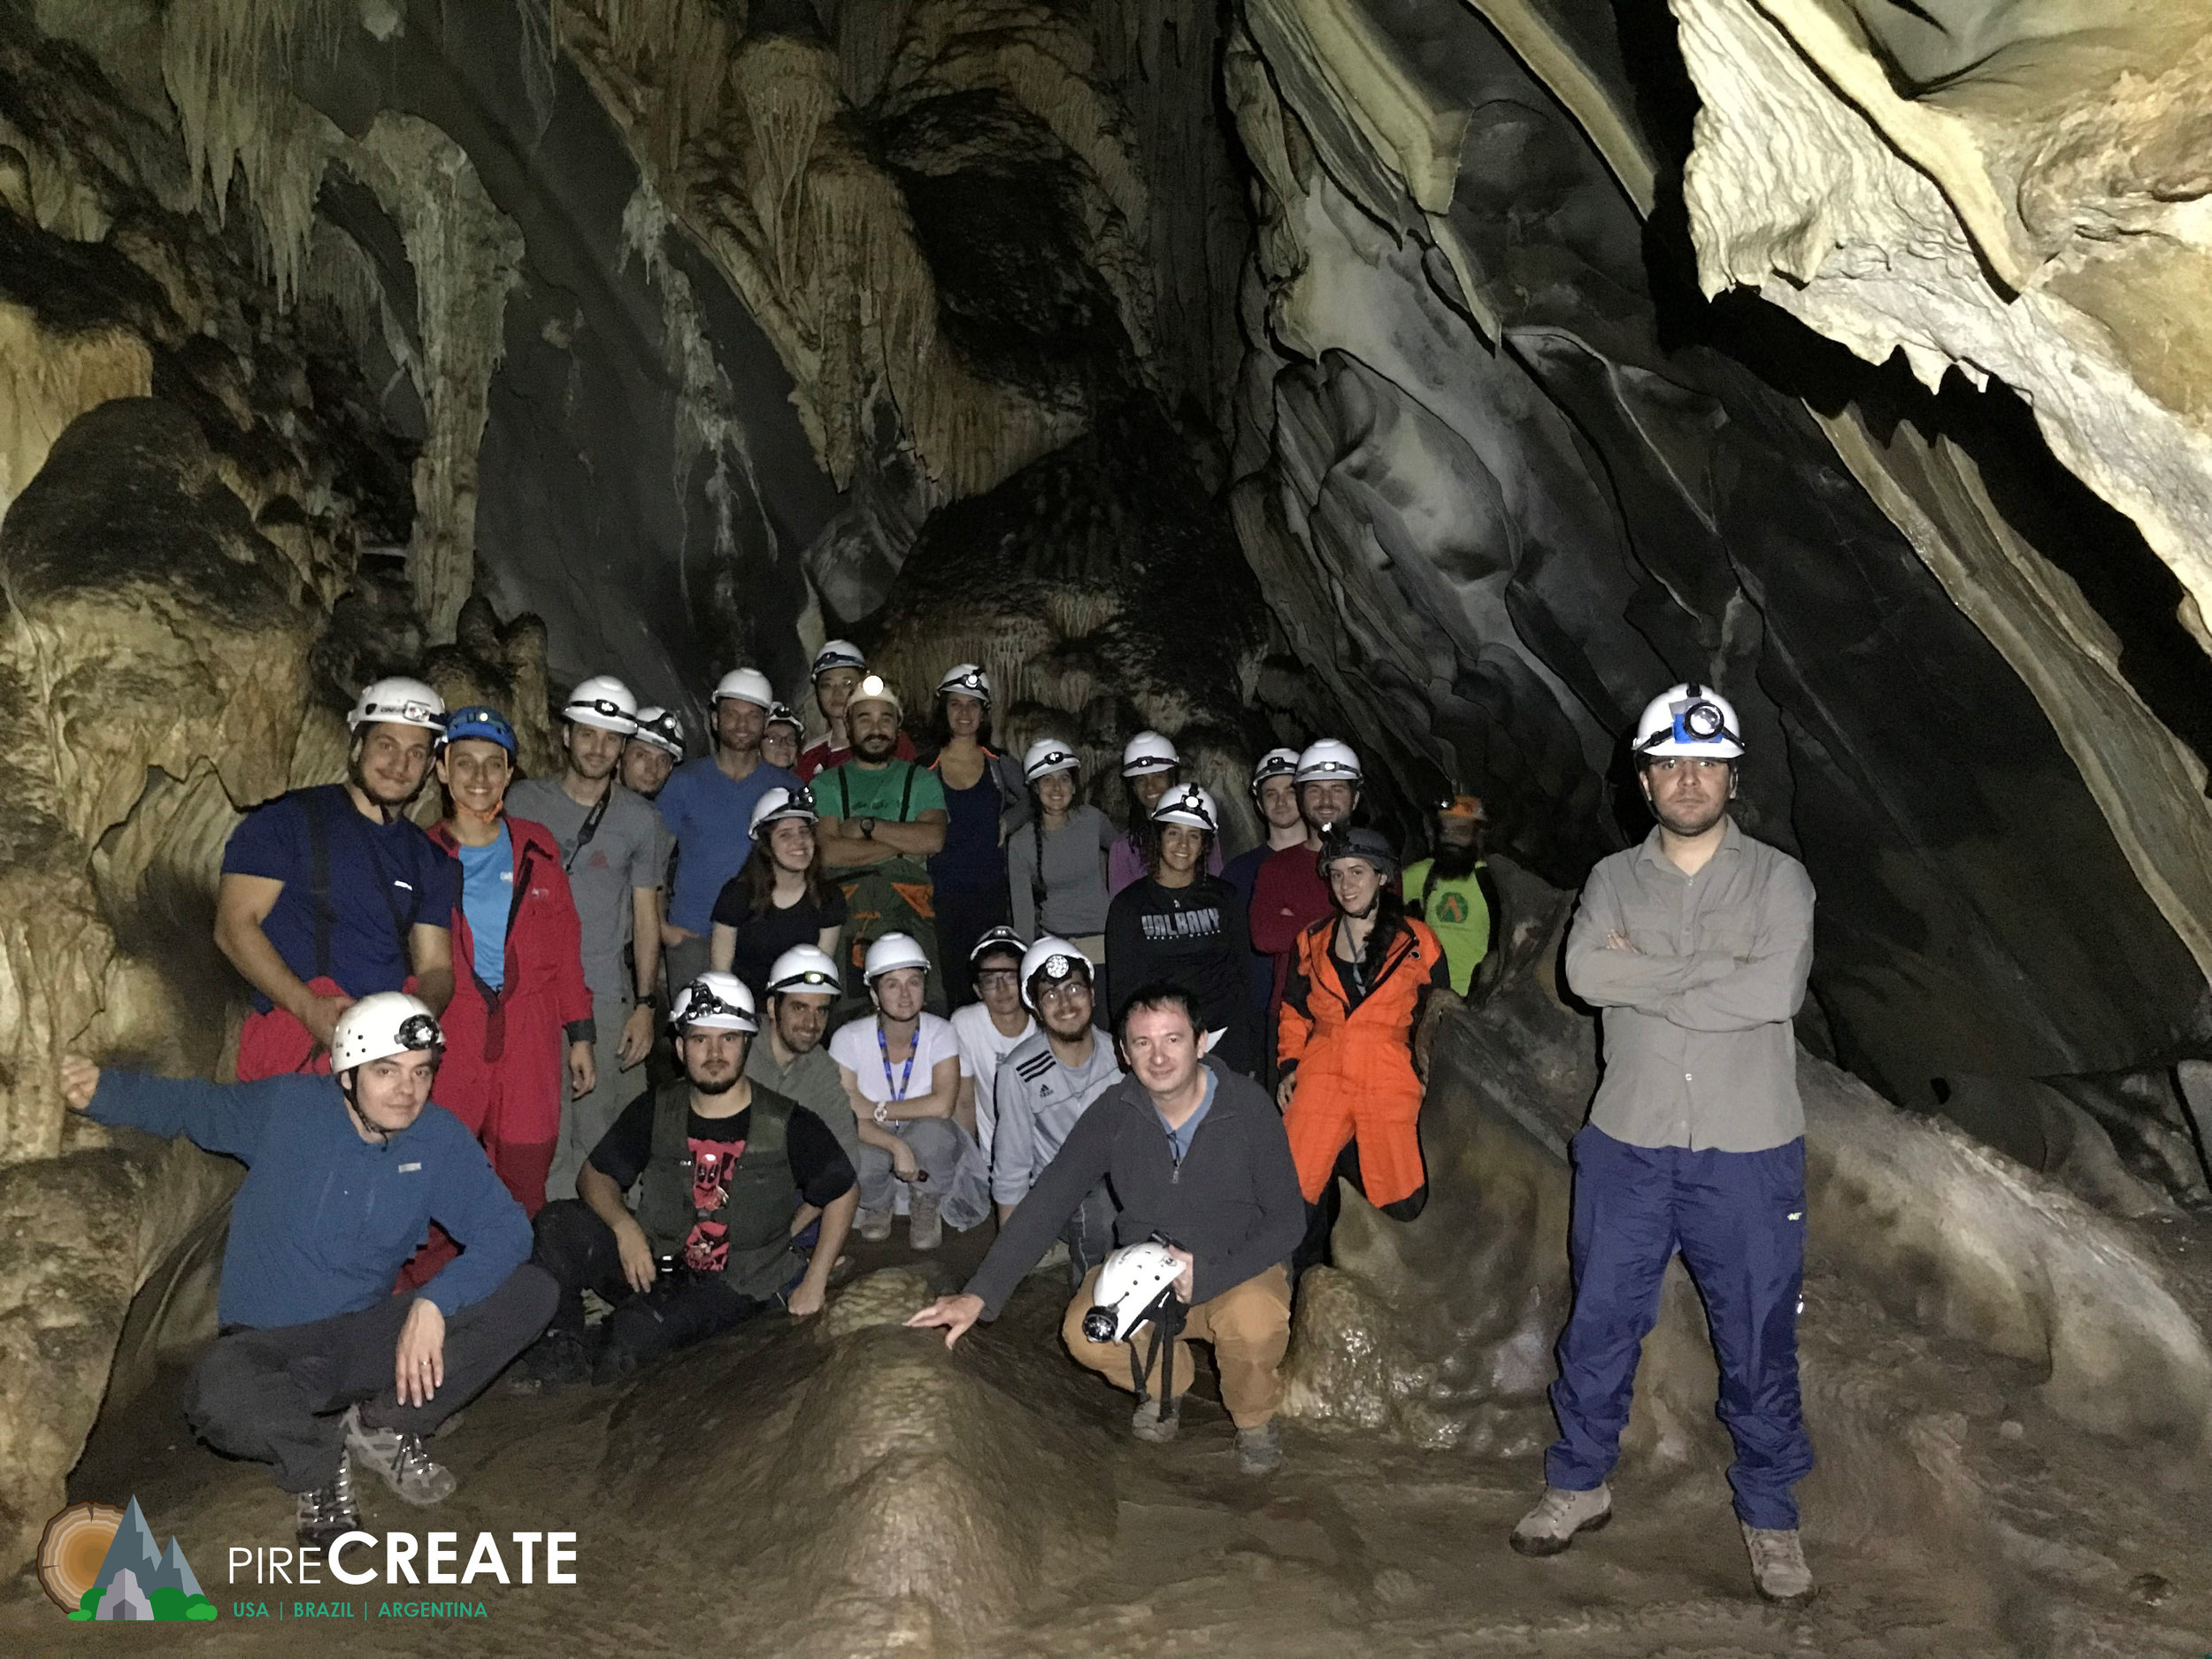
B.S. in Environmental Science
Core environmental fundamentals + four specializations:
Climate Change: long-term variability and change → Climate Science B.S.
Ecosystems: ecology, biodiversity, sustainability
Geography: land-use planning, resource management, GIS
Sustainability Science and Policy: renewable energy, air quality
Also available:
Sustainability Minor & Emergency Preparedness, Homeland Security, and Cybersecurity Minor
Geographic information systems (GIS) certificate
Notes:
The bachelor of science degree in environmental science prepares our students in the core environmental issues of how humans interact with the environment around us and the use of natural resources. Our majors choose one of three concentrations: climate (what control variability of Earth’s climate (like El Nino), how climate has changed in the past and how it will change in future); biology (ecology and sustainability, which is becoming an increasingly bigger issue); geography (land-use planning and geographical information systems, how do we plan in a smarter way to minimize costs and impacts to the environment)

Slide 27
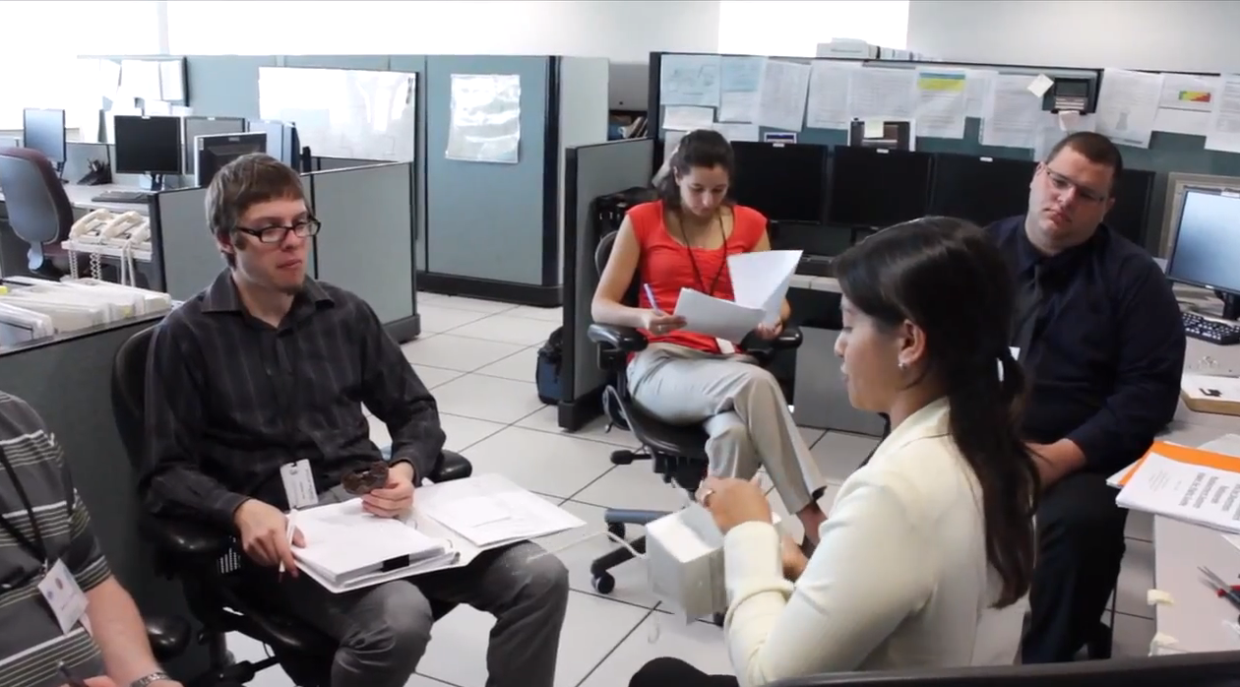

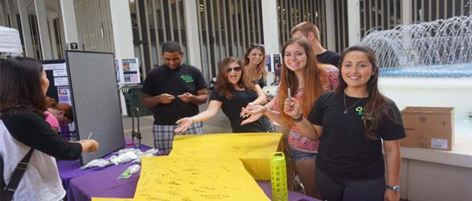
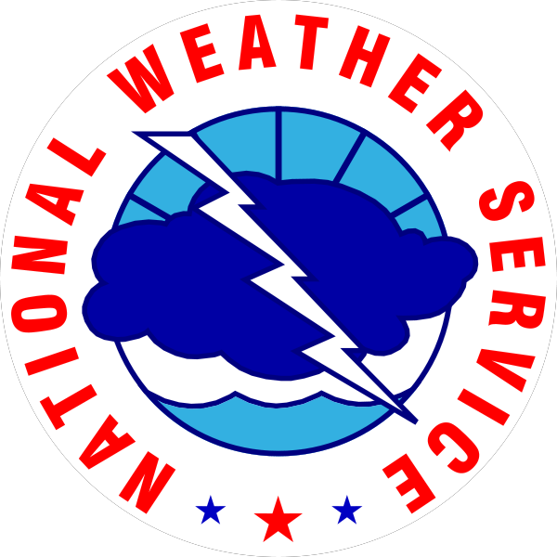


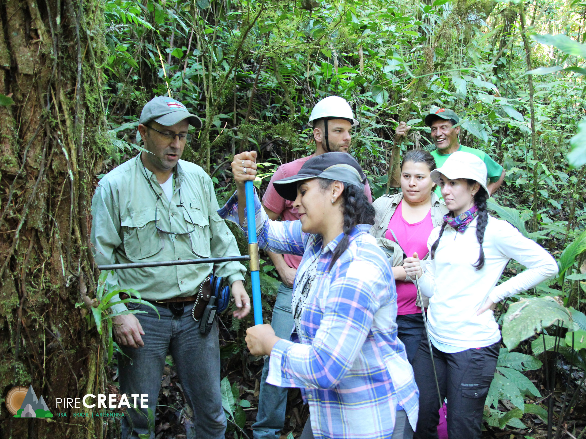

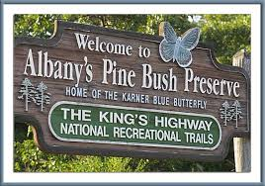



Hands-on research, internships and student involvement
Notes:
This also allows for opportunities from hands-on research and internships. Internships with the National Weather Service, which is located very near campus. Some undergraduates even get to go out into the field. This particular example was from a lightning study, showing one of our recent undergraduates standing by some of the photography equipment.

Slide 28
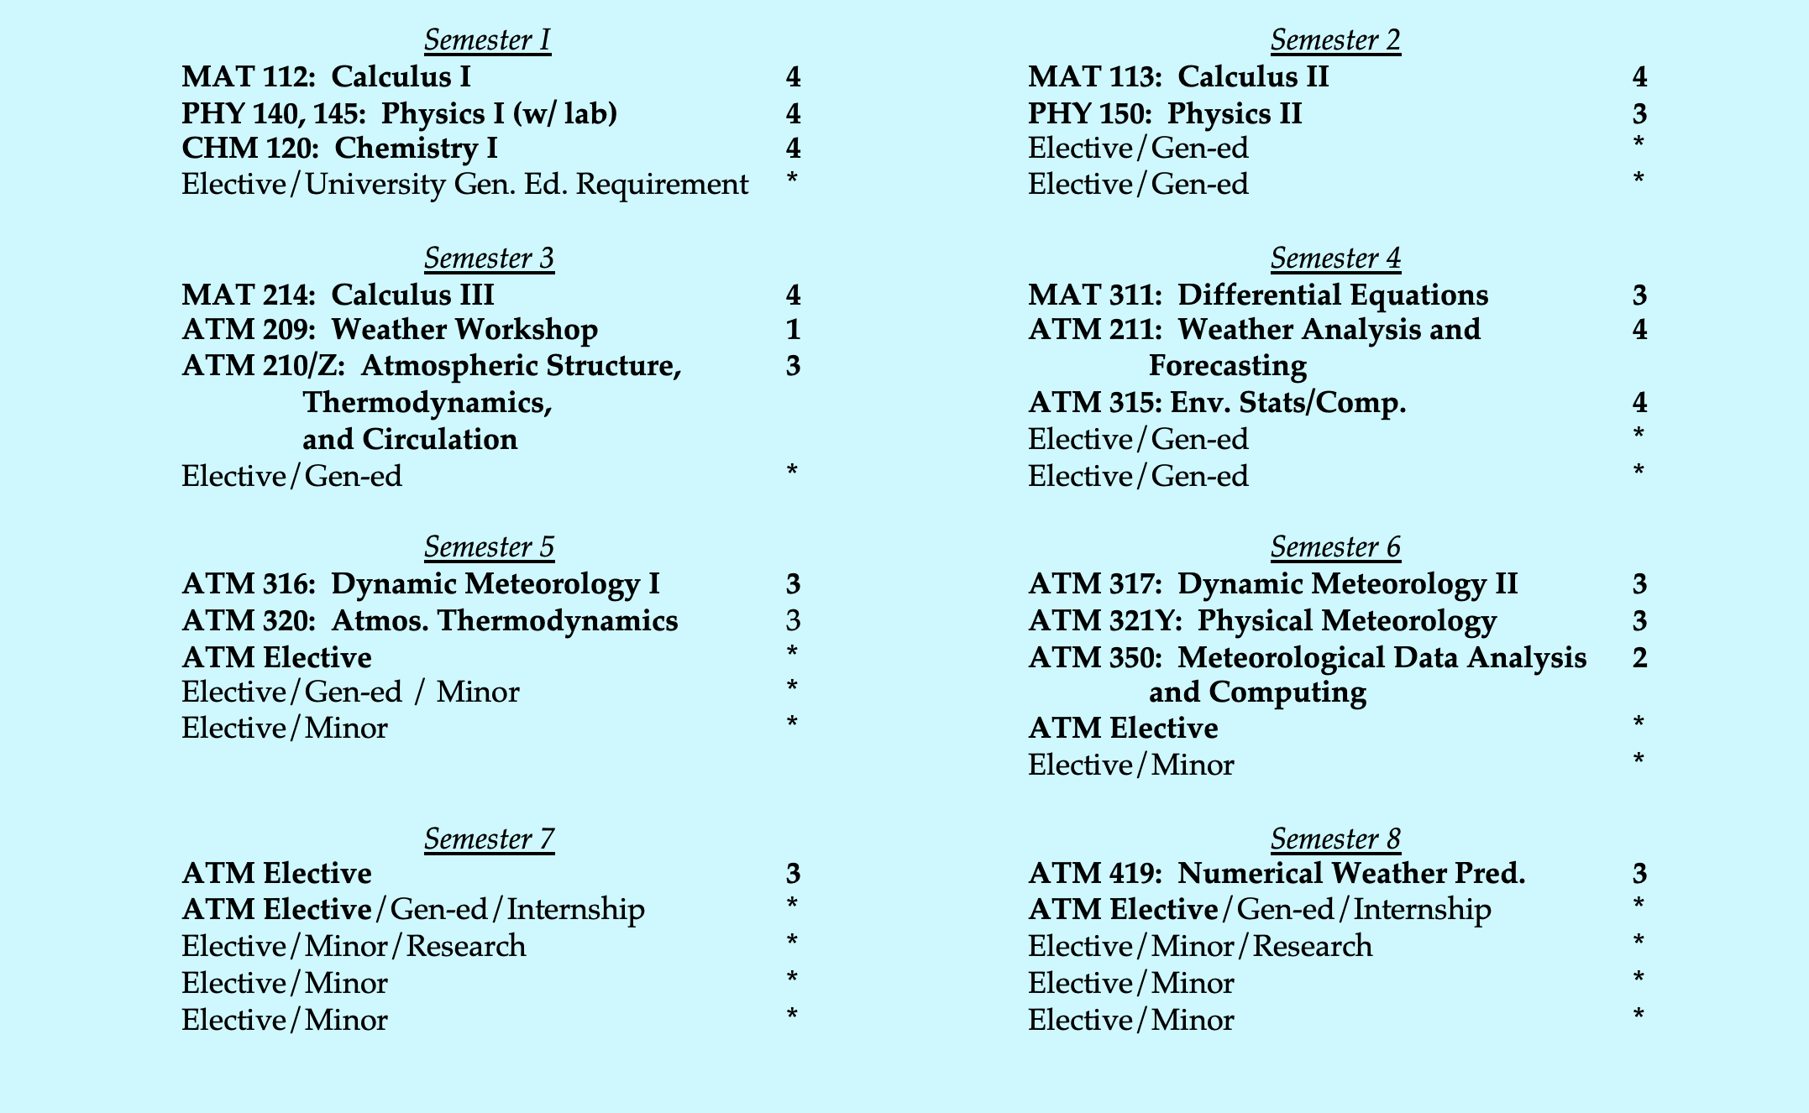
Atmospheric Science B.S.

Slide 29
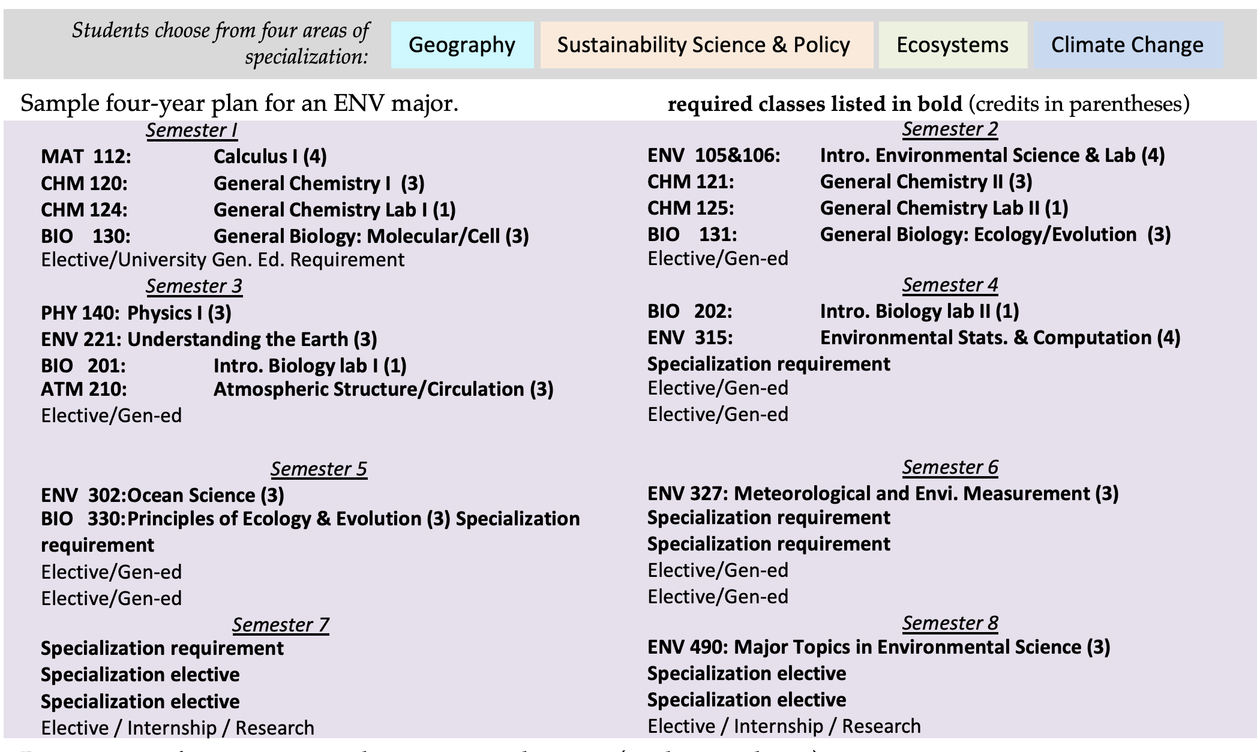
Environmental Science B.S.

Slide 30
Atmospheric Science Honors Program
Environmental Science Honors Program
•Apply junior year
-Email DAES UG director, Justin Minder
-Two letters of recommendation
•Requirements
-Six additional credits of ATM electives (300- or higher)
-Six credits of research (ATM 499):
•Research
-Work with one or more faculty on a two- semester research project
-Thesis, and present to department
•Maintain 3.25 cumulative GPA, 3.50 major GPA
•Apply junior year
-Email DAES UG director, Justin Minder
-Two letters of recommendation
•Requirements
-MAT 113 (Calculus II)
-Additional specialization elective
-Six credits of research (ENV 498):
•Research
-Work with one or more faculty on a two- semester research project
-Thesis, and present to department
•Maintain 3.25 cumulative GPA, 3.50 major GPA

Slide 31
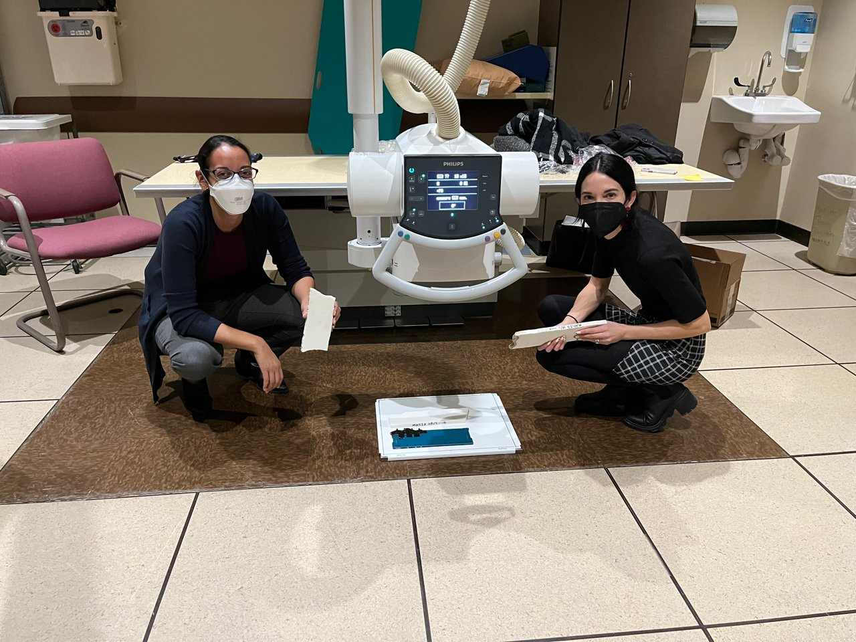
Recent undergrad research in Atmospheric and Environmental Sciences

Slide 32
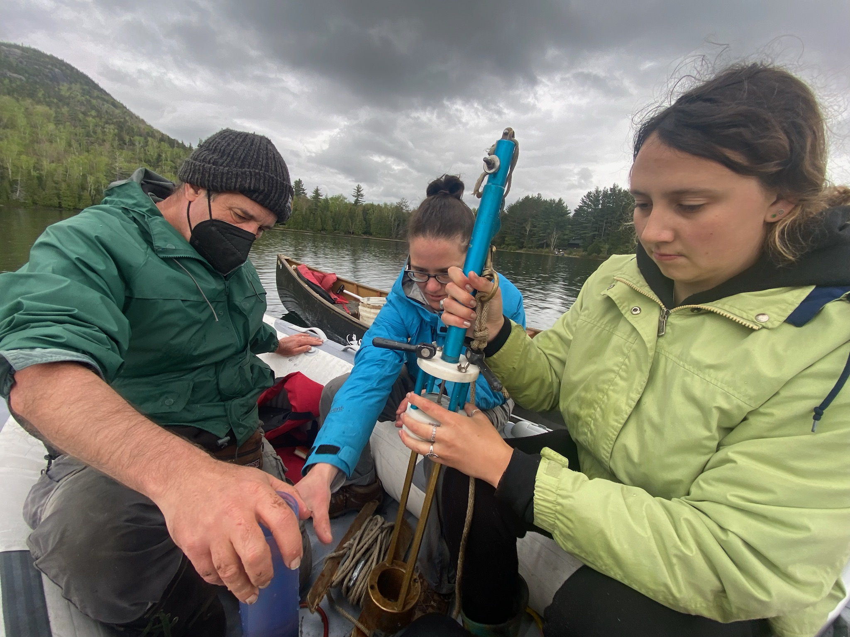
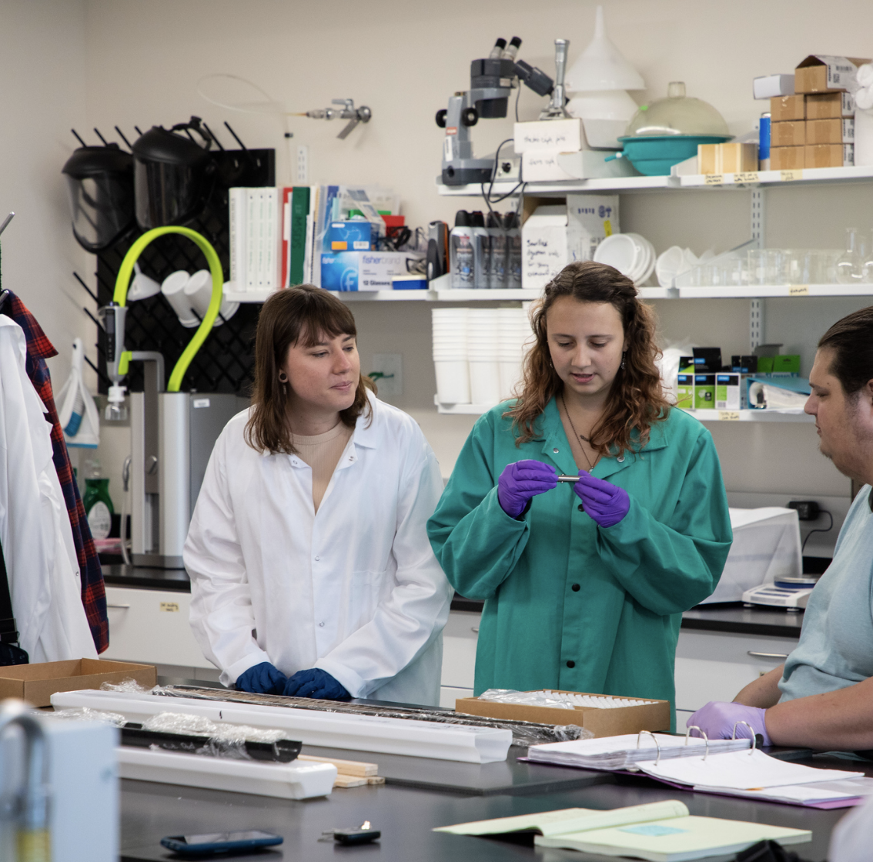
Recent undergrad research in Atmospheric and Environmental Sciences

Slide 33
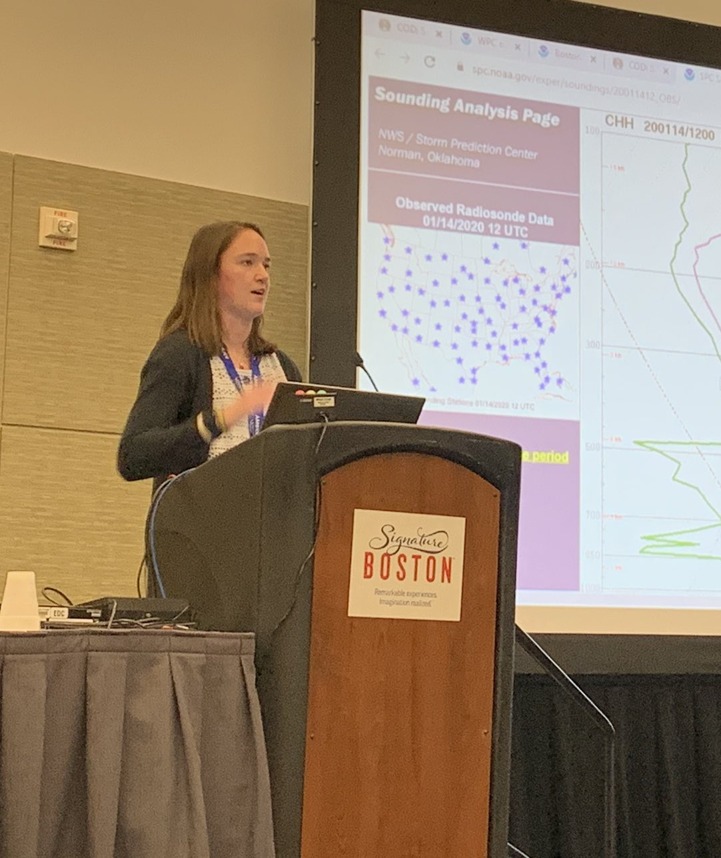
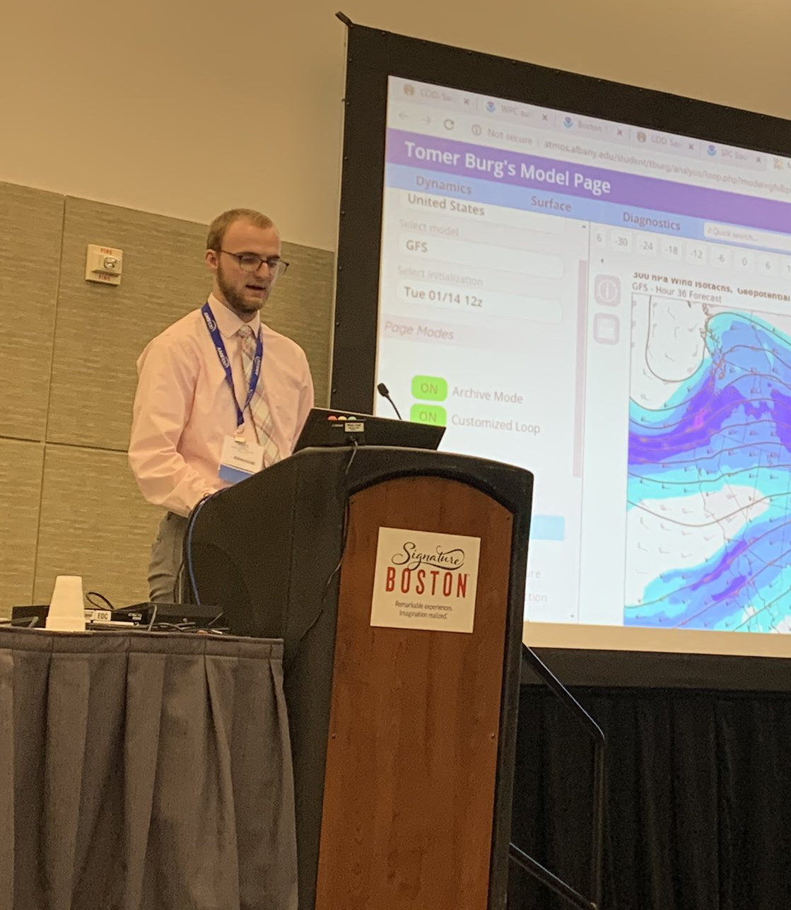
Recent undergrad research in Atmospheric and Environmental Sciences

Slide 34
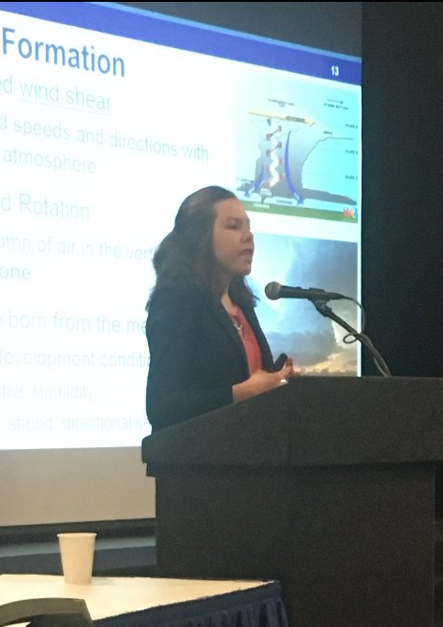
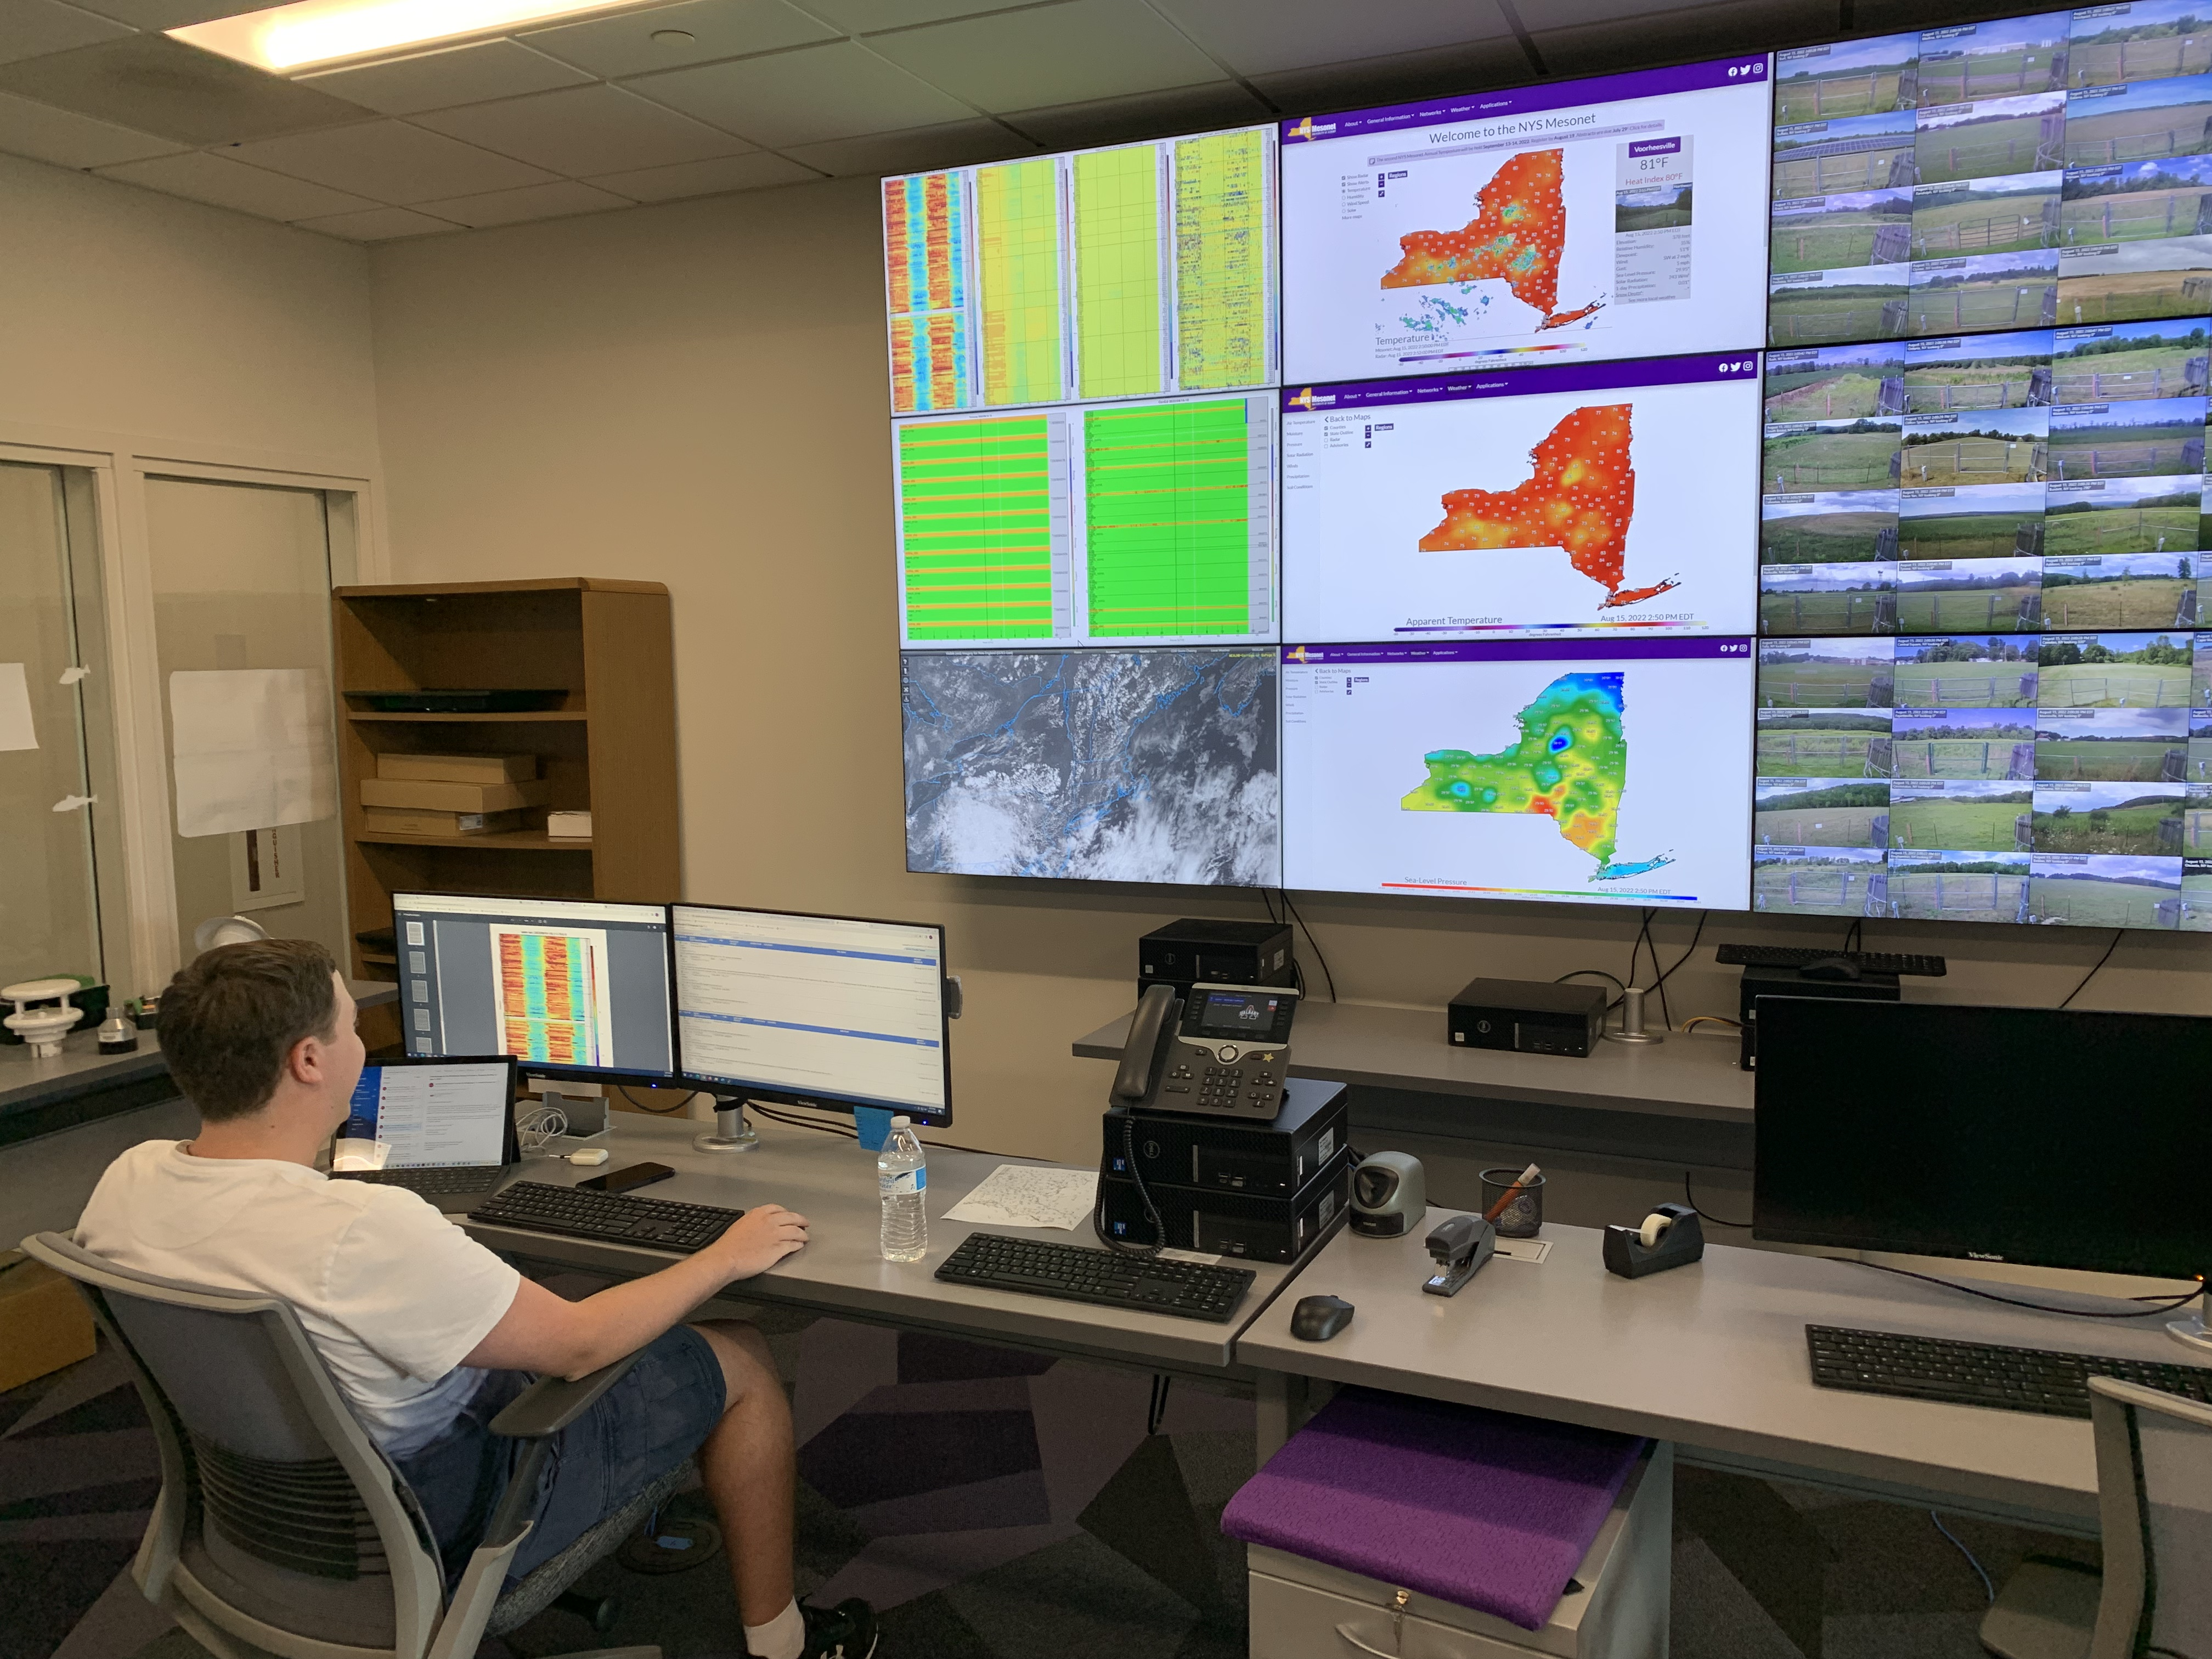
Recent undergrad research in Atmospheric and Environmental Sciences

Slide 35


Questions?
DAES Director of Student Engagement and Recruitment: Ross Lazear – rlazear@albany.edu
DAES Undergraduate Program Director: Justin Minder – jminder@albany.edu

Slide 36









Where some of our recent graduates are now:
Graduate school
National Weather Service
United States Geological Survey
US & NY Environmental Protection
Renewable energy companies
Local and national media
New York State Mesonet
Environmental Consulting
Emergency Preparedness
Risk assessment in Insurance/Financial sectors

Slide 37





Demand for atmospheric and environmental scientists
in a variety of fields
Academics
Consulting
Economics
Education
Forensics
Government
Insurance
Media
Planning
Research
Transportation
Notes:
What can I do with an atmospheric science of environment science degree and the answer is that there is a demand for atmospheric and environmental scientists in a variety of fields: consulting, insurance, transportation, research, planning, economics, education, media, forensics, and government.

Slide 38

Environmental Science B.S. specializations

