Slide 1
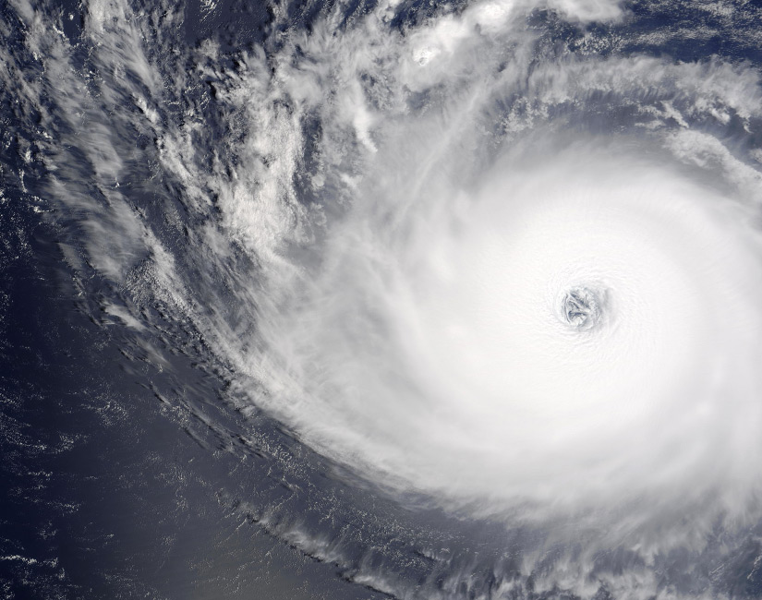
Hurricanes
Kristen L. Corbosiero
Department of Atmospheric & Environmental Sciences
University at Albany
Hurricane Floyd (1999)

Slide 2
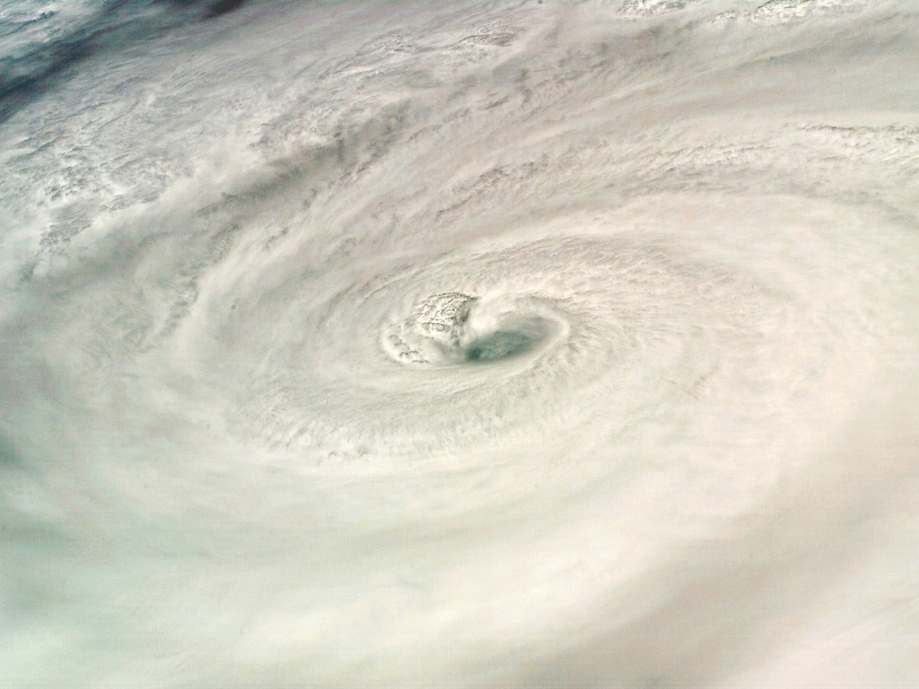
What is a hurricane?
A hurricane (typhoon = Pacific, cyclone = Indian) is a large, rotating, low pressure area with winds >74 miles per hour.

Slide 3
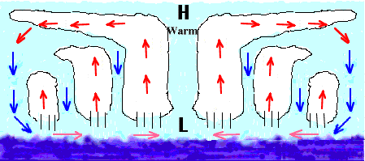
What is a hurricane?
A hurricane (typhoon = Pacific, cyclone = Indian) is a large, rotating, low pressure area with winds >74 miles per hour.
Air flows counterclockwise and inward, where it converges and rises in the eyewall, the location of the fastest winds and heaviest rains.

Slide 4
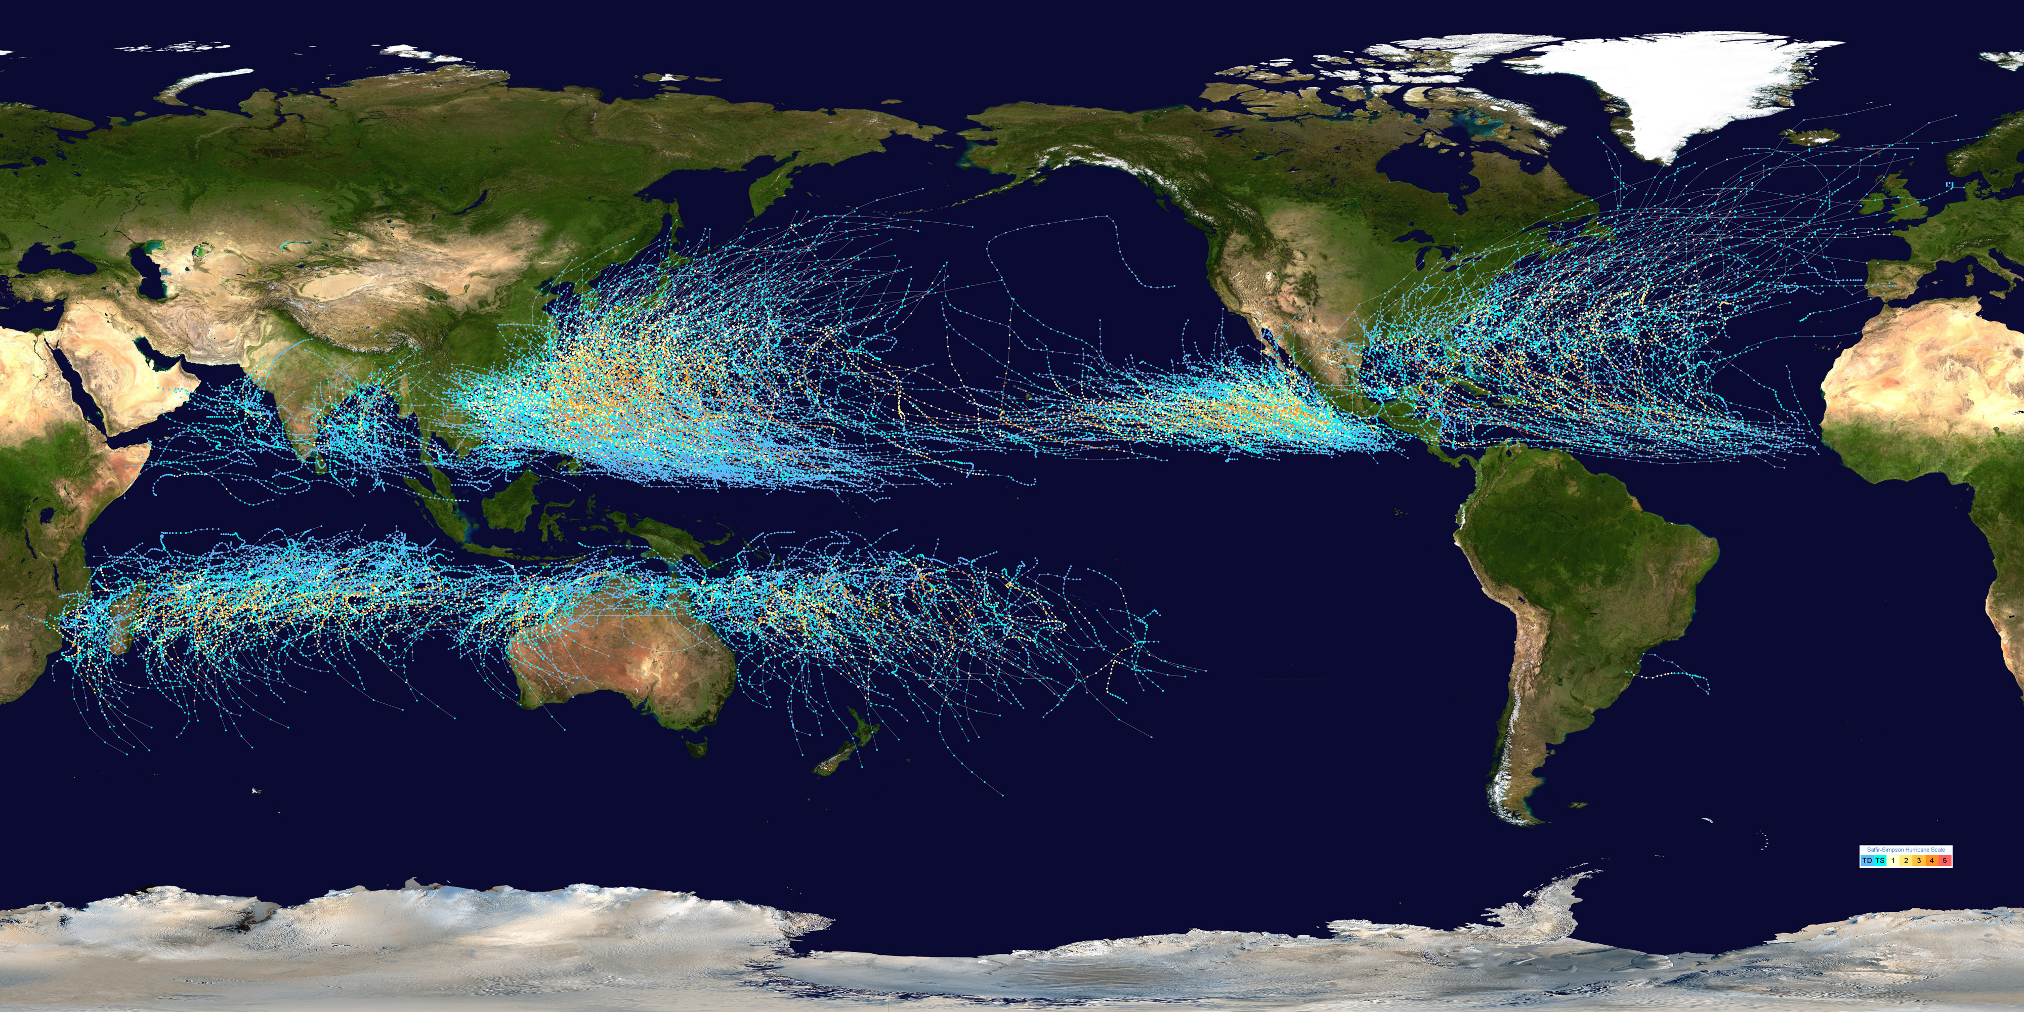
Where do hurricanes form?
Only over the tropical oceans!

Slide 5
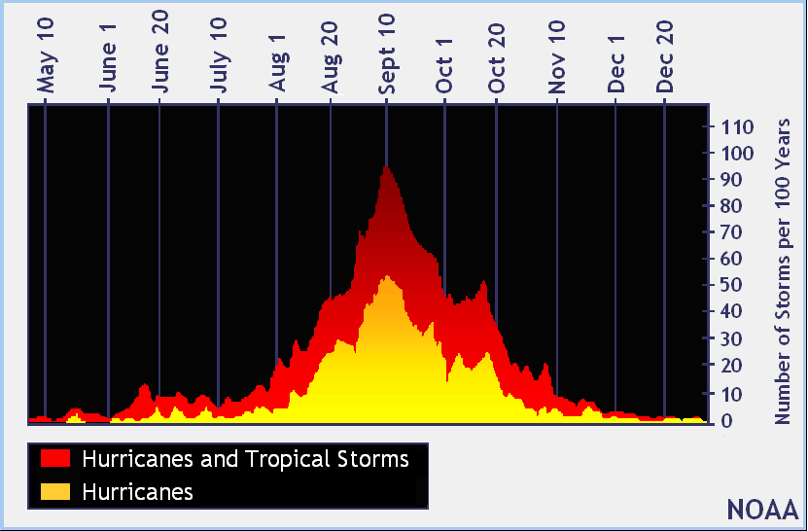
When do hurricanes form?
During the late summer months

Slide 6
How many hurricanes form each year?
On average, seven in the Atlantic, but there is a lot of variability from year to year!

Slide 7
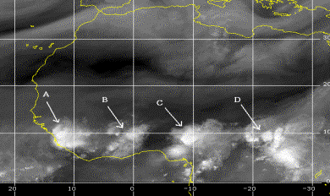
What is necessary for a hurricane to form?
1) A large group of strong thunderstorms

Slide 8
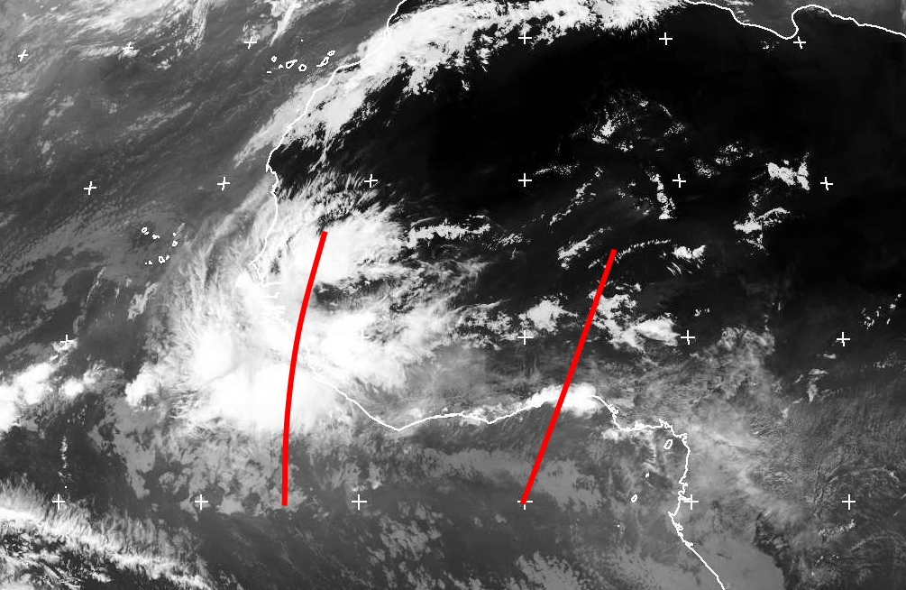
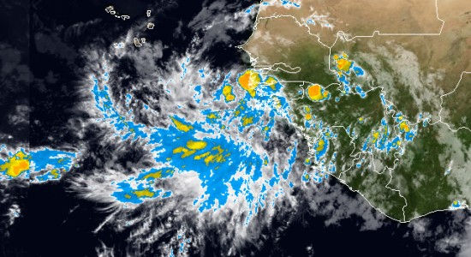
What is necessary for a hurricane to form?
1) A large group of strong thunderstorms

Slide 9
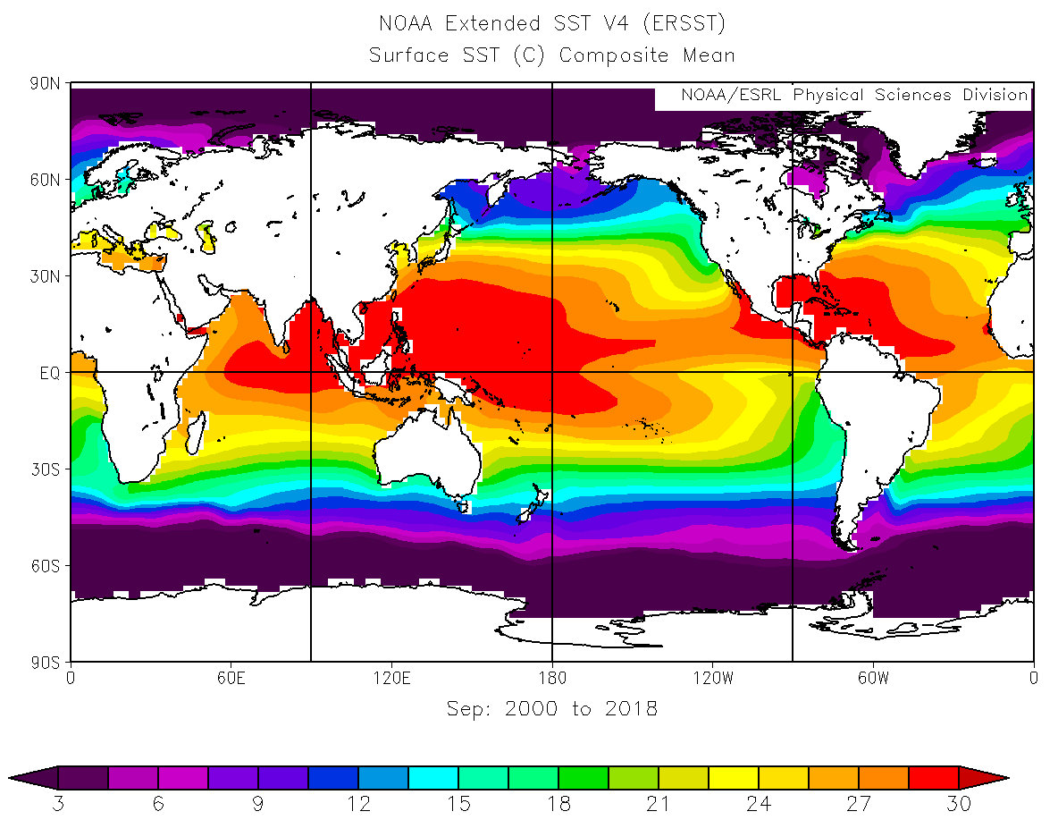
What is necessary for a hurricane to form?
2) Warm sea surface temperatures ( Greater than 26ºC or 79ºF)

Slide 10
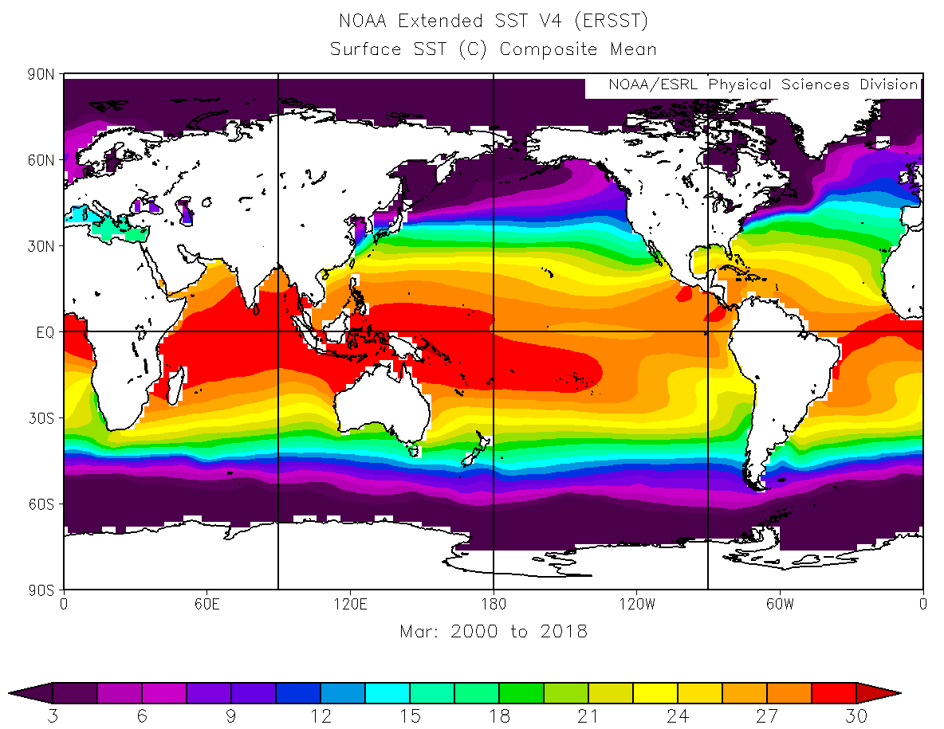
What is necessary for a hurricane to form?
2) Warm sea surface temperatures ( Greater than 26ºC or 79ºF)

Slide 11
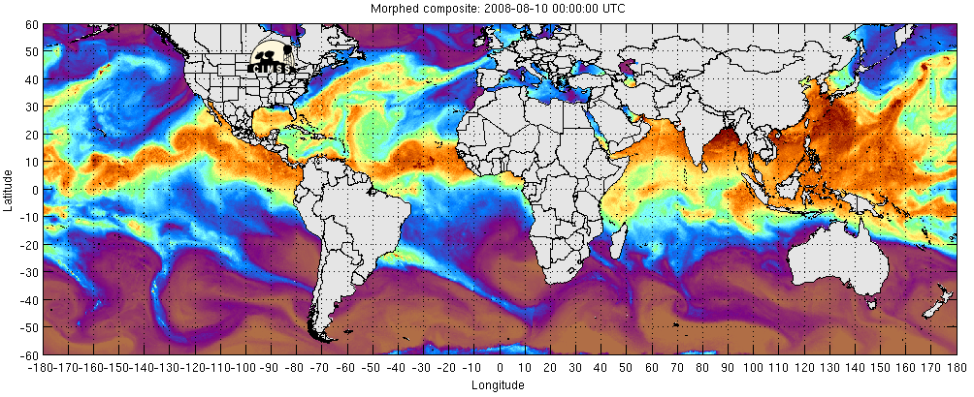
What is necessary for a hurricane to form?
3) A lot of moisture in the air

Slide 12
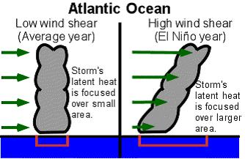
What is necessary for a hurricane to form?
4) Weak winds above the hurricane

Slide 13
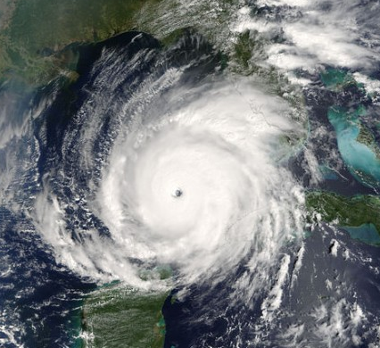
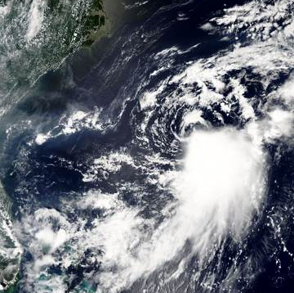
What is necessary for a hurricane to form?
4) Weak winds above the hurricane

Slide 14
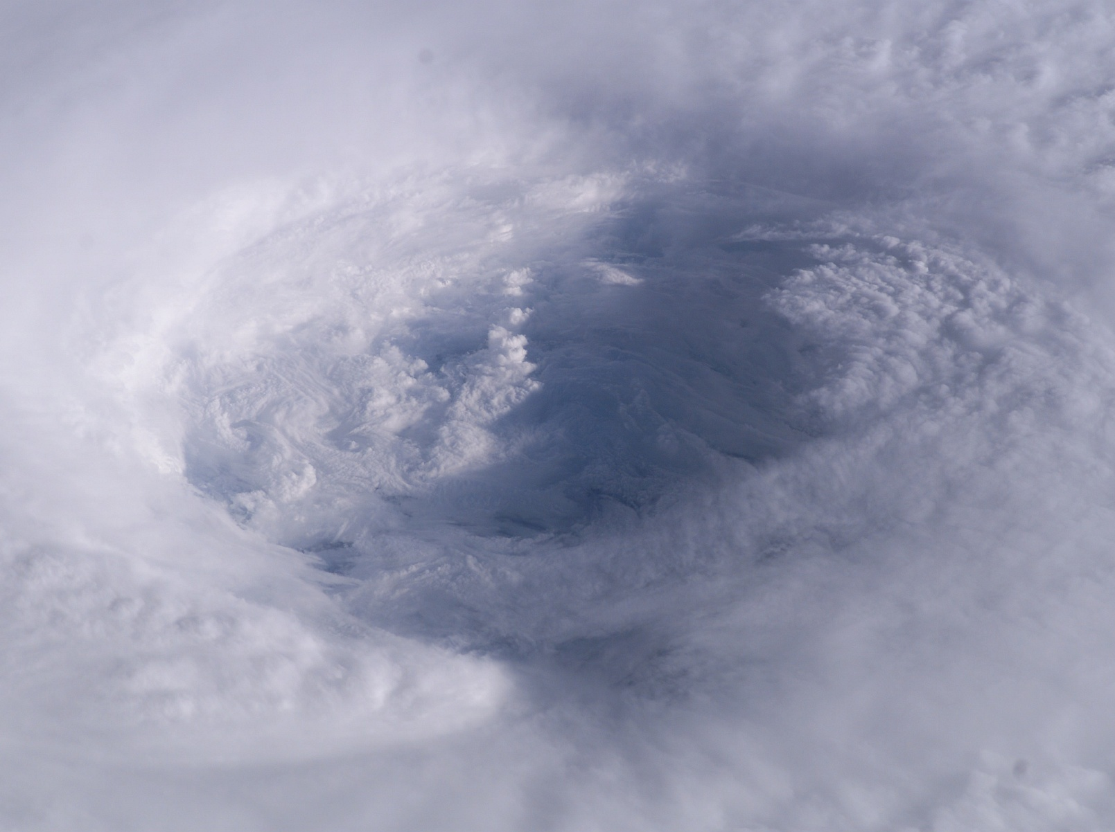
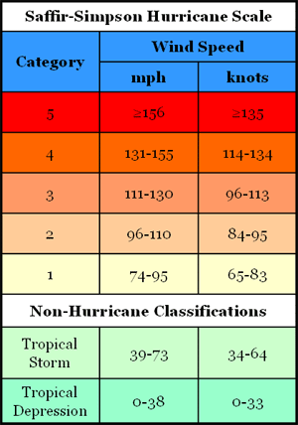
If all four factors are in place, a tropical depression can form and strengthen into a named tropical storm.

Slide 15
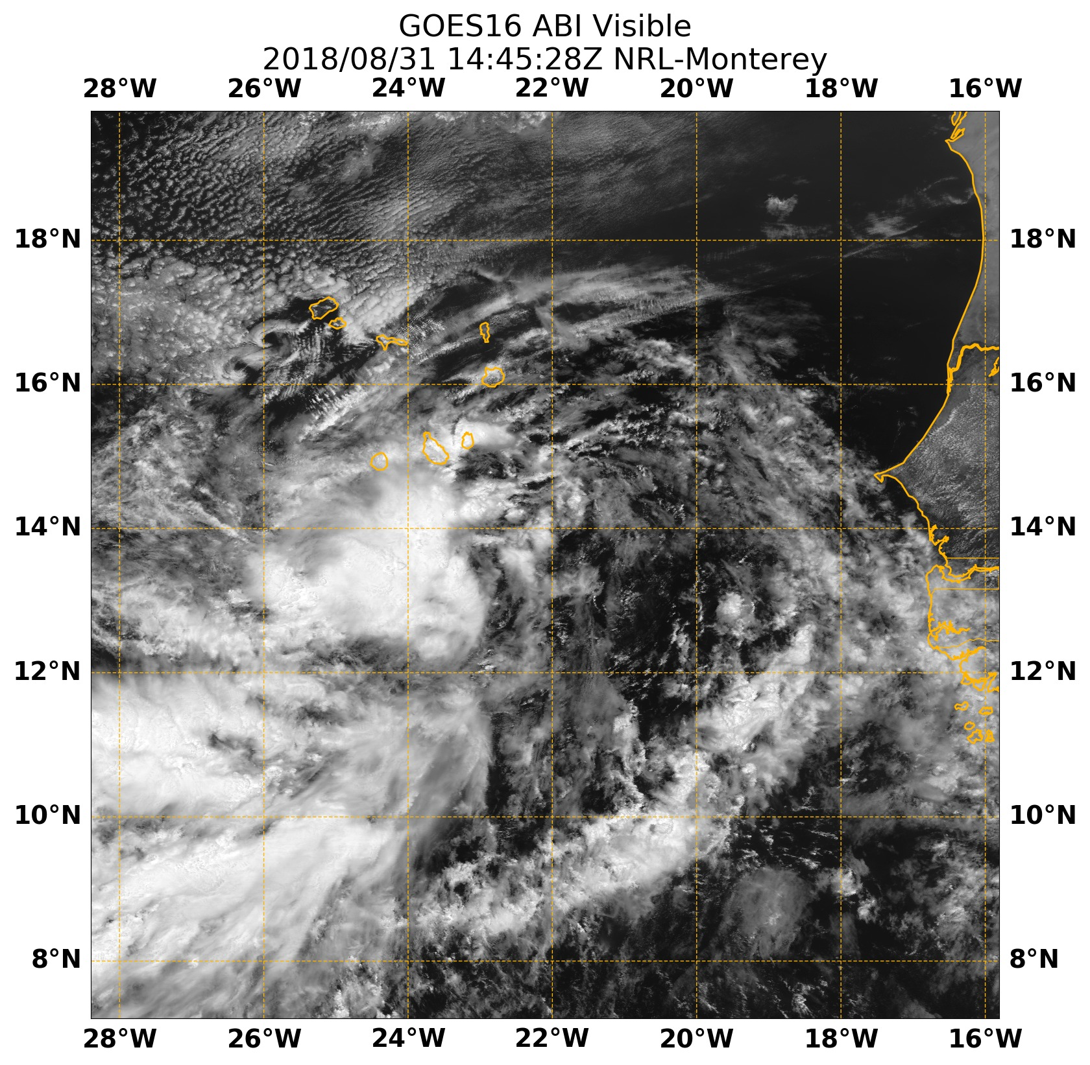
If all four factors are in place, a tropical depression can form and strengthen into a named tropical storm.
Tropical Depression #6

Slide 16
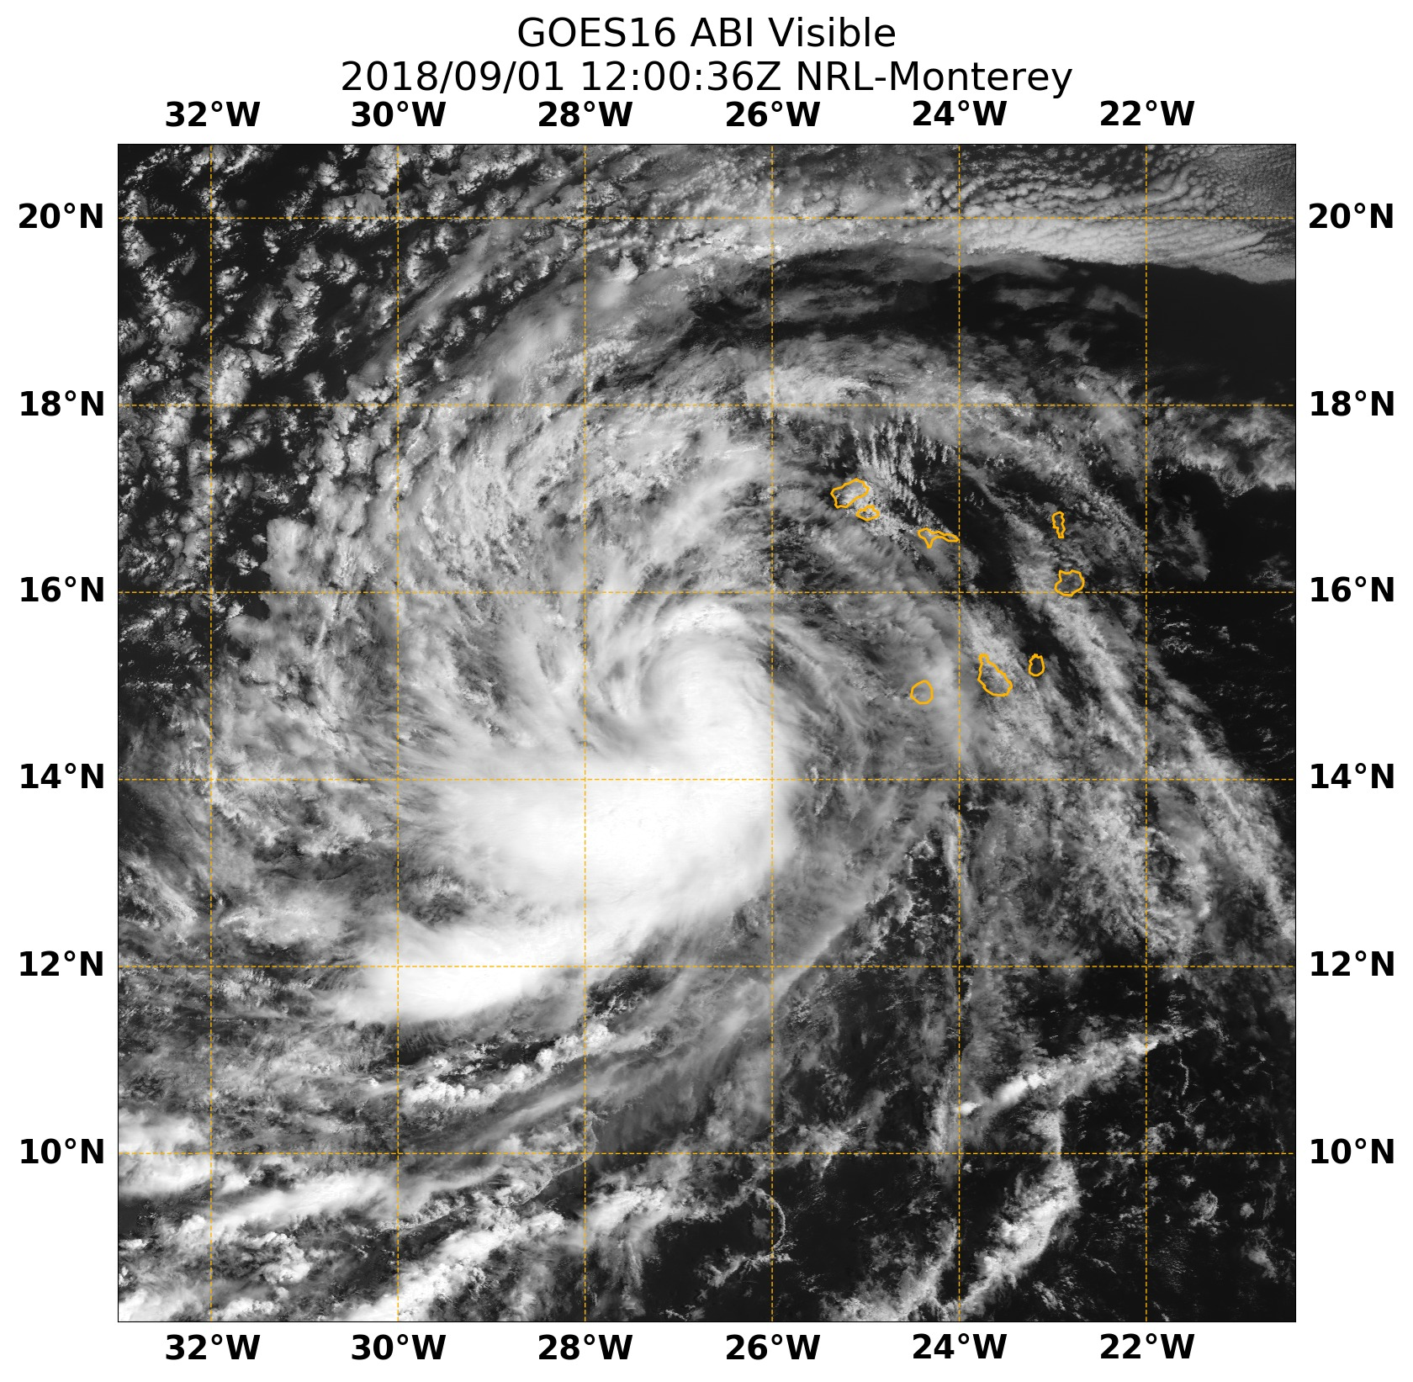
If all four factors are in place, a tropical depression can form and strengthen into a named tropical storm.
Tropical Storm Florence
Tropical Depression #6

Slide 17
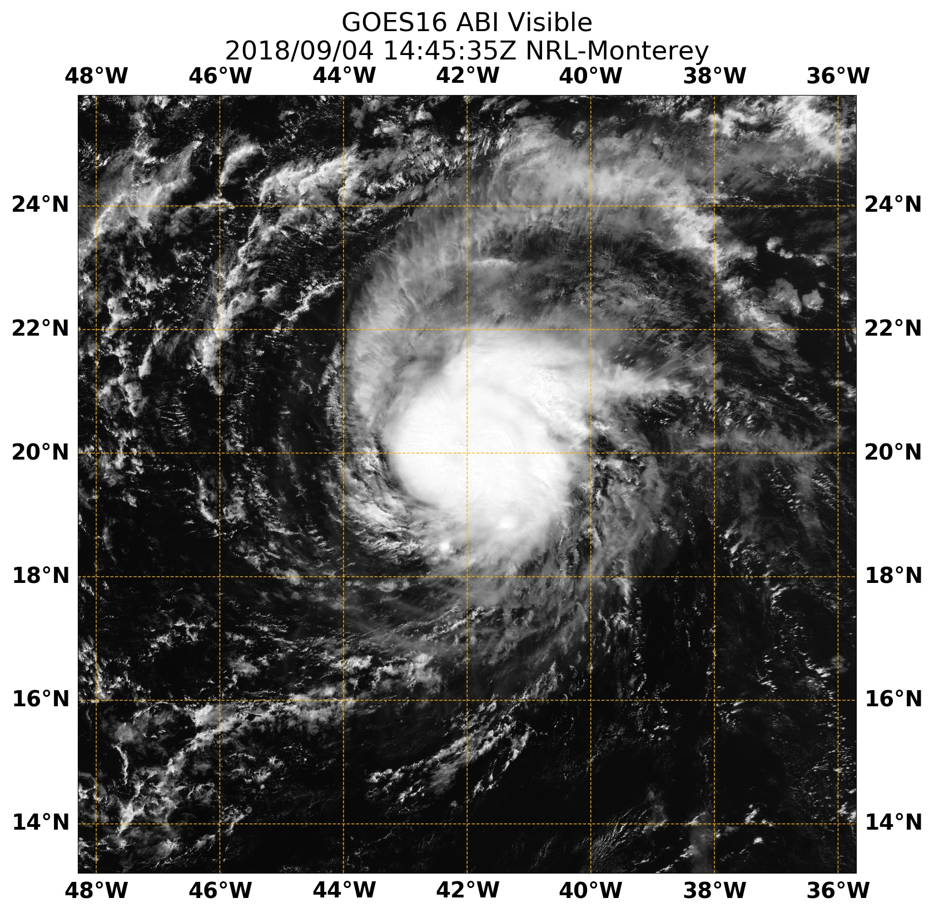
Category 1 Florence

Slide 18
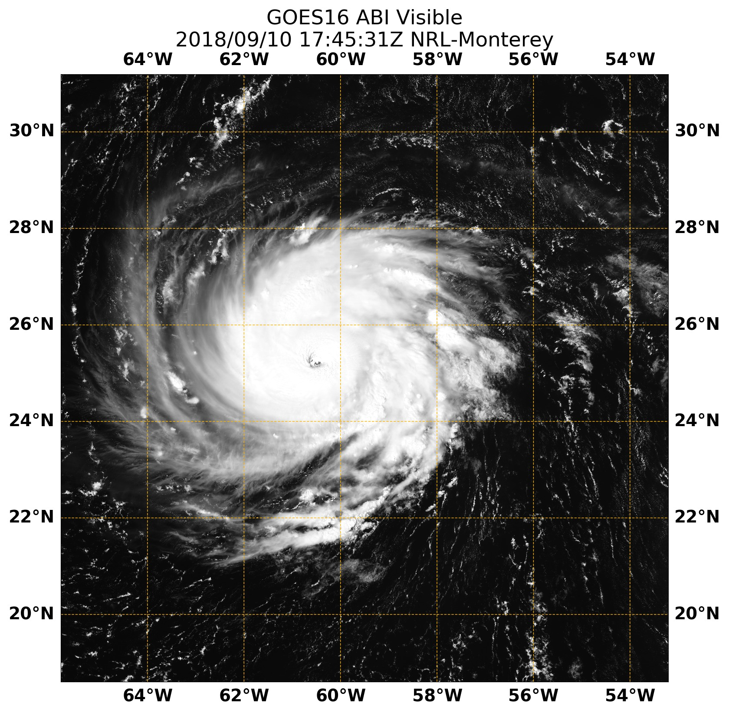
Category 1 Florence
Category 4 Florence

Slide 19
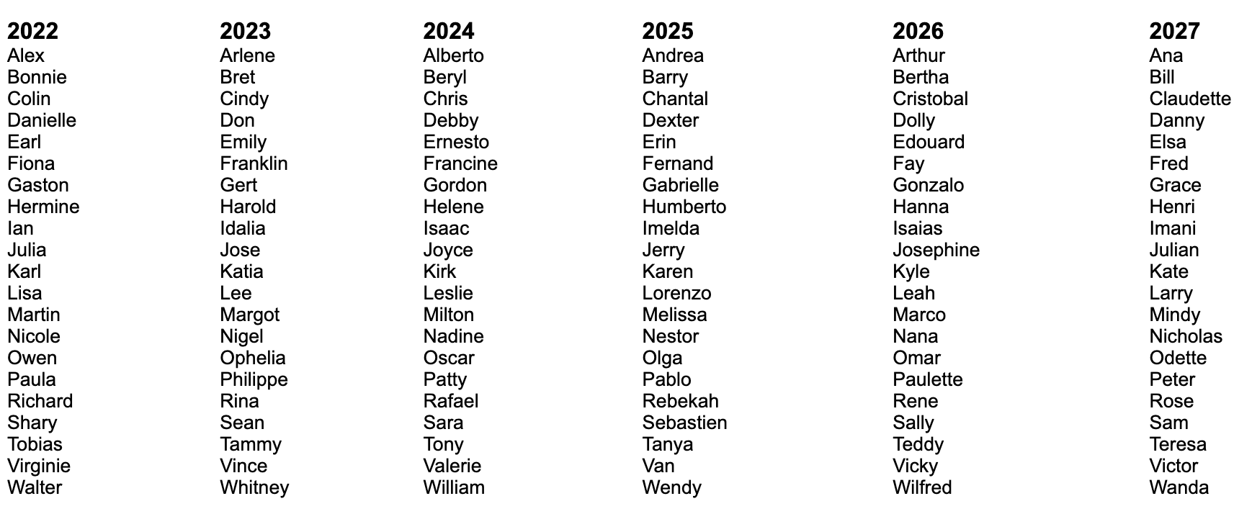
Atlantic Ocean hurricane names repeat every six years, unless the name is retired because the storm was severe and destructive.

Slide 20
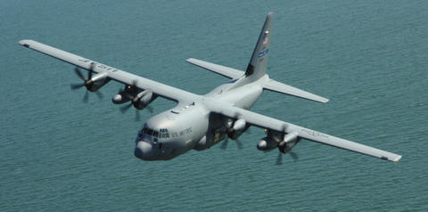
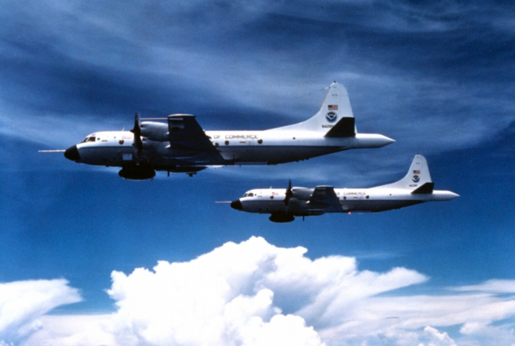
Air Force Reserve C-130
NOAA P-3s

Slide 21
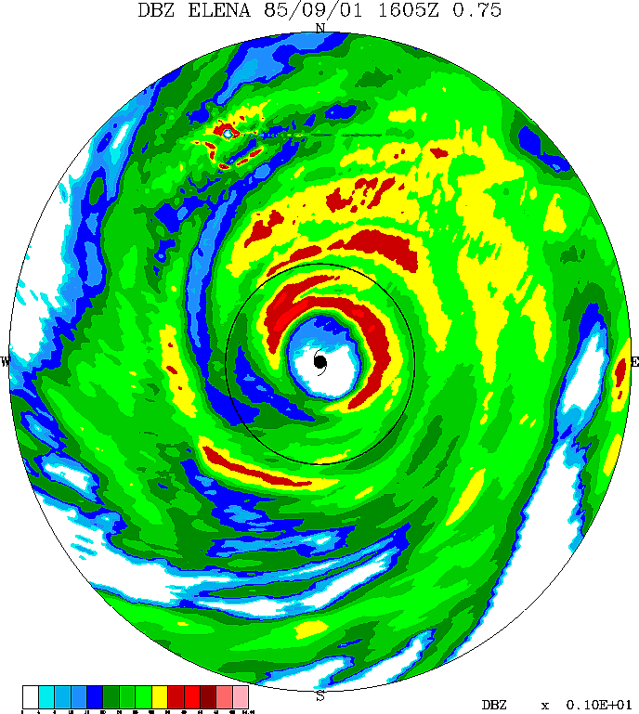
“Figure 4” flight path and precipitation structure in Hurricane Elena (1985)
Wind speed and vertical air motion at 1 mile above the ground along the southern flight path
Tangential wind speed (m s⁻¹)
Vertical wind speed (m s⁻¹)
Corbosiero et al. (2005, 2006)

Slide 22
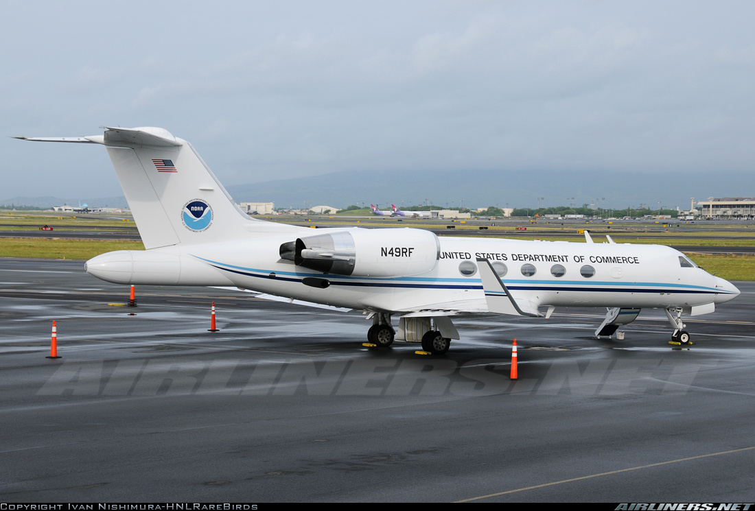
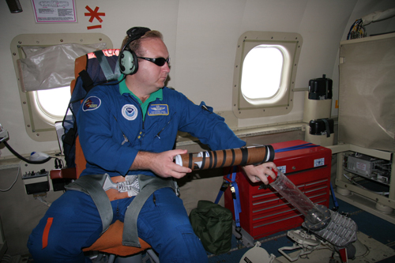
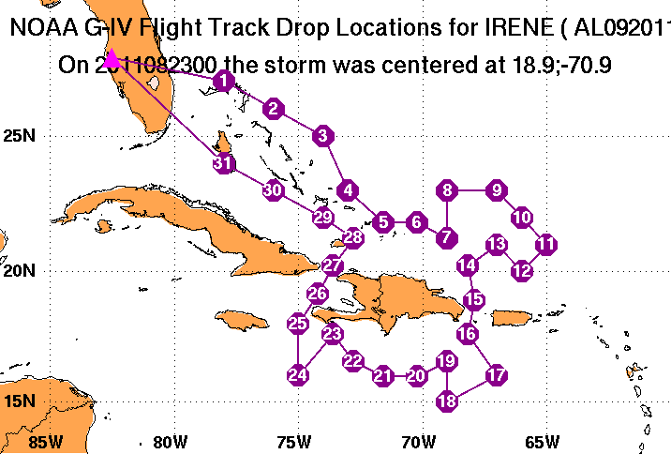
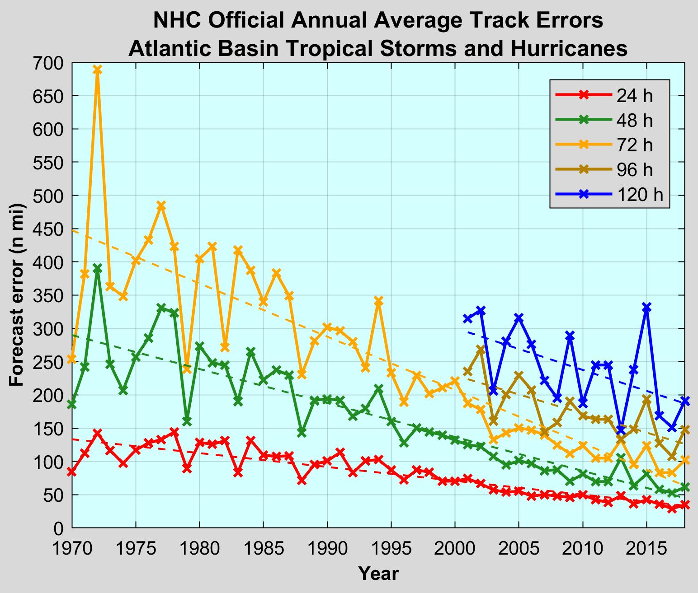
NOAA G-IV

Slide 23
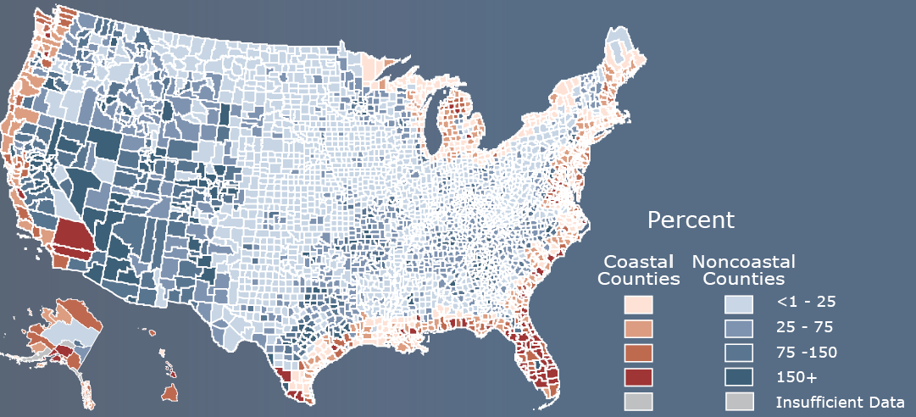
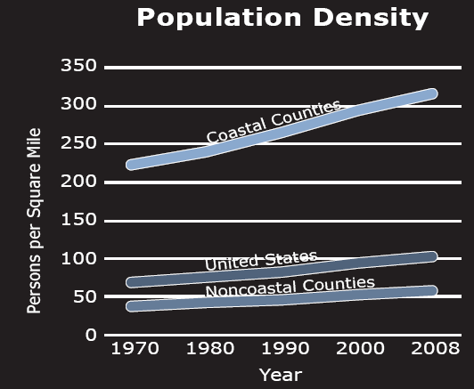
US Census Bureau NOAA NOS
Population change 1980-2010
Coastal counties contain 53% of the US population, yet account for only 17% of the US land area
Five of the six counties with the fastest growing coastal populations are in Florida and Georgia

