Slide 1


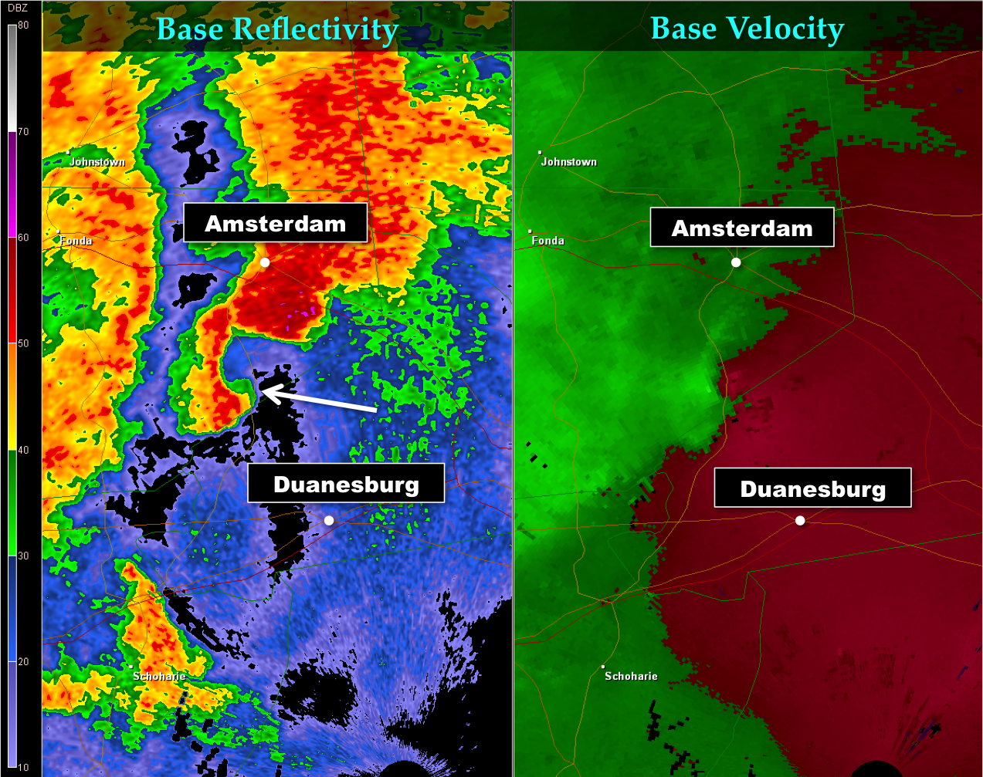
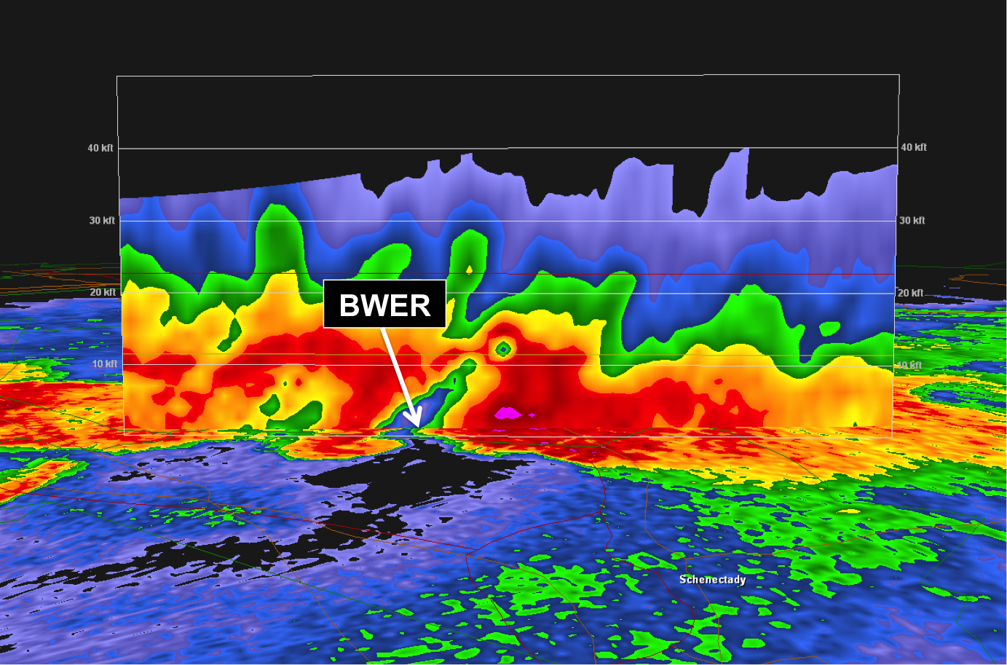
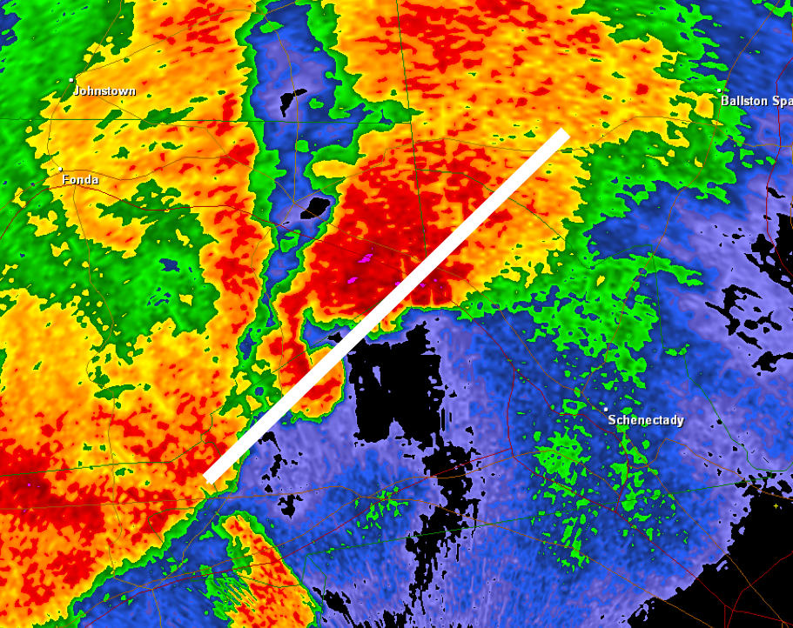
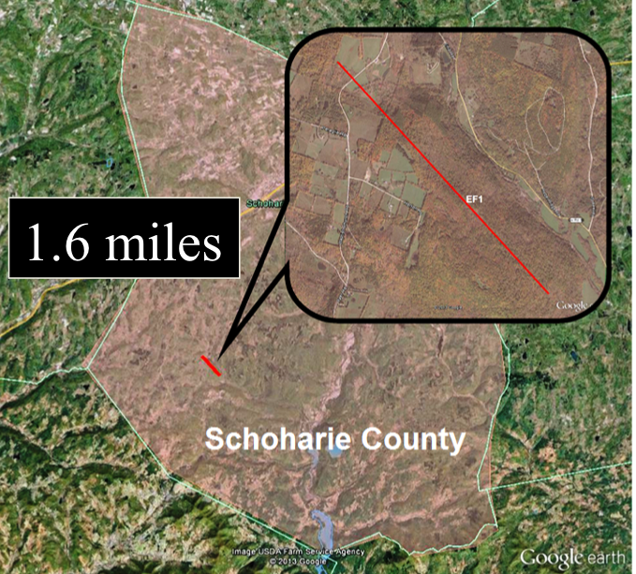
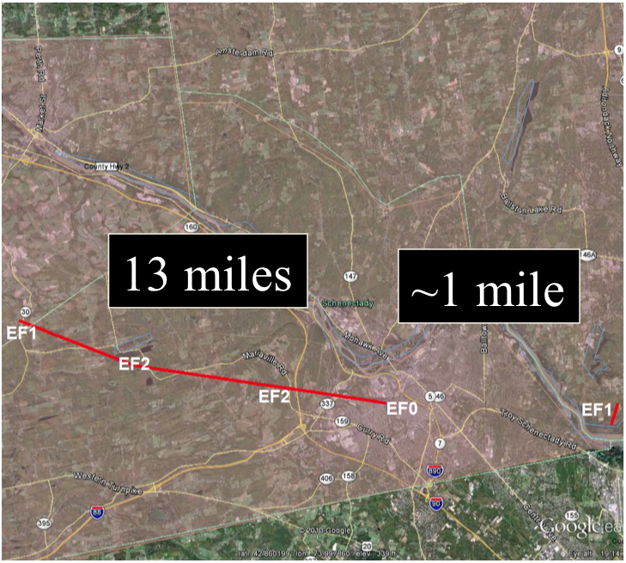
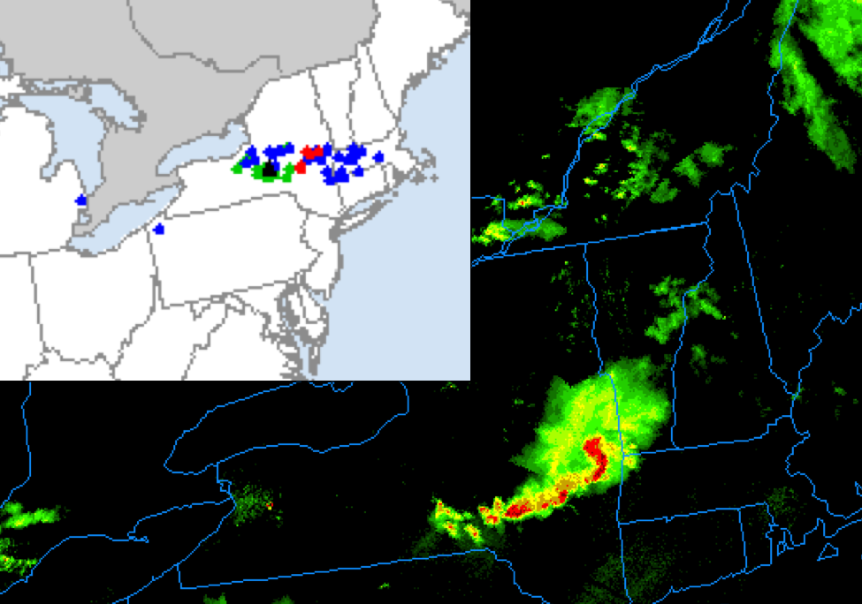
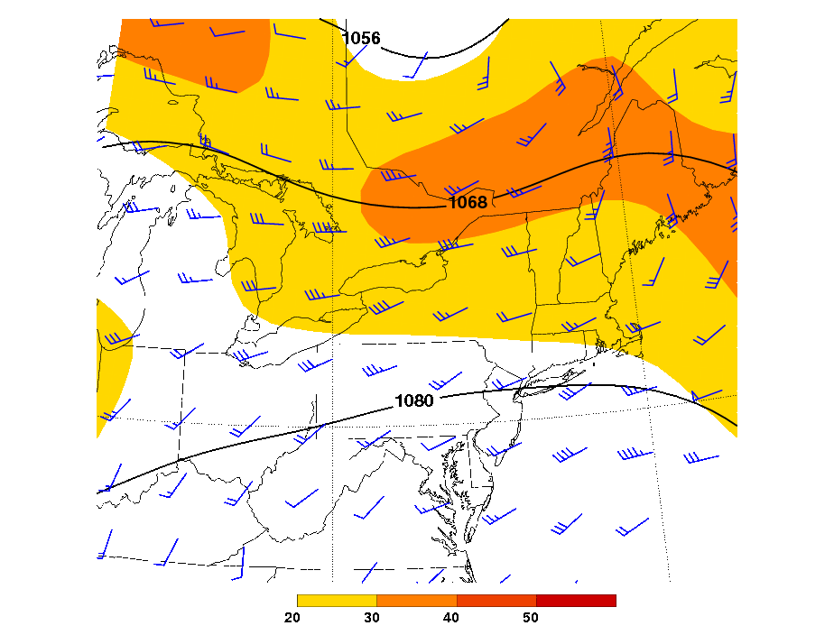
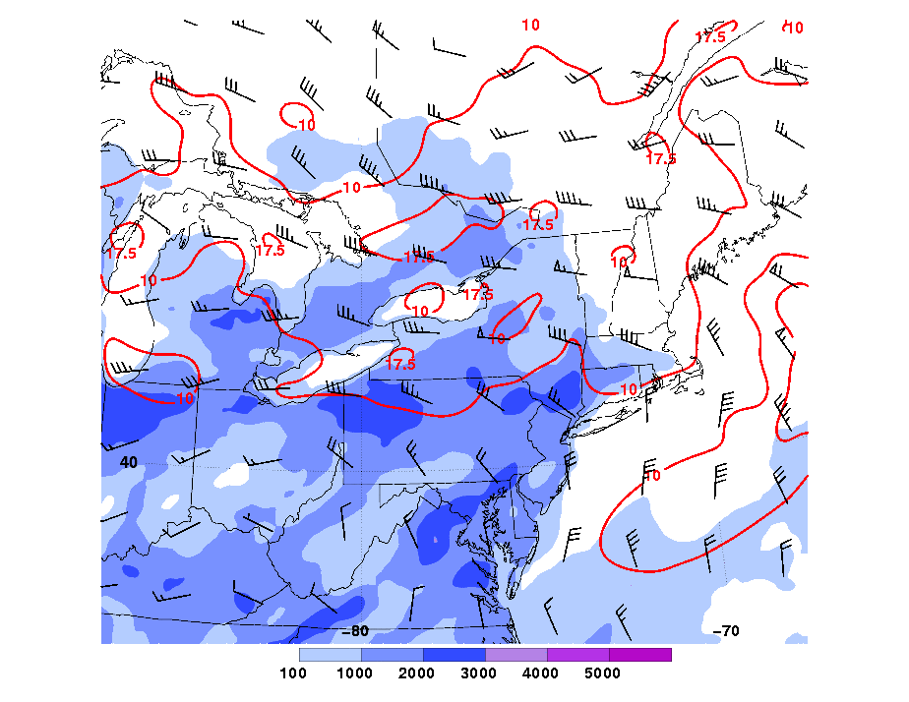
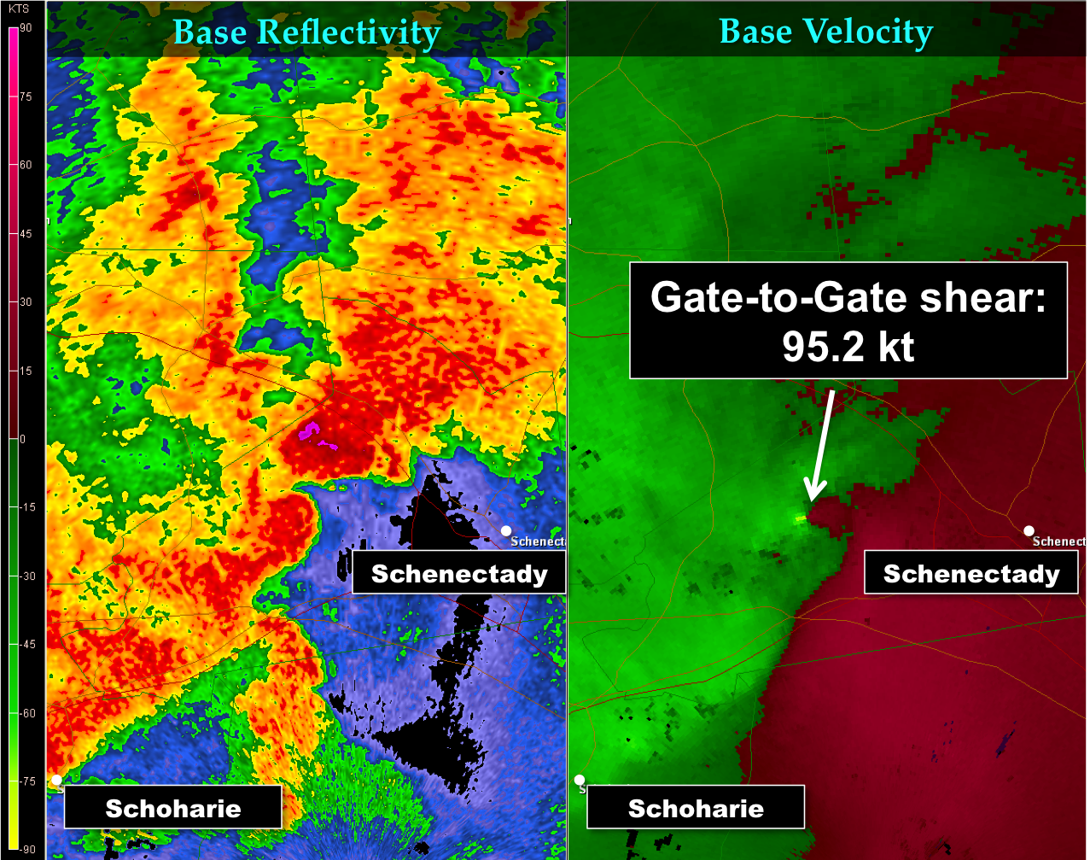
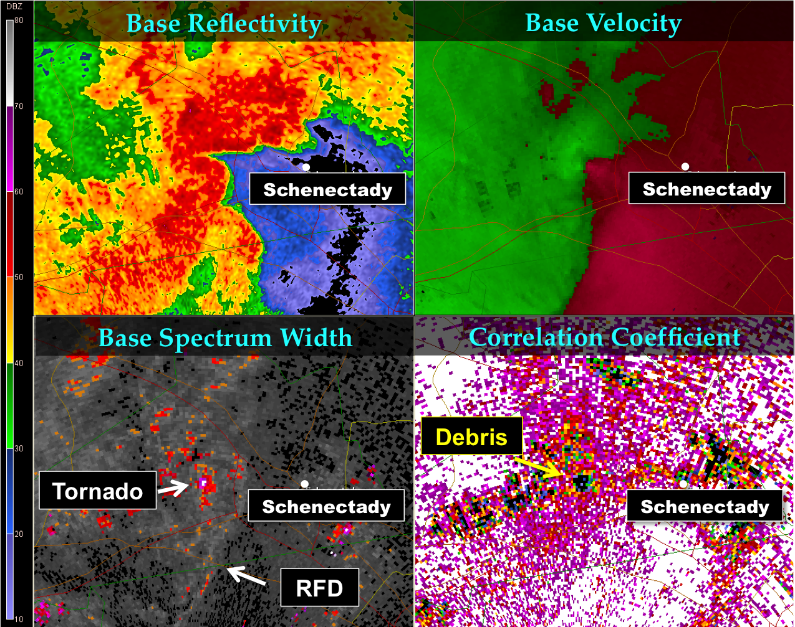
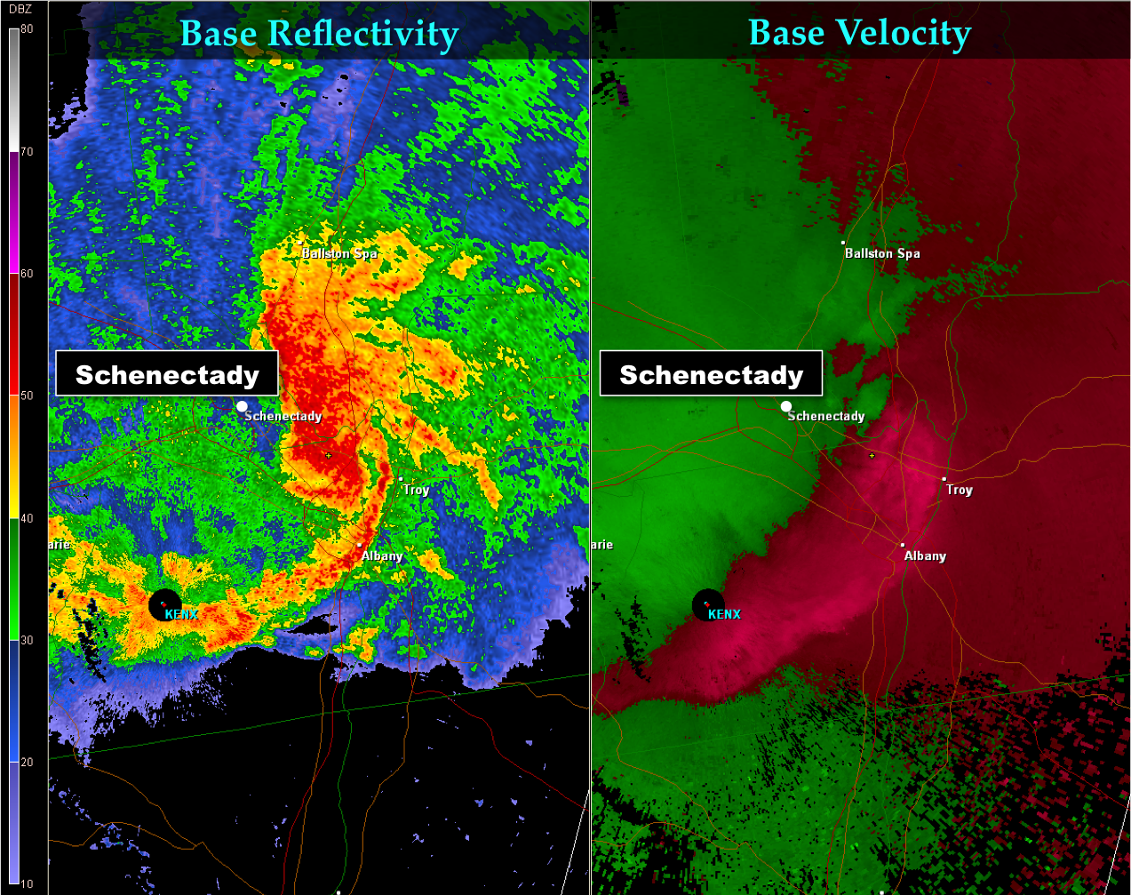
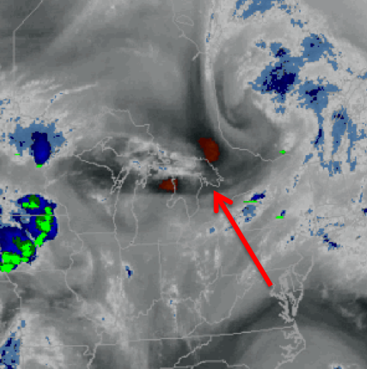
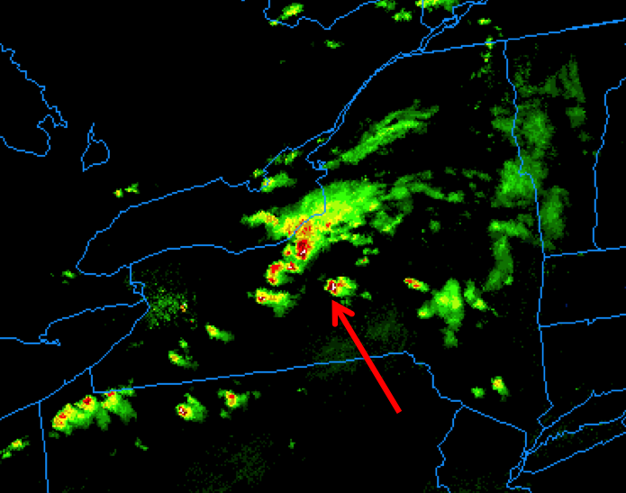
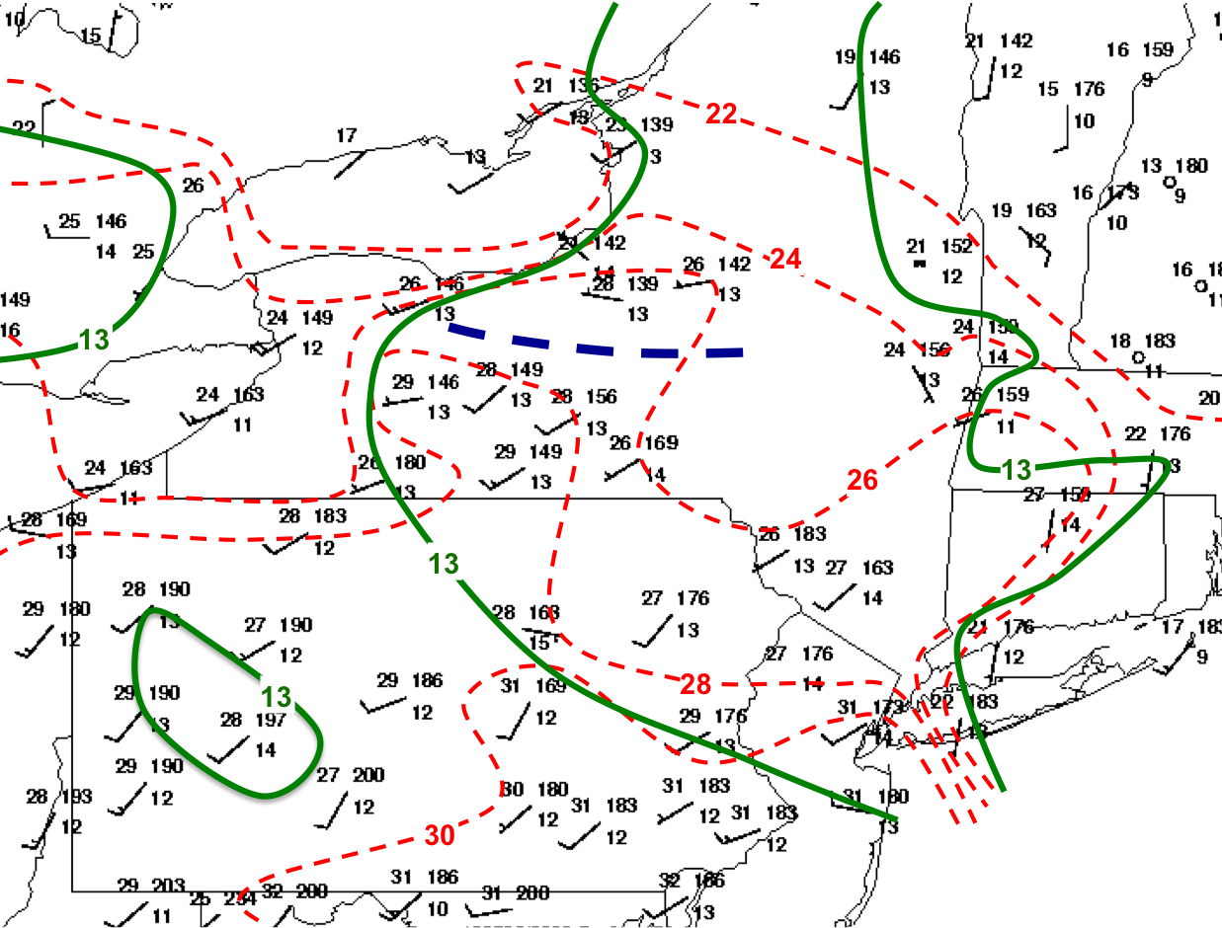
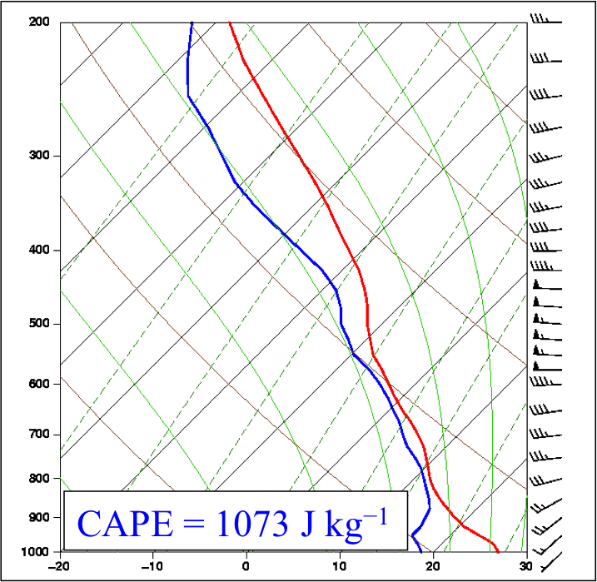
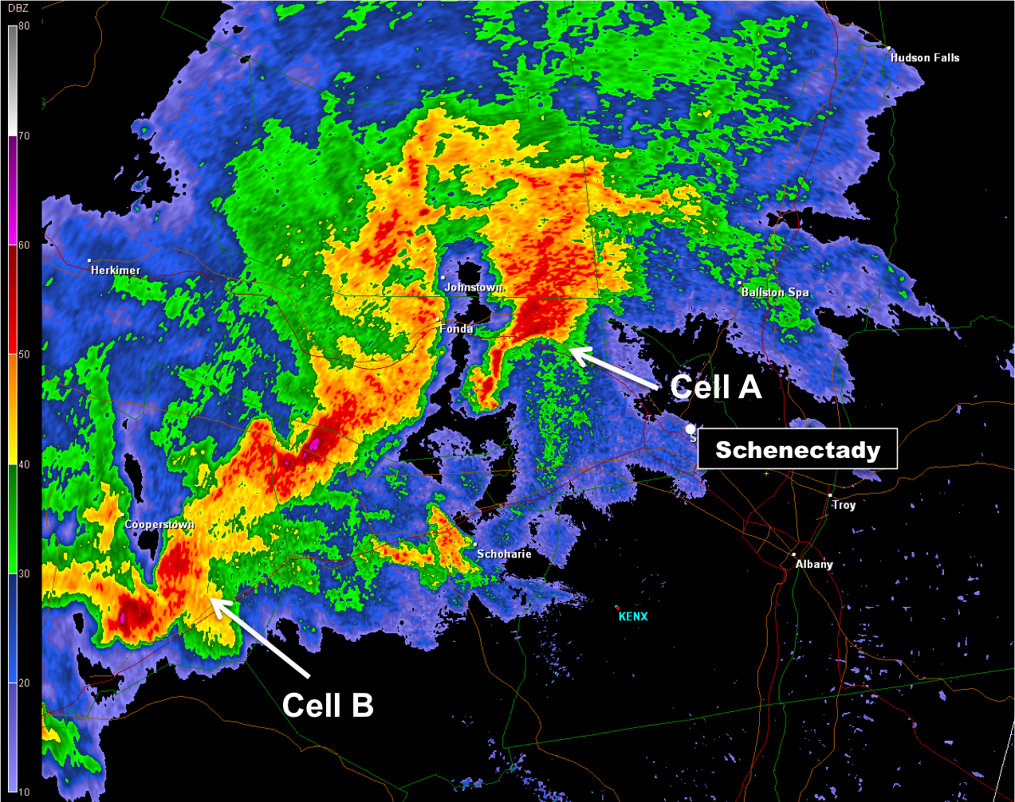
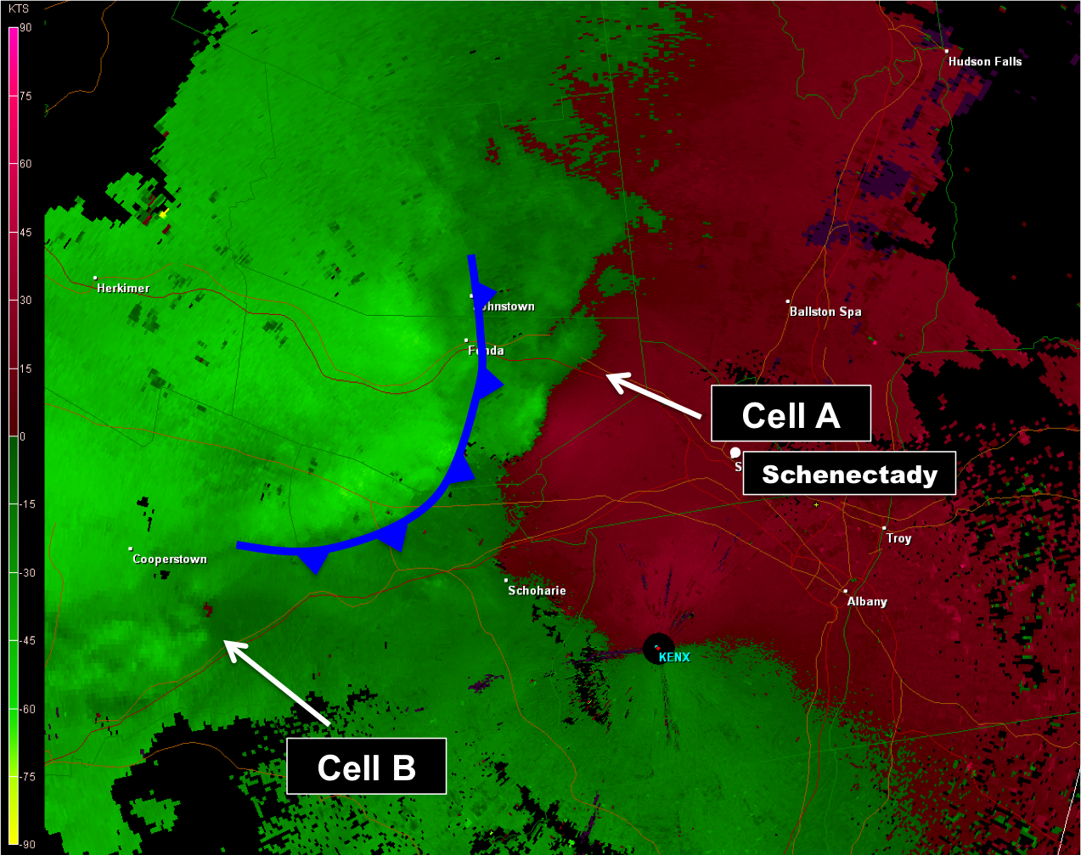
A Multiscale Analysis of the 29 May 2013 Severe Weather Outbreak near Albany, New York
Radar Evolution cont.:
Nicholas D. Metz¹ and Ross A. Lazear²
¹Hobart and William Smith Colleges ²University at Albany, SUNY
Introduction:
On the afternoon of 29 May 2013, convection developed over western and central New York. Initially this convection featured isolated supercells located in close proximity to a disorganized mesoscale convective system (MCS). These supercells produced three tornadoes, an EF1 in Schoharie County, an EF1 in Saratoga
Source: NWS Albany
County, and an EF2 in Montgomery and Schenectady Counties that had a path length of thirteen miles (Fig. 1). The convection eventually grew
Fig. 1a
Fig. 1b
2242Z/29
Source: NCDC
Fig. 9
2247Z/29
Source: NCDC
Fig. 10
upscale as it passed Albany, and the resulting bow echo produced numerous severe wind reports across eastern New York and western Massachusetts (Fig. 2). This convection evolved in a region of relatively complex topography (e.g., Bosart et al. 2006).
Just prior to tornadogenesis at 2242Z/29 (Fig. 9), rotation within the mesocyclone of Cell A contracted and intensified in the proximity of the hook
At 2242Z/29, the gust front associated with growing MCS was located only ~10 km west of the supercell (Fig. 9)
The National Weather Service in Albany identified 2247Z/29 as the time of EF2 tornadogenesis in Florida, NY
Vertical cross section of reflectivity at the time of tornadogenesis reveals a classic supercell structure, with a bounded weak echo region (BWER) and base reflectivity values >60 dBZ in the forward flanking portion of supercell (Fig. 10)
2330Z/29
Source: MMM UCAR and SPC
Fig. 2
Synoptic and Mesoscale Overview:
Fig. 3
20Z/29
Fig. 4
20Z/29
Convection formed in the equatorward entrance region of a 30 m s⁻¹ 250-hPa jet stream ahead of a midlevel short-wave trough (Fig. 3)
Low-level convergence (not shown) occurred in the convective initiation region in association with broad 20 m s⁻¹ 850-hPa flow (Fig. 4)
MCS and supercells formed in an environment that featured 1000–2000 J kg⁻¹ of CAPE and nearly 25 m s⁻¹ of 0–6-km shear (Fig. 4)
Low-level shear may have been enhanced due to local topography in the Mohawk Valley (not shown)
2252Z/29
2257Z/29
2317Z/29
Source: NOAA HDSS Server
Source: NCDC – KTYX Radar
Source: 13-km RAP
Source: 13-km RAP
Convection formed near a weak quasi-stationary boundary and region of confluence situated across central New York (Fig. 5)
Convective environment featured mixing ratio values in excess of 13 g kg⁻¹ (Fig. 5)
RAP sounding taken immediately downstream of convective initiation region (Figs. 4, 5, and 6) shows a veering wind profile indicative of warm advection and moderate directional shear
Fig. 5
20Z/29
Fig. 6
Fig. 11
Fig. 12
Fig. 13
By 2252Z/29, gate-to-gate shear reached a maximum of ~95 kt, and the tornado vortex became rain-wrapped (Fig. 11) as evidenced by an areal increase in reflectivity in the hook echo, perhaps also contributed to by debris as the tornado moved towards Rotterdam, NY
By 2257Z/29, the rear-flanking gust front began to occlude (Fig. 12) – the RFD can be seen as a linear maximum in spectrum width associated with rapid changes in wind speed and direction, wrapping cyclonically beneath the mesocyclone north of the tornado vortex
The debris signature, a circular minimum in correlation coefficient, was at a maximum diameter at 2257Z/29 (Fig. 12)
The tornado dissipated by 2304Z (not shown) just southwest of Schenectady as the upstream MCS took over the supercell and continued to grow upscale
The mesocyclonic circulation ultimately became a bookend vortex in the MCS, which produced several severe wind reports near Albany, NY
Source: NCDC
Source: NCDC
Source: NCDC
Source: Iowa State GEMPAK
Source: 13-km RAP
20Z/29
Radar Evolution:
2237Z/29
2237Z/29
Two distinct supercells formed immediately ahead of MCS by 2237Z/29 (Figs. 7 and 8)
Radar indicated rotation was apparent with each supercell (Fig. 8)
Cell A produced the 13 mile long EF2 and will be the focus for the remainder of this poster (Figs. 1b and 8)
Cell B produced the EF1 in Schoharie County (Fig. 1a) and was quickly overtaken by the upstream MCS
Summary and Future Work:
Beginning on 29 May 2013, a relatively localized severe weather outbreak occurred in the northeast. The convection initiated ahead of an upper-level short-wave trough and in the equatorward entrance region of an upper-level jet streak. The convective environment featured ~1500 J kg⁻¹ of CAPE, ~20 m s⁻¹ of 0–6-km shear, and ~15 m s⁻¹ of 0–1 km shear. A weak frontal boundary (confluence zone) may have aided in focusing storm development. Two discrete supercells formed that produced multiple reports of large hail and three tornadoes, the most intense of which was a thirteen mile long EF2. Convection eventually evolved upscale into an MCS and bow echo leading to wind damage across eastern New York and New England. Future work will focus on potential linkages between convective initiation/evolution and the complex topography of the Mohawk Valley region of New York.
Source: NCDC
Fig. 7
Source: NCDC
Fig. 8
References: Bosart, L. F., A. Seimon, K. D. LaPenta, and M. J. Dickinson, 2006: Supercell Tornadogenesis over Complex Terrain: The Great Barrington, Massachusetts, Tornado on 29 May 1995. Wea. Forecasting, 21, 897–922.
Acknowledgements: Funding for this research was provided by the HWS Provost Office.
Notes:
k

