Slide 1
A Multiscale Analysis of the 29 May 2013 Severe Weather Outbreak near Albany, NY
Nicholas D. Metz¹ and Ross A. Lazear²
¹Hobart and William Smith Colleges, Geneva, NY
²University at Albany, SUNY, Albany, NY
E-mail: nmetz@hws.edu
Support Provided by the HWS Provost’s Office
39th Northeastern Storm Conference
Rutland, Vermont
8 March 2014

Slide 2
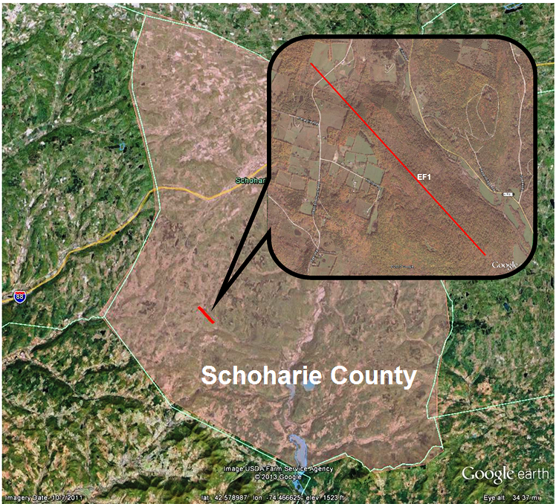
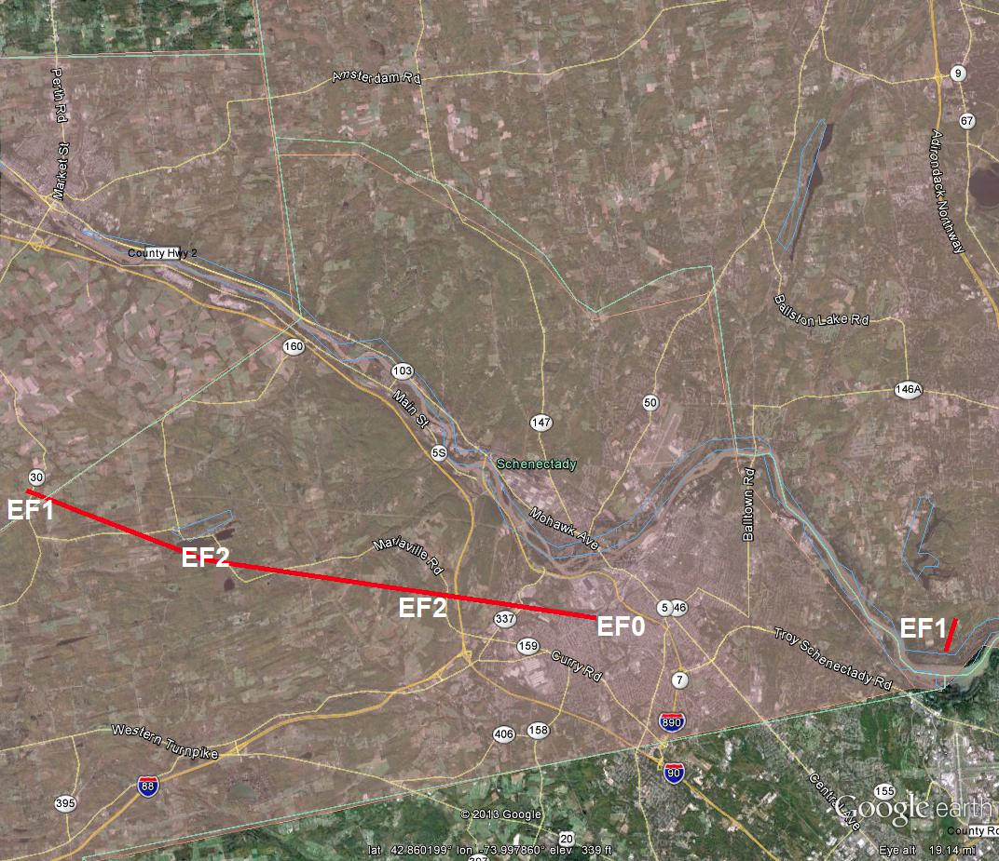
Motivation
EF1: Schoharie County
EF2: Mont./Schenectady Counties
EF1: Saratoga County
1.6 miles
13 miles
~1 mile

Slide 3
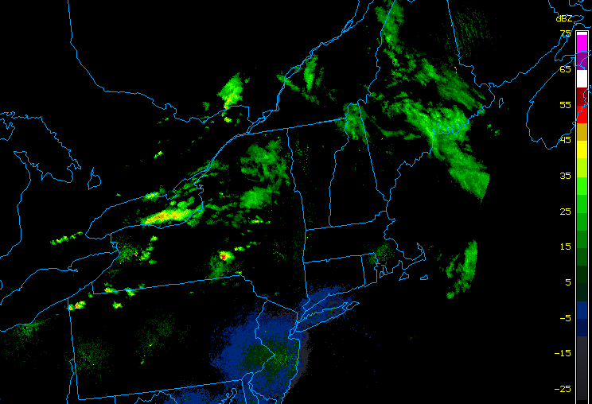
Radar Overview – 29–30 May
1930 UTC 29 May

Slide 4
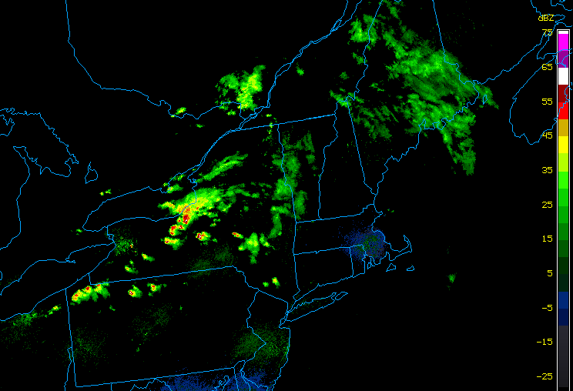
Radar Overview – 29–30 May
2030 UTC 29 May

Slide 5
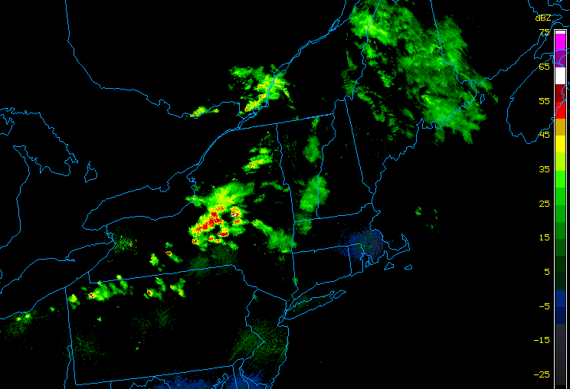
Radar Overview – 29–30 May
2130 UTC 29 May

Slide 6
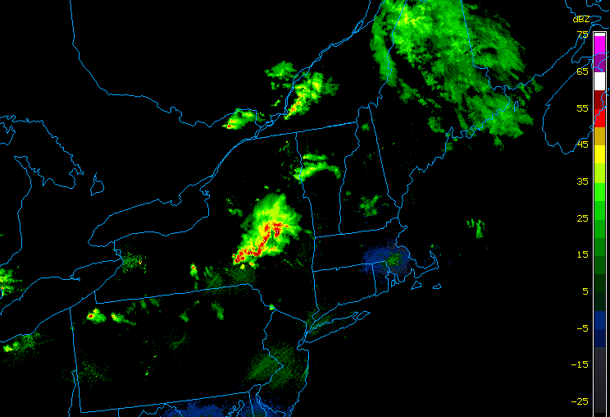
Radar Overview – 29–30 May
2230 UTC 29 May

Slide 7
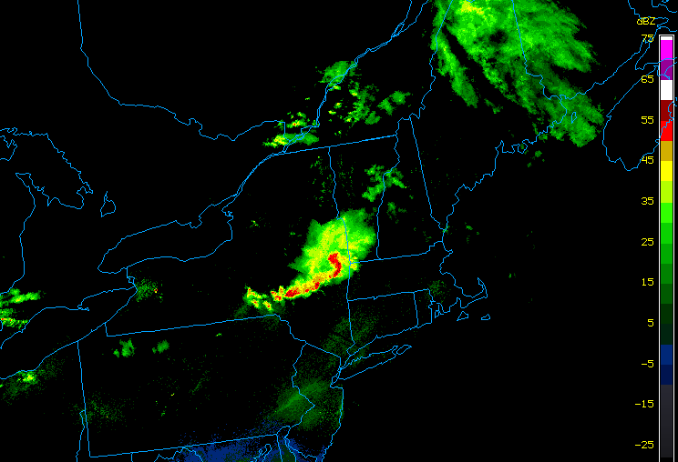
Radar Overview – 29–30 May
2330 UTC 29 May

Slide 8
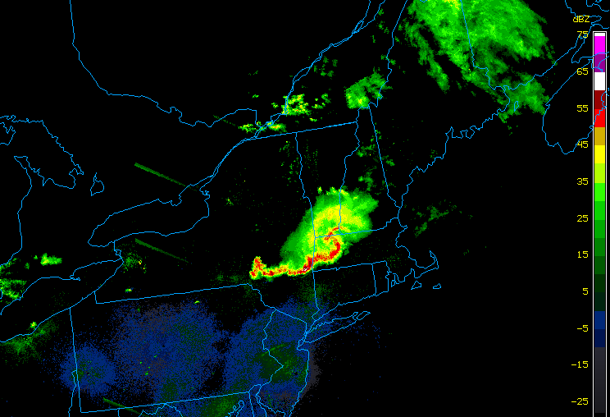
Radar Overview – 29–30 May
0030 UTC 30 May

Slide 9
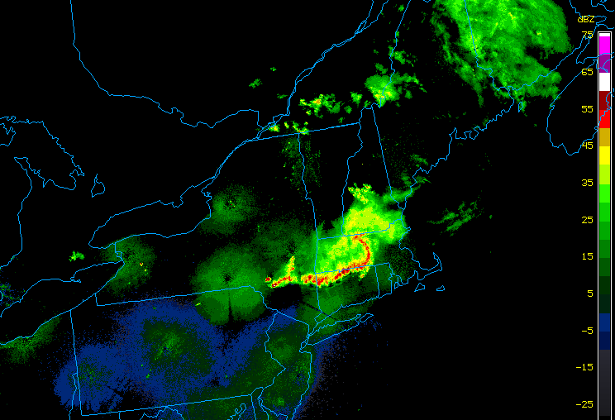
Radar Overview – 29–30 May
0130 UTC 30 May

Slide 10
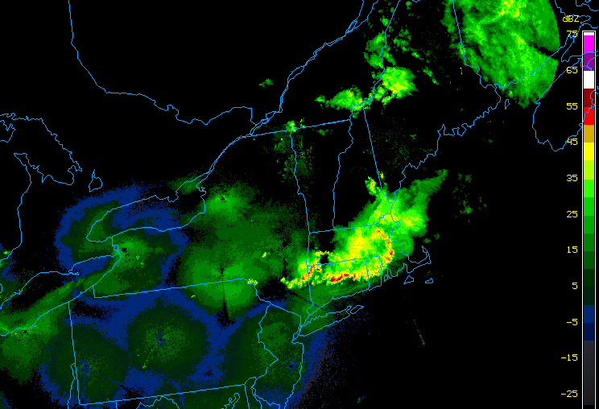
Radar Overview – 29–30 May
0230 UTC 30 May

Slide 11
Overview
Describe the synoptic and mesoscale conditions that contributed to supercell and MCS development
Examine the radar signatures associated with the multiple tornadic supercells

Slide 12
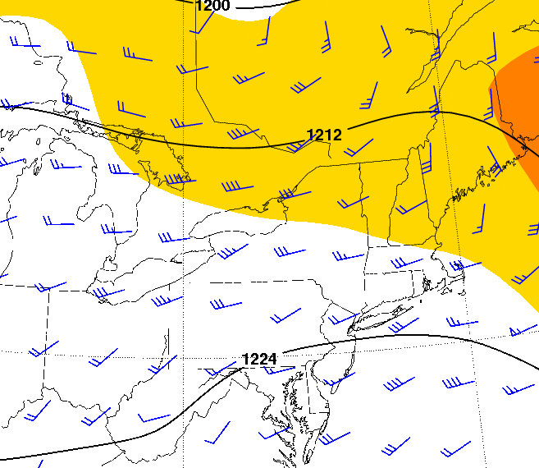
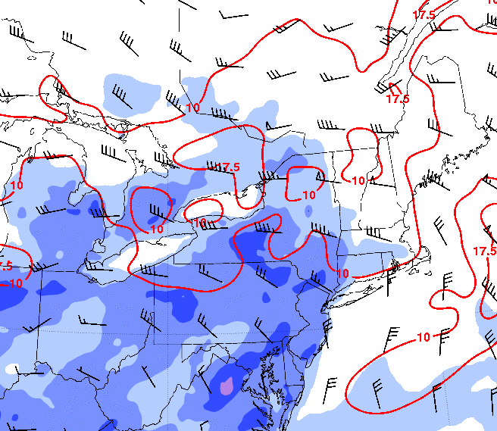
1900 UTC 29 May
200-hPa Heights (dam), 200-hPa Winds (m s⁻¹), 850-hPa Winds (m s⁻¹)
MUCAPE (J kg⁻¹), 0–1 km Shear (m s⁻¹),
0–6 km Shear (m s⁻¹)
Source: 20-km RUC
m s⁻¹
J kg⁻¹
Source: 20-km RUC

Slide 13
1900 UTC 29 May
MUCAPE (J kg⁻¹), 0–1 km Shear (m s⁻¹),
0–6 km Shear (m s⁻¹)
Water Vapor Satellite Image
Source: 20-km RUC
m s⁻¹
J kg⁻¹
Source: 20-km RUC

Slide 14
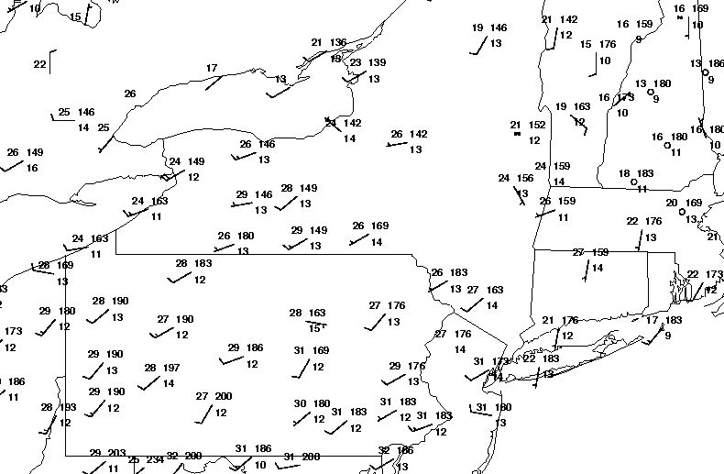
2000 UTC 29 May
Surface Temperature (°C), and Surface Mixing Ratio (>14 g kg⁻¹)
22
24
13
26
13
13
13
28
30

Slide 15
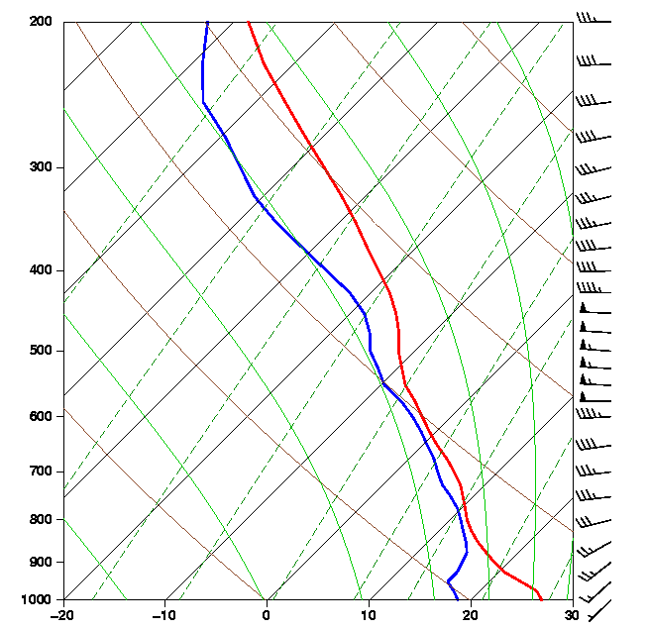
2000 UTC 29 May
Surface Temperature (°C), and Surface Mixing Ratio (>14 g kg⁻¹)
22
24
13
26
13
13
13
28
CAPE = 1073 J kg⁻¹
30

Slide 16
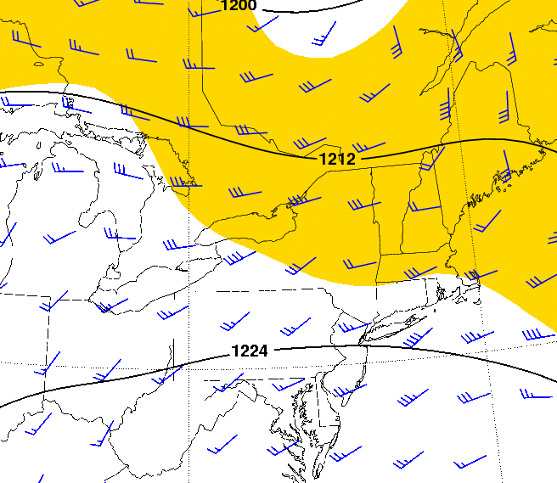
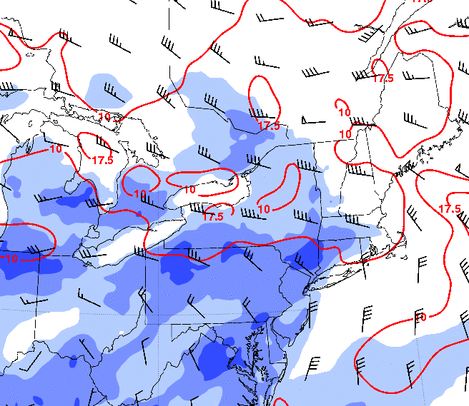
2100 UTC 29 May
200-hPa Heights (dam), 200-hPa Winds (m s⁻¹), 850-hPa Winds (m s⁻¹)
MUCAPE (J kg⁻¹), 0–1 km Shear (m s⁻¹),
0–6 km Shear (m s⁻¹)
Source: 20-km RUC
m s⁻¹
J kg⁻¹
Source: 20-km RUC

Slide 17
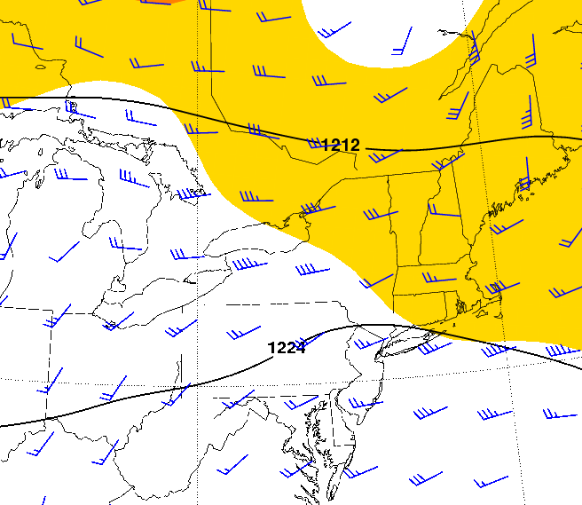
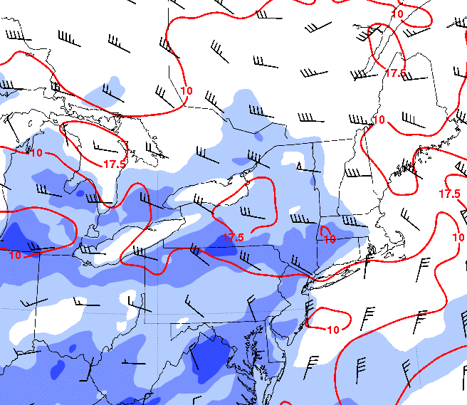
2300 UTC 29 May
200-hPa Heights (dam), 200-hPa Winds (m s⁻¹), 850-hPa Winds (m s⁻¹)
MUCAPE (J kg⁻¹), 0–1 km Shear (m s⁻¹),
0–6 km Shear (m s⁻¹)
Source: 20-km RUC
m s⁻¹
J kg⁻¹
Source: 20-km RUC

Slide 18
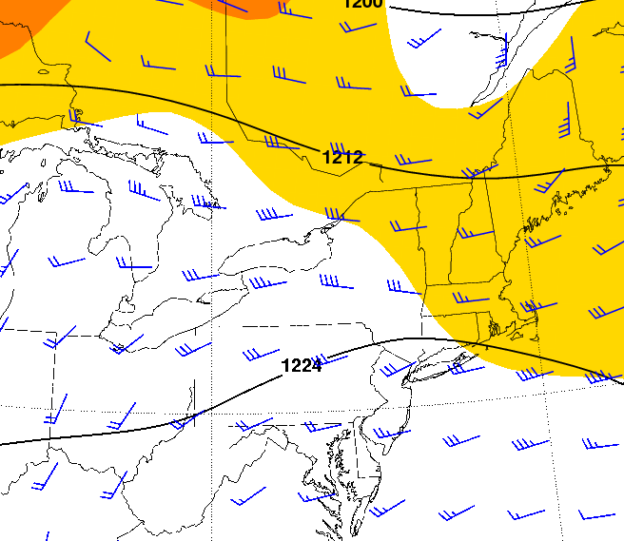
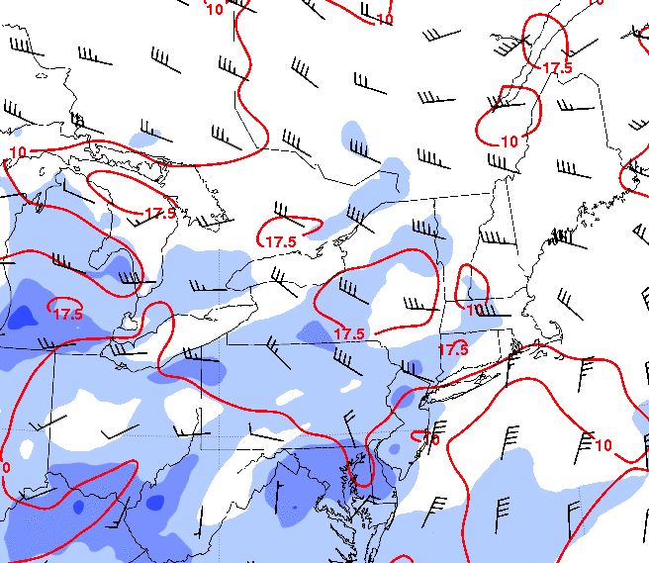
0100 UTC 30 May
200-hPa Heights (dam), 200-hPa Winds (m s⁻¹), 850-hPa Winds (m s⁻¹)
MUCAPE (J kg⁻¹), 0–1 km Shear (m s⁻¹),
0–6 km Shear (m s⁻¹)
Source: 20-km RUC
m s⁻¹
J kg⁻¹
Source: 20-km RUC

Slide 19
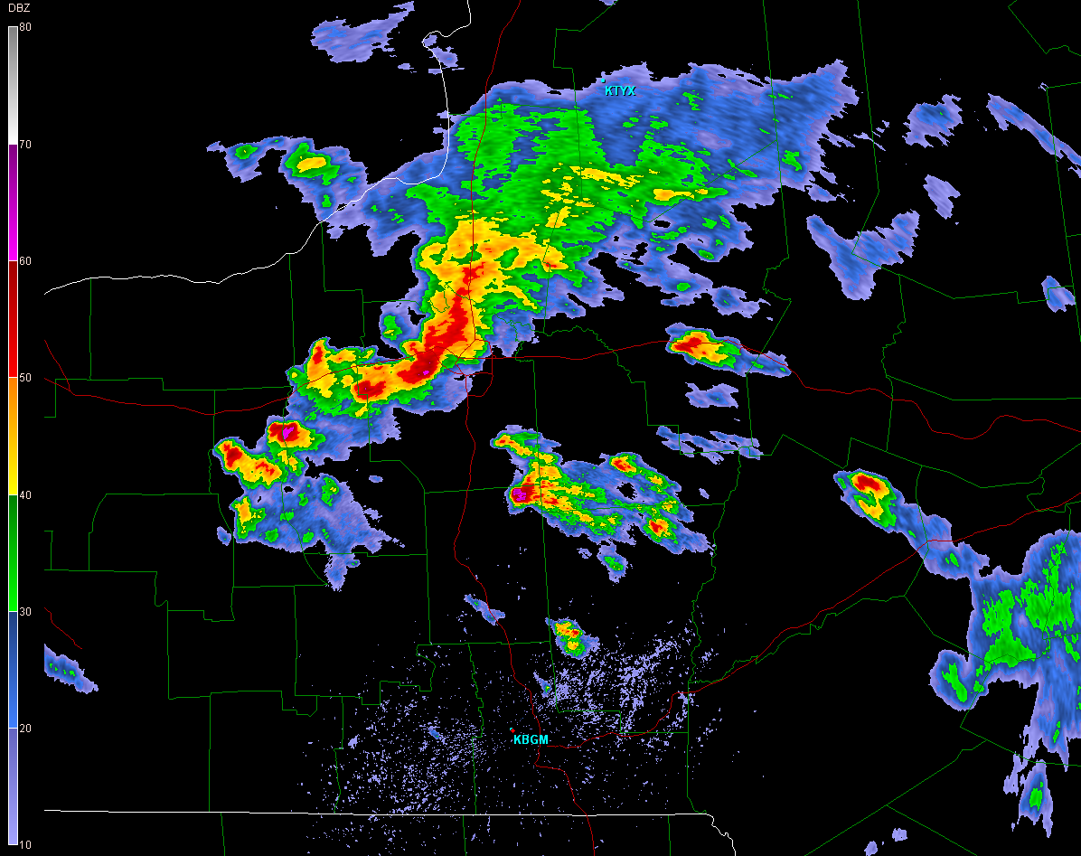
KBGM Base Reflectivity – 2055 UTC 29 May 2013
Cell A
Cell B

Slide 20
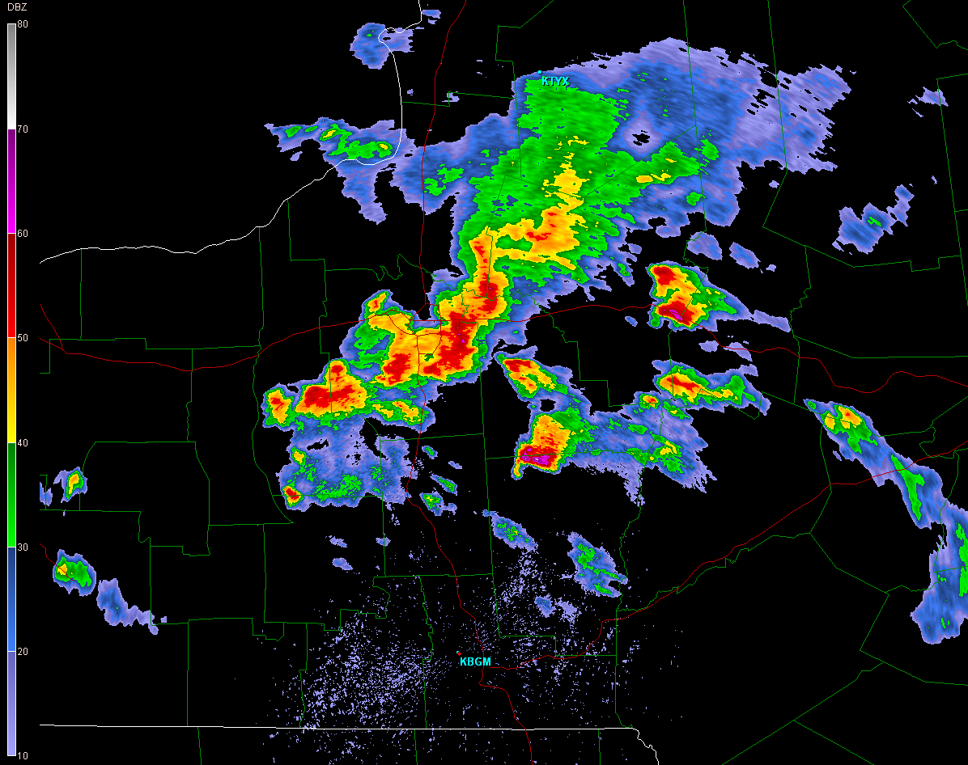
KBGM Base Reflectivity – 2113 UTC 29 May 2013
Cell A
Cell B

Slide 21
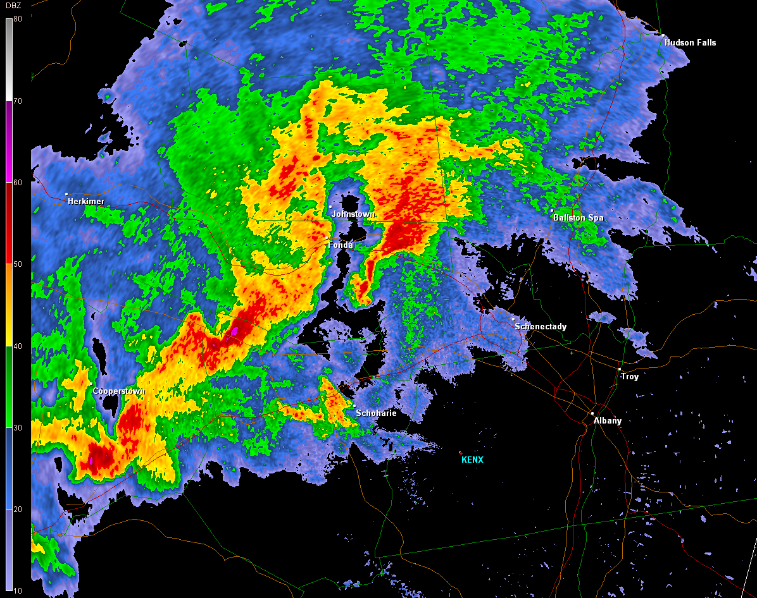
KENX Base Reflectivity – 2237 UTC 29 May 2013
Cell A
Cell B

Slide 22
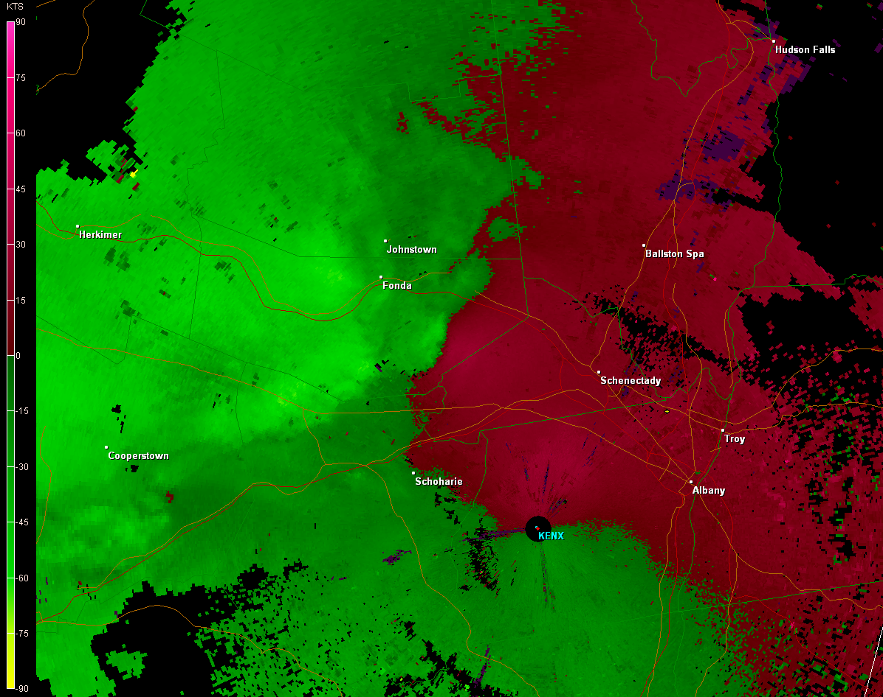
KENX Base Velocity – 2237 UTC 29 May 2013
Cell A
Cell B

Slide 23
KENX Base Velocity – 2237 UTC 29 May 2013
Cell A
Cell B

Slide 24
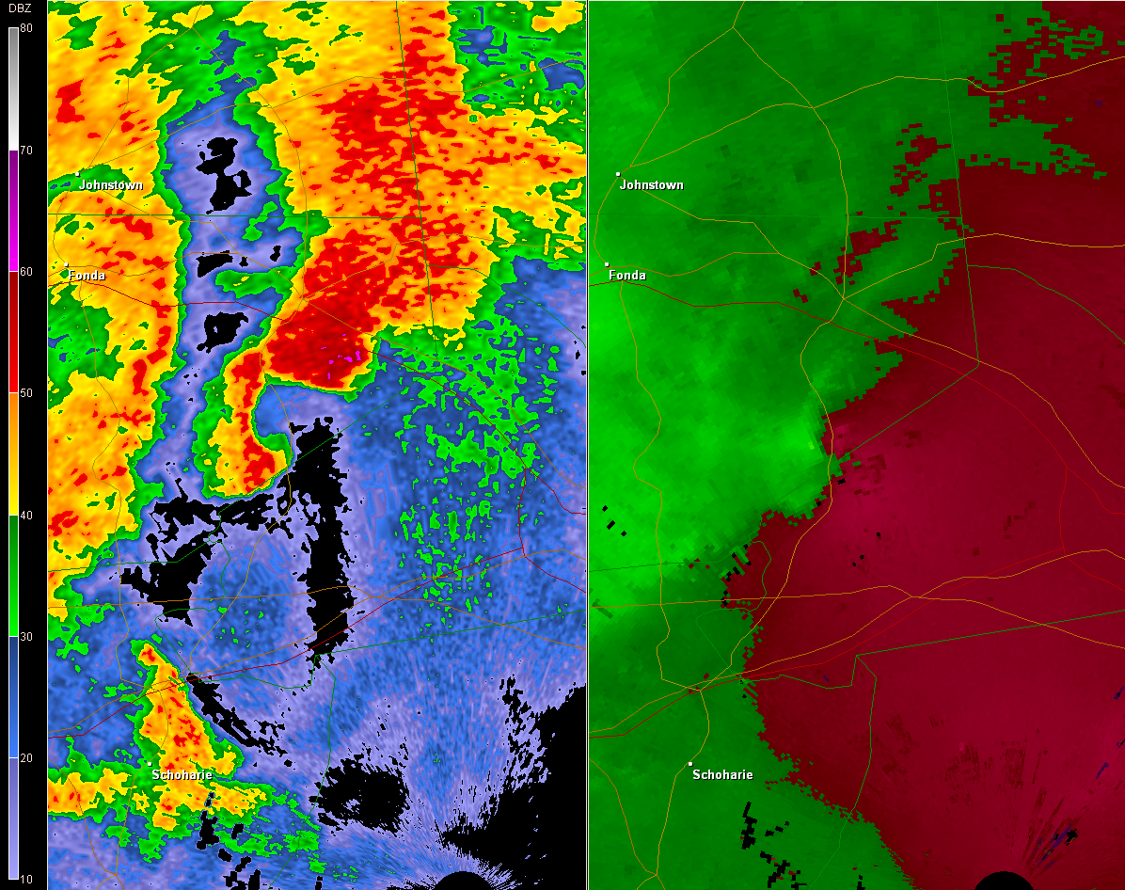
2242 UTC 29 May 2013
Base Reflectivity
Base Velocity
Amsterdam
Amsterdam
Duanesburg
Duanesburg

Slide 25
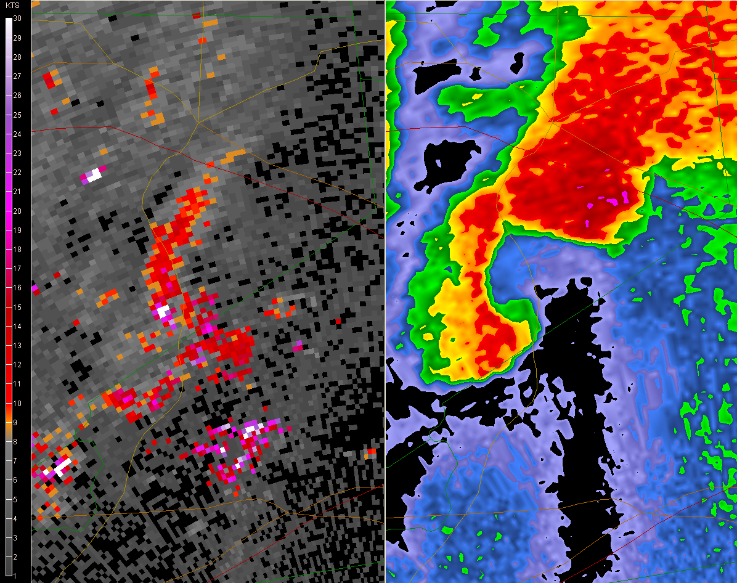
2242 UTC 29 May 2013
Base Spectrum Width
Base Reflectivity
Amsterdam
Amsterdam
Tornado
RFD
Duanesburg
Duanesburg

Slide 26
2242 UTC 29 May 2013
Base Spectrum Width
Base Reflectivity
Amsterdam
Amsterdam
Tornado
RFD
Duanesburg
Duanesburg

Slide 27
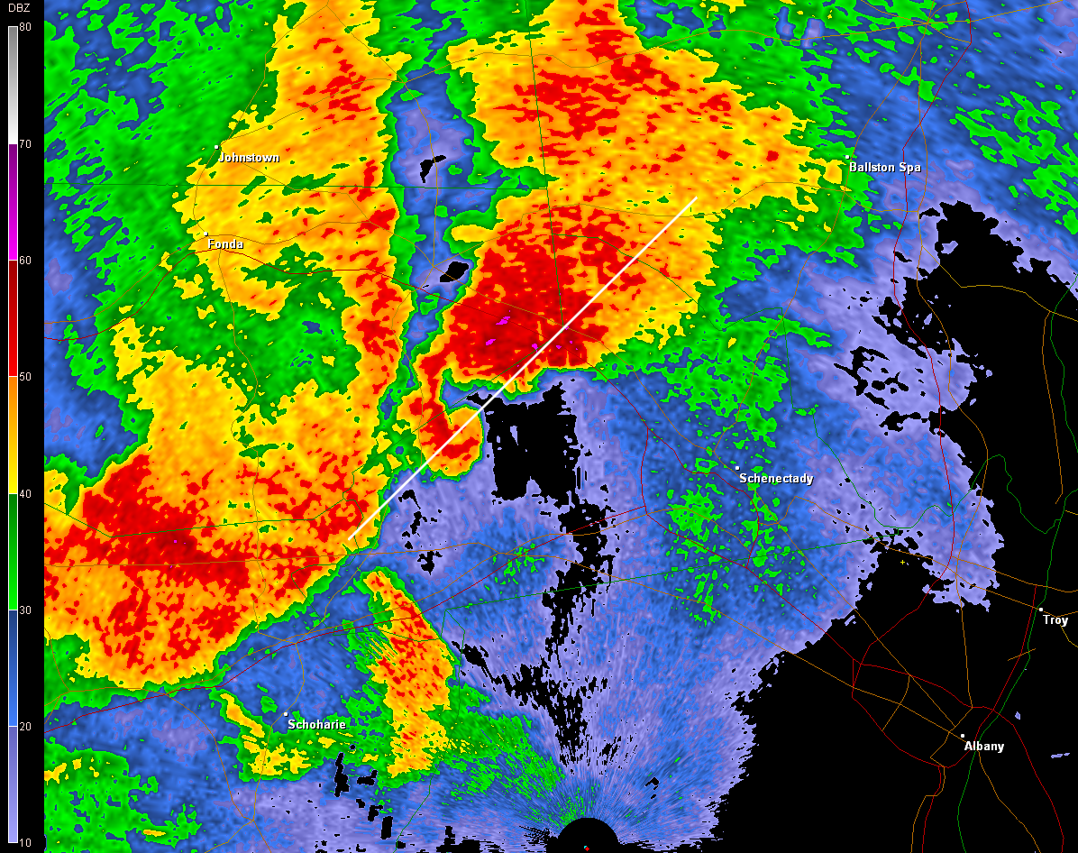
KENX Base Reflectivity – 2247 UTC 29 May 2013

Slide 28
KENX Reflectivity Cross Section
2247 UTC 29 May 2013
BWER

Slide 29
KENX Reflectivity – 50 dBZ Isosurface
2247 UTC 29 May 2013
BWER

Slide 30
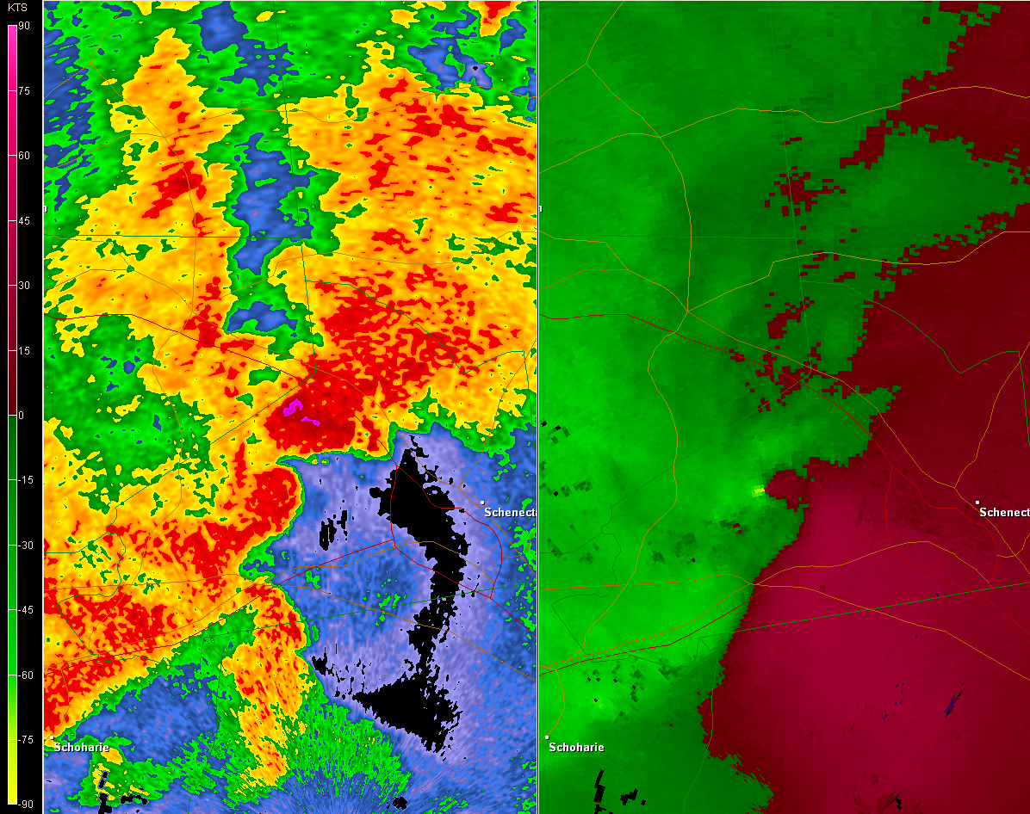
2252 UTC 29 May 2013
Base Reflectivity
Base Velocity
Gate-to-gate shear:
95.2 kt

Slide 31
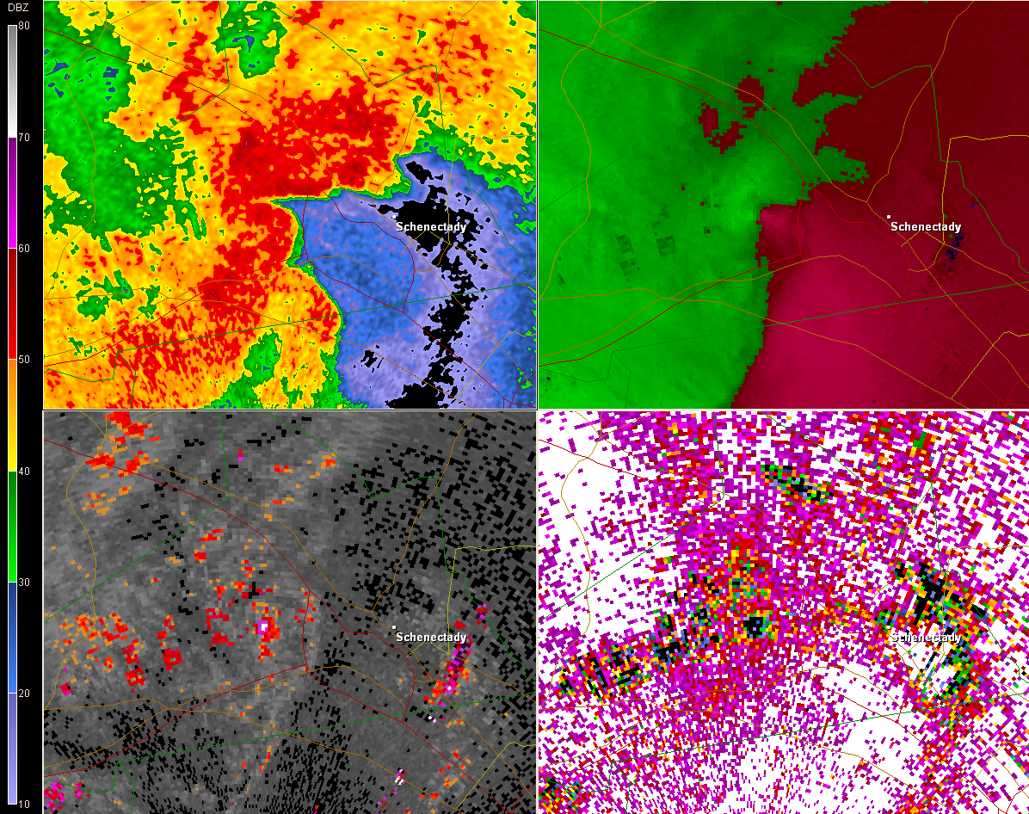
2257 UTC 29 May 2013
Base Reflectivity
Base Velocity
Base Spectrum Width
Correlation Coefficient
Debris
Tornado
RFD

Slide 32
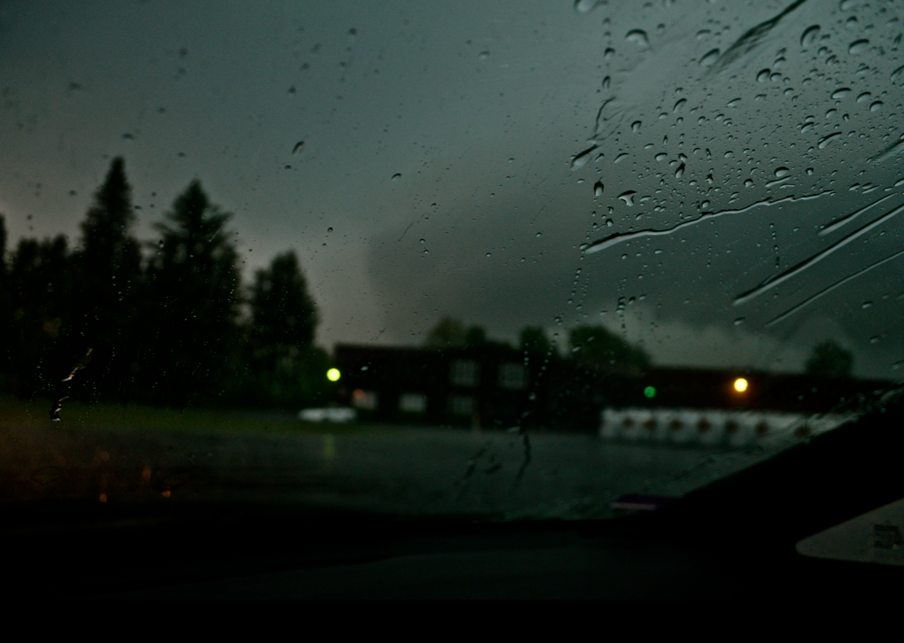
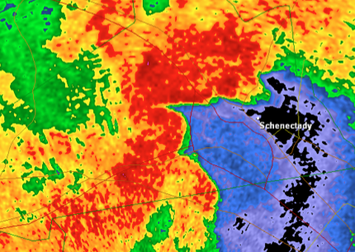
2305 UTC 29 May 2013 – from Scotia, NY

Slide 33
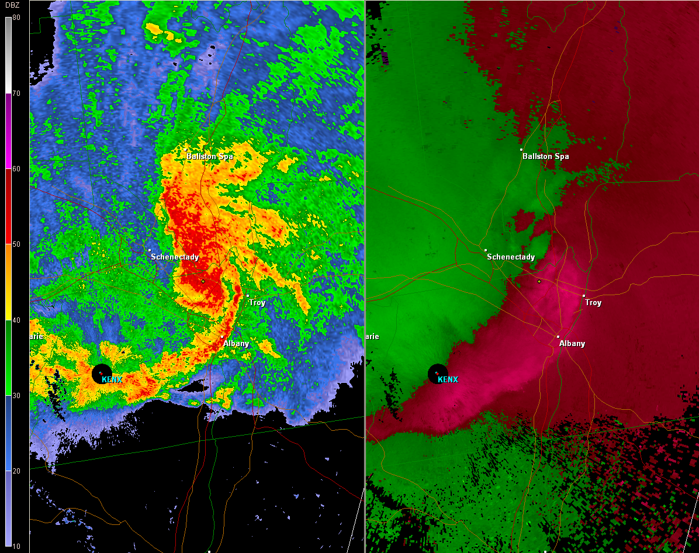
2317 UTC 29 May 2013
Base Reflectivity
Base Velocity

Slide 34
2317 UTC 29 May 2013
Base Reflectivity
Base Velocity

Slide 35
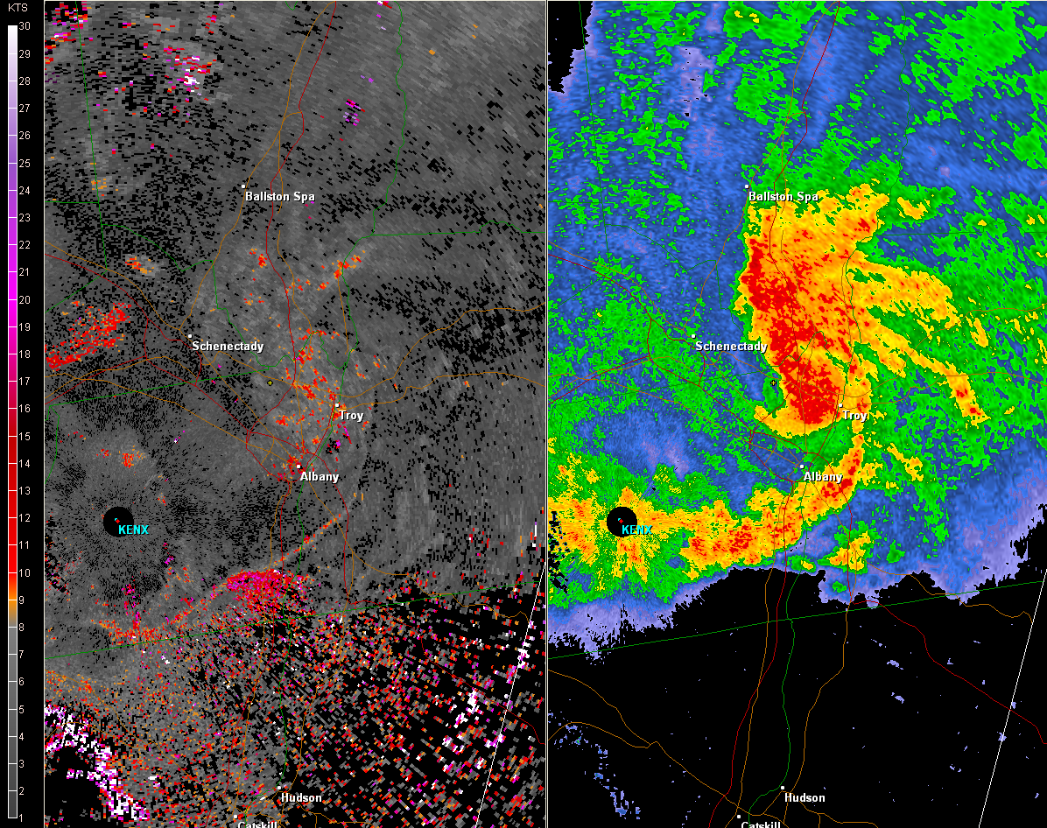
2321 UTC 29 May 2013
Base Spectrum Width
Base Reflectivity

Slide 36
Summary
Convection initiated ahead of an upper-level short-wave trough, in a region of ~1500 J kg⁻¹ of CAPE, ~20 m s⁻¹ of 0–6-km shear and ~17.5 m s⁻¹ of 0–1-km shear
Weak frontal boundary/confluence zone may have aided in focusing storms
Two discrete supercells produced multiple reports of large hail and three tornadoes (max EF-2)
Evolved upscale into MCV with bow echo, causing significant wind damage across Albany metro

