Slide 1
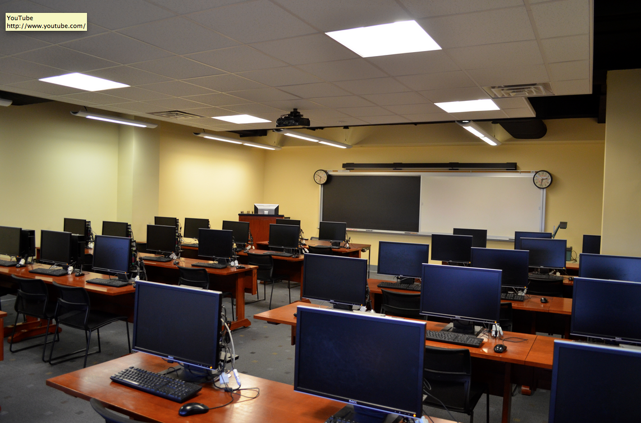
Main computer classroom (attached to map room)

Slide 2
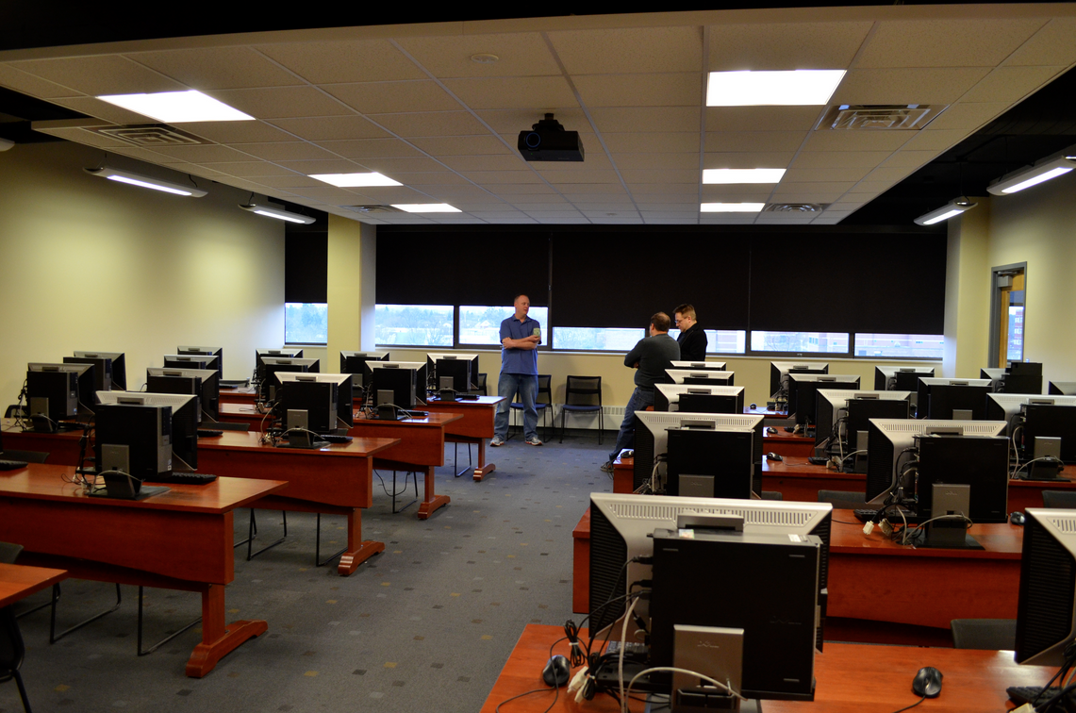
Main computer classroom (attached to map room)

Slide 3
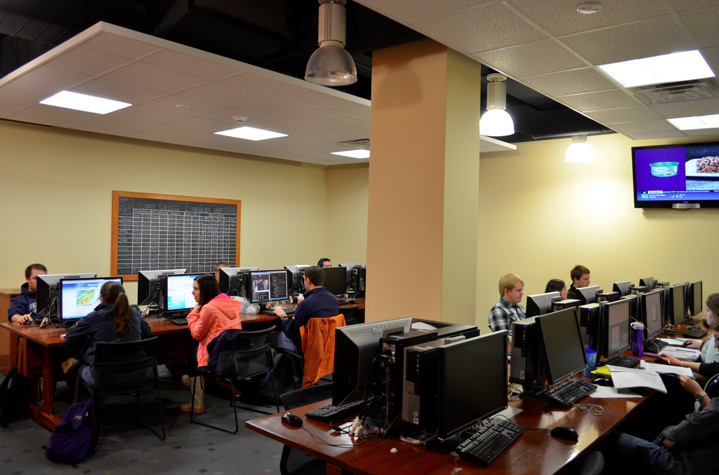
Student computer lab (attached to map room)

Slide 4
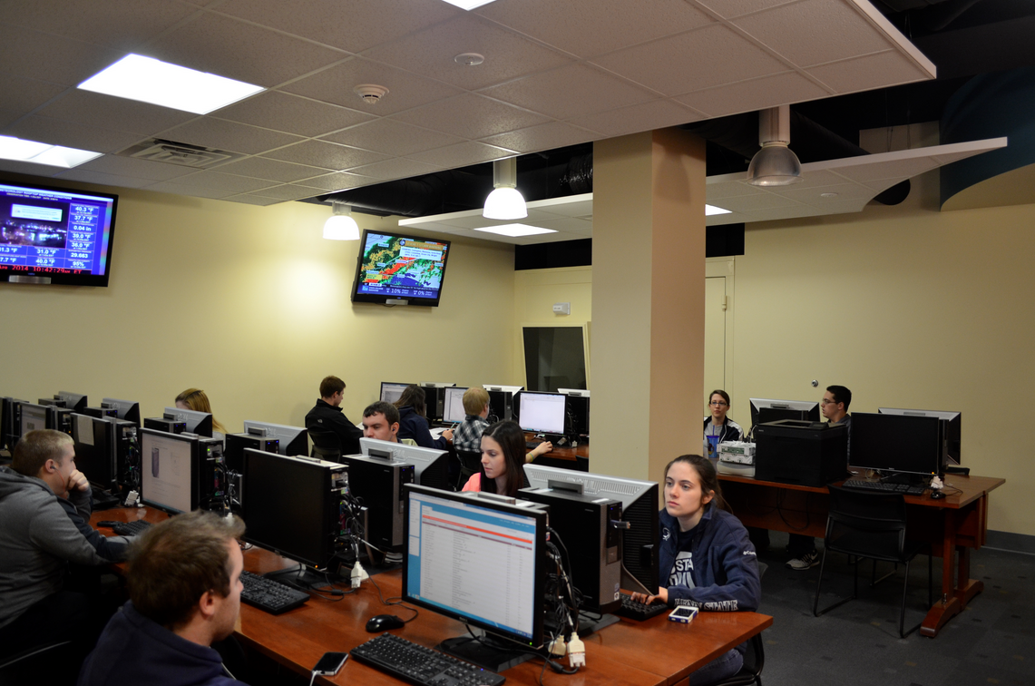
Student computer lab (attached to map room)

Slide 5
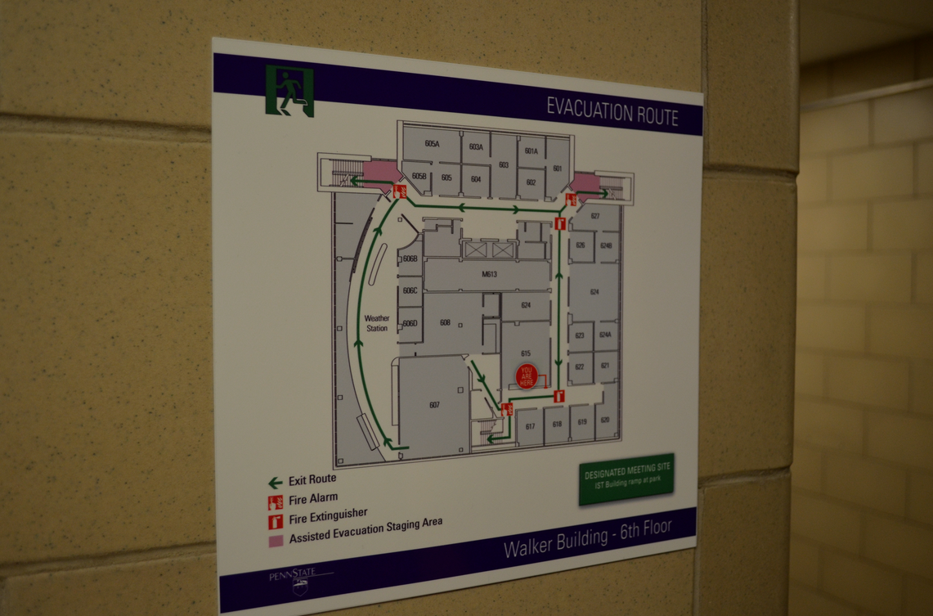
607 – Comp Classroom 1; 608 – Comp lab; “Weather Station” = map room

Slide 6
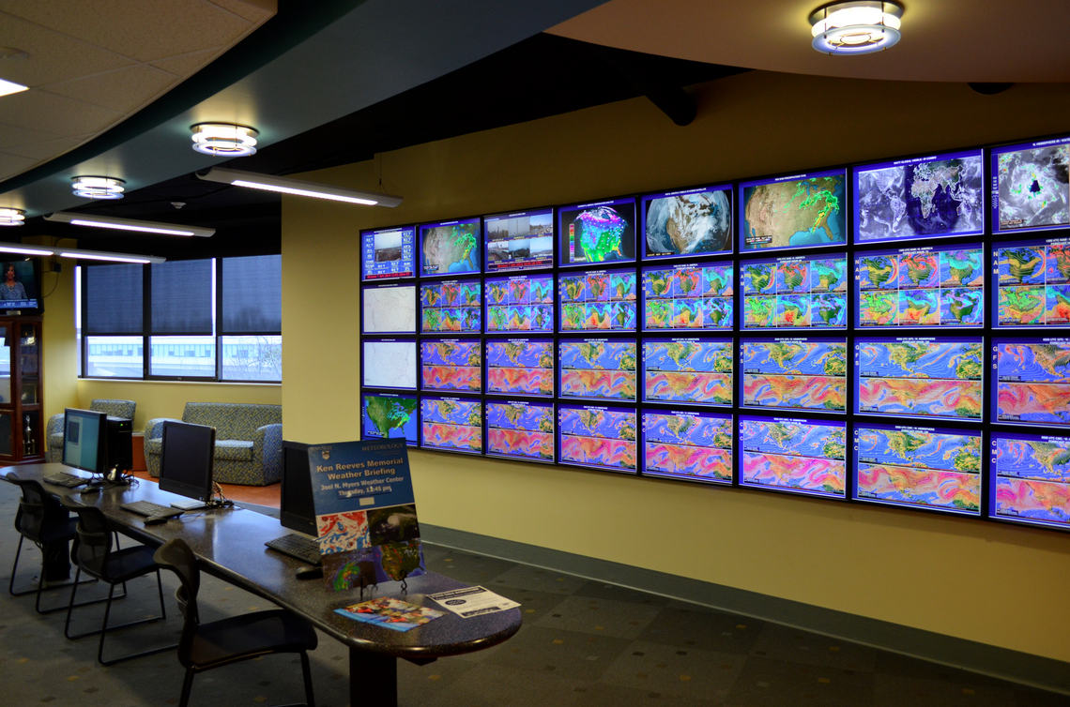
Map wall in map room

Slide 7
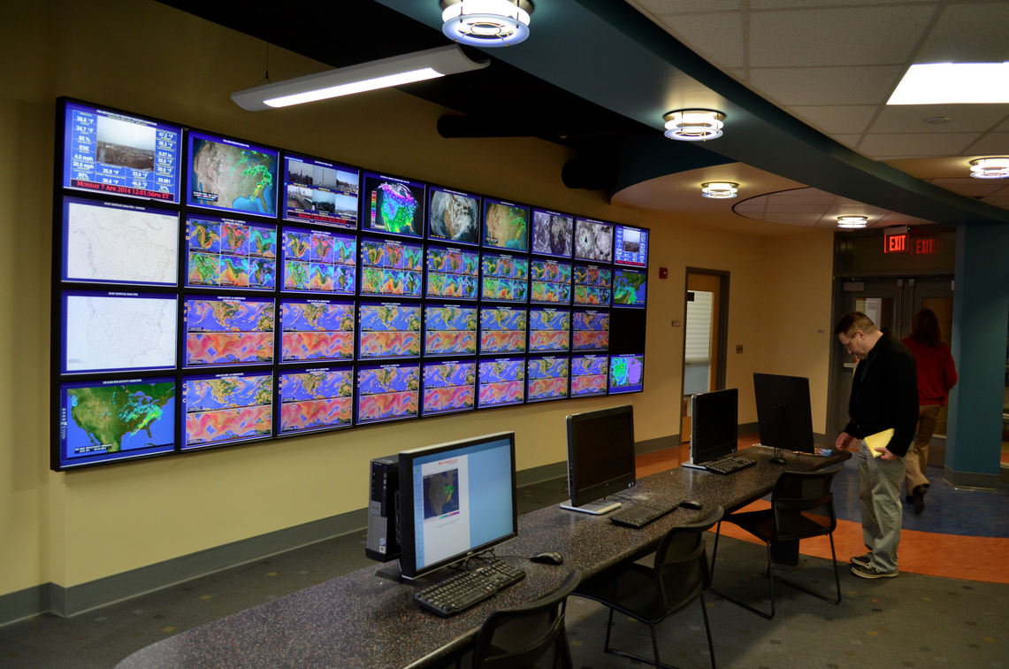
Map wall in map room

Slide 8
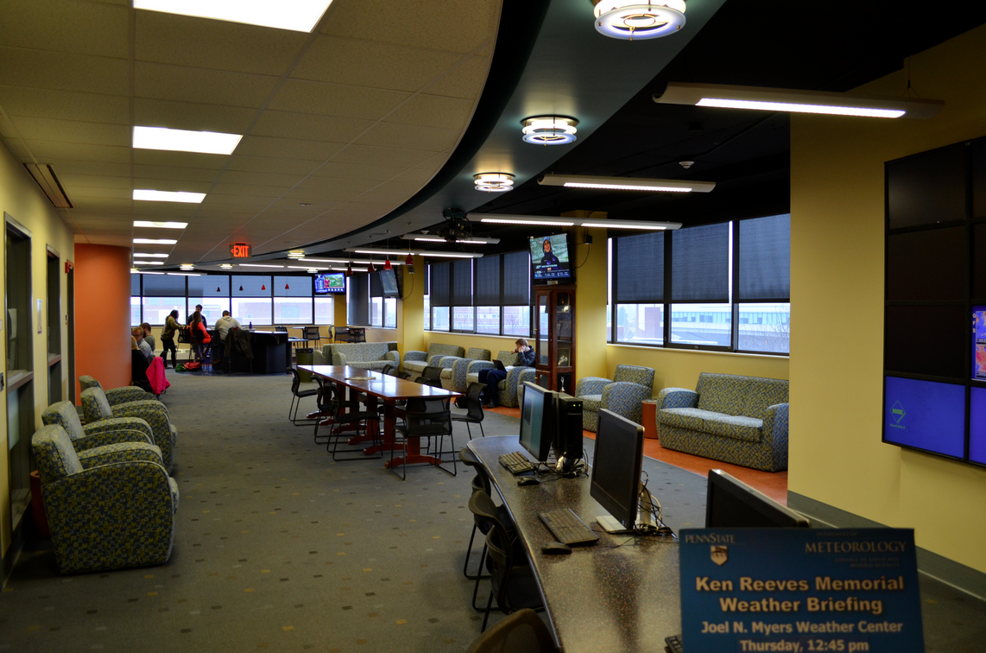
Map room

Slide 9
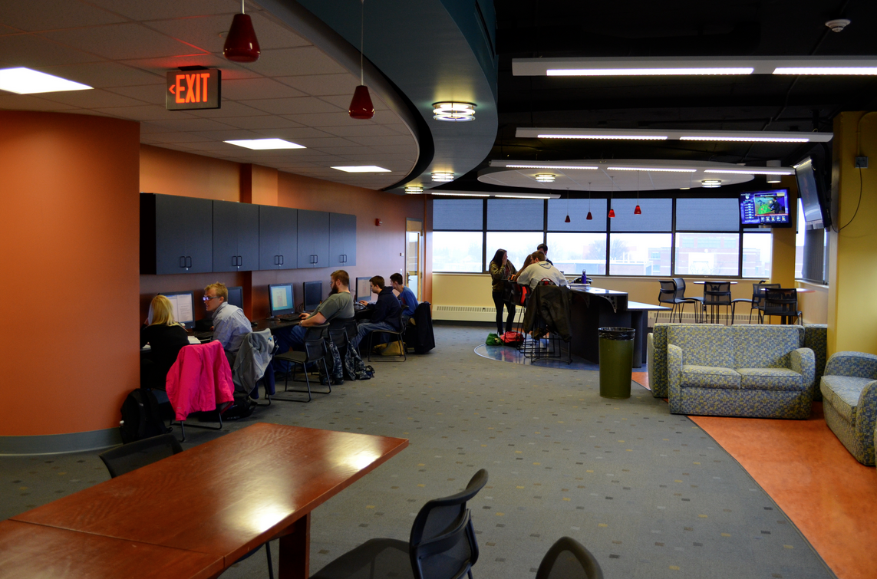
Map room

Slide 10
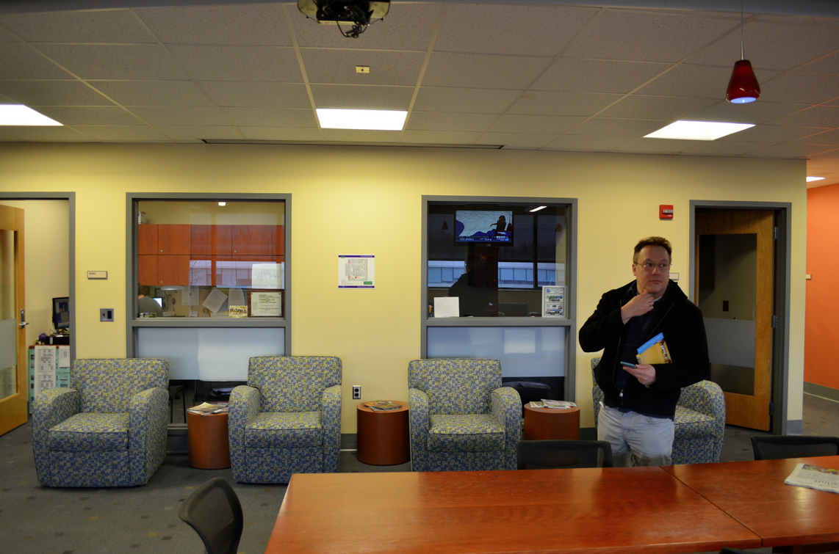
Map room

Slide 11
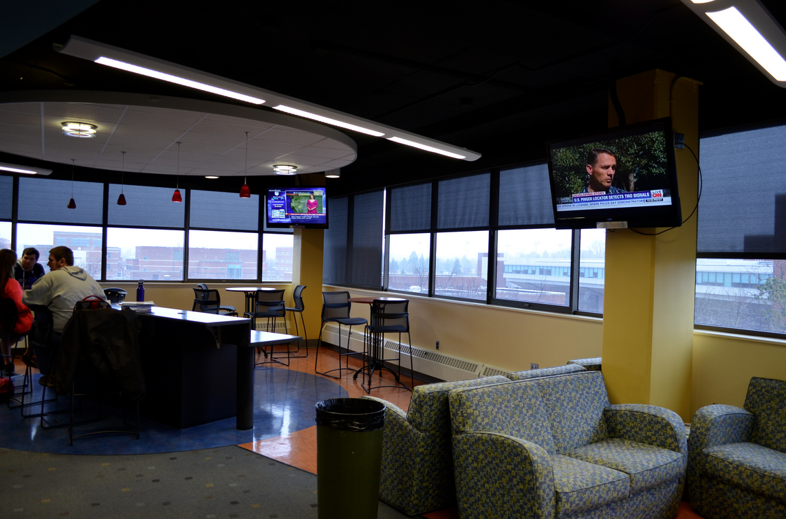
Map room

Slide 12
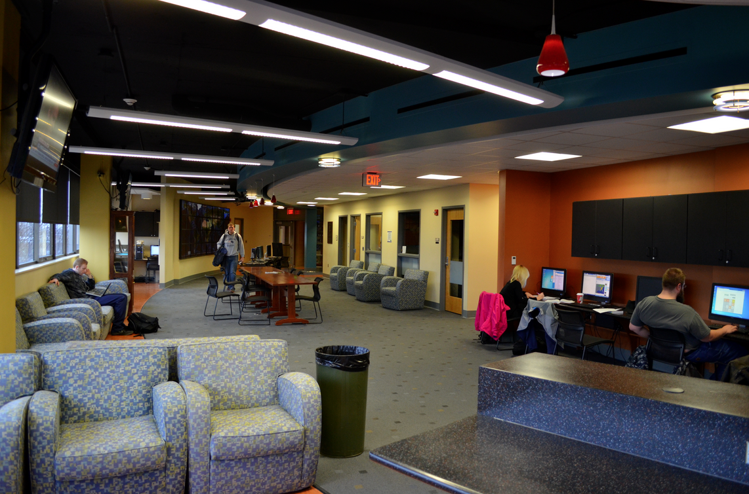
Map room

Slide 13
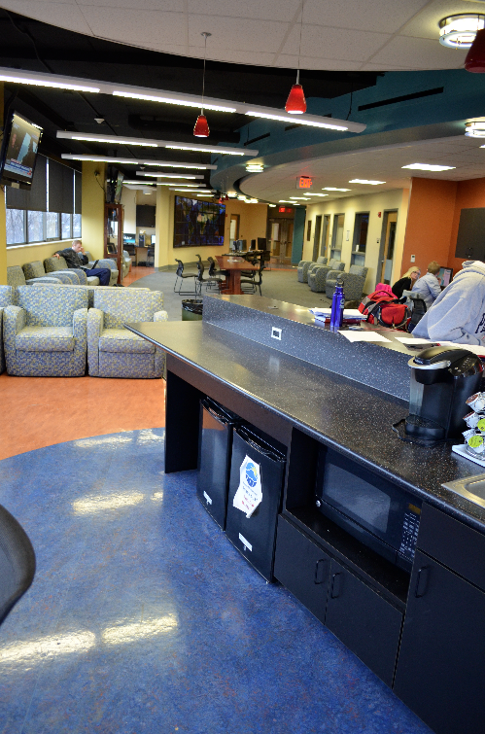
Map room

