Slide 1
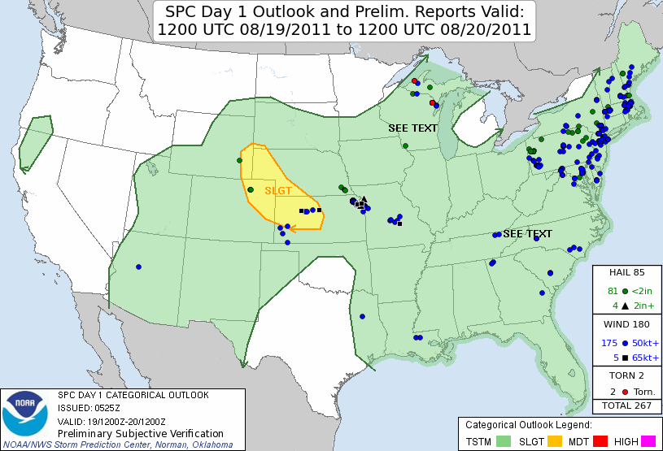
Low probability of detection (POD) high impact event example
• What characterizes an event with low POD?
• What synoptic-scale patterns might represent such “overperforming” cases?

Slide 2
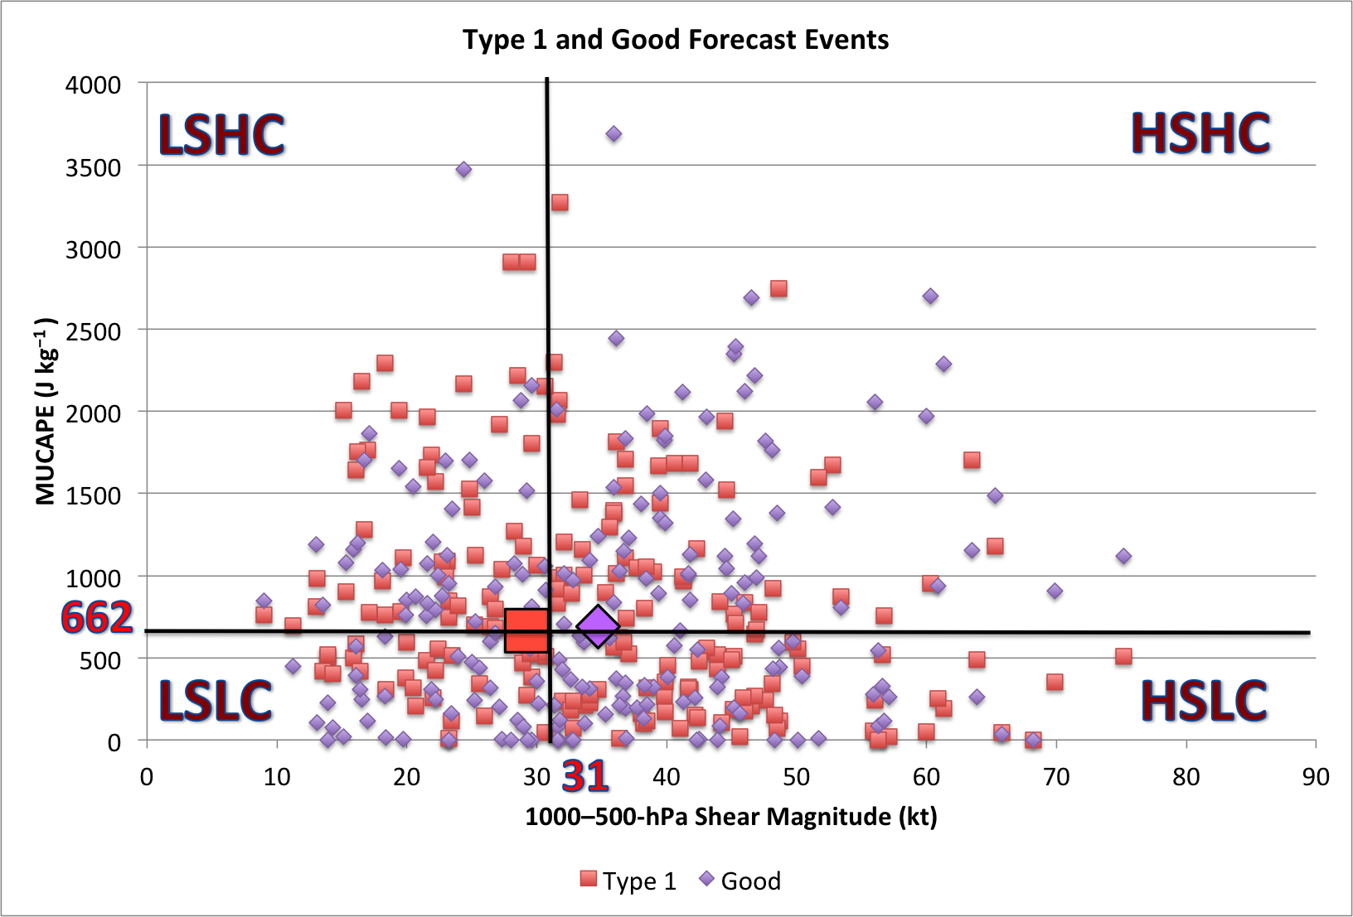
MUCAPE–Wind Shear Phase Space for case types
Low Probability of Detection cases
Good forecast cases
• Low POD cases are characterized as having less deep-layer shear than good forecast cases
• Associated with weaker upper-level winds and less syntopic-scale forcing for ascent

Slide 3
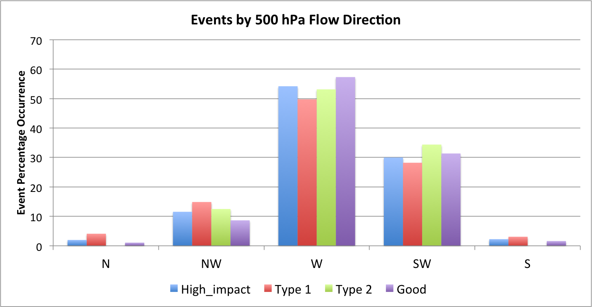
MUCAPE–Wind Shear Phase Space for case types
High impact events
Low Probability of Detection events (overperforming)
High False Alarm Rate events (underperforming)
Good forecast events
• Low probability of detection events are the most common type of northwesterly 500-hPa flow events

Slide 4
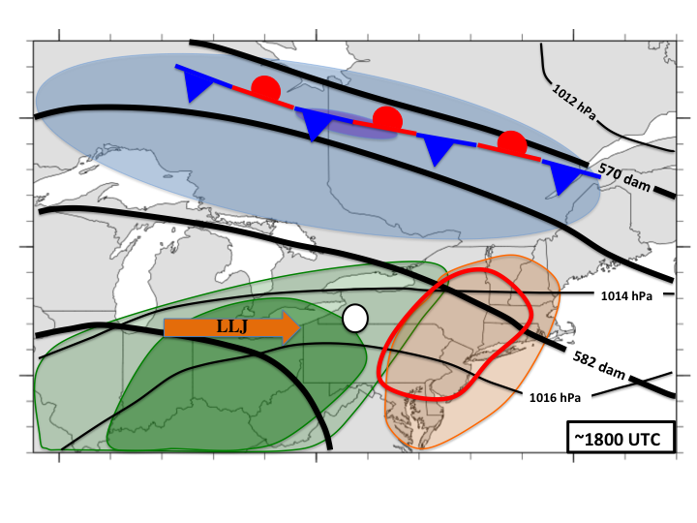
Low Probability of Detection – Northwesterly flow cases
• TS initiation

Slide 5
MUCAPE–Wind Shear Phase Space for case types
High impact events
Low Probability of Detection events (overperforming)
High False Alarm Rate events (underperforming)
Good forecast events
• Low probability of detection events are the most common type of northwesterly 500-hPa flow events

