Slide 1
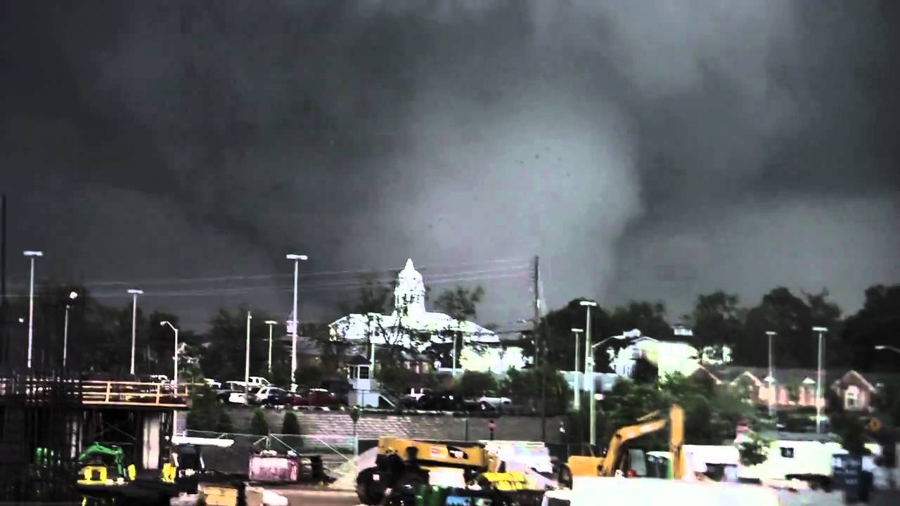
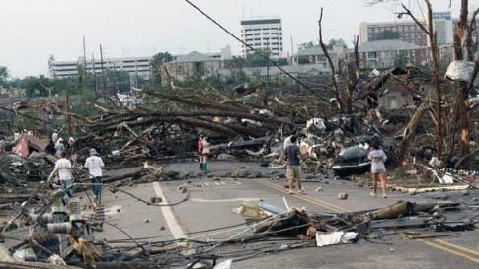
Tuscaloosa-Birmingham Tornado
By: Nick Barbieri

Slide 2
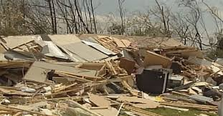
Background Information
Formed on April 27, 2011 at 4:43 p.m. CDT
EF4 tornado with winds estimated at 190mph
64 fatalities and an estimated 1500 injuries
$2.4 billion in damages
Path of destruction of 80.9 miles through Greene, Tuscaloosa, and Jefferson counties.
This presentation will show what caused such a deadly tornado on this day by displaying soundings, radar, a surface analysis map, and maps of warm air advection before and after the tornado touched down.

Slide 3
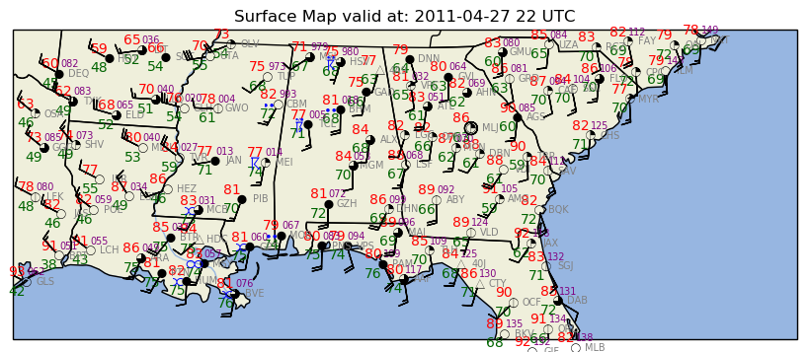
Surface Analysis (April 27, 2011 @22Z)
-The Tuscaloosa observation has the highest surface winds at around 20 knots.
-There is heavy precipitation in Tuscaloosa
-There are thunderstorms just southeast of Tuscaloosa

Slide 4
Birmingham Radar (April 27, 2011 @23Z)
-In the radar loop, we can see that there is a very high reflectivity band going through the Alabama region. This signifies a substantial amount of precipitation and potentially debris from the tornadoes that took place on this day.
-Red signifies the highest reflectivity which we can see in this radar loop.

Slide 5
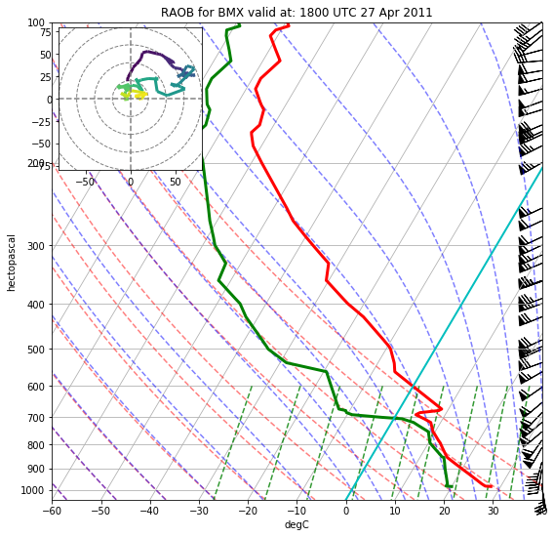
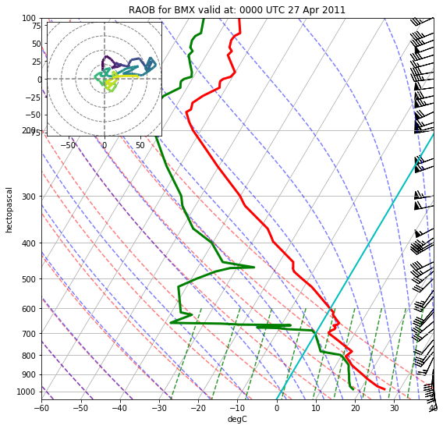
Birmingham Skew-t Diagram (18Z + 00Z)

Slide 6
Skew-t Diagram Information
As we can see in the skew-t, there is a lot of vertical wind shear. This signifies a shift in wind speed and direction with height. Vertical wind shear is a vital component for tornado formation. In the diagram, wind speeds increase with height and the winds shift from slightly northwesterly, to northeasterly, and then easterly.

Slide 7
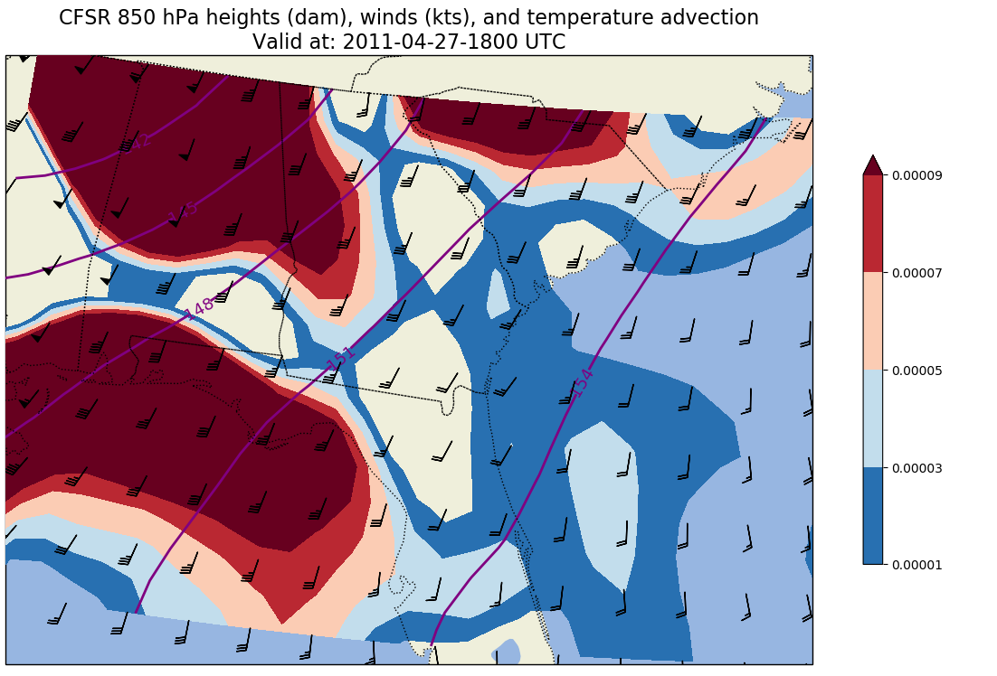
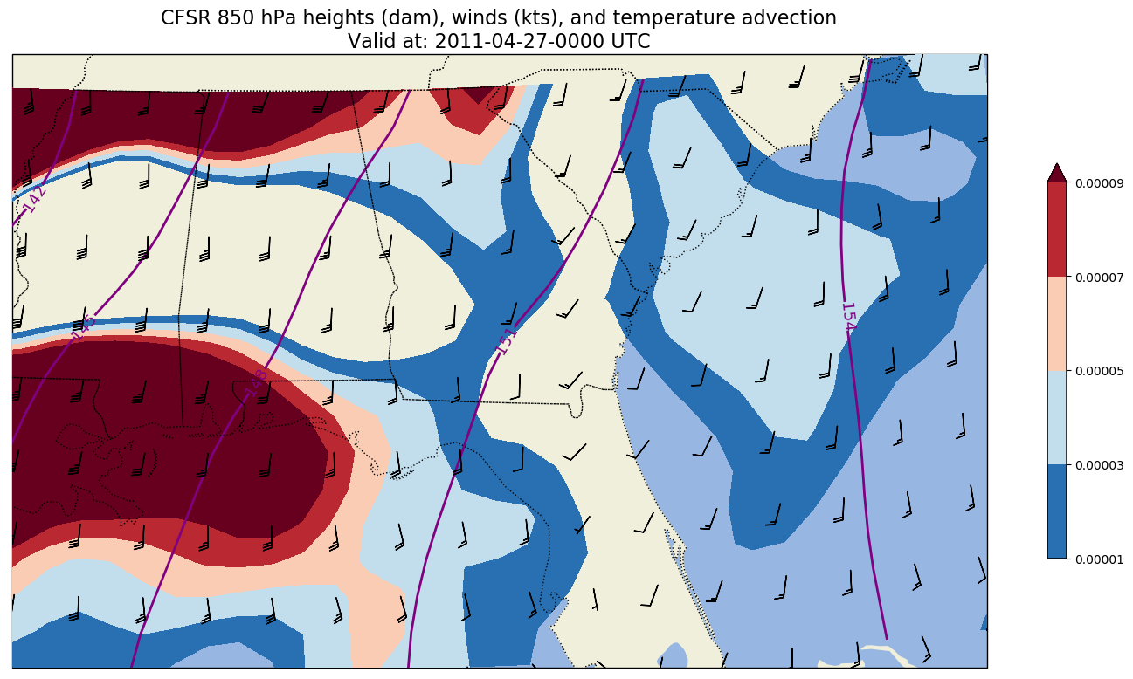
Temperature Advection

Slide 8
Temperature Advection Cont.
-As we can see, before the tornado occured, there was substantial warm air advection coming in from the north.
-Warm air is less dense than cool air, thus, creating widespread ascent in the region producing atmospheric instability.
-After the conclusion of the tornado, in the 0Z map, we can see the warm air advection begin to subside and not be as strong as it was before the tornado hit.
-There’s a large height gradient in the region.

Slide 9
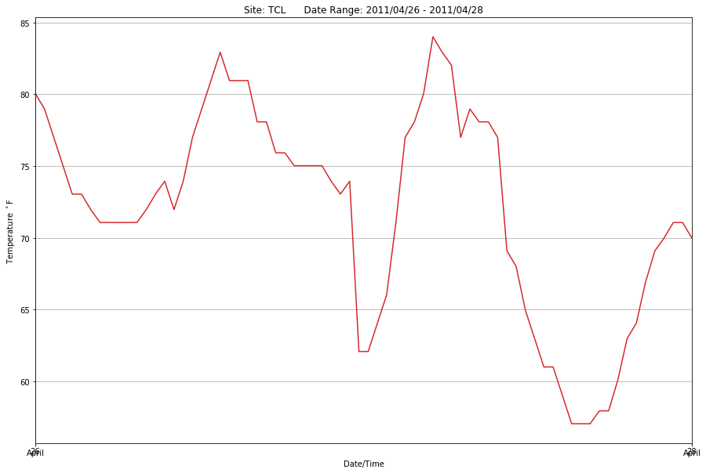
Meteograph

