Slide 1
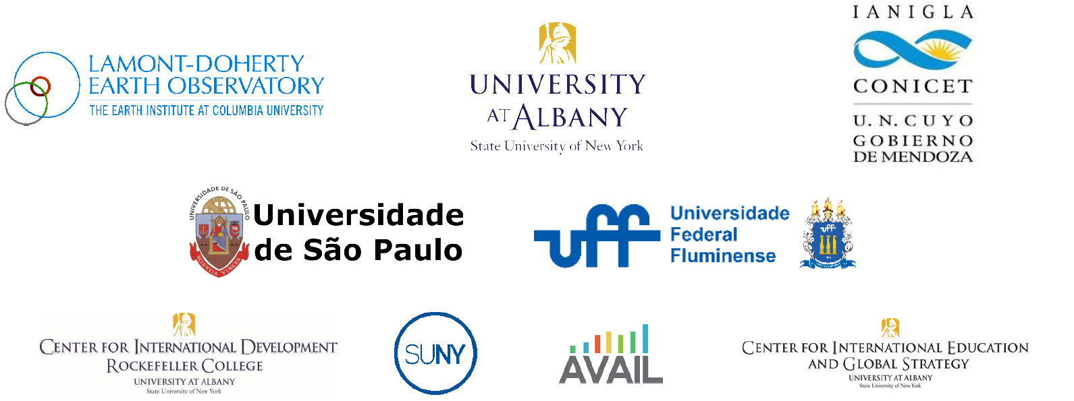
Partnership in International Research and Education (PIRE)
Focuses on Climate and Environmental Research in South America
Study Abroad and internship opportunities (fully paid)
Research opportunities (summer schools in Brazil & Andes – fully paid)
2017-2023 – $5M project

Slide 2
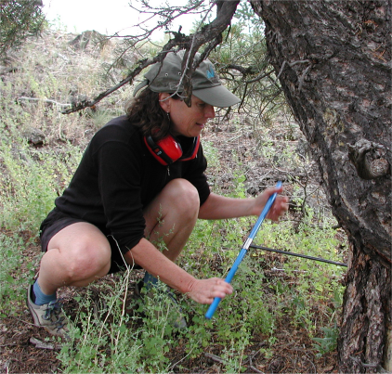
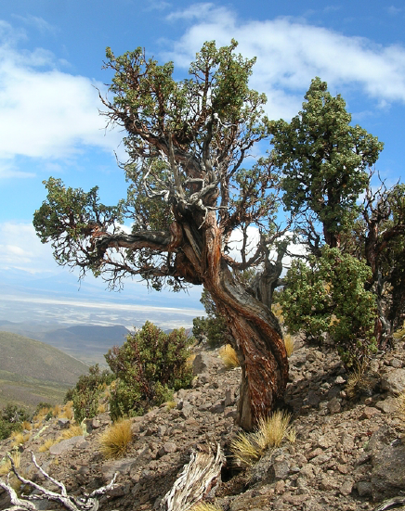
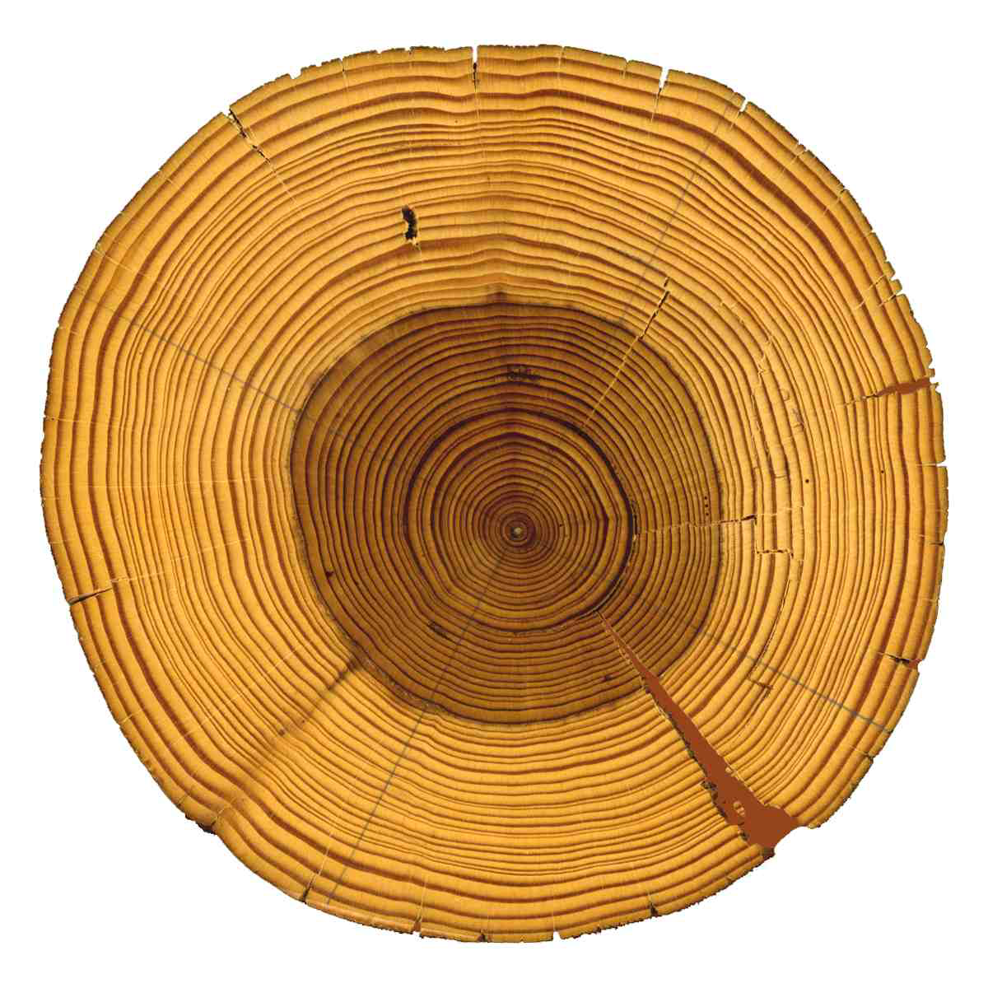
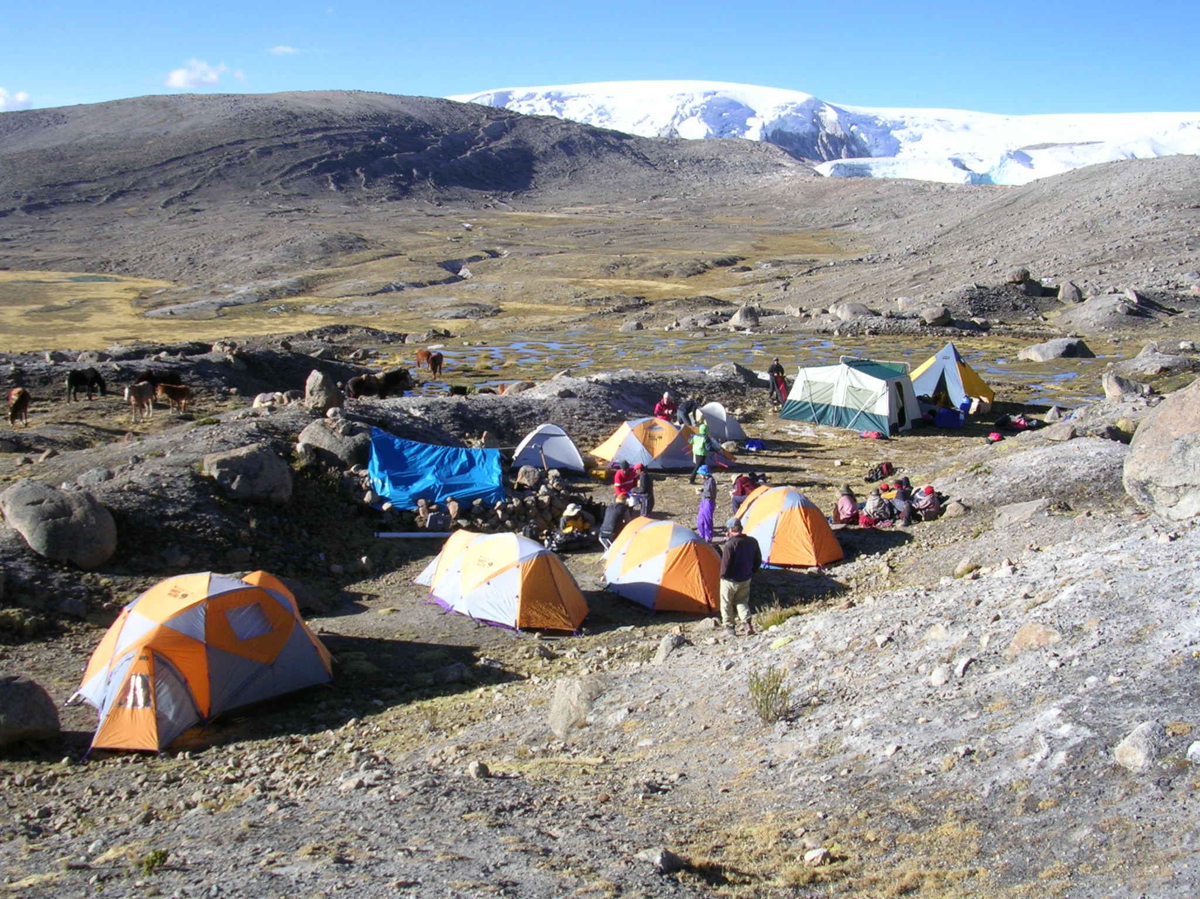
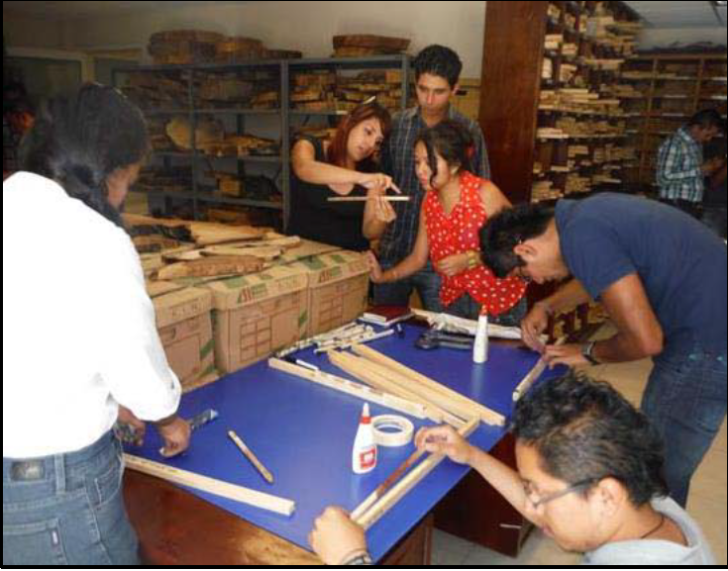
Summer schools on tree ring research (Dendrochronology)
in Peru and Argentina

Slide 3
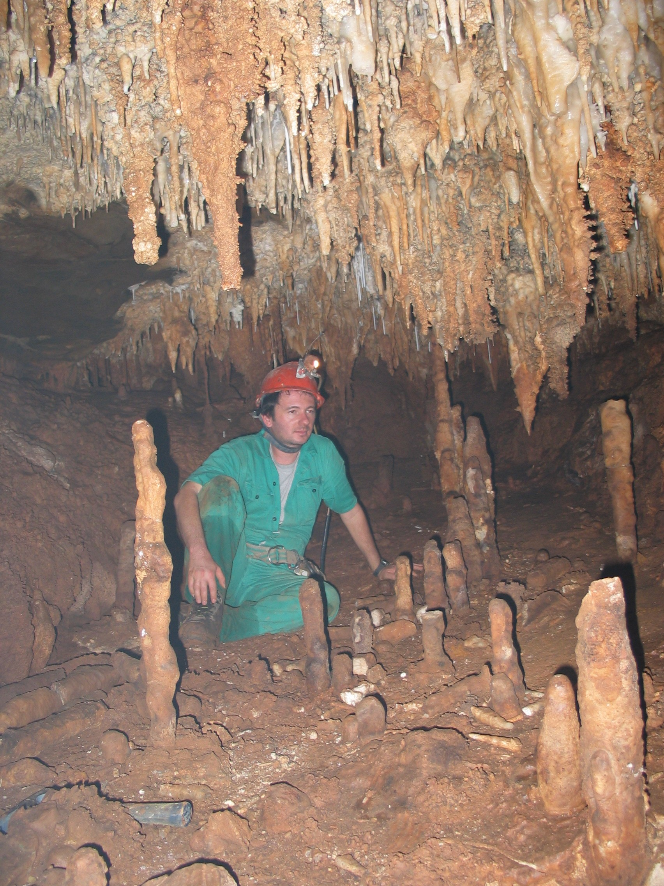
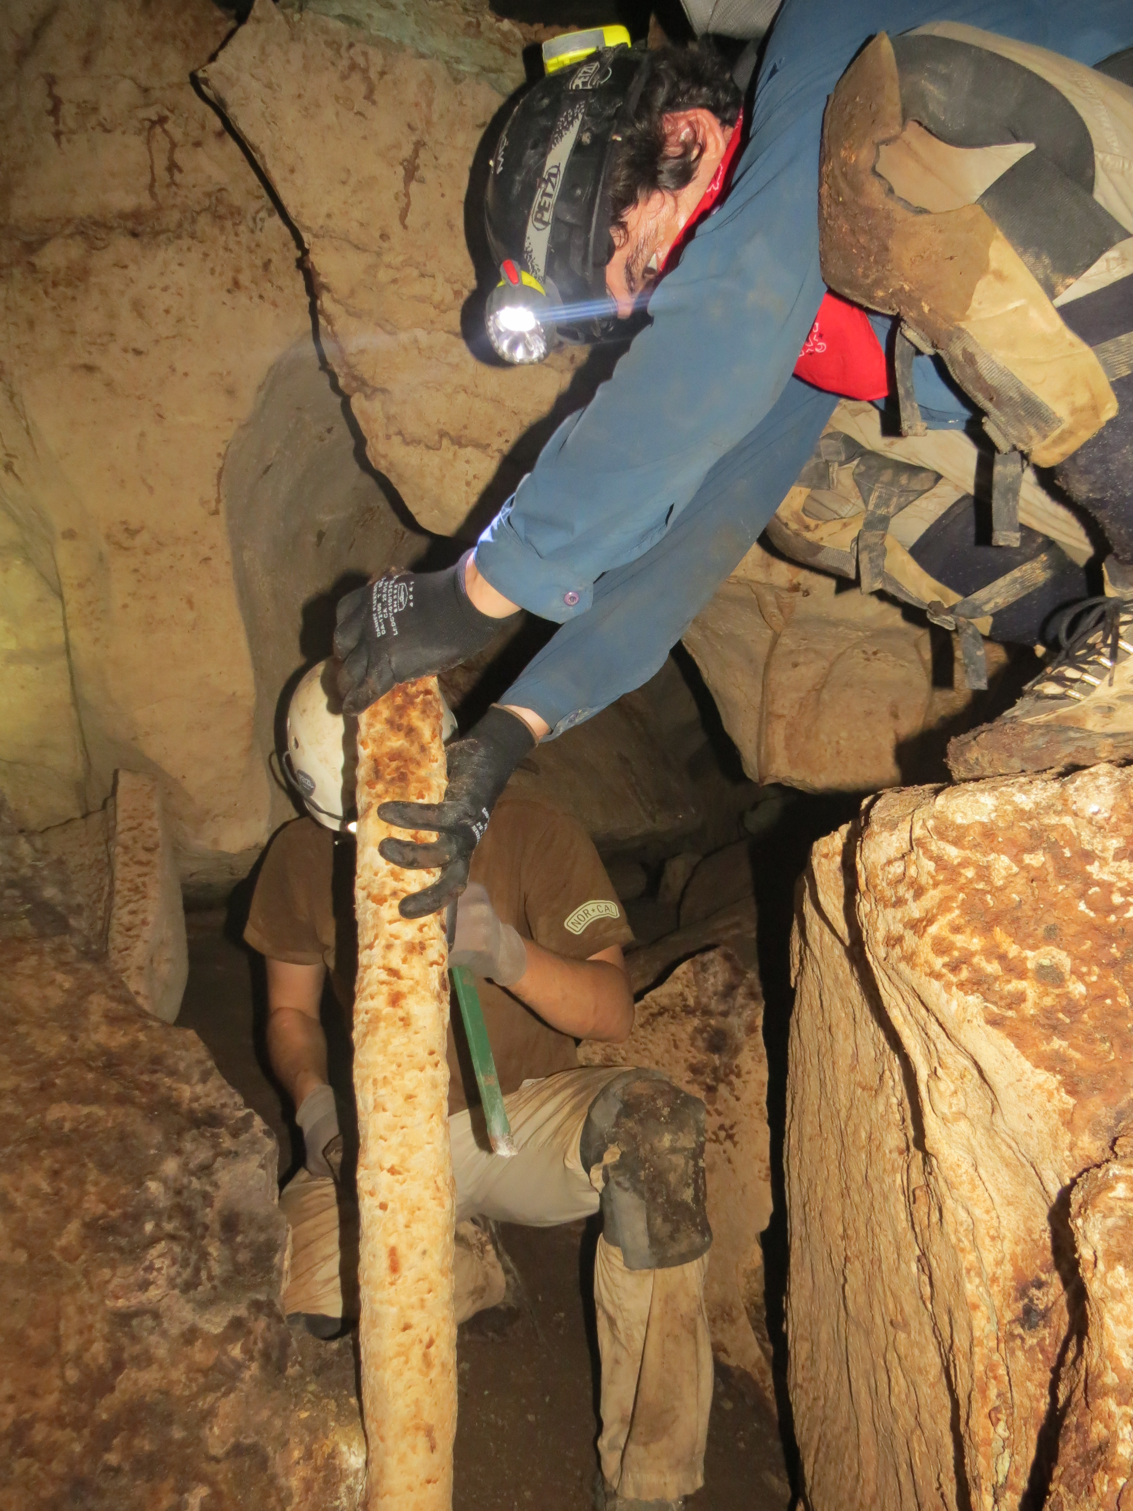
Summer schools on cave research (stalagmites) in Brazil

Slide 4

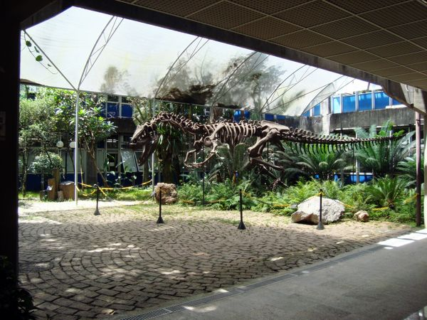
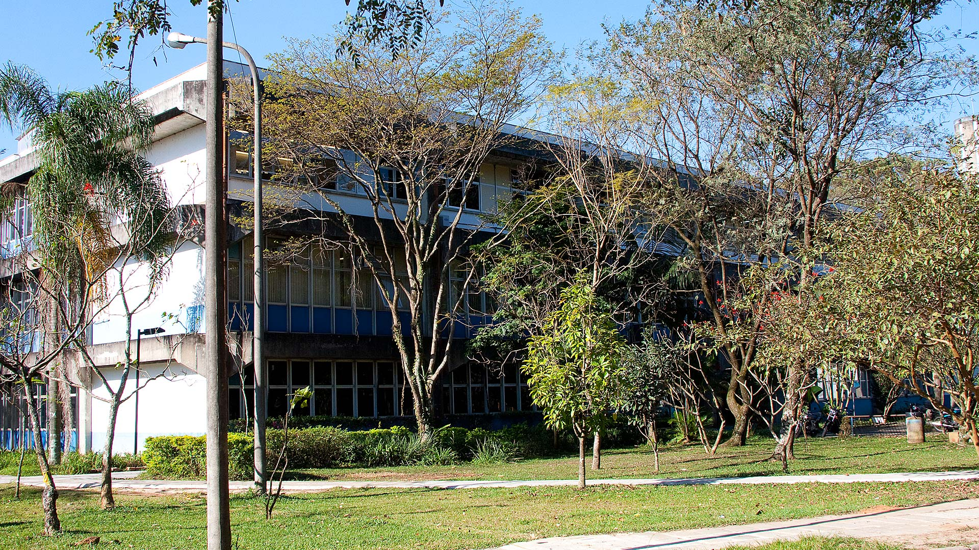

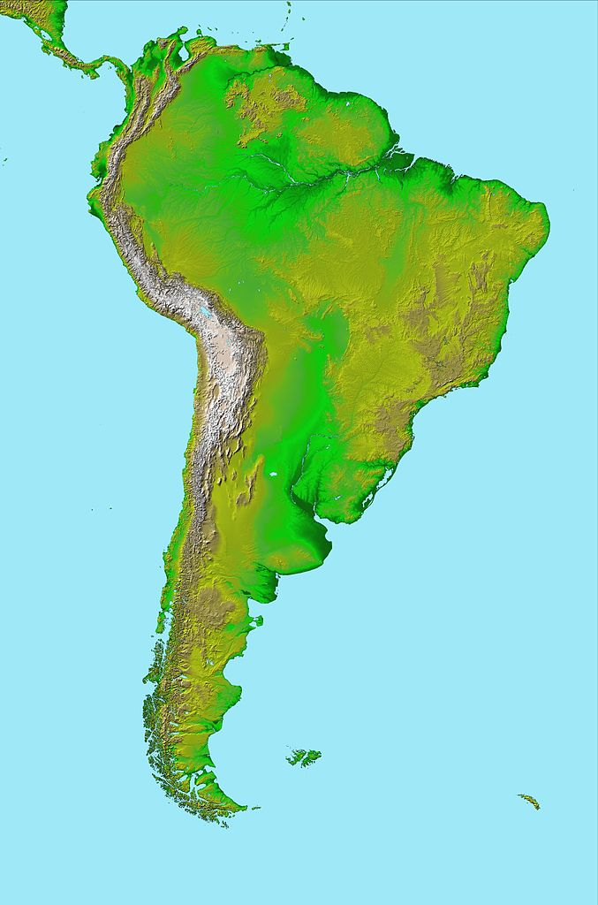
Study abroad opportunities (junior or senior year)
University of Sao Paulo (USP)
•
Requirements: good grades – Intro Portuguese classes
Benefits: full credit for classes taken toward degree (no time lost) – fully paid!

Slide 5
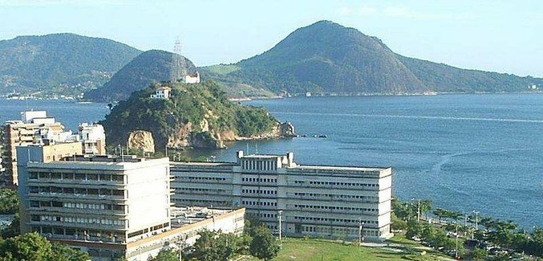

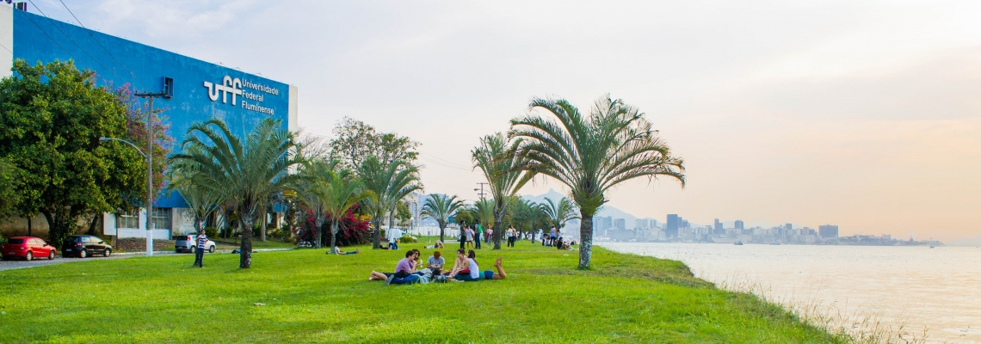
Study abroad opportunities (junior or senior year)
University Federal
Fluminense (UFF)
•
Requirements: good grades – Intro Portuguese classes
Benefits: full credit for classes taken toward degree (no time lost) – fully paid!

Slide 6
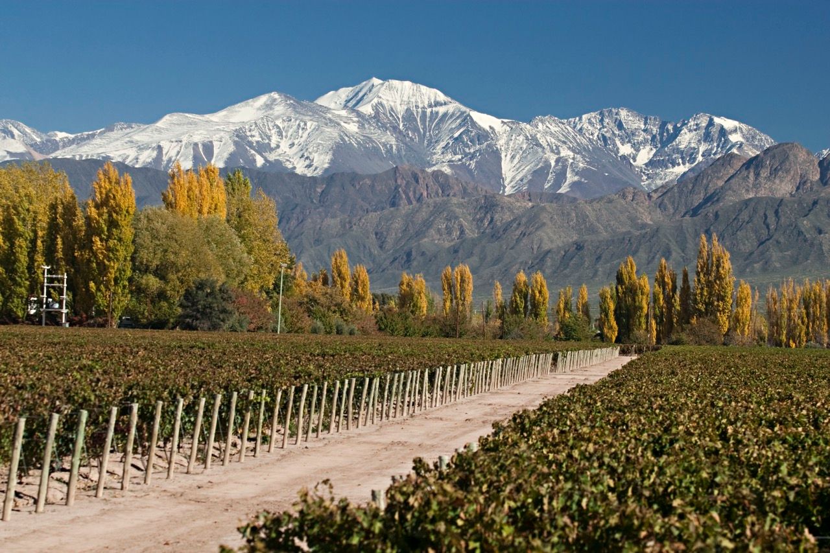
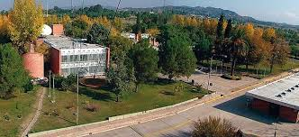

Study abroad opportunities (junior or senior year)
Argentinean Institute for Environmental Glacier and
Snow Research (IANIGLA) in Mendoza
•
Requirements: good grades – Intro Spanish classes
Benefits: Research/Internship credit for time spent – fully paid!

