Slide 1
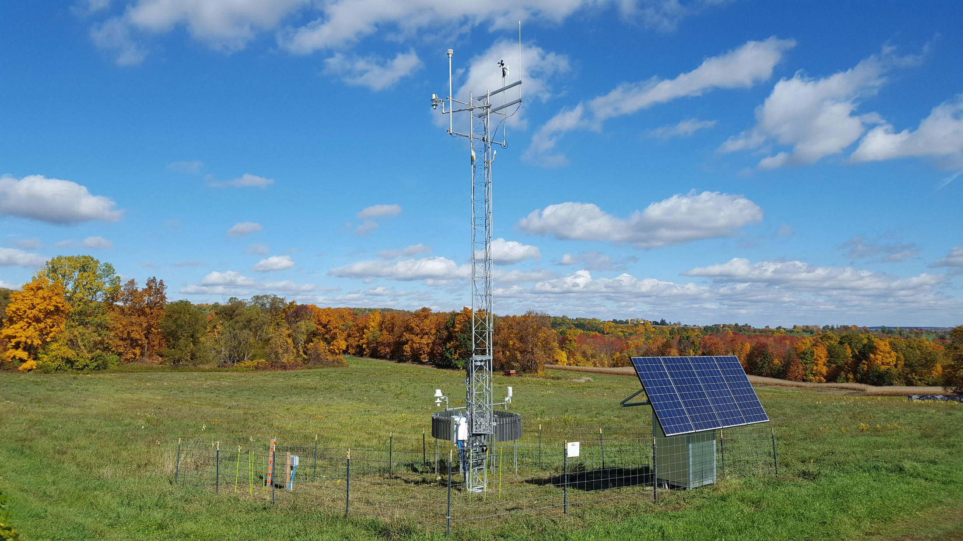
New York State Mesonet
Jerry Brotzge, Ph.D.
Program Manager

Slide 2
Brief Bio
Undergraduate degree – Saint Louis University
Graduate degrees (MS, PhD) – University of Oklahoma
Wanted to do paleoclimatology work, but didn’t have a clue where to go. So, my 2nd option was radar work, and OU was the best option for that. And I had heard how tough OU was, so had to go there.
My advisor had a heart attack, so I switched from radar work to the OK Mesonet.
Hired in 2001 by OU to do SEB/PBL modeling work with CAPS
2003 - Within CAPS, became a program manager for a NSF project called CASA (radar ‘Mesonet’)
2014 – Hired by Ualbany as Program Manager for NYS Mesonet

Slide 3
As a “Program Manager”, what do I do?
Whatever needs to be done! The Mesonet is similar to a “start-up”.
Hiring
Planning (budgeting, siting, purchasing sensors, …)
Scheduling (installs, site visits, ….)
Coordinating (site hosts, contractors, gov’t, private sector, …)
Communicating (internally, externally; speaking, writing, …)

Slide 4
Future employment w/Mesonet?
Unfortunately, few jobs within the ‘mesonet’ community.
However, growing employment opportunities in the energy sector (oil/gas & renewables) for more data/instrumentation expertise
Ever growing need for high-res data (drones! High-res NWP!)
Summer students internships are available!
Please contact June Wang (jwang@albany.edu) or me (jbrotzge@albany.edu)

