Slide 1
A Career With the National Weather Service
Dan Thompson
Meteorologist, General Forecaster
National Weather Service at Albany, NY

Slide 2
Why I Like My Job
Mission Statement: Protection of Lives and Property and Enhancement of the National Economy Science-based service organization
Excitement level of being in the “hot seat” during high-impact weather
Community outreach and developing partnerships
Look at “cool weather stuff” and get paid for it

Slide 3
My Background
MS, Atmospheric Science, SUNY Albany 2010–2012
Born: Eau Claire, WI
Meteorologist Intern, NWSFO Detroit/Pontiac, MI 2013–2016
General Forecaster, NWSFO Albany 2016–present
BS, Atmospheric and Oceanic Sciences, University of Wisconsin – Madison 2004–2008
Meteorologist, WeatherWorks 2012–2013
Meteorologist/Graphics Technician, Weather Central, Inc. 2008–2010

Slide 4
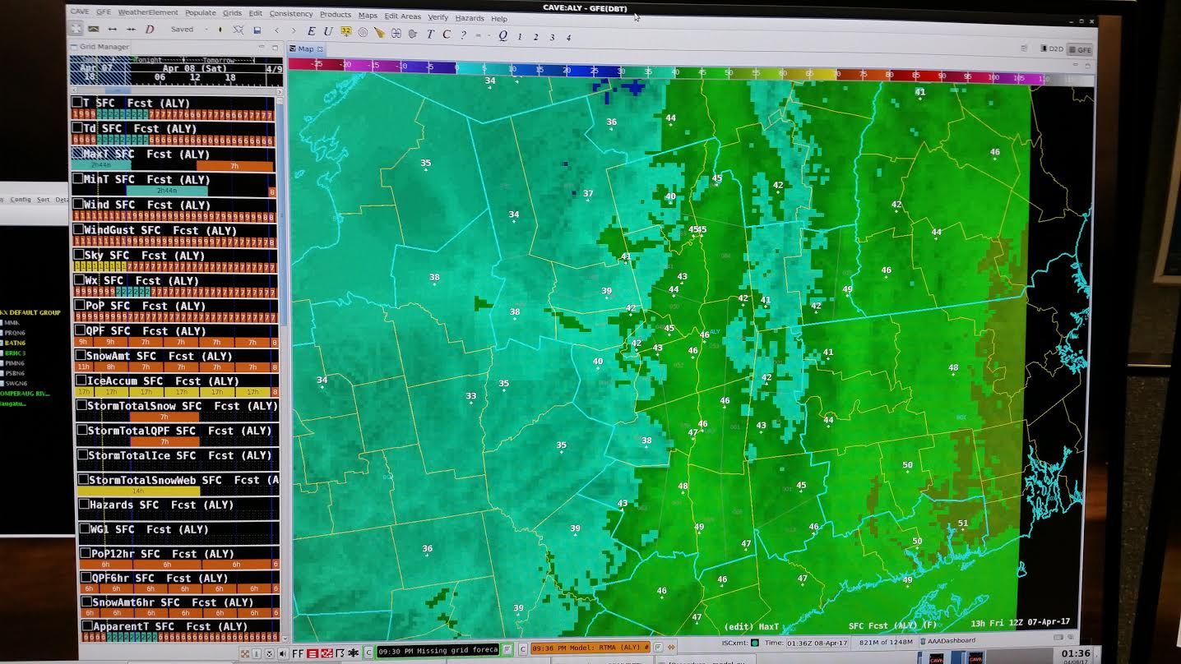
Responsibilities
Government
Department of Commerce
NWS – National Weather Service
NOAA – National Oceanic and Atmospheric Administration
Department of Defense
Military
NASA (Space Weather)
ENCON (NYS)
Aviation
FAA

Slide 5
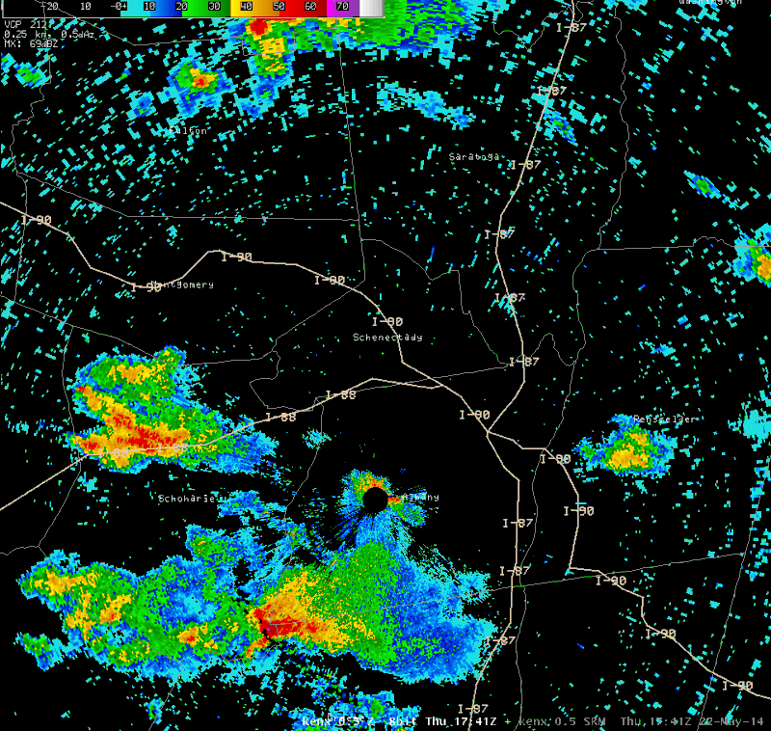
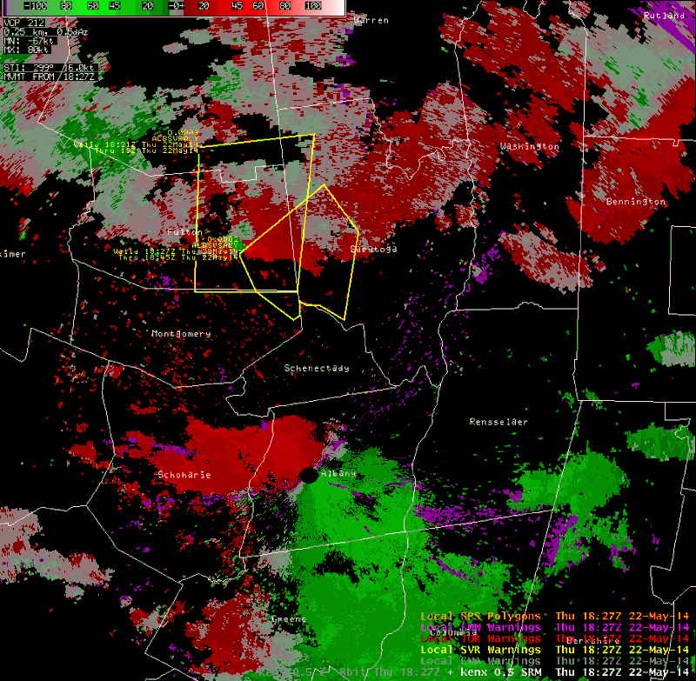
Responsibilities
Government
Department of Commerce
NWS – National Weather Service
NOAA – National Oceanic and Atmospheric Administration
Department of Defense
Military
NASA (Space Weather)
ENCON (NYS)
Aviation
FAA

Slide 6
Responsibilities
Program Management/Extracurricular Activities
Aviation
Marine
Hydrology
Fire Weather
Research
Upper Air
Data Collection
AWIPS/Computers
Doppler Radar
Weather Radio
Web Site
Outreach
Spotter Training
Climate Data
Social Media

Slide 7
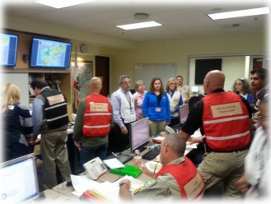
NWS Evolve
WFOs Transitioning to IDSS – Impact-Based Decision Support Services
IDSS – Connecting our forecasts and warnings to decision-makers on the local, state, and federal levels to save lives and property
Examples:
NWS meteorologists embedded with local/state emergency managers
Working with our partners to determine their weather-related needs and thresholds

Slide 8
National Weather Service Forecast Office Structure
Meteorologist-in-Charge
Warning
Coordination
Meteorologist
Administrative
Support
Assistant
Science &
Operations
Officer
Service
Hydrologist
5 Senior
Forecasters
5 General
Forecasters
Observing
Program
Leader
3 HMTs/Interns
Electronic
Systems
Analyst
3 Electronic
Technicians
Information
Technology
Officer

Slide 9
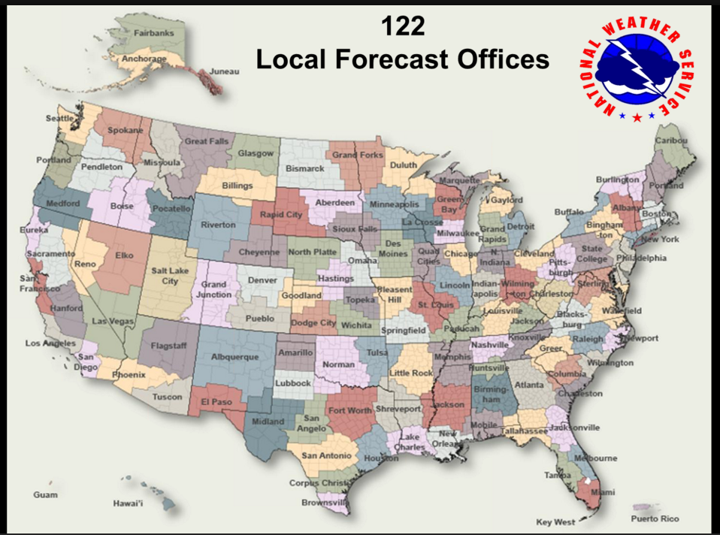
Other Considerations
Rotating shift work
Quiet vs. Active weather
Supply vs. demand
Moving around

Slide 10
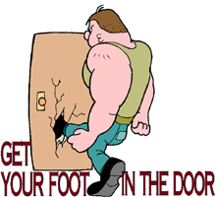
Tips for Employment
Experience – NWS Internships, Pathways, Private Sector
Advanced degree – research/teaching experience
Extra coursework – GIS, Communications, Social Media, Emergency Management
Get yourself a good recommendation
Don’t be afraid to fail
Job postings: USAJobs.gov

Slide 11
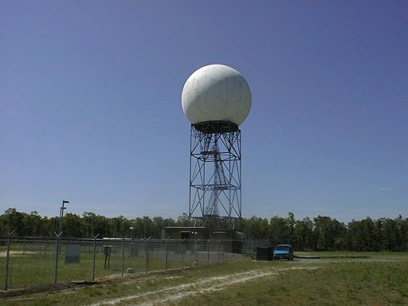
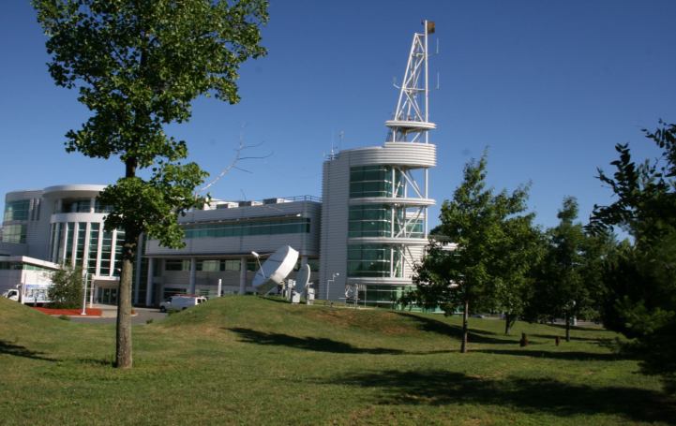
Contact
dan.b.thompson@noaa.gov

