Slide 1
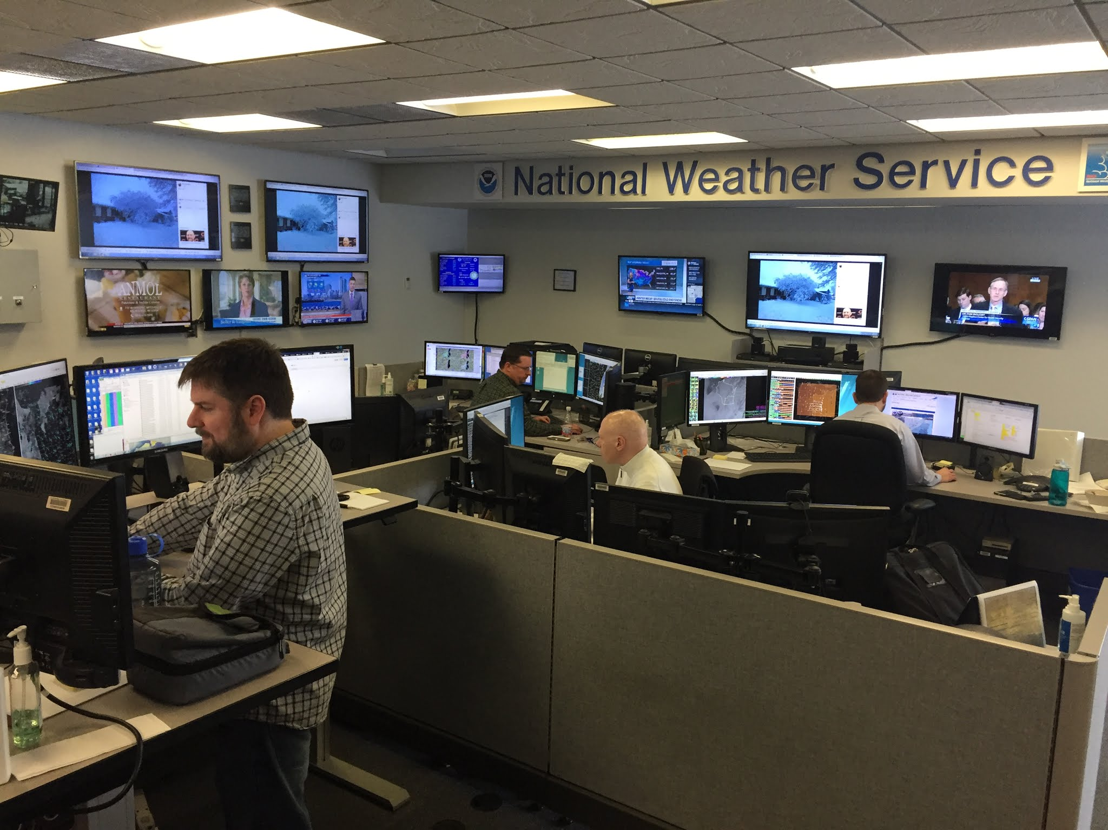
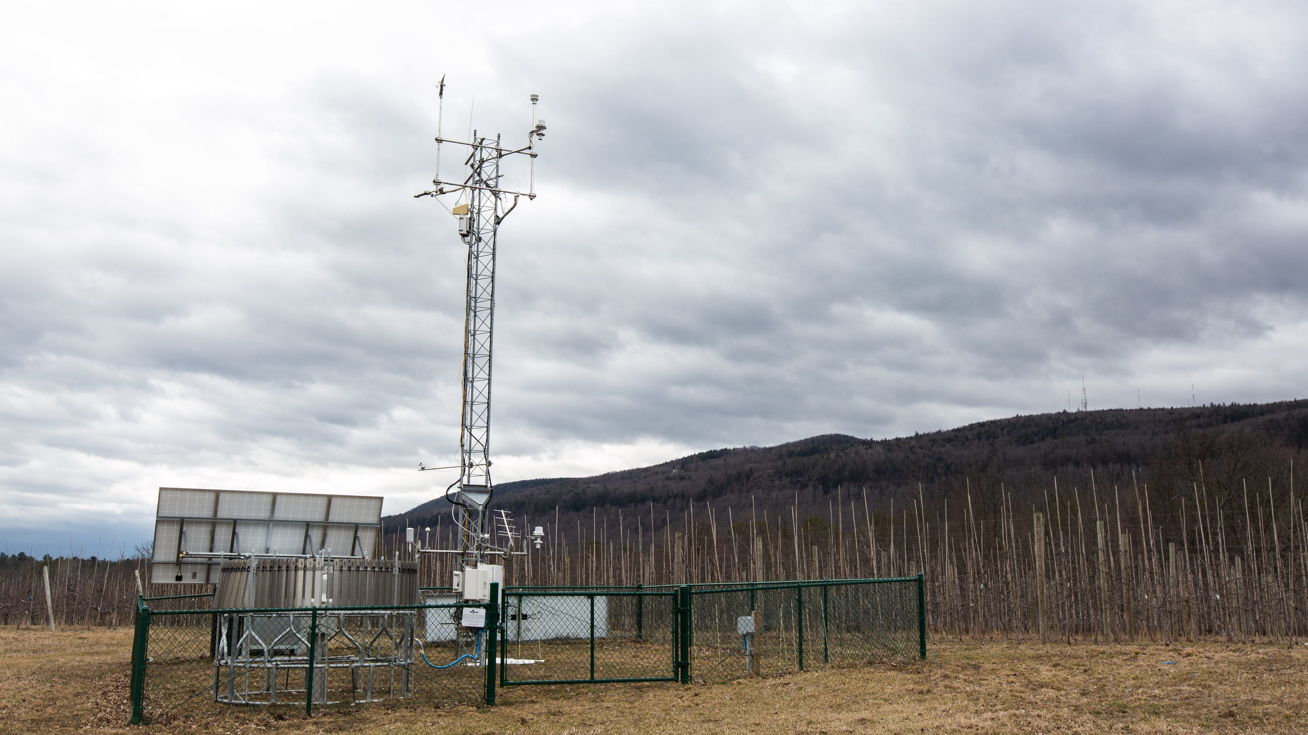
Undergraduate Internships
Department of Atmospheric and Environmental Sciences
New York State Mesonet
National Weather Service

Slide 2
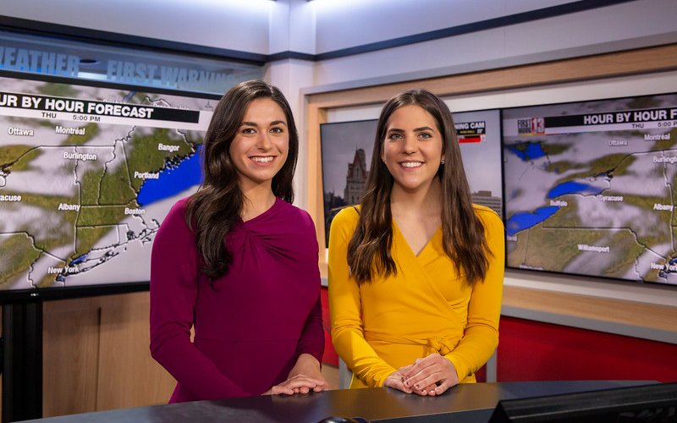
Undergraduate Internships
Department of Atmospheric and Environmental Sciences
NYS Office of Emergency Management
Broadcast meteorology
Private sector

Slide 3
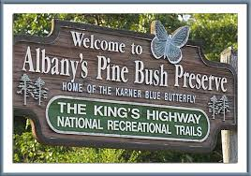
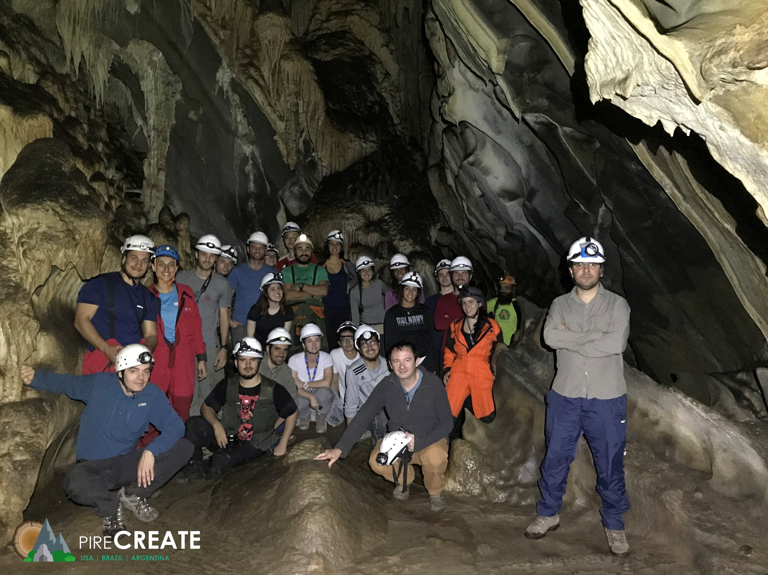
Undergraduate Internships
Department of Atmospheric and Environmental Sciences

Slide 4
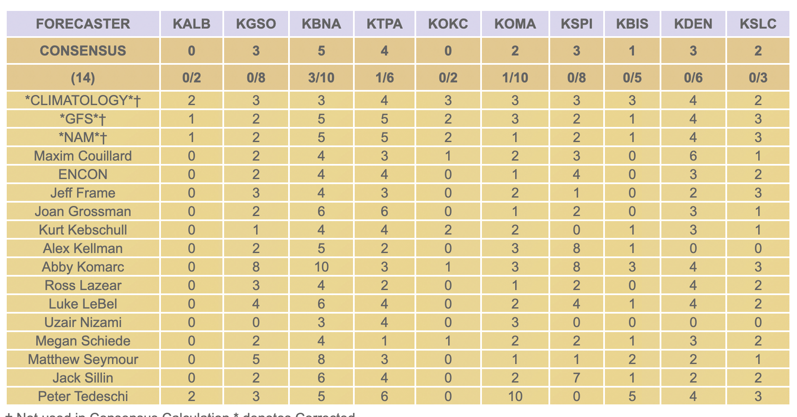
UAlbany Thunderstorm Forecast Contest

Slide 5
UAlbany Thunderstorm Forecast Contest

Slide 6
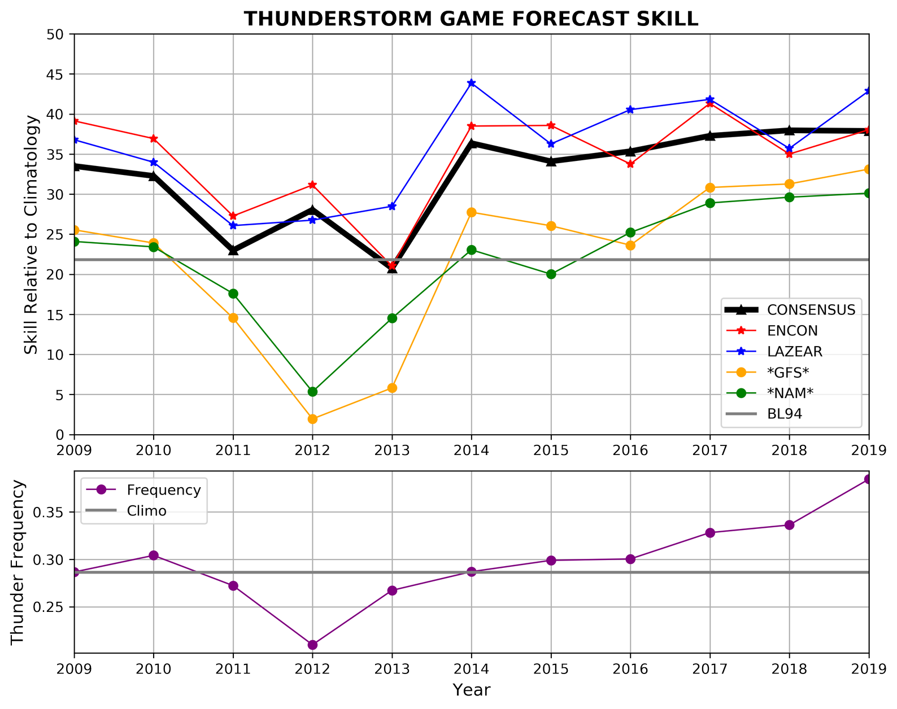
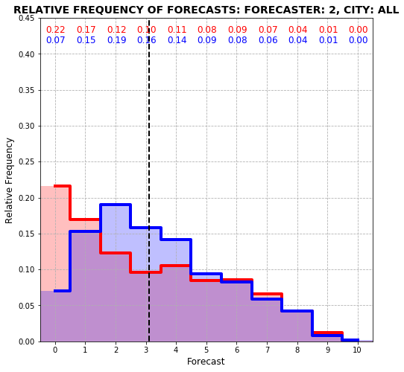
UAlbany Thunderstorm Forecast Contest
1983–94 2009–19

Slide 7
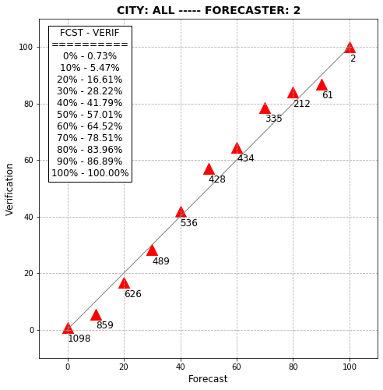
UAlbany Thunderstorm Forecast Contest
1983–94
2009–19

