Slide 1
Supercell Thunderstorms and Tornadoes in Upstate New York
Ross A. Lazear
Dept. of Atmospheric and Environmental Sciences
University at Albany, SUNY
Cohoes High School Science Symposium, June 11, 2015

Slide 2
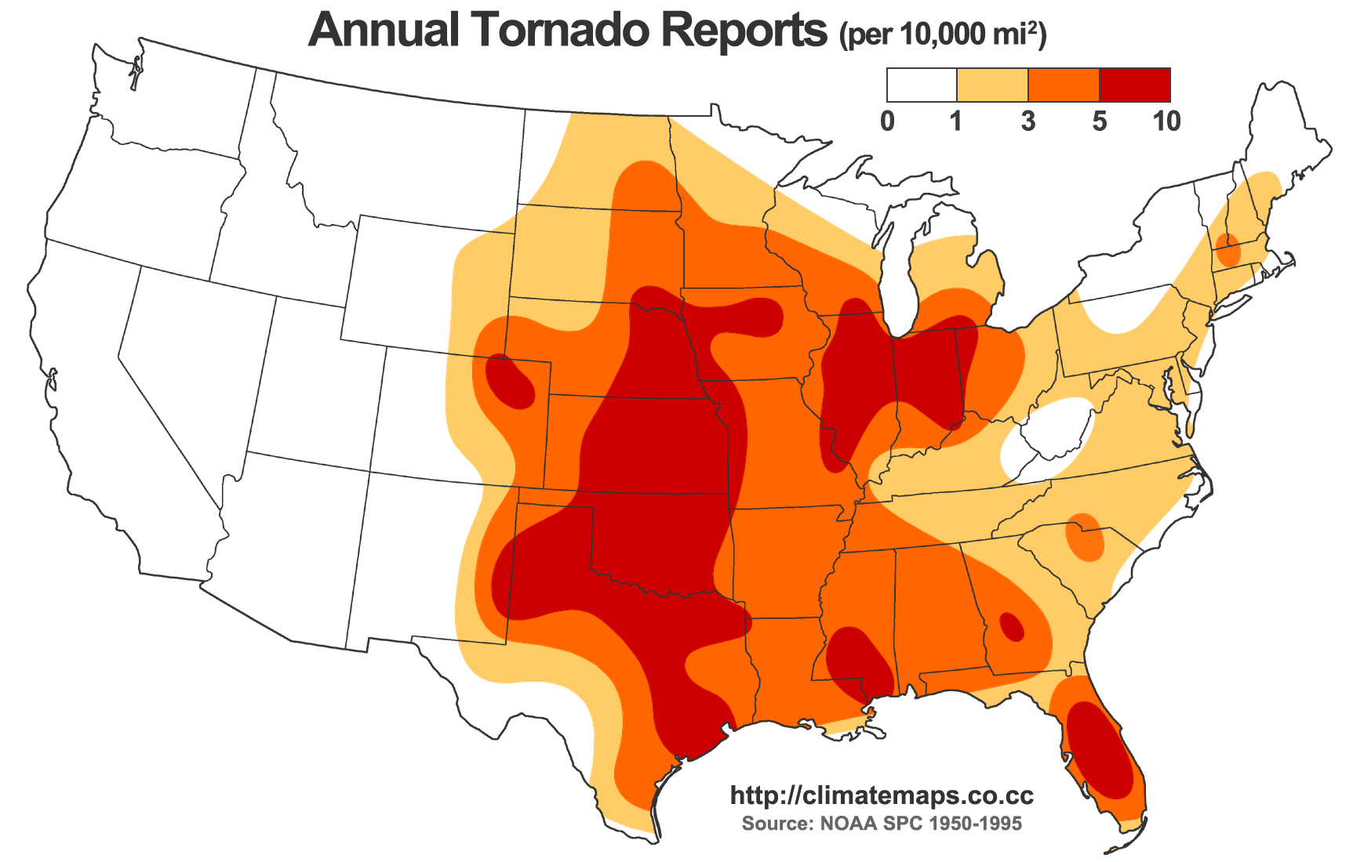

Slide 3
Recent Major Tornadoes in the Northeast
• Great Barrington, MA – May 29, 1995
• Mechanicville, NY – May 31, 1998
• Springfield, MA – June 1, 2011
• Duanesburg, NY – May 22, 2014
• Smithfield, NY – July 8, 2014

Slide 4
Recent Major Tornadoes in the Northeast
• Great Barrington, MA – May 29, 1995
• Mechanicville, NY – May 31, 1998
• Springfield, MA – June 1, 2011
• Duanesburg, NY – May 22, 2014
• Smithfield, NY – July 8, 2014

Slide 5
Ingredients for the Development of a Rotating Storm
• Warm, moist air at surface
• Cool, dry air aloft (> ~2 km above surface)
-Unstable environment
• Change in wind speed and direction with height
-Wind shear

Slide 6
Unstable environment
-- ~10 km: Top of troposphere
Cold, dry air aloft
--1 km
Warm, moist air

Slide 7
Unstable environment
-- ~10 km: Top of troposphere
Cold, dry air aloft
More dense
--1 km
Warm, moist air
Less dense

Slide 8

Unstable environment
-- ~10 km: Top of troposphere
Cold, dry air aloft
More dense
--1 km
Warm, moist air
Less dense

Slide 9

Photo by Ross Lazear
Kerrville, Texas
Now we have convection (cumulonimbus).
How do we get ROTATION?

Slide 10
Vertical wind shear
Change in wind speed and direction with height
10 km
5 km
N
Surface
E
S

Slide 11
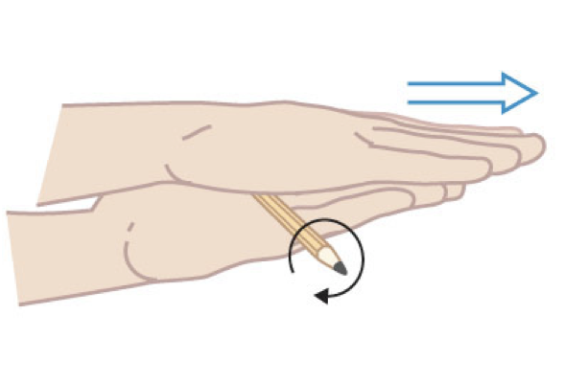
Vertical wind shear
Change in wind speed and direction with height
Wind shear creates a horizontal vortex

Slide 12
Add instability . . .
10 km
5 km
COLD, DRY, MORE DENSE
N
WARM, MOIST, LESS DENSE
Surface
E
S

Slide 13
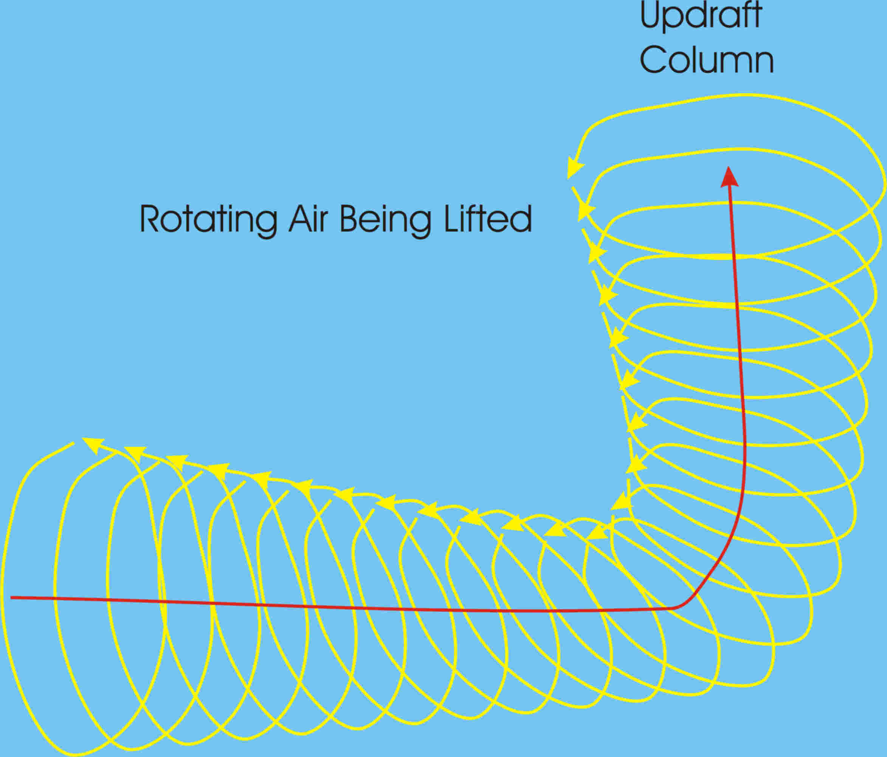
Convective “updraft” plus Vertical wind shear
From MadSciTech.org

Slide 14
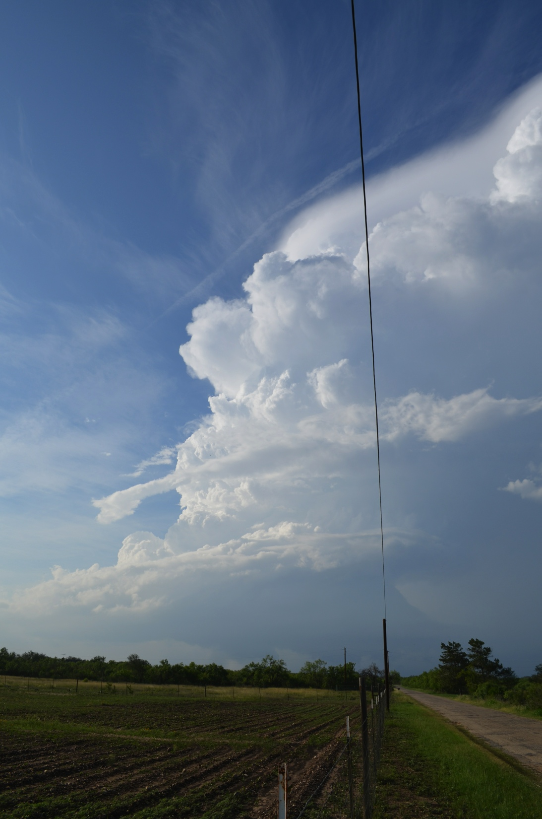
May 27
2014
CastrovilleTexas

Slide 15
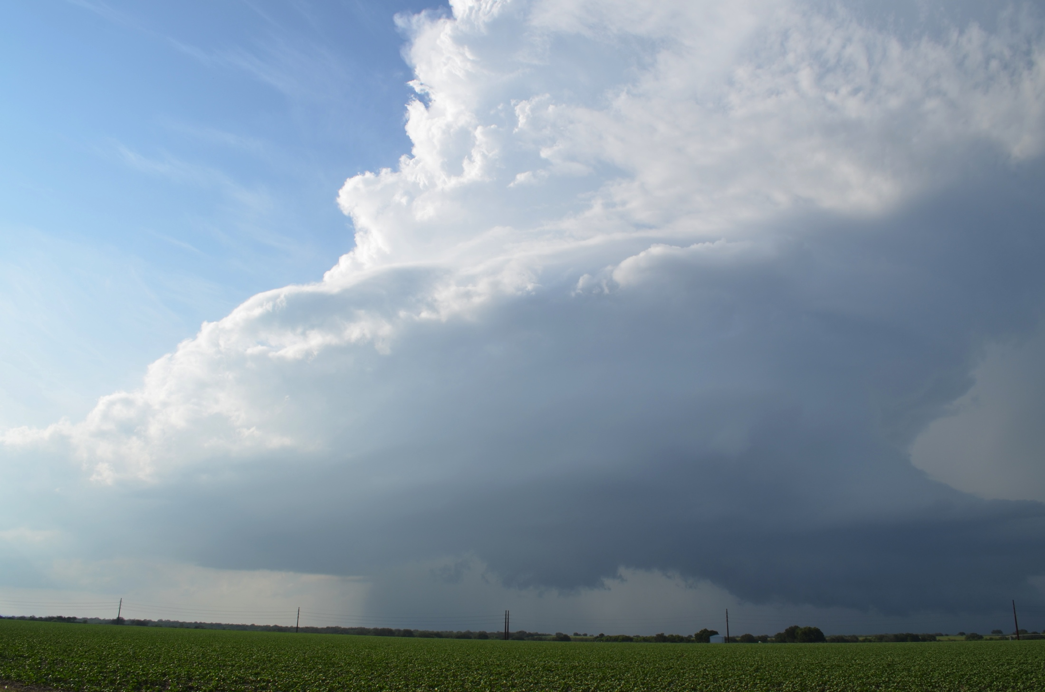
May 27, 2014 – Castroville, Texas

Slide 16
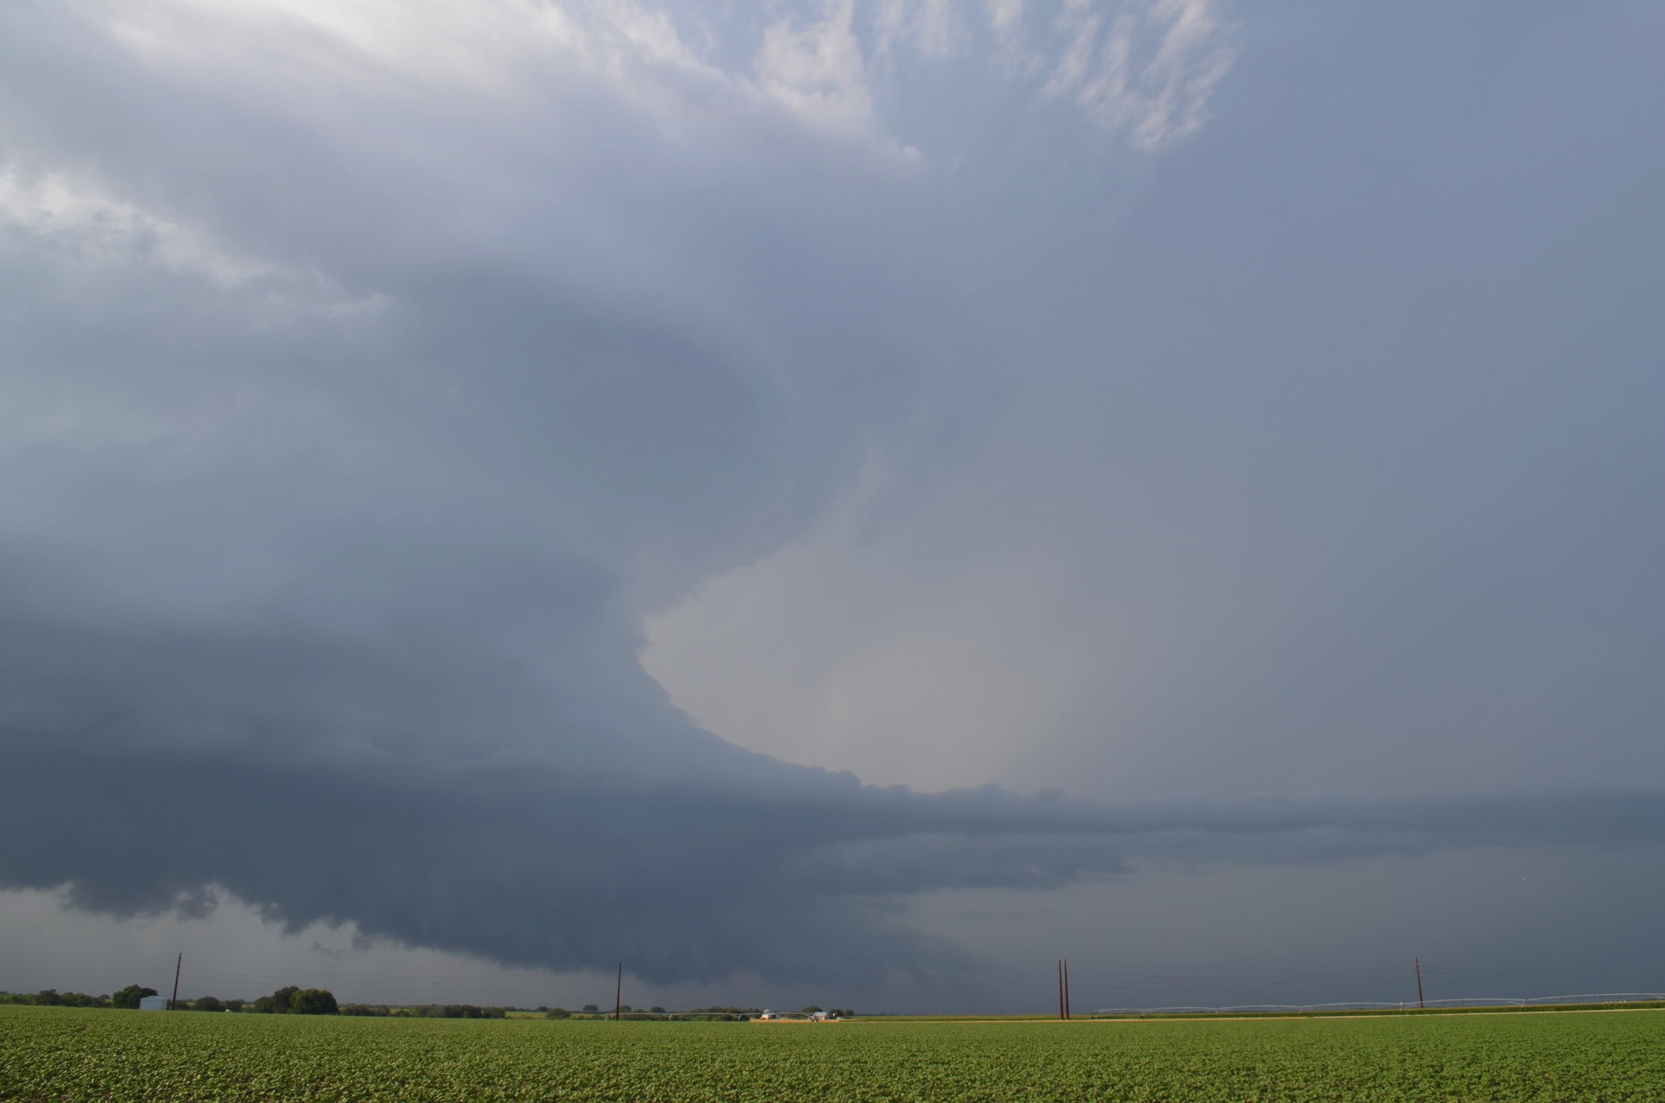
May 27, 2014 – Castroville, Texas

Slide 17
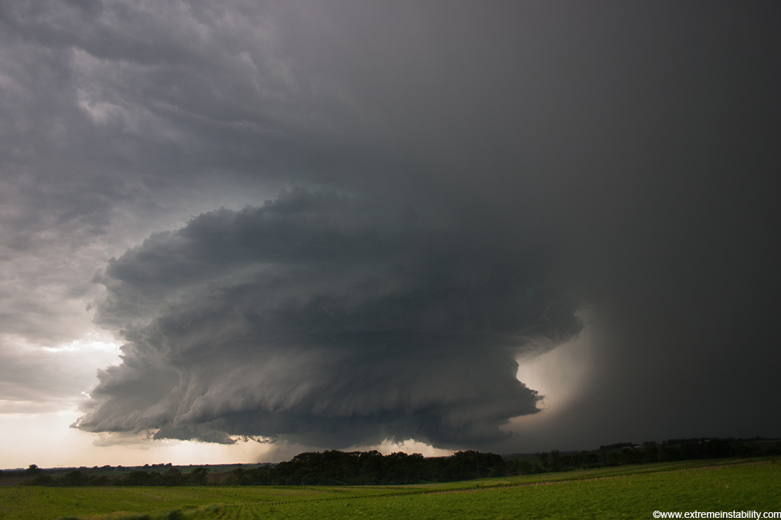
Photo by Mike Hollingshead
June 13, 2004 – Alvo, Nebraska

Slide 18
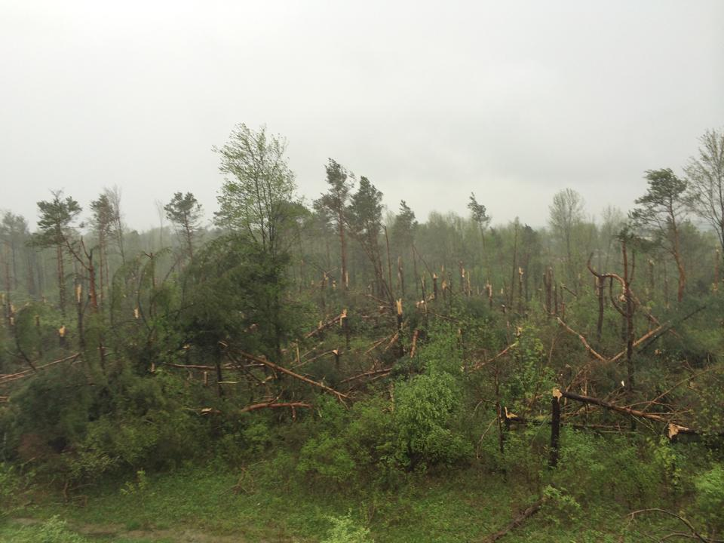
Duanesburg EF-3 Tornado
May 22, 2014
Photo by Craig Duesler

Slide 19
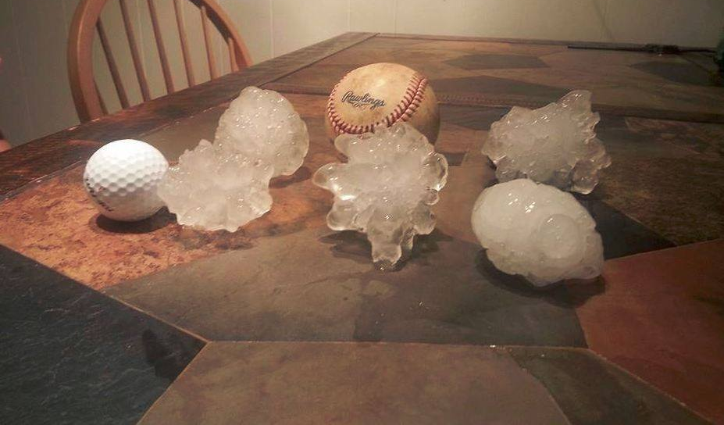
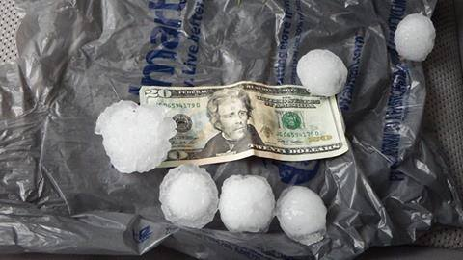
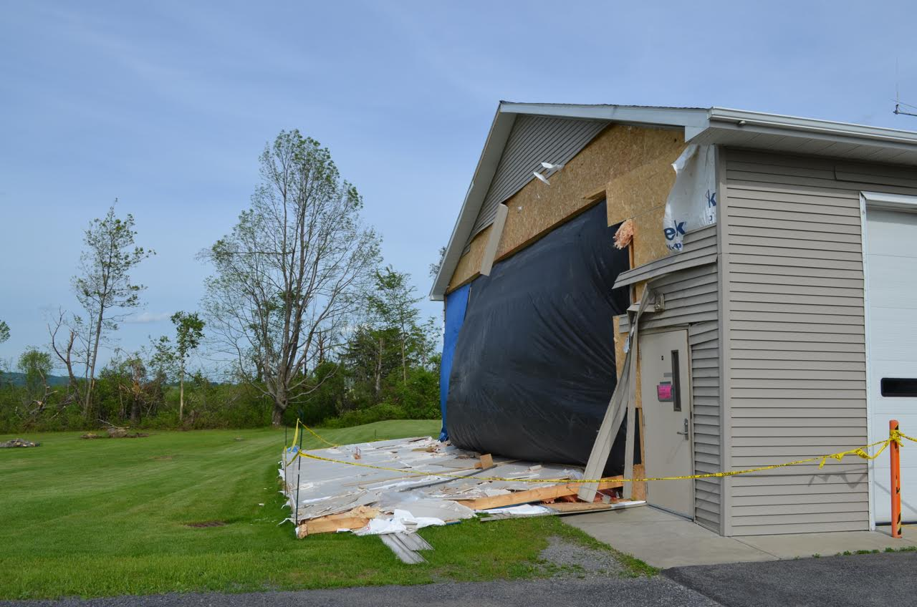
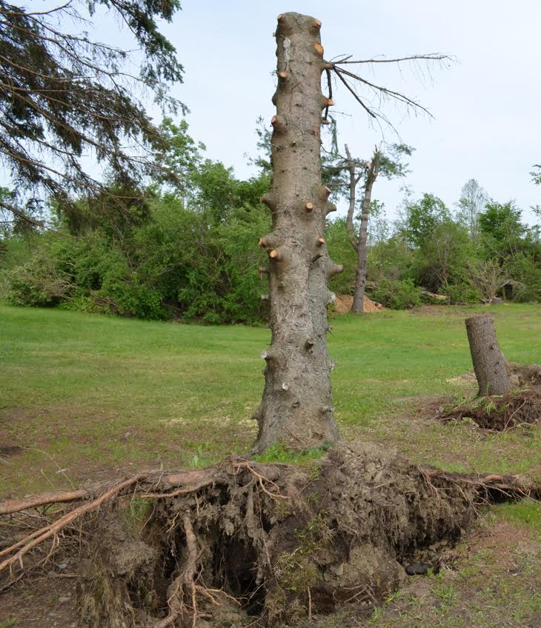
Duanesburg EF-3 Tornado
May 22, 2014
Photo by Rich Iwanski
Photo by Mike Robinson
Photos by Ross Lazear

Slide 20
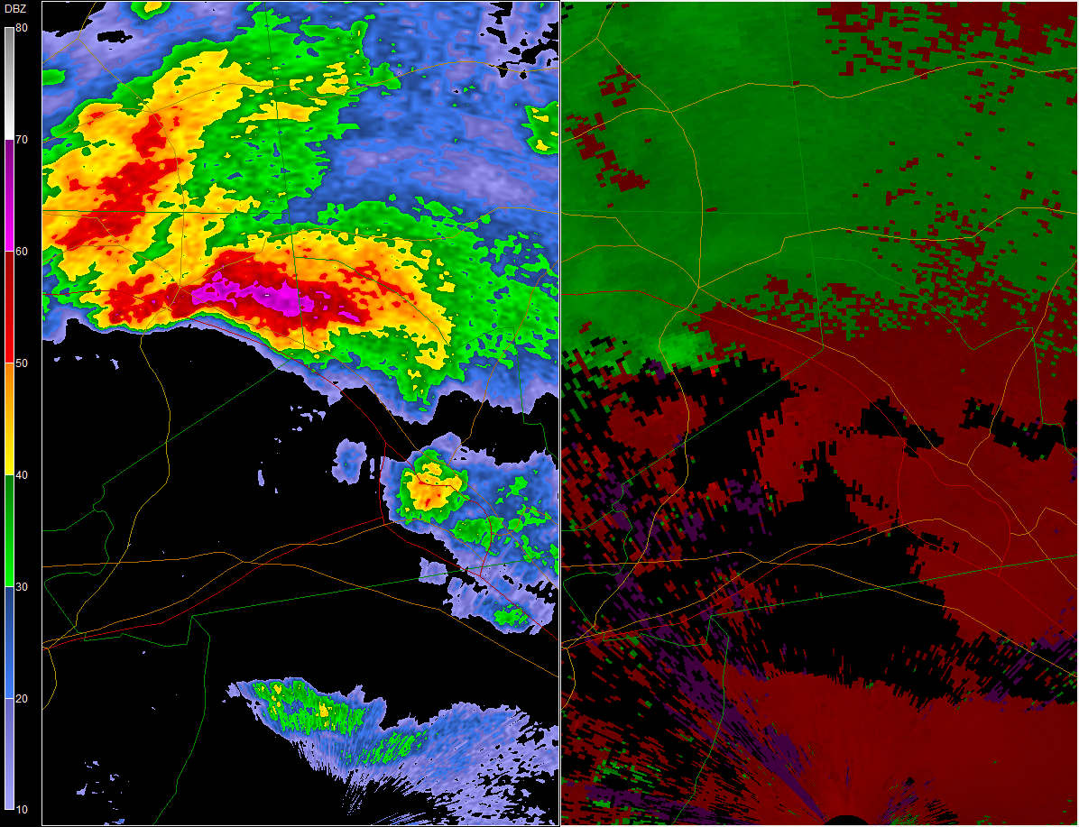
Duanesburg, NY Tornado
Schenectady
Schenectady

Slide 21
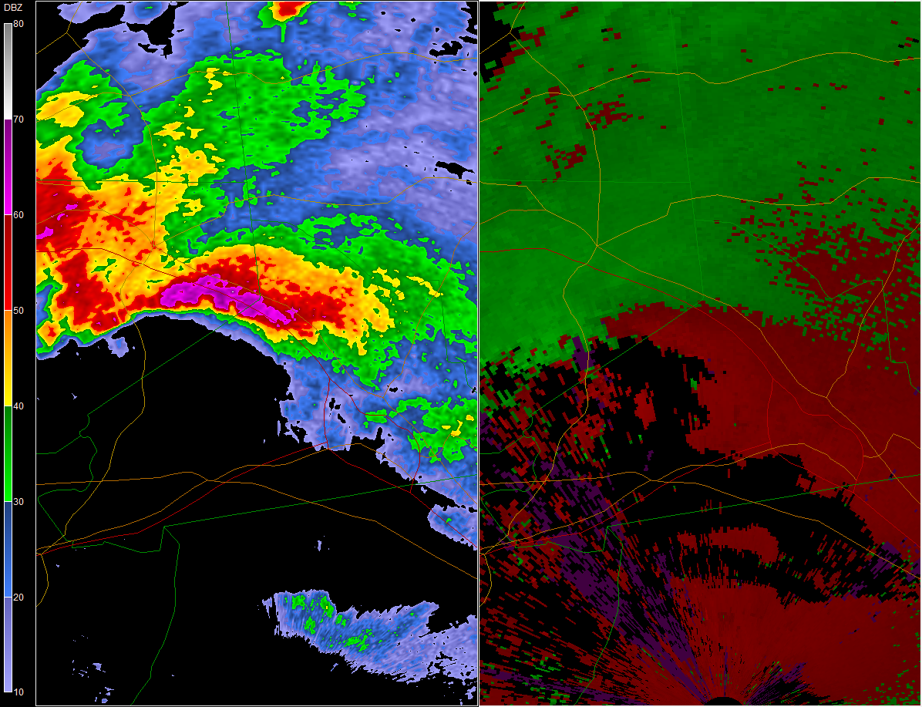
Duanesburg, NY Tornado
Schenectady
Schenectady

Slide 22
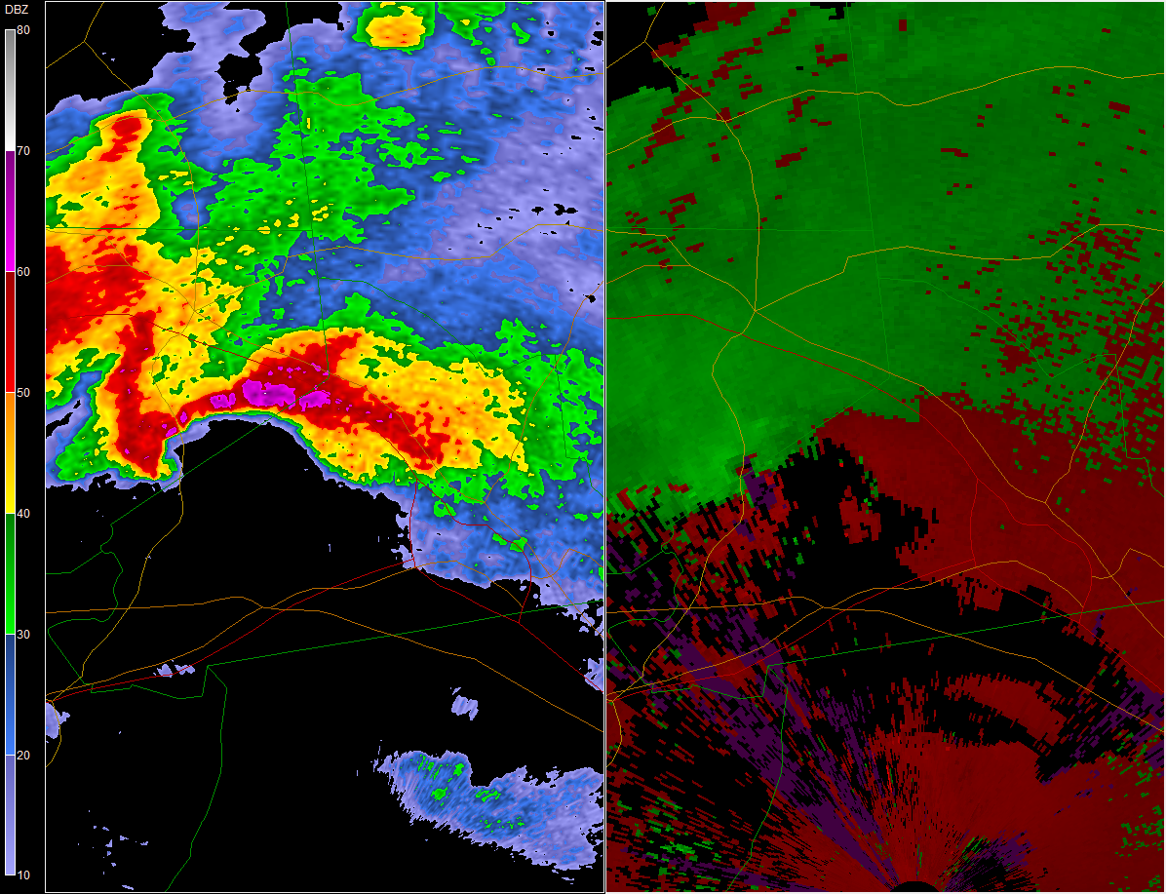
Duanesburg, NY Tornado
Schenectady
Schenectady

Slide 23
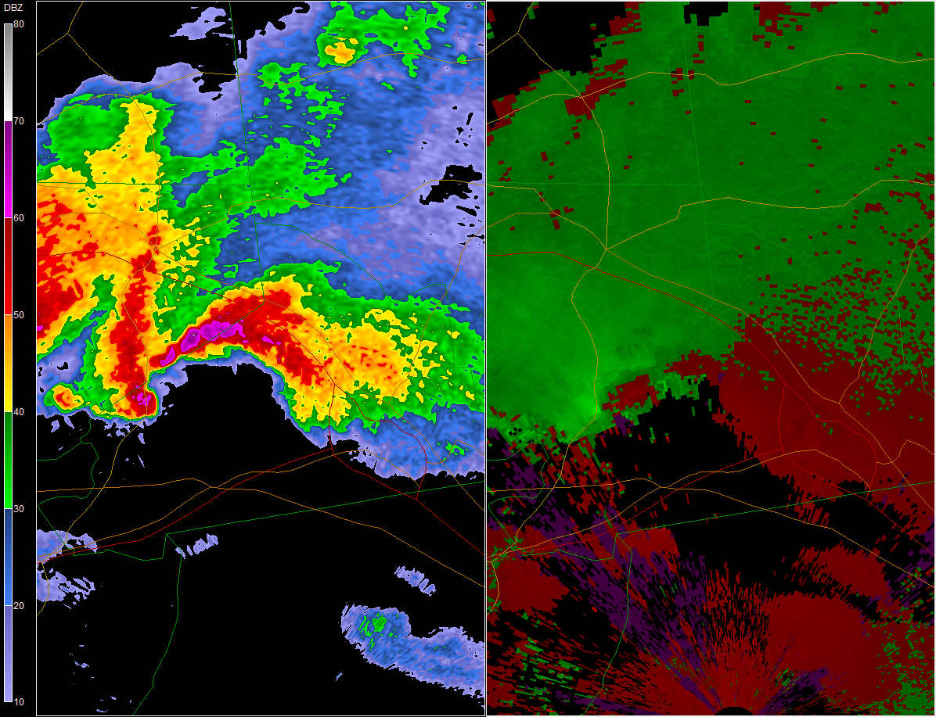
Duanesburg, NY Tornado
Schenectady
Schenectady

Slide 24
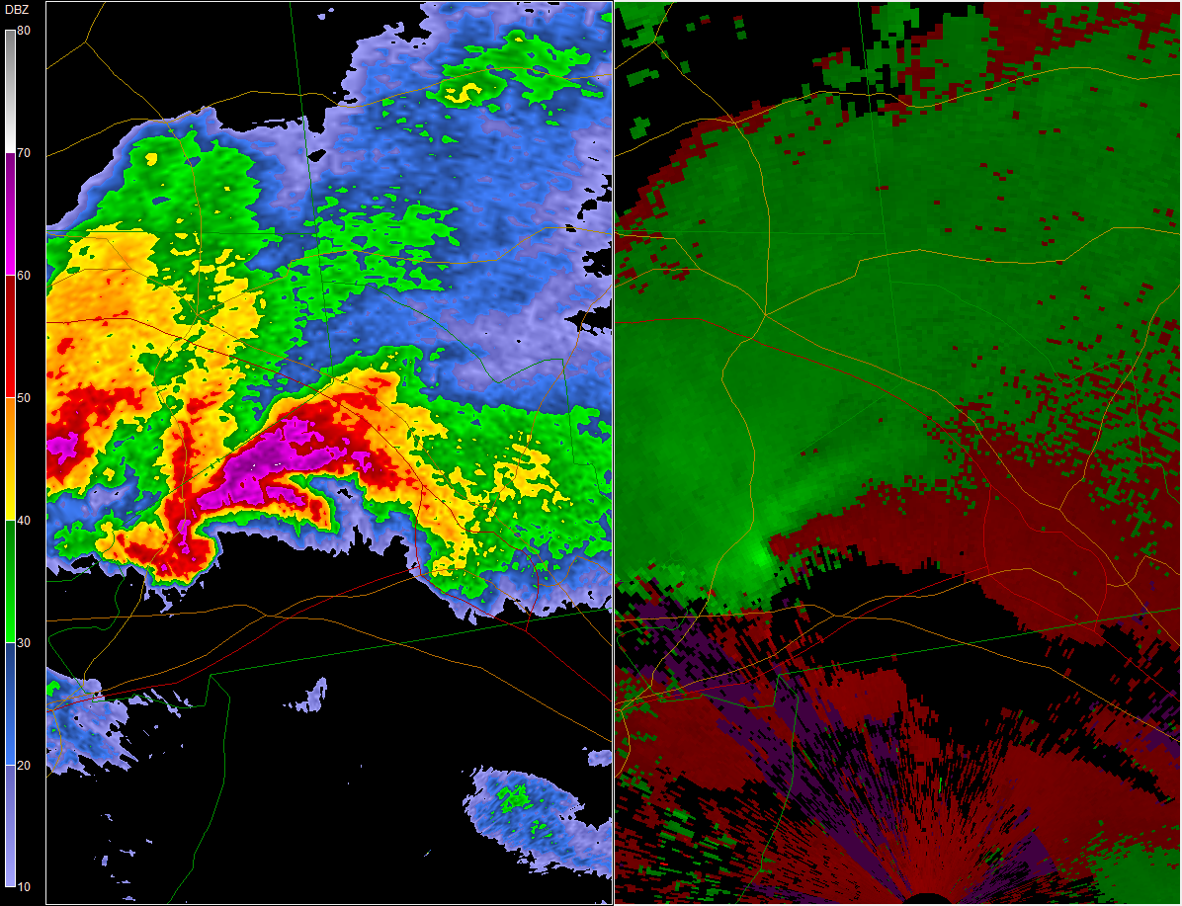
Duanesburg, NY Tornado
Schenectady
Schenectady

Slide 25
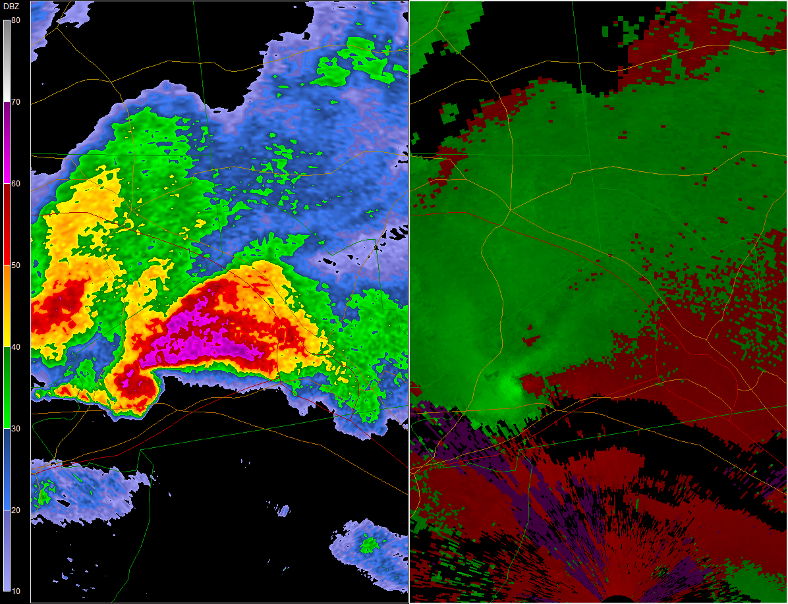
Duanesburg, NY Tornado
Schenectady
Schenectady

Slide 26
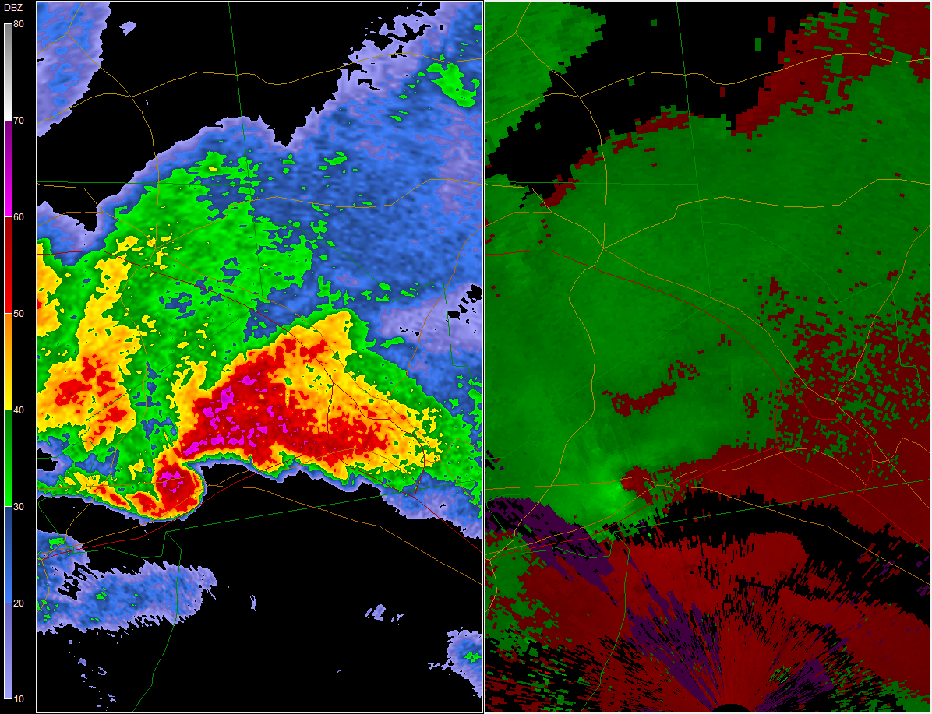
Duanesburg, NY Tornado
Schenectady
Schenectady

Slide 27
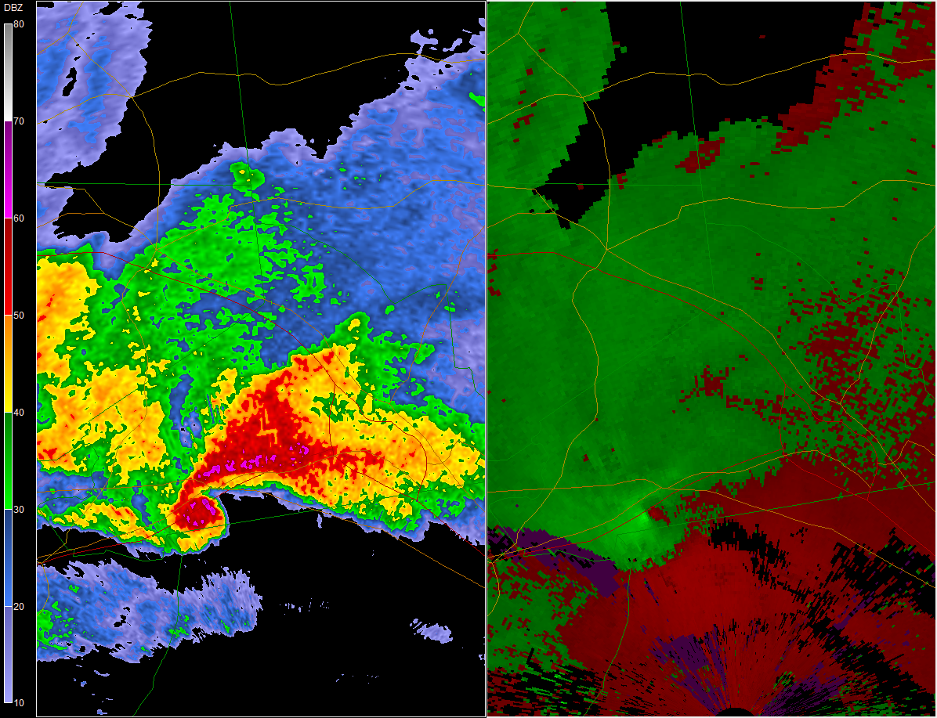
Duanesburg, NY Tornado
Schenectady
Schenectady

Slide 28
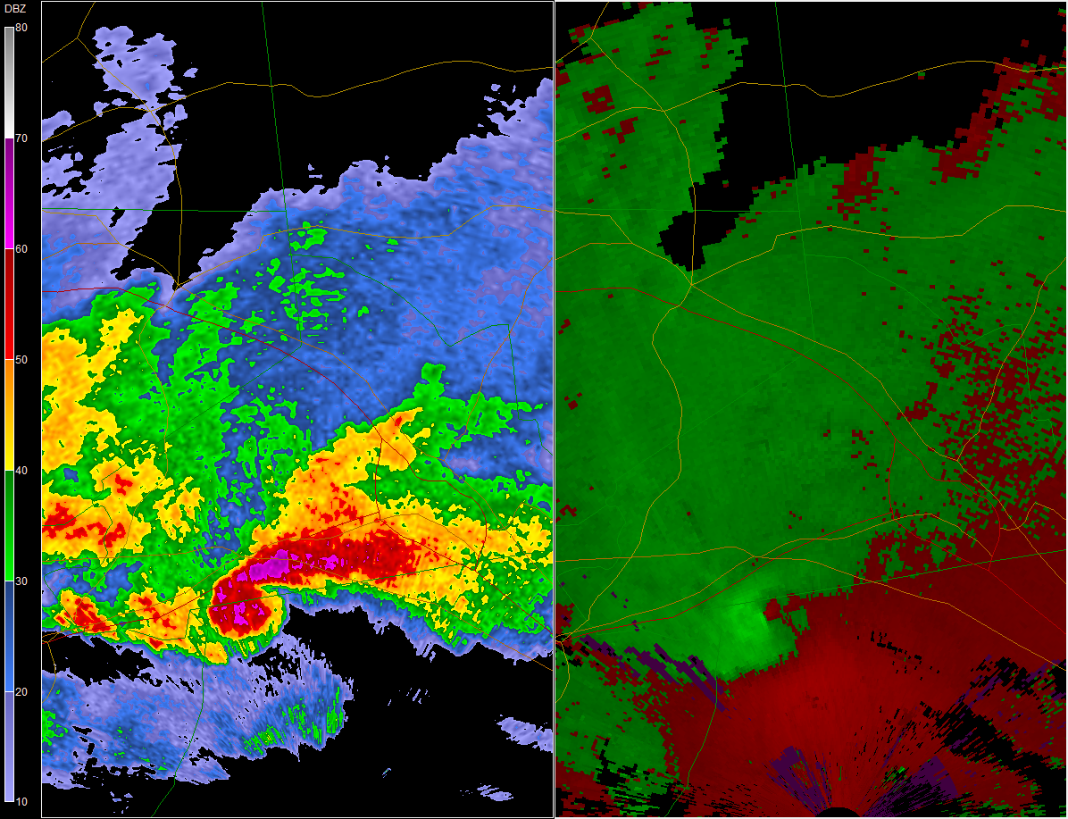
Duanesburg, NY Tornado
Schenectady
Schenectady

Slide 29
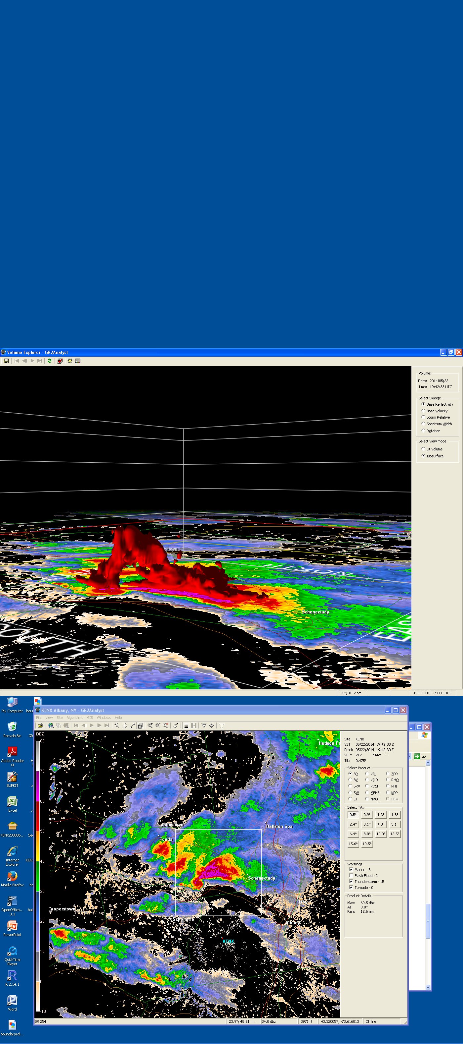
Duanesburg, NY Tornado

Slide 30
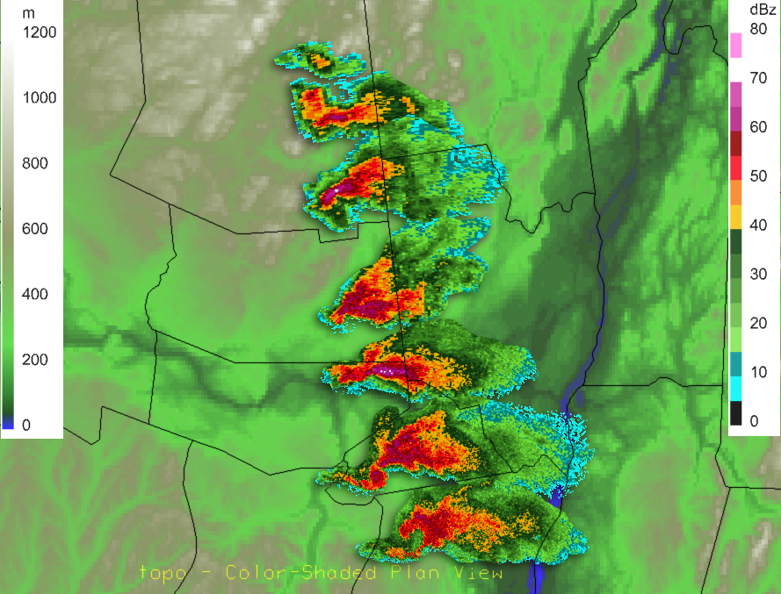
1528Z
1630Z
1731Z
1832Z
1905Z
Amsterdam
1947Z
Duanesburg
2015Z
Albany
Notes:
Radar montage. 1) Convective initiation. Descended down the SE side of the Adirondacks. Weakening signature as it did so (not shown) 2) Became reinvigorated in the Mohawk Valley around 1832Z, cross the Mohawk River 1905Z, cycling again, and then forming a classic supercell structure S of of Mohawk River, where the tornado occurred, before occluding and dissipating over Albany County.

Slide 31
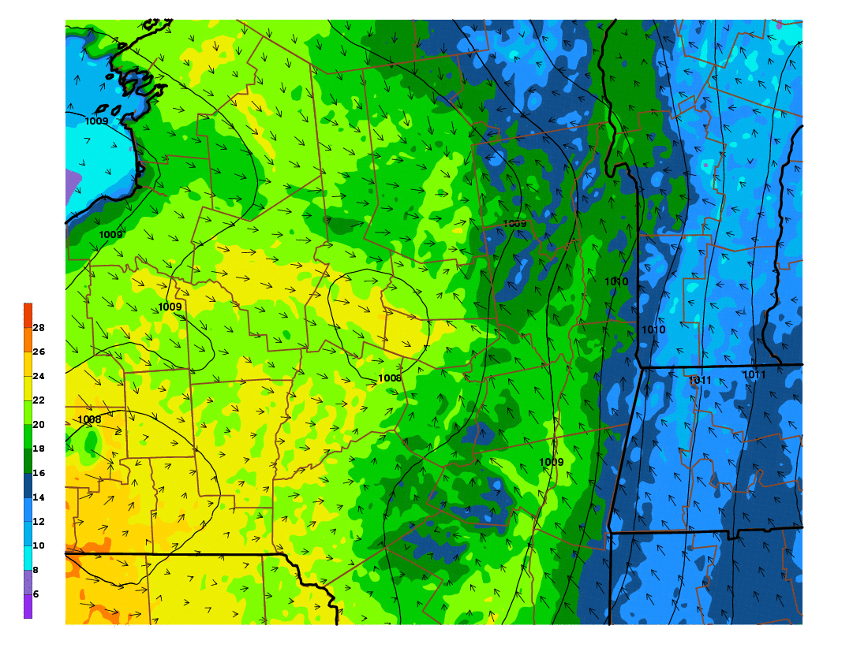

Slide 32
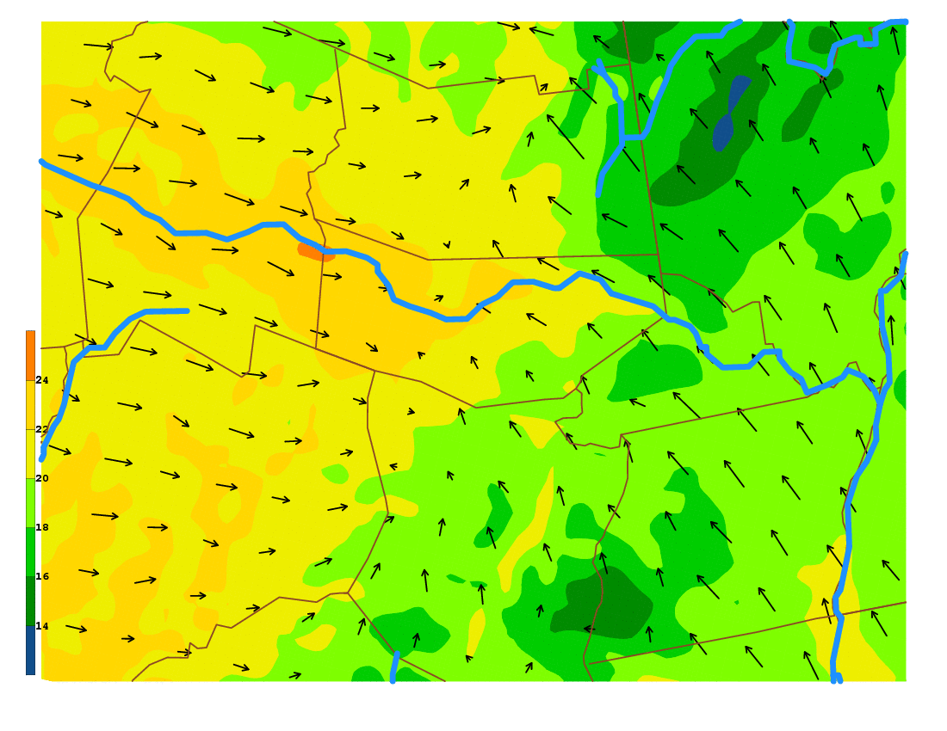

Slide 33
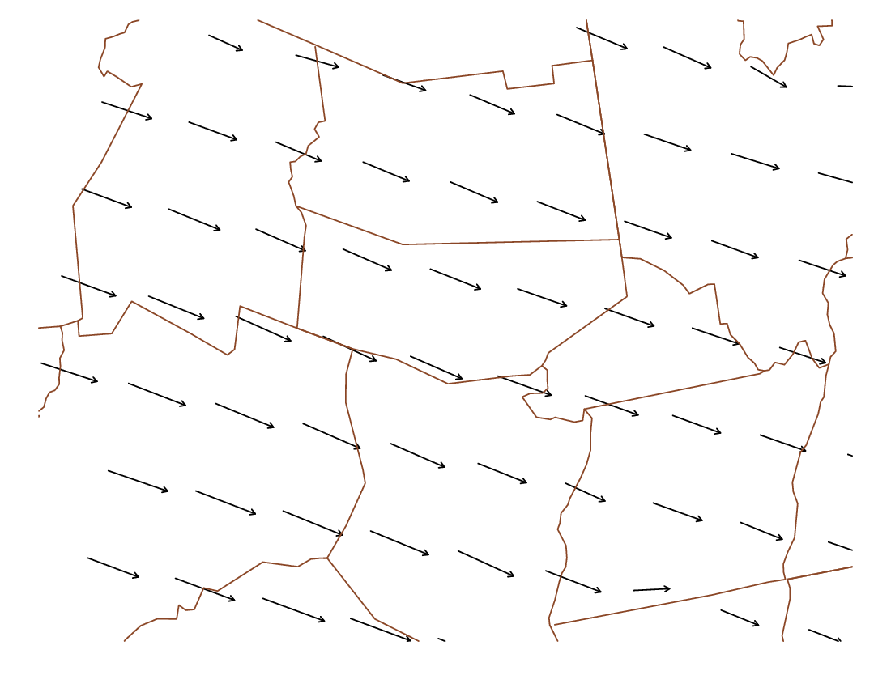

Slide 34
Wind Shear in Vicinity of Duanesburg Tornado
Upper-level northwesterly wind
Surface southeasterly wind

Slide 35
Wind Shear in Vicinity of Duanesburg Tornado
Upper-level northwesterly wind
Surface southeasterly wind

Slide 36
Conclusions
• Combination of shear and instability can result in rotating thunderstorms
• Upstate N.Y.: Challenge to predict when shear and instability line up just right.
-Example: Monday, June 8 – High shear, low instability
• May 22, 2014:
-Winds channeling up Mohawk Valley contributed to enhanced shear locally

Slide 37
Research in Science
•Research something that excites you…
-Scientific research often has a direct positive effect on the planet, and all living things on it!
Thank you!

