Slide 1
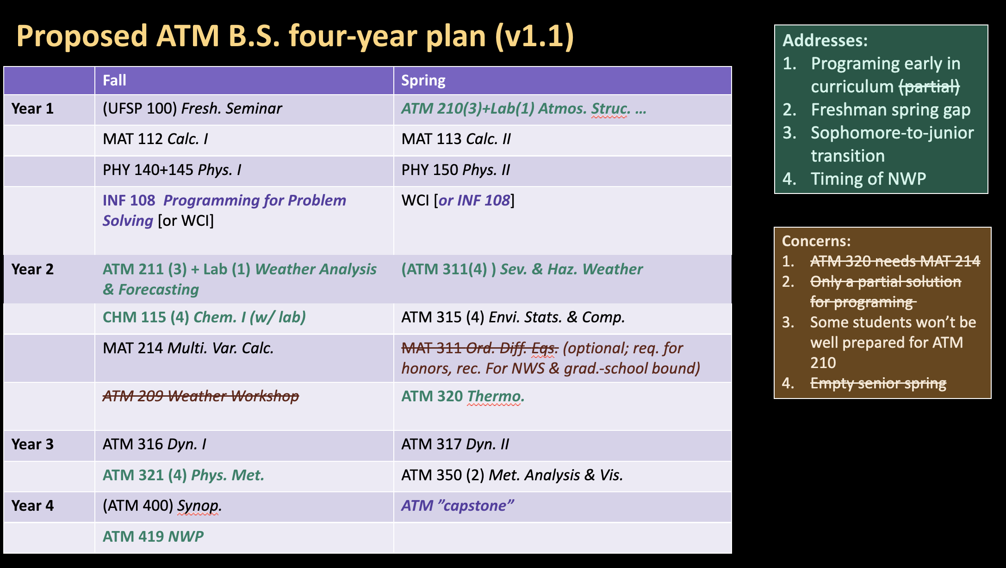

Slide 2
Courses that have changed time:
ATM 210 → Spring … Begins Spring ‘24
ATM 211 → Fall … Begins Fall ‘24
ATM 311 → Spring … Begins Spring ‘25 (combine soph/jr)
ATM 320 → Spring … Begins Spring ‘24 (This may be difficult to schedule, could wait until Spring ‘25).
Option 1: Spring ’24
Option 2: After Fall ‘23, not taught again until Spring ‘25
ATM 321 → Fall … Begins Fall ‘24 (combine sr/jr depending on when ATM 320 moves)
ATM 419 → Fall … Begins Fall ‘24
Capstone: Begins Spring ‘25?

Slide 3
Current Juniors (class of 2024)
Fall 23 (sr) Spring 24 (sr)
ATM 419

Slide 4
Current Sophomores (class of 2025)
Fall 23 (jr) Spring 24 (jr)
ATM 311 ATM 317
ATM 316 ATM 350
ATM 320
Fall 24 (sr) Spring 25 (sr)
ATM 321 (opt 1 w/jr) Capstone (not required yet for this class)
ATM 419

Slide 5
Current Freshmen (class of 2026)
Fall 23 (soph) Spring 24 (soph)
ATM 209 ATM 211
ATM 210 ATM 315
ATM 320 (opt 1)
Fall 24 (jr) Spring 25 (jr)
ATM 321 (opt 1 w/sr) ATM 311 (w/ soph)
ATM 316 ATM 317
ATM 320 (opt 2) * ATM 350
Fall 25 (sr) Spring 26 (sr)
ATM 321 (opt 2 w/jr) Capstone (still not technically requirement)
ATM 419
*With option 2, could also consider having ATM 320 spring ‘25, taken with the sophomores instead (only suggested if teaching schedule necessitates this).

Slide 6
Current H.S. seniors (class of 2027)
Fall 23 (fr) Spring 24 (fr)
ATM 210 (+lab)
Fall 24 (soph) Spring 25 (soph)
ATM 211 ATM 311 (w/ jr)
ATM 315
ATM 320*
Fall 25 (jr) Spring 26 (jr)
ATM 321 (opt 2 w/sr) ATM 317
ATM 316 ATM 350
Fall 26 (sr) Spring 27 (sr)
ATM 419 Capstone (still not technically req.?)
*From previous slide, could be taken with juniors, to benefit teaching schedule

Slide 7
Course schedules
ATM 210 ATM 311
Fall 2023 Fall 2023
Spring 2024 (+lab?) Spring 2024
Spring 2025 (+lab) Spring 2025
… …
ATM 211 ATM 419
Spring 2023 Spring 2024
Fall 2024 (+lab) Fall 2024
Fall 2025 (+lab) Fall 2025
… …

Slide 8
Course schedules
Option 1 Option 2
ATM 320 ATM 320
Fall 2023 (taught to juniors) Fall 2023 (taught to juniors)
Spring 2024 (taught to sophomores) Fall 2024 (taught to juniors)
Spring 2025 or…Spring 2025 (taught to jr and soph)
… Spring 2026 (taught to soph)
… …
ATM 321 ATM 321
Fall 2024 (taught to seniors and juniors) Fall 2024 (taught to seniors)
Fall 2025 (taught to juniors) Fall 2025 (taught to juniors and seniors)
Fall 2026 (taught to juniors) Fall 2026 (taught to juniors)
… …

