Slide 1
R2O
• In addition to theses, oral and powerpoint presentations…
• Short (approx. five page) PDF
- Only results pertinent to operations
- (e.g., no methodology, data used, etc.)
- Theses and other details available!
• Annotated web video
- Talk through operationally relevant results with supporting figures

Slide 2
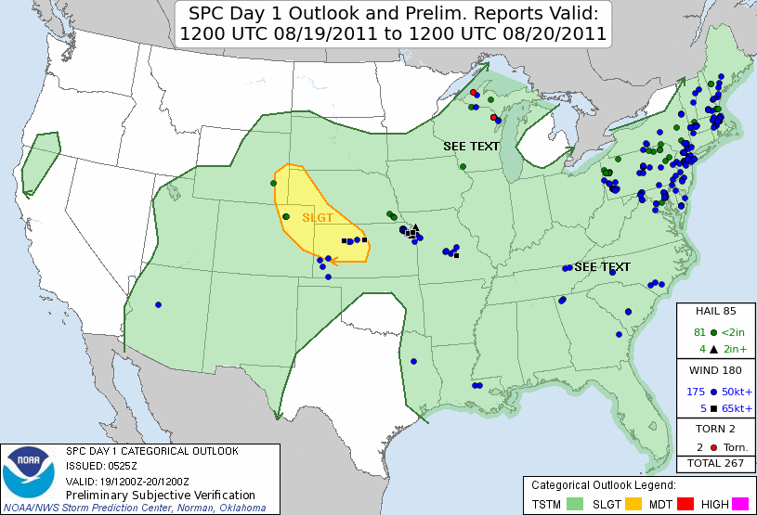
Low probability of detection (POD) high impact event example
• What characterizes an event with low POD?
• What synoptic-scale patterns might represent such “overperforming” cases?

Slide 3
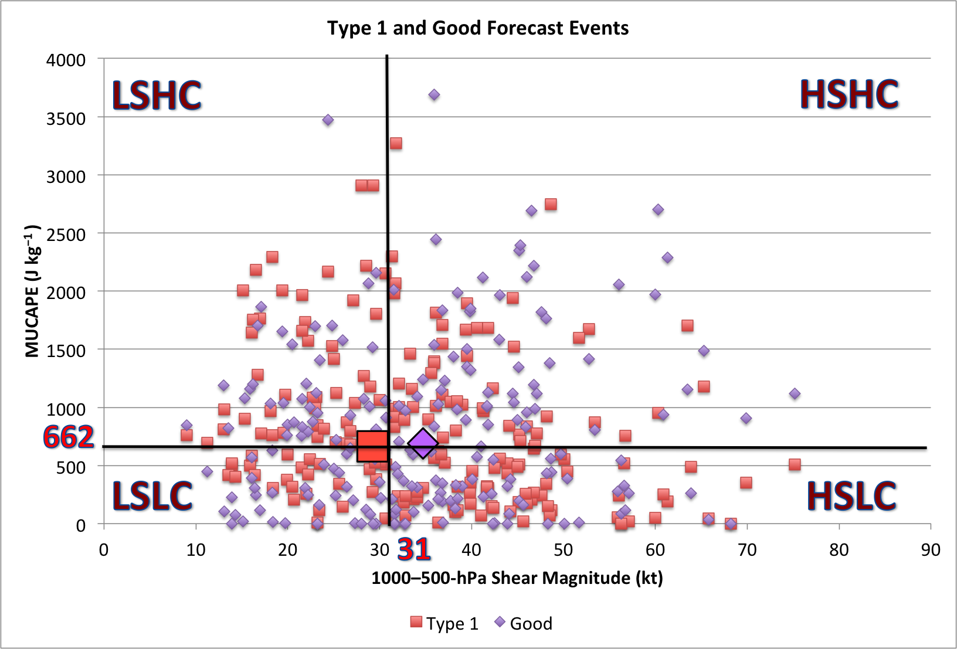

MUCAPE–Wind Shear Phase Space for case types
Low Probability of Detection cases
Good forecast cases
• Low POD cases are characterized as having less deep-layer shear than good forecast cases
• Associated with weaker upper-level winds and less syntopic-scale forcing for ascent

Slide 4
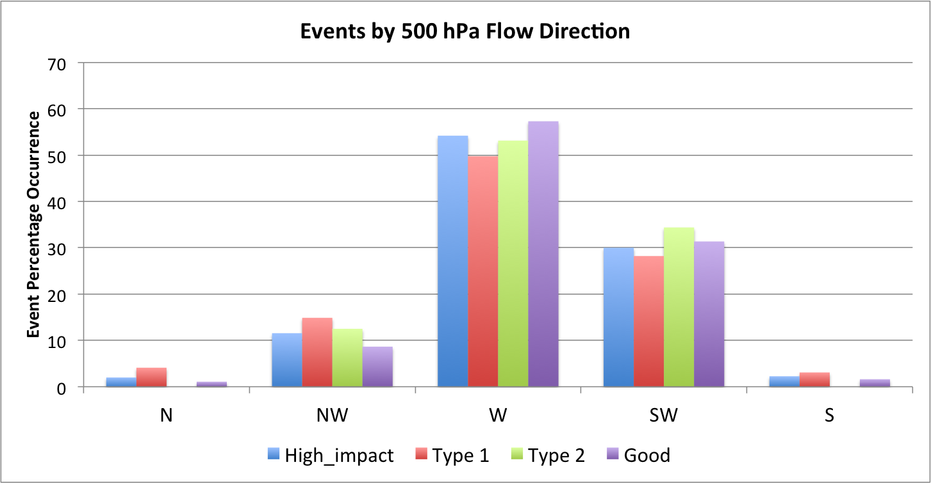
High impact events
Low Probability of Detection events (overperforming)
High False Alarm Rate events (underperforming)
Good forecast events
• Low probability of detection events are the most common type of northwesterly 500-hPa flow events

Slide 5
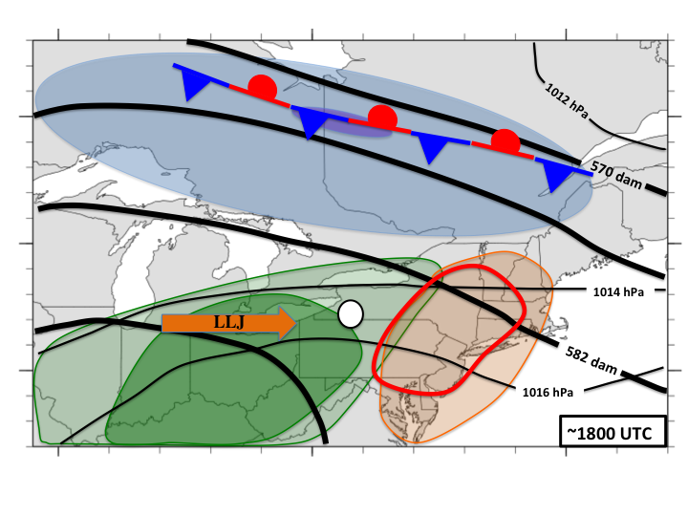
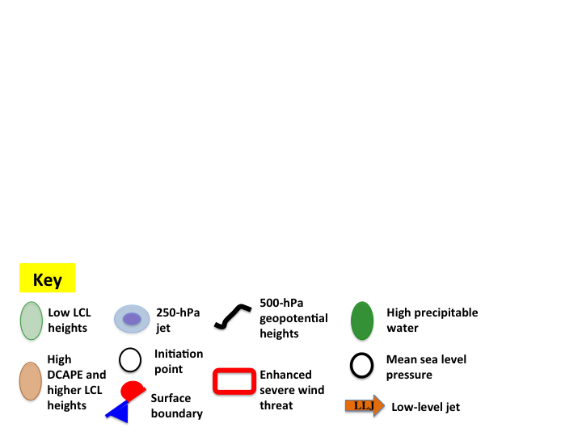
Low Probability of Detection – Northwesterly flow cases
• TS initiation upstream in high precipitable water environment on leading edge of a low-level jet (LLJ)
-Equatorward of zonal jet and baroclinic zone
• TS moves into environment with high DCAPE and high LCL height (deep PBL)
• Despite weaker shear, severe wind threat enhanced

Slide 6
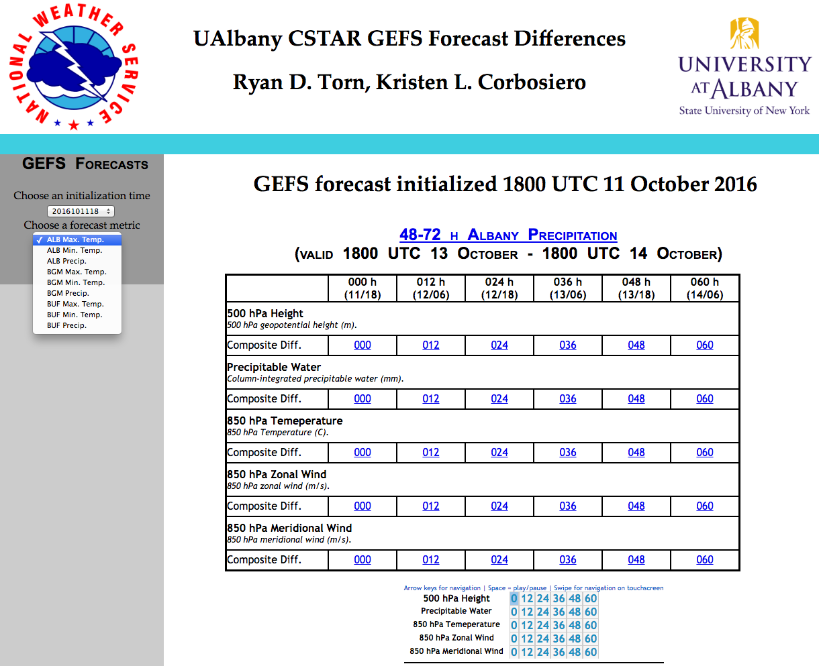
Select GEFS initialization time
Select forecast metric
Composite difference variables for selected metric
www.atmos.albany.edu/facstaff/torn/CSTAR_ediff/gefs_diff.php

Slide 7
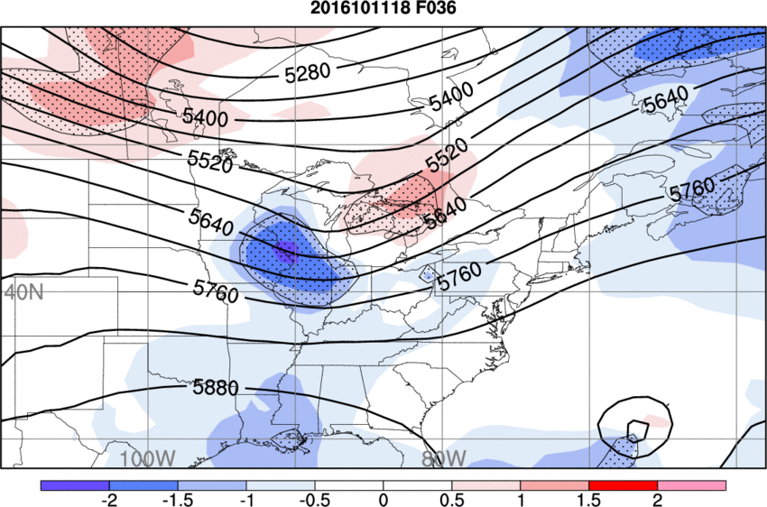
Metric: Total precipitation at KALB between F48-F72
GEFS F36 initialized at
1800 UTC 11 October 2016
Normalized 500-hPa height difference between the mean of the five members with the largest metric value (ALB precip), and the mean of the five members with the smallest metric value
Blue shading – Wetter members have lower 500-hPa heights (stippling = 95% statistical significance)
Red shading – Wetter members have higher 500-hPa heights (stippling = 95% statistical significance)
Black contours – GEFS mean 500-hPa height (m)

Slide 8
Metric: Total precipitation at KALB between F48-F72
How can a forecaster use this information?
GEFS F36 initialized at
1800 UTC 11 October 2016
• A deeper, slower 500-hPa shortwave trough at F36 results in
more precipitation at KALB between F48-F72
• Forecasters can easily track the timing of this shortwave in successive model simulations, having a better understanding of its implications on KALB precipitation

Slide 9
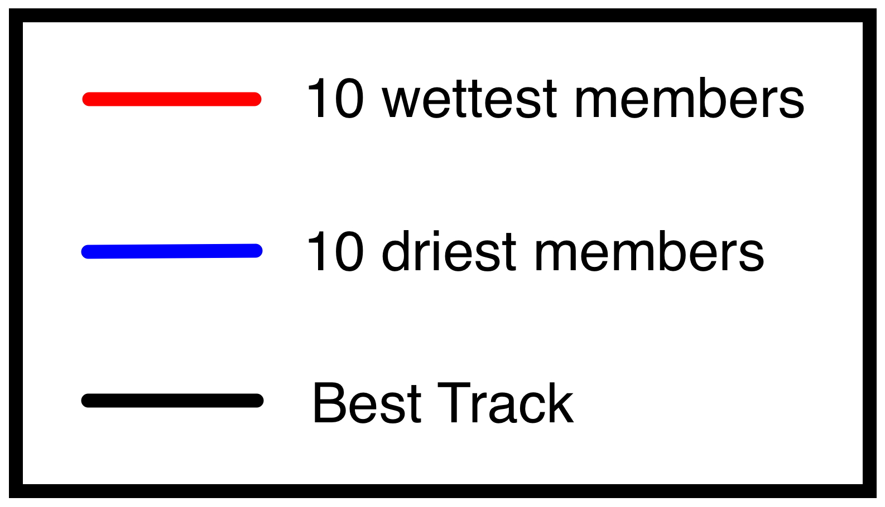
Hurricane Irene – 28 August 2011
• 10 wettest GEFS members in Catskill region have a track farther west than 10 driest GEFS members (right)
• Track differences appear to be a result of how upstream potential vorticity within interacting trough
• 3-km WRF ensemble (below) continues to show dramatic differences in Catskill precipitation due to subtle differences in Irene’s track
Western members
Central members
Eastern members
Easterly
Northeasterly
Northerly
Low-level flow direction during heaviest precipitation

