Slide 4
Research Overview
HRRR-based WRF-ARW configuration, not assessing all differences between HREFv2.1 members and NAM Nest
All results are specific to OWLeS IOP2b, may not be representative of other LeS cases
Does MP or PBL/SL choice contribute more to spread in QPF amounts? Key causes?
PBL/SL ensemble has slightly more spread in max QPF amounts than MP ensemble
MP mostly affects intensity, PBL affects intensity + LeS band morphology
MP differences due to relative amounts of snow and graupel produced
PBL differences due to amount of heat/moisture fluxes off Lake Ontario
Which schemes used in operational models don’t perform well in this case?
Thompson MP (HRRR) is too snow-dominant while WSM6 (HREF ARW & NSSL) is too graupel-dominant, reality is somewhere in between but closer to Thompson
WSM6 has too-intense LeS rates, more QPF windward of Tug Hill
MYJ PBL/SL (HREF ARW NSSL, NMMB, NAM Nest) has larger fluxes than MYNN (HRRR), increasing QPF, MYJ LeS band-max intensity too high but QPF may be slightly better than MYNN
Any other consistent model biases in LeS representation?
Model forecast LeS bands are consistently too small in total area across both MP and PBL/SL ensembles (QNSE PBL only exception)
Position of LeS bands is also likely sensitive to differences in initial and boundary conditions affecting wind flow across Lake Ontario

Slide 5
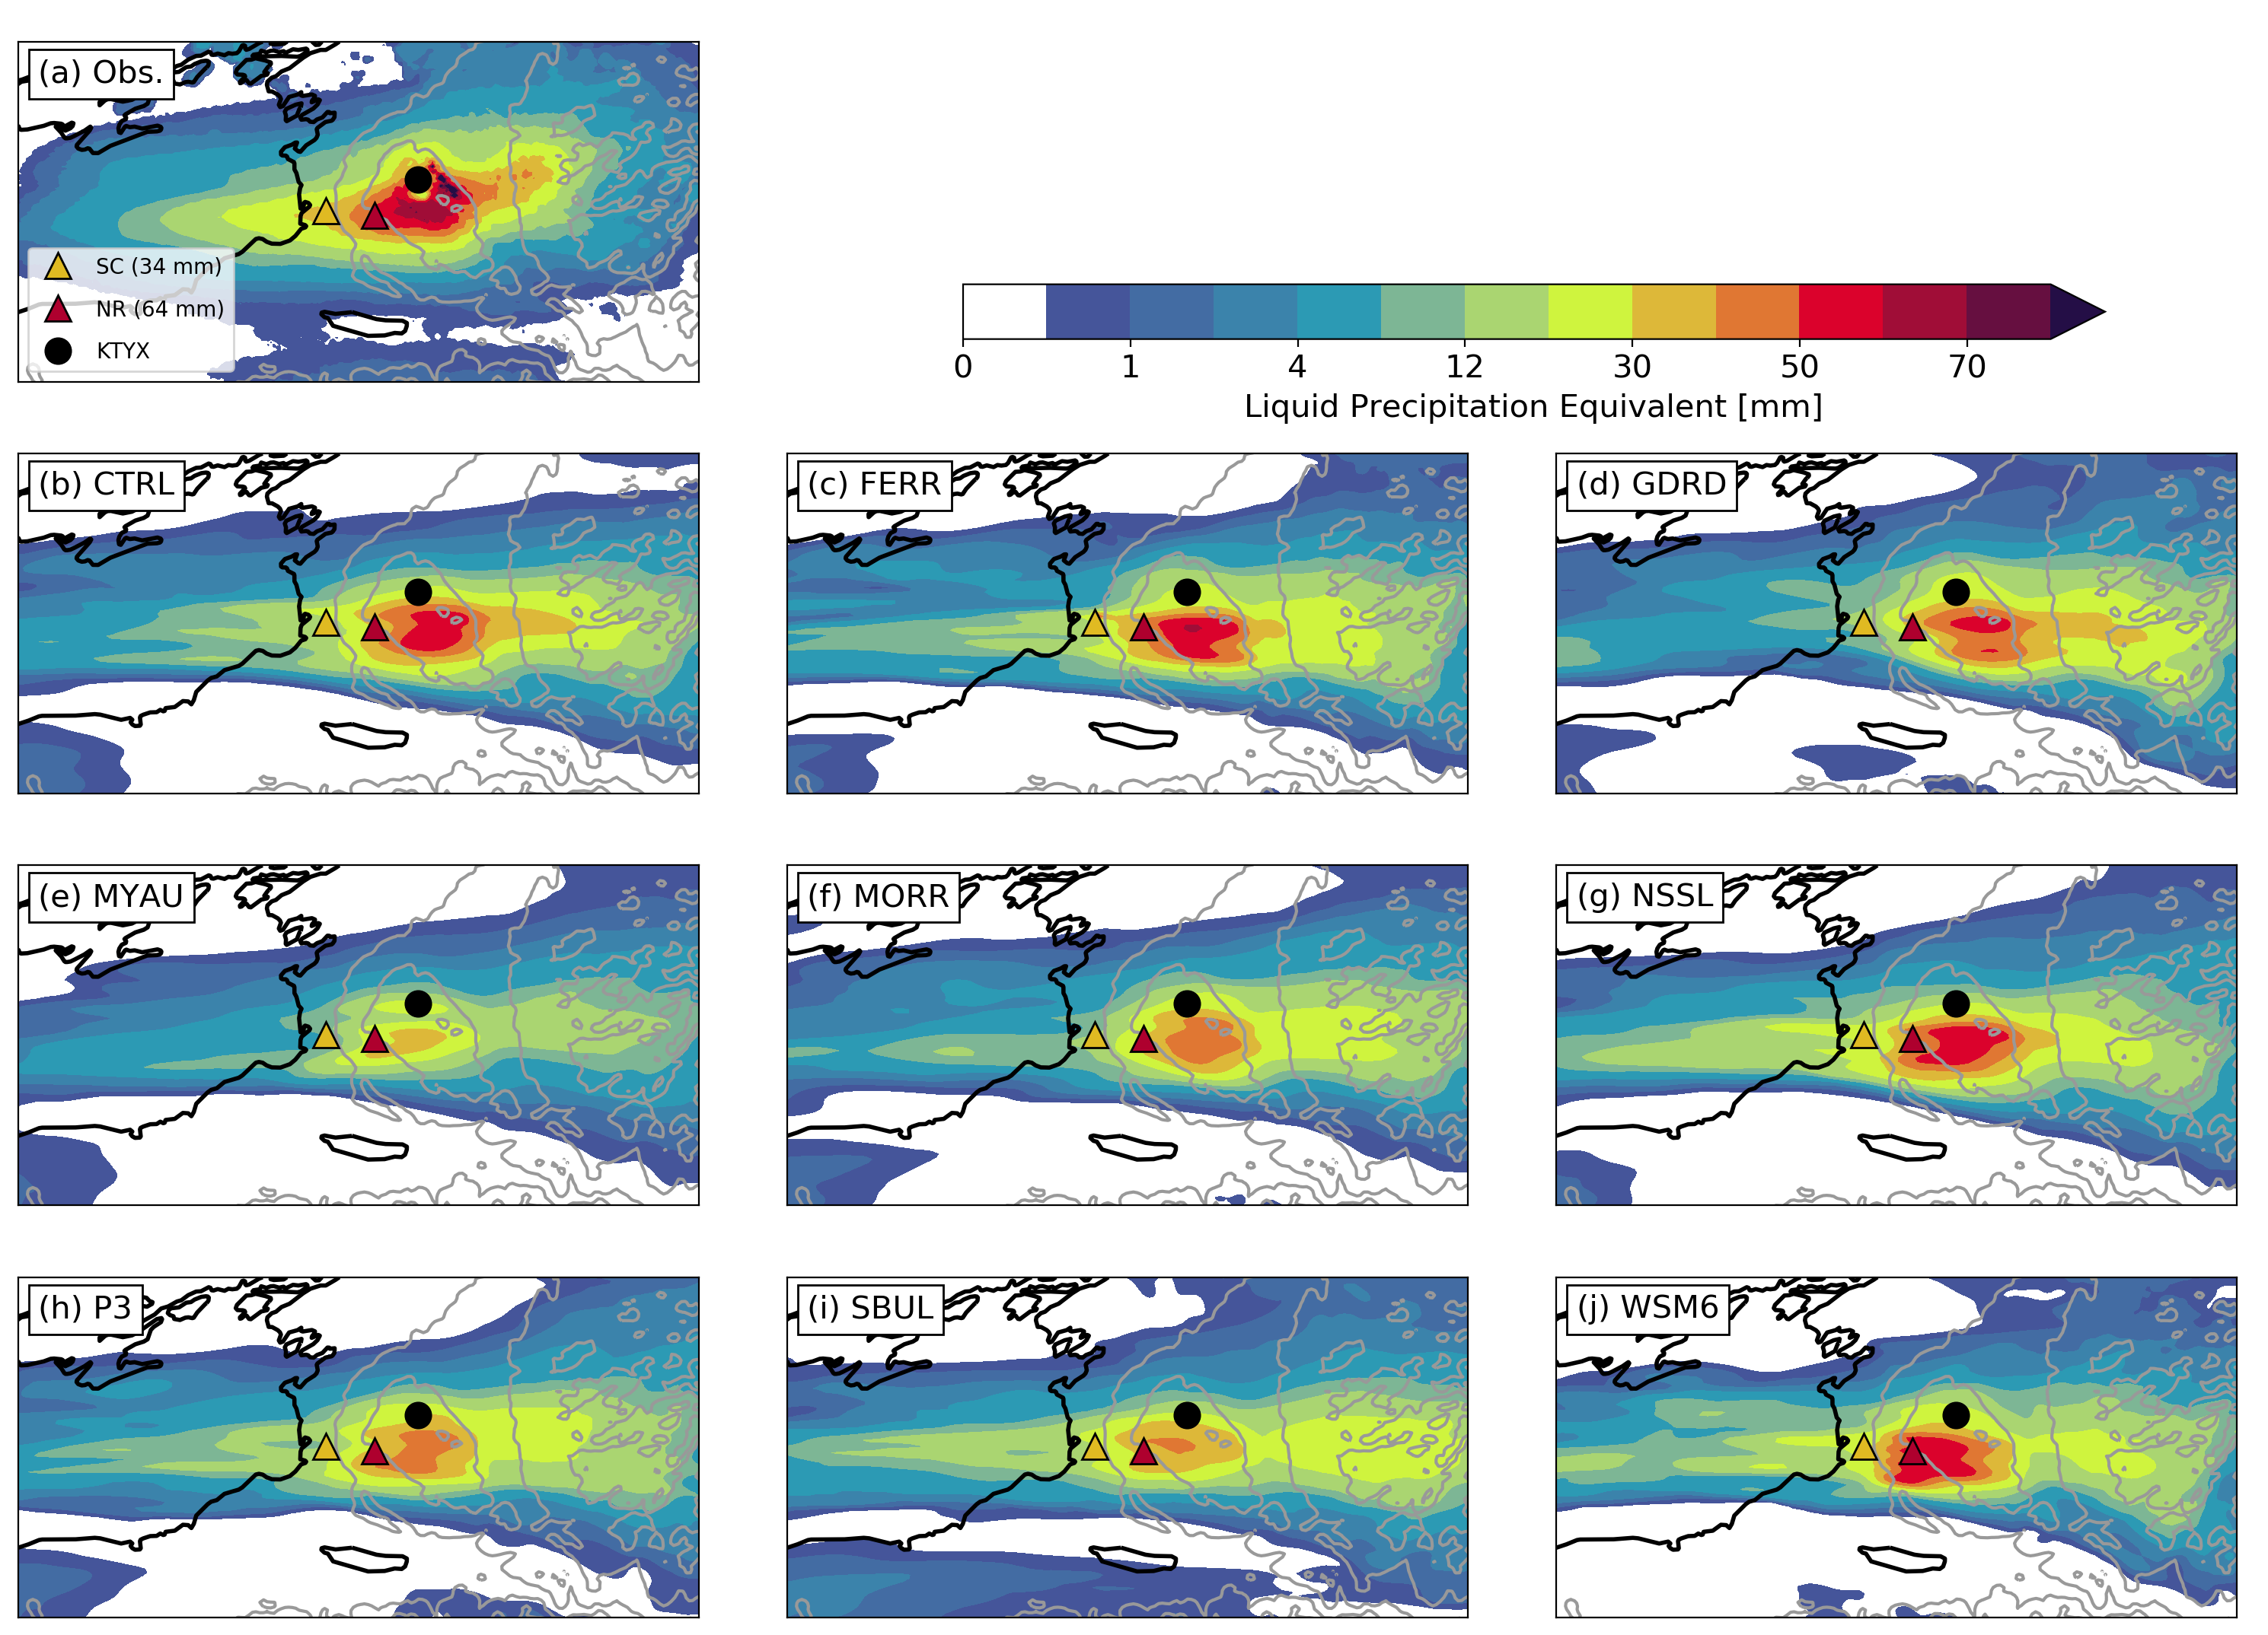
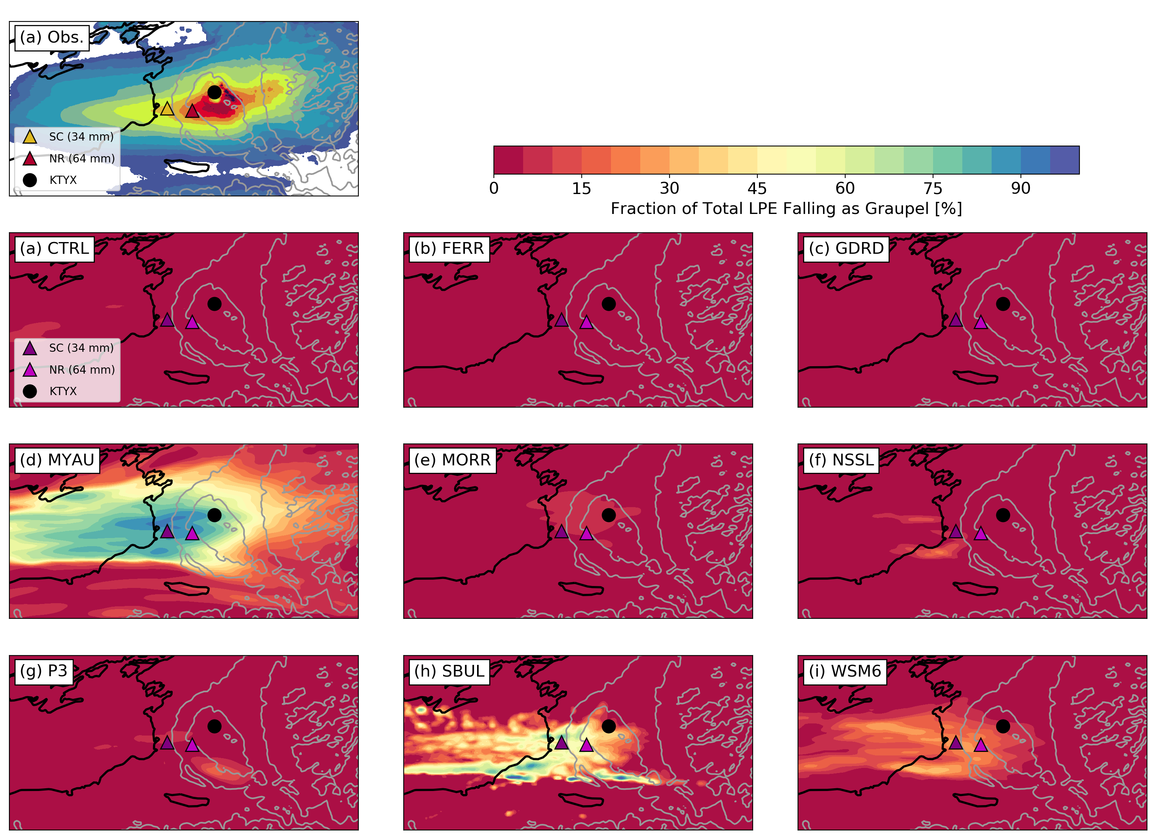
MP Sensitivity – Key Results
Event-Total Precipitation
Graupel Fraction
Red = all SN
Indigo = all GR
Primary differences between MP scheme experiments are precipitation intensity and precipitation-type
Precipitation-type affects whether the heaviest precipitation remains near the coast or extends inland

Slide 6
PBL/SL Sensitivity – Key Results v1
MP Ensemble
Event-Total Precipitation
PBL/SL Ensemble
Event-Total Precipitation
Primary differences between PBL/SL scheme experiments are LeS band morphology and precipitation intensity due to differences in sensible and latent heat flux off Lake Ontario
Precipitation-type affects whether the heaviest precipitation remains near the coast or extends inland

Slide 7
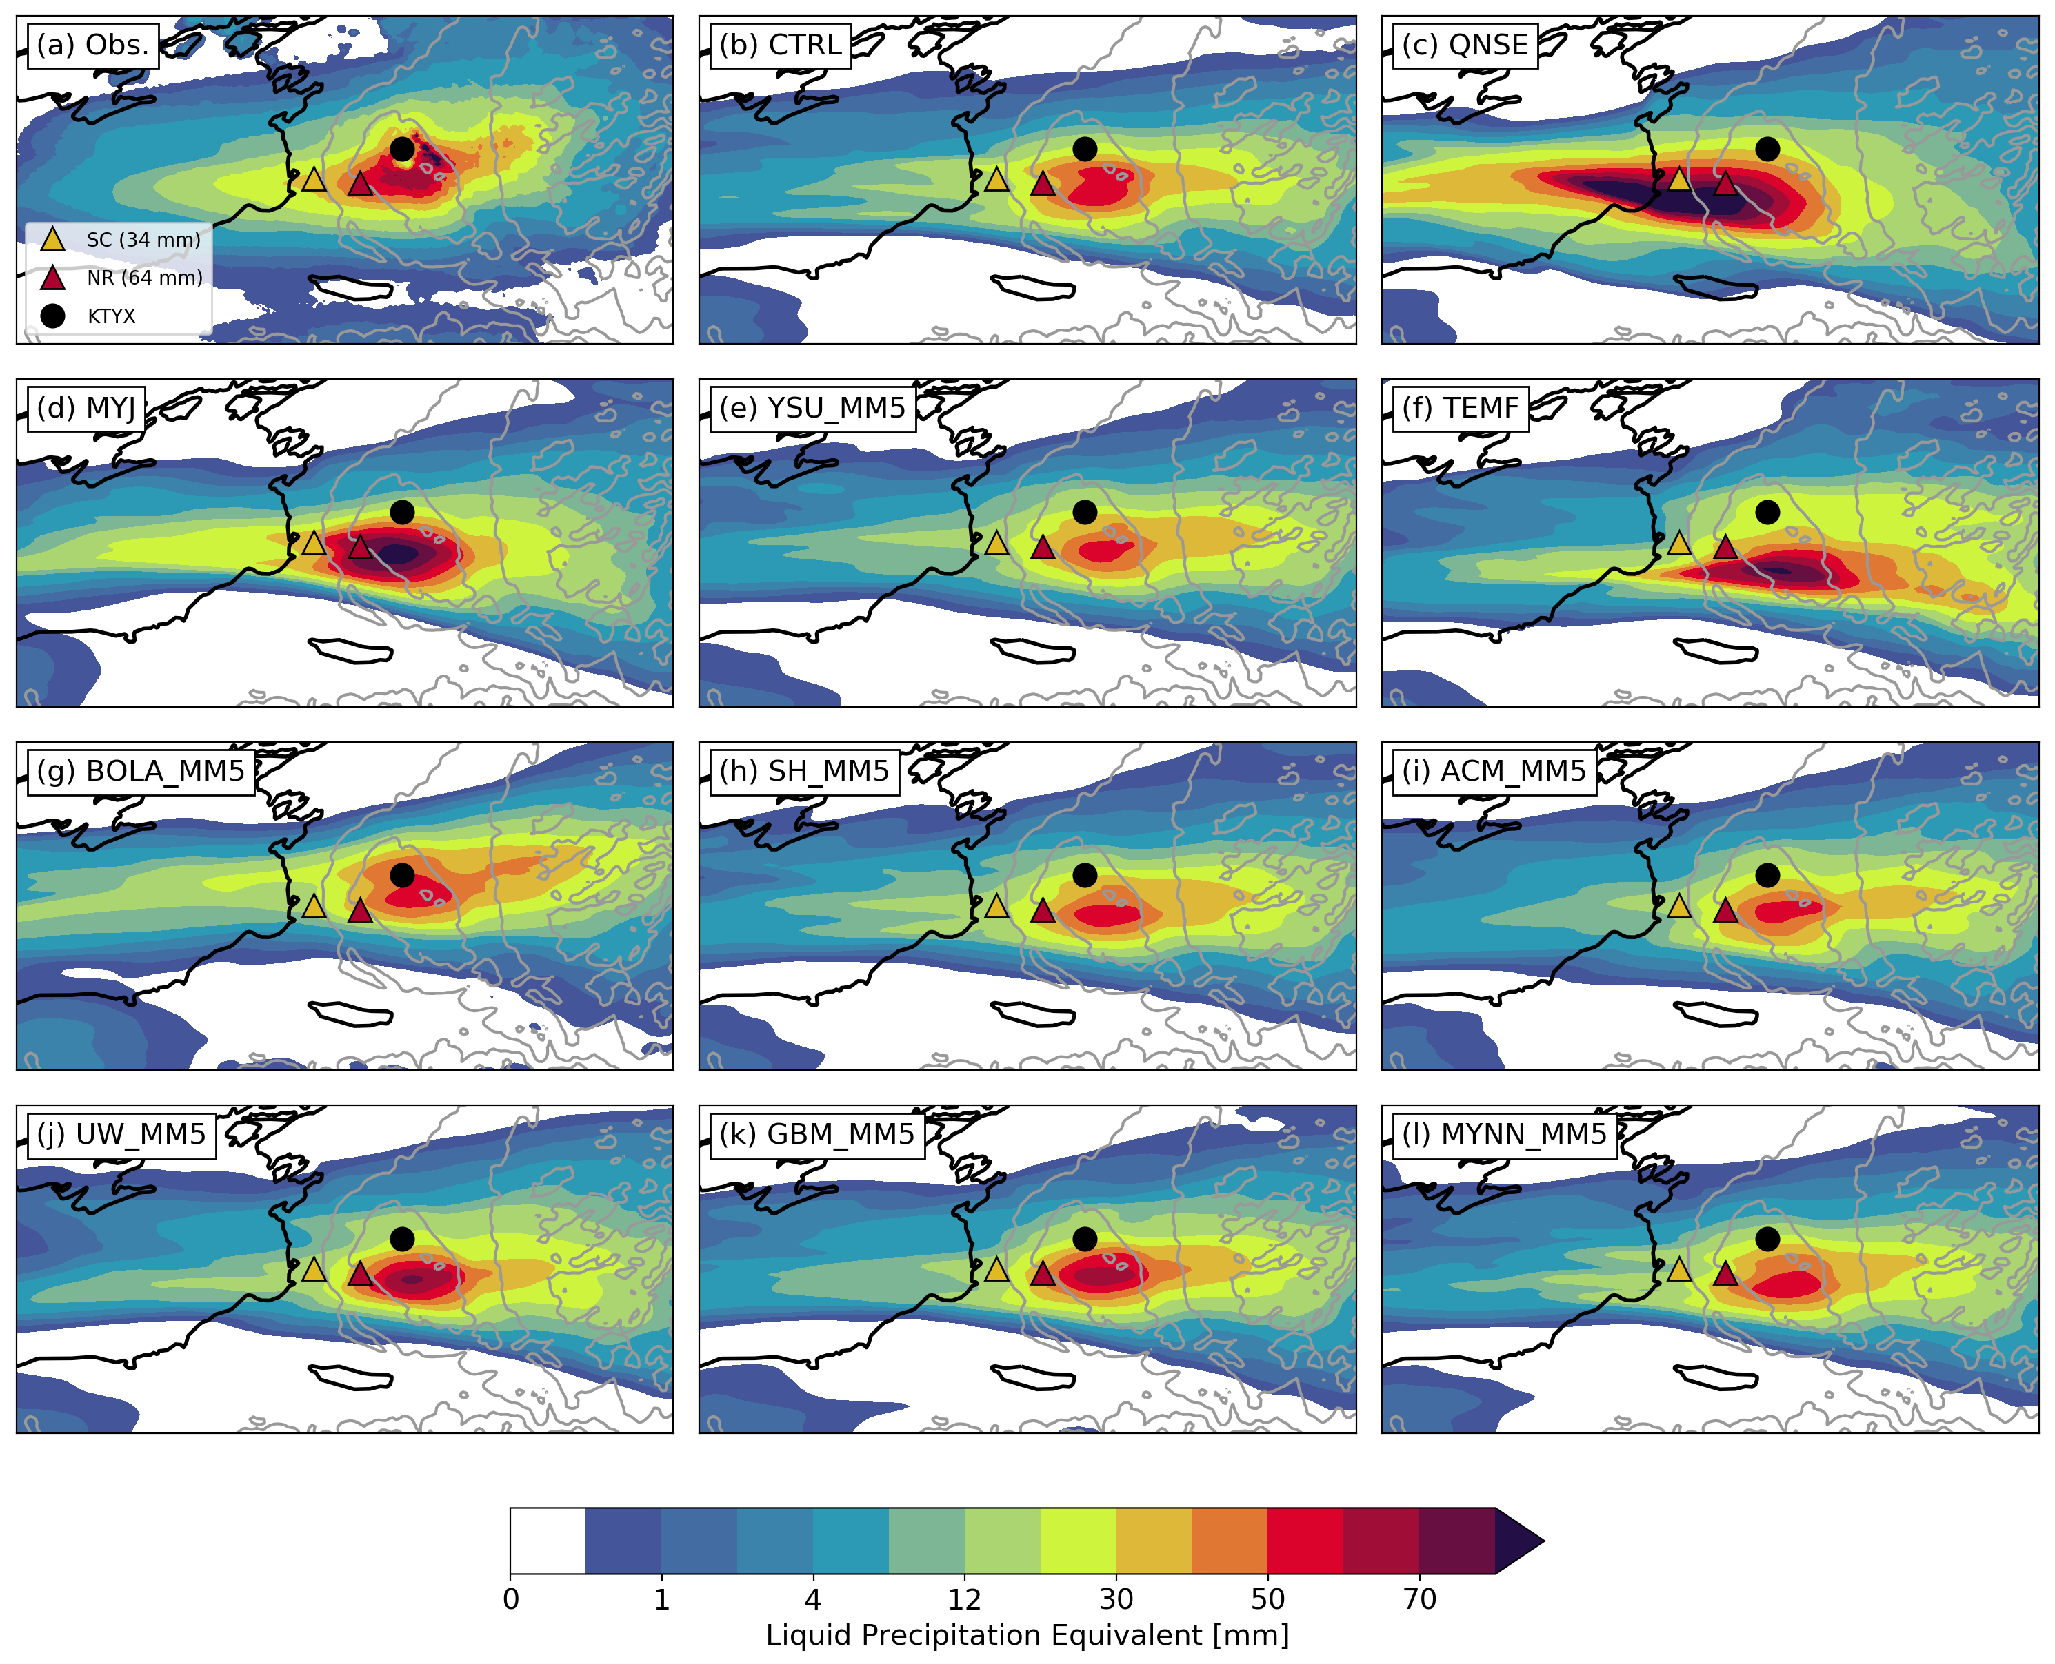
PBL/SL Sensitivity – Key Results v2
Event-Total Precipitation
24-h Avg. Sensible Heat Flux
Primary differences between PBL/SL scheme experiments are LeS band morphology and precipitation intensity due to differences in sensible and latent heat fluxes off Lake Ontario

Slide 8
Summary of Key MP and PBL/SL Results
MP Scheme (HREFv2.1 Model) | Band-Max Intensity | Total Band Area | Precipitation Types | QPF relative to CTRL (THOM) | Heat/Moisture Fluxes
THOM (HRRR) | Similar to KTYX obs | Too small | >95% SN, very little GR
WSM6 (ARW, NSSL) | Too high | Too small | 30% GR windward of Tug, SN elsewhere | More QPF windward of Tug, less leeward
PBL/SL Scheme (HREFv2.1 Model) | Band-Max Intensity | Total Band Area | Precipitation Types | QPF relative to CTRL (MYNN) | Heat/Moisture Fluxes
MYNN/MYNN (HRRR) | Similar to KTYX obs | Too small | >95% SN
YSU/RevMM5 (ARW) | Similar to KTYX obs | Too small | >95% SN | Similar to MYNN | Similar to MYNN
MYJ/MYJ (NSSL, NMMB, NAM Nest) | Too high | Too small | >95% SN | More QPF windward of Tug, similar elsewhere | Higher than MYNN

Slide 9
CSTAR Google Analytics
Fall 2019 CSTAR meeting

Slide 10
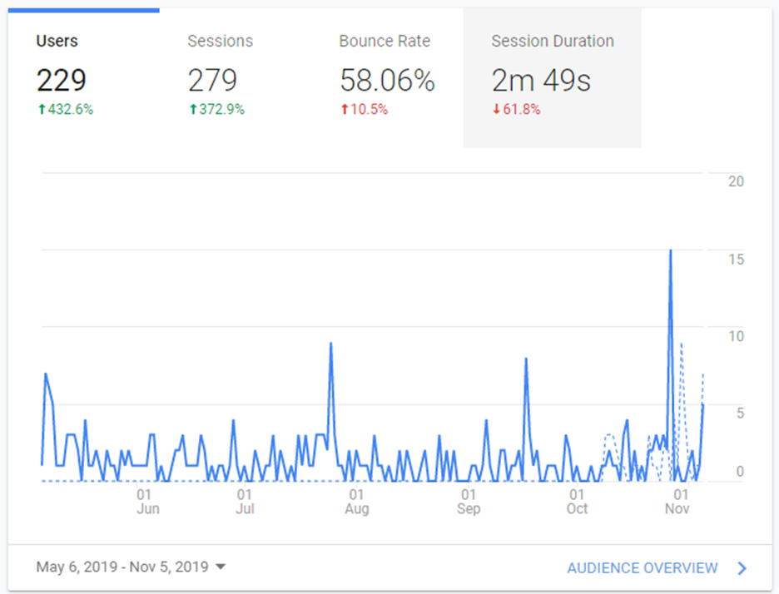
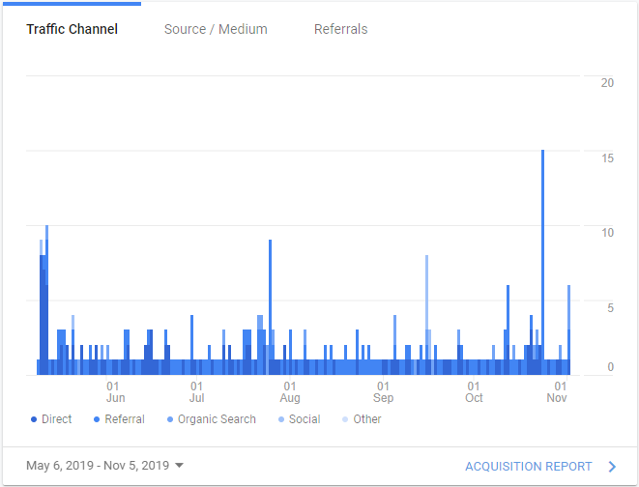
Traffic

Slide 11
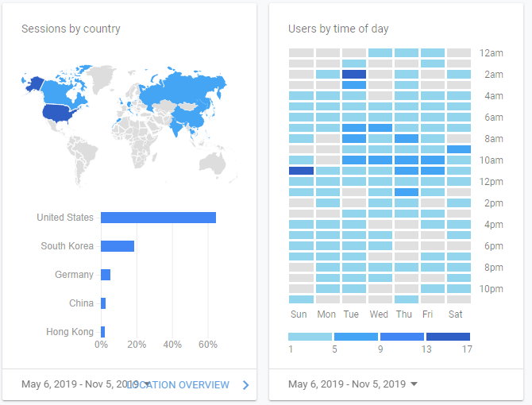
Location
Session by country
Users by time of day

Slide 12
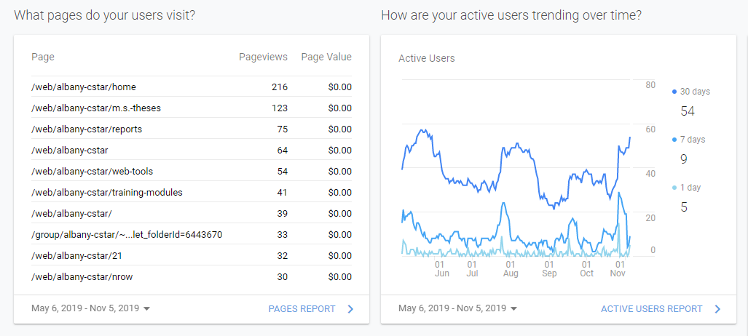
Page Visits and Trends

Slide 13
Devices

