Slide 1
How do Meteorologists Make a Forecast?
Ross A. Lazear
February 29, 2012

Slide 2
Why the discrepancy? Forecasting is often extremely challenging!
There are *many* forecasts made available to the public…
*National Weather Service
*The Weather Channel
*AccuWeather
*Wunderground
*Your iPhone
…etc…

Slide 3
Types of Forecasts
*Nowcasting (Up to six hours)
*Short/medium range (Up to 7-10 days)
*Long range/intraseasonal/seasonal
*Climate (IPCC)

Slide 4
Types of Forecasts
*Nowcasting (Up to six hours)
*Short/medium range (Up to 7-10 days)
*Long range/intraseasonal/seasonal
*Climate (IPCC)

Slide 5
Nowcasting
When will the thunderstorm hit?
When will the snow taper?
When will the rain change to snow/sleet/freezing rain?

Slide 6
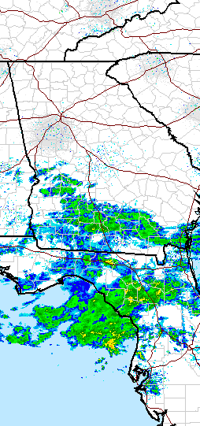
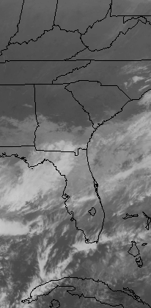
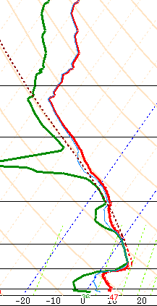
Nowcasting Tools
Radar Satellite Soundings

Slide 7
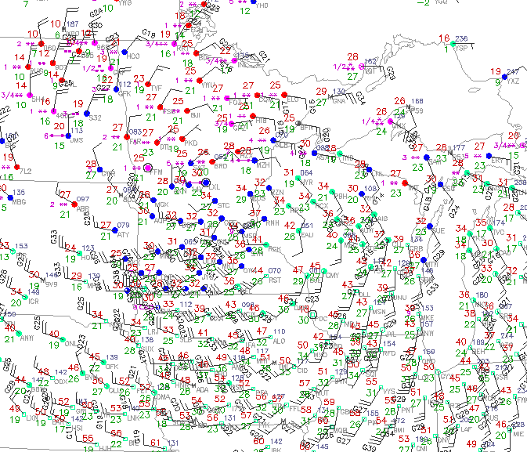
Nowcasting Tools
Surface (airport) observations

Slide 8
Types of Forecasts
*Nowcasting (Up to six hours)
*Short/medium range (Up to 7-10 days)
*Long range/intraseasonal/seasonal
*Climate (IPCC)

Slide 9
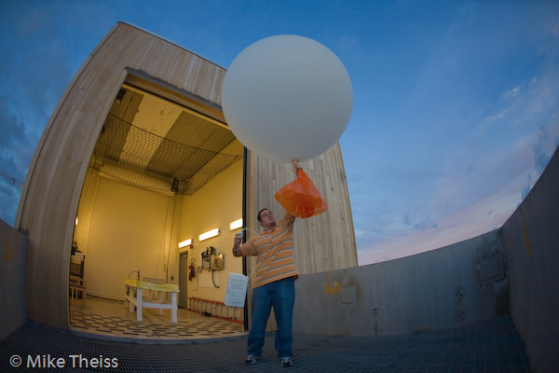
Short/Medium Range Forecasting
Computer models needed!
Models use:
-Current surface observations
-Upper air observations
-Previous forecast
…and then…

Slide 10
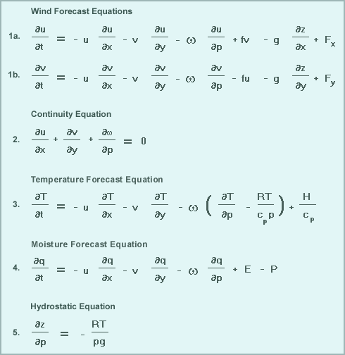
Short/Medium Range Forecasting
From MetEd / UCAR

Slide 11
Models
GFS - 16 days, global, U.S.A.
NAM - 84 hours, N. America, U.S.A.
HRRR/Rapid Refresh, 18 hours, U.S.A.
ECMWF - 10 days, global, U.K.
UKMET - global, U.K.
NOGAPS - global, U.S.A. (Navy)
JMA - Japan
CMC - Canada
WRF - Multiple domains, also run locally at Albany!

Slide 12
Types of Forecasts
*Nowcasting (Up to six hours)
*Short/medium range (Up to 7-10 days)
*Long range/intraseasonal/seasonal
*Climate (IPCC)

Slide 13
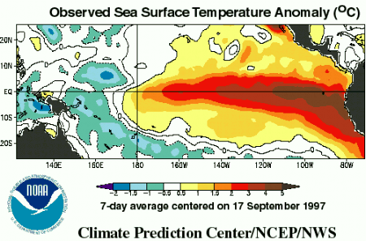
Long Range/Intraseasonal/Seasonal
Various global “signals” that help meteorologists forecast on longer time scales.
-ENSO (El Niño/La Niña)

Slide 14
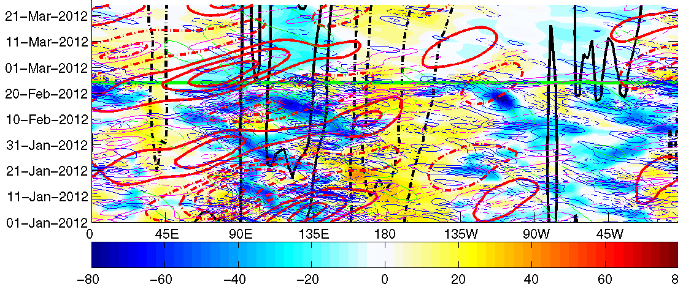
Long Range/Intraseasonal/Seasonal
Also…
-Lots of other complex atmospheric waves in the tropics…
From Dr. Paul Roundy, UAlbany

