Slide 1
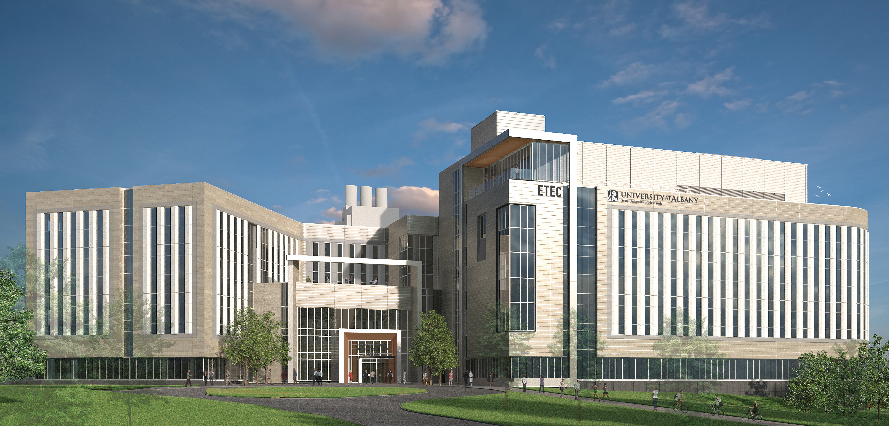
UAlbany ETEC
Completion Summer 2021

Slide 2
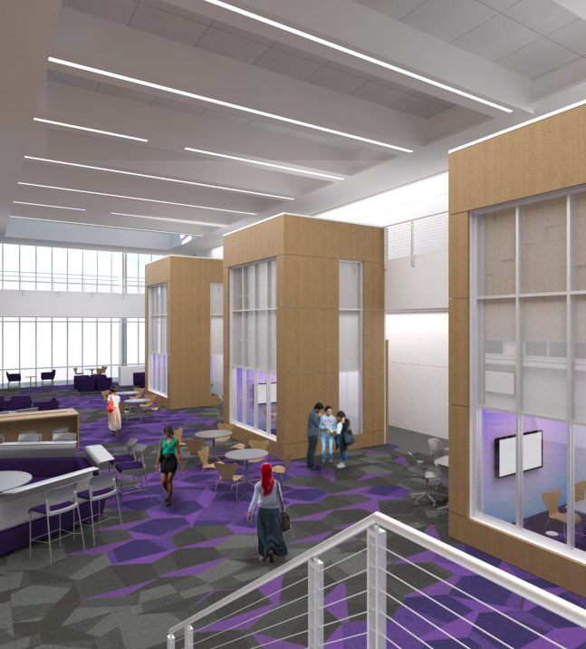
Occupants:
Department of Atmospheric and Environmental Sciences
Atmospheric Science Research Center
National Weather Service
New York State Mesonet
College of Emergency Preparedness, Homeland Security, and Cybersecurity
Private partnerships

Slide 3
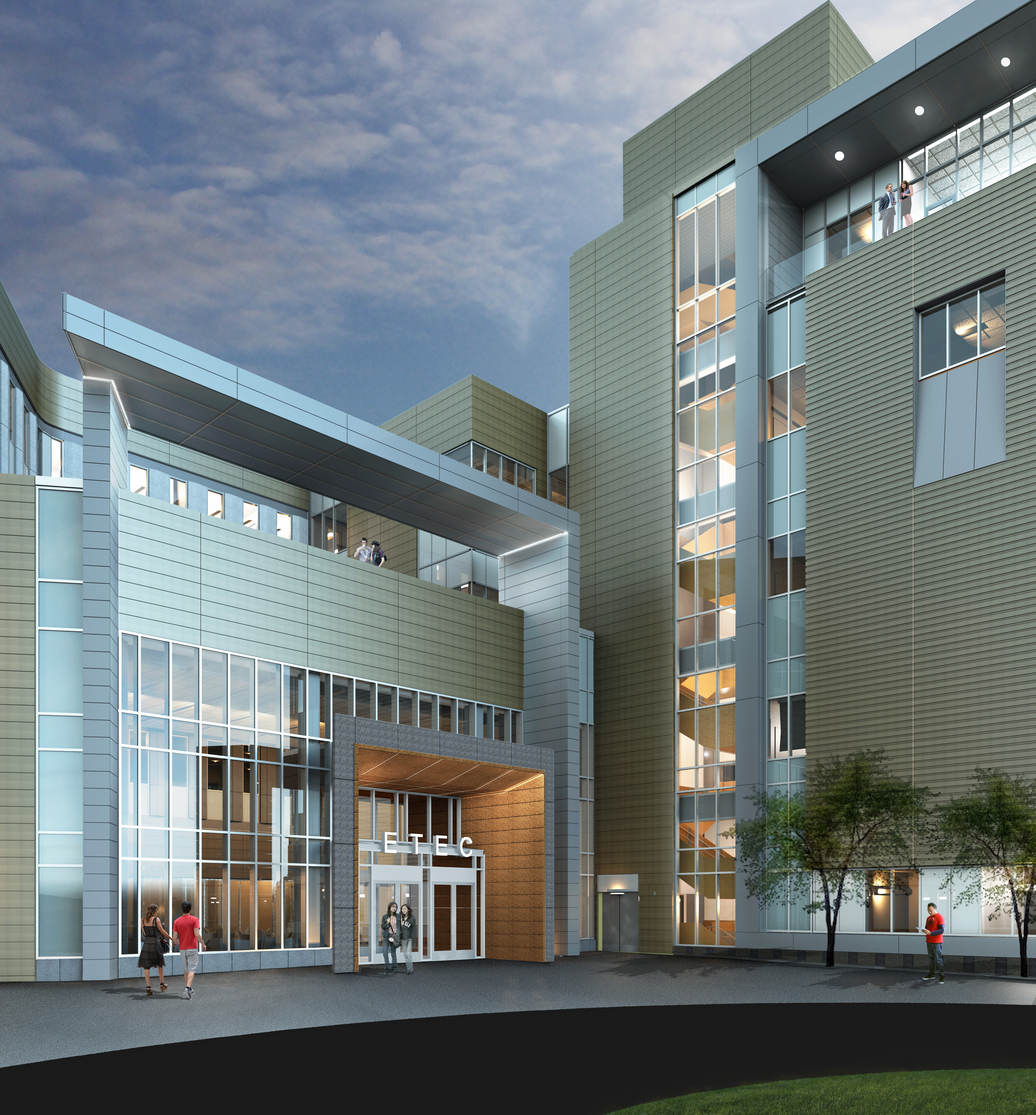
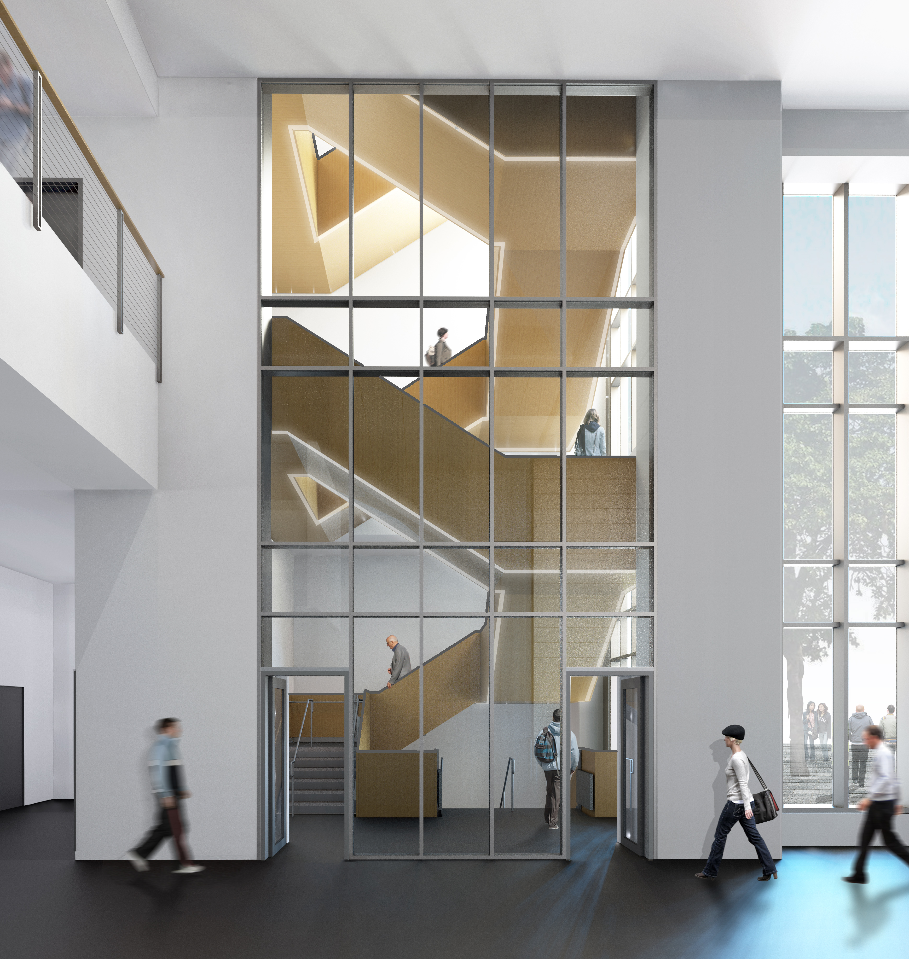

Slide 4
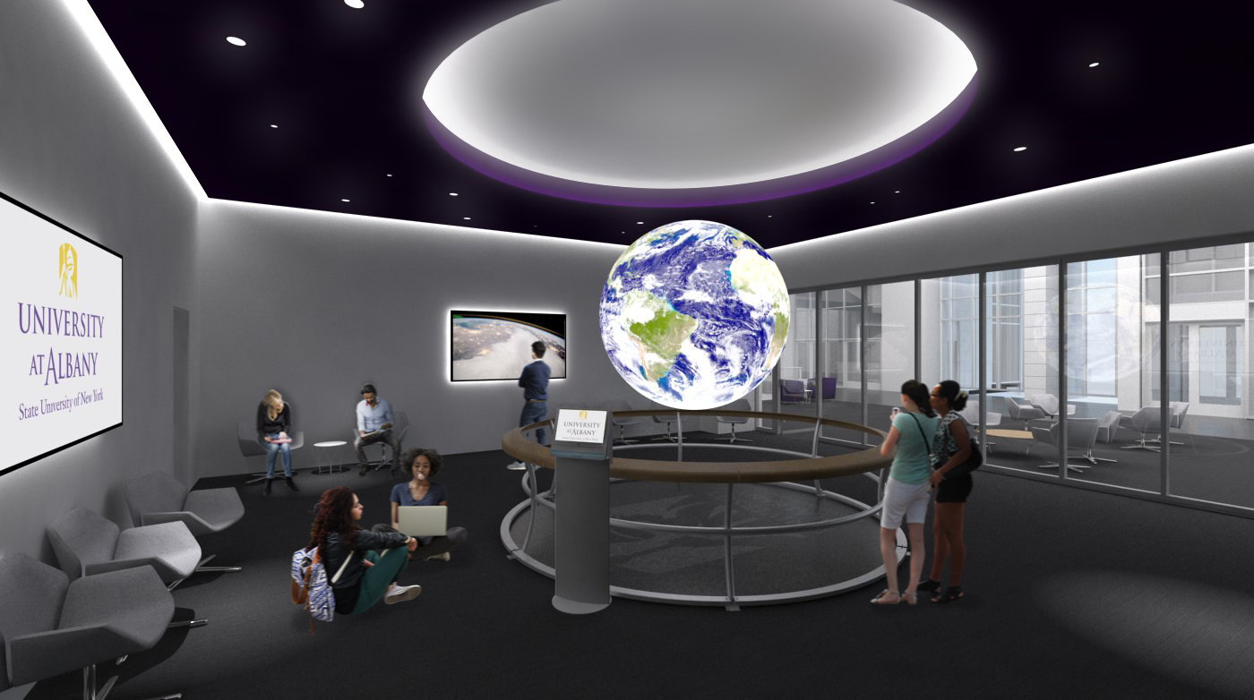
Science on a Sphere
Dept. of Atmospheric and Environmental Sciences

Slide 5
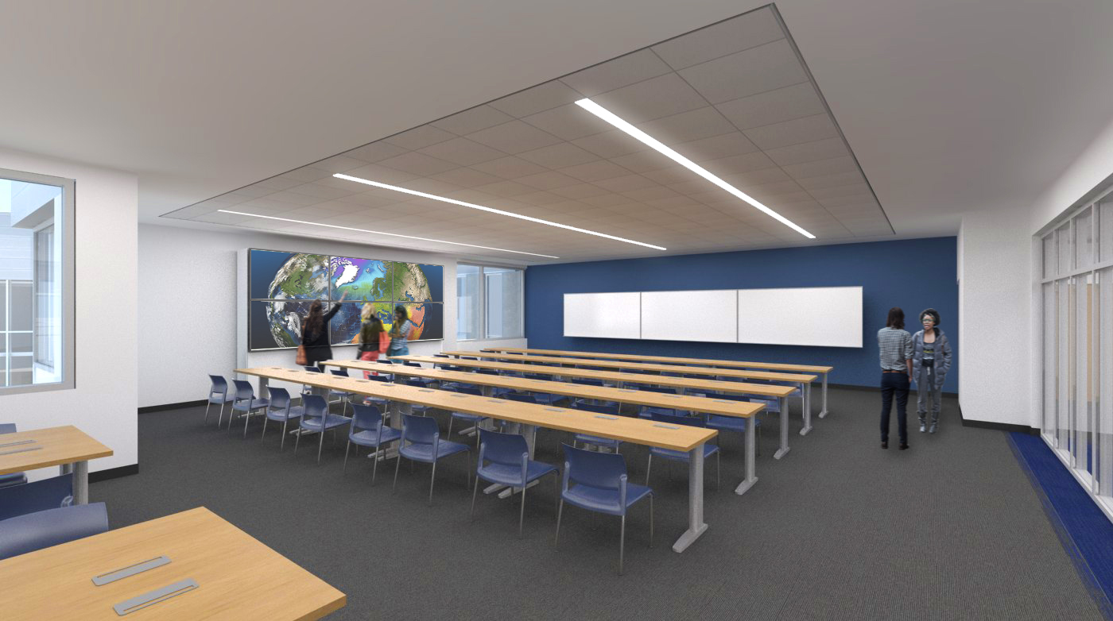
Dept. of Atmospheric and Environmental Sciences
Map Room
Weather discussions, classes, labs, events, collaboration space

Slide 6
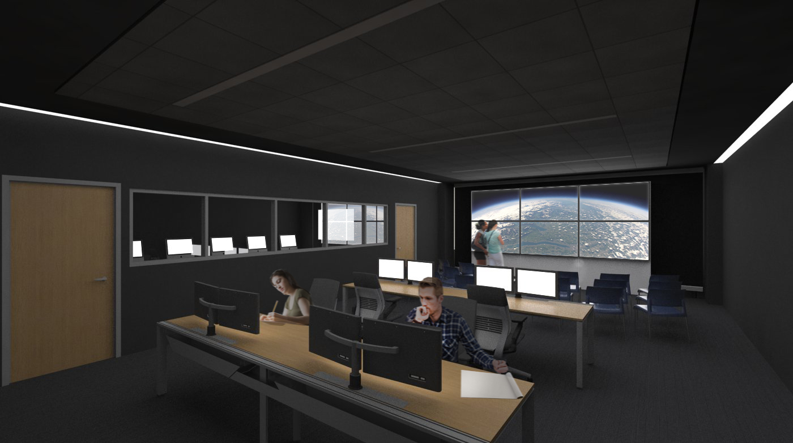
Atmospheric Sciences Research Center
Extreme Collaboration, Innovation, and Technology (xCITE) Laboratory
Multidisciplinary collaboration, software innovation, artificial intelligence, data visualization

Slide 7
