Slide 1
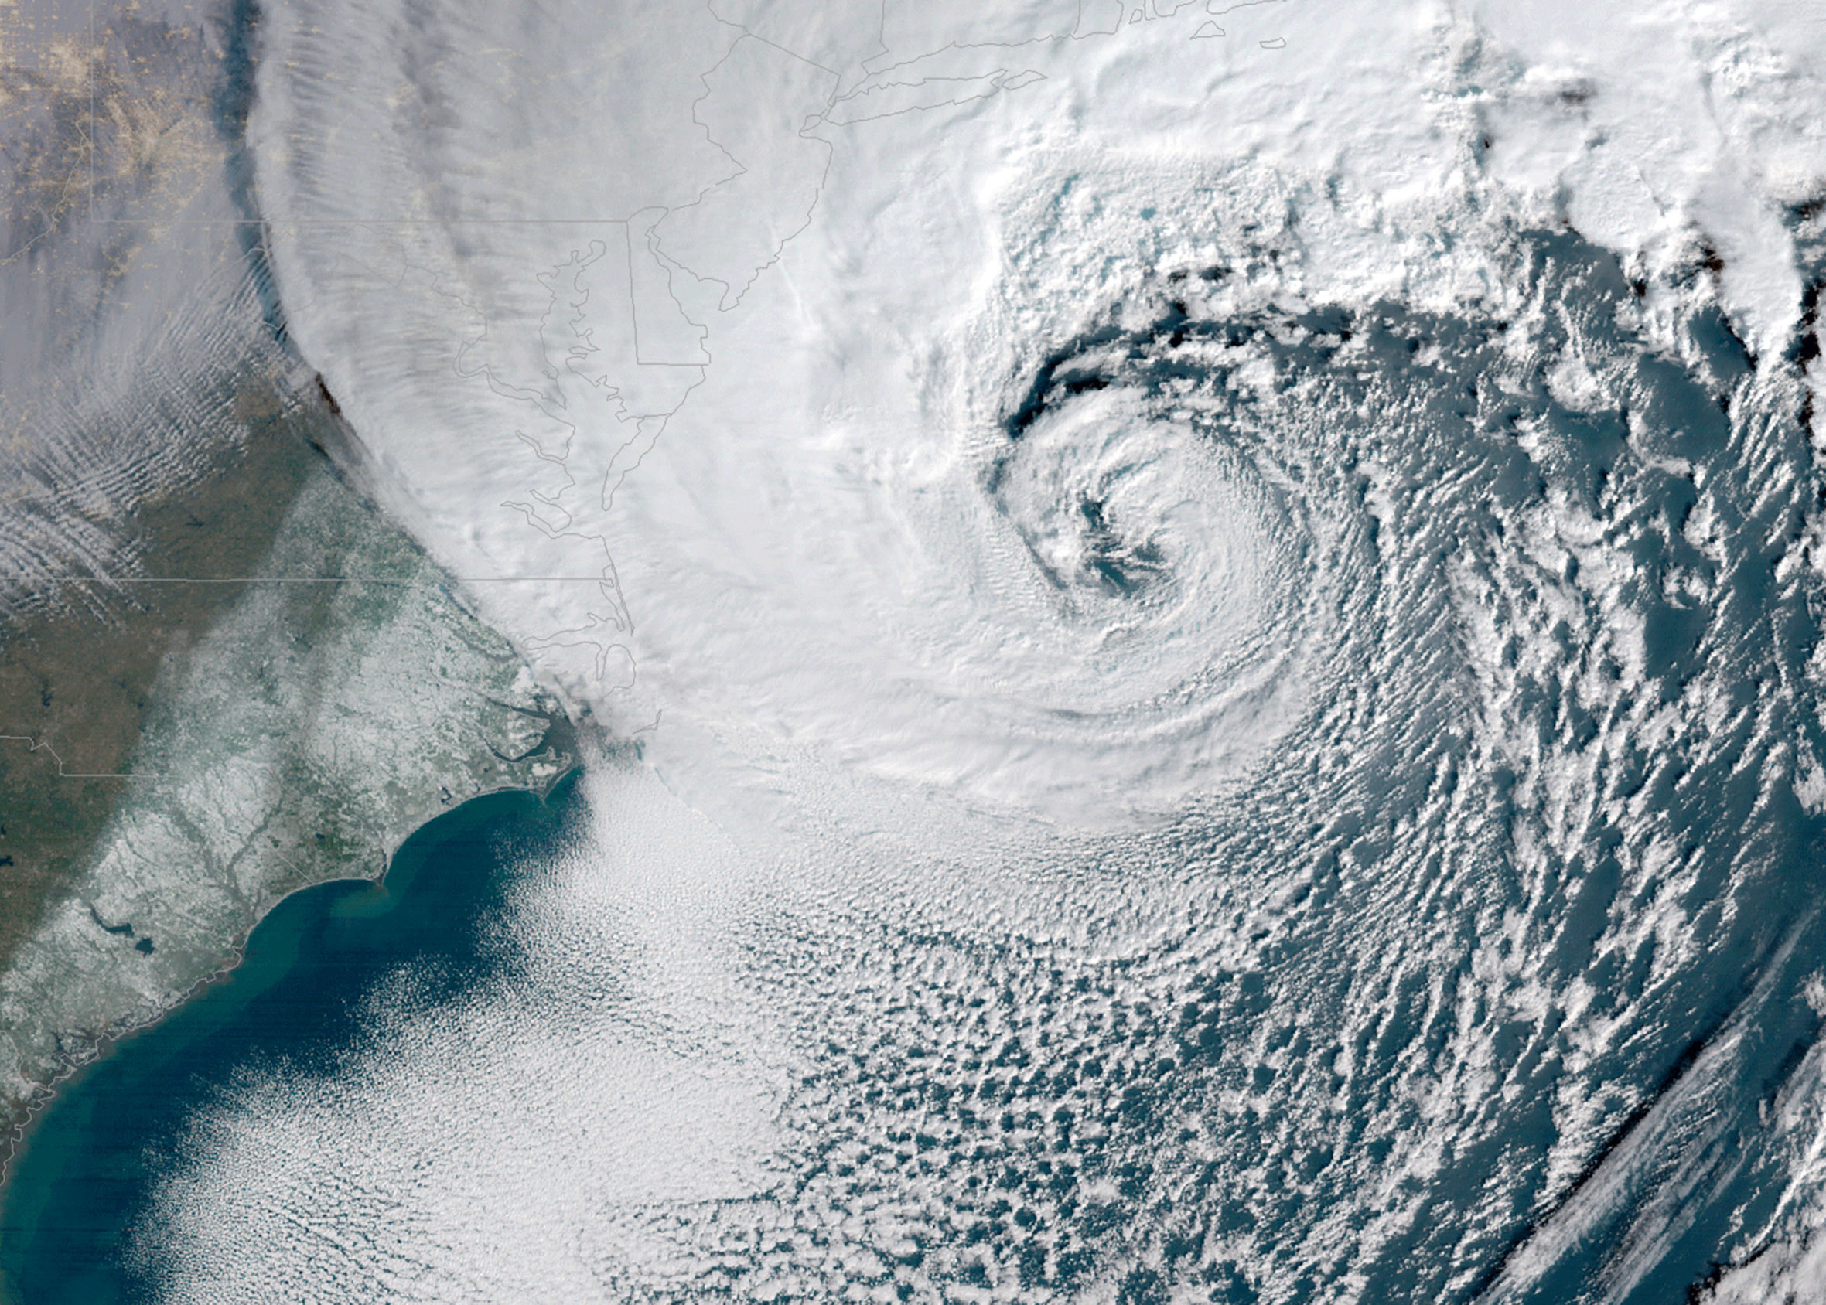
The Past, Present, and Future of Weather Forecasting
Ross A. Lazear
Department of Atmospheric and
Environmental Sciences
August 25, 2019

Slide 2
Outline
• History of weather forecasting
• Modern weather forecasting
-Nowcasting
-Weather forecasting (up to approx. 7 days)
-Seasonal to subseasonal forecasting
-Climate forecasting
• Future of forecasting

Slide 3
“…behind each [weather] prediction is one of humankind’s greatest accomplishments—something that requires armies of people all over the globe collecting and sharing data, exquisite mathematical modeling, and staggering computer power. The weather doesn’t respect political or geographic boundaries: we’re all living under the same sky. And so weather prediction has been a marvel not only of technology but also of international cooperation. As we enter an era of more storms and greater uncertainty than we’ve ever experienced, let’s hope it stays that way.”
–Hannah Fry, The New Yorker, June 24, 2019

Slide 4
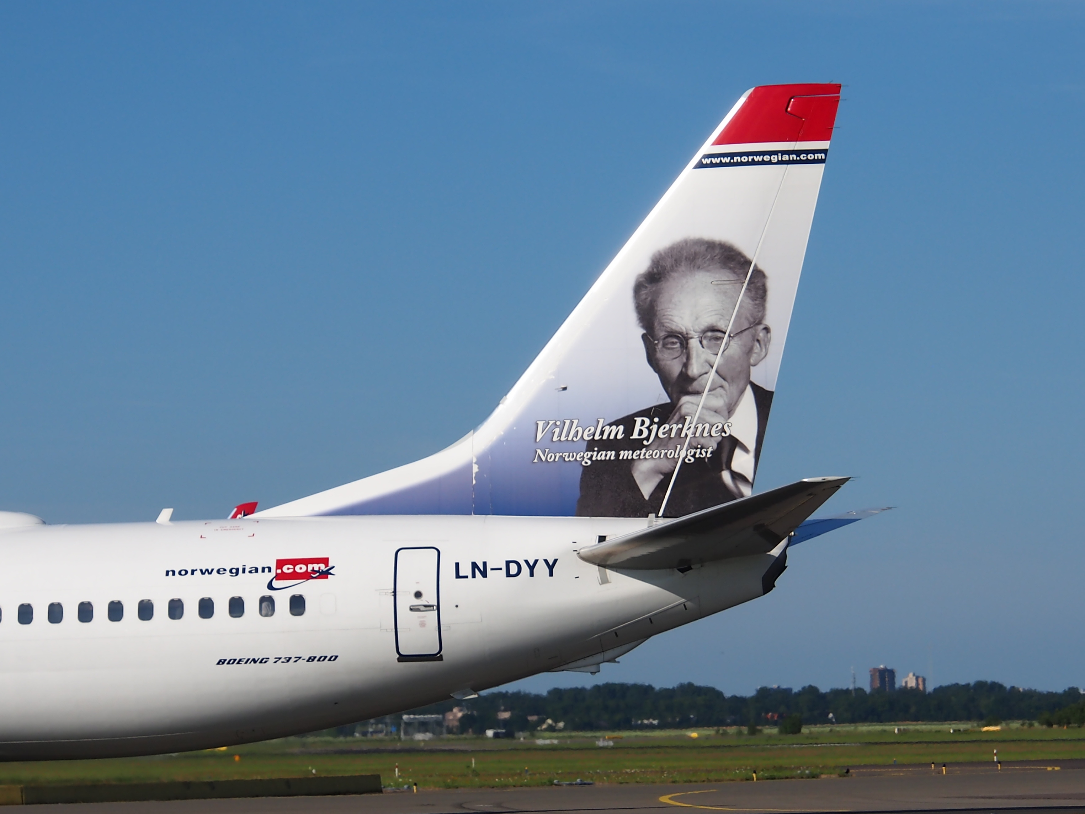
History of Weather Forecasting

Slide 5
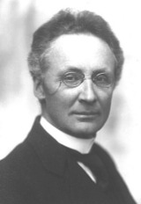
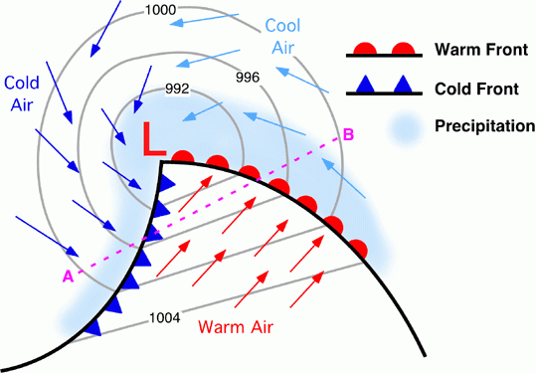
History of Weather Forecasting
Vilhelm Bjerknes
Father of Modern of Meteorology
Worked with Heinrich Hertz (of the unit of frequency) on the existence of electromagnetic waves and instruments that transmit/receive radio pulses
1895 – Professor at the University of Stockholm
Using a combination of fluid dynamics and thermodynamics,
developed primitive equations to describe atmospheric motion (still used today!!!!)
Prof. Vilhelm Bjerknes
1904 – Theorized that these equations could be used to predict atmospheric motion
Given a set of initial conditions, use the equations to integrate forward in time to solve for a future state
→ Given the lack of computing technology of 1904, this was not possible!
• Developed the cyclone model after observing Norwegian coastal weather conditions during World War I
Norwegian Cyclone Model

Slide 6
The forecast that changed the world…
Original invasion planned for June 5, but unusually strong late spring weather system was approaching!
With a new storm approaching over the North Atlantic, it was feared that the invasion would have to wait two weeks until the tidal conditions were ideal again.
U.K. meteorologists Pettersen and Douglas asserted that the morning of June 6 would provide a brief weakening of the winds between weather systems.
This narrow window of relatively tranquil weather allowed for the invasion, and any delay may have cost the allied forces the war.
Steve Kahn / Thomas Valle (WGN-TV)

Slide 7
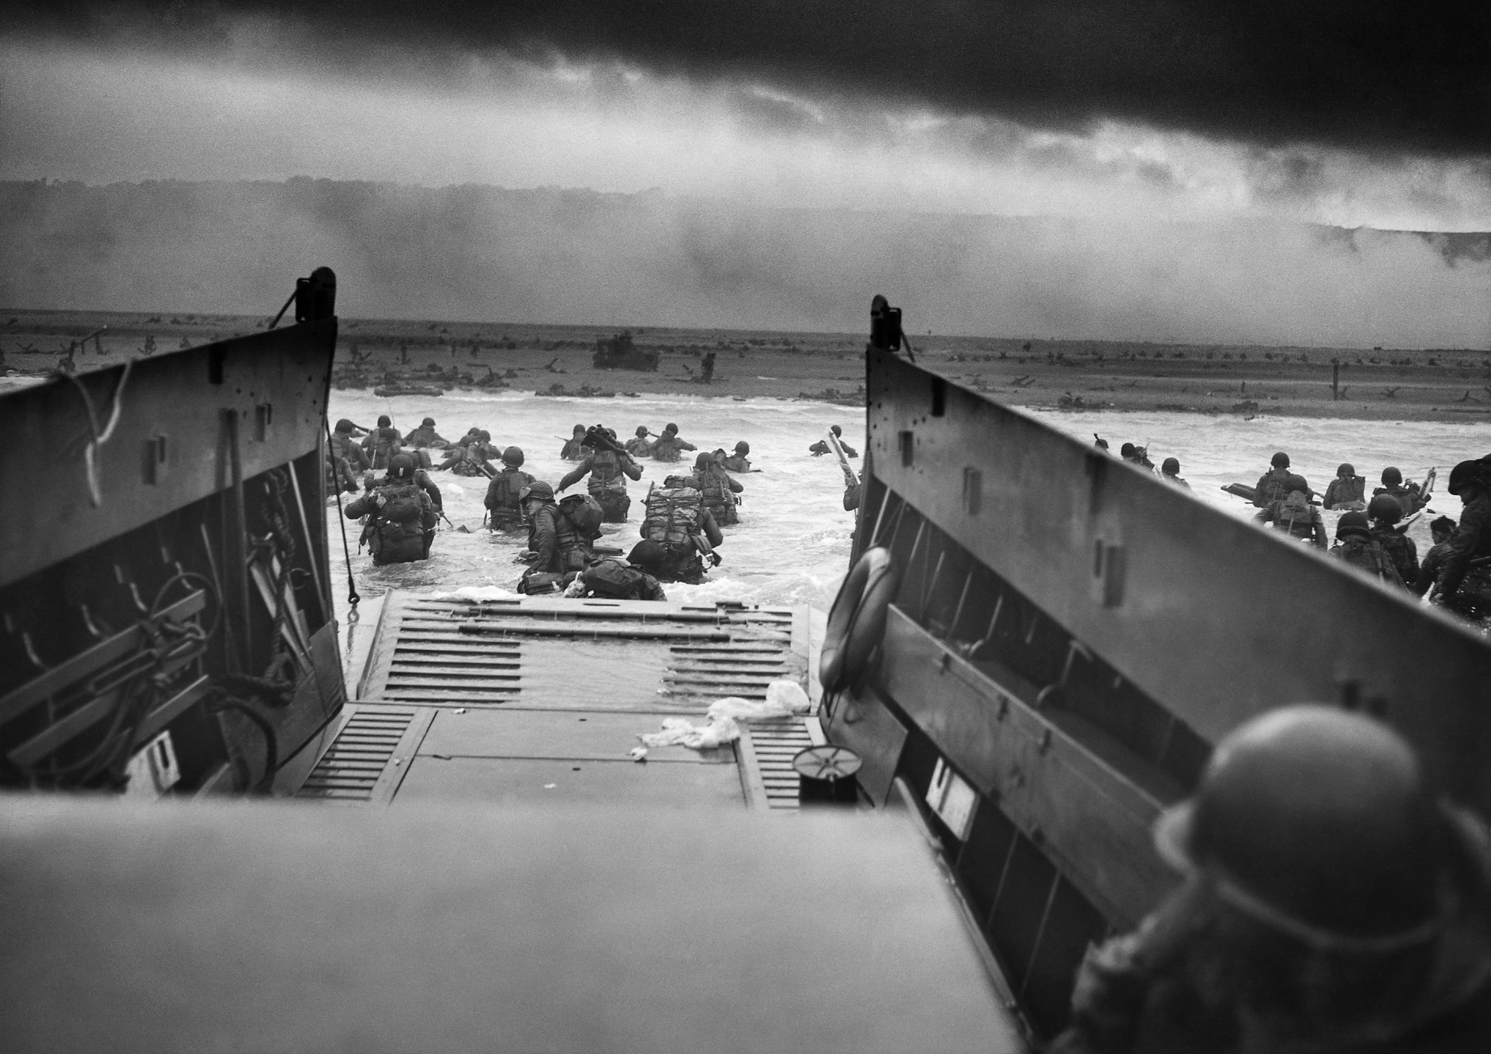
D-Day: June 6, 1944

Slide 8
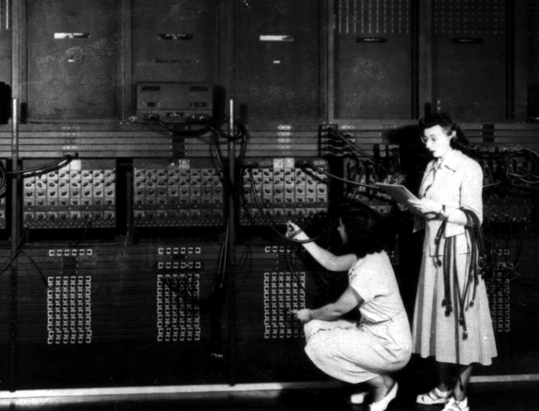
Using Bjerknes’ equations now possible with …
Electronic Numerical Integrator and Computer (ENIAC), 1950

Slide 9
Using Bjerknes’ equations now possible with …
National Centers for Environmental Prediction
Supercomputer 2016
10,000 times faster than a modern desktop computer!

Slide 10
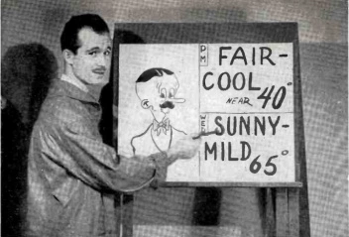
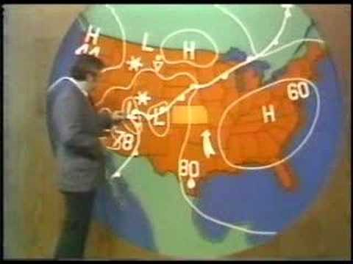
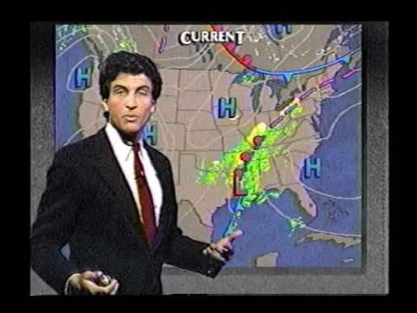
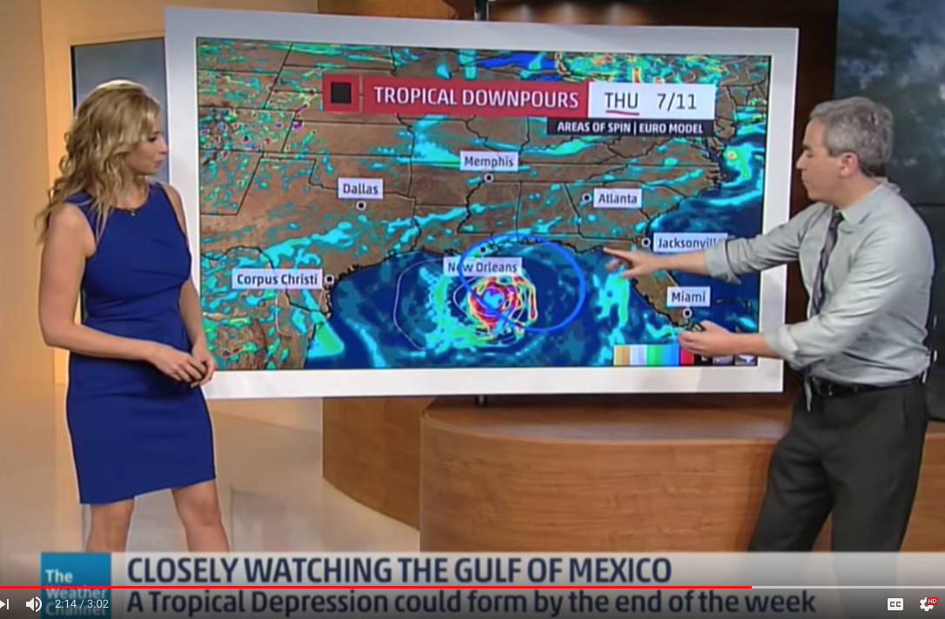
1949
1970s
1990s
2019

Slide 11
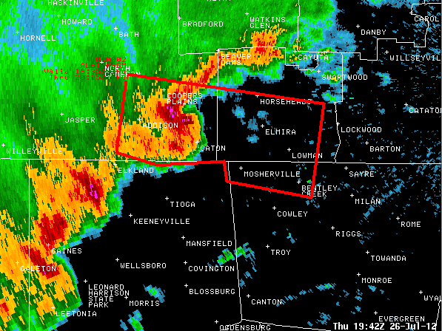
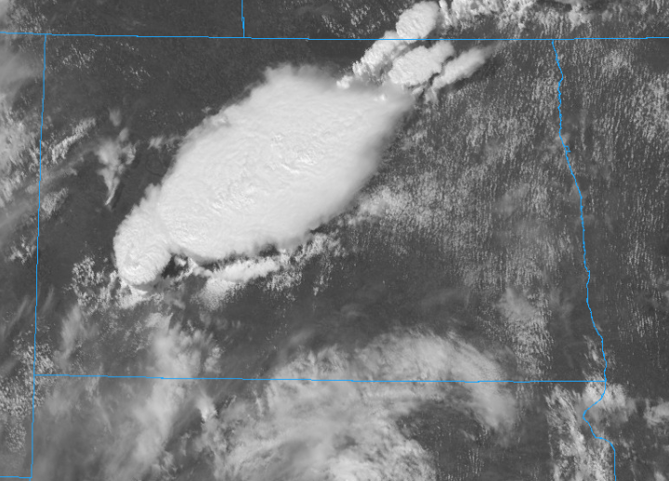
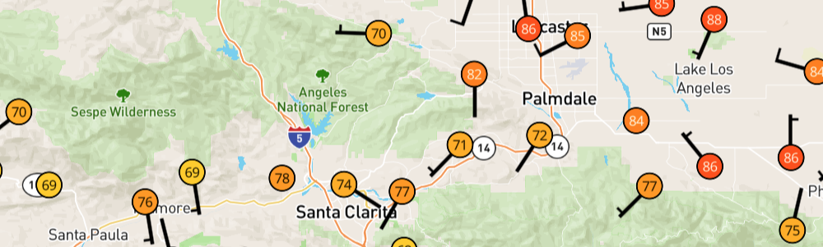
Types of forecasts
Nowcasting:
Forecasts of up to six hours in advance

Slide 12
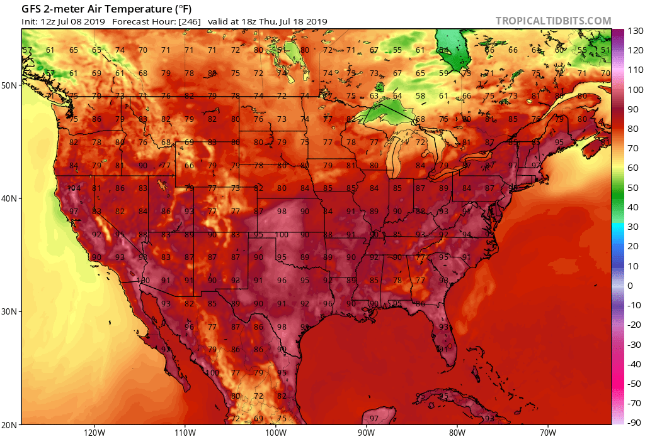
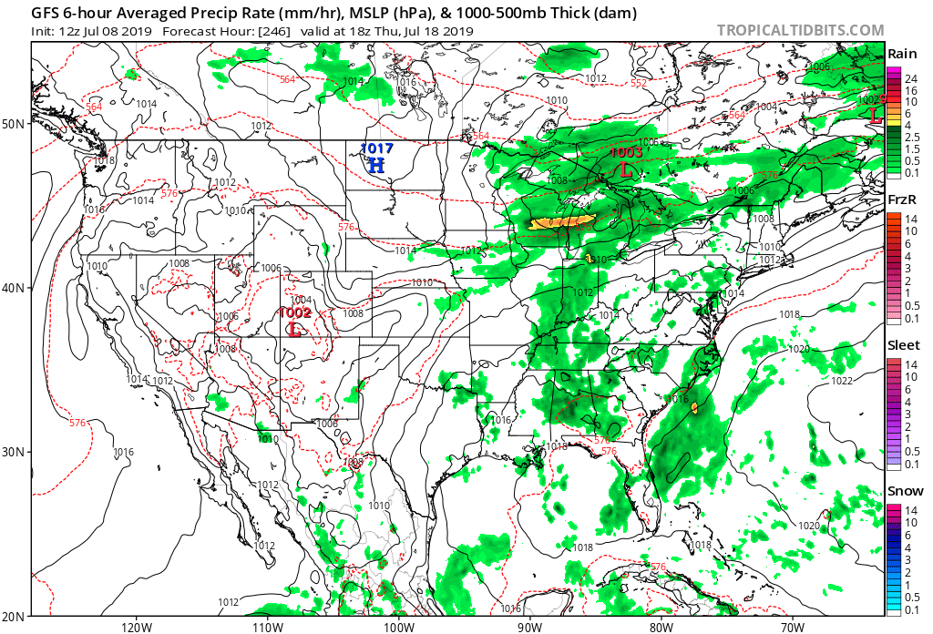
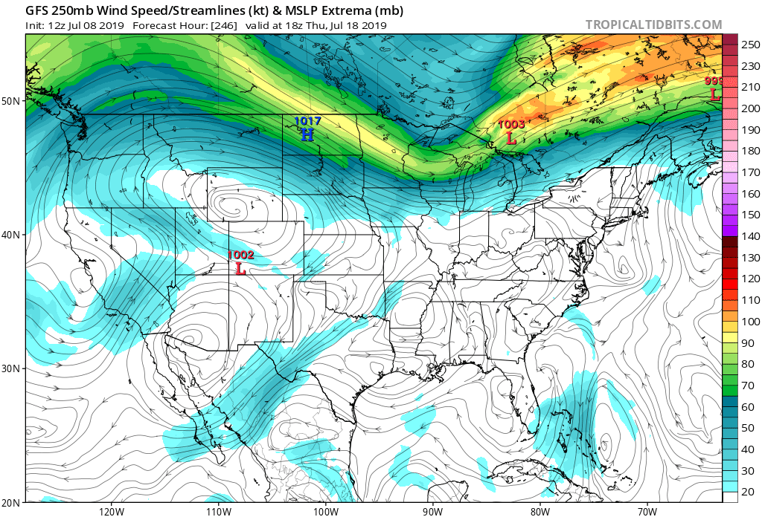
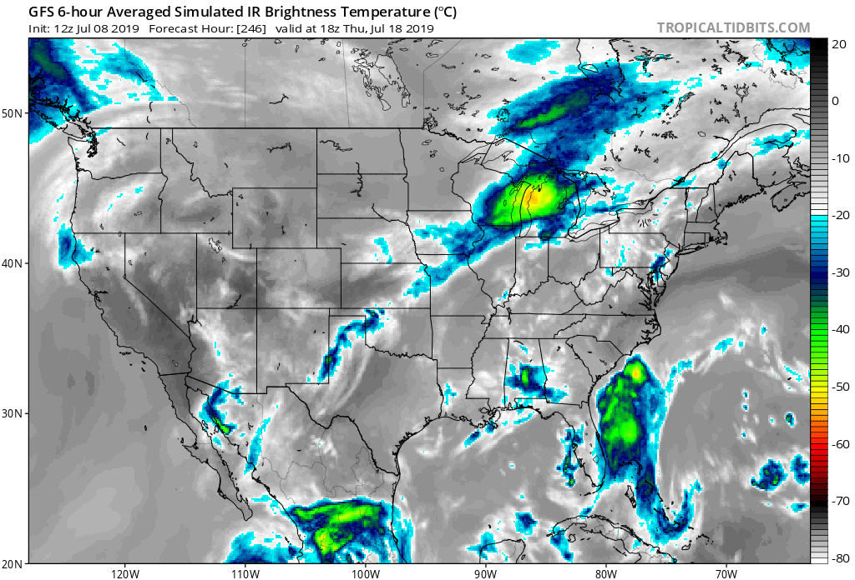
Short-range weather forecasts:
Forecasts of up to 7-10 days in advance

Slide 13
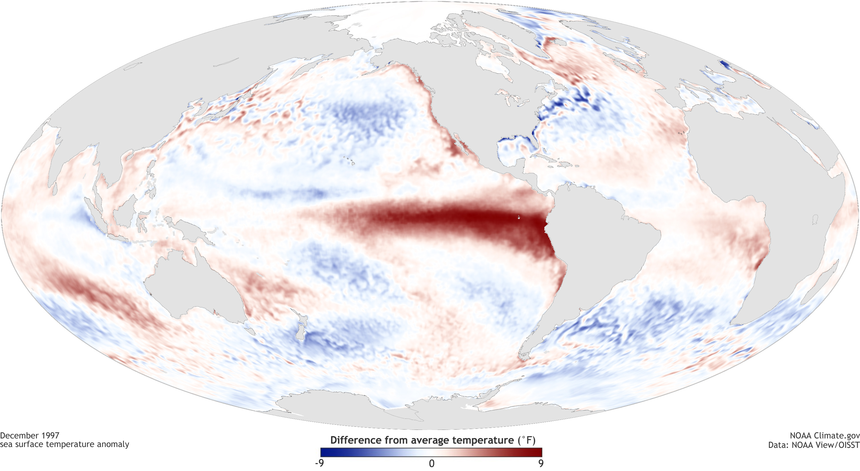
Seasonal to Subseasonal forecasting
What is the probability of a snowy winter? A hot summer?
Sea surface temperatures in December 1997 (El Niño)
Up to 10°F warmer than normal over the Tropical Pacific!

Slide 14
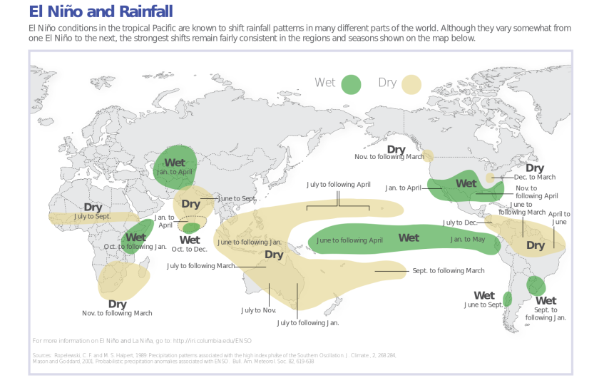
Seasonal and Subseasonal forecasting
What is the probability of a snowy winter? A hot summer?

Slide 15
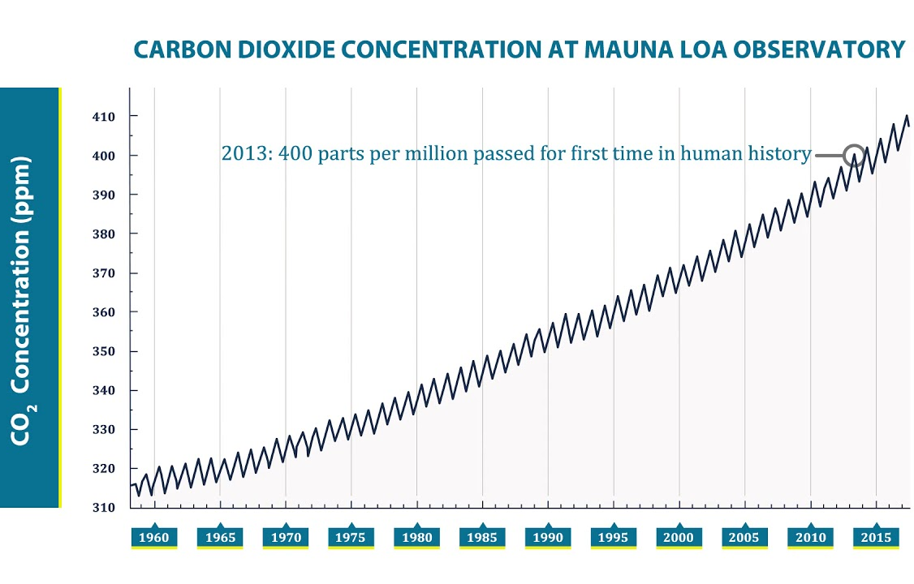
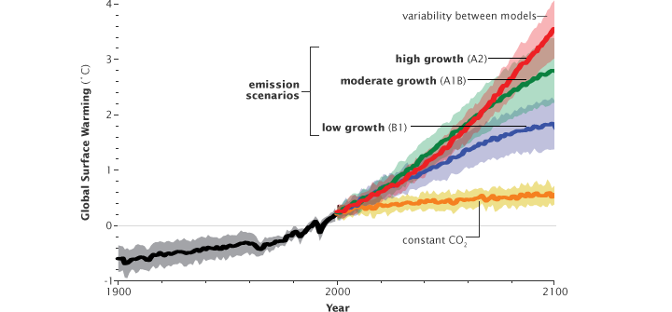
Climate forecasting
How will natural and human-induced changes to our planet affect global temperatures and precipitation?
IPCC Report, 2007
Scripps Institute for Oceanography

Slide 16
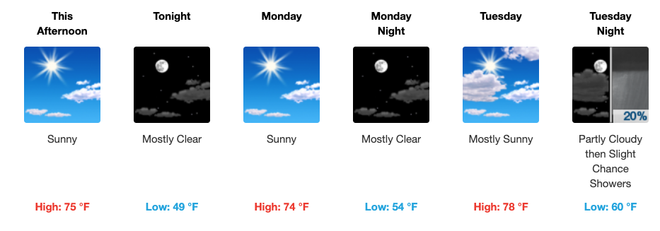
How do meteorologists make a weather forecast?
National Weather Service forecast for Albany, N.Y. – August 25, 2019
• Current weather
• Weather models
• Research
• Intuition (memory and understanding of past similar events)
Part of why an unprecedented storm, like Superstorm Sandy, is a tough forecast!

Slide 17
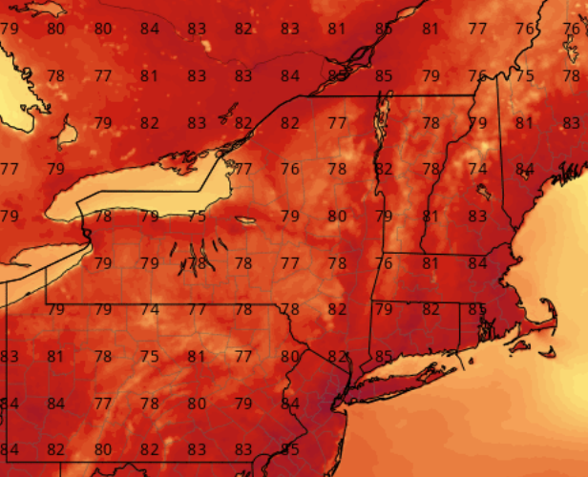
What is a weather model?
Models start with the current weather conditions (from observations at airports, planes, weather balloons, satellite imagery, etc.)
Combine observations with a recent forecast to make a best guess of the current conditions on a grid within the domain of a model
Take Bjerknes’ equations and integrate forward in time!
77
+
77
81
81
76
86
83
85
89
Temperatures from a prior model run
Combine with current observations

Slide 18
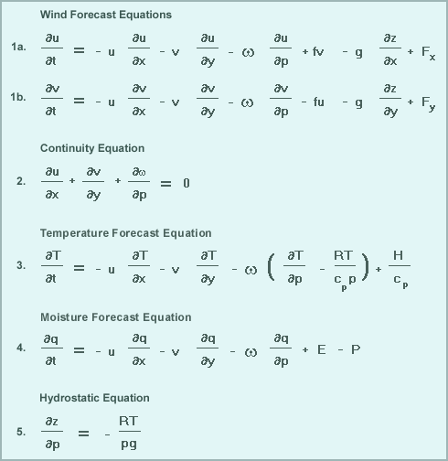
Integrate forward in time …
From MetEd / UCAR

Slide 19
How many models are there..?
High-resolution Rapid Refresh (HRRR) – 36 hours
WRF-NMM – 48 hours
WRF-ARW – 48 hours
NSSL WRF – 48 hours
NAM – 84 hours
GFS – 16 days
ECMWF (Euro) – 10 days
UKMET – 10 days
CMC (Canadian) – 10 days
RGEM – 48 hours
HRDPS – 48 hours
NAVGEM (U.S. Navy) – 144 hours
JMA (Japanese)
….and more…

Slide 20
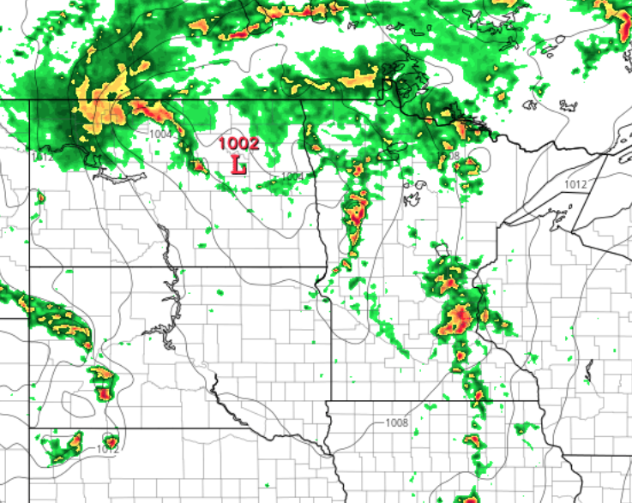
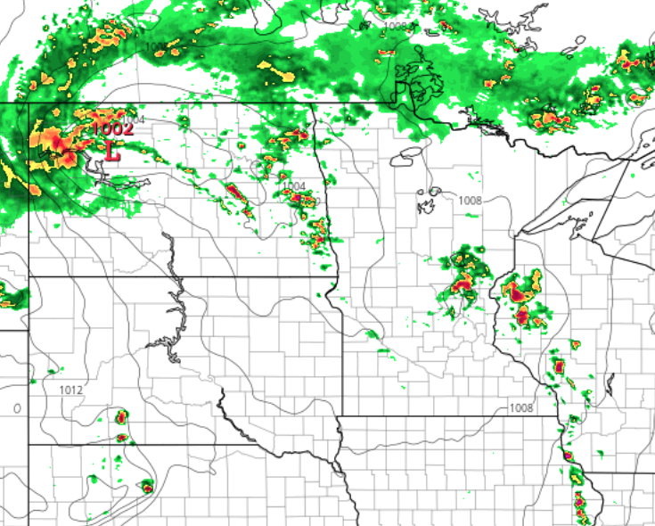
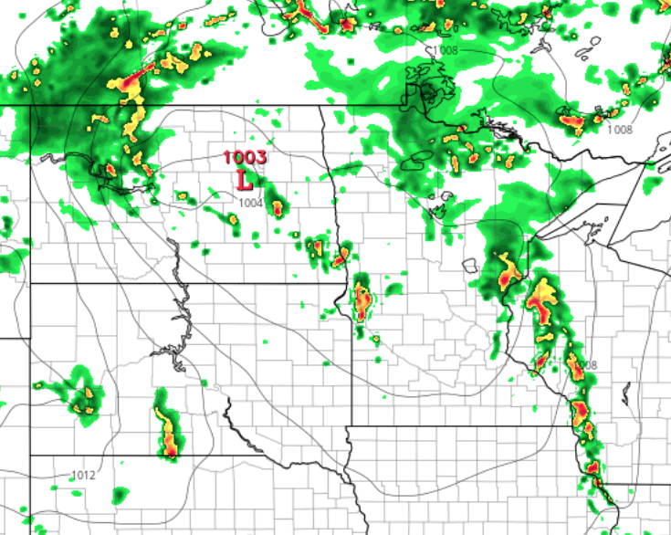
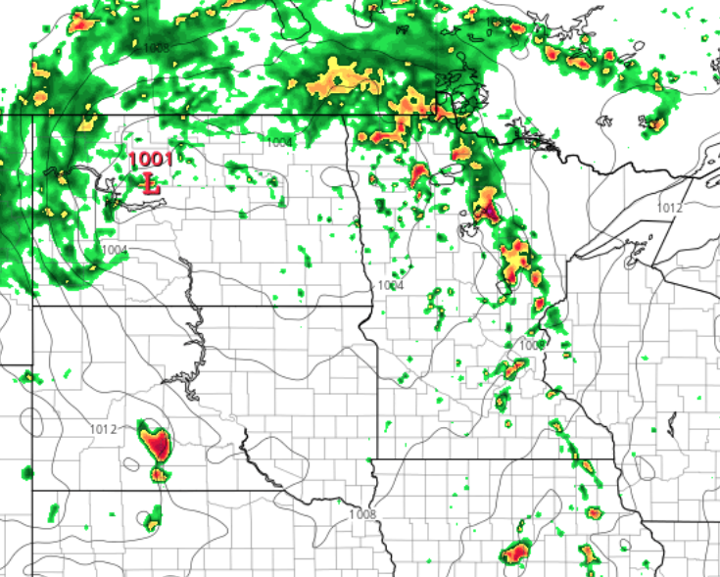
Four different model runs of 12-hour forecasts
WRF-NMM
NAM
HRRR
NSSL WRF

Slide 21
Probabilistic forecasting
Because models inherently develop errors over time and offer a wide range of solutions, meteorologists refrain from using wording like:
There will be a thunderstorm at 3:00 PM tomorrow
The rain will change to snow at midnight on Friday
It will not rain this weekend
These are “deterministic” forecasts. Instead, meteorologists turn to probabilistic forecasts:
There is increased likelihood of a thunderstorm tomorrow afternoon
Most models indicate the rain changing to snow around midnight on Friday
At this point, models indicate a dry weekend ahead
Probabilistic forecasting requires using a model ensemble.
• Take a model (GFS)
• Make tiny changes to the initial state of the atmosphere 20+ times
• 20+ model solutions that show a range of possible outcomes

Slide 22
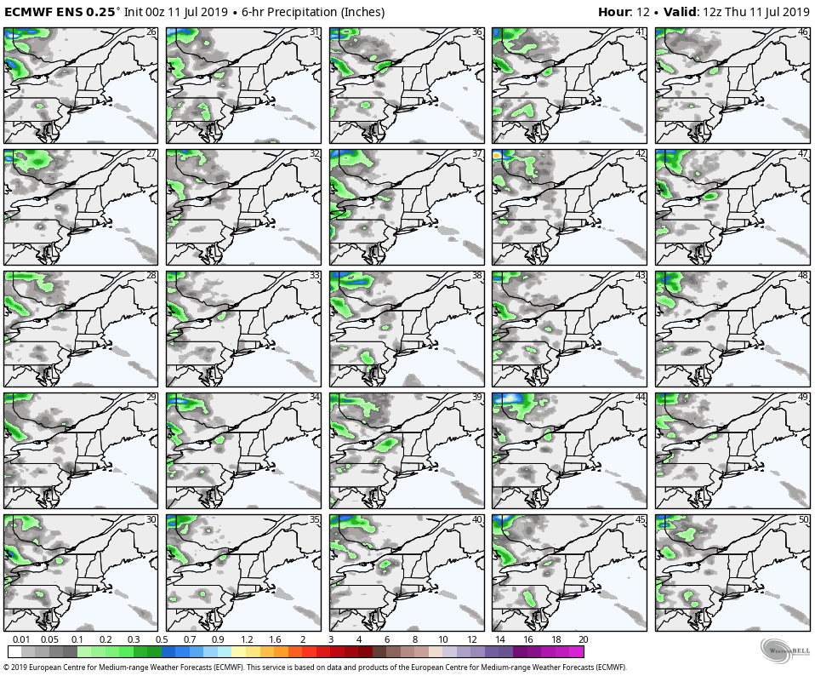
Ensemble forecasting: 12-hour forecast
Weatherbell.com

Slide 23
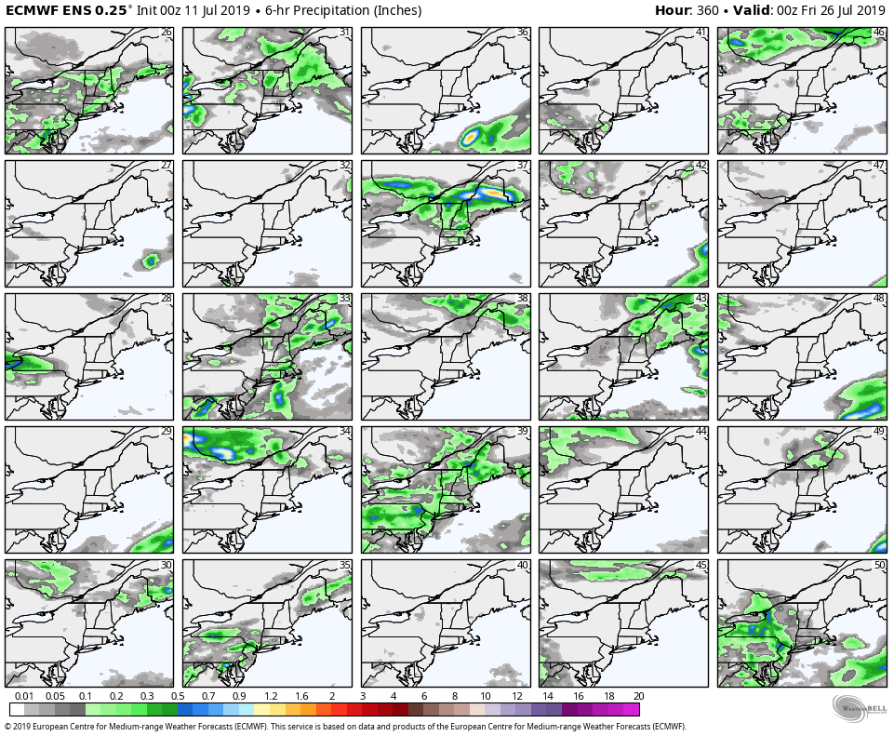
Ensemble forecasting: 360-hour (15-day) forecast
Weatherbell.com

Slide 24
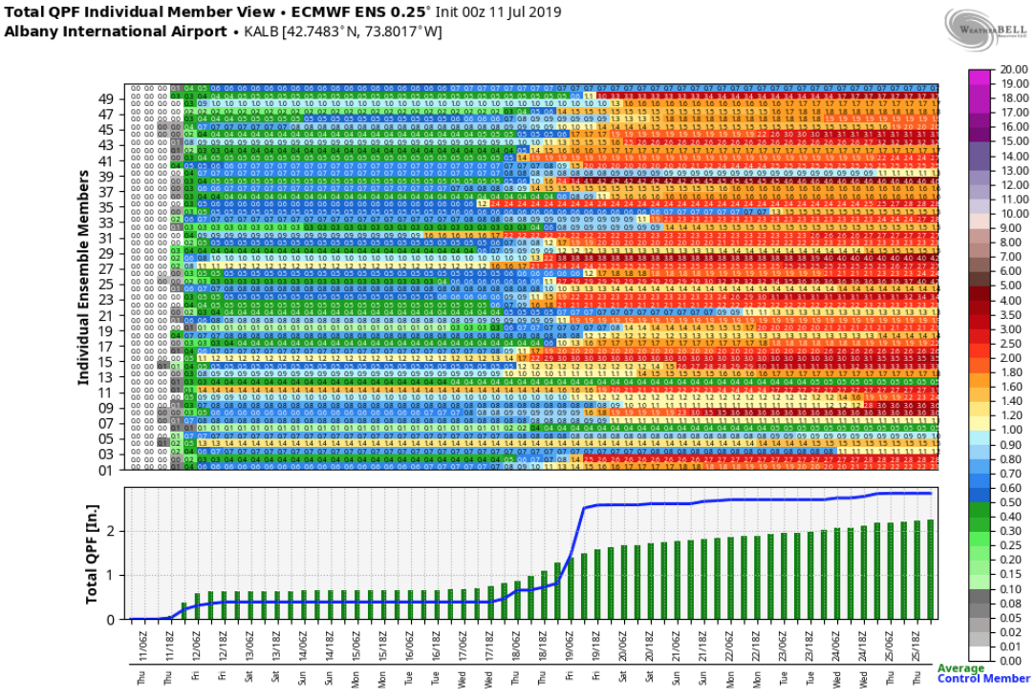
Ensemble forecasting
Weatherbell.com

Slide 25
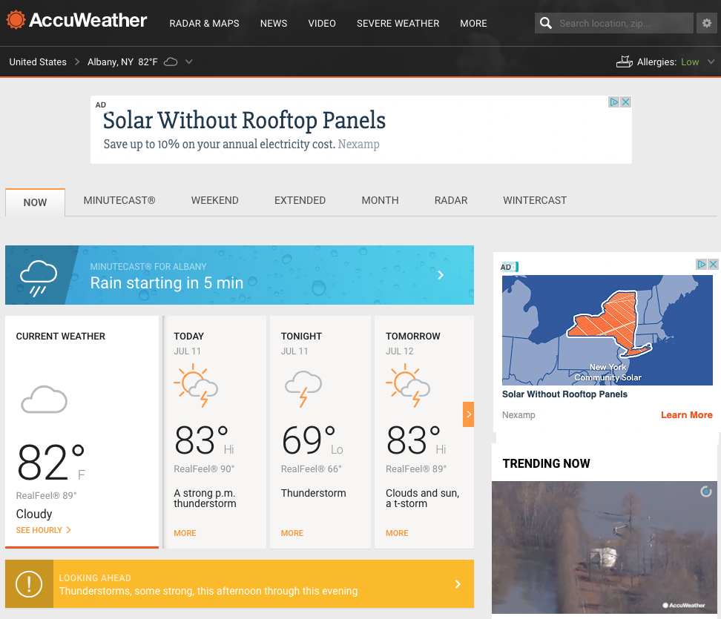
So, if there is such low predictability past two weeks, then why….

Slide 26
So, if there is such low predictability past two weeks, then why….
!!!!!!!!!!

Slide 27
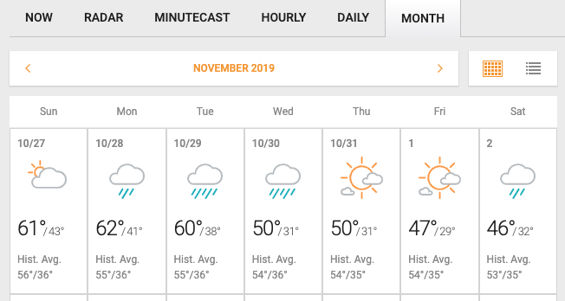
So, if there is such low predictability past two weeks, then why….
This forecast is garbage!

Slide 28
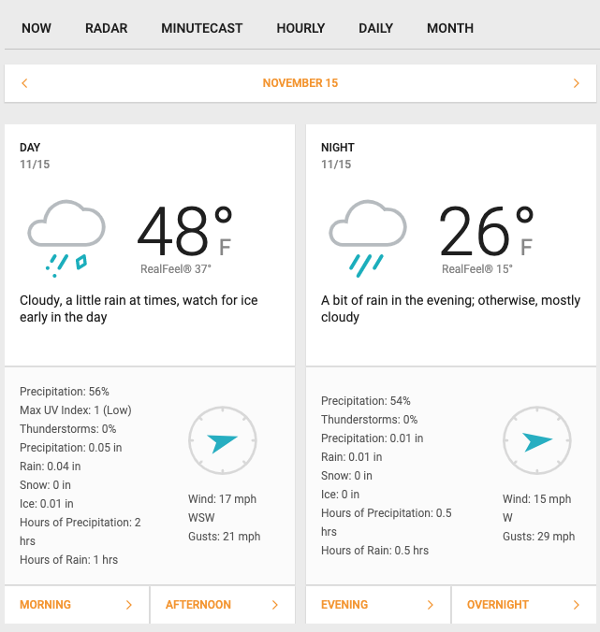
So, if there is such low predictability past two weeks, then why….
This forecast is garbage!

Slide 29
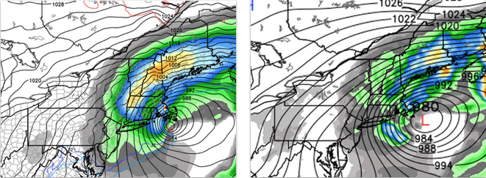
Forecast model failure … January 27, 2015
ECMWF 12Z 26 Jan 2015
GFS 12Z 26 Jan 2015
Forecast precipitation for 00Z to 06Z 27 Jan 2015

Slide 30
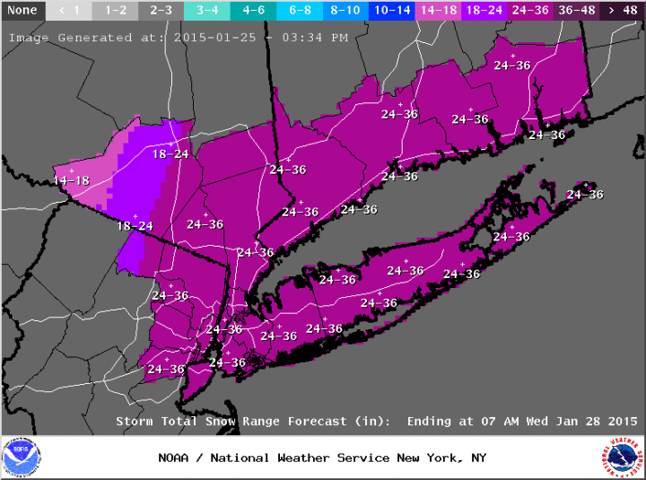
Forecast model failure … January 27, 2015

Slide 31
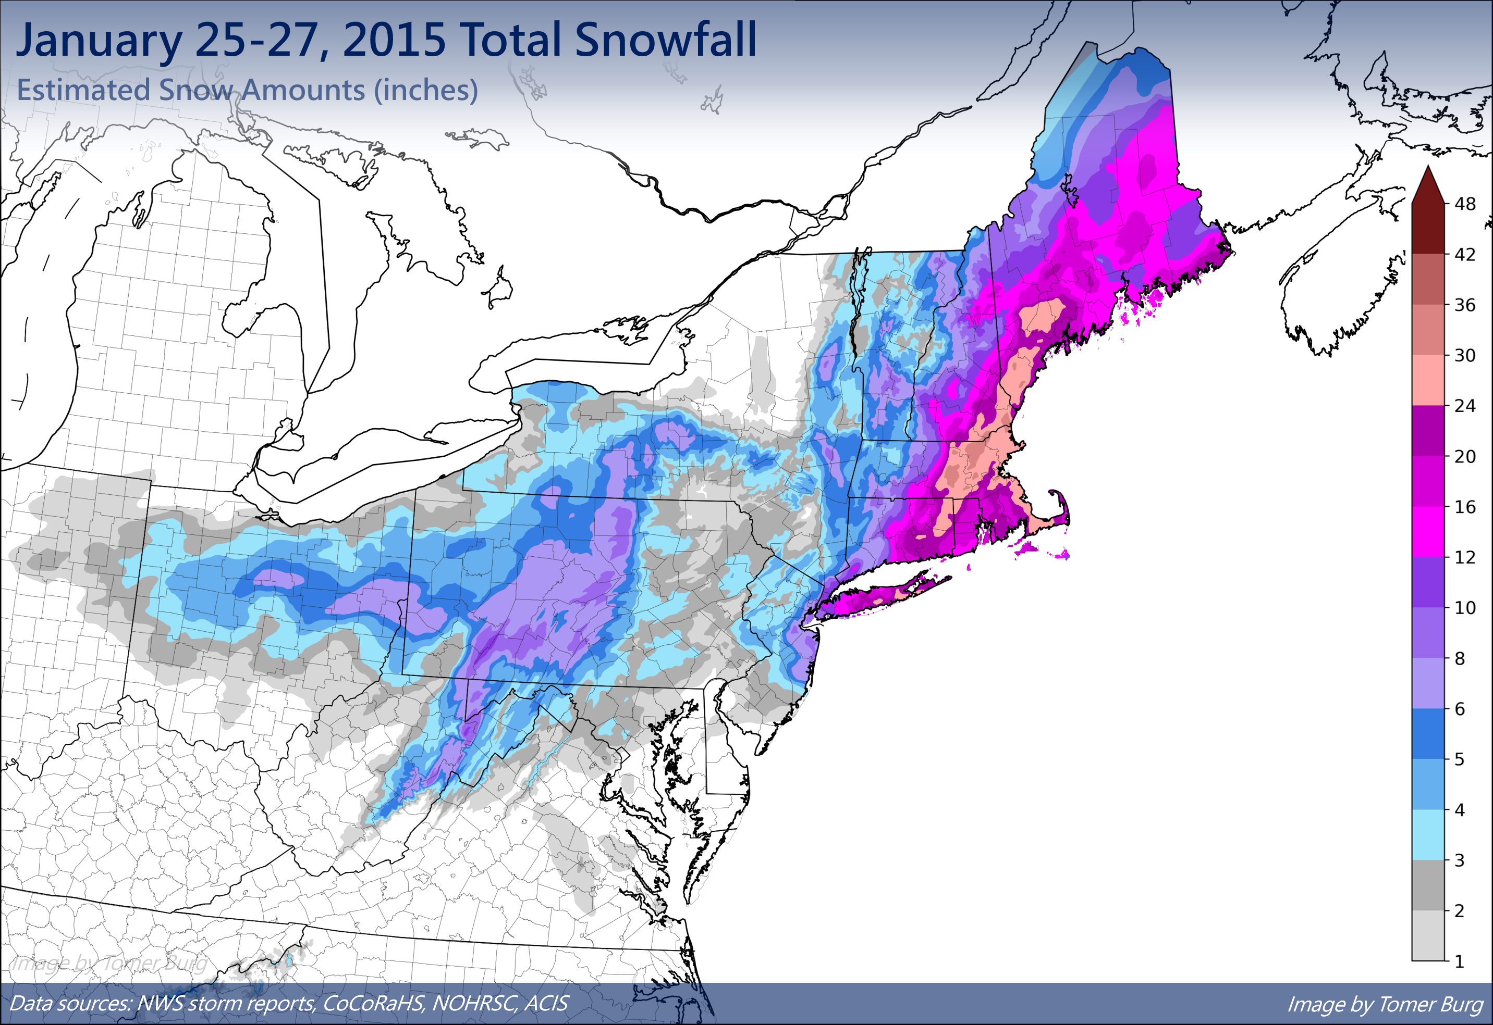
Forecast model failure … January 27, 2015

Slide 32
Recent change:
National Weather Service now makes
probabilistic snowfall forecasts!
National Weather Service
Mount Holly, N.J.

Slide 33
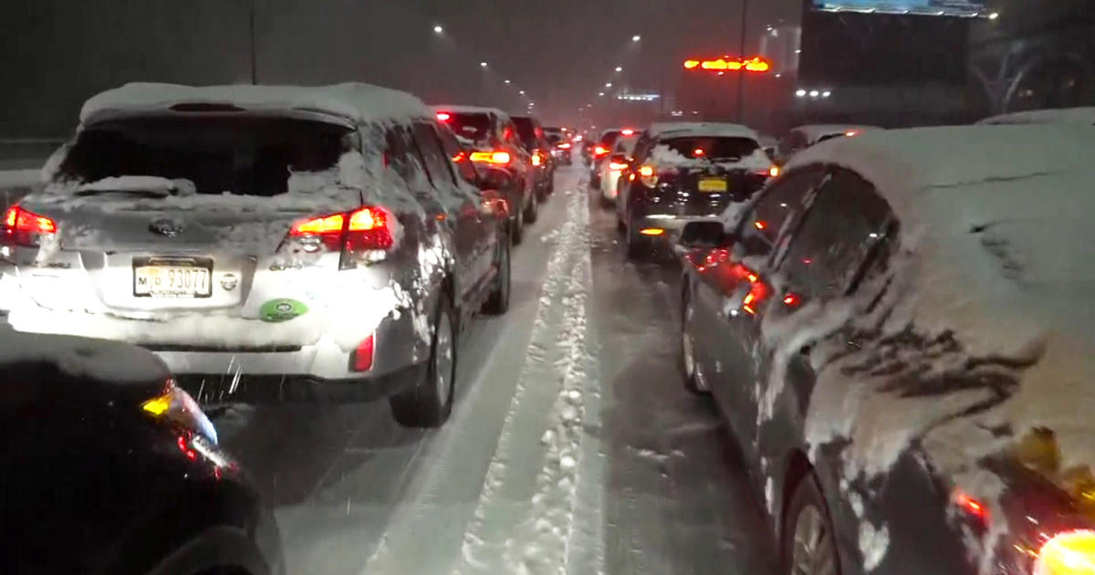
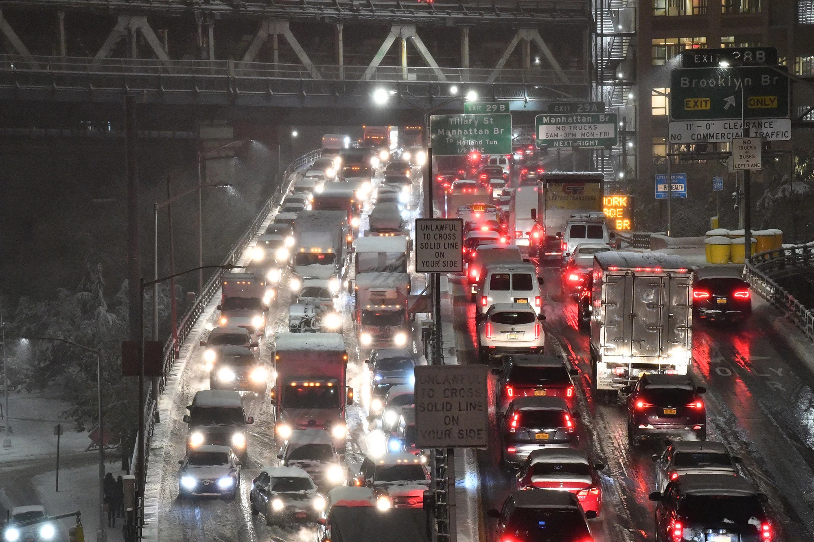
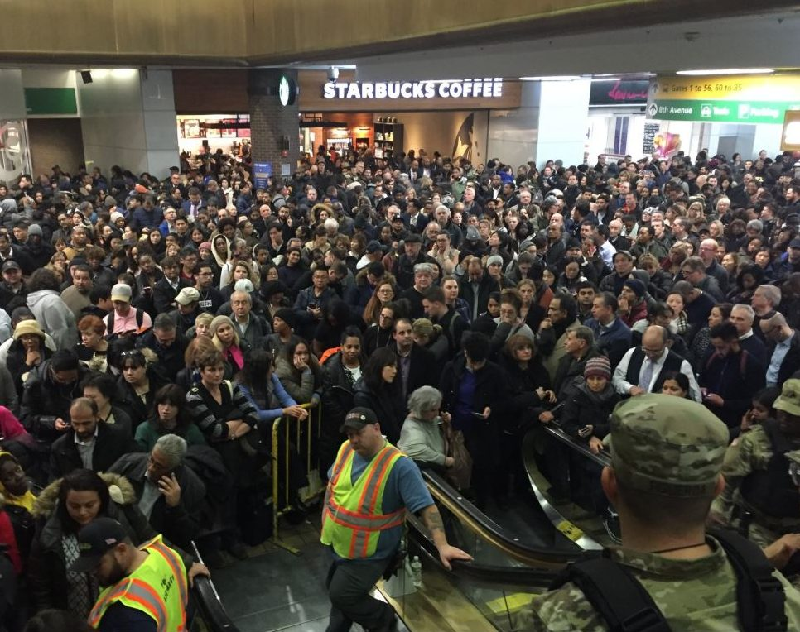
Forecast communication failure … November 15, 2018
Heavy snow during afternoon and evening in NYC
Poor forecasts despite fairly good and consistent model simulations
CBS News
New Jersey Globe
NY Post

Slide 34
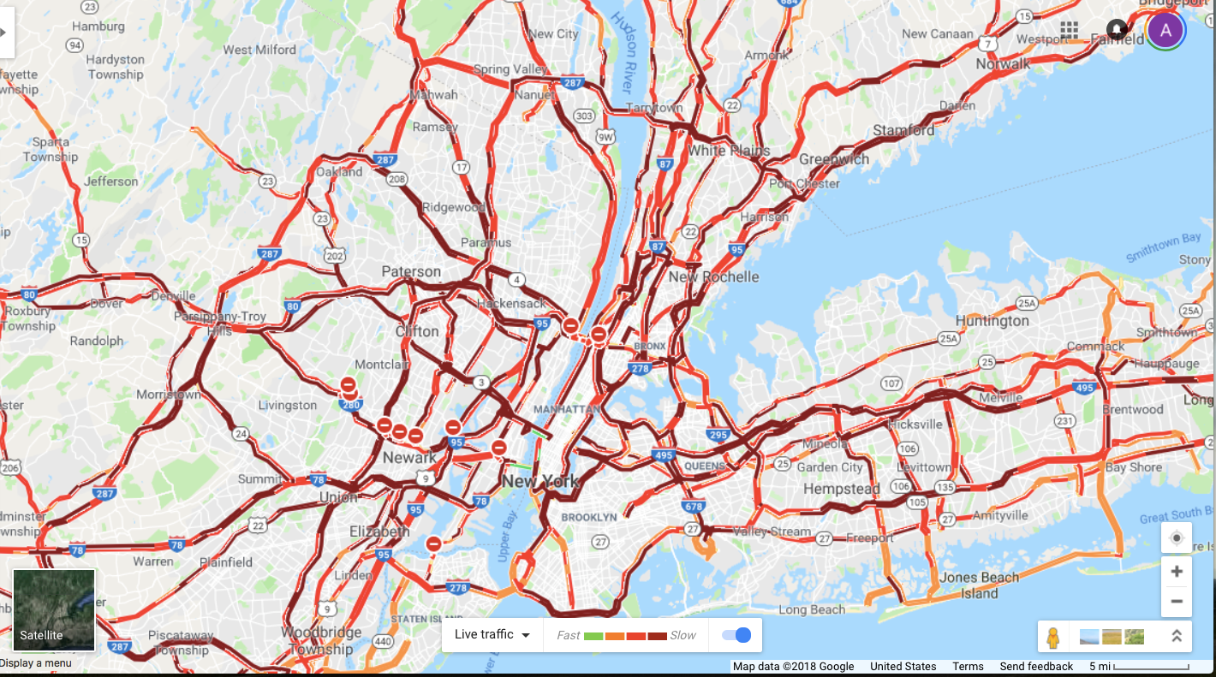
Forecast communication failure … November 15, 2018

Slide 35
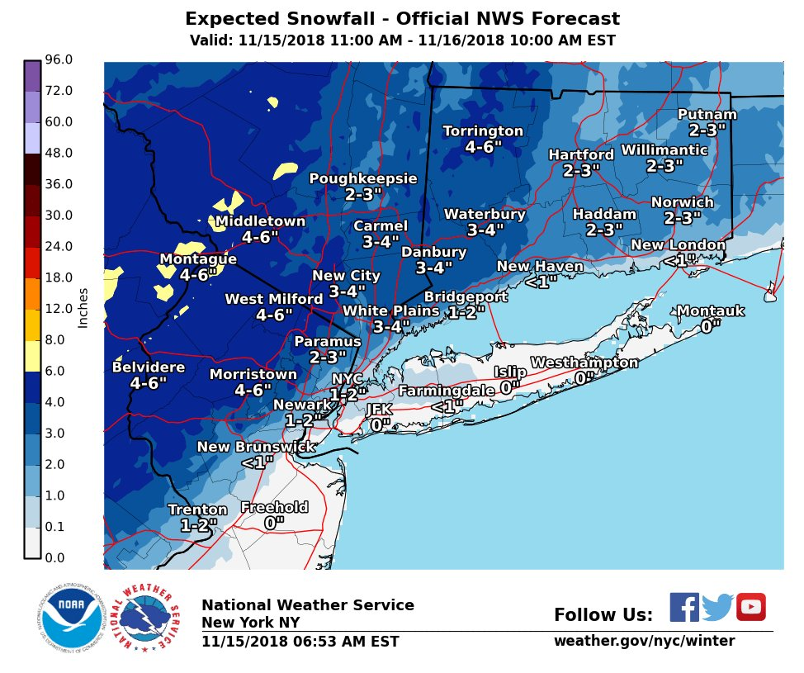
Forecast communication failure … November 15, 2018

Slide 36
Forecast communication failure … November 15, 2018
National Weather Service
New York, N.Y.
Officially 6.4” at Central Park

Slide 37
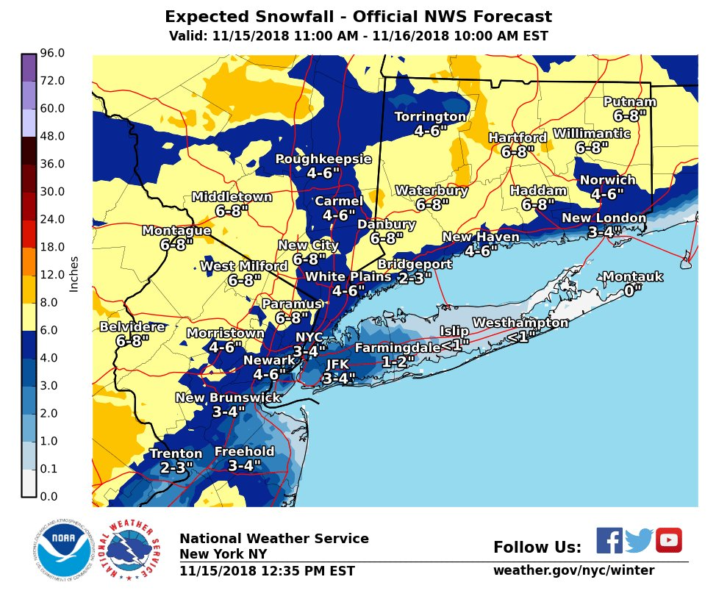
Forecast communication failure … November 15, 2018

Slide 38
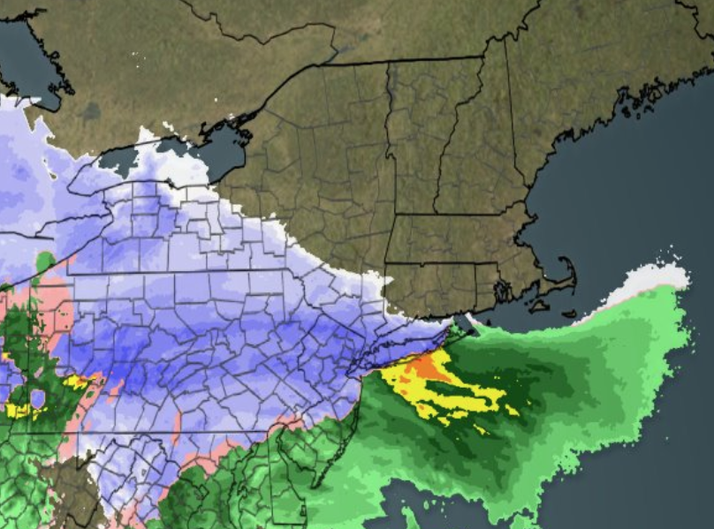
Forecast communication failure … November 15, 2018
What went wrong?
• Time of year
Unusual to have a major snowstorm in the Mid-Atlantic to New York City in mid-November, especially with relatively warm ocean waters
• While some models were very consistent, others were less so, and meteorologists were hesitant at going “all in”
• Air was unusually dry
With surface winds coming from Canada,
the air was drier than models indicated.
Result: More evaporation, and more cooling
(longer duration snow!)
Penn State

Slide 39
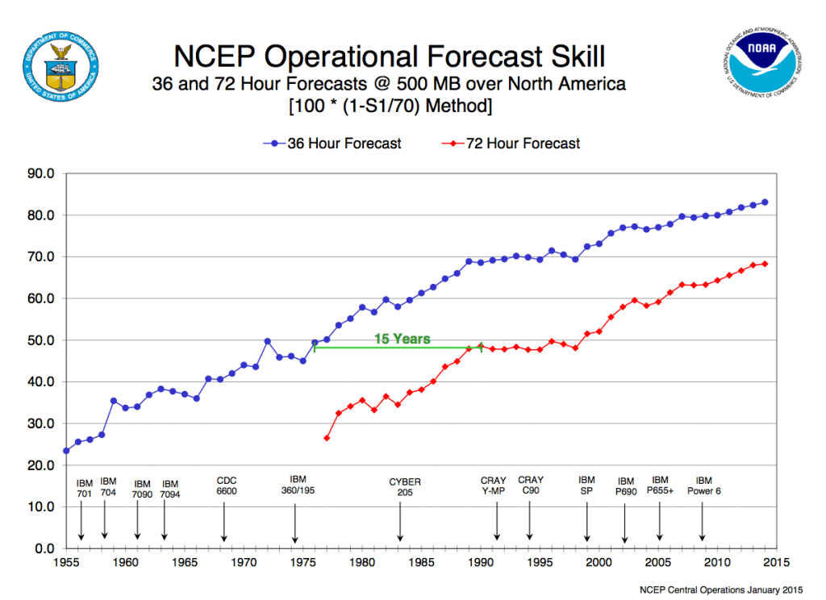
We learn from storms like these …
… and models and forecasters are improving every year!

Slide 40
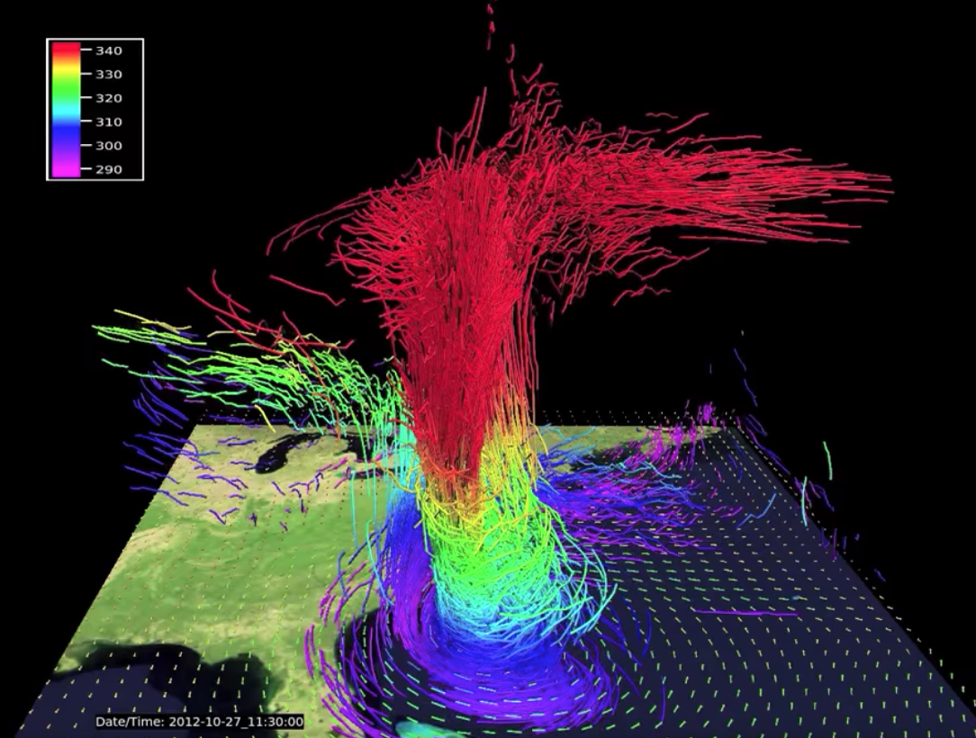
Future of weather forecasting
National Center for Atmospheric Research

Slide 41
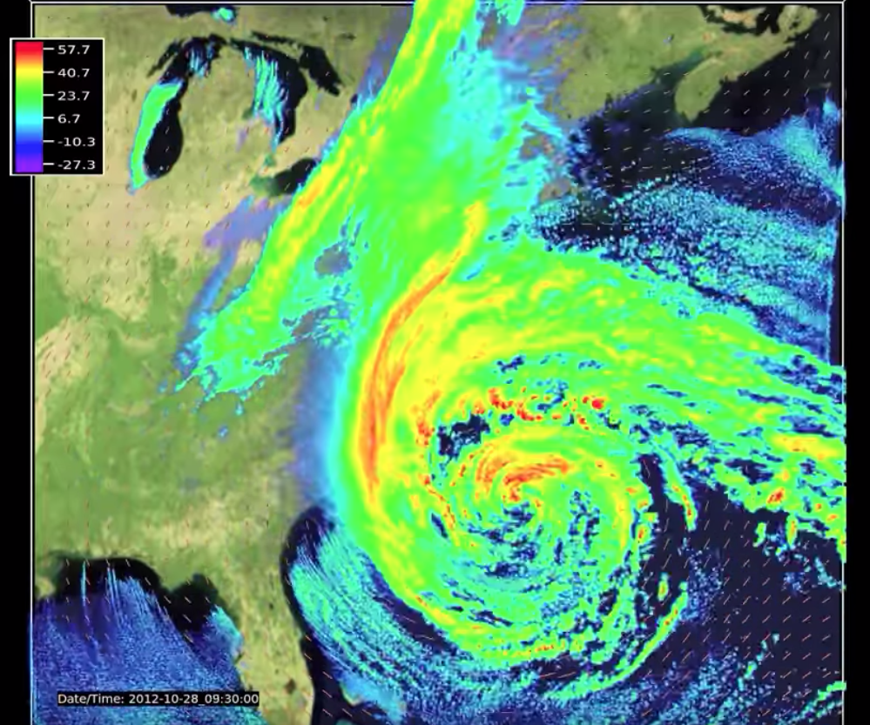
Future of weather forecasting
National Center for Atmospheric Research

Slide 42
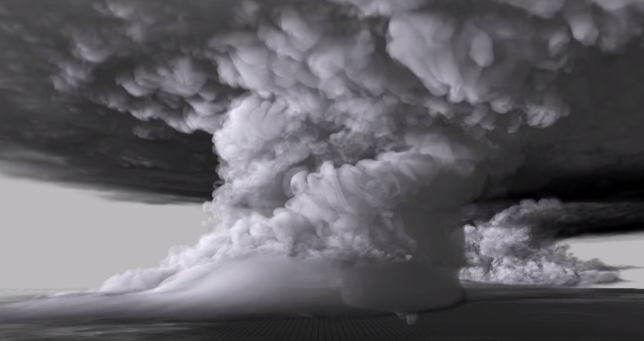
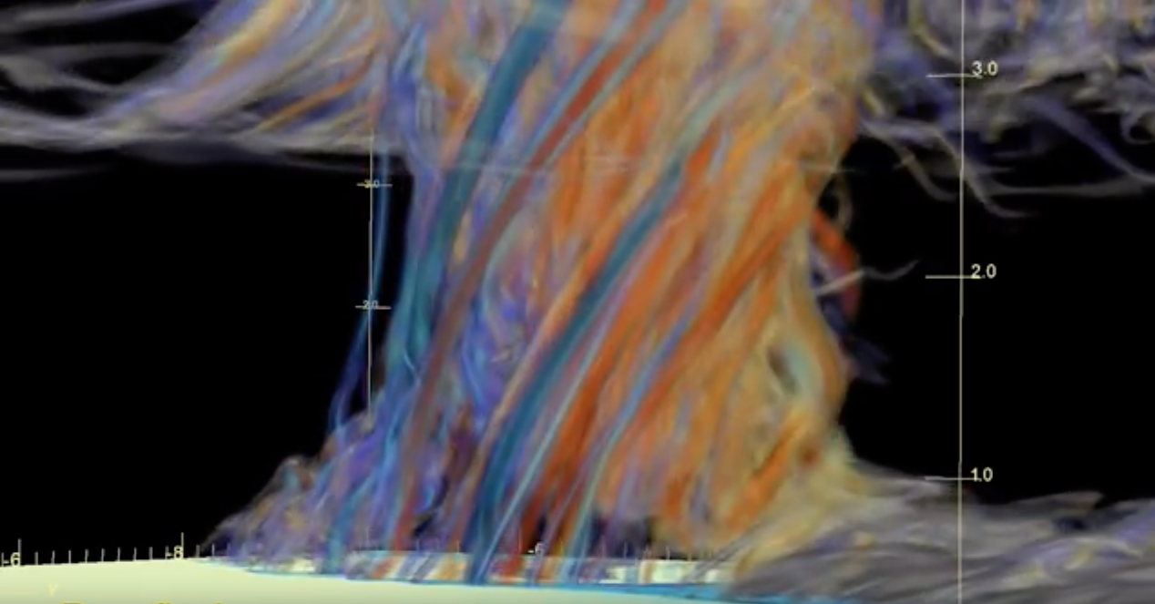
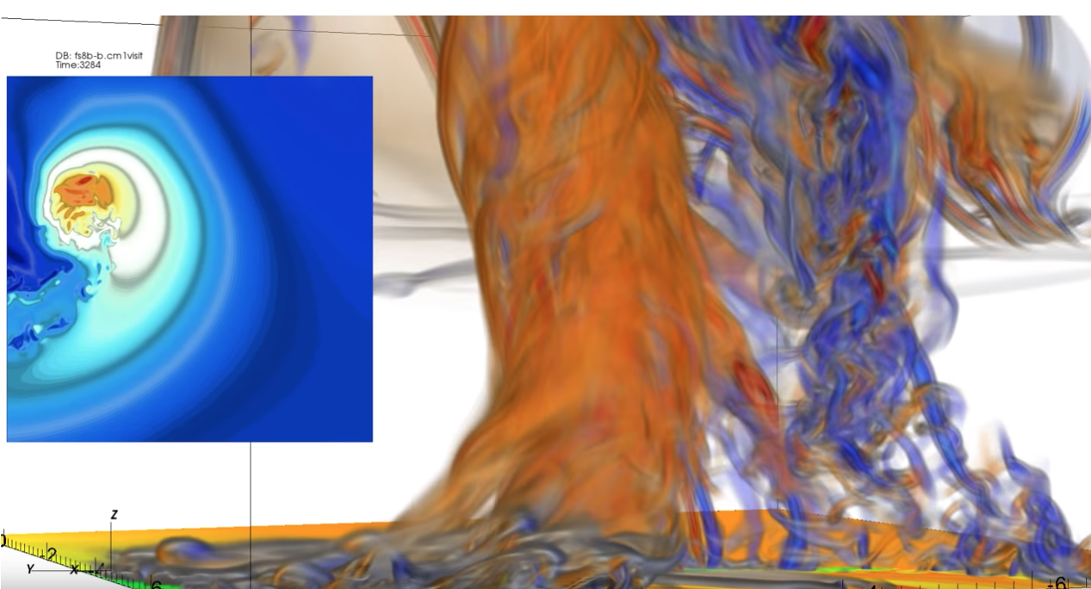
Dr. Leigh Orf (orf.media)

Slide 43
Artificial intelligence and weather forecasting
Rather than use a model to forecast the weather, we can use pattern recognition
Train a machine learning algorithm to learn what certain objects look like:
Sample cats and dogs from entire training dataset (from Adil Moujahid)

Slide 44
Artificial intelligence and weather forecasting
Rather than use a model to forecast the weather, we can try pattern recognition
Train a machine learning algorithm to learn what certain objects look like:
Dog (Quint)
Cat (Maya)

Slide 45
Artificial intelligence and weather forecasting
freeCodeCamp
Can a machine learning algorithm tell the difference between:
A chihuahua and a blueberry muffin?

Slide 46
Mostly yes … but what does this have to do with weather?!

Slide 47
Artificial intelligence and weather forecasting
Will severe hail fall in a particular thunderstorm?
NO HAIL
HAIL
HAIL
NO HAIL

Slide 48
Artificial intelligence and weather forecasting
Will a particular jet stream result in a major nor’easter?

Slide 49
In summary …
Past: With the 20th century advent of advanced computing, we were able to make use of early equations theorized to predict the weather.
Present: We are presented with many models, and model ensembles!
-Must come up with better ways to disseminate probabilistic forecasts
-New methods of seasonal and subseasonal forecasting
-Climate models
Future:
-Higher resolution models
-Artificial intelligence as a new, non-dynamical forecasting method

Slide 50
Thank you!
Questions?

Slide 51
Trivia for a $100 gift card to the UAlbany Bookstore!
Check out their mobile app and branch in the Campus Center.
Special thanks to SEFCU for supporting Explore UAlbany!

Slide 52
Next Steps to Success…
NOW: Learn about support offices
9/24: Meet faculty and advisors from all majors and minors
ANYTIME: Get to know a professor or advisor over lunch

