Slide 1
Weather and Climate Observations
Freshman Seminar

Slide 2
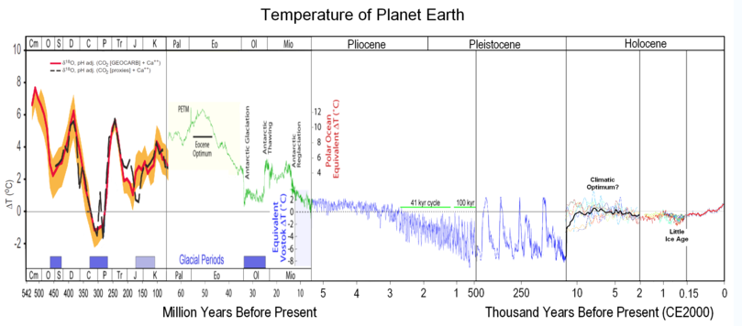
Climate Observations
How do we know?
“Indirect” measurements tell us about past climates

Slide 3
Climate Observations
Isotopic studies
• O-18 (Heavy Oxygen) within H₂O evaporates from oceans in less abundance in cold temperatures
• H₂O forms clouds, and ultimately snow
• Air is trapped inside snow, and deep ice sheets (Greenland, Antarctica)
• Analyzing trapped air tells us about the temperatures during the time period when the snow fell!

Slide 4
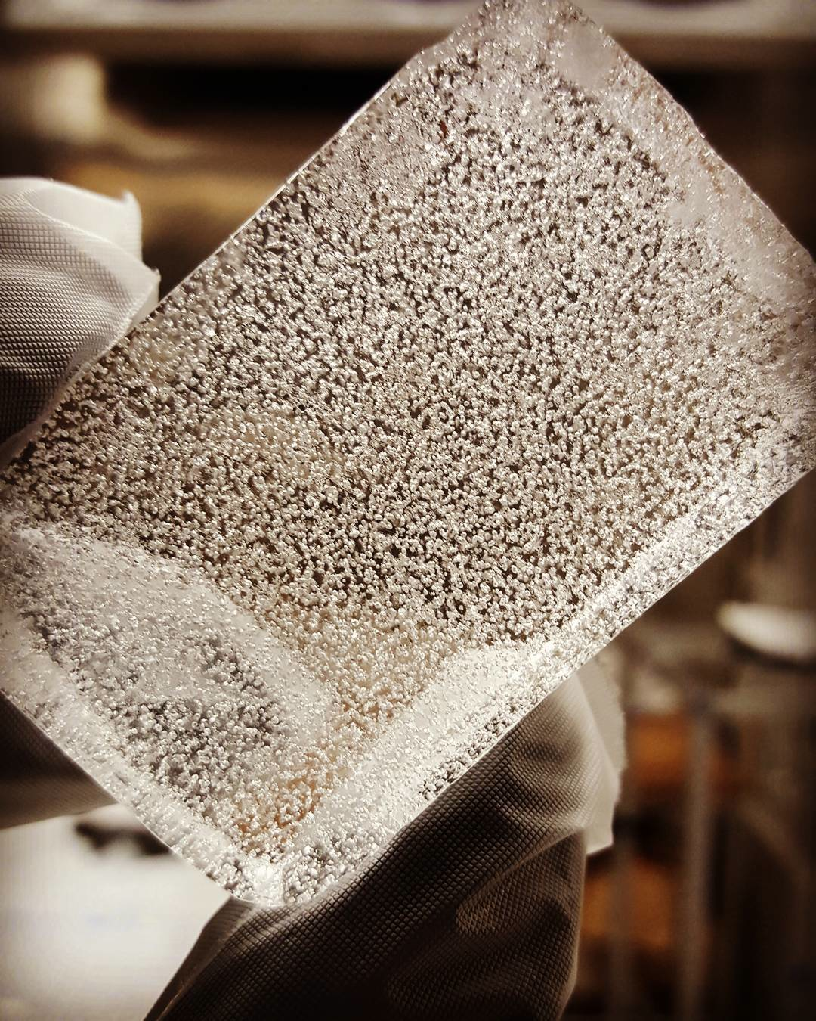
Gas trapped within
ice core
Photo courtesy of Melinda Nicewonger, UC Irvine

Slide 5
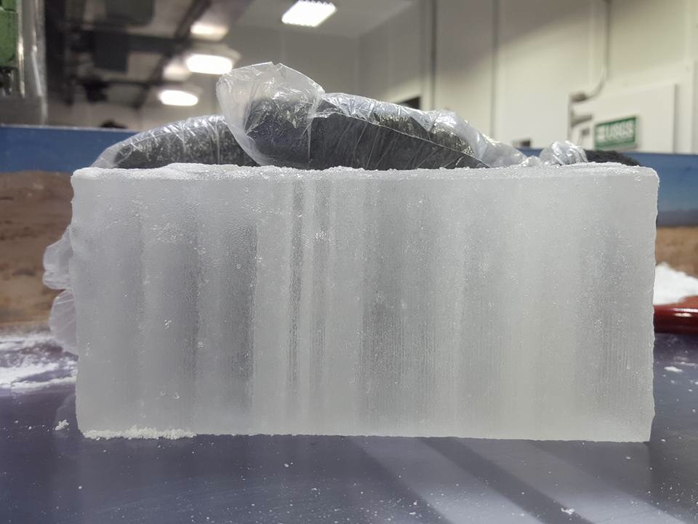
Photo courtesy of Melinda Nicewonger, UC Irvine

Slide 6
Ice core drilling video:
http://www.atmos.albany.edu/facstaff/ralazear/img/Drilling_3xspeed.mp4
National Ice Core Laboratory video:
http://www.atmos.albany.edu/facstaff/ralazear/img/NICLtour.mp4
Videos courtesy of Melinda Nicewonger, UC Irvine

Slide 7
Other types of indirect climate observations:
• Tree rings
• Sediment (mud) layers
• Fossils
• Corals
• Pollen distribution (in ice, sediment, etc.)

Slide 8
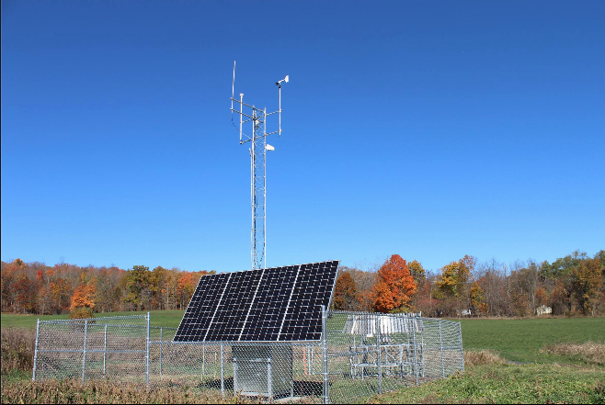
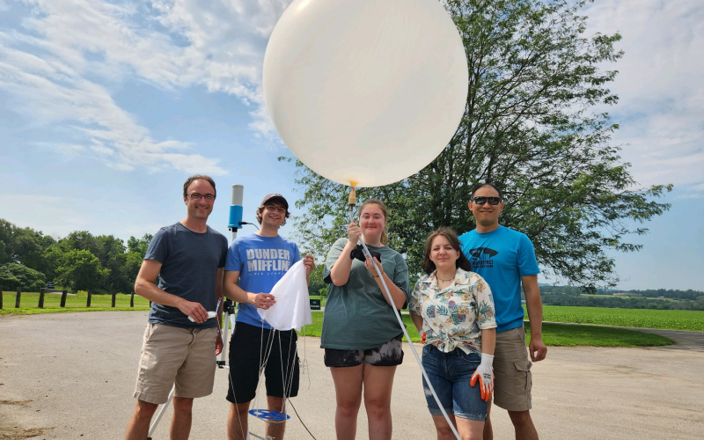
Weather observations
• Pressure (barometer)
• Temperature (thermometer)
• Moisture (hygrometer)
• Wind speed and direction (anemometer)
• Observations taken at surface (airports) and using weather balloons
Surface (NYS Mesonet)
Photo courtesy of Bridget Collins
Upper air (radiosonde)
From innovim.com

Slide 9
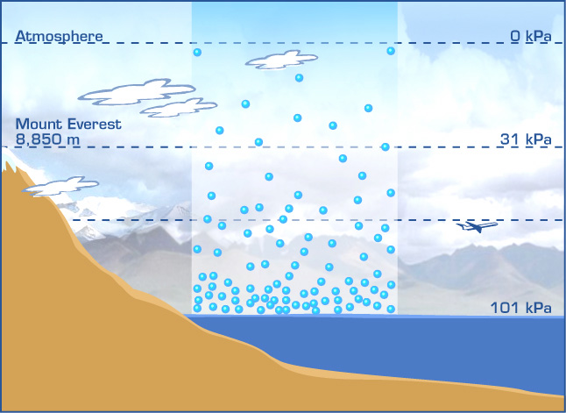
Weather observations
• Atmospheric pressure: The pressure (force per unit area) exerted by the molecules in the atmosphere on the surface
http://hendrix2.uoregon.edu/~imamura/102/images/Sea-Level-Barometric-Pressure.jpg

Slide 10
Weather observations
• As an air parcel is lifted from the surface, there is expansion due to less atmospheric pressure exerted on the parcel
• Result: As volume increases (expansion), temperature decreases (Ideal Gas Law)
Now, let’s experiment with barometers and thermometers as we rise 24 stories in Mohawk Tower . . .
• 4 m (12 ft.) per floor * 24 = 96 m, or ~300 ft.

