Slide 1
Severe Weather and Storm Chasing
UFSP 100
Ross A. Lazear

Slide 2
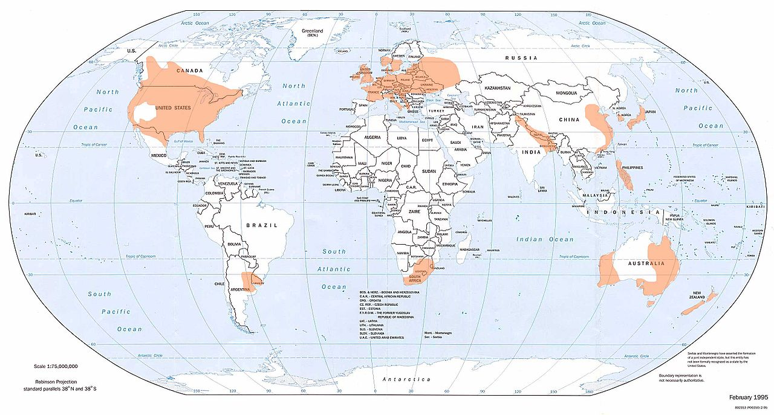
Global Tornado Occurrence
National Climatic Data Center (NCDC)

Slide 3
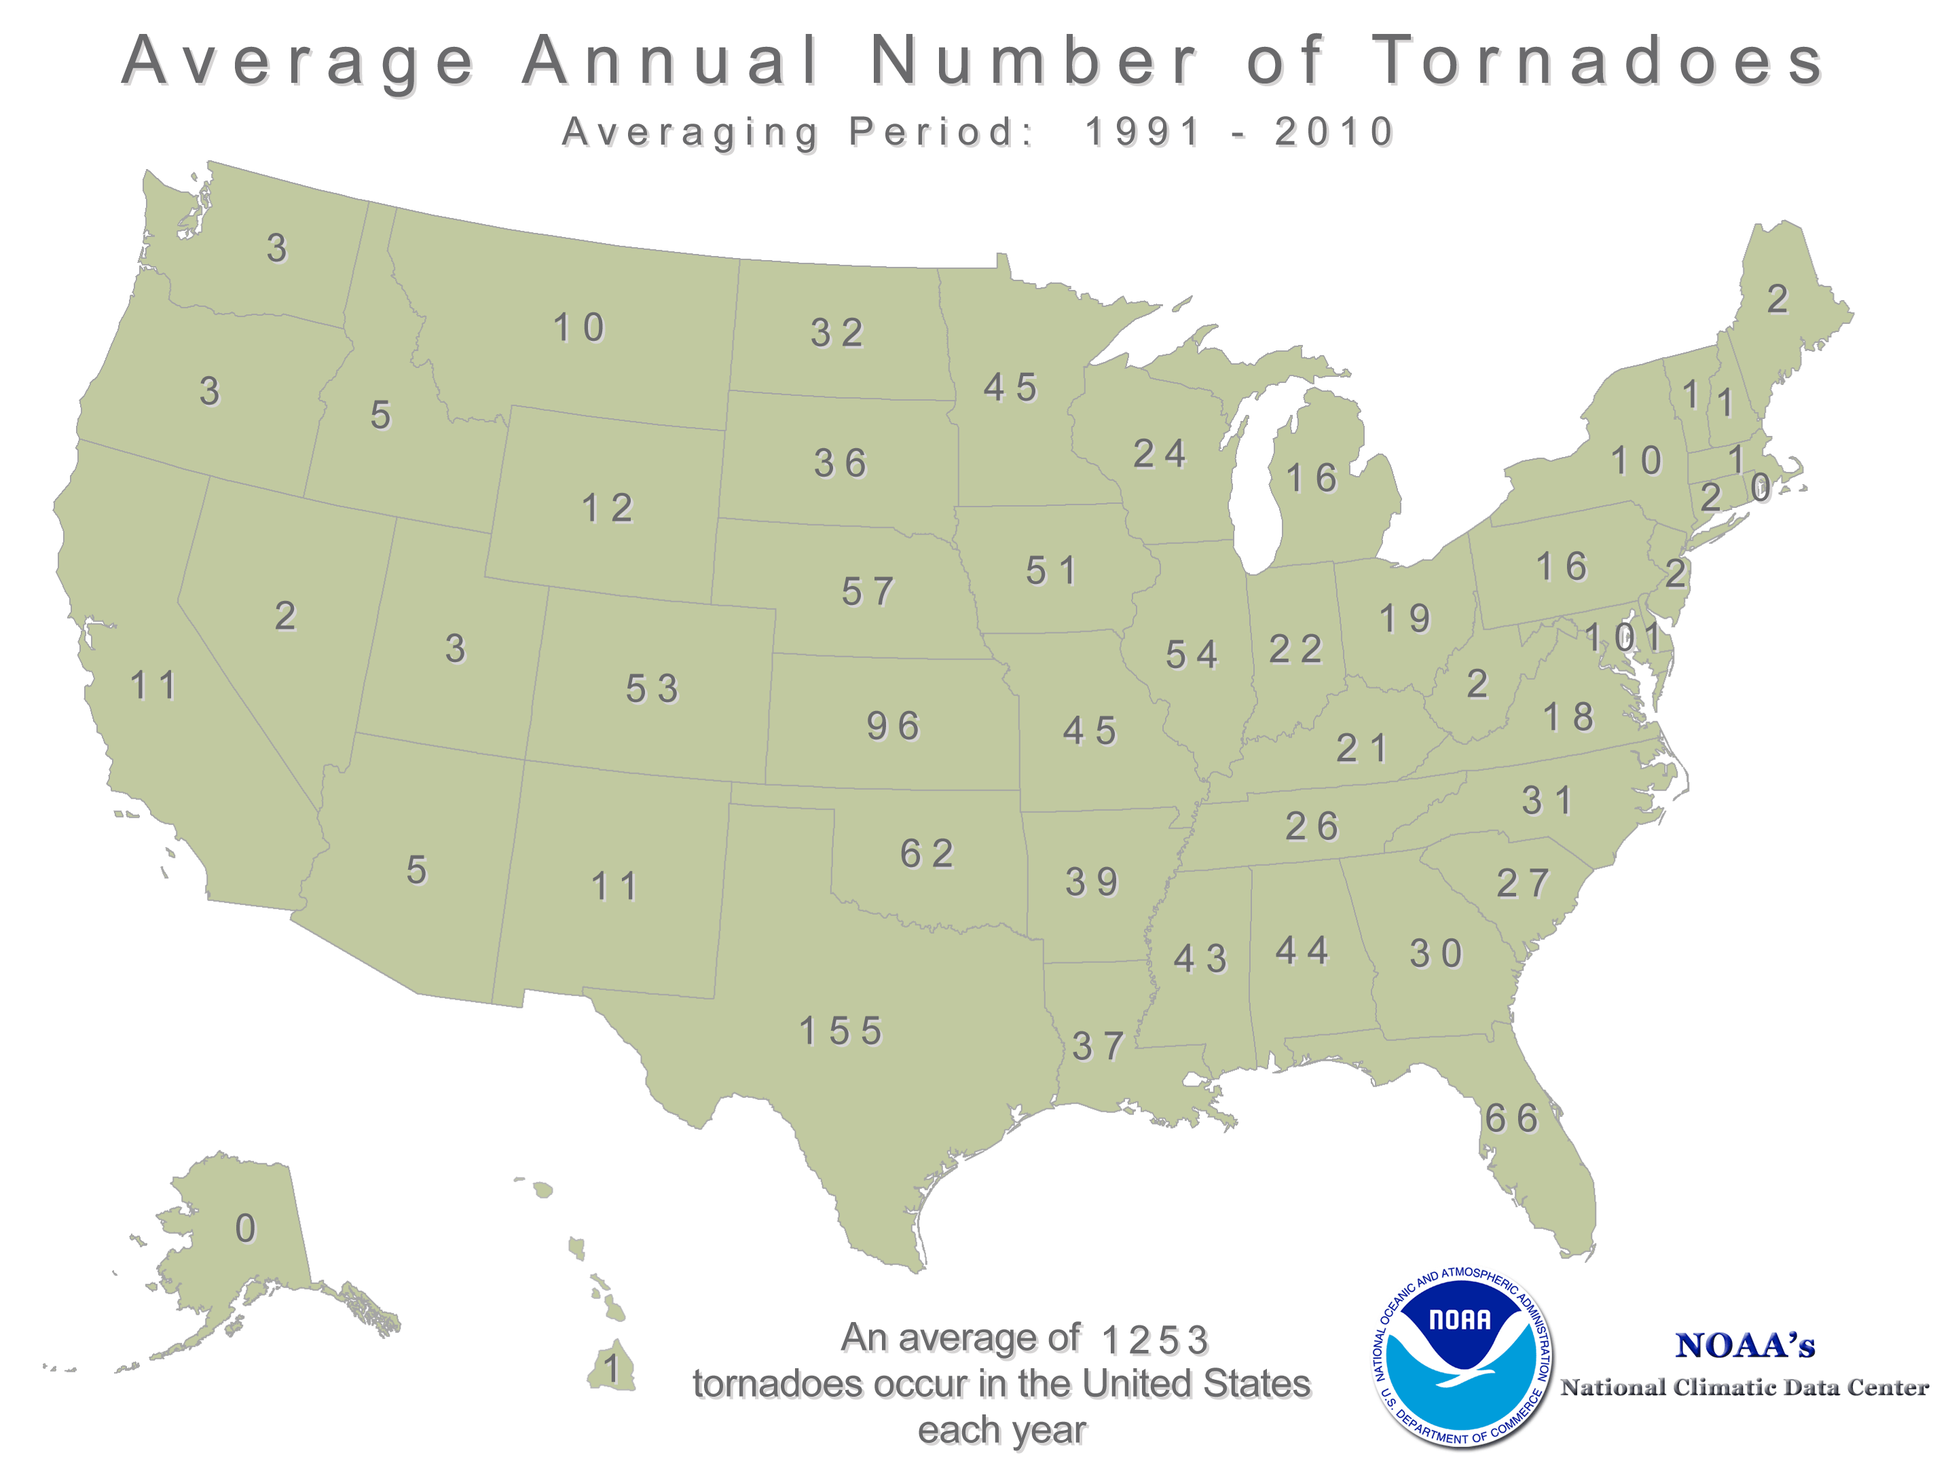

Slide 4
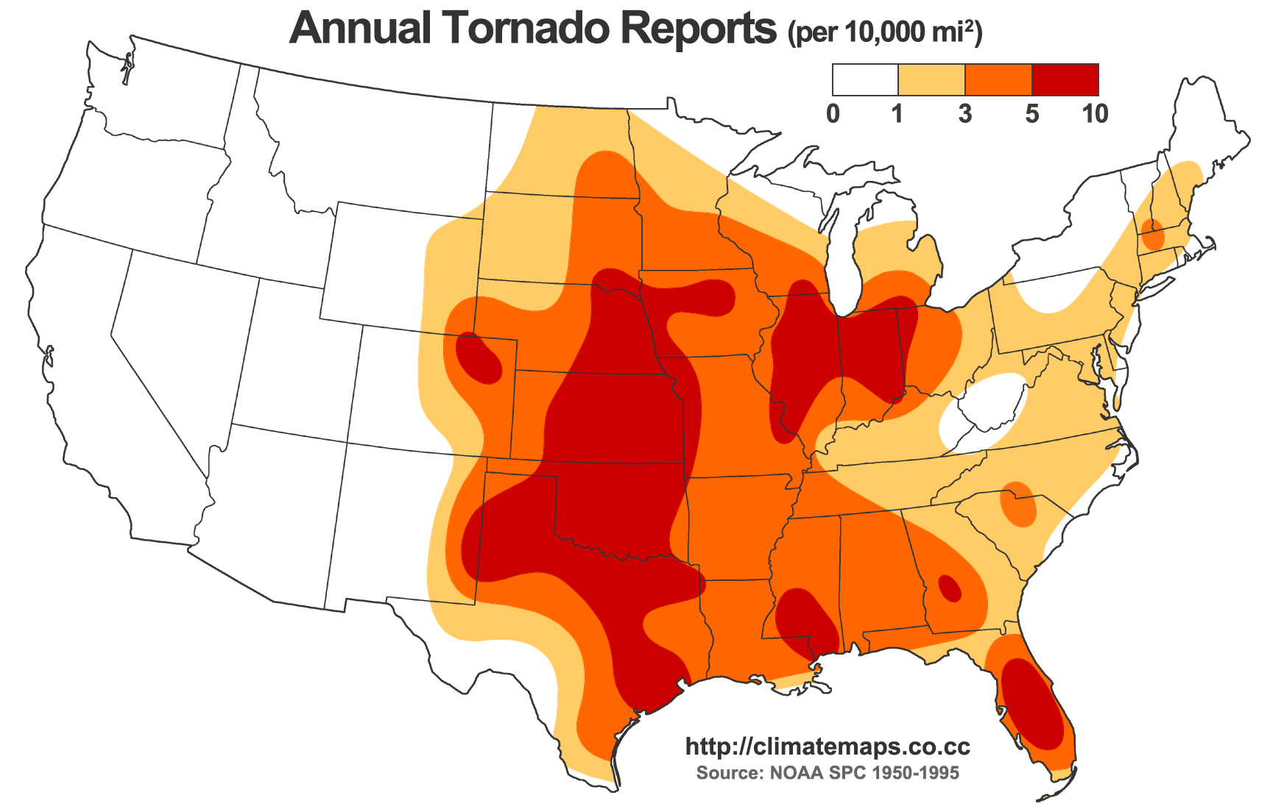

Slide 5
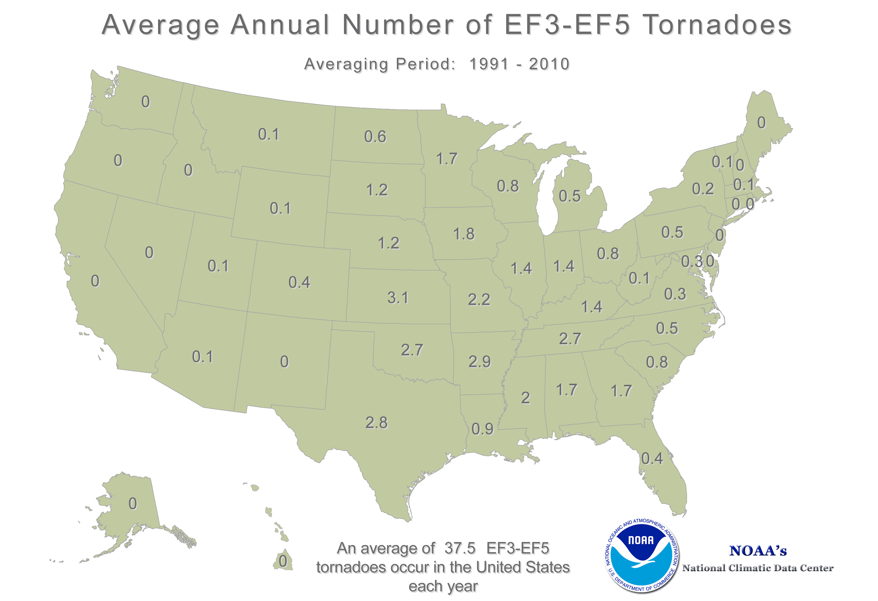

Slide 6
Why “Tornado Alley”?
Perfect combination of . . .
• Warm, moist air at surface
• Cool, dry air aloft (> ~2 km above surface)
-Instability
• Coupled with this is often a change in wind speed and direction with height
-Wind shear
Why are these tornado ingredients, and why are they such a common occurrence in Tornado Alley?

Slide 7
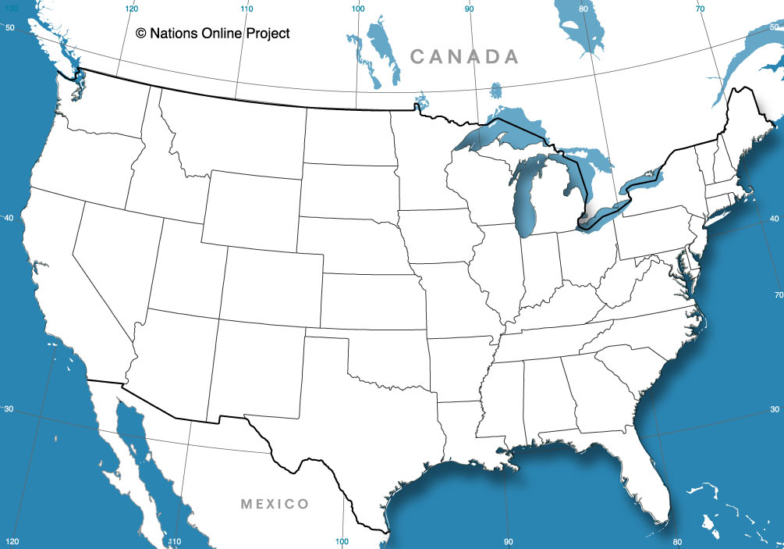
Why “Tornado Alley”?
L

Slide 8
Why “Tornado Alley”?
L

Slide 9
Why “Tornado Alley”?
L
Cold, dry air aloft
Warm, moist air

Slide 10
Why “Tornado Alley”?
-- ~10 km: Top of troposphere
Cold, dry air aloft
L
--1 km
Warm, moist air

Slide 11
Why “Tornado Alley”?
-- ~10 km: Top of troposphere
Cold, dry air aloft
More dense
L
--1 km
Warm, moist air
Less dense

Slide 12

Why “Tornado Alley”?
-- ~10 km: Top of troposphere
Cold, dry air aloft
More dense
--1 km
Warm, moist air
As in the convection tank:
Warm, less dense air rises
Less dense

Slide 13
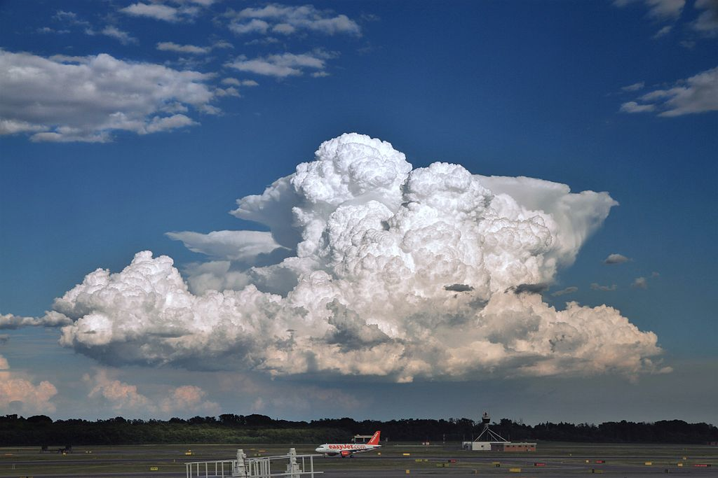
Now we have convection (cumulonimbus).
How do we get ROTATION?

Slide 14
Vertical wind shear
Change in wind speed and direction with height
10 km
5 km
N
Surface
E
S

Slide 15
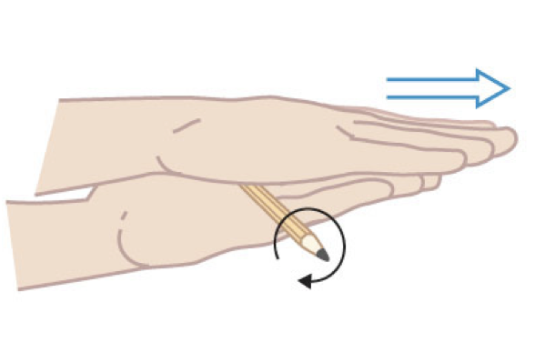
Vertical wind shear
Change in wind speed and direction with height
Wind shear creates a horizontal vortex

Slide 16
Add instability . . .
10 km
5 km
COLD, DRY, MORE DENSE
N
WARM, MOIST, LESS DENSE
Surface
E
S

Slide 17
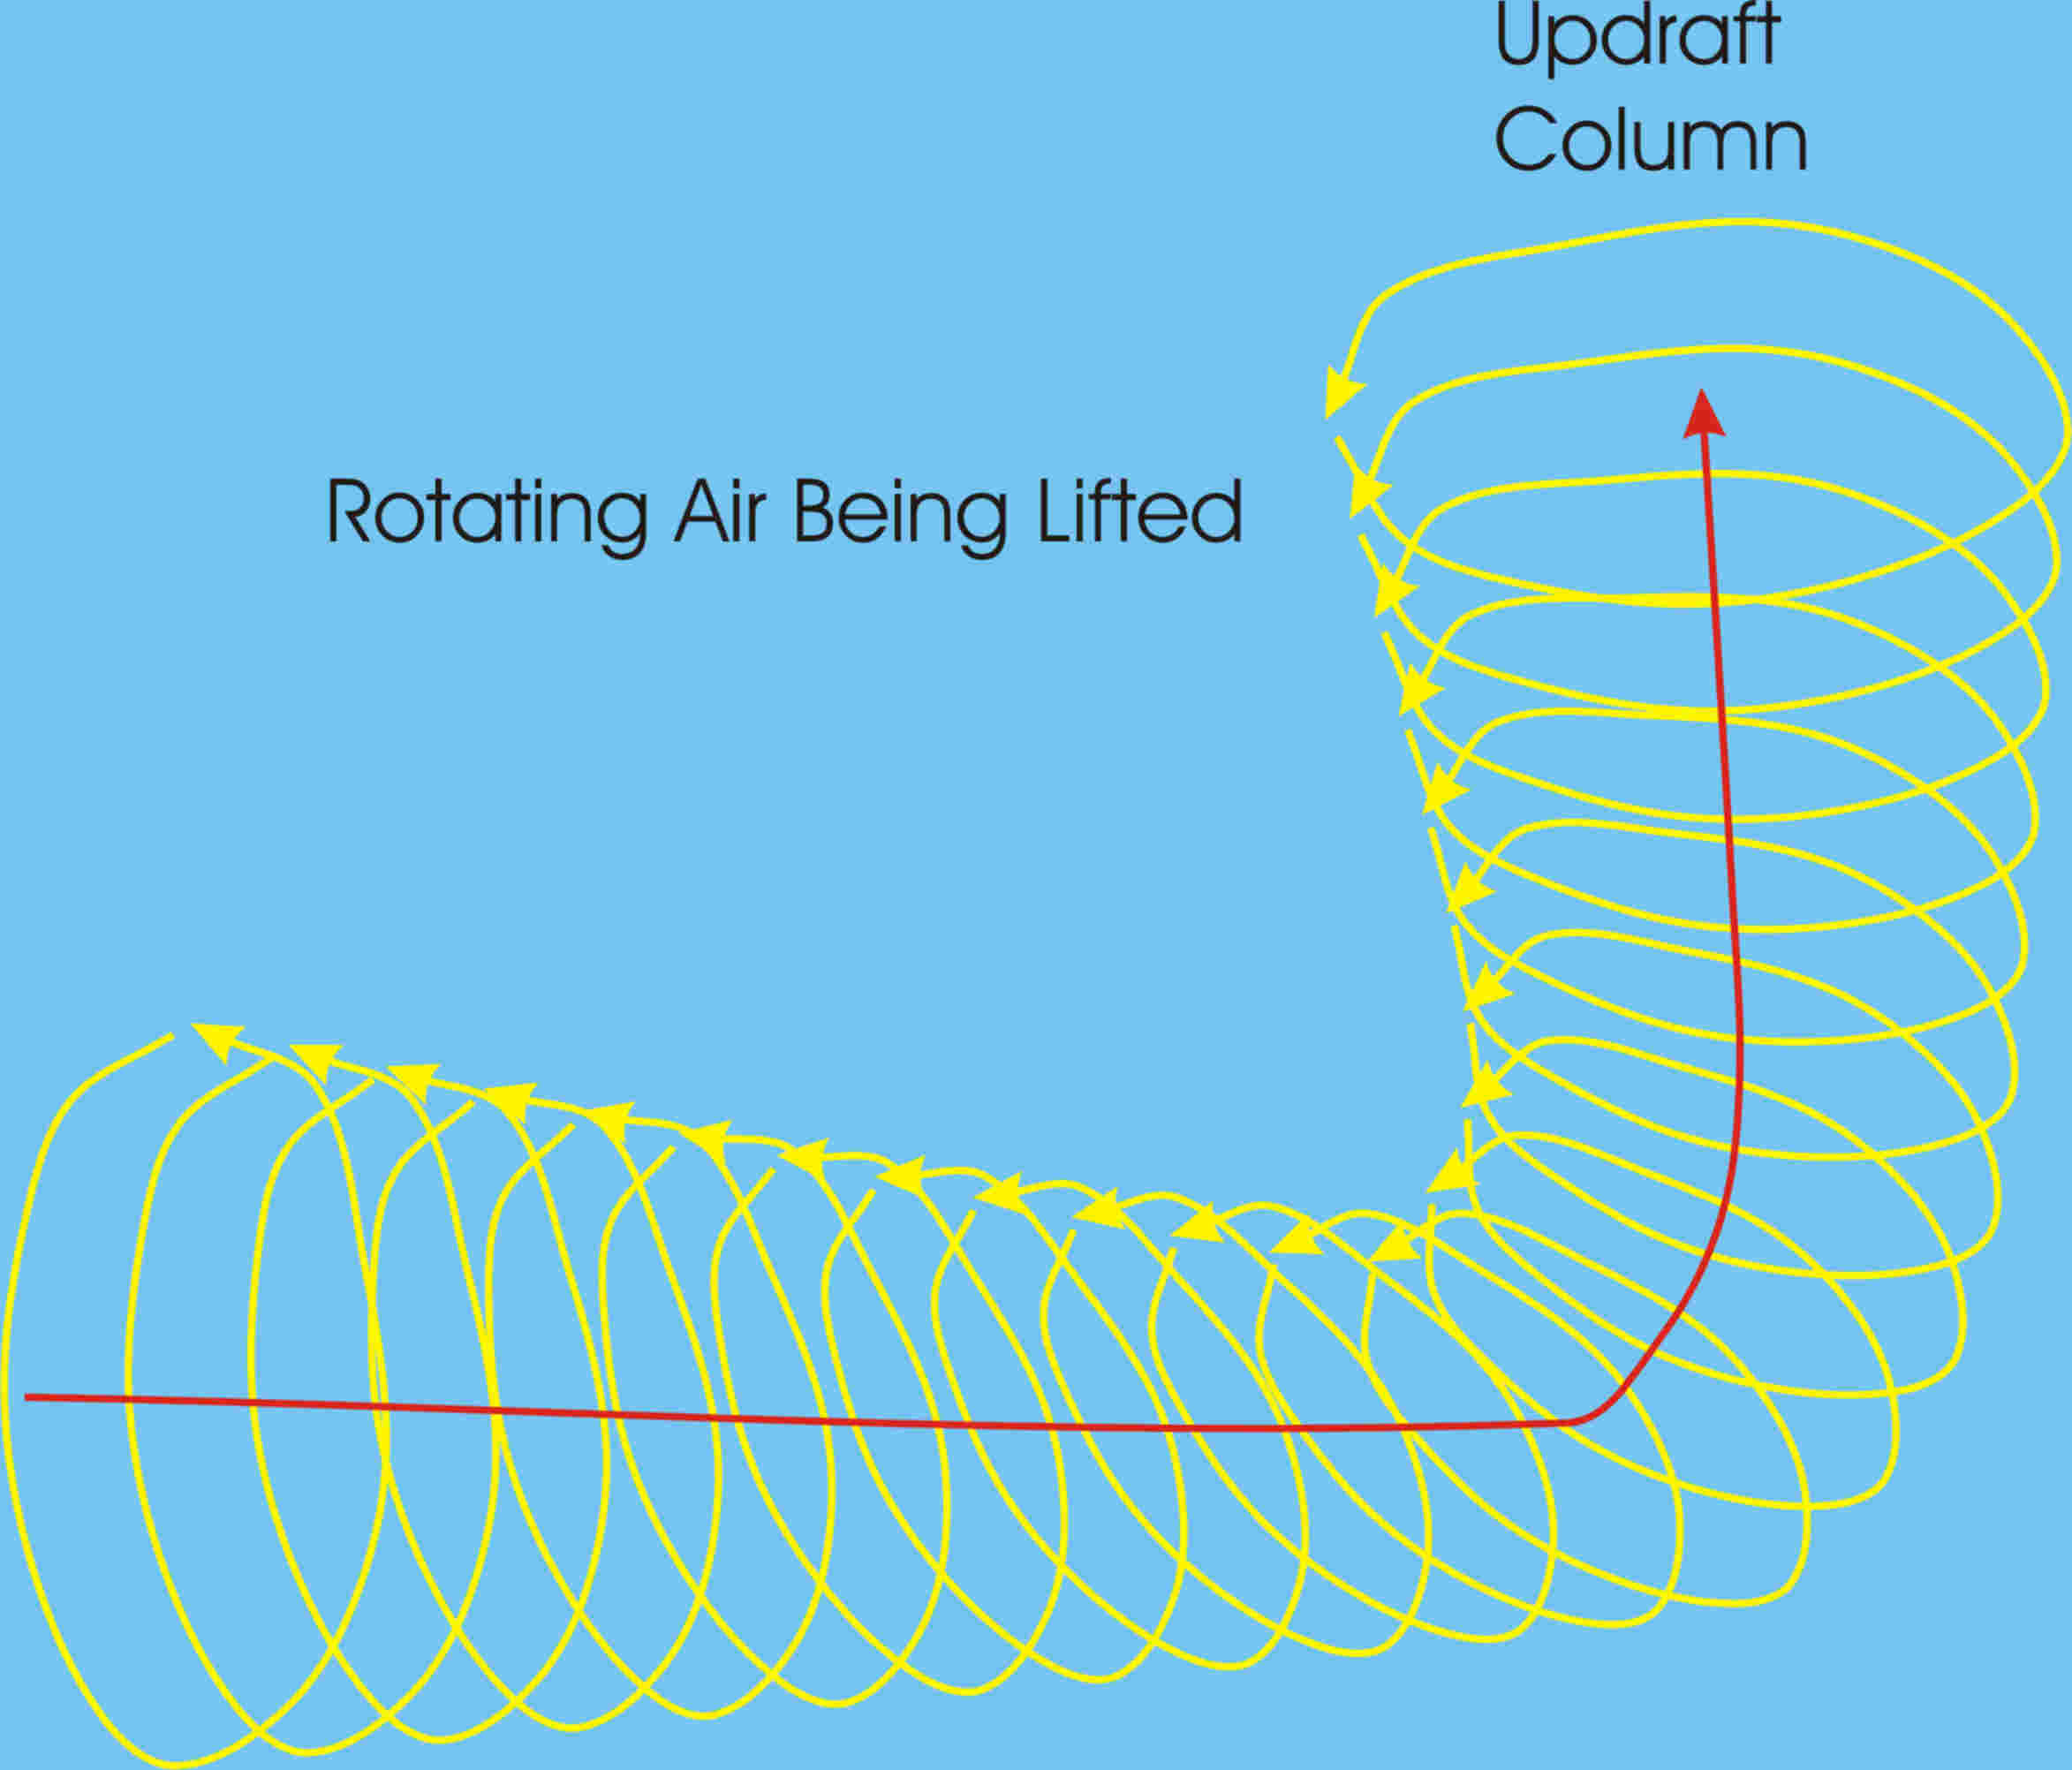
Convective “updraft” plus Vertical wind shear
From MadSciTech.org

Slide 18
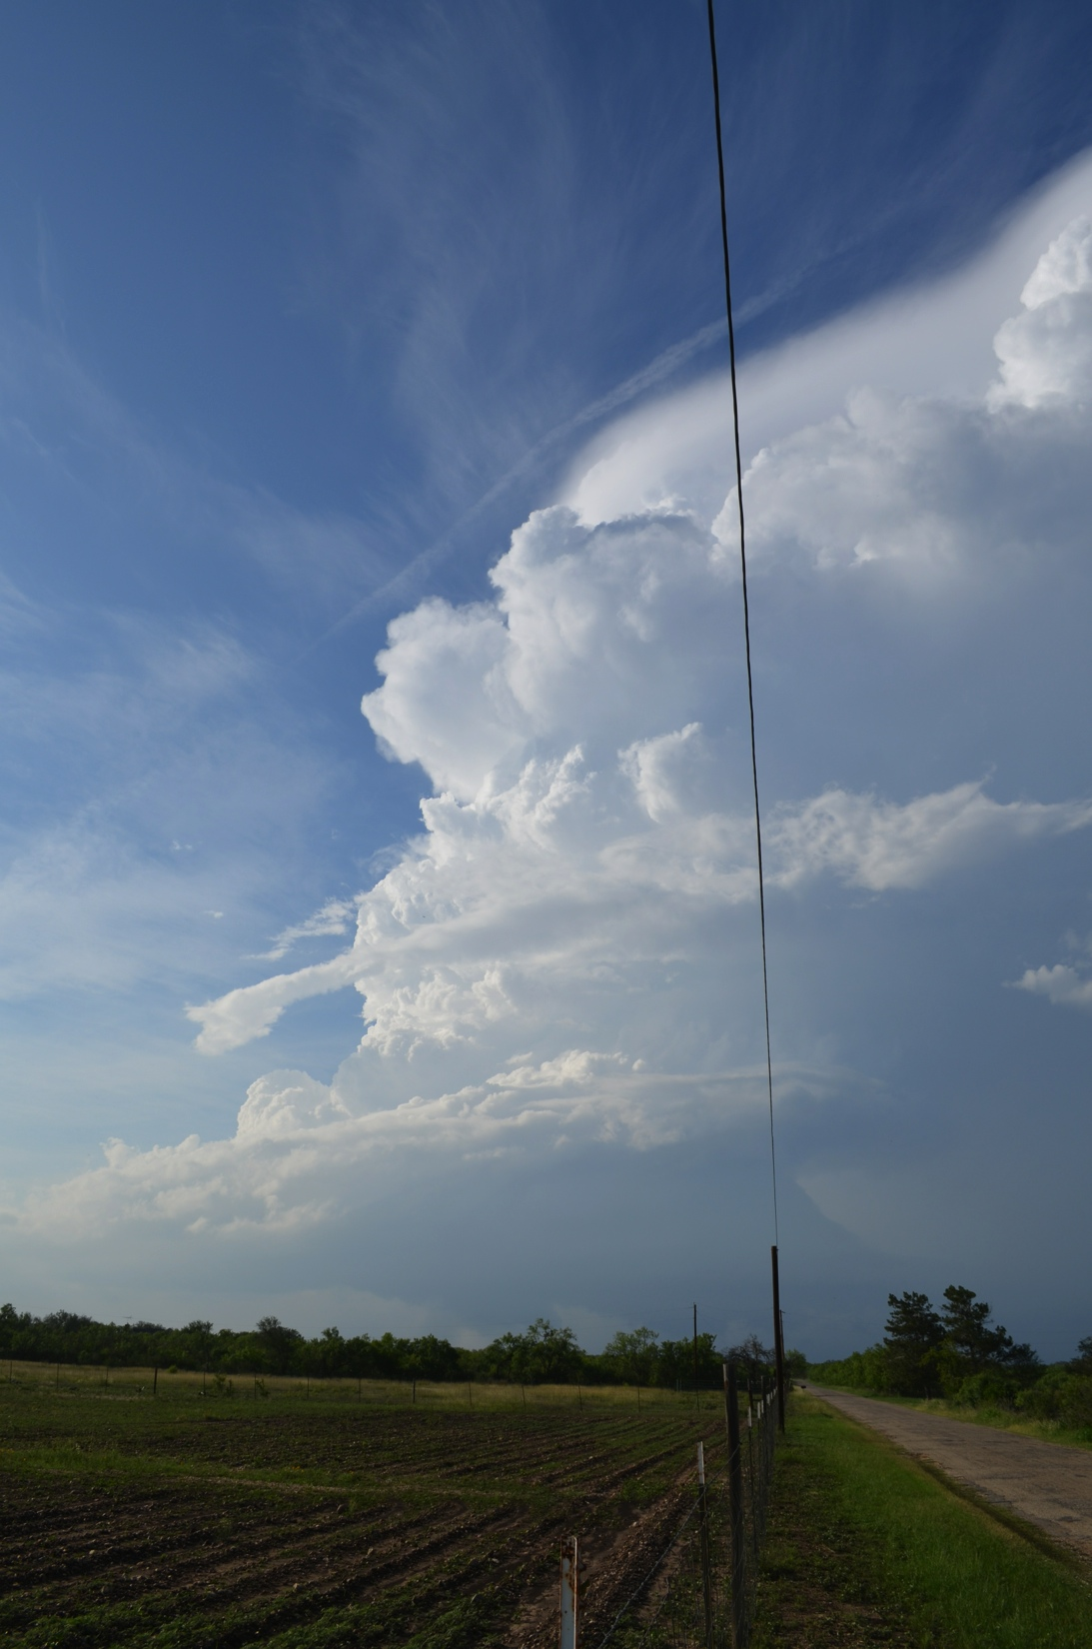
2324 UTC
27 May
2014
CastrovilleTexas

Slide 19
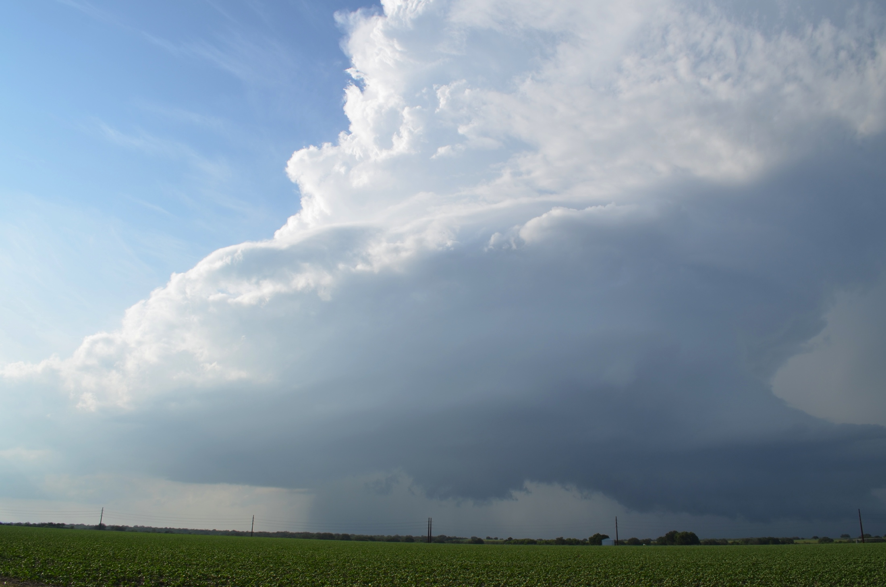
2334 UTC 27 May 2014 – Castroville, Texas

Slide 20
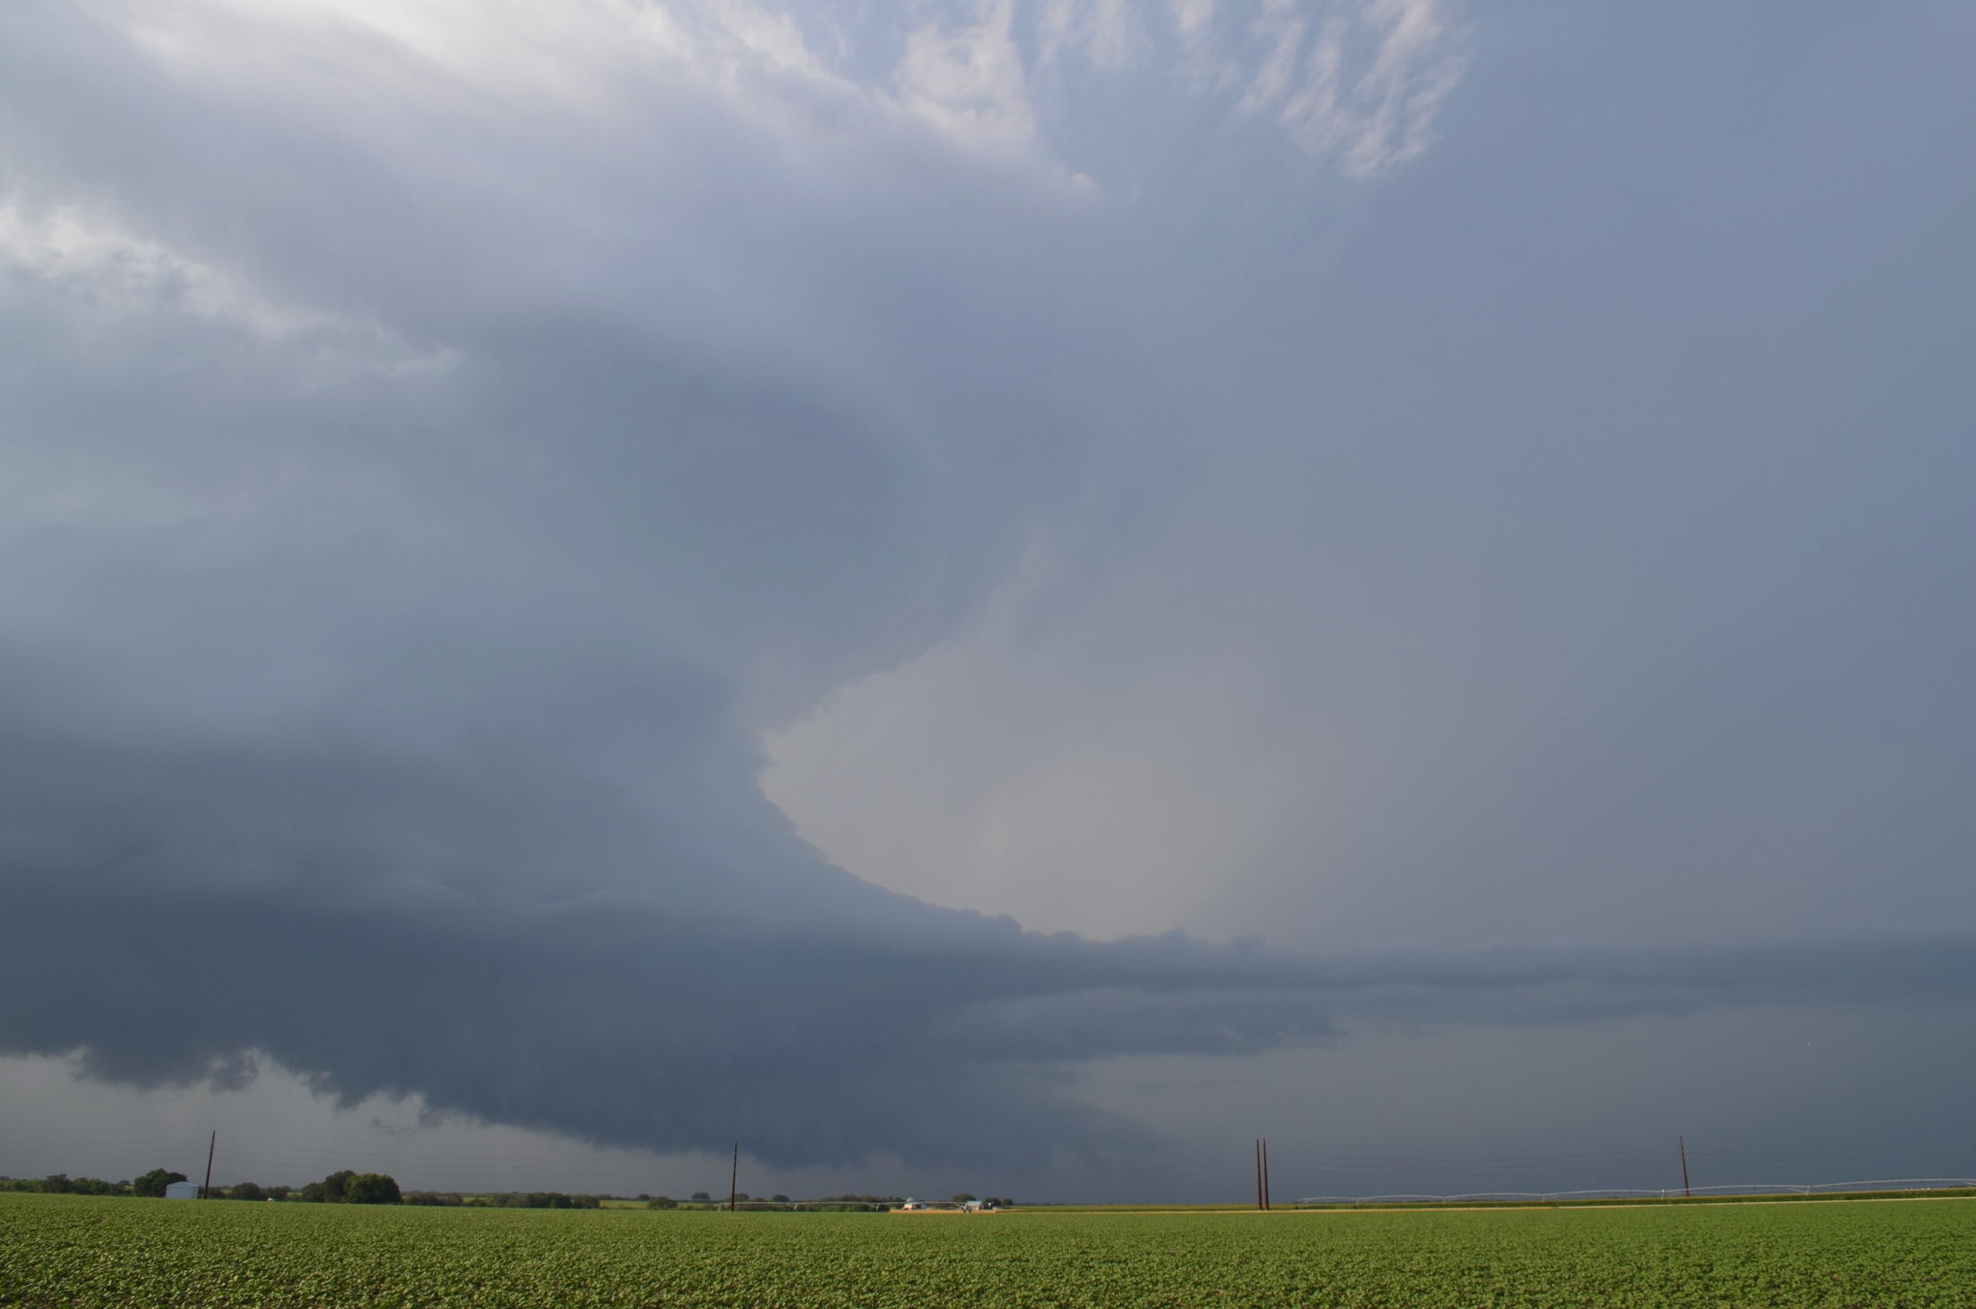
2337 UTC 27 May 2014 – Castroville, Texas

Slide 21
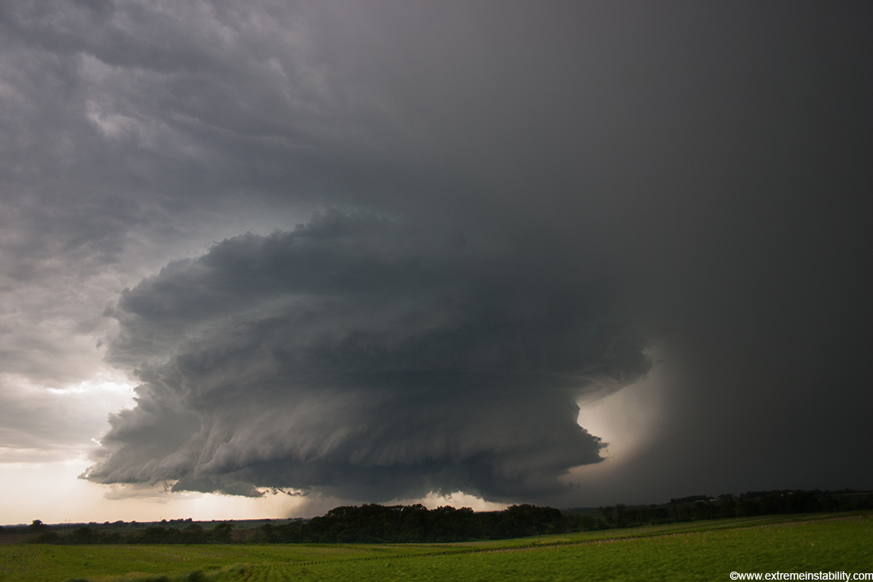
Photo by Mike Hollingshead
June 13, 2004 – Alvo, Nebraska

Slide 22
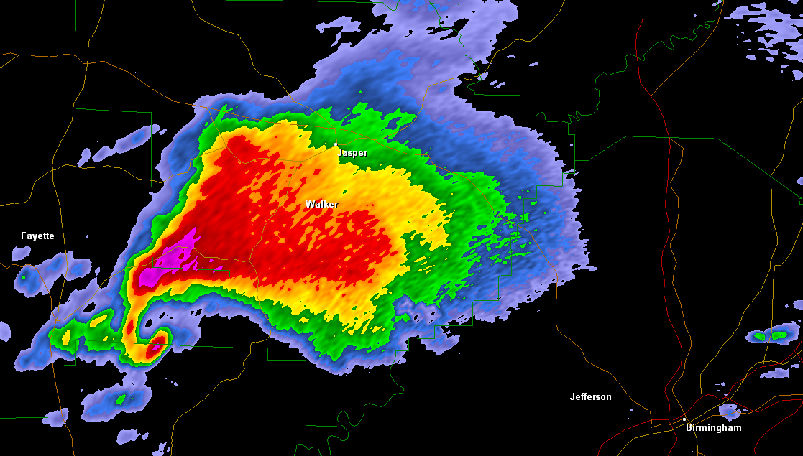
Supercell Thunderstorm
A thunderstorm with a rotating updraft (mesocyclone)
Supercell near Birmingham, AL on April 27, 2011

Slide 23
Supercell Thunderstorm
A thunderstorm with a rotating updraft (mesocyclone)
Hook echo
Supercell near Birmingham, AL on April 27, 2011

Slide 24
Supercell Thunderstorm
A thunderstorm with a rotating updraft (mesocyclone)
Mesocyclone
Supercell near Birmingham, AL on April 27, 2011

Slide 25
Supercell Thunderstorm
A thunderstorm with a rotating updraft (mesocyclone)
Hail shaft
Supercell near Birmingham, AL on April 27, 2011

Slide 26
Supercell Thunderstorm
A thunderstorm with a rotating updraft (mesocyclone)
Warm, moist, inflow
Supercell near Birmingham, AL on April 27, 2011

Slide 27
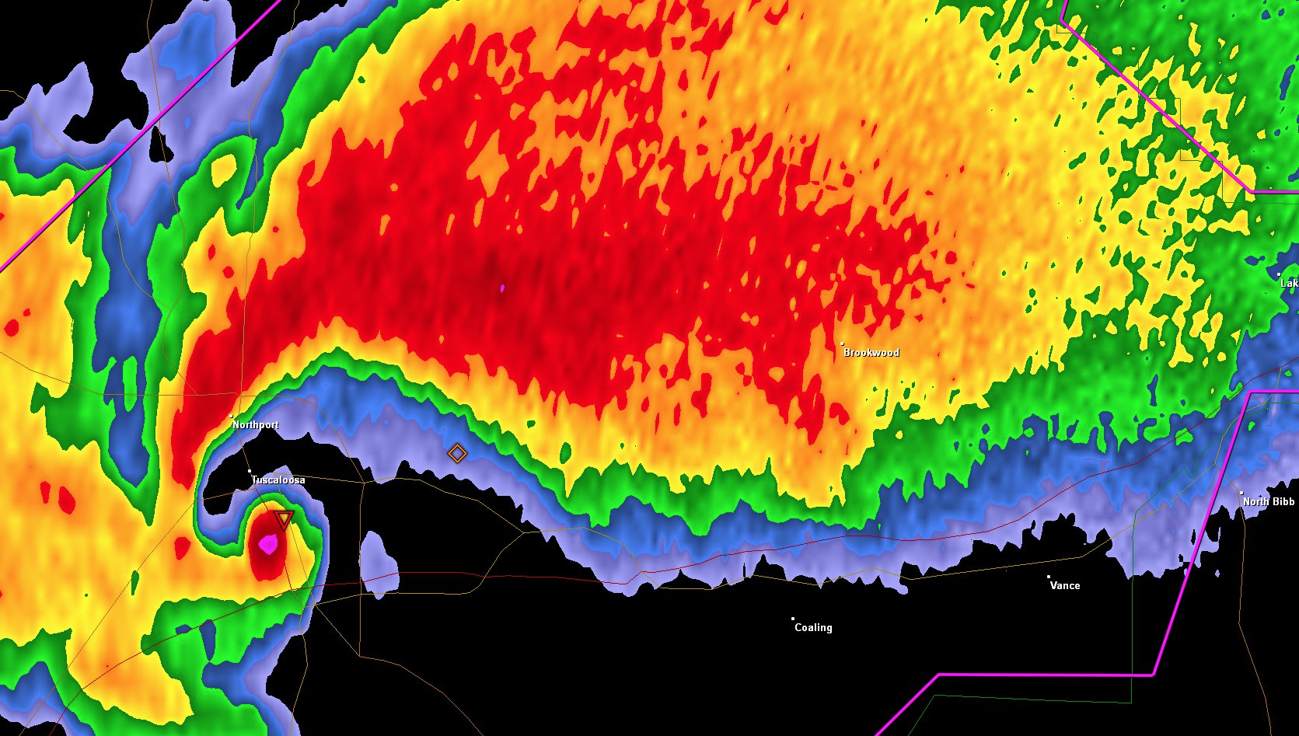
Supercell Thunderstorm
Debris ball
Supercell near Tuscaloosa, AL on April 27, 2011

Slide 28
“Chasing” a tornado . . .
Vehicle location
Supercell near Tuscaloosa, AL on April 27, 2011

Slide 29
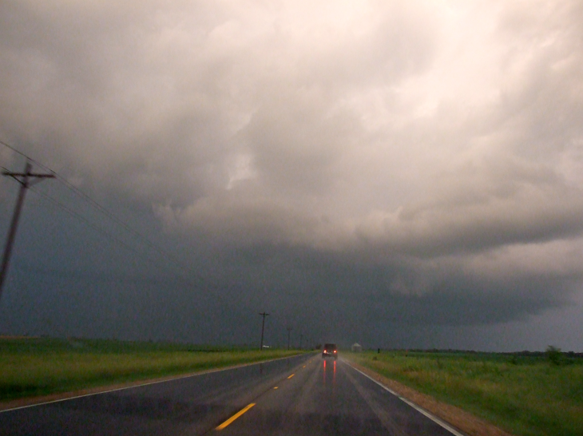
“Chasing” a tornado . . .
Vehicle location
Photo from storm chase on June 5, 2010 near Magnolia, IL

Slide 30
“Chasing” a tornado . . .
Vehicle location
Supercell near Tuscaloosa, AL on April 27, 2011

Slide 31
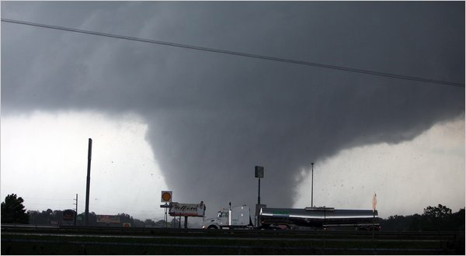
“Chasing” a tornado . . .
Vehicle location
Photo by Dusty Compton/Tuscaloosa News, 4/27/11

Slide 32
Storm Chase
June 4, 2005
Northwest Missouri

Slide 33
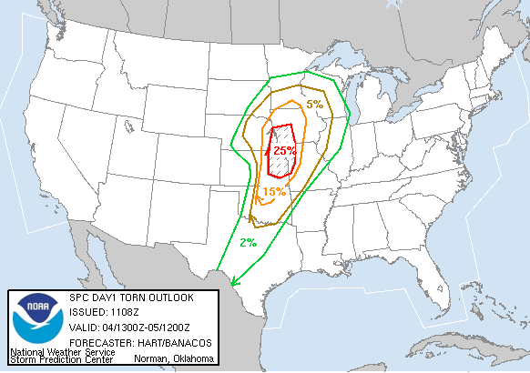
Storm Prediction Center
Tornado Outlook

Slide 34
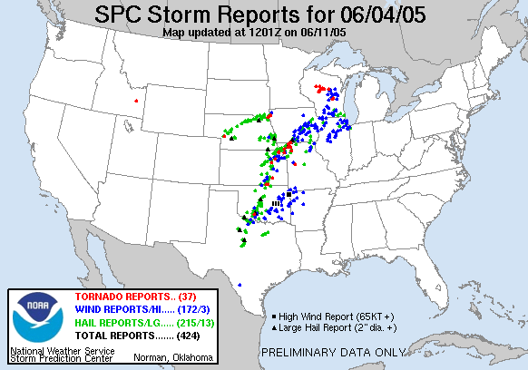
Storm Prediction Center
Storm Reports

Slide 35
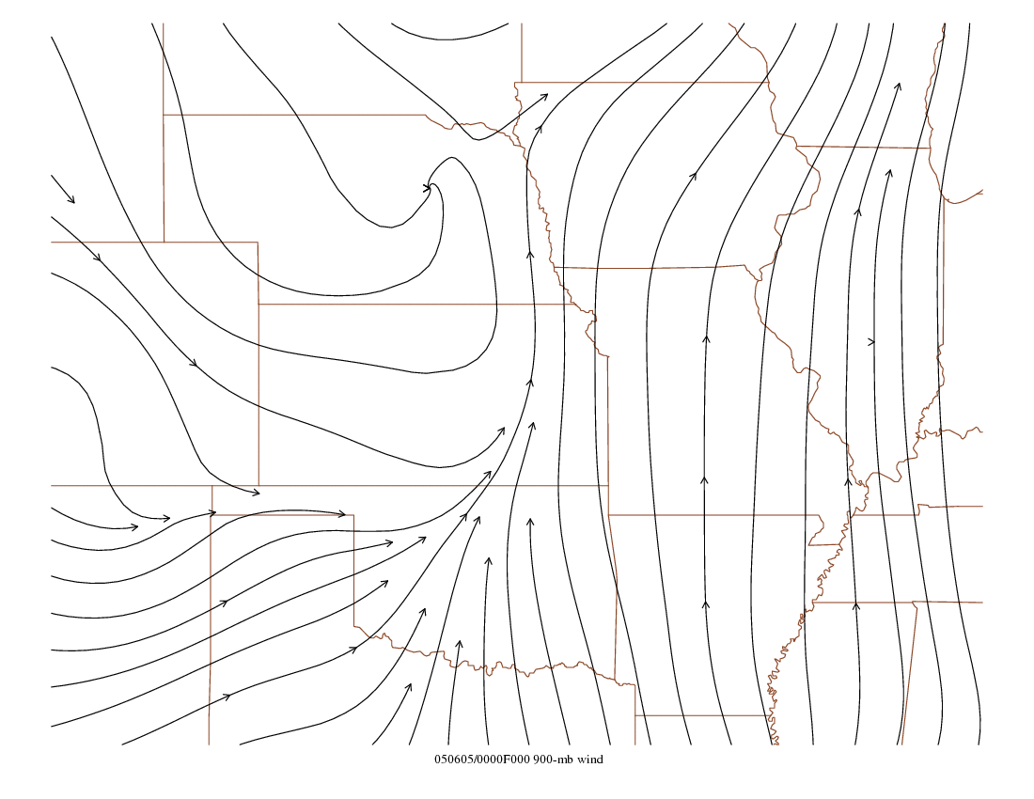

Slide 36
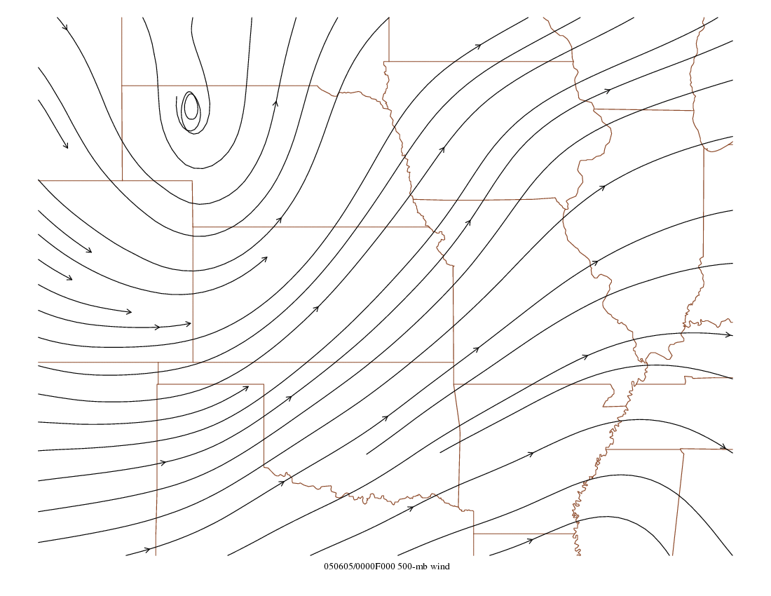

Slide 37
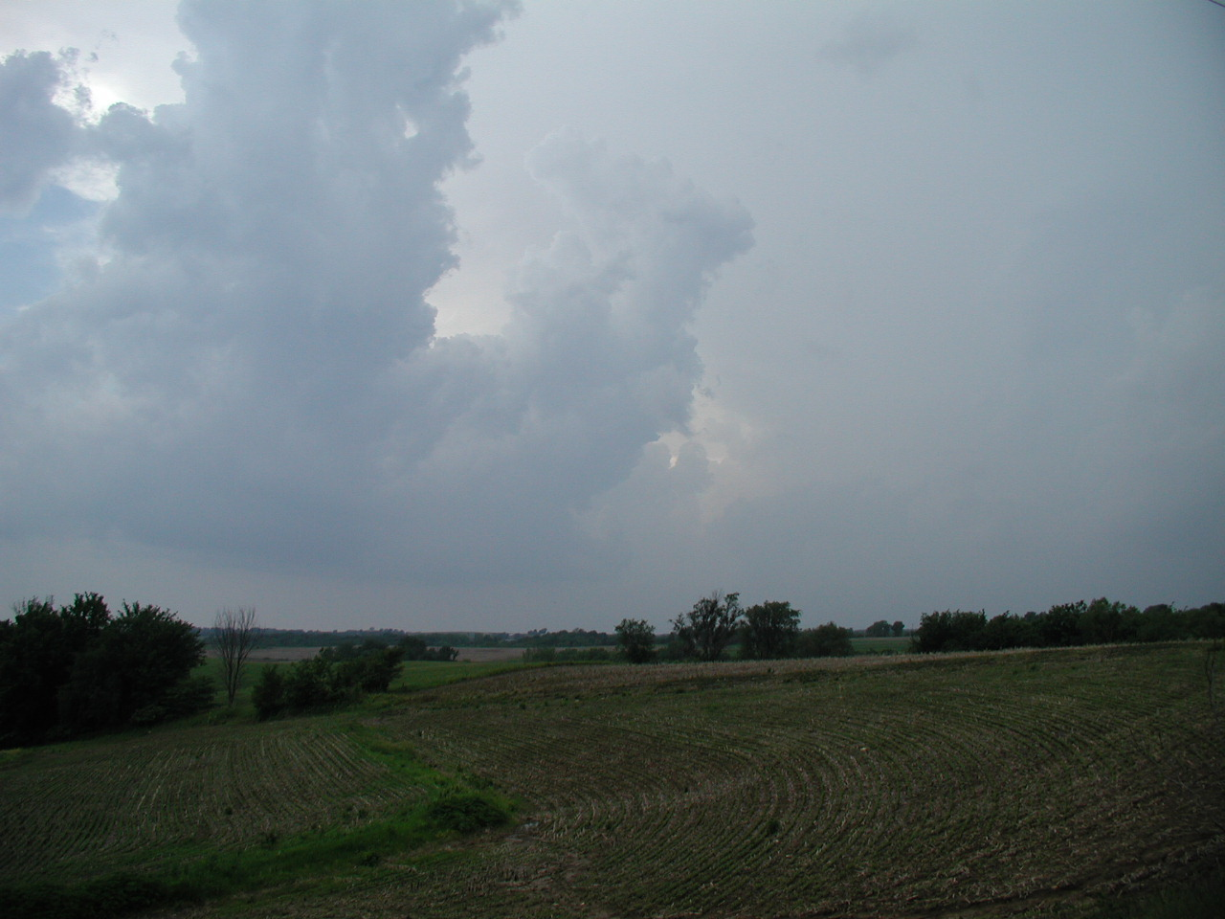

Slide 38
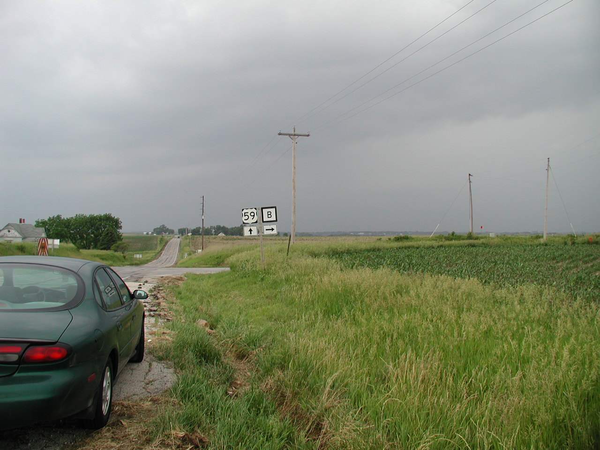

Slide 39
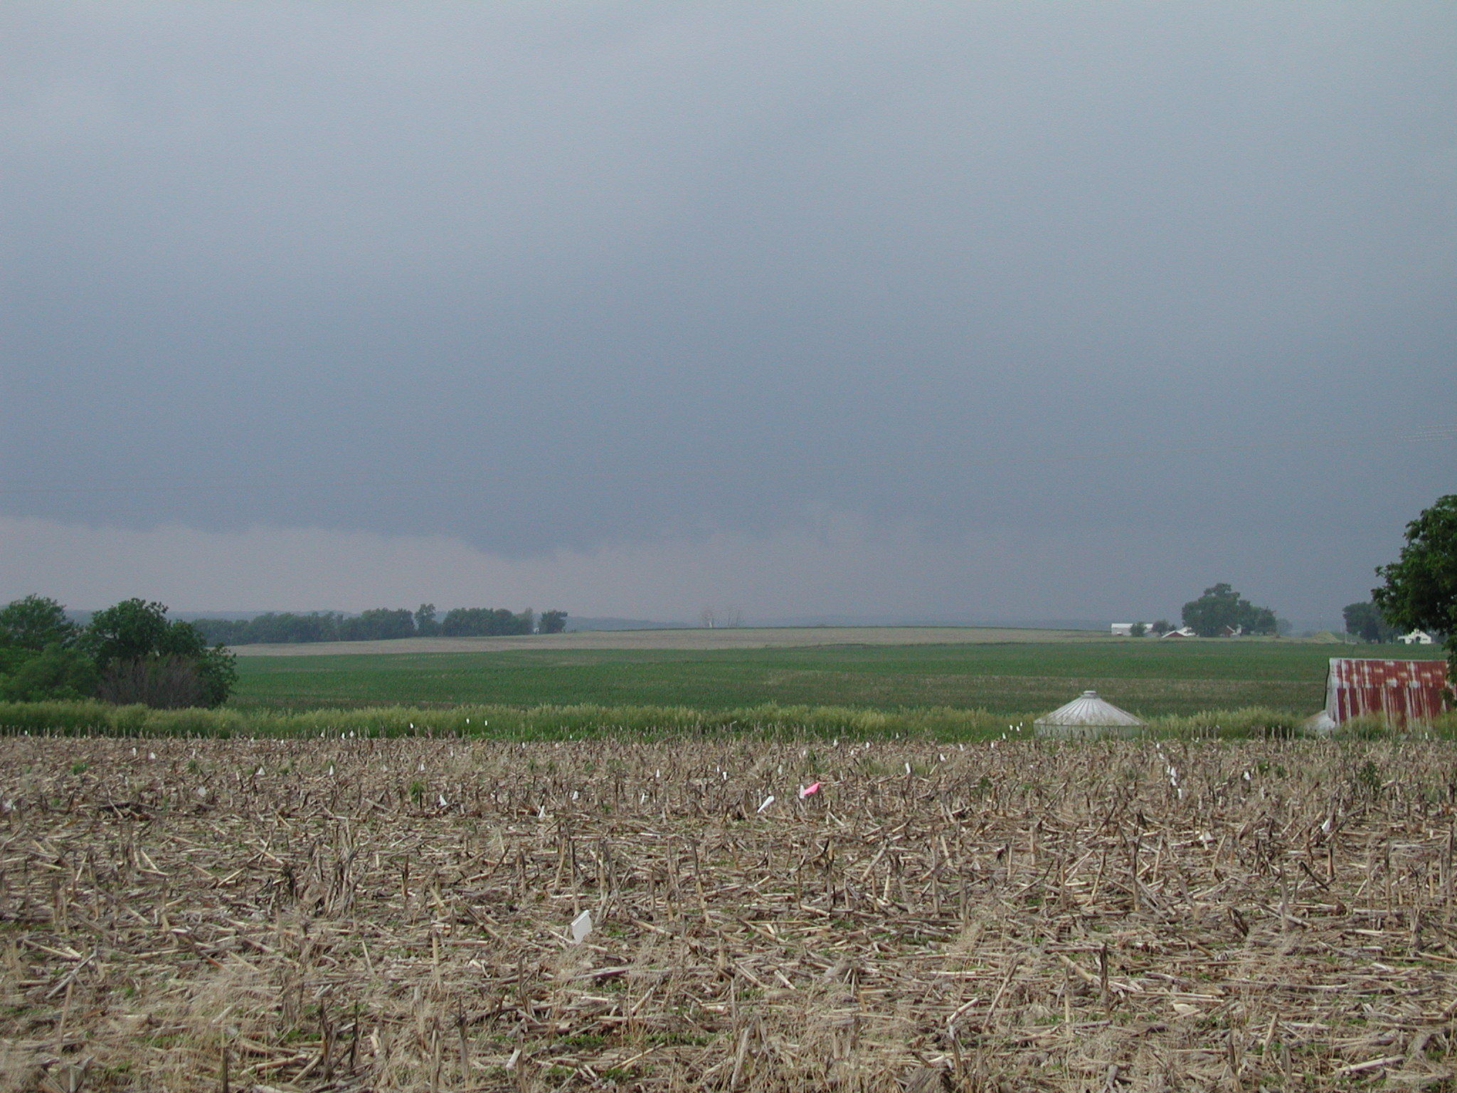

Slide 40
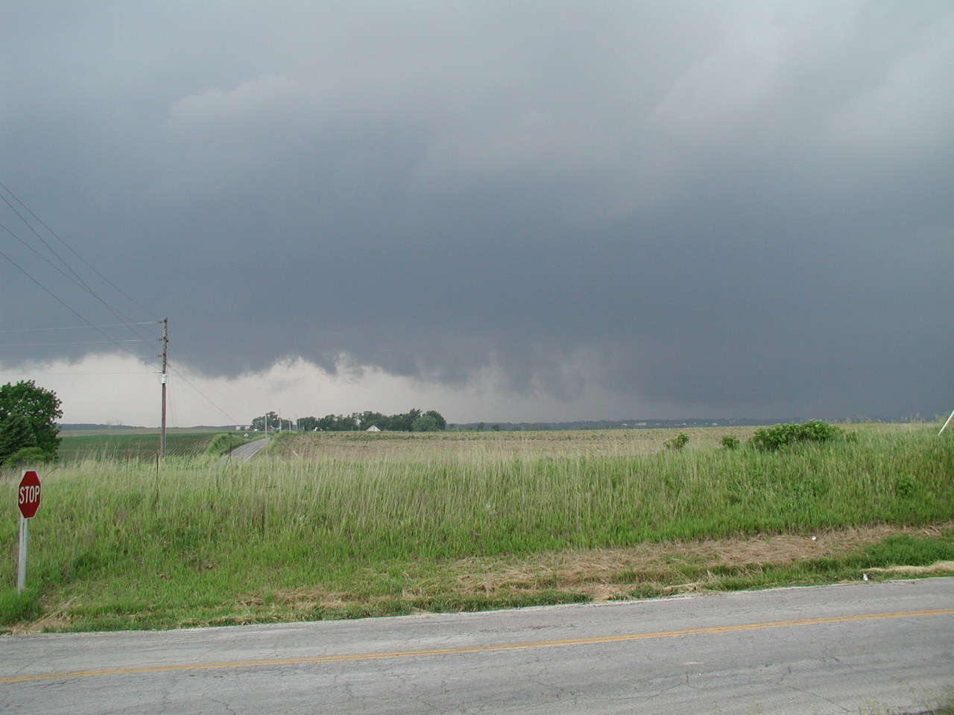

Slide 41
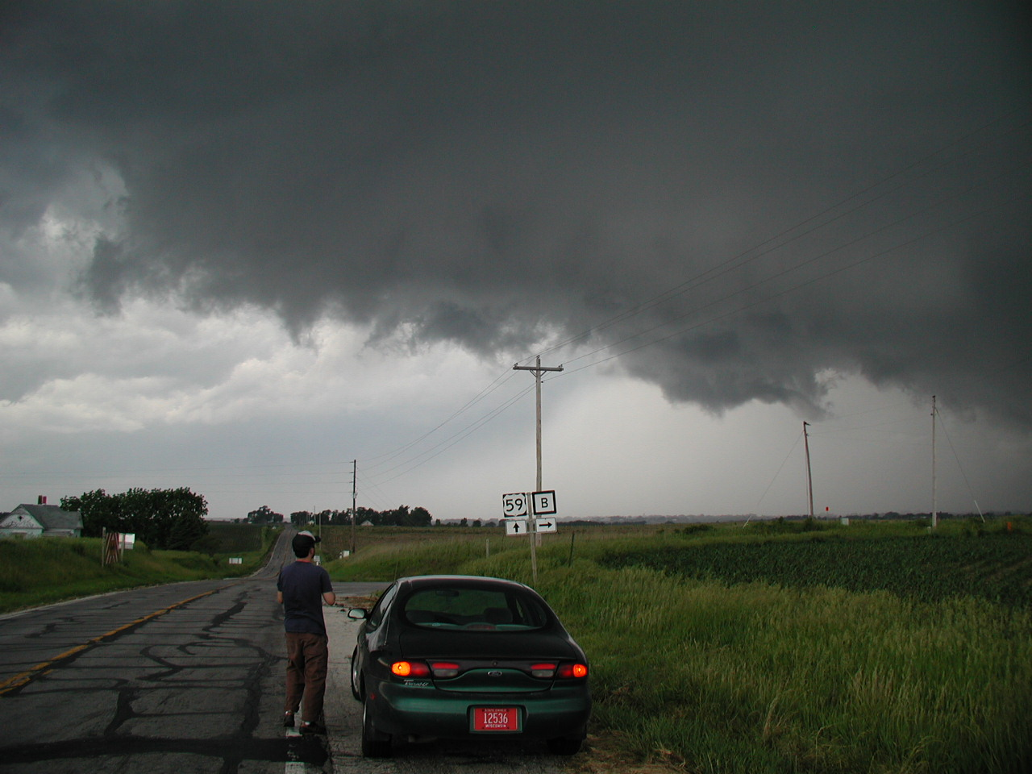

Slide 42
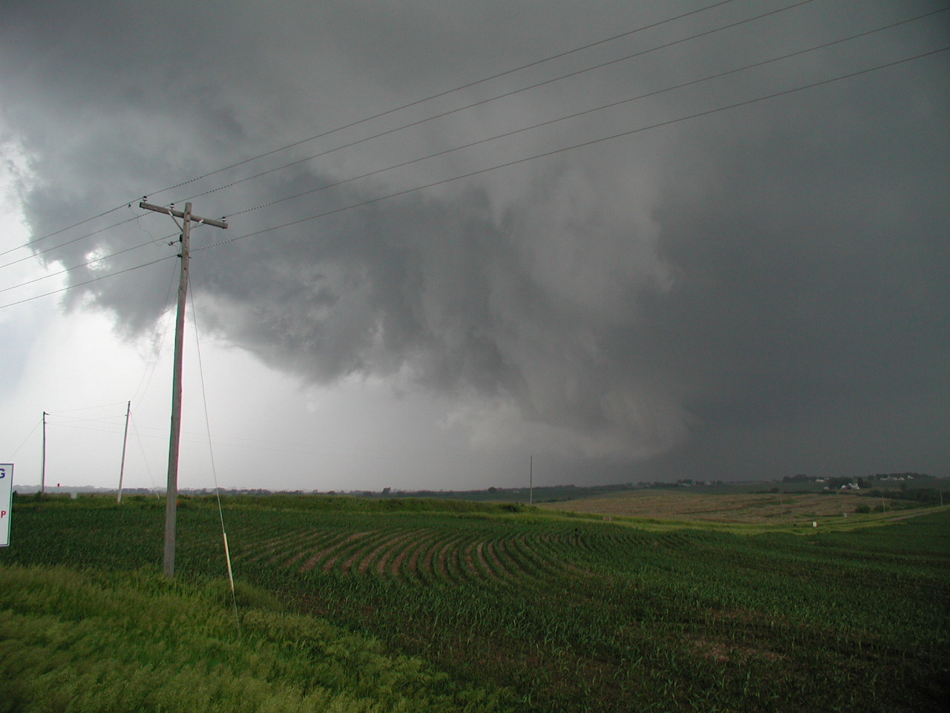

Slide 43
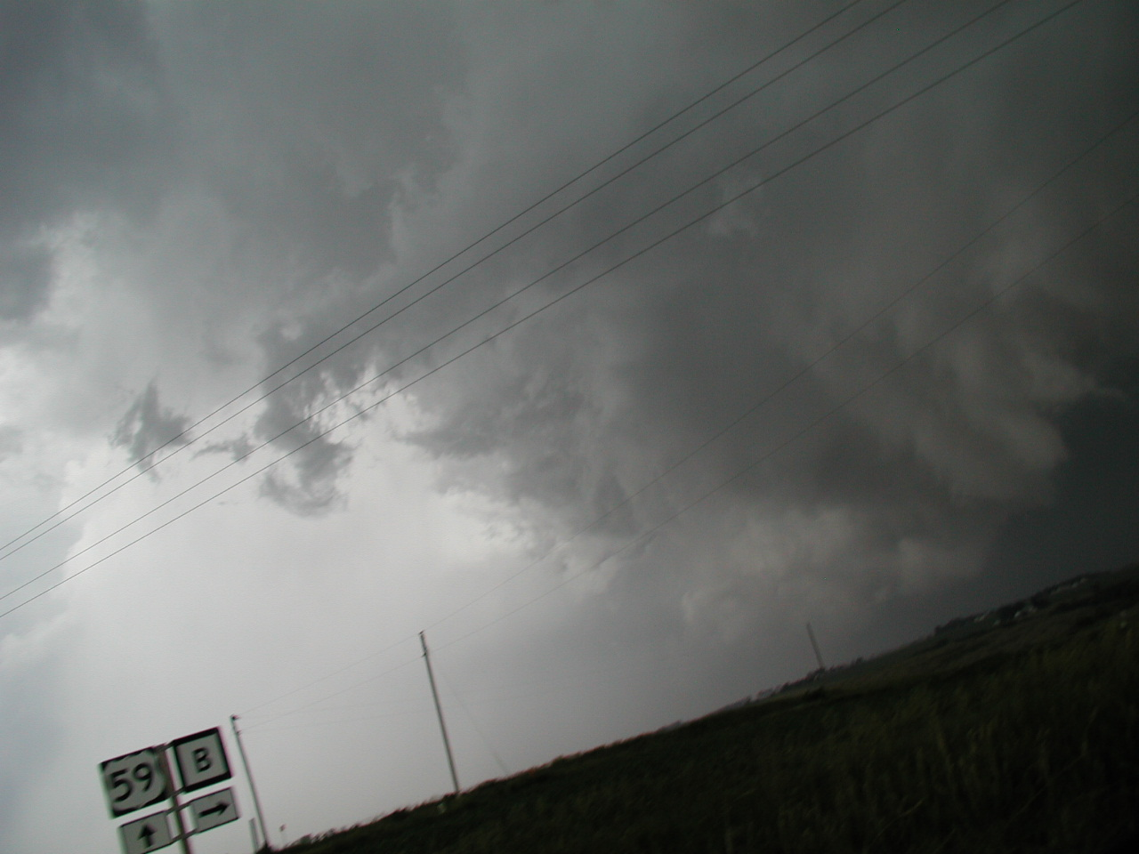

Slide 44
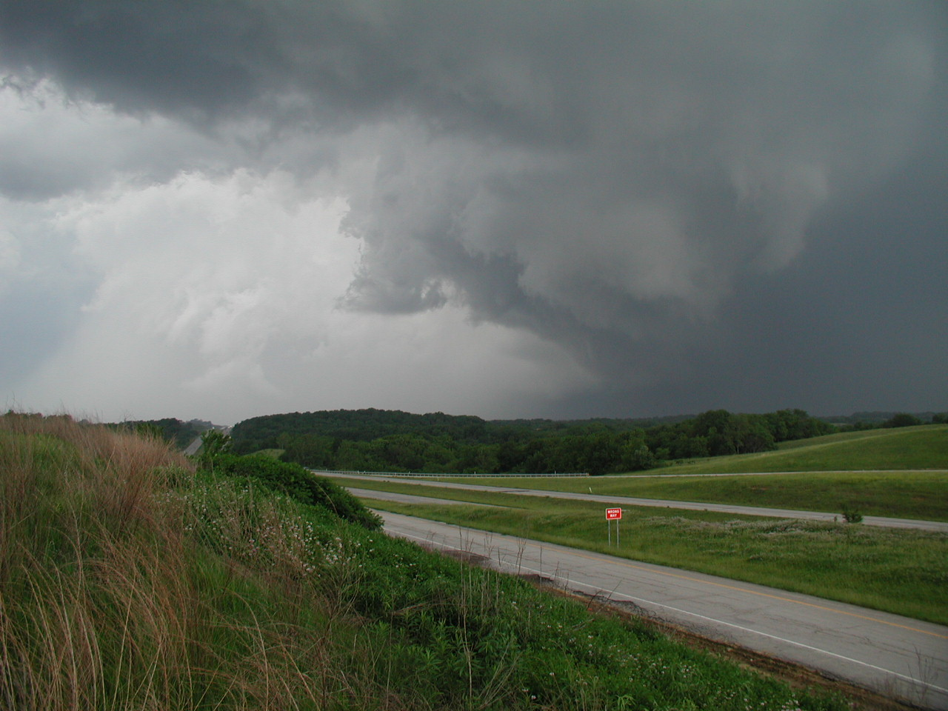

Slide 45
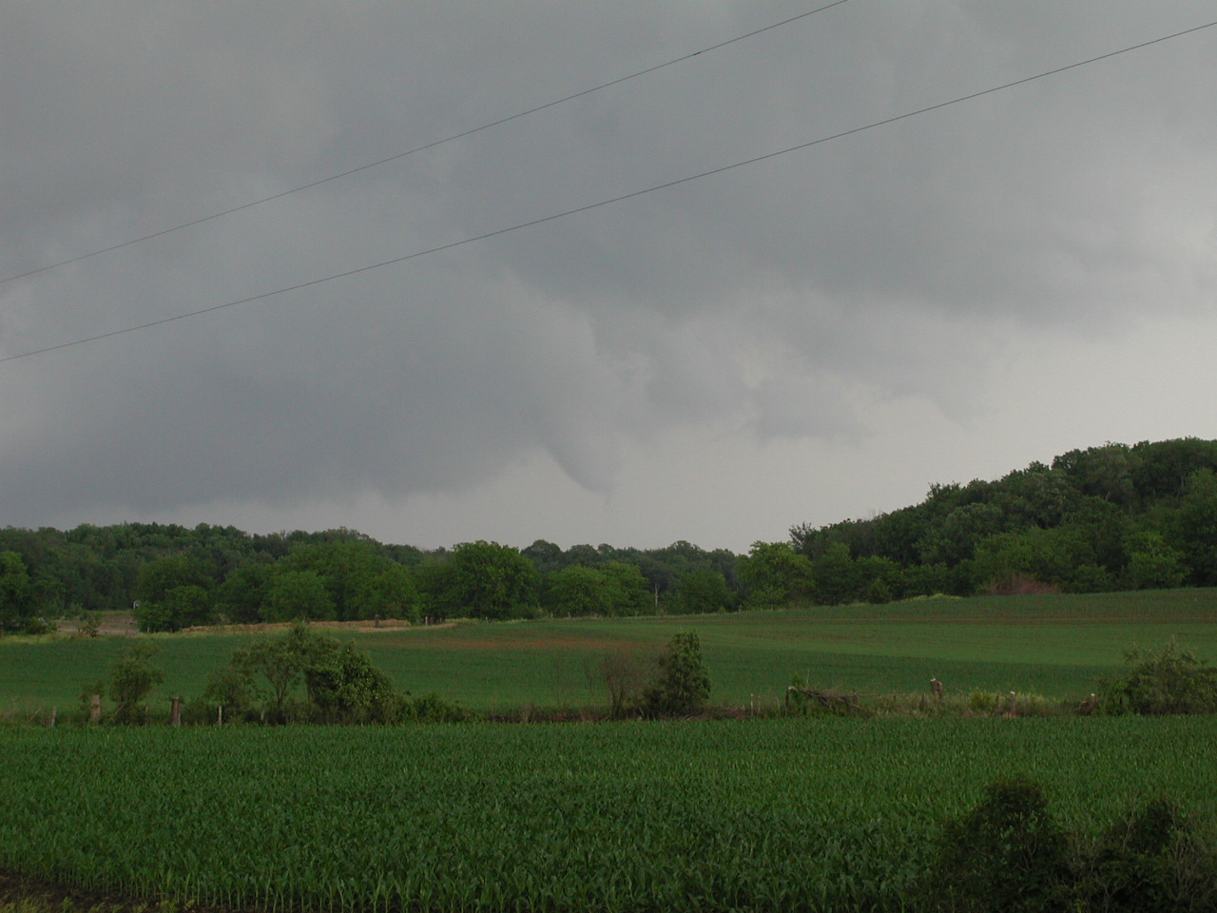

Slide 46
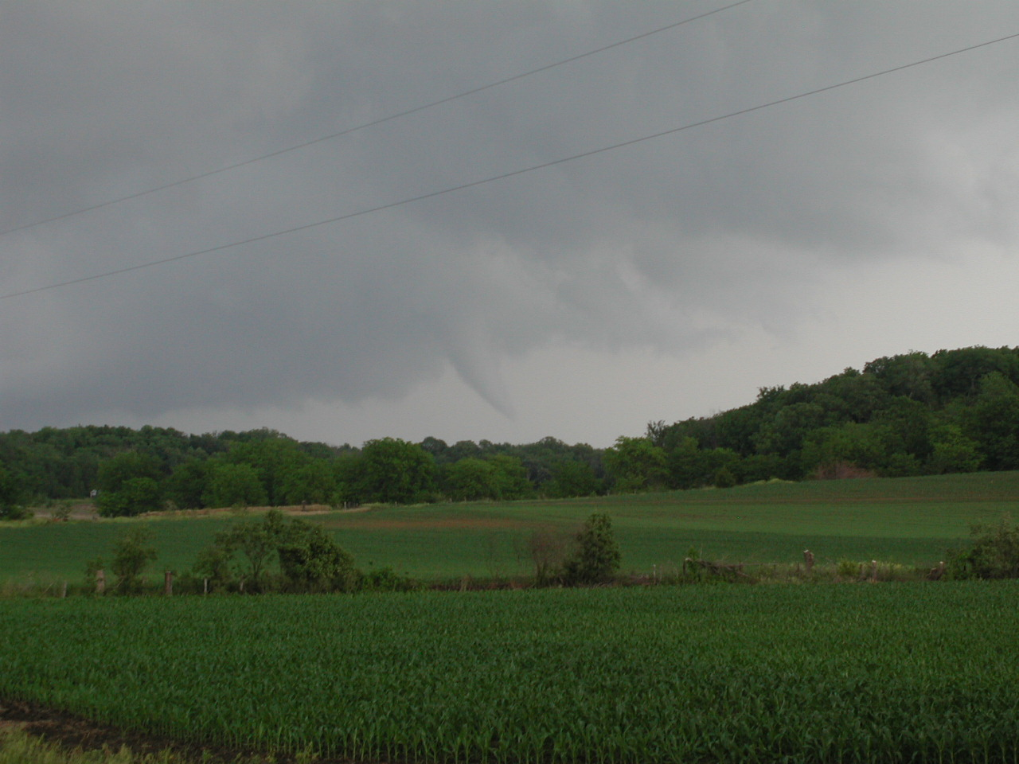

Slide 47
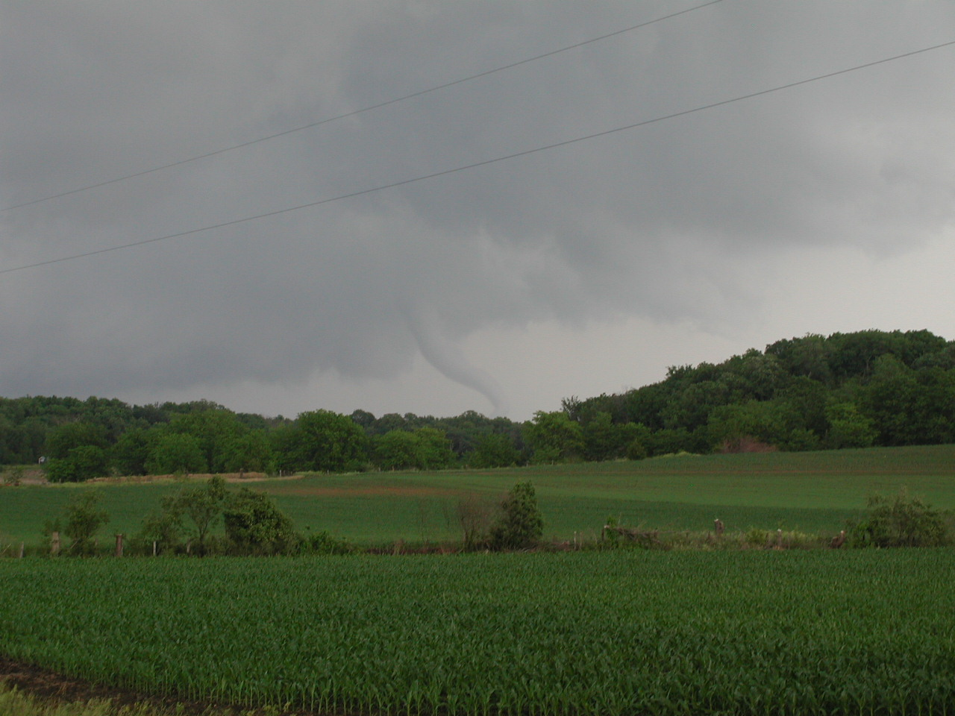

Slide 48
Storm Chase
June 5, 2010
North Central Illinois

Slide 49
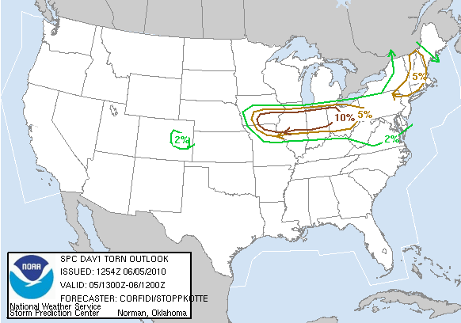
Storm Prediction Center
Tornado Outlook

Slide 50
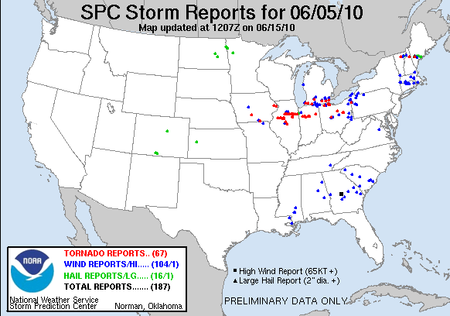
Storm Prediction Center
Storm Reports

Slide 51
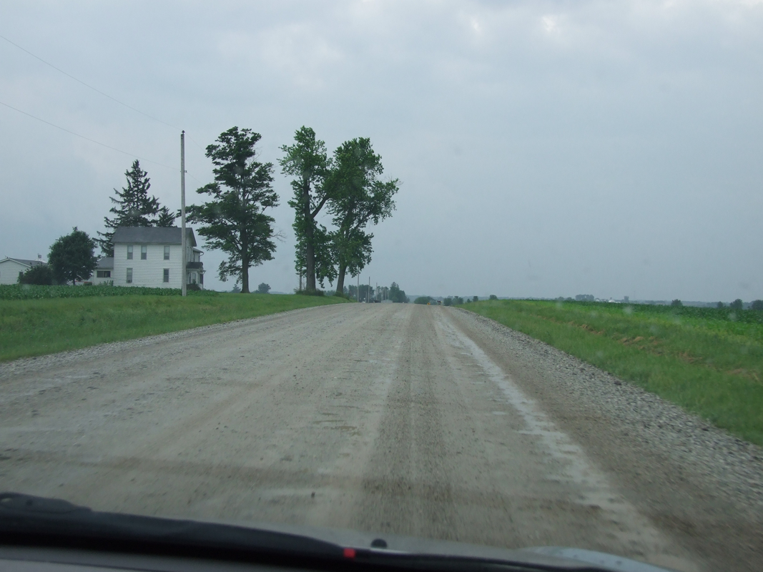

Slide 52
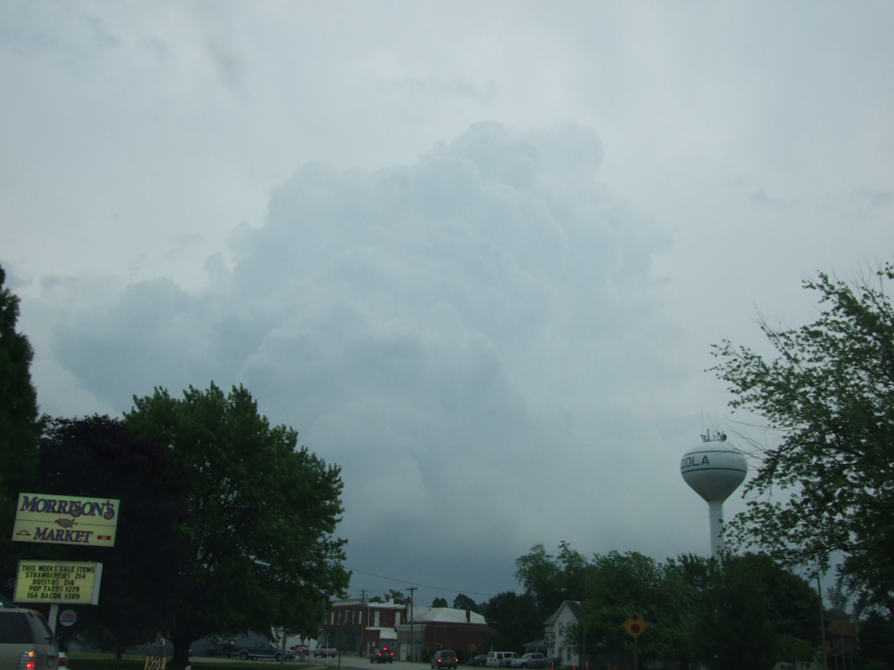

Slide 53
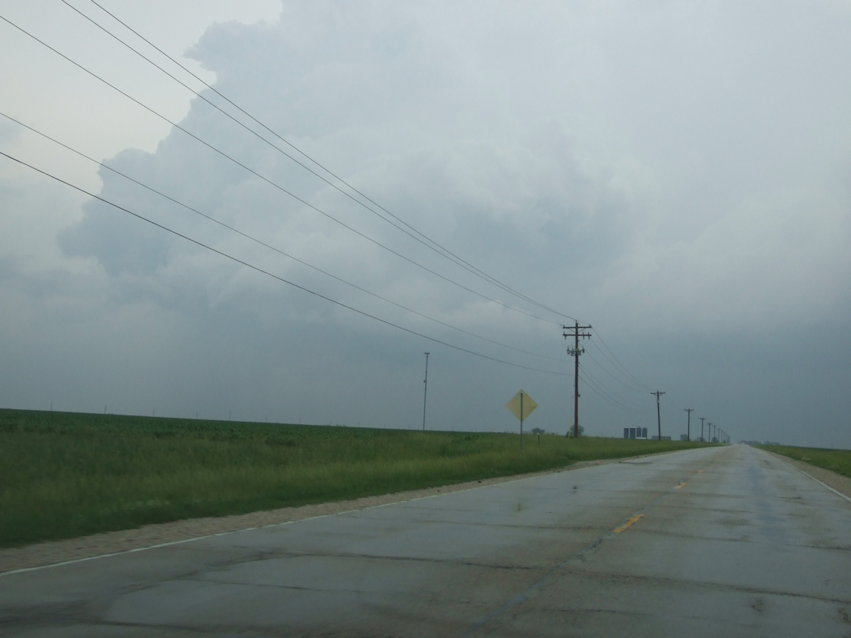

Slide 54
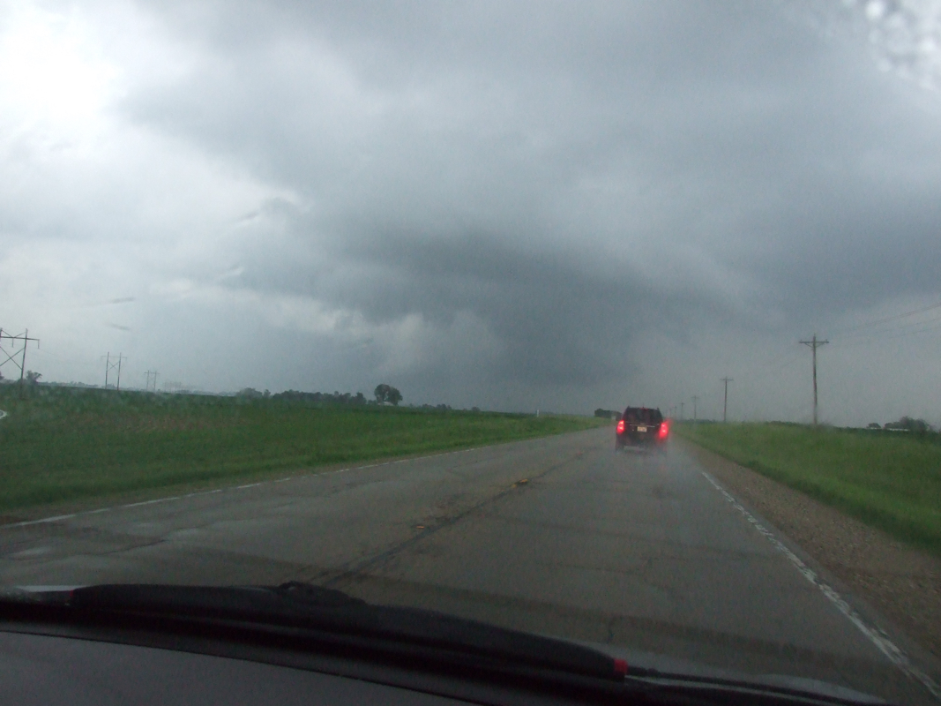

Slide 55
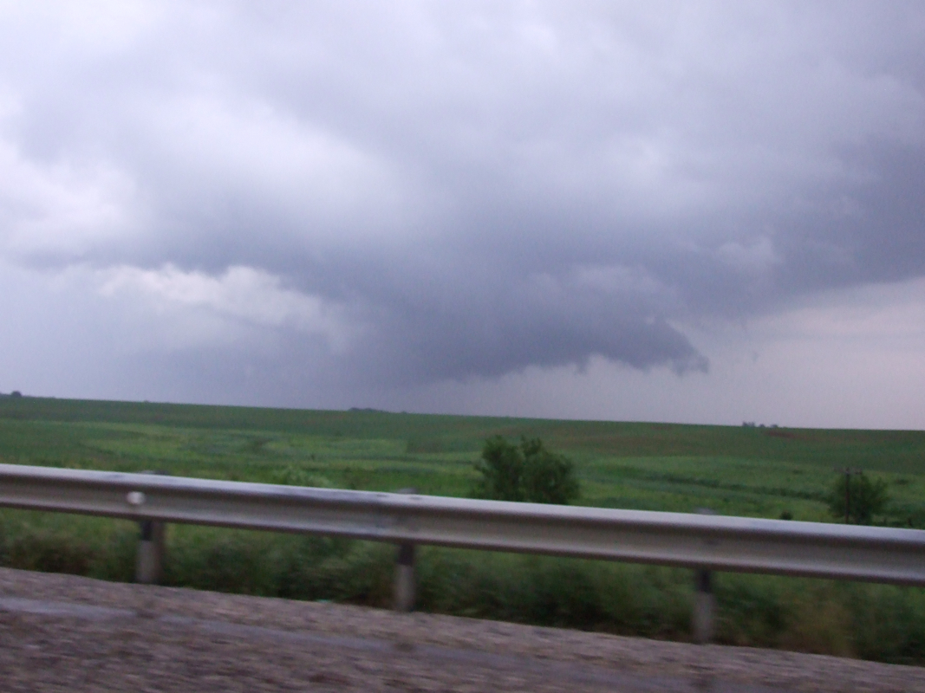

Slide 56
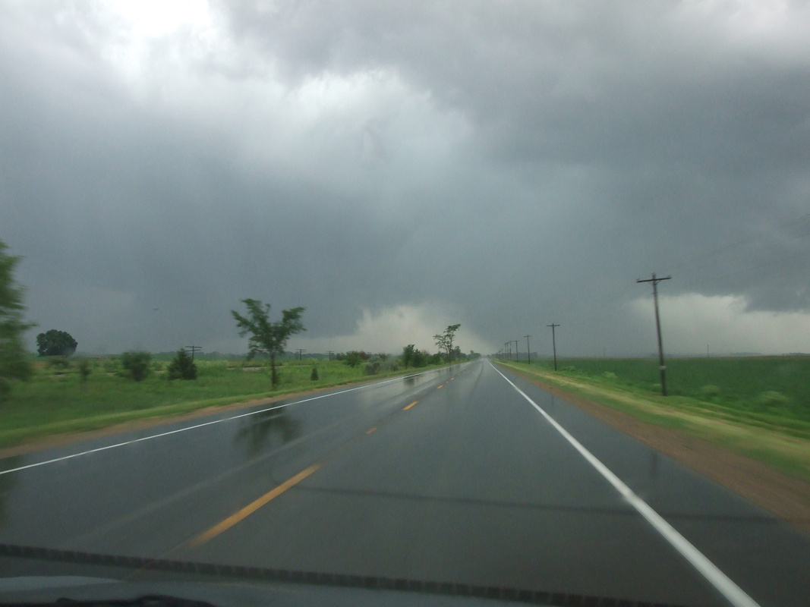

Slide 57
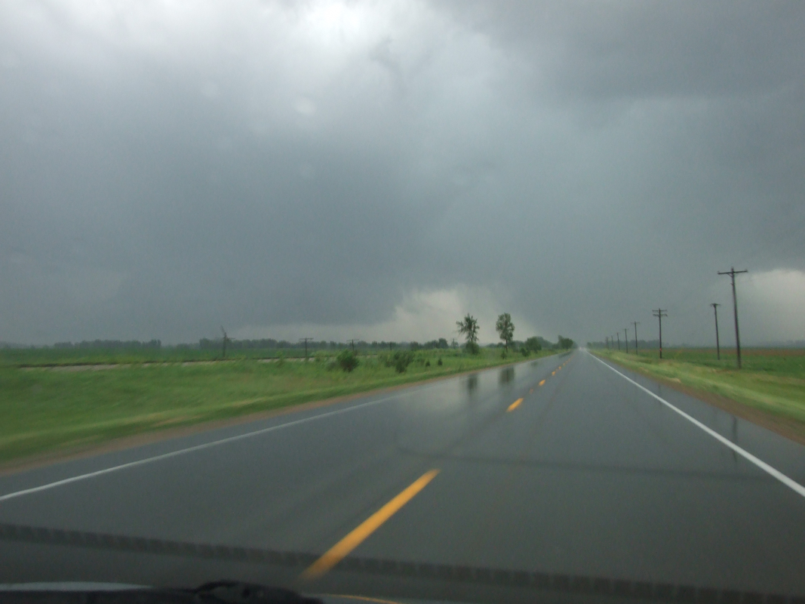

Slide 58
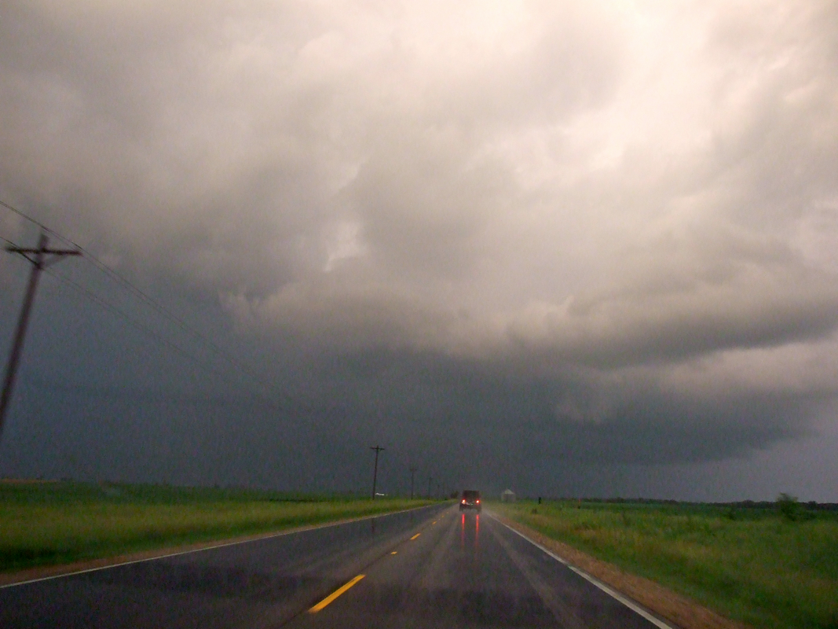

Slide 59
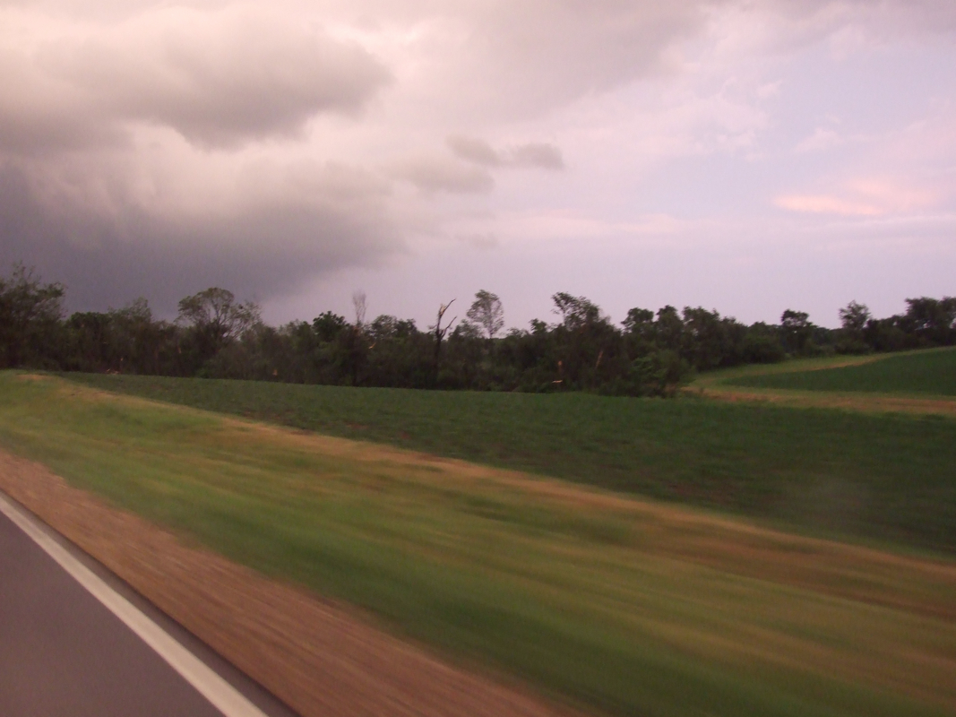

Slide 60
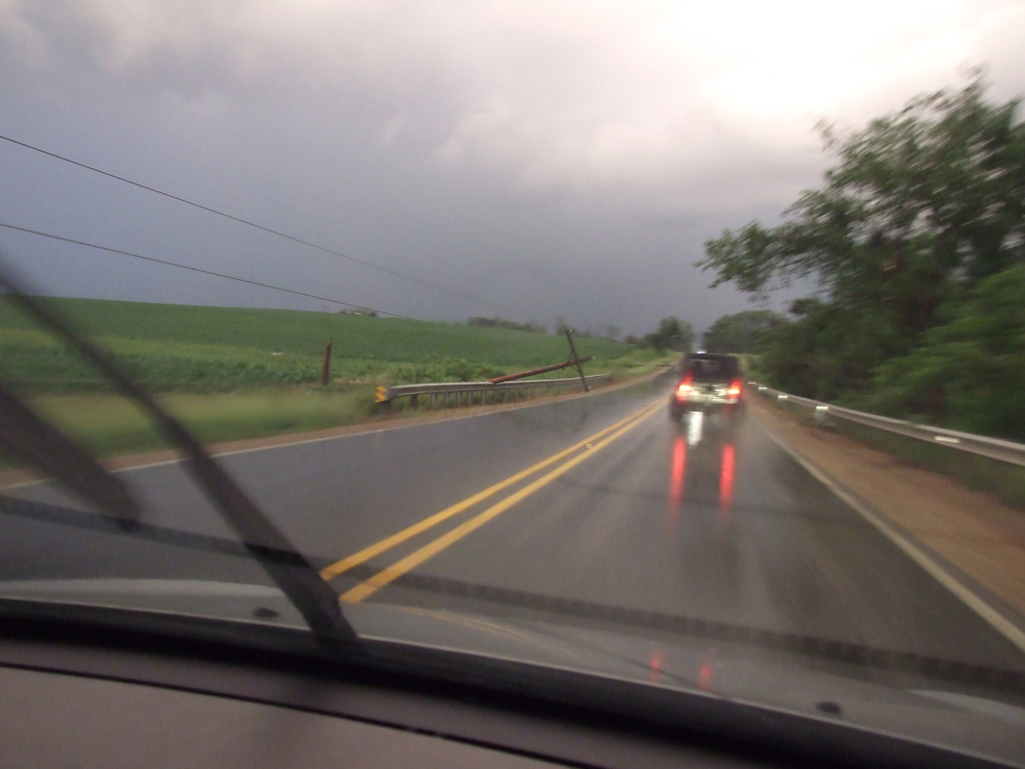

Slide 61
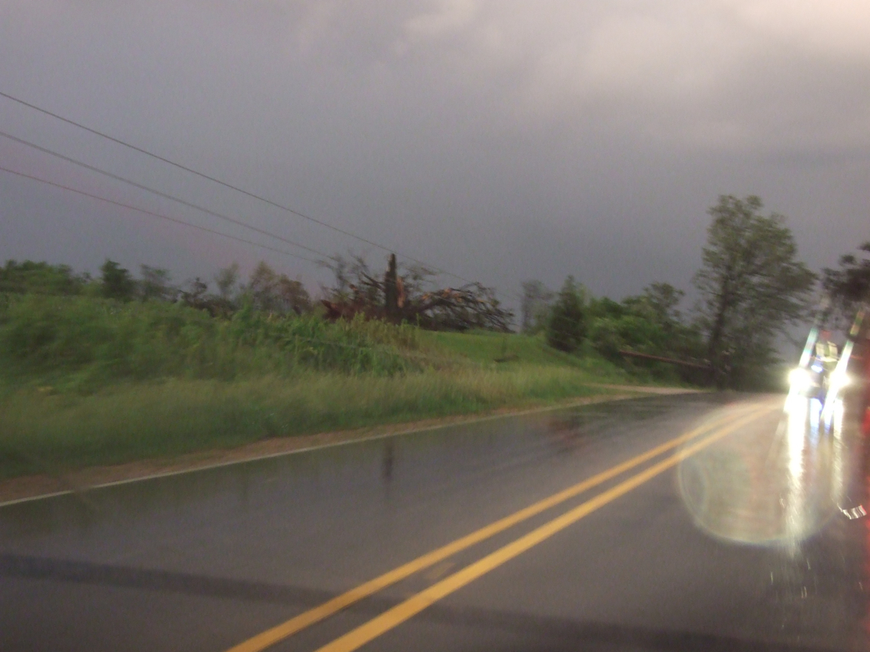

Slide 62
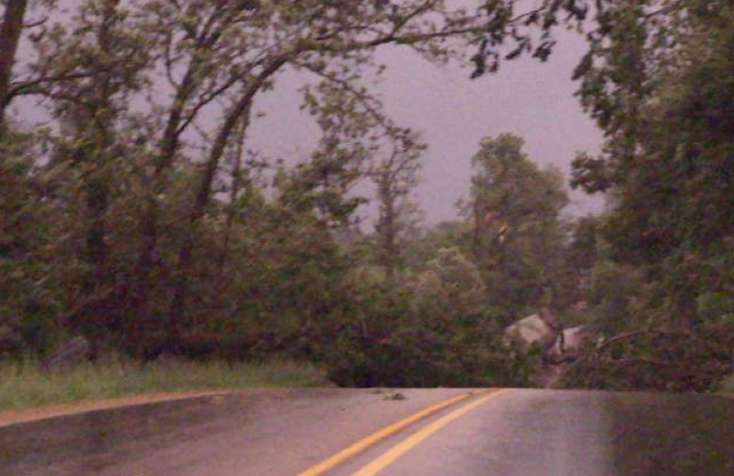
Google Maps link

Slide 63
Storm Chase
May 22, 2014
Montgomery and Schenectady County, New York
Slides courtesy of Prof. Brian Tang

Slide 64
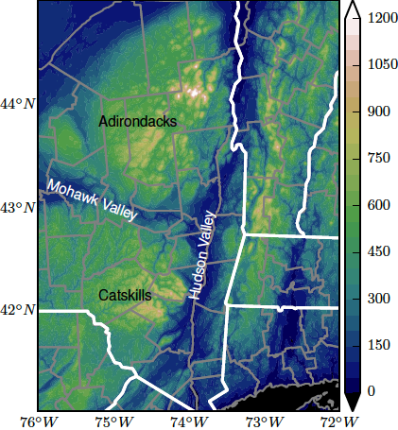
Low-level winds channel WNW up the Mohawk Valley, enhancing shear!

Slide 65

Reflectivity
Differential Reflectivity
1905 UTC

Slide 66
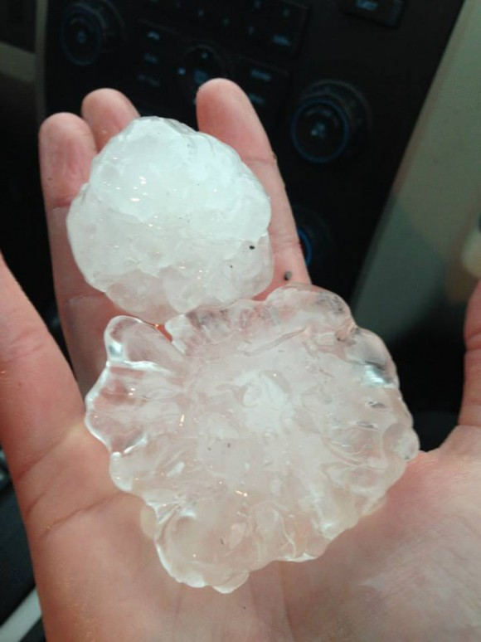
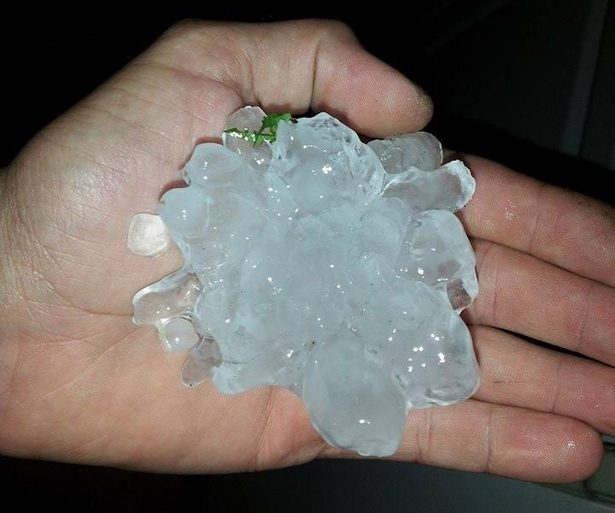
1920 UTC: 4” (10 cm) hailstone in Amsterdam, NY, tying New York state record
Source: CBS

Slide 67
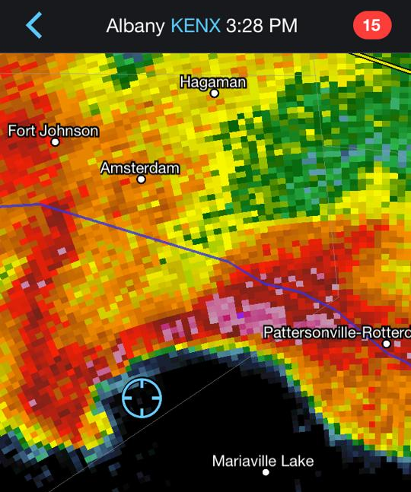
Five minutes prior to tornado touchdown west of Mariaville Lake

Slide 68
AT 351 PM EDT...NATIONAL WEATHER SERVICE DOPPLER RADAR CONTINUED TO INDICATE A TORNADO ON THE GROUND WITH A TORNADIC DEBRIS SIGNATURE JUST SOUTH OF DUANESBURG IN SCHENECTADY COUNTY
Reflectivity
Correlation Coefficient
1951 UTC

Slide 69
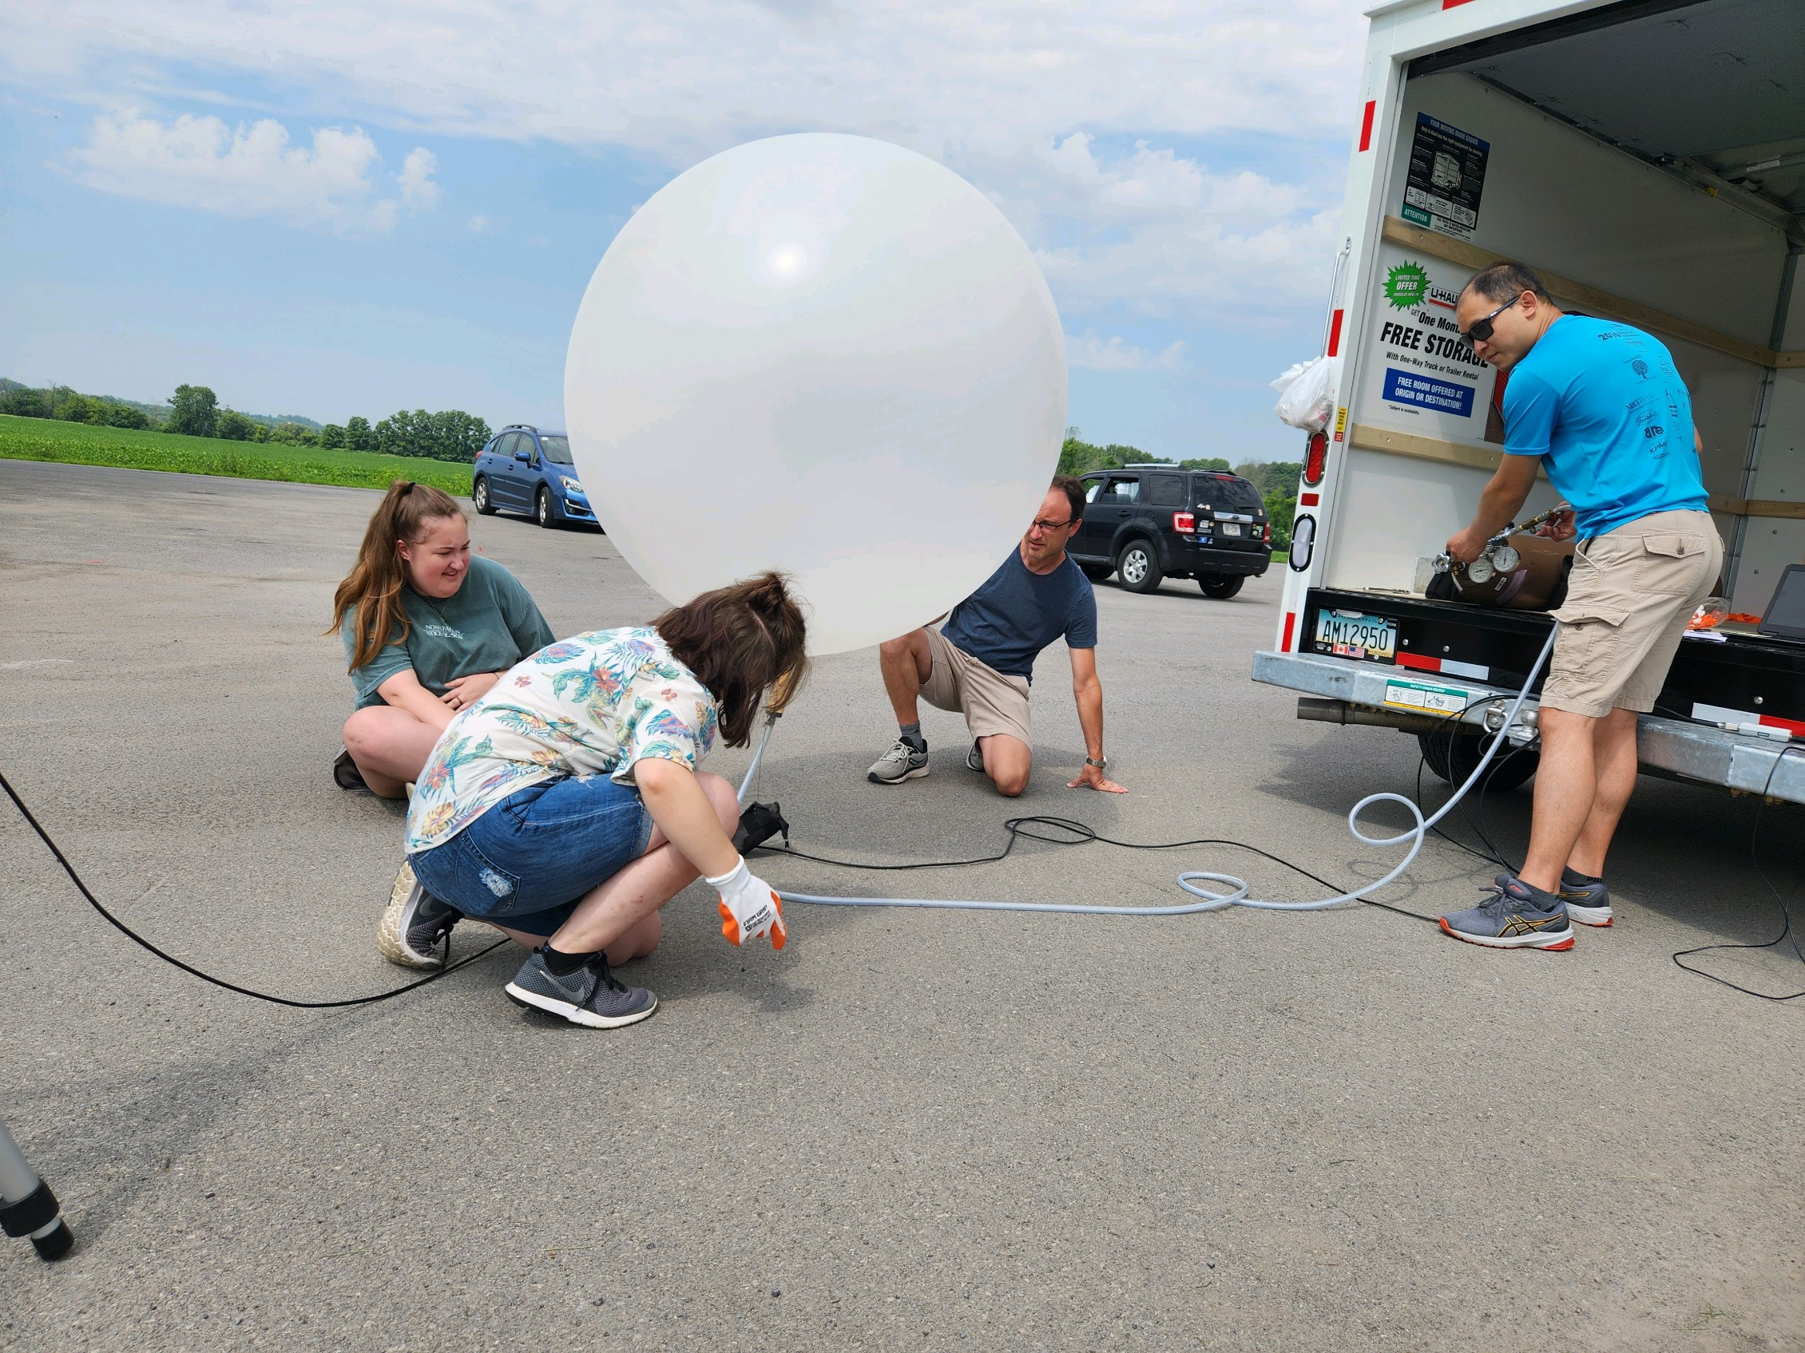
ICECREAM Field Campaign – Summer 2023

Slide 70


